Slide 2


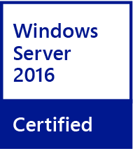



Affordable dual-core multimedia NAS w/ PCIe
Dual-core J3355
Apollo Lake SoC
2.0GHz
Base
2.5GHz
Max burst
Dual-channel RAM
Up to DDR3L-1866
2 x SODIMM slots, up to 8 GB total (4+4)
TS-251B-2G
2 GB RAM (1 x 2 GB)
TS-251B-4G
4 GB RAM (1 x 4 GB)

Slide 3
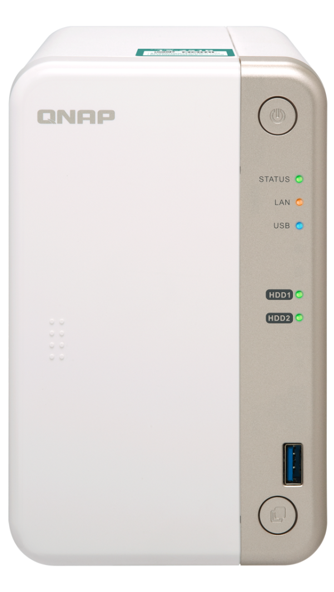
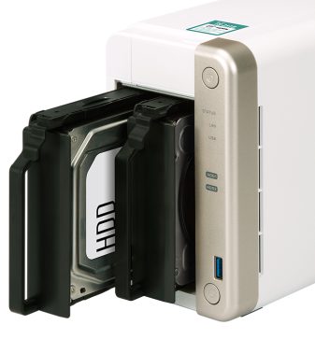
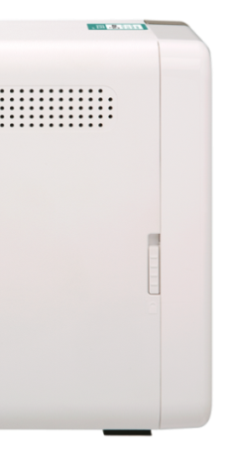
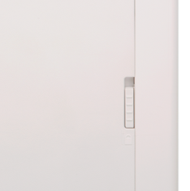
TS-251B front view
2 x 3.5”/ 2.5”
SATA 6Gb/s
HDD/SSD
Power button
LEDs:
STATUS, LAN, USB
LEDs:
Drive 1, Drive 2
1 x USB 3.0 port
Lockable magnetic front cover
Copy button

Slide 4
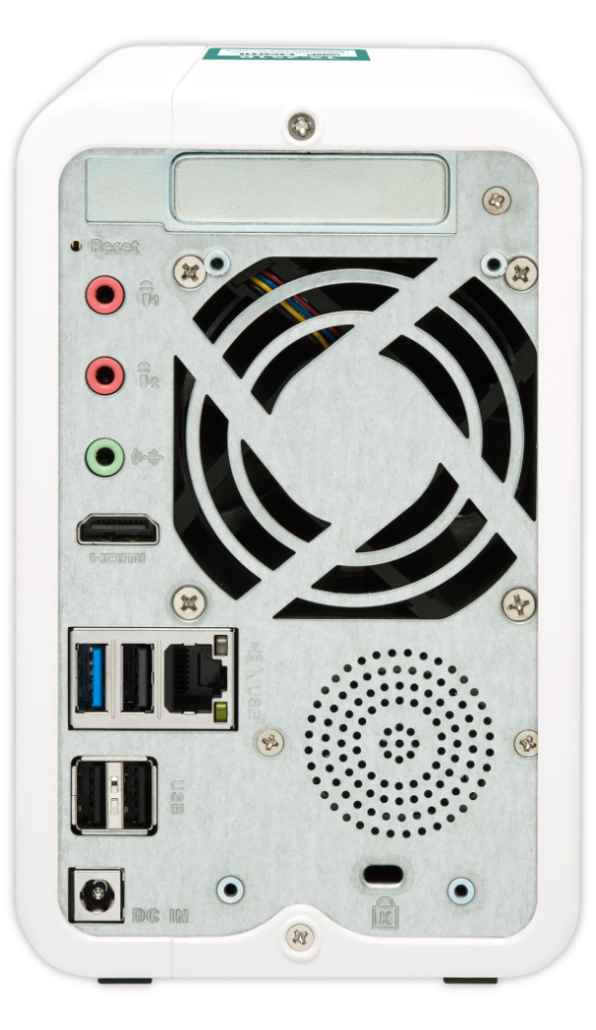
TS-251B rear view
2 x 3.5mm microphone input
1 x PCIe 2.0 (x2) slot
1 x 3.5mm audio line out
1 x 7cm smart fan
1 x 4K HDMI v1.4b 30Hz
1 x USB 3.0
3 x USB 2.0
1 x speaker
1 x RJ45 GbE LAN
DC 12V power input

Slide 5
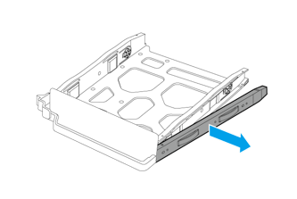
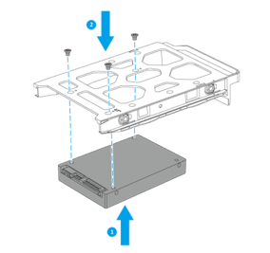
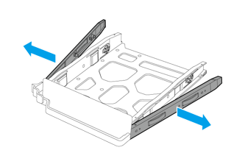
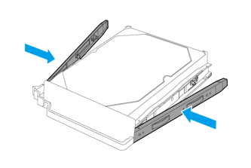
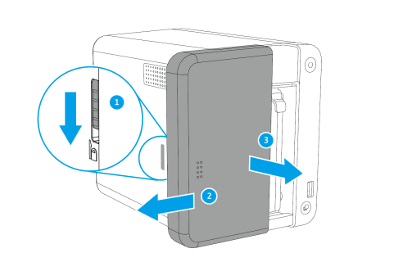
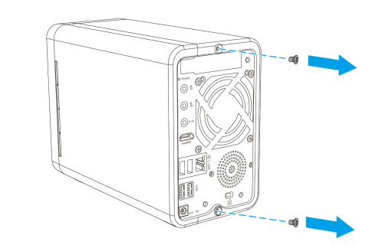
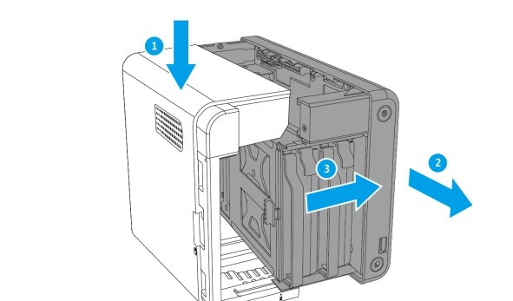
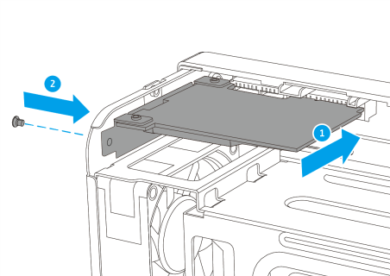
Easy to get started
3.5-inch HDD：tool-less installation
2.5-inch HDD/SSD：screw installation
1
2
1
2
Install a PCIe card by removing a few screws and the cover
1
2
3
4

Slide 6
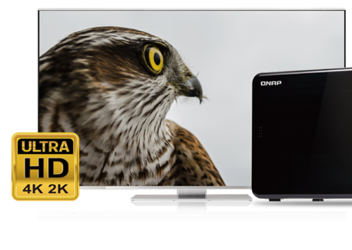
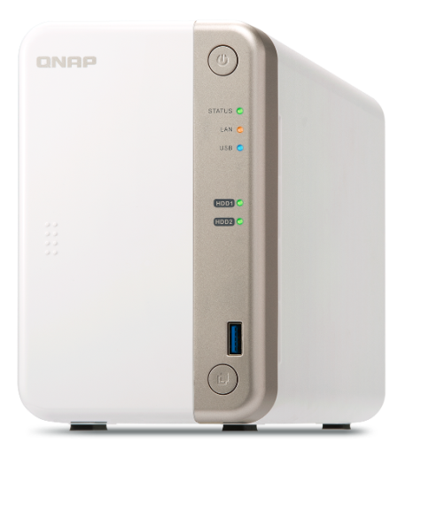





Full multimedia experience over competitors
4K HDMI v1.4b 30Hz output
Integrated speaker for
system events and music
Up to 2-ch 4K real-time transcoding
Use Cinema28 for multi-room streaming
Optional RM-IR004 remote

Slide 7


2-channel 4K video real-time transcoding
Integrates Intel® HD Graphics 500 graphics processor, up to 700 MHz, providing up to 2 channels of video playback and transcoding for smooth playback on versatile client devices.

Slide 8




Plex Media Server
Internet
Media management
Media information
Supports many media types
Sharing management

Slide 9


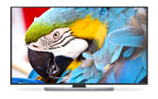





Play content via network or HDMI
Streaming
Streaming
Smart TV
Computer
Streaming
Phone
Tablet
Local display
HDMI
TV / monitor

Slide 10

Get more with Plex Pass
Feature | Free | Plex Pass
Supports most media formats
Support various devices, such as Apple TV
Library Organization
Sharing
Trailers and Extras
Hardware Acceleration
For details, please visit: https://www.plex.tv/

Slide 11


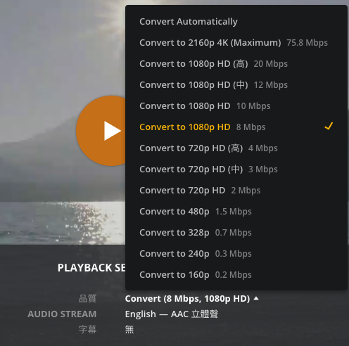

Plex real-time transcoding
Transcode options
Video quality:
The higher the resolution selection, the greater the network bandwidth requirement.

Slide 12


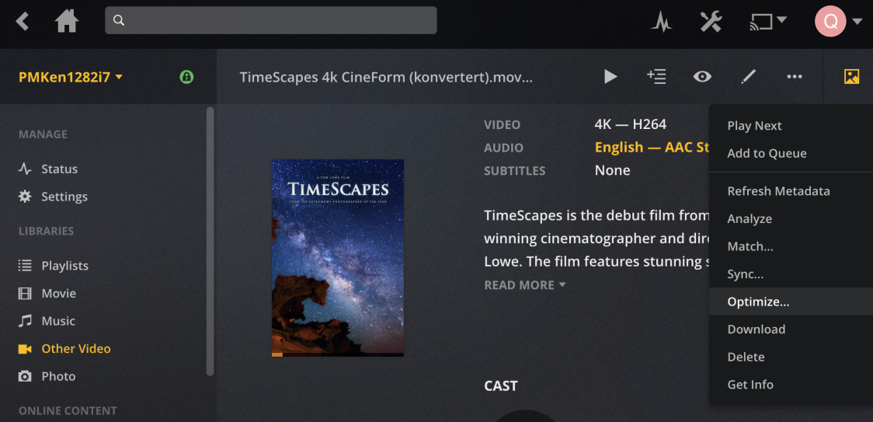

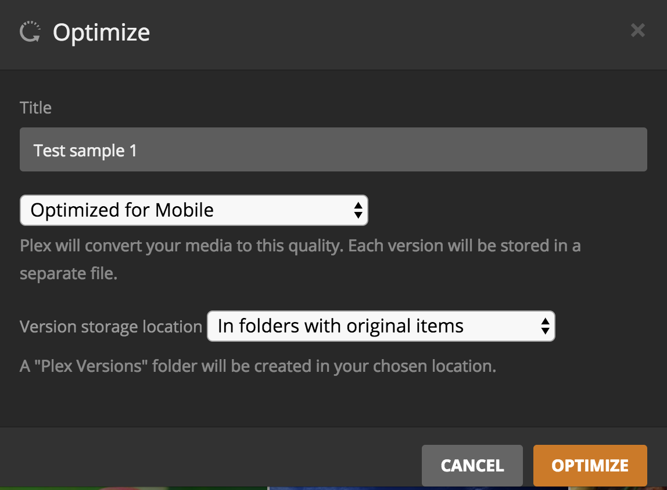
Offline transcoding
Set up a offline transcoding process

Slide 13


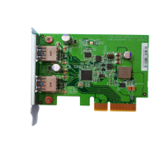


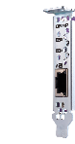
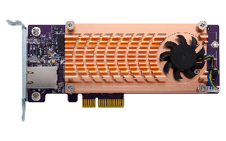
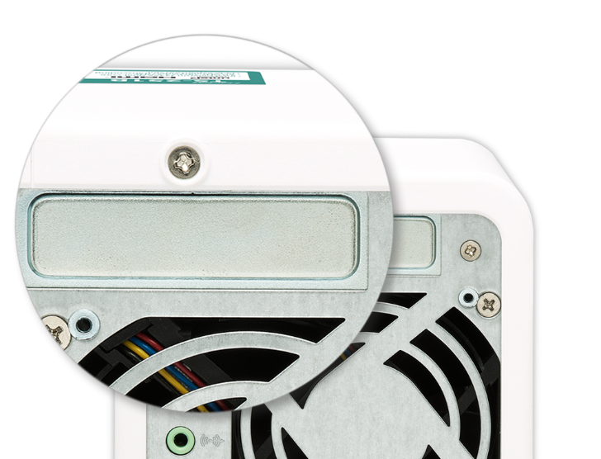
A versatile NAS that moves forward with you
Cache
2Xperformance
SSD
Volume/LUN
10Gb/s
Tiered Space
5Gb/s
Storage pool
USB 3.0
USB 3.1 Gen 2
DBDC 2.4 GHz/5 GHz
wireless expansion card (AP function)
QM2 M.2 SSD / 10GbE
network expansion card
2-port USB 3.1 Gen 2 Type-A expansion card
1 PCIe 2.0 x2 slot

Slide 14
Demo
Install a PCIe expansion card

Slide 15
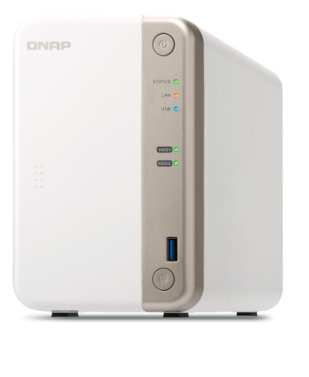

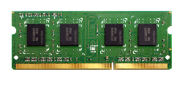
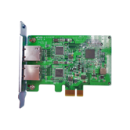

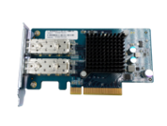
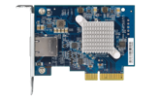

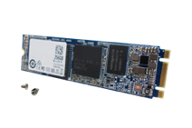
Accessories for TS-251B
Memory modules
USB 3.1 Gen 2 expansion card
RAM-4GDR3LA0-SO-1866
RAM-2GDR3LA0-SO-1866
USB-U31A2P01
Wired network adapters
Wireless network adapter
LAN-10G2SF-MLX
QXG-10G1T
LAN-1G2T-I210
QWA-AC2600
QM2 M.2 SSD/10GbE network expansion cards
256GB M.2 SATA 6Gb/s SSD*
QM2-2S
QM2-2P
QM2-2S10G1T
QM2-2P10G1T
…and many more
SSD-M2080-256GB-B01
* To install M.2 SSD to TS-251B, a QM2 expansion card is required.

Slide 16
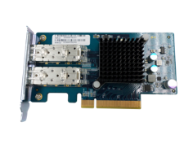
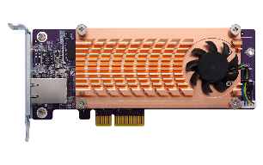
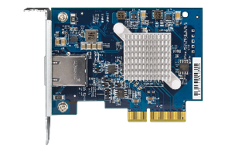
10GbE via PCIe expansion
1 x 10GbE, TS-251B
2 x SFP+
1 x 10GBASE-T
720
LAN-10G2SF-MLX
QM2-2S10G1T
QM2-2P10G1T
672
540
(MB/s)
435
360
1 x 10GBASE-T
180
QXG-10G1T
0
Windows
Download
Windows
Upload
Tested in QNAP lab. Results vary depending on the environment.
Test Configurations: NAS: TS-251B, QTS 4.3.4
RAID Configuration: RAID 0; 2 x Intel S3500 240GB SSDs (SSDSC2BB240G4); QNAP LAN-10G2SF-MLX 2 port 10GbE SFP+
Client PC: Intel® Core TM i7-4770 3.40GHz CPU; DDR3L 1600Hz 16GB; WD 1TB WD10EZEX; Intel Gigabit CT( MTU 1500 ) ; Windows® 7 Professional 64bit SP1 & Windows 8.1 Pro 64-bit

Slide 17
Demo
10GbE performance
QXG-10G1T
1 x 10GBASE-T
2 x 2.5”SSD: RAID 0

Slide 18
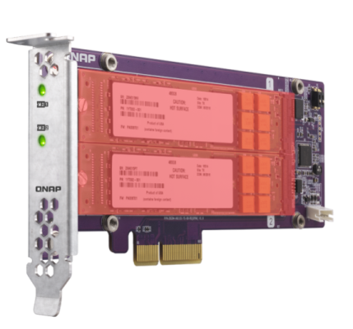


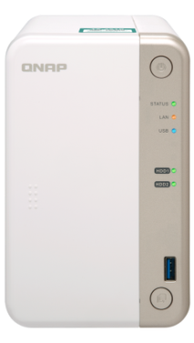
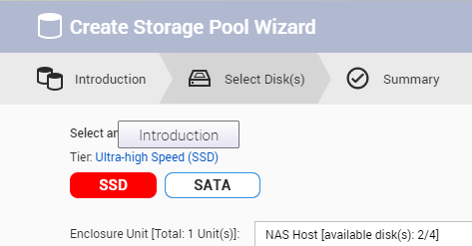

Add M.2 SSD slots to TS-251B with a QM2 card
Accelerates random IOPS
SSD cache
QM2 SSD RAID 0/1
QM2-2S
SSD tier
Performance and storage capacity

Slide 19
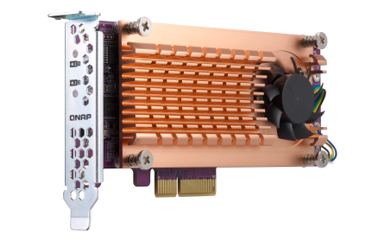
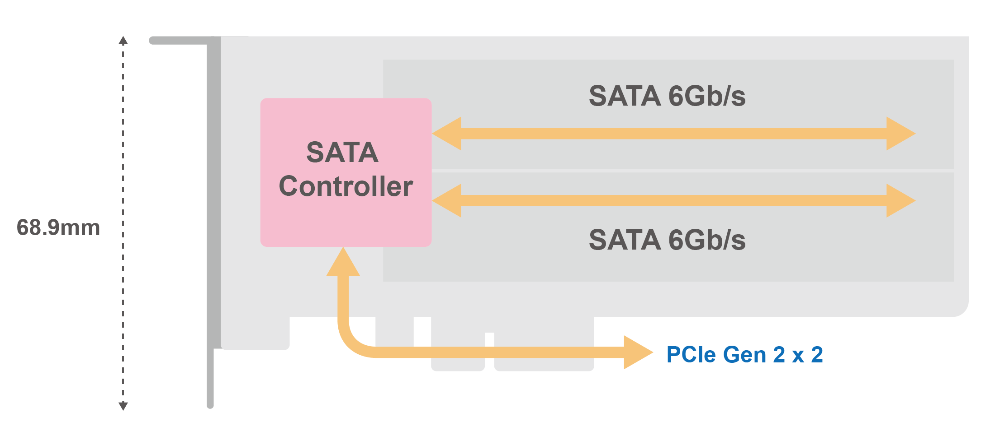
QM2-2S-220A: Add two M.2 SATA SSD slots
QM2-2S-220A
2 x M.2 2280 SATA 6Gb/s
147 mm

Slide 20

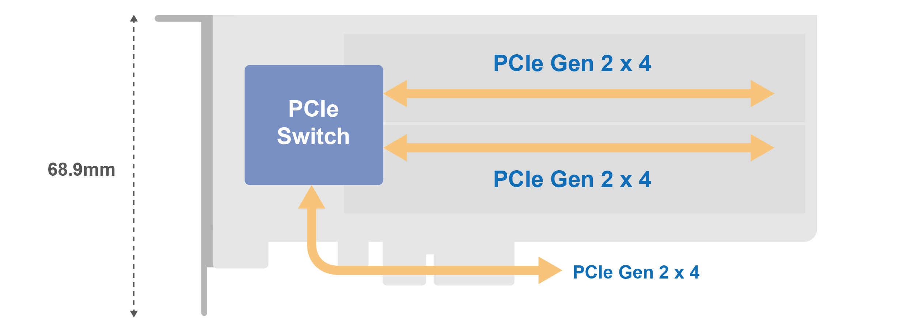
QM2-2P-244A: add two M.2 NVMe SSD slots
QM2-2P-244A
2 x M.2 2280 PCIe NVMe
147 mm

Slide 21
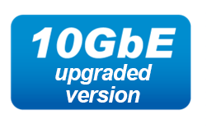

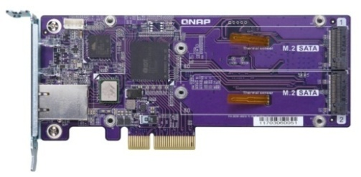
QM2-2S10G1T: add two M.2 SATA SSD slots + 10GBASE-T
2 x M.2 2280 SATA 6Gb/s SSD +
1 x 10GBASE-T (10G/5G/2.5G/1G/100M)
QM2-2S10G1T

Slide 22
QM2-2P10G1T: add two M.2 NVMe SSD slots + 10GBASE-T
2 x M.2 2280 PCIe NVMe SSD +
1 x 10GBASE-T (10G/5G/2.5G/1G/100M)
QM2-2P10G1T

Slide 23

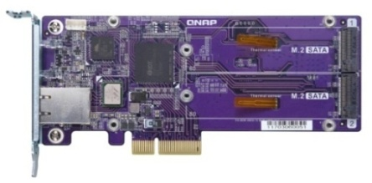
Demo
Qtier 10GbE performance
QM2-2S10G1T
1 x 10GBASE-T
2 x M.2 SATA SSD: RAID 1
2 x HDD: RAID 1

Slide 24

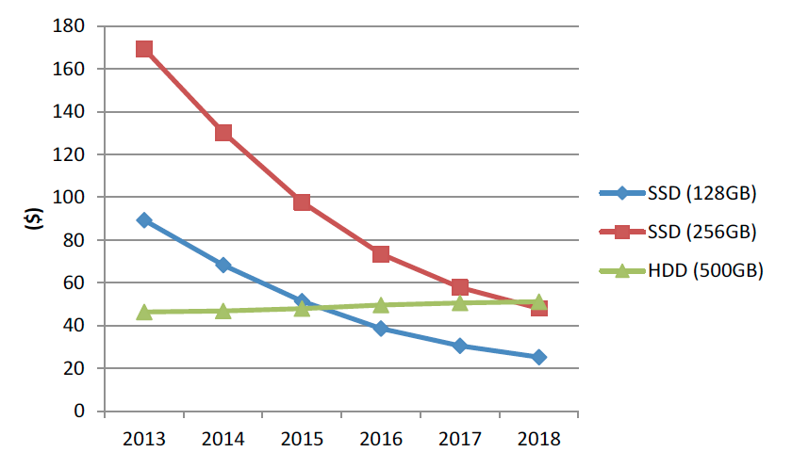
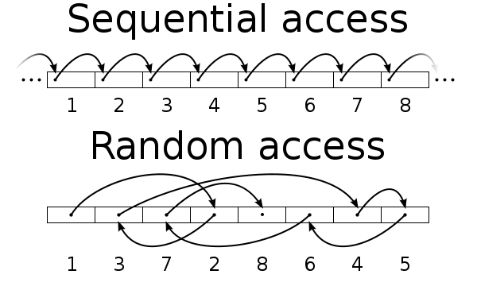
SSD usage in Network Attached Storage
SSD can provide high random IOPS for multi-client sync and business applications that can not be achieved with HDD.
In 2018, SSD price also comes close to the sweet spot.
You need not only choose the right SSD, but also choose the right NAS!
Drive Type | Sequential Access (MB/s) | Random Access (IOPS)
HDD | 100 | 350
SSD | 300 | 60000
SanDisk estimates the
256 GB SSD per GB price in 2018 is only 30% compared to that of 2013
https://www.sandisk.com/business/datacenter/resources/white-papers/the-ssd-enabled-pc-total-cost-of-ownership
SanDisk's Statistic for Global SSD/HDD Price Trend

Slide 25
SSD internal over-provisioning
SSD as Flash storage, its capacity should be presented with Gibibyte (GiB)
2^30 = 1,073,741,824 Bytes。
As storage device, SSD actually reports it's capacity back with Gigabyte (GB)
10^9 = 1,000,000,000 Bytes。
Every GB in SSD contains 73,741,824 Bytes(7.37%) for the Garbage Collection operation, and enterprise SSD may reserve more!
SSD actual size (GiB) | SSD present size (GB) | Vendor designed OP % | Actual internal OP % | Size show in the NAS (GiB)
256 GB | 256 GB | 0% | 7% | 238 GB
256 GB | 240 GB | 7% | 15% | 223 GB
256 GB | 200 GB | 28% | 37% | 186 GB
In the NAS system, all capacity are actually be calculated and showed in the GiB format
https://www.seagate.com/tw/zh/tech-insights/ssd-over-provisioning-benefits-master-ti/
Data Source: https://www.kingston.com/us/ssd/maintaining
Notes:
25

Slide 26
SSD extra over-provisioning
QNAP Software-defined
Having more over-provisioning is proven to be beneficial.
Besides SSD internal over-provisioning (OP), QTS introduces the extra over-provisioning that can be adjusted based on usage.
Data
Usable Space
Over-provisioning Space
SSD Free Space (Can also be deemed as OP with Trim)
QNAP Software-defined, RAID Level, SSD extra Over-Provisioning
Additional OP 0%~28+%
Additional OP 0%~28+%
Additional OP 0%~28+%
SSD internal OP 7.37%
SSD internal OP 7.37%
SSD internal OP 7.37%
Notes:
26

Slide 27
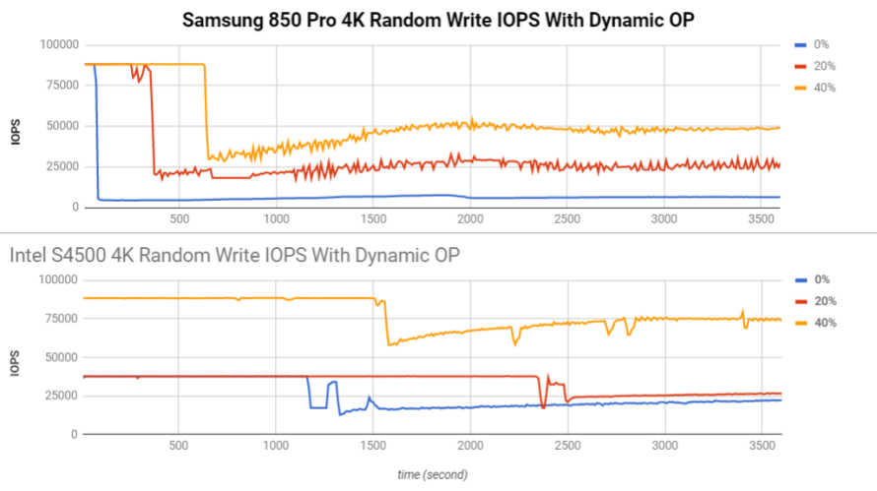
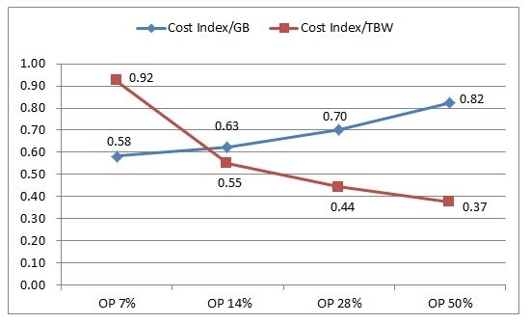
The advantage of software-defined over-provisioning
Performance and endurance of SSD can be increased.
Let consumer-grade SSD reach near enterprise-grade SSD performance & reliability, and further enhance enterprise SSD advantages with reduced TCO (Total Cost of Ownership)
(Although usable space is reduced, actual used space is unchanged.)
http://www.atpinc.com/technology/ssd-over-provisioning-benefits-configure
Notes:
27

Slide 28
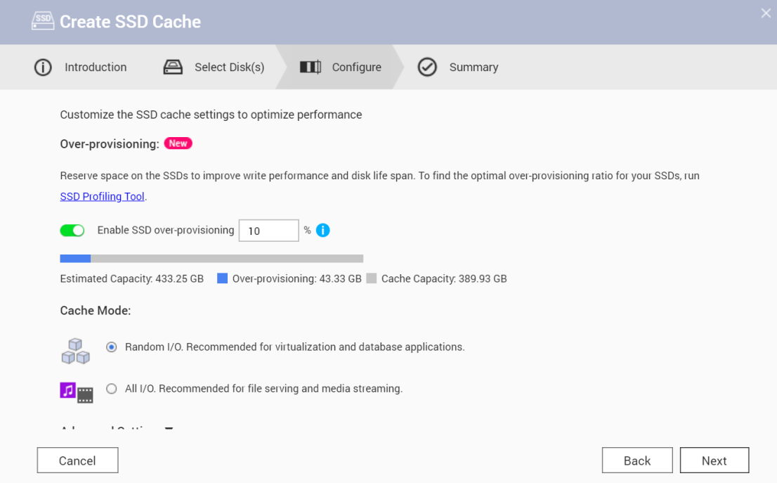

Configure the software-defined SSD extra over-provisioning
Since QTS 4.3.5, user can decide OP amount for SSD cache, Qtier pool and static volume.
A number between 1% to 60% in addition to vendor defined amount.
Note:
The over-provisioning can only be configured when a storage space is created and cannot be enabled for existing cache/volume unless recreating the storage.
Notes:
28

Slide 29







How Snapshots protect data from ransomware attack
Snapshots are stored out of volume and cannot be seem normally at the file system level.
This not only keeps snapshots from accidental modifications, but
further from ransomware attacks.
Ransomware cannot overwrite snapshots which are stored out of volume
File Level
Removable Drives
Block Level
A’
B’
C’
D’
E’
Local Drives
Cloud / NAS
A
B
C
D
E

Slide 30
QNAP Snapshot features
1. Fully supports all storage configurations at the storage pool level.
2. Easily take, manage and restore snapshots.
3. Using the mature Ext4 file system for “out of volume” snapshots
4. Supports all latest QNAP with flexible snapshot number.
(Every 1 TB of Volume/LUN need 0.5 MB of RAM for mounting each Snapshot)
RAM Size | TS-251B SKU | Maximum Total Snapshot Number | Maximum Snapshot Number per Volume/LUN
2GB | TS-251B-2G | 64 | 32
4GB and more | TS-251B-4G | 1024 | 256

Slide 31
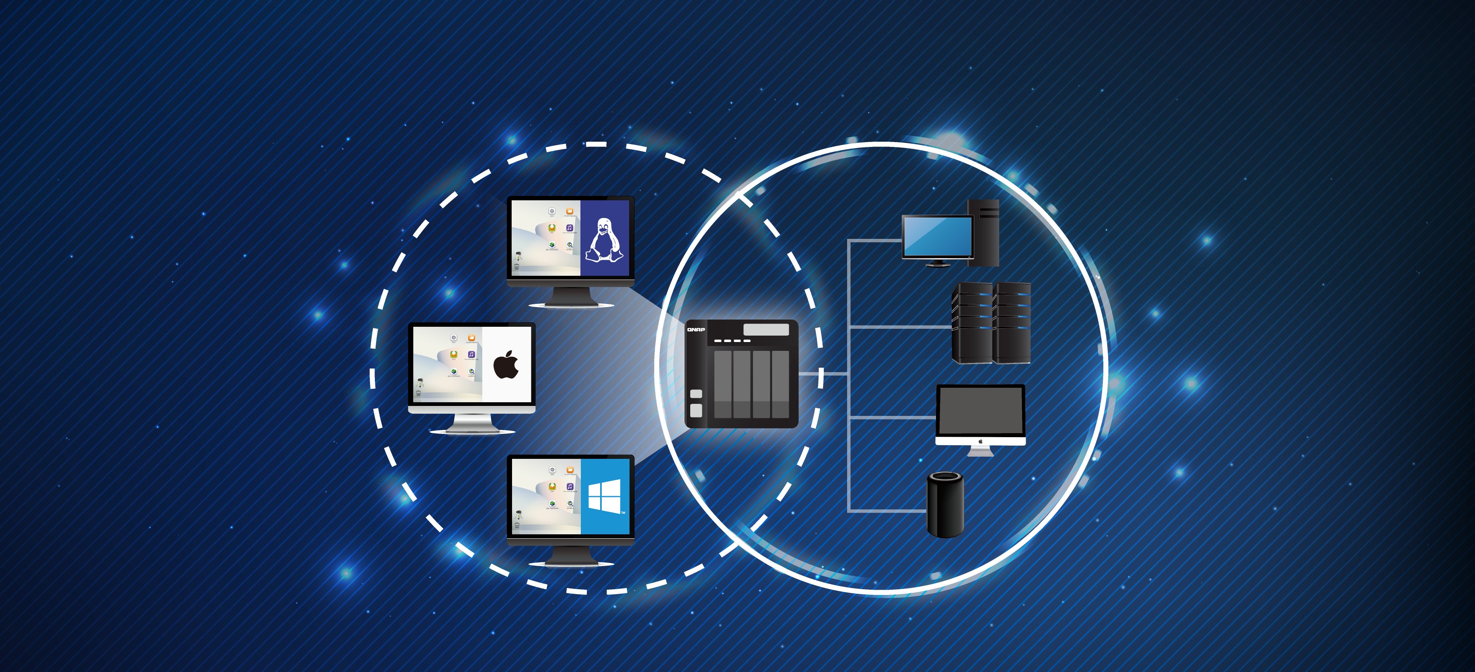
QNAP NVS (Network & Virtual Switch)
QNAP NVS strings the high speed network between physical and virtual interfaces.
It's the best tool to bridge your versatile devices and NAS!
Virtual
Physical

Slide 32
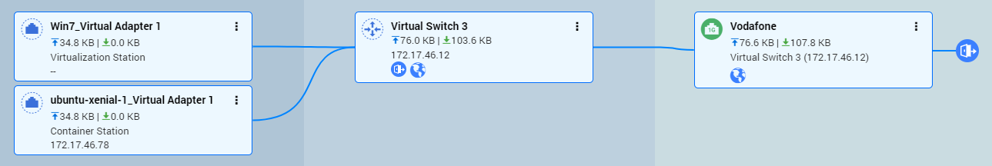
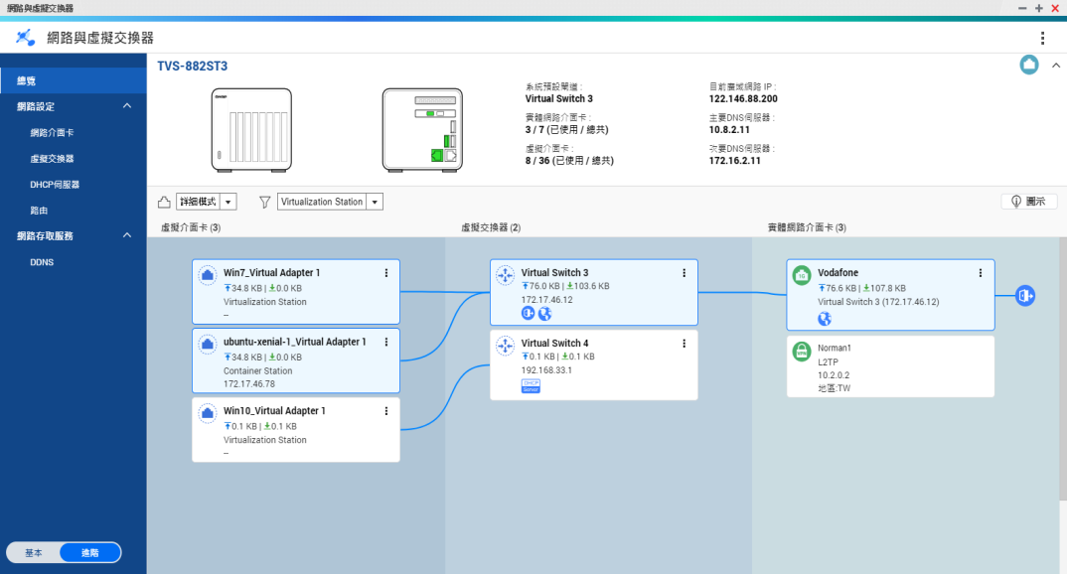




Overview helps you quickly check overall status
Connected to external network by the physical 1G adapter through the virtual switch 3. Earth symbol shows that the environment can access the Internet.
This group of VM is connected by virtual switch 4. Without earth and NAT symbols, this indicates the environment is a independent network.

Slide 33


Faster wireless AP network delivered with new QNAP solution
+
QWA-AC2600 PCIe AC wireless adapter

Slide 34



Wireless makes things easier…
When physical wiring for your home is not feasible.

Slide 35

Wireless setup made easy

Slide 36

QVPN topology map

Slide 37







QNAP's new proprietary VPN protocol - QBelt
Secure Encrypted Connection:
DTLS + SSL + AES-256 encryption
New protocol:
Decreases the chance of being detected
Works on (almost) all your devices
Easy to Use
Notes:
Works on all your devices
Protect your Internet connection across mobile devices or desktop with QNAP apps. Our app & utility offer a variety of easy-to-configure, automatic features, ensuring your connection remains encrypted at all times.

Slide 38



New desktop app will soon be available
macOS
Windows

Slide 39




New mobile app will soon be available
Android
iOS
Notes:
可搜尋出周遭的其他QNAP NAS,
以此安全連線去連線周遭其他NAS (需各自的密碼),
再以NAS為媒介建立第三組連線
以VPN安全連線使用其他APP

Slide 40




QTS and virtualization applications
Many OS in one NAS
Run Windows/Linux VMs and containers
Virtualization
Station
Container
Station

Slide 41



QVR Pro surveillance solution
5,000+ compatible IP cameras
8 free camera channels
128 channels max. (optional license)
QUSBCam2 for webcam recording
Surveillance Station 5.1
2 free channels
32 channels max. (optional license)

Slide 42




Use Virtual JBOD to expand NAS capacity
Max 8 VJBOD connections
TS-832XU
1GbE / 10GbE
iSCSI VJBOD connections
TS-832X

Slide 43
TS-251B sets the new standard
NAS model | QNAP TS-251B | Synology DS218+
Processor | Intel x86 Celeron J3355 dual-core 2.0 GHz，burst up to 2.5 GHz
Memory (expandable) | TS-251B-2G: 2 GB TS-251B-4G: 4 GB Max. 8 GB (4 GB + 4 GB) | 2 GB Max. 6 GB (2 GB + 4 GB)
PCIe slot | 1 x Gen2 (x2) slot | ---
10GbE LAN | Expandable via a PCIe adapter | ---
Performance | Read 672 MB/s; Write 435 MB/s | Read/Write 113 MB/s
M.2 SSD slots | Expandable via a QM2 PCIe adapter | ---
HW transcoding | Yes | Yes
HDMI output | 4K HDMI v1.4b 30Hz, optional remote | ---
USB 3.0 / 2.0 | USB 3.0: 2 USB 2.0: 3 | USB 3.0: 3 USB 2.0: 0
Audio in/out | 2 x 3.5mm MIC in + 3.5mm line out + speaker | ---
Camera licenses | free: 8 / max: 128 | free: 2 / max: 25

Slide 44
Copyright © 2018 QNAP Systems, Inc. All rights reserved. QNAP® and other names of QNAP Products are proprietary marks or registered trademarks of QNAP Systems, Inc. Other products and company names mentioned herein are trademarks of their respective holders.

