Slide 1


Slide 2

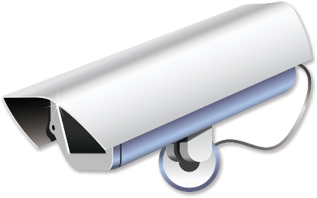

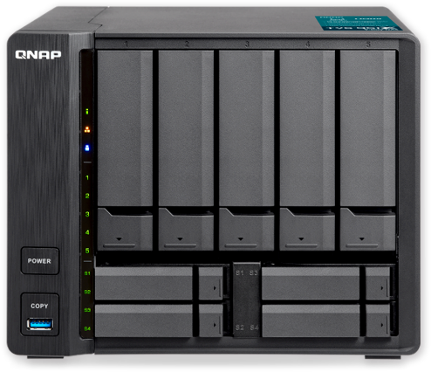

Agenda
Business security requirement
Business security Demo Video
Business security solution
Business security Live Demo
QVR
Pro

Slide 3
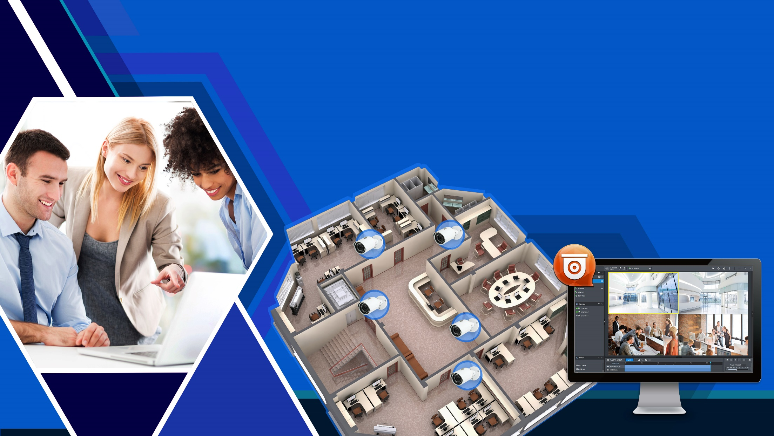


Business security requirement

Slide 4









Business security major requirements
Is the function complete enough to meet the needs of different scenarios?
Is system and data protections solid enough?
Can events be elevated in time when they occur for immediate responses?

Slide 5

Four major concerns for business users
How does QVR Pro make it better?
System deployment Instant recording and recording playback need to be configurable. Also, support specific camera models, cross-platform devices and flexible settings.
Convenient and practical functions
Can QVR Pro make it？
Is the function of the surveillance system complete and meet
the needs of the users? It has to be able to view surveillance
images easily and clearly.
How does QVR Pro make it better?
System stability
Data is extremely important for enterprises. The system needs to be operational without interruption. The failover system is a required too.
How does QVR Pro make an awesome job？
Event management
When emergency happens, the security staff must be informed immediately to prevent the significant losses due to handling were delayed.

Slide 6



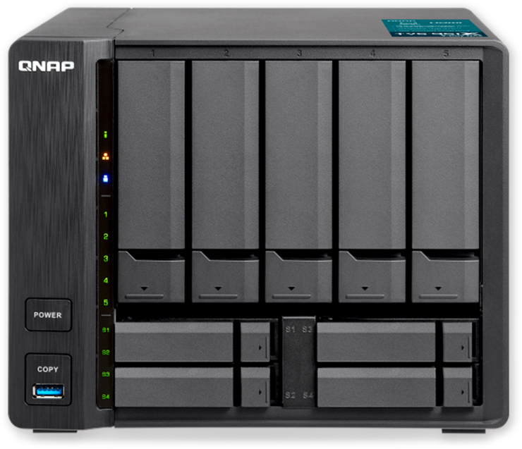
Why QNAP QVR Pro？
Complete surveillance features
Powerful data protection/ failover system
NAS + Surveillance system two in one
Notes:
6

Slide 7




Business security
Live
Live

Slide 8
Business security solution

Slide 9



Business security solution – Case study
Pet supplies stores need to install 32 cameras, which require playback of video recordings within 30 days, and a failover solution to avoid recording interruptions.
 | Description
In the store | There are lots of pet product orders in the office, which need to be kept properly. In addition, 24/7 recording is required to ensure uninterrupted monitoring and protection. 12 fisheye cameras: installed at the counter and store area. 12 regular cameras: installed in the entrance and exit, pet grooming area.
Outside of the store | 8 regular cameras: only need to do the recording task when someone pass by at 20:00～10:00.
Privilege | Managers who often go abroad: can watch the video of all areas. Including the inside and outside of the store, warehouses, etc. Clerk: can only watch the video inside the store.

Slide 10






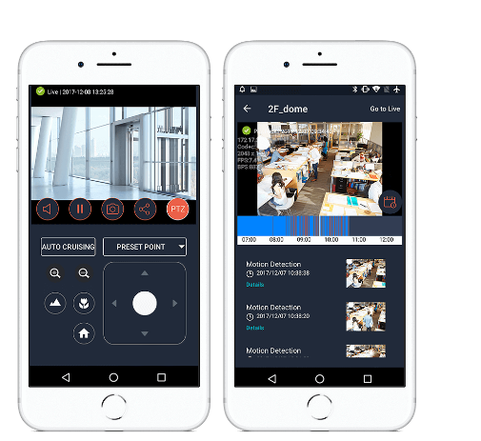
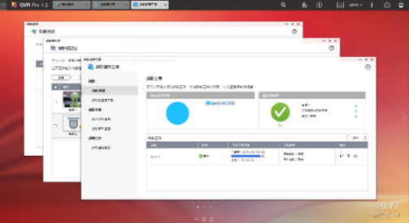
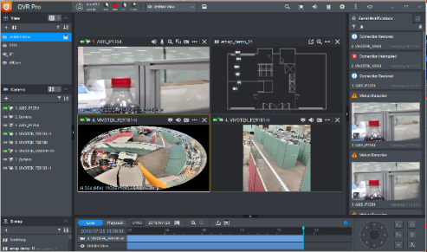
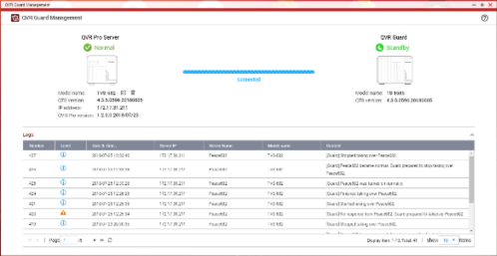
Business security solution
QVR Pro
QVR Pro Client
QVR Pro Client
QVR Guard

Slide 11

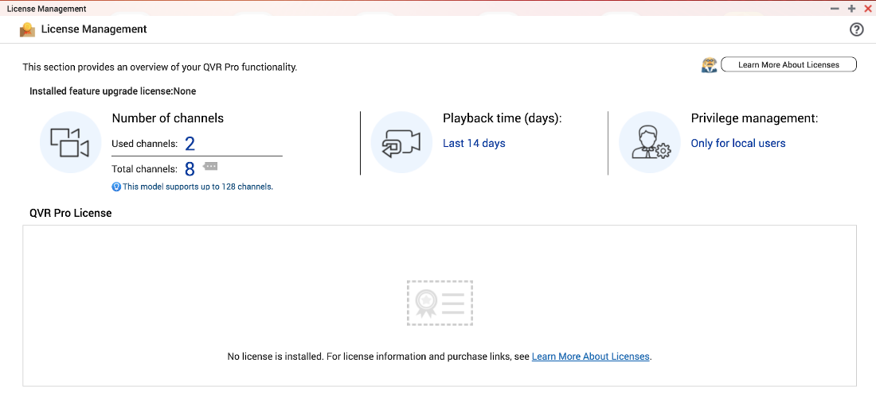

Business security solution
“System deployment”, How does QVR Pro make it better?
1. Eight default channels for free
Built-in 8-channel license for playback of video recording within 14 days with QVR Pro Client. If business users have a larger number of cameras or playback days requirement, QVR Pro Gold (the maximum number of channels is 16 channels, and the number of recording playback days is unlimited) can be purchased. And additional camera channel extension license (up to 128 channels).
8 built-in channels

Slide 12

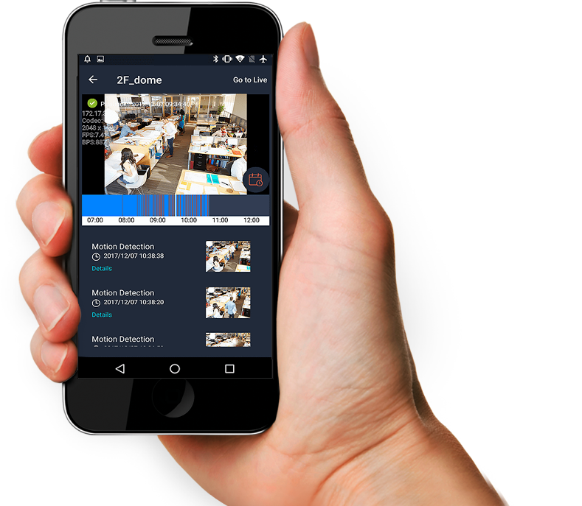
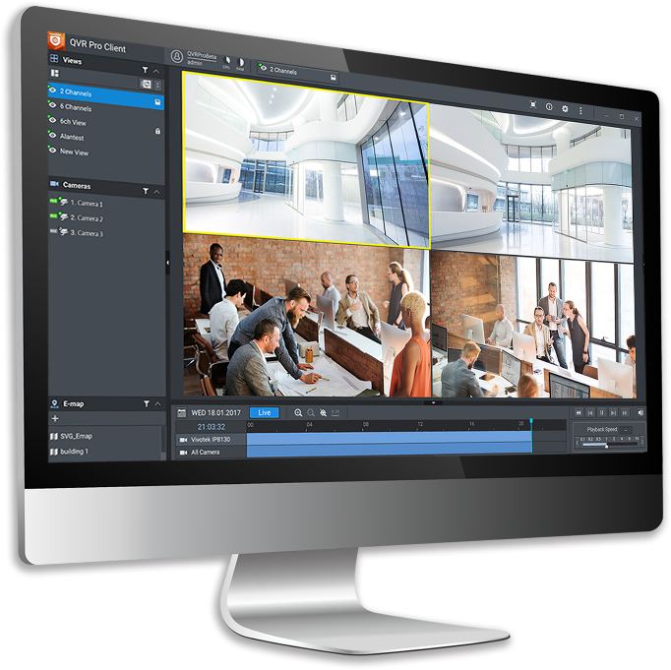

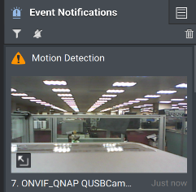
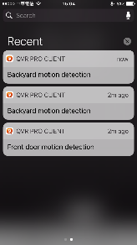

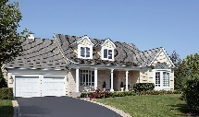

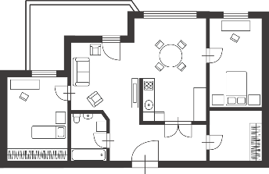
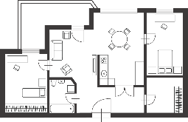
Business security solution
“System deployment”, How does QVR Pro make it better?
QVR Pro records the video and sound. Support more than 5,000 different IP camera models. QVR Pro Client supports 6 platforms (Windows, Mac, Ubuntu, HDMI Local Display, iOS, Android) you can switch between live and playback with just one click.
2. Record and surveillance

Slide 13
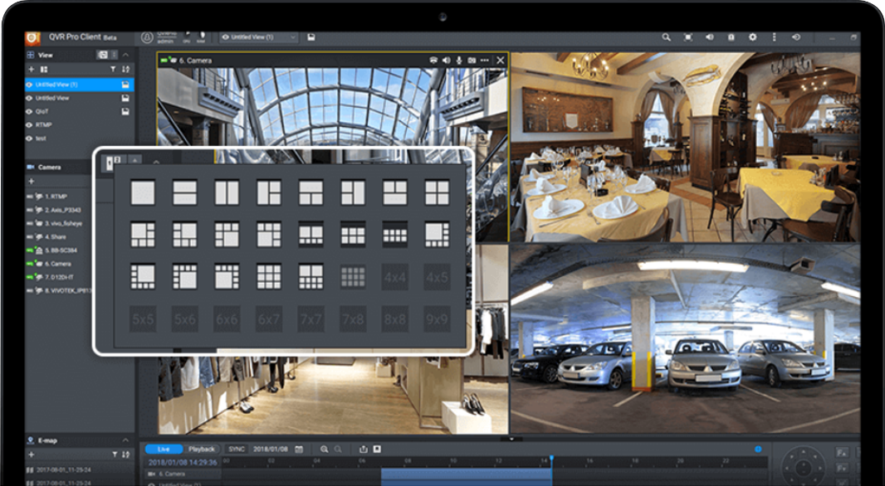
Business security solution
“System deployment”, How does QVR Pro make it better?
3. Flexible view layout and sequential
If you want to enlarge the camera screen of important locations (such as counters and gates), you can adjust the display camera channel scale and position. You can also use sequential mode to rotate different views, so that you can monitor a large number of camera screens in turn.

Slide 14
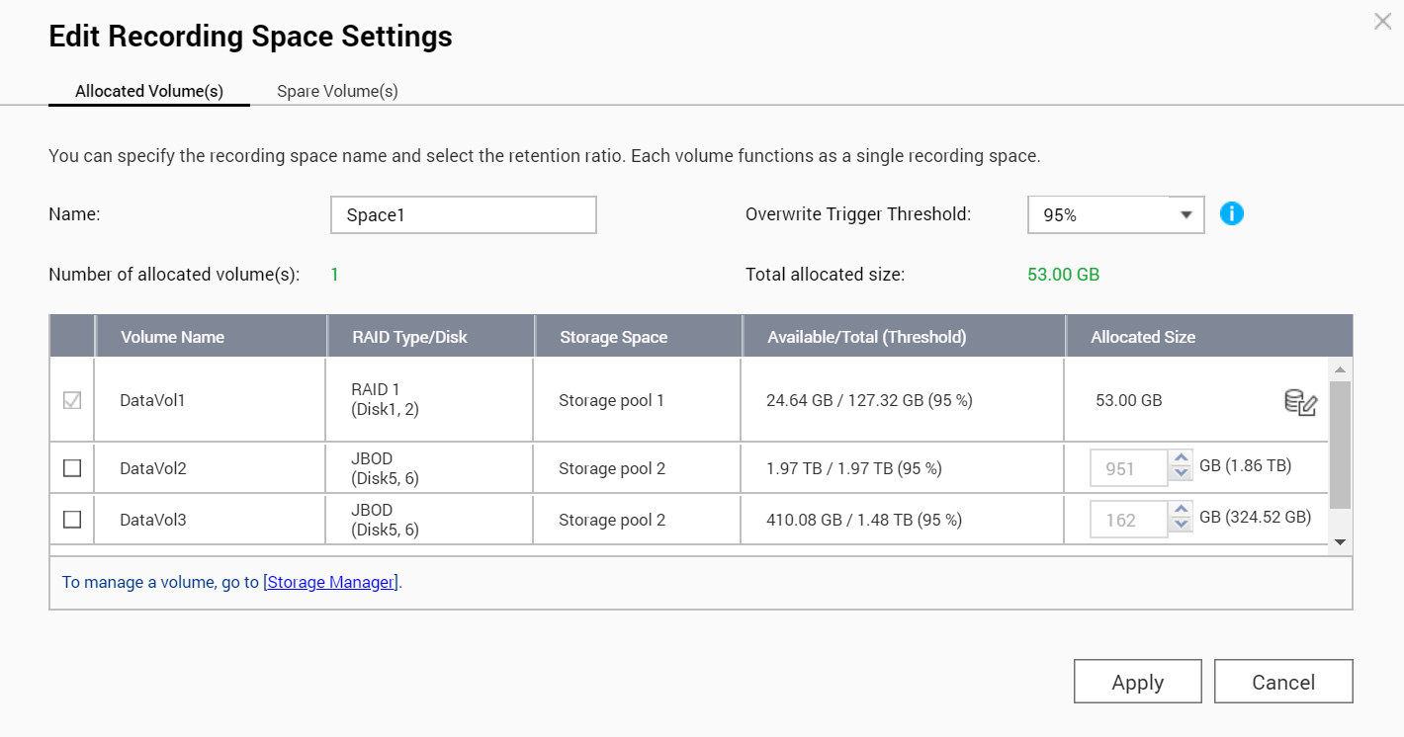
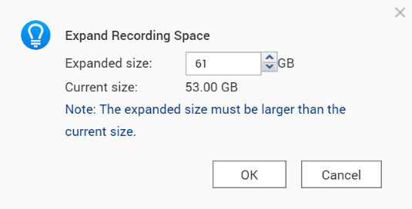

Business security solution
“System deployment”, How does QVR Pro make it better?
4. Flexible storage settings
The user can configure the volume to create a recording space. And specify the cameras to record at different space.
As long as the volume has not been fully configured, the recording space can always be expanded afterwards.

Slide 15
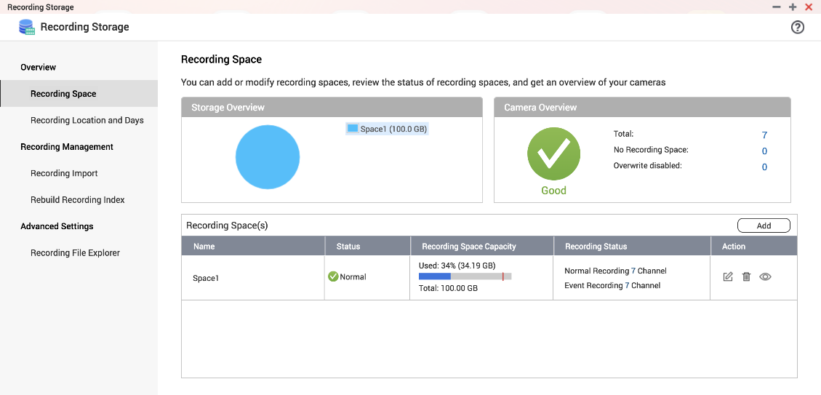

Business security solution
“System deployment”, How does QVR Pro make it better?
5. Normal/Event recording
If the capacity of the hard disk allows, select ”normal recording
“ in case you don’t want to miss
any second.
If the hard disk capacity is
not large but you still want
to record when things
happened, select
"Event Recording".

Slide 16
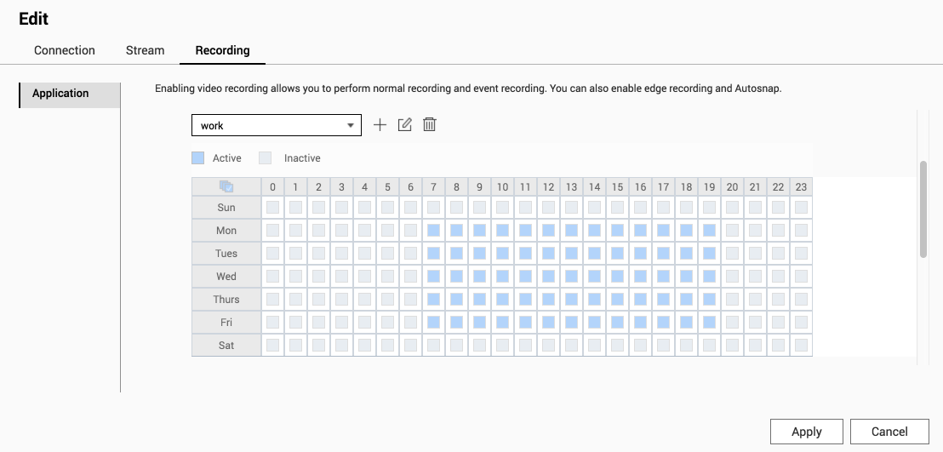
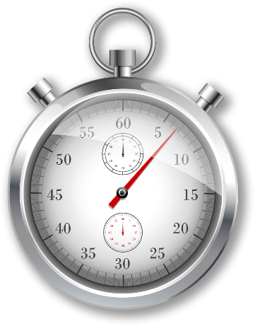
Business security solution
“System deployment”, How does QVR Pro make it better?
6. Schedule recording
Whether normal recording or event recording, you can all specify the
recording time (detailed to hours), especially record the time that
store is close.

Slide 17
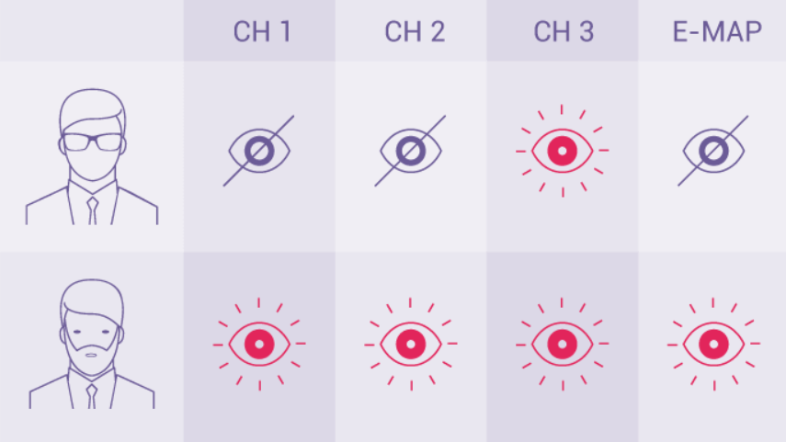

Business security solution
“System deployment”, How does QVR Pro make it better?
7. Privilege setting
The company can specify different privilege settings base on positions and department (for example, the IT staff has the right to change
the settings, and the senior
supervisor has the right to
view all the camera
recordings).

Slide 18


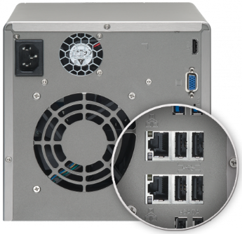



Business security solution
“System deployment”, How does QVR Pro make it better?
8. Live feed routing distribution
Use network interface assignment to avoid video recording stop due to the camera live feeds need large bandwidth.

Slide 19
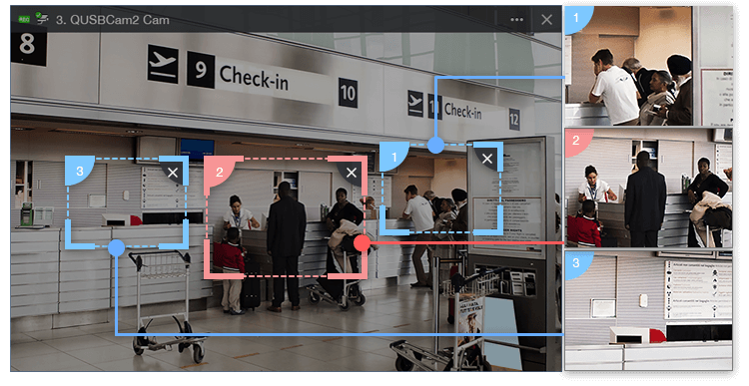

Business security solution
“Convenient and practical functions “, Can QVR Pro make it?
1. Region of Interest
In the convenience store, when a dispute occurs, use region of interest to focus on the video area to clarify the situation.

Slide 20
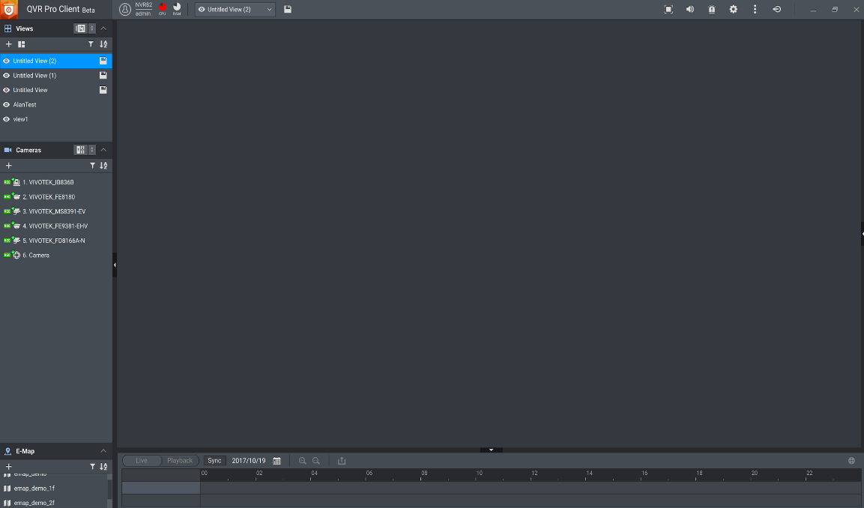
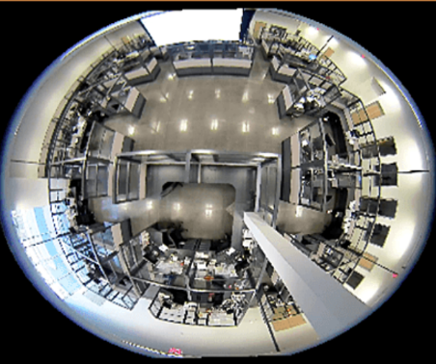
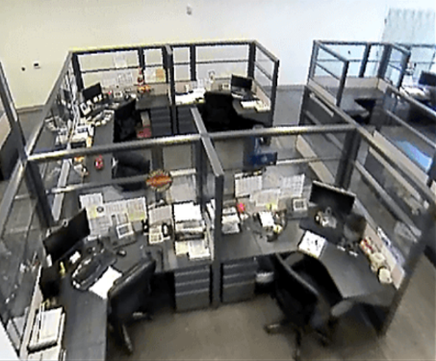
Business security solution
“Convenient and practical functions “, Can QVR Pro make it?
2. Fisheye dewarp technology
Fisheye camera is suitable for large-scale monitoring, QVR Pro is not limited to camera models and enables users to view standard fisheye camera recordings in proportional ratios and sizes without affecting original recordings.

Slide 21
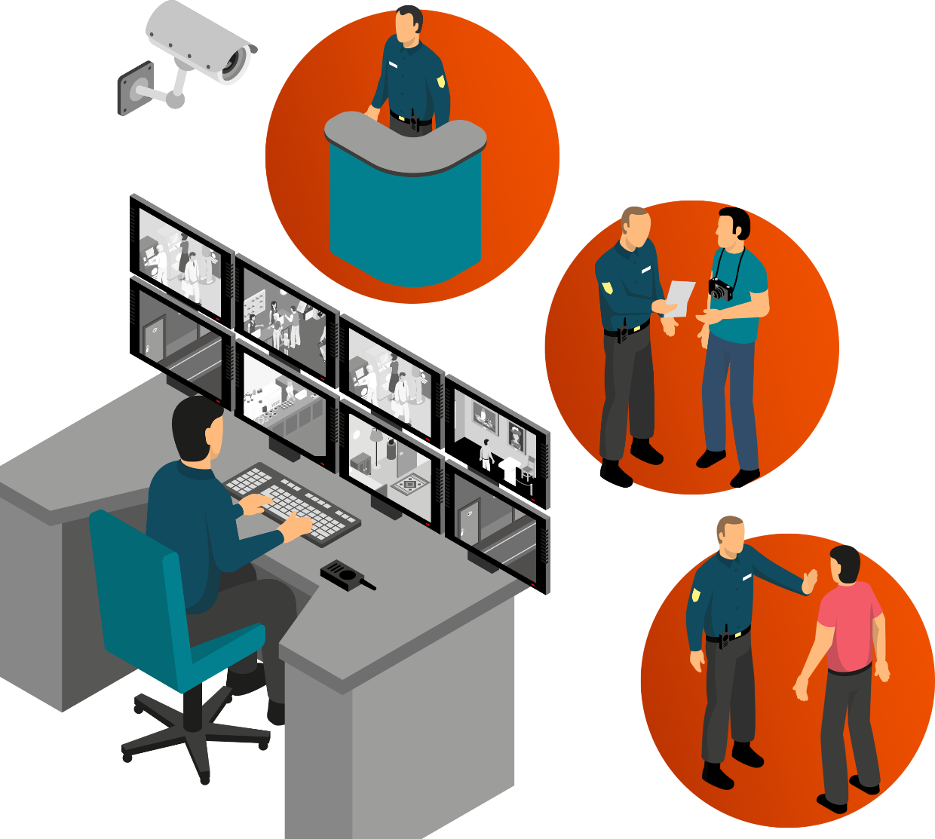
Business security solution
“Convenient and practical functions “, Can QVR Pro make it?
3. Monitoring video wall
When you need to focus on the specific camera screen, you can directly use a single computer to operate, and with the monitoring video wall function, up to 8 screens can be supported at the same time.

Slide 22
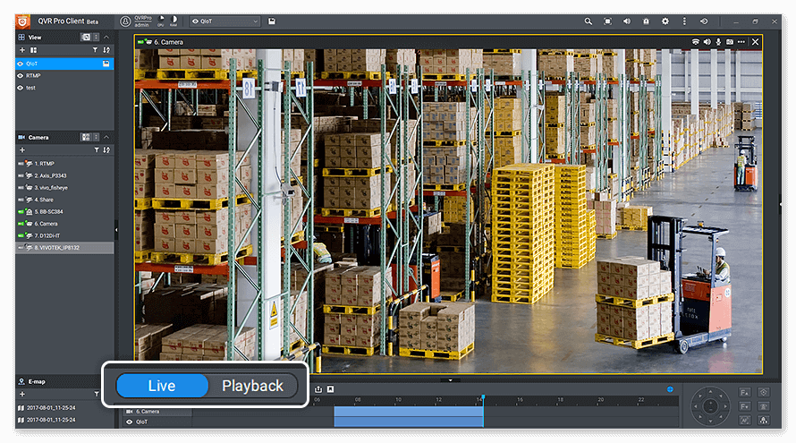
Business security solution
“Convenient and practical functions “, Can QVR Pro make it?
4. Flexible monitor mode
Monitor the live view or check the recordings playback ? You do not need to choose one.
QVR Pro Client can monitor them at the same time in a single view. Also, QVR Pro Client can one click switch between live and playback.

Slide 23

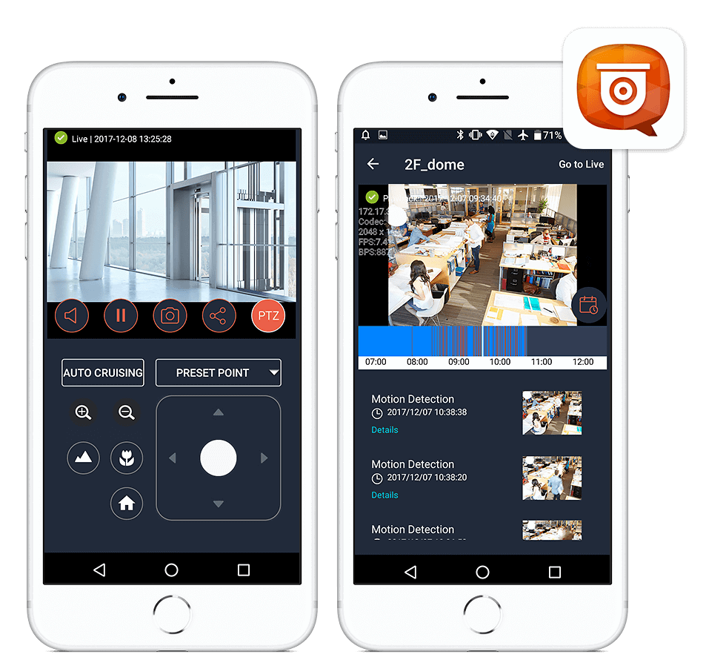
Business security solution
“Convenient and practical functions “, Can QVR Pro make it?
5. Monitor with mobile device
Just use QVR Pro Client for iOS and Android on your mobile device, and you can watch the live video or playback anytime, anywhere.

Slide 24
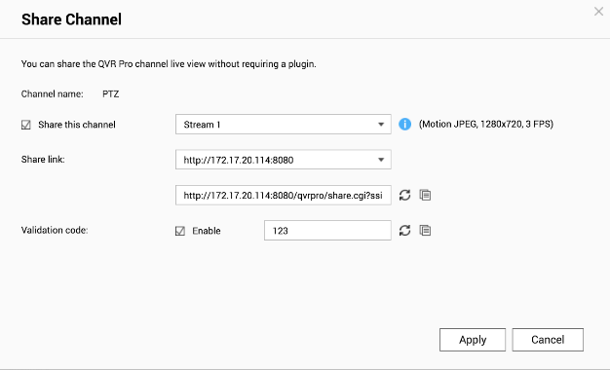

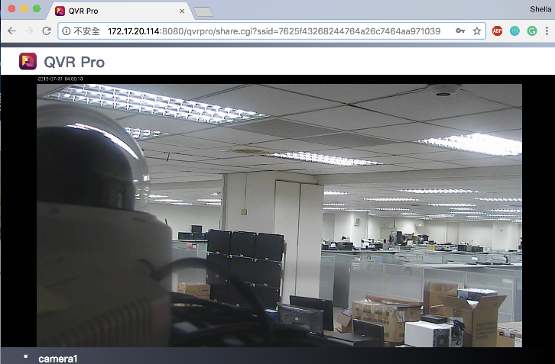

Business security solution
“Convenient and practical functions “, Can QVR Pro make it?
6. Easy to share
Just provide a short URL.
one can immediately enjoy the live video with web browsers. For example, pet in the hotel, the pet owner can see them anytime, anywhere.

Slide 25
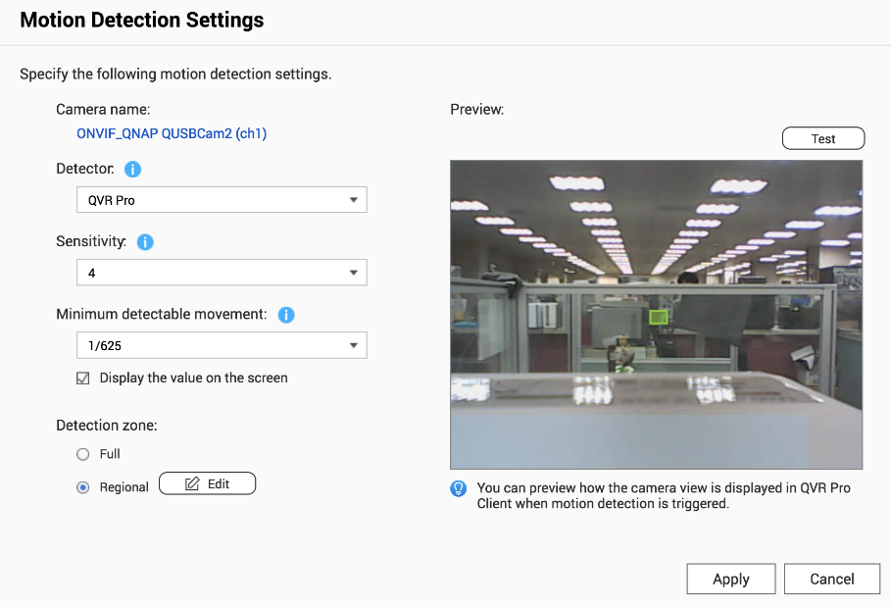

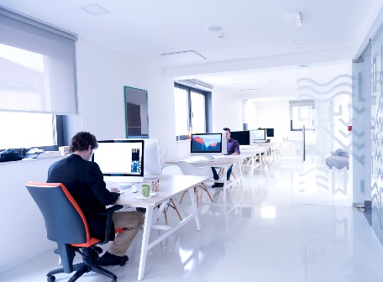
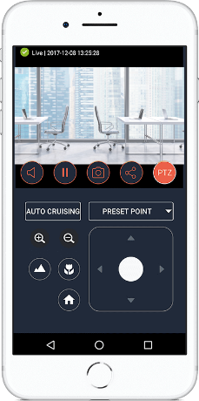


Business security solution
“Convenient and practical functions “, Can QVR Pro make it?
7. Motion detection with webcam
The webcam, which is easy-to-buy and affordable, does not support motion detection by itself. But with QVR Pro video analysis you can still set up motion detection rules.
Motion Detection
Event Management

Slide 26


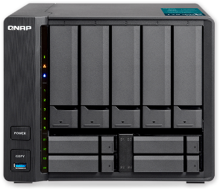



Business security solution
"System stability", How does QVR Pro make it better?
1. Support data protected methods
QVR Pro
Main volume
1
3
In addition to RAID support & snapshot function, you can also back up data to a remote NAS.
When the main volume of QVR Pro is abnormal, you can also enable the spare volume to record, ensure video recording are saved.
RAID
2
QVR Guard
Backup
QVR Pro
Spare volume
4
Real-time Remote Replication
(RTRR)

Slide 27
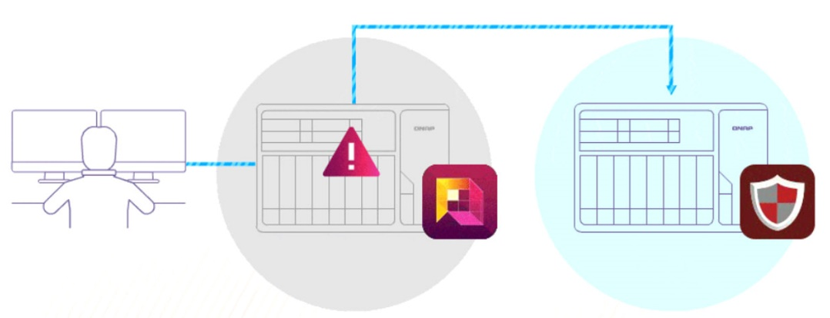
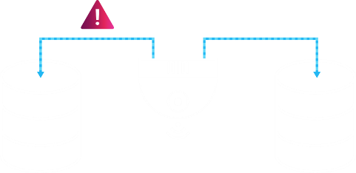
Business security solution
"System stability", How does QVR Pro make it better?
2. QVR Guard failover management
When the NAS was damaged, you don't need to worry about the recording stopped. QVR Guard will take over and ensure that important recording are not missed.

Slide 28
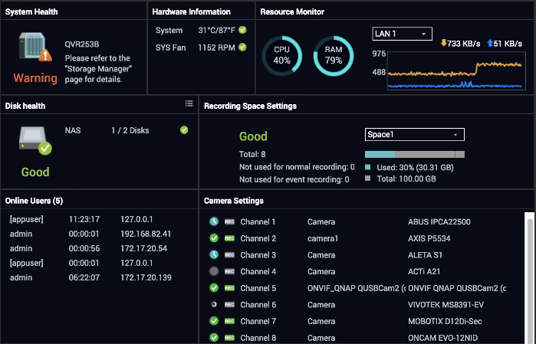
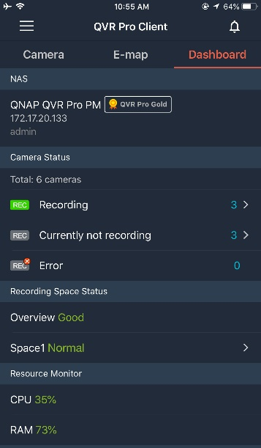

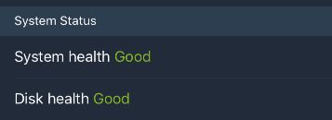
Business security solution
"Maintain operating system", How does QVR Pro make it better?
3. Clear dashboard interface
Through the dashboard, you can clearly control the current system/hard disk health, hardware usage, camera status.

Slide 29

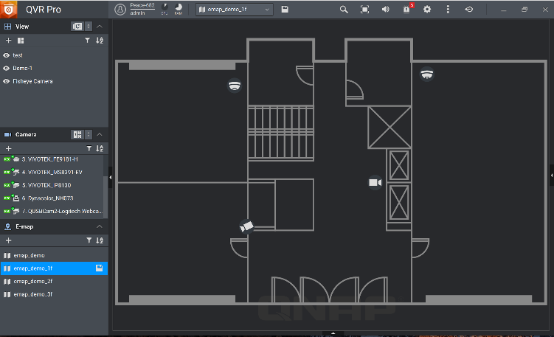
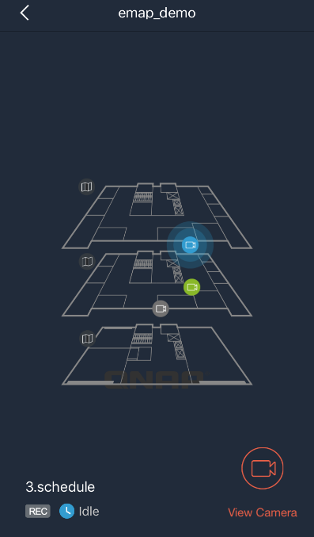

Business security solution
“Event management” , How does QVR Pro make a awesome job？
1. E-map
If an event occurs, you can quickly know the camera's location on the visualized e-map to ensure a timely response.

Slide 30
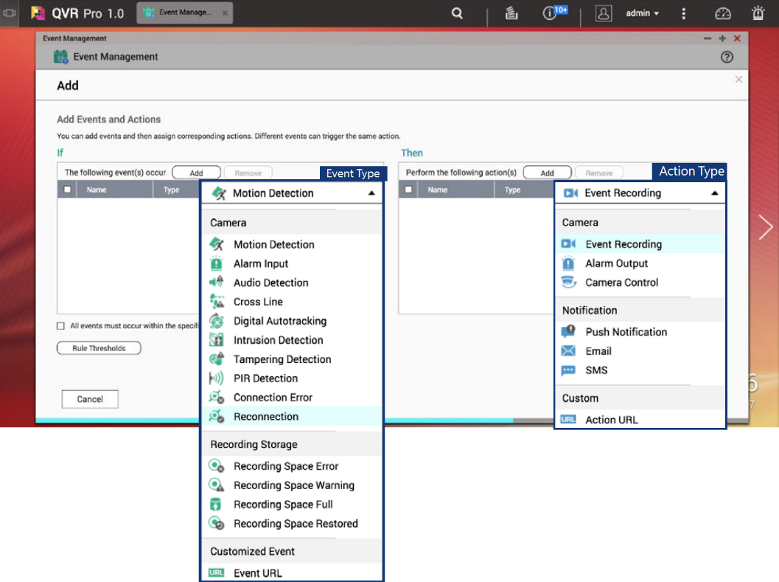

Business security solution
“Event management” , How does QVR Pro make a awesome job？
2. Smart event engine
Face the camera to the exit and set up motion detection, alarm input.. etc. When the alarm is triggered, security guard can check the video see if someone breaks in.

Slide 31
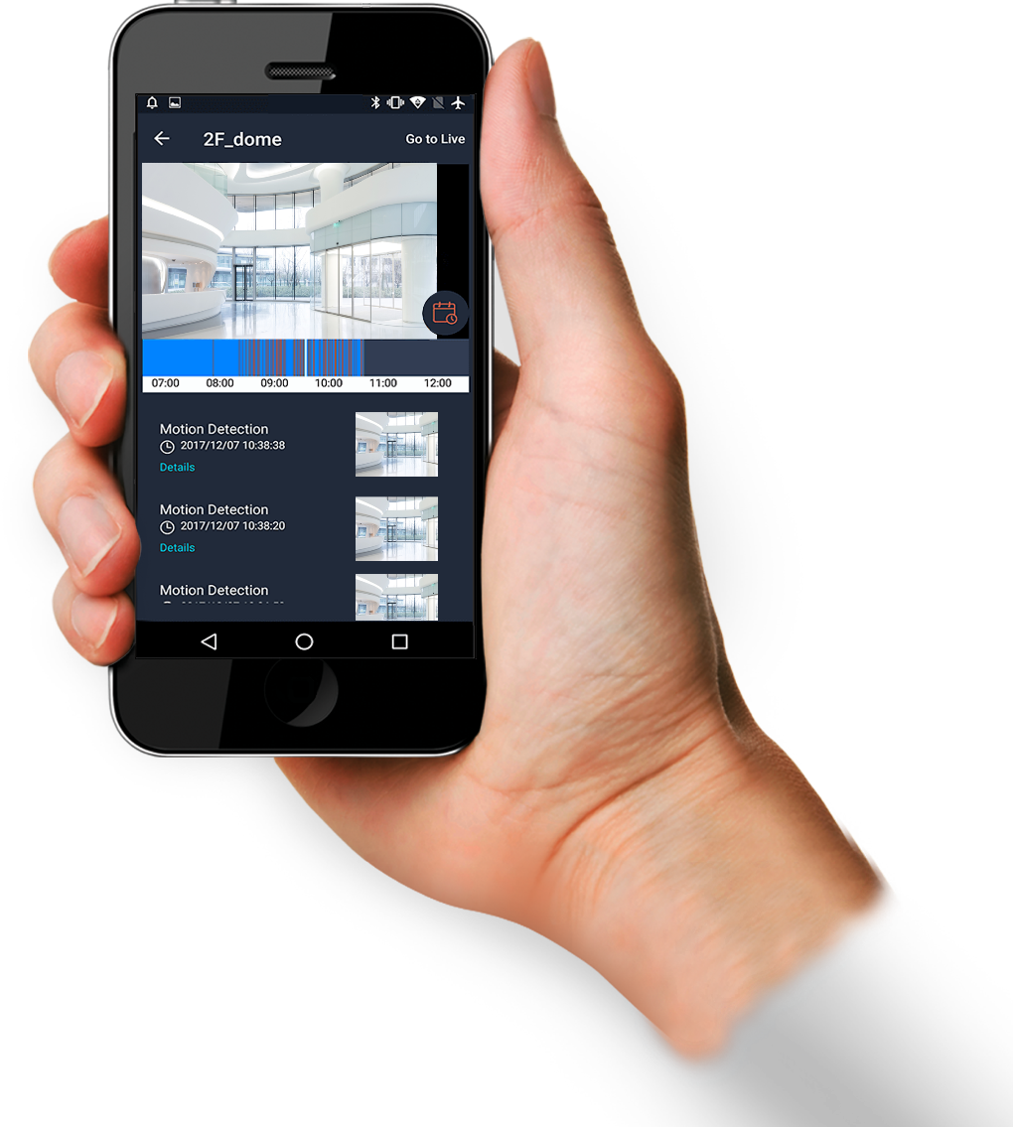



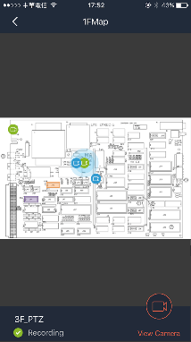
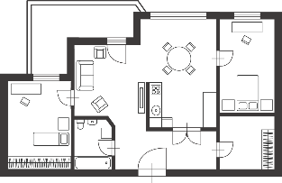
Business security solution
“Event management” , How does QVR Pro make a awesome job？
3. Various notification
methods
With the QVR Pro event engine, you can set up various notifications methods such as mobile push notification, Email & SMS. If necessary, set up the rule “IF motion detection THEN alarm output” to deter the intruder.

Slide 32
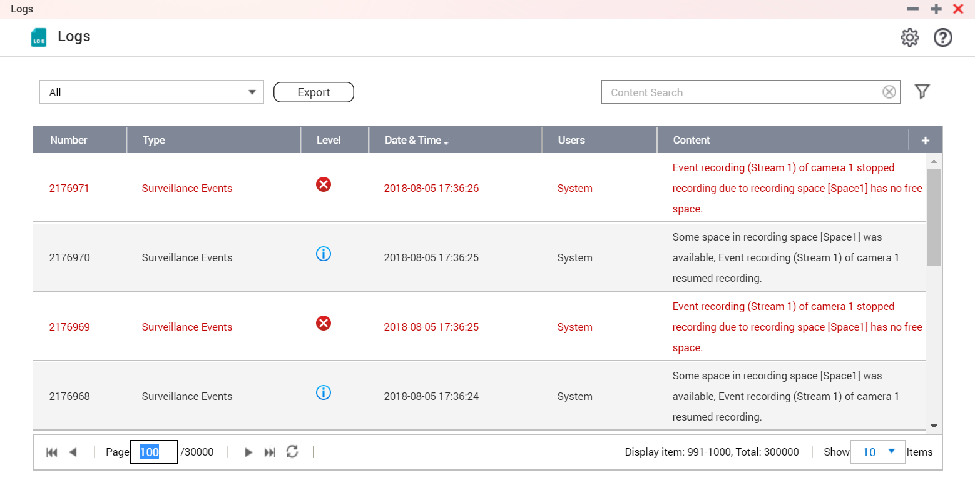

Business security solution
“Event management” , How does QVR Pro make a awesome job？
4. Event logs
If IT staff want to check whether cameras are disconnected or other type of events in this month, they can search quickly via event logs interface.

Slide 33
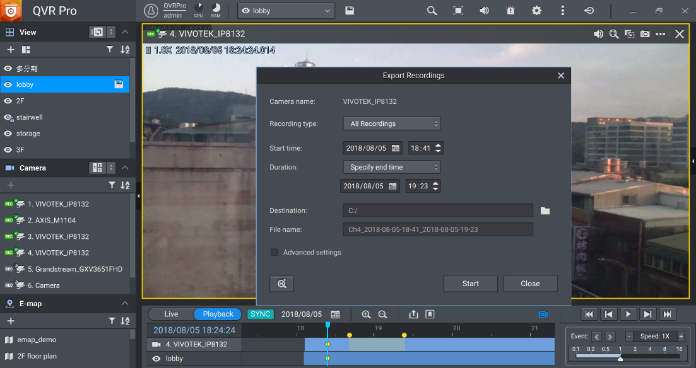


Business security solution
“Event management” , How does QVR Pro make a awesome job？
5. Bookmark & Export recordings
When a store is broken into, you can add a bookmark on the timeline time period. Easy to search for the specific robbery video when needed. You can also export the video files for the police.

Slide 34











Business security solution – architecture
Business (With QNAP NAS)
QUSBCam2
QVR Pro Client
IP camera
QVR Pro (Max. 128 channels)
QVR Guard

Slide 35
Business security
Live
Live

Slide 36


QNAP surveillance solution vs conventional surveillance solution
 | Features | Data security | Maintain
Conventional IP cam+ Surveillance system | less (only for surveillance) | low (If hard disk broke, data is damaged and cannot be recovered) | hard (hard to maintain and control system status)
QNAP NAS (With QVR Pro App) | versatile (NAS features+ surveillance) | high (Support many backup functions, you do not need to worry even the hardware are damaged) | easy (QNAP NAS has it 's own dashboard to control the system status)
8 build-in channels

Slide 37












NAS for your business surveillance
Built-in HDMI
Local Display
3 HDMI for small scale Video Wall solution
Expansion Unit support for PB Level Storage
TVS-951X-8G
TVS-1282-i7-64G
TDS-16489U-SA1

Slide 38

Copyright © 2018 QNAP Systems, Inc. All rights reserved. QNAP® and other names of QNAP Products are proprietary marks or registered trademarks of QNAP Systems, Inc. Other products and company names mentioned herein are trademarks of their respective holders.

