Slide 1

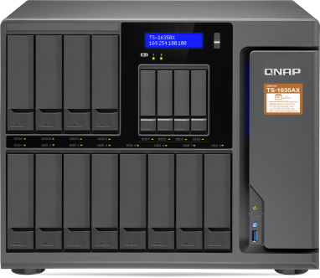
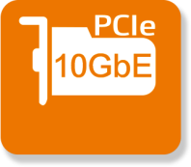


Launching ARMv8 64-bit NAS
that supports containers & 10GbE
In collaboration with
Quad-core, 16-bay,
with high capacity & high expandability
2 x PCIe slots
2 x M.2 SSD
slots
Qtier
TS-1635AX

Slide 2


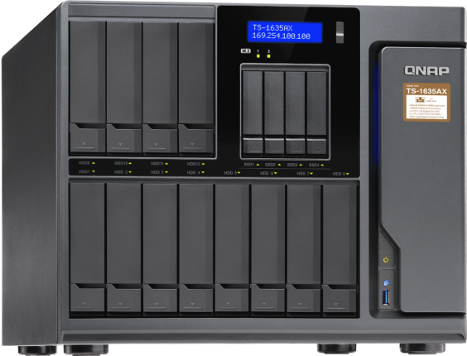

QNAP x Marvell excels
Huge 12 + 4 + 2 bay capacity
  12 x 3.5” SATA HDD +
  4 x 2.5” SATA SSD +
  2 x M.2 SATA SSD (2280)
TS-1635AX-4G
4C Cortex-A72 1.6GHz, 4GB RAM (1x 4GB
TS-1635AX-8G
4C Cortex-A72 1.6GHz, 8GB RAM (1x 8GB)

Slide 3
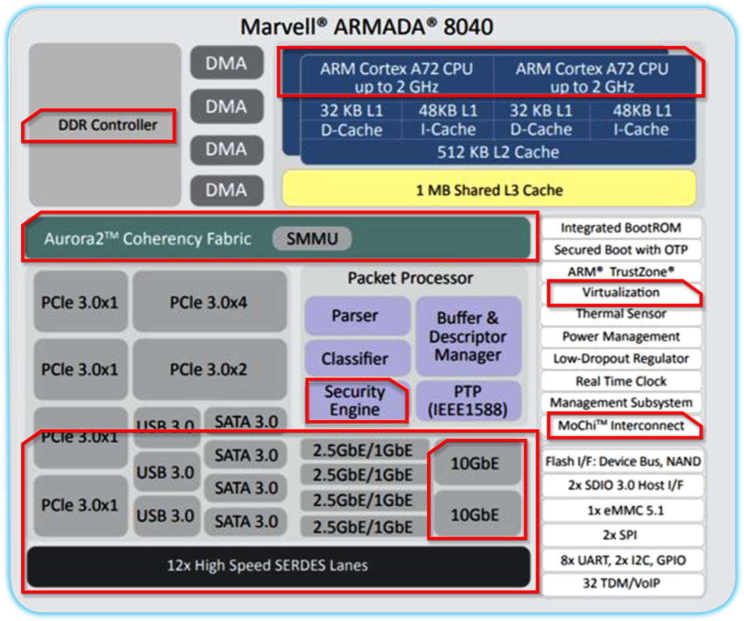
The best ARM NAS to date
DDR4 high-speed memory controller
4 x 64-bit ARMv8
Cortex-A72 1.6 GHz
embedded processor (SoC)
2nd generation Aurora2 high speed, coherency sync can effectively combine the CPU clusters and MCI interface to achieve higher performance
Up to AES 256-bit
encryption engine
Unique MoChi modular technology can agilely support various functional customization requirements
12 high speed
lanes for 10GbE,
PCIe slots, USB and drive bays
Source: 2018.04.13 https://www.marvell.com/documents/zjpkrnvwlqmrkdfcmbwb/

Slide 4

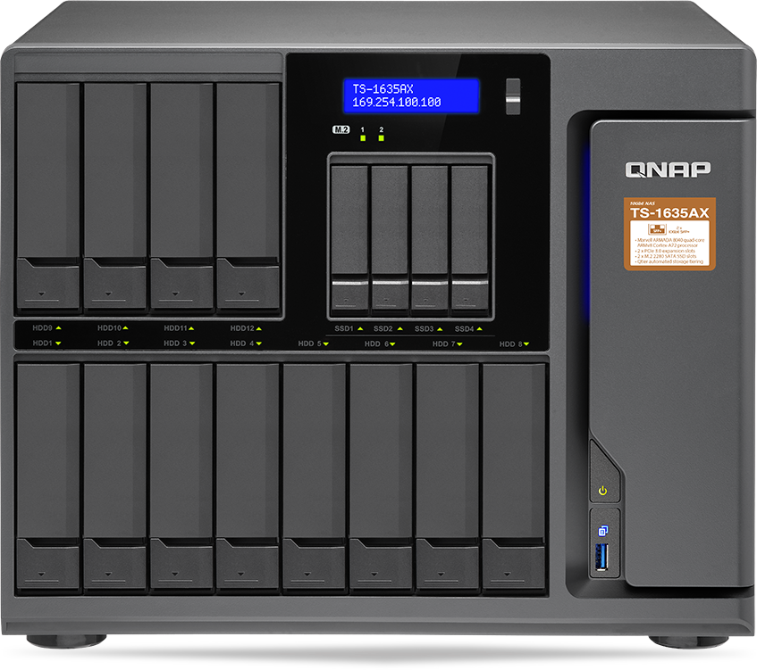


TS-1635AX front view
LCD with
Enter & Select buttons
4 x 2.5" SATA 6 Gbps SSD slots, supporting Qtier auto tiering & SSD cache
Power button
USB 3.1 Gen 1 &
One Touch Copy
button
12 x 3.5"/2.5" SATA 6 Gbps HDD/SSD slot (3.5" HDD installation is toolless)

Slide 5

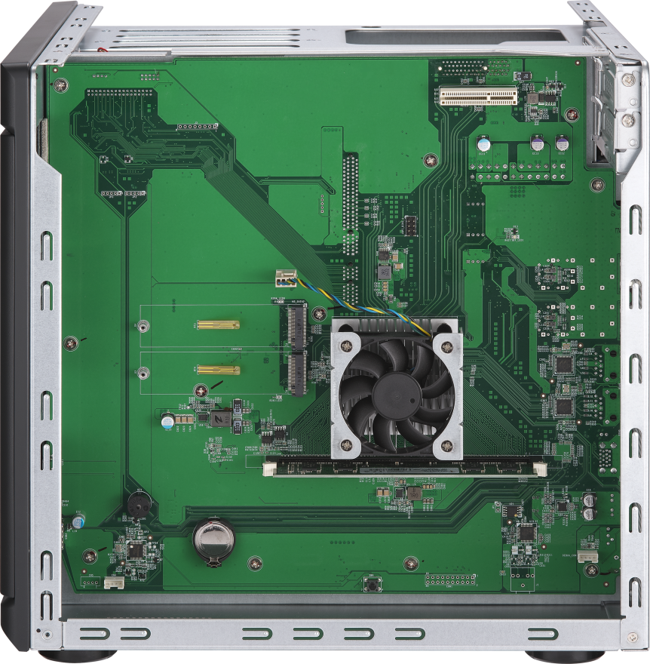

TS-1635AX internal view
2 x M.2 SATA SSD slots (2280 form factor)
Thermal sensor & Qtier / SSD cache
Compartmentalized smart cooling
Separately detects the CPU and hard drive temperatures to dynamically control fan speeds for more quiet operations.
Up to 16 GB DDR4
1 x DDR4 Long-DIMM
memory slot

Slide 6
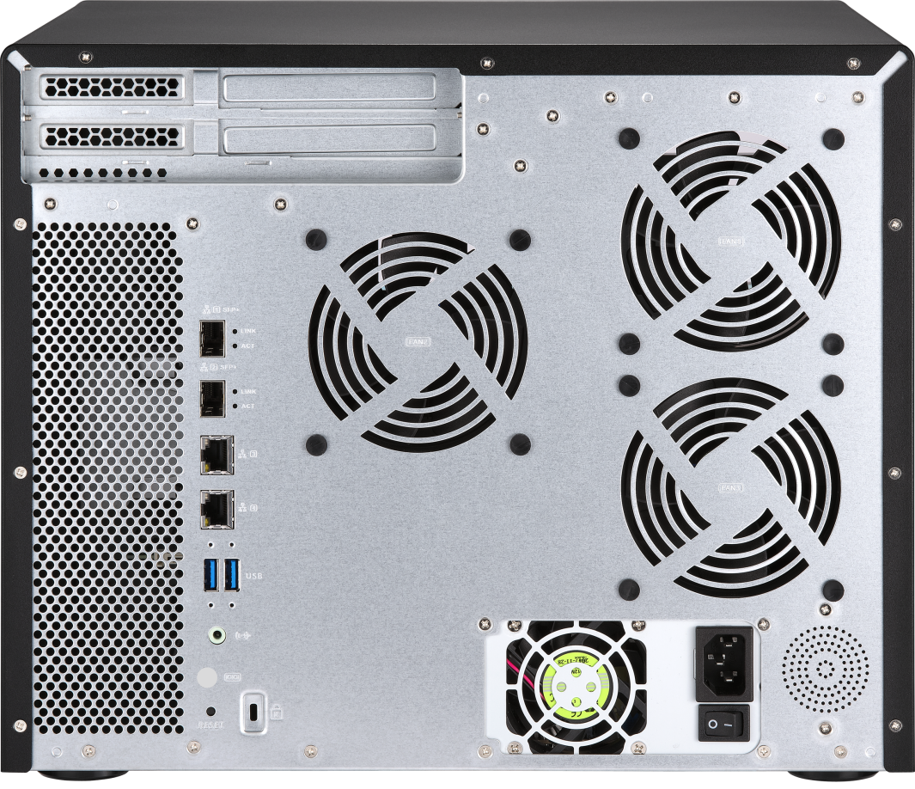






TS-1635AX rear view
1 x PCIe 3.0 x1
1 x PCIe 3.0 x2
3 x 9.2cm system fan
2 x 10GbE SFP+
2 x GbE LAN
2 x USB 3.0
Type-A
250 W power supply
Speaker
1 x line out
Kensington security slot

Slide 7



Qtier with hybrid HDD/SSD design
Boost both performance
and capacity
12 x 3.5”HDD
2 x M.2 SATA SSD (2280)
4 x 2.5”SSD
Qtier™ a multi-tier storage management system, automatically moves the most active data to high-performance drives while less active data is migrated to high-capacity drives.

Slide 8
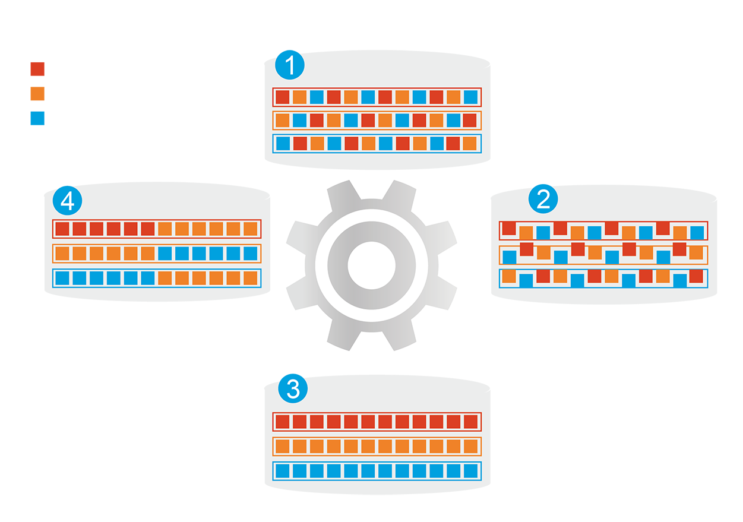






Qtier with hybrid HDD/SSD design
Automatically moves data between different tiers
Before tiering:
Frequently-accessed data
performance is not optimized
Frequently-accessed data
Infrequently-accessed data
Rarely-accessed data
Changes in data
access patterns
SSD cache capacity will not be limited by
the RAM size
Start data tiering
How Qtier Works
After tiering:
Frequently-accessed data
performance is optimized

Slide 9
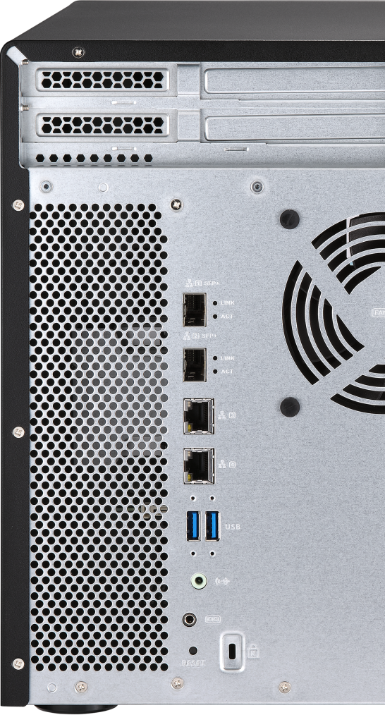

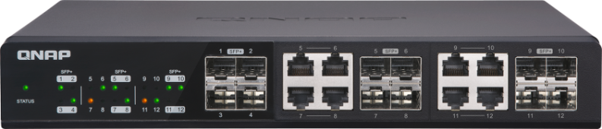

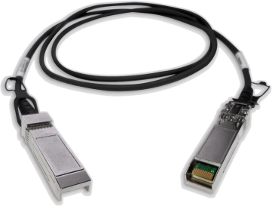
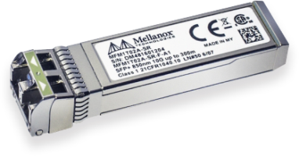


Dual 10GbE SFP+ ports & 10G switch
QSW-1208-8C
TS-1635AX
Connect to a 10G switch
with a DAC cable or a transceiver module
CAB-DAC15M-SFPP-DEC01
TRX-10GSFP-SR-MLX

Slide 10
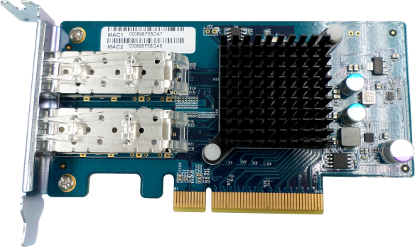







Dual 10GbE SFP+ ports & 10G PC
LAN-10G2SF-MLX
TS-1635AX
Connect to a 10G PC/Server with a DAC cable
CAB-DAC15M-SFPP-DEC01

Slide 11

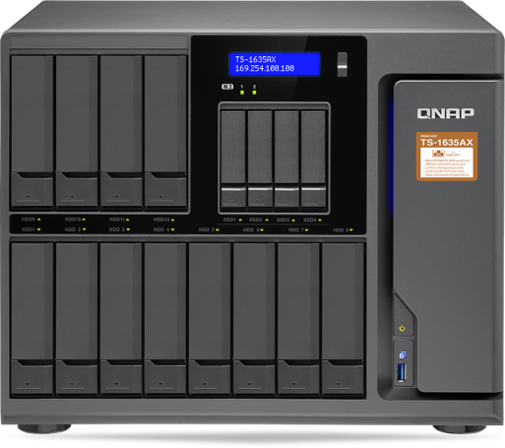
10GbE VJBOD expands capacity of other NAS
QNAP VJBOD (Virtual JBOD) is network-based JBOD, allowing you to expand the storage of a QNAP NAS with multiple QNAP NAS units. The TS-1635AX can provide virtual storage pools and volumes on virtual disks for operating NAS services.
Using VJBOD over 10GbE iSCSI networks is faster than USB /eSATA connections!

Slide 12

Born with 10GbE performance
TS-1635AX integrates 2 x 10GbE SFP+ ports already
Dual PCIe slots supporting QNAP QXG-10G1T 10GBASE-T card
iSCSI
Read
1018 MB/s
Write
831 MB/s
Tested in QNAP Labs. Figures may vary by environment.
1 x 10GbE iSCSI test environment：
NAS： TS-1635AX
OS：QTS 4.3.4
Volume：RAID 5; 12 x Intel SSDSC2BB240G4 SSD
Client PC：Windows 10, Intel Core i7-6700 3.4 GHz, 32GB RAM, QNAP LAN-10G2SF-MLX, IOMeter iSCSI 2M

Slide 13



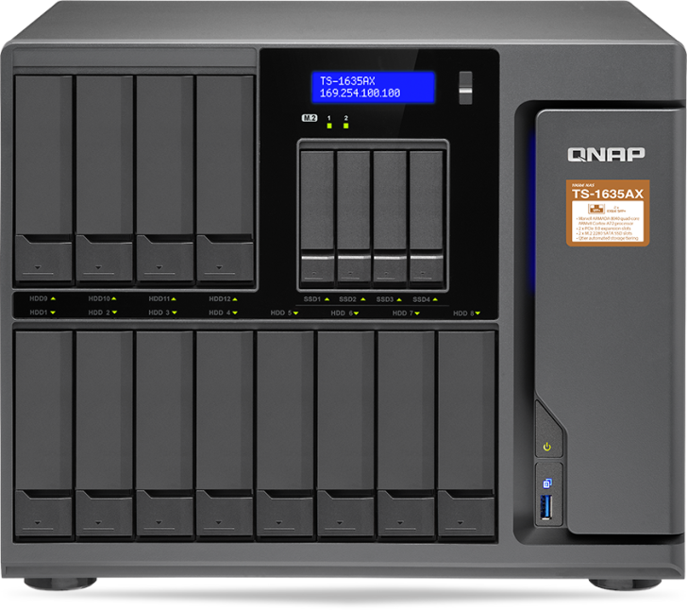
Components upgrade and
10GbE performance
Upgrade memory
Install M.2 SATA SSD
10GbE iSCSI performance
test

Slide 14




2 PCIe 3.0 slots for expansion
QM2 card
10G/ 1G NIC
Provides 2 x M.2 SSD ports and 10GBASE-T LAN port for Qtier and SSD cache
Provides high bandwidth, lower latency for efficient business productivity
USB 3.1 Gen 2 card
DBDC wireless card
Up to 10Gb/s with USB Type-A ports for legacy USB 3.1 Gen 1/2.0 device compatibility
QWA-AC2600 + WirelessAP Station turn NAS into 2.4 GHz /
5 GHz access point

Slide 15
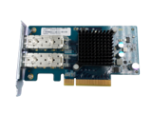



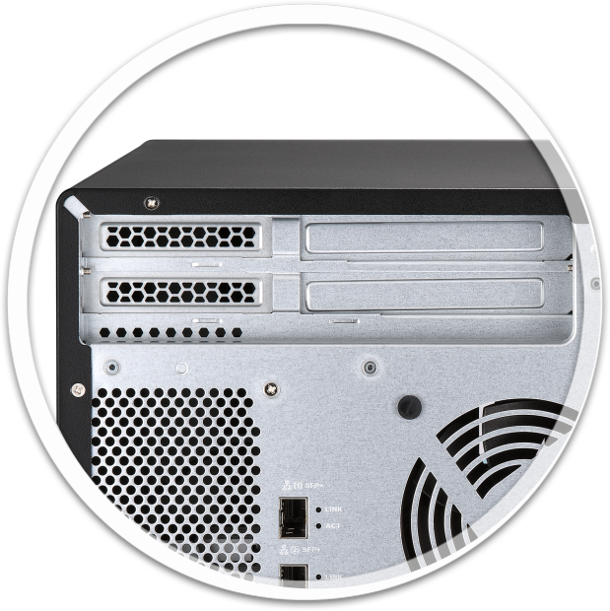

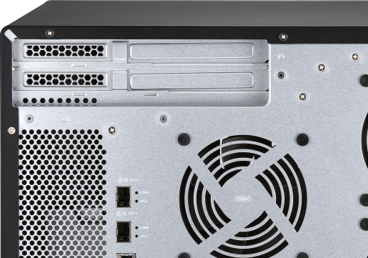
Plenty of PCIe expansion cards
10GbE/1GbE NIC
LAN-10G2SF-MLX
QXG-10G1T
LAN-10G1TA
LAN-1G2T-I210
Wireless network card
USB-A 3.1 10G card
NEW
QWA-AC2600
USB-U31A2P01

Slide 16



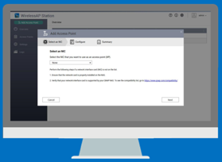
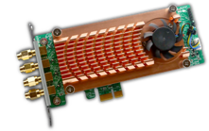


Turn into a wireless access point
Install WirelessAP Station, and let wireless devices connect to NAS
Independent traffic, bandwidth reservation ( IoT/VM/Container)
High-performing quad-core 1.6GHz, supporting 2 cards
QWA-AC2600
wireless card
4 x 4 MIMO AC2600 2.4G/5G
Dual Band Dual Concurrent

Slide 17


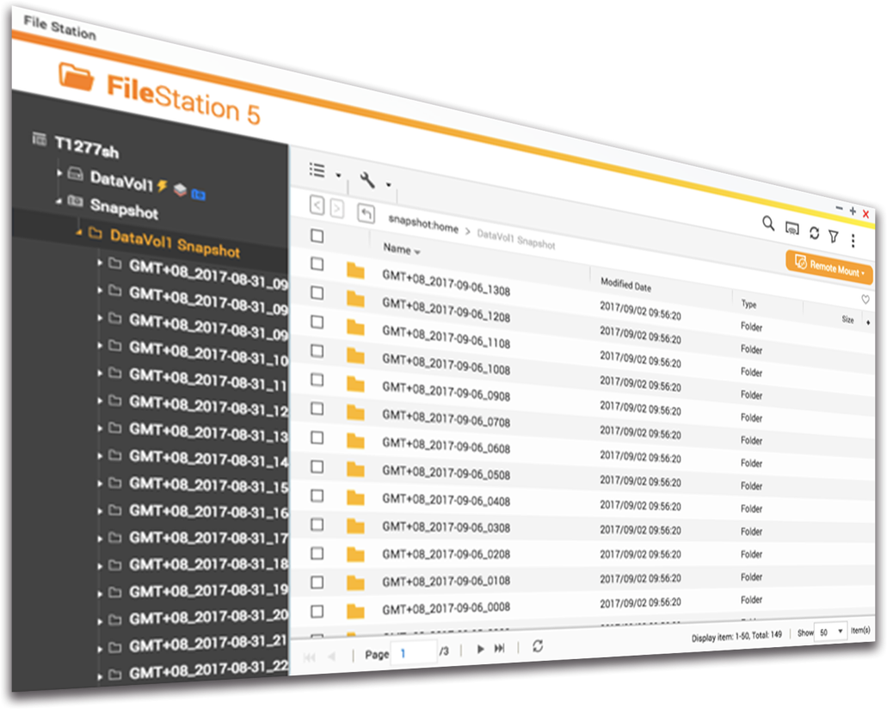


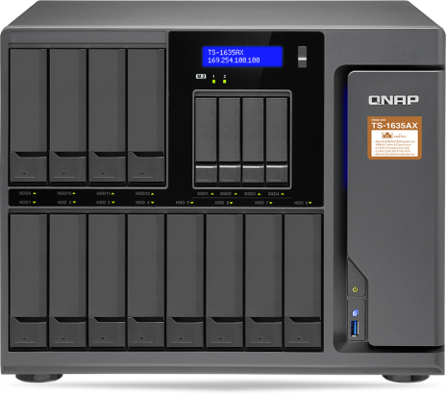

Snapshot for data security
4GB/8GB
RAM
Max snapshot
per NAS
256
----------------------------------------------
Max snapshot
per Volume/LUN
64
Block level; data recovery & protection from ransomware threats!

Slide 18


Container Station for IoT deployment
Integrates Docker® container & LXC

Slide 19


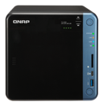

Surveillance with super-high capacity potential
Surveillance Station 5.1
Free: 8 channel licenses
Max: 40 ch (optional license)
QVR Pro
Free: 8 channel licenses
Max: 16 ch (optional license)
QUSBCam2
Up to 1080p USB Webcam recording

Slide 20






Expand NAS capacity with a UX unit
UX-800P
Connect max 1
UX-800P/UX-500P expansion unit
UX-500P
Notes:
add USB & network connection

Slide 21
A solid leap from the predecessor
NAS model | TS-1635AX | TS-1635
Processor | 64-bit ARMv8 Cortex-A72 Marvell ARMADA 8040 4C 1.6 GHz | 32-bit ARMv7 Cortex-A15 Annapurna Labs 4C AL-514 1.7 GHz
Memory | Up to 16GB DDR4 | Up to 16GB DDR3
PCIe slot | 2 ( 1 x 3.0 x2, 1 x 3.0 x1) | 1 (1 x Gen2 x2)
1GbE LAN port | 2 x RJ45 | 2 x RJ45
10GbE LAN port | 2 x SFP+ | 2 x SFP+
Qtier auto tiering | Yes | Yes (since QTS 4.3.4)

Slide 22



The flagship ARM quad-core processor NAS & the new era of containers & 10GbE SFP+
2 x PCIe slots
2 x M.2 SSD
slots
Qtier
TS-1635AX

