Slide 1



Enhanced network management
Preview
Network & Virtual Switch
QVPN 2.0

Slide 2

QTS 4.3.5 highlights - Network
High speed 10G era (VM / Container / vQTS )
  ￭ H/W: QNAP 10G switch + QNAP 10G NAS
  ￭ S/W: Connect everything together with [Network & Virtual Switch].
Brand new UI design (Easy to locate the ethernet port/USB wireless dongle)
￭ Clear topology for virtual and physical networking.
  ￭ User Story: Lots of forum users have the same issue: they
  are not sure about how to connect virtual and physical environment.
  Updated interface for wireless connections and support for QNAP PCIe wireless adapters (QWA-AC2600) in client mode.

Slide 3
QTS 4.3.5 highlights - Network
Added support for network :
  ￭ More streamlined functions for users:
    Network interfaces can now display customized names.
    Supports customized DDNS and allows multiple services.
  ￭ Advanced functions:
  Support stateful/stateless auto-configuration of IPv6 addresses, and each network interface supports full RADVD services.
  Supports reserved IPs with the DHCP service.
  Auto Default Gateway + NCSI service can now be disabled.
  Supports IPv4 & IPv6 static routes.
    Summary
    QNAP NVS (Network & Virtual Switch) connects your virtual and physical environments with high speed networks.

Slide 4

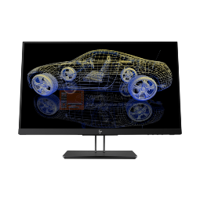
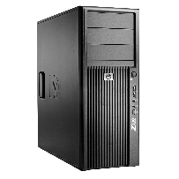



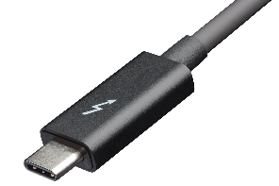
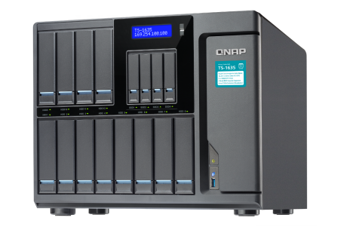
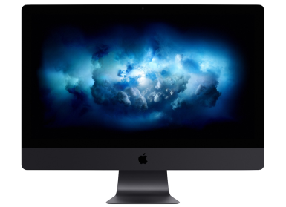

Are you ready for 10G evolution?
Not only QNAP NAS, virtually all elements support high speed transmission now.
VM
VM 10G
QNAP 10G Switch
10G Windows
DT/NB
10 to 20G
Thunderbolt network
10G Mac DT
QNAP 10G NAS

Slide 5


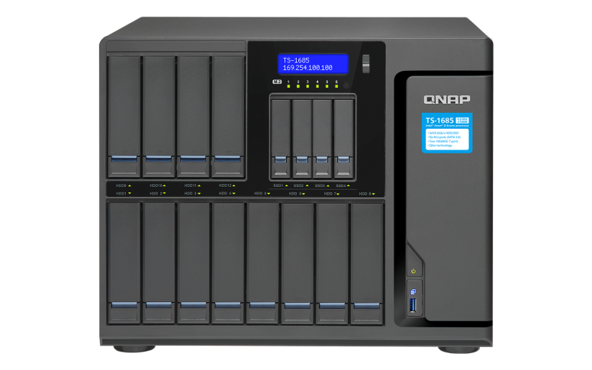

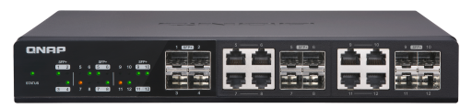

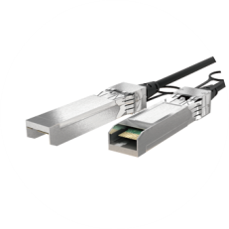
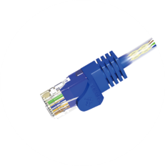


Link internally with 10G transmission
NVS connect internal and external environments with 10G speeds
- internal virtual machines connect in the 10G speed as well
NVS
(Network & Virtual Switch)
High speed 10G
VM: 10G
Container: 10G
vQTS: 10G

Slide 6

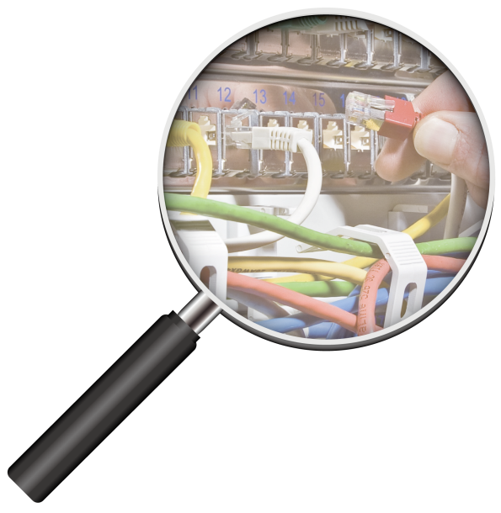
Connectivity checking always gives you a hard time?

Slide 7
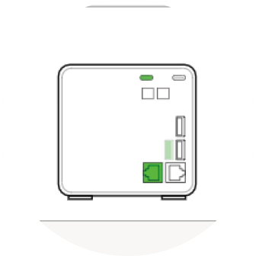
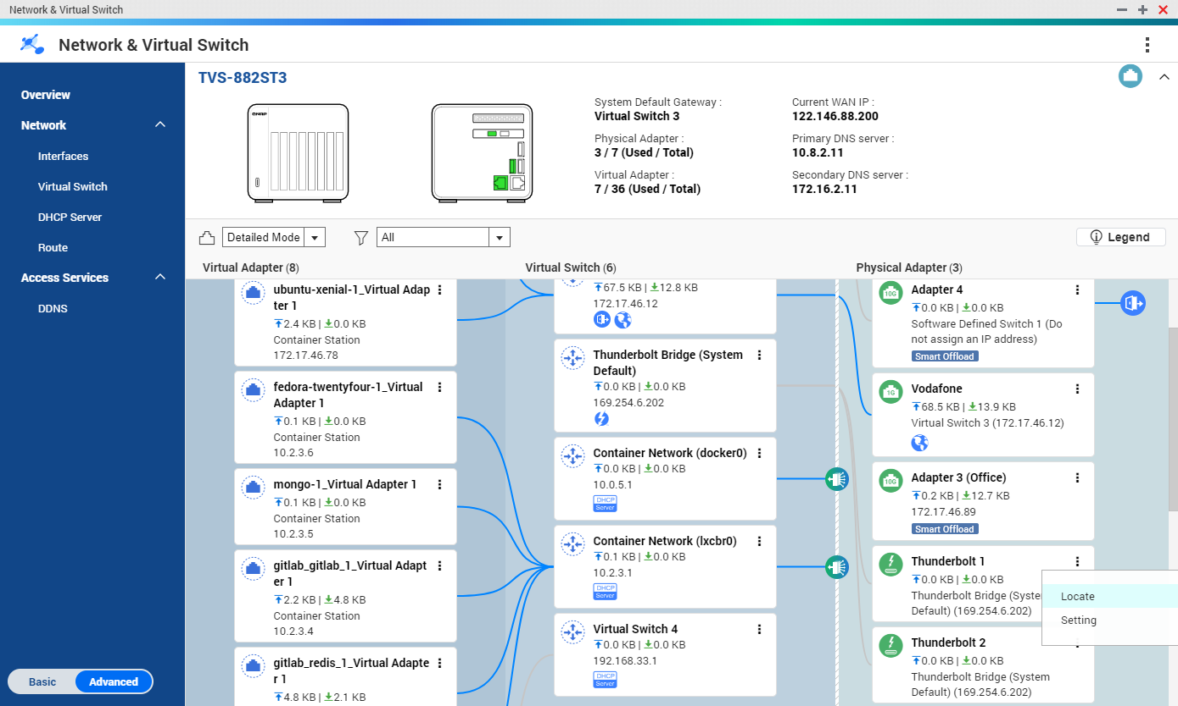
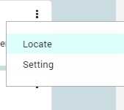
New overview screen: easy to identify port locations
Just click locate and find out where it is on your NAS immediately.

Slide 8
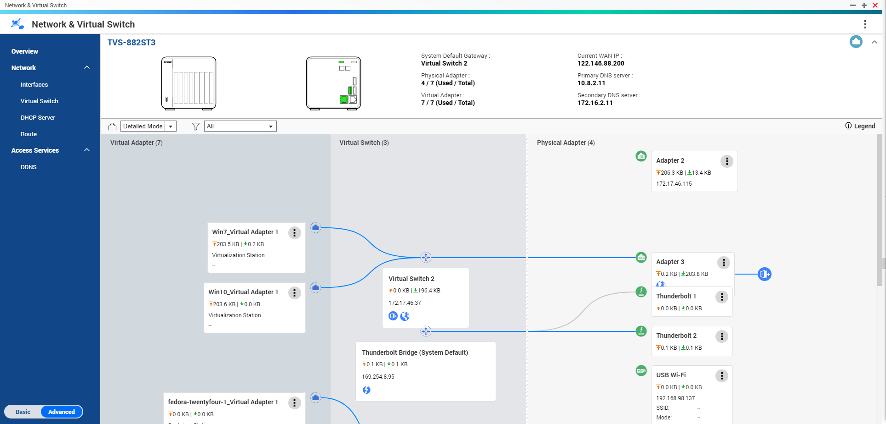
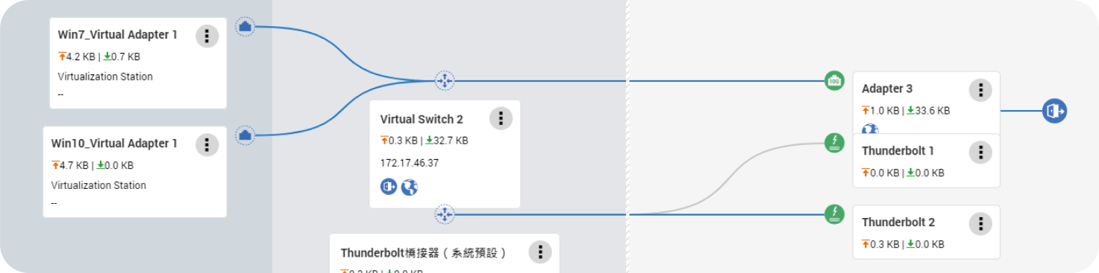
Clear network topology for virtual and physical networking
Virtual machines can be bridged to external networks by virtual switches and physical network ports.

Slide 9
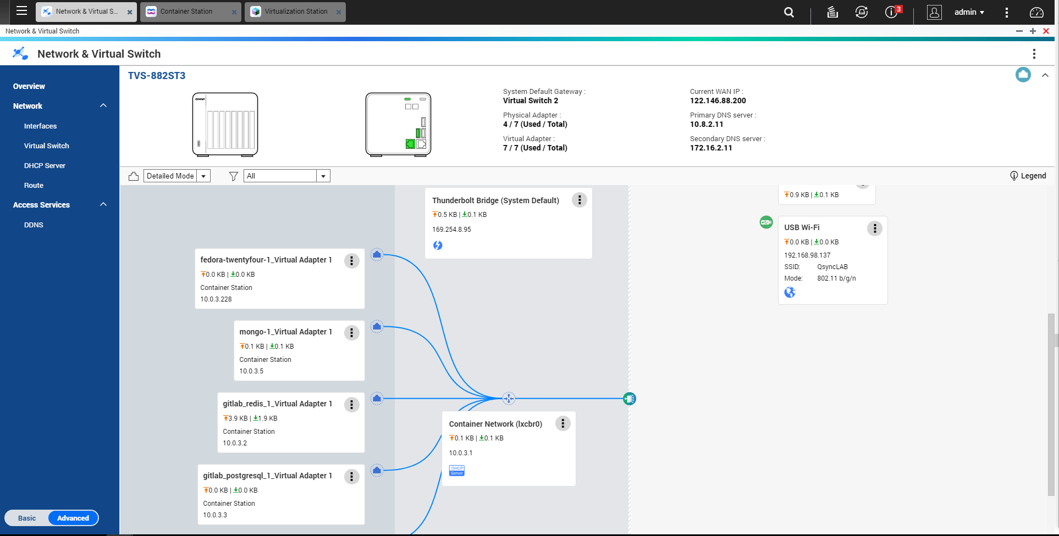
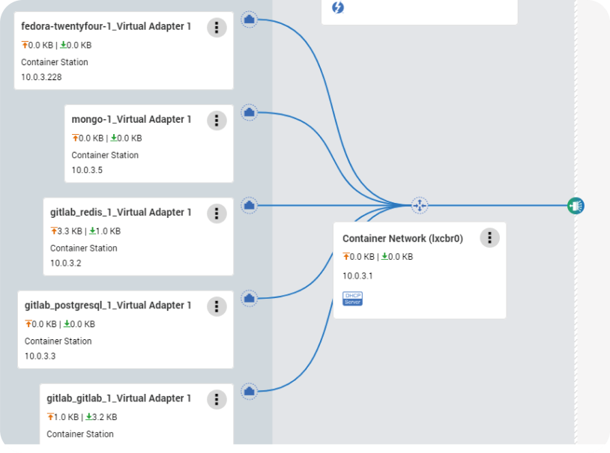
Virtual network won't bother you anymore
Containers will be using a closed and independent network built by a virtual switch, and only internal access is allowed. (DHCP will assign IP addresses automatically, and NAT can be enabled if Internet access is required)

Slide 10
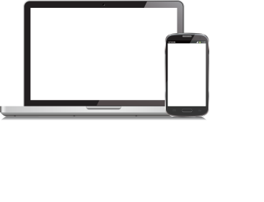
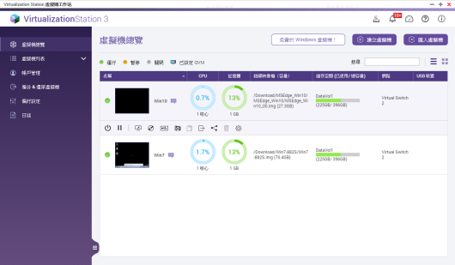

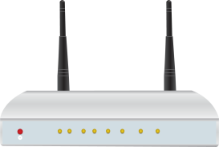
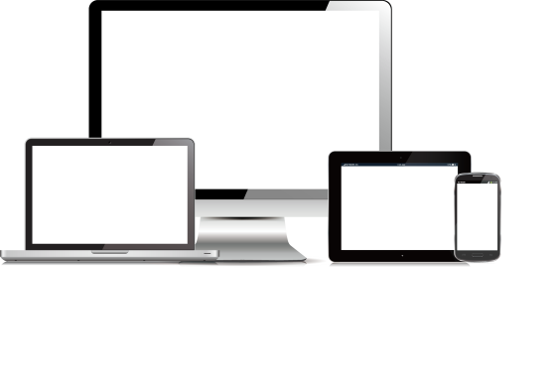



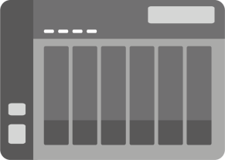

Common problems from forums (1)
I have set up a virtual machine; how can other users access it within the same local network, as well as from the Internet side?
Internet
OK

Slide 11

Common problems from forums (1) : Solution
QVS will bridge the VM with the system default gateway as a virtual switch when 1st launched.
The router of the current physical network segment will assign an IP address to the VM
VM just looks like an independent device on this network.
(Careful! All services running on this bridge mode virtual switch might affect this network.)
You could configure the vNIC to be bridged with another adapter.
All devices on the same segment could access this VM.
Router: set port forwarding to the IP address of the VM
VM can be accessed from Internet side with router WAN IP + port number

Slide 12
Common Problems (1) - Demo

Slide 13

Common problems from forums (2)
I have set up a virtual machine; how can I prevent other local devices from accessing it? How can I keep VM isolated and secure so I can run sandbox tests on it?
OK

Slide 14
Common problems from forums (2) : Solution
Click configure to modify settings
Uncheck the selection of physical adapters
It's a closed and independent network, and access from local networks can be blocked.
(You could run functional verification, internal data computing, sandbox testing, etc.)
Set static IP for the virtual switch
Enable DHCP to assign IP addresses for VM
The DHCP default gateway should be the same as that in step 3
NAT can be enabled if VMs need access to the Internet

Slide 15
Common Problems (2) -Demo

Slide 16
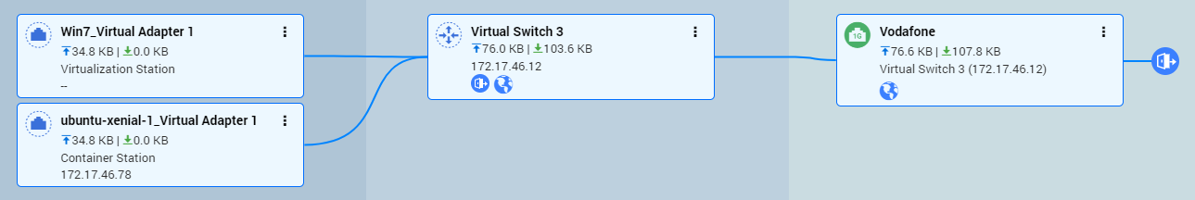
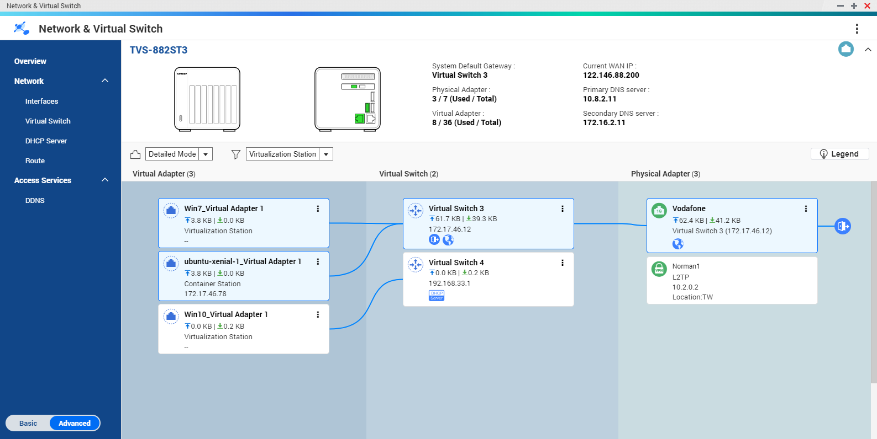


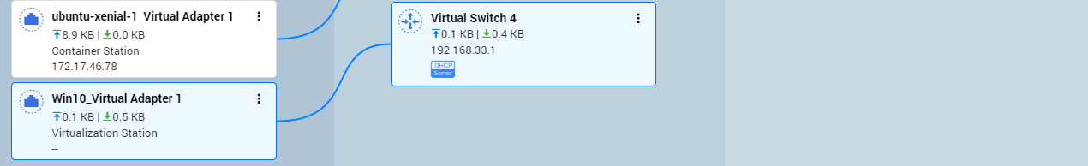

Overview helps you quickly check overall status
Connected to external network by the physical 1G adapter through the virtual switch 3. Earth symbol shows that the environment can access the Internet.
This group of VM is connected by virtual switch 4. Without earth and NAT symbols, this indicates the environment is a independent network.

Slide 17
4.3.5 Brand new features :
Make your NAS easy to master

Slide 18

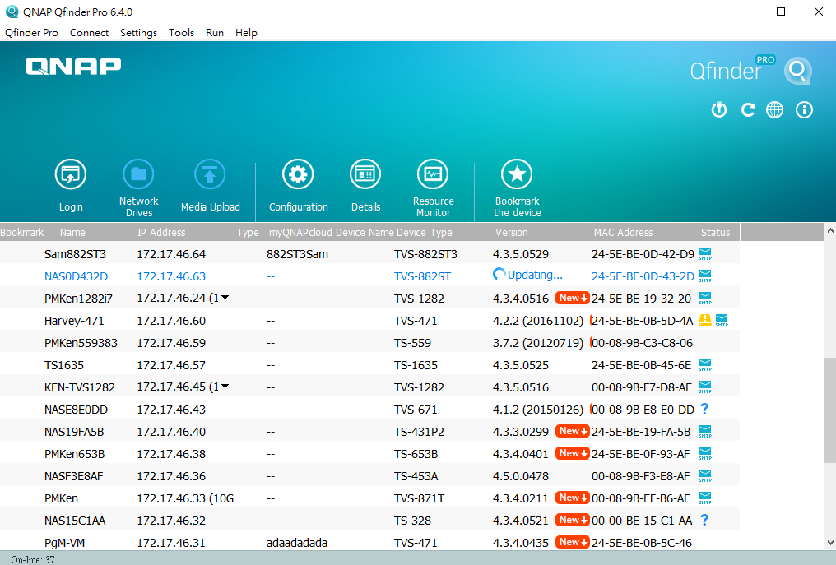
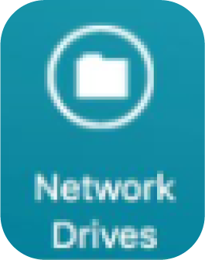
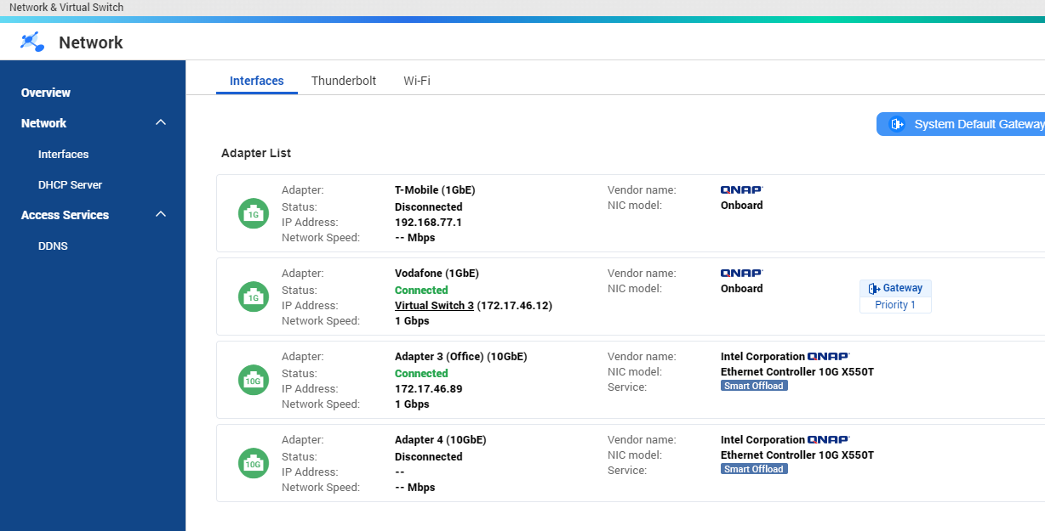
Just plug in network cable and start using NAS
Download Qfinder Pro
Control Panel > Network & Virtual Switch
Find your NAS:
(1) Open NAS web UI by clicking in the list
(2) Mount shared folders easily
If you do not use VM / Container, just check the IP address, and confirm the adapter speed before starting to use your NAS.

Slide 19
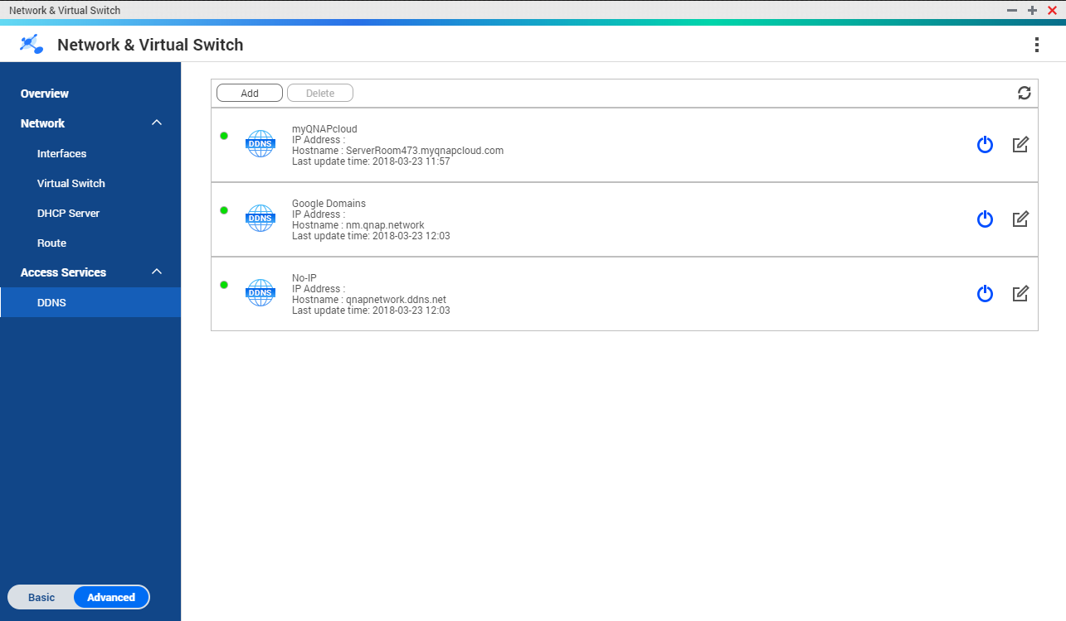
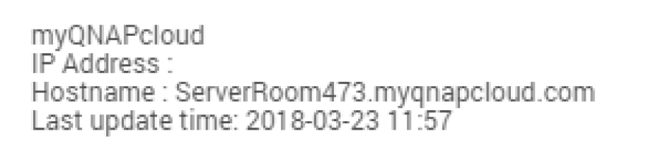
Multiple DDNS – more than 1 URL for NAS
Access your NAS easily via DDNS URL
QNAP myQNAPcloud
More service providers
(Google domains, etc.)
Customize for virtually any online services

Slide 20

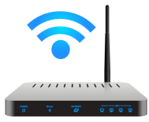
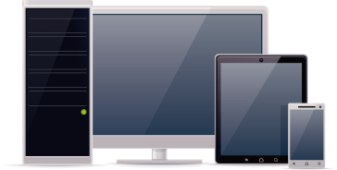

Easy to access from Internet
(DDNS + router setting)
DDNS
UPnP / set router manually
Web Server
FTP Server
VPN Server
LAN IP1
…………….
LAN IP2
Access the NAS anytime, anywhere!

Slide 21

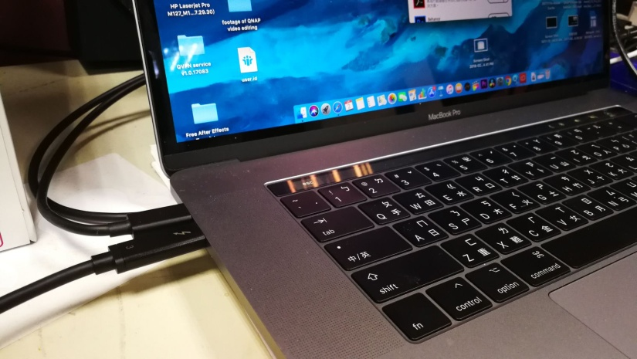
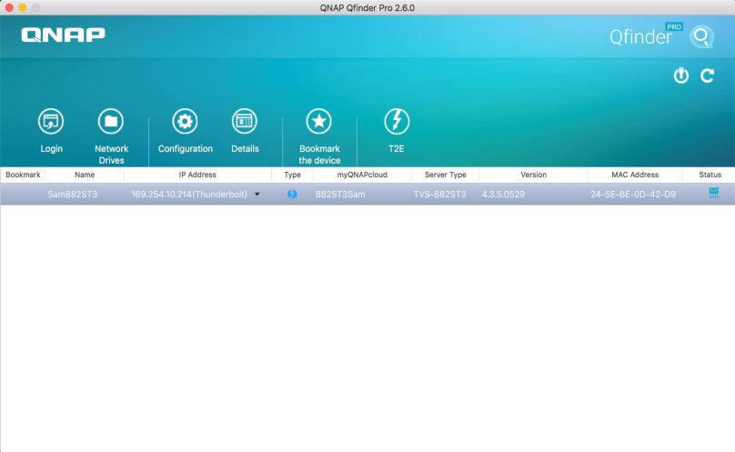
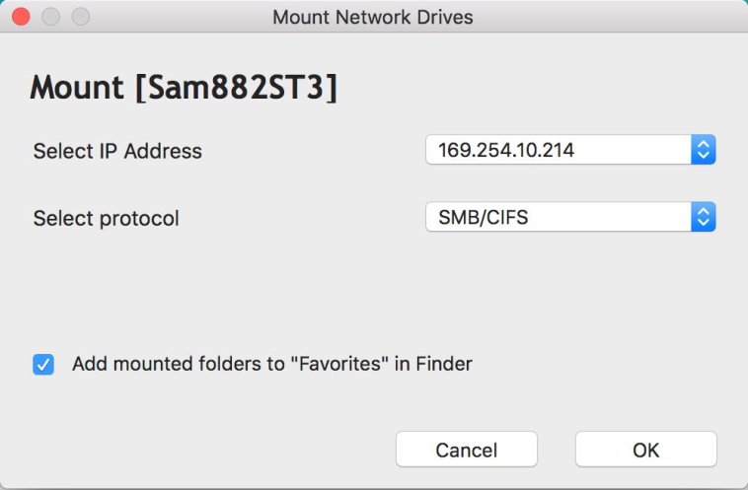
Thunderbolt (on select QNAP NAS) – more convenient for Mac users
Plug in
Qfinder Pro auto scan
mount & auto adjustment
Easy to use for all Mac users!

Slide 22
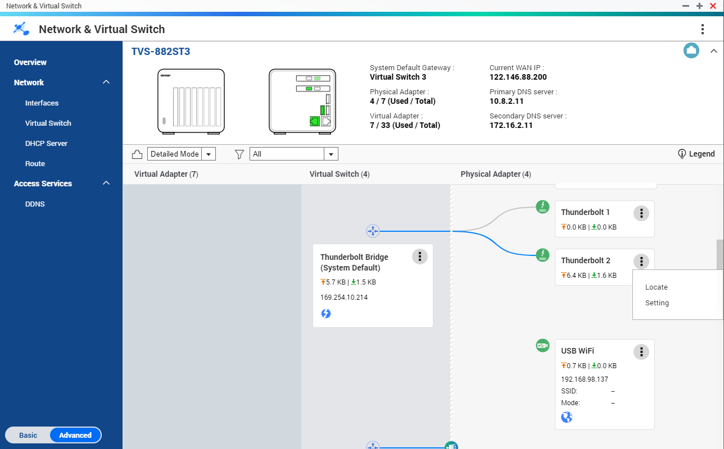
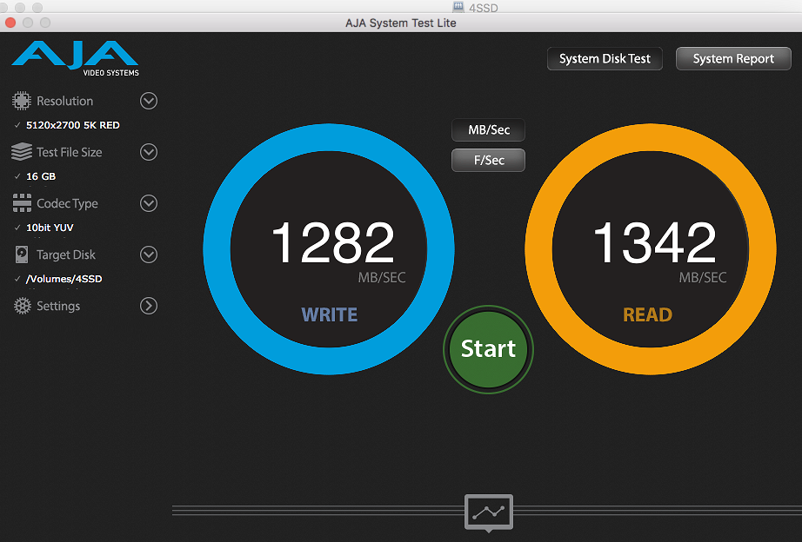
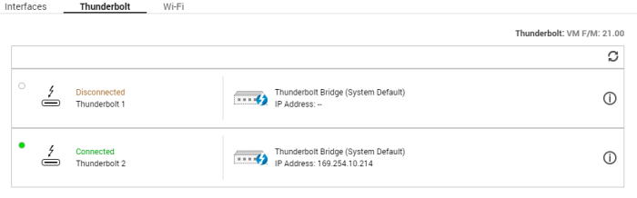
Dedicated Thunderbolt info tab
& highly performance
Dedicated UI
Performance with Mac
Equivalent to built-in 10~20G NIC
(some Windows PCs have almost 2,000 MB/s performance)

Slide 23
4.3.5 Brand new features:
Enhanced advanced features

Slide 24
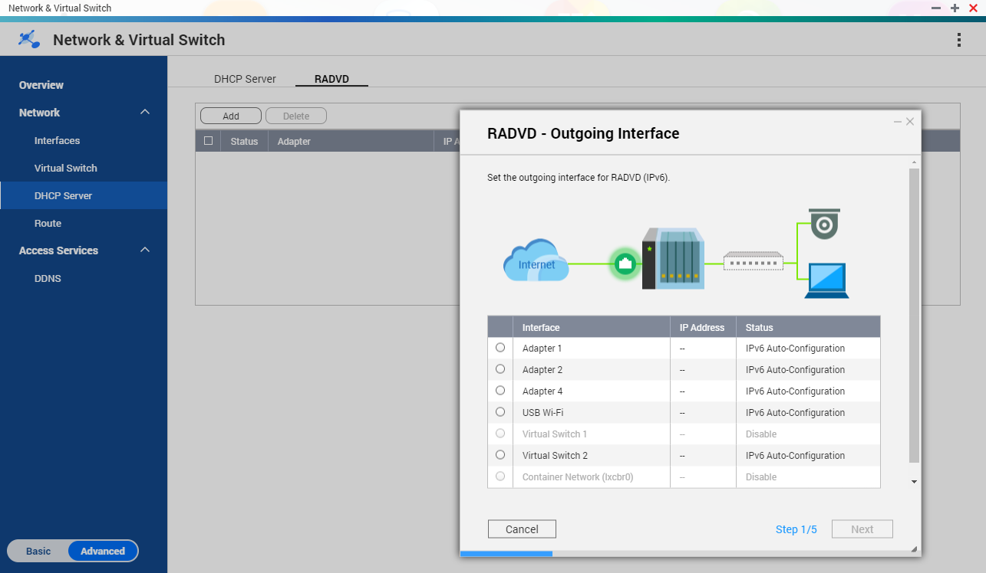
1. Improved IPv6 & RADVD support
IPv6 revision and more support:
IPv6 stateful
IPv6 stateless
Every adapter can act as the IPv6 RA server

Slide 25



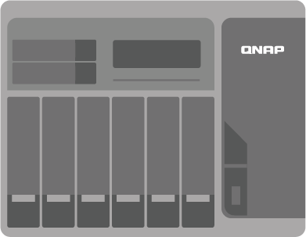
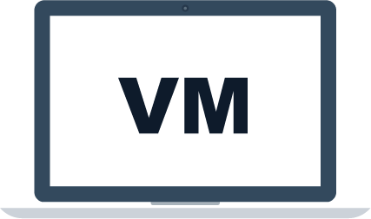

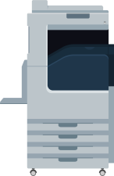

2. DHCPv4 supports reserved IP addresses
Clients
Virtual Switch
DHCP Server
The server running on in the VM will always be given the same IP address
The printer will always be given the same IP address
Notes:
圖需要修飾改掉

Slide 26
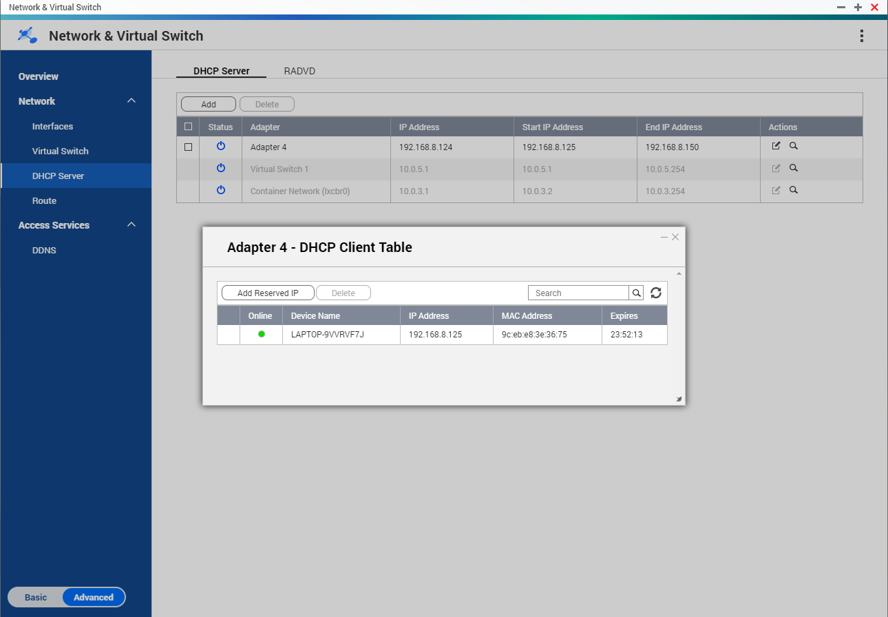

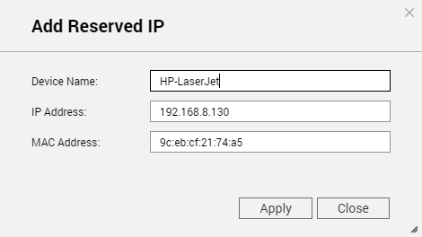

How to configure reserved IP addresses
1
3
2
Notes:
圖需要修飾改掉

Slide 27
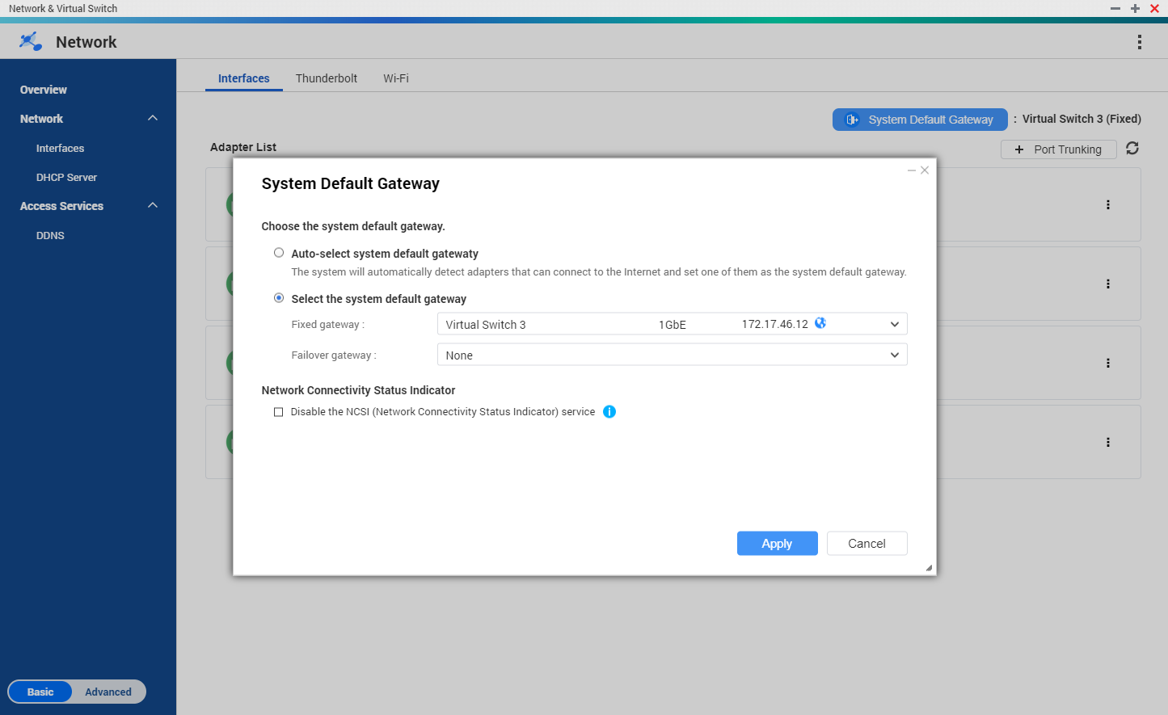





3. Auto Default Gateway + NCSI setting
    Network failover
    Support VPN / PPPoE
    It checks NAS Internet connection status automatically (similar to Microsoft NCSI), and provide the setting to disable the auto-detect function.
ISP - AT&T
ISP - Comcast
172.17.46.0/24
192.168.100.0/24

Slide 28

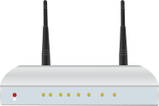


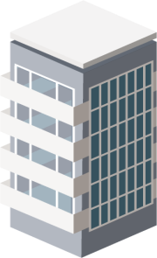

4. Static Route: Allows you to configure packet direction
You can browse the Internet, and access the office network via VPN static route.
Static Route:
Specify the packet direction.
Public IP
Internet
LAN
192.168.1.20
VPN(A)
10.6.0.2
Physical adapter
192.168.99.1
(NAT virtual switch + DHCP server)
VPN(A)
10.6.0.1
VPN
PPPoE
Office Server:
pm.qnap.com
172.18.33.210
Add rule: 172.18.0.0/16 via VPN(A)
192.168.99.20

Slide 29

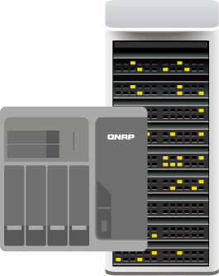
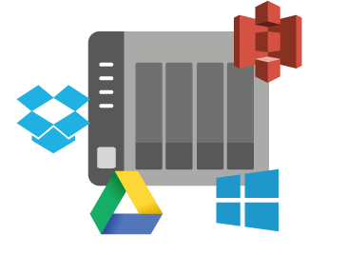



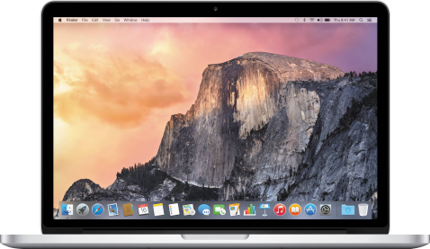



Applications of various high-speed network interfaces
GbE
10GbE
Thunderbolt
Notes:
QNAP NAS的各種端口能用來做什麼呢?
GbE: 進行一般網路傳輸， 雲端備份(S3， google cloud， one drive， dropbox)， 下載東西(download station， happyget)， 進一步還可以 shared link讓別人網路下載， 用web伺服器架站
Thunderbolt: 能讓您的Mac進行快速資料拷貝， 以及一下子就能完成TimeMachine備份. 新一代高階的Windows筆電也不需要透過隨身碟或WiFi慢慢傳檔， 他們也開始內建Thunderbolt接口帶來最方便的體驗.
10 GbE: 原本主要用在高階快速的機房， 但現在您在家就可以透過NAS架起來虛擬化的世界. 另外還有跨入家用市場的影像編輯， 機器間的快速備份(HybridBackup sync)， 甚至佈建5~8百萬畫素， 高達4K解析度的監控系統.

Slide 30


Faster wireless network delivered with new QNAP solution
QWA-AC2600 PCIe AC wireless adapter

Slide 31


Wireless makes things easier…
When physical wiring for your home is not feasible.

Slide 32


New wireless setup screen

Slide 33

QNAP NVS(Network & Virtual Switch)
QNAP NVS strings the high speed network between physical and virtual interfaces. It's the best tool to bridge your versatile devices and NAS!
Virtual
Physical
Notes:
Experience high speed transmission & performance, and virtual network infrastructure

Slide 34
QTS 4.3.5
is your best choice!
Copyright © 2018 QNAP Systems, Inc. All rights reserved. QNAP® and other names of QNAP Pr oducts are proprietary marks or registered trademarks of QNAP Systems, Inc. Other products and company names mentioned herein are trademarks of their respective holders.

Slide 35
Preview
QVPN 2.0
Virtual Private Network
Secure network experience

Slide 36
What is VPN? (Virtual Private Network)
Notes:
what is VPN? it’s a technology for internet and use the software to let it be the Virtual private LAN.
Maybe you have heard that term in association to privacy and to geo-location but what exactly is it how does it work and what can it do for you?
Well, let me explain it.

Slide 37


The general Internet style
Internet
Notes:
Now, before the VPN technology, Let us discuss the general Internet style and how it works.
If you stay home and your NAS behind you, then your laptop access your NAS or your phone access your NAS that`s the part of your private network, and that doesn`t go out into the Internet, it stays inside your house.
But the moment you go outside, like drink a coffee with your friend at Starbucks and you want to shared some data in your NAS. So you open a webpage to access the NAS in your house. The data flows through the current network service like Starbuck WiFi or your mobile phone telecom and it will travel across the internet until it gets to the NAS. Then the NAS will reply with some information some data that come back through the internet and back into your laptop or mobile phone.
Through this flow, all your data exposed on public network. The hackers, ISPs will easily keep tabs on you and exploit your private data.

Slide 38


What is VPN?
UNENCRYPTED
ENCRYPTED
ANONYMOUS
Notes:
So, What does VPN do? It use the software to encrypt the data, and all data sent in a VPN network is encrypted since it travels through a public network to easily access the data. Once the data is encrypted, it is sent through the virtual tunnel. And it means you will be anonymous on the Internet.

Slide 39


When you connect through the VPN
Internet in Tunnel
Notes:
So, when you connect through the VPN, all the data encrypted and transfer like in the hidden tunnel on the Internet. No matter hackers or ISPs, they are not easy to get hold your password, your private information, your browser contents during the data transmission process.

Slide 40










Who needs the VPN service
Business Users
Multinational businesses
(Sending and backing up files)
Home Users/ Gamers
(Regional restrictions)
Sensitive data
(Financial transactions)
Notes:
Here we have been collect some users information and make the conclusion that who or what scenario needs the VPN service.

Slide 41


VPN does make you feel secure
Offers the flexibility for employees to take advantage of the company's Intranet over an existing Internet connection. (It can also be the case between student and school)
Secure communication is easier
Privacy protection
Reduces business travel costs
Access to geo-blocked contents

Slide 42

QVPN Service
Set up your own VPN server

Slide 43

New: QVPN topology map

Slide 44







QNAP's new proprietary
VPN protocol - QBelt
Secure Encrypted Connection
DTLS + SSL + AES-256 encryption
New protocol
decreases the chance of being detected
Works on all your devices
Easy to Use
Notes:
It use the DTLS to establish the SSL connection, with AES-256 encryption.
You can protect your Internet connection across mobile devices or desktop with QNAP apps.
Our app & utility offer a variety of easy-to-configure, automatic features, easy-to-use, and the most important is ensuring your connection remains encrypted at all times.

Slide 45


Select the suitable DNS service
Set manually or apply NAS default settings
Choose a suitable public DNS server

Slide 46






Secure folder mount: VPN + File Station

Slide 47

Mount remote folder via VPN in File Station
1

Slide 48


Mount remote folder via VPN in File Station
2
3

Slide 49
The most common issues when you set up a VPN server

Slide 50


The most common issues
!
The connection is blocked by the firewall
?
The router does not know which device to relay the traffic to

Slide 51
QNAP NAS helps you set up the VPN easily

Slide 52

Manually set up the router
Port Forwarding
DMZ
Control everything yourself
Super easy
Supported by most routers
1. Set the forwarding IP
Set the port to be forward
2. All ports/packets forwarded
More secure
(only open the required port)
Security Concern =>
all ports exposed
VPN passthrough can be enabled
too many steps and complicated
Notes:
要設VPN passthrough

Slide 53



UPnP auto enables VPN port forwarding
myQNAPcloud will take care of it!
Sets automatically
UPnP router required

Slide 54



The best tool when the IP address is not fixed
QNAP NVS DDNS
(include myQNAPcloud…..)
UPnP (Auto Router Configuration)
port
Web Server
port
FTP Server
port
VPN Server
LAN IP1
port
…………….
LAN IP2
xxx.myqnapcloud.com:port

Slide 55
How to set up client devices to connect to NAS via VPN

Slide 56






Use Windows to connect to VPN
Click Start Menu > [Settings]
Select the VPN type: for PPTP, only entering the credential is required; for L2TP, one more setting of Pre-shared key is required
Choose [ Network & Internet ]
Choose [ VPN ] >> [ Add a VPN connection ]

Slide 57


Use macOS to connect to VPN
System Preferences => Network
Next, click "Authentication Settings...", then set the Password & Shared Secret
click the plus sign to add a VPN interface, Type is L2TP over IPsec
Notes:
Step.1 Open System Preferences and click the Network icon.
Step.2 Click on the Plus button in the bottom left corner to add a new interface. here switch the drop down list and select VPN. VPN type is L2TP over IPsec.
Step.3 click "Authentication Settings...", then set the Password & Shared Secret

Slide 58


Use Android to connect to VPN
Setting
Wireless & Network
choose VPN
add Network
If VPN type L2TP is selected, you must insert the IPsec pre-shared key
Insert the credential when you connect

Slide 59


Use iOS to connect to VPN
Settings
click VPN
Add VPN configuration
The type should be L2TP
Insert credential & Secret (pre-shared key)

Slide 60


New desktop app will soon be available
macOS
Windows

Slide 61




New mobile app will soon be available
Android
iOS
Notes:
可搜尋出周遭的其他QNAP NAS,
以此安全連線去連線周遭其他NAS (需各自的密碼),
再以NAS為媒介建立第三組連線
以VPN安全連線使用其他APP

Slide 62
Let your NAS connect to remote NAS/VPN server via the VPN Client function

Slide 63

Your NAS can reach almost everywhere
Your NAS can connect to another VPN easily. (Yours / shared NAS from your friend / public VPN server)
QBelt (QNAP only)
PPTP
L2TP / IPsec
OpenVPN

Slide 64

Supports versatile VPN client modes
Set the necessary VPN parameters
QBelt
PPTP
L2TP
OpenVPN
Allows other local networked devices to connect to the same VPN connection.

Slide 65

Set VPN as NAS default gateway with failover support
VPN =
NAS gateway
Set the secondary VPN as redundant one

Slide 66









Use QWA-AC2600 to share VPN wirelessly
2.4G
5G
QNAP QWA-AC2600

Slide 67

A way to securely back up between 2 NAS
QBelt VPN
Secures your data

Slide 68

Detailed connection log of VPN Client

Slide 69




Cross the world with your NAS !
Integrated the service provider VyprVPN
(It could help you if you don’t have VPN resources at the target location)
VPN Tunnel
VPN Tunnel
Notes:
If you want to connect to one country but without any friend can help you there or without the resource of public server, you can apply the 3rd-party VPN service - VyprVPN is one of VPN service provider which already integrated with QNAP to help you cross to anywhere around the world.

Slide 70


QWA-AC2600 share the VPN wirelessly
Demo
QNAP QWA-AC2600

Slide 71
QVPN is
your Best Choice
Thank you !
Copyright © 2018 QNAP Systems, Inc. All rights reserved. QNAP® and other names of QNAP Pr oducts are proprietary marks or registered trademarks of QNAP Systems, Inc. Other products and company names mentioned herein are trademarks of their respective holders.

