Slide 2
Are you facing troubles at work?
Can't find important correspondence between employees and customers?
Too many accounts to manage?
When you need to present evidence, but can't find the key email? !
Work handover, unable to find emails between the predecessor and customers...
Human error, email was accidentally deleted...

Slide 3
Are you facing troubles at work?
There are too many contacts to find? Have you had enough duplicate contact information?
How to manage your long-term accumulation of customers, vendors, external cooperation and internal contacts ?

Slide 4
Are you facing troubles at work?
Company arranges an itinerary, Google Calendar has another activity? Always miss important events and meetings?
What should I do if my Outlook schedule on my computer is not in sync with my Google Calendar?

Slide 5



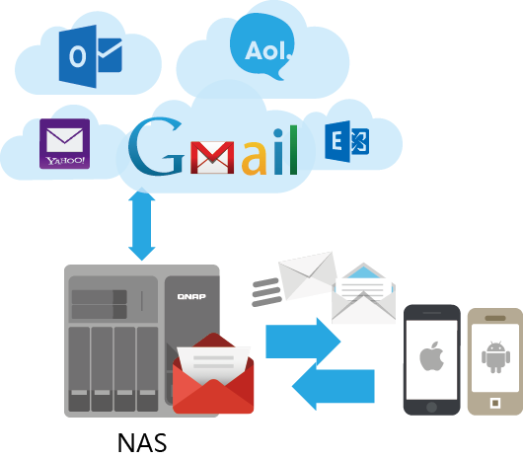
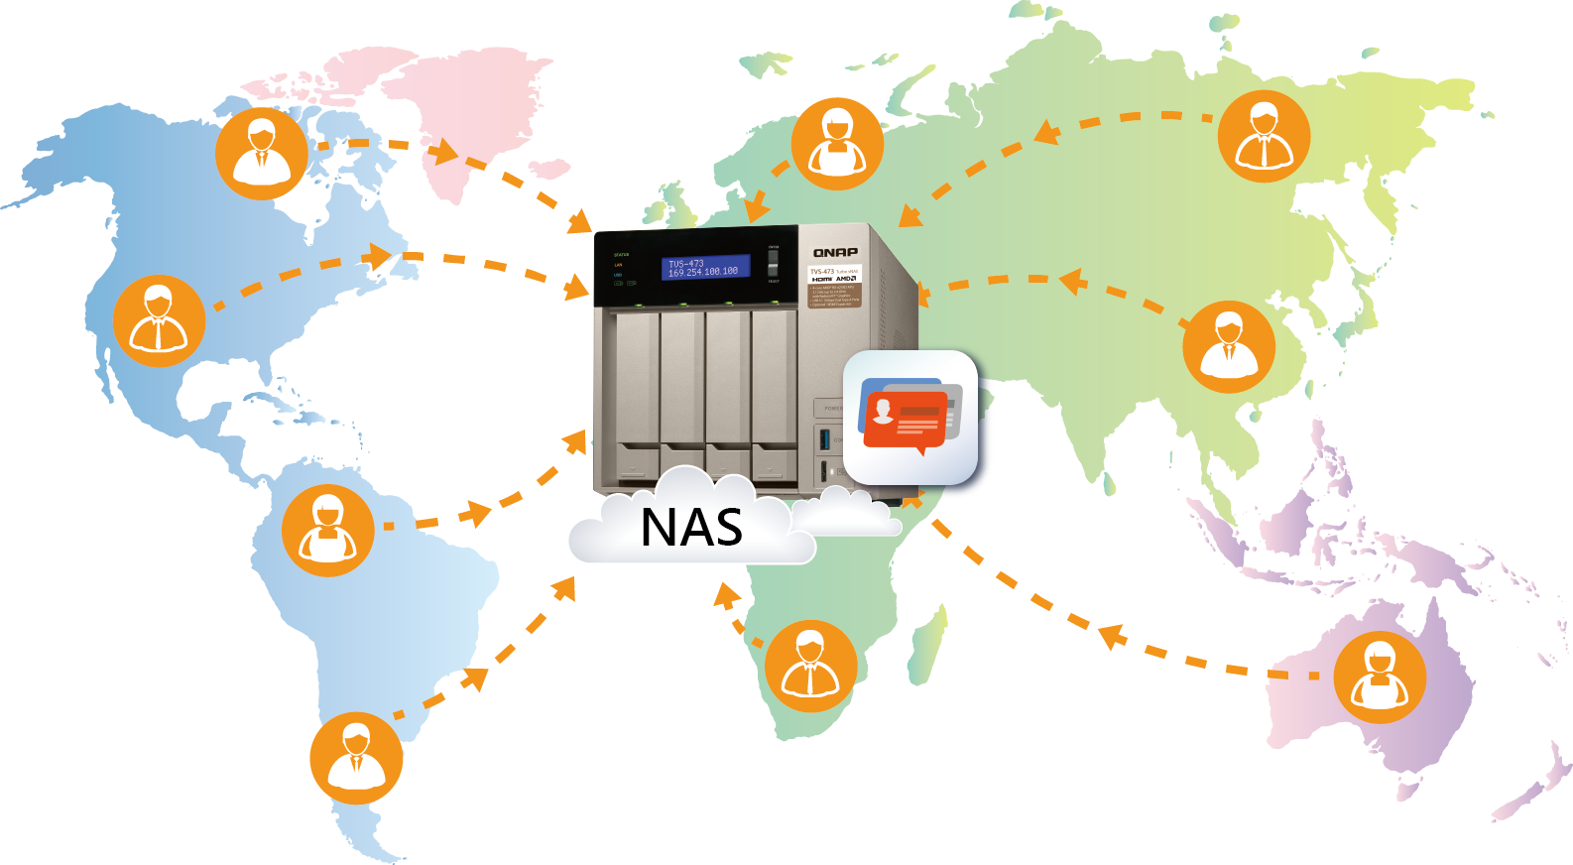
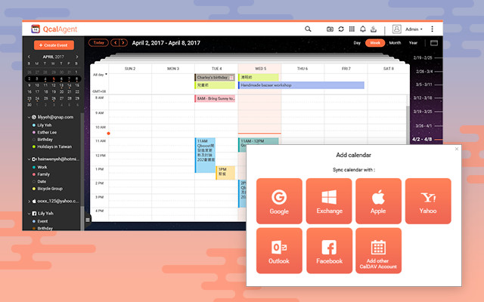
Upgrade productivity with QNAP！
Use tools to help you back up emails, calendars, and contacts from Office 365 and G Suite cloud to NAS for proper storage.
QmailAgent
Qcontactz
QcalAgent
Collectively manage
＆
back up your email
Management of massive # of contacts
Integrated online calendars improve workflow

Slide 6

QmailAgent solves it!
Can't find important correspondence between employees and customers? Too many accounts to manage?

Slide 7



QmailAgent- Collectively Manage and Back up your emails with QNAP NAS
Employee's important mail backup and retention.
Back up company emails with QmailAgent.
Control the customer and business situation after the employee left the company.
When having a legal dispute between company and customer, retained info can become a powerful proof.
Multiple accounts in one place.

Slide 8
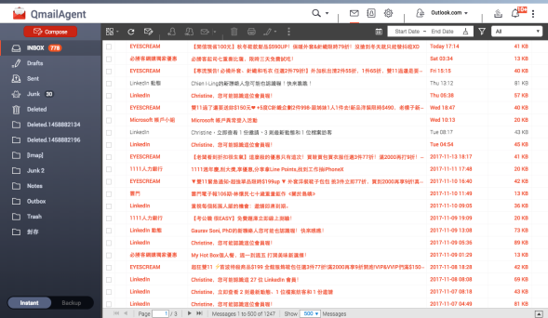
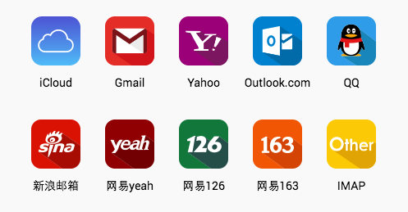
QmailAgent- Collectively Manage and Back up your emails with QNAP NAS
QmailAgent is not a mail server. The main purpose is to archive email messages as soon as it is received or sent, making sure that all your personal and business mailboxes is properly backed up.
Centrally manage all personal and business mailboxes. E.g. Office 365 and G suite.
Keep complete email messages for later use as references. Instant searching & future usage of archived email are available.
Log in
查看信件，可編輯回覆轉寄
Select from multiple service provider
Back up and manage all mailboxes

Slide 9
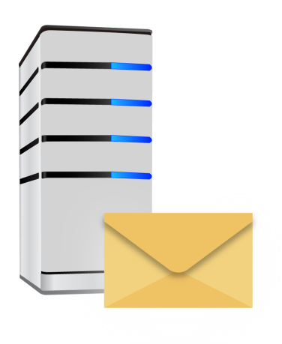
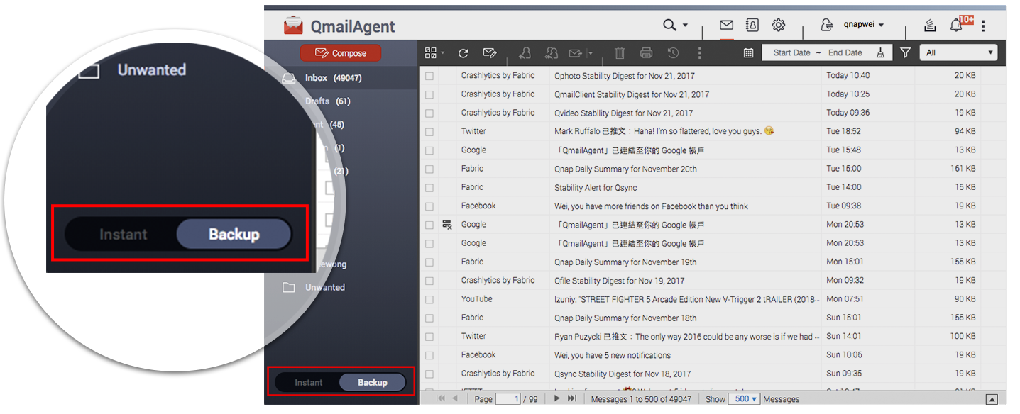



Easily auto back up your complete email messages
Automatically back up all email messages on the server to NAS upon logging in.
Flexibly adjust automatic download interval settings.
Switch between Backup and Instant View easily.
Instant : View the current status of email messages on the mail server.
Backup : View and manage email messages, including those that have been downloaded.

Slide 10
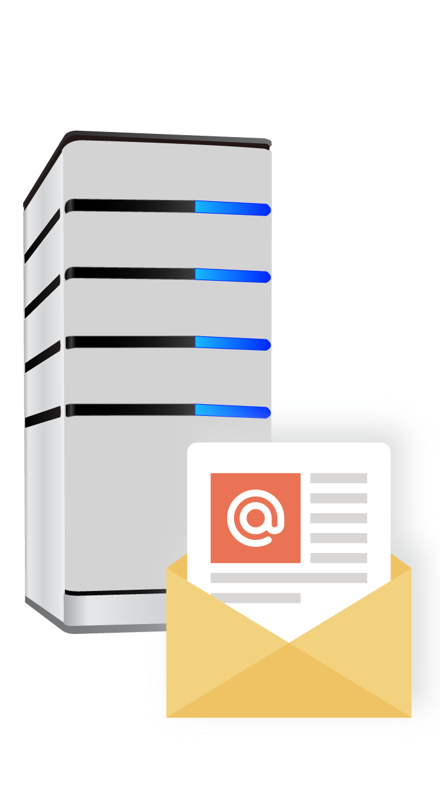

Restore from backed up email messages
Easily recover email messages that might have been accidently deleted.
Restore
Mail Server

Slide 11
Don't want others to see my private email?
What should I do?

Slide 12
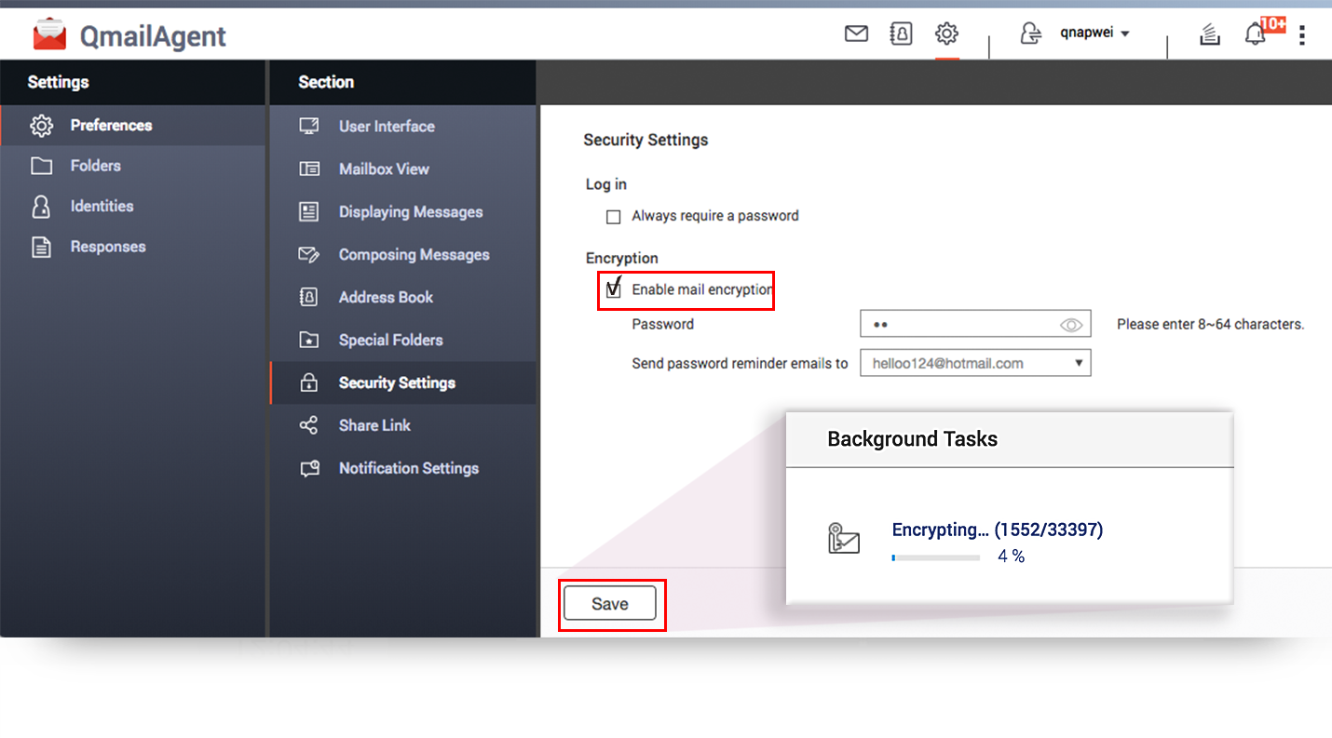





Email message encryption
A password can be used to protect backed up email messages and attachments on NAS.
Enable mail encryption

Slide 13
When you need to present evidence, but can't find the key email? !

Slide 14
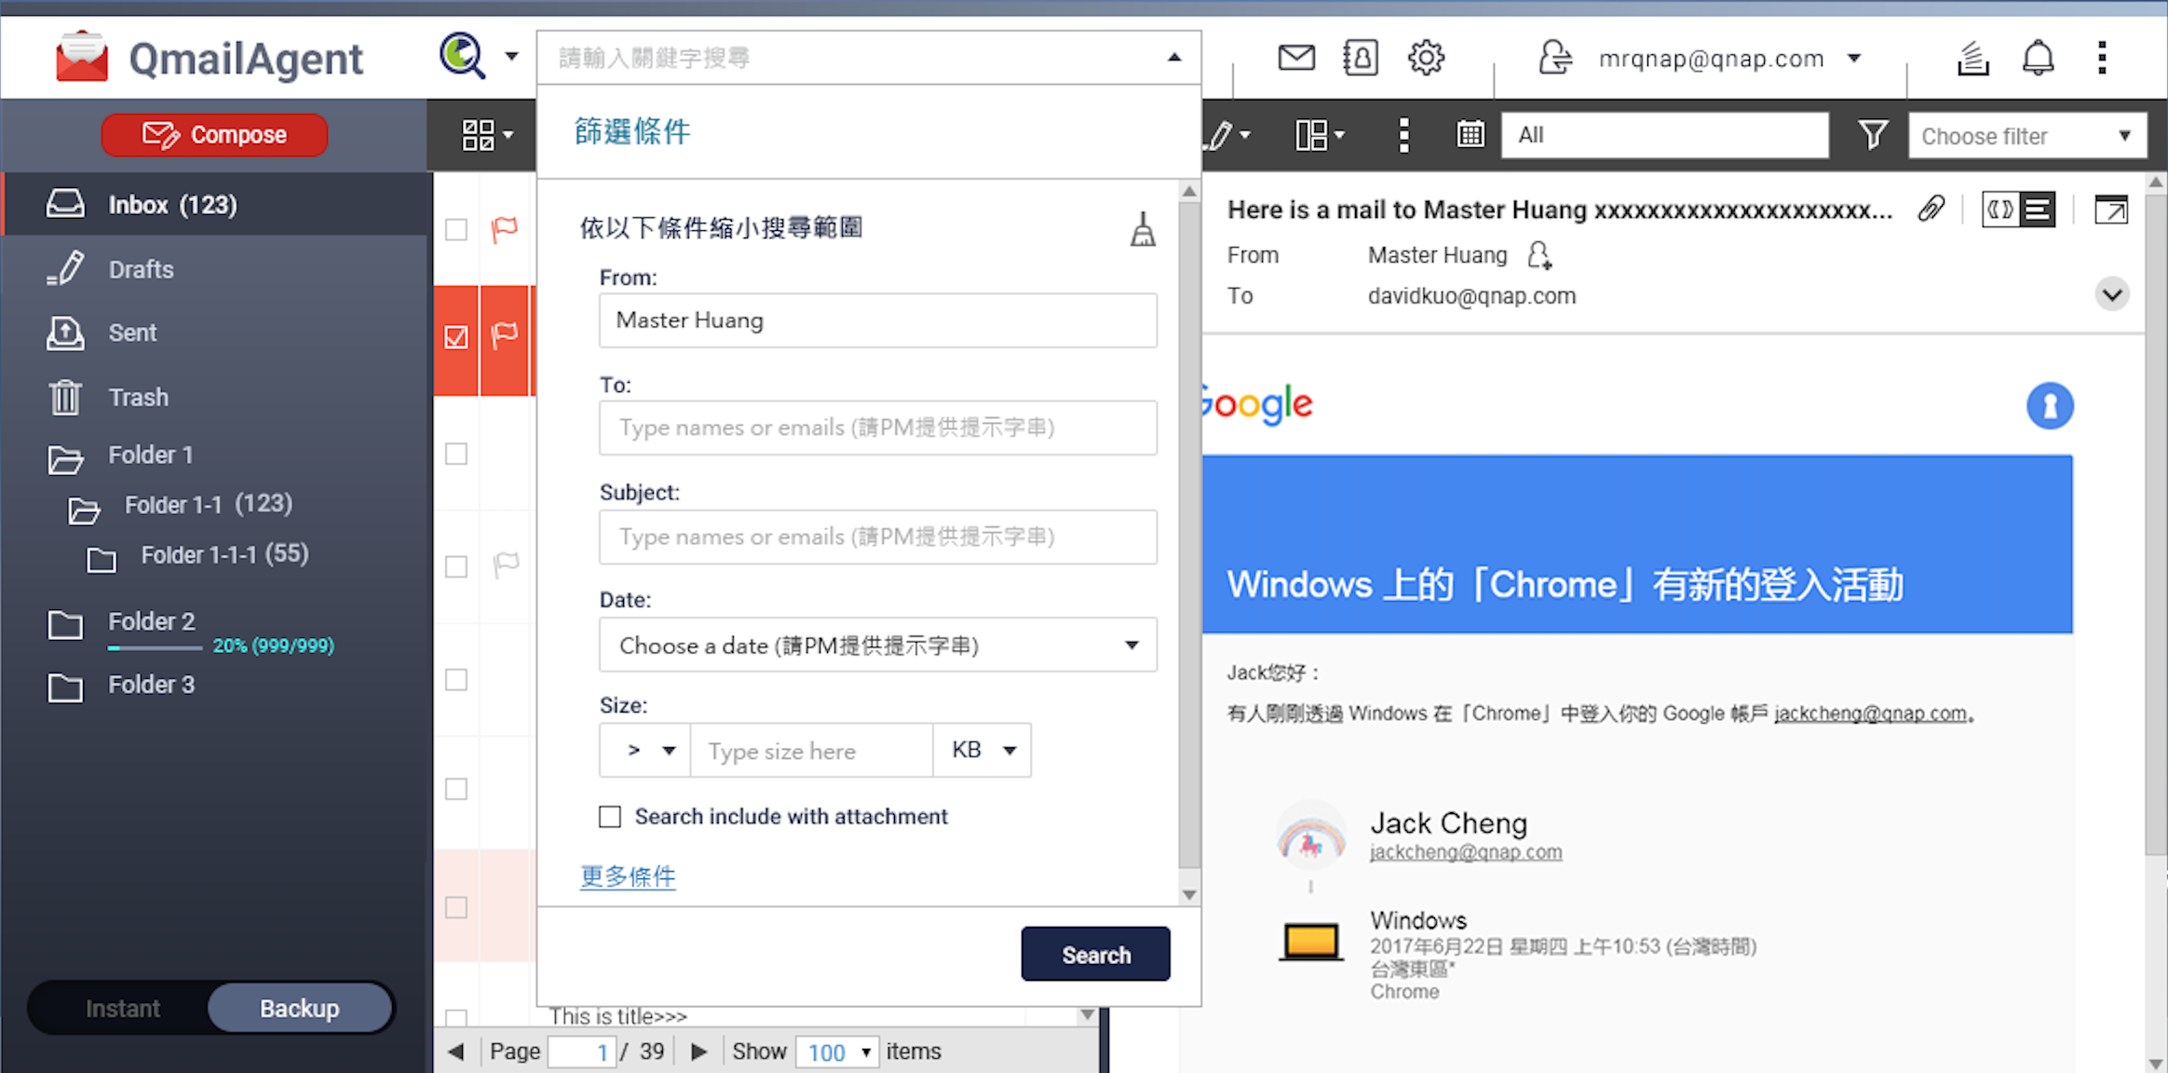
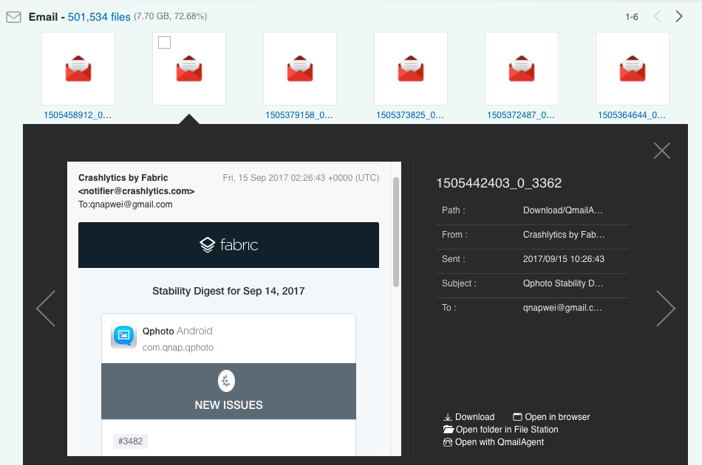
Qsirch - The powerful NAS search engine
Provides high speed indexing and fast file searching , giving search results within seconds. Messages can be opened directly.
Users can search using criteria including sender, recipients, subject, content, date, etc.
Switch to Qsirch

Slide 15
Live Demo

Slide 16
Qcontactz solves it!
There are too many contacts to find?
Have you had enough duplicate contact information?

Slide 17
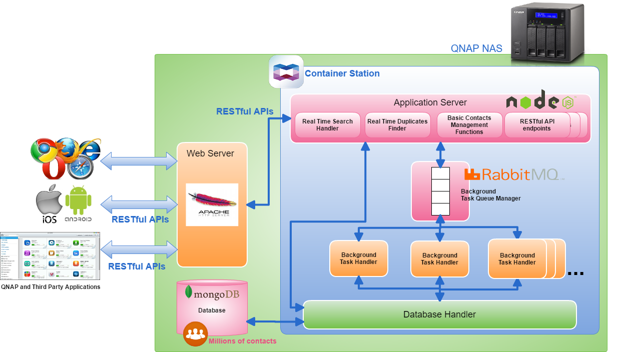
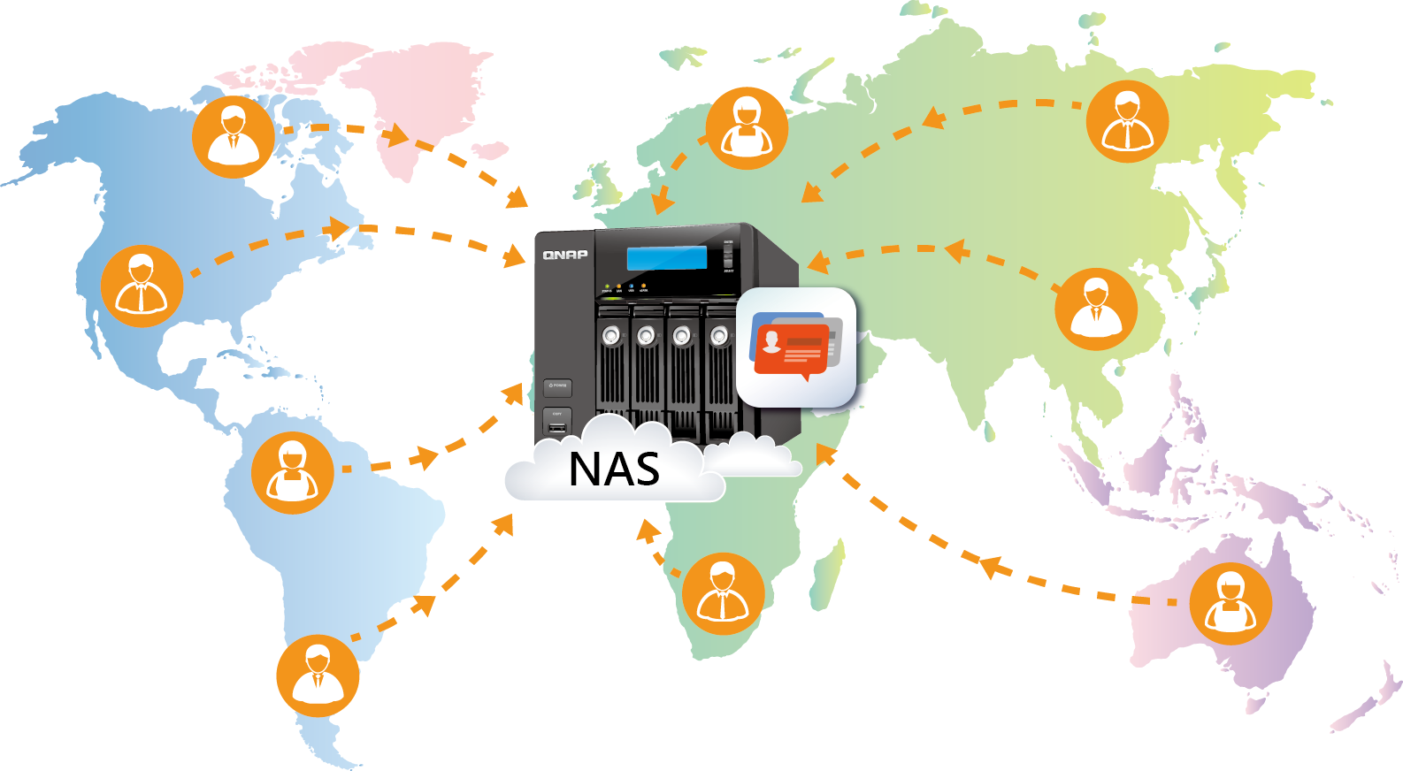
What is Qcontactz?
Qcontactz allows you to centrally manage your contact information on the QNAP NAS.
Store millions of contacts in the company.
Completely search the entire database instantly.

Slide 18
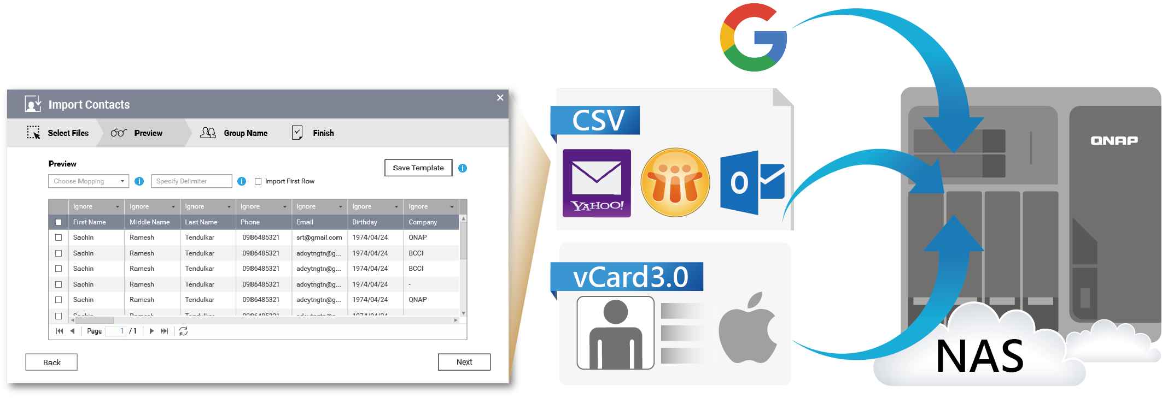

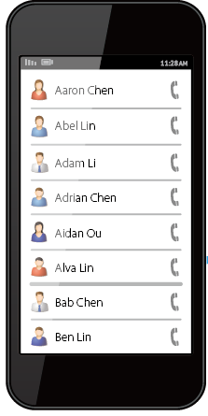
Manage massive contact information across platforms
Setting schedule, one-way synchronization – Google Contacts
Import from vCard/vcf file – Apple & Skype
Import from CSV file – Yahoo & Outlook
Import from mobile – Android & iOS

Slide 19
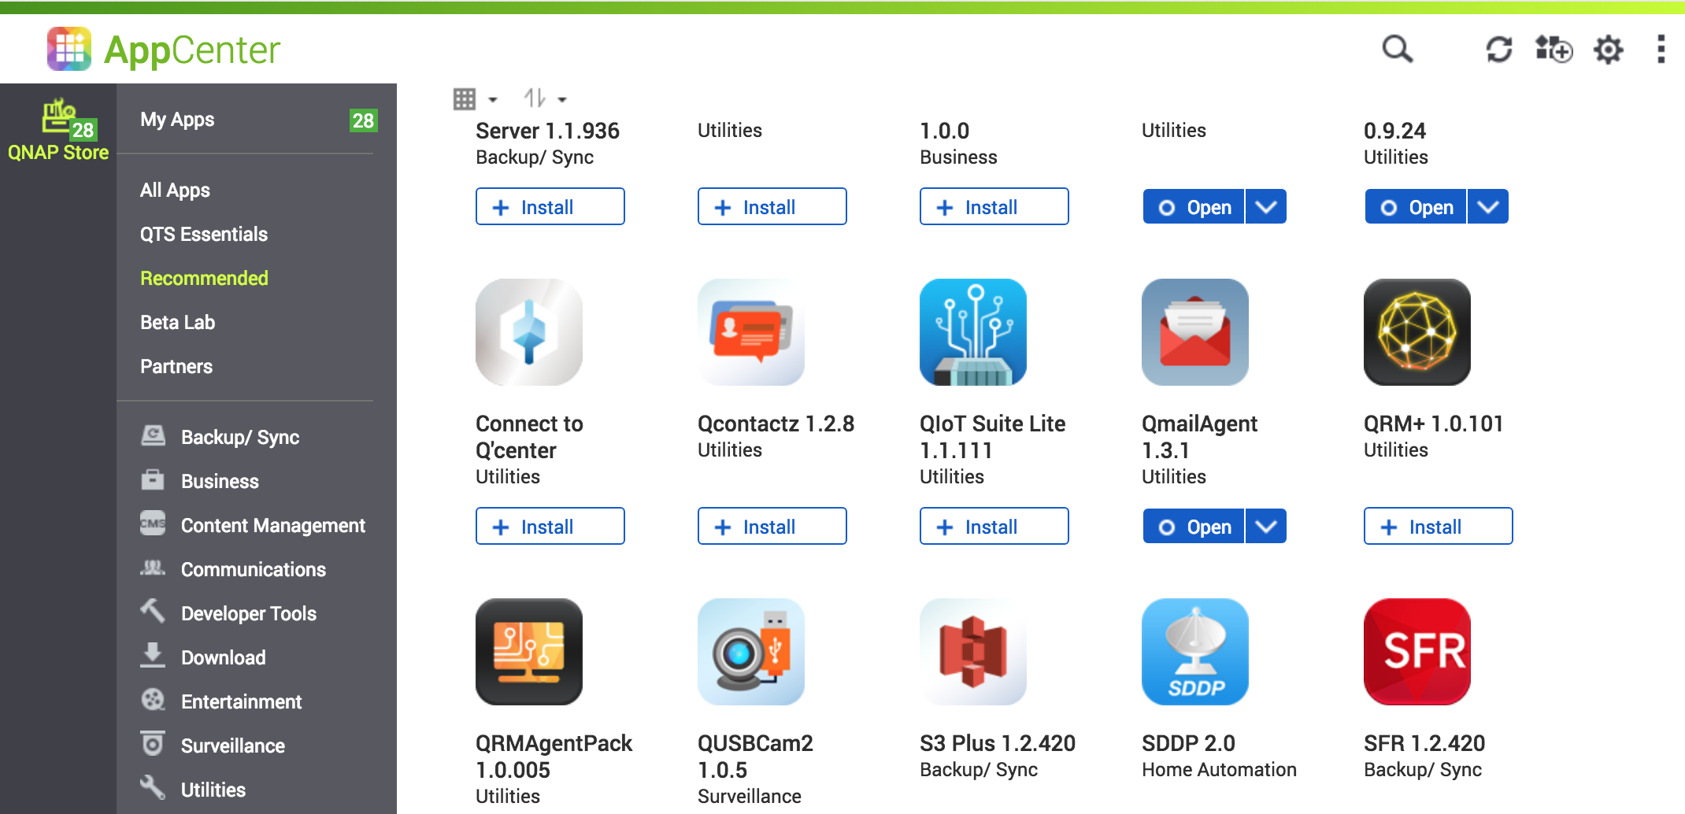
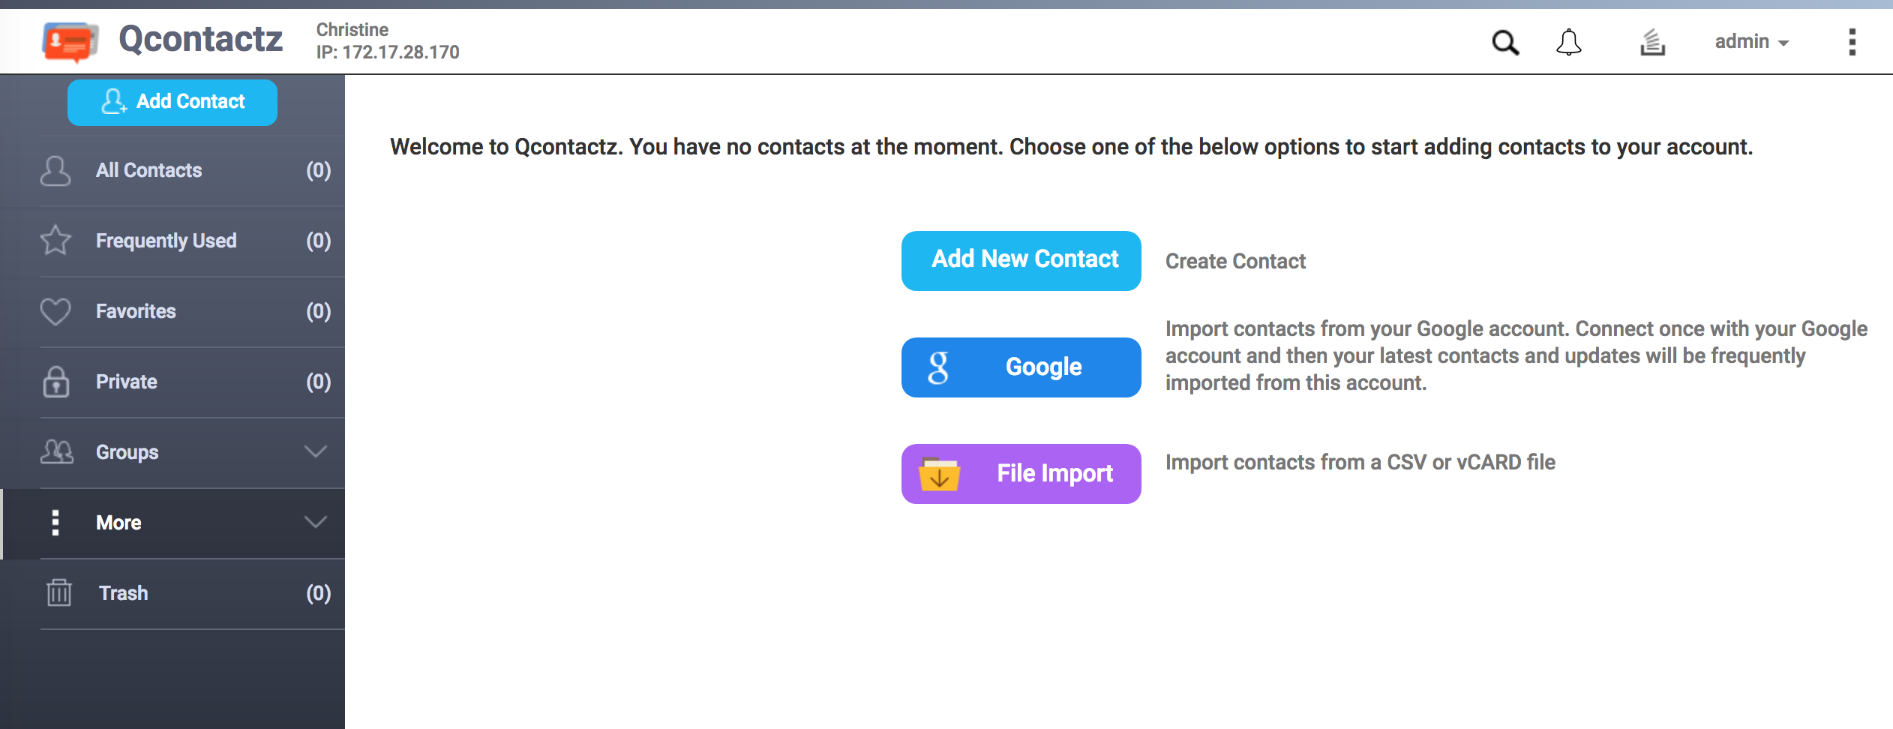
Three steps to start contact management
1
2
Install Qcontactz
Select import contact method
Manually add contacts, import from Google and files

Slide 20
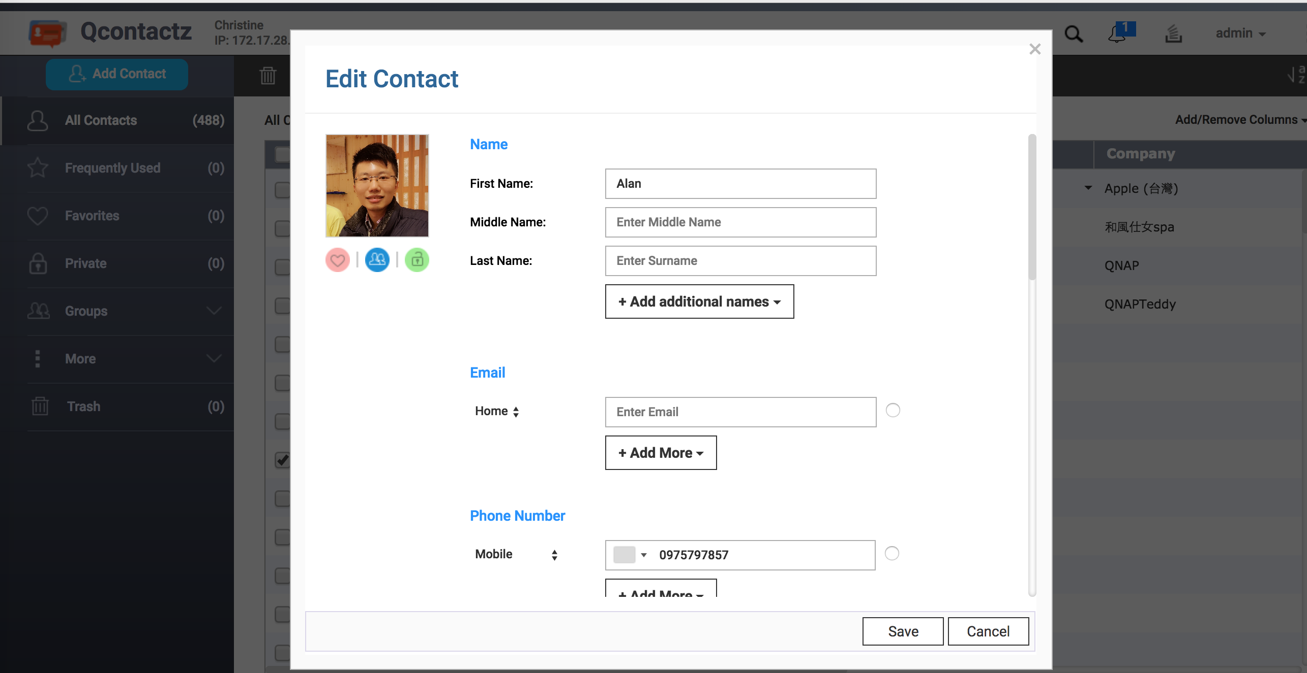
Three steps to start contact management
3
After the import is successful, you can start managing your contacts!

Slide 21
Qcontactz –
Management function analysis

Slide 22
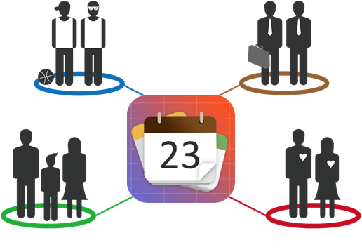


Manage contact information
Manage contact information in groups.
Add, edit, delete contact groups.
Adds to "My Favorites" contact.
Search millions of contact instantly.
Friends
Work
Family
Relationship
Proactively identify and organize your most used contact information.

Slide 23
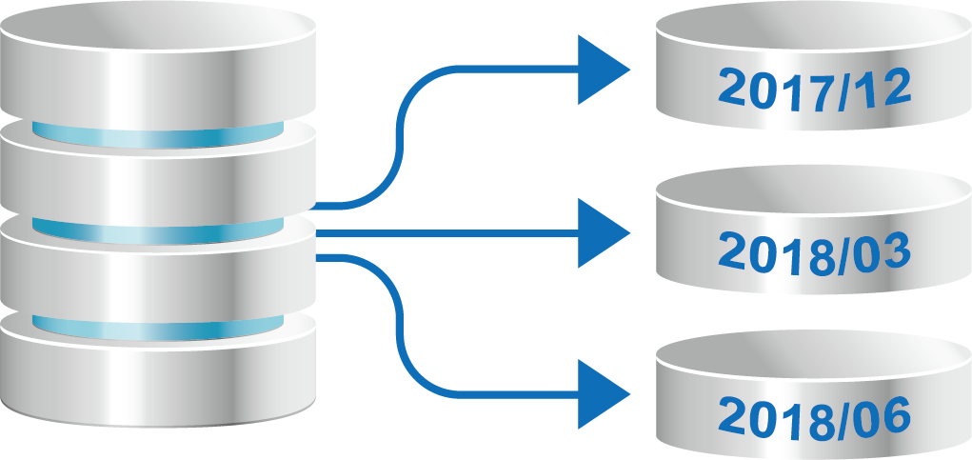
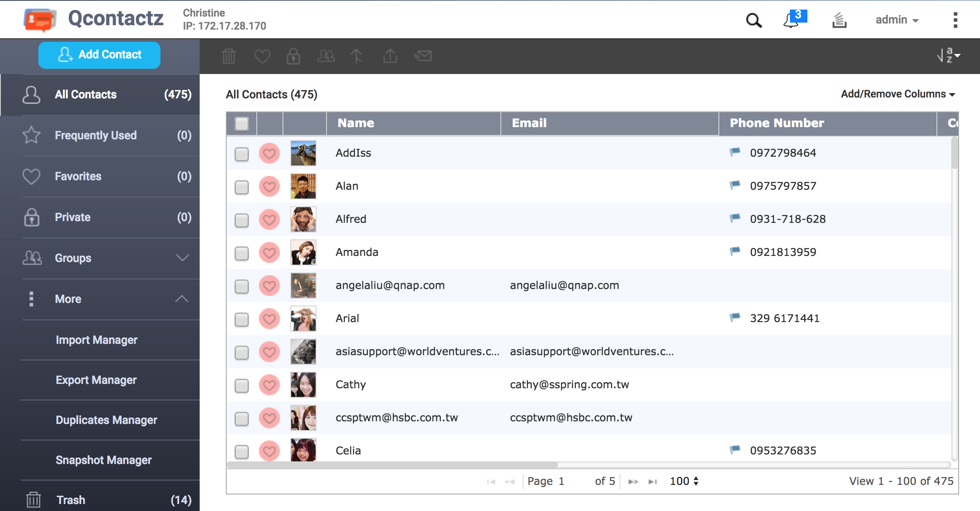

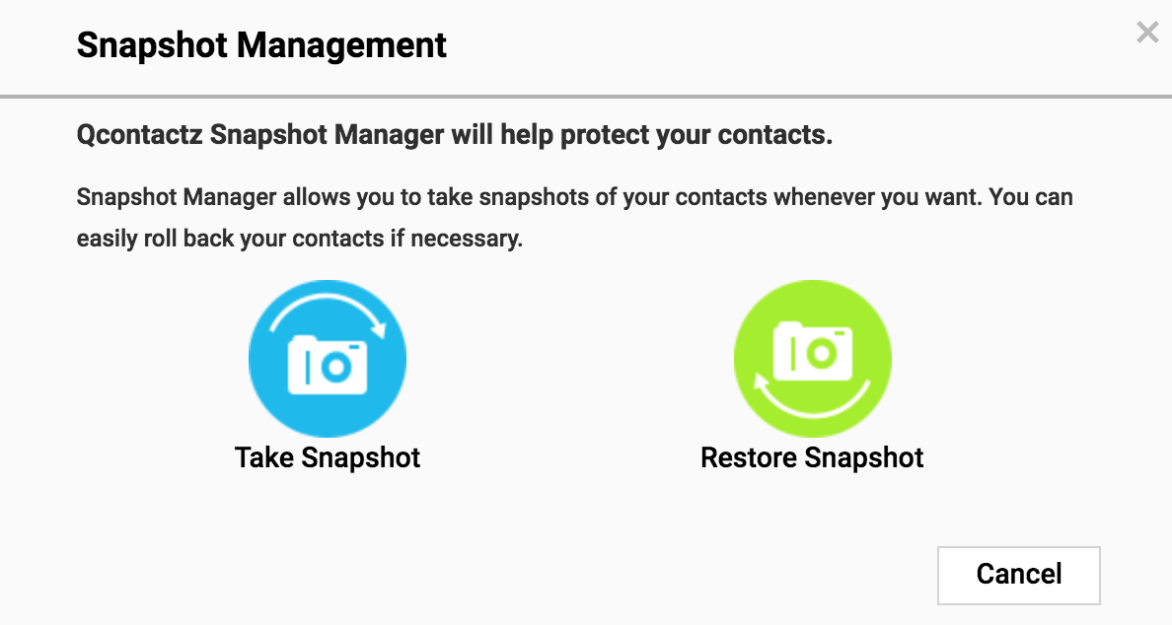
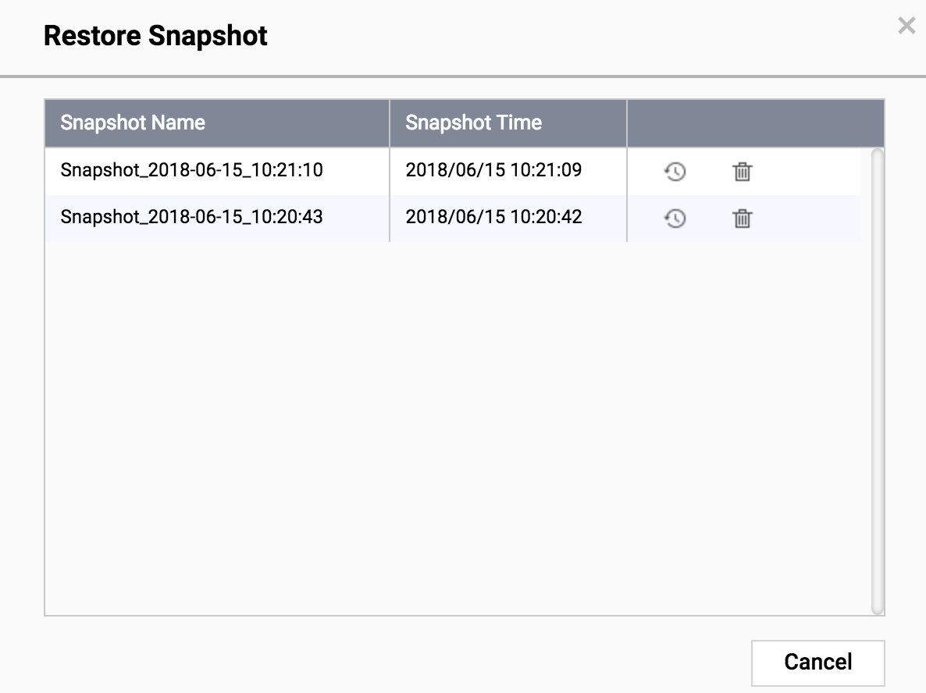
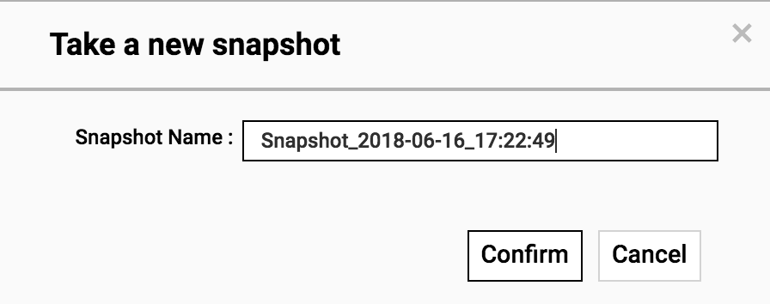
Version management & snapshot + restore
Backup and manage multiple versions of contact lists.
Easily return your contact list to any previous backed up version.
Snapshot Manger

Slide 24
How can I remove duplicated contact information?

Slide 25
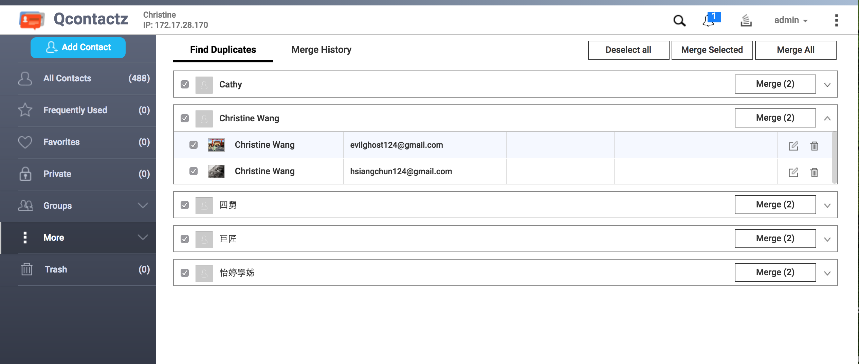
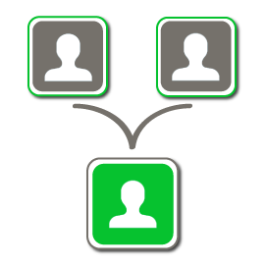
Smart Tools to Simplify Management
Merge duplicate contact information.
View merge records.
Restore merged contact information.
Duplicates Manager

Slide 26
Business Solution

Slide 27

Flexible API Integration - Enhanced productivity
The Qcontactz API is available to third-party as well for integrating with existing corporate CRM/ERP databases.
Notes:
Qcontactz 開放 API 接口供第三方應用程式與系統整合使用。只要在瀏覽器上輸入 [NAS IP:9090/api/v1/docs] 即可瀏覽文件，亦可將 Qcontactz 聯絡人管理應用整合於企業原有的 CRM / ERP 資料庫，提供跨平台、多終端的聯絡人管理解決方案。

Slide 28
Live Demo

Slide 29
QcalAgent solves it!
Company arranges a itinerary, Google Calendar has another activity? Always miss important events and meetings?

Slide 30
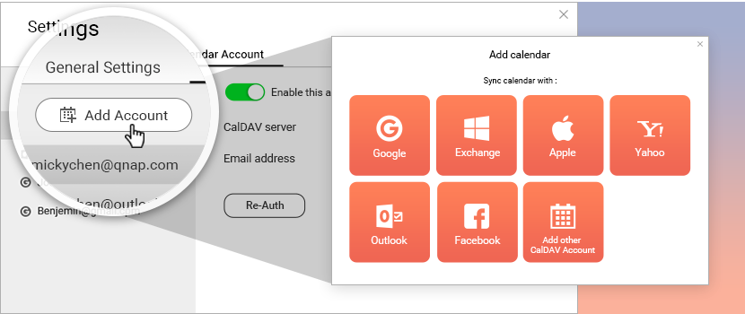
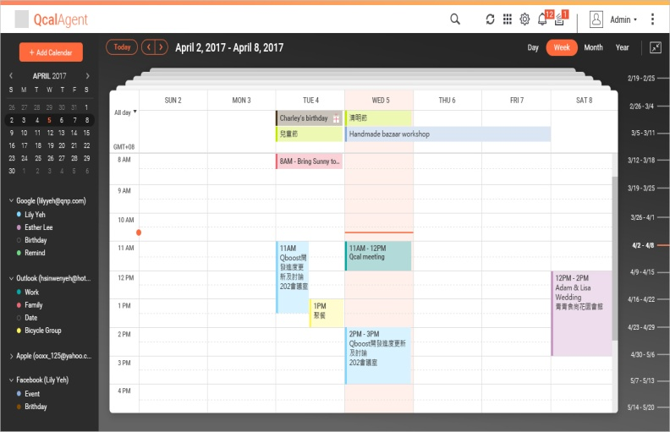

QcalAgent - Complete mastery of work and life
Easy login your calendar account from Google, Outlook or Yahoo, or directly from CalDAV account.
Centralized management of private, corporate calendar.
Keep track of important events, share your schedule, and create multiple calendars.
Login
Sync
Back up to high capacity potential NAS and collectively mange calendars -QcalAgent

Slide 31
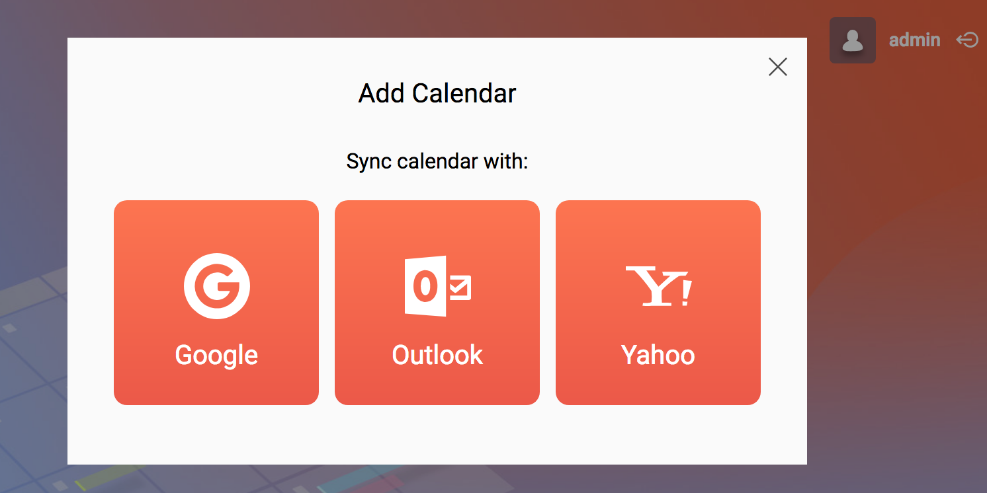
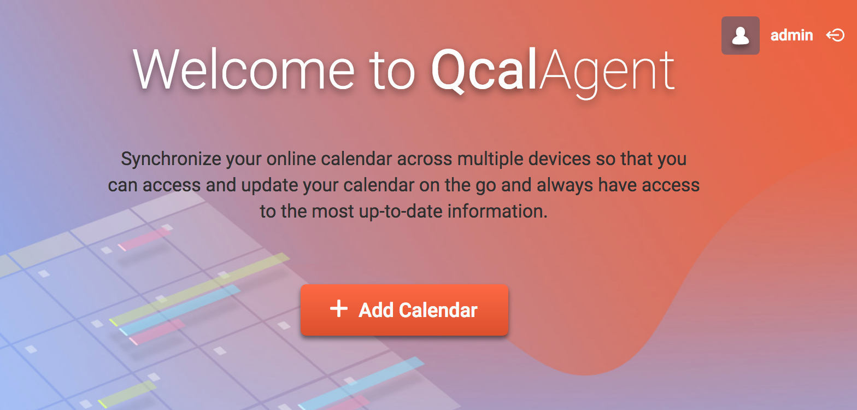
How to integrate your calendar
1
Install QcalAgent ,
Go to Main Page
2
Choose to add your calendar server
1

Slide 32
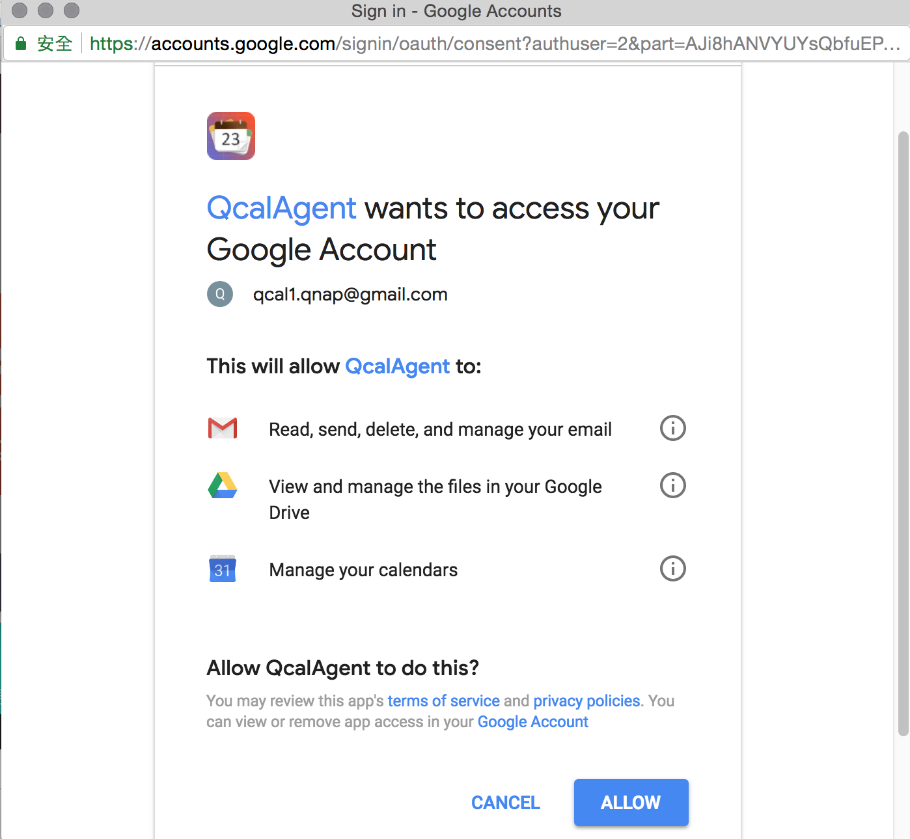
How to integrate your calendar
3
4
Verify account information
Start using QcalAgent
1

Slide 33
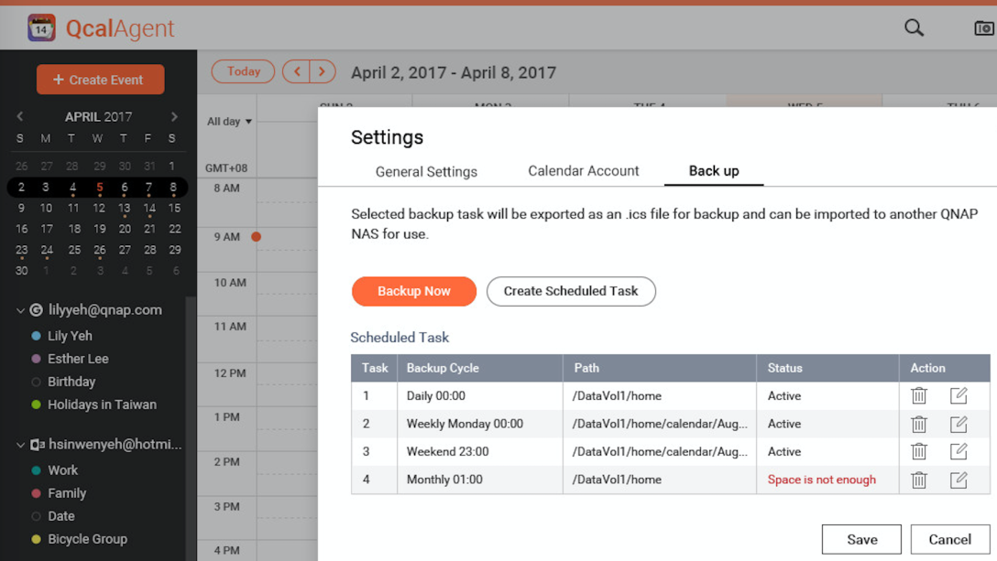

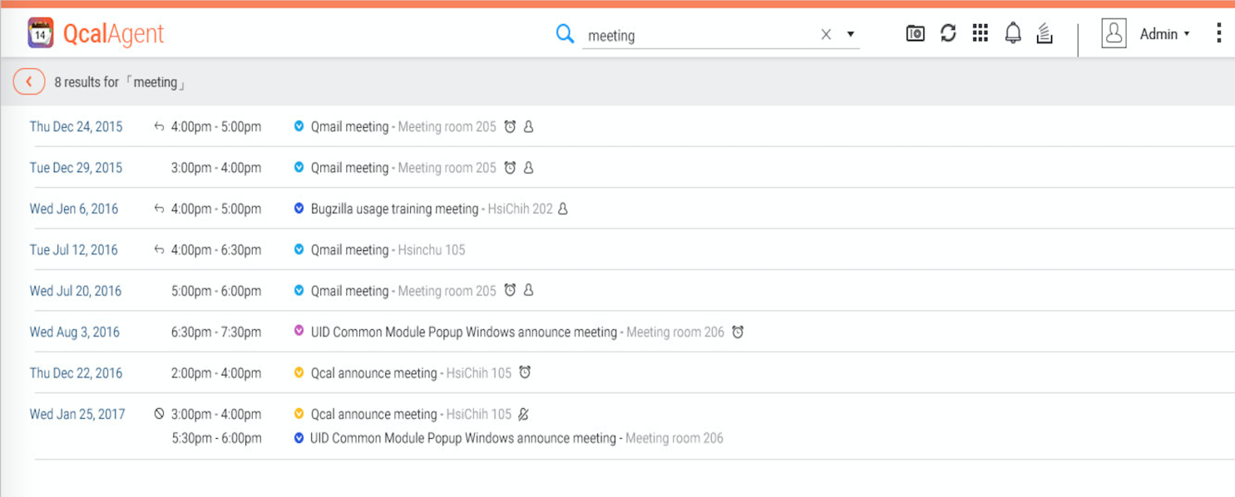

Save activity record on NAS for long term archiving
All activity records are stored on NAS Private Cloud to protect your important events and mission schedules.
Check past events, meeting …
定時備份
Backup regularly
50TB+

Slide 34

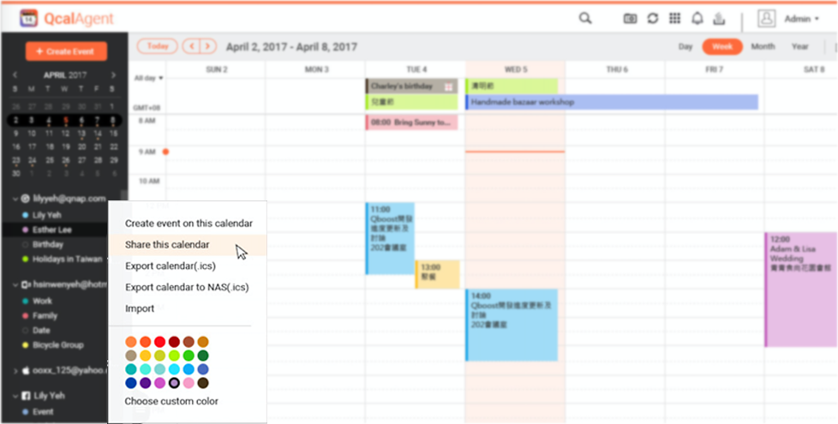
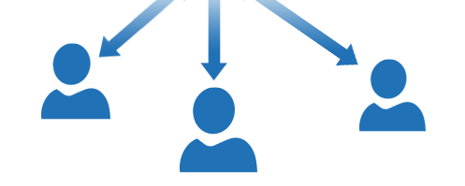
Smart scheduling for events and meetings
You can share calendars with family to view each member's common activities time.
Schedule events quickly by checking coworkers' availability or layering their calendars in a single view.
Friend
Work
Allow multiple NAS user to have QcalAgent
Family
Relationship

Slide 35
Live Demo

Slide 36
The best combination of applications
QmailAgent + Qcontactz + QcalAgent

Slide 37
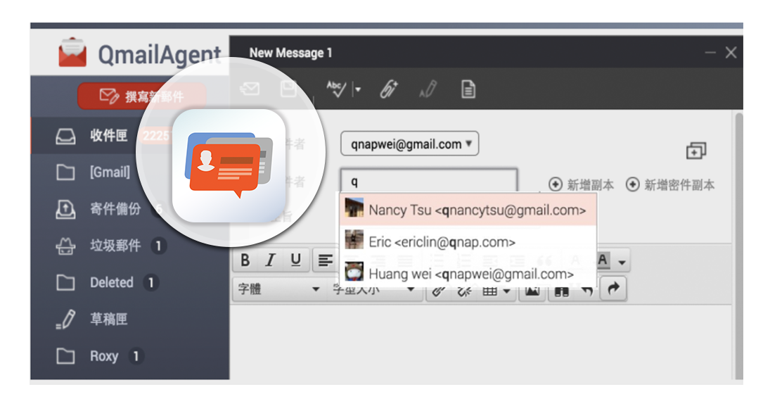
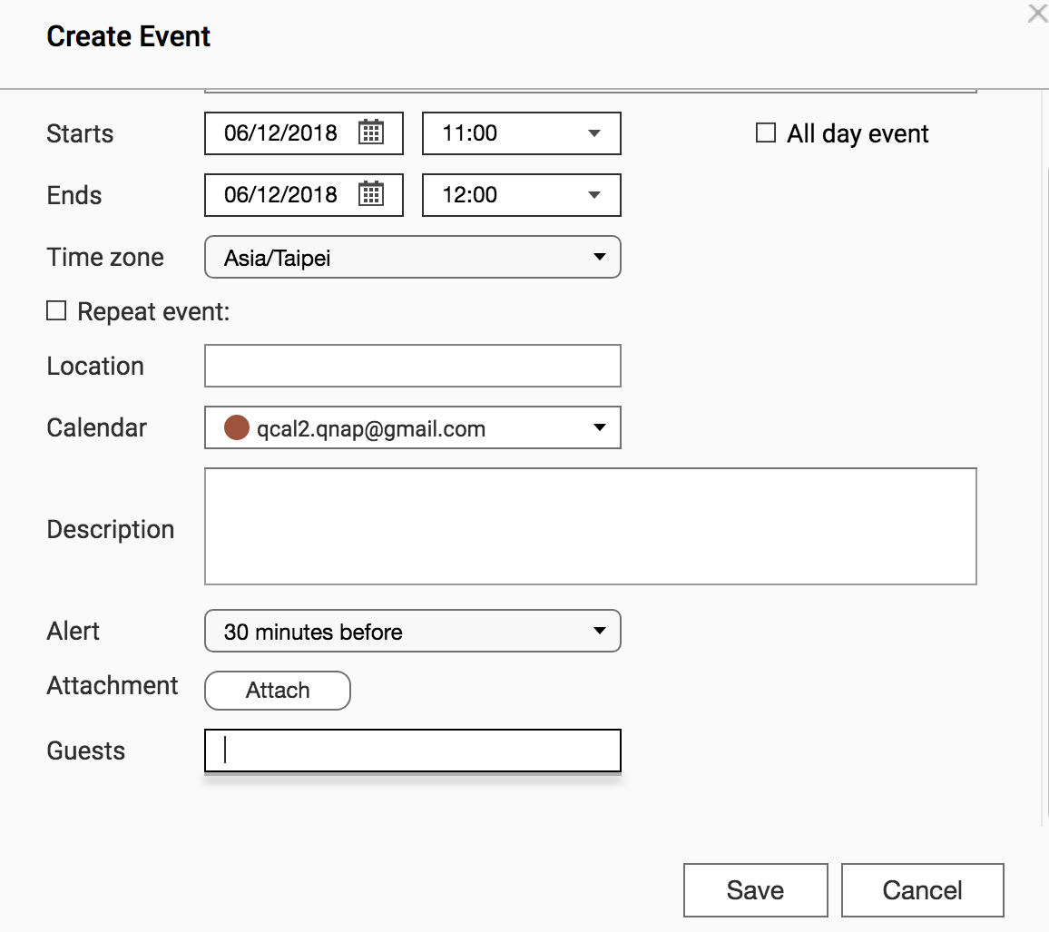
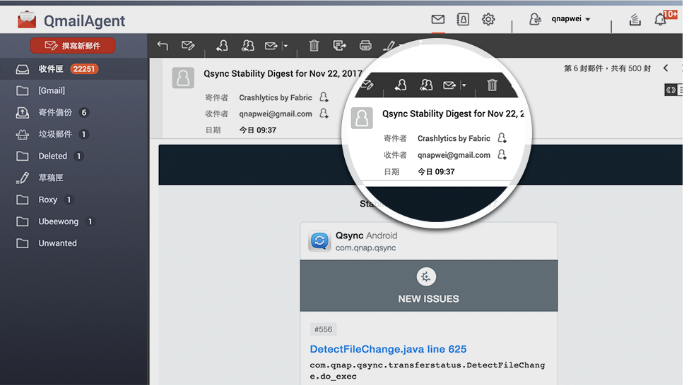
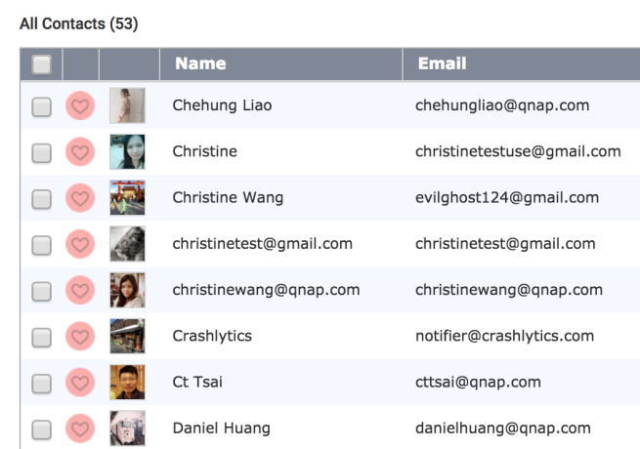


The Best Combination of Applications
Contact information will be automatically synced to QcalAgent and QmailAgent, and the system will automatically load you contact information for Qcontactz.
New contacts can be automatically added to Qcontactz. In Qcontactz, you can choose a contact and directly compose a new email message.
Guests

Slide 38
Why is it the company's best productivity choice?

Slide 39

Protect Data with Remote Backups
For multiple considerations, most users only back up data with a single device at a single location. But a really secure backup solution is more than that…
If stored directly on the NAS, you can enjoy a simple and convenient complete, multiple-layer backup solution.
RTRR

Slide 40
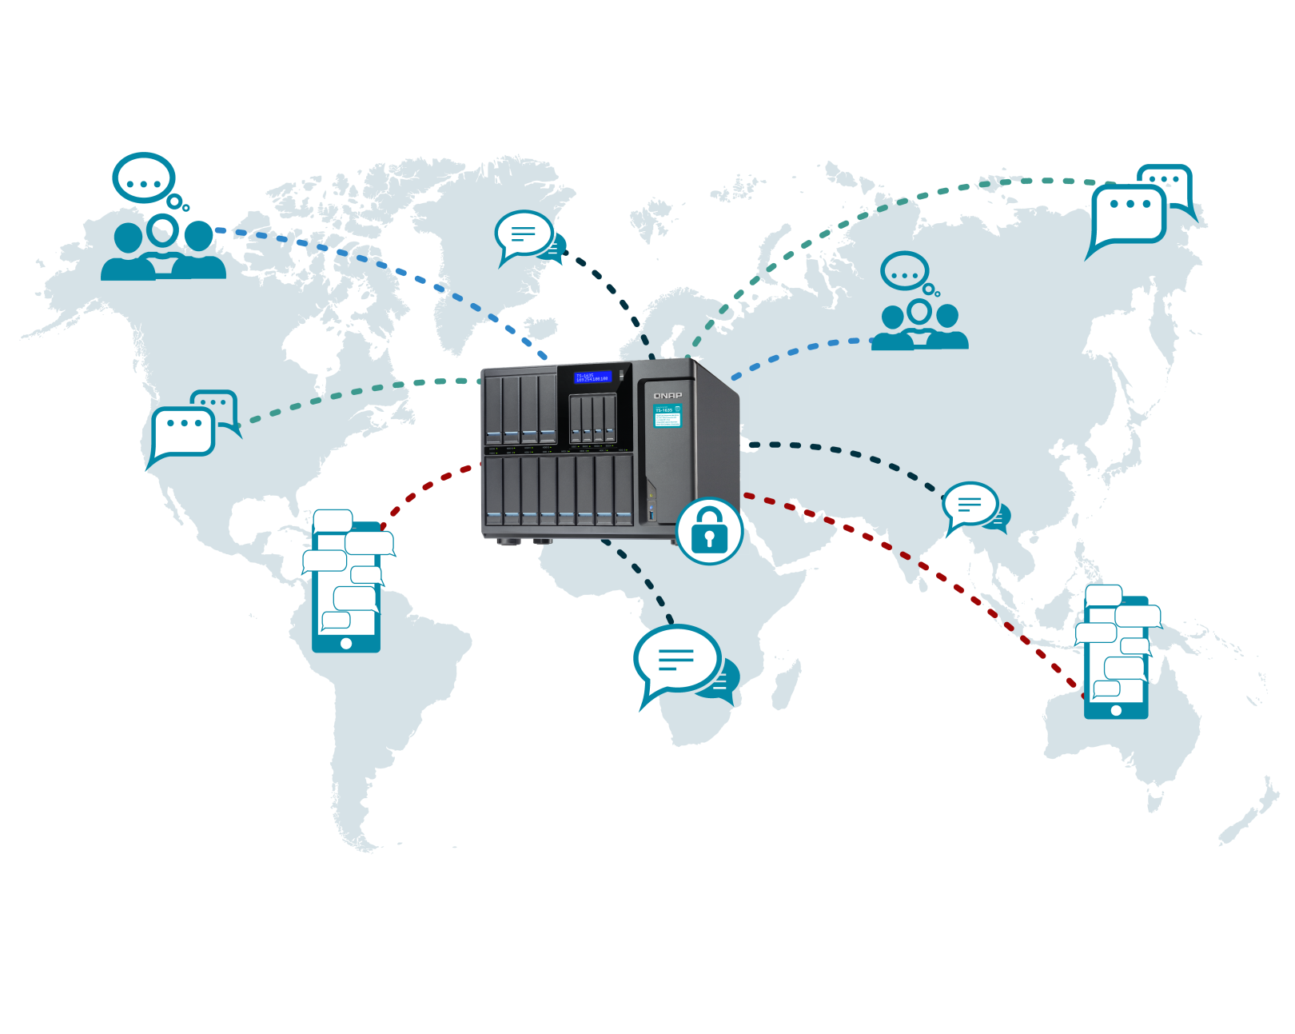

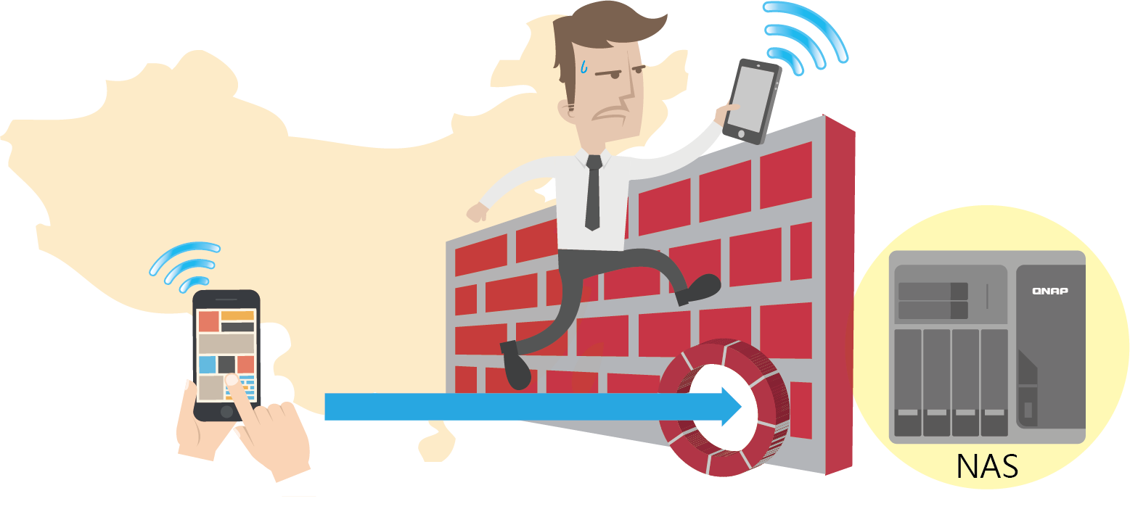


Check your data via NAS – better privacy protection
Securely send email messages, track important events and find contacts anywhere in the world.
You can access any email, calendar accounts (even on local network area).

Slide 41
QNAP mobile apps family
Access your data from anywhere

Slide 42


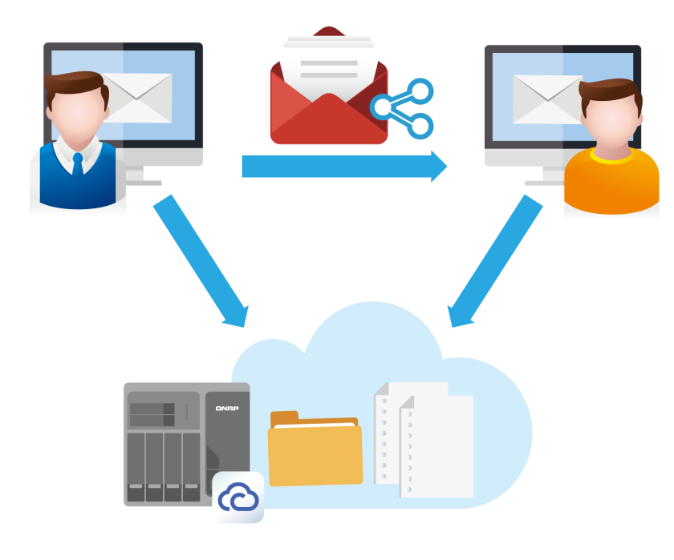

QmailClient
All-in-one mail app
Live Demo
Instantly switch between multiple email accounts.
Share link for large files.
Push notification for new email messages.
Send emails with share links
Change share link setting
View or download from linked page

Slide 43



Qcontactz
Ultimate contacts pool
View all contacts in a single dashboard.
Instantly find and merge duplicates.
Import data from your mobile phone to the NAS and update the contact list synchronously.

Slide 44


Access from your laptop, tablet or phone
How to sync with QcalAgent on your phone?
Sync with your phone’s built-in calendar app to connect to the NAS QcalAgent Server.
Google calendar
Microsoft Outlook
iPhone calendar
QcalAgent

Slide 45
Choose the best productivity app so you can work more easily!
Copyright © 2018 QNAP Systems, Inc. All rights reserved. QNAP® and other names of QNAP Pr oducts are proprietary marks or registered trademarks of QNAP Systems, Inc. Other products and company names mentioned herein are trademarks of their respective holders.

