Slide 1
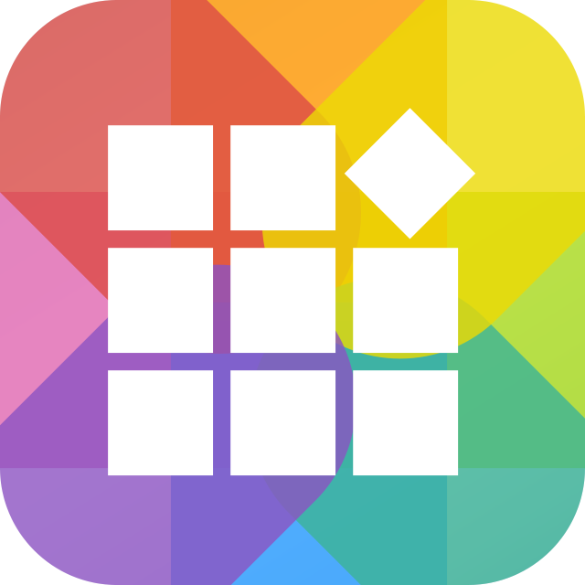
An in-depth guide for application developers
QDK makes self-developed apps run smoothly on a NAS

Slide 2

QNAP Development Platform
The QNAP development platform is designed for use by professional software developers, network and system integrators, and independent software developers to construct complete hardware and software integration platforms and develop applications. We welcome all passionate professionals to join our development team and help create a win-win future for QNAP and you.
Notes:
[Felix]
The QNAP development platform is a platform designed for everyone to construct complete hardware and software integration or to develop applications with QNAP NAS.
We welcome all passionate developers to join our platform to create a win-win future for both developers and QNAP.

Slide 3


QNAP Development Platform
Rich and built-in features to save you effort and time on application development
QNAP Turbo NAS is a feature-rich, private cloud system. With storage as the core theme, the QNAP Turbo NAS offers an array of practical and value-added features, including user and privilege management, backup, multimedia and entertainment, and IP security surveillance. As a development platform, QNAP Turbo NAS is a total solution that dramatically reduces your development effort, and through the influential brand image of QNAP, your success can be easily achieved.
Notes:
[Felix]
QNAP NAS has many rich built-in features.
Include Authentication, backup / restore your data, and manage your file.
Also we have multimedia, data sharing, and other features.
These built-in features are provided by QNAP, you can develop your app base on these built-in features.
You can stand on the shoulders of QNAP to develop your own app.

Slide 4

QNAP Development Platform
If you are a professional software vendor or system integrator seeking a great hardware platform to integrate your valuable software applications into a solution for your clients, the QNAP Turbo NAS is definitely your top choice.
If you are an independent software programmer with brilliant ideas to share with the world, then the QNAP Turbo NAS is the ideal platform for you to shine.
Notes:
[Felix]
So, who are the target of QNAP development platform?
If your app needs storage features, you are the right audience.
No matter you are a professional software vendor, or you are an independent software programmer.
QNAP always welcome you to join our development platform.
And QNAP is always your best choice.

Slide 5

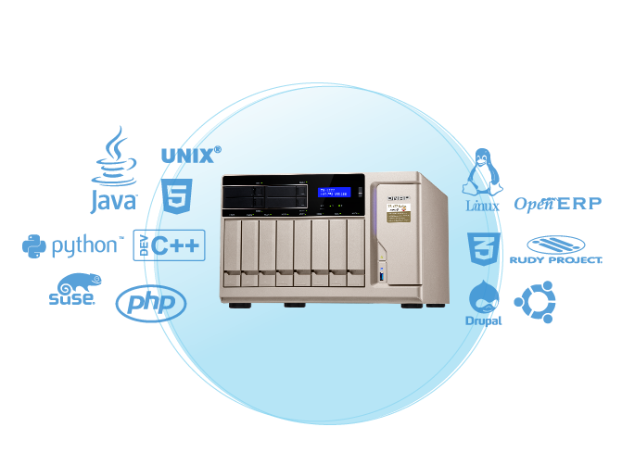
Virtual Machine (VM) Integration
Integration through a virtual machine (VM) allows any operating system or third-party software to run on our NAS without the need for modification, ensuring an easy and efficient integration.
Notes:
[Chris]
There are many ways for developers to integrate their app with QNAP NAS.
First of all, developer can integrate their app with QNAP NAS by virtual machine integration.
If you already have an application, you don’t need to change anything.
Just convert it to a virtual machine and deploy to QNAP NAS via QNAP Virtualization Station.
And then your application has been integrated with QNAP NAS.
(Is easy? Yes)

Slide 6

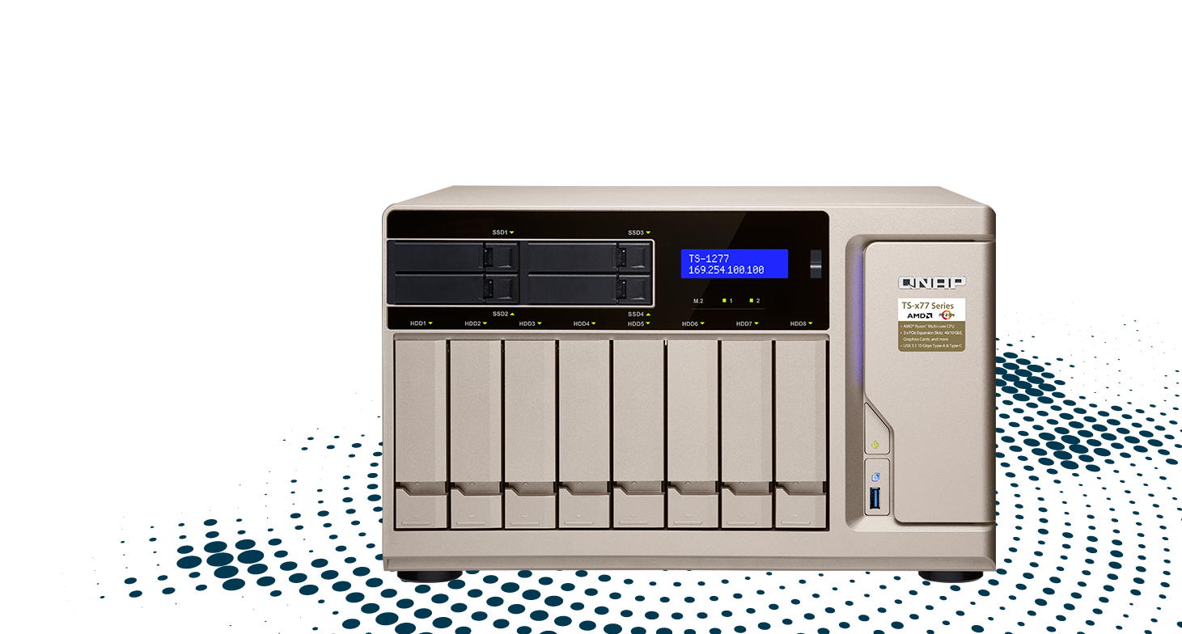
Virtual Machine (VM) Integration
Virtual Machine (VM) technology enables third-party software that was originally developed for the Windows or Linux platforms to run on QNAP NAS without the need for modification.
Advantages :
No need to re-develop application; the existing one can directly be used.
No need to invest in additional hardware.
Have a familiar and user-friendly UI.
Notes:
[Chris]
There are some advantages.
You don’t need to redevelop your application.
The runtime environment of your application will be a virtual machine, it is hardware-independent.
And you can directly use the original user-friendly User Interface, you don’t need to redesign it.
For example, if you have an existing application, the access control system.
How will you deploy the system?
You will need a server to run your system. And you also need a storage (it should be a QNAP NAS) to store the in-out record.
It means, you need a server and a NAS, right? (Yes)
But, if you convert your application into a virtual machine and deploy it to QNAP NAS, user only needs “ONE” QNAP NAS.
QNAP NAS can not only store your data, but also execute your application.
(so you can save your money. That’s great!)

Slide 7


QNAP Development Kits
Developers can use the QNAP development kits (QDK) provided by QNAP to design software running on QNAP NAS, personal computer or smartphone.
Notes:
[Felix]
Besides VM integration, we provide another way to achieve integration.
We will introduce you the QNAP Development Kits, also called the QDK.
With QDK, developers can develop their own app running on QNAP NAS, PC and smartphone.

Slide 8

QDK Type
PC / Mobile QDK
  For computer or mobile application
  The application will be able to access and manage files on NAS.
NAS QDK
  For QTS App
  NAS is a platform; third-parties can develop their own creative.
Notes:
[Felix]
We have two different type of QDK.
The PC / Mobile QDK and the NAS QDK.
For PC / Mobile QDK, it is designed for developing computer and mobile application.
With the QDK, the application will have the ability to access and manage files on NAS.
For NAS QDK, it is designed for developing app on NAS.
Nas will be a platform, developers can implement their own ideas on it.

Slide 9
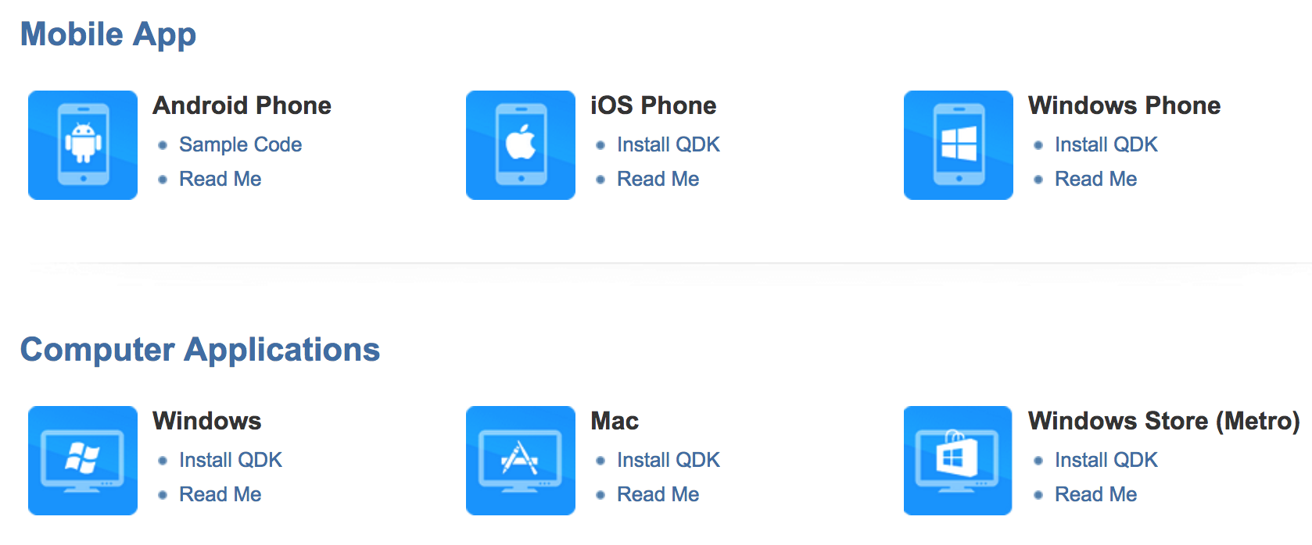
PC / Mobile QDK - Supported Clients
Notes:
[Felix]
Our PC / Mobile QDK support many PC and mobile devices.
For mobile device, we support Android, iOS and Windows Phone platforms. (Almost all mobile platforms? Yes, we support all popular mobile platforms.)
For personal computer, we support Windows, MacOS and Windows Store platforms. (Also support many platforms)
We also provide many documents and sample codes. The developers can refer them to develop their own applications.

Slide 10

NAS QDK - QPKG
NAS apps are also known as QPKG, short for QNAP Package.
Install on-demand apps to expand NAS functionality.
A QPKG makes it easy for anyone to install and remove apps on QNAP NAS.
Notes:
[Felix]
On the other hand, with NAS QDK, we can develop app on QNAP NAS.
The NAS QDK will pack a NAS app into a package. The package is named QPKG, short for QNAP package.
With QPKG, user can install on-demand apps to extend their NAS features.
It's easy for anyone to install and remove apps on QNAP NAS.
Today we will focus on introducing the NAS QDK.
Chris will introduce you how to develop a NAS app.

Slide 11






Steps of developing NAS apps
Prepare a QNAP NAS or vQTS
Set Up NAS QDK environment
Create a QPKG project
Develop your QPKG
Build your QPKG
Test your QPKG
Notes:
[Chris]
To develop a NAS App, there are some steps.
First, you should prepare a QNAP NAS or have a vQTS environment.
(What is vQTS? vQTS is short for virtual QTS. With vQTS environment, developer can develop their NAS APP in an individual QTS environment. Don’t need to afraid to break your NAS.)
(Is the vQTS a virtual machine? Yes)
Second, you should set up a NAS QDK environment on your NAS.
Third, you should create a QPKG project.
And then you can start to develop your App.
After you finish it, you should build the QPKG for your App.
And then manually install the QPKG on your NAS to test your App.

Slide 12

A Demo of Setting Up NAS QDK
Demo
Notes:
[Chris]
OK, then there is a demo about how to setup your NAS QDK environment.

Slide 13
Steps of developing NAS apps
Prepare a QNAP NAS or vQTS
Set Up NAS QDK environment
Create a QPKG project
Develop your QPKG
Build your QPKG
Test your QPKG
Notes:
[Chris]
To develop a NAS App, there are some steps.
First, you should prepare a QNAP NAS or have a vQTS environment.
(What is vQTS? vQTS is short for virtual QTS. With vQTS environment, developer can develop their NAS APP in an individual QTS environment. Don’t need to afraid to break your NAS.)
(Is the vQTS a virtual machine? Yes)
Second, you should set up a NAS QDK environment on your NAS.
Third, you should create a QPKG project.
And then you can start to develop your App.
After you finish it, you should build the QPKG for your App.
And then manually install the QPKG on your NAS to test your App.

Slide 14
A Demo of Developing a NAS App
Demo
Notes:
[Chris]
After setup your NAS QDK environment, you can start to develop your NAS App.
Then I will show you how to build a simple breakout game App with QNAP NAS.
…
(So you just copy and paste the source code. Don't need to change anything?)
...
See! It’s very easy, right? We just take less than 10 minutes, then we get a NAS app now.
(Wow! I also want to write my own NAS app immediately.)

Slide 15
QPKG Configuration Settings
QPKG_NAME | Name of the packaged application.
QPKG_DISPLAY_NAME | Displayed name of the packaged application.
QPKG_VER | Version of the packaged application.
QPKG_AUTHOR | Author or maintainer of the package.
QPKG_WEBUI | Relative path to web interface. (ex: /HelloWorld)
QPKG_WEB_PORT | Port number for the web interface.
QPKG_WEB_SSL_PORT | Port number for the SSL web interface.
Notes:
[Chris]
Also, there are some options you can set in your QPKG configuration files.
You can set QPKG name, display name, version and author。
If your NAS App has user interface, you should set the path of your webpage and port of your web server.

Slide 16
QPKG Configuration Settings
QPKG_USE_PROXY | The QPKG may have its own HTTP service port. 1: QTS HTTP server will act as a proxy. Clients connect via QTS HTTP port. Other: Do not use proxy.
QPKG_DESKTOP_APP | 1: Open QPKG as a QTS desktop window Other: Open QPKG as a new browser tab
QPKG_DESKTOP_APP_WIN_WIDTH | Desktop Application Window default inner width
QPKG_DESKTOP_APP_WIN_HEIGHT | Desktop Application Window default inner height
QTS_MINI_VERSION | Minimum QTS version requirement.
QTS_MAX_VERSION | Maximum QTS version requirement.
Notes:
[Chris]
If your app uses the different web server from QTS, and you wish to connect to your App through QTS http server, you should enable the proxy option.
You can also integrate your APP UI into QTS desktop, and set the window width and height.
You can also set support range of QTS version.

Slide 17
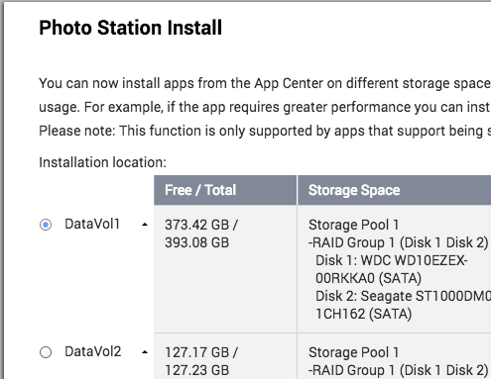
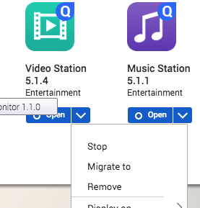
QPKG Configuration Settings
QPKG_VOLUME_SELECT | Can user select volume for installation or migration? 0: Not Supported 1: Support installation 2: Support migration 3: (1+2) support both installation and migration
QPKG_VISIBLE | Who can see the QPKG? 1(default): administrators 2: all NAS users.
QDK_DATA_DIR_ICONS | Location of icons for the packaged application.
Notes:
[Chris]
There are more options you can set.
Include, volume selection while installation and migration,
and who can see your APP.

Slide 18
NAS App vs. Linux App
 | NAS App | General Linux Application
Package Format | Uniform Format QPKG | Many Formats yum, rpm, apt, dpkg
Toolchain | Uniform Standard QNAP Provided | Many Formats Platform Vendor Provides
SDK | Additional Option (QNAP SDKs) Linux Libraries and QNAP HTTP APIs | Linux Standard Library Linux Libraries
UI / UX | Additional Option (QTS Integration) QTS Integration or User Design | User Design Developer Design
Notes:
[Felix]
What is the difference between develop QNAP NAS App and Linux Application?
In QNAP, we use QPKG as the package format. In Linux, there are many formats, it depends on different Linux distribution.
They have yum, rpm, apt and dpkg.
If you need toolchain, QNAP provides it. In linux, you should get from the platform vendor.
In SDK, both NAS app and linux app use Linux libraries. The NAS App can also use the QNAP HTTP APIs.
In user interface and user experience. You can design by yourself on both NAS App and Linux App. But in NAS App, you can integrate with QTS Desktop.

Slide 19
NAS App vs. Linux App
 | NAS App | General Linux Application
Software Store | Unified Store QNAP App Center | Many Stores Package Management
Storage Integration | Powerful QTS Storage Graphical User Interface, RAID Management, Snapshot.. | Linux Built-in LVM, RAID
Built-in Feature | Many Built-in Features Linux Built-in Features and QNAP Built-in Features (Web Server, File Station, ..) | Linux Built-in Compression, Transcoding..
Technical Support | QNAP Support + Forum Helpdesk, QNAP/Linux Forums | Forum Linux Forums
Notes:
[Felix]
In Software Store, QNAP has QNAP App Center. In Linux, you should find applications in package management system.
In Storage Integration, QNAP has powerful QTS Storage. QNAP will manage the storage for you. In linux, you can use the embedded linux features, such as LVM, RAID... You need to configure it and control the error handling by yourself.
In built-in features, both NAS app and Linux app can use linux built-in features, such as compression, transcode... In QNAP NAS app, there are also many rich QNAP built-in features, such as web server, file station or IOT.
In technical support, you can seek help from forums for both Nas App and linux App. In QNAP, you can also use helpdesk to get QNAP support.

Slide 20

QNAP SDK - Others
Toolchain
  A toolchain is a set of programming tools that are used to perform a complex software development task or to create a software product, which is typically another computer program or a set of related programs.
  You can develop a native app on several NAS platforms, such as x86/ARM platforms.
  QNAP HTTP APIs
  QNAP HTTP APIs help you access those built-in features, such as file management, account management, storage management, etc.
Submit QPKG to QNAP App Center
  Let the world see your App: everyone can install and enjoy your App.
Notes:
[Chris]
There are something you need to know about NAS SDK.
We have toolchain for you to develop native app on several NAS platforms, such as x86 and arm platforms.
Also we provide QNAP HTTP APIs for you to access those built-in features.
The last thing is that after you finish develop your NAS App, you can submit your QPKG to QNAP App Center.
There will be lots of QNAP NAS users will see your App, and try to install and use your APP.

Slide 21
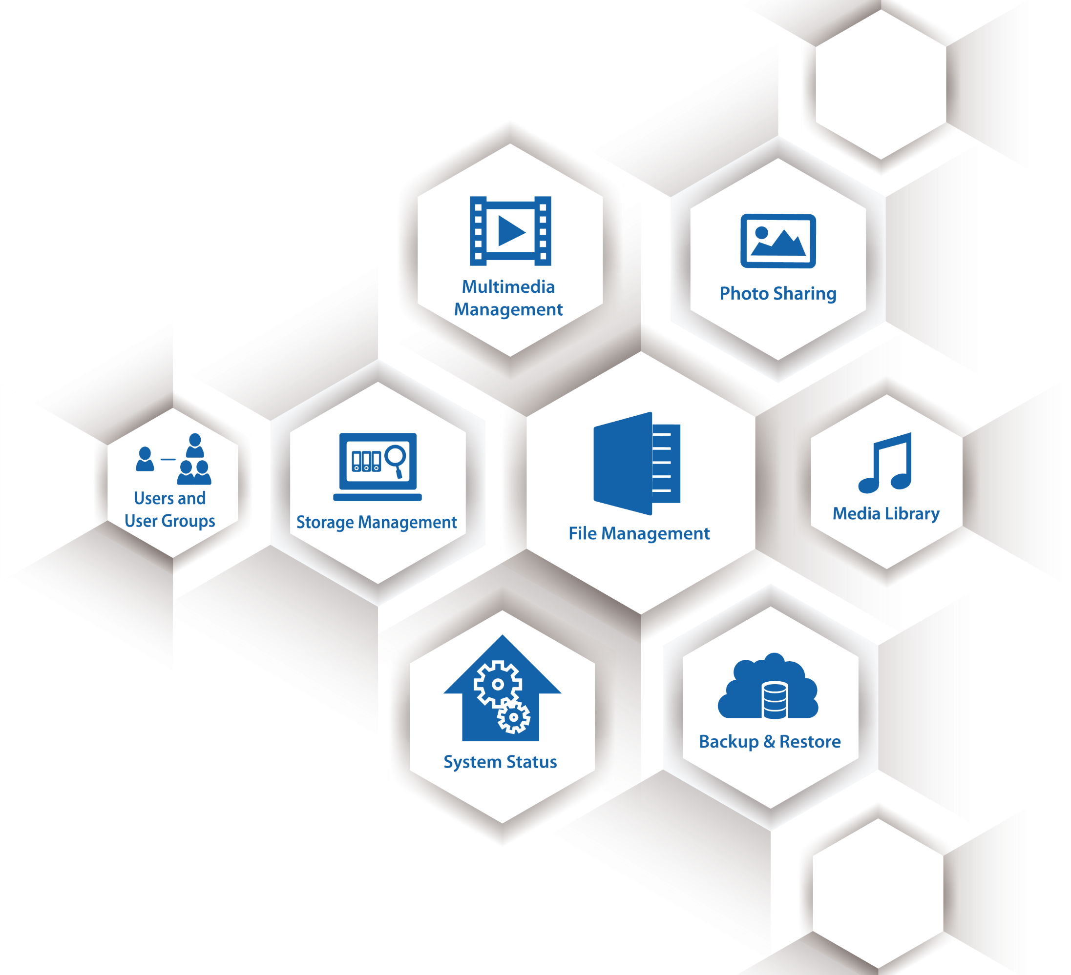
QNAP HTTP APIs
Authentication
Backup & Restore
File Management
Multimedia Management
Music Station
Photo Station
Shared Folders
Storage Management
System Status
Users and User Groups
...
Notes:
[Chris]
With QNAP HTTP API, you can use many built-in features of QNAP NAS.
Include Authentication, backup and restore your data, and manage your file.
Also we have multimedia features, data sharing features.
You can also check system status of NAS through the API.
These built-in features are provided by QNAP, you don’t need to develop yourself.
If you want to use these APIs, and require some documents, please contact us.

Slide 22


Submit apps to QNAP App Center
You: Develop your QPKG
You: Install Helpdesk app on NAS
You: Send QPKG and mandatory information via Helpdesk app
QNAP: Review / test your QPKG
QNAP: Upload your NAS app to QNAP App Center
All QNAP NAS Users: Discover, install and enjoy your NAS app
Notes:
[Felix]
If you are ready to submit your app to QNAP App Center, there are some steps you need to follow.
First you should develop your QPKG.
After that, you should install Helpdesk App on your NAS.
Then you should fill some mandatory information about your app and send your QPKG through Helpdesk.
After QNAP receives your QPKG, we will start to review and test your APP.
When everything is fine, QNAP will upload your NAS App to QNAP App center.
Then there will be lots of QNAP NAS users start to see your App, try to install and use your app.

Slide 23
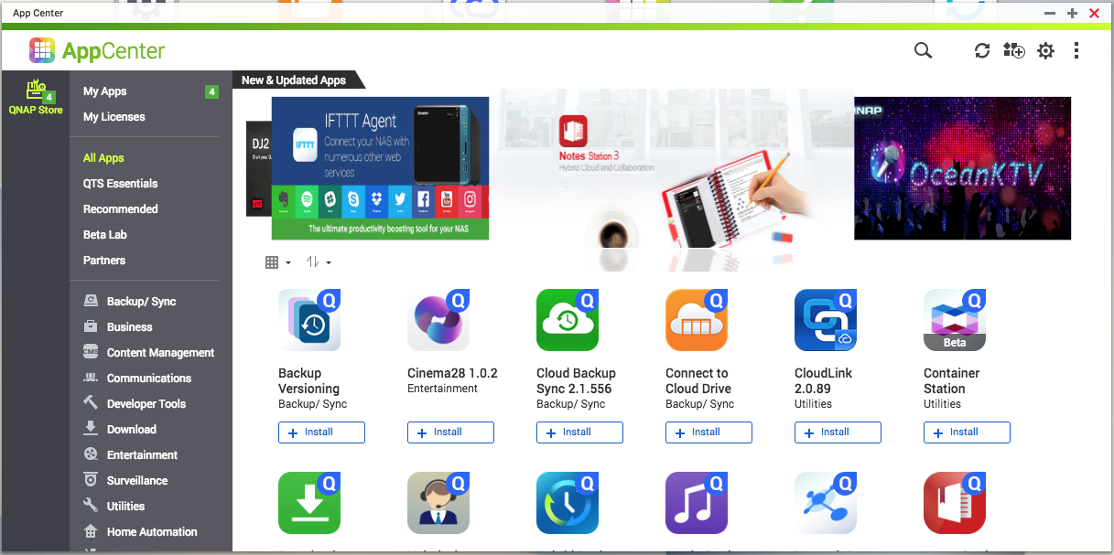
Shine in QNAP App Center
After you complete the development of your app, you can contact us to display the app in QNAP App Center. Many QNAP NAS users will see your app.
Notes:
[Felix]
After you submit your app to QNAP App Center. You will become one of our partners. And your app will shine in the QNAP App Center.

Slide 24
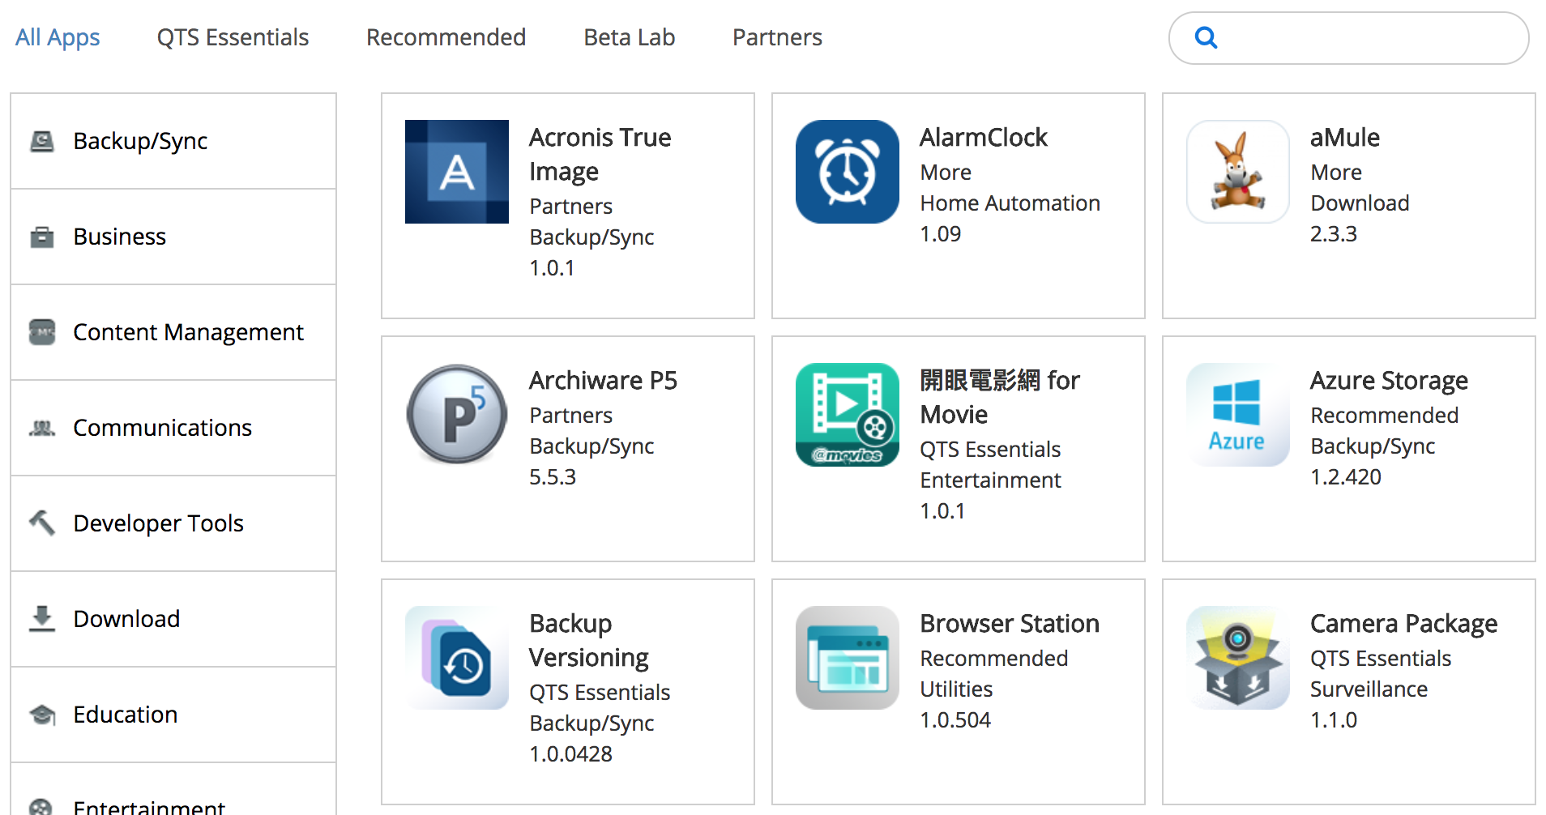
QNAP App Center on QNAP Website
Notes:
[Felix]
You can also discover NAS app from QNAP App Center on QNAP website.

Slide 25
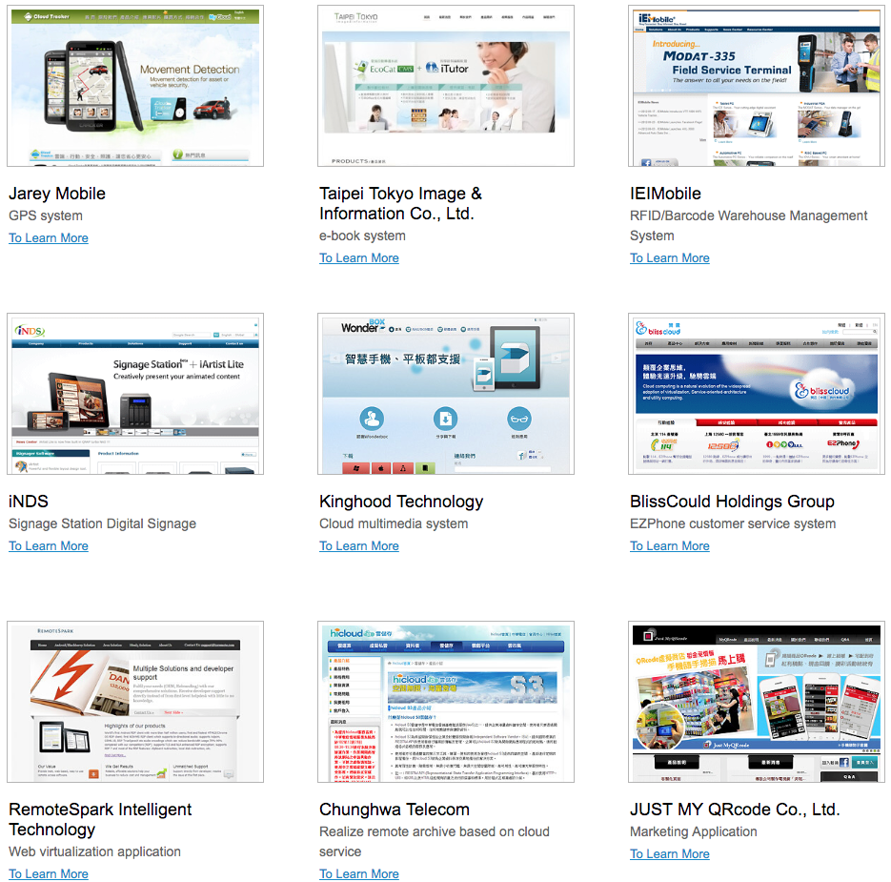
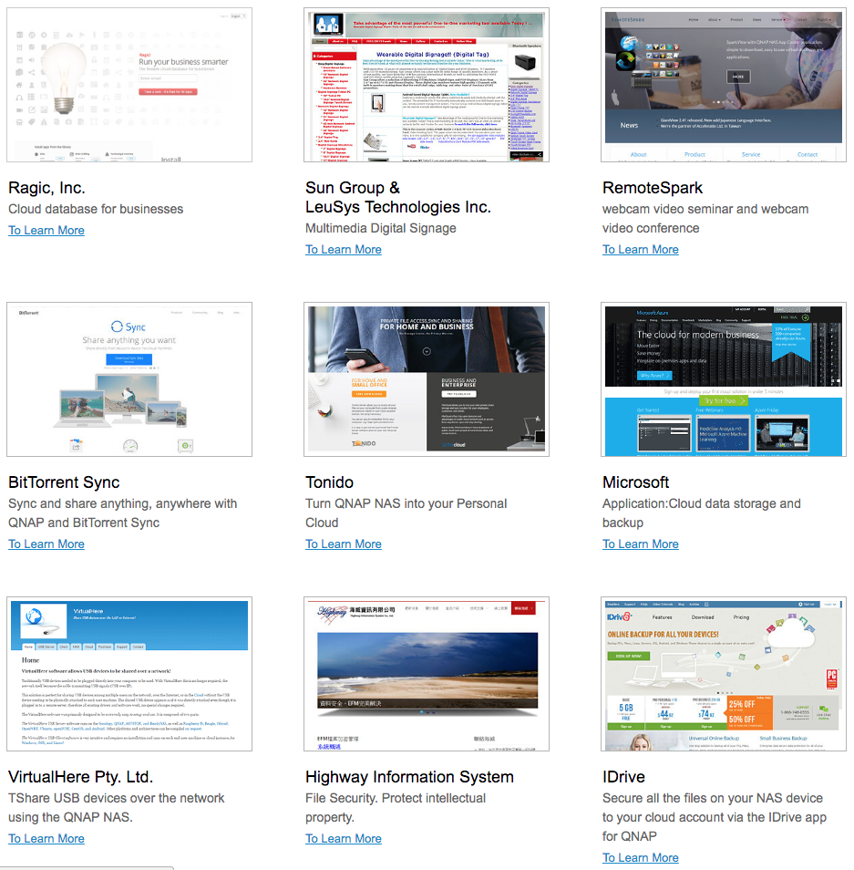
QDK Partner Success Stories
There are already a number of success stories on partnership/cooperation with QNAP; have a look to see how easy it is to develop apps on QNAP NAS.
Notes:
[Felix]
There are a lot of successful stories from our customers.
It's really easy to develop app with QNAP NAS. Please take a look on QNAP website.

Slide 26
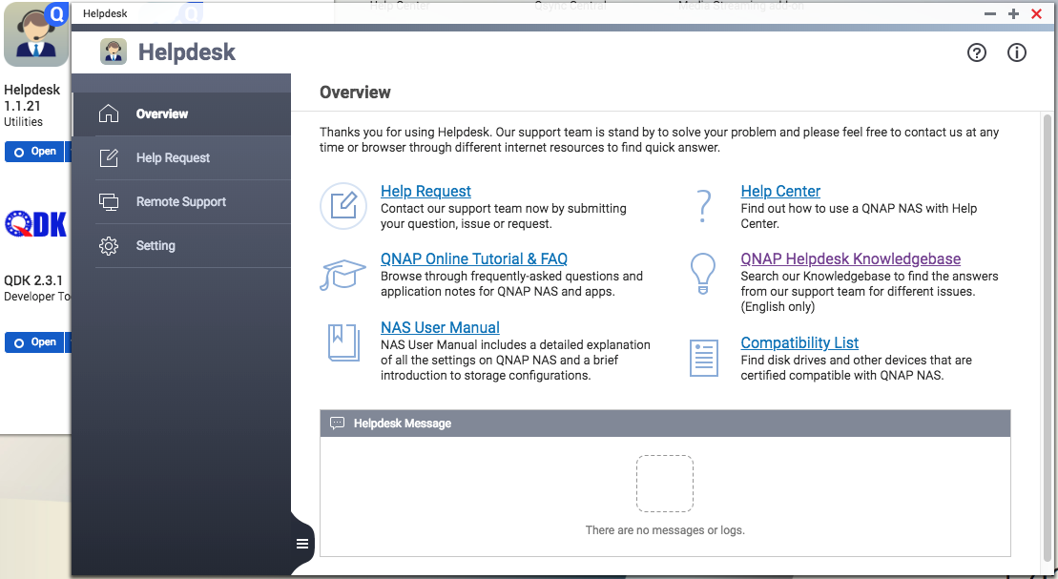
If you have technical difficulties, please...
Notes:
[Felix]
Finally, If you have any technical issues, problems about developing QNAP application, please contact us through the Helpdesk.

Slide 27
Develop with QNAP Your best choice!
Copyright © 2018 QNAP Systems, Inc. All rights reserved. QNAP® and other names of QNAP Products are proprietary marks or registered trademarks of QNAP Systems, Inc. Other products and company names mentioned herein are trademarks of their respective holder
Notes:
Develop with QNAP, is always your best choice.

