Slide 1
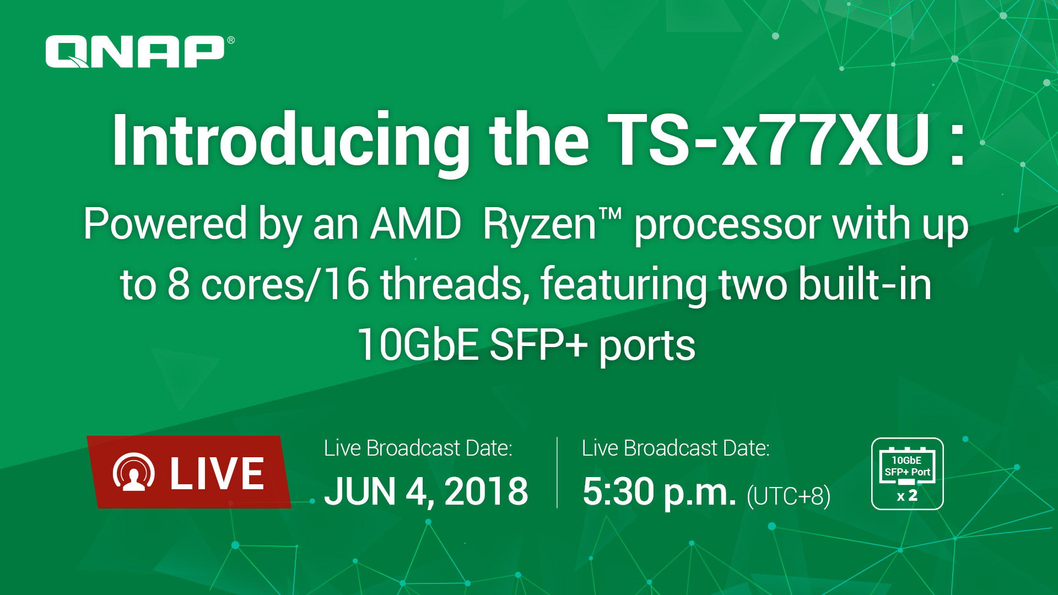

Slide 2
TS-x77XU
Ryzen Enterprise NAS

Slide 3

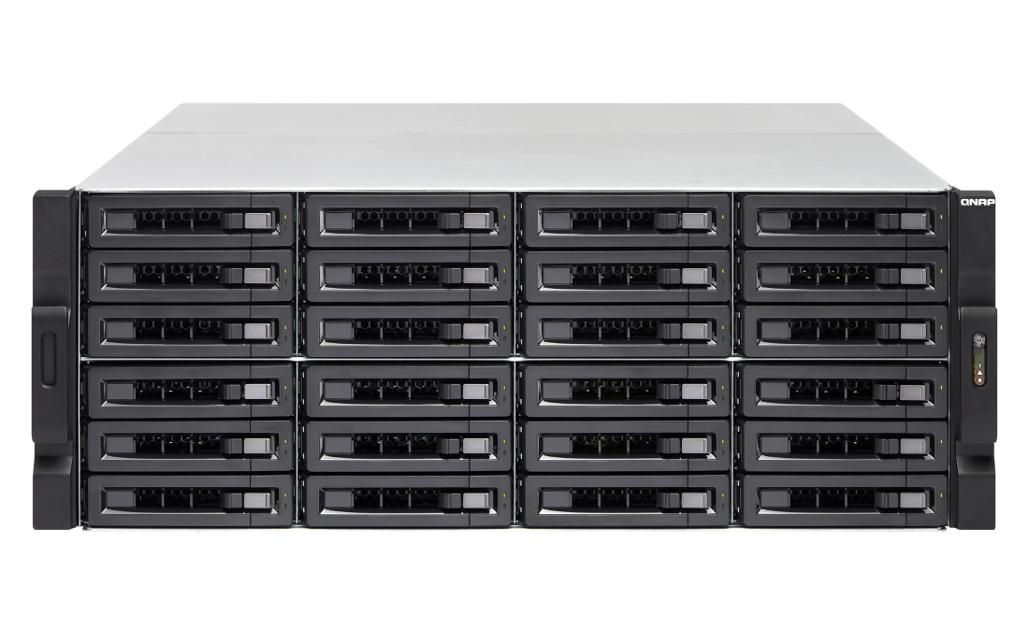
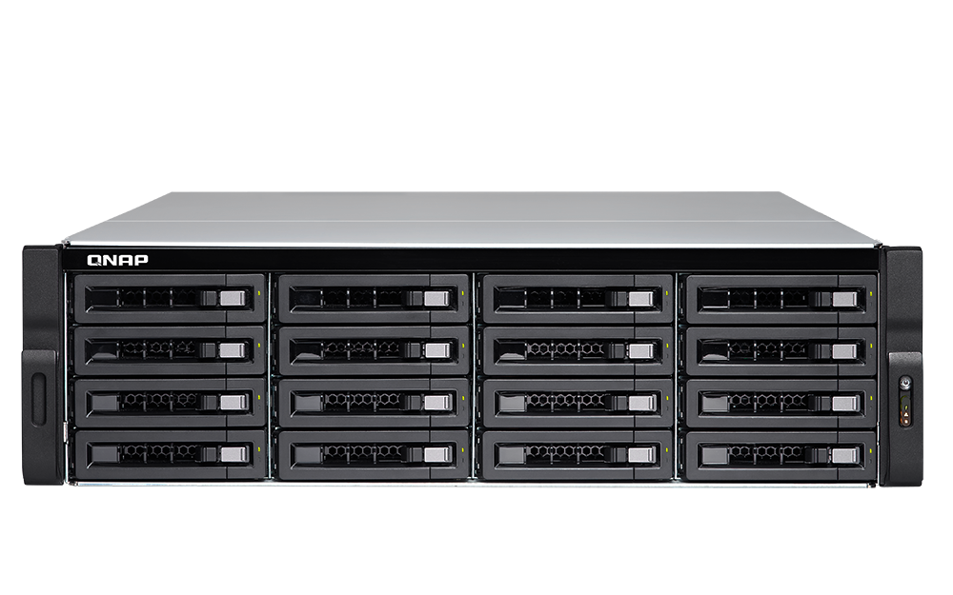



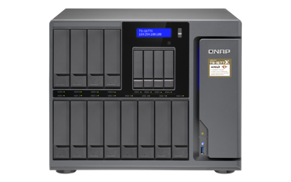
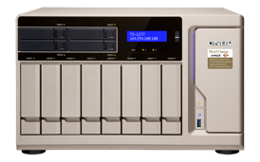
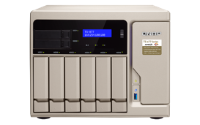
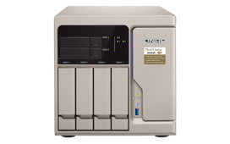
New to the Ryzen NAS Family
New
TS-x77XU rackmount NAS
2 x SFP+ 10G SmartNIC
TS-2477XU-RP
TS-1677XU
TS-1677XU-RP
TS-1277XU
TS-1277XU-RP
TS-877XU
TS-877XU-RP
TS-977XU
TS-977XU-RP
TS-x77 desktop NAS
2 x 10GBASE-T
TS-1677X
TS-1277
TS-877
TS-677
Notes:
原標題: Ryzen 戰線成員全員到齊

Slide 4

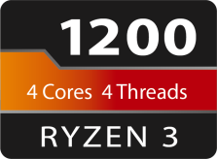
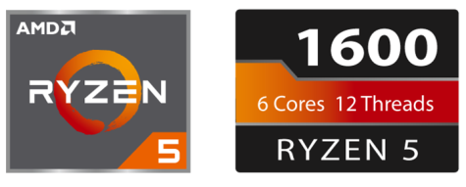
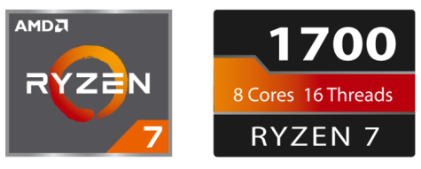
Superb performance with 65W TDP
4-core, 4-thread | 3.1 GHz / 3.4 GHz
6-core, 12-thread | 3.2 GHz / 3.6 GHz
8-core, 16-thread | 3.0 GHz / 3.7 GHz

Slide 5



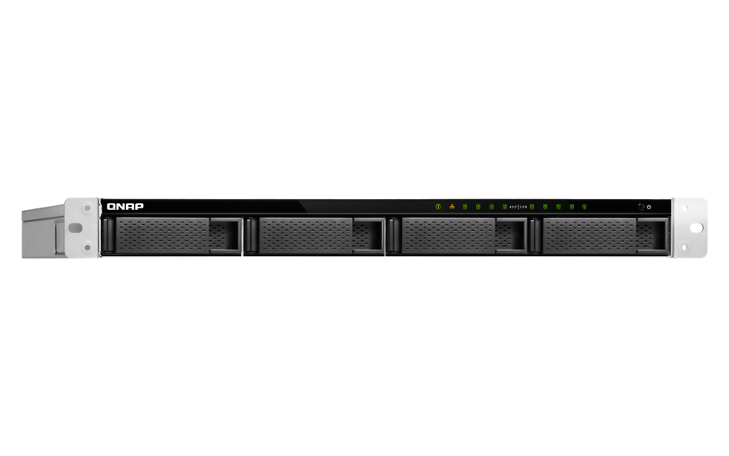
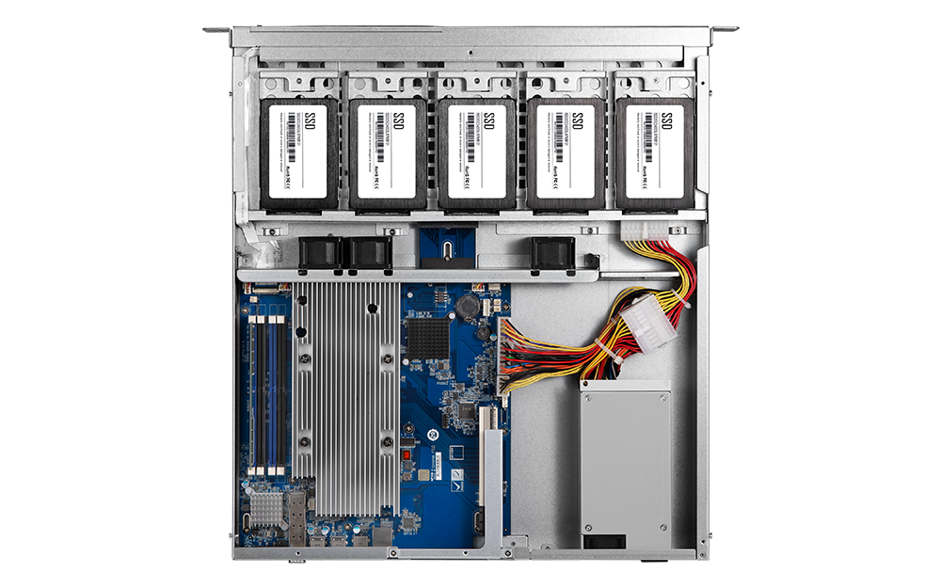
Complete product portfolio – 1U 9-bay
250W
Redundant PSU
2 x 300W
Single PSU
TS-977XU-1200-4G
Ryzen 3 1200, 4GB RAM (1x 4GB)
TS-977XU-RP-1200-4G
Ryzen 3 1200, 4GB RAM (1x 4GB)
TS-977XU-RP-1600-8G
Ryzen 5 1600, 8GB RAM (2x 4GB)
[
5 x SSD (inside)
4 x HDD
9-bay
Notes:
白手起家款

Slide 6
Complete product portfolio - 2U 8-bay
TS-877XU-1200-4G
Ryzen 3 1200, 4GB RAM (1x 4GB)
350W
Single PSU
TS-877XU-RP-1200-4G
Ryzen 3 1200, 4GB RAM (1x 4GB)
2 x 250W
Redundant PSU
TS-877XU-RP-1600-8G
Ryzen 5 1600, 8GB RAM (2x 4GB)
8-bay
Notes:
白手起家款

Slide 7

Complete product portfolio – 2U 12-bay
350W
TS-1277XU-1200-4G
Ryzen 3 1200, 4GB RAM (1x 4GB)
Single PSU
單電源
TS-1277XU-RP-1200-4G
Ryzen 3 1200, 4GB RAM (1x 4GB)
2 x 300W
雙電源
Redundant PSU
TS-1277XU-RP-1600-8G
Ryzen 5 1600, 8GB RAM (2x 4GB)
TS-1277XU-RP-1700-16G
Ryzen 7 1700, 16GB RAM (2x 8GB)
12-bay
Notes:
白手起家款

Slide 8
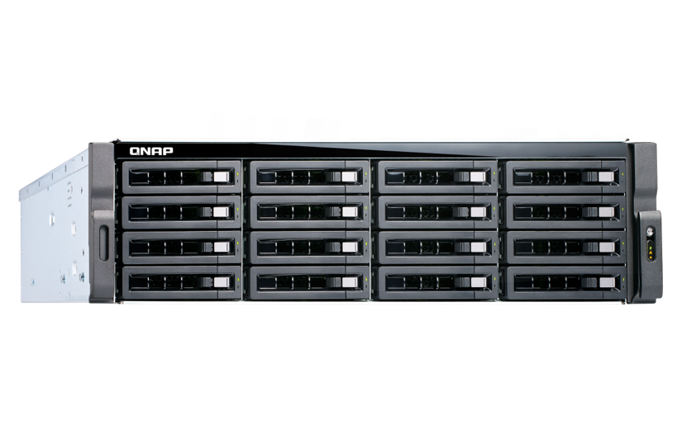
Complete product portfolio – 3U 16-bay
500W
TS-1677XU-1200-4G
Ryzen 3 1200, 4GB RAM (1x 4GB)
Single PSU
TS-1677XU-RP-1200-4G
Ryzen 3 1200, 4GB RAM (1x 4GB)
2 x 500W
Redundant PSU
TS-1677XU-RP-1600-8G
Ryzen 5 1600, 8GB RAM (2x 4GB)
TS-1677XU-RP-1700-16G
Ryzen 7 1700, 16GB RAM (2x 8GB)
16-bay
Notes:
白手起家款

Slide 9
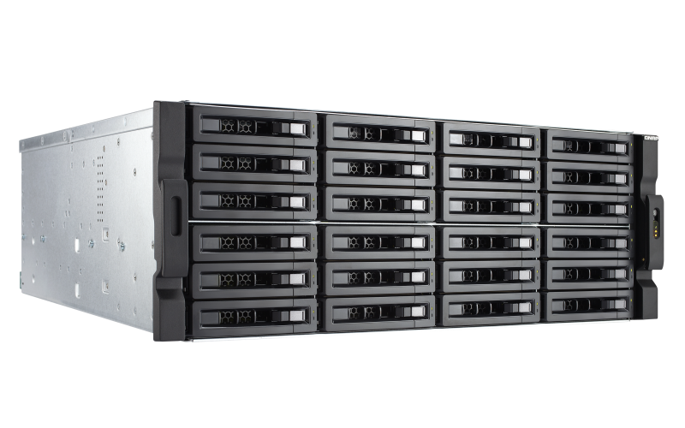
Complete product portfolio – 4U 24-bay
雙電源
2 x 800W
Redundant PSU
TS-2477XU-RP-1700-16G
Ryzen 7 1700, 16GB RAM (2x 8GB)
TS-2477XU-RP-1600-8G
Ryzen 5 1600, 8GB RAM (2x 4GB)
24-bay
Notes:
白手起家款

Slide 10
TS-x77XU
Hardware Introduction

Slide 11
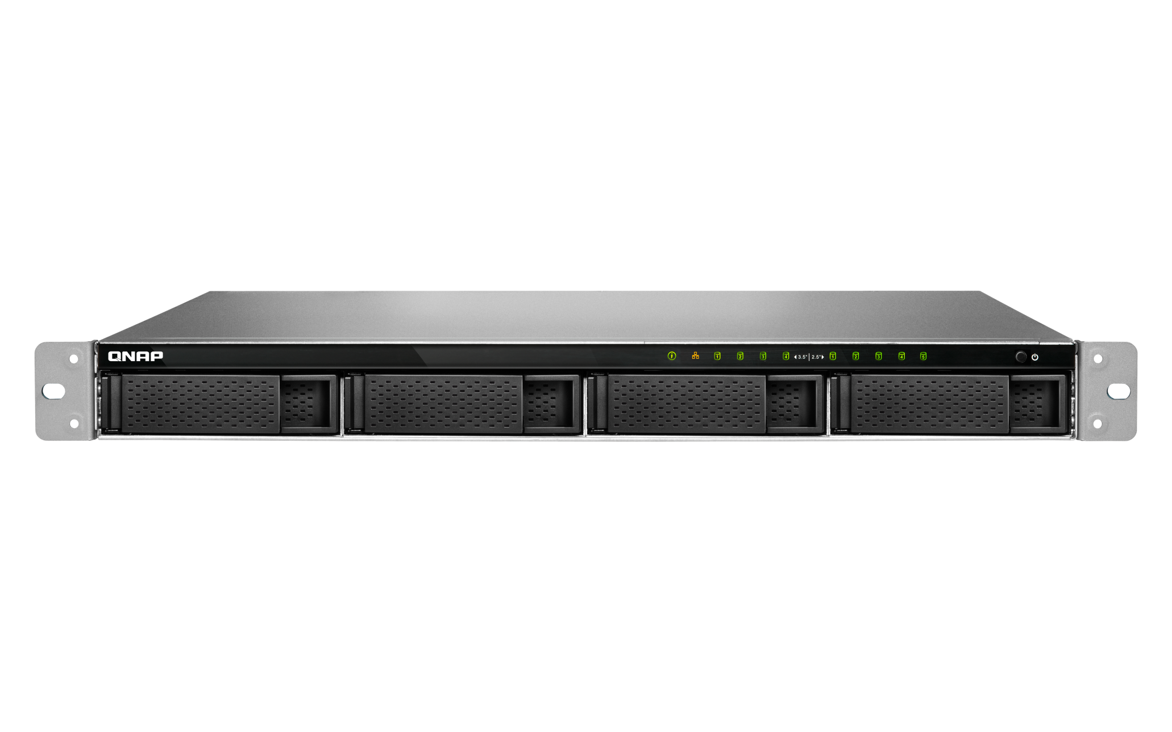
Enjoy Qtier and SSD cache in a 1U NAS
5 x 2.5”
SATA 6Gb/s SSD ports
LED indicators:
System status, network, disks
4 x 3.5”SATA 6Gb/s HDD/SSD ports
Notes:
白手起家款

Slide 12
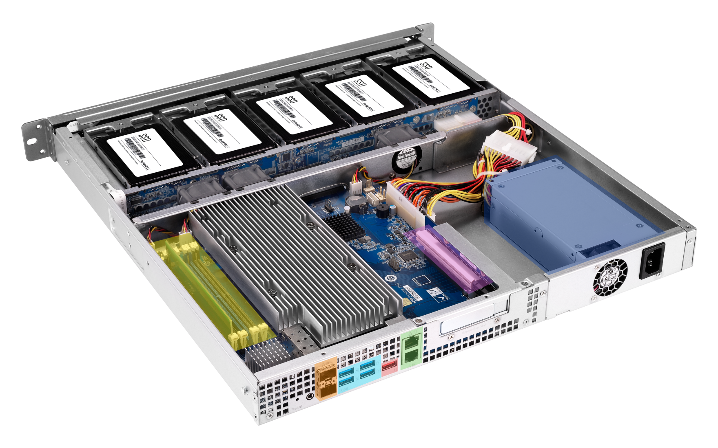

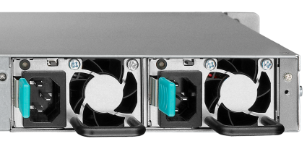
TS-977XU/TS-977XU-RP rear view
Single PSU
Low profile PCIe 3.0 x16 slot
250W
2 x 250W
Redundant PSU
4 x DDR4
Long-DIMM slots
4 x USB 3.0 ports
2 x 10GbE SFP+ ports
USB 3.1 Gen2 (10G) port
2 x GbE RJ45 ports
Notes:
白手起家款

Slide 13
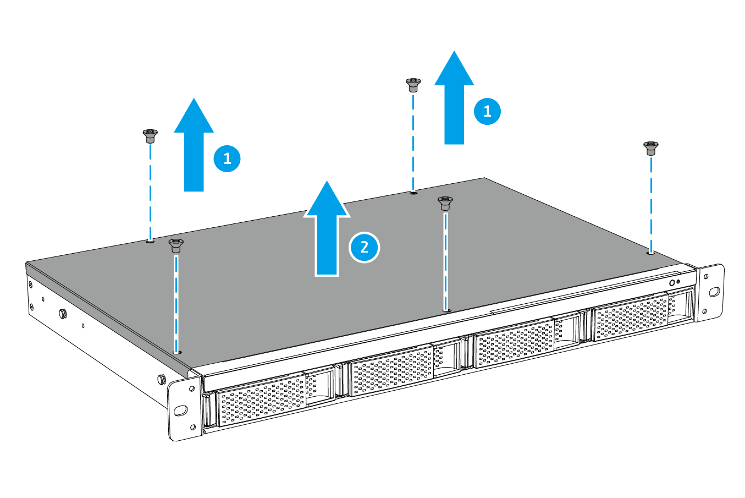
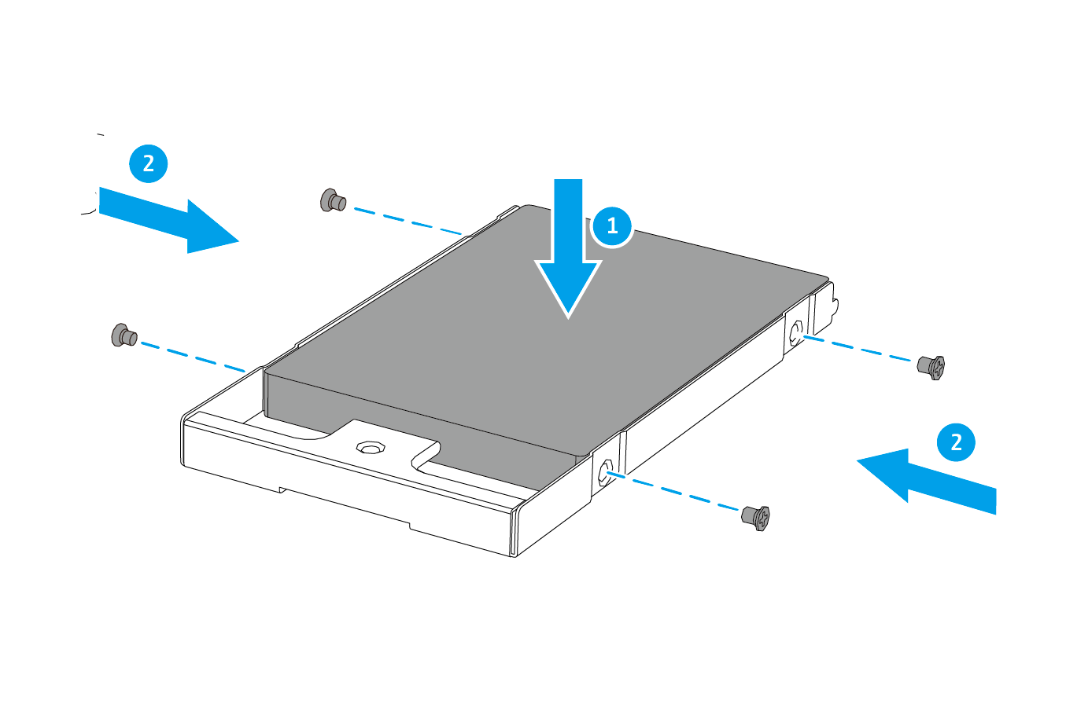
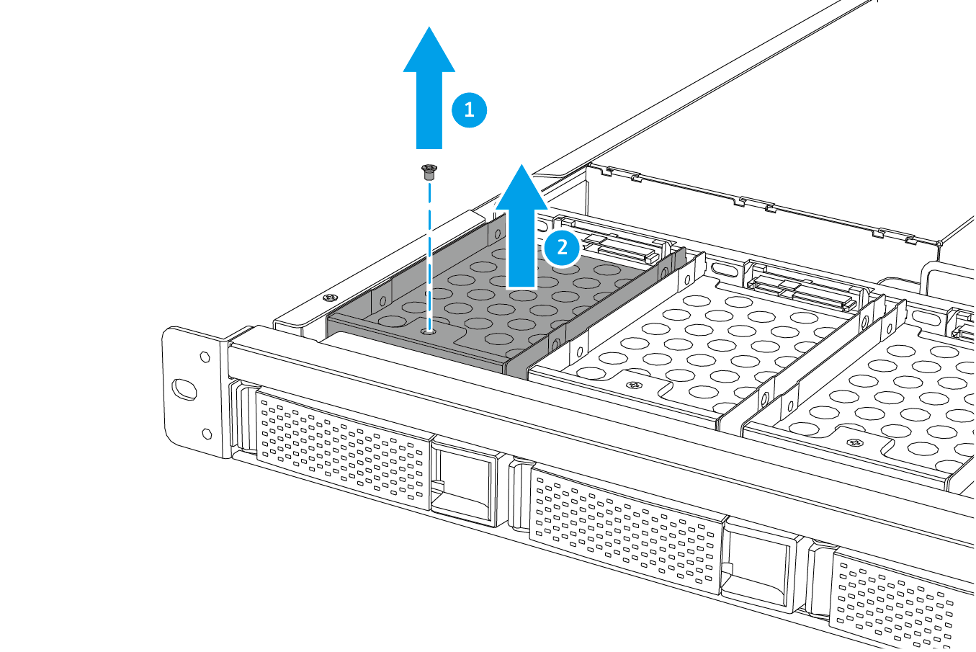
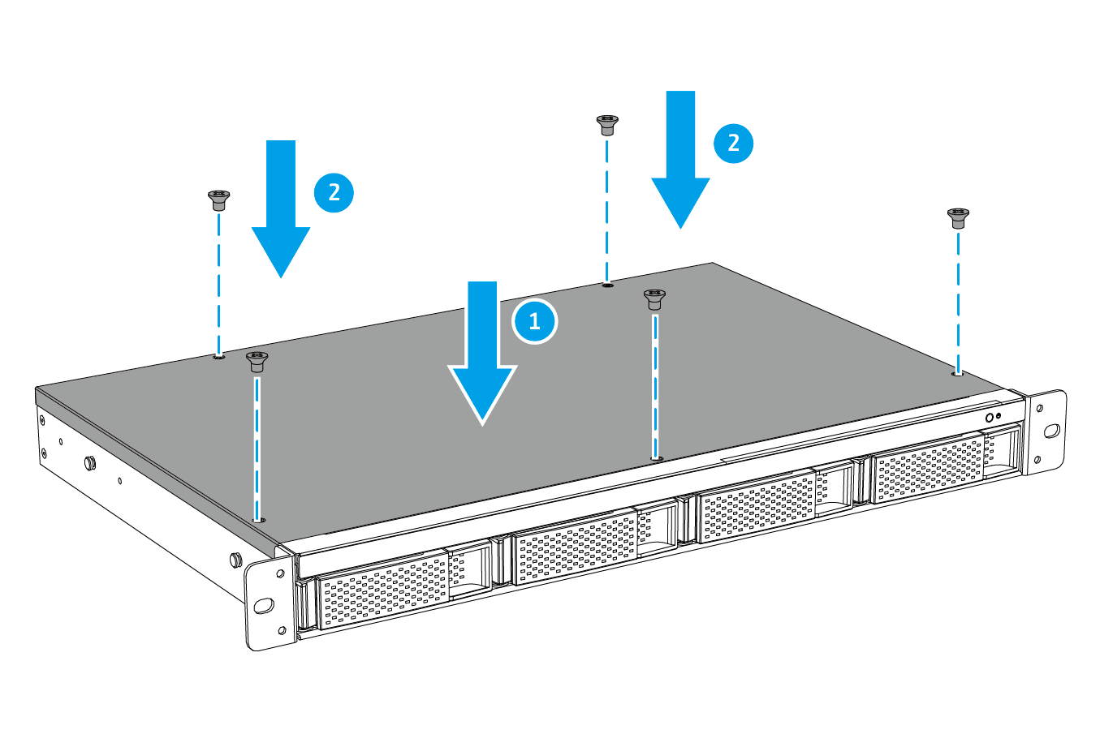
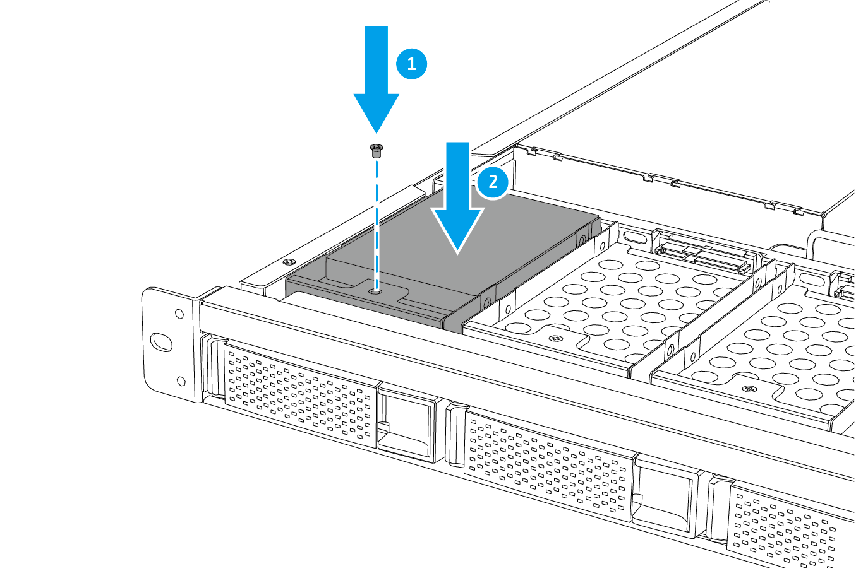
TS-977XU SSD Installation
1
2
3
Step
Step
Step
4
5
Step
Step

Slide 14

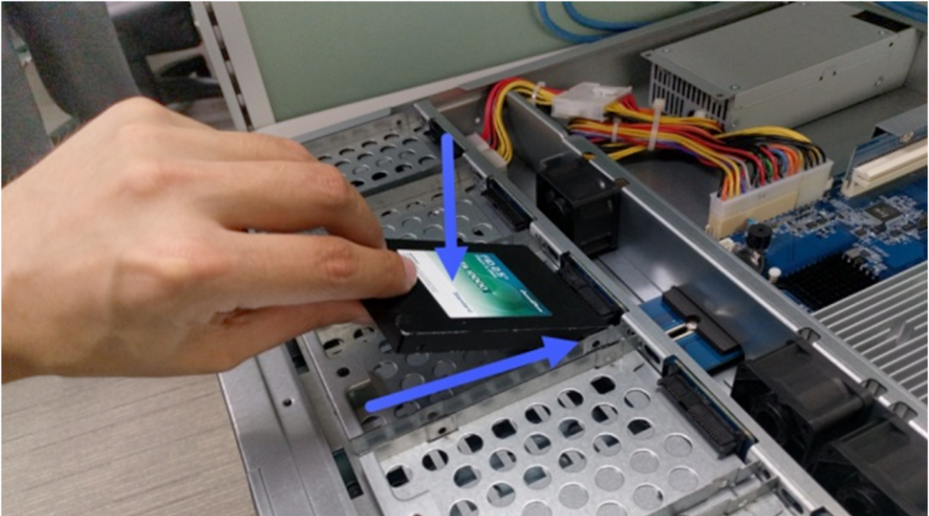
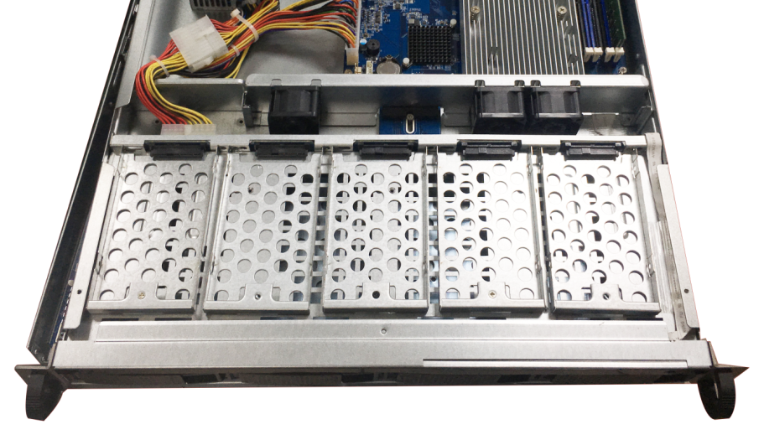
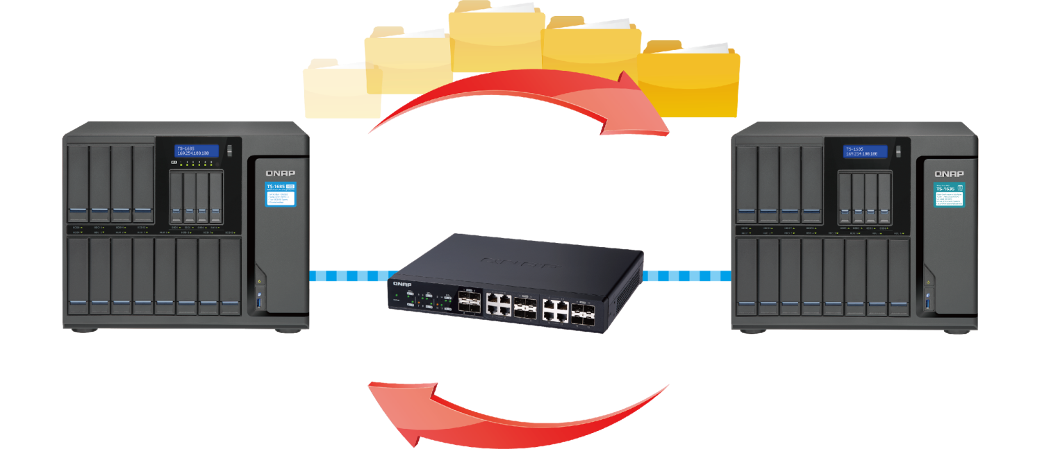
Demo
SSD Installation

Slide 15
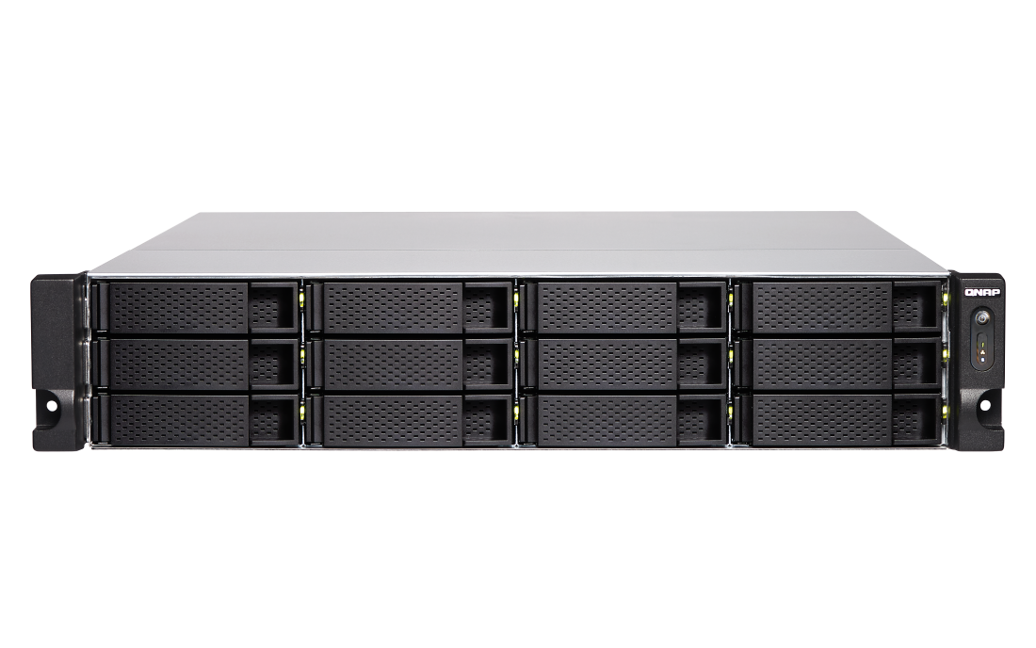
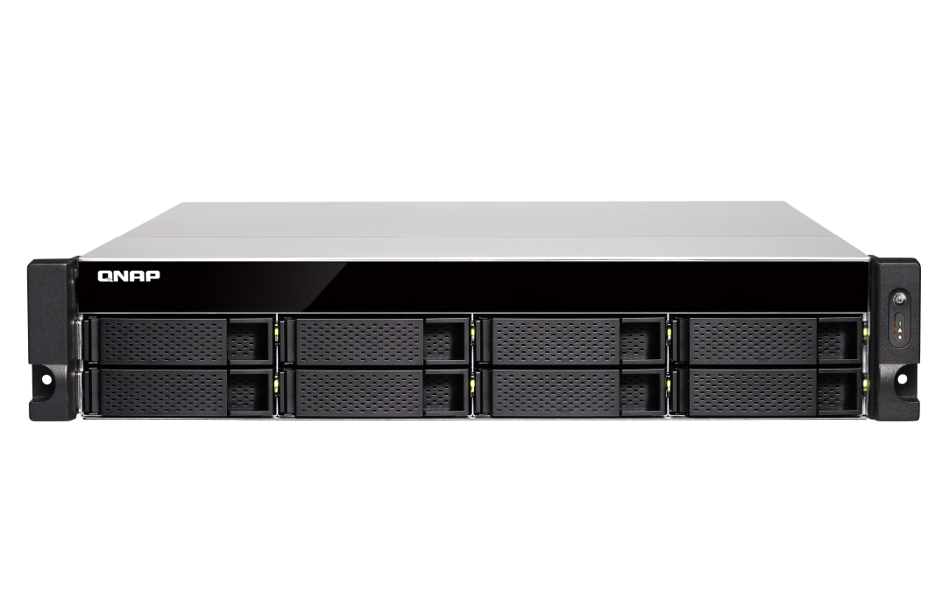
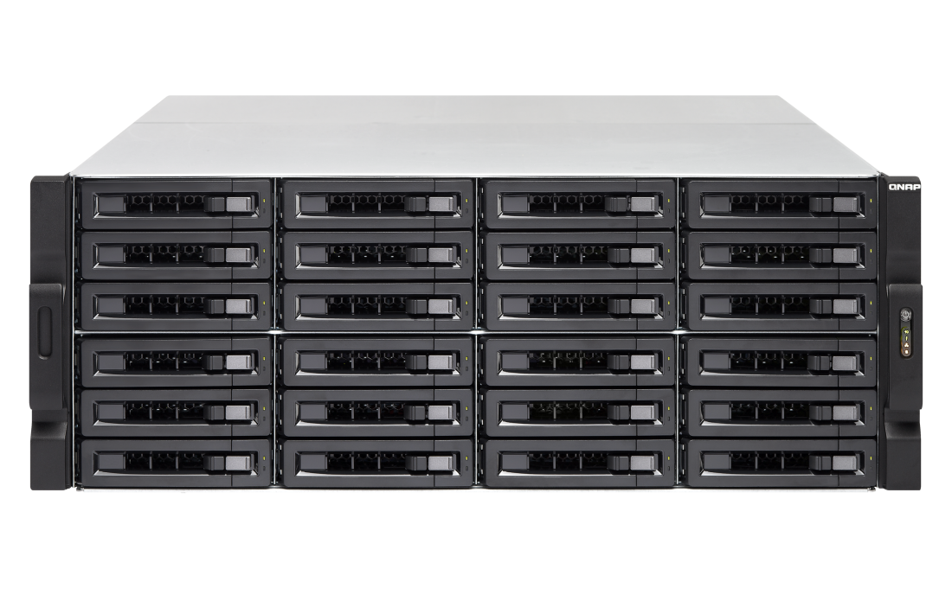
2U/3U TS-x77XU Front View
24/ 16/ 12/ 8 x 3.5”SATA 6Gb/s HDD/SSD Ports
TS-1277XU / TS-1277XU-RP
TS-877XU / TS-877XU-RP
TS-2477XU-RP
TS-1677XU / TS-1677XU-RP
Notes:
白手起家款

Slide 16

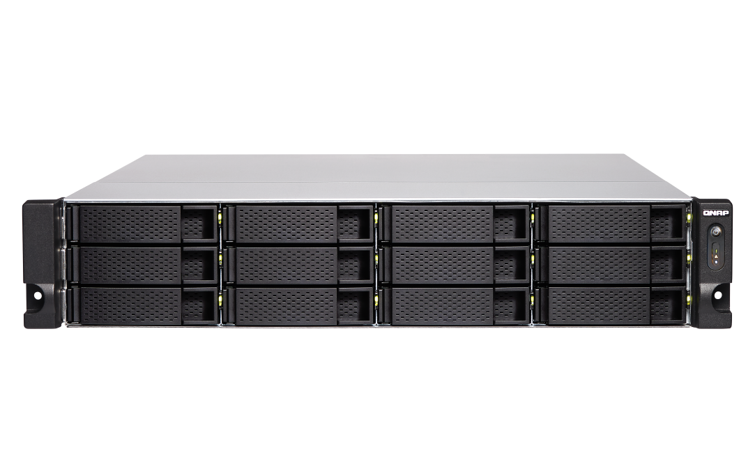
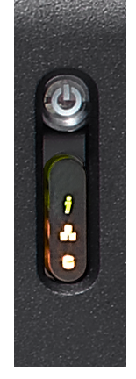
2U/3U TS-x77XU Front View
2U
Power switch
LED indicators: system status, network, external expansion enclosures, disks
4U
3U
Notes:
白手起家款
2U/3U

Slide 17
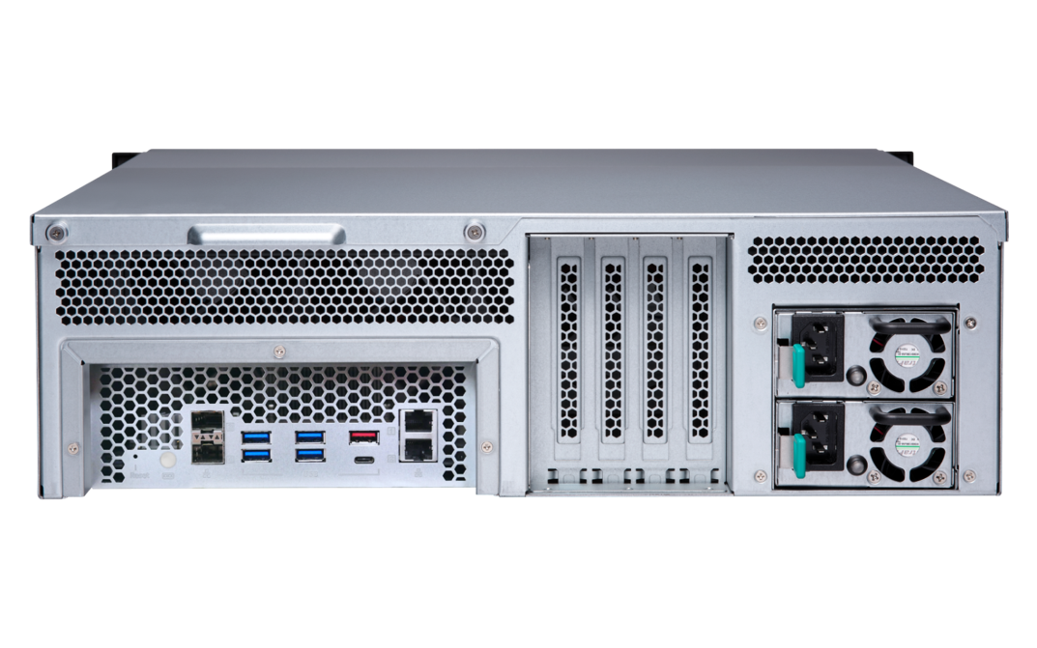
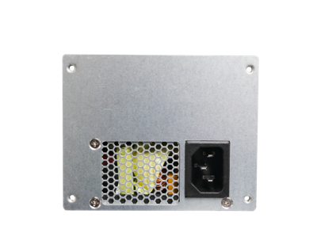
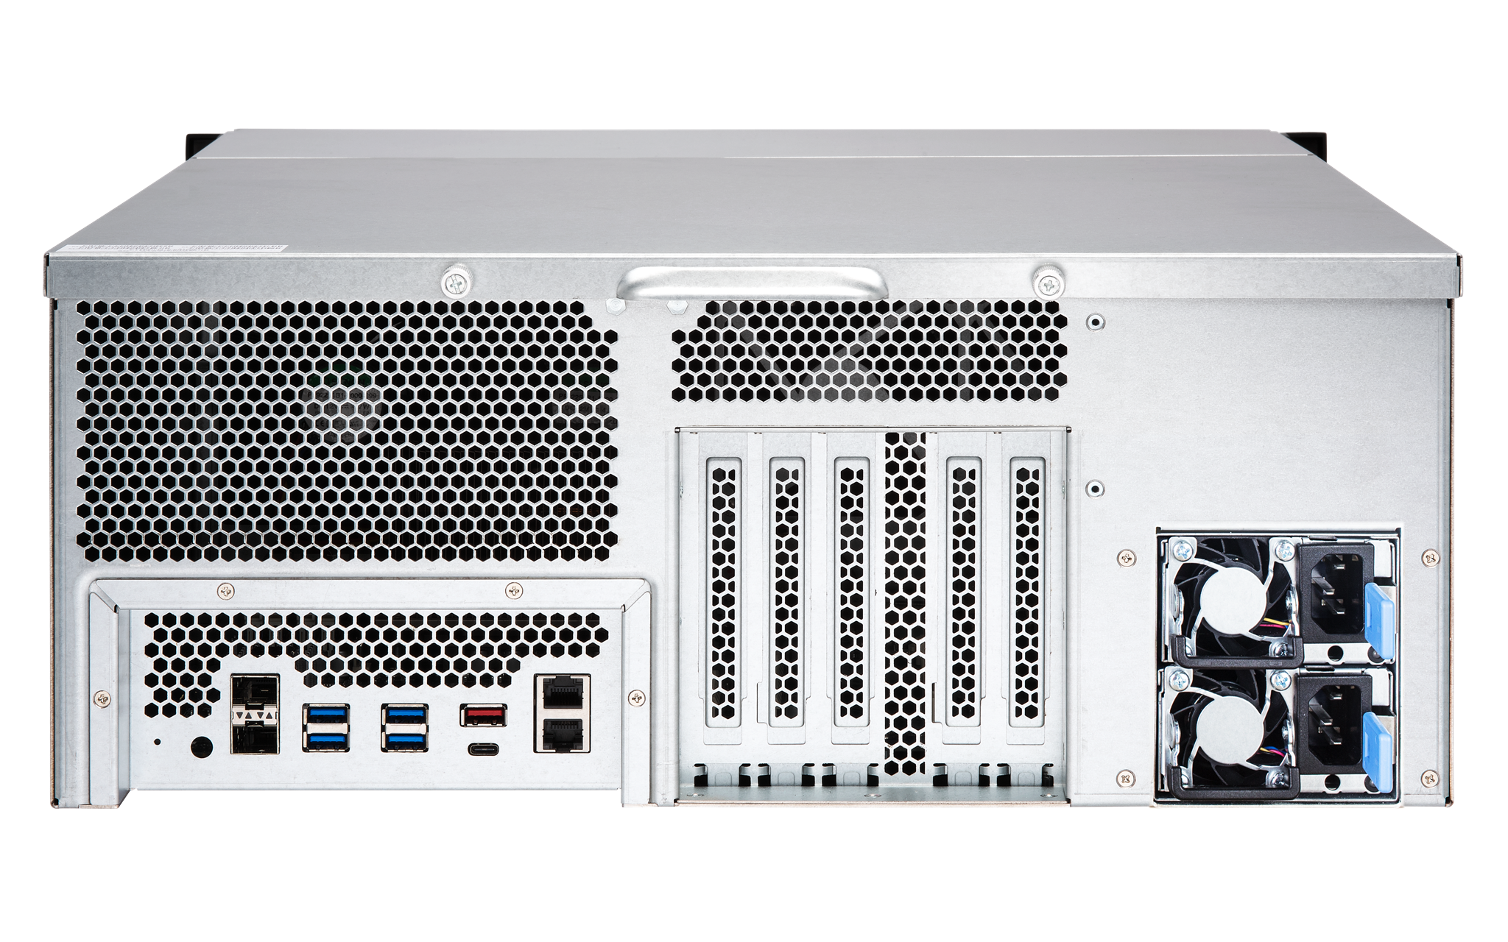
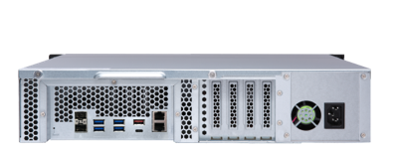
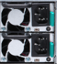
2U/3U/4U TS-x77XU Rear View
2 x 10Gb SFP+ SmartNIC ports
4 x USB 3.0
Type-A ports
2 x 1Gb network
Single PSU
Redundant PSU
USB 3.1 Gen2 (10G) Type-A & Type-C ports
8-bay
12-bay
Single PSU
24-bay
Redundant PSU
Redundant PSU

Slide 18
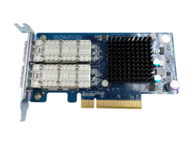
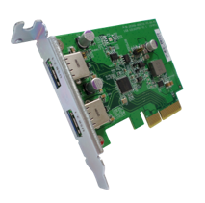
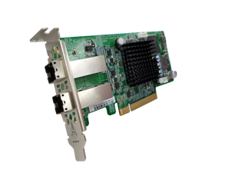
Industry-leading PCIe expansion options
QM2 provides 10GBASE-T port and/or M.2 SSD slots for SSD cache or Qtier tiered storage for optimized storage performance.
40GbE/10GbE and wireless network expansion cards
provide high bandwidth, low latency, or wireless AP functionality.
USB 3.1 Gen 2 expansion cards provide 10Gb/s for external USB devices．Type-A port is also backward compatible with USB 3.0/2.0 devices.
SAS expansion card is for adding support of REXP expansion units for up to 40 additional SAS/SATA drives.

Slide 19
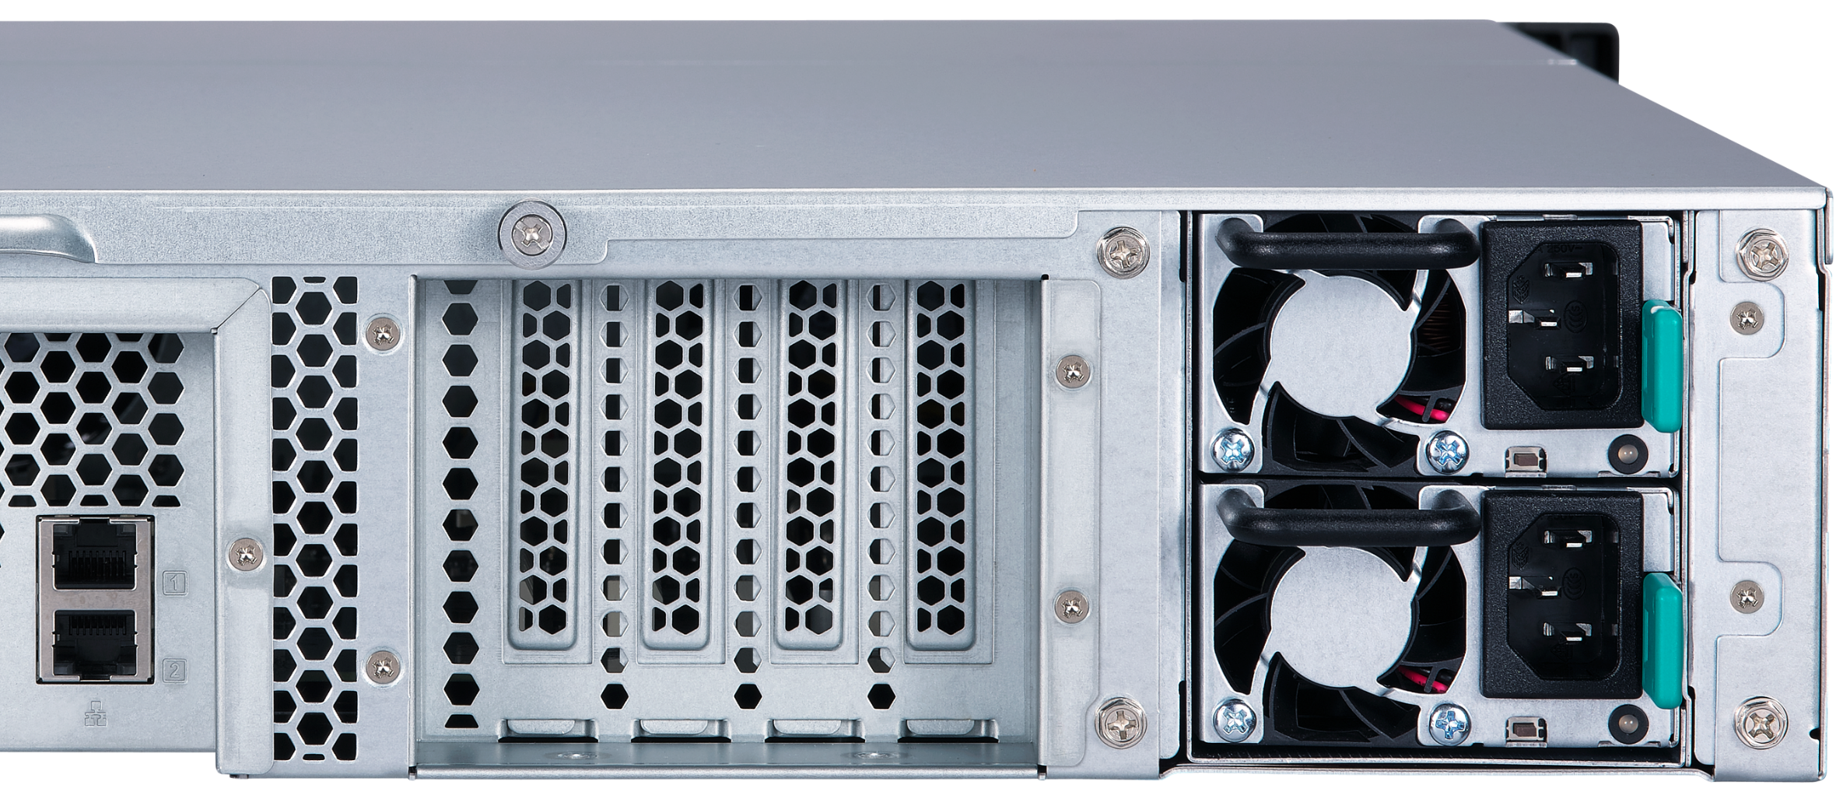
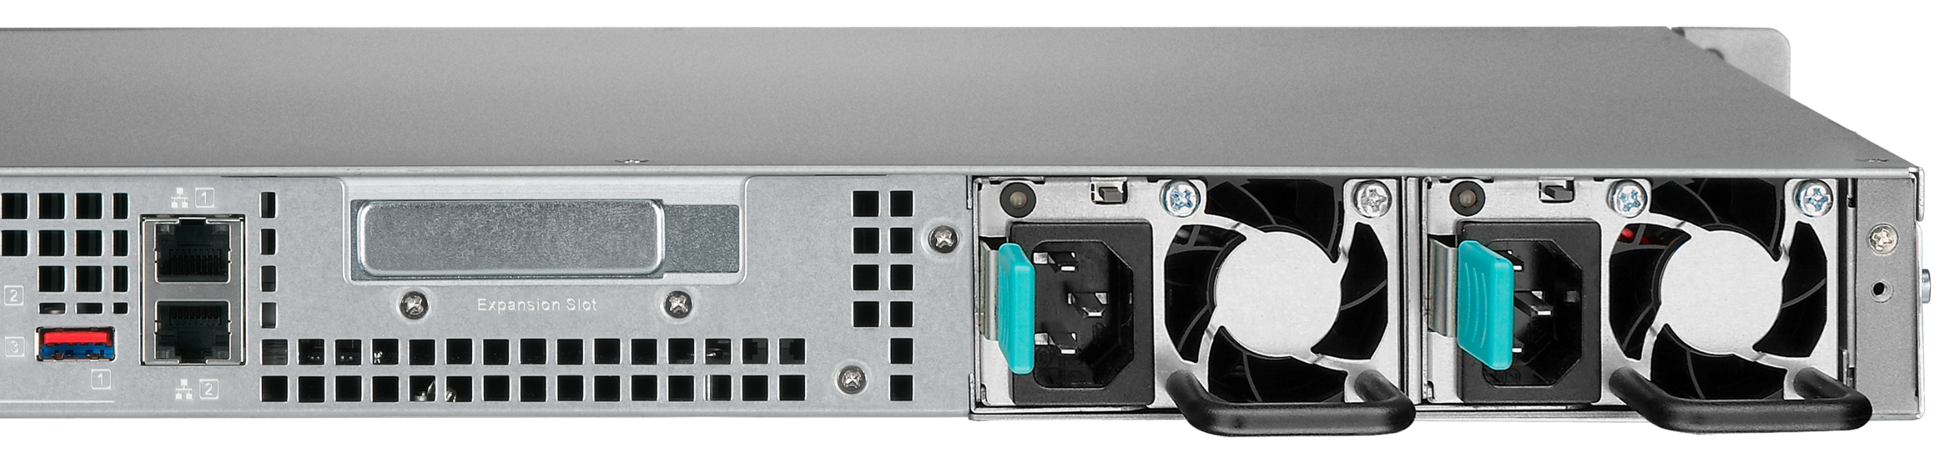
TS-x77XU PCIe slots
1U/2U: low profile
4
3
2
1
1
3U/4U: full height
4
3
2
1
4
3
2
1
Notes:
這頁需要

Slide 20
Flexible PCIe Allocation (2U/3U)
PCIe x8
PCIe x8
PCIe x4
PCIe x4
PCIe x4
PCIe x4
#4
#3
#2
#1
#4
#3
#2
#1
4 x PCIe slot
(from CPU)
4 x PCIe slot
(from CPU)
Occupied
Empty

Slide 21
Flexible PCIe Allocation (4U)
PCIe x8
PCIe x8
PCIe x4
PCIe x4
PCIe x4
PCIe x4
#4
#3
#2
#1
#4
#3
#2
#1
4 x PCIe slot
(from CPU)
4 x PCIe slot
(from CPU)
Occupied
Empty

Slide 22
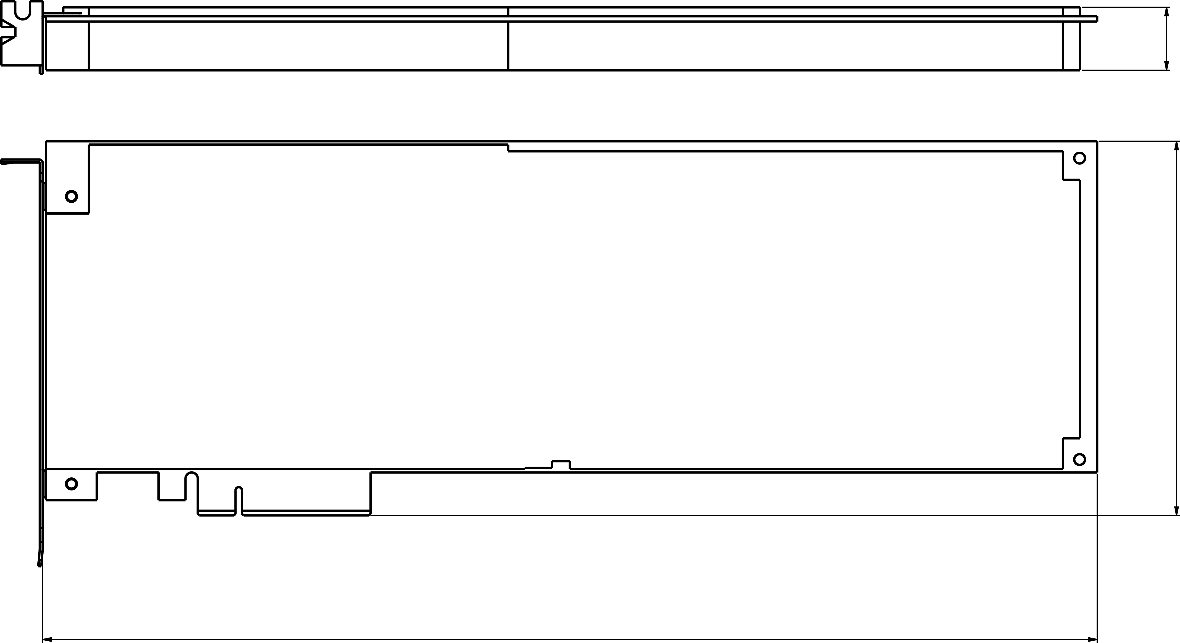
GPU card slots and supported dimensions
​ | Slot | Dimension W x H x L (mm)​
TS-877XU​ TS-877XU-RP​ | Slot 2​ | 37 x68.9 x 214​
 | Slot 4​ | 37 x 68.9 x 214​
TS-1277XU​ TS-1277XU-RP​ | Slot 2​ | 37 x 68.9 x 214​
 | Slot 4​ | 37 x 68.9 x 214​
TS-1677XU​ TS-1677XU-RP​ | Slot 2​ | 38.5 x 111 x 214​
 | Slot 4​ | 38.5 x 111 x 214​
TS-2477XU-RP​ | Slot 2​ | 55 x 138 x 312​
 | Slot 3​ | 55 x 138 x 312​
W
H
L

Slide 23
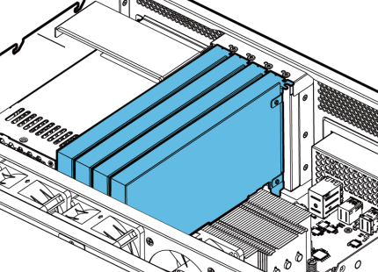
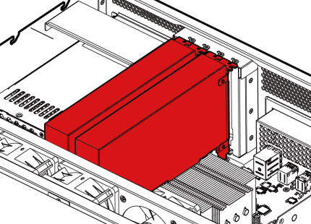
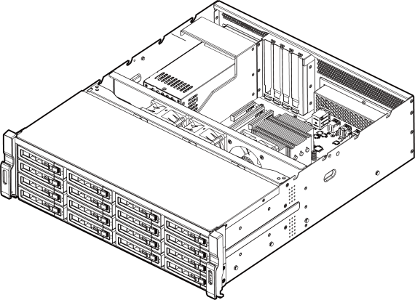
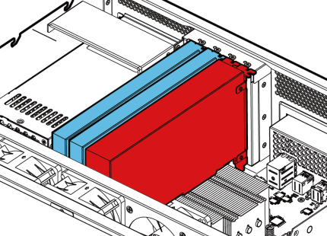
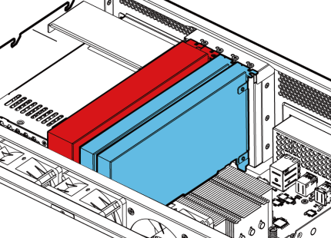
3U PCIe Card Combination
Combination
A
C
B
D
Notes:
白手起家款

Slide 24
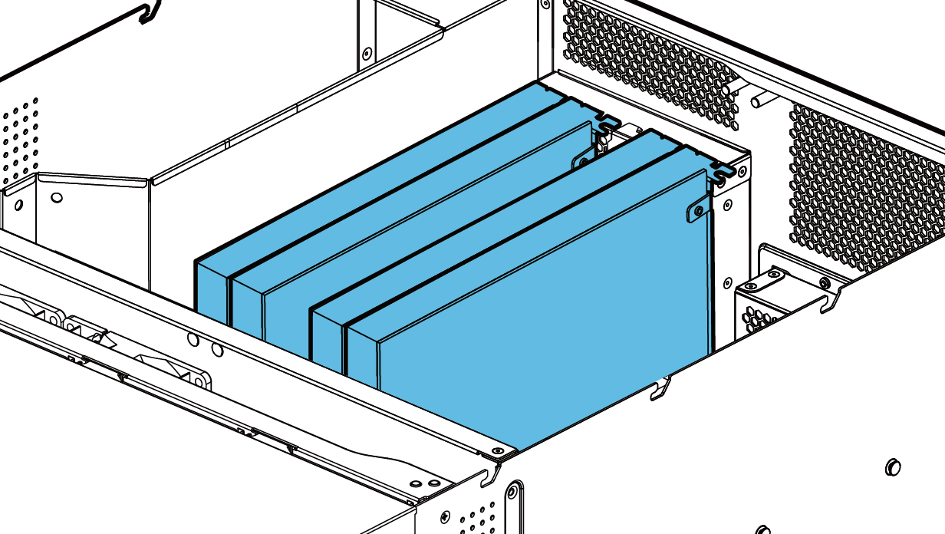
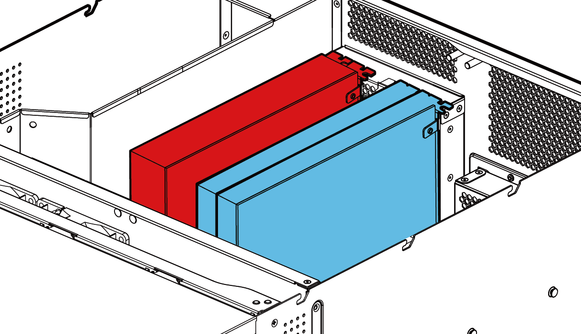
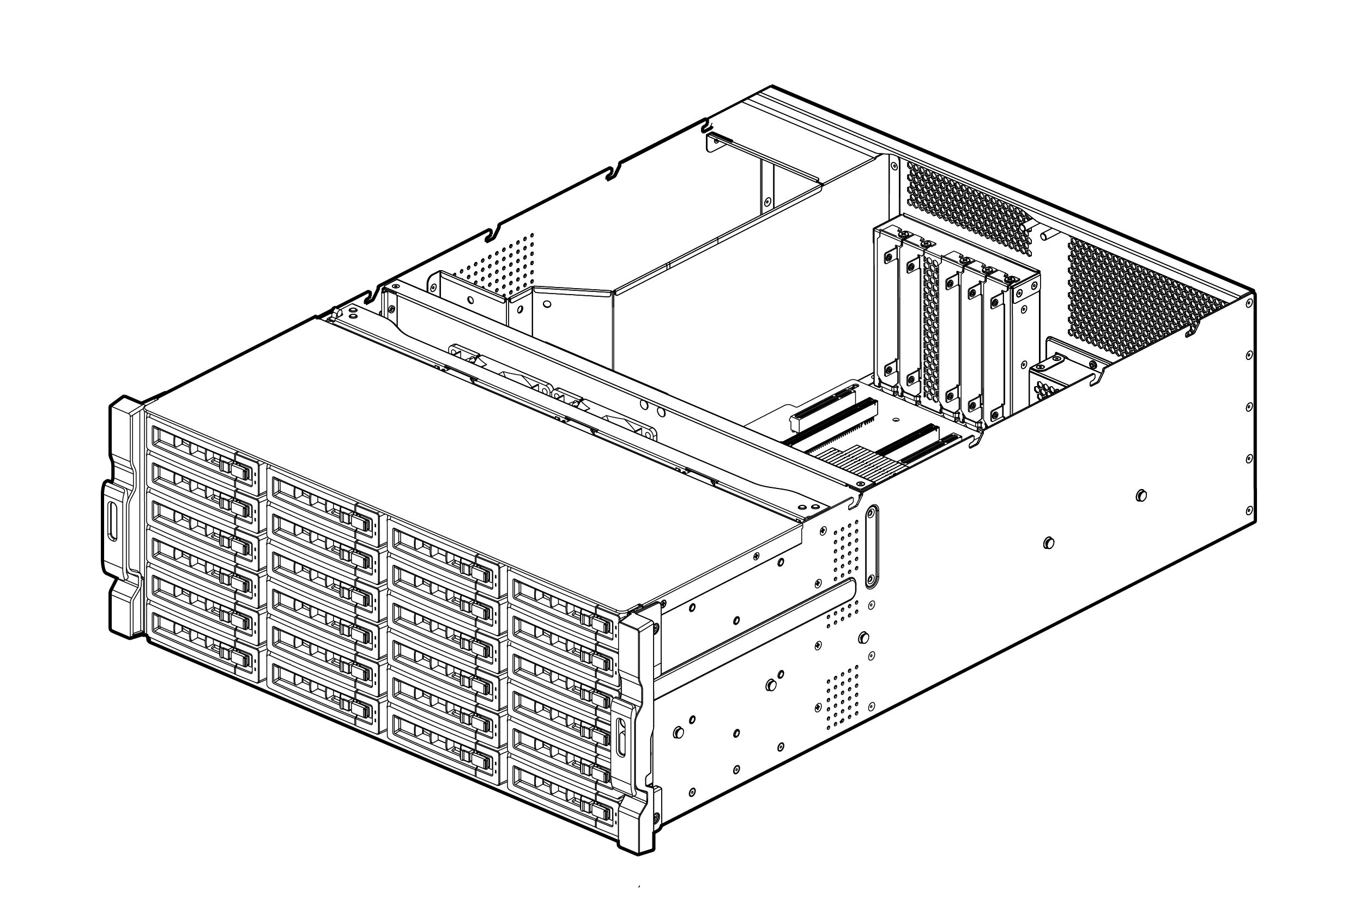
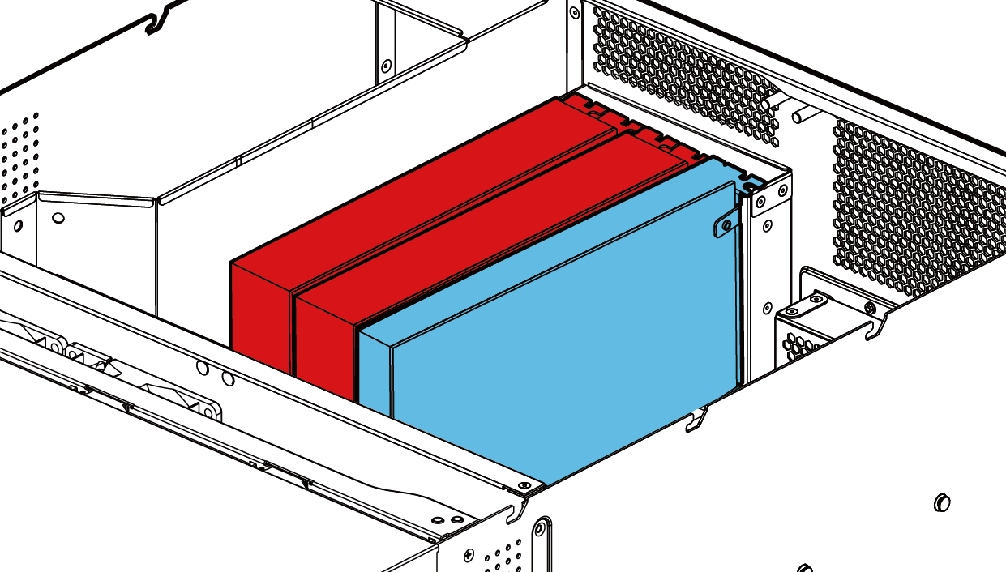

4U PCIe Card Combination
combination
A
C
B
D
Notes:
白手起家款

Slide 25


Tool-less rail kit
RAIL-B02
RAIL-A03-57
RAIL-A02-90
Supported NAS：
TS-877XU/1277XU
Max. Load：20kg
Supportd NAS：
TS-1677XU
Max. Load：37kg
Supported NAS：
TS-2477XU
Max. Load：90kg

Slide 26


Hardware upgrade made easy
Pull it out and lift
up the cover

Slide 27


More Efficient Backup with USB 3.1 Gen 2
TYPE-C
2X
USB 3.1
SPEED UP
10Gb/s
TYPE-A
5Gb/s
USB 3.0
USB 3.1 Gen 2
Notes:
Type-A是紅色的

Slide 28




Super high capacity surveillance
Surveillance Station 5.1
Default: 8 free channels
Max: 80 CH (optional license)
QVR Pro
Default: 8 free channels
Max: 128 CH (optional license)
QUSBCam2
Up to 1080p USB Webcam recording
* 在 QVR Pro 正式發行時，正式頻道授權數請參閱 QNAP 官網．

Slide 29
Demo
Memory upgrade
GPU card installation
GPU card configuration in QTS

Slide 30



10GbE SmartNIC with offload function
Buit-in Mellanox ConnectX 4Lx 10GbE SmartNIC
Supports iSER

Slide 31

Offload tasks from CPU with iSER
iSER (iSCSI Extension for RDMA)
Without iSER
Socket Layer and Network Drivers
Socket Layer and Network Drivers
Memory
Ethernet
Ethernet
Memory
With iSER
Socket Layer and Network Drivers
Socket Layer and Network Drivers
Memory
Ethernet
Ethernet
Memory

Slide 32

Comes with two 10GbE Ports
10GbE x 2 (Sequential)
1800
1200
1561
1560
600
0
Read
Write
(MB/s)
Tested in QNAP Labs. Figures may vary by environments.
Test environment:
NAS: TS-1677XU-1700-16G with QTS 4.3.4
Volume type: RAID 5; 16 x Intel S3500 240GB SSDs (SSDSC2BB240G4)

Slide 33
Demo
10GbE Performance Demo

Slide 34







Running vQTS via Virtualzation Station
Conventional VM:
Windows, Linux, UNIX
Vitual QTS - vQTS
Virtualization Station

Slide 35





One-for-many
It allows IT admins to flexibly allocate system resources to different departments or groups for different privileges and applications.
Management
Finance
Customer
service
Engineers

Slide 36





Dedicated resource allocation
Allocation of dedicated HW resources (CPU, RAM, storage space, and Internet) ensures performance quality.
Quad-core
4 GB
250 GB
1
Octa-core
8 GB
500 GB
2

Slide 37



The best platform for vQTS
Number of allowed vQTS instances is based on the number of cores of the physical CPU.
AMD Ryzen™ 5 1600 6-core =
2
4
AMD Ryzen™ 7 1700 8-core =

Slide 38



QTS & virtualization increase productivity
QTS 4.3.4
Storage & Snapshot Manager, and multimedia management
Supports Windows/Linux VMs and containers
Virtualization Station
Container Station

Slide 39




Do more with graphics cards
3U/4U NAS: 500W+ power supply
support full-high GPU card which required external power
QuAI
TS-1677XU-RP
support helf-high GPU card and required no external power，e.g.: NVIDIA GT1030
2U NAS: 250W/300W power supply

Slide 40


Add-on GPU Card Applications
AI
Compute Acceleration
QTS/vQTS
Transcod Acceleration
Virtualization Station
GPU Passthrough

Slide 41









Ride the AI wave with “QuAI”
QNAP QuAI
>> AI Developer Package
Is intended for data scientists and developers to quickly build, train, and optimize their AI Models on QNAP NAS.
+
+
=
AI
QNAP NAS
GPU accelerated computing
QuAI

Slide 42



Smooth Video Experience
Virtualization Station
HybridDesk Station, Linux Station
QVR Pro Client (HD Station)
Video Station
Plex Media Server

Slide 43





GPU upgrades image/video processing
For OpenGL & DirectX applications
H/W accelerated with GPU to lower CPU usage.
w/ GPU
w/o GPU
Tested at QNAP Lab. Results vary by actual environments.
NAS：TS-1677X Ryzen 1700
QTS 4.3.4, Seagate ST4000VN0001
nVIDIA GeForce GTX 1060 6GB

Slide 44


Product Launch Schedule
June, 2018
TS-1677XU/TS-1677XU-RP
TS-1277XU/TS-1277XU-RP
TS-877XU/TS-877XU-RP
Q3, 2018
TS-2477XU-RP
TS-977XU/TS-977XU-RP

Slide 45
TS-x77XU
Ryzen Enterprise NAS
Your Best Choice
Copyright © 2018 QNAP Systems, Inc. All rights reserved. QNAP® and other names of QNAP Pr oducts are proprietary marks or registered trademarks of QNAP Systems, Inc. Other products and company names mentioned herein are trademarks of their respective holders.

