Slide 1


Slide 2
Qphoto Instant Upload
With burst mode and time-lapse mode
Truely boosts your power of photography

Slide 3

“Gotta snap!”

Slide 4



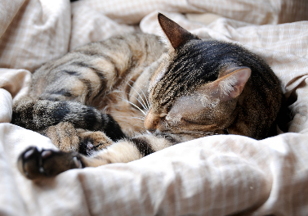
Moments
that you can’t recreate
Notes:
生活中有許多無法預期、想記錄下來的珍貴時刻
圖片編號 : 73565714

Slide 5
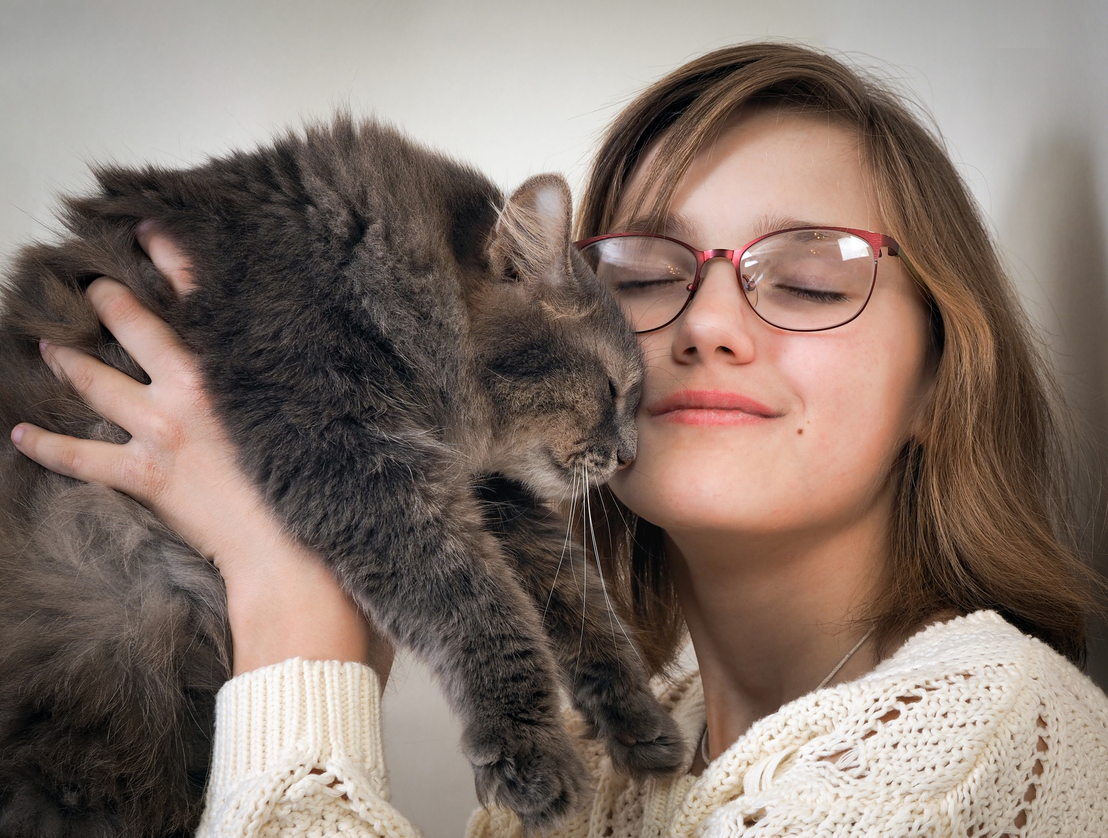


Your cat being affectionate
A friend telling a funny joke
Every first-time of your baby
Notes:
圖片編號 : 59039374

Slide 6
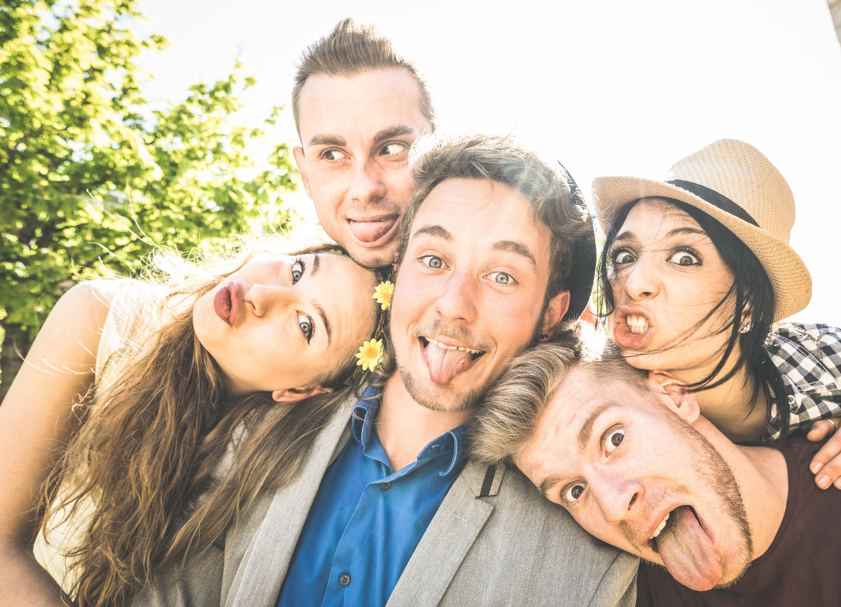



Memories
that you can’t afford losing
Notes:
圖片編號 : 32817412、圖片編號 : 31054367

Slide 7



The concert of your favorite band
The most difficult subject of all time
That dreamy trip
Notes:
自身的使用情境

Slide 8

But first, STORAGE!

Slide 9







Slide 10


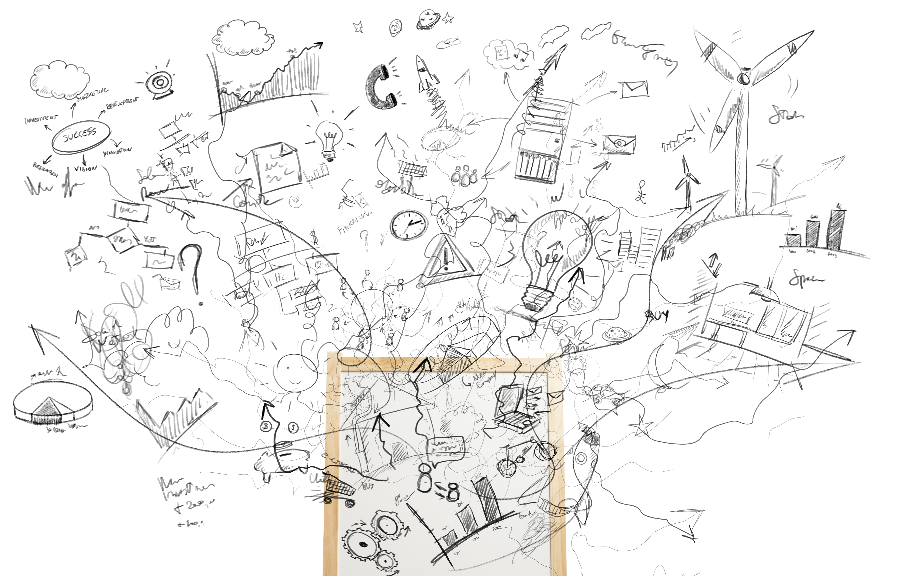
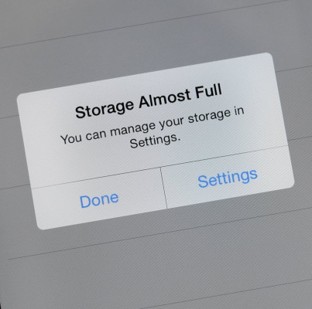
“Get Google Photos and get rid of storage limitations?”

Slide 11






How people struggle with storage limits
step by step…
Take pics
camera app
Save to local
album app
Upload to Cloud
Google Photos
Clear local device
Album/ Google Photos

Slide 12

What smart people would do
One click does it all
take pic
Brand New Qphoto + Photo Station
With time-lapse and burst function,
capture every precious moment
free your local memory
upload
Notes:
Qphoto能一步做到所有事情

Slide 13





Save your files directly to NAS
Just a single app needed, no local storage clean-up
16 GB local storage
Through Wifi/ 4G
16 GB mobile storage + 2 TB NAS
* Minimal local storage: Android 150MB, iOS 300MB
Notes:
圖片編號 : 39298990

Slide 14
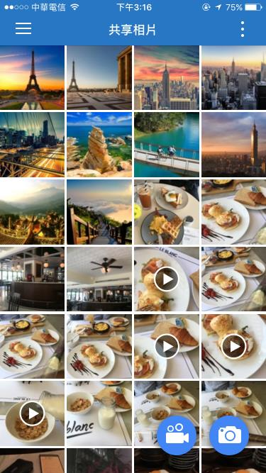
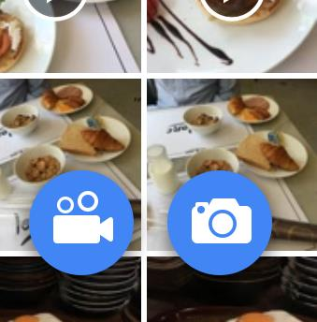


Inside Qphoto
Click the Instant Upload buttons
( iOS 3.5 / Android 3.3 )

Slide 15

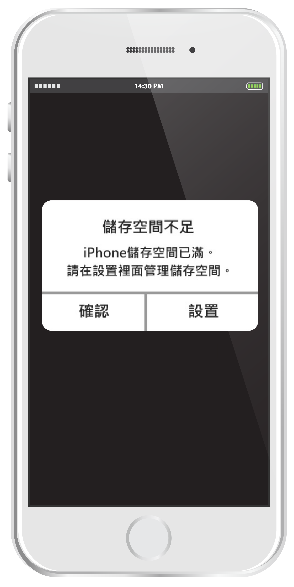




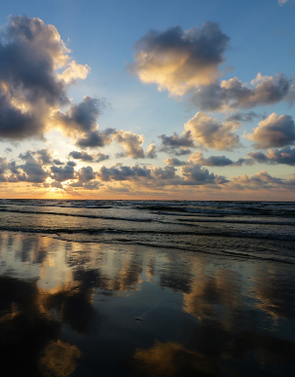

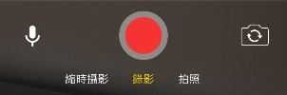
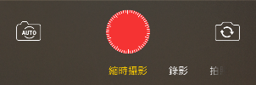

Video
Time-lapse
Photo and Bursts

Slide 16
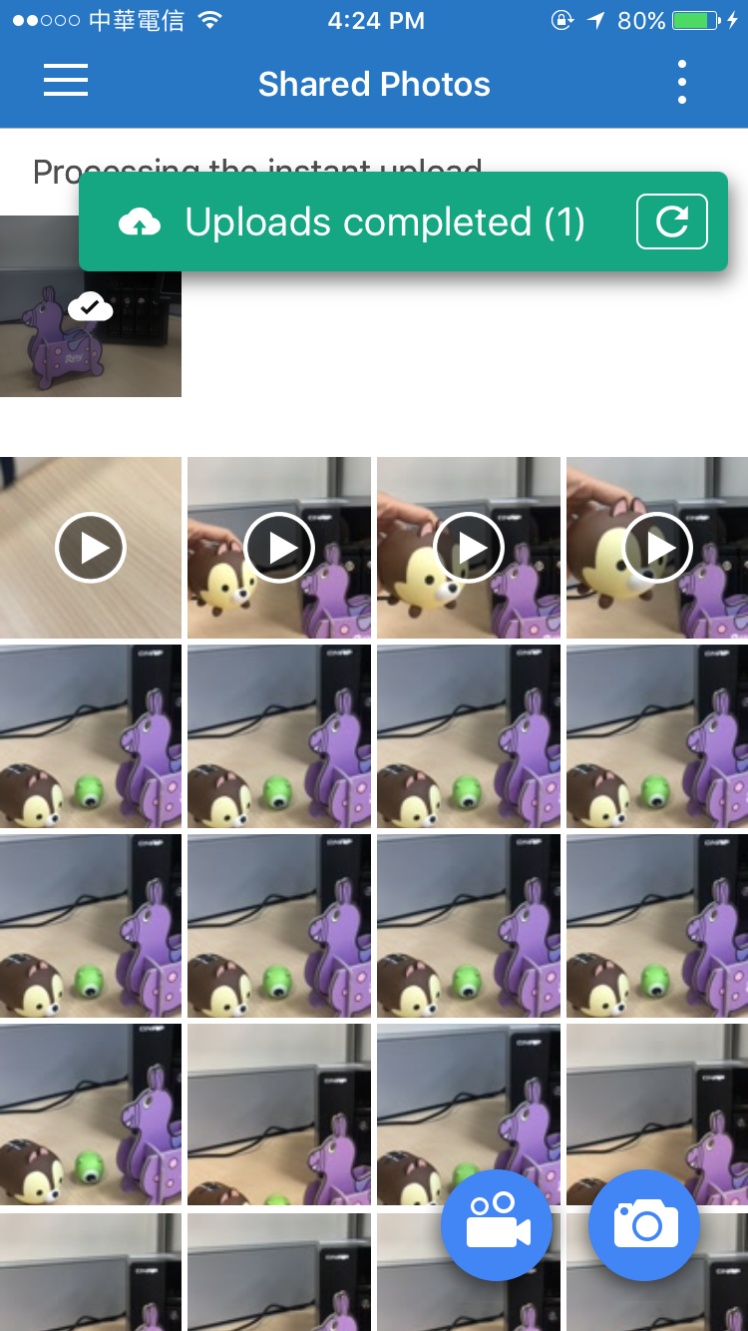
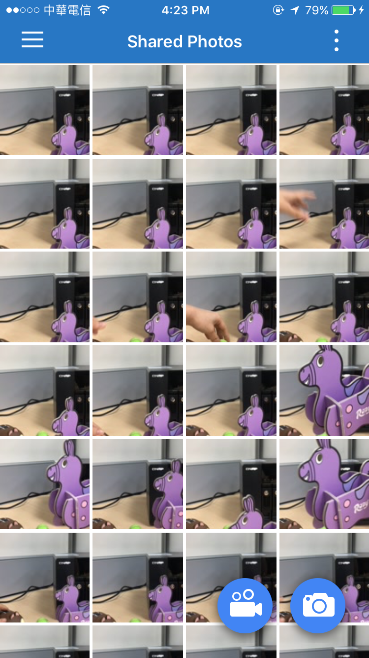
View contents
All photos and videos
are available in Shared Photos

Slide 17
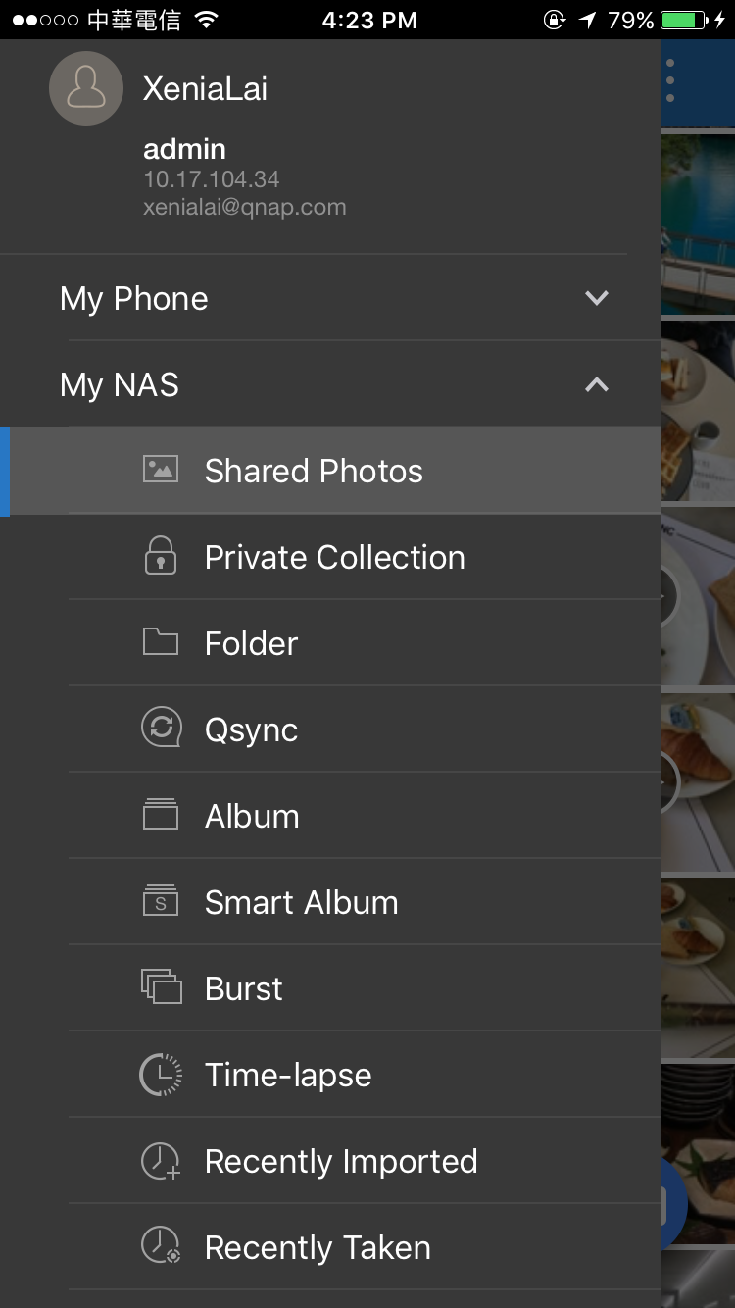
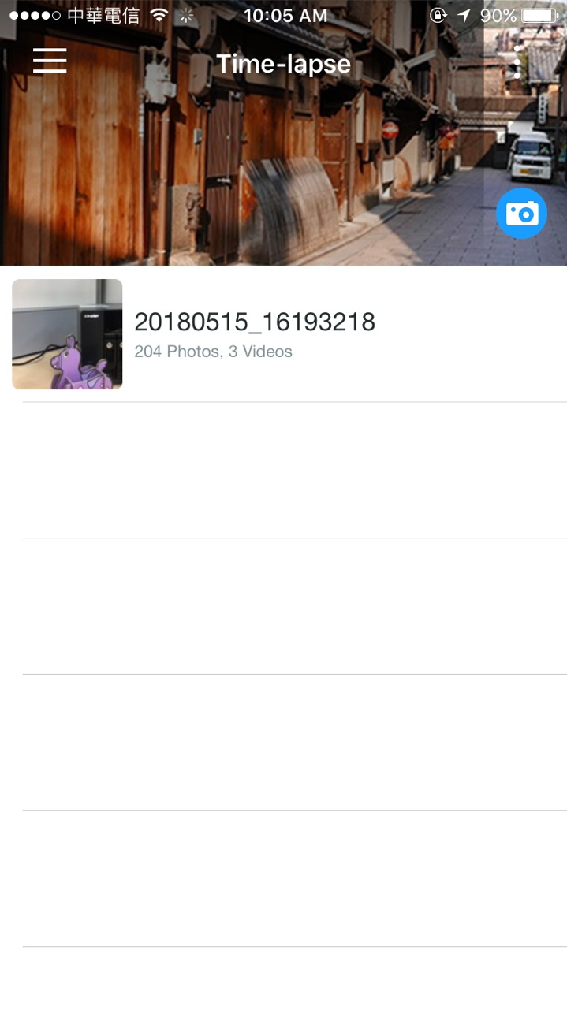
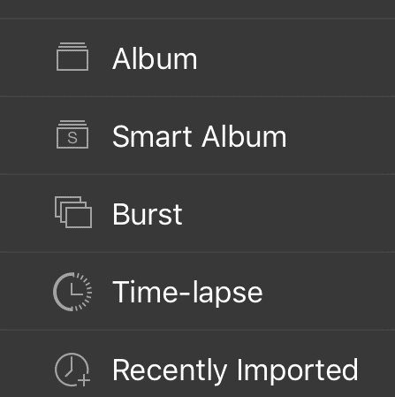
View contents
Bursts
And
Time-Lapse videos
Each has own isolated category

Slide 18
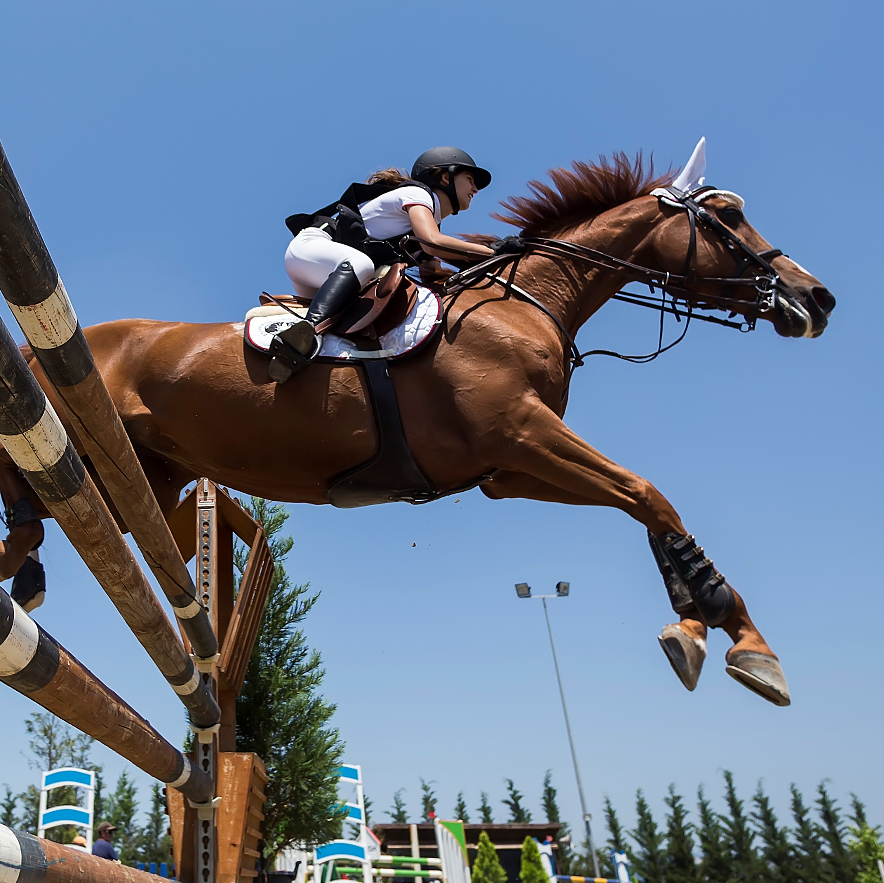


Have fun with burst mode
Athletes’ movement
Jumping
One of a million

Slide 19

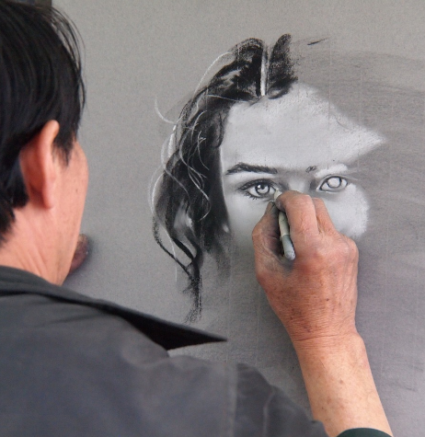

Have fun with time-lapse video
Scenery transformation
Process of creation
Botanic growth documentary
Notes:
自身的使用情境

Slide 20


Qphoto Instant Upload
Boost your time-lapse power
long term time-lapse
save as burst photos
recreate time-lapse video

Slide 21
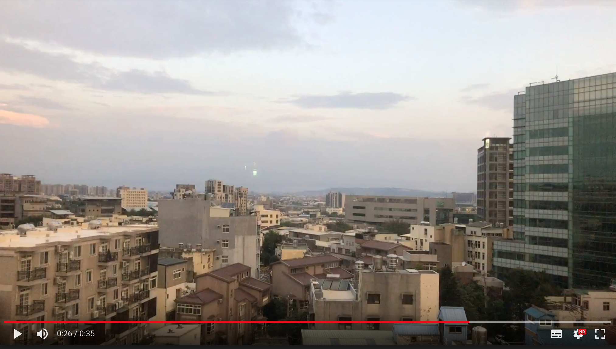
Long term time-lapse
Location: QNAP Inc. Hsinchu Office
Time: 2018/4/26 2:00-9:00
Interval: 128 sec

Slide 22
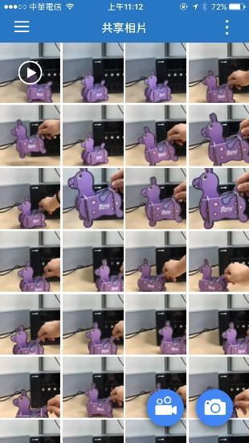

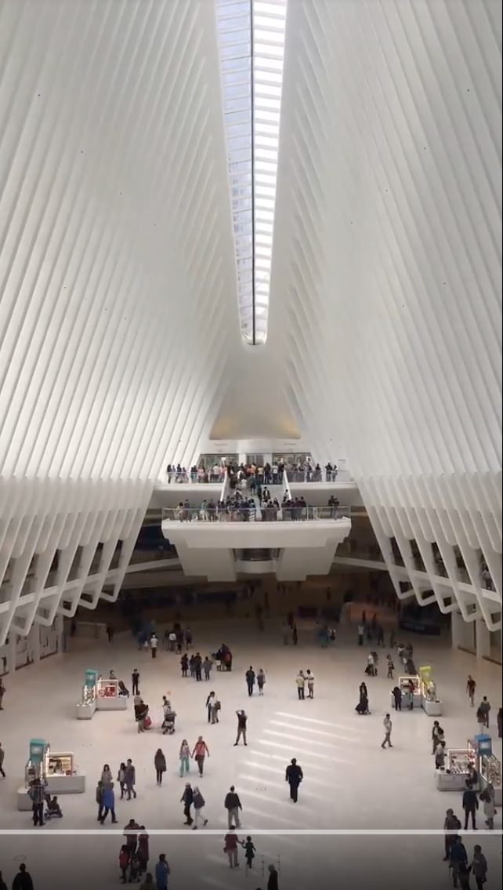



Save as burst photos
Time-lapse video
Lively and fun
Save as burst photo
Flexible and free

Slide 23
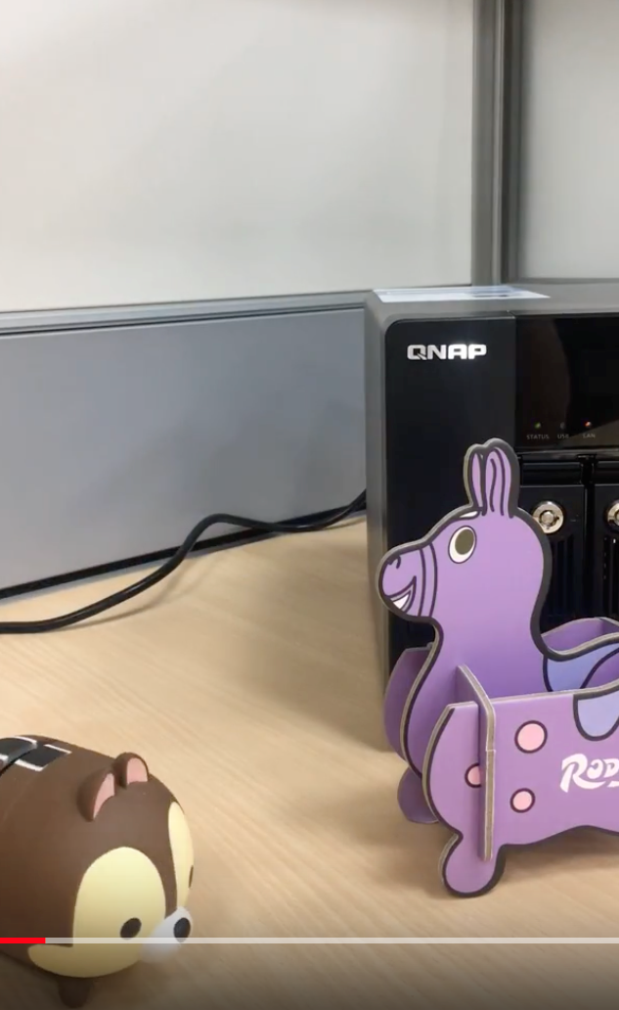
Recreate time-lapse video
Original
Interval: 1 sec
Recreated
Interval：4 sec

Slide 24
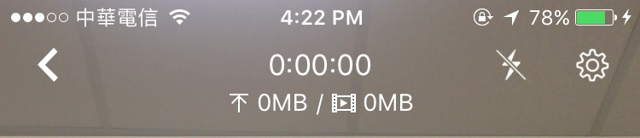
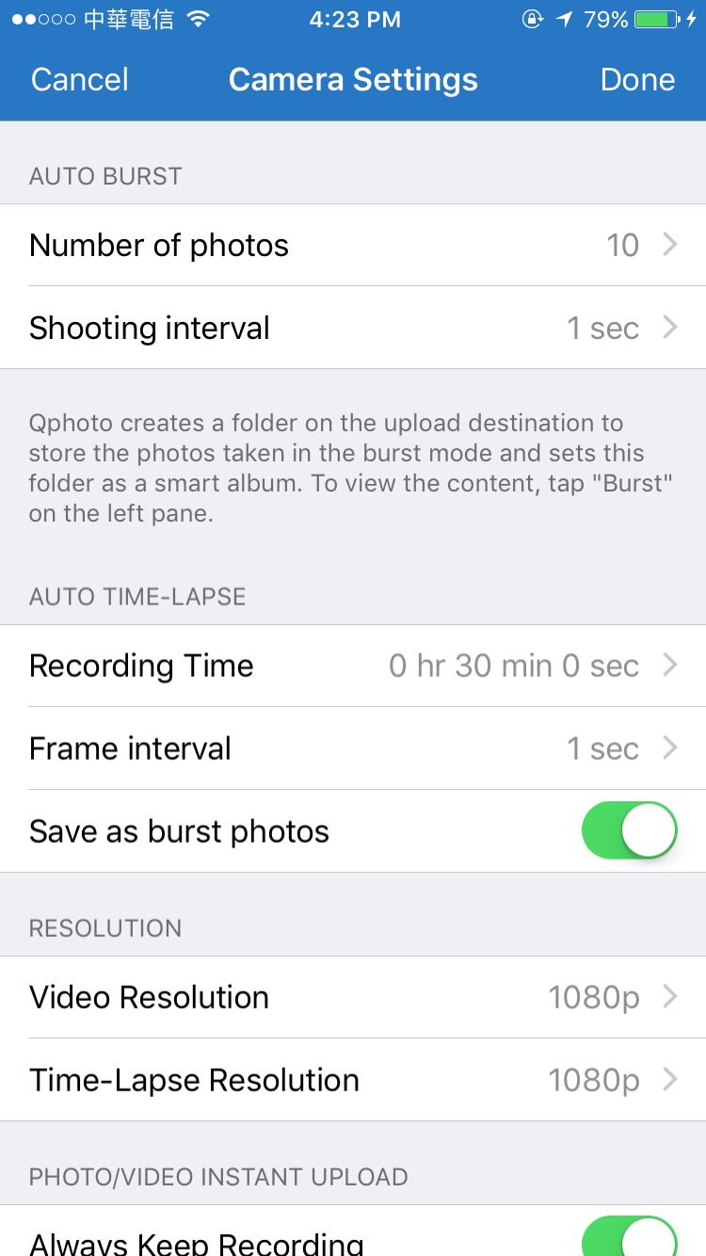


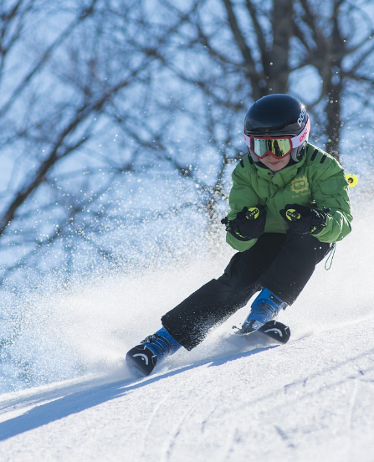




縮時攝影
時間長度 畫格間隔 另存照片
Camera settings
①
Auto burst
number of photos, shooting interval
①
②
Auto time-lapse
recording time, frame interval,
save as burst photos
②
③
Resolution
Video, Time-lapse
③
Notes:
敘述連到截圖

Slide 25
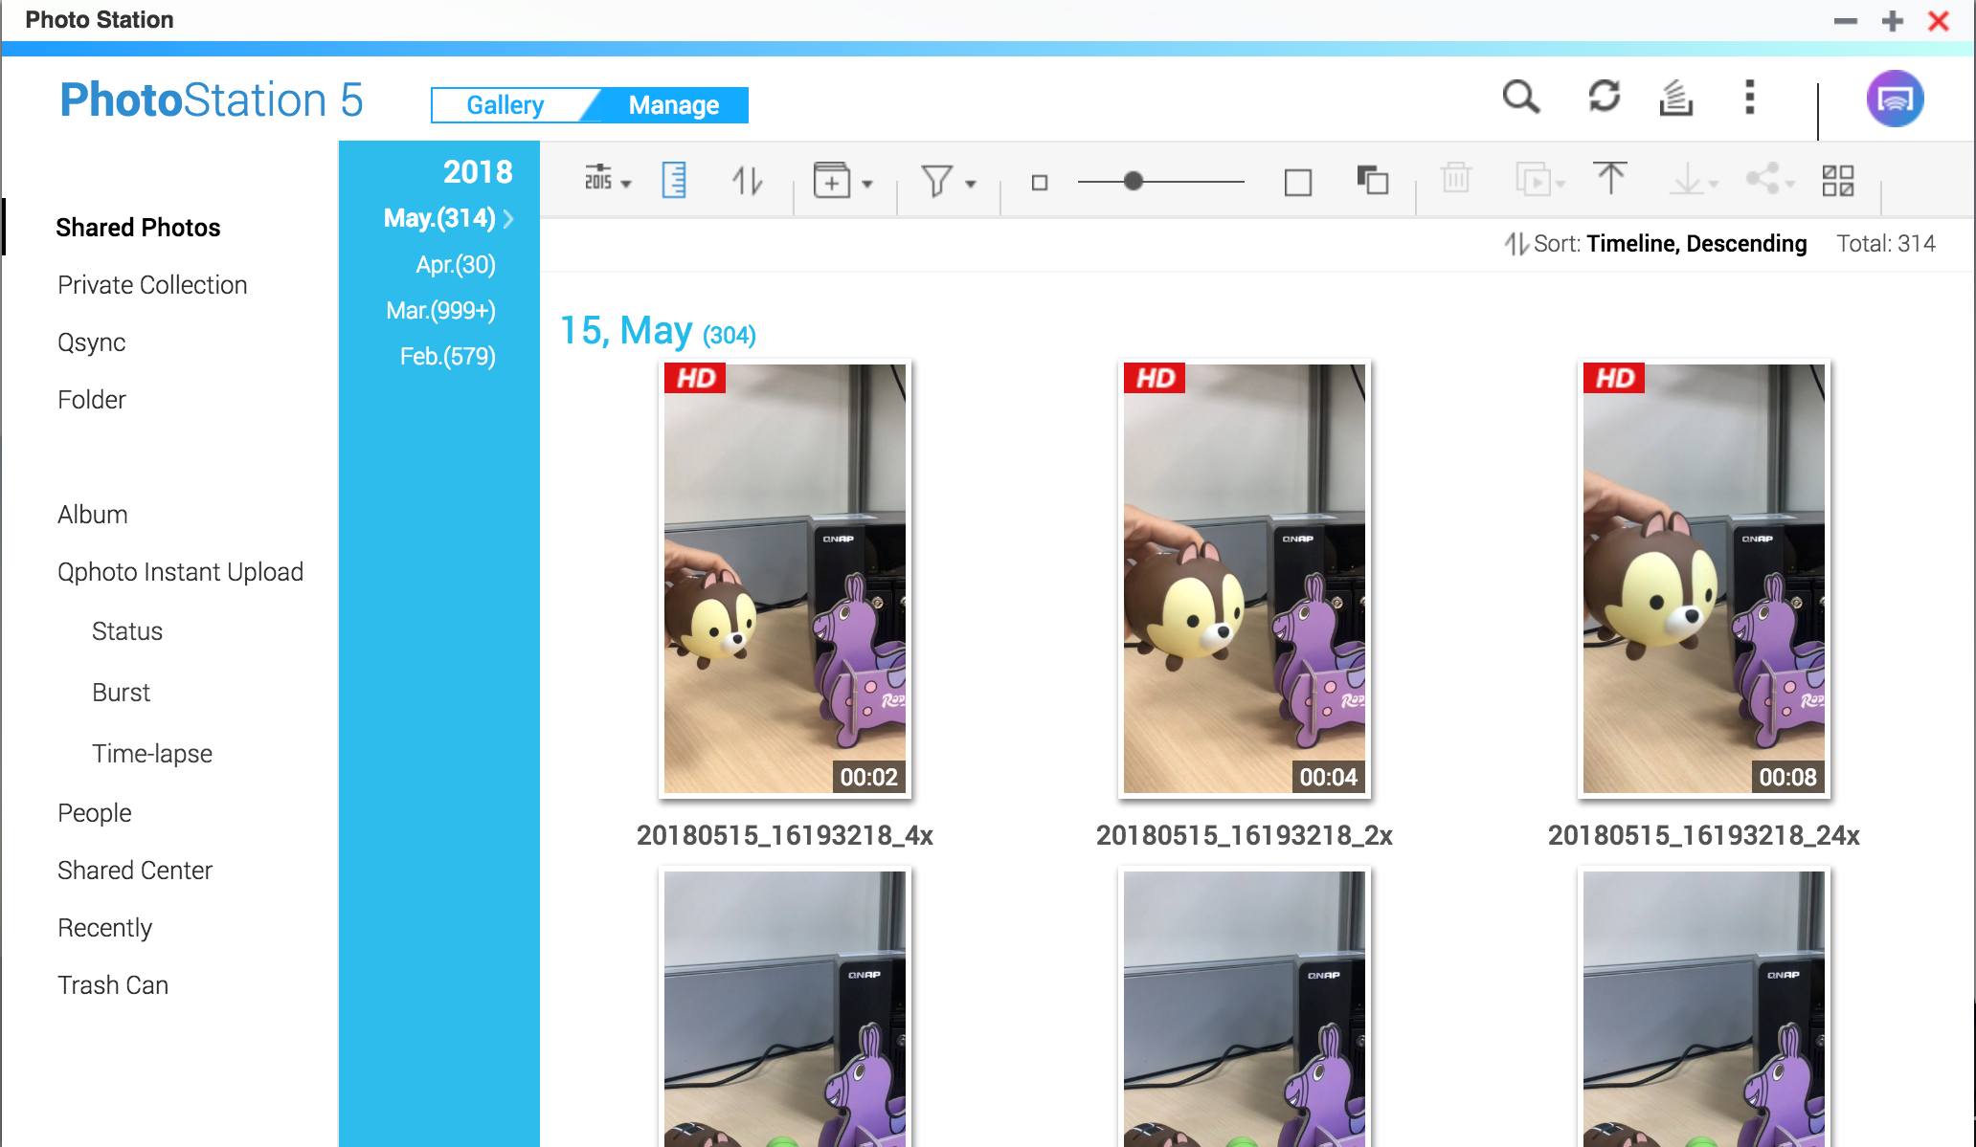
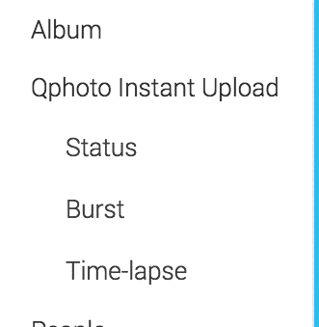
Photo Station 5.7
Status check
View burst photos and time-lapse videos
Recreate Time-lapse video
Complete your Qphoto Instant Upload Experience
Notes:
濾鏡不透明（讓字明顯）

Slide 26
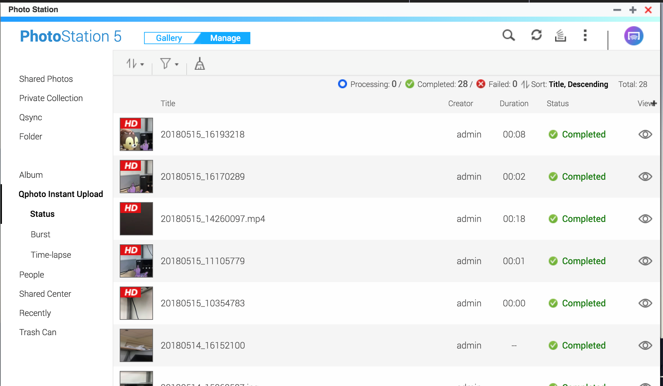


Everything at a glance
status shown as
“ ”
when recording
Notes:
狀態追蹤：確認拍攝狀況（e.g.放在公司拍縮時）、上傳進度、直接檢視
放標題做重點

Slide 27
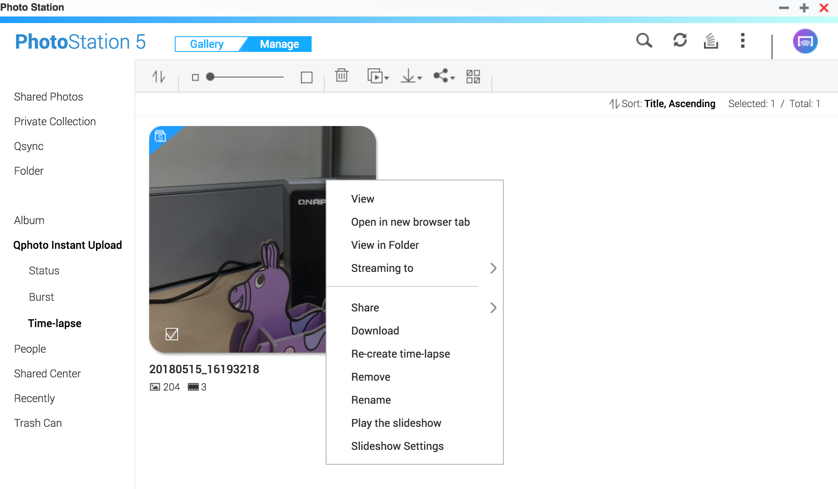
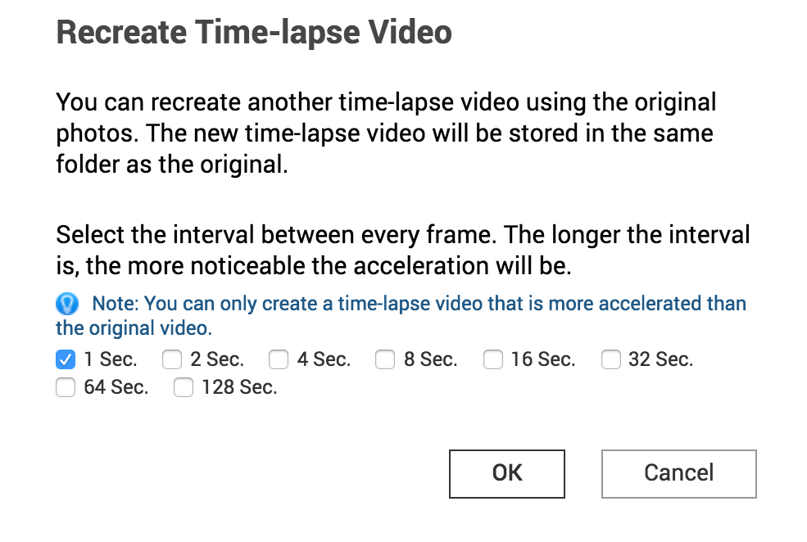
Easy-peasy to recreate
!Notice!
Burst photo amount should remain the same as original
Notes:
（加文字提醒：一張都不能少）、解釋畫格

Slide 28

(sec)
1
2
3
4
5
6
7
8
9
10
Original interval: 1-second
1
2
3
4
5
6
7
8
9
10
(total frame number: 10)
Recreate time-lapse video with 2-sencond interval
1
2
3
4
5
(total frame number: 5)
Longer interval = more noticable acceleration

Slide 29

Sync photos from Google Photos to your NAS

Slide 30
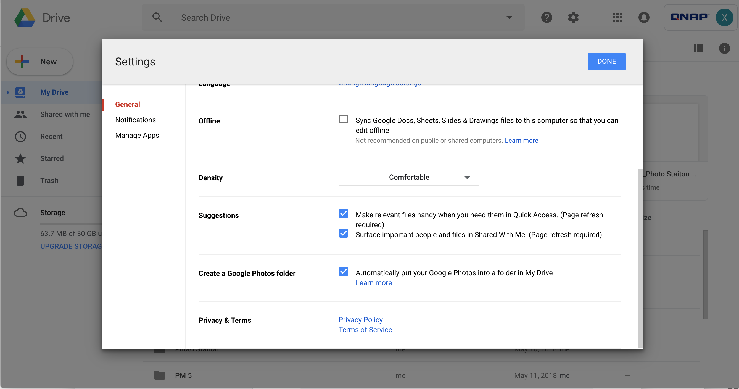
①
Go to Google Drive settings
②
Enable Google to automatically put Google Photos into a folder in My Drive

Slide 31
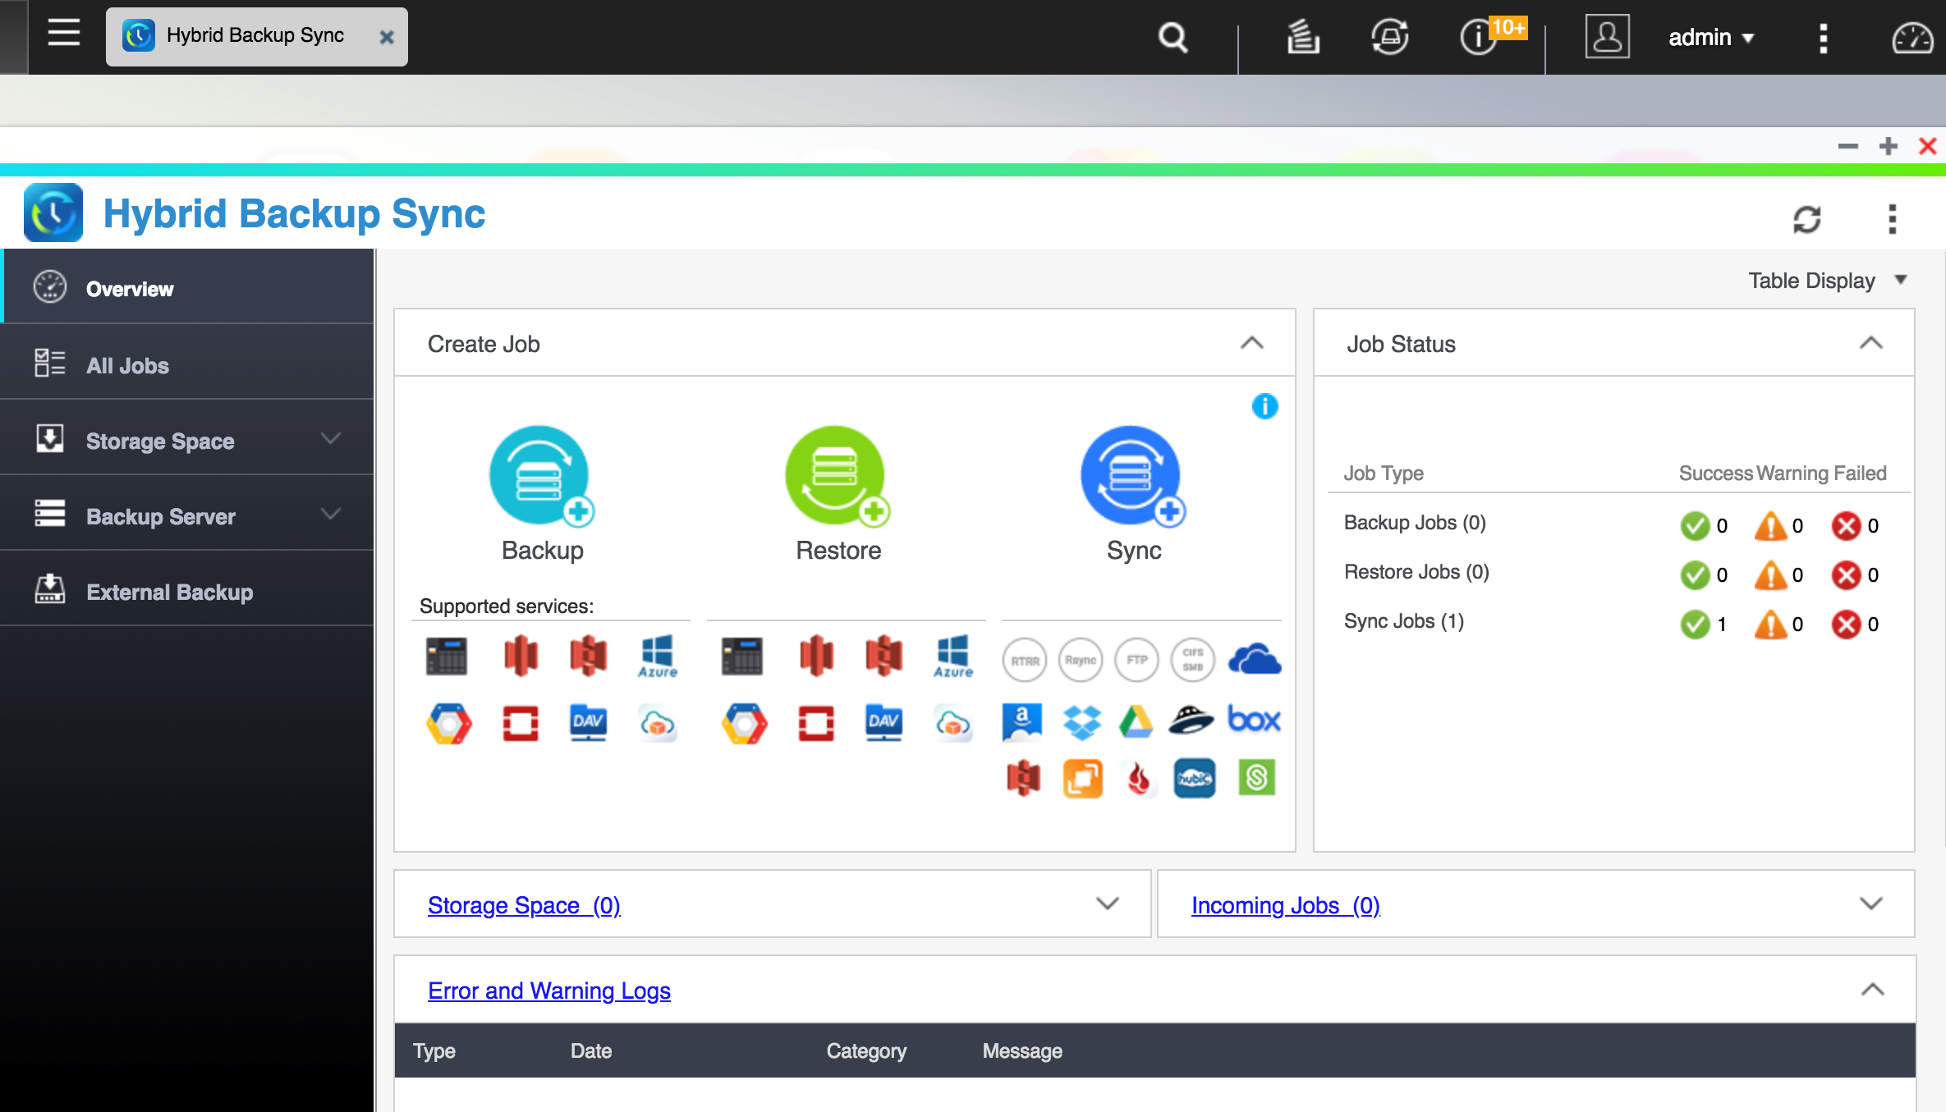

③
Go to Hybrid Backup Sync in QTS
④
Select “Sync”

Slide 32
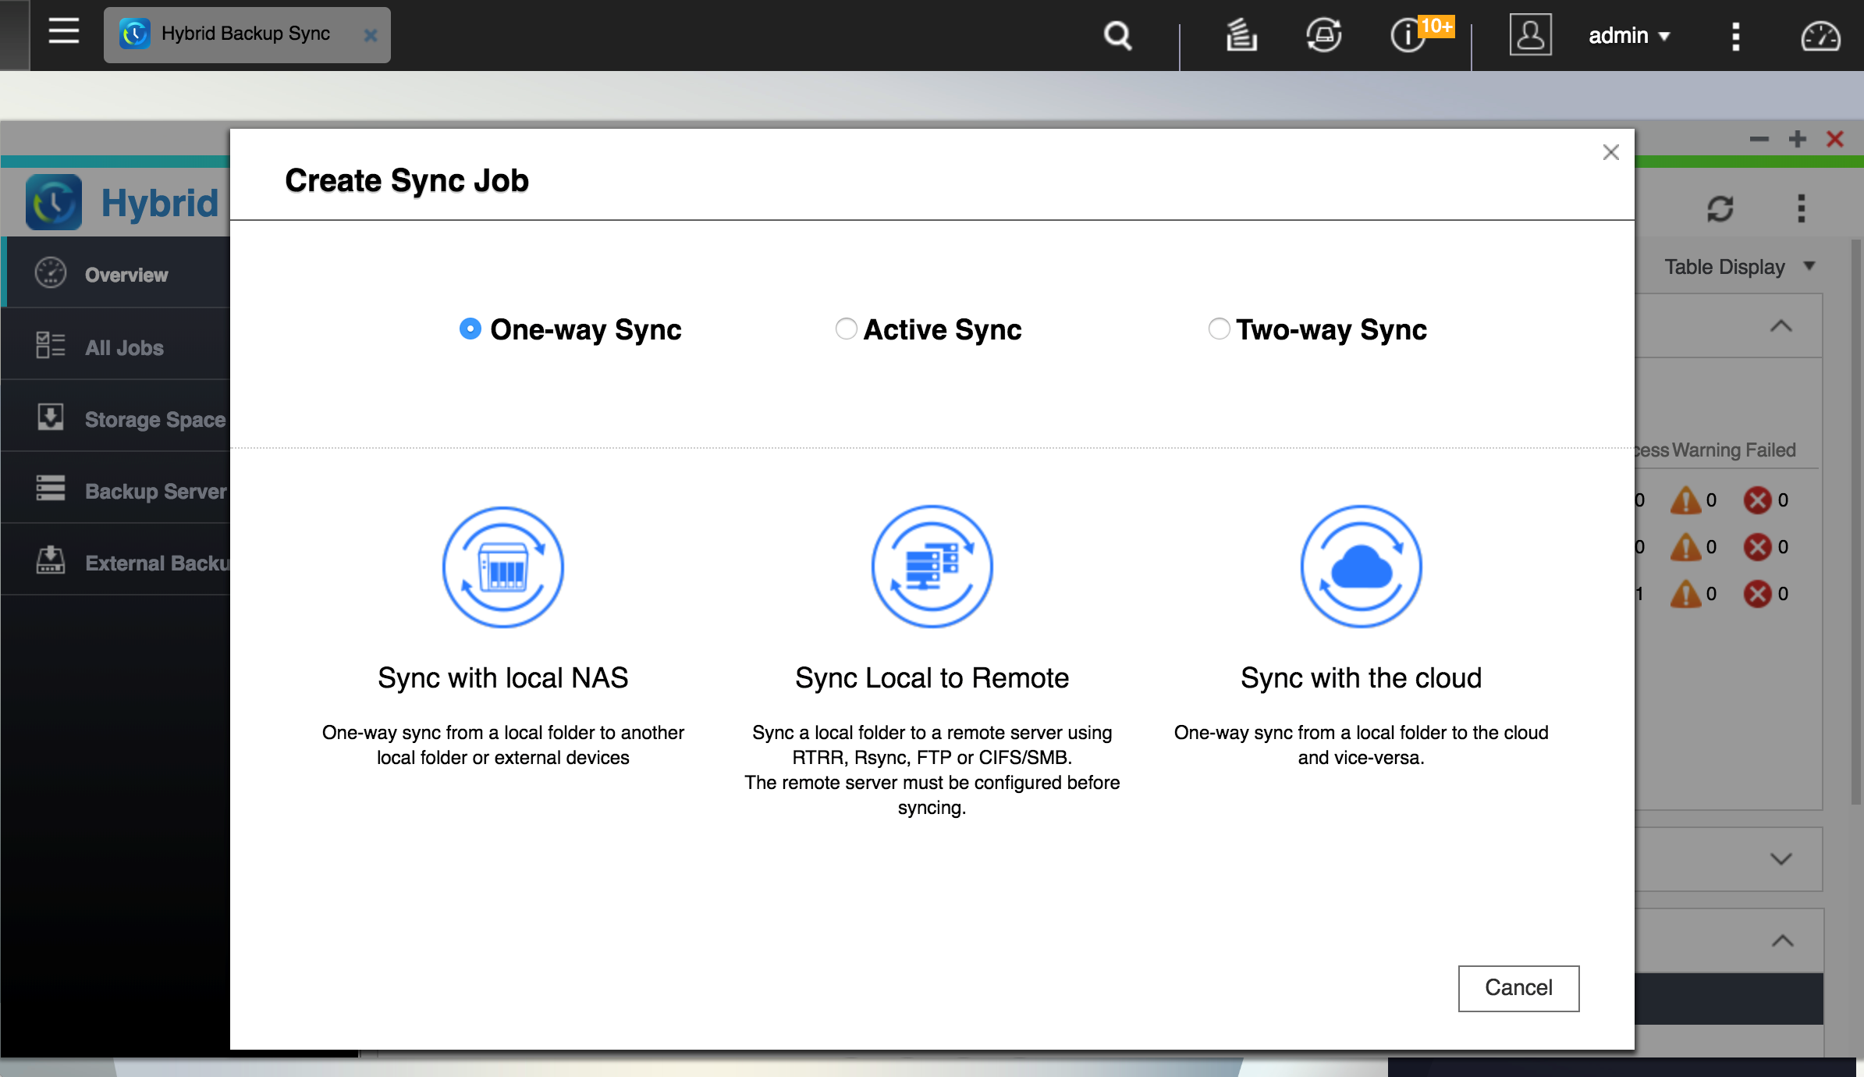

⑤
One-way sync > Sync with the cloud > Cloud to local sync > “Google Cloud”
Notes:
建立同步工作加一頁

Slide 33
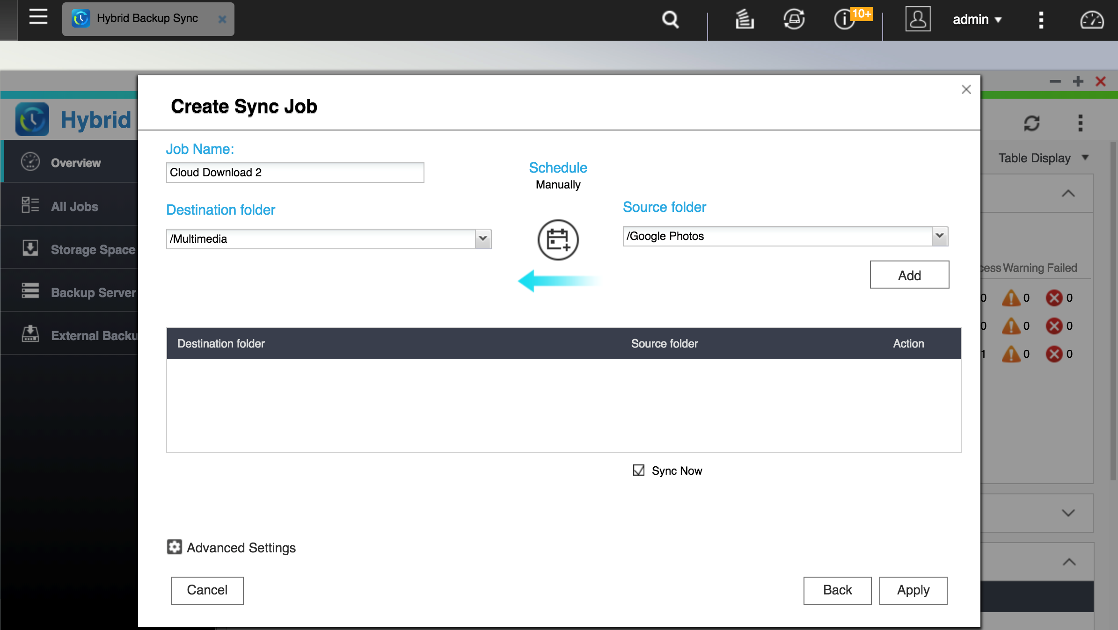
⑥
Set “Google Photos” as source folder and Multimedia as Destination folder

Slide 34
Qphoto Instant Upload
Record every of your precious moments
Photo Station 5.7
To manage and to edit with ease
Your best mobile photography management solution
* Qphoto iOS 3.5/ Android 3.3 (Coming soon)/ QTS 4.3.4

Slide 35
Qphoto, your best choice!
Copyright © 2018 QNAP Systems, Inc. All rights reserved. QNAP® and other names of QNAP Products are proprietary marks or registered trademarks of QNAP Systems, Inc. Other products and company names mentioned herein are trademarks of their respective holders.

