Slide 1


Slide 2

The Mobile NAS
QNAP Mobile apps family

Slide 3

Access your data from anywhere
Notes:
[OK]
戶外、家中、辦公室，您總是希望在任何地方都能夠自在地運用所有的資料

Slide 4
















QNAP Mobile Apps
File & System Management
Multimedia
Productivity Tools
Qfile
File Management
Qphoto
Photo Management
DJ2 Client
Private LIVE Streaming
QmailClient
Mail Management
Qsync
File Sync
Qvideo
Video Library
Photo Tagger
Instantly tag photos
Qcontactz
Contacts
Qsirch
Smart Search
Qmusic
Streaming & Playback
Qremote
HD Station Controller
Qnotes3
Sync Notes
Qmanager
System Montor
Ocean KTV Client
Mobile Karaoke
Qget
Download Task Management
QVR Pro Client
Surveillance Monitor

Slide 5
Stay connected with your NAS

Slide 6

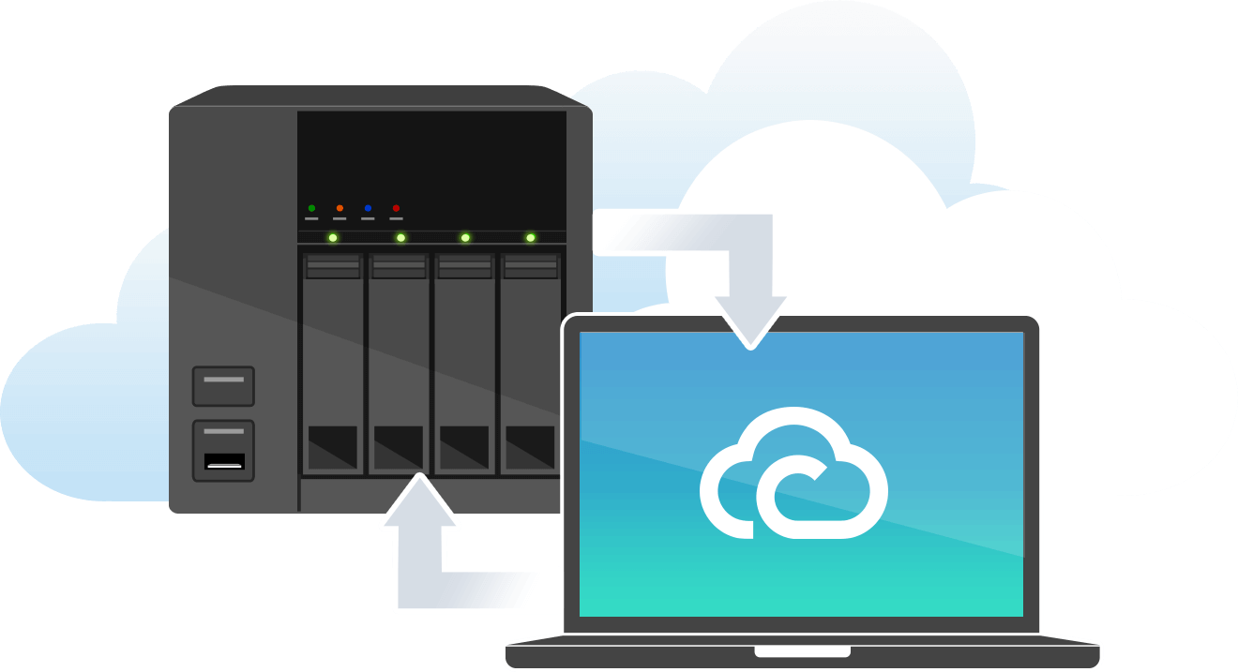
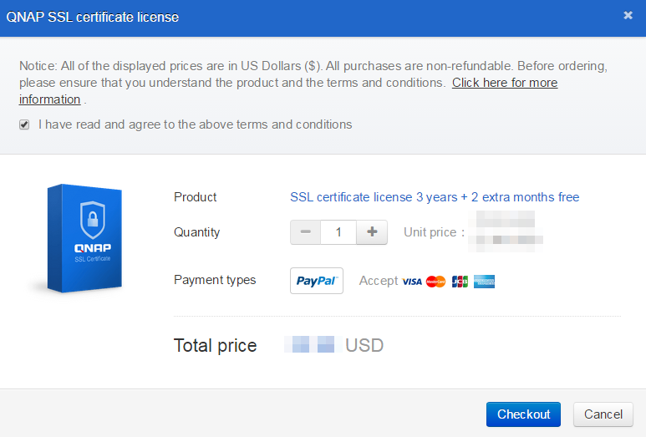
myQNAPcloud & QNAP ID
Remote Connection
Purchase Certificate
Receive Notifications
Supports login with both Email and phone number!

Slide 7






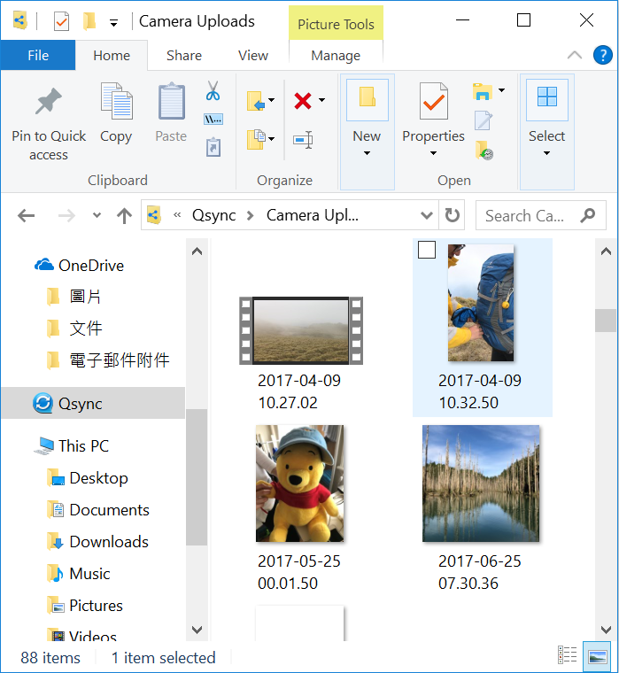


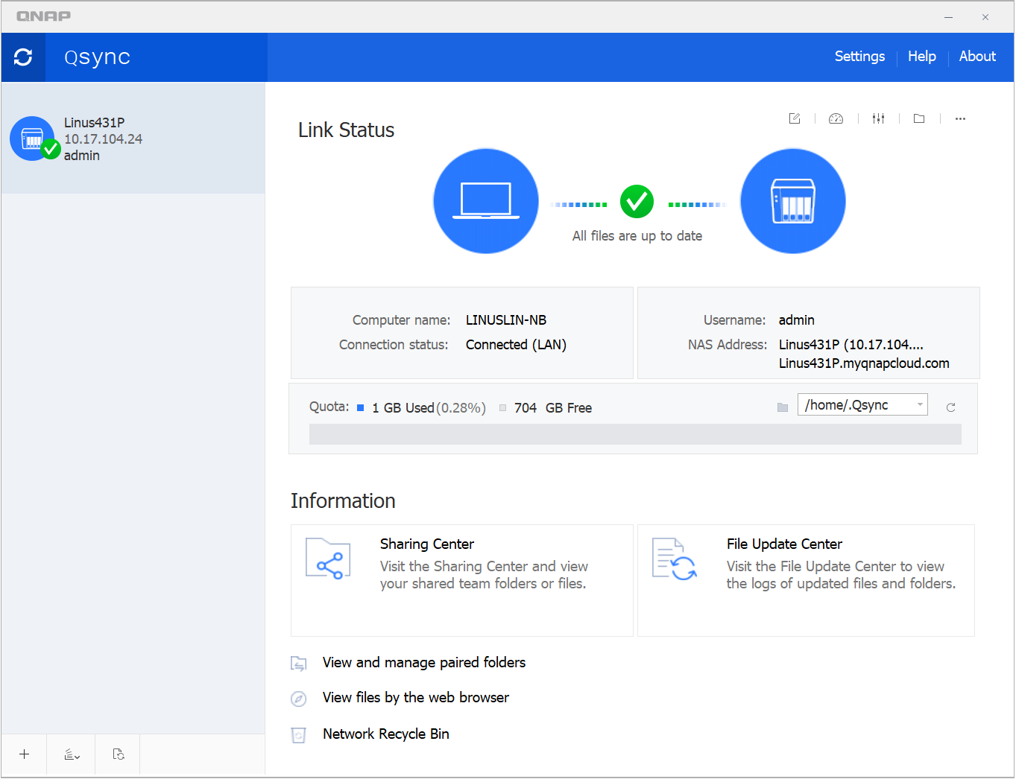




Data in hand, anytime, anywhere
Browser
PC Utility
Mobile App
...more

Slide 8
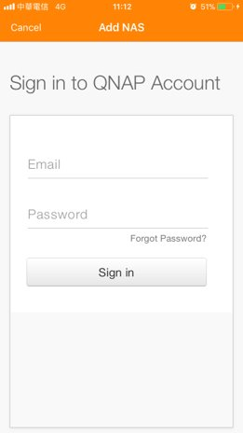
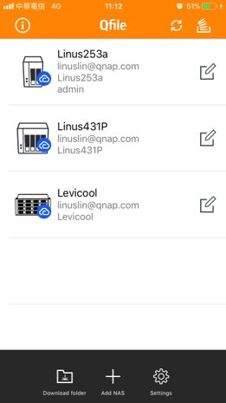
Mobile Connection - 1
Import all NAS info at once
Connected!!!
Click "Add NAS"
Sign in with QNAP ID
Imported successfully!
Notes:
[OK]

Slide 9
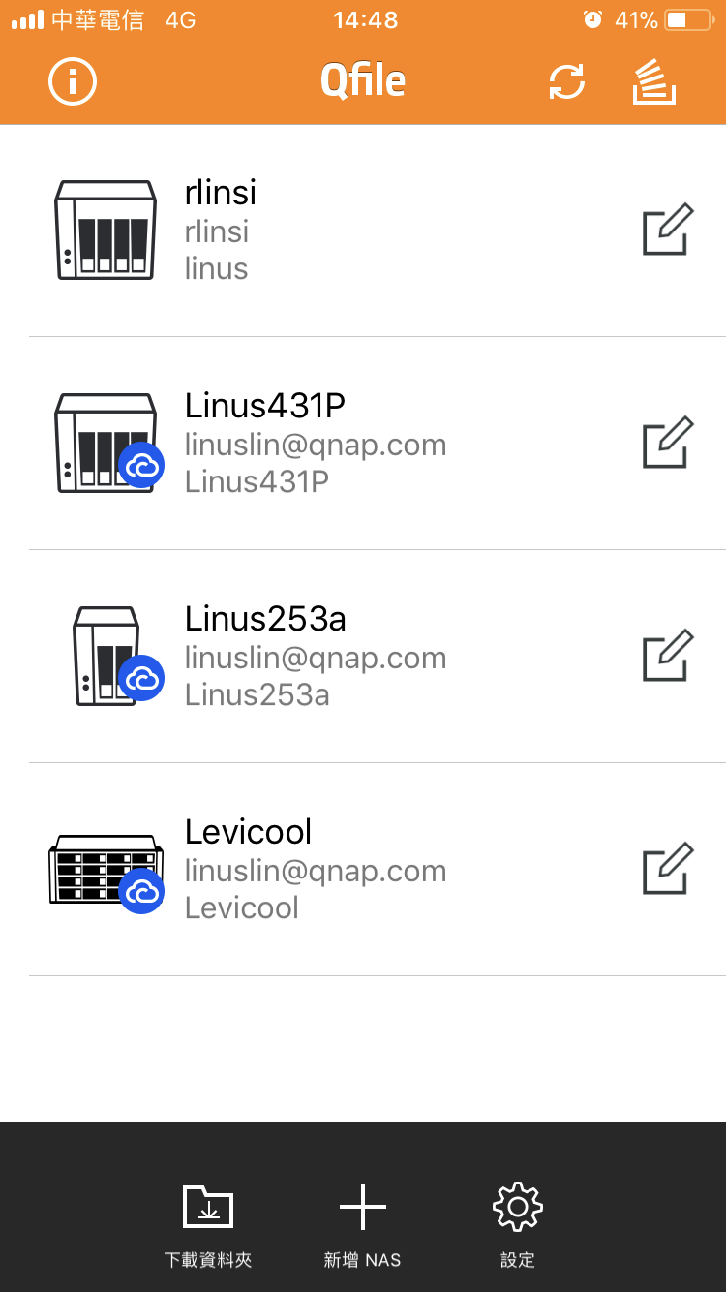
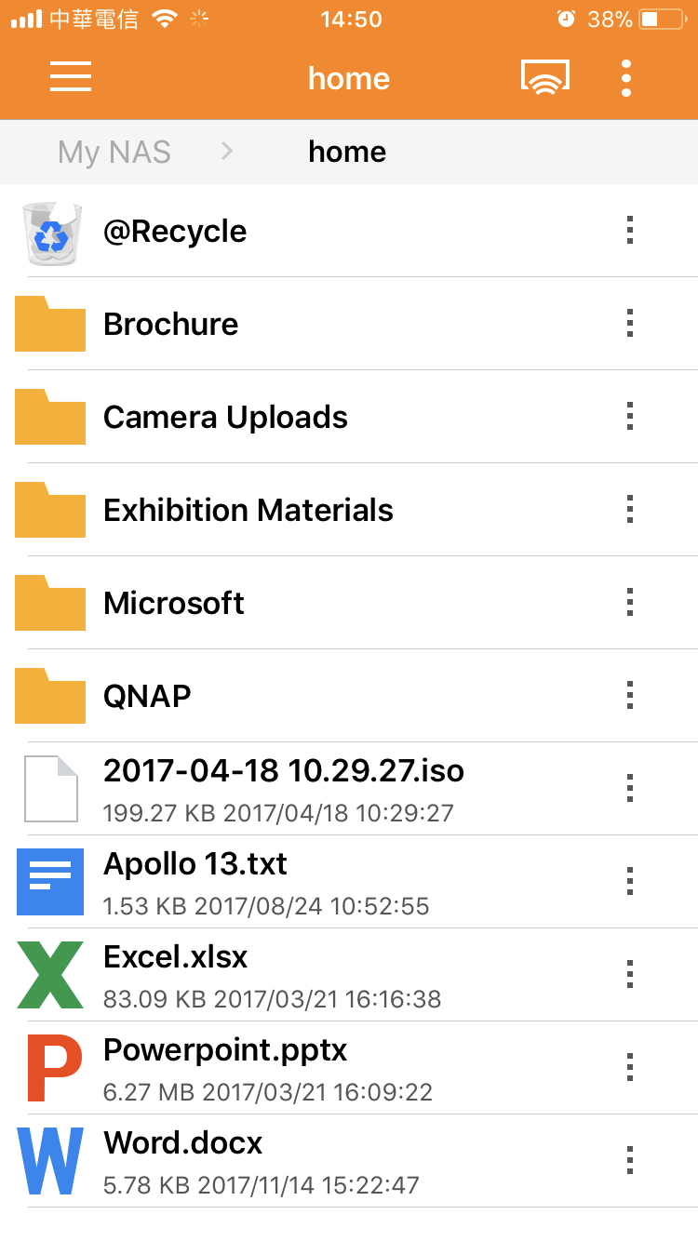
Mobile Connection - 2
Import all NAS info at once
Connected!!!
Automatically uses the best connection method
Notes:
[OK]

Slide 10
File & System Management

Slide 11

Qfile
All files in your pocket
All files in one app
Auto Upload
Instantly share files & links
Notes:
[OK]

Slide 12

Qmanager
System Manager
Monitor system status
Manage NAS service
Power off or restart NAS
Notes:
[OK]

Slide 13

Qsync
Sync across devices
File Synchronization
Online/Offline File
Instantly share files & links
Notes:
[OK]

Slide 14

Qsirch
Powerful Search Engine
Full Content Search
40+ Smart Filters
Offline search for Qfile, Qphoto, Qmusic and Qvideo
Notes:
[OK]

Slide 15
Multimedia

Slide 16

Qphoto
Browse & Share photos
Browse Photos & Albums
Share your best moments
Instant Upload + Time Lapse
Notes:
[OK]

Slide 17
Qvideo
Enjoys videos on demand
360 degree panoramic video playback
IMDB, posters, series information
Notes:
[OK]

Slide 18

Qmusic
Music streaming on demand
Spotlight recommended playlist
Sleep mode
Notes:
[OK]

Slide 19
Photo Tagger
Tag your photos
Tag photos
Works without NAS
Notes:
[OK]

Slide 20
Ocean KTV Client
Mobile Karaoke
Easy playback
Karaoke bar on demand
Record personal clip
Notes:
[OK]

Slide 21
DJ2 Client
Private live streaming
Start live streaming
Play previous broadcasts
Share with Google Accounts
Notes:
[OK]

Slide 22

Qget
Download Task Manager
Download files on the go
Backup videos from video sharing sites
Notes:
[OK]

Slide 23

Qremote
Handy Remote Controller
HD Station remote control
Multimedia playback
Perform as remote keyboard, supporting multi-language input.
Notes:
[OK]

Slide 24
Productivity Tools

Slide 25

QmailClient
All in one mail app
Instantly switch between multiple email accounts
Share link for large files
Notes:
[OK]

Slide 26

Qcontactz
Ultimate contacts pool
View all contacts in a single dashboard
Instantly find and merge duplicates
Notes:
[OK]

Slide 27

Qnotes3
Share your inspirations
Team collaboration
Add tags for notes
Easily share notes
Notes:
[OK]

Slide 28
QVR Pro Client
Mobile surveillance monitor
E-map specifying device locations
Instant notifications
One-touch switching between playback and live monitoring
Notes:
[OK]

Slide 29
From work to entertainment
QNAP mobile apps make life better
Copyright © 2018 QNAP Systems, Inc. All rights reserved. QNAP® and other names of QNAP Products are proprietary marks or registered trademarks of QNAP Systems, Inc. Other products and company names mentioned herein are trademarks of their respective holder

