Slide 1
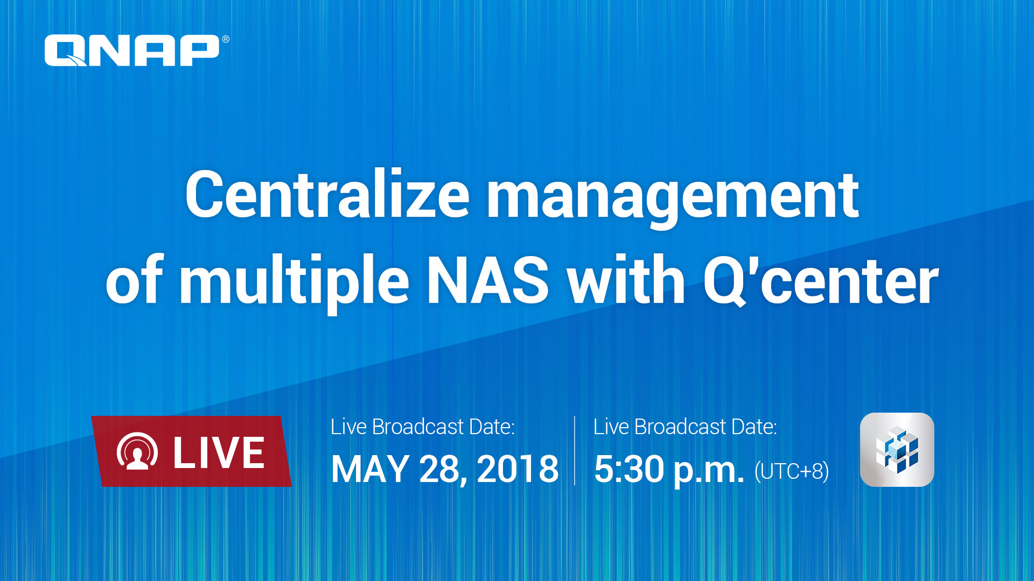

Slide 2
IT Manager's Best Choice

Slide 3
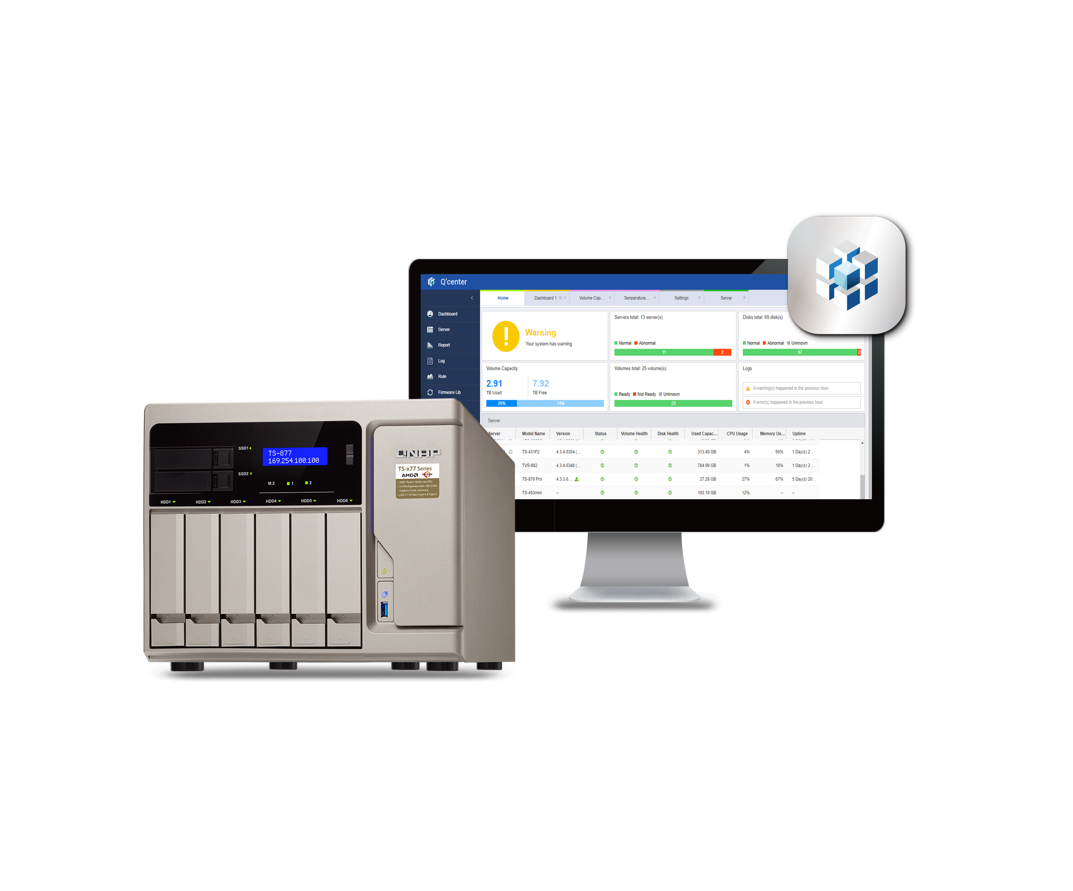
Q'center ARM/vQTS support
Control permissions with Q'center and
Active Directory
Security and protection
Notes:
麻煩換成Q‘center螢幕截圖

Slide 4

Your challenges, our solutions:
In a SMB environment, what is the best practice to deploy Q'center?
Notes:
43324792

Slide 5
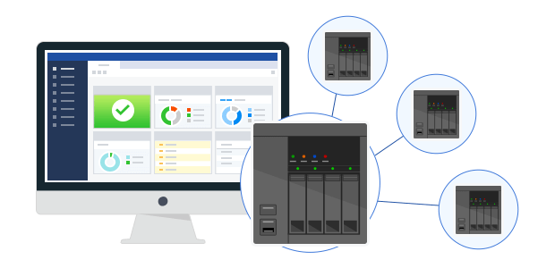
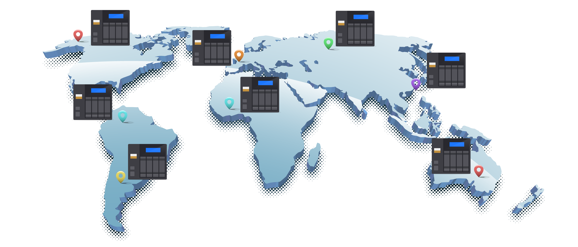
The CMS Recognized by IT Users
Provided by QNAP, Q'center is the CMS for QNAP NAS.
Q'center collects over 100 attributes from NAS every minute.
Q'center is used by 10,000 NAS users worldwide.
Managed NAS range from 1 to 300.
Notes:
5

Slide 6
Q'center Server Hardware Requirement
Affected by:
1. Number of monitored NAS.
2. Monitored NAS configurations (e.g. number of disks).
Only NAS with Intel Core CPUs can use Q'center?
No. of NAS | CPU | RAM | Storage | SSD Cache | Model
1~50 | Quad-core | 1GB | 100GB | Not Required | TS-x51
50~100 | Intel® Celeron® | 4GB | 100GB | Not Required | TS-x53B
100~500 | Intel® i5 | 8GB | 200GB | Required | TVS-x82
500~1000 | Intel® Xeon® E3 | 16GB | 200GB | Required | TVS-x80U
500~1000 with complex settings | Intel® Xeon® E5 | 64GB | 500GB | Required | TDS-x89U
Notes:
6
75027278

Slide 7
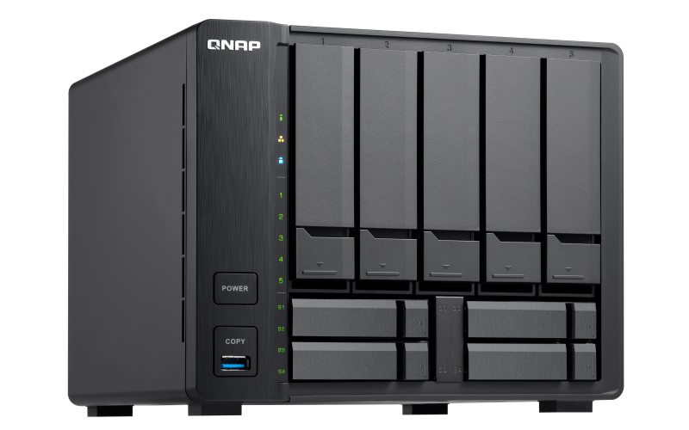
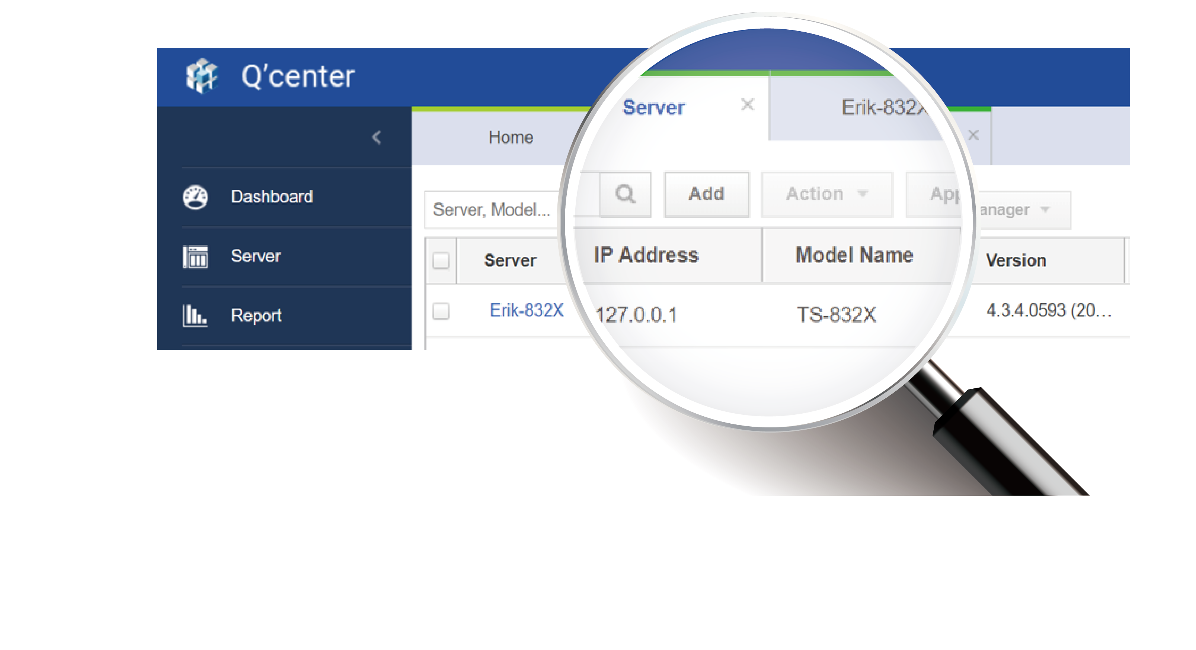
Q'center Server Supports ARM Models
Q'center 1.8 can be installed on latest ARM models.
Including TS-932X, TS-832X, TS-1635AX, etc.
The high-ROI NAS monitoring solution for SMB.
Notes:
7

Slide 8
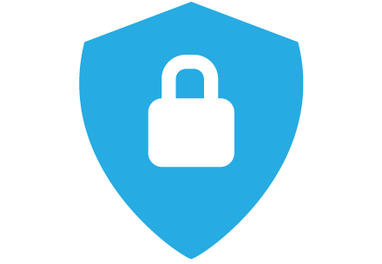




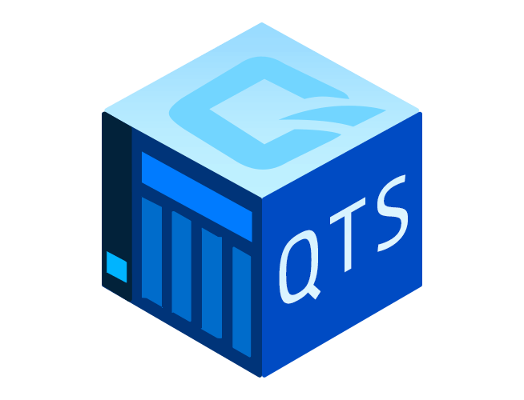
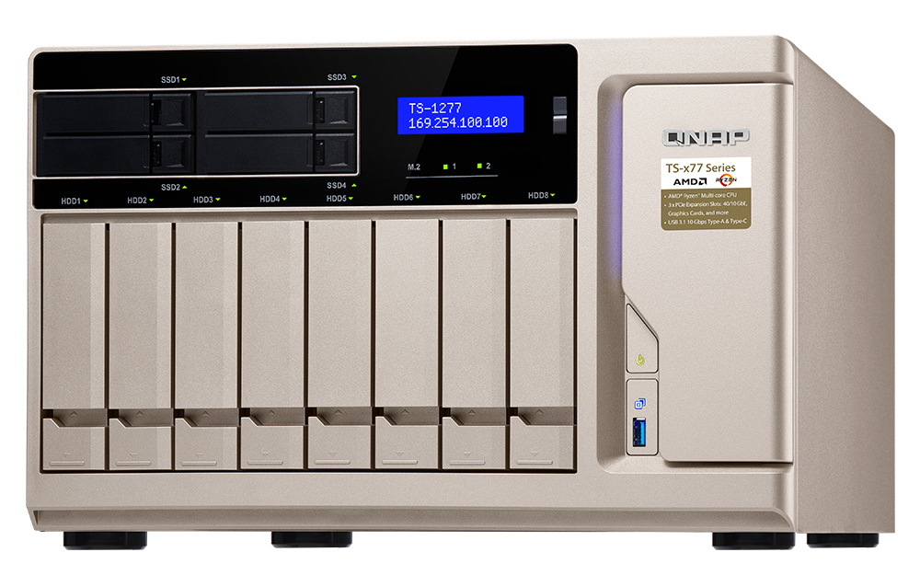
Q'center Can Monitor vQTS
Use Q'center to monitor vQTS (virtual QTS).
Deploy both vQTS and Q'center on the TS-x77, and quickly configure all vQTS for each user to have full QTS experience.
Notes:
8

Slide 9
Manage more than 200 vQTS with TS-1677X
Compared with the Q'center on TVS-871T that manages the same number of NAS: TS-1677X CPU resource usage is lower than that of TVS-871T.
TVS-871T CPU:
Intel i7 Quad core
TS-1677X CPU:
AMD Ryzen 5 Hexa Core
With TS-1677X CPU it is possible to monitor 1000~2000
NAS
For best practice please visit https://www.qnap.com/en/how-to/tutorial/article/best-practices-for-deploying-qcenter
Notes:
9

Slide 10
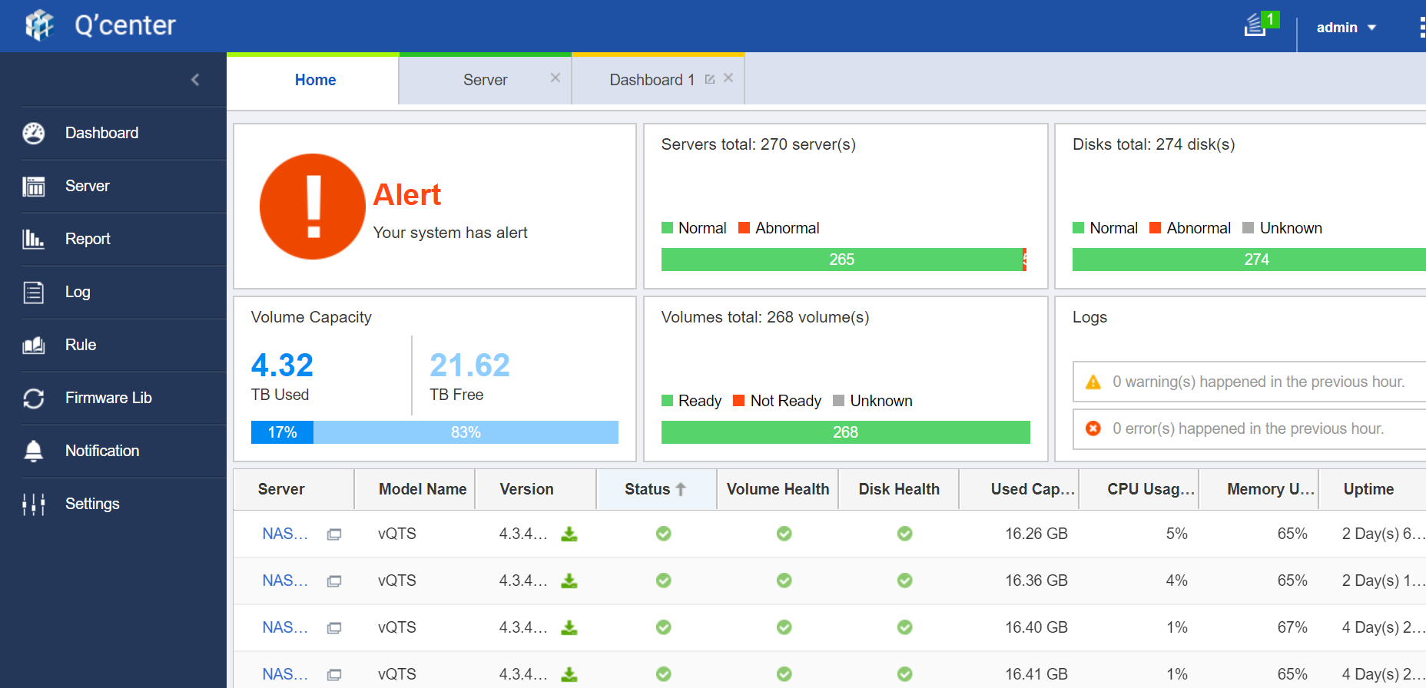
More than 200 vQTS managed by Q'center

Slide 11

Demo:
Using TS-1677X to monitor vQTS in large scale.
Notes:
36521380

Slide 12
Your challenges, our solutions:
With the new GDPR, how can I ensure my (multiple) NAS is secure?
Notes:
72006517

Slide 13
The Security Risk in Managing Multiple NAS
Real Bid: insurance company in Korea
200 NAS deployed in branch offices with personal data of customers.
Following items must be controlled.
Internal: Inventory and accessing right
External: Possible illegal access
Prevention: NAS security update
Investigation: NAS accessing history
Notes:
45840475

Slide 14



Use Q'center to Secure Your Customer Data
The business and customer data are the major responsibility for IT.
With Q'center, you can adapt 3 security methods to protect the NAS.
Monitoring
connection
record on all NAS
Enable protection and update OS on all NAS at the same time
Using Q’center and Active Directory to control permissions on multiple NAS
Full Security Introduction：http://files.qnap.com/news/pressresource/datasheet/data-security-eng-20180509.pdf
Notes:
14

Slide 15
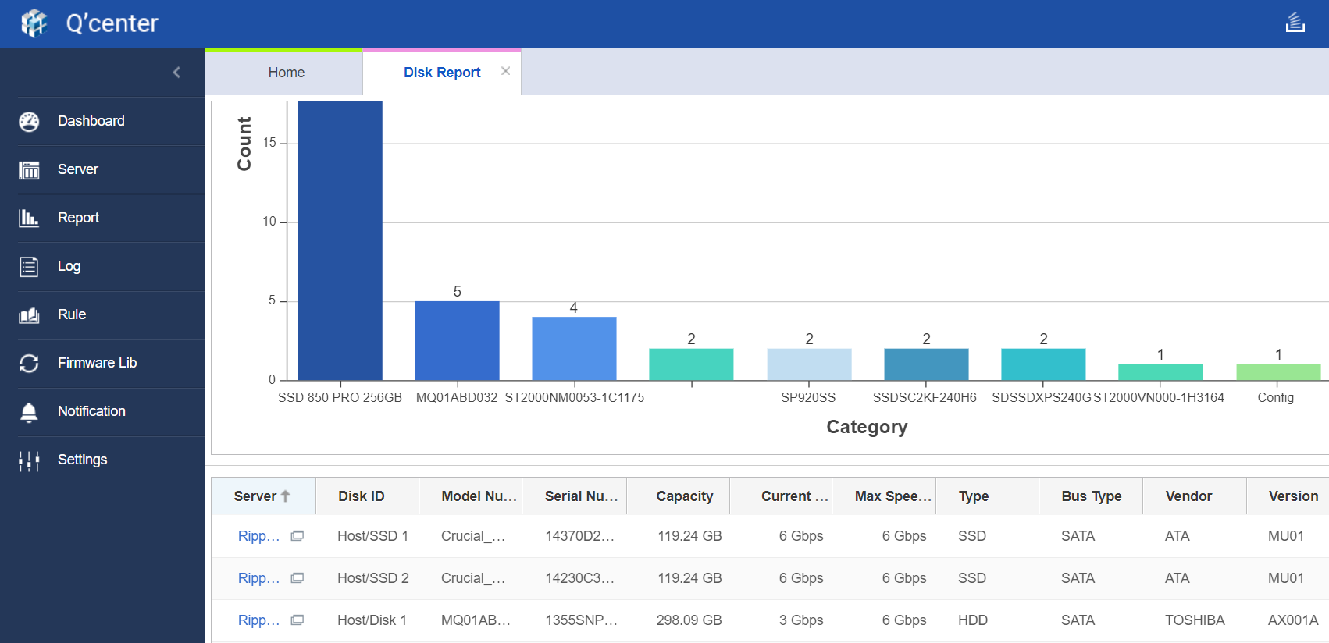

Q'center Inventory
Q'center reports include NAS, disk and REXP inventory.
Remove processes of manually check storage inventory while increasing the accuracy of security check.
Notes:
15
43403466

Slide 16
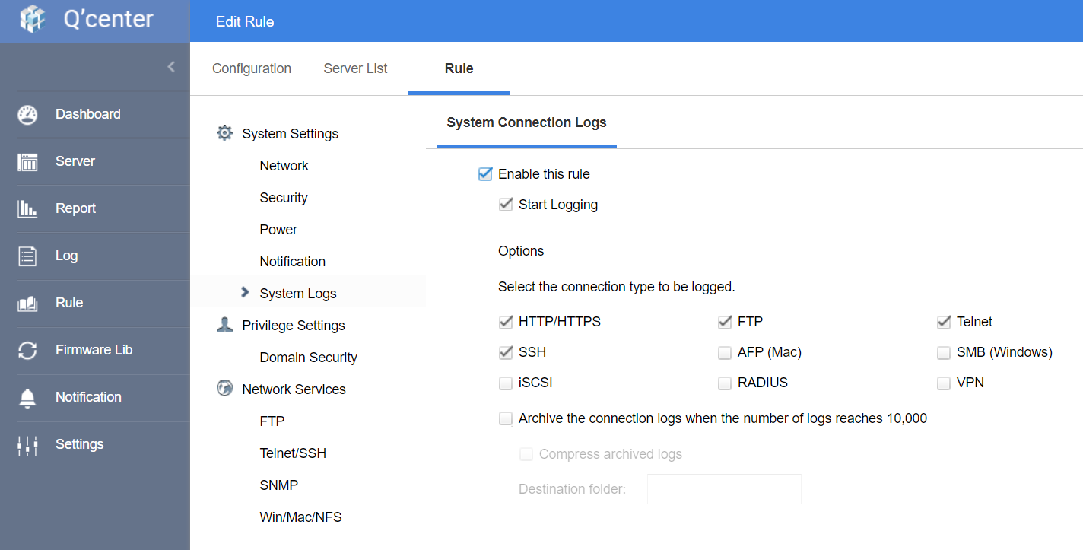
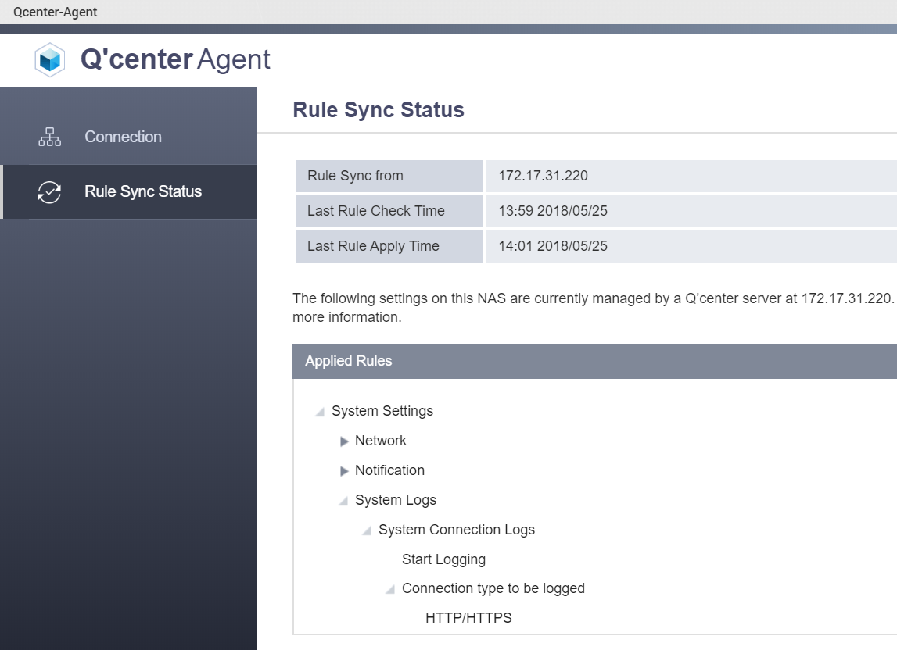

Q'center Customized Rules
Q'center Rule are configuration samples for multiple NAS.
The defined rule will not only be applied to NAS, but also continue be checked and updated by the Q'center Agent on NAS.
More than 20 rule options including system setting, network, etc.
Notes:
16

Slide 17
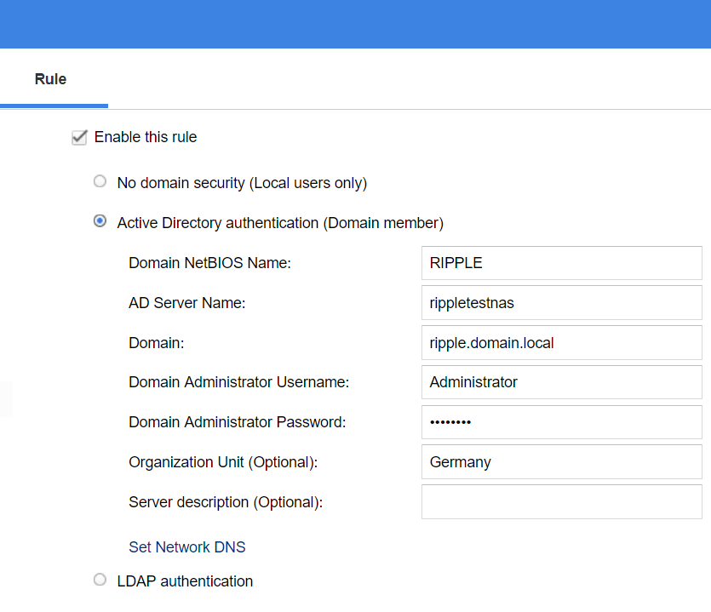

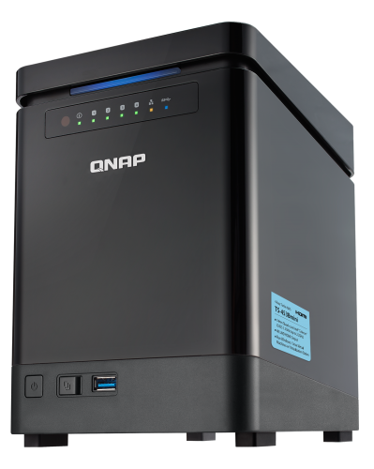
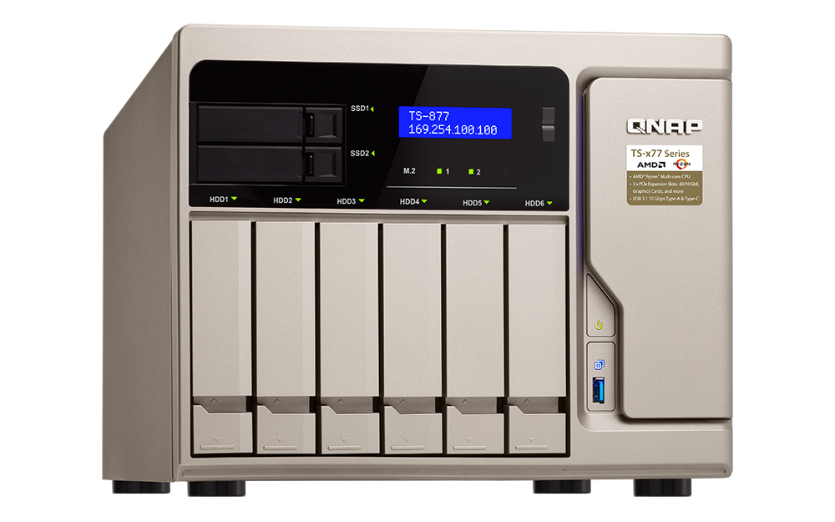
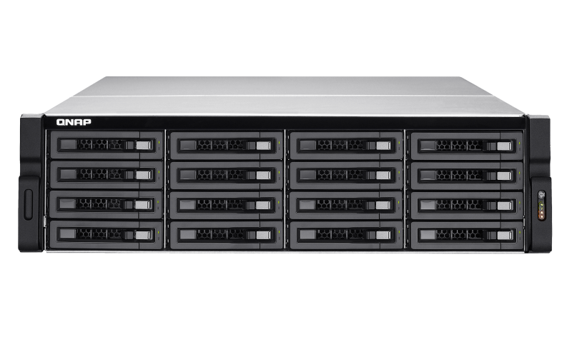
Combine Q'center & Active Directory for Multiple NAS Account Control
Comes with Windows Server, the most used users and device management system
Using Q'center rule to let multiple NAS join the AD to inherit the AD’s user and user group.
Control the folder permission in each NAS with existing structure.
Active Directory
France
Taipei
Germany
Notes:
17

Slide 18


Set New Shared Permission With AD User in Q'center
After joined the AD, the permission change still needs to be adjusted in each NAS.
The Q'center “Create Share” function also supports AD users.
Active Directory
Taipei
France
Germany
Notes:
18

Slide 19
Demo:
Use Q'center and AD
to Change NAS Permission Settings.
Notes:
36521380

Slide 20
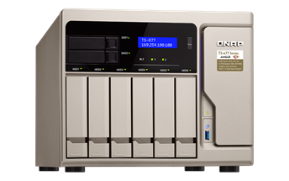
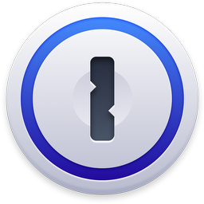
Update All NAS Password
Windows AD can be used to change any user password, but not the NAS admin password.
Q'center can update all NAS admin or user password.
Match company policy on changing password regularly.
Notes:
20
47562331

Slide 21
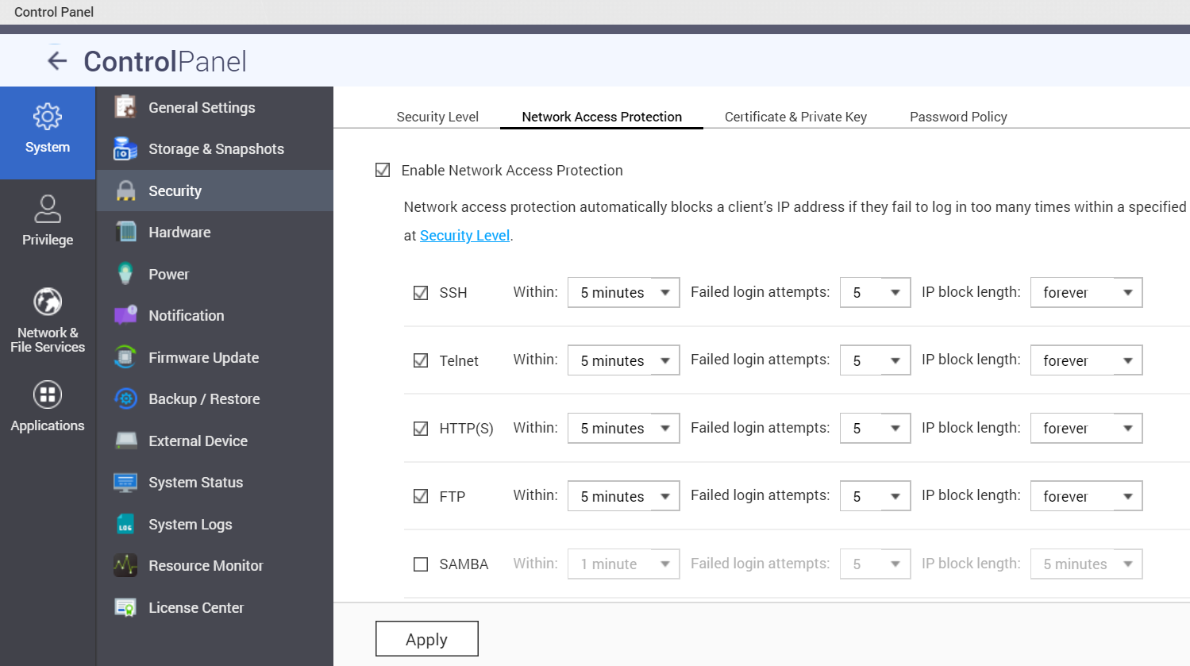

Setup Connection Protection With Q'center
In business environment, 2 QTS security settings are a must:
- Security Level：Block access from address outside the company.
- Network Access Protection: Block unwanted login attempt.
Notes:
21

Slide 22
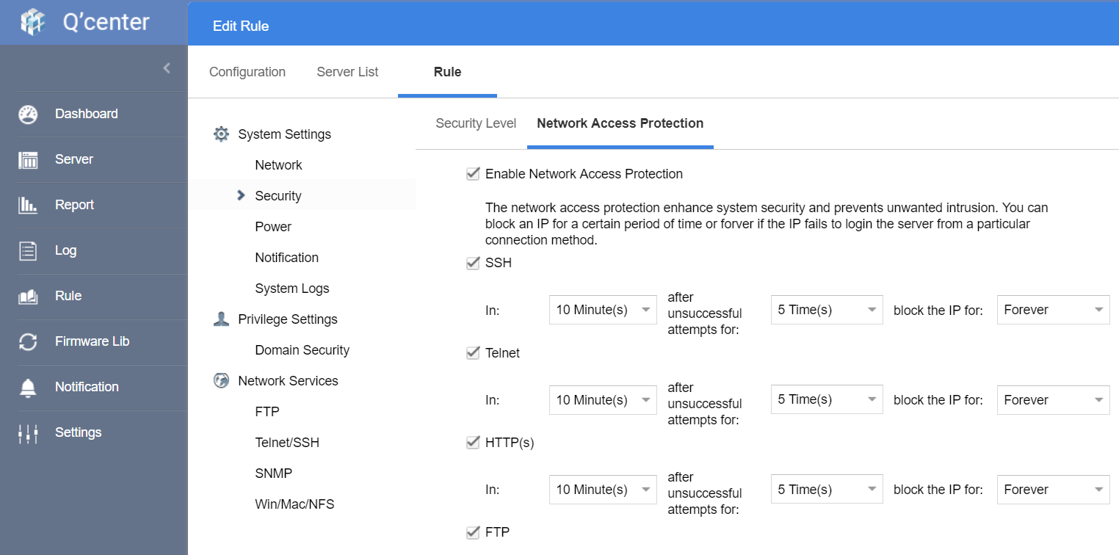
Unified Security Settings with Q'center
With Q'center rule, IT manager can apply those settings to all NAS.
With Q'center agent, the settings will be synced continually.
Notes:
22

Slide 23
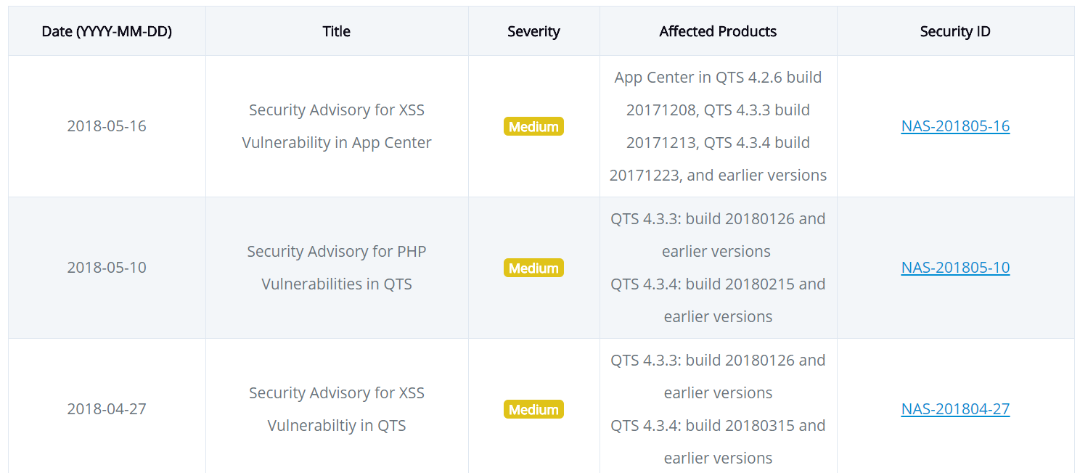
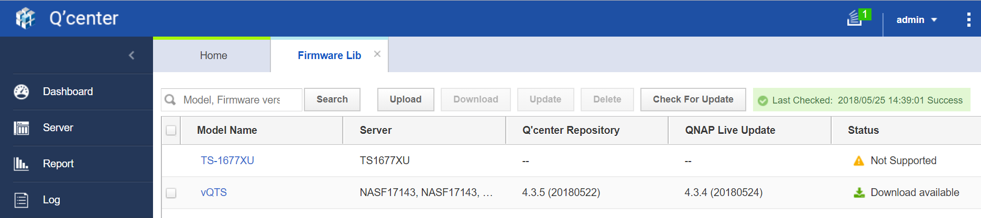
Use Q'center to Update all NAS
QTS software update will be released with new security improvements.
Q'center Firmware lib allow storing QTS software on Q'center and deploy on all NAS when ready.
QNAP Security Advisory: https://www.qnap.com/en/security-advisory
Notes:
23

Slide 24
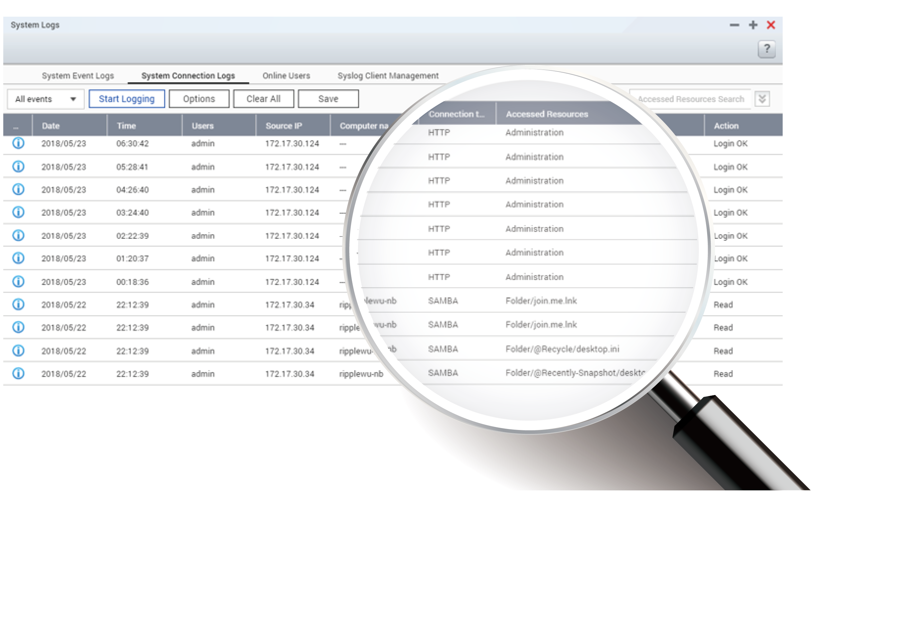

QTS System Connection Log
The "System Connection Logs" in QTS can record each access.
The function is disabled by default for performance but is critical for
investigation when identifying potential security breaches.
Notes:
24

Slide 25
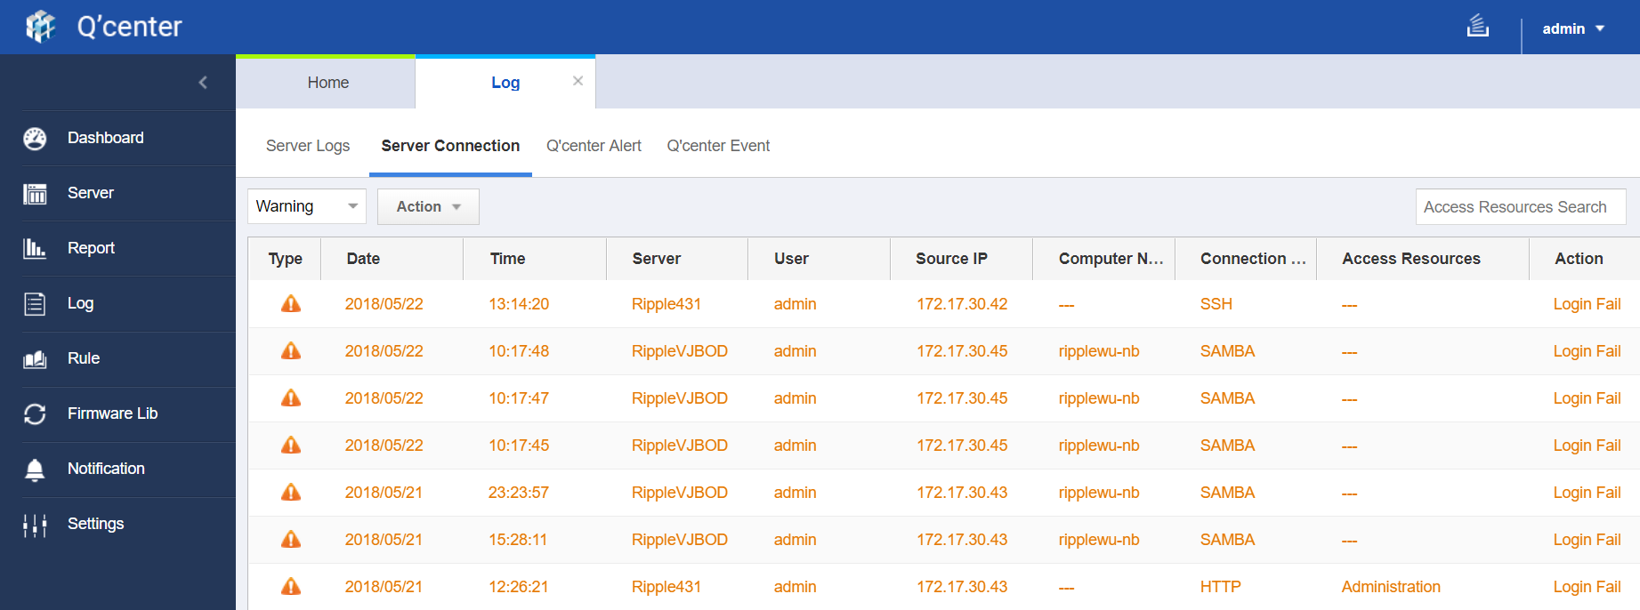
Use Q'center to enable and collect all connection records
In Q'center, IT manager can enable connection logs on all NAS.
The connection logs will be uploaded to Q'center.
Even in the worst case that NAS cannot be logged in, the record will still be kept in Q'center.
Notes:
25
47562331

Slide 26
Demo:
Using Q'center to update NAS software to the latest version.
Notes:
36521380

Slide 27
Recap: Q'center is IT Managers' Top Choice
3 Steps to ensure security with
Q'center on multiple NAS.
Q'center Server supports ARM models.
Use with AD for permission control.
Deploy security policy with Q'center.
01
Add all NAS into Q'center.
02
Update all NAS to latest SW and setup Q'center security rule.
03
Continue monitor the NAS connection logs.
Notes:
27

Slide 28
Your Best Choice
Copyright © 2018 QNAP Systems, Inc. All rights reserved. QNAP® and other names of QNAP Pr oducts are proprietary marks or registered trademarks of QNAP Systems, Inc. Other products and company names mentioned herein are trademarks of their respective holders.

