Slide 1
QNAP SYSTEMS, INC.
COMPANY PROFILE
Leading storage, network & computing solution provider. File storage, backup, sharing, multimedia, surveillance, virtualization, IoT, A.I., machine learning and more.

Slide 2
Overview of IEI Group
Innovation & Integration lead to Private Cloud Total Solution

Slide 3
Industrial Integrated IoT Solution Provider
Leading storage, network & computing solution provider
Unique Electronic Manufacturing Service
Intelligent Medical System Provider
Leading Automation System Products Provider
Professional Chassis Manufacturer

Slide 4
About QNAP
Innovative software development and hybrid-cloud-based AI platform
Complete portfolio from development and hardware design to accelerate enterprise deployment of AI​ solutions
Global market presences
1000+ total employees. Software engineers make up 60% of the company workforce
Leading storage, network & computing solution provider

Slide 5
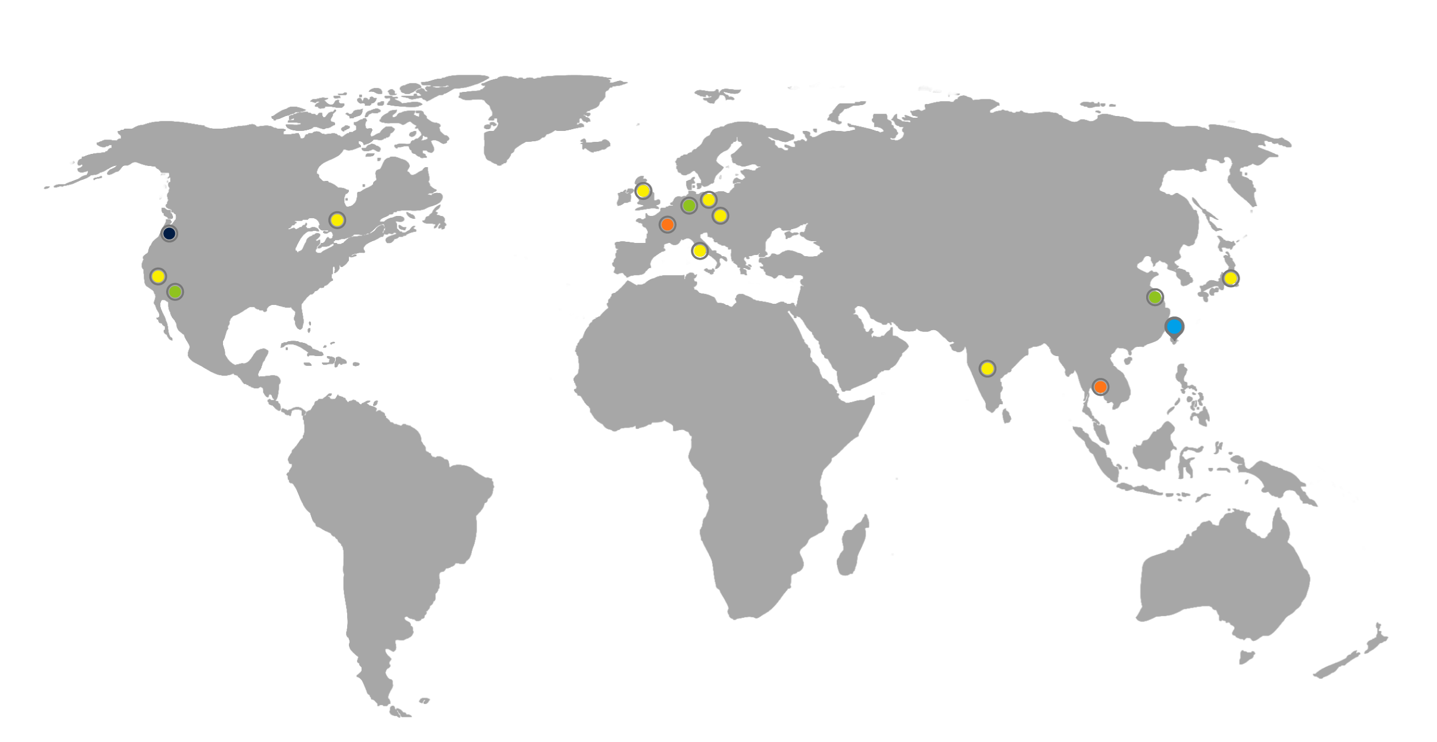
Worldwide Presence
IEI & QNAP Headquarters
QNAP Branches
QNAP Regional Sales Office
QNAP Logistics Center
IEI Shanghai
IEI USA

Slide 6
See the Bigger Picture with Us
In collaboration with IEI, we envision our upcoming QNAP NAS models to serve as an intelligent gateway that empowers both home life and work environments.

Slide 7
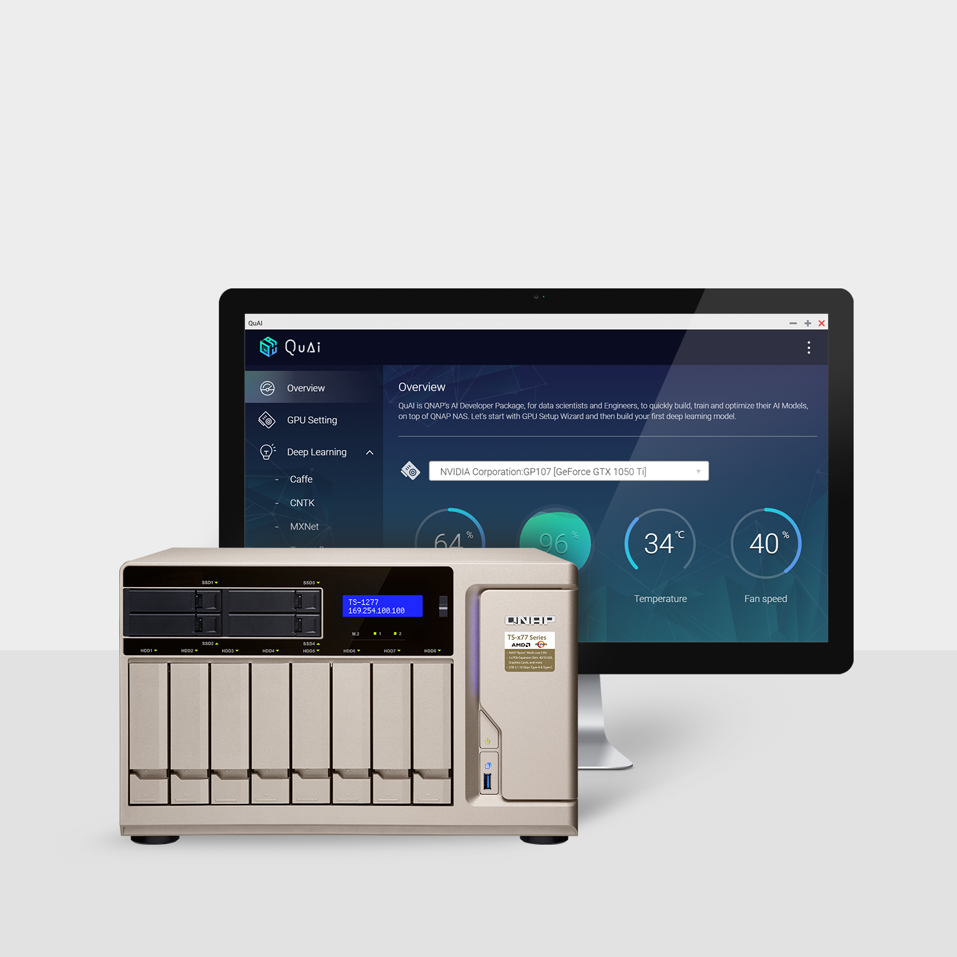
Ride the AI wave with
QNAP QuAI
QNAP’s AI Developer Platform
Intended for data scientists and developers to quickly build, train, and optimize AI models running on QNAP NAS
GPU-accelerated computing empowers AI
Easily host AI applications on QNAP NAS

Slide 8
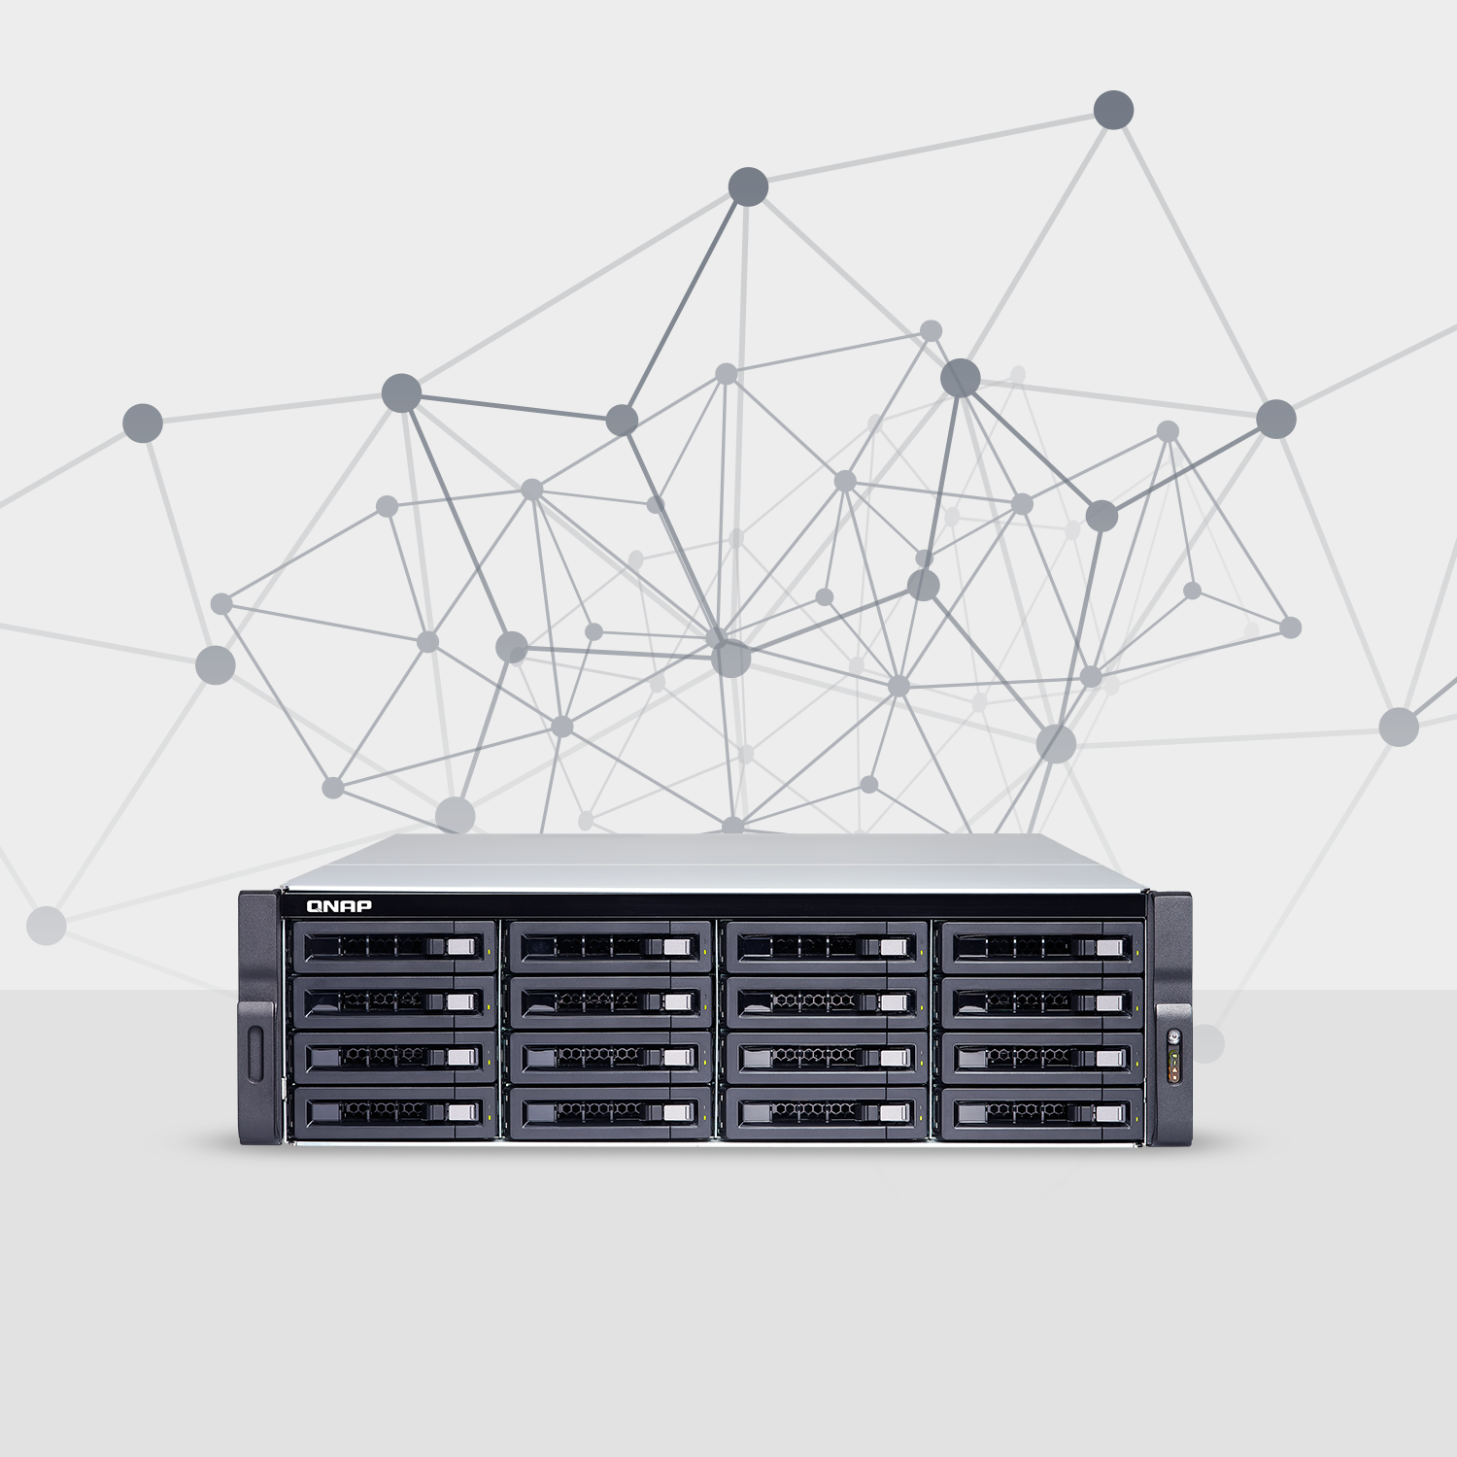
QNAP NAS as
an intelligent hybrid network application server
Implementation of AI & machine-learning mechanisms
Network computing ability & data security
Providing “IoT-oriented” services and applications

Slide 9
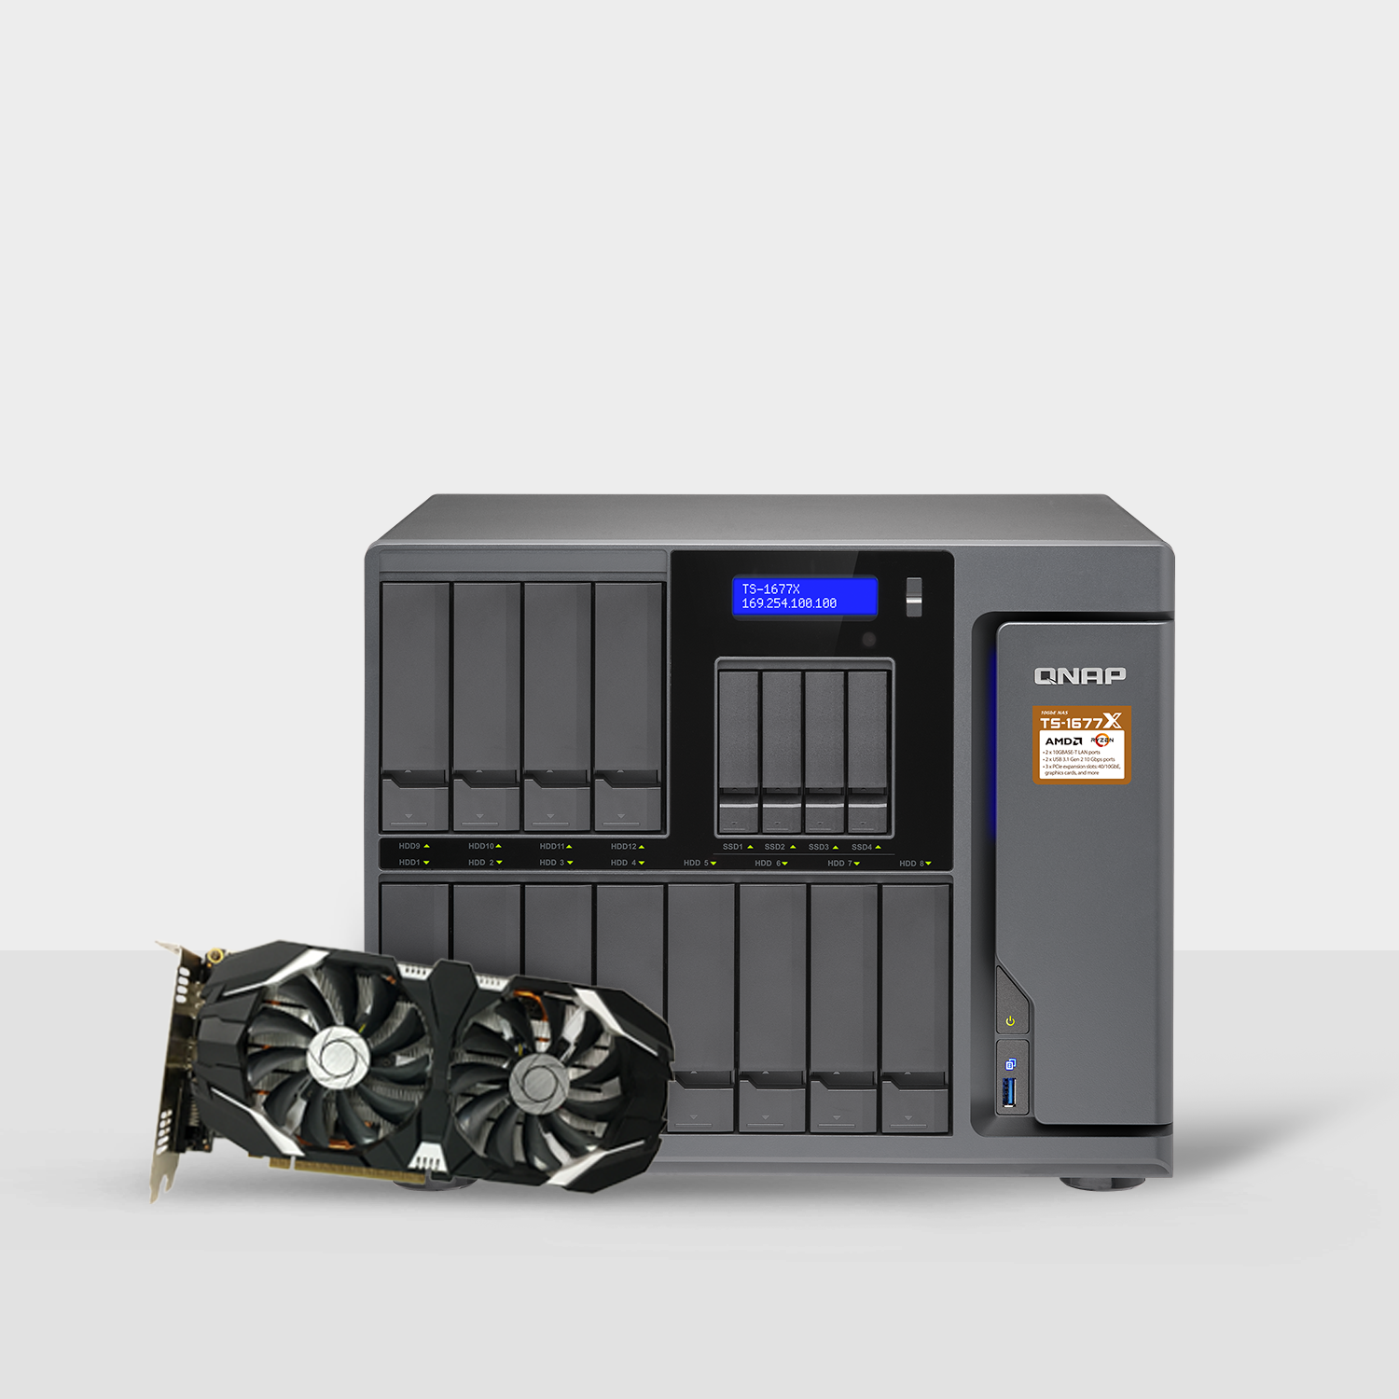
QNAP NAS as
a GPU-empowered computing solution
Graphics card support for video processing and GPU pass-through to virtual machines.
Accelerate AI applications with GPU computing power

Slide 10
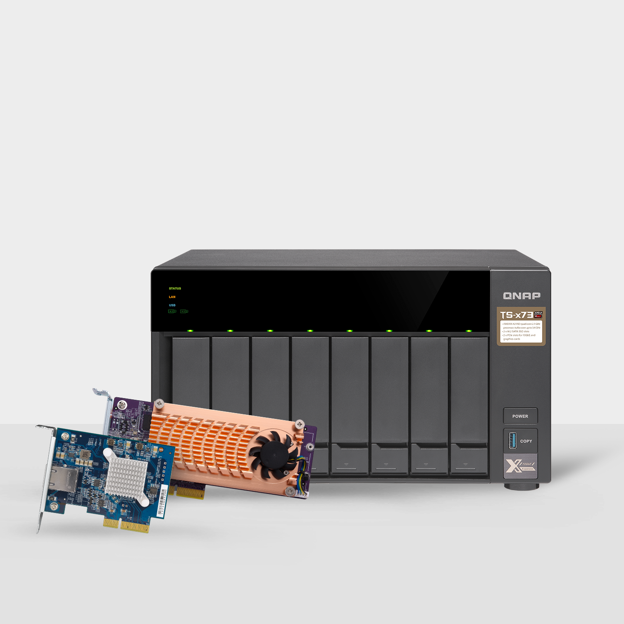
Fast NAS Solutions with
10GbE connectivity and SSD caching
Aimed at extending NAS functionality, QNAP presents a variety of 10GbE and SSD cache applications
Implementation of 10GbE connectivity and SSD caching helps to optimize the storage efficiency and data transmission capabilities of QNAP NAS

Slide 11
Achievements & Recognition
Over 100 Corporate & Product Awards Worldwide

Slide 12
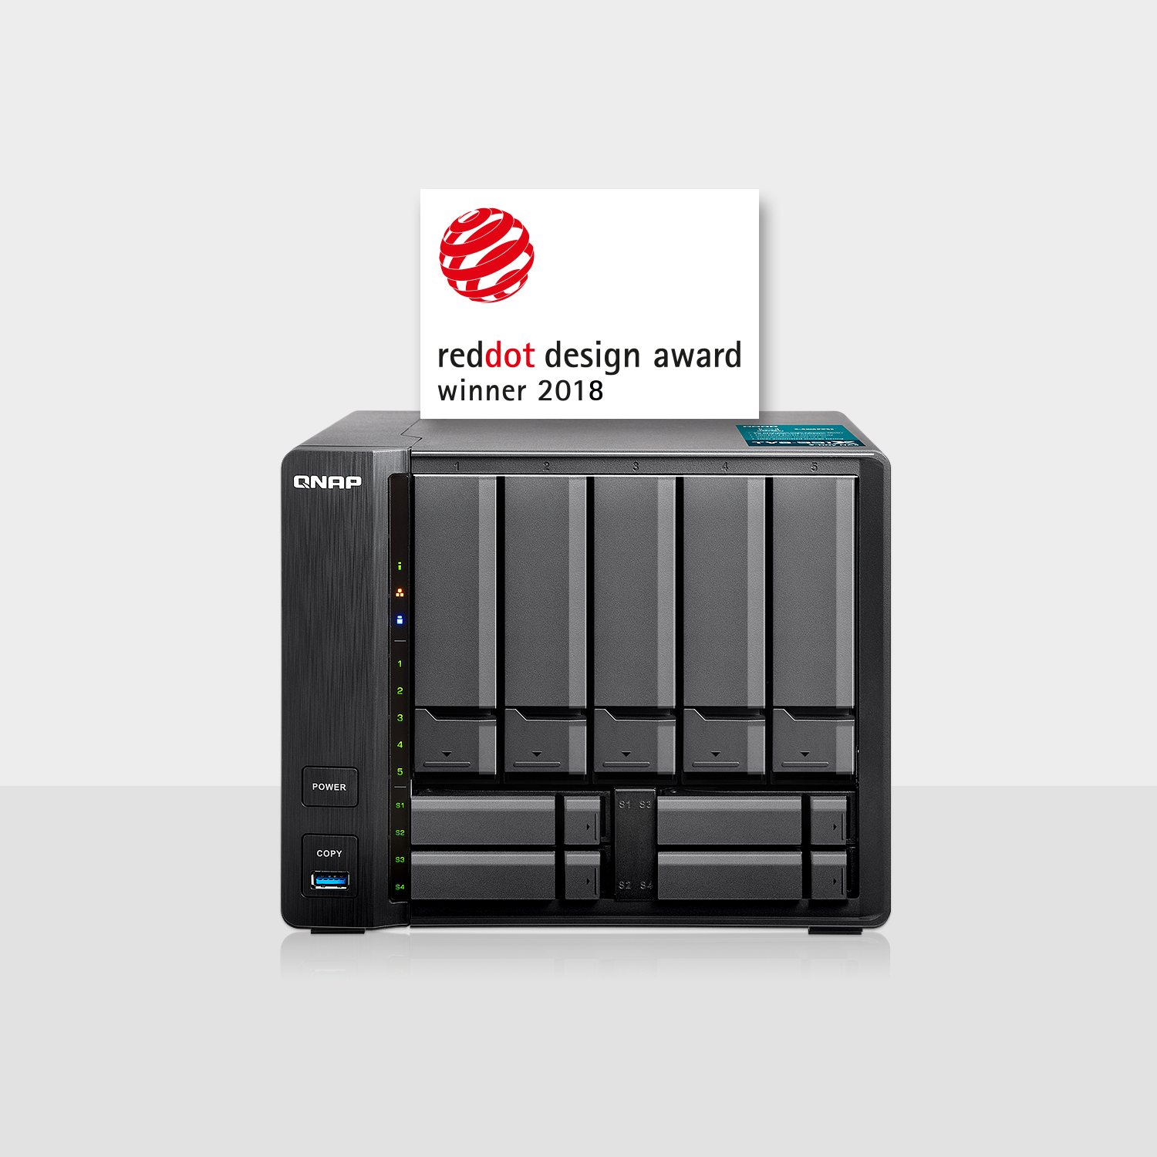
Red Dot Design Award 2018
TVS-951X 9-bay 10GbE multimedia NAS

Slide 13
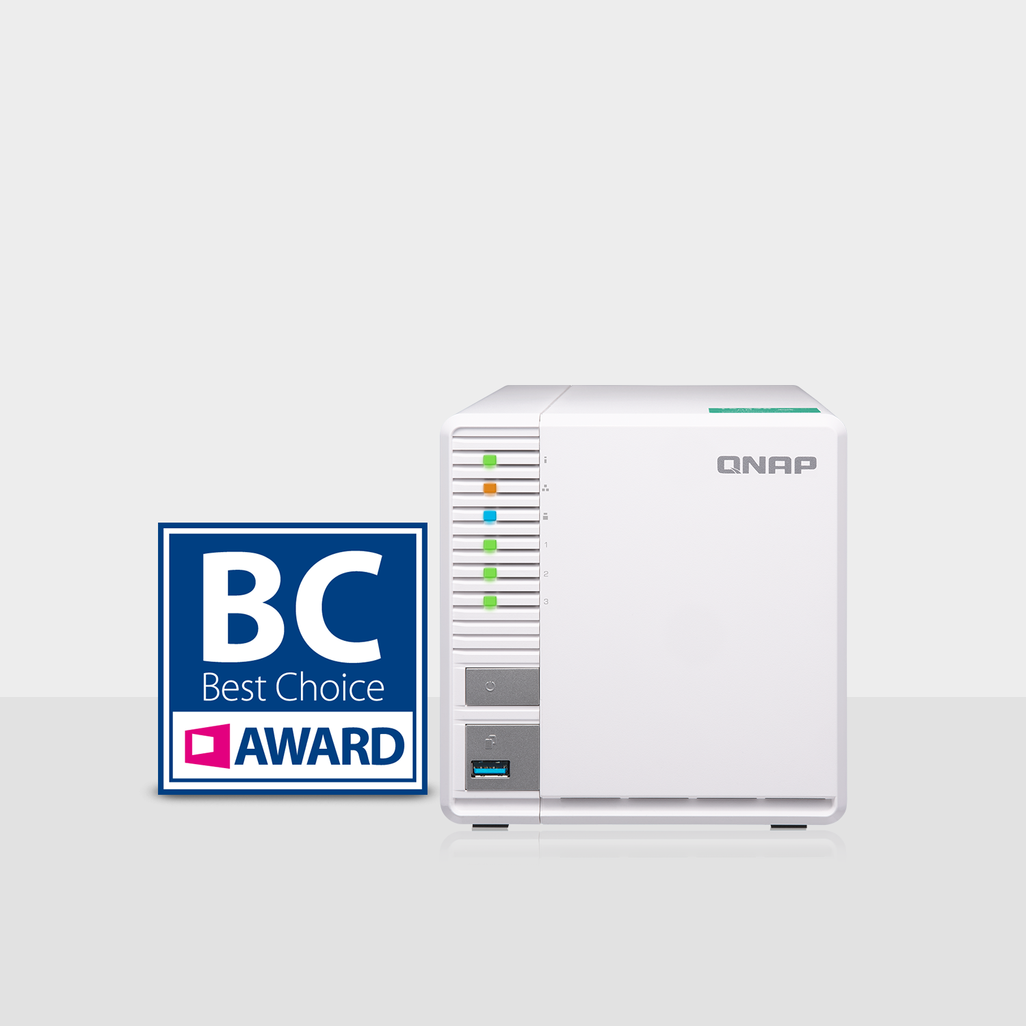
Best Choice Award 2018
TS-328 3-bay RAID 5 NAS

Slide 14
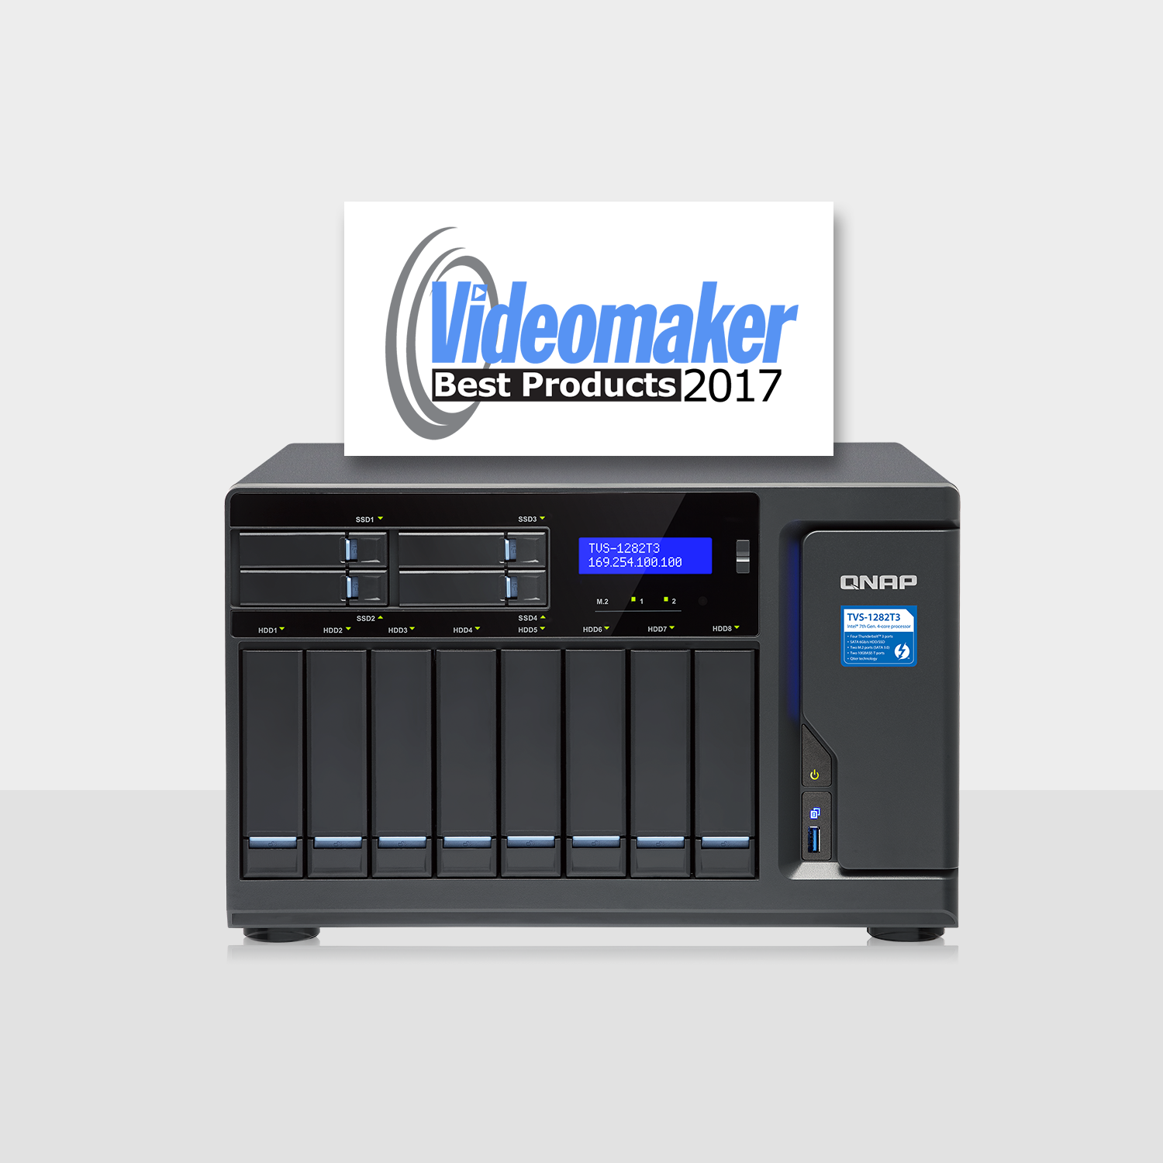
Videomaker’s Best Products 2017
Best Storage Award
TVS-1282T3 Thunderbolt™ 3 NAS

Slide 15
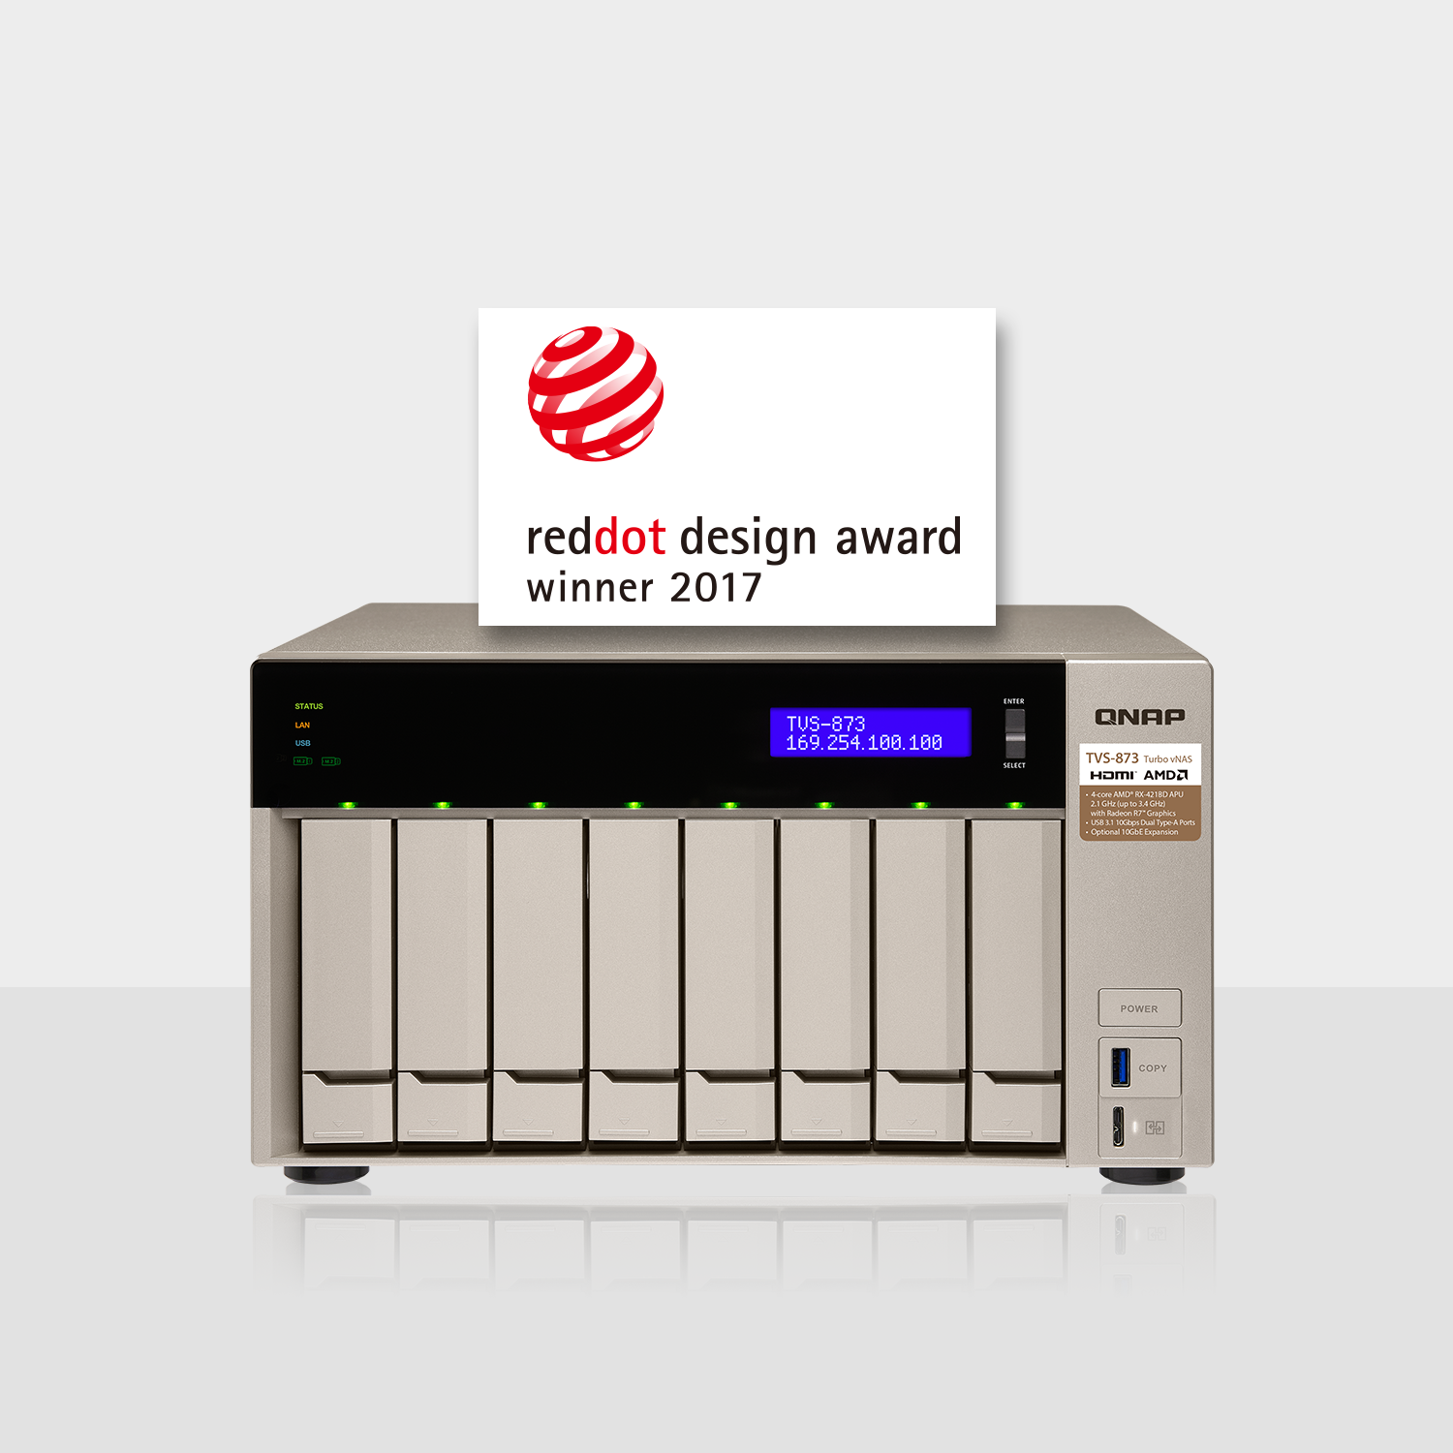
Red Dot Award 2017
TVS-873 10GbE-enabled business NAS

Slide 16
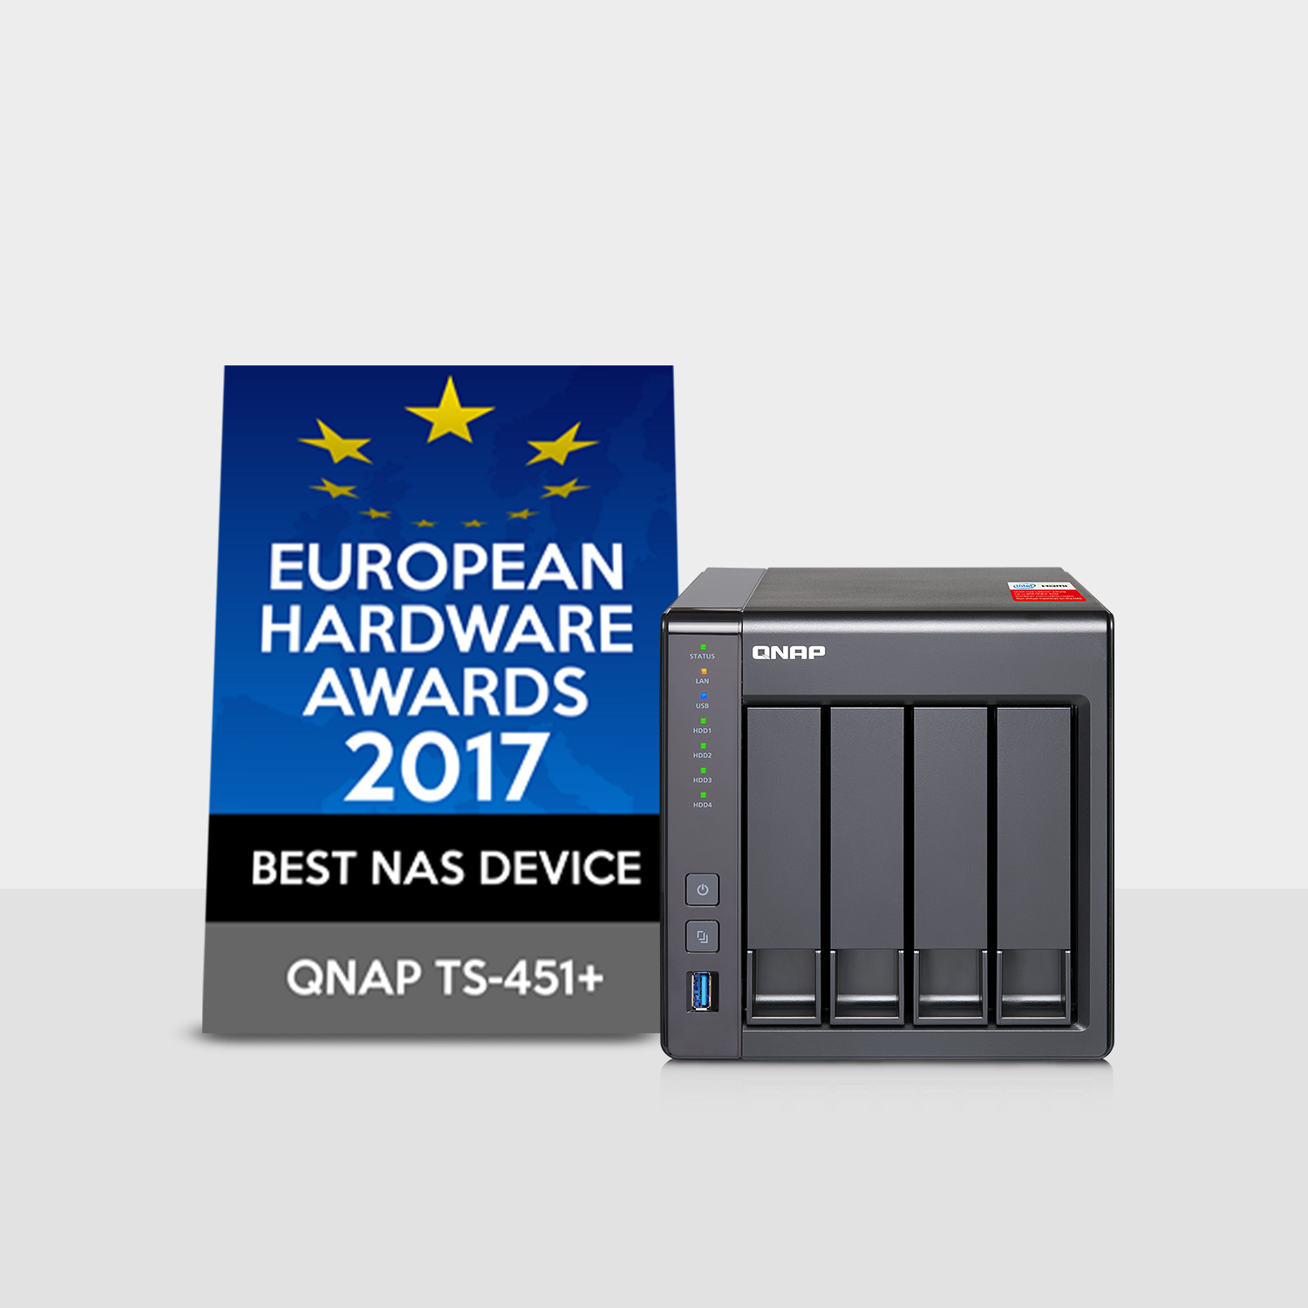
European Hardware Awards 2017 Best NAS Device
TS-451+ quad-core NAS

Slide 17
QNAP Leads the Way
Comprehensive NAS products that reflect technology and market trends

Slide 18
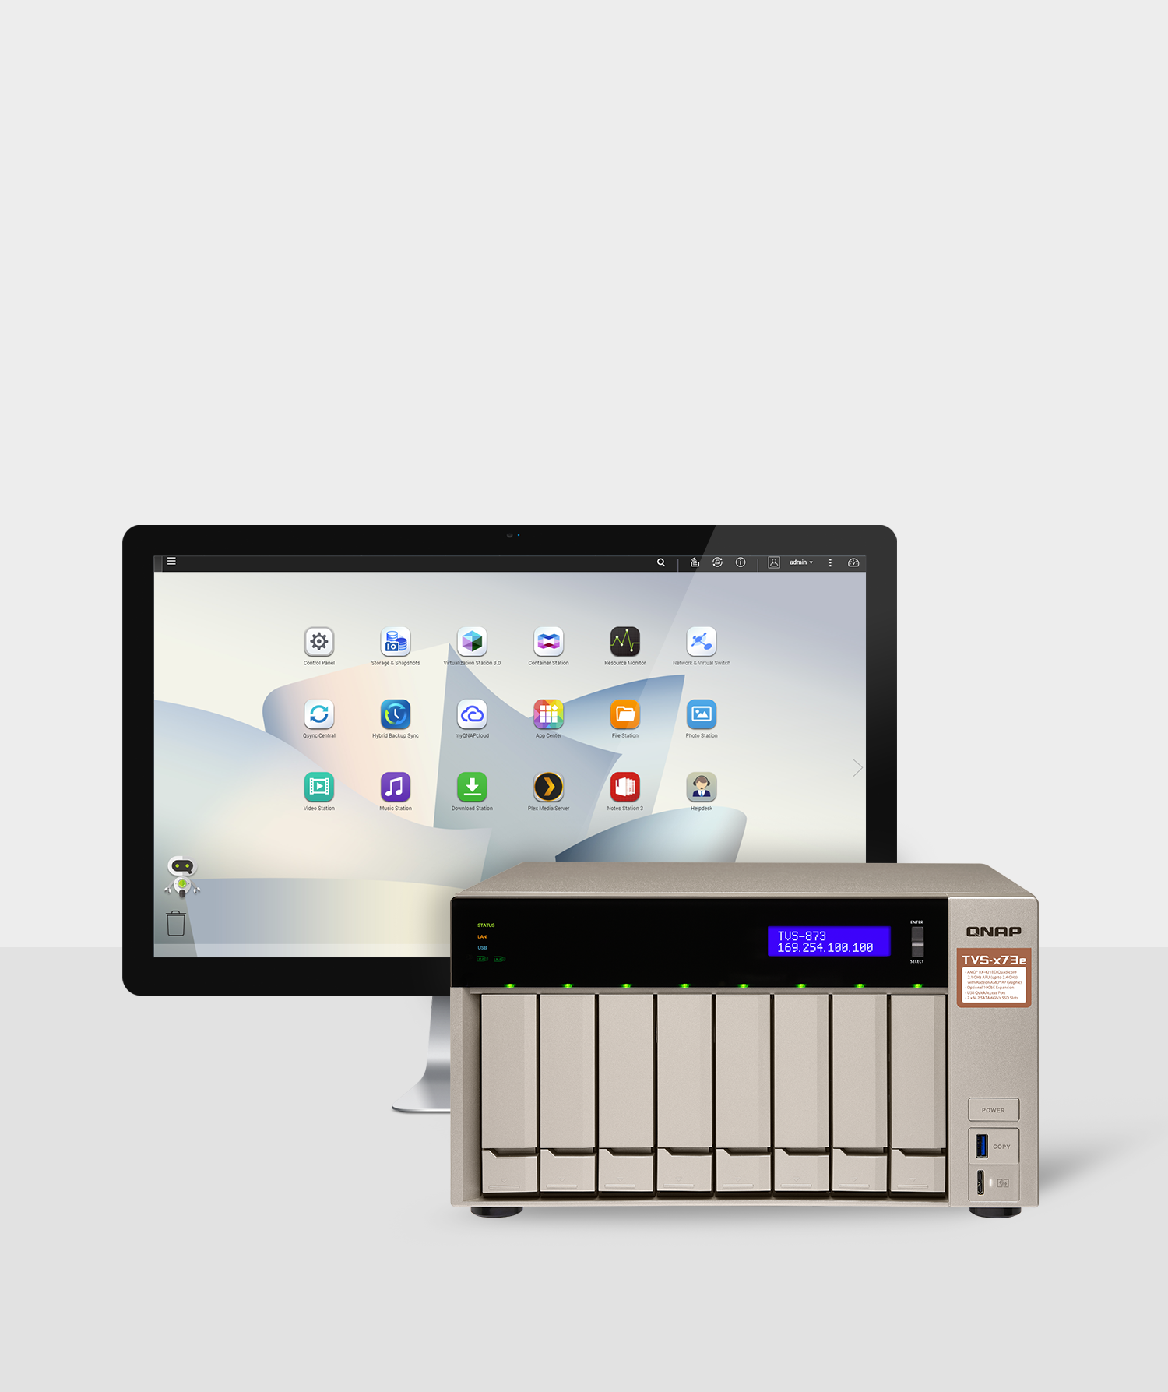
QTS 4.3.5
Empowering the network and storage functionalities of QNAP NAS
QTS 4.3.5 future-proofs the network and storage functionalities of QNAP NAS with even more software innovations. The latest generation of QTS is tailored for users with greater needs for advanced network infrastructure deployment and storage management.

Slide 19
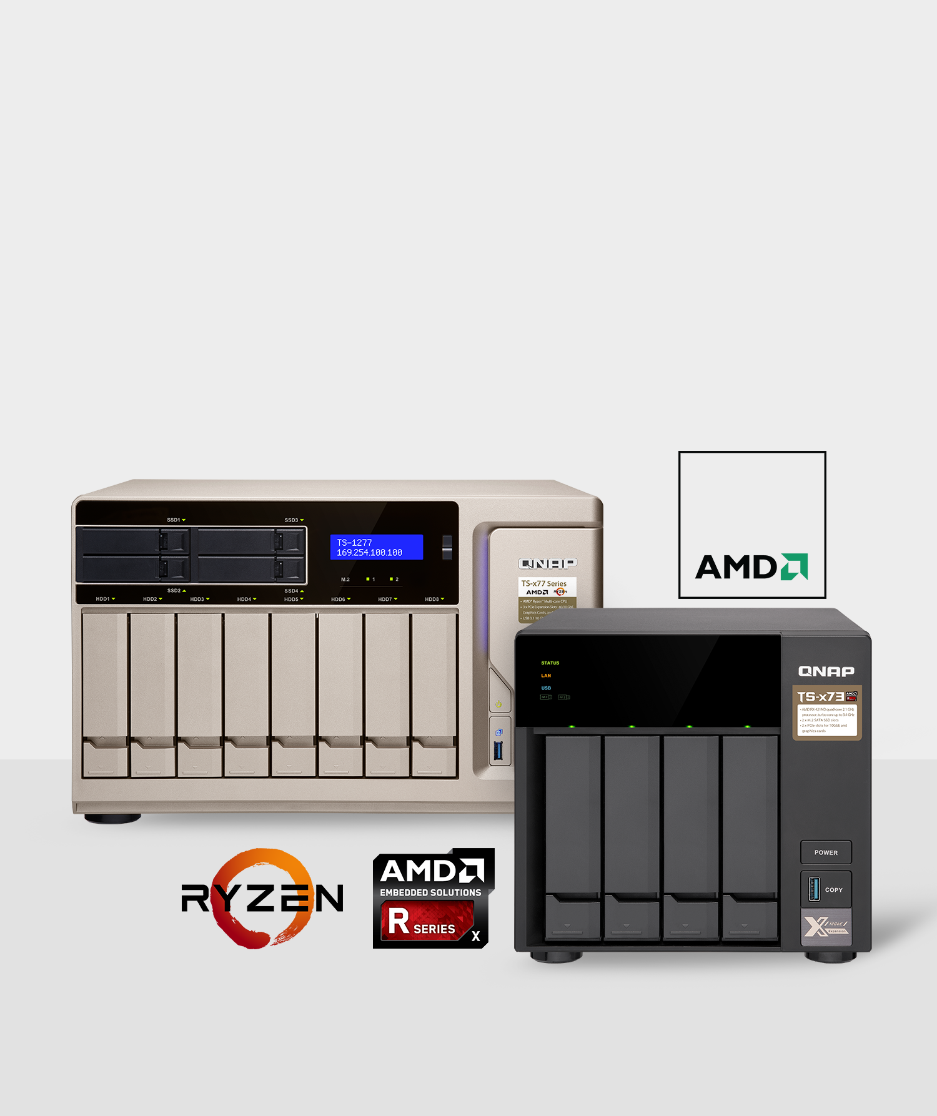
QNAP NAS Series Featuring AMD® CPUs and APUs
QNAP offers a comprehensive portfolio of AMD-based NAS to meet a wide range of user requirements. AMD-based NAS solutions delivers uncompromising performance to facilitate performance-demanding applications including high-speed data transfer, backup/recovery, virtualization, media playback and graphics display.

Slide 20
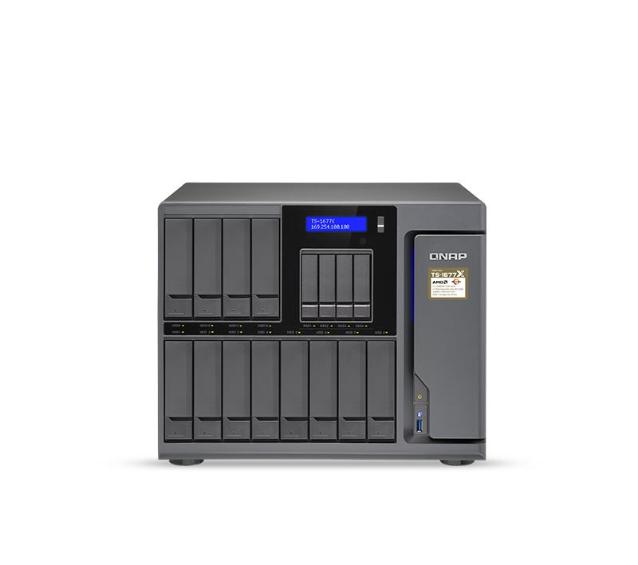
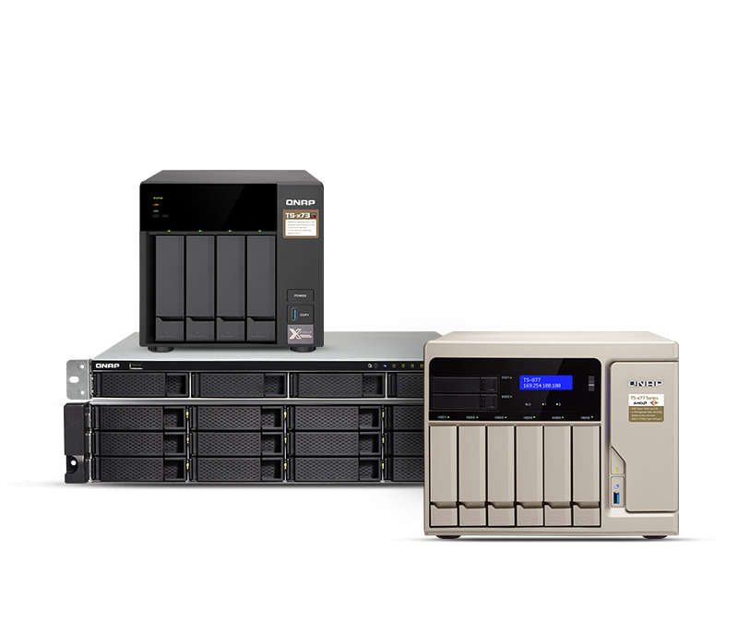
AMD CPU-based NAS
Enterprise
SMB

Slide 21
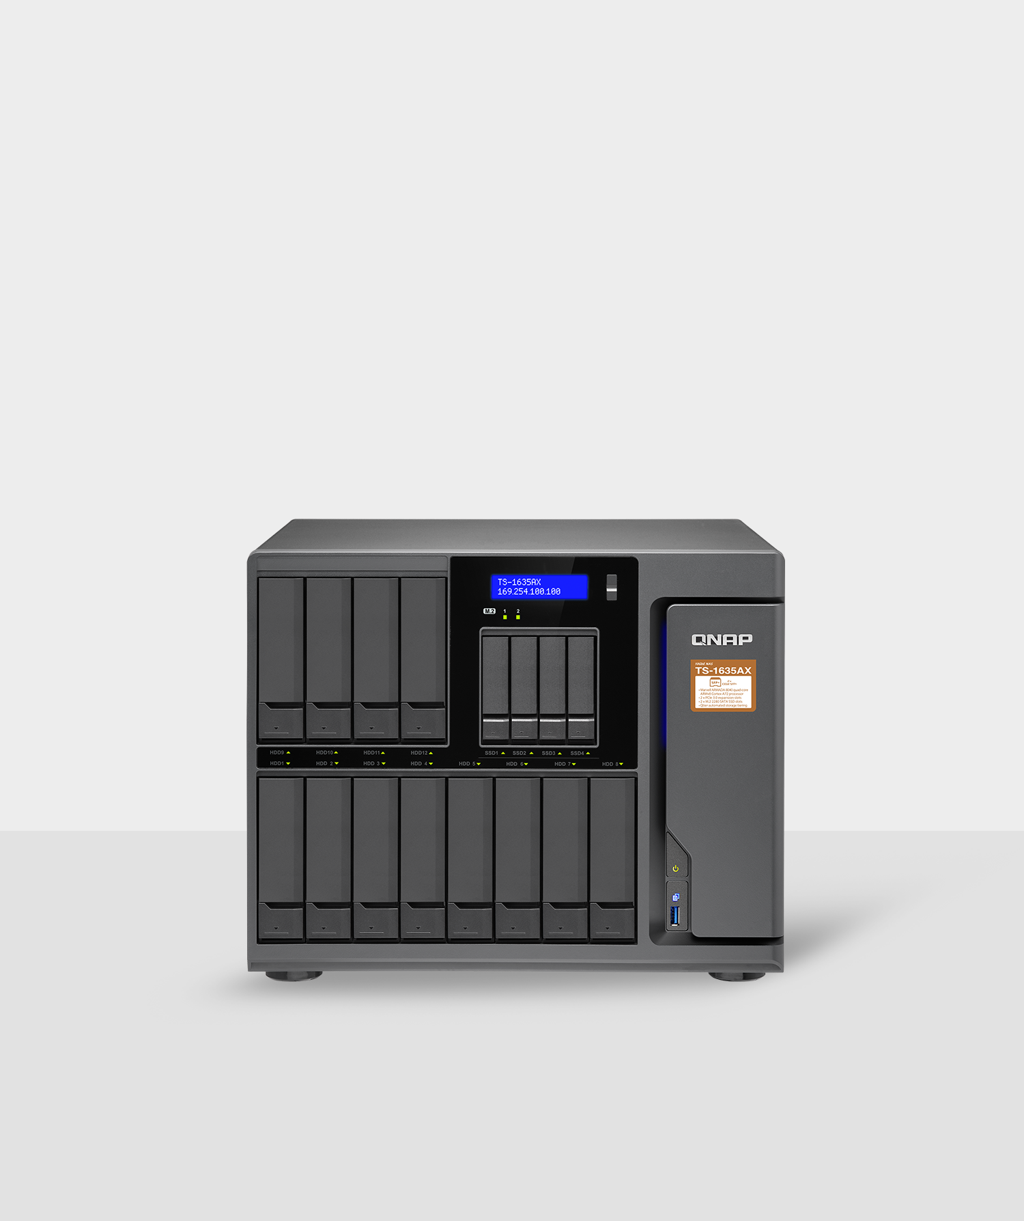
High-capacity16-bay NAS Solutions
Store more and smarter
Featuring epic storage potential, the 16-bay NAS solutions incorporate both high performance and high capacity for continuously optimized storage efficiency to tackle mission-intensive applications necessary for modern data centers such as virtualization and massive data backup and recovery.

Slide 22
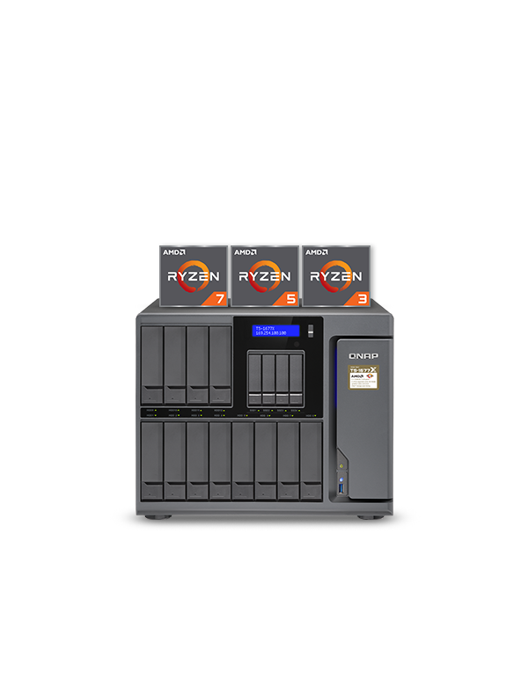
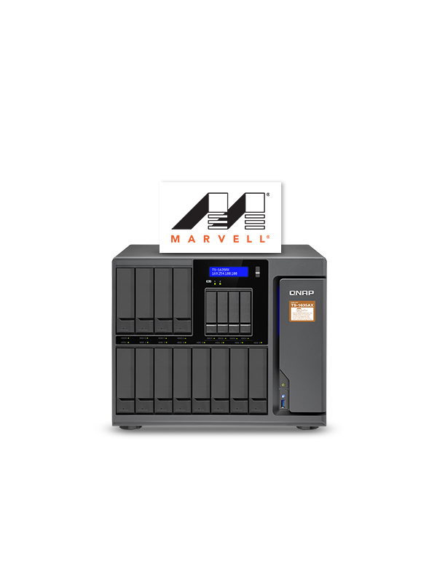
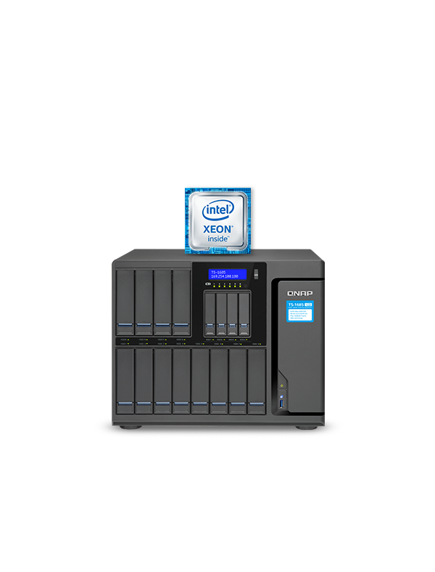
16-bay NAS Models
TS-1677X
TS-1635AX
TS-1685

Slide 23
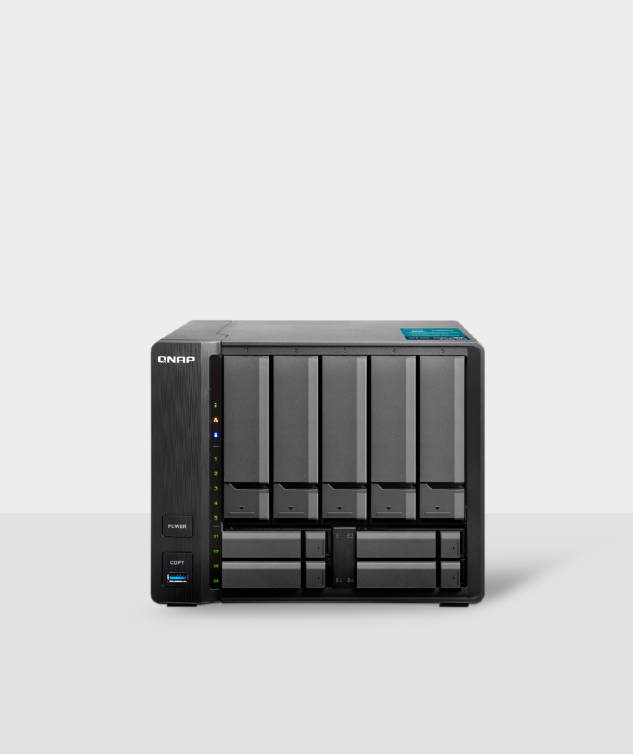
9-bay Hybrid NAS Solutions
Slim size, big capacity
Designed to accommodate five 3.5-inch HDD bays and four 2.5-inch SSDs bays, QNAP’s 9-bay models fully enable SSD caching and Qtier to provide both high-capacity storage potential and optimal system performance.

Slide 24
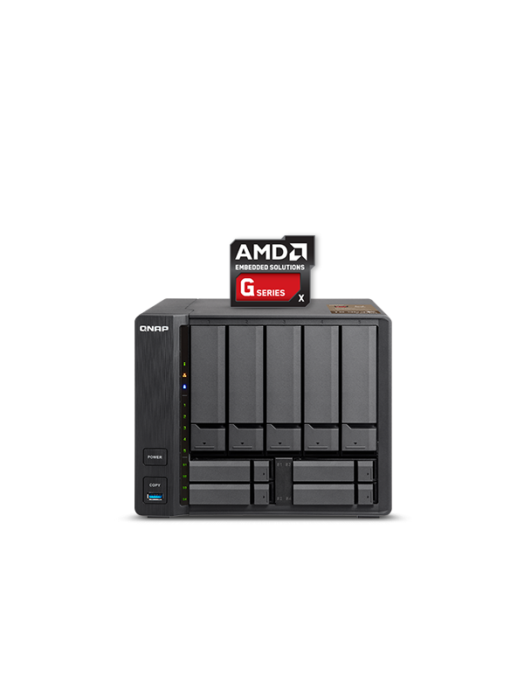
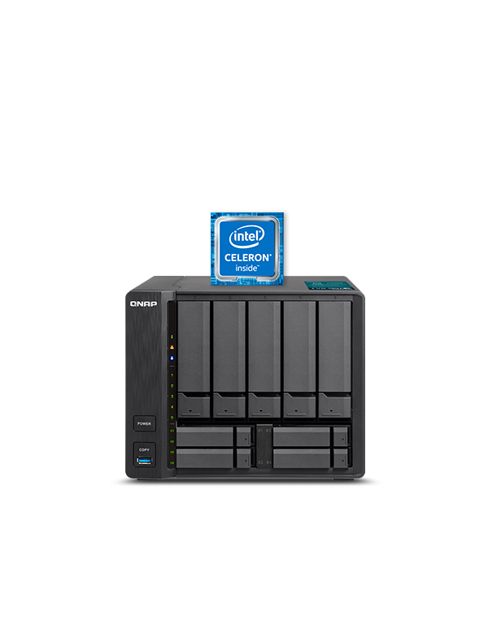
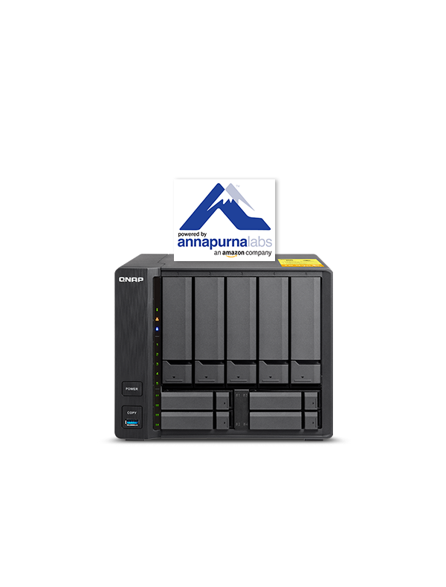
9-bay NAS Models
TS-963X
TS-951X
TS-932X

Slide 25
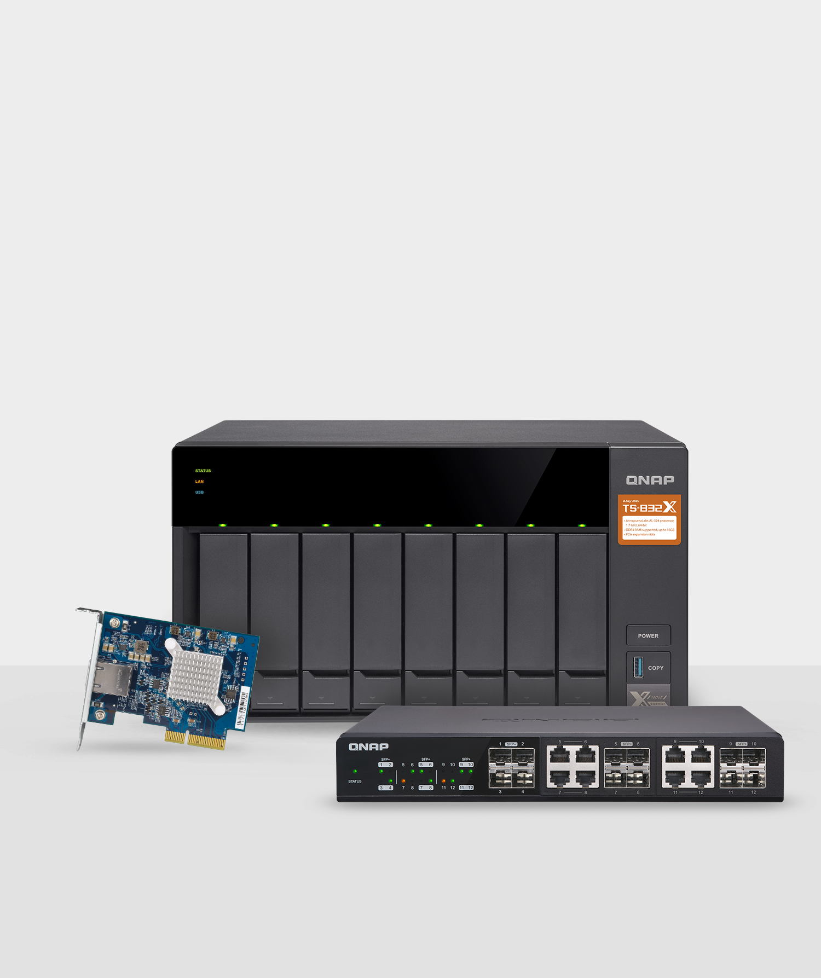
10GbE Solutions
Standardizing 10GbE environments
QNAP offers powerful-yet-affordable high-speed 10GbE-ready NAS and peripherals suited for all organizations - from huge enterprises to small offices - to improve overall network performance and bandwidth-demanding applications.

Slide 26
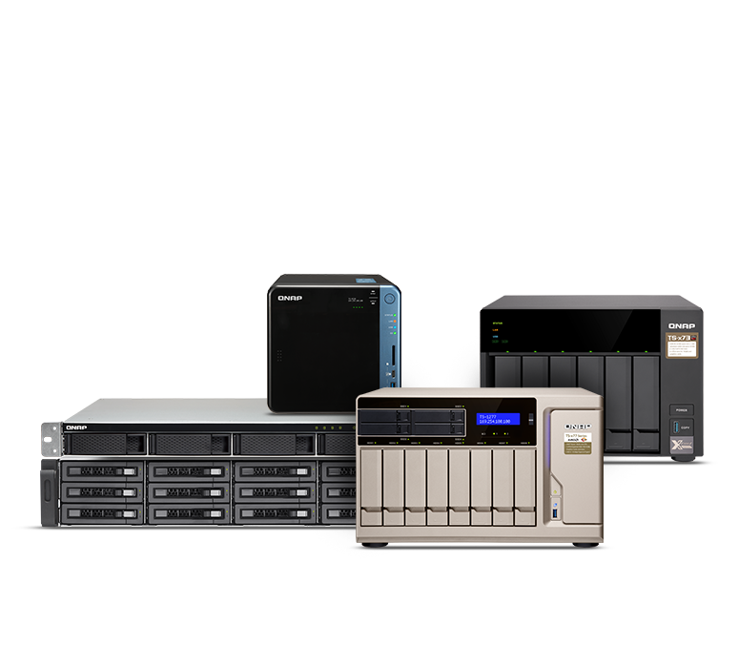
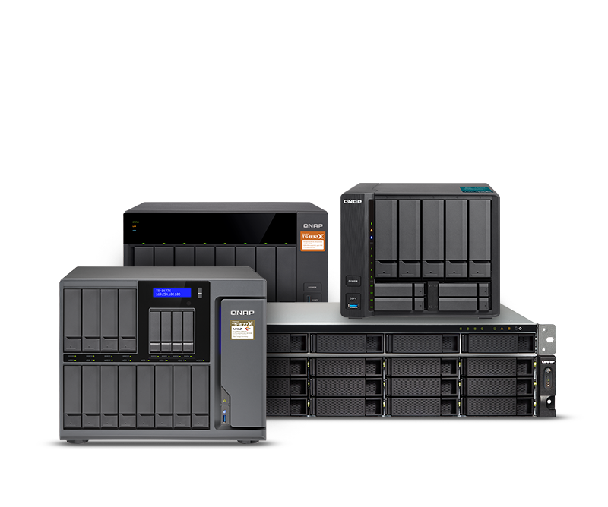
10GbE-ready NAS
Built-in 10GbE port (s)
Optional 10GbE expandability

Slide 27
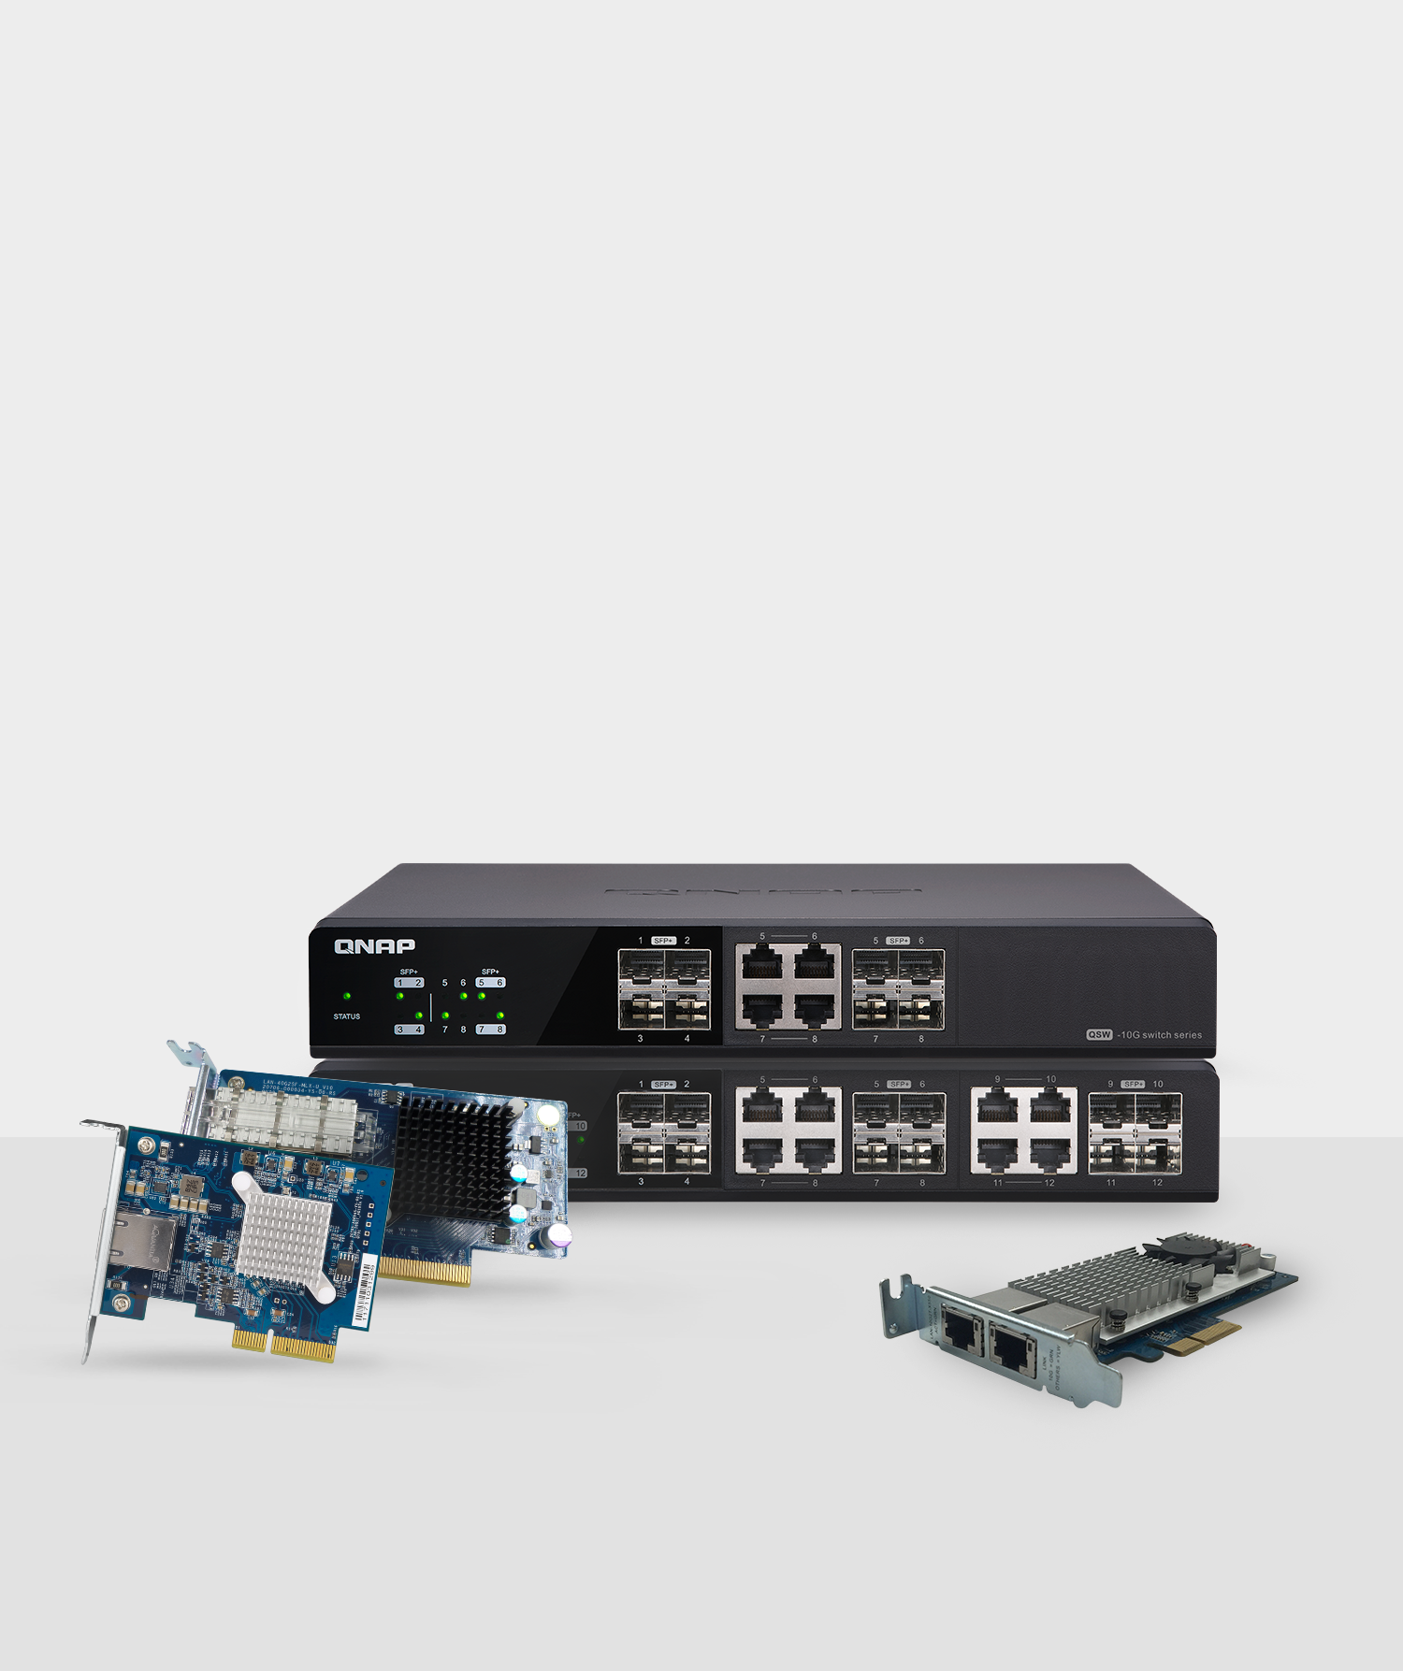
10GbE Switches & Network Expansion Cards
Upgrading network environment at a cost-effective price
QNAP provides economical solutions for businesses, organizations, and advanced home users to adopt 10GbE network infrastructure. With 10GbE connectivity, users can boost the performance of bandwidth-demanding tasks and team collaboration.

Slide 28
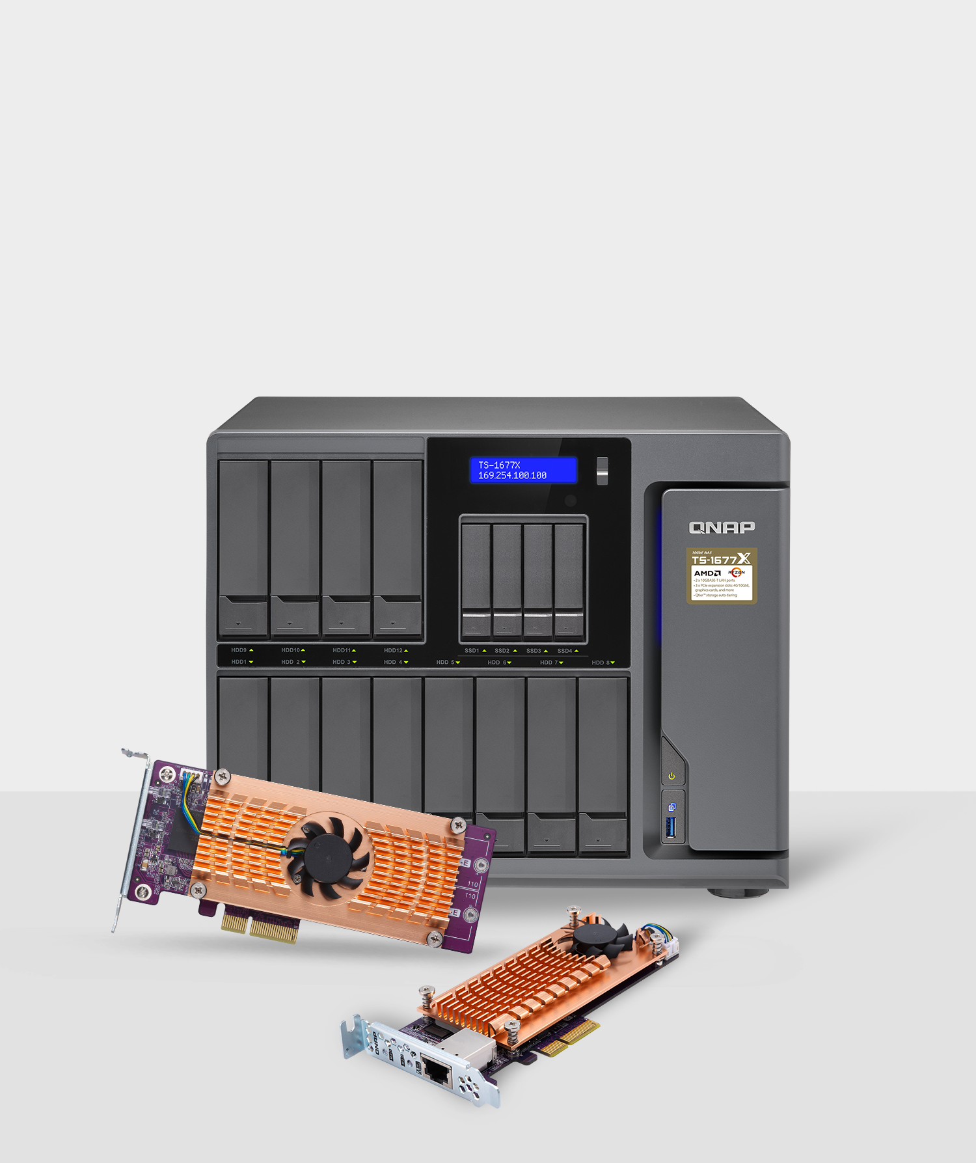
QM2: M.2 SSD/10GbE PCIe Expansion Cards
Optimize 10GbE applications with M.2 SSD caching
The QM2 series PCIe cards add support for M.2 SSDs and 10GbE RJ45 connectivity (optional) to a QNAP NAS. Combining SSD and 10GbE connectivity into one solution, the QM2 helps improve overall NAS performance while providing an affordable upgrade path for adopting 10GbE networks.

Slide 29
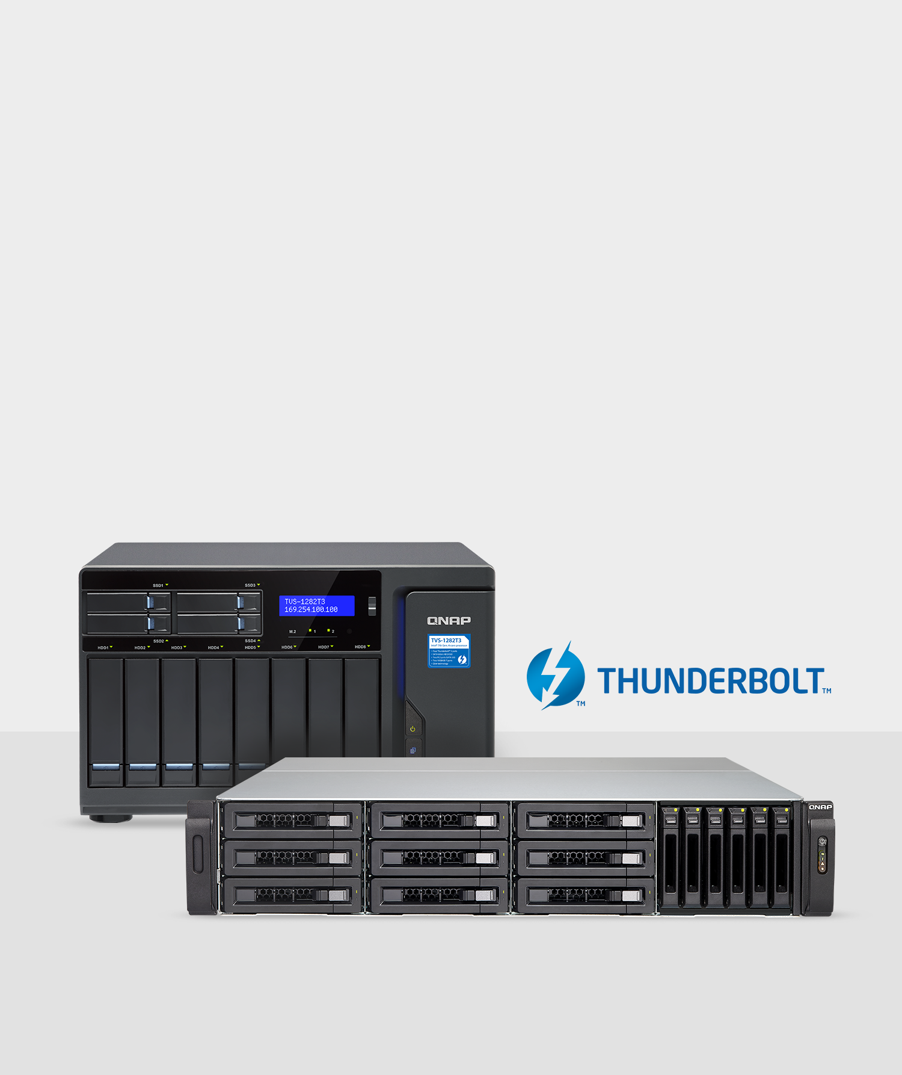
Thunderbolt™ NAS
Boost creative media collaboration
QNAP Thunderbolt NAS solutions features ultra-high transfer speeds with expandable data storage, boosting productivity with 4K workflows and empowering collaborative video editing for Thunderbolt-equipped Mac & Windows users.
Coupled with 10GbE connectivity, Thunderbolt NAS brings incredible flexibility for network connectivity, helping users tackle today's challenges in fast-paced multi-workstation environments.

Slide 30
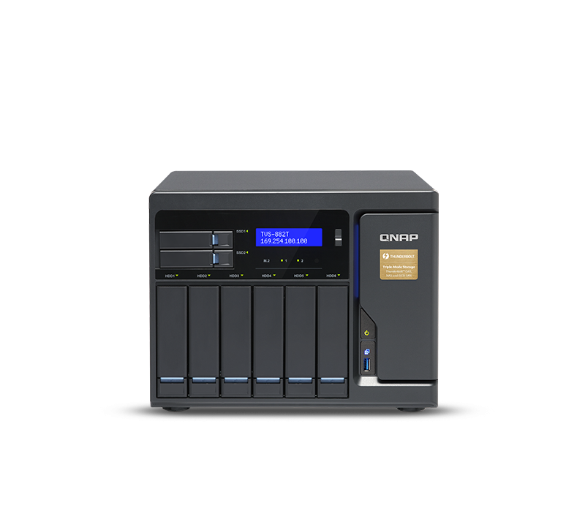
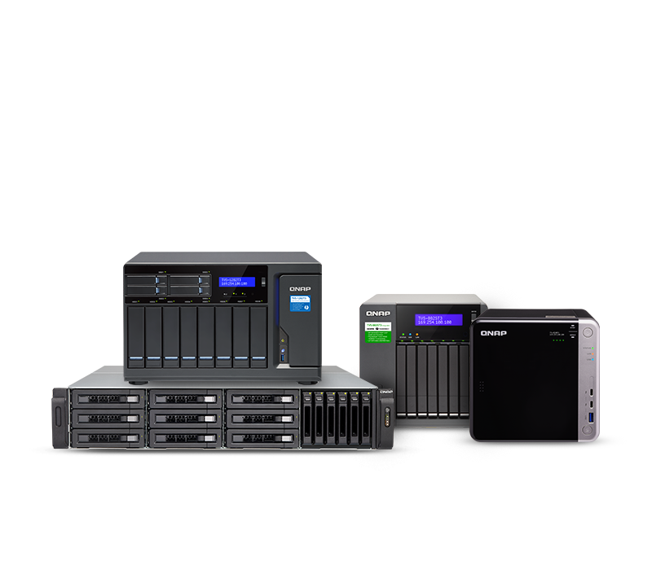
Thunderbolt NAS Series
Thunderbolt 2 NAS
Thunderbolt 3 NAS

Slide 31
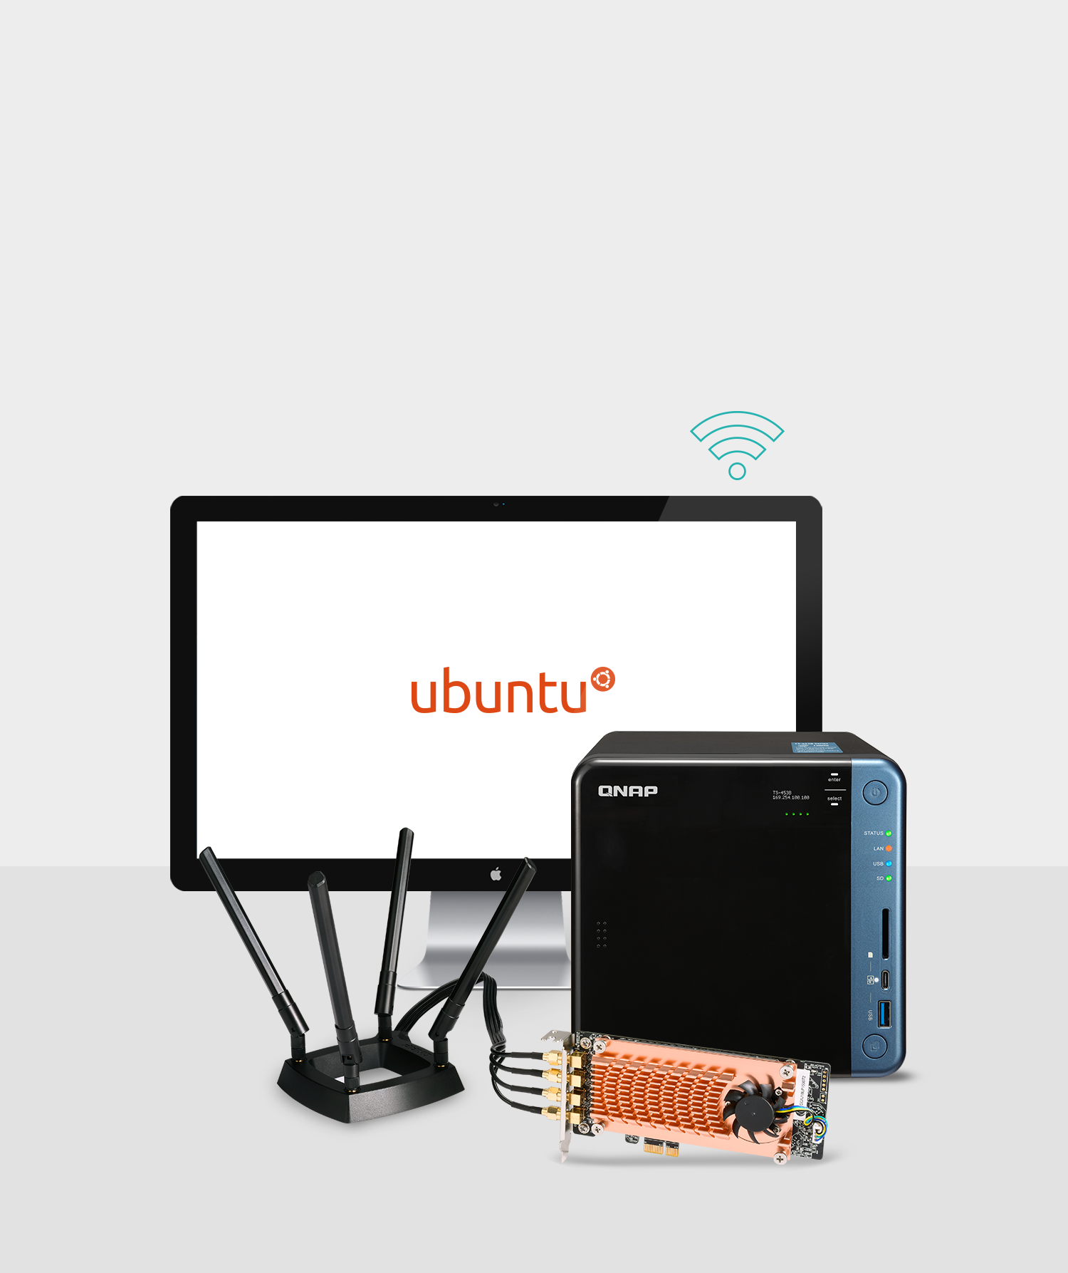
Wireless Adapter: QWA-AC2600
A tailor-made private wireless network that meets your needs
The QWA-AC2600 turns a Ubuntu/Linux PC or QNAP NAS into a high-performance and secure wireless access point/base station.
Leveraging the higher compatibility of 802.11n and faster connection of 802.11ac, the solution empowers versatile applications including wireless LANs in the workplace and Internet of Things (IoT) deployment in the field.

Slide 32
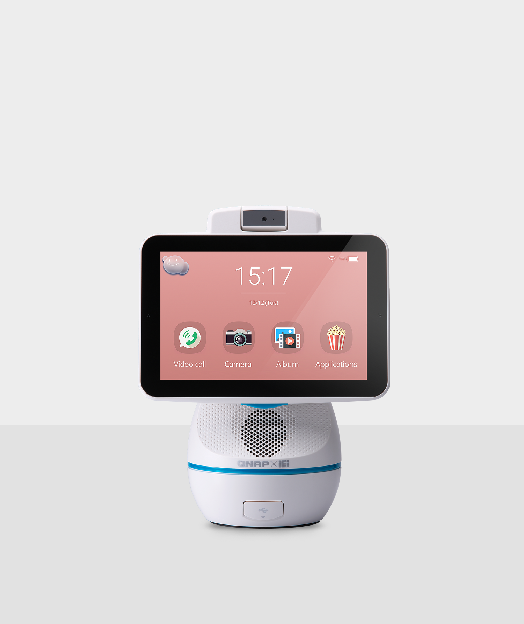
AfoBot
QNAP's first video companion robot
Designed with a focus on home environments, AfoBot is your intelligent companion assistant. AfoBot features voice interaction, face recognition and video calls. It helps foster easy communication, family care, entertainment, and daily life assistance, enhancing quality of life and providing greater communication opportunities at home.

Slide 33
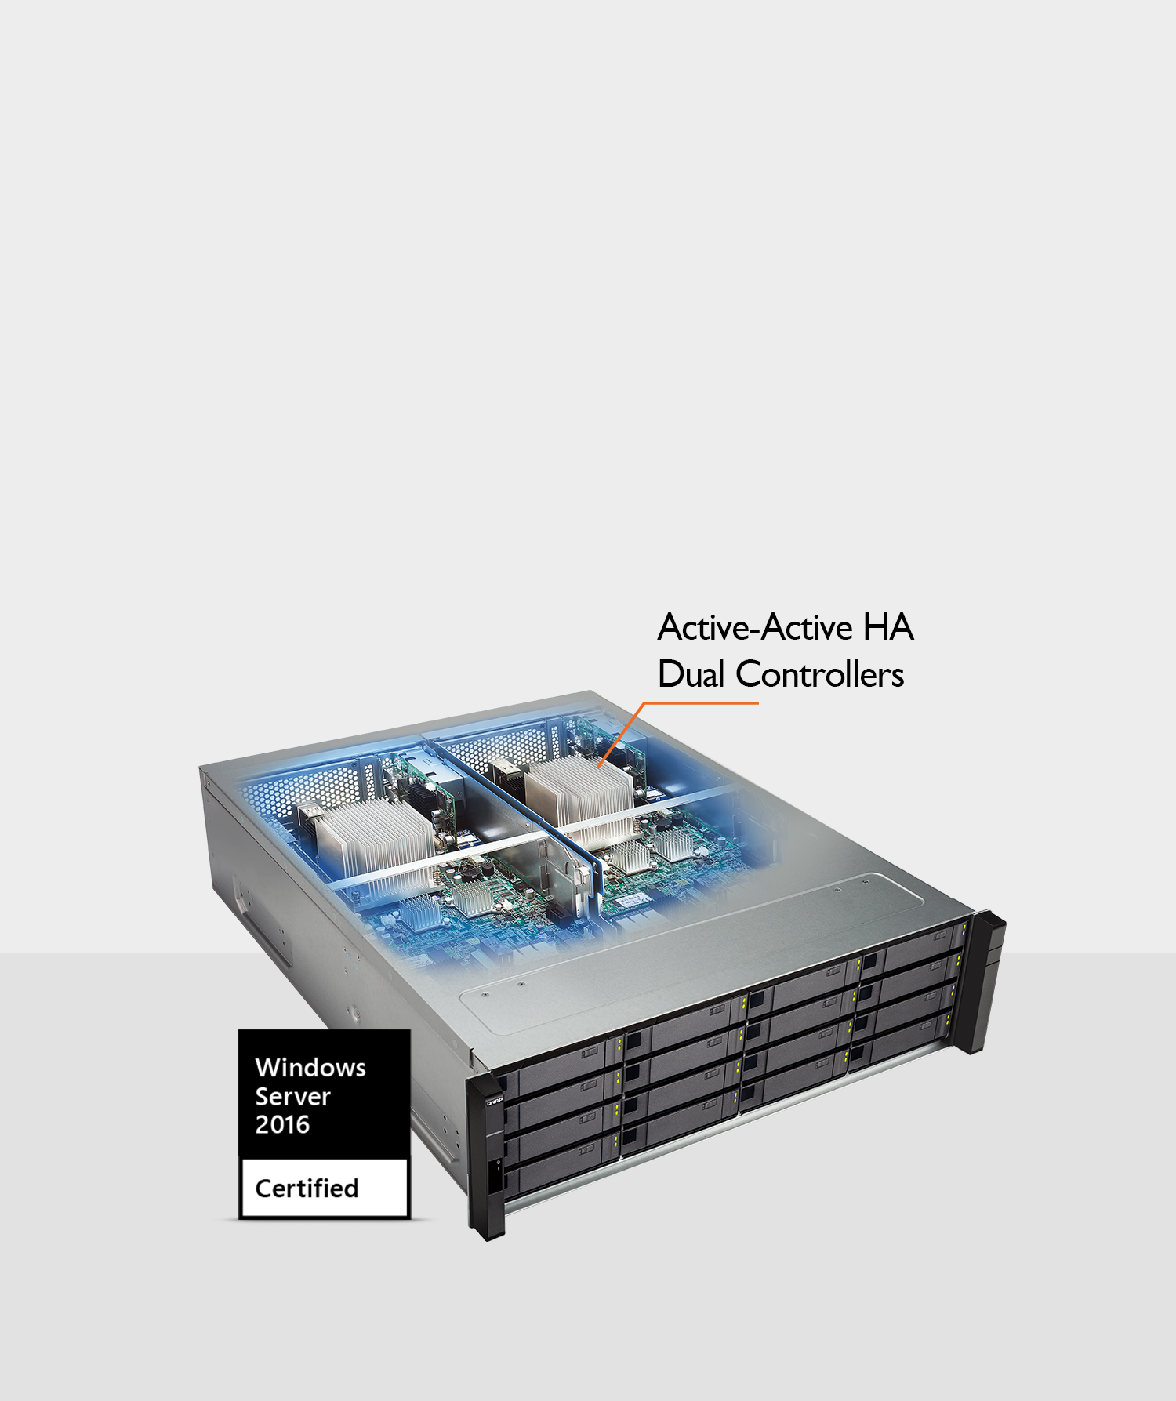
High Availability
Dual-controllers for near-zero downtime
Designed for mission-critical IT tasks, the Enterprise ZFS NAS excels in providing High Availability solutions for file servers, virtualization servers, virtual desktops, online video streaming, snapshots and remote recovery.

Slide 34
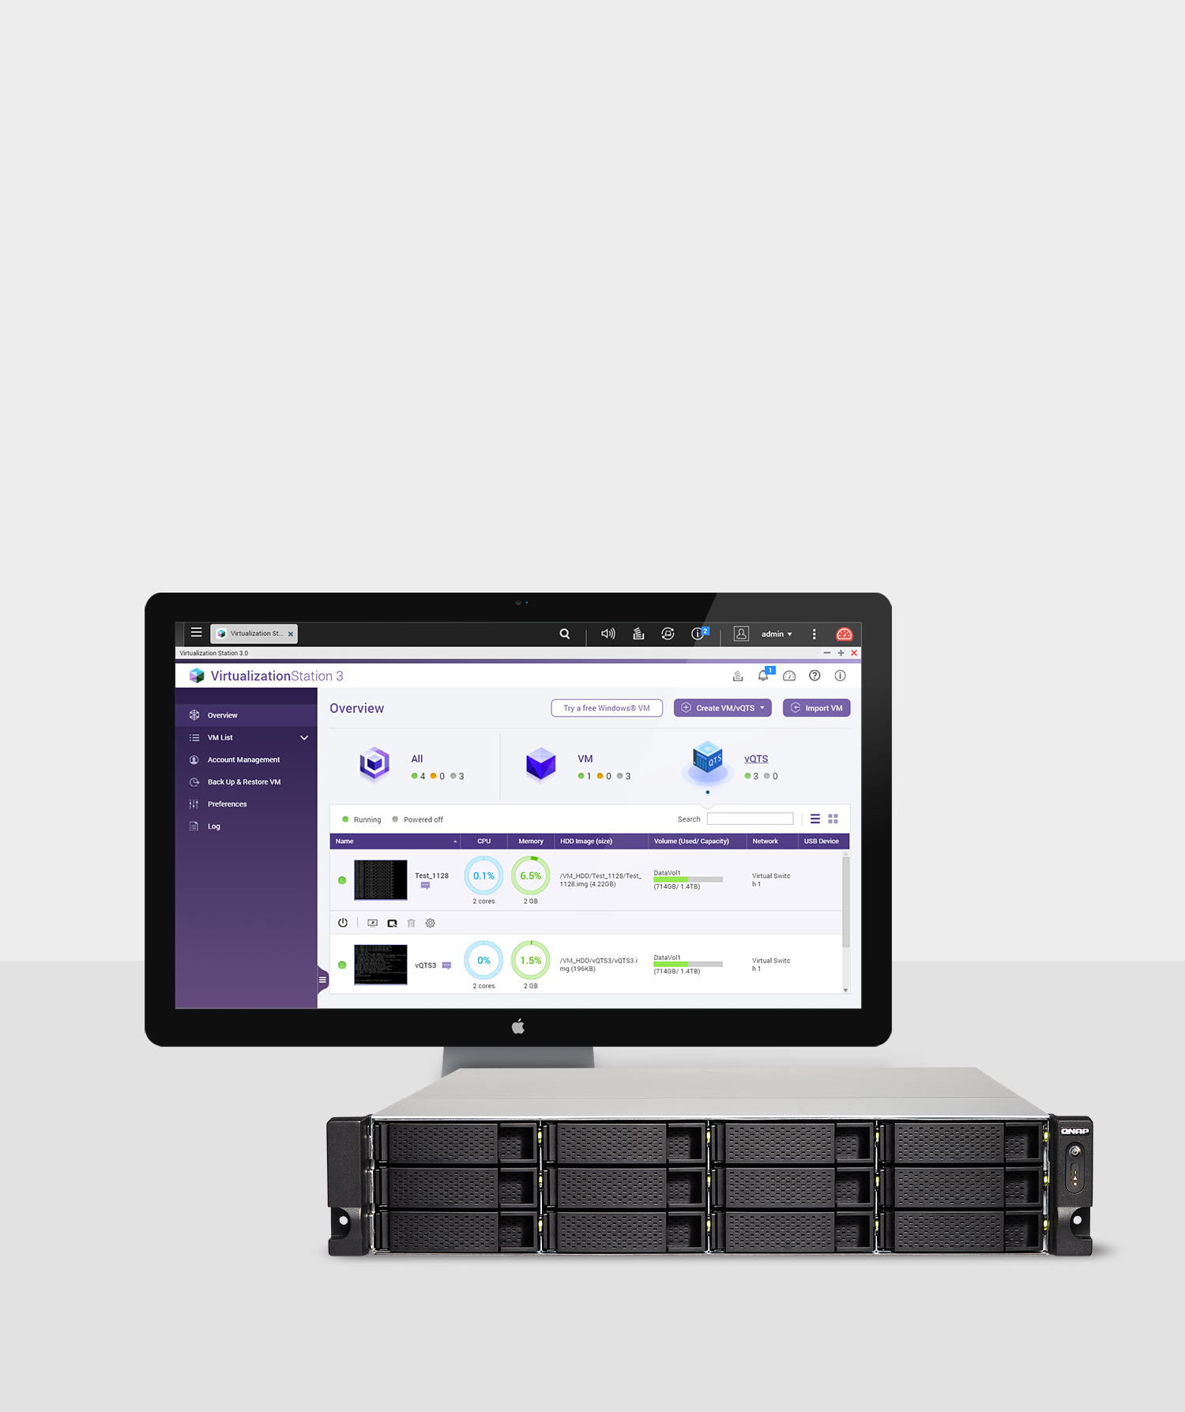
Virtualization
Storage for virtualized environments, VMs and containers
QNAP NAS provides high-performance, reliable and affordable storage solutions for VMware® vSphere™, Microsoft® Hyper-V®, and Citrix® XenServer™. It is also a server to host virtual machines (with Virtualization Station) and containerized apps (with Container Station) for greater usage potential.

Slide 35
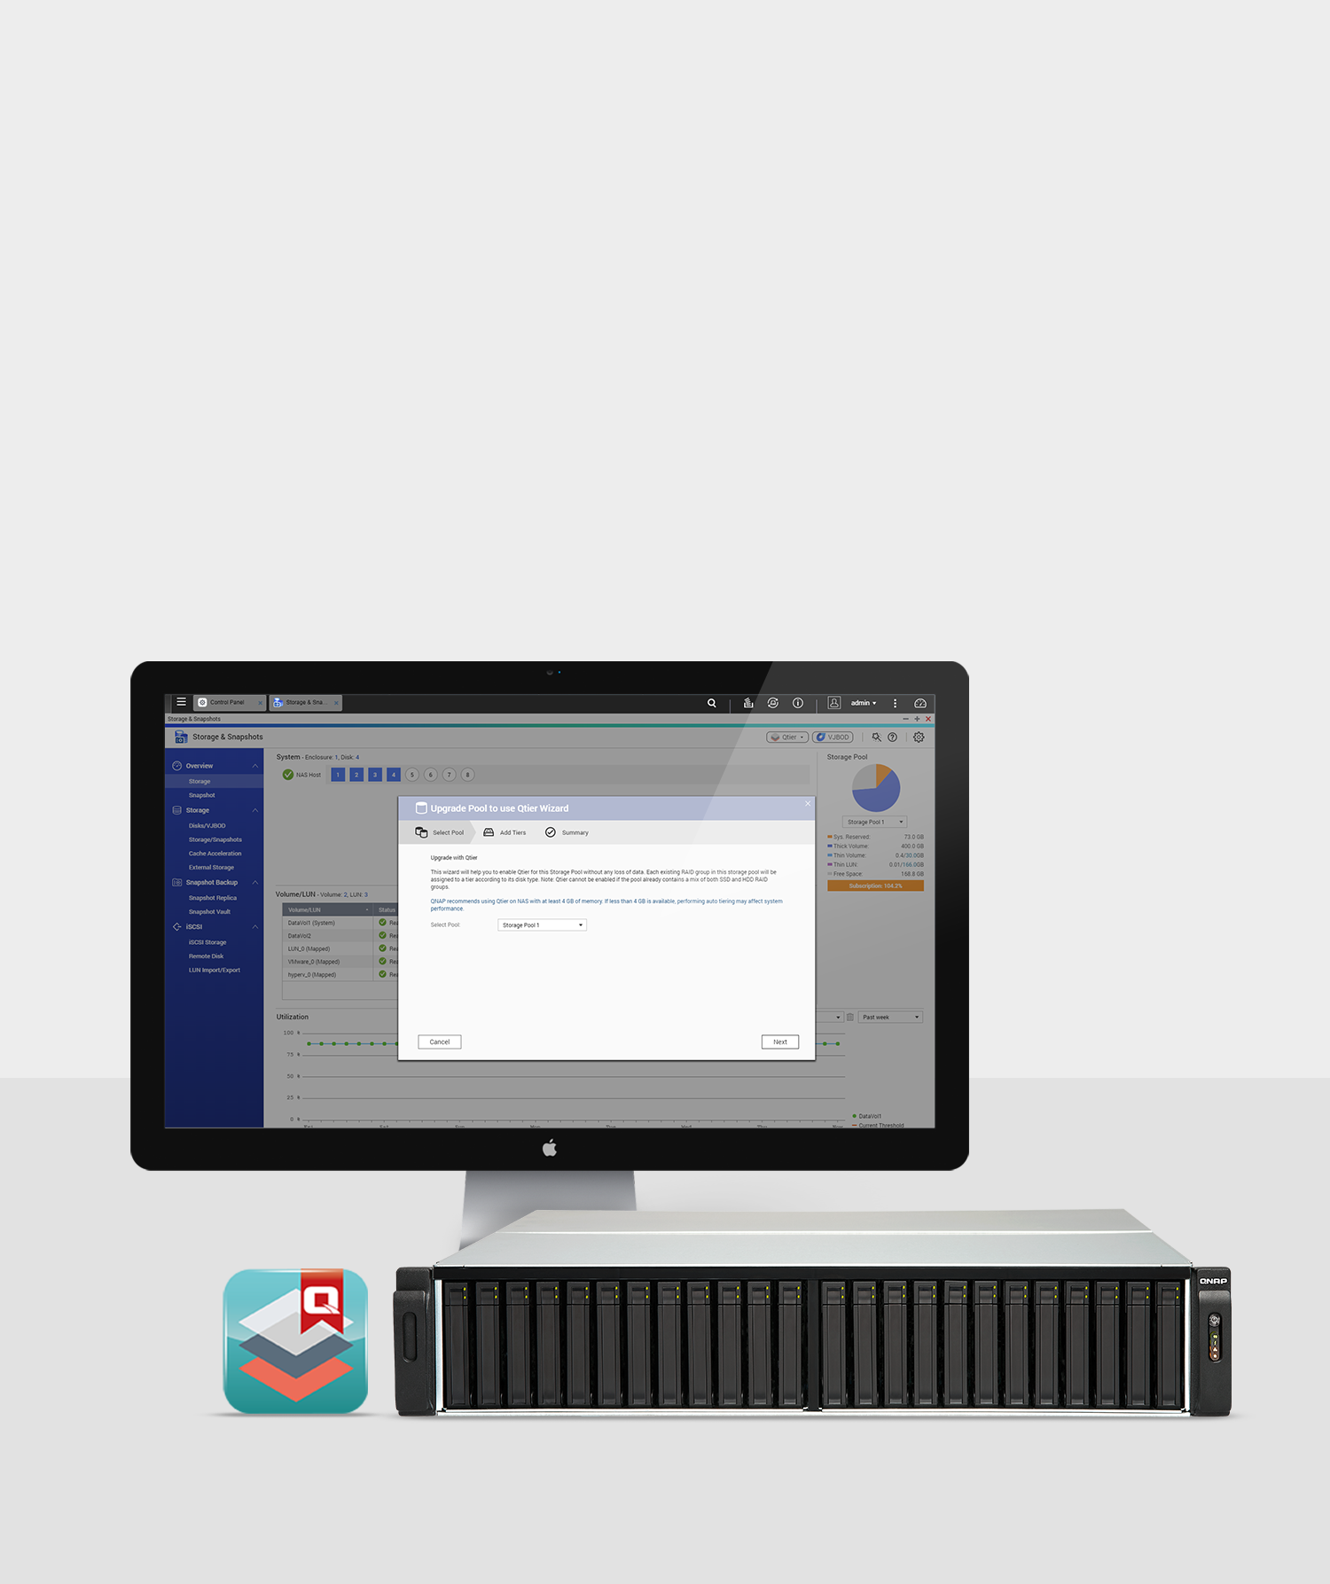
Qtier™ Optimization
Enabling 24/7 optimized storage efficiency
Qtier Technology empowers QNAP NAS with Auto Tiering that helps continuously optimize storage efficiency across SSD, SAS, and SATA drives for around-the-clock acceleration.

Slide 36
4K live-stream broadcasts
Embracing live-streaming trends
DJ2 Live is an exclusive live broadcasting platform based on a private cloud that supports up to 4K video live-stream broadcasts and stores all the videos on the private, secure, high-capacity QNAP NAS.

Slide 37
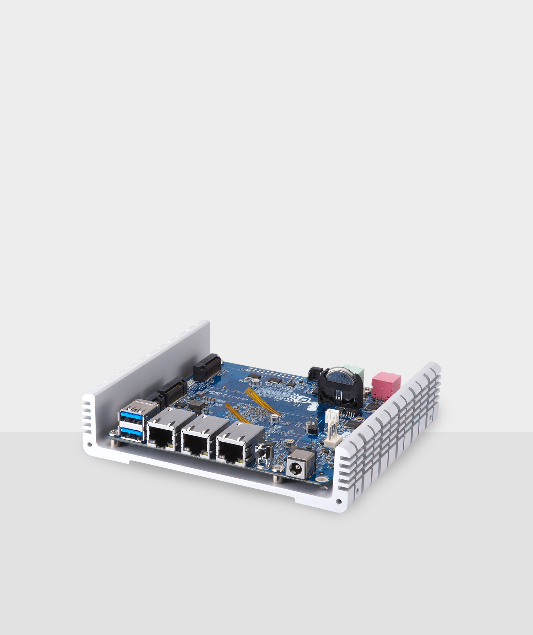
Internet of Things
Private IoT cloud platform & IoT server
QIoT Suite provides easily-adoptable practical modules for developers, accelerating IoT development and services. QBoat Sunny (QTS IoT Server) helps connect and manage IoT devices and applications to provide a handy solution for the great potential industrial demands of IoT.

Slide 38
QNAP Innovates
Full-throttle innovations accommodating comprehensive business & home entertainment applications.

Slide 39
Backup & Restoration
Efficient backup and disaster recovery
Hybrid Backup Sync consolidates backup, restoration and synchronization functions into a single QTS app for data transfer to local, remote and cloud storage spaces.

Slide 40
Synchronization
File sharing and syncing across devices
Qsync enables efficient file synchronization between a QNAP NAS and linked devices such as computers, laptops and mobile devices.

Slide 41
Web Automation Service
User-defined NAS rules and services
IFTTT Agent allows connecting your QNAP NAS with apps like Gmail, Facebook, and Twitter to automate daily tasks based on user-defined rules to boost productivity.

Slide 42
Centralized Device
Management
Single point solution for
networked computing devices
QRM+ is QNAP’s Centralized Remote Management solution that provides a single-point solution for IT administrators to discover, map, monitor and manage IPMI-compatible Windows and Linux devices such as Servers/PCs/Thin Clients.

Slide 43
Multi-zone Home Entertainment
NAS as a multimedia control center across devices
Cinema28 is a centralized management platform for multimedia streaming devices, allowing users to stream media files from a single platform, greatly enriching multimedia experiences for home and SOHO users.

Slide 44
File Management Solutions
Simplified file organization and data search tools
Qfiling automates your file organization - all you need to do is categorize your files, set a schedule, and leave the rest to Qfiling.

Slide 45
File Management Solutions
Simplified file organization and data search tools
Qsirch is an exclusive whole-NAS search engine that supports file indexing, content preview, personalized search filters, enhanced email search and management of stored emails.

Slide 46
Workplace Productivity
Manage your work and daily life smartly
QNAP provides various management tools to help you smartly manage your work and daily life. QmailAgent and Qcontactz allow you to centrally manage multiple email accounts and contacts. QcalAgent is a centralized schedule management app that can synchronize with multiple calendar services, including Google Calendar, Outlook Calendar, and CalDAV-based calendar services.

Slide 47
OpenStack Deployment Solution
Fast integration of QNAP NAS with OpenStack environment
QNAP’s Cinder driver supports OpenStack Ocata, turning QNAP's enterprise-grade NAS into an integral part of OpenStack ecosystems, providing businesses with a flexible, easy-to-use, and low-cost storage solution.

Slide 48
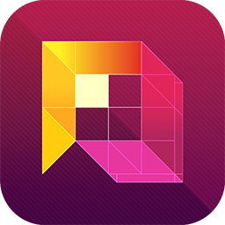
QVR Pro
A professional NVR solution on QNAP NAS
QVR Pro is a professional surveillance application that runs alongside the NAS OS as an independent operating environment. With various APIs available, developers can create an open event platform that integrates QVR Pro's resources to build a surveillance solution to meet their needs.

Slide 49
QVR Center & QVR Guard
Surveillance applications for QVR Pro
QVR Center offers a central management platform for multiple QVR Pro deployed within various environments. Users can centrally monitor live feeds, play back surveillance footage, and receive event notifications from multiple QVR Pros to respond quicker to events.
QVR Guard features failover functionality that protects QVR Pro from system failure and ensures uninterruptible surveillance recordings.

Slide 50
Alliance

Slide 51
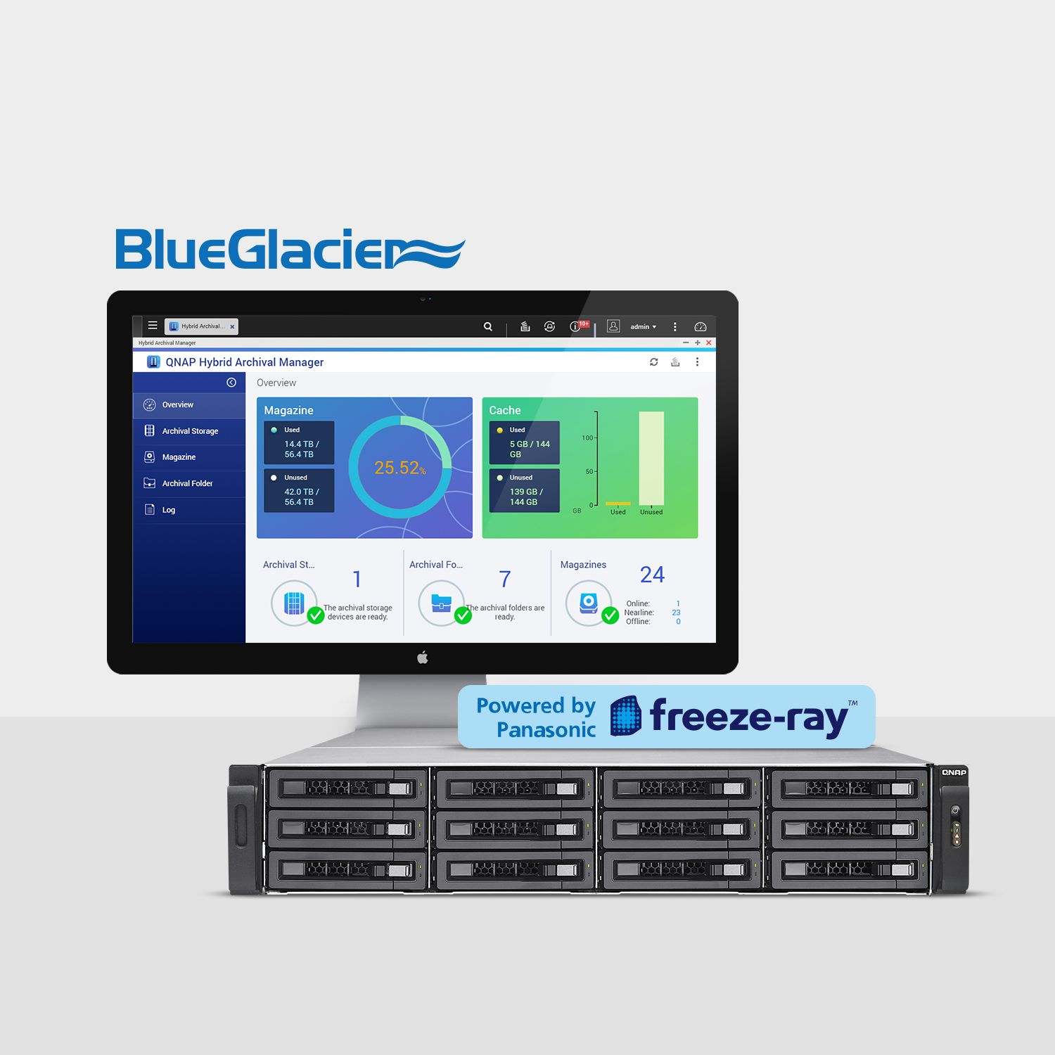
QNAP X Panasonic
Enterprise storage & archiving solutions
QNAP partners with Panasonic to present a Blu-ray Disc archiving solution for large-volume data by integrating QNAP NAS with Panasonic’s "freeze-ray" scalable Optical Data Archive System.

Slide 52
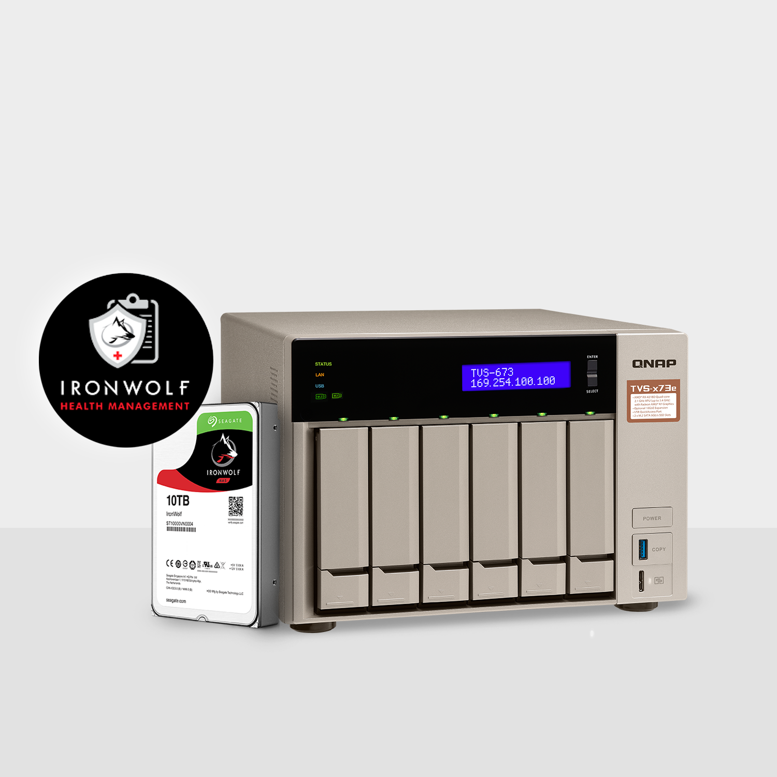
QNAP X Seagate
Boost NAS Health with IronWolf Health Management
Seagate’s IronWolf Health Management (IHM) is now available on QNAP NAS. IHM provides a suite of diagnostic tools to improve NAS system reliability with powerful prevention, intervention and recovery capabilities.

Slide 53
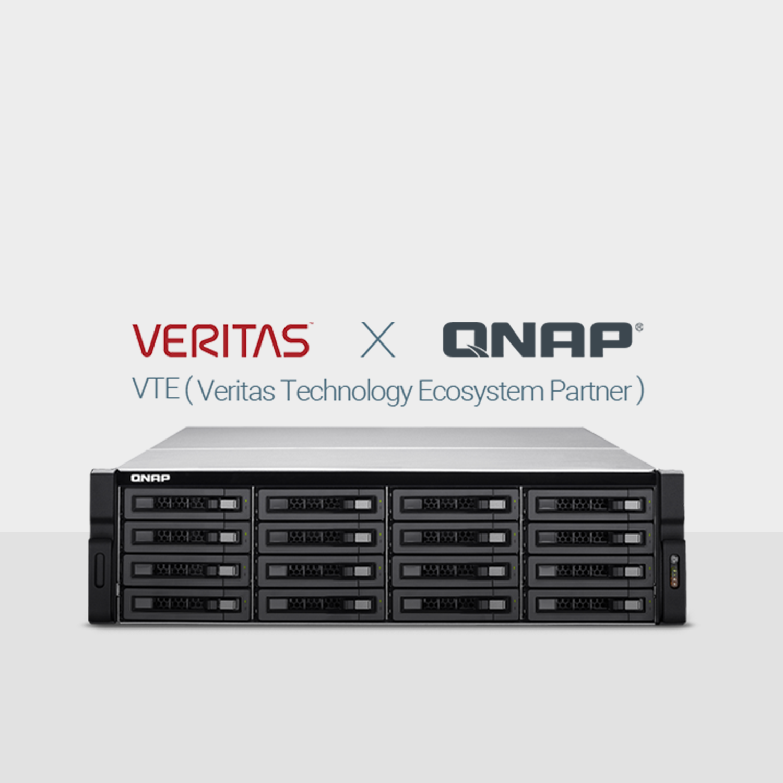
QNAP X Veritas
All-in-one backup solution across physical, virtual and cloud environments
QNAP NAS and Veritas Backup Exec introduce a comprehensive storage solution tailored for the data and system backup needs of small and medium businesses. QNAP Enterprise NAS now supports the Veritas Backup Exec solution to provide higher-performance and highly-scalable backup service across physical, virtual and cloud environments

Slide 54
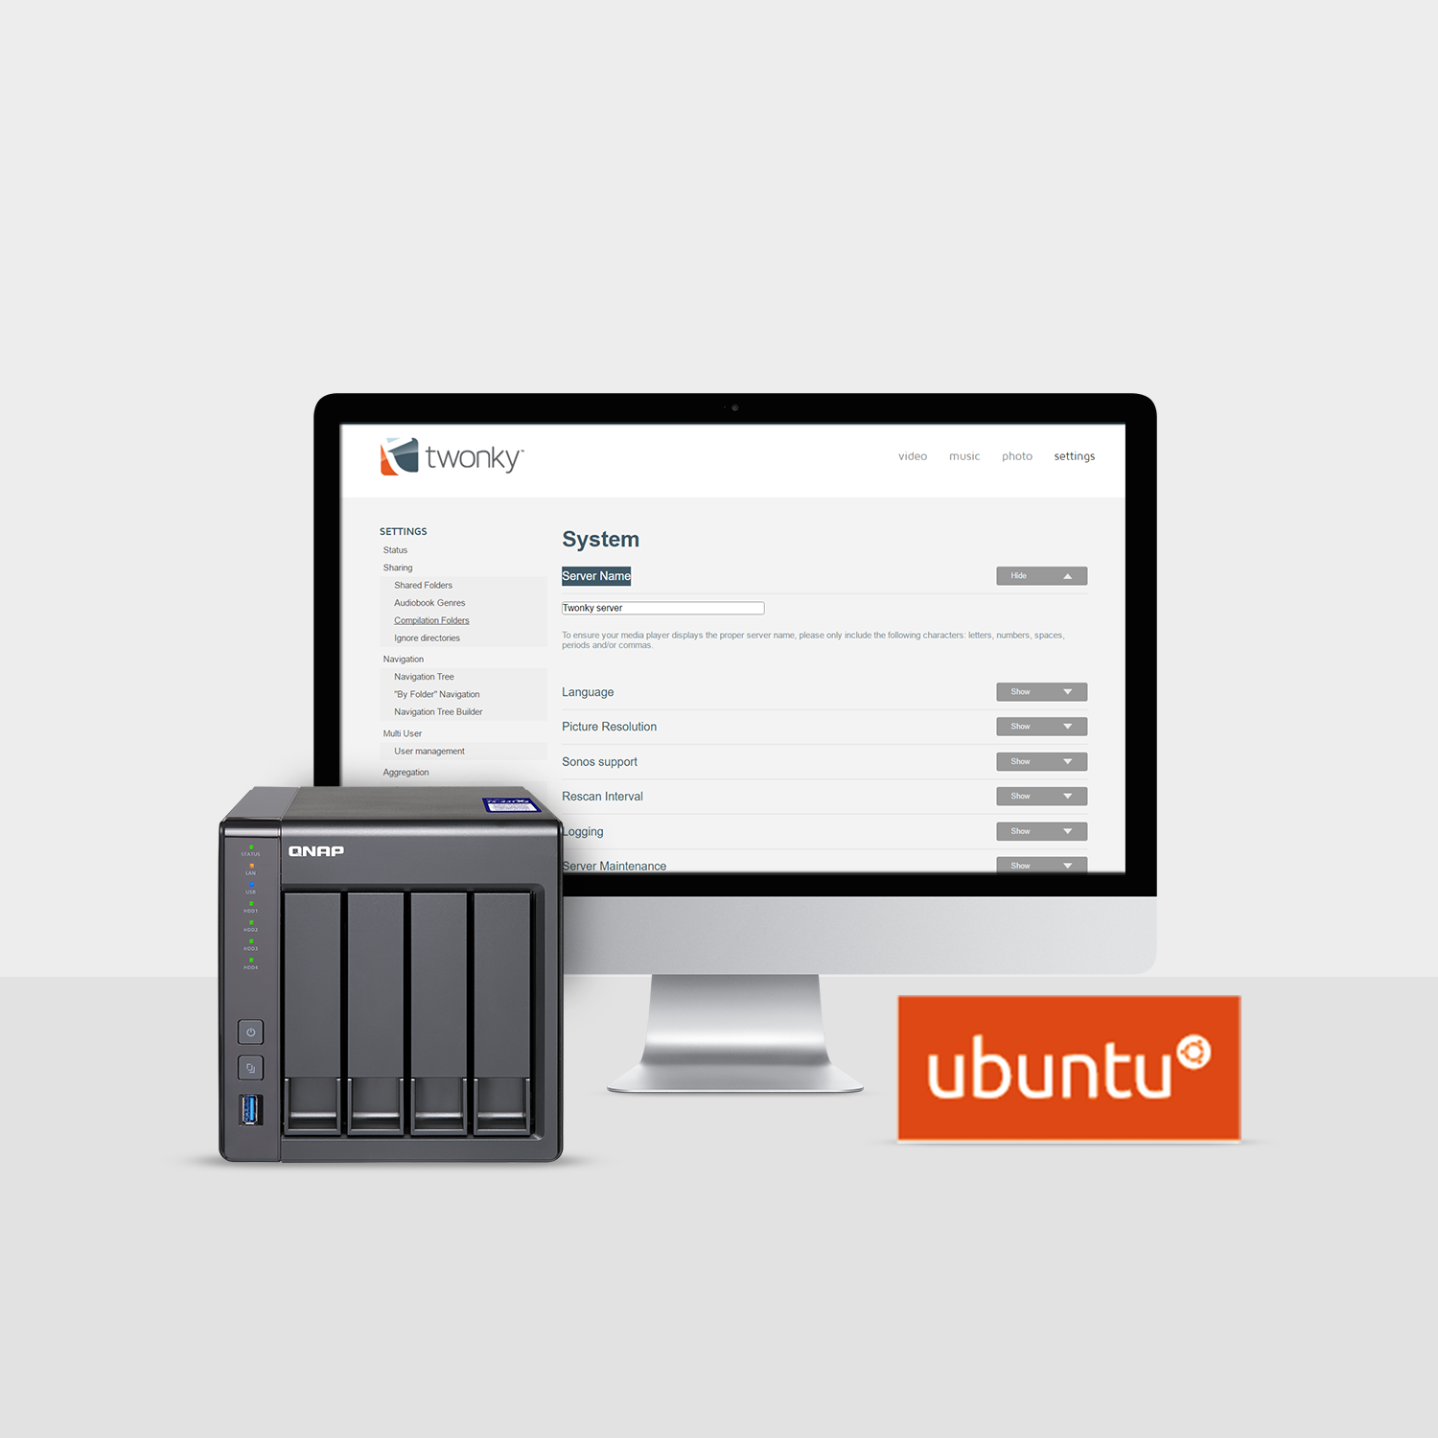
QNAP X Canonical
Dual operating systems
Leveraging QNAP’s QTS OS and Ubuntu, Linux Station provides an advanced platform for the development of Internet of Things (IoT) services and applications.

Slide 55
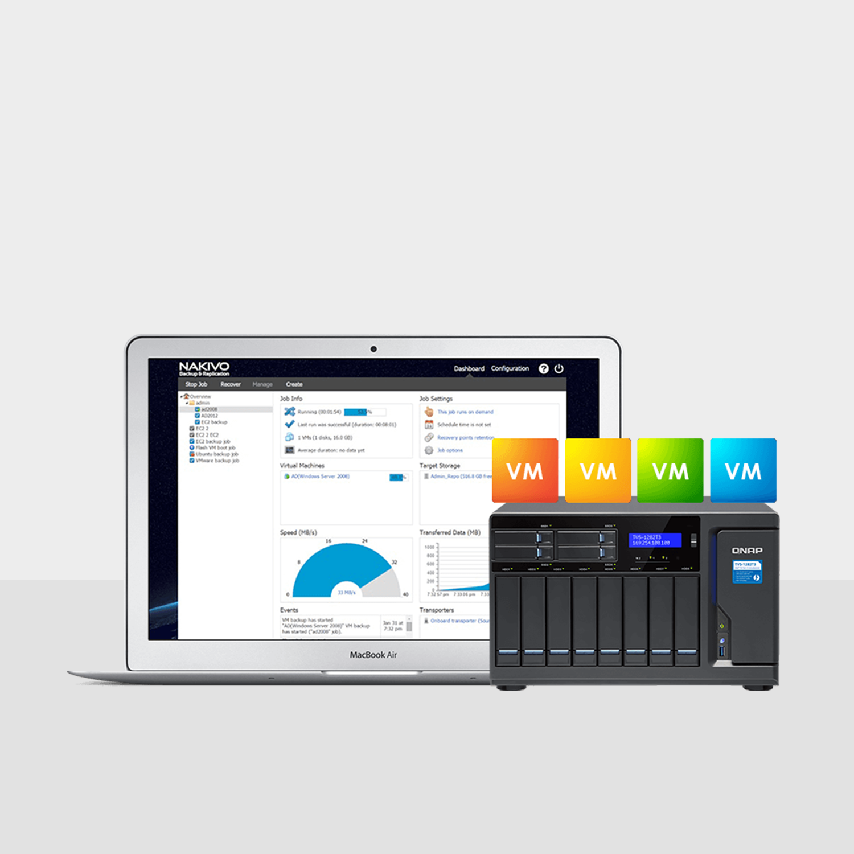
QNAP X Nakivo
All-in-one backup solution for VM backup
QNAP has teamed up with NAKIVO® to provide NAKIVO Backup & Replication v7, a high-performance yet affordable VM backup solution that is fully integrated with QNAP NAS.

Slide 56
More Feature-rich
Applications

Slide 57
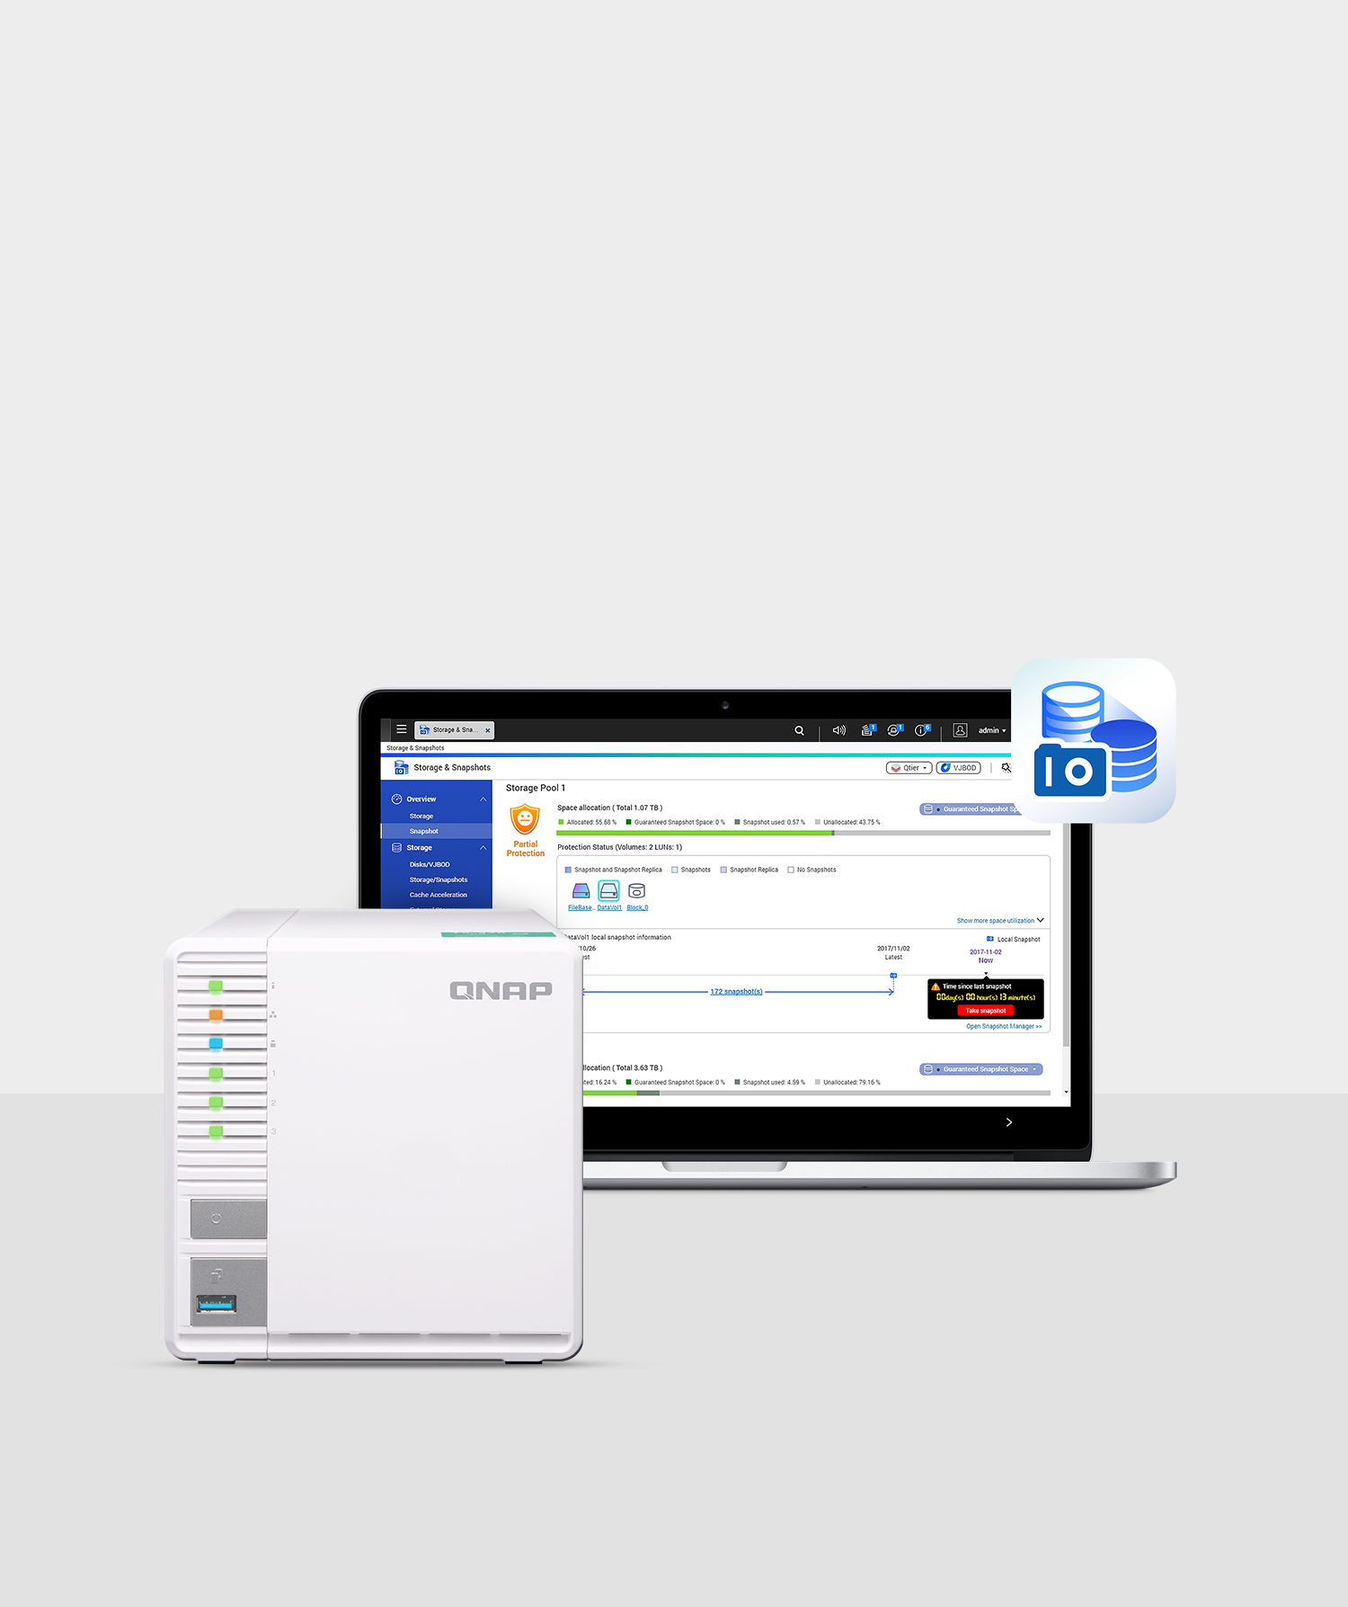
Data Protection with Snapshots
Ext4-based snapshot provides uncompromised storage performance
Now also supported by ARM-based NAS
Adequate disaster recovery option against ransomware attacks
Fast and precise data backup with block-based LUN snapshots to reduce disaster recovery time
Snapshot Replica & Snapshot Reserve Space

Slide 58
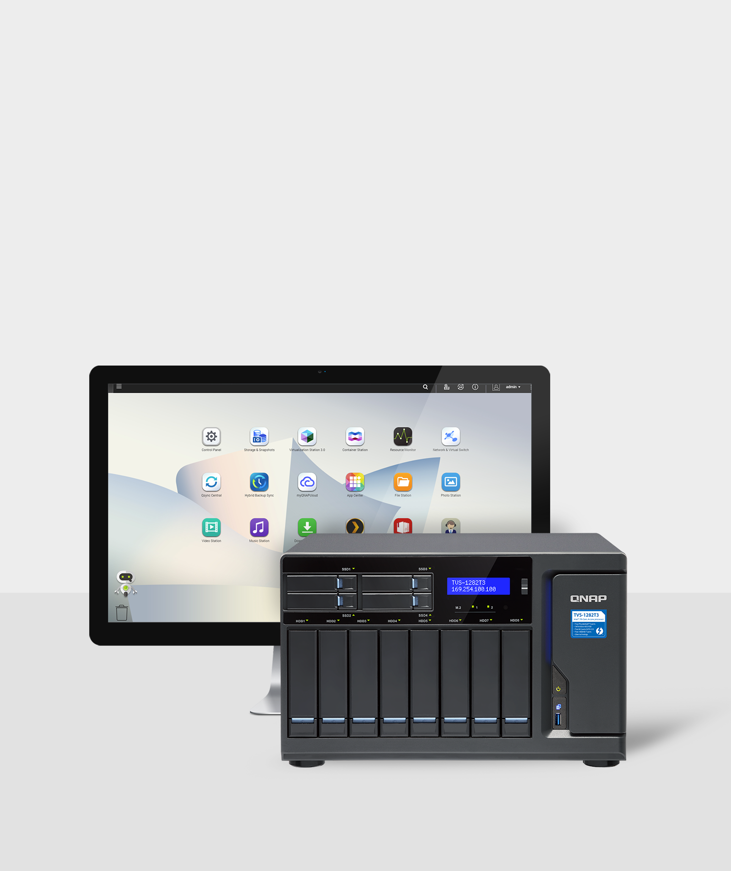
Storage
QNAP NAS provides a secure, high-capacity centralized file center to store up to petabytes of data.
Comprehensive RAID support
Cross-platform file sharing (SMB/CIFS, AFP, WebDAV, and NFS)
VJBOD (Virtual JBOD) for using a QNAP NAS to expand the capacity of other QNAP NAS
Scalable design with QNAP expansion enclosures

Slide 59
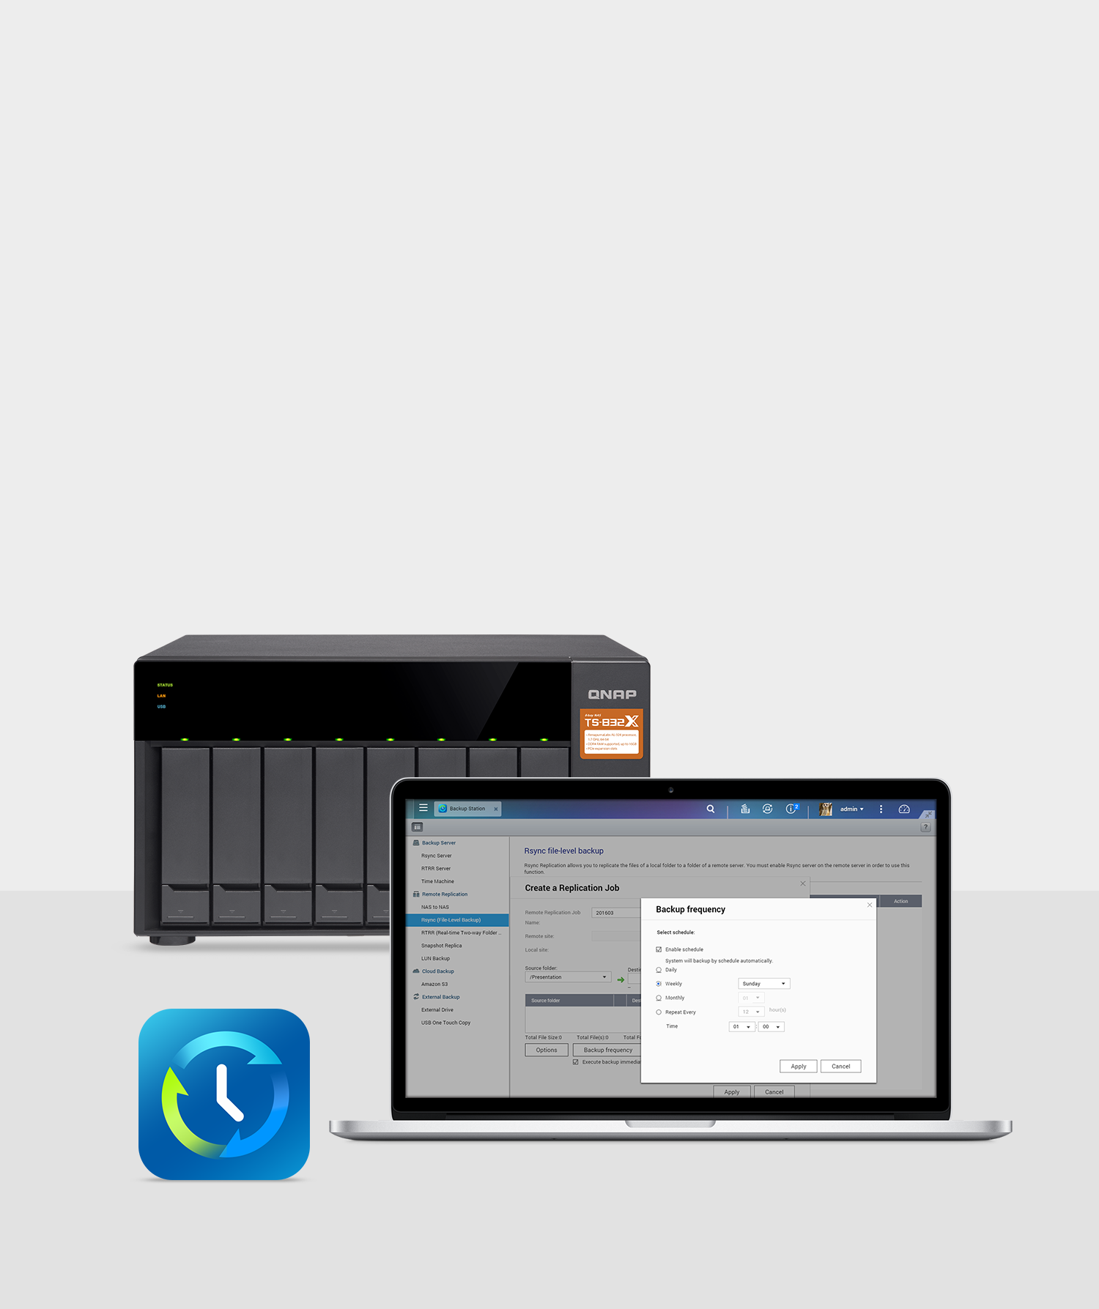
Backup
QNAP NAS assists in mitigating data loss with complete data backup and disaster recovery options.
Desktop/laptop backup
Business critical backup and recovery
VM backup
Remote backup (RTRR, rsync) Volume & LUN Snapshots
Hybrid Backup Sync consolidates backup, restoration and synchronization between local, remote and cloud storage.

Slide 60
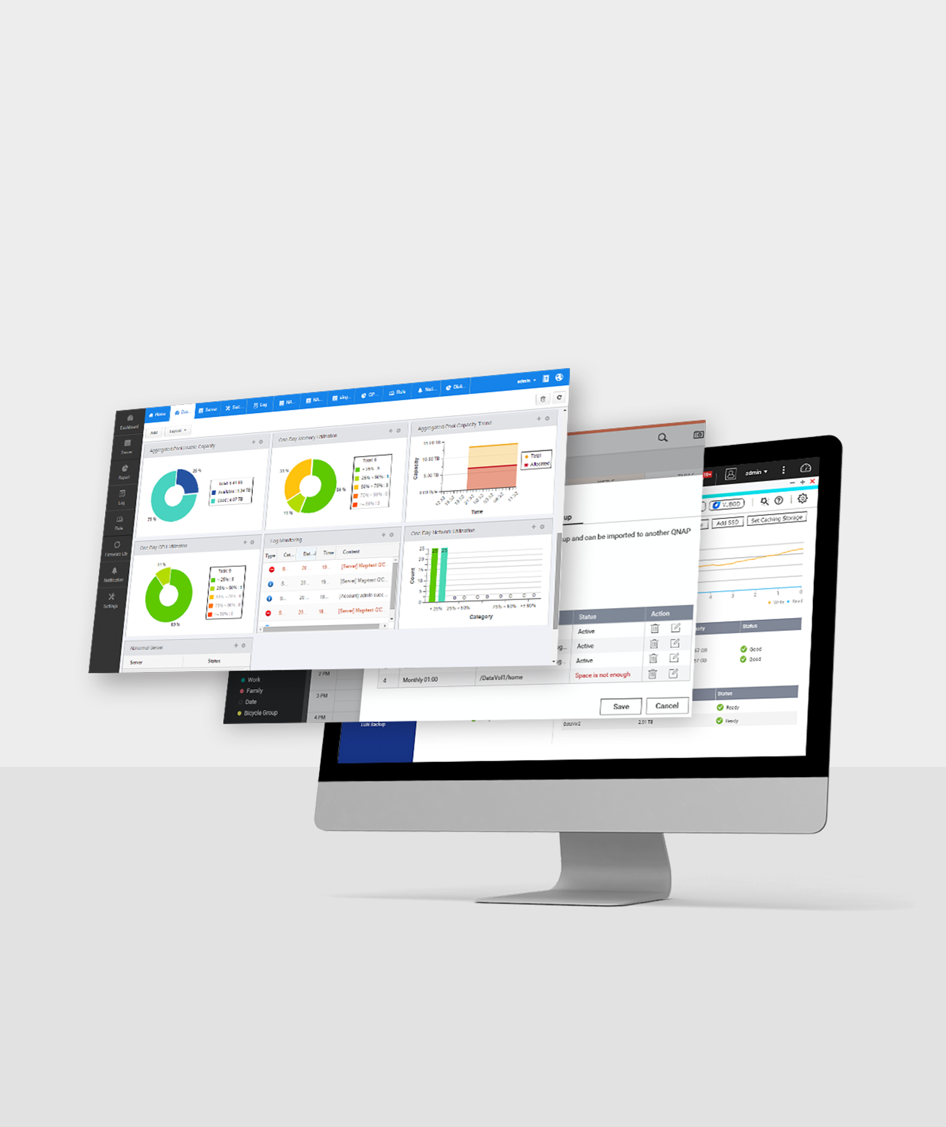
Productivity
QNAP NAS provides various apps and features to multiply productivity to quickly finish more tasks
SSD Cache
QvPC Technology
Q’center
CloudLink
exFAT support

Slide 61
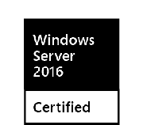
Virtualization
QNAP NAS is virtualization-ready, and supports hosting VMs and containers as cost-efficient storage with optimized performance
Virtualization Readiness - Storage for virtualization
Virtualization Station - Hosts multiple VMs on the NAS
Container Station - Integrates LXC and Docker lightweight containerized virtualization

Slide 62
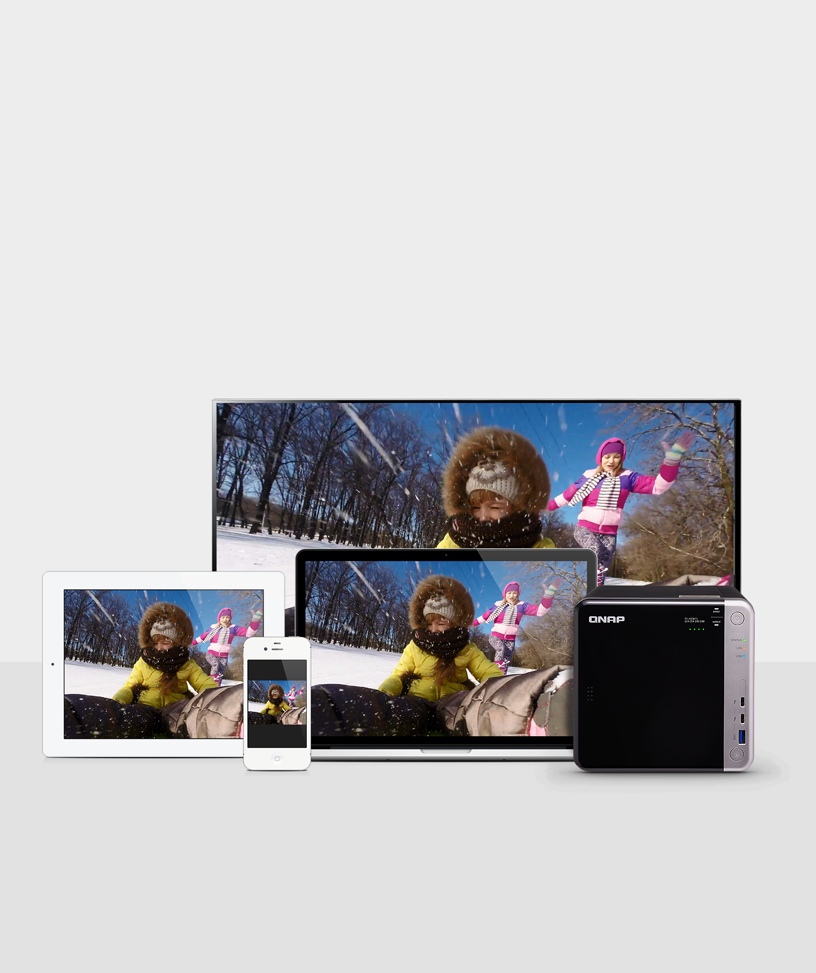
Multimedia
QNAP NAS is an all-in-one multimedia center to collect, back up and share multimedia files for a complete entertainment experience
Photo Station, Music Station
Media Streaming via DLNA, Apple TV, Chromecast, Plex Server or Roku platform
Multi-zone multimedia streaming
Media transcoding
HDMI connectivity for 1080p/4K video playback
OceanKTV - a NAS-based karaoke system

Slide 63
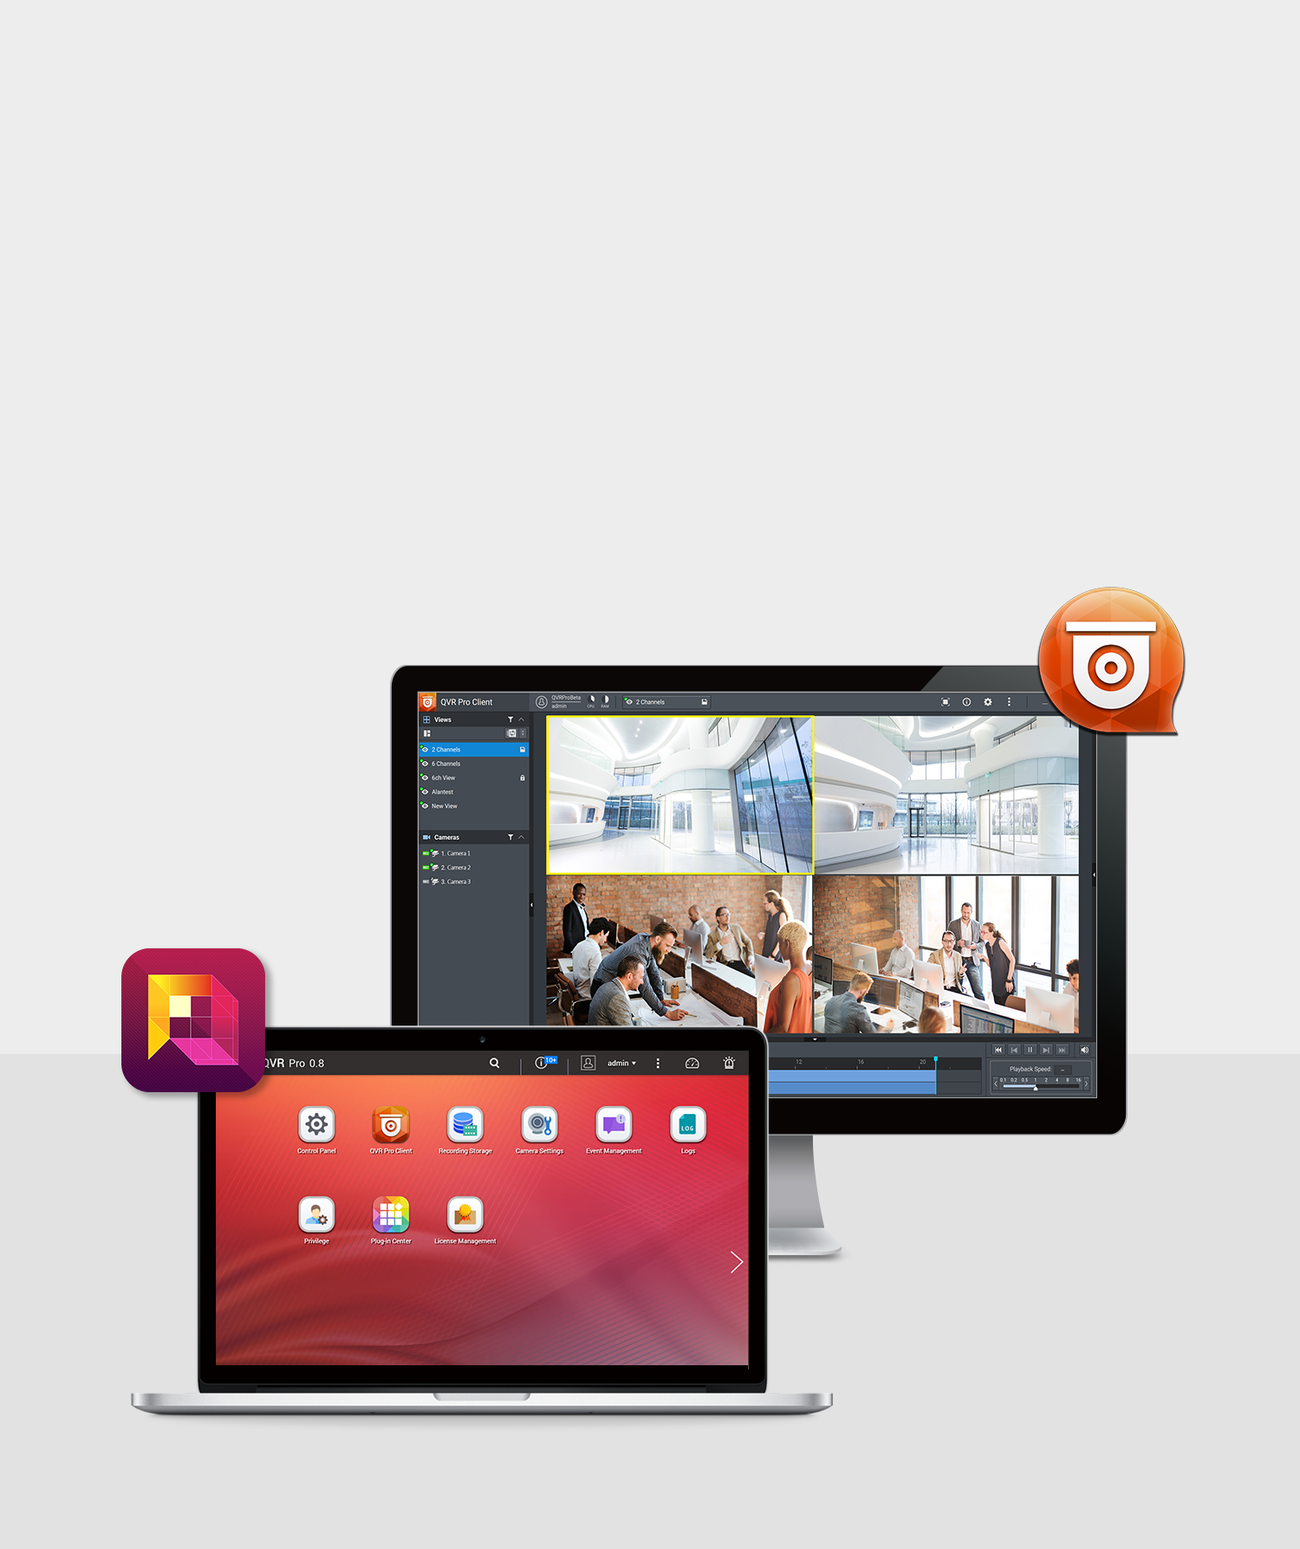
Surveillance
QNAP NAS provides a comprehensive surveillance solution for safeguarding office and home environments with 24/7 security
QVR Pro, a professional network surveillance video management system
User-friendly management interface
Real-time monitoring, video & audio recording and playback
Over 5,000 compatible IP camera models
Expandable IP camera channel licenses
Milestone IP surveillance platform

Slide 64
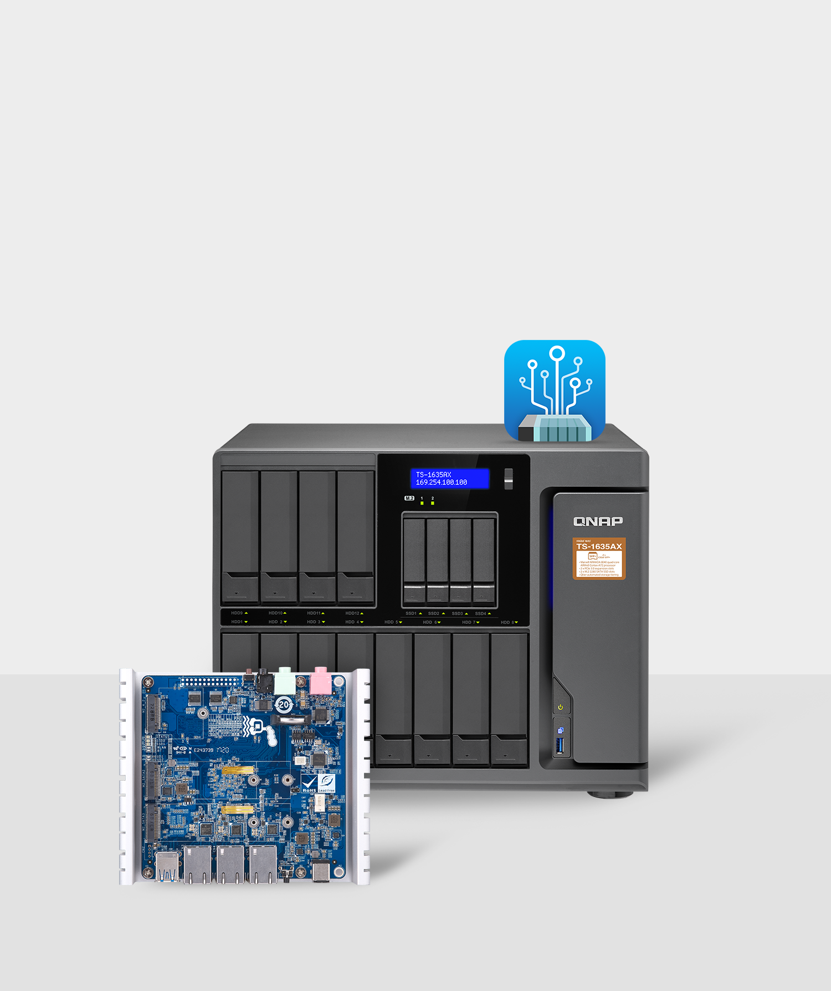
QIoT
QIoT Suite Lite: QNAP’s private IoT cloud platform for microservices-based architectural patterns as applied to IoT systems
QNAP NAS with large storage capacity
Well-rounded security
Protocols for IoT (MQTT, MQTTS, HTTP, HTTPS, CoAP)
Shorter design lifecycle
Scalability for micro services
Integrated with public clouds

Slide 65
QNAP Mobile Apps
QNAP provides numerous apps for iOS, Android, and Windows-based mobile devices to increase the flexibility, manageability and accessibility of QNAP NAS services
Qfile
Qmanager
Qmusic
Qphoto
Qvideo
Qsync
Qsirch
QmailClient

Slide 66
QNAP Utilities
QNAP provides a range of specialized utilities to bring out the best of QNAP NAS
Qfinder Pro
myQNAPcloud Connect
Qsync
NetBak Replicator
Snapshot Agent
vSphere (Web) Client plug-in
Q'center Virtual Appliance
QVHelper
Video HD
Qmedia

Slide 67
QNAP on the Web

Slide 68
www.qnap.com
Facebook
YouTube
Let’s Connect
Instagram
Twitter
Google+

Slide 69
Thank you
Copyright ©2018 QNAP Systems, Inc. All Rights Reserved.

