Slide 1
QNAP helps companies respond to GDPR implementation
Are you ready for GDPR?

Slide 2
Agenda
• What is the GDPR
• Steps to take for GDPR compliance
• Challenges of traditional methods
• Ready-to-use QNAP solutions for GDPR
• Ready for new technologies

Slide 3
What is the GDPR
• The General Data Protection Regulation (GDPR)
• Unified data protection legislation in EU
• Becomes enforceable on 25 May 2018
• GDPR fines up to €20 million or up to 4% of the annual worldwide turnover (whichever is higher)

Slide 4
Steps to take for GDPR compliance
Data control
Right to erasure
Risk mitigation and due diligence
Breach notification
Data Security

Slide 5
Conventional methods of storing unstructured data
USB external
storage
Cloud storage Service
Company PC or laptop
Company local storage

Slide 6
Challenges of conventional methods

Slide 7
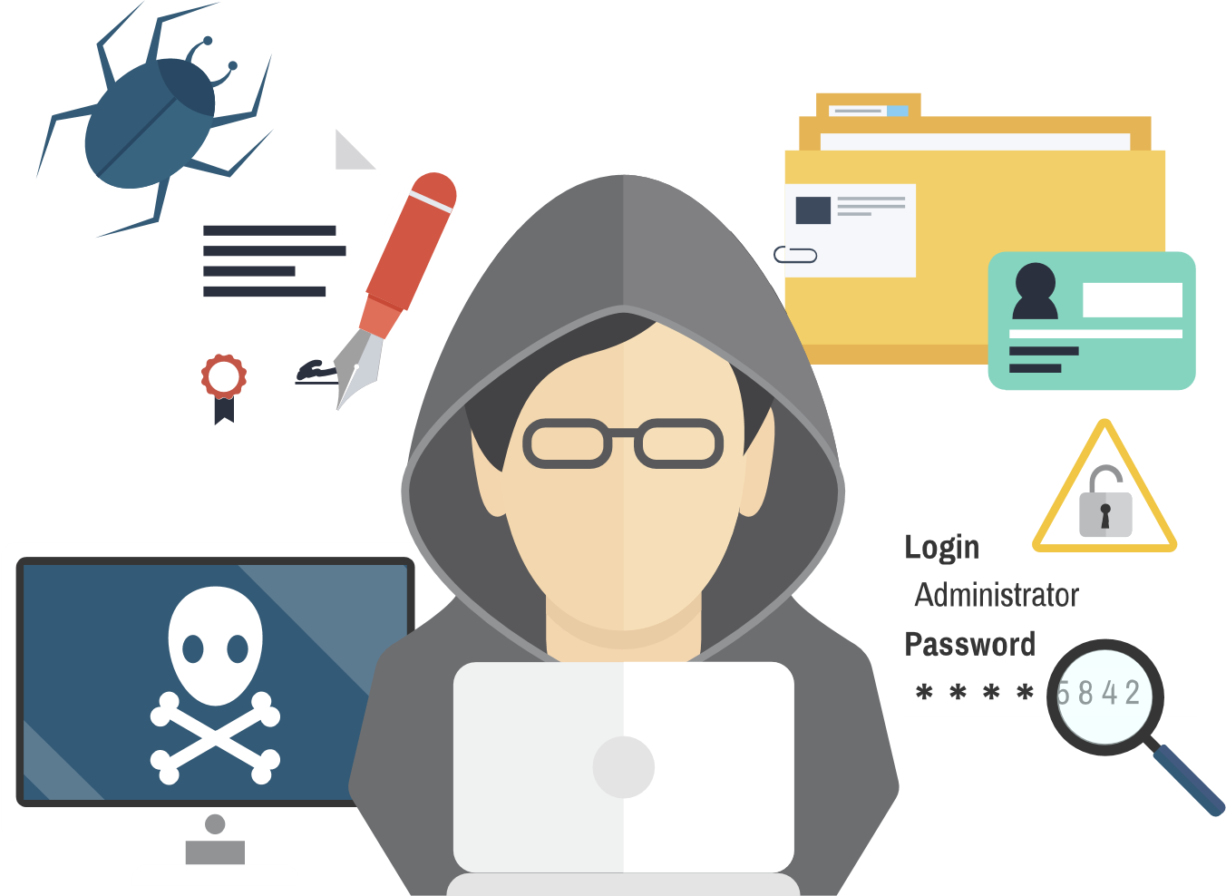
Risks of conventional methods
• Data lost (ex: natural disasters to datacenters, loss of data encryption key)
• Data stolen or encrypted by malware
• Data deleted or modified
by unauthorized personnel
• Difficulties in finding specific data

Slide 8
QNAP provides solutions to assist you in responding to GDPR
Data theft prevention
solution
Access rights management solution
Data encryption mechanism
Encryption of data transmitted
Privilege Management and Authentication
Network access protection mechanism
Data retrieval solution
Data Retention & Protection solution
Data retrieval and system management mechanism
Data locating
Storage, RAID, Snapshot, Backup & Sync

Slide 9
Live Demo

Slide 10
Advanced Data Retention & Protection Solution
RAID
Disk SMART
RAID Level
snapshot & snapshot replication
Antivirus
ClamAV
McAfee
Encryption by 256bit AES
Volume encryption
Folder encryption

Slide 11
Data Backup & Sync Solution
Data to be stored
USB external
storage
Computer / Mobile Devices
JBOD
Cloud Storage Service
NetBak Replicator
Hybrid Backup Sync
Qsync
Local NAS in Munich
NAS in Frankfurt

Slide 12
Network Access Protection and Management Solution
• Windows Active Directory
• LDAP authentication
• Access control and Permission setting

Slide 13
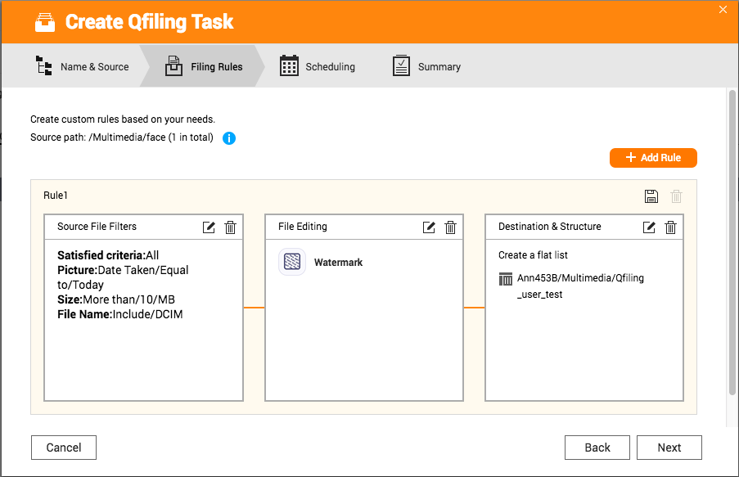
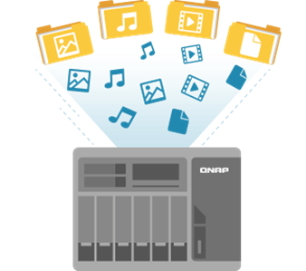
Data Retrieval and Management Solution
Qsirch
Qfiling

Slide 14
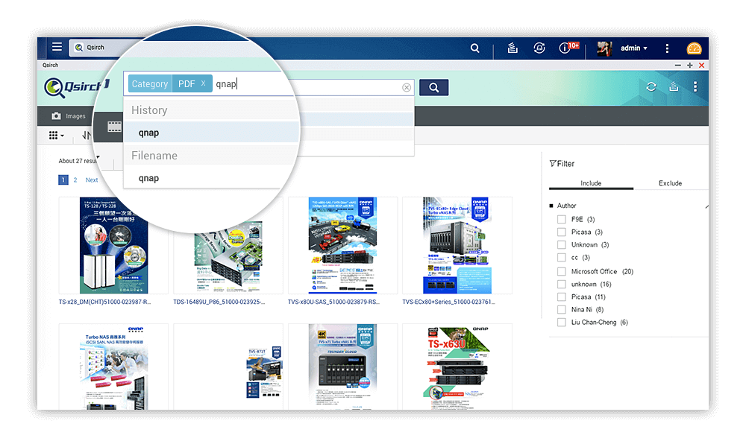
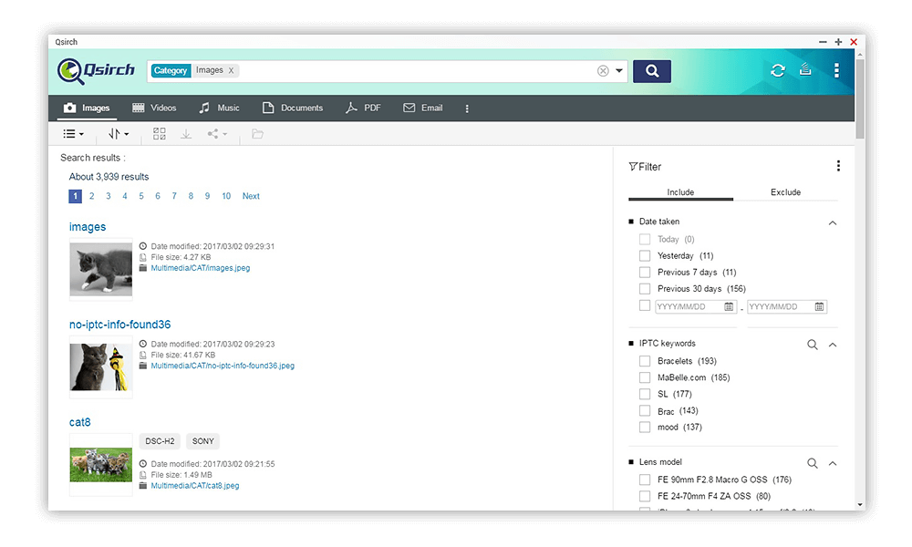
Qsirch - Quickly locate files with full-text search and real-time search engine

Slide 15
Qfiling: customized file archiving helper
Source
Archiving criteria setting
Destination

Slide 16
Active system monitoring and auditing solution
Q′center
Implement multiple NAS management
System connection log
Syslog Client/Server

Slide 17
Works with new third-party GDPR apps
• Enterprise backup software， ex: Acronis™, Veritas™...etc
• GDPR compliance check tool
Container/Docker
Virtualization Station

Slide 18
QNAP NAS
is your good partner for GDPR
Copyright © 2018 QNAP Systems, Inc. All rights reserved. QNAP® and other names of QNAP Products are proprietary marks or registered trademarks of QNAP Systems, Inc. Other products and company names mentioned herein are trademarks of their respective holder

