Slide 2
QNAP OpenStack Ready NAS
For a Robust and Reliable Cloud Platform

Slide 3
Agenda
IT transformation and challenges
OpenStack—A new star in the cloud world
How does OpenStack satisfy IT demands?
QNAP + OpenStack (Qcinder & Qmanila)
QNAP OpenStack Ready NAS models
Notes:
Manila: ES
Cinder: ES + TS
主打ES features supported on OpenStack(ZFS snapshots)
Cinder provides consistency group for replication

Slide 4
IT Transformation and Challenges

Slide 5
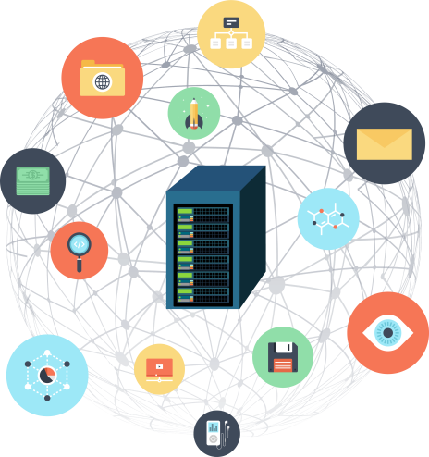
Various IT applications and services
Enterprise applications and services become more and more versatile, while IT response time becomes more and more limited...

Slide 6
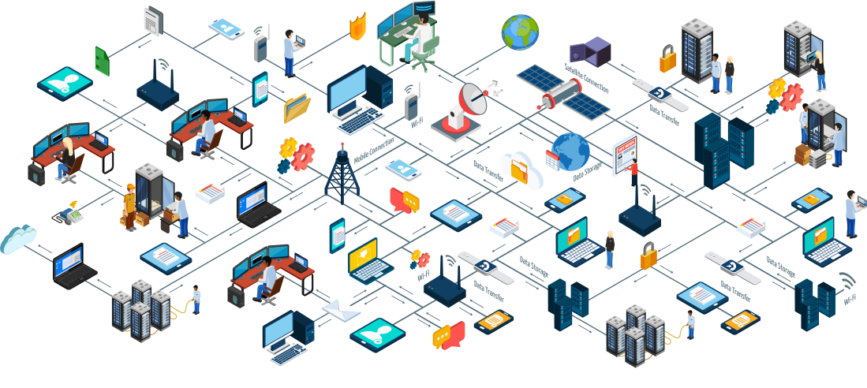
IT World Blueprint
The real IT environment looks like this...
Looks complex at the first glance, however...
Notes:
managing and monitoring this whole environment in this picture is extremely hard if you have to keep switching tools
Using multiple tools places an additional cognitive load on your engineering, operations, and support staff. The more tools they need to learn and use to do their jobs, the harder it is for them to do a good job.
You need a standardized strategy that works across your entire organization and handles all of its needs in the same way!

Slide 7
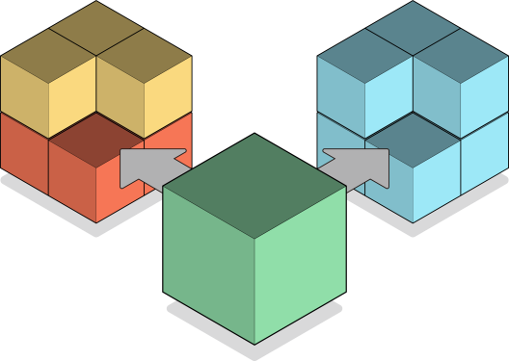
Key elements of IT systems
Actually, it’s all about these 3 elements:
Computing, Networking, and Storage
Computing
Storage
Networking

Slide 8
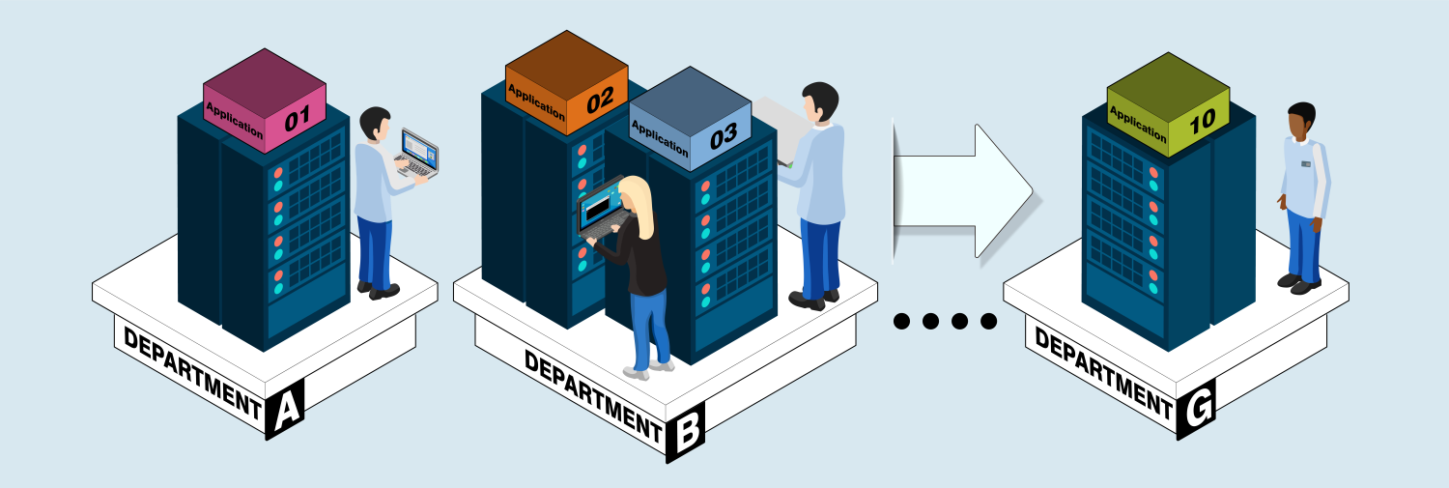
Inside the server room...
Notes:
傳統資料中心主要是使用一個龐大的機房，在機房裡面建置了機架、散熱等基礎設施。在這些基礎設施基礎之上，還有一些網絡設備將伺服器連結起來。
根據統計，伺服器的平均使用率低於 30%，但真正遇到高峰期的業務量時、現有伺服器仍無法滿足需求
也就是說有 70% 的時間，伺服器是處於閒置的狀態。然而大部分的時間雖然處於閒置，但到了某些時段的業務量高峰期時，光是目前的伺服器又無法滿足高峰期的工作需求；只為了滿足這些短暫的高峰期需求，可能企業還得要額外去購買多幾台的伺服器。

Slide 9
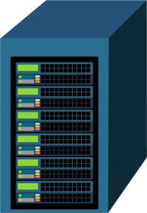
Different expansion methods
Scale-Up
Scale-Out

Slide 10
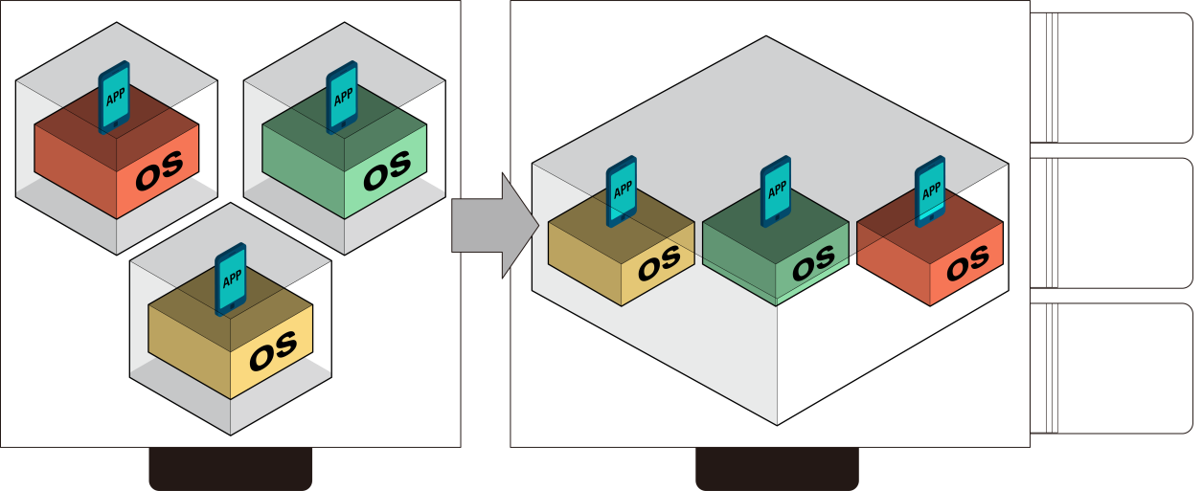
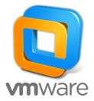
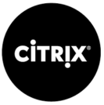
Here comes virtualization
For better allocation of storage resource, here comes virtualization.
Before
Current
Notes:
The hypervisor gave us the ability to run virtual machines all on a single box, and really start to utilize our hardware better,and save us from things like multiple workstations sitting under the desk, each one having a different OS, or maybe all even the same OS just different configurations. You had to do compile and testing for your code and everything on each one individually. It’s painful and expensive. Thanks to the hypervisor, we started to have the ability to do things like have one single workstation and be able to run four or five different VMs inside of it.

Slide 11
From virtualization to cloud
Data Center
Alleviate the management difficulty and reduce costs.
Consistent and standardized management through the cloud platform
Notes:
when we continue to scale our virtual environment, we’ll start to find it difficult to deploy a VM. We may not direct access, we would have to go to an admin, an IT admin, and request a VM be, deployed, not to mention the difficulty added with trying to deploy more hypervisors. All of these things start to get more and more complex. Then we’ll start to see things like storage performance degradations, trouble setting up networks and getting everything to talk. We start to really get into some management complexity that cause some difficulties and started to lose some of the efficiencies that we've gained.
雖然要建構雲端運算環境不一定要虛擬化，但確實只有虛擬化才能將所有資源池化，達到最佳的資源使用率，所以企業通常會選擇虛擬化來作為邁向雲端的第一步。
雲端環境需要達到完全自動化來簡化管理及維運成本，並能透過自我服務的方式來實踐IT自動運營的目的。
虛擬化是雲端的關鍵基礎

Slide 12
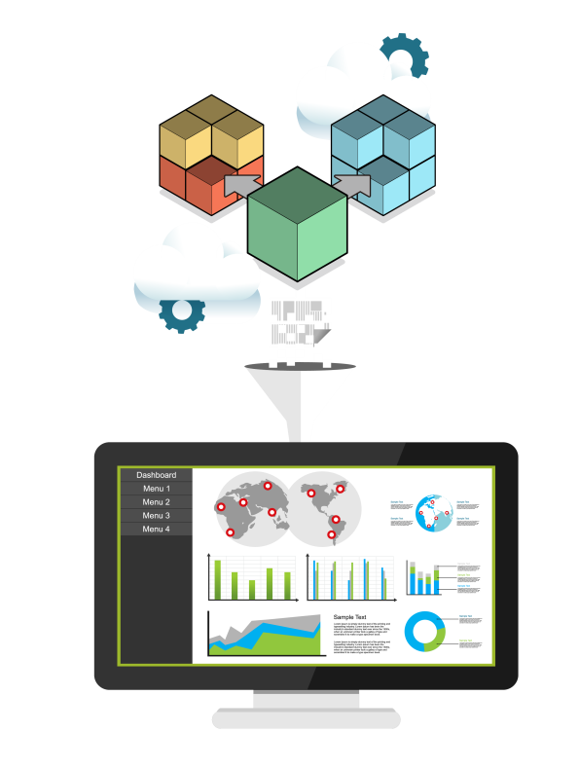
Build your own cloud platform
A single centralized management interface for managing the 3 key elements- Computing, Networking, Storage.

Slide 13
OpenStack—A new star in the cloud world

Slide 14
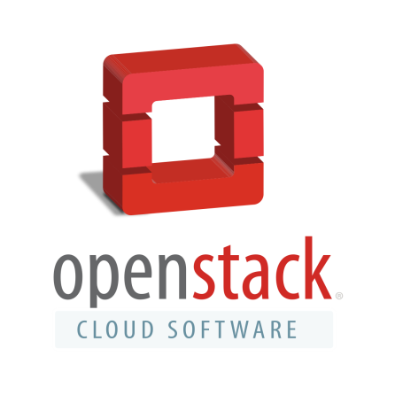
About OpenStack
OpenStack is a cloud operating system that controls large pools of compute, storage, and networking resources throughout a datacenter, all managed through a dashboard that gives administrators control while empowering their users to provision resources through a web interface.
Notes:
2010年由美國航太總署與Rackspace合作研發
開放原始碼的IaaS(基礎架構即服務)平台供使用者建置及管理雲端環境
提供雲端控管運算(Computing)、網路(Networking)與儲存(Storage)等資源
透過網頁儀表板介面進行管理

Slide 15
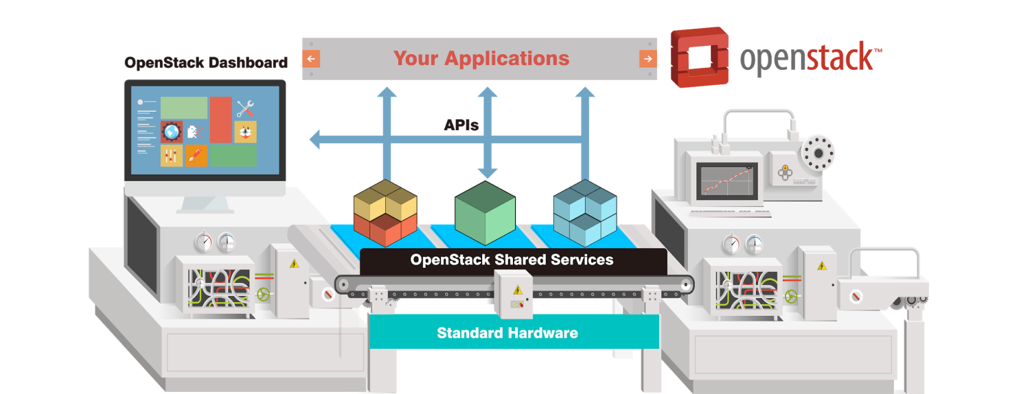
OpenStack architecture
Deploy and manage cloud environment through OpenStack APIs of multiple open source software projects
Notes:
透過多個開放原始碼的軟體專案的OpenStack API，建置及管理雲端環境

Slide 16
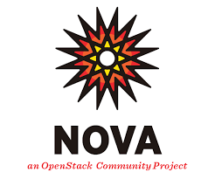
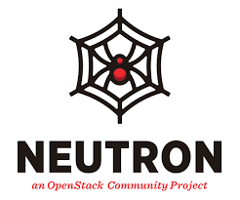
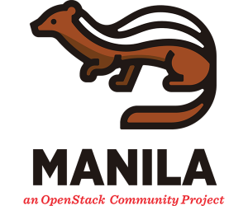
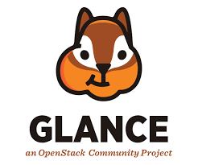
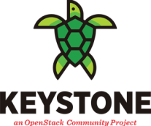
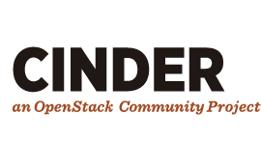
Many avaialable projects
The open source software project satisfies 3 key elements of IT : Computing, Networking, and Storage.
QNAP Support
Notes:
開放原始碼的軟體專案滿足最基本的IT關鍵三元素：運算(Computing)、網路(Networking)與儲存(Storage)，細部包含身分驗證機制、虛擬機器磁碟映像檔傳送服務...等等

Slide 17
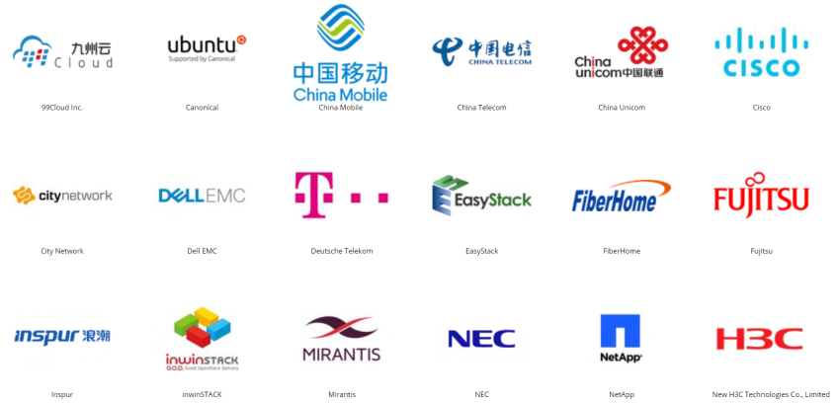
Massive ecosystem
The OpenStack community has accumulated 90,000 members in 187 countries, including large companies such as Intel, Cisco, Huawei, and China Mobile, as well as storage industry leaders such as NetApp and Dell EMC.
Notes:
Just a fraction of the huge OpenStack community.
OpenStack基金會它是一家非盈利組織
個人會籍是免費無門檻的，他們可憑藉技術貢獻或社區建設工作等參與到OpenStack社區中。而公司參與的會根據各司贊助會費的情況，分成白金會員、黃金會員、企業贊助會員以及支持組織者，其中白金和黃金會員的話語權最大
OpenStack社群已在187個國家累積高達90,000個會員，其中不乏Intel、Cisco、華為、中國移動等大型企業，以及Netapp、EMC等儲存領域翹楚。
2017年 騰訊成為白金會員

Slide 18
How does OpenStack satisfy IT demands?

Slide 19
5 factors of a cloud environment
Compatibility
Controllability
Based on the 3 key elements of IT systems, satisfy the 5 factors of a cloud environment.
Standardization
Scalability
Flexibility
Notes:
圍繞在IT三大元素上，滿足雲端環境需求五大面向

Slide 20
Controllability
Won’t be restricted and locked-in to some specific vendors.
Able to integrate 3rd parties' technology with your own’s, to satisfy your demand.
Notes:
控制性：開放原始碼的平台意味著不會被某個特定的廠商綁定和限制，而且模組化的設計能將自身與第三方的技術進行整合，以滿足自身業務需要。OpenStack所提供的雲端計算，讓IT團隊可以成為自己的雲端計算服務廠商，構建和維護一個開放原始碼私有雲並不一定適合每一家公司；但是如果擁有基礎設施和開發人員，OpenStack將是很好的選擇。

Slide 21
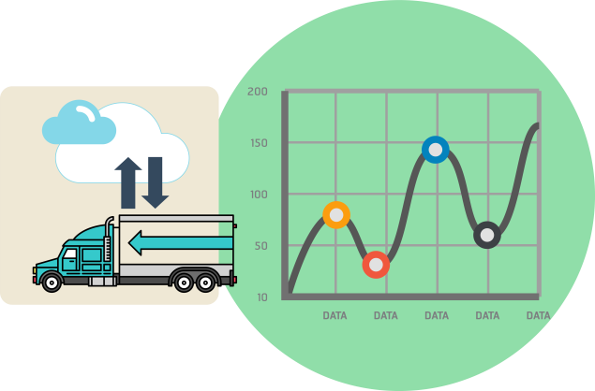
Compatibility
You will be able to migrate data between the public cloud and private cloud.
Notes:
企業在將來可以輕鬆地將數據和應用，遷移到基於安全策略的、經濟的和其他關鍵商業標準的公有雲中。使用亞馬遜網絡服務及其他雲服務的企業，抱怨最多的就是“使用者被綁架，無法輕易轉移數據”。在雲端應用領域，有一個流行的概念，即數據是有重量的，一旦將數據存在某個雲端服務商那裡，它就變得繁重而難以遷移，作為企業最重要的資源，如果在遷移的過程中不能保護好數據安全，很有可能會給企業帶來災難，相信沒有公司願意承擔這個風險。

Slide 22
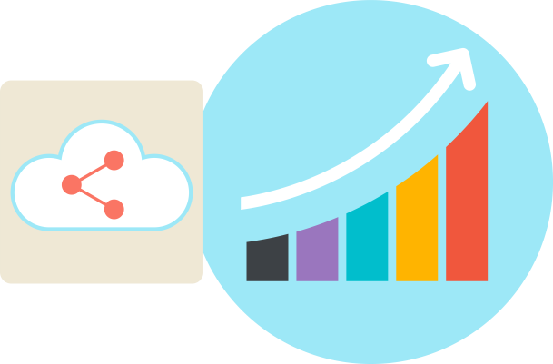
Scalability
OpenStack support mainstream Linux OS such as Ubuntu, CentOS, Red Hat, Fedora, and SUSE.
It helps a lot when deploying and scaling the cloud environment.

Slide 23
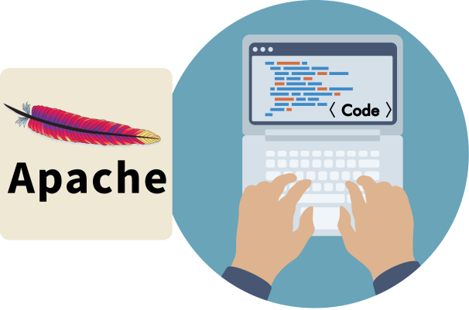
Flexibility
OpenStack project is provided under the Apache 2.0 license. Any 3rd party vendors can develop their own applications based on it.
Notes:
OpenStack project 的程式在極為寬鬆自由的Apache 2.0認證下發布，意味著任何第三方都可以重新發布這些程式碼，在其基礎上開發私有軟體，並按照新的許可發布，給眾多的雲計算企業，留下了的更大的發展空間。
The OpenStack API has become a standard for the industry because it enables tooling to access multiple environments and for the IT department to take a “build once, deploy anywhere” approach.

Slide 24
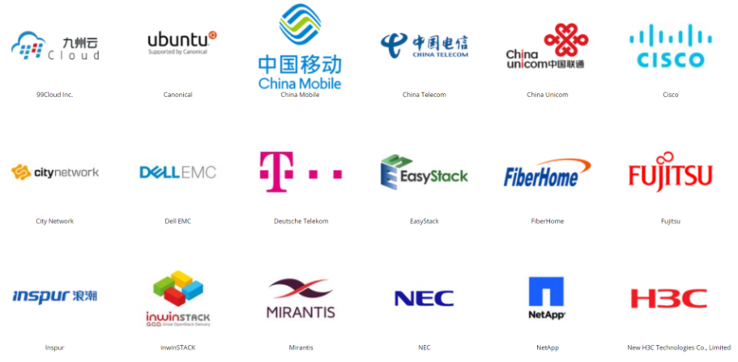
Standardization
More and more major enterprises join the ecosystem, meaning that OpenStack is recognized for its open source standard.
Notes:
領軍企業的加入，會無形透露出一個信息，就是OpenStack未來可能會成為一個行業標準，而且OpenStack項目研發的初衷就是製定一套開放原始碼軟體標準。

Slide 25
QNAP + OpenStack (Qcinder & Qmanila)
Notes:
最初提的三要素: 運算、網路、儲存 三要素中最基本的是什麼？ 是儲存!
因為無論您在OpenStack環境上進行了哪些運算應用，網路如何配置，不可或缺的基本建設就是儲存設備

Slide 26
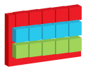
What do enterprises need?
Data Store
Protection
Migration
Data Integrity
Snapshots Protection
Disaster Recovery
Access Efficiency
High
Availability
Remote Replication

Slide 27
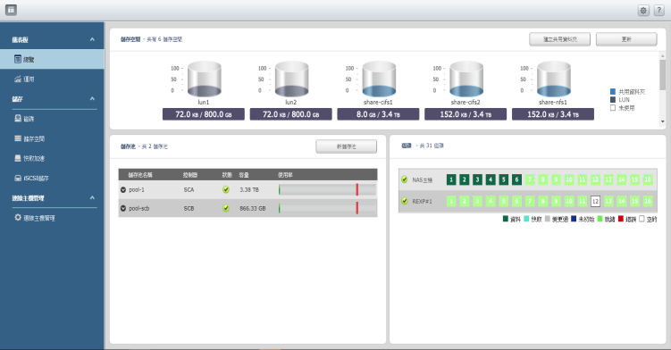
QES - designed for enterprises
Data storage
QNAP ZFS Based
Storage System
- Self-Healing for Data Availability
- Compression & Deduplication
Data protection
- Snapshot Local Protection
Data migration
- SnapSync Remote Protection

Slide 28
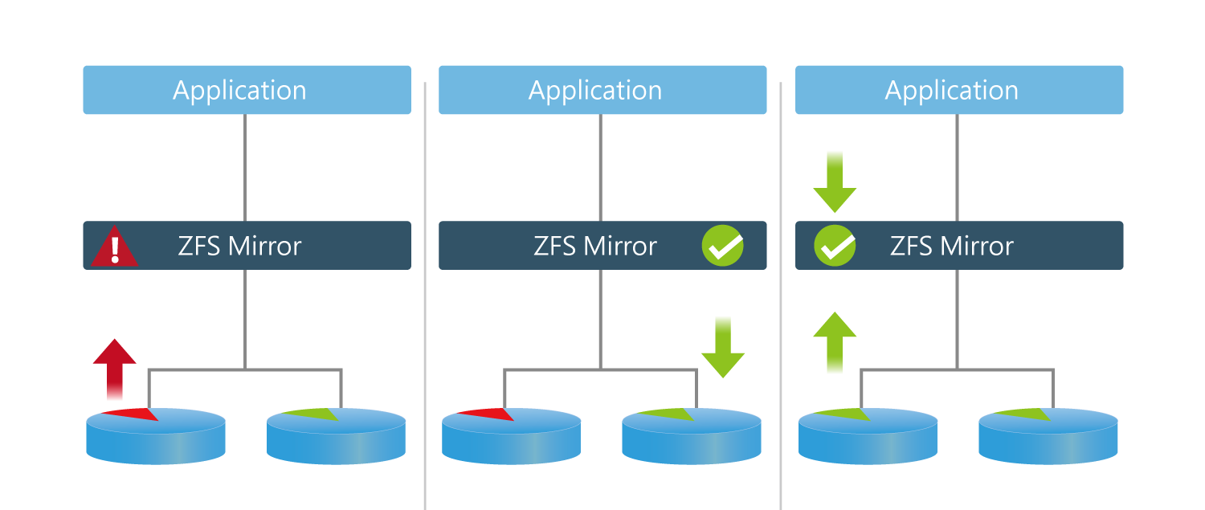
Keep data away from corruption
ZFS uses its end-to-end checksums to
detect and correct silent data corruption.
Data Integrity
Worry-free data storage (Silent data corruption)
Found a corrupted section
Load data from the mirror section
Correct the corrupted section
Notes:
Billy

Slide 29
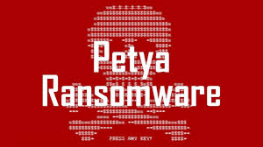
Snapshots to the rescue
Backup versioning
Recovery from human errors
Fast recovery from ransomware attacks
Notes:
Kevin
Reason #1 ZFS is the Best – Copy on Write File System
The copy on write architecture is the foundation of what makes ZFS so awesome. With a copy on write architecture no data is overwritten which means a write no matter how large can be written as a single atomic transaction. An interrupted write is never committed because the pointer to the new uberblock, which is the last action of a write is never written. This same copy on write architecture enables several other features such as snapshots and clones to happen with minimal resources. By leaving a pointer to the top of the tree for the old data ZFS enables a snaphot, a pointer to a valid copy of data at a particular time. A clone is simply a duplicated pointer which can now move independently from the old pointer

Slide 30
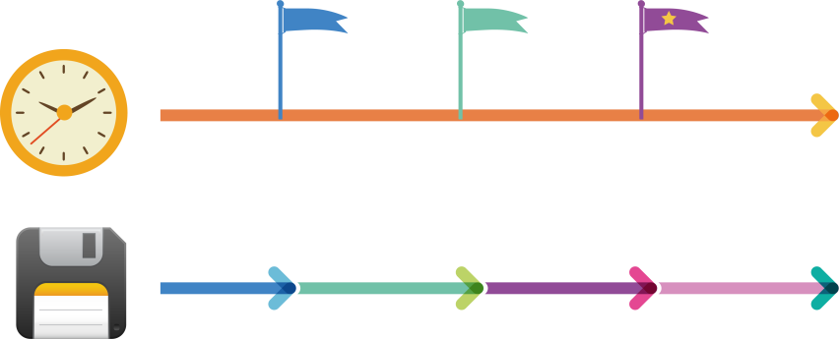
QES snapshot protects you
QES near-unlimited snapshots
Near real-time
- Data Protection
13:00
13:10
13:20
Fast recovery
- Review & Access
Insert timestamp, and then keep writing
Notes:
技術解釋為何 QES 的 snapshot 很快？ (Copy on write)
插時間戳記，繼續寫資料 (Copy on write)

Slide 31
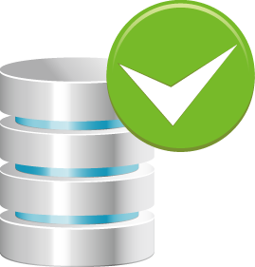
Of course, services non-stop
Flexible way to revert / clone
Non Stop
12:50
13:10
13:30
14:00
14:30
Notes:
Billy

Slide 32
Not only safe, but more efficient
QES makes the storage space more efficient
Deduplication
Compression
In-line
Deduplication
In-line
Compression
Notes:
data reduction

Slide 33
SnapSync is easy and fast
Easy backup through SnapSync
Server
Server
iSCSI | Samba
iSCSI | Samba
Snapsync
(Block Level)
Primary Site
DR Site
Notes:
Billy

Slide 34
Qcinder
About Cinder
Block storage service for OpenStack
Virtualizes the management of block storage devices
Provides end users with a self service API
About Qcinder
Provide block storage service of QNAP storage for OpenStack
Perform snapshot protection on the QNAP storage
Support extra specs of QNAP Storage, such like compression,
deduplication and thin provisioning..etc
Notes:
提供區塊儲存服務
將區塊儲存設備的管理虛擬化
提供自我服務的API操控區塊儲存設備
The short description of Cinder is that it
virtualizes the management of block storage devices
provides end users with a self service API
to request and consume those resources without requiring any knowledge of where their storage is actually deployed or on what type of device.
提供區塊儲存空間給OpenStack環境
於儲存設備端進行快照服務
支援對儲存空間進行細部規格的定義(如資料壓縮、資料重複刪除、精簡配置等)

Slide 35
Live Demo - Qcinder

Slide 36
Qmanila
About Manila
Shared file system service for OpenStack
Support CIFS and NFS protocol
About Qmanila
Provide shared file system service of QNAP storage for OpenStack
Perform snapshot protection on the QNAP storage
Support extra specs of QNAP Storage, such like compression,
deduplication and thin provisioning..etc
Notes:
提供共用資料夾服務
支援CIFS及NFS協定
提供共用資料夾儲存空間給OpenStack環境
於儲存設備端進行快照服務
支援對儲存空間進行細部規格的定義(如資料壓縮、資料重複刪除、精簡配置等)

Slide 37
OpenStack supportability comparison
Supported Feature | QNAP | S Brand | E Brand | N Brand
Block storage Volume operations(Create/Delete/Attach/Detach/Extend/) | o | o | o | o
Block Storage Snapshots(Create/Delete/List/) | o | o | o | o
Create Block Storage Volume from Snapshot/Image/Clone/Volume | o | o | o | o
Block Storage Volume Migration | o | x | o | o
Create/Delete Shares | o | x | o | o
Manage Shares | o | x | x | o
Create/Delete Share Snapshots | o | x | o | o
Manage Share Snapshots | o | x | x | o
Create Share from Snapshots | o | x | o | o
Notes:
https://wiki.OpenStack.org/wiki/CinderSupportMatrix
https://docs.OpenStack.org/manila/pike/contributor/share_back_ends_feature_support_mapping.html

Slide 38
QNAP OpenStack Ready NAS models

Slide 39
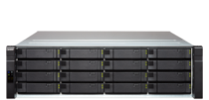
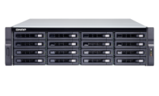
Best choice for enterprises
ES1640dc v2
Enterprise
High-Availability NAS
TES-x85U Series
TES-1885U
TES-3085U
(QTS / QES Ready)
TDS-16489U
A multifunction computing/storage server
(QES Ready)
(QTS Ready)
Intel® Xeon ® E5
dual active-active controllers
Up to 96 GB Memory
Intel ® Xeon ® D processor
Up to 128GB DDR4 Memory
Dual QNAP OS ready to use
Dual Intel® Xeon® E5 processor
Up to 1TB Memory
Optional 40GbE
Notes:
Billy

Slide 40
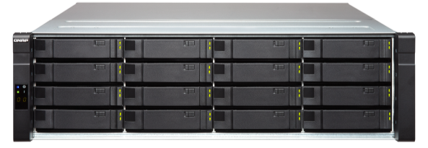
ES1640dc v2
ES1640dc v2
Specification
Best Choice for Non-stop Service
3U rack mount
16 x 3.5” SAS 12Gb/s disk/SSD
Dual Controller
Notes:
Kevin

Slide 41
TES-3085U
TES-3085U
Specification
2U rack mount
24 x 2.5” SAS 12Gb/s, 6Gb/s
SATA 6Gb/s disk and SSD
6 x 2.5” SATA 6Gb/s SSD
Best Choice for All Flash Storage
Notes:
Kevin

Slide 42
TES-1885U
Specification
TES-1885U
2U rack mount
12 x 3.5”/2.5” SAS 12Gb/s, 6Gb/s, SATA 6Gb/s disk and SSD
6 x 2.5” SATA 6Gb/s SSD
Best Choice for Data Backup
Notes:
Kevin

Slide 43
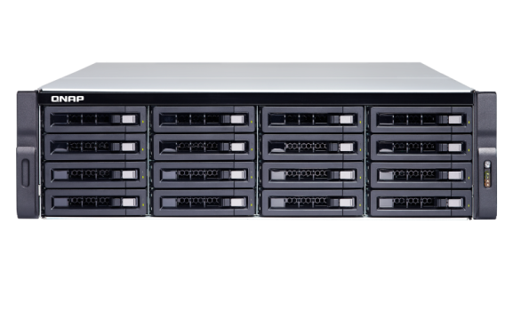
TDS-16489U
Specification
3U rack mount
Front : 16 x 3.5”/2.5” SAS 12Gb/s, 6Gb/s, SATA 6Gb/s HDD and SSD
Rear : 4 x 2.5”
SAS 12Gb/s SSD
SAS/SATA 6Gb/s,3Gb/s SSD
Business-ready multifunction server – fulfilling computing and storage in one box

Slide 44
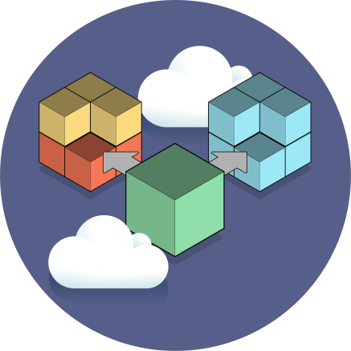
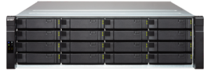
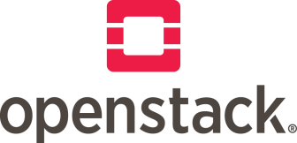
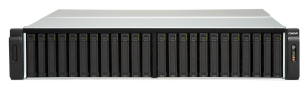
Conclusion
QNAP OpenStack Ready products help you build a robust and reliable cloud platform which thoroughly satisfies enterprise IT demand.
Enterprise Storage
Iaas Cloud Platform
Data Store, Protection and Migration
Infrastructure for data management

Slide 45
QNAP OpenStack Ready is your best choice!

