Slide 2
Enhance your NAS data security with our in-depth guide
Notes:
標題：駭客退散！你一定要知道的 NAS 資料安全術

Slide 3
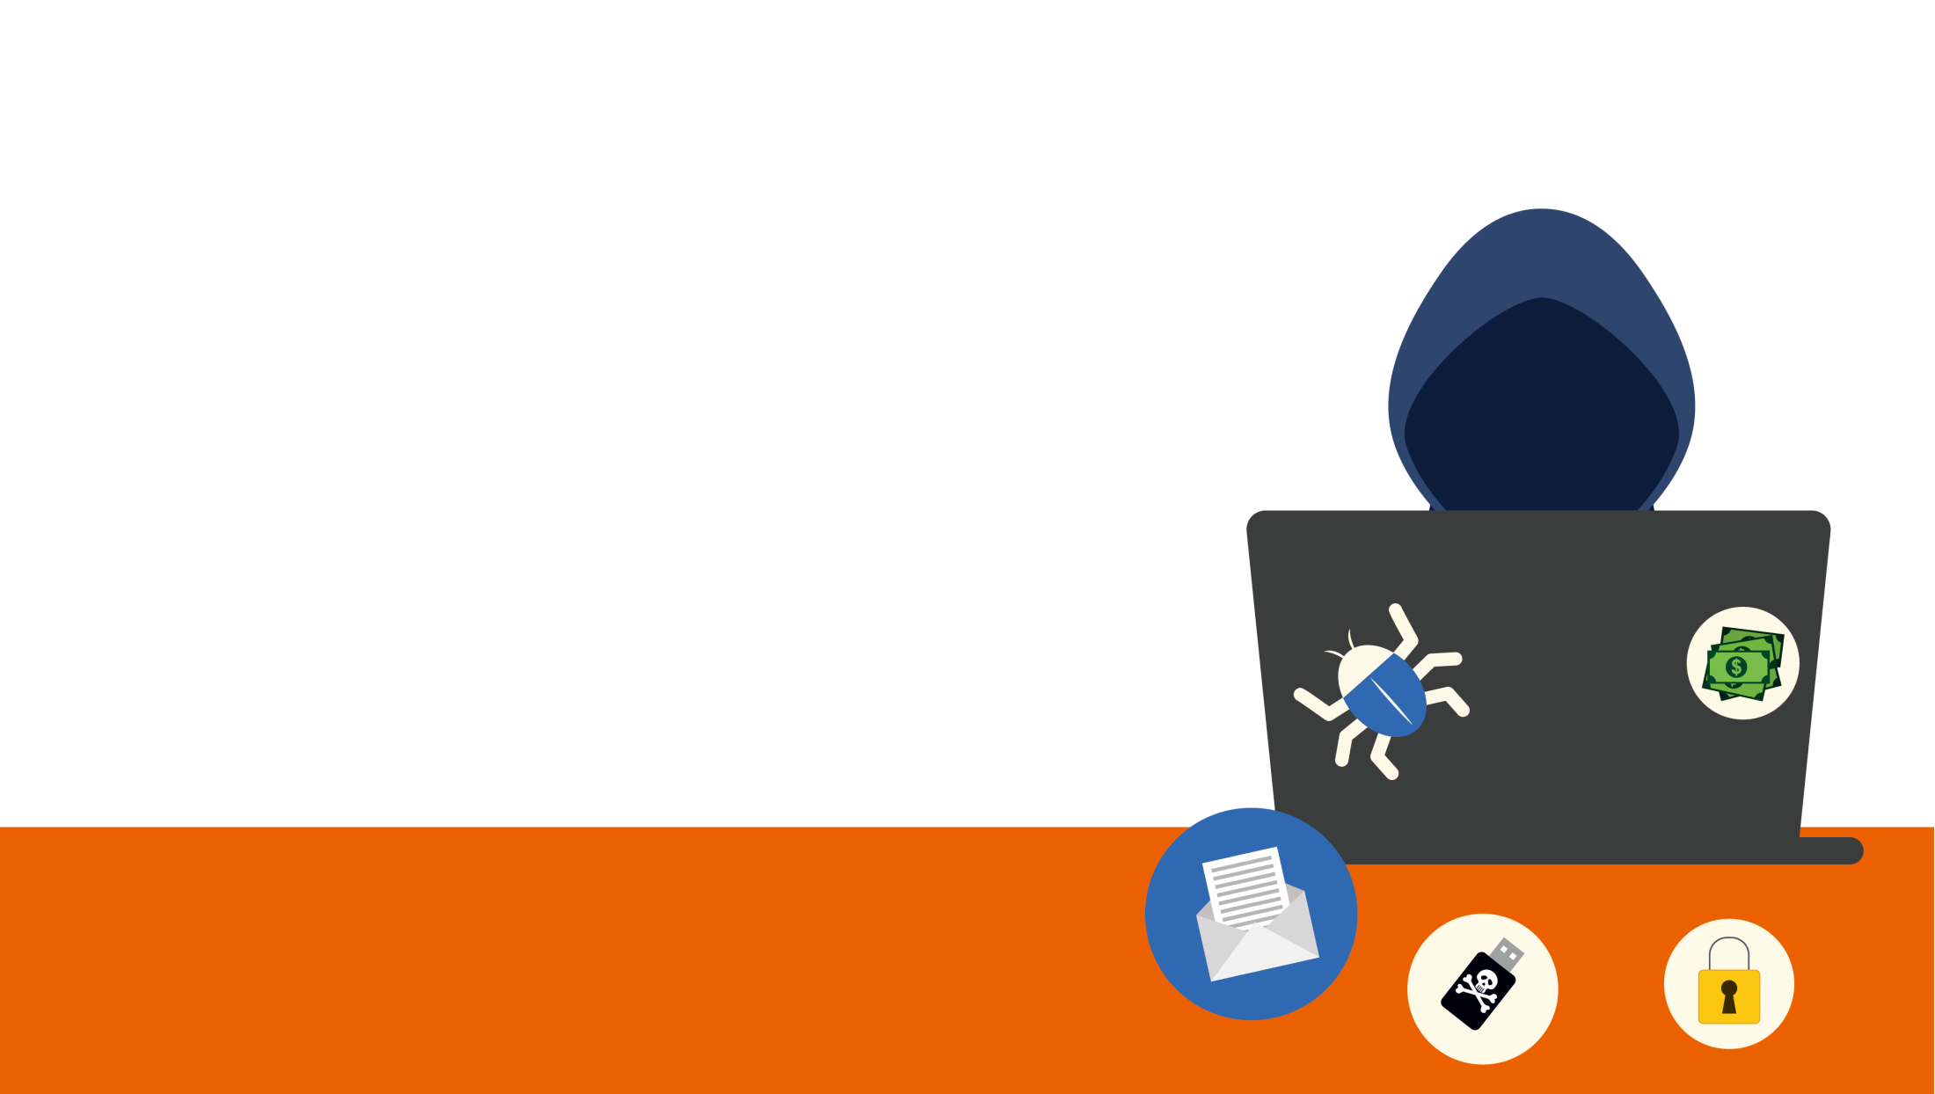
Targeted Attacks on your NAS
Weak credentials / Default password
Older firmware
Default port
Disabled HTTPS
Don’t Forget the Little Things！The easier things are, the more easily they'll be overlooked!

Slide 4
Keep your NAS secured and your data safe.

Slide 5
How to Secure Your NAS
Security
Settings
Security Advisory
Antivirus and Malware Remover
Snapshots, backup and encryption
Security Applications
Notes:
Total live video：80 mins
Security Settings：40 mins
Antivirus：5 mins
Snapshots：10 mins
Applications：20 mins
Security Advisory：5 mins

Slide 6
To fight against data breach,
check the following categories
Account
Network
System
Update

Slide 7
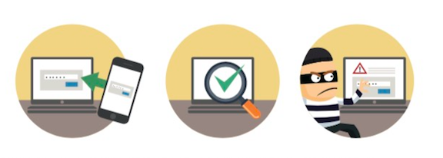
Security Settings
Antivirus &
Malware Remover
Snapshots, backup and encryption
Security Applications
Security Advisory
Account
Network
System
Update
Password Strength：Use strengthen password or force regularly change password.
2-step Verification：2-step verification is to enhance the security of user accounts.

Slide 8
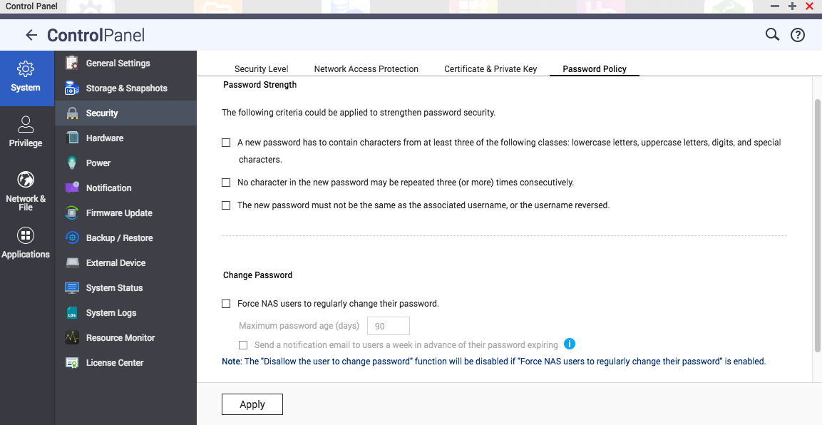
Enhance Password Strength

Slide 9
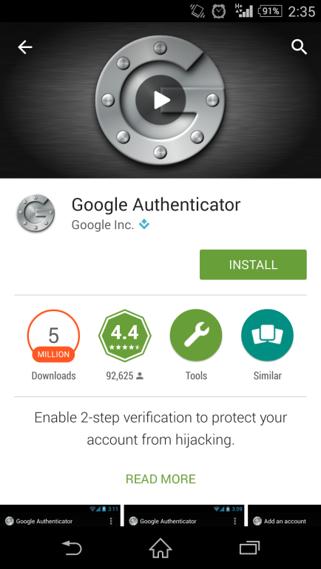
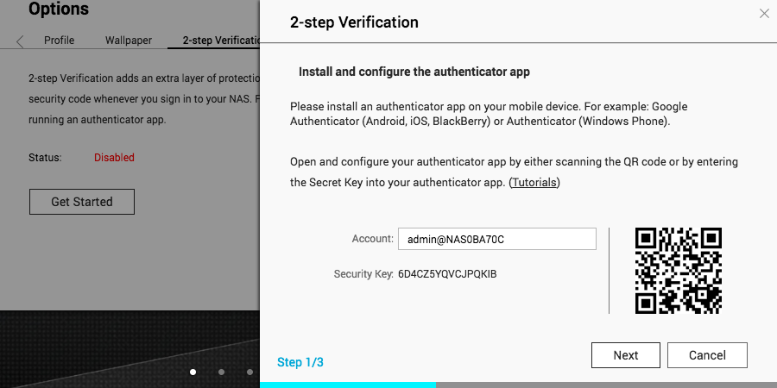
Enable 2-step Verification
(1) Install the authenticator app on your mobile device
For Android and iOS devices, install the Google Authenticator app from their respective app stores.
For Windows Phone, install the Authenticator from its Store.
(2) Enable 2-step Verification
Go to "Options" > "2-step Verification" and click "Get Started". Complete the steps in the wizard to set up the NAS and your mobile device.
Kind Reminder:
The system time of your mobile device and NAS must be synchronized. It is recommended to use the time provided from the Internet.
Notes:
https://www.qnap.com/en-us/how-to/tutorial/article/how-to-enhance-account-security-using-2-step-verification
Once enabled, you will need to enter a one-time security code in addition to your password whenever you sign in to the NAS. To obtain a security code, you need a mobile device capable of running an authenticator app.

Slide 10
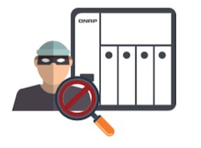
Security Settings
Antivirus &
Malware Remover
Snapshots, backup and encryption
Security Applications
Security Advisory
Account
Network
System
Update
Disable Telnet/SSH/FTP/TFTP if you don’t need them.
Change SSH/HTTPS/HTTP/FTP port
Enable SSL/TLS if you need to use connection, eg FTP service

Slide 11
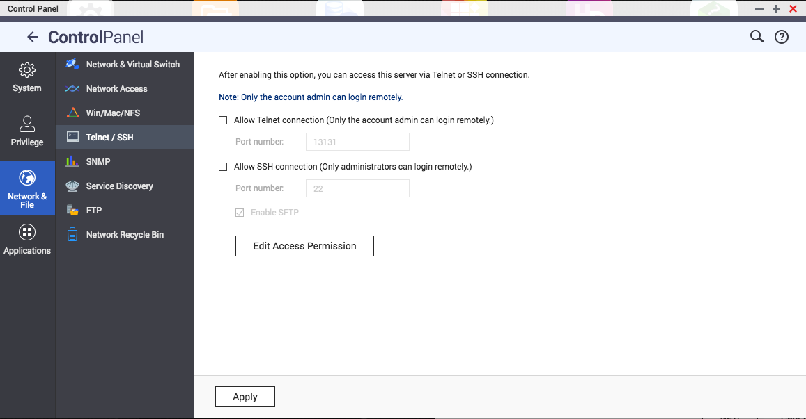
Disable Telnet/SSH/FTP/TFTP if you don’t need them.
Notes:
實際 demo

Slide 12
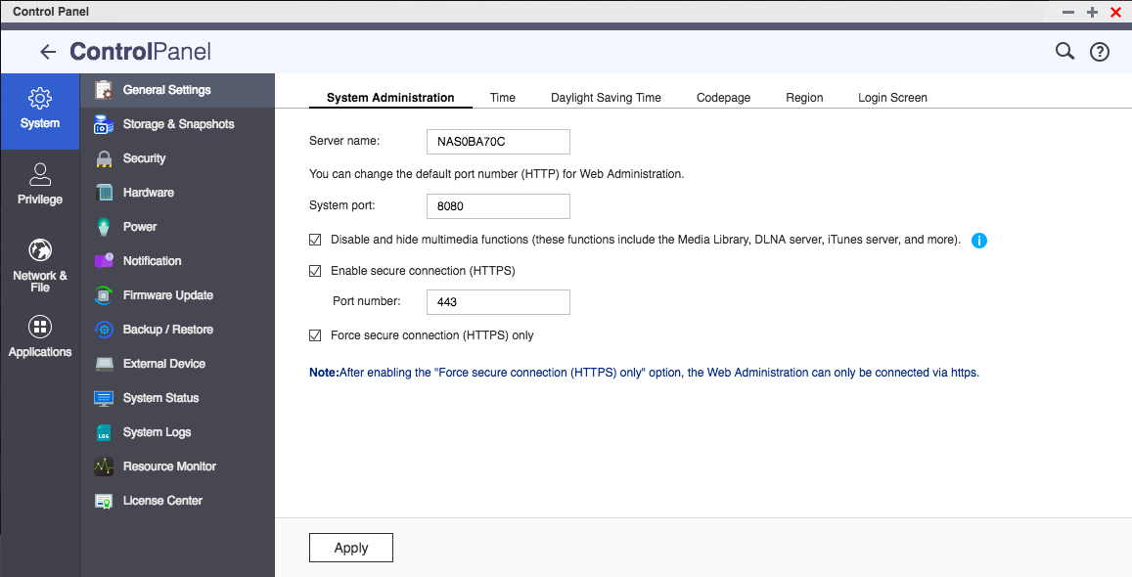
Change SSH/HTTPS/HTTP port
Notes:
實際 demo

Slide 13
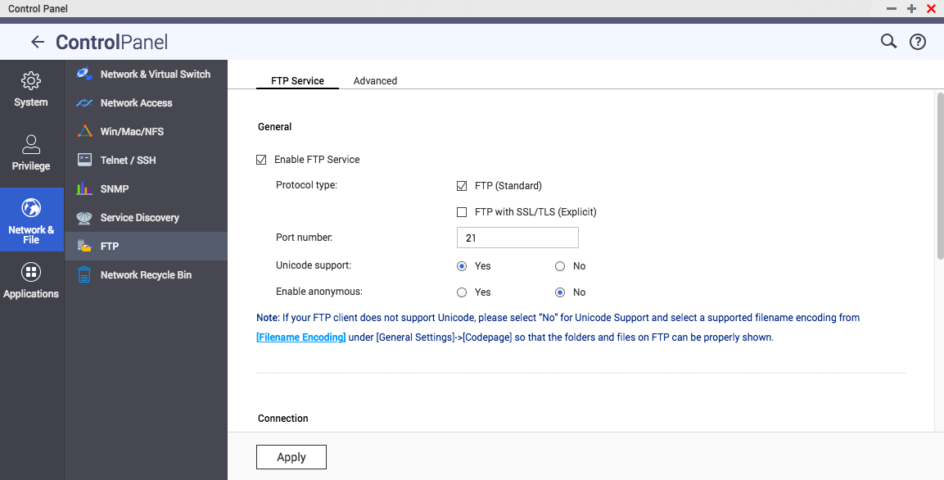
Enable FTP with SSL/TLS (Explicit)
Notes:
實際 demo

Slide 14
Security Settings
Antivirus &
Malware Remover
Snapshots, backup and encryption
Security Applications
Security Advisory
Account
Network
System
Update
Deny/Allow connections list：
You can set to allow or deny the connection of any specific IP address or the range.
Enable Network Access Protection：
You can define the rules of IP blocking for different services or protocols. You can check the list of blocked IPs under “Security Level”.
Avoid installation of non-QNAP Store apps.
Use SSL certificate：
Certificates are used to verify the identity of a NAS and to create SSL/TLS encrypted communications between users and their NAS services (including web sites, FTP, and more).

Slide 15
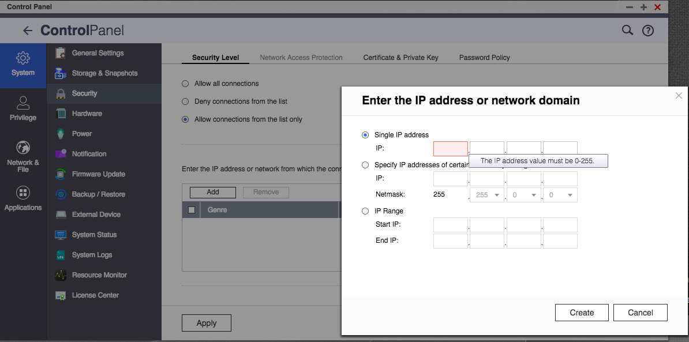
Manage your Deny/Allow connections list

Slide 16
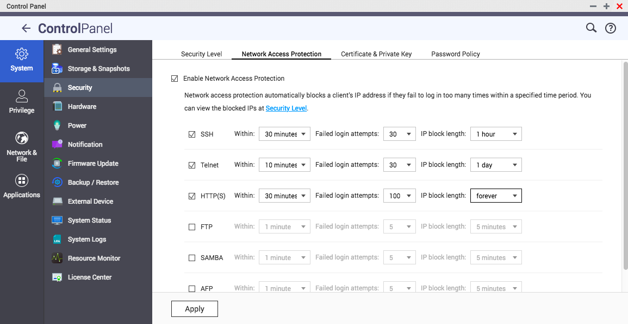
Enable Network Access Protection

Slide 17
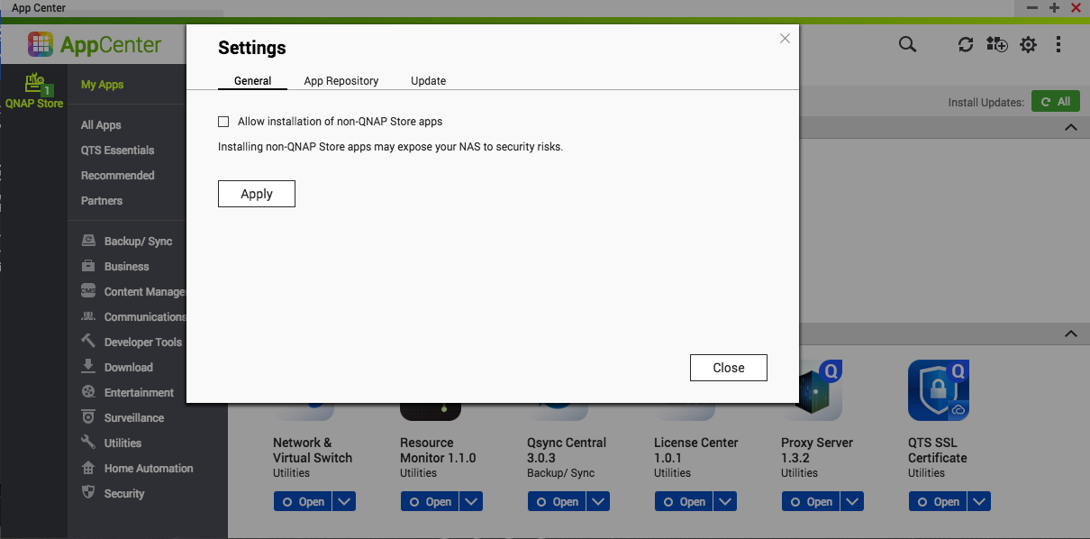
Disable ‘’Allow installation of non-QNAP Store apps.’’

Slide 18
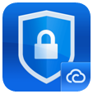
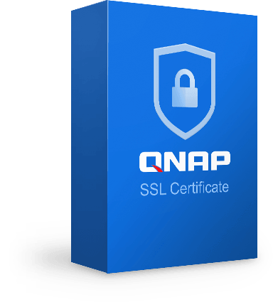
Choices to Secure the Connection
QTS SSL Certificate
myQNAPcloud
SSL Certificate
Paid License
Free
Full Technical Support
Partly Support
Enterprise’s top choice
Auto Renew License
Notes:
Please refer the video: https://youtu.be/DWCJN2RopCE?t=1906 (31:46)

Slide 19
Demo
Notes:
Demo: how to use SSL certificate.

Slide 20
Security Settings
Antivirus &
Malware Remover
Snapshots, backup and encryption
Security Applications
Security Advisory
Account
Network
System
Update
Always use the most up-to-date version of firmware and applications to ensure that known security issues are fixed.
Firmware (QTS)
Application (NAS App)
Malware Remover
Antivirus

Slide 21
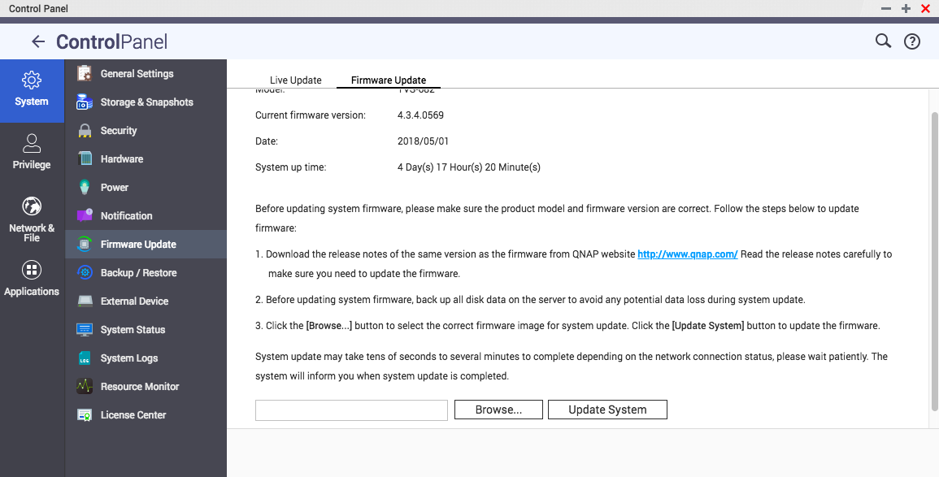
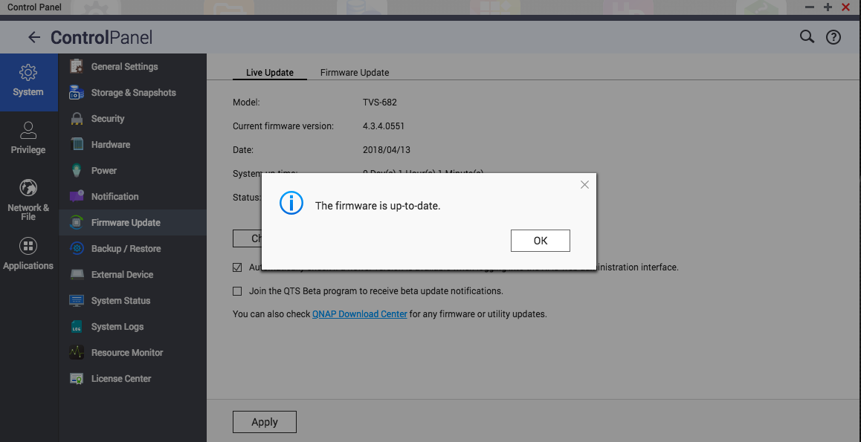
Check for updated Firmware
Firmware update
Live update

Slide 22
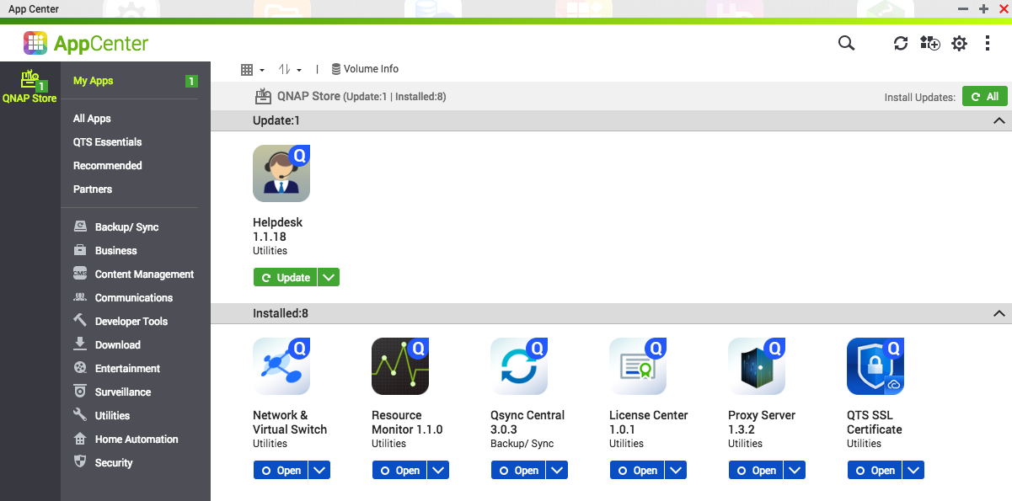
Check for updated Applications

Slide 23
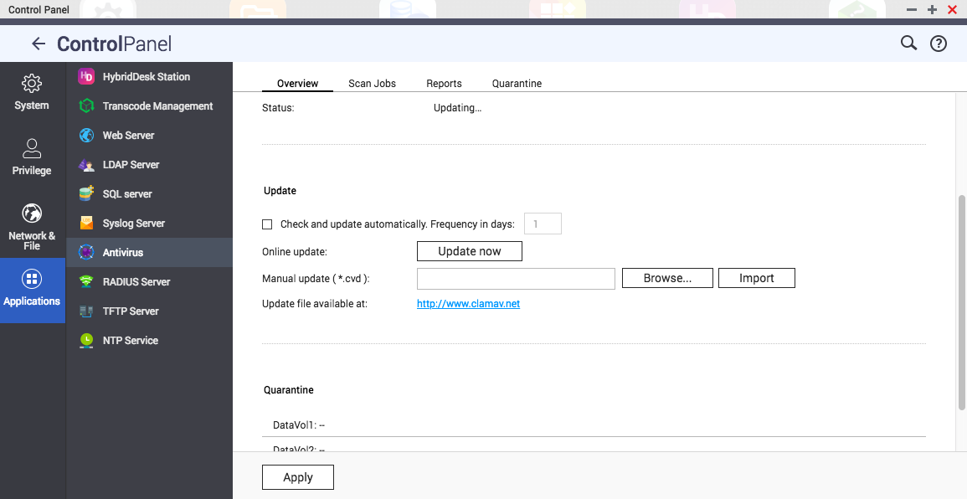
Check for updated Antivirus (Clam AV / McAfee)

Slide 24
To fight against malware attacks,
enable Antivirus and Malware Remover

Slide 25
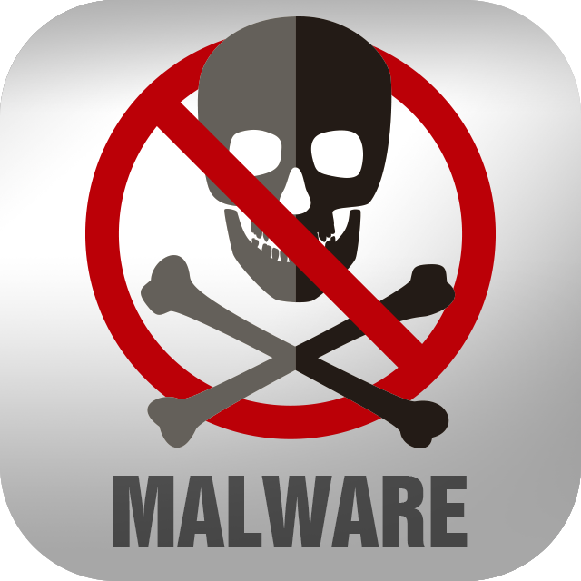
Security Settings
Antivirus &
Malware Remover
Snapshots, backup and encryption
Security Applications
Security Advisory
McAfee helps to protect your data from viruses and malware by identifying, quarantining, and deleting infected files.
ClamAV will scan the NAS manually or on recurring schedule and delete, quarantine, or report files infected by viruses, malware, Trojans, and other malicious threats.
Malware Remover will scan your QNAP NAS and quarantine any detected malware.

Slide 26
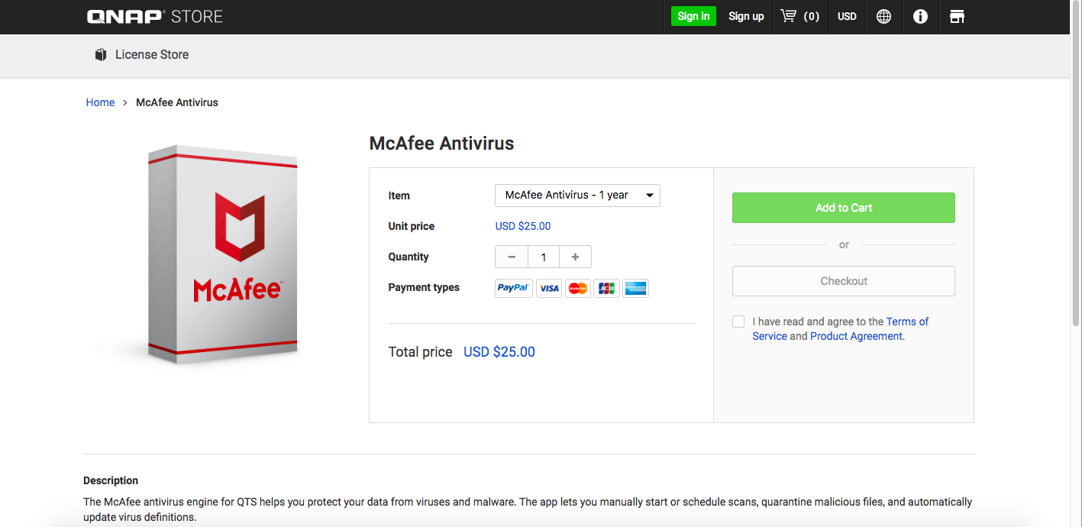
To buy McAfee, go to License.qnap.com

Slide 27
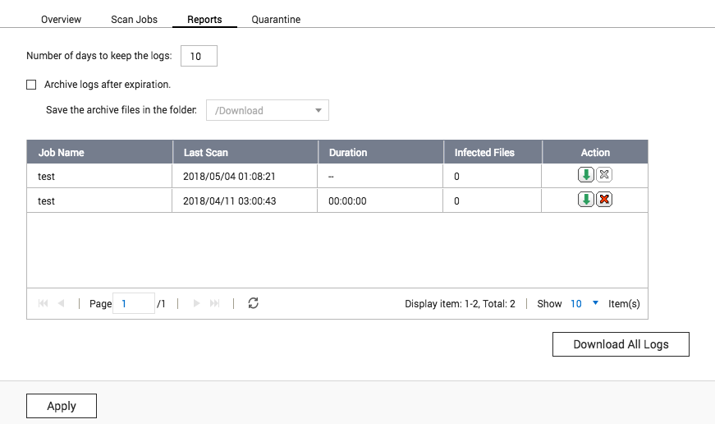
Clam AV
Notes:
Best Linux Antivirus: Top 10 Reviewed and Compared
https://www.ubuntupit.com/best-linux-antivirus-top-10-reviewed-compared/

Slide 28
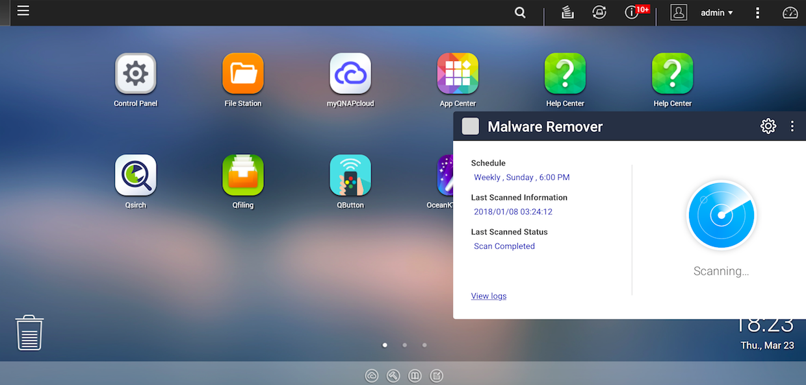
Malware Remover

Slide 29
Demo
Notes:
Demo above antivirus: just show the UI for user, where can you set up.
Malware Remover demo: https://172.17.36.117/cgi-bin/ (admin/damin)

Slide 30
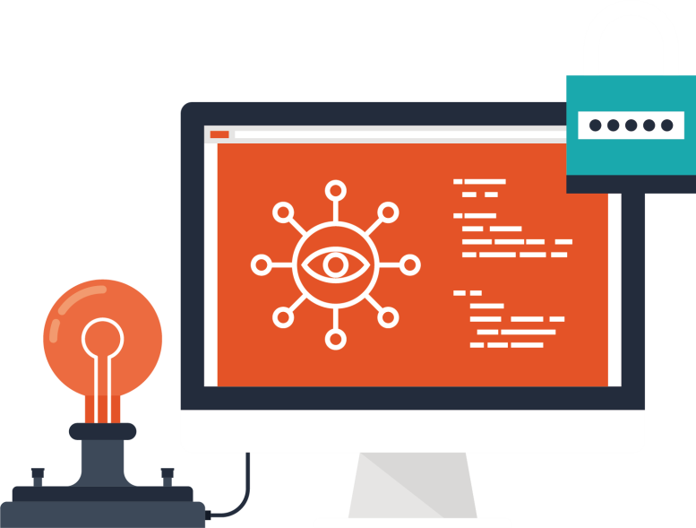
To avoid ransomware, use snapshots, backup and encryption

Slide 31
Security Settings
Antivirus &
Malware Remover
Snapshots, backup and encryption
Security Applications
Security Advisory
Snapshot
Backup
Encryption
Make a recovery plan against encryption-based locker malware!
Block-based snapshots
Restore in a click
QNAP’s block-based snapshot supports incremental backups to save storage space. While copying only the changes made, it also saves time for backing up and restoring.
Data recovery through snapshots only takes a few minutes. As they are separated from the file system, snapshots allow users to restore the original, unencrypted files even if the volume is affected by ransomware.
Snapshot Replica
Snapshot Reserve Space
After creating snapshots, you can efficiently copy them to another QNAP NAS for double protection.
Ransomware's continual writing of data may cause snapshot protection to fail due to running out of space. QNAP’s unique "Snapshot Reserve Space" helps prevent this by reserving dedicated space for snapshots.
Notes:
https://www.qnap.com/solution/snapshots/en/

Slide 32
Security Settings
Antivirus &
Malware Remover
Snapshots, backup and encryption
Security Applications
Security Advisory
Snapshot
Backup
Encryption
Multifunctional backup and recovery plan
Hybrid Backup Sync is a multifunctional backup solution where you can easily back up data from a QNAP NAS to several local, remote and the cloud storage.
Hybrid Backup Sync can help prevent data loss from accidents and disasters.
Notes:
https://www.qnap.com/solution/hybrid-backup-sync/en/index.php

Slide 33
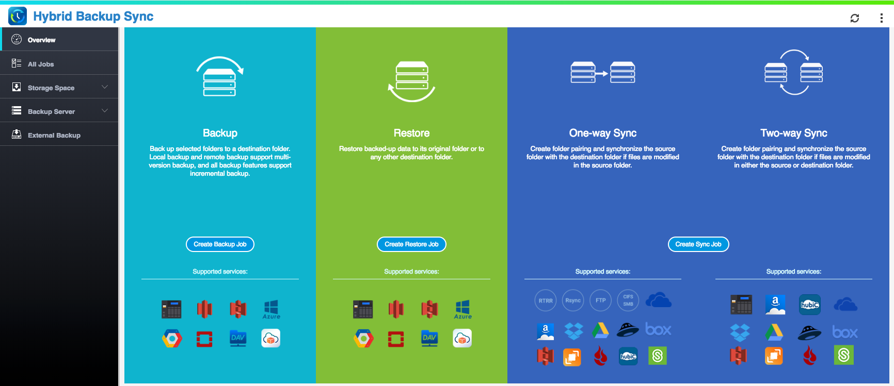
Hybrid Backup Sync - A central management system for backup/restore/sync of local, remote and cloud storage.

Slide 34
Security Settings
Antivirus &
Malware Remover
Snapshots, backup and encryption
Security Applications
Security Advisory
Snapshot
Backup
Encryption
Hardware-accelerated AES-256 encryption for volumes/LUNs to protect confidential data.
Encrypted disk volumes can only be mounted for normal read/write access by using the authorized password. Encryption protects confidential data from unauthorized access even if the hard drives or the entire NAS were stolen.
Encrypt share folders to protect confidential data from unauthorized access.
Notes:
Volumes:
https://www.qnap.com/en/how-to/tutorial/article/how-do-i-encrypt-the-data-on-a-qnap-nas
Share folder:
https://www.qnap.com/en/how-to/faq/article/how-to-encrypt-a-shared-folder

Slide 35
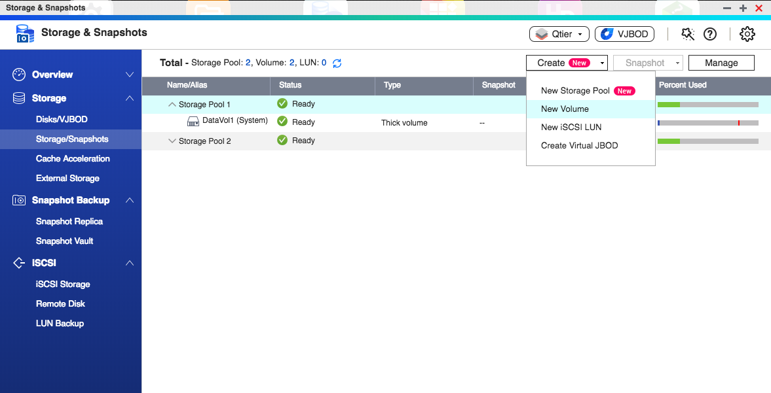
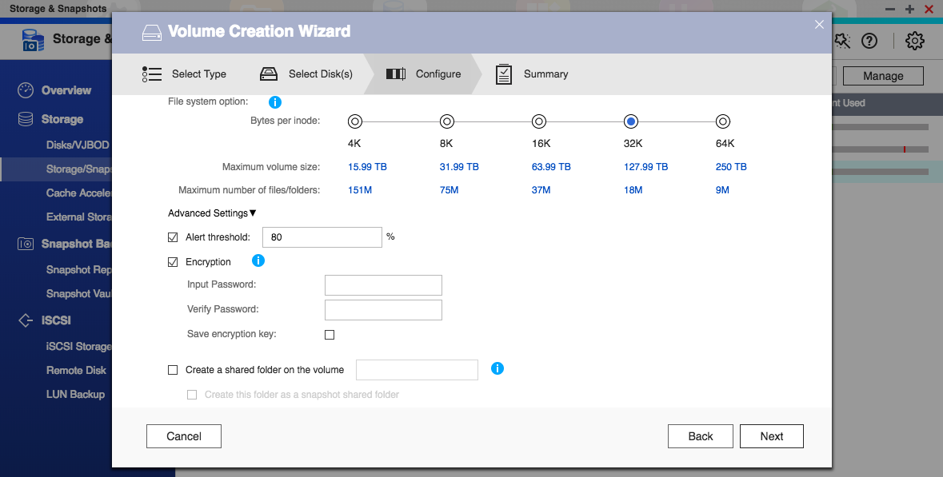
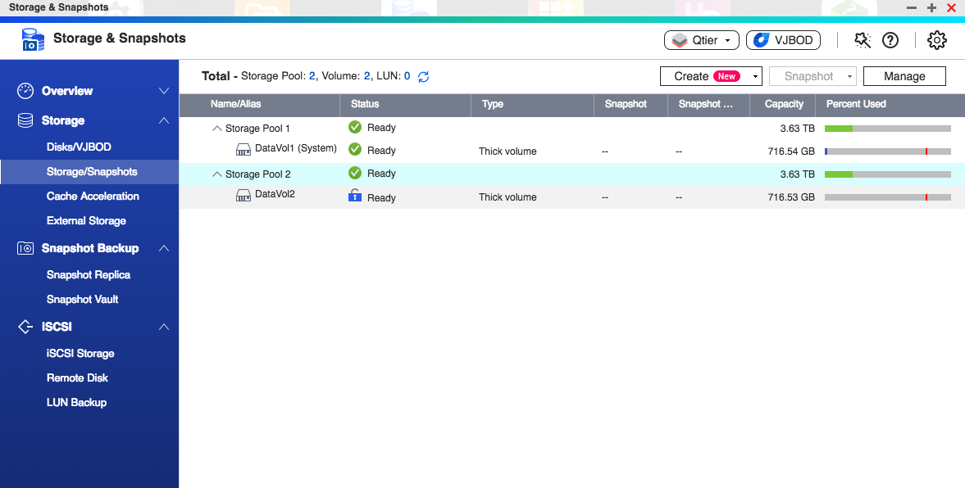
Encrypt disk volumes
Create a New Volume
Check ‘’Encryption’’and input password
1
2
Done

Slide 36
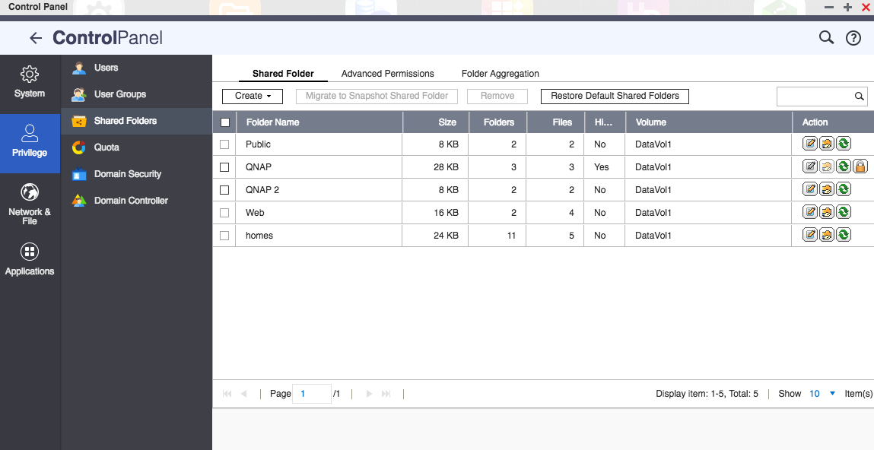
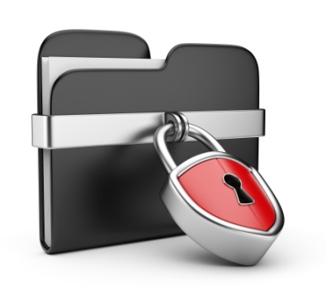
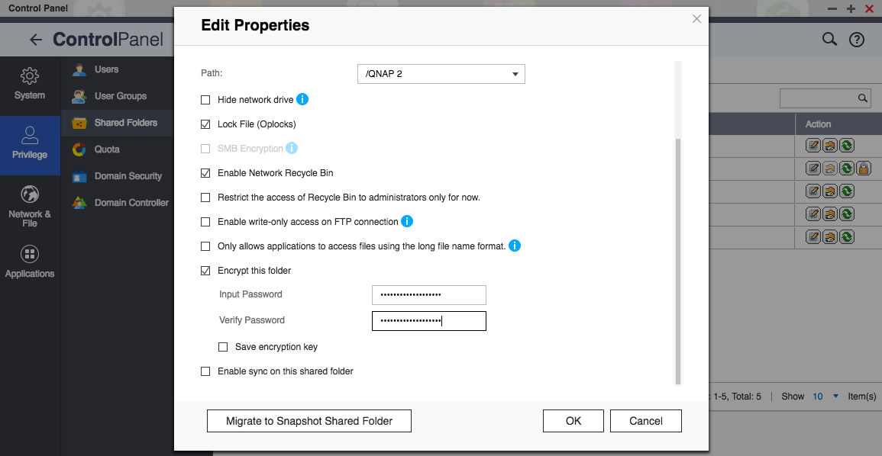
Encrypt share folders
Go to ‘’Control Panel’’ > ‘’Share Folders’’, choose the folder and then click ‘’Edit Properties’’
Check ‘’Encrypt this folder’’ and input password.
1
2
Done

Slide 37
Reduce the risk of being attacked by hackers,
use QVPN Service and Proxy Server

Slide 38
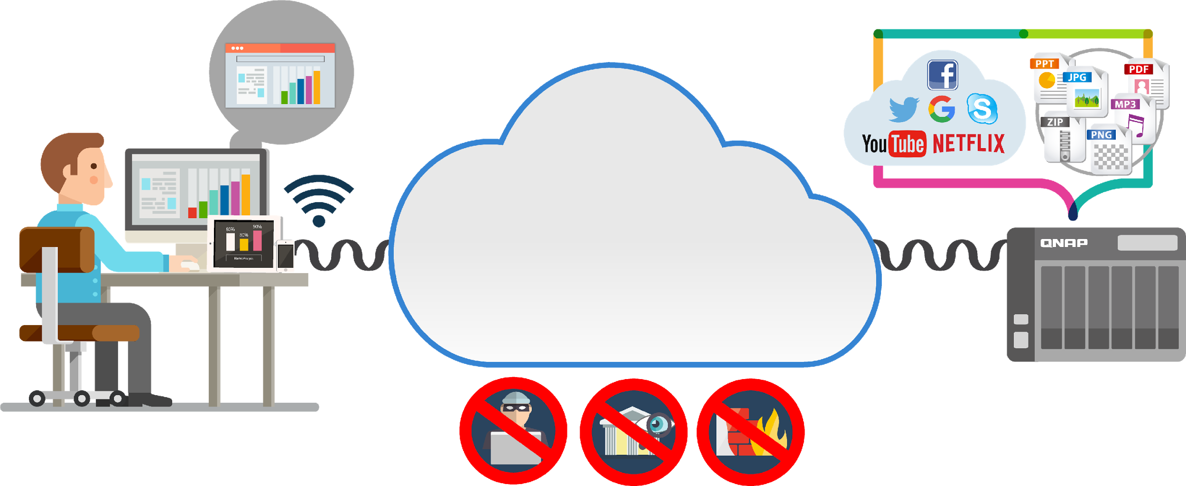
Security Settings
Antivirus &
Malware Remover
Snapshots, backup and encryption
Security Applications
Security Advisory
QVPN
Proxy
When you connect through the VPN
Access NAS using secured tunnel
Notes:
Please refer the live video: https://youtu.be/YorUx-DcnsM?t=148 (02:28)
So, here you can see on this slide, when you connect through the VPN, all the data encrypted and transfer like in the hidden tunnel on the Internet. No matter hackers or ISPs, they are not easy to get hold your password, your private information, your browser contents during the data transmission process.

Slide 39
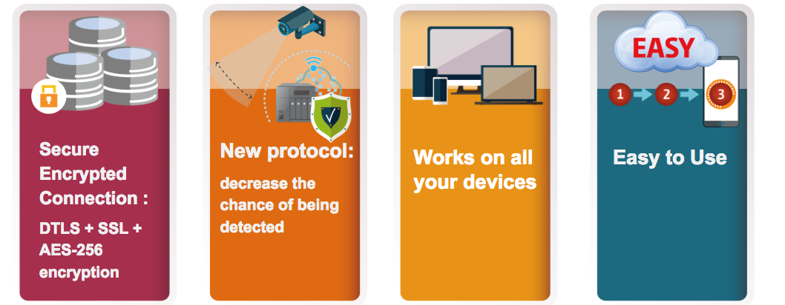
Q1, 2018 QNAP proprietary VPN protocol - QBelt
For QTS 4.3.5
Notes:
Please refer the live video: https://youtu.be/YorUx-DcnsM?t=1066 (17:45)
It use the DTLS to establish the SSL connection, with AES-256 encryption.
Protect your Internet connection across mobile devices or desktop with QNAP apps.
Our app & utility offer a variety of easy-to-configure, automatic features, ensuring your connection remains encrypted at all times.

Slide 40
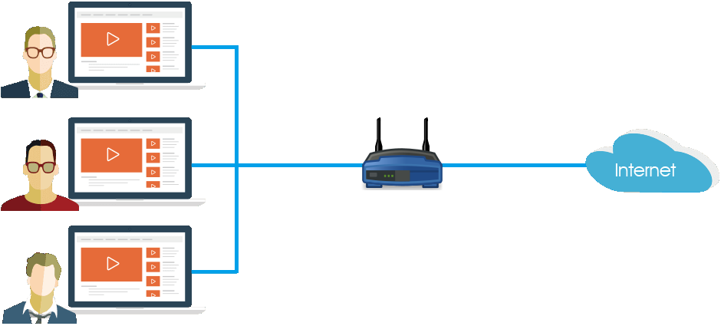
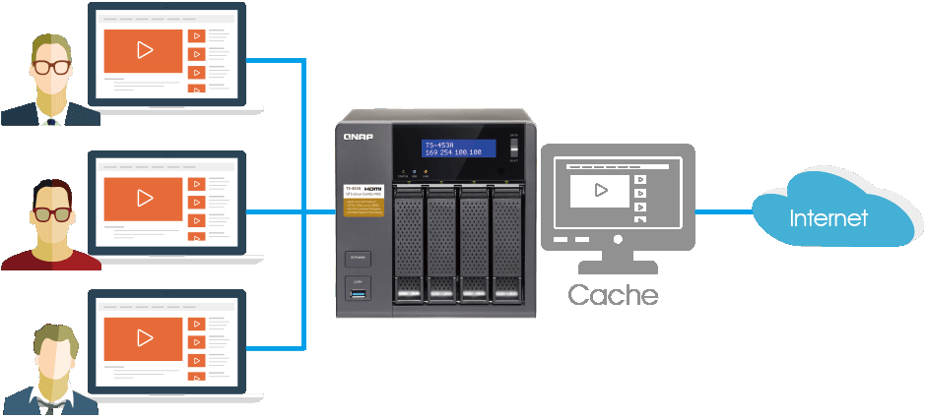
Security Settings
Antivirus &
Malware Remover
Snapshots, backup and encryption
Security Applications
Security Advisory
QVPN
Proxy
Proxy Server provides protected connection and able to utilize network usage more effectively.
Every computer connect to Internet via a router. All the connections and data protections are handled by themselves. And may result some weak points in LAN when browse malicious websites from unprotected computer.
Using Proxy Server can surf internet via NAS may save outgoing bandwidth. And server also provide unified protection to prevent accidental access to vicious websites.
Notes:
https://www.qnap.com/solution/proxy-server/en/index.php

Slide 41
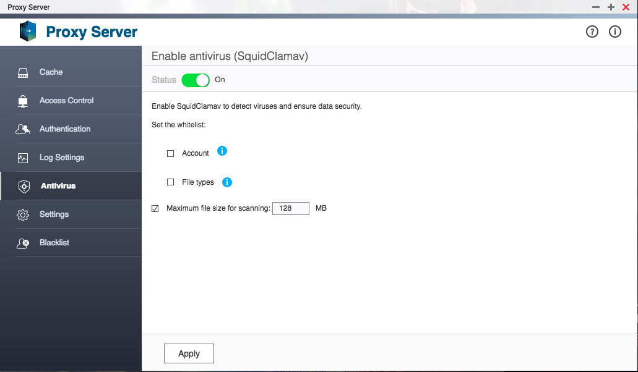
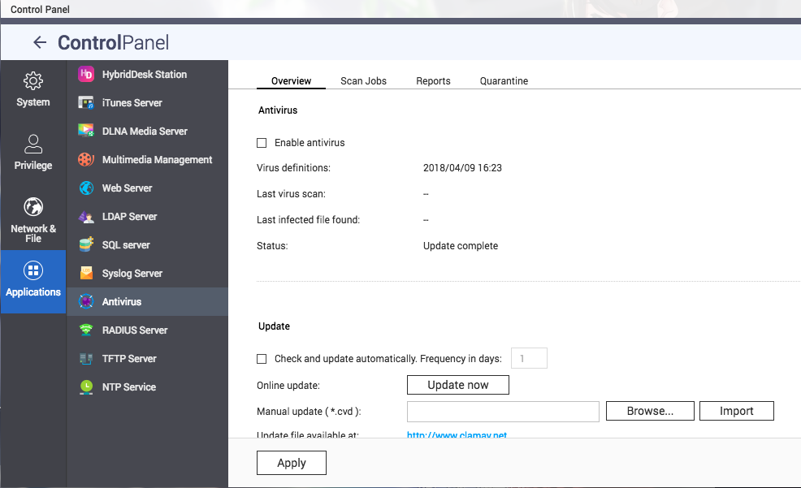
Proxy Server suggested configuration
1
Enable virus scan
Proxy Server will notify you to download latest virus definition file if you did not enable ClamAV on this NAS before.
Notes:
How to set up a proxy server on QNAP Turbo NAS?
https://www.qnap.com/en/how-to/tutorial/article/how-to-set-up-a-proxy-server-on-qnap-turbo-nas

Slide 42
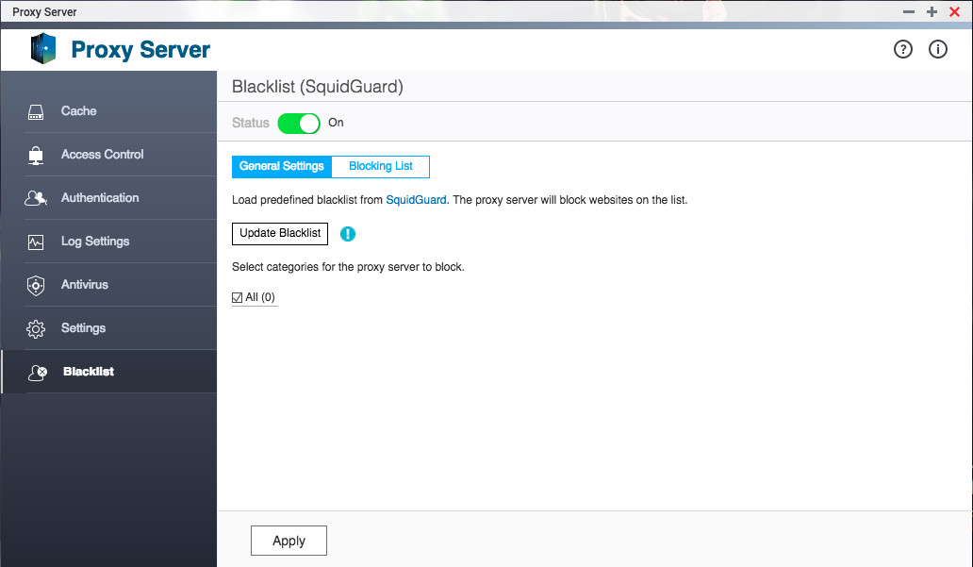
Proxy Server suggested configuration
2
Enable smart blacklist
Click [Update Blacklist] when enable Blacklist feature. Proxy Server will download and process latest blacklist information. It may take ten or more minutes to finish the process. You may choose catalogues you want to block from the list.

Slide 43
Demo
Notes:
Demo: where can you find QVPN service and Proxy server. show the UI

Slide 44
Reduce vulnerability risk,
follow Security Advisory

Slide 45
Security Settings
Antivirus &
Malware Remover
Snapshots, backup and encryption
Security Applications
Security Advisory
CVE: QNAP is a recognized CNA (CVE Numbering Authority) by the MITRE Corporation. QNAP has the power to assign a CVE ID for vulnerabilities within our software. All security issues are handled transparently.
Security Advisory: The QNAP Security Response Team continuously investigates all security threats and releases updates as necessary to safeguard QNAP NAS users from the impact of malware and attacks.
處理
公告
Notes:
https://www.qnap.com/en/security-advisory

Slide 46
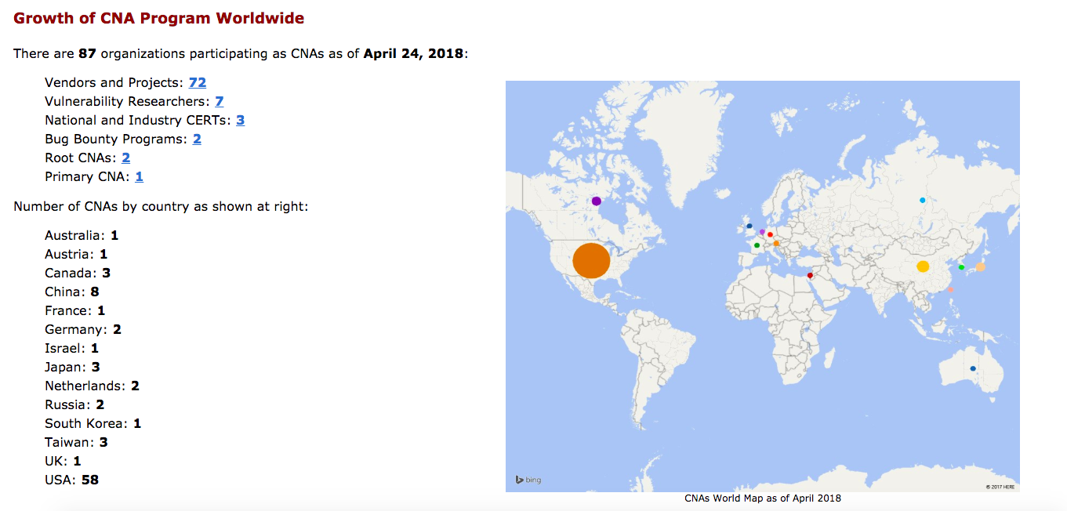
Only 87 organizations in the world have obtained CNA status. There are only 3 in Taiwan.
QNAP is one of them!
Source: https://cve.mitre.org/cve/cna.html
Notes:
https://cve.mitre.org/cve/cna.html

Slide 47
Demo
Notes:
Demo Security Advisory website: https://www.qnap.com/en/security-advisory

Slide 48
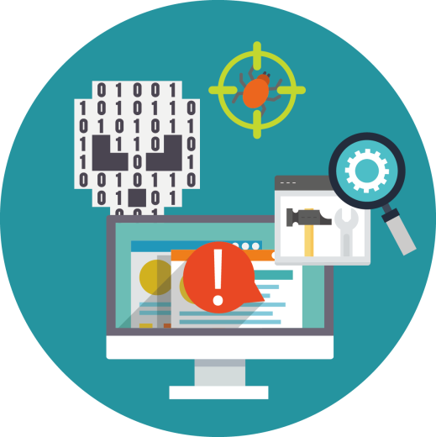
No sweat! QNAP keeps your NAS safe!
Vulnerability Scan
Use scan tools to discover any vulnerabilities on QNAP NAS.
Penetration Test
Work with security experts to perform penetration testing to find security holes and watch for any signs of cyber attacks.

Slide 49
Copyright © 2018 QNAP Systems, Inc. All rights reserved. QNAP® and other names of QNAP Products are proprietary marks or registered trademarks of QNAP Systems, Inc. Other products and company names mentioned herein are trademarks of their respective holder

