Slide 2
Build a perfect wireless video streaming environment

Slide 3
Agenda
1
Foreword: video file and wireless network
Video data storage and protection
Build a wireless video streaming environment
Video management (Video Station)
Video playback
2
3
4
5
Direct streaming from each device
Cinema28 multi-room streaming

Slide 4
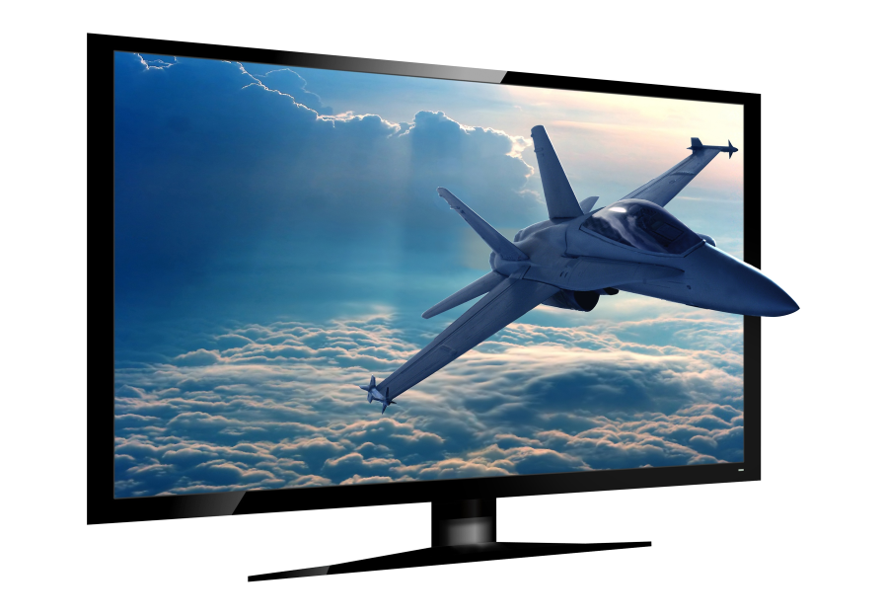
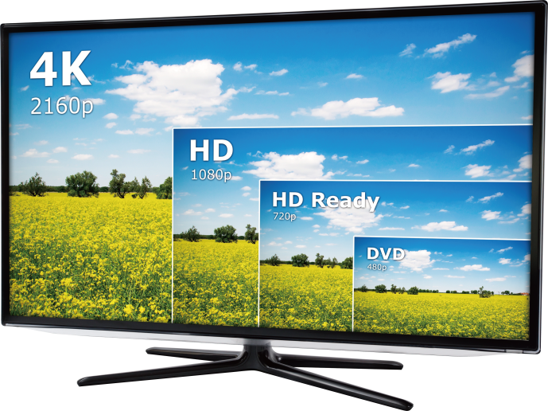
Video: file size increases as video quality improves
As technologies evolve, the size of video files have grown proportionally with the resolution.
VCD (352×240) > DVD (720X480) > HD (1280x720) > FHD (1920x1080) > 4K UHD (3840x2160)
AR / VR

Slide 5
The age of wireless networks
Wireless network will completely replace wired network in the next 10 years, becoming the mainstream of future device networking
It is estimated that by 2020 there will be 50 wireless networked devices in each home
Most devices in life are dominated by wireless Internet connections

Slide 6
As a video enthusiast......
The use of multimedia devices is complicated to set up and operate?
How to easily organize massive video files?
How to build an efficient video streaming network environment ?
How to choose the most suitable playback method?
How to store and protect a large number of audio and video files?

Slide 7
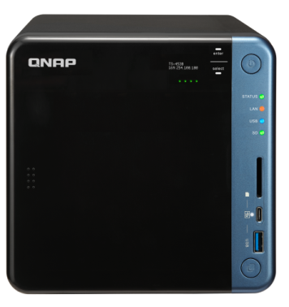
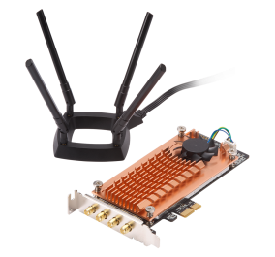
Build a wireless video playback environment
QNAP NAS
Complete file protection mechanism for videos + QWA-AC2600 PCIe
wireless adapter
Video Station
Video library for flexible management
Cinema28
Multi-room audio and video control center

Slide 8
Wireless video storage solution
A storage device designed for videophile

Slide 9
Four major features for wireless video storage/playback solution
1
High-performance storage management
Direct access through wireless network
Support complete video streaming methods
Cinema28 centralized video streaming management
2
3
4

Slide 10
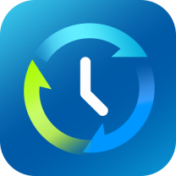
QNAP NAS Protect Your Multimedia Files
RAID Data Protection
Backup
Snapshot
No worries for disk damage with RAID1/RAID5. A copy is always there.
Backup to cloud storage and/or remote NAS.
Keep away from the threat of ransomware

Slide 11
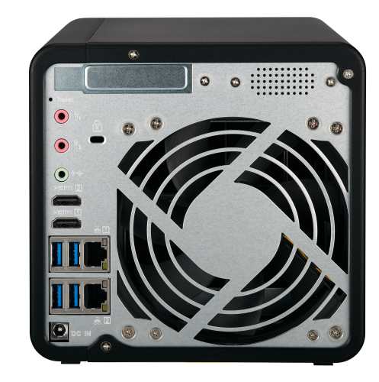
Powerful hardware for audio/video
Powerful Processor
Sound Output
Build-in Speaker
3.5mm line out
GPU Transcoding
Files Transfer
HDMI Output
Enjoy 4K Videos
SD Card Slot
USB-C QuickAccess

Slide 12
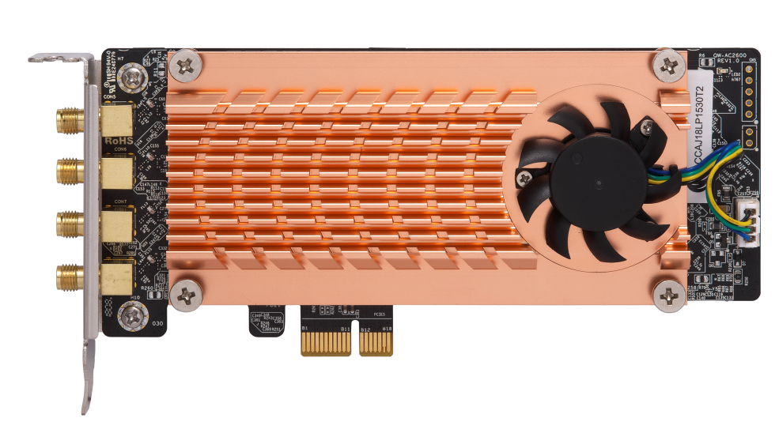
QWA-AC2600 PCIe wireless adapter
Removing the bottleneck of multiple devices and wireless networking at the same time >>>
Dual Qualcomm QCA9984 support Dual Band Dual Concurrent technology
Up to 2600 Mbps total bandwidth
802.11ac (5GHz): up to 1733 Mbps 802.11n (2.4GHz): up to 800 Mbps

Slide 13
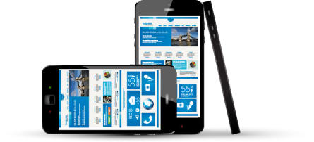
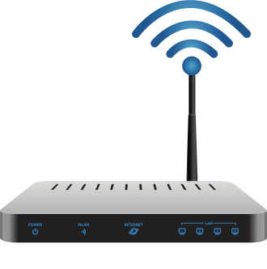
The Bottleneck of Video Wireless Streaming
With multiple devices and lager files, the bottleneck of data transmission will be stuck in the channel between the router and the NAS.

Slide 14
Direct access to data in the access point
Through direct data access between the QWA-AC2600 dual-band wireless PCIe expansion card and the NAS, an optimized network environment can be achieved.

Slide 15
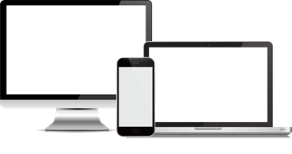
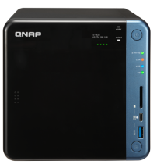
Create a Wireless Video Streaming Environment that can be shared
Establish a private secure network for multimedia applications

Slide 16
Video Station:
Video Management Center Specialized management functions for audio and video enthusiasts

Slide 17
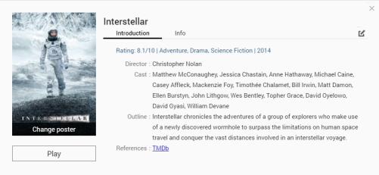
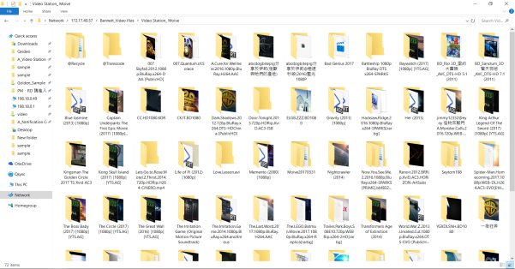
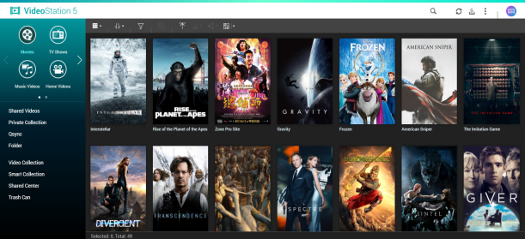
Optimized audio/video list/display
Before
After

Slide 18
Video Station: Three Major Management Features
Flexible Category Customization
Optimized Display
Advanced Search & Filter
Customize your own categories
Private Collection
Collection and Smart Collection
TV Shows: Display by seasons and episodes.
Multiple online database selection
Movie and Drama Poster Presentation
Support multi- criteria search.
Support filter by Genre, Year, Director and Cast.

Slide 19
Video Playback Solution Supports all video playback platforms to meet all your needs

Slide 20
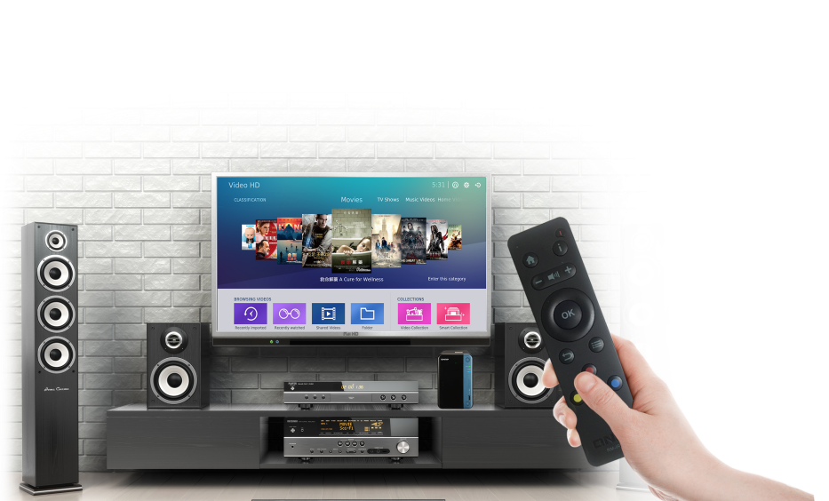
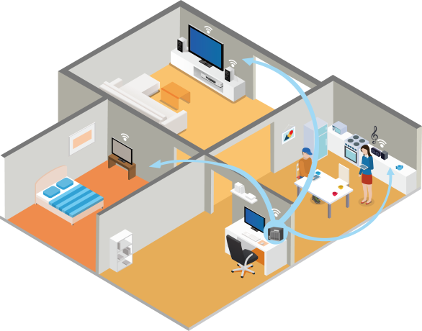
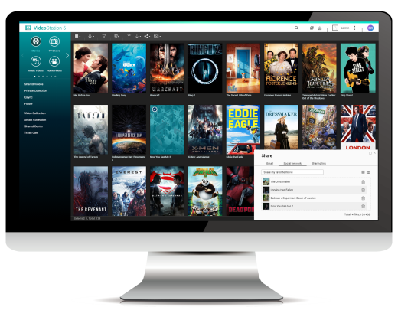
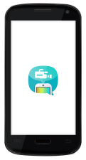
QNAP offers three video playback methods
General video streaming
Multi-room streaming
NAS local playback
Use multimedia devices such as web browsers, mobile applications and smart TVs to play multimedia files on NAS.
The user can play the multimedia files on the NAS simultaneously to multiple multimedia devices.
Output directly to the screen via HDMI, can be used with Linux Station or HD Station.

Slide 21
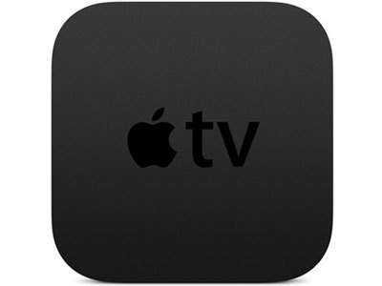
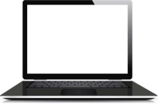
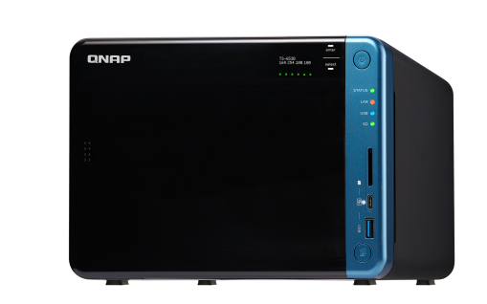
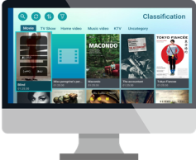
Diverse Video Streaming Platform to Meet All Your Needs
Streaming(TV)
Streaming(Web Browser)
QTS
Streaming(Phone/tablet)
Local Playback (HDMI)

Slide 22
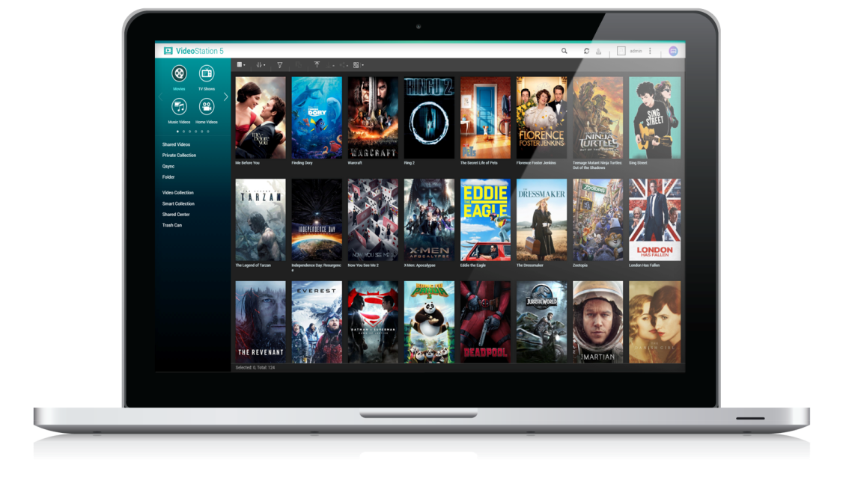
Watch on Your Computer : Windows / Mac
Play videos directly through various browsers
QVHelper streams videos to a third-party player on the computer
Support third-party players on the computer side！

Slide 23
The Advantages of QVHelper
1
Fully support all kinds of video formats
2
Does not affect NAS computing performance and effectively offload NAS CPU load
3
Perfect combination of professional player: player specific functions can be used

Slide 24
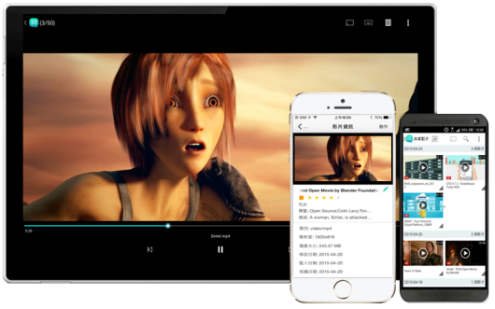
Video library on the go - Qvideo
Support Android / iOS operation system
Fully compatible with Video Station media library
Sync all video play back record
Support 360-degree video playback and VR mode.
Support offline playback
Support Resume Playback
Support play with other players, such as MX Player, VLC Player, KODI etc.
Support Multi-room Streaming

Slide 25
Enjoy Videos on Your Big TV - Qmedia
Big screen big enjoyment >>>
Qmedia Android TV
A Video Station application on the Android TV system, you can stream your NAS media files to the big screen, with intuitive operations, so that all your families can easily enjoy the big screen browsing.

Slide 26
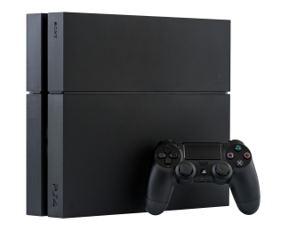
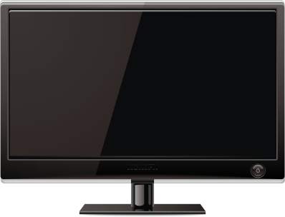
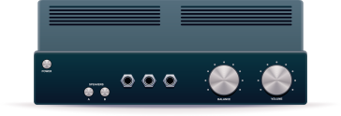
DLNA Connects All Home Multimedia Devices
DLNA( Digital Living Network Alliance) is to formulate a unified transmission specification that allows various brands and types of audio and video device to communicate with each other.
PlayStation 4
TV
amplifier
QNAP NAS
Certified by DLNA Association
DLNA
Application

Slide 27
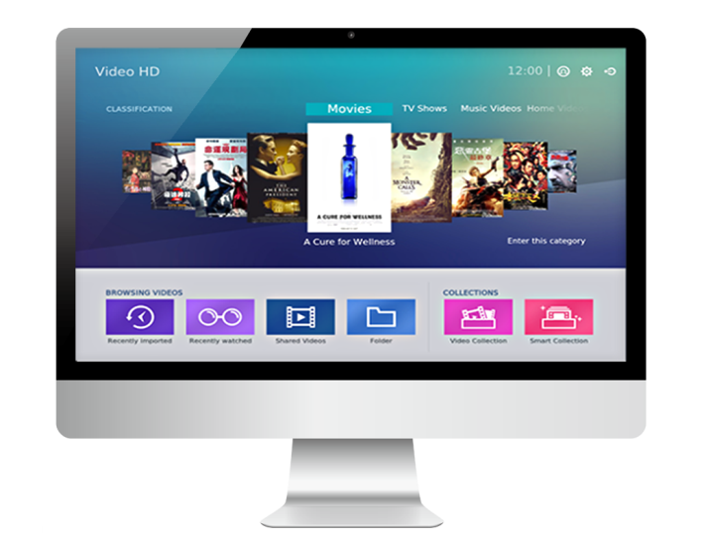
Powerful Add-on for KODI: Video HD
Local Playback >>>
QNAP Video HD
a free KODI add-on with complete support for Video Station features, such as: playback progress, video classification, online subtitle search and other functions, combined with KODI powerful playback and video format decoding capabilities to provide the best user video Watch the experience

Slide 28
Cinema28: facilitate A perfect multi-room playback Make every corner of your home awesome

Slide 29
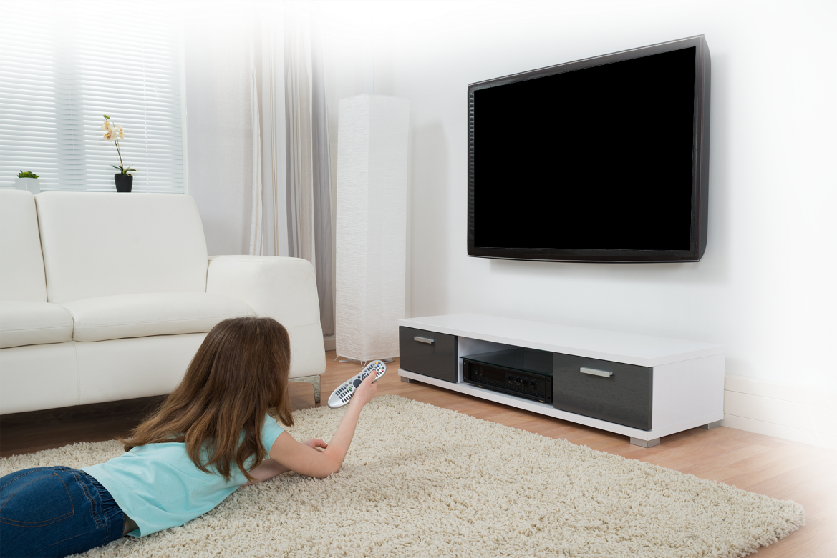
Setting Up These Devices is Really Painful...
Daddy, I want to see the next episode of cartoon.
Dear, how can I resume playback from last time?
Play finished..

Slide 30
What is Multi-room Video Streaming?
Integrate multiple streaming devices and streaming protocols into a single interface for centralized management, allowing users to easily stream digital multimedia files to audio/video devices in every corner of the home.

Slide 31
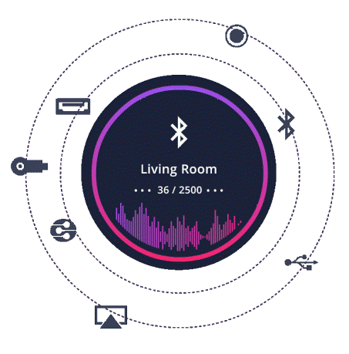
Four Major Features of Cinema28
1
One interface monitors all device states
2
Supports up to eight types of streaming protocols
3
Intuitive stream operation and device setup
4
Complete support for three video multimedia files

Slide 32
Cinema28 Support Devices
Cinema28 aims to enhance your multi-room streaming experience and can stream files to eight different devices.
HDMI
(Audio)
USB DAC
Bluetooth
Line Out
HDMI
(HD Player)
Chromecast
DLNA
AirPlay

Slide 33
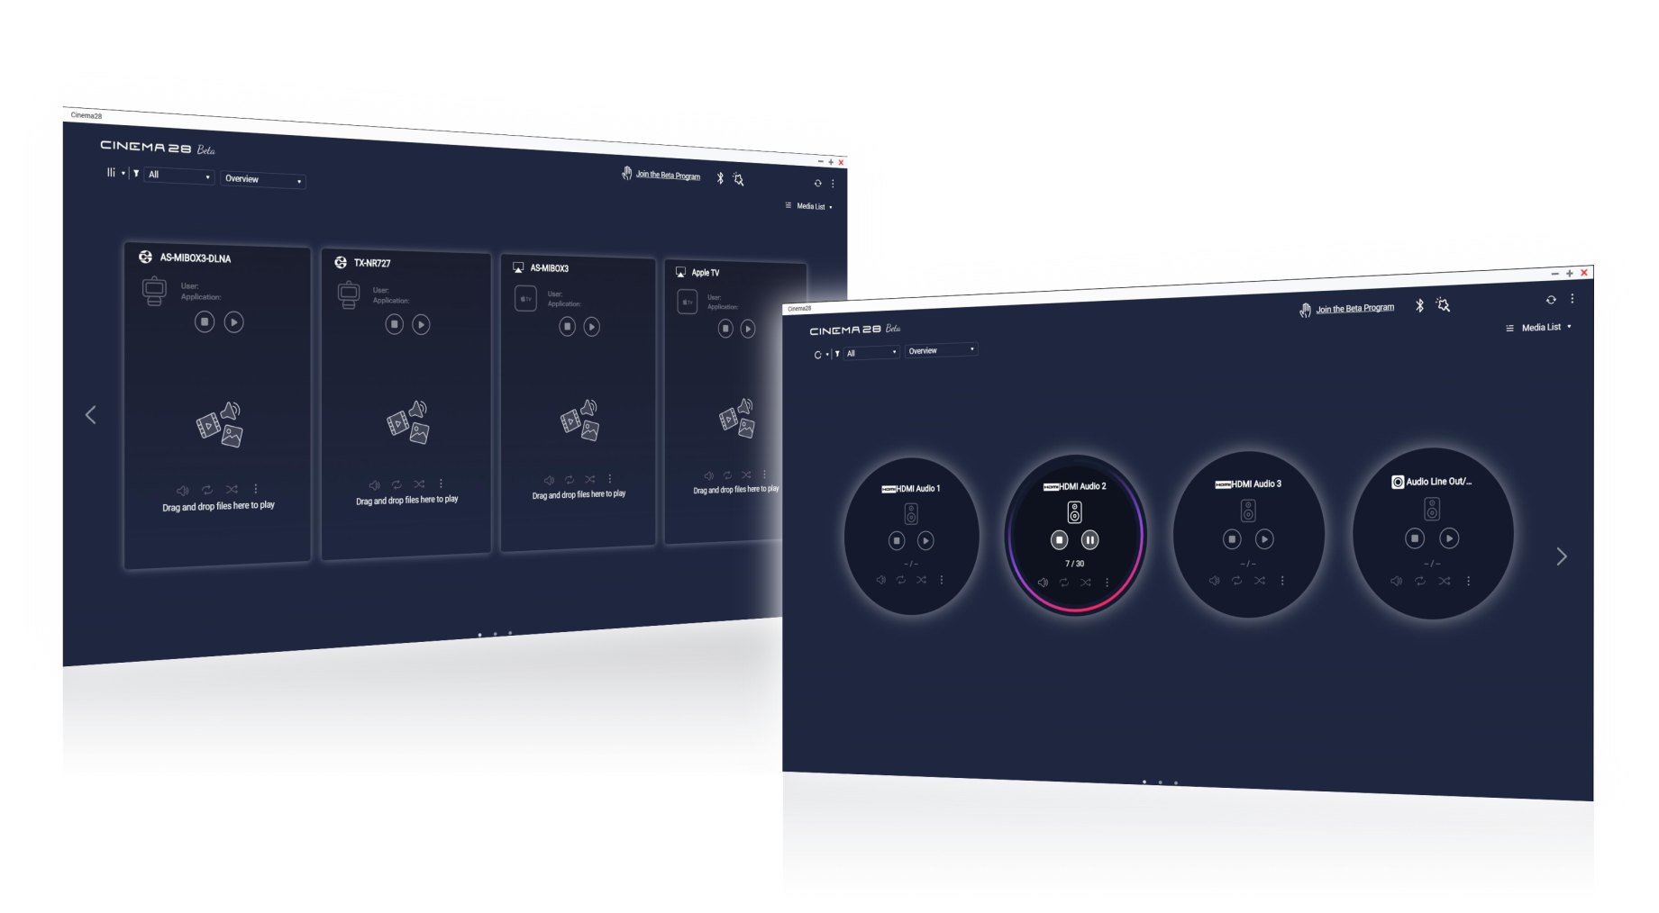
Monitor all multimedia devices in your home
Supports two modes for different scenario.
Monitor statuses of all equipment

Slide 34
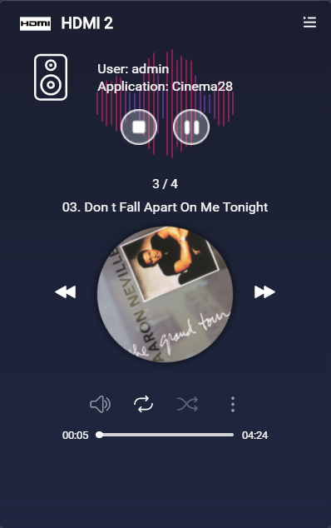
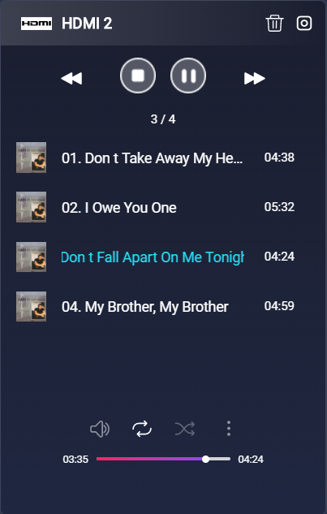
Monitor all multimedia devices in your home
Device Name
User Info
Playlist status, sorting and management
Operation Settings:
Volume adjustment
Loop/Repeat
Shuffle Playback
Stream to other devices

Slide 35
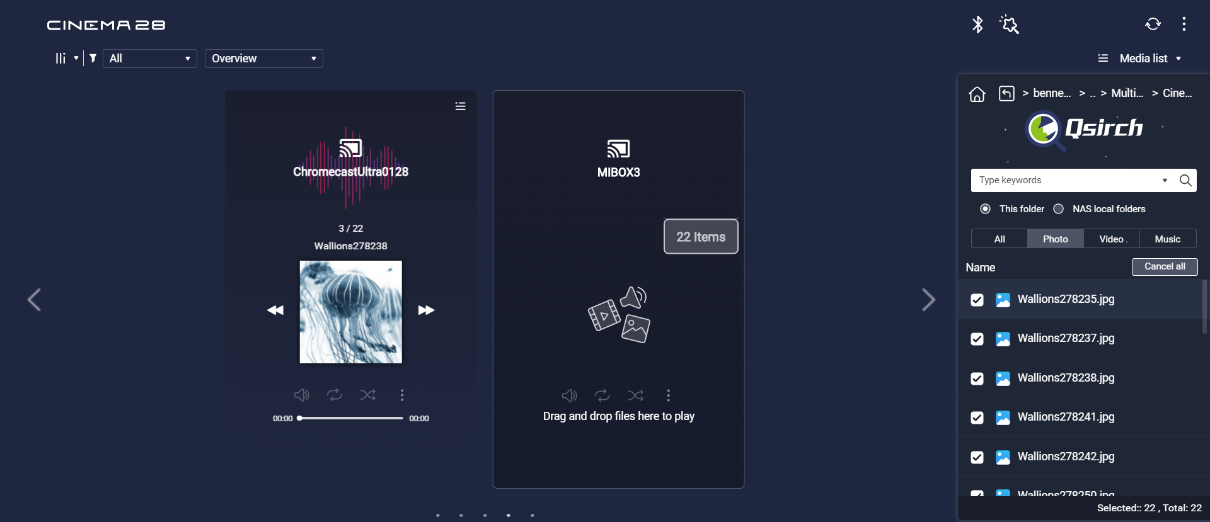
Easily drag and drop files in Cinema28
Drag multimedia files directly to the device to play

Slide 36
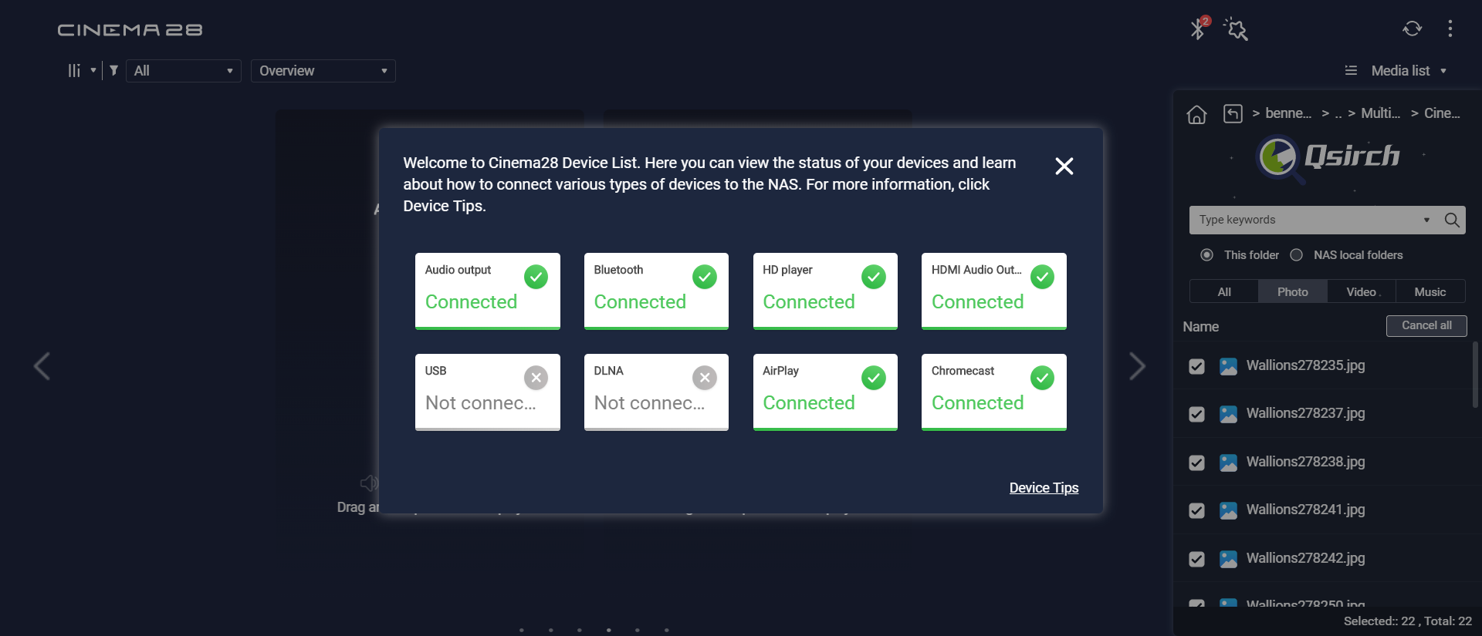
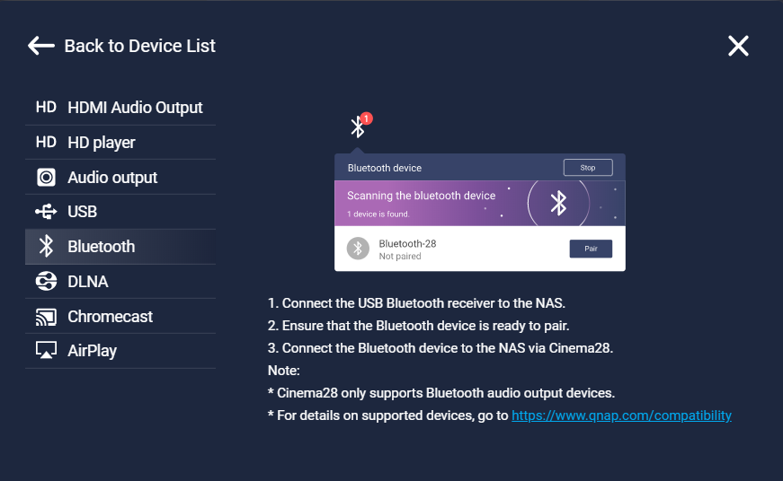
Cinema28 Device Wizard
Detect connection status of the device
Solve almost all kinds of difficulties

Slide 37
Comparison of general and multi-room streaming
 | General Video Streaming | Multi-room Streaming
Operation | Each device operates independently | Central Management
Flexibility | High flexibility (not limited to space) | Low Flexibility (devices need to be within the same subnet)
Device Status | Can't know the status of each device | Ability to control the use of each device

Slide 38
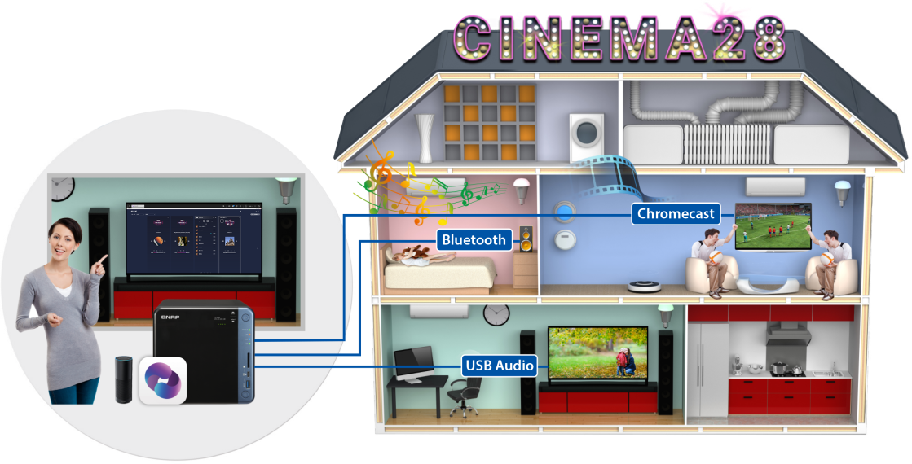
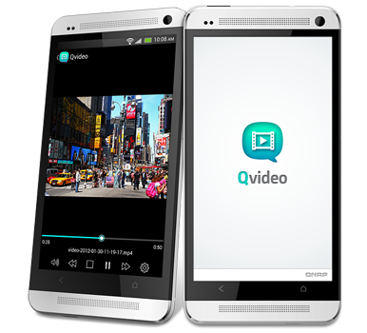
Meet all Your Media Playback Scenarios
Outdoor
In the House
Enjoy video files stored on the NAS at home through Qvideo mobile app
Use the Cinema28 to manage the home multimedia devices and stream videos to various rooms

Slide 39
Perfect file protection mechanism for videos + QWA-AC2600 PCIe Wireless Adapter
QNAP NAS
The Golden Combination for video streaming
Video library for flexible management
Video Station
Cinema28
Multi-room control center

Slide 40
QNAP Video Streaming Solution Your Best Choice!
Copyright © 2018 QNAP Systems, Inc. All rights reserved. QNAP® and other names of QNAP Products are proprietary marks or registered trademarks of QNAP Systems, Inc. Other products and company names mentioned herein are trademarks of their respective holder

