Slide 2
Rackmount NAS with single & redundant power
AMD GX-420MC 64bit quad-core 2.0 GHz

Slide 3
Upgraded 10GbE port: 10GBASE-T
Offers the same 10GbE performance,
but adds Multi-Gigabit support
TS-x63U-RP
1 x 10GbE SFP+
1 x 10GbE 10GBASE-T
TS-x63XU-RP

Slide 4
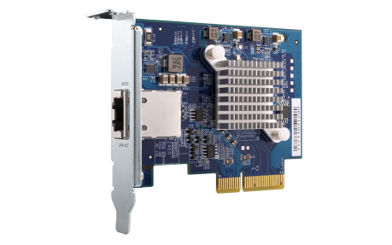
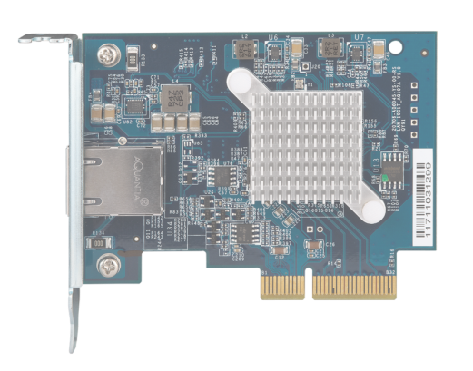
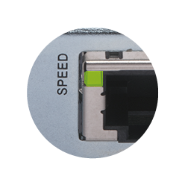
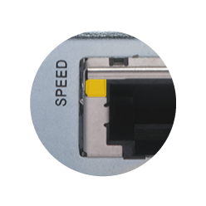
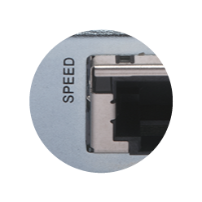
Multi-Gigabit 10GBASE-T port
Aquantia AQC107 controller
Multiple speeds
10G
Multi-Gig supporting vendors
5G/2.5G/1G/100M
Disconnected

Slide 5
Instantly upgrade to five speeds
 | CAT 5e | CAT 6 | CAT 6A & CAT 7
100M | ✔ | ✔ | ✔
1G | ✔ | ✔ | ✔
2.5G | ✔ | ✔ | ✔
5G | ✔ | ✔ | ✔
10G | X | ✔(55m) | ✔
Supports Multi-Gigabit NBASE-T
With QNAP 10G switch，existing RJ45 cables can be used for faster speeds!
多種連線速度
QSW-1208-8C

Slide 6
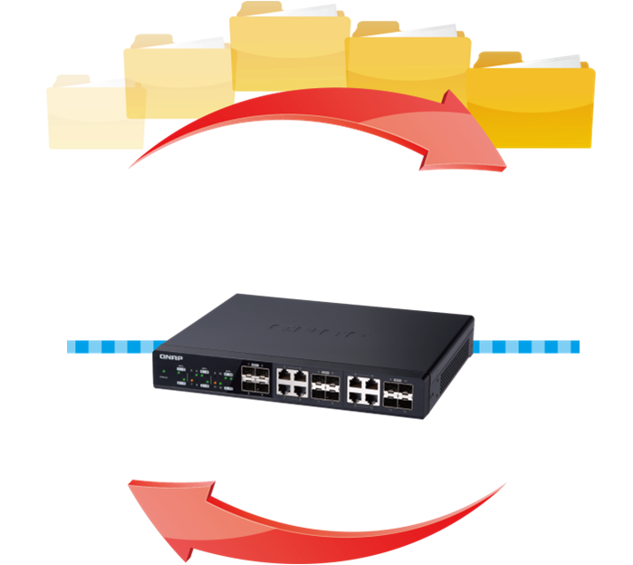
10GbE for fast data backup & recovery
Economical business disaster recovery solution
High-performance backup
Real-time and in-time recovery
Safeguard confidential and sensitive data
Backup
Recovery

Slide 7
A single portal for backup & recovery
Hybrid Backup Sync
Backup
Recovery
Sync

Slide 8
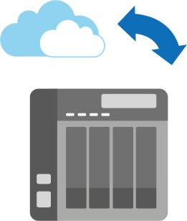
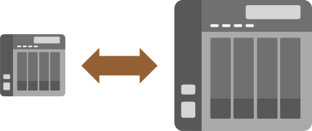
Backup – Hybrid setup
Cloud
Local
Remote

Slide 9
Multi-version backup
Simple backup
Smart backup
NOW
JAN.
APR.
SEP.
DEC.

Slide 10
Demo: solid 10GbE performance
The TS-1263XU provides 1 x 10GbE 10GBASE-T port
iSCSI
Read
1079 MB/s
Write
602 MB/s
Tested in QNAP Labs. Figures may vary by environment.
1 x 10GbE iSCSI test environment： NAS： TS-1263XU OS：QTS 4.3.4 Volume：RAID 5; 12 x Intel SSDSC2BB240G4 SSD
Client PC：Windows 10, Intel Core i7-6700 3.4 GHz, 32GB RAM,
QNAP LAN-10G2T-X550 card, IOMeter 2M

Slide 11
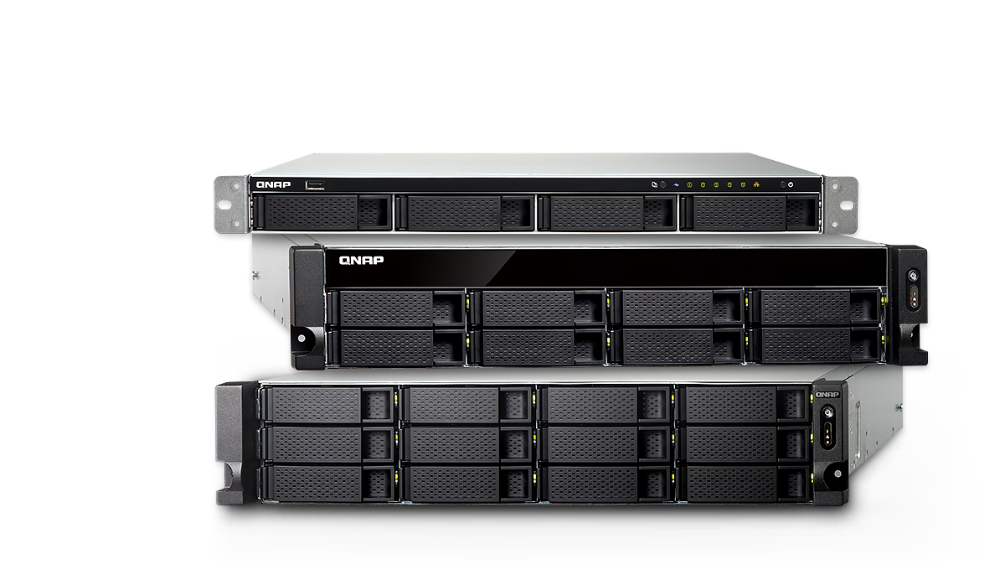
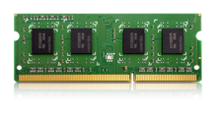
AMD quad-core 2.0 GHz processor
Long-term support
AES-NI encryption acceleration
2 x SODIMM DDR3L
memory up to
64-bit 4-core 2.0 GHz SoC
AMD GX-420MC processor
16GB
(2 x 8GB)

Slide 12
TS-463XU & TS-463XU-RP
TS-463XU-4G
4GB RAM (1x 4GB)
TS-463XU-RP-4G
4GB RAM (1x 4GB)
Single
250W
Redundant
2 x 250W
4-bay

Slide 13
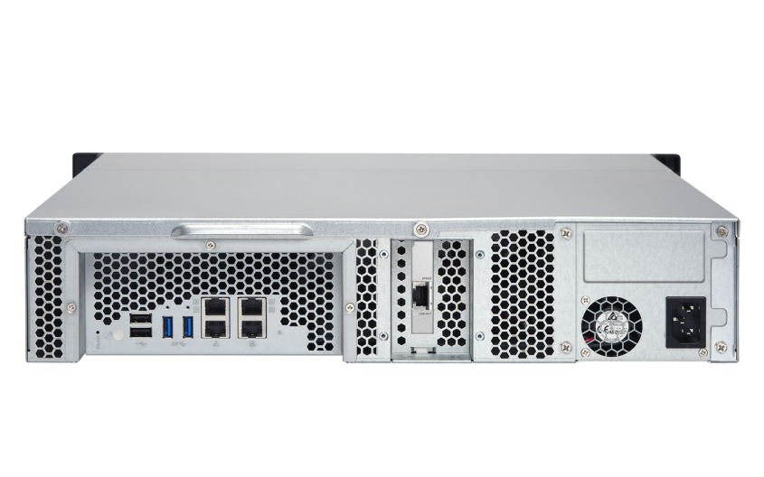
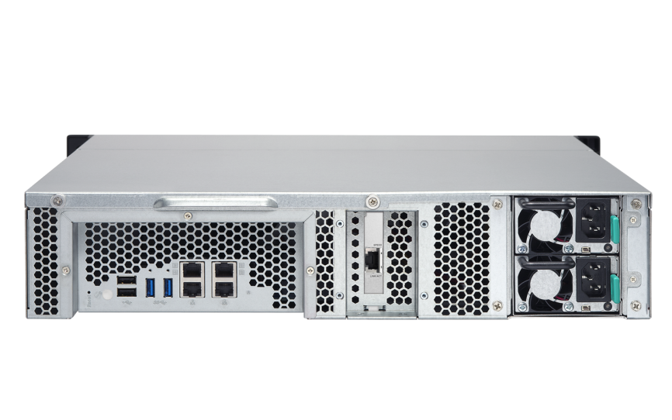
TS-863XU & TS-863XU-RP
TS-863XU-4G
4GB RAM (1x 4GB)
TS-863XU-RP-4G
4GB RAM (1x 4GB)
Single
250W
Redundant
2 x 250W
8-bay

Slide 14
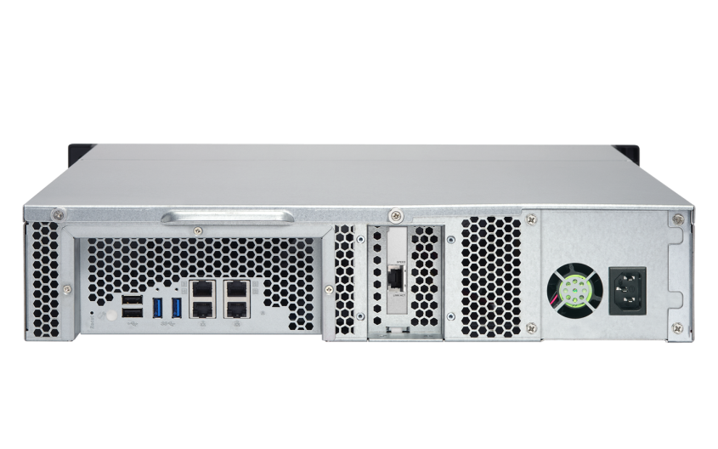
TS-1263XU & TS-1263XU-RP
TS-1263XU-4G
4GB RAM (1x 4GB)
TS-1263XU-RP-4G
4GB RAM (1x 4GB)
Single
350W
Redundant
2 x 300W
12-bay

Slide 15
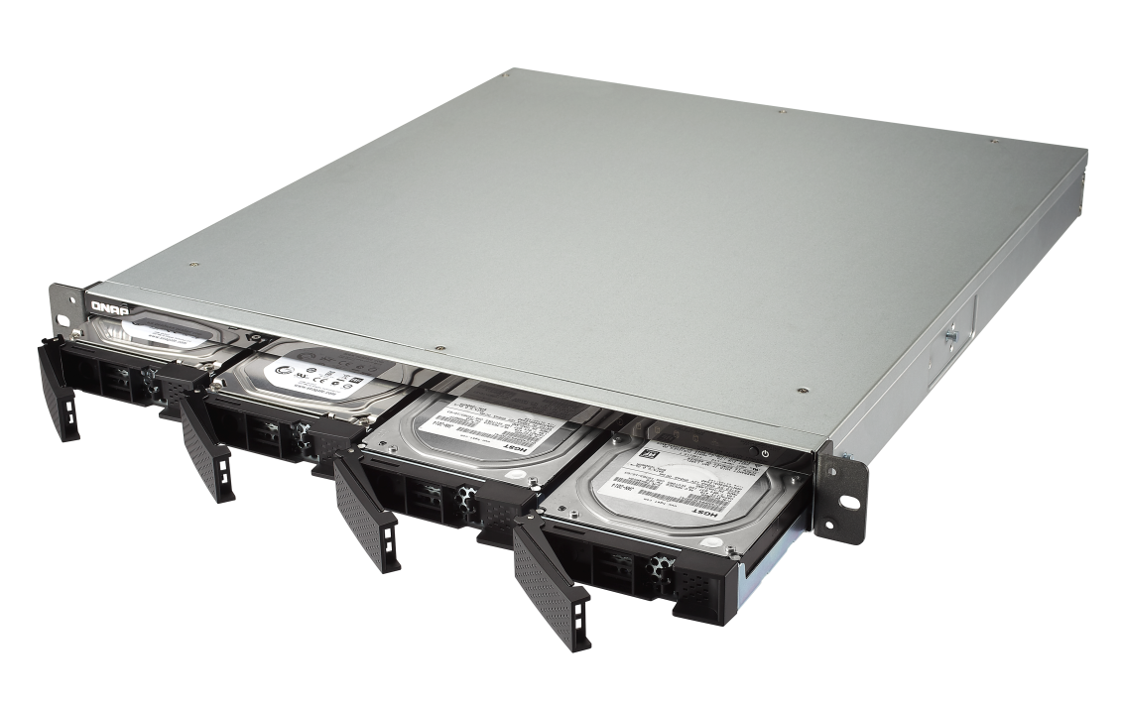
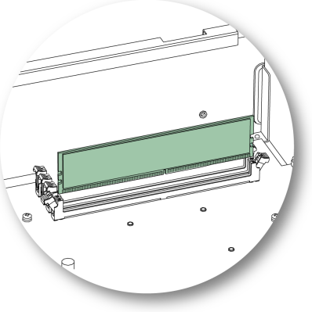
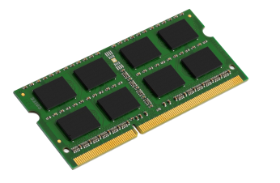
Up to 16GB DDR3L memory
2 x DDR3L SODIMM RAM slots
Up to 16GB
Preinstalled with
1 x 4GB DDR3L SODIMM
QNAP
optional accessories
4GB, 8GB,
16GB RAM

Slide 16
4-bay front view
USB 2.0
USB one touch copy button
LEDs:
Status,
LAN,
HDD
Power button

Slide 17
8-bay / 12-bay front view
LEDs:
Status
LAN
Expansion unit
Power button
HDD Status LEDs
TS-1263XU-4G
TS-1263XU-RP-4G
TS-863XU-4G
TS-863XU-RP-4G

Slide 18
4-bay rear view
2 x USB 3.1 Gen 1
2 x USB 2.0
4 x 1GbE RJ45 LAN ports
2.0 x4 half-height PCIe slot
Single PSU
TS-463XU: 250W
Dual PSU
TS-463XU-RP: 2 x 250W
Reset

Slide 19
8-/12-bay rear view
2 x USB 3.1 Gen 1
2 x USB 2.0
4 x 1GbE
RJ-45 LAN ports
2.0 x4 half-height PCIe slot
Single PSU
TS-863XU: 250W
TS-1263XU: 350W
Dual PSU
TS-863XU-RP: 2 x 250W
TS-1263XU-RP: 2 x 350W
Reset

Slide 20
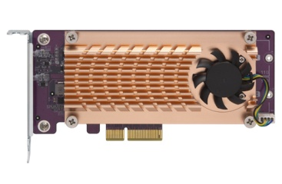
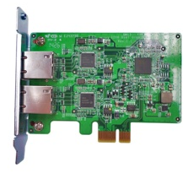
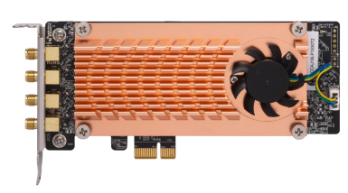
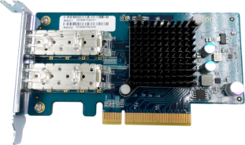
PCIe slot for versatile applications
TS-x63XU has a half-height PCIe 2.0 x4 expansion slot, and the pre-installed 10GBASE-T card can be replaced with many other PCIe cards.
M.2 SSD / 10GbE port
2 x GbE LAN
10G SFP+ LAN
2.4G/5G wireless AP
QM2-2S, QM2-2S10G1T
QM2-2P, QM2-2P10G1T
QM2-2S-220A, QM2-2P-244A
LAN-1G2T-I210
LAN-10G2SF-MLX
QWA-AC2600
PCIe 2.0 x4
TS-1263XU-RP

Slide 21
Hardware upgrade
Memory
PCIe card

Slide 22
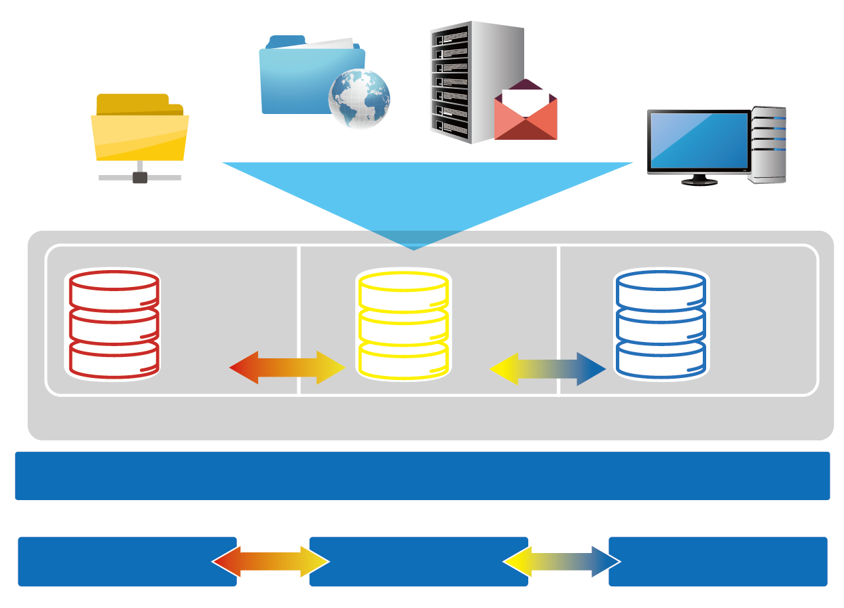
The leading hybrid storage NAS
Web server
Email Server
Advantages
File server
Virtual Desktop Application
SSD as storage
Satisfy both random and sequential usages
Triggered by events, data tiering
PCIe NVMe,
M.2, SSD RAID
SAS HDD RAID
NL, SATA HDD RAID
Use Cases
Qtier storage pool
File Server
Web Server
Mail Server
VDI Hosting
Local NAS

Local NAS
Expansion unit 1
Expansion unit 2
Notes:
22

Slide 23
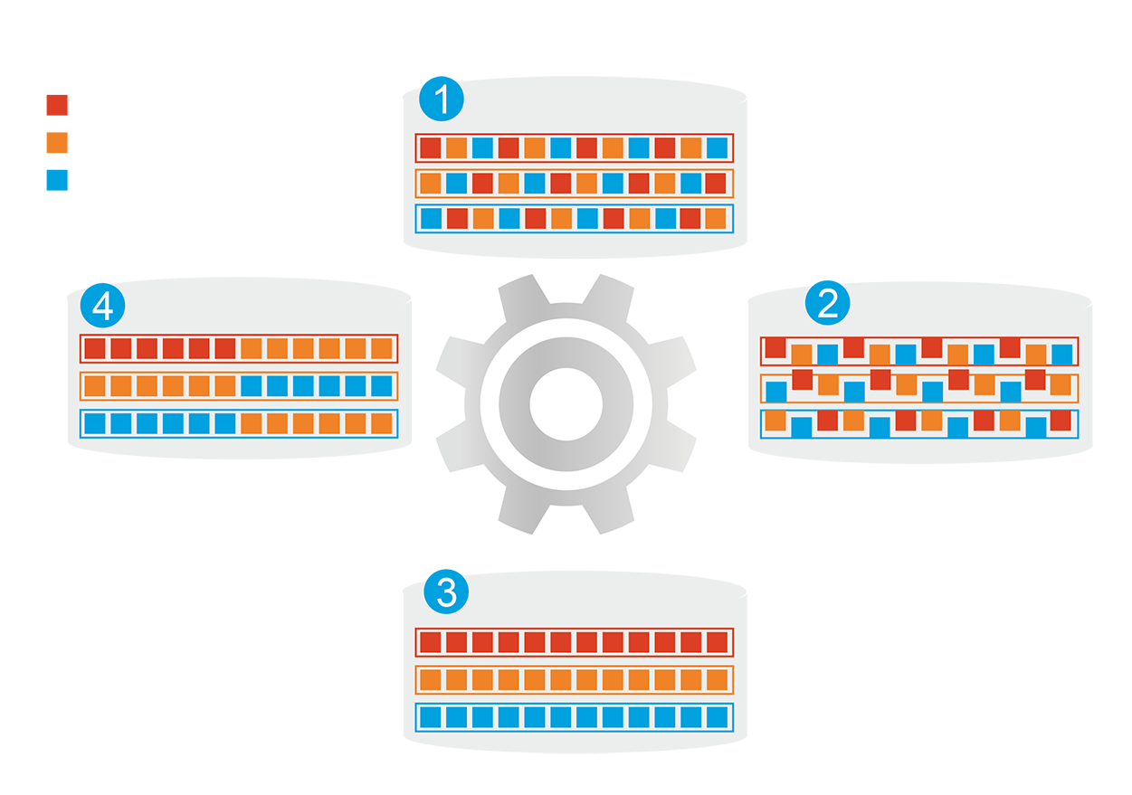
Hybrid Storage System
Before tiering: Frequently-accessed data performance is not optimized
Frequently-accessed data
Infrequently-accessed data
Rarely-accessed data
Changes in data access patterns
Start data tiering
How Qtier Works
● Automatically moves data
between different tiers
● SSD cache capacity will
not be limited by RAM size
After tiering: Frequently-accessed data performance is optimized
Notes:
23

Slide 24
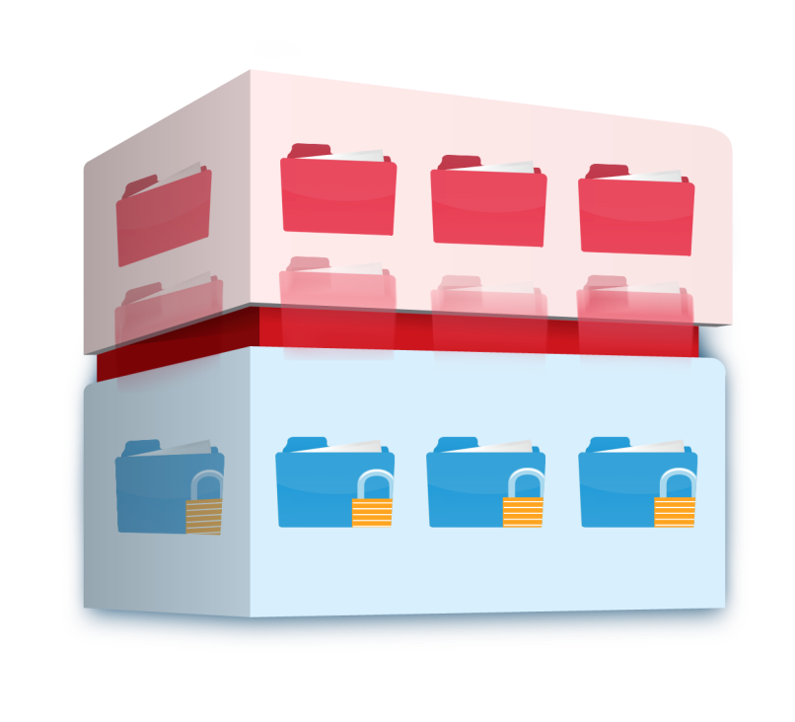
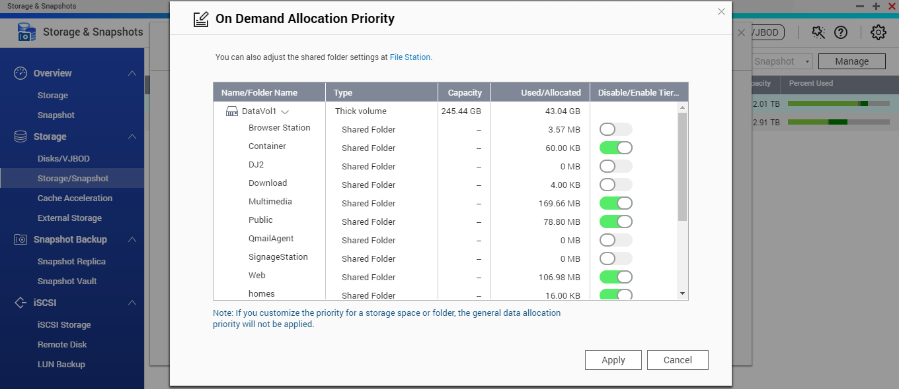
Qtier 2.0 Tiering On Demand
● SSD only has limited capacity that can be used on key applications
● Enable or disable auto-tiering for individual shared folder or iSCSI LUN
Hot data and reserved block
Cold and archived data
Notes:
24
演示SSD快取、關閉Qtier和開啟Qtier間針對連續檔案傳檔的效能差異。

Slide 25
QTS and virtualization
QTS 4.3.4 storage and snapshot management plus multimedia
enhancements
Multi-OS in One
Run Windows/Linux VMs and containers
Virtualization Station
Container Station

Slide 26
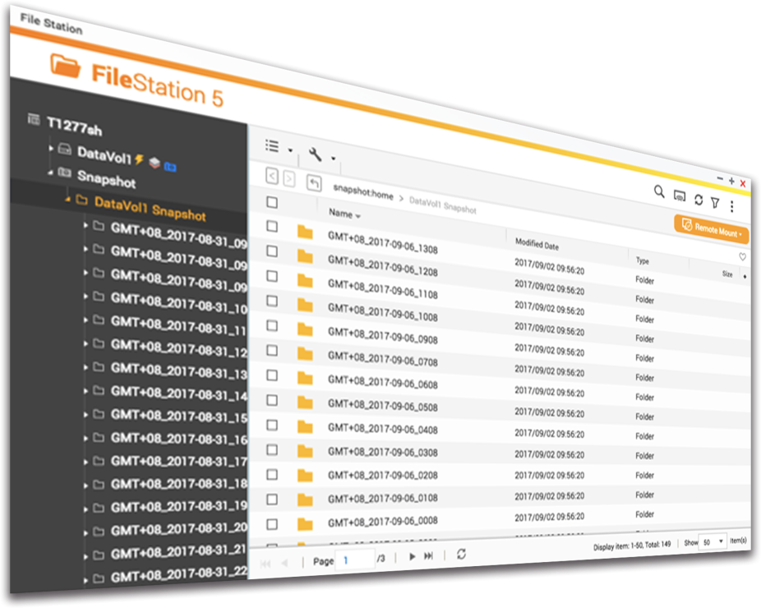
Snapshot data protection
Protection against ransomware!
Max per NAS
1024
--------------------------------------
Max per volume/LUN
256

Slide 27
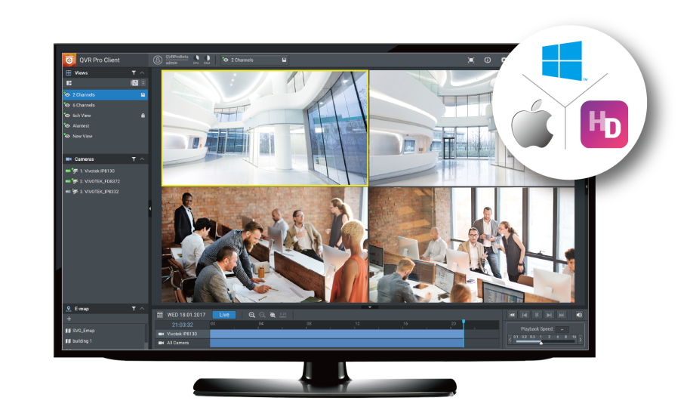
High-capacity surveillance solution
Surveillance Station 5.1
Free: 4 camera channels
Max: 40 channels (optional licenses)
QVR Pro
Free: 8 camera channels
Max: 128 channels (optional licenses)
QUSBCam2
Up to 1080p USB Webcam recording
* 在 QVR Pro 正式發行時，正式頻道授權數請參閱 QNAP 官網．

Slide 28
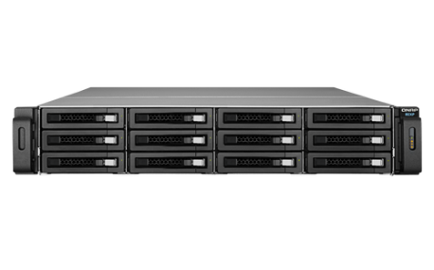
Use iSCSI / JBOD to Expand NAS
● NAS+iSCSI Target ： Limited functions without knowing target storage condition
TS-463XU-RP
TS-1263XU-RP
● NAS+JBOD： Limited ports with RAID protection on the host
RAID
TS-1263XU-RP
UX-1200U-RP#1
UX-1200U-RP#2

Slide 29
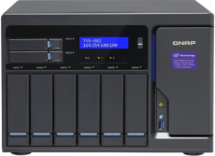
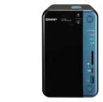
Replacing JBOD with iSCSI VJBOD
● Uses VJBOD to mount a
LUN as a local disk
● Create Storage Pool, take
snapshot, use media library, Qsirch indexing
● Fully utilize storage space
of NAS
Container Station
iSCSI LUN
1 x 10GBASE-T
2 x GbE
TS-1263XU-RP
Virtual pool 1
RAID
Ethernet, flexible connection
Virtual pool 2
Notes:
29
NAS > eSATA < JBOD > LUN backup > to other NAS

Slide 30
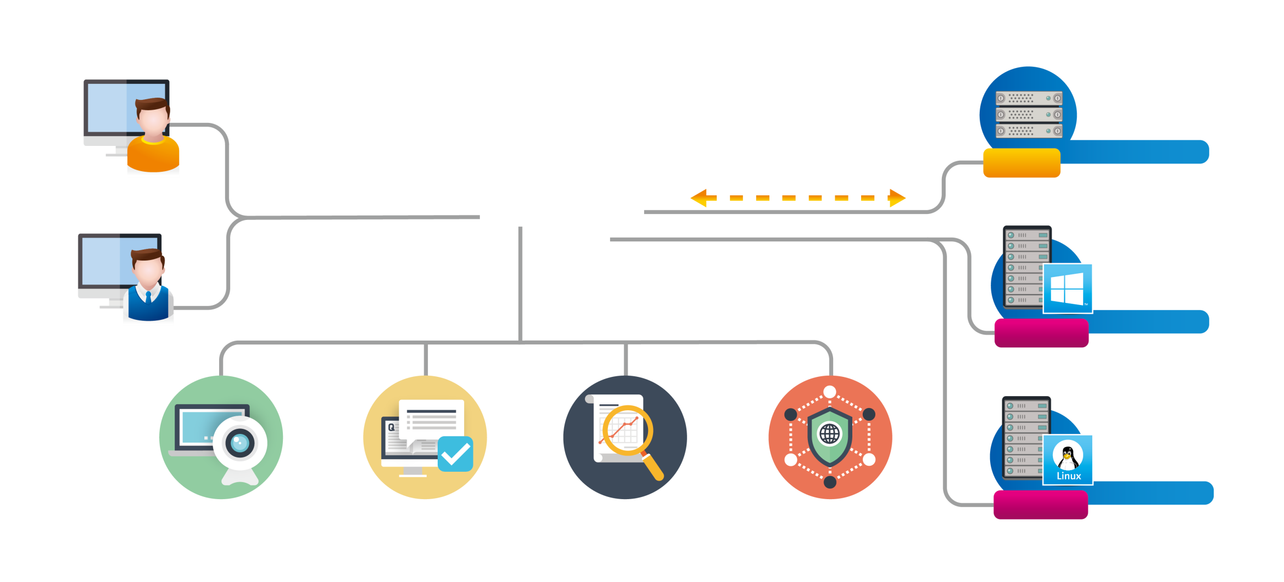
Introduction to QRM+
IPMI
Servers with IPMI
System Administrator
KVM-over-IP
Agentless
Monitoring
QRMAgent
Windows Server
Operator
Agent-based Monitoring
QRMAgent
Linux Server
Continuous monitoring
Troubleshooting
Analysis
Issue Prevention
Agent-based Monitoring

Slide 31
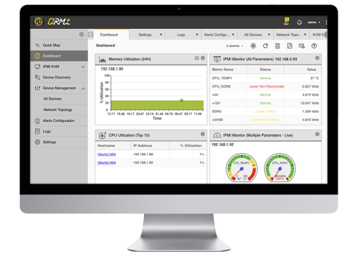
Workflow of QRM+
Add devices
Comprehensive QRM+ Device Monitoring
Continuous Monitoring
Troubleshooting
Analysis
Issue Prevention
√ Data collection
√ Dashboard
√ Network topology
√ Support IPMI
√ Web-based
remote access
√ Historic data
√ Remote
recording and
playback
√ Alert and notification
√ Log mgnt.

Slide 32
Create your private
IoT cloud platform

Slide 33
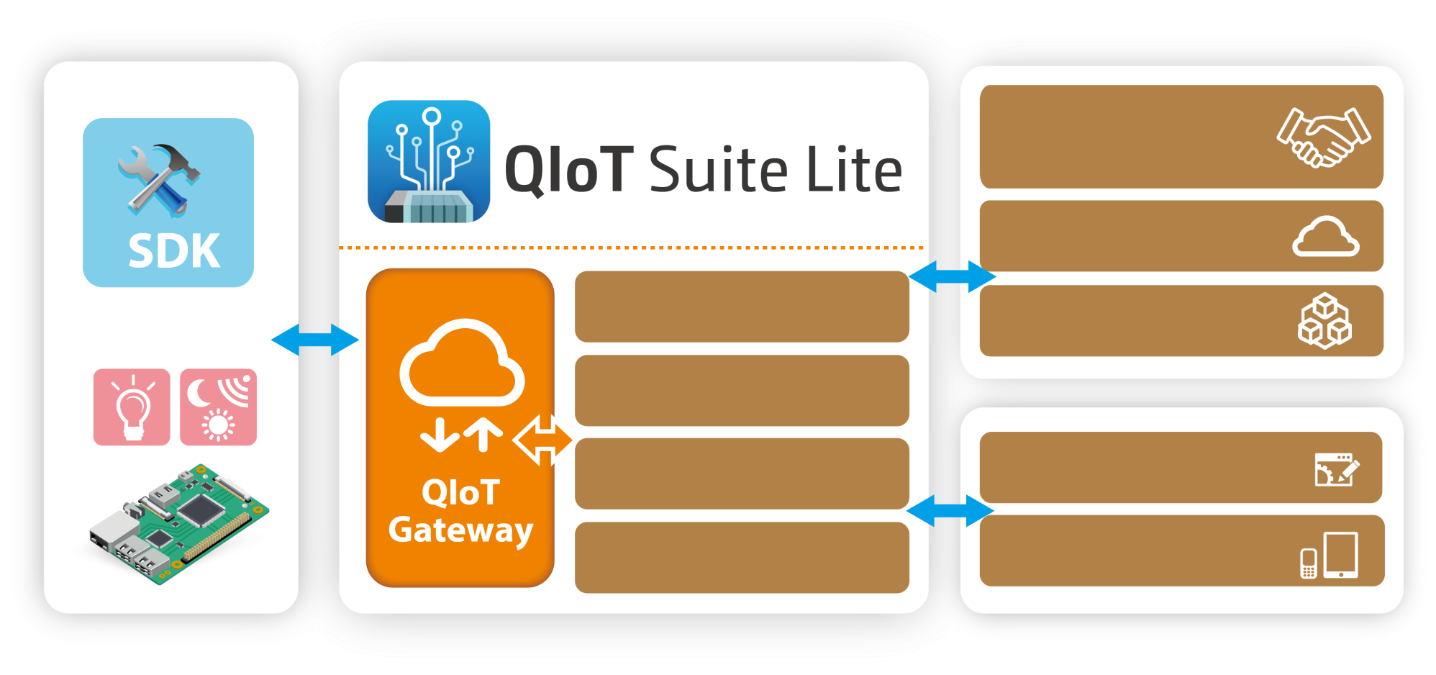
IoT Cloud Solution
Third Party Data and Service
PaaS
User Management
SaaS
Device Management
Rules Engine
Enterprise Systems
Dashboard
Mobile Devices

Slide 34
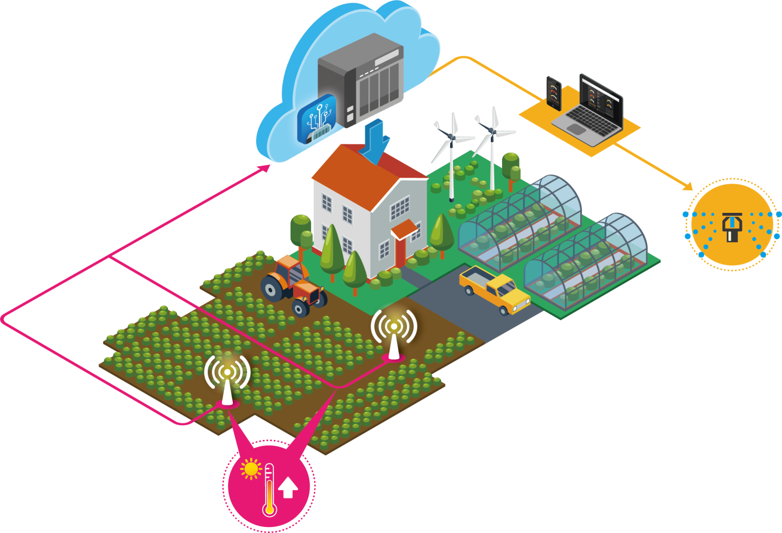
Smart Farm application
Analyzing Data
Action can be taken in real-time.
Operation efficiency.
Visualizing Reports
Optimize farm management &
resource usage.
3
Generating reports & taking actions
2
Data collecting
& processing
1
Data transmission

Slide 35
QNAP NAS is your best choice
Copyright © 2018 QNAP Systems, Inc. All rights reserved. QNAP® and other names of QNAP Pr oducts are proprietary marks or registered trademarks of QNAP Systems, Inc. Other products and company names mentioned herein are trademarks of their respective holders.

