Slide 2
leveled up! Now with more customizable options

Slide 3
You have too much information to handle, and how to properly keep it is a problem!
Files scattered everywhere, and it is difficult to organize them!
It takes too much time to organize photos. I really want to rename and share them with a simple click!
The storage capacity is almost full, and I need help quickly removing unnecessary files!

Slide 4
Qfiling 2.0 core competencies
Flexible
Create your Qfiling rules in 3 steps
Efficient
Scheduling for auto filing
Total control
With system logs, filing status is easily accessible
Fast
With recipes, tasks are done with one click

Slide 5
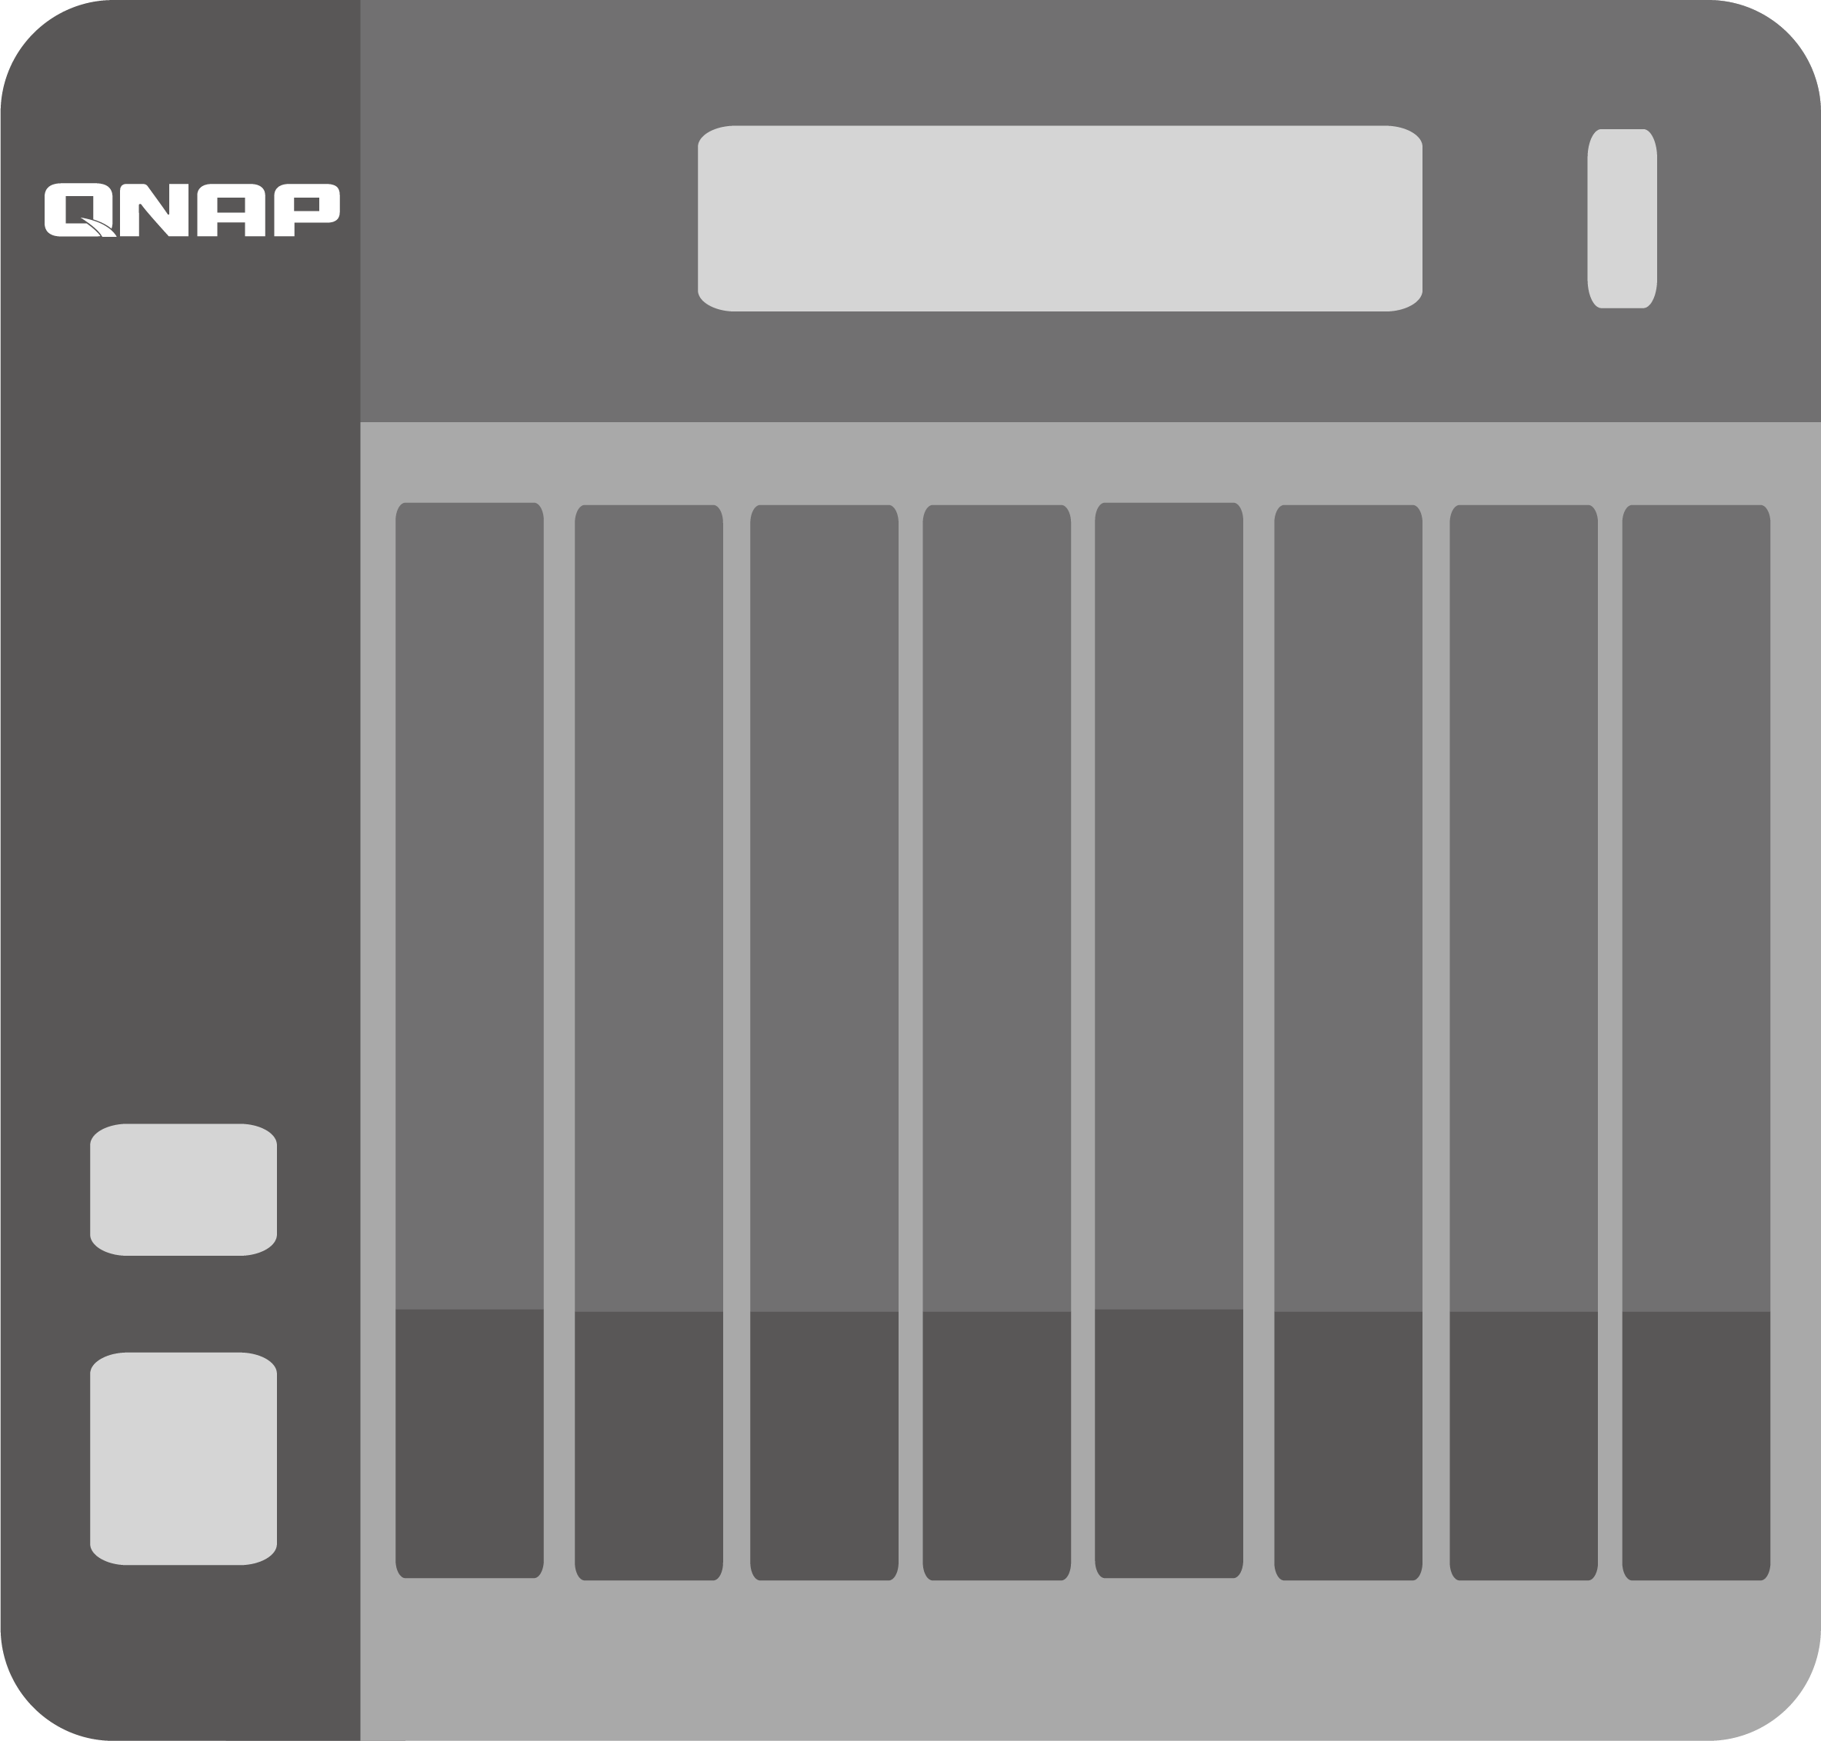
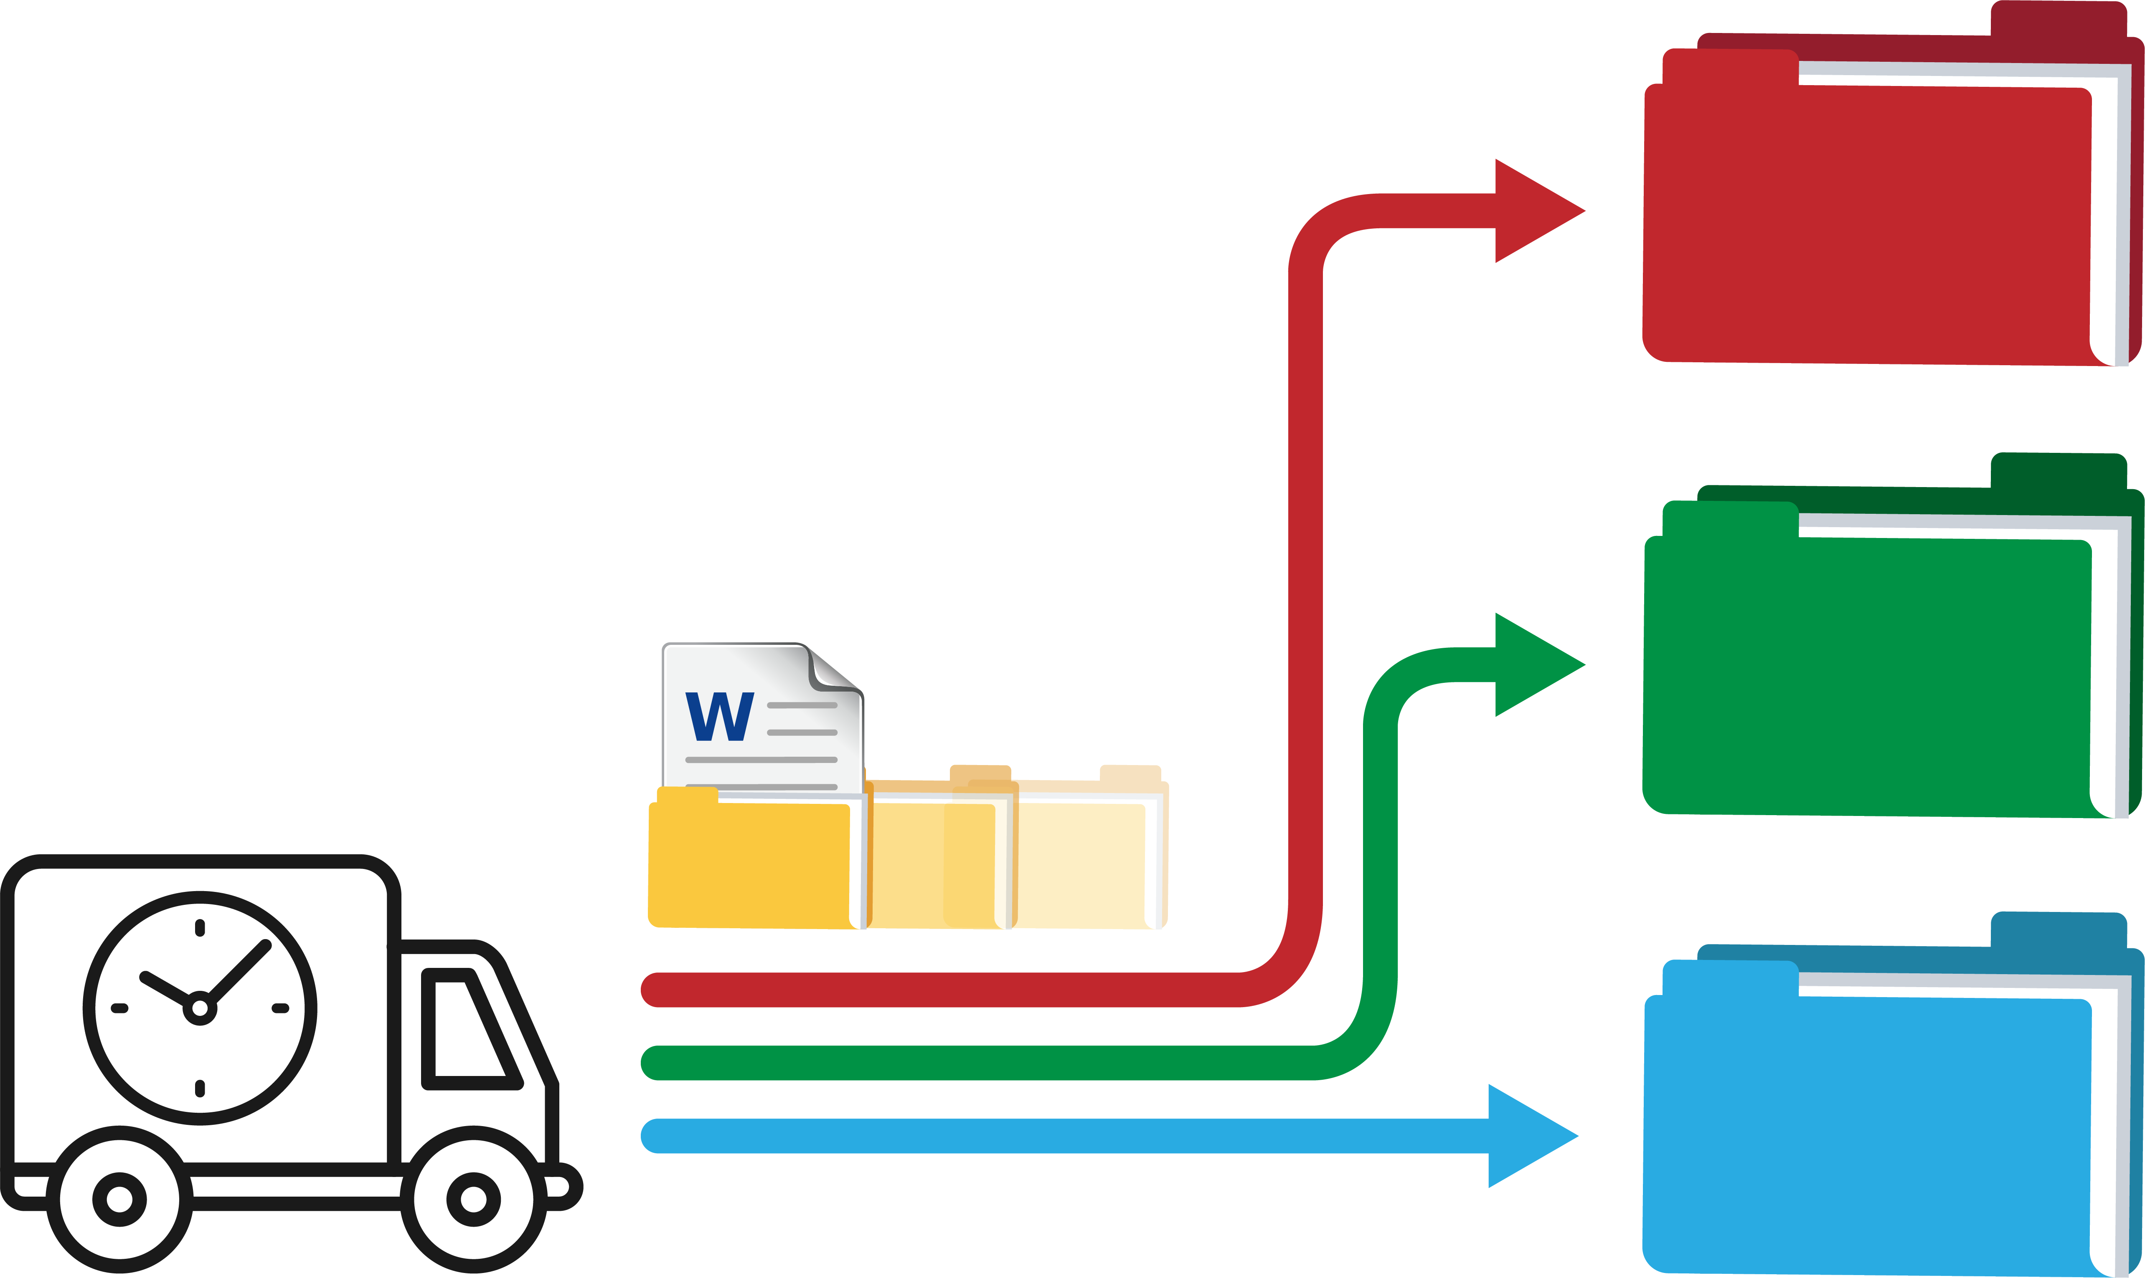
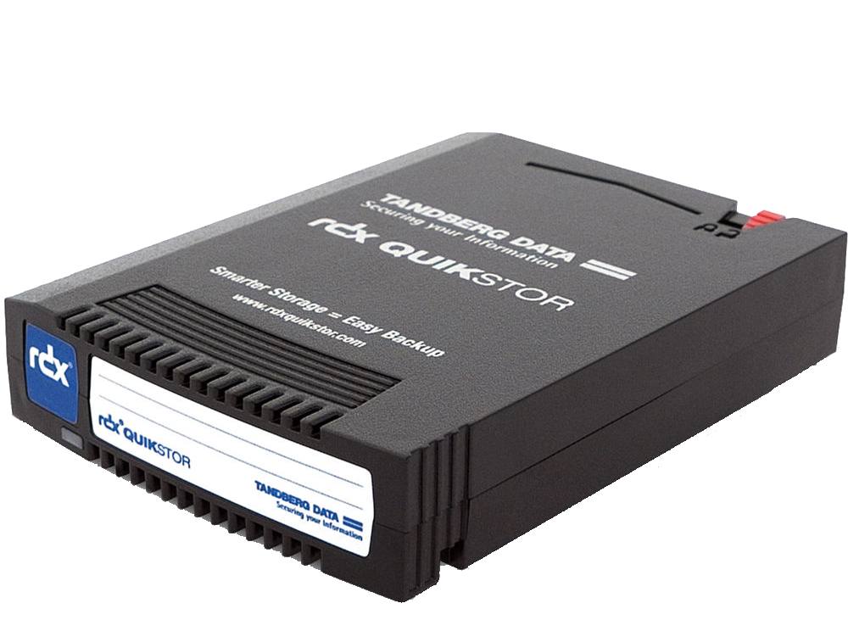
How does Qfiling work?
Select source
Set filing criteria
Select destination
Document
NAS
iSCSI
NAS
iSCSI
Image
USB
DVD
USB
Mobile
Video
RDX
Mobile
RDX

Slide 6
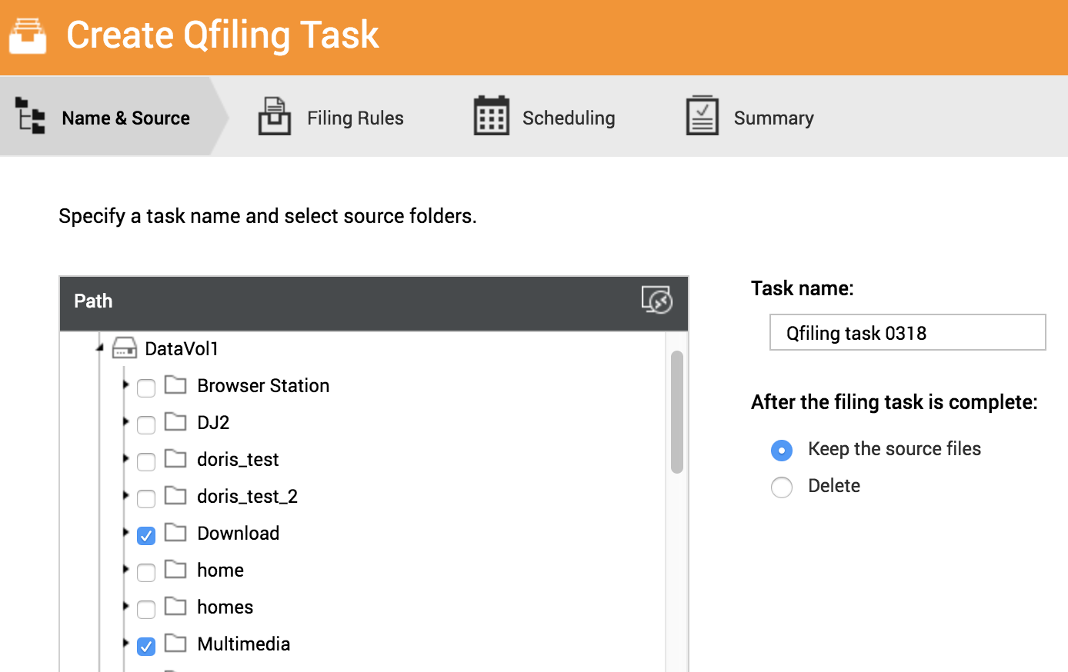
Create your Qfiling rules in 3 steps
Select source
Set filing criteria
Select destination
Support 6 device types:
NAS
iSCSI
USB
Mobile
DVD
RDX
Free up NAS storage space by setting to “delete" the source files after the filing task is completed.

Slide 7
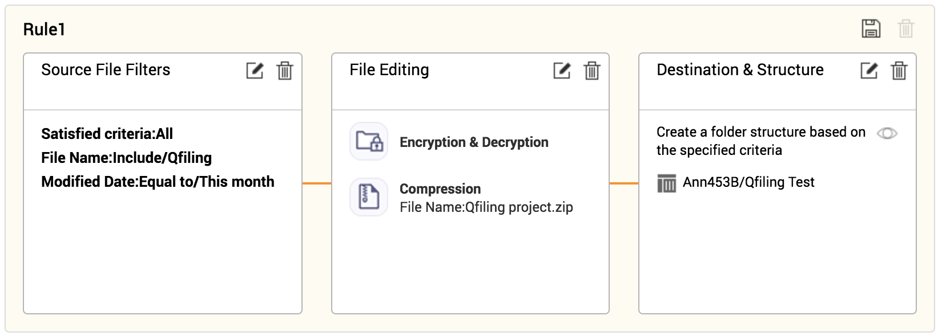
Create your Qfiling rules in 3 steps
Select source
Set filing criteria
Select destination
Source file filters
File editing
Destination & Structure

Slide 8
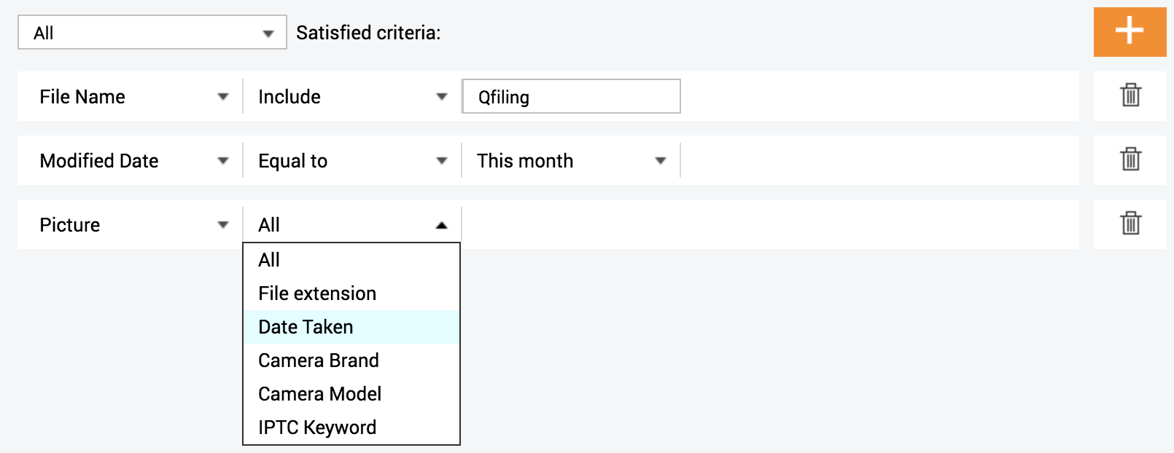
Create your Qfiling rules in 3 steps
Select source
Set filing criteria
Select destination
Source file filters
File editing
Destination & Structure
20+ filter criteria to help you pick the files you need!

Slide 9
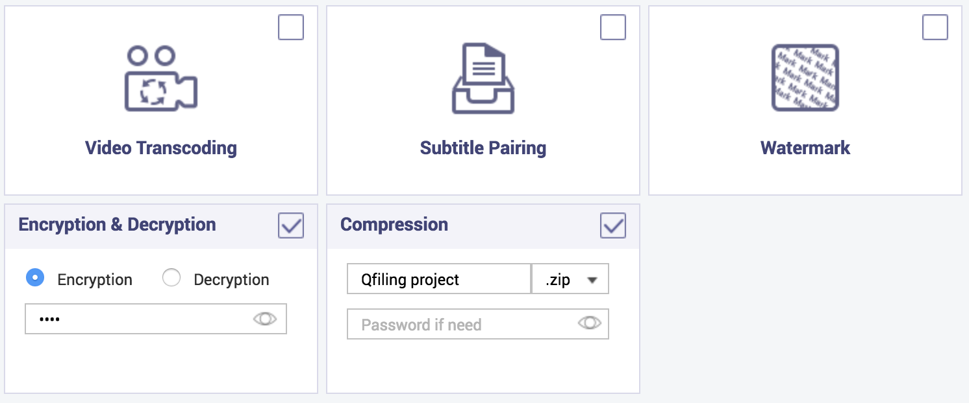
Create your Qfiling rules in 3 steps
Select source
Set filing criteria
Select destination
Source file filters
File editing
Destination & Structure
It can not only encrypt and compress files, but add watermarks to pictures when archiving!

Slide 10
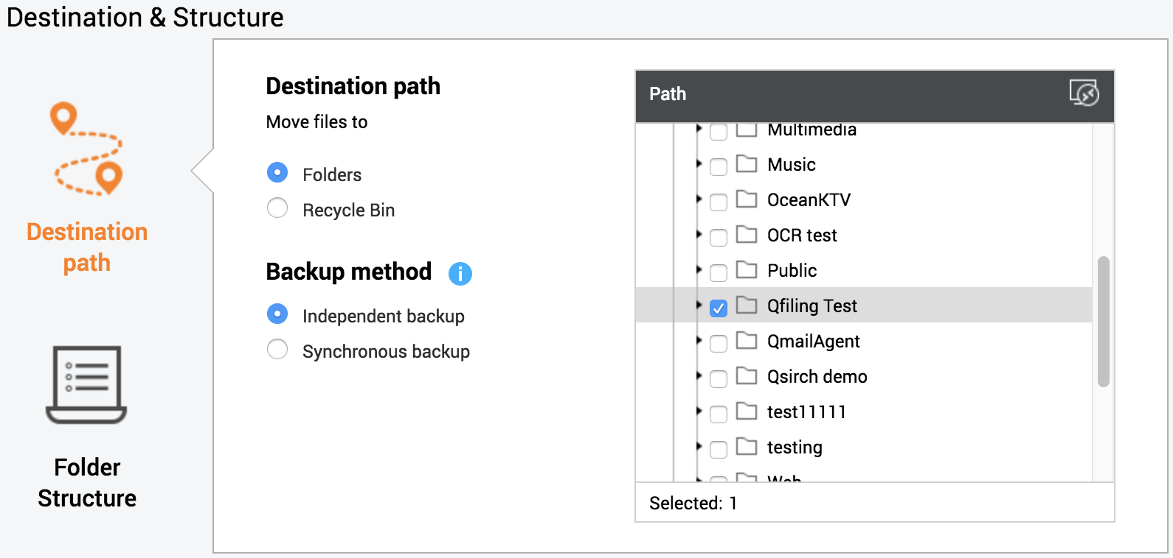
Create your Qfiling rules in 3 steps
Select source
Set filing criteria
Select destination
Source file filters
File editing
Destination & Structure
Select multiple destinations: one to local, one to mounted remote NAS.
Specify "Recycle Bin" as the destination to periodically clean up files!

Slide 11
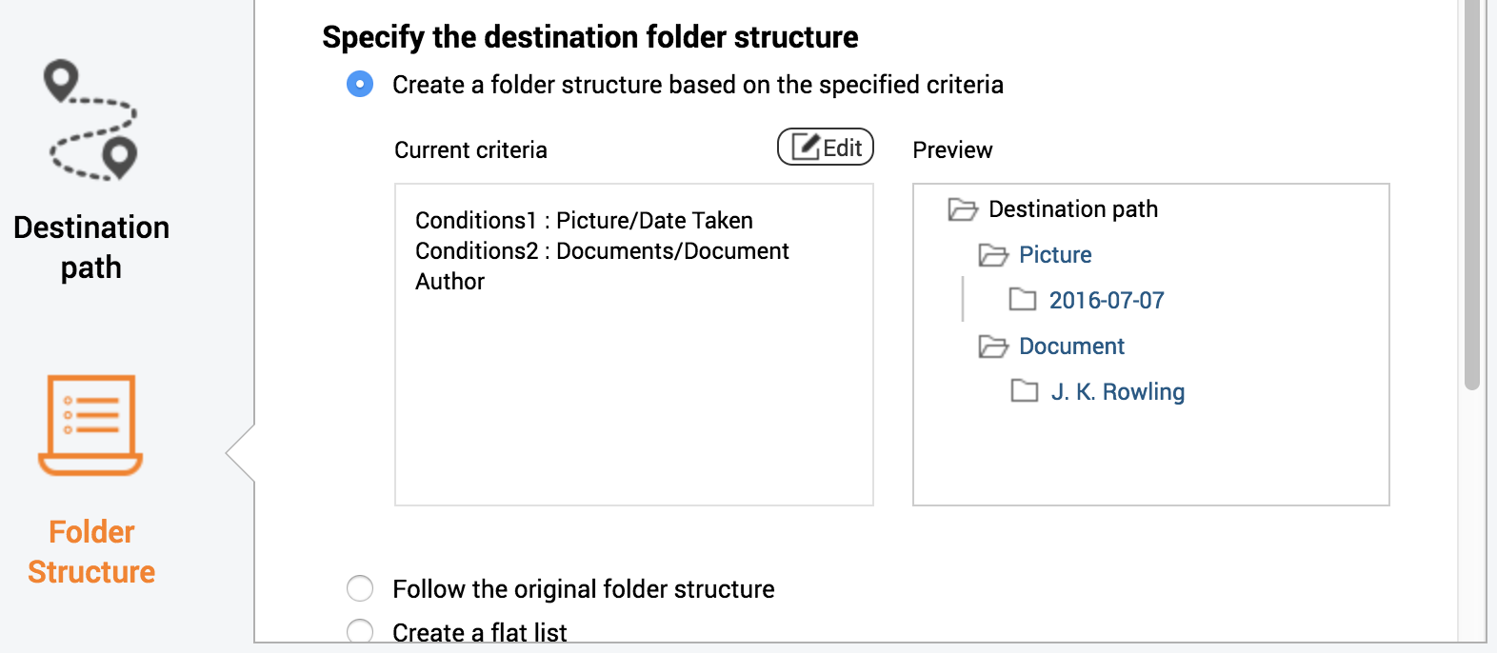
Create your Qfiling rules in 3 steps
Select source
Set filing criteria
Select destination
Source file filters
File editing
Destination & Structure
Three ways to specify the destination folder structure: select the best way to organize the files!

Slide 12
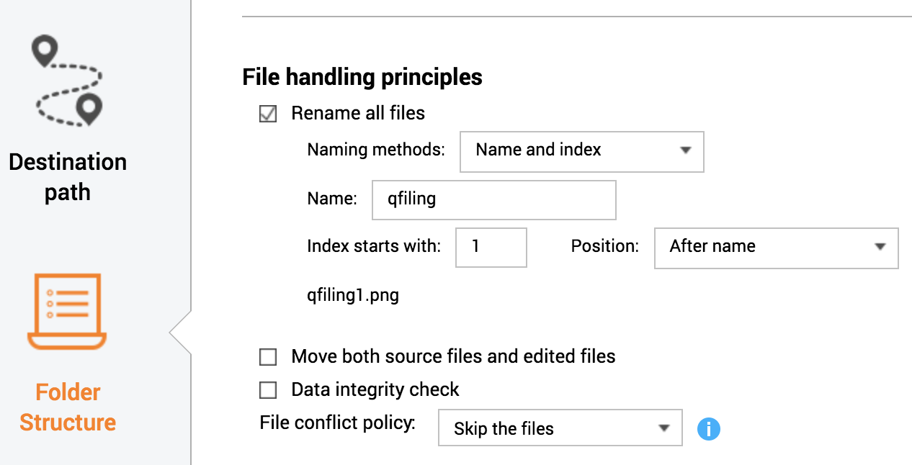
Create your Qfiling rules in 3 steps
Select source
Set filing criteria
Select destination
Source file filters
File editing
Destination & Structure
Archive and rename all files at the same time. Select “File conflict policy” to only archive the same file once!

Slide 13
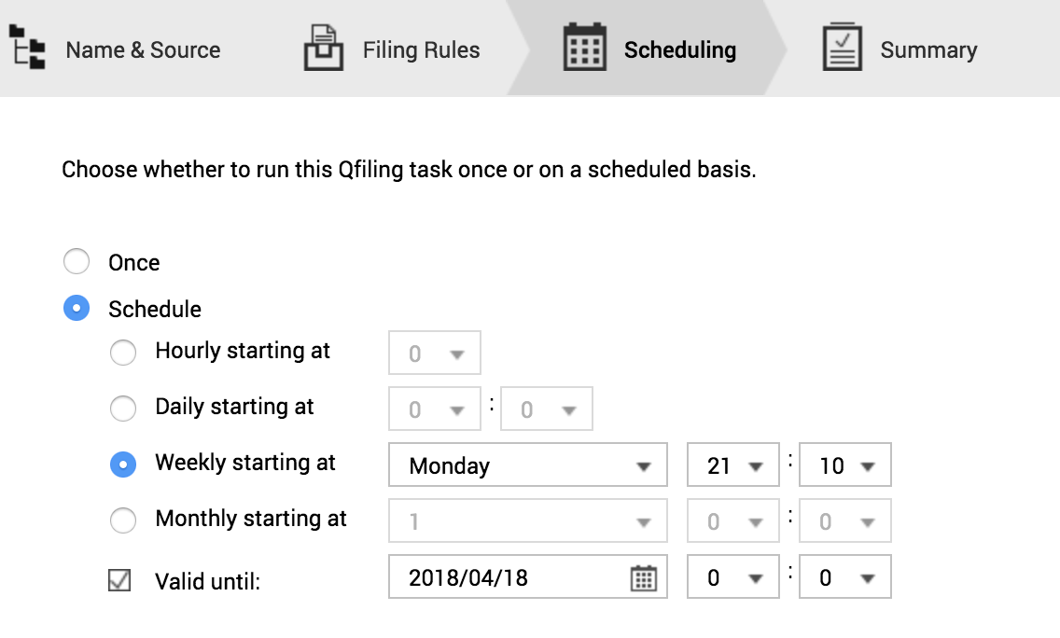
Schedule and results
Select source
Set filing criteria
Select destination

Slide 14
Filing status easily accessible with system logs
Summary
System logs
Task logs

Slide 15
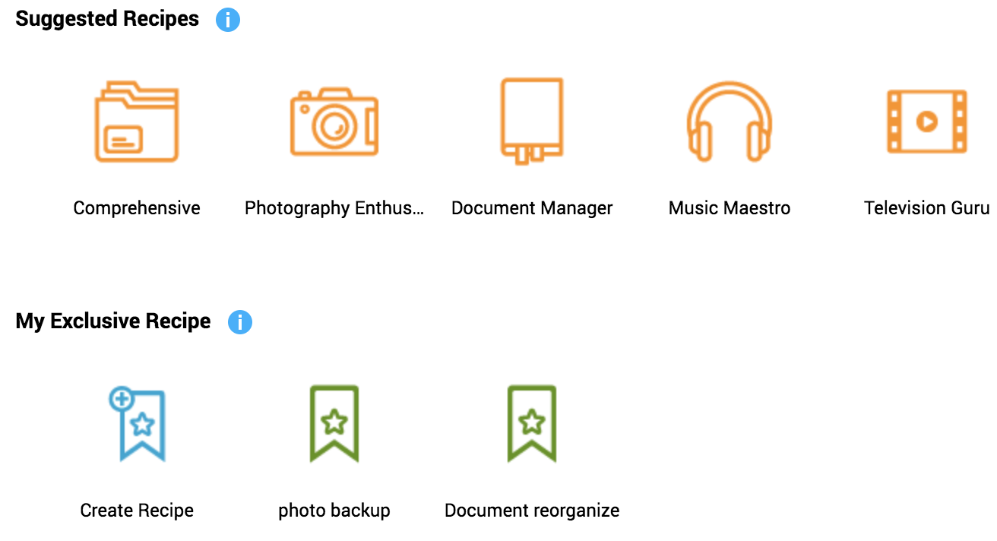
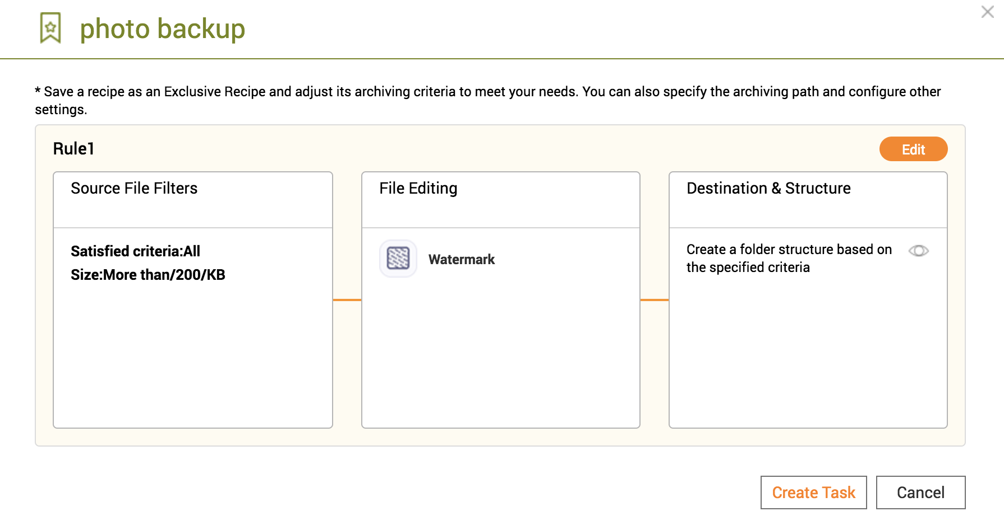
With recipes, tasks are done with just one click
Select a recipe
Create a task

Slide 16
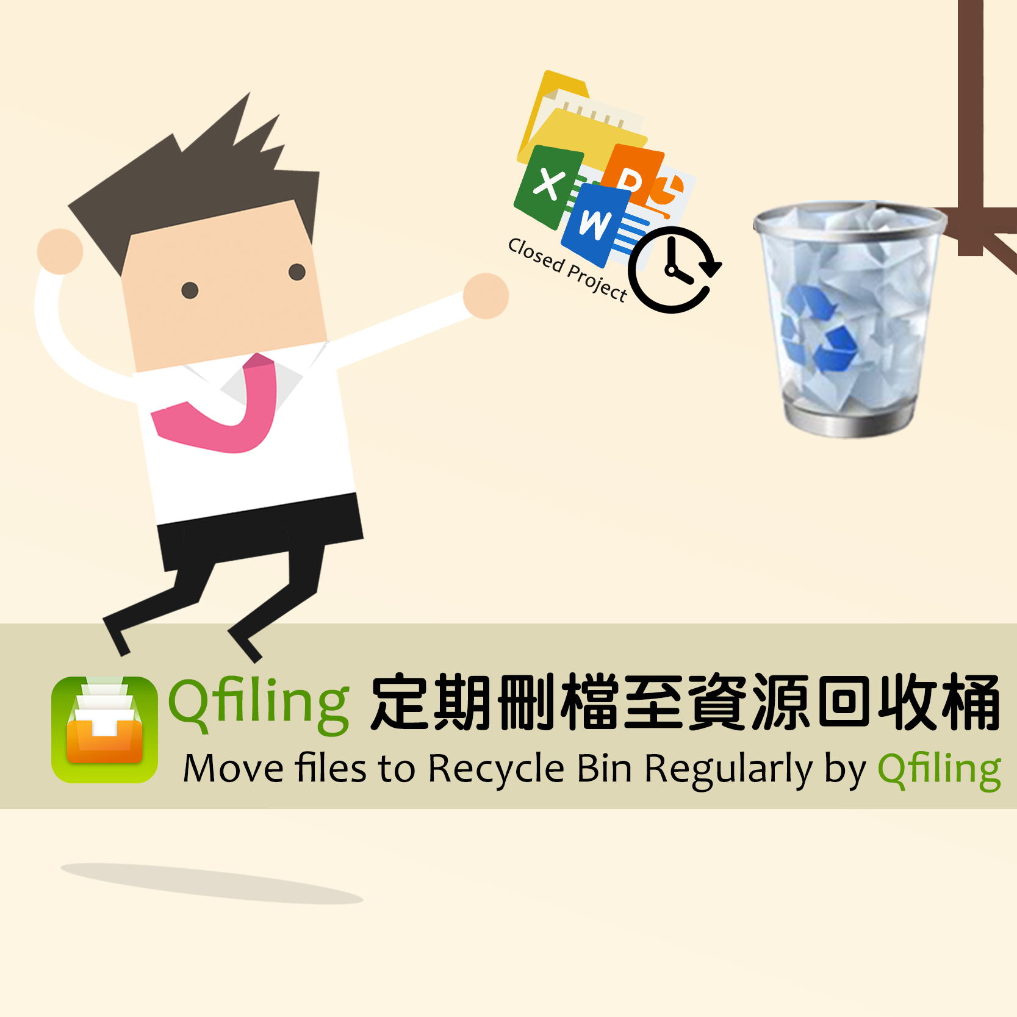
The way experts use Qfiling
Document Manager
Archiving after filtering a specific file name
Photography Enthusiast
Rename and add a watermark when archiving
System Administrator
Specify conditions to periodically move files to the recycle bin

Slide 17
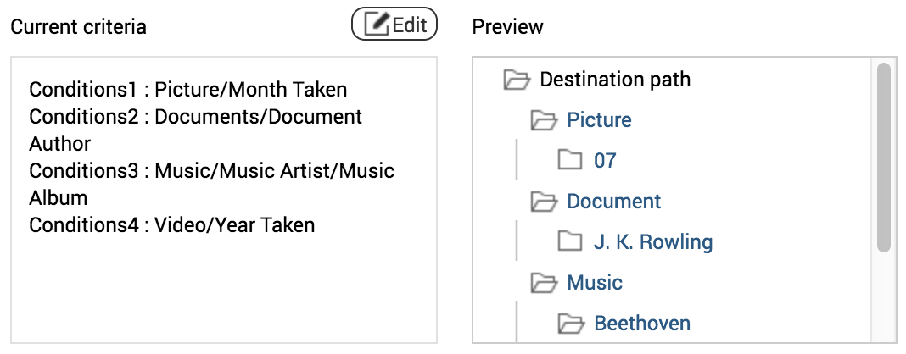
Document Manager
01
Source File Filters
Filter files with a specific file name and modified date.
02
File Editing
Set encryption and compression options.
03
Destination & Structure
Create a folder structure based on the specified criteria.

Slide 18
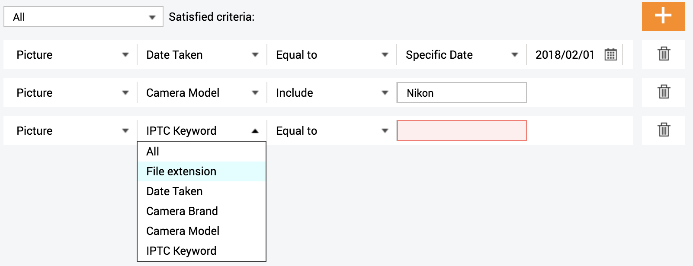
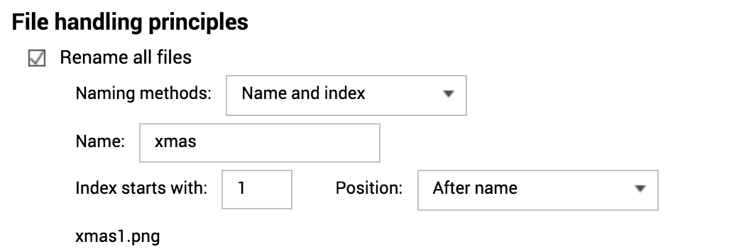
Photography Enthusiast
01
Source File Filters
Filter files with a specific camera model and taken date.
02
File Editing
Setting the watermarking option.
03
Destination & Structure
Duplicated files are backed up only once. Renaming files is also possible!

Slide 19
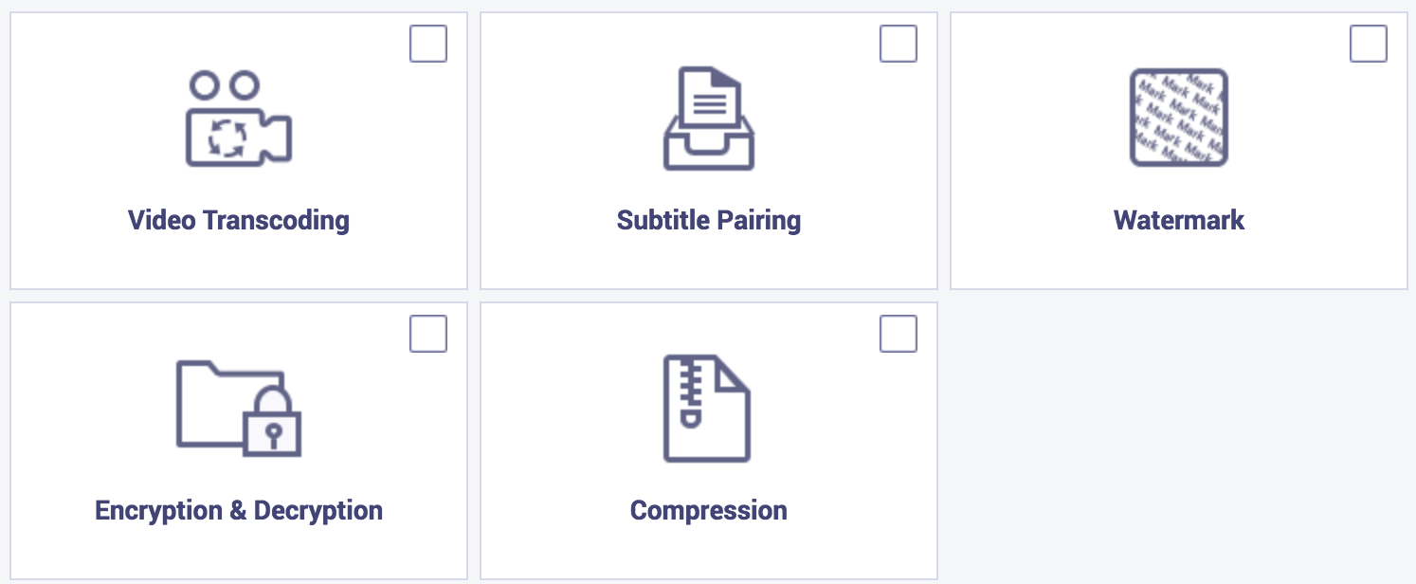
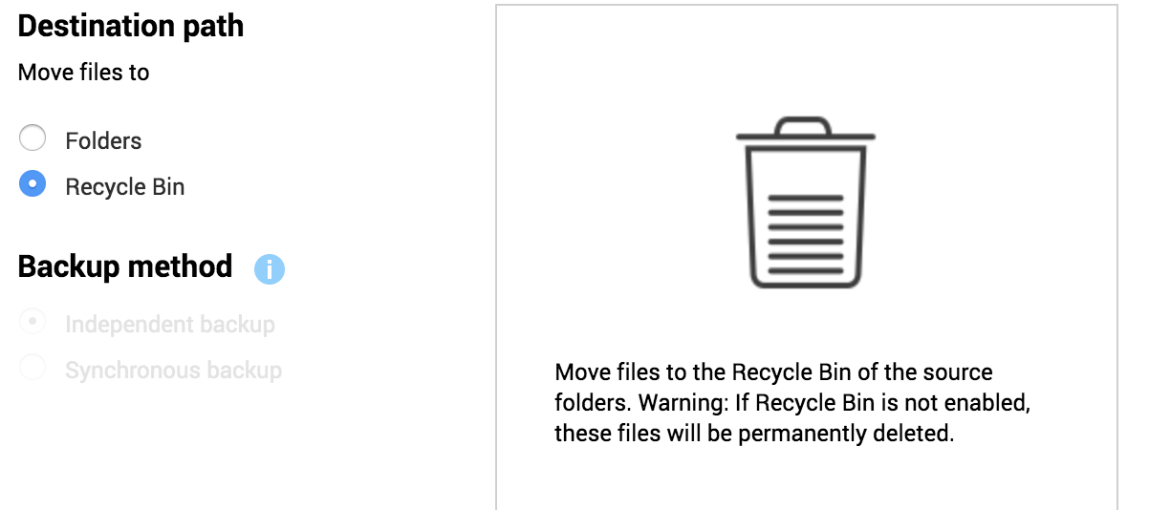
System Administrator
01
Source File Filters
Filter files with a specific file type and modified date.
02
File Editing
Specifying options is not necessary.
03
Destination & Structure
Select the recycle bin.

Slide 20
DEMO

Slide 21
A quick recap on Qfiling
Flexible
Create your Qfiling rules in 3 steps
Efficient
Scheduling for auto filing
Total control
With system logs, filing status is easily accessible
Fast
With recipes, tasks are done with one click

Slide 22
Your best choice!
Copyright © 2018 QNAP Systems, Inc. All rights reserved. QNAP® and other names of QNAP Products are proprietary marks or registered trademarks of QNAP Systems, Inc. Other products and company names mentioned herein are trademarks of their respective holder

