Slide 2
An In-depth Analysis of
QNAP Thunderbolt3 / 10GbE NAS
the Best Solution for Final Cut Pro X Video Editing

Slide 3
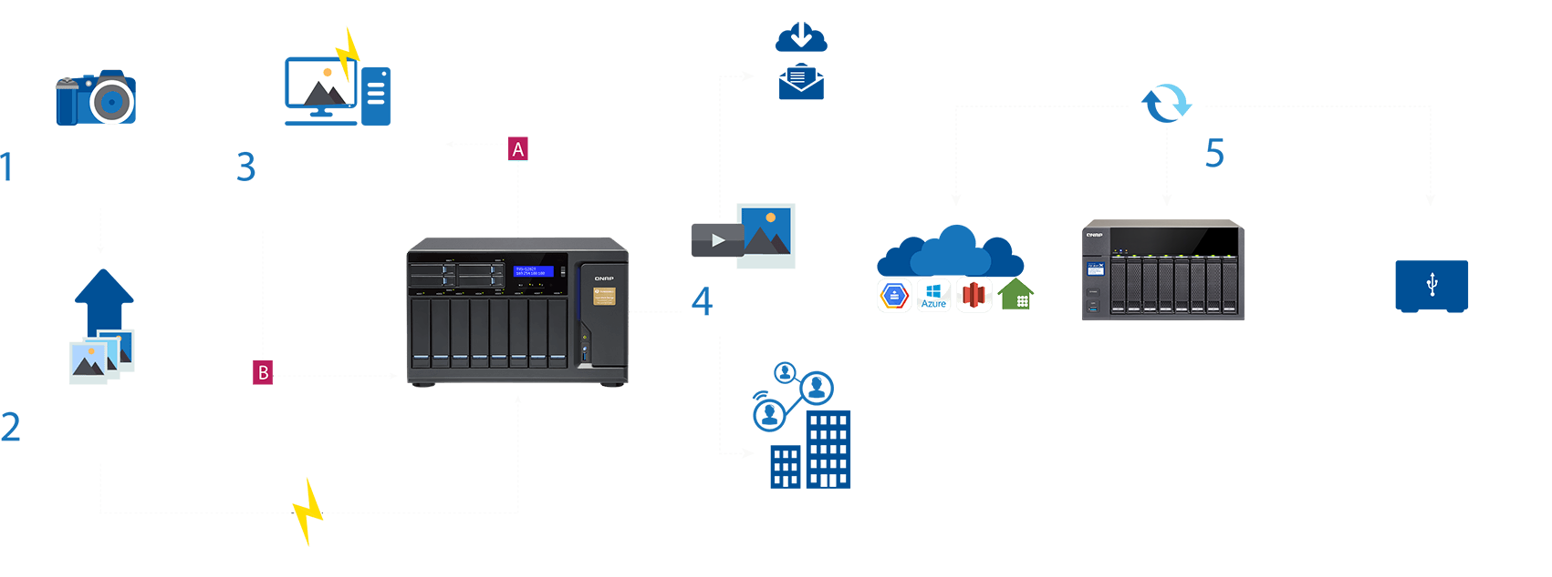
The post-production workflow of Final Cut Pro + QNAP NAS
Notes:
To start the presentation, let’s talk about the workflow, how user do post production and the whole eco-system of the video-editing.
First, they always shoot the video by high resolution cameras, and after shooting, they will export the video footage to the QNAP NAS.
When all material be shared via NAS, all of the editors could work in their separate office, consider all the footage, re-order the first cut, director’s cut, producer’s cut, and all related post production jobs like adding the sound effect, subtitle, video effect.

Slide 4
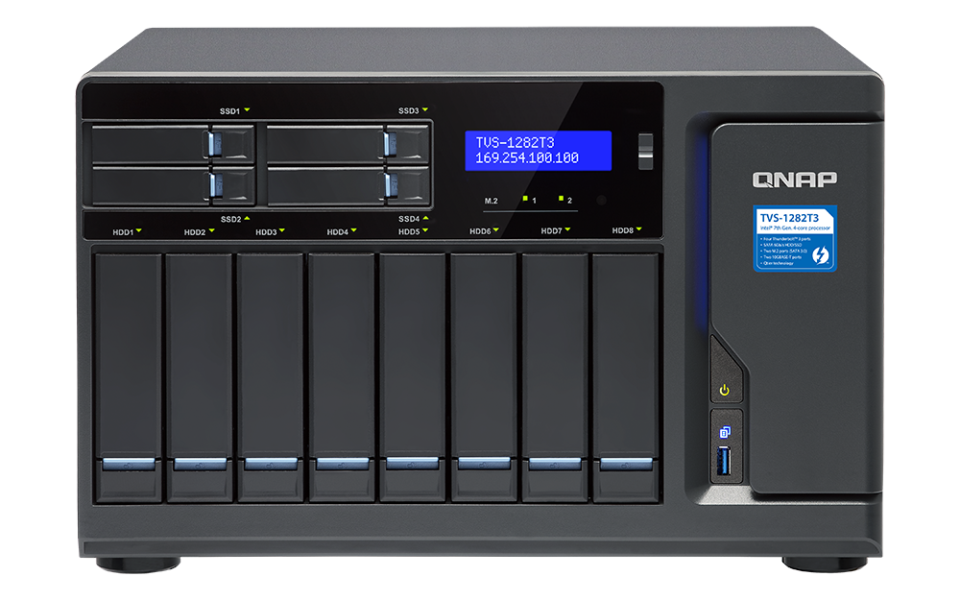
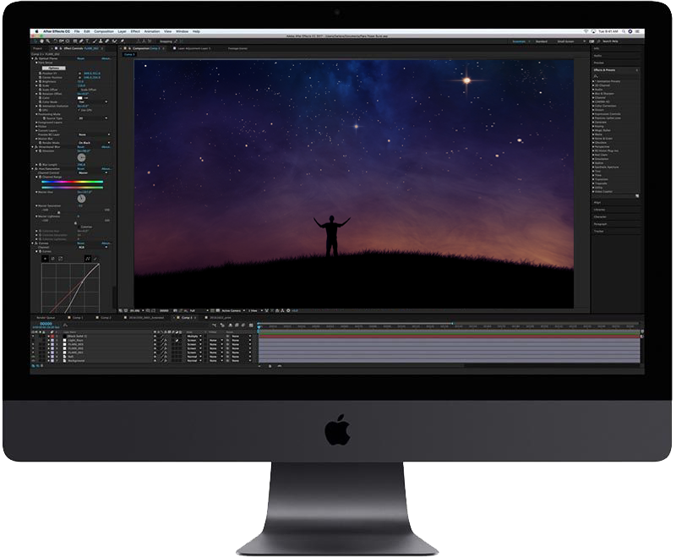
The best combination for video editing
QNAP 10G/Thunderbolt NAS
Final Cut Pro X

Slide 5
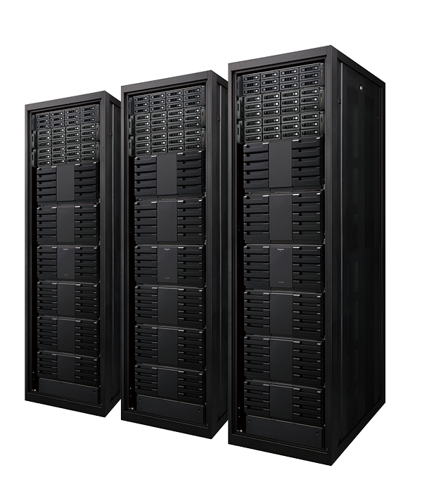
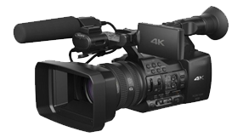
Required storage in video editing flow
4K~8K material (CFast/SSD)
Archive (BluRay)
Shared storage: NAS(SSD/HDD)
Local Storage of desktop (NVMe)
Notes:
Currently, The footage will be saved in the Cfast card or SSD when shoot the video by 4K, 6K or 8K cameras.
Then you need offloading footage to QNAP NAS, and then the footage could be shared to all editors of post-production.

Slide 6
Storage Solution Comparison
 | Mac Local Storage | External / DAS | SAN | NAS
Storage capacity | small | medium | large | large
Protection | N/A | Limited | Supported | Supported
File Sharing | N/A | N/A | Limited | Supported
Remote Replication | N/A | N/A | limited model | Supported (another NAS or Cloud)
Access speed | Fastest (NVMe) | Fast | Fast | Fast (Thunderbolt / 10G / 40G)
FCPX Library | Supported | Supported | Limited | Supported (NFS/SMB3)

Slide 7
QNAP NAS is the best storage with FCPX
The interface that is available with all Mac:
10~20G Thunderbolt network, Plug & Play
Notes:
The reversible Type-C connector makes it even simpler to connect your Mac to NAS. The thunderbolt actually supports many protocols but it offer the 10~20G network here. That’s why it could shared the file via the thunderbolt.

Slide 8
Thunderbolt port: convenient and fast
For Mac users, it's easy and efficient!
Plug & Play
Qfinder Pro auto scan
Mount and adjust parameters

Slide 9
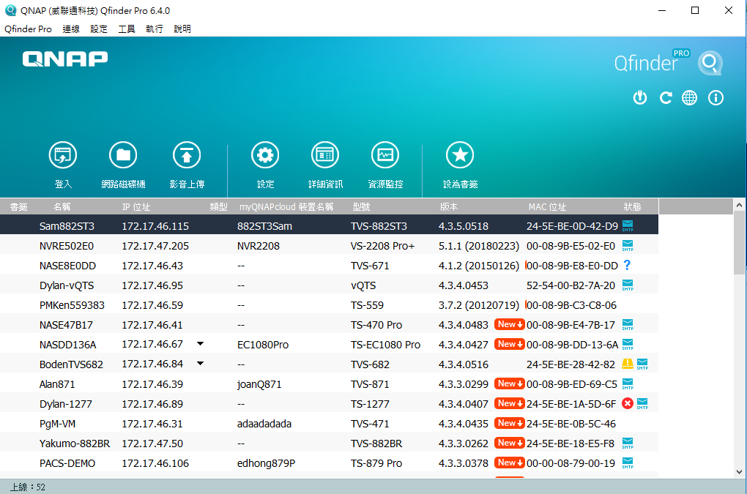
Auto detect/shared folder mount tool makes it easier
Download Qfinder Pro utility
Final Cut Pro X starts to support users to directly create libraries in shared folders on a NAS.
(1) FCPX 10.3 or newer
(2) Mount with SMB 3 protocol
Search your NAS: (1) Click on the list to open the web interface for system configuration.
(2) Easily mount shared folders

Slide 10
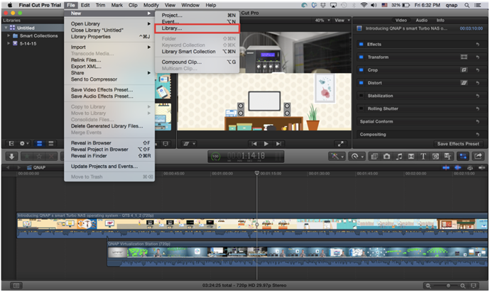
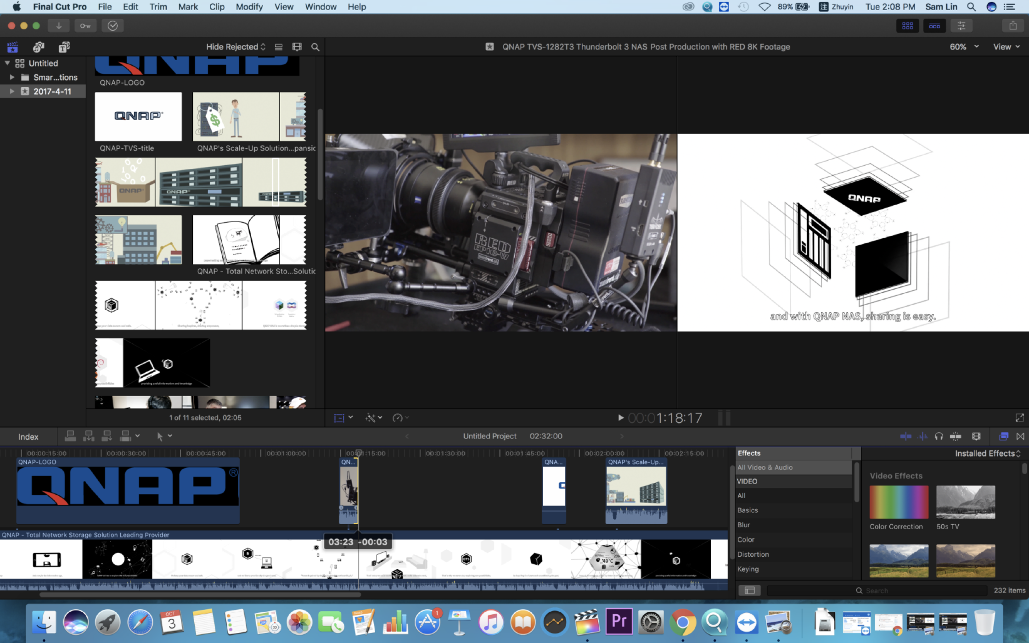
QNAP NAS supports FCPX Library
• Create FCPX Library on shared storage directly.
• Store material files from your Mac to the NAS.
!
Attention: must mount as NFS or SMB 3 protocol.

Slide 11
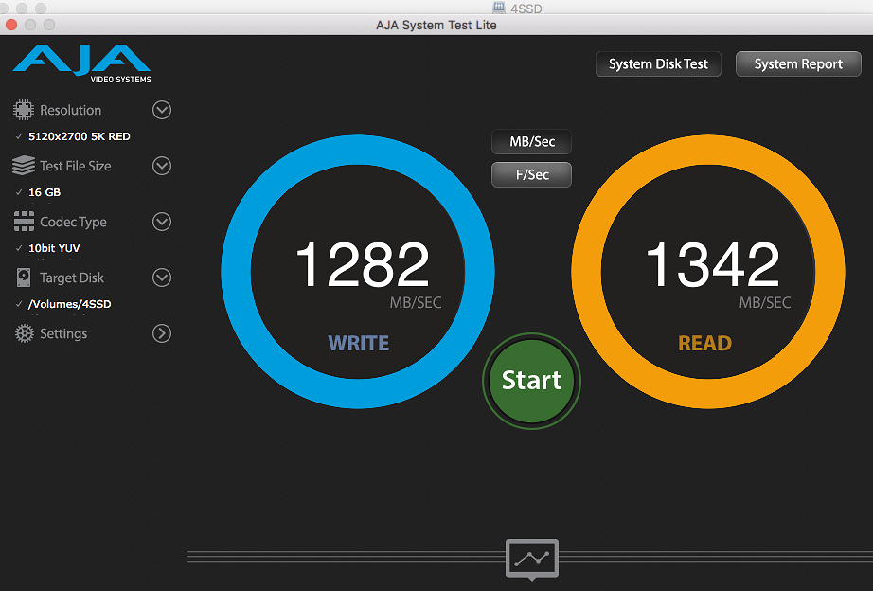
Amazing performance: Thunderbolt 3
Mac : high speed transmission
Environment: • Client: MacBook Pro
• Connection: Thunderbolt 3
• NAS: TVS-1282T3 (i5)
Equivalent to built-in 10~20Gb high performance NIC!
Notes:
I hope you, our customer could impressed with the thunderbolt 3 amazing throughput, You could see the transfer rates in this slide. We used Apple’s MacBook Pro to connect to our NAS TVS-1282T3 with thunderbolt 3 cable. With these rates, you can transfer a 10 GigaByte blu-ray video in less than 10 seconds.

Slide 12
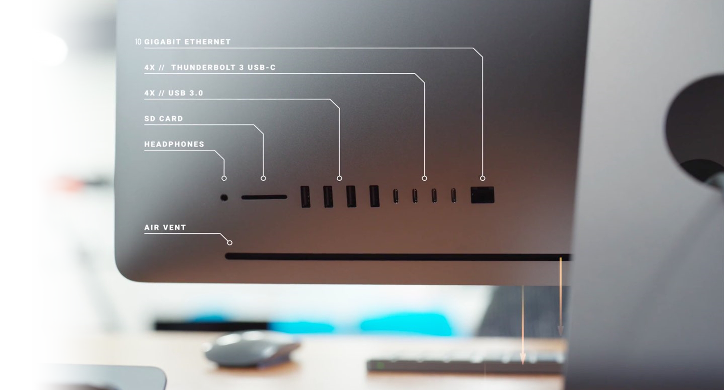
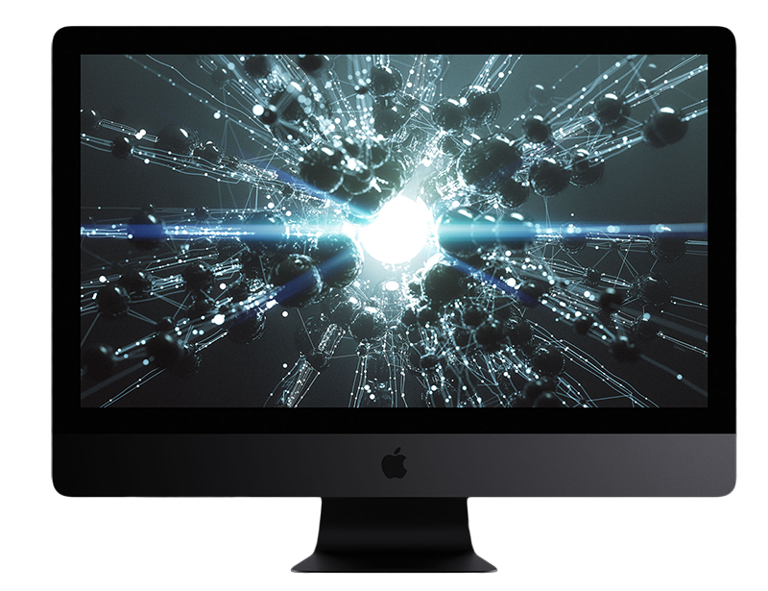
2018 iMac Pro built-in 10Gb NIC
Notes:
And now in 2018, Apple announce their new iMac Pro, and it built in the 10gigabit Ethernet port. So it can connect to QNAP NAS via 10G.

Slide 13
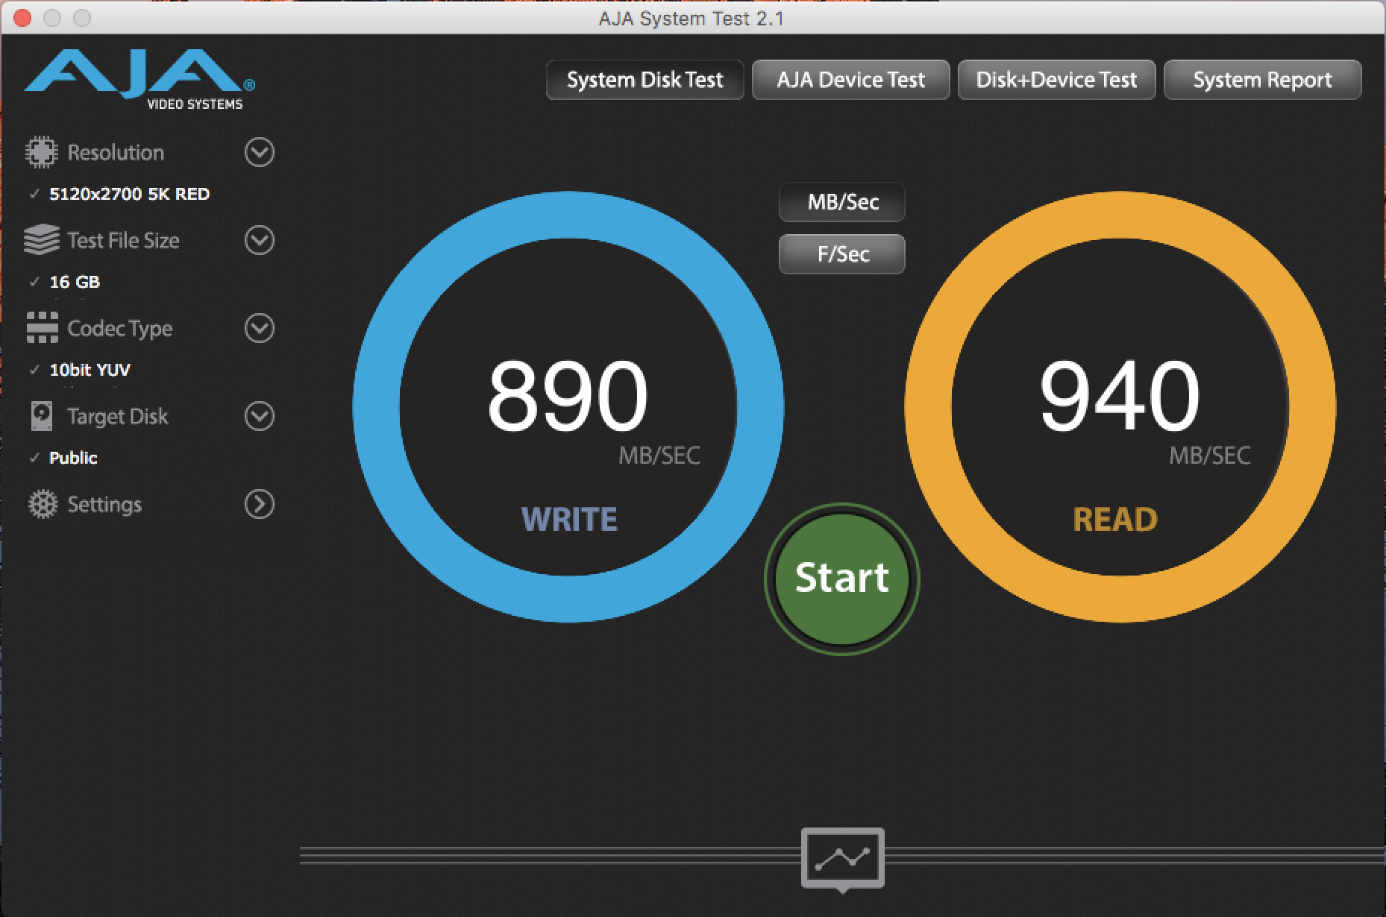
Get full 10G performance with QNAP 10Gb switch
Mac : 10Gb performance
With QNAP 10Gb switch, multiple editors can have high speed access to NAS at the same time.
10G high speed transmission

Slide 14
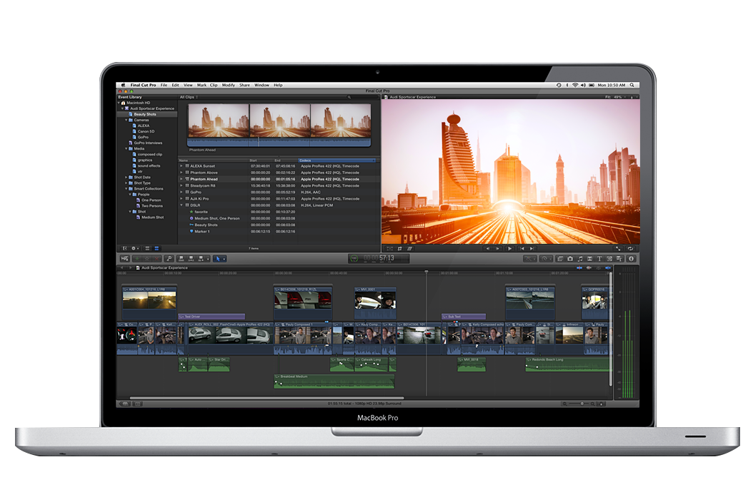
Live Demo
How to store FCPX libraries on your NAS

Slide 15
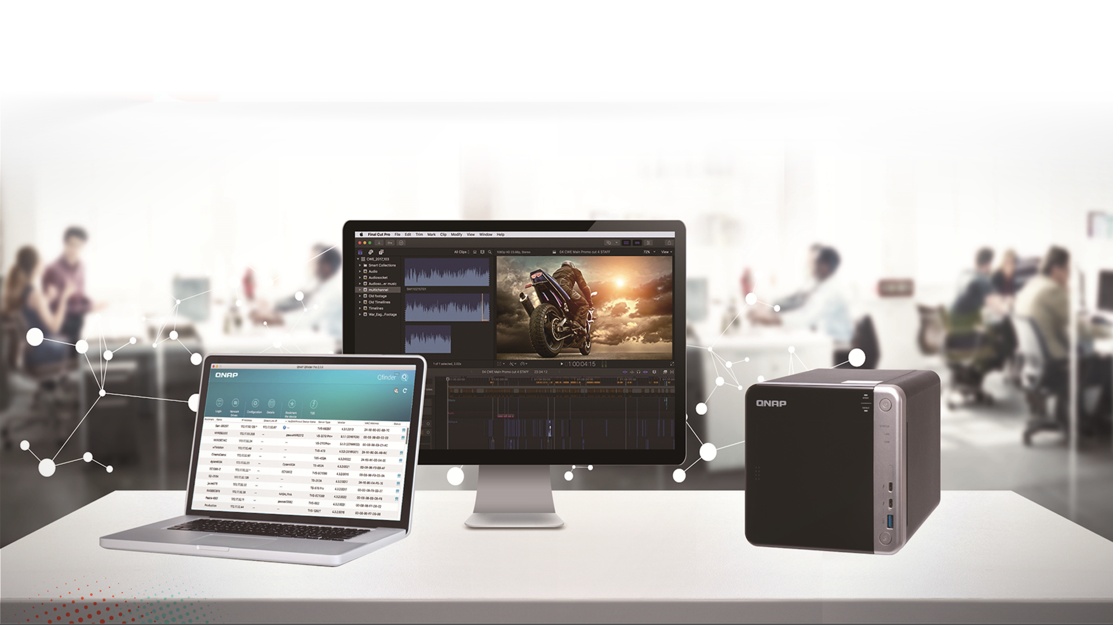
QNAP recommended – Entry level model
TS-453BT3: Easily experience high-speed transfer faster than Gigabit LAN
Notes:
After live demo, allows me to introduce some of our recommended models to you. First, for the mostly consumers of Mac users, this is our recommended to offer a entry-level Thunderbolt shared solution. It’s the cheapest thunderbolt NAS on the market, around thousand dollars to let you easily experience high-speed transfer faster than Gigabit LAN.

Slide 16
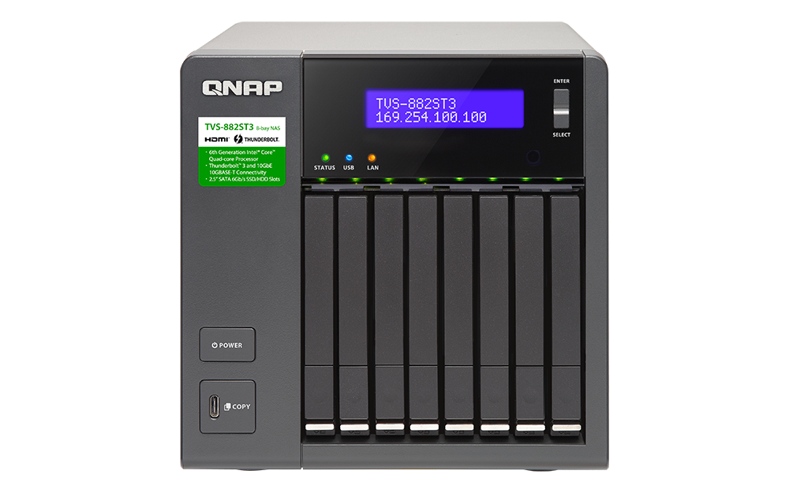
QNAP recommended – Professional Tower model
TVS-882ST3
TVS-1282T3
2x Thunderbolt 3 + 2x 10GbE
4x Thunderbolt 3 + 2x 10GbE
Compact, suitable to carry out
The best companion of studio
Notes:
They both offer the thunderbolt 3 ports, and 10GbE ports for high-speed data transfer, the difference is TVS-882ST3 much smaller, only 2 thunderbolt ports and all 2.5 inch drives, it is a compact NAS designed for the small office user and easy carry out.
TVS-1282T3 is the bigger one to provide exceptional performance to handle the critical tasks and more connection requirement.

Slide 17
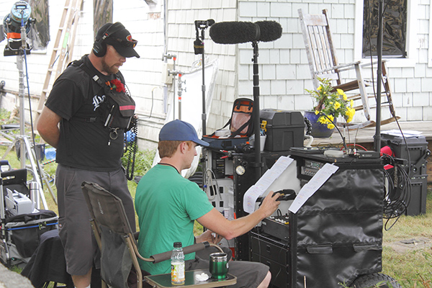
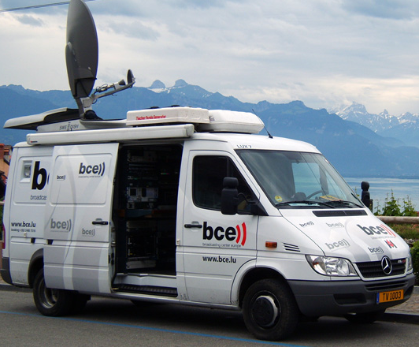
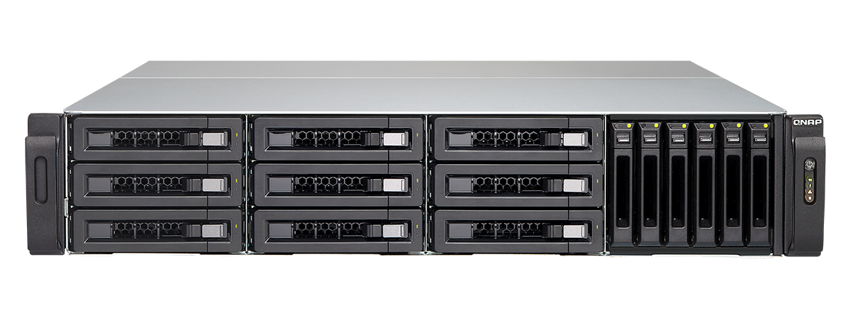
QNAP recommended – Rackmount model
TVS-1582TU
4x Thunderbolt 3 + 2x 10GbE
Notes:
Server Room
Trolley rack mount cabinet: because the production team will always swap to different scene studio for a different program or different TV show. When moving to the next scene studio, it easy to use this kind of trolley to go.
Van for outside video shooting: In this van it use the standard bracket to secure the equipment when high speed driving.

Slide 18
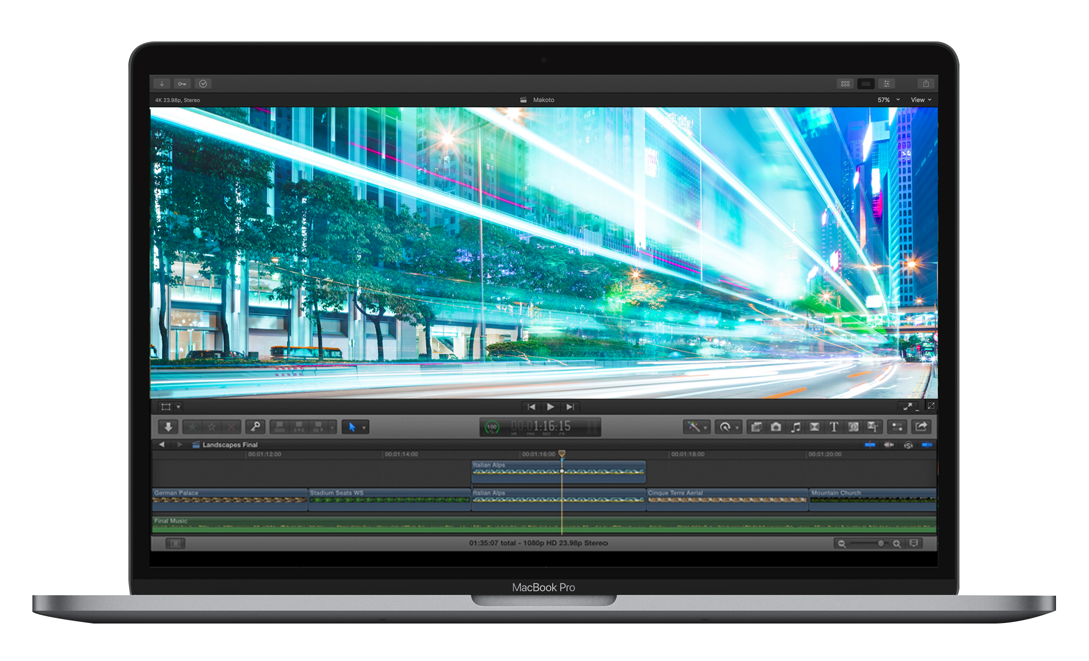
Construct the High Speed Editing Environment

Slide 19
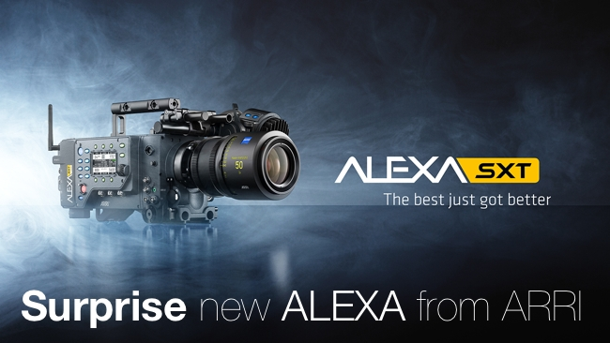
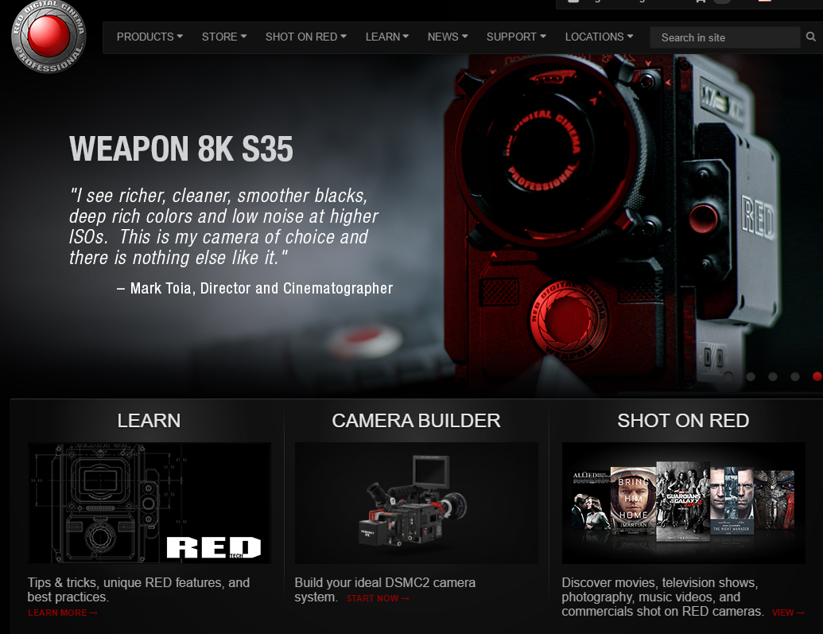
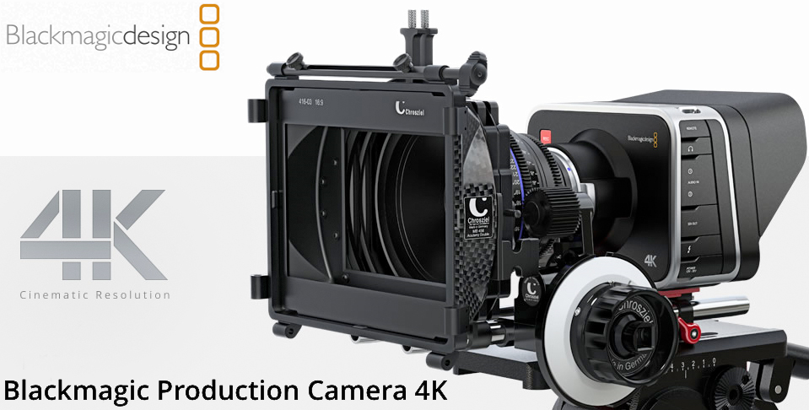
Why you need the higher bandwidth?
Notes:
You may curious, In this broadcast why we mention many time about high-speed data transfer? When producing videos with camera models such as ARRI Alexa, Blackmagic, and Red, they are the top 3 cameras brand of the film industry, the video RAW data is beginning from 4K, 6K, and even 8K resolution. Data rate per second can reach as high as several GB/s , and one hour of video recording will more than 1TB of size.

Slide 20
Higher quality means larger file sizes
Format | bit rate | Size
HD 1080P (ProRes 422) | 220 Mb/s | 90GB/hr
4K (ProRes 422) | 880 Mb/s | 400GB/hr
BlackMagic 4K | 1.4 Gb/s | 630GB/hr
Canon 4K | 2.3 Gb/s | 1TB/hr
Phantom Flex 4K | 2.3 Gb/s | 1TB/hr
Red 6K | 2.4 Gb/s | 1.1TB/hr
ARRI Alexa 6K | 6.6 Gb/s | 3TB/hr
Notes:
20
Here is the list about the bitrate of different video format. And the most videos resolution which you uploaded online is 1080P, and they were converted from RAW data of 4K resolution or above. Therefore, choosing a networking solution that supports higher bandwidth is necessary for video production teams. Thunderbolt and 10GbE networking will allow you to transfer files quickly and conveniently.

Slide 21
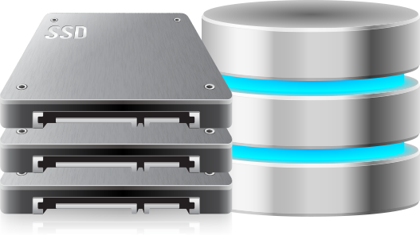
High speed transmission needs more external help
SSD？
HDD?
Your SSD fast enough?
CPU？
Cable?
Is your high speed connection fully utilized?
RAID configuration?
Is your storage pool flexible and secure enough to ingest massive data?
Notes:
You may wonder why the file transfer speed in some work environment is different from the test in QNAP. Here I have identified some performance bottlenecks for you.
The CPU and RAM are the first important elements will affect the performance. For example, The CPU i5 & 16GB RAM will be enough for 1080P or compressed 4K entry level footage, However, i7 CPU & 64GB RAM is much powerful for multiple users and high resolution applications on post production workflow, and it's also good for the virtualization environment.
And next slide we will discuss about your storage configuration, is your SSD fast enough? Is your RAID configuration correct and suitable?

Slide 22
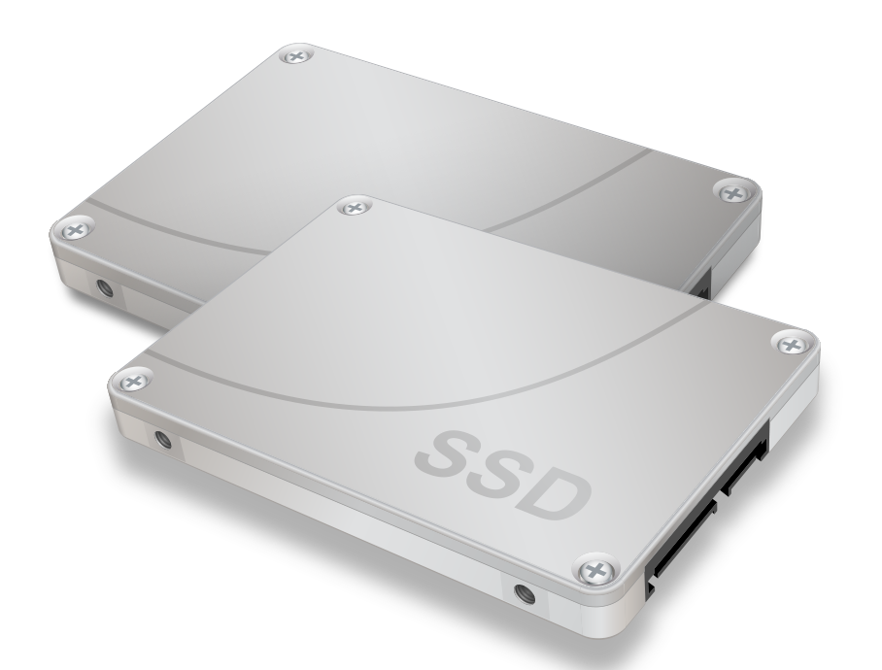
Storage configurations can greatly affect efficiency
Disk speed (Unit speed)
• MLC/SLC SSD (highest performance but expensive) => 500~600 MB/s
• Enterprise HDD => 250MB/s
• New NAS HDD (like IronWolf......etc) => 220MB/s
• TLC SSD (popular and commonly) => 500MB/s? => Sustained is 120MB/s when cache full
• Regular HDD => 150MB/s
RAID configuration
• RAID 0 (fastest but without data protection)
• RAID 10
• RAID 5
• RAID 6
• RAID 50 or 60
Notes:
First of all, as we can see from the slide, the MLC/SLC SSD provides the highest performance. If high cost is not a concern, we recommend using MLC/SLC SSDs for good performance. Enterprise HDDs and New NAS HDDs (such as IronWolf) are also cost-effective options because they provide good performance and are not expensive. We do not recommend using the popular TLC SSDs on the market for video editing because they only retains good performance when transferring small files, but the performance drops down quickly when transferring large files. and slower than the regular HDD.
For RAID configuration, RAID 0 provides the best performance, but it doesn’t have any data protection scheme. RAID 10 and 5 are both good choices in terms of performance, but RAID 10 generates higher cost for taking up more space for data protection. Beside that, QNAP just announce RAID 50 and 60 configurations, which are new options that strike a balance between performance and cost.

Slide 23
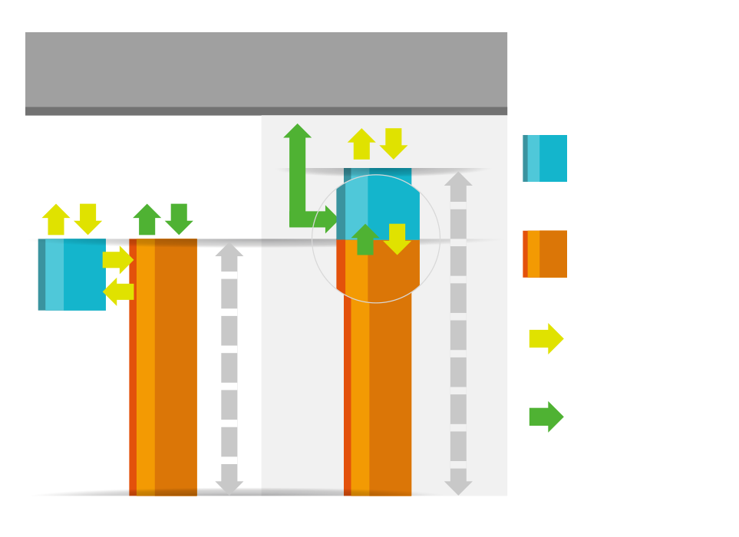
Qtier 2.0 - make the read/write faster
SSD Cache
Application Layer
• Cannot be used to store data • Fixed bypass options > For short term performance boost
SSD
HDD
Qtier 2.0
• The SSD tier can keep data • IO Aware and Tiering On Demand > For both short and long term
performance improvements
Random
Sequential
Video Editing recommended
SSD Cache
Qtier 2.0
Notes:
Tip: you should consider the daily access size, then make sure that SSD volume could be the triple size of it.

Slide 24
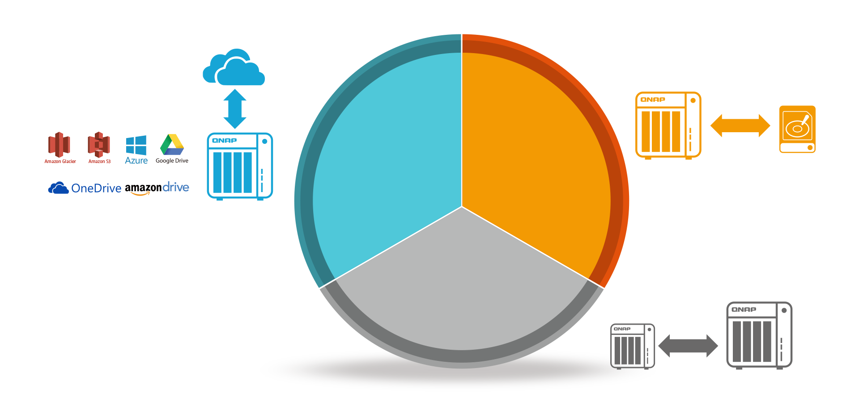
Multi-layer protection secures your digital assets
Hybrid Backup Sync
Cloud
Local
Remote

Slide 25
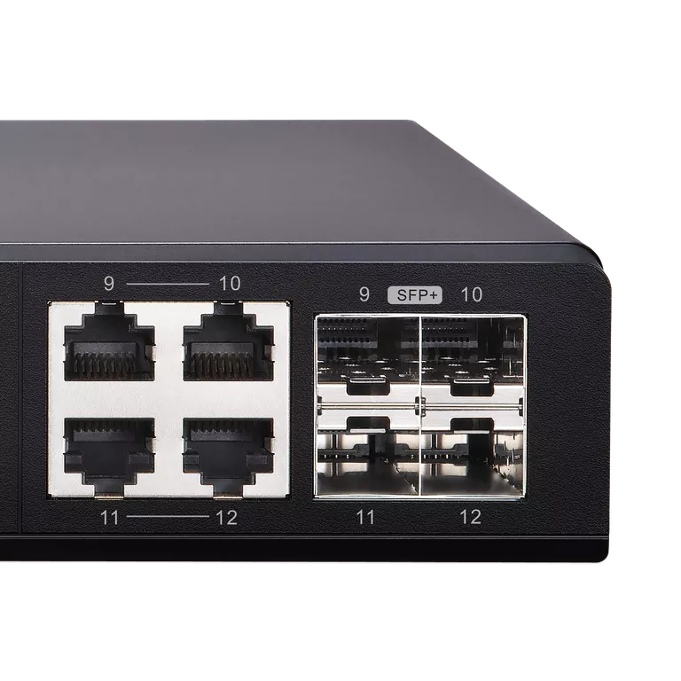
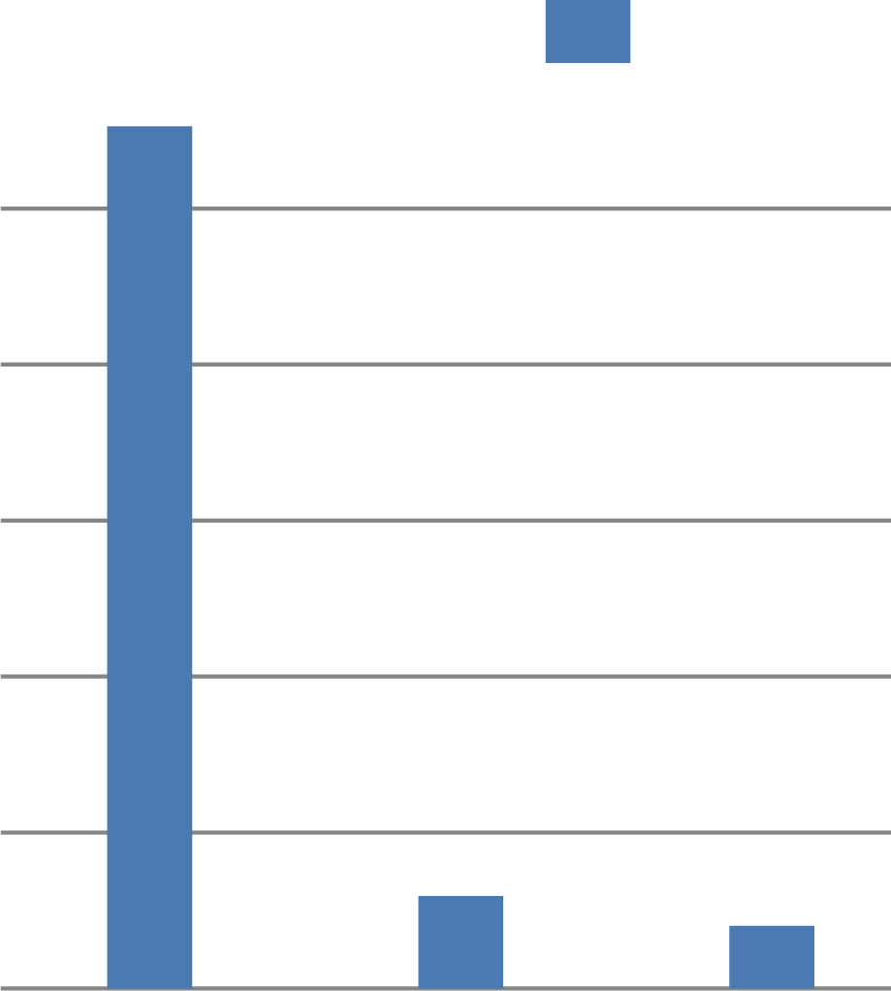
Strengthen work efficiency because time is money
• When you need to process 4TB Raw Data，it takes 11 hours via 1GbE.
• Use 10GbE / Thunderbolt for the same data, only 1 hour is needed.
• When most QNAP products are ready for 10GbE networks in 2018, is your infrastructure ready for it?
Hours
4TB data
QSW-1208-8C
10
8
6
4
2
0
1 GbE
10 GbE
Thunderbolt 3

Slide 26
Summary
"We have been able to condense a rather eclectic collection of different hard drives and storage systems into one single unit. This makes data-wrangling a whole lot easier."
- Nick Rains
Since adopting the TVS-1282T3, Nick Rains has reported over 50% increases in his productivity and work efficiency. This is in no doubt due to being able to deliver 4K video to Final Cut Pro in real time combined with being able to consolidate his storage library to one device.

Slide 27
QNAP NAS the Best Solution for Video Editing
Copyright © 2018 QNAP Systems, Inc. All rights reserved. QNAP® and other names of QNAP Products are proprietary marks or registered trademarks of QNAP Systems, Inc. Other products and company names mentioned herein are trademarks of their respective holder

