Slide 1
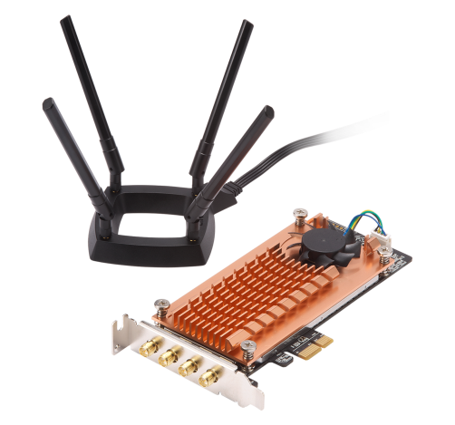

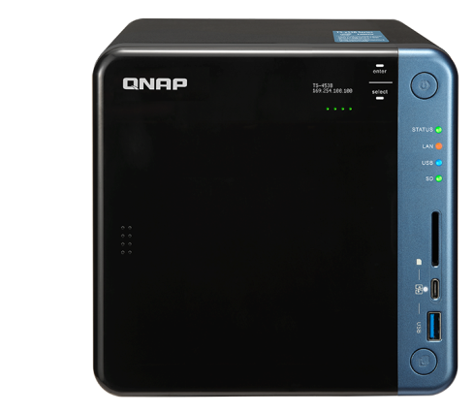
Specially made for
Ubuntu Linux & QNAP NAS
QWA-AC2600 Dual band dual concurrent wireless PCIe expansion NIC
Notes:
Introduce specially made for Ubuntu Linux QWA-AC2600 dual band wireless PCIe expansion NIC

Slide 2

Easy to build a network for your device
1
2
3
4
Wireless network card advantages
QWA-AC2600
Introduction
Build a AP station
step-by-step
Application introduction
Notes:
we have four chapter in presentation
The first we will tell you this wireless network card advantages
And second we have QWA-AC2600 introduction
Third we will tell you how to build a AP station step-by-step
Fourth we have some application introduction

Slide 3

Wireless network card advantages
1

Slide 4

What are the advantages of wireless network card?
Direct access to wireless terminal data, effectively reducing the physical wireless routers loading.
---------------------------------------------------------
QWA-AC2600 provides 5Ghz and 2.4Ghz dual-band,
allow working together at some time.
---------------------------------------------------------
Flexible configuration and expansion, one single PC/NAS can be configured with 2 or more NICs for expansion
---------------------------------------------------------
Create private network applications
Notes:
What are the advantages of wireless network card?
1.You can direct access to your NAS/PC , effectively reducing the physical wireless routers loading.
2.QWA-AC2600 provides 5Ghz and 2.4Ghz dual-band allow working together at some time.
3.You can flexible configuration and expansion, one PC/NAS can be configured with 2 or more NICs for expansion
4.you can also create a private network applications

Slide 5



Good news for DIY maker
Build your own wireless network base station
Ubuntu system
QWA-AC2600
Notes:
We have good news for all DIY makers, now you can use Ubuntu system and QWA-AC2600 to build your own wireless network base station.

Slide 6


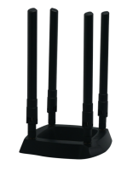

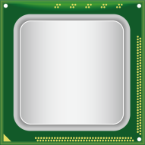

Wireless edge computing
PC / NAS
Data
Data
Data
Data collection
Direct access, compute & process
Show results
Notes:
You also can use QWA-AC2600 to do wireless edge computing in your PC/NAS

Slide 7
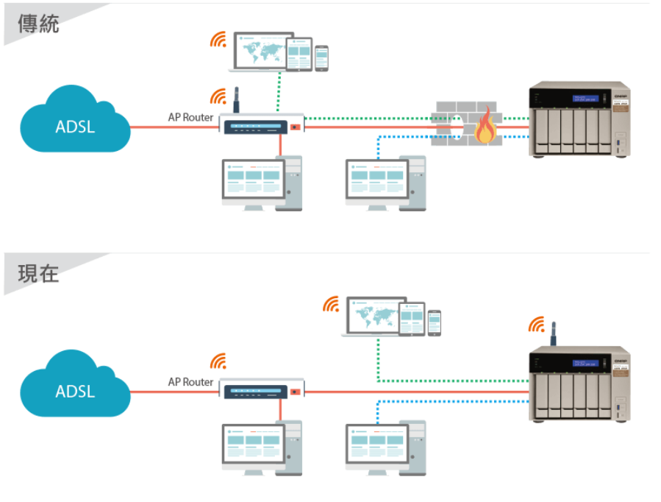


Enjoy network optimization
with traffic shunting
Traditional
Router loading high
PC / NAS
Separate NAS traffic to avoid
busy routers slowing down
the network
NOW
PC / NAS
Notes:
In tradition we use all device connect to AP router, that will make high loading for router.
Now we can direct to access to PC/NAS to avoid high loading make router slowing down the network

Slide 8

Set up a flexible wireless environment
Through QWA-AC2600 dual IC design, It allow dual-band working at some time, 1 band as client and 1 band as AP.
2.4G as AP
2.4G as Client
5G as AP
PC / NAS
PC / NAS
Notes:
QWA-AC2600 2 IC design allow 2.4Ghz and 5Ghz working at some time , so we can use 1 band as client and 1 band as ap to connect PC or NAS

Slide 9
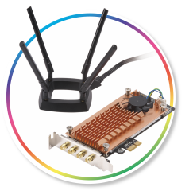

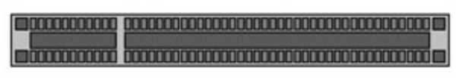
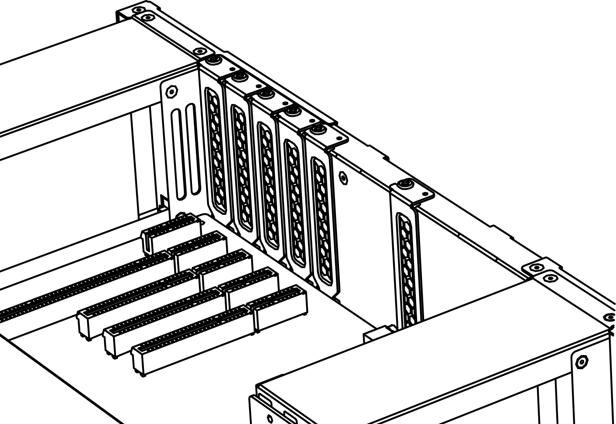
Add multiple expansion wireless NICs IN A PC/NAS
Expand more physical bandwidth for more user
PC / NAS PCIe slot
Notes:
It can also allow expand more physical bandwidth for more user and more device.

Slide 10















Turn Ubuntu PC into wireless AP
Build Ubuntu PC as a wireless access point with QWA-AC2600
Notes:
The most important is you can turn Ubuntu PC into a wireless PC wich QWA-AC2600

Slide 11
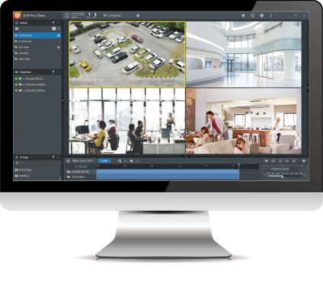
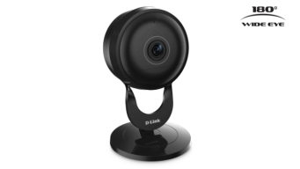
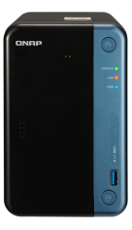

Turn QNAP NAS into wireless AP
TS-253Be
QWA-AC2600
WirelessAP Station app
Notes:
You also can turn your QNAP NAS into wireless AP with QNAP App WirelessAP Station and QWA-AC2600

Slide 12
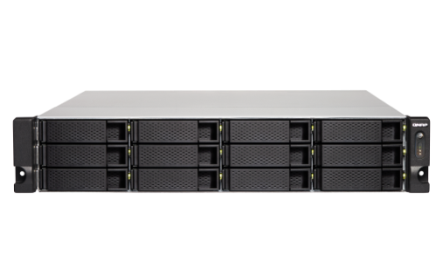
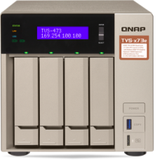
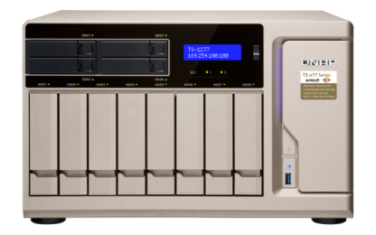
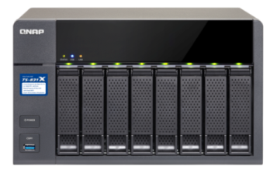
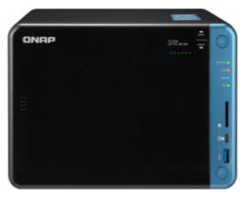
Supports NAS models with PCIe slot(s)
ARM-based processor
x86-based processor
TS-x31XU
TS-832X
TS-1635, TS-1635AX
*TS-531P, TS-531X, TS-831X
TS-x53B/x53Be, TS-x53BU
TVS-x63, TS-x63U
TVS-x73/x73e, TS-x73U
TS-x77
TVS-x82/x82T, TVS-1582TU
*QTS 4.3.5 or newer required
Notes:
QWA-AC2600 NIC card supports most QNAP NAS with PCIe slot, for example ARM-based processor like TS-1635AX model and intel AMD based processor

Slide 13
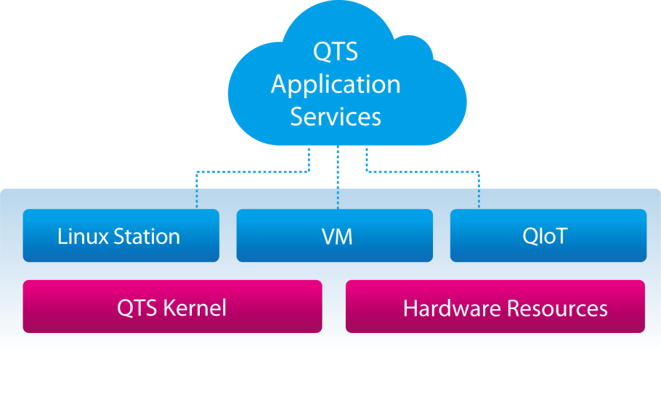
Freely set up independent, secure wireless connection interface
you can also assign individual NICs to the Container or use different QNAP services as required through integration with QNAP Network & Virtual Switch, and enjoy a separate wireless connection interface.
For example: If you need to set up a private IOT environment, you can set it up to not pass through any other devices, so that your IoT network becomes a highly secure and reliable independent network.
Notes:
You can also freely set up independent, secure wireless connection interface

Slide 14
QWA-AC 2600 introduction
2

Slide 15
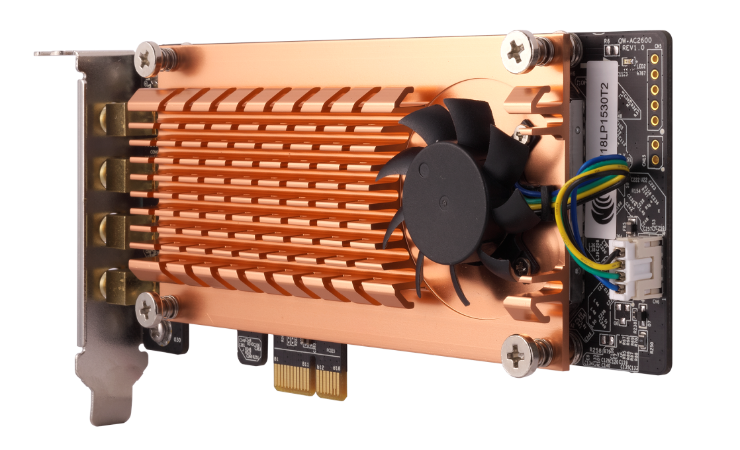
QWA-AC2600 PCIe wireless NIC
Active cooling module to ensure the transmission quality
4 X Detachable RP-SMA connector
For extending to Quad-antenna magnetic base
Adjust the 3-level fan speed by real time chip temperature
Low profile PCIe
3 size bracket for all QNAP NAS
(include X70 model)
Up to 500 MB/s PCIe bandwidth
With a PCIe 2.0 x1 interface
Notes:
You can see we give you 4 detachable connector and quad antenna base
We make I with low profile PCIe can compatible with all QNAP NAS we also give you 3 size bracket
It used smart fan to auto adjust 3-level speed by real time chip temperature

Slide 16

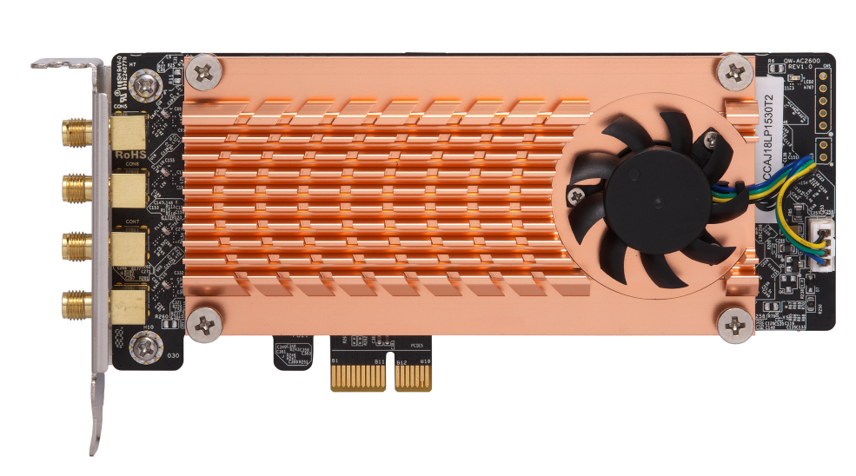
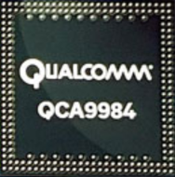
5 GHz and 2.4 GHz dual band
Dual Qualcomm QCA9984 support Dual Band Dual Concurrent
Up to 2600 Mbps total bandwidth
802.11ac (5GHz): up to 1733 Mbps
802.11n (2.4GHz): up to 800 Mbps
Notes:
It have 2 Qualcomm QCA9984 IC can support 5Ghz and 2Ghz working at same time.
QWA-AC2600 = 5G 1733 + 2.4G 600
5G: 1733 Mbps (4*433Mbps)
2.4G: 600 Mbps (4*150Mbps)

Slide 17
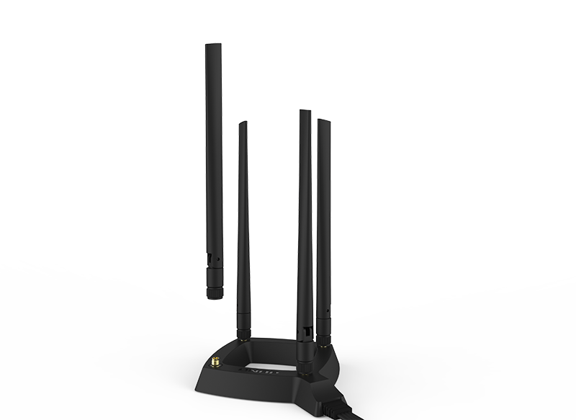

High mobility Quad-antenna base
0.8 m RF high frequency coaxial cable
For optimized antenna placement
4 detachable omni-directional high gain antennas
Upgrade or replace the antenna by demand
Notes:
Give you a longer antenna cable and 4 detachable connectors

Slide 18

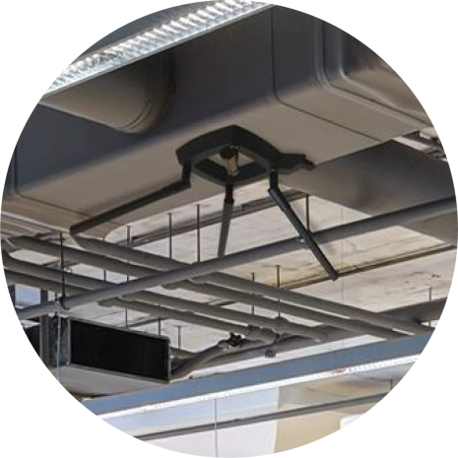


Flexible deployments with the antenna base
Wall-mount
Magnetic
Attached on the wall or ceiling
Attached to metal surfaces
Notes:
Wall-mount:Attached on the wall or ceiling
Magnetic:Attached to metal surfaces

Slide 19



2 Qualcomm QCA9984 wireless NIC
4 x 4 MU-MIMO
Simultaneously communicate with multiple devices
Compliant with IEEE 802.11ac wave 2
Compatible with IEEE 802.11ac, IEEE 802.11n and IEEE 802.11a/b/g
Notes:
We used 2 Qualcomm QCA9984 IC it support multiple user – multiple in multiple out

Slide 20
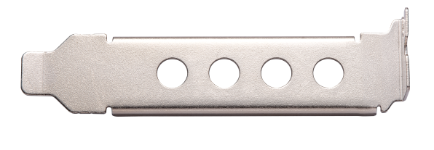
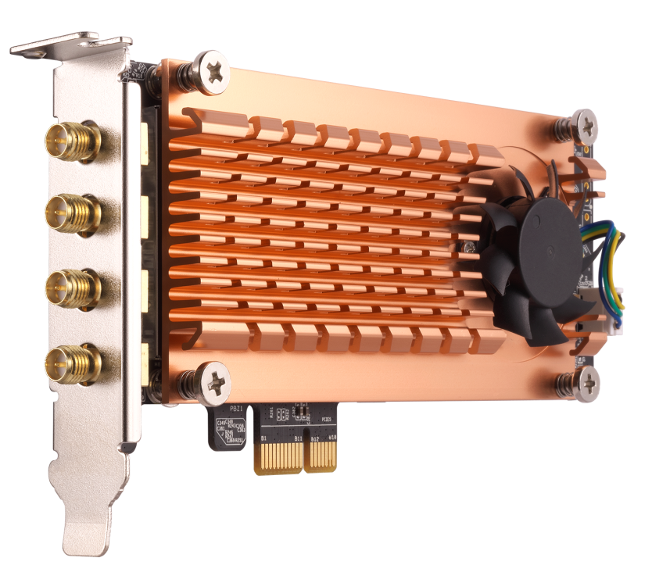
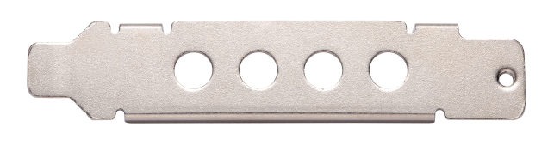
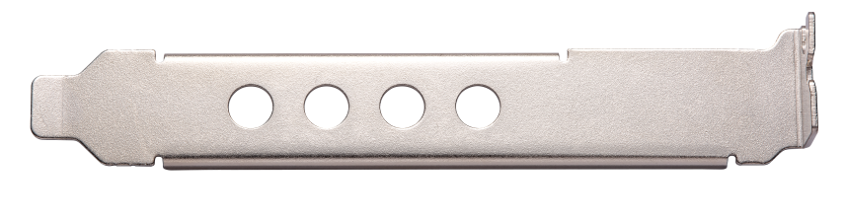
All QNAP NAS PCIe card bracket
Low profile PCIe expansion card design
Low profile bracket
Special half height bracket
(For some QNAP NAS)
Standard full height bracket
Notes:
We can see all QNAP NAS PCIe card bracket here

Slide 21
Wireless base station setup
3
Ubuntu
QNAP NAS

Slide 22
Ubuntu PC
Wireless base station setup

Slide 23
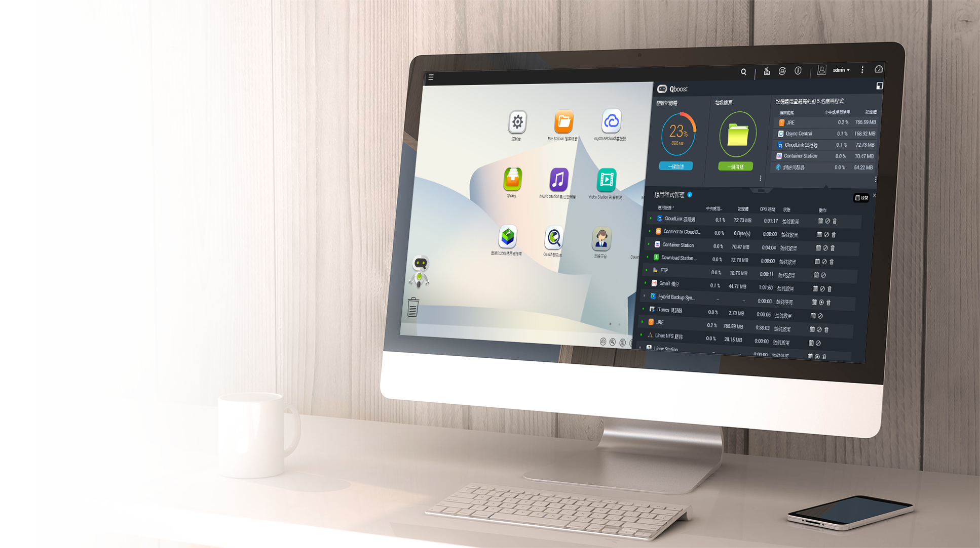
Ubuntu PC system requirement
Ubuntu version : 17.10 or later
Kernel version: 4.13 or later
Driver : ATH10K
(Ubuntu system built-in）

Slide 24





3 step to build a Wireless AP with Ubuntu PC
Install and setup
AP suite：Hostapd
Client: wpa_supplicant
Install Ubuntu 17.10
Install QWA-AC2600

Slide 25
Install AP Suite
AP suite：Hostapd
  command：sudo apt-get install hostapd
Ubuntu default setting will lock the network management function,
need to unlock by instruction.
  sudo nmcli radio wifi off
  sudo rfkill unblock all
If need to change network interface card name(or use default name)
sudo ip link set wlp4s0 name wifiap0
sudo ip link set wlp5s0 name wifiap1
Notes:
Ubuntu default setting will lock the network management function, need to unlock by instruction
We also can use command to change network interface card name

Slide 26
Set up Hostapd #1
Create /etc/hostapd/hostapd_5G.conf Profile
interface set up to wifiap0
# AP netdevice name (without 'ap' postfix, i.e., wlan0 uses wlan0ap for
# management frames); ath0 for madwifi
interface=wifiap0

Slide 27
Set up Hostapd #2
Set up driver
# Driver interface type (hostap/wired/madwifi/test/none/nl80211/bsd);
# default: hostap). nl80211 is used with all Linux mac80211 drivers.
# Use driver=none if building hostapd as a standalone RADIUS server that does
# not control any wireless/wired driver.
driver=nl80211

Slide 28
Set up Hostapd #3
4. Set up SSID for Wireless network：
# SSID to be used in IEEE 802.11 management frames
ssid=QNAP-AP
5. Set up Wireless network operation mode:
# Operation mode a(5G)
# Default: IEEE 802.11b
hw_mode=a

Slide 29
Set up Hostapd #4
6. WPA Setting：
# Enable WPA. Setting this variable configures the AP to require WPA
# bit0 = WPA
# bit1 = IEEE 802.11i/RSN (WPA2) (dot11RSNAEnabled)
wpa=2

Slide 30
Set up Hostapd #5
7. Input password for wireless network：
# WPA pre-shared keys for WPA-PSK.
wpa_passphrase=QNAP12345
8. #Start up hostapd
sudo /usr/sbin/hostapd -B /etc/hostapd/hostapd_5G.conf
sudo /usr/sbin/hostapd -B /etc/hostapd/hostapd_2.4G.conf

Slide 31
Hostapd detail information
interface=wifiap0
driver=nl80211
ssid=QNAP-AP-5G
hw_mode=a
channel=0
preamble=1
auth_algs=3
wpa=2
wpa_key_mgmt=WPA-PSK
rsn_pairwise=CCMP
wpa_passphrase=QNAP12345
wmm_enabled=1
uapsd_advertisement_enabled=1
disassoc_low_ack=1
country_code=TW
ieee80211d=1
ieee80211n=1
ht_capab=[HT40+][SHORT-GI-20][SHORT-GI-40][LDPC][TX-STBC][RX-STBC1][DSSS_CCK-40][MAX-AMSDU-7935]
ieee80211ac=1
vht_capab=[MAX-MPDU-11454][RXLDPC][VHT160-80PLUS80][SHORT-GI-80][SHORT-GI-160][TX-STBC-2BY1][RX-STBC-1][SU-BEAMFORMER
][SU-BEAMFORMEE][MU-BEAMFORMER][BF-ANTENNA-2][BF-ANTENNA-3][SOUNDING-DIMENSION-2][SOUNDING-DIMENSION-3][MAX-A-MPDU-LE
N-EXP7][RX-ANTENNA-PATTERN][TX-ANTENNA-PATTERN]
vht_oper_chwidth=1
vht_oper_centr_freq_seg0_idx=0
vht_oper_centr_freq_seg1_idx=0

Slide 32


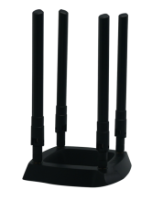
Private ubuntu wireless network architecture
Using the Ubuntu system with QWA-AC2600 to collect, process, and analyze wireless network data.
Notes:
Now we already have a wireless network in Ubuntu PC

Slide 33
QNAP NAS
Wireless base station setup

Slide 34
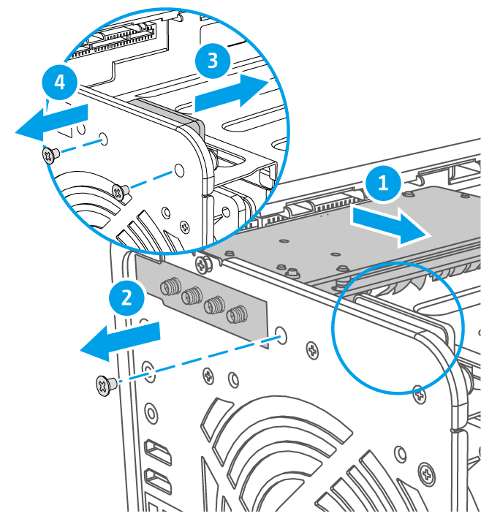
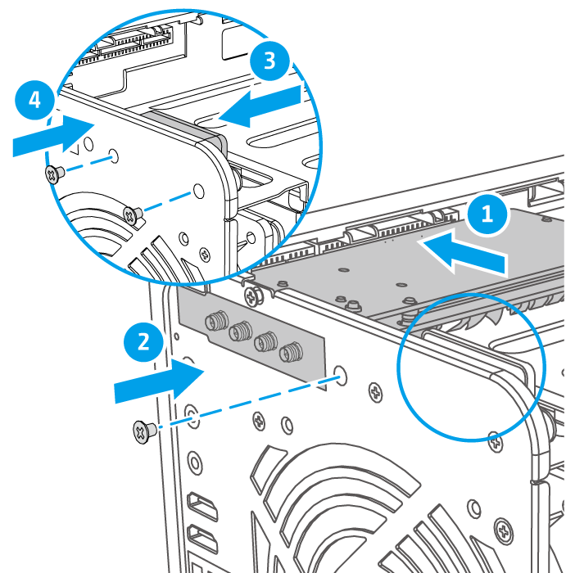
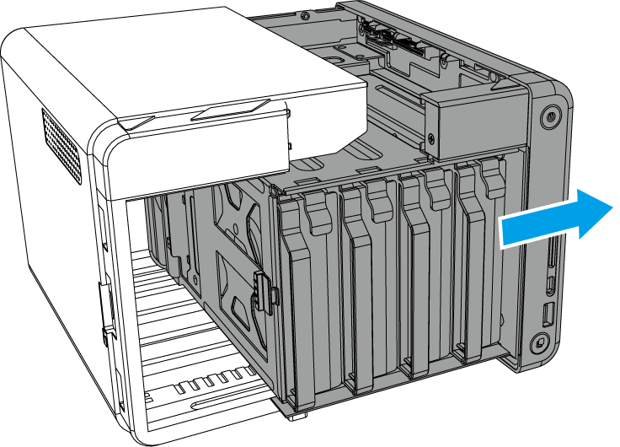
Installation of QWA-AC2600
Remove the cover of TS-453Be
Remove the PCIe cover
Install QWA-AC2600
NOTE 1：Some model may require its speaker to be temporary removed to install QWA-AC2600
NOTE 2：Bracket exchange of QWA-AC2600 is required to install it in the some model
Notes:
首先移除外殼螺絲 => 移除外殼 => 移除 PCIe 插槽檔板 => 安裝 QWA-AC2600 => 裝回外殼

Slide 35
Install WirelessAP Station suite
Exclusive wireless Network bandwidth Application suite for NAS
QNAP
Directly connect to the NAS with a wireless network
Scalable physical AP –
add several access points with multiple expansion cards
Set up separate wireless connection interfaces (such as IoT/VM/Container) as needed
Enjoy network optimization with traffic shunting
Notes:
WirelessAP Station 是一套使用非常簡單的軟體 三個步驟就可以輕鬆將QNAP NAS 設置為專屬無線基地台，讓所有設備都能一同使用，享受直達 NAS 的專屬網路頻寬。
X86等級處理器建立更快速的無線存取點
我們可以直接使用設備連接NAS 不須透過Router或其他線路造成延遲
可透過擴充實體網卡增強效能
透過NAS與裝置間的專屬無線網路享受私人的運用 例如IOT設備或是監控IP CAM
可將NAS的傳輸分流 減輕Router負擔 避免其他連網設備傳輸阻塞

Slide 36

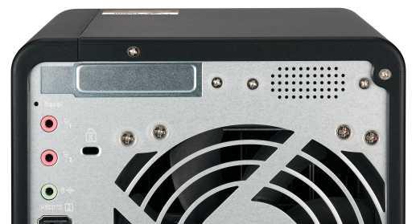
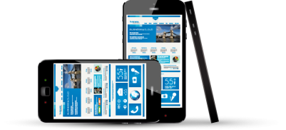
Set up separate wireless connection interfaces
  Now you can freely set up independent, secure wireless connection interface
QWA-AC2600
Notes:
建立 NAS 與裝置間的無線專屬網路，形成小型的私人網路，當我們需要建制隱密性較高的私人物聯網環境時，就可以不用透過其他分享器，直接完成NAS與物連網裝置直接溝通的私有網路。

Slide 37
Application introduction
4

Slide 38
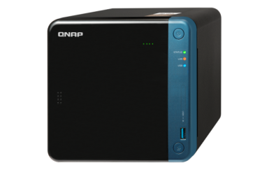

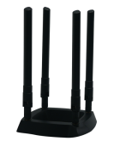


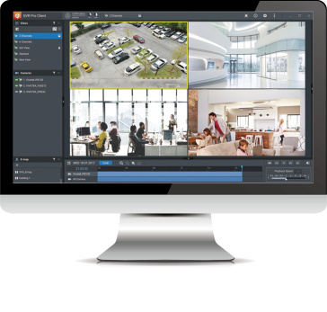
Setting of QWA-AC2600
Normal application
QNAP NAS wireless AP
Advance application
private network
environment(Router)
Notes:
基本應用
設定NAS無線網路
進階應用
建置安全監控環境

Slide 39




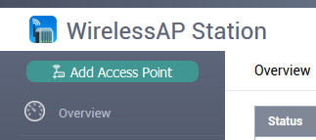
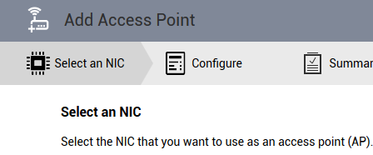
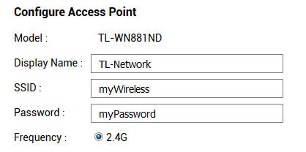
3 Step convert a QNAP NAS into an AP
Download and install WirelessAP Station form QTS App Center
Click “Add Access
Point”
Select QWA-AC2600
Configure the Access Point
QWA-AC2600
Notes:
接下來我們透過簡單的三個步驟 1.點 「新增存取點」2.選擇 QWA-AC2600 網卡 3輸入 AP 存取點的設定

Slide 40
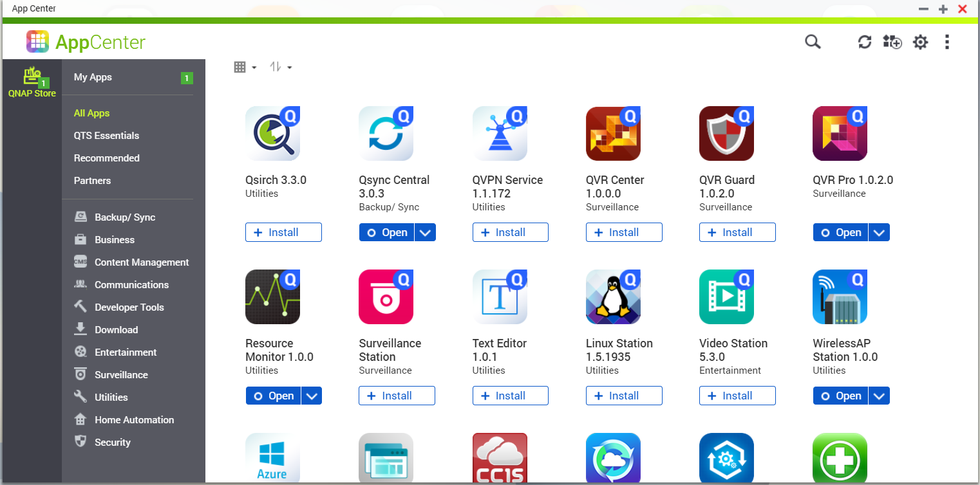
Install Wireless AP Station suite
Install and Open WirelessAP Station form App Center

Slide 41
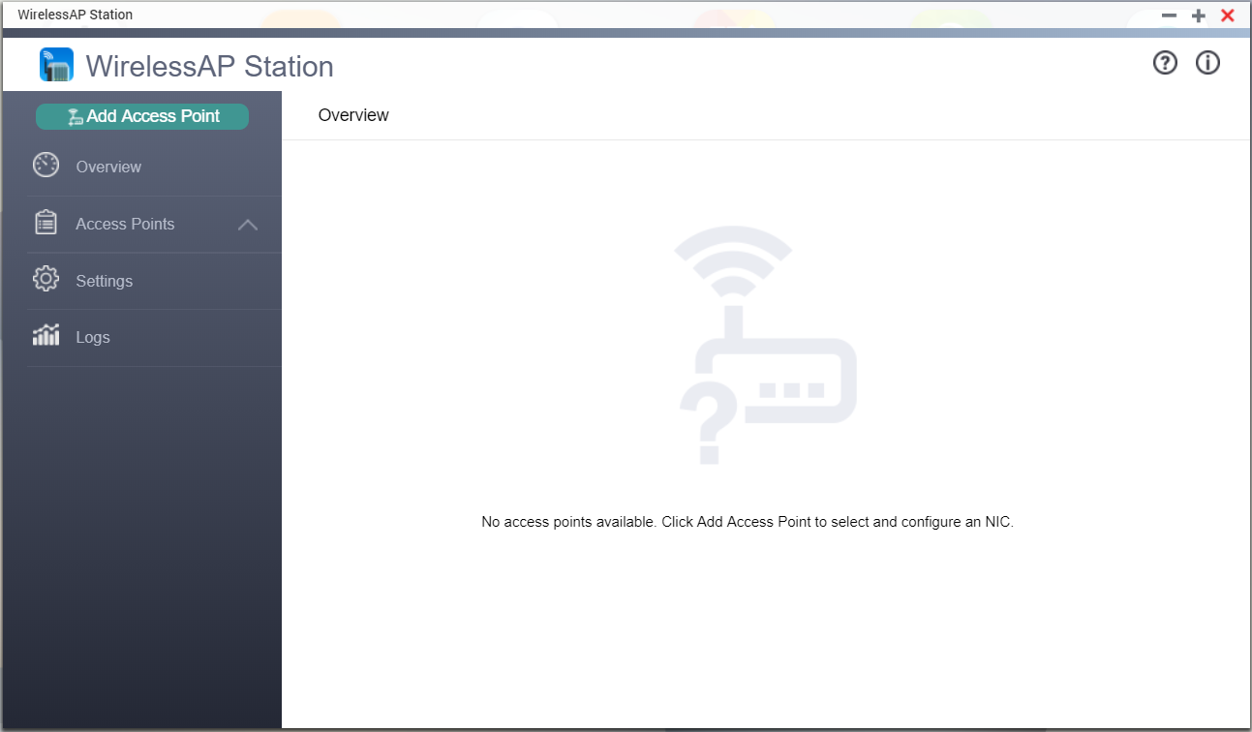
Add Access Point
Click “Add Access Point” to select and configure a network interface card (NIC) as an access point

Slide 42
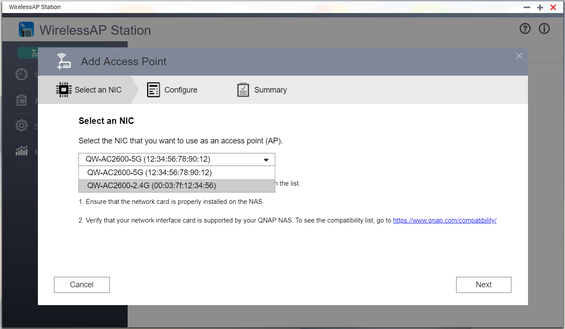
Select an NIC
Select the NIC that you want to use as an access point
1
QWA-AC2600 support
5G/2.4G dual IC
2

Slide 43
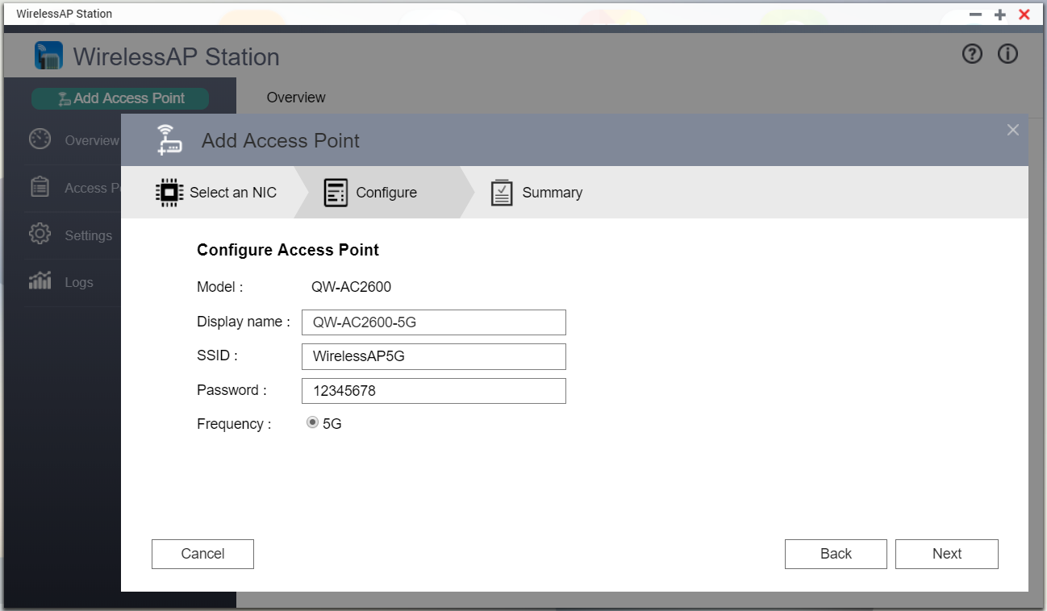
Configure Access Point
Setting SSID and Password
1
2

Slide 44
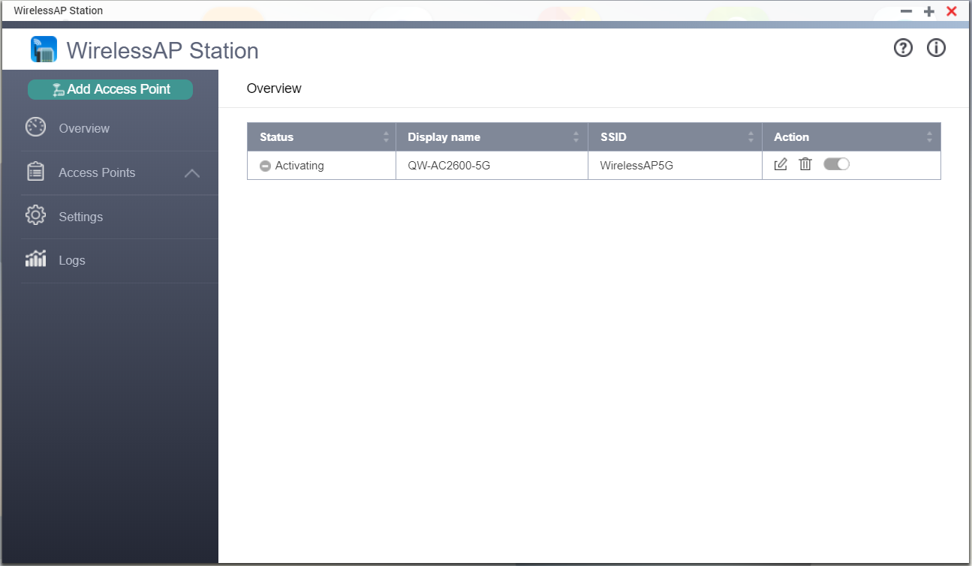
Configure Access Point
Waiting the Status turn to Active

Slide 45
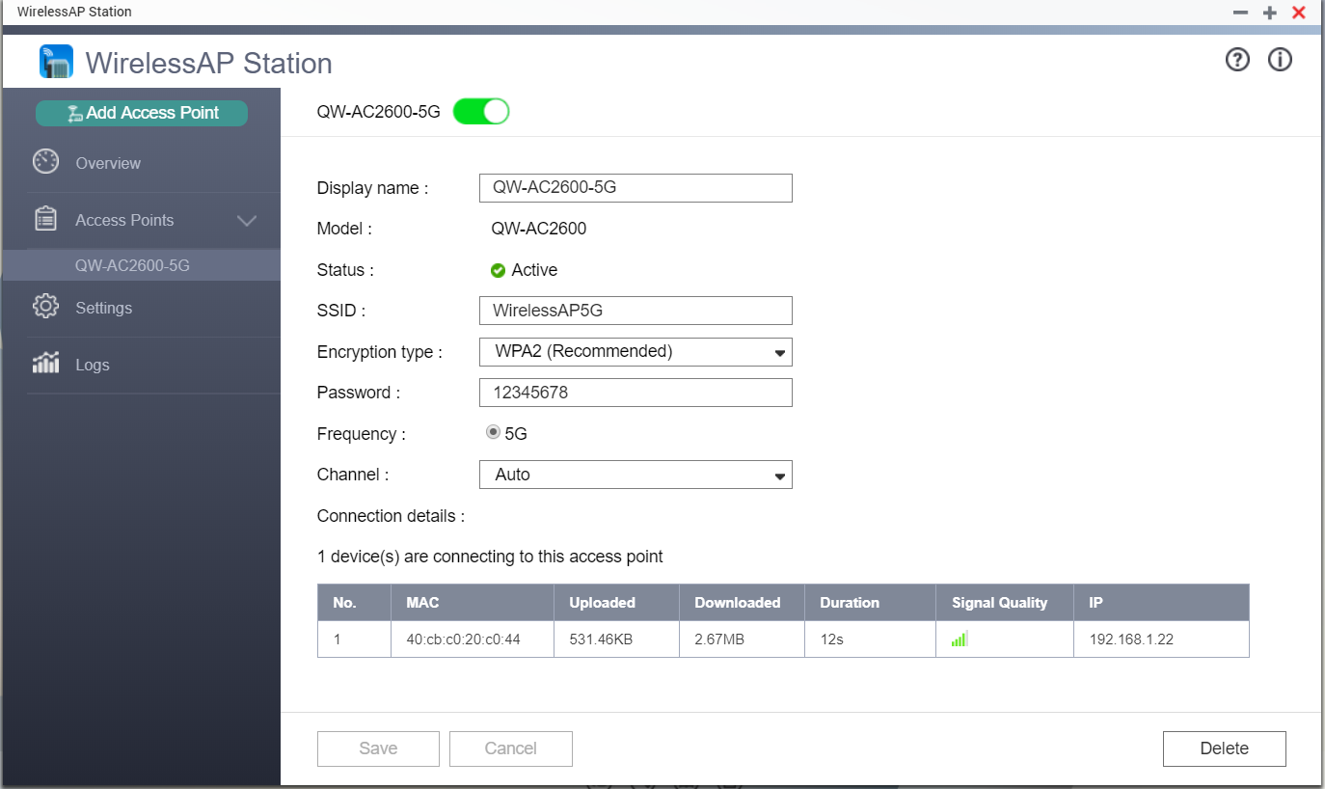
Editing an Access Point Profile
Check and modify Wireless AP setting
Review the connection details

Slide 46
DEMO
Notes:
1.先架設5G網路 2.連線192.168.2.20(視情況) 秀傳輸速度 速率為50MB/S左右 = 400bps

Slide 47


Advance: Private Surveillance
Connect wireless cameras to the network provided by WirelessAP Station and build a secure and professional surveillance system with QVR Pro
Notes:
接著我們說明進階應用的部分

Slide 48





Enable DHCP & NAT services to a secure surveillance environment
Create a Virtual Switch to a private network by
QTS "Network and Virtual Switch" function
QVR Pro Client
Adapter 1
1 Gbe
10.0.0.3
Virtual Switch 1
Wireless camera
WirelessAP 1
10.0.0.1
10.0.0.2
Set SSID as QVR Pro
Wireless encryption as WPA2

Slide 49

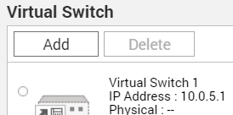
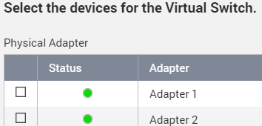

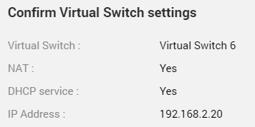
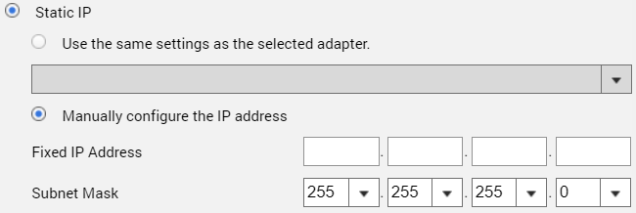
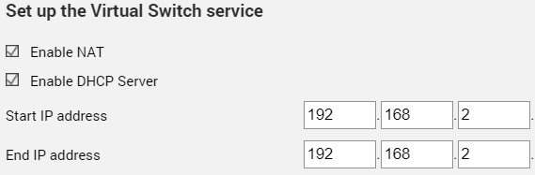
6 step to set up secure wireless connection interface
Open Network & Virtual Switch form QTS
1
Click「Add」
2
Select Advanced Mode
3
Select the devices for the Virtual Switch
4
Set up the Virtual Switch IP address
5
Set up the Virtual Switch service
6
Confirm Virtual Switch settings

Slide 50


Open Network &
Virtual Switch form Control Panel
1
2

Slide 51

Select Advanced Mode
1
2

Slide 52


Create a Virtual Switch
1
2
Select Advanced Mode

Slide 53

Select the devices for the Virtual Switch
1
Choose physical adapter for the Virtual Switch
2

Slide 54

Set up the Virtual Switch IP address
Manually configure the IP address
1
2

Slide 55

Enable NAT and DHCP Server
1
Set up IP address and DNS server
2

Slide 56

Confirm setting and Apply
Check the setting

Slide 57

Setting completed
QVR Pro Client
Adapter 1
1 Gbe
10.0.0.3
Virtual Switch 1
無線攝影機
WirelessAP 1
10.0.0.1
10.0.0.2
設定 SSID 為 QVR Pro
無線加密安全性為 WPA2

Slide 58
DEMO

Slide 59

Made for Ubuntu PC and QNAP NAS
Copyright © 2018 QNAP Systems, Inc. All rights reserved. QNAP® and other names of QNAP Products are proprietary marks or registered trademarks of QNAP Systems, Inc. Other products and company names mentioned herein are trademarks of their respective holder
Notes:
以上是我們本次的介紹 謝謝各位的觀看

