Slide 1
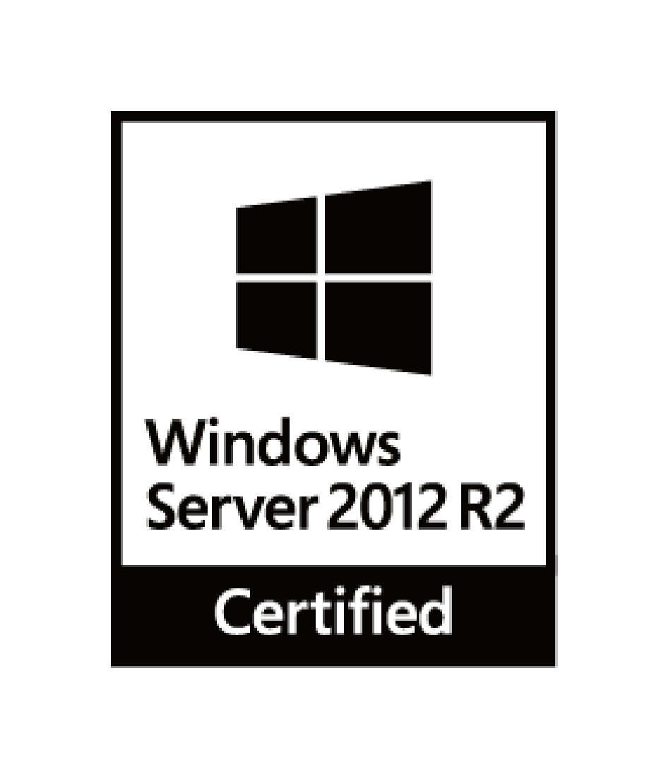

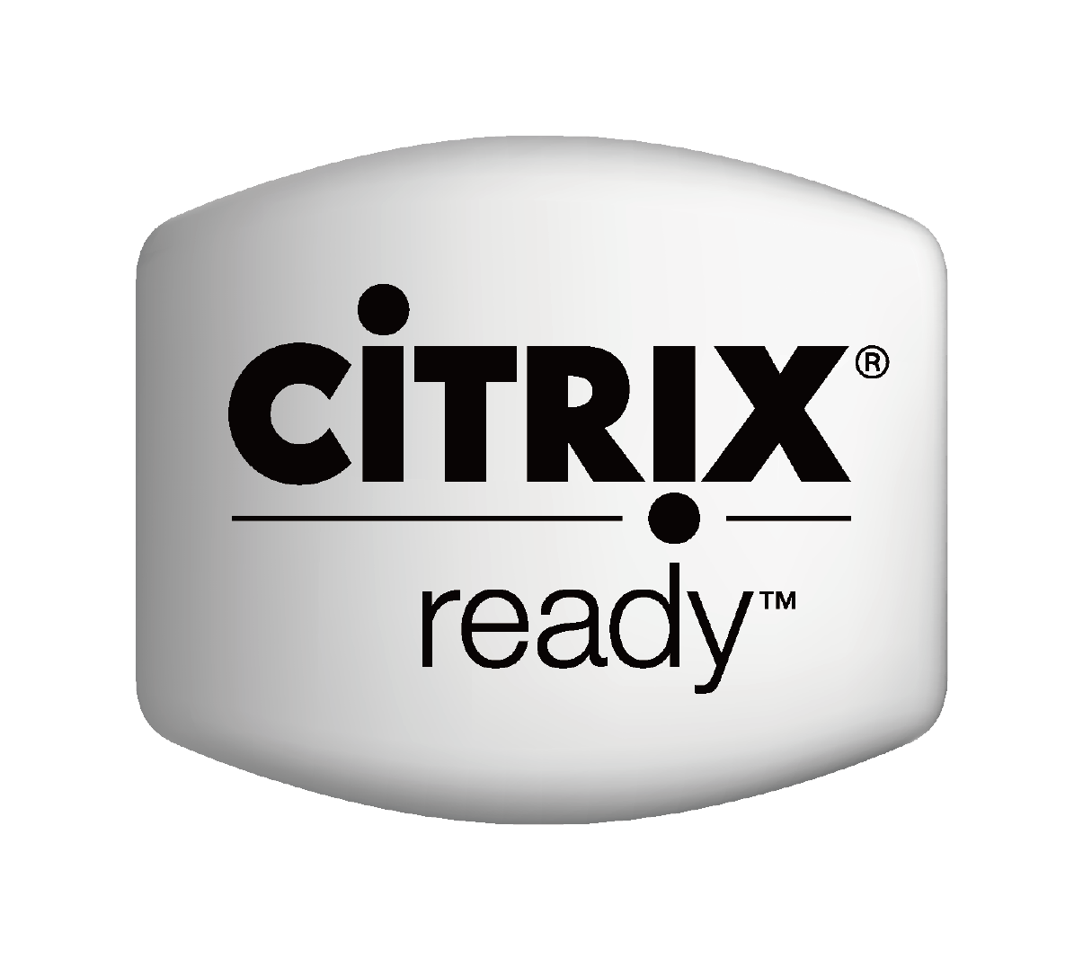


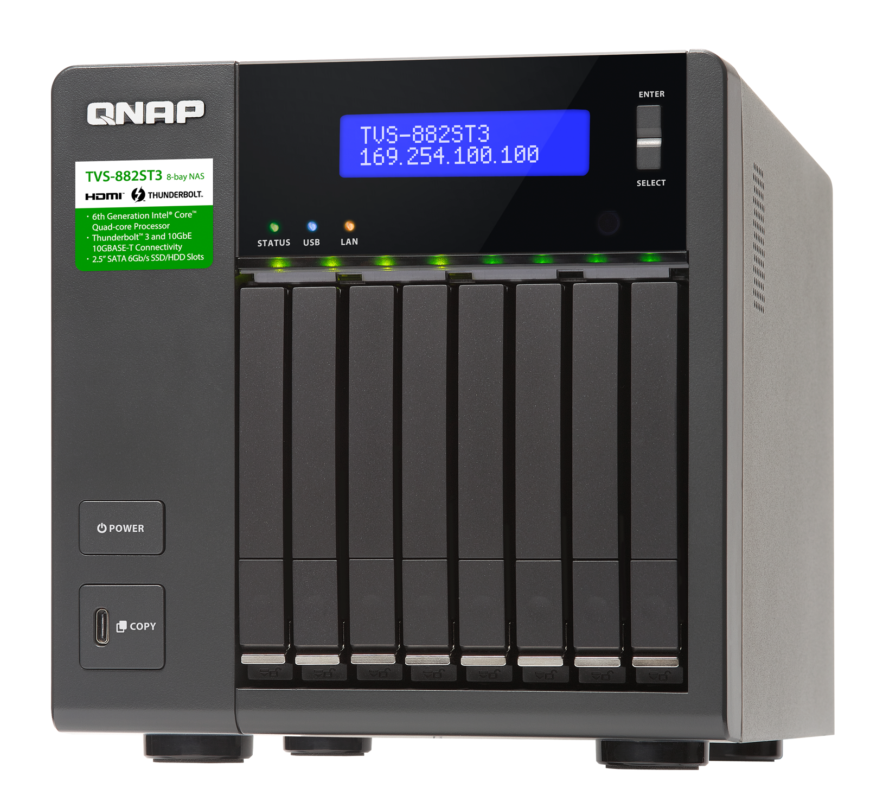


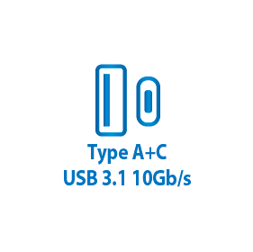
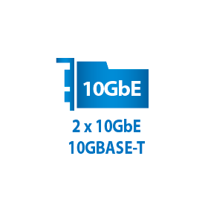
TVS-882ST3
The perfect match for Mac
with Thunderbolt 3 and 10GbE connectivity

Slide 2
Outlines
1
The specification and features you should know
2
Live Demo – Qfinder connection and performance
3
Case Sharing
4
Expand devices with your growing team members
5
Live Demo – Expansion volume

Slide 3

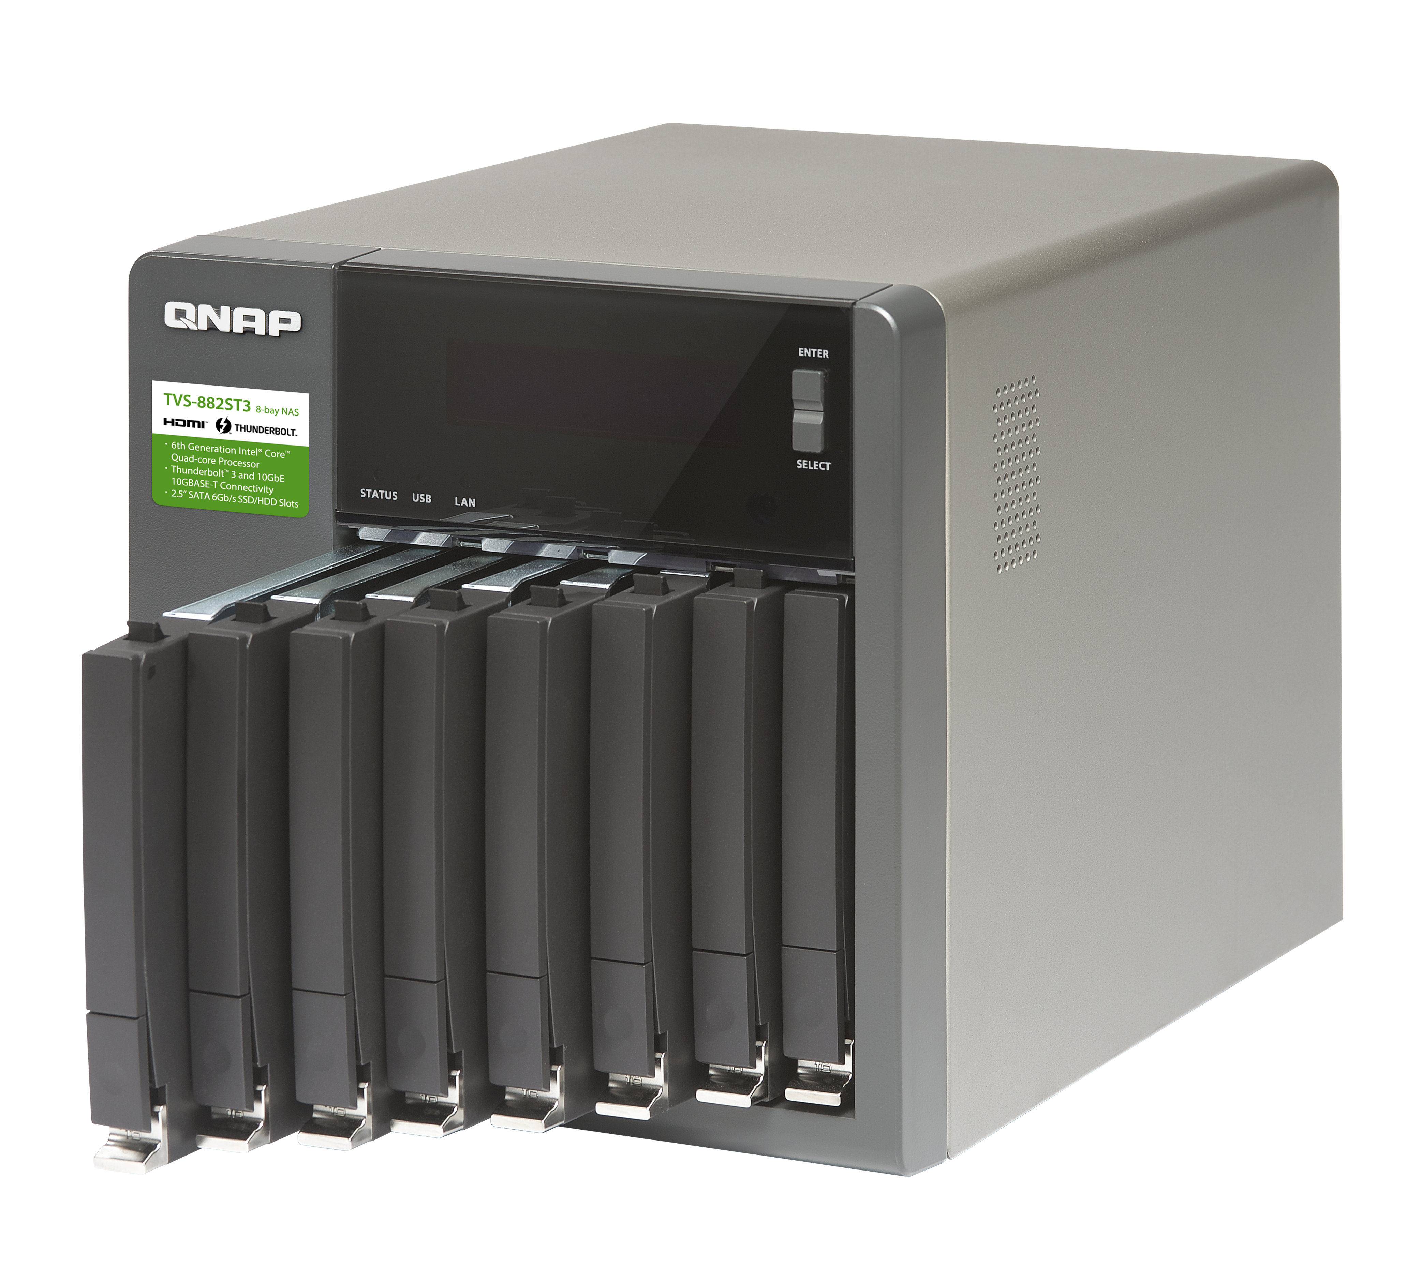

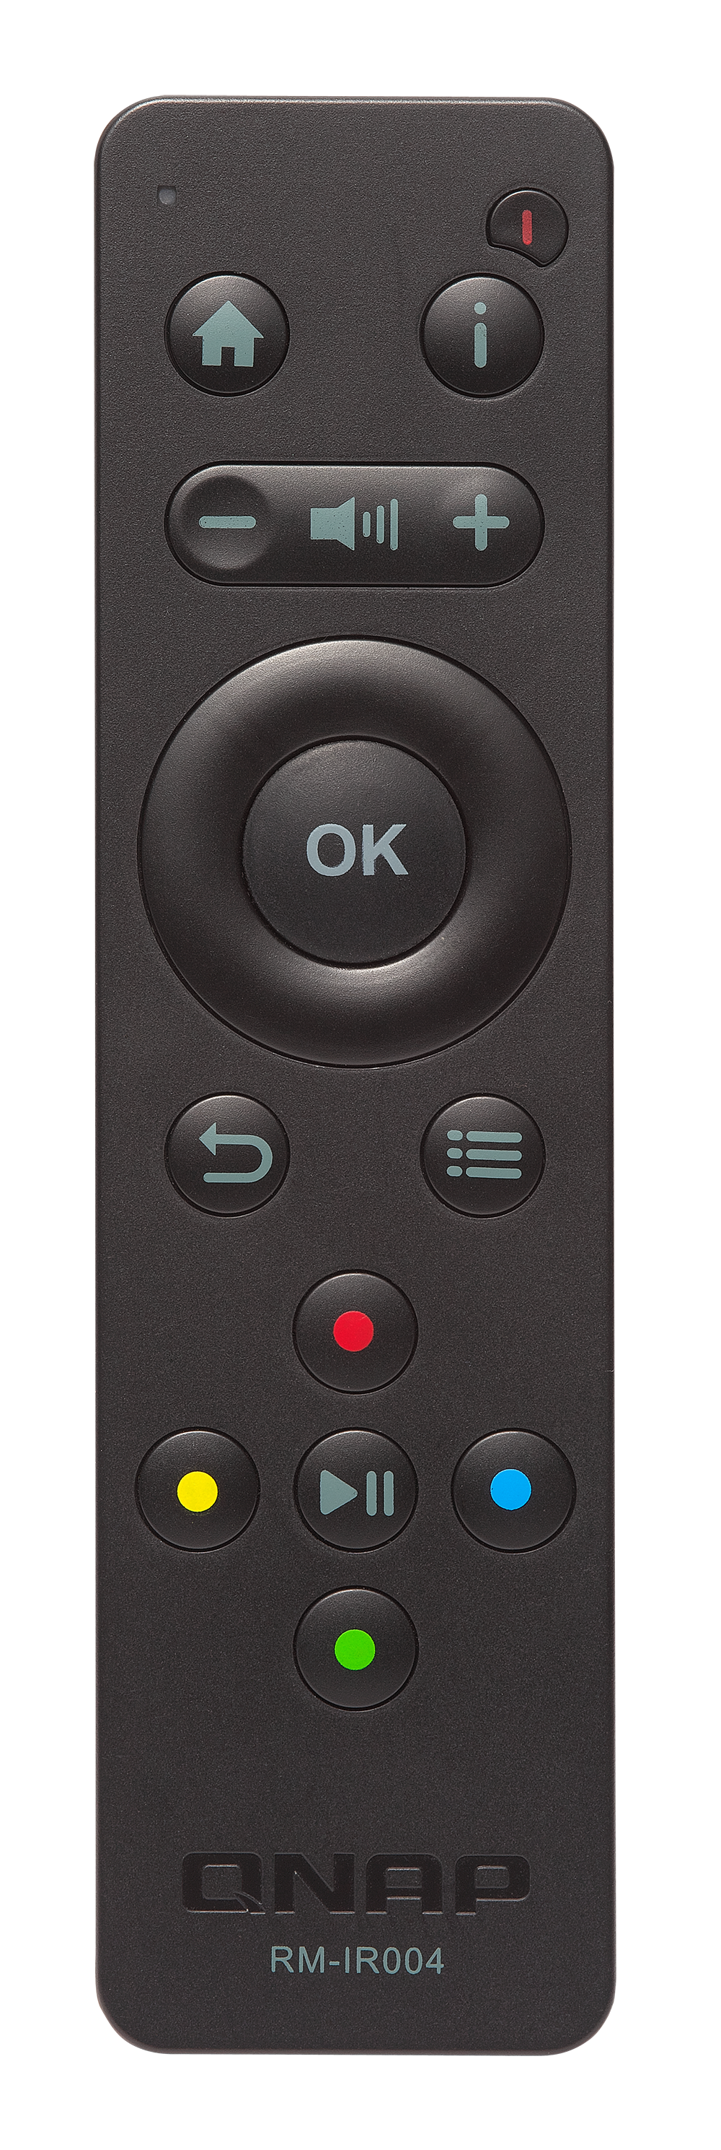
Ideal Thunderbolt NAS for video editing
TVS-882ST3
Intel® Core™ i7-6700HQ
Quad-core 2.6 GHz
Highest 3.5 GHz
8-bay, 16 GB Dual Channel RAM
(2 x 8 GB DDR4-2133)
Up to 32GB RAM
Remote
RM-IR004

Slide 4
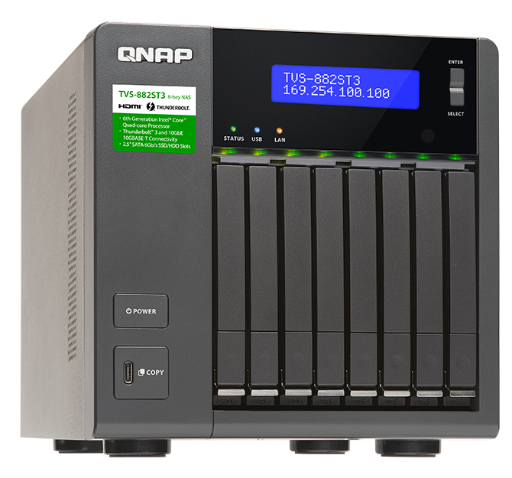
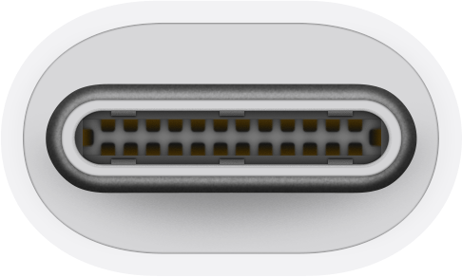
Something you are familiar and happy with
2 x
Thunderbolt 3 Type-C ports

Slide 5
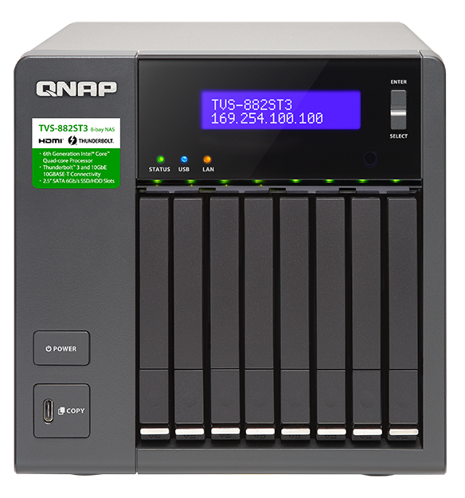
Front view
LED :
power/status, USB, HDD 1 - 8
OLED status display and capacitive touch buttons
IR receiver
8 x 2.5”SATA 6Gb/s HDD/SSD slots
ON/OFF
1 x USB 3.1 Gen 2
Type-C port & One Touch Copy button

Slide 6
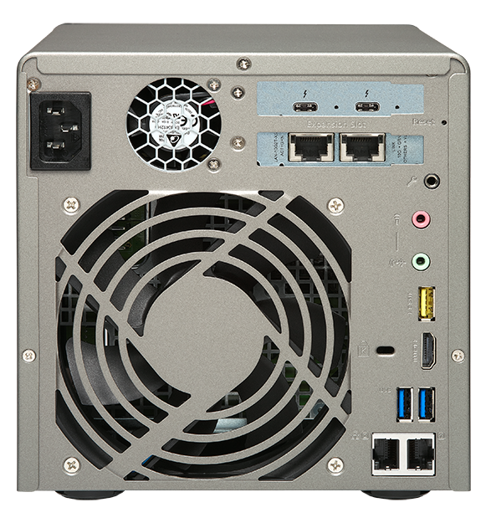
Rear view
2 x Thunderbolt™ 3 ports
2 x 10GBASE-T ports
ATX 250W power
3.5 mm Audio in
12 cm fan
3.5 mm Line out
USB 3.1 Gen 2 Type-A port
Kensington security lock
4K HDMI v1.4b output
2 x USB 3.1 Gen 1 ports
2 x 1000BASE-T ports

Slide 7
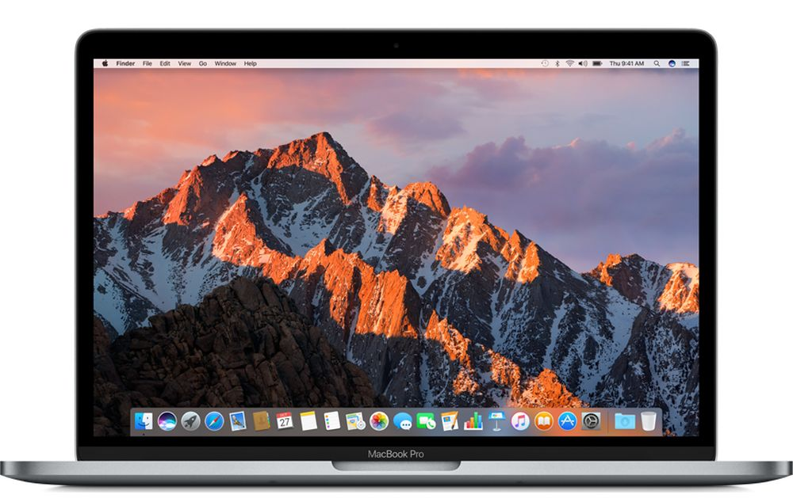

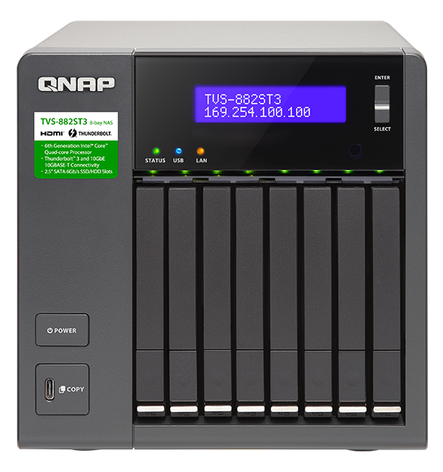

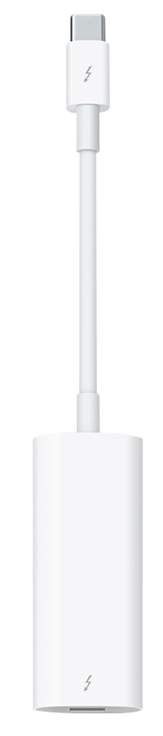
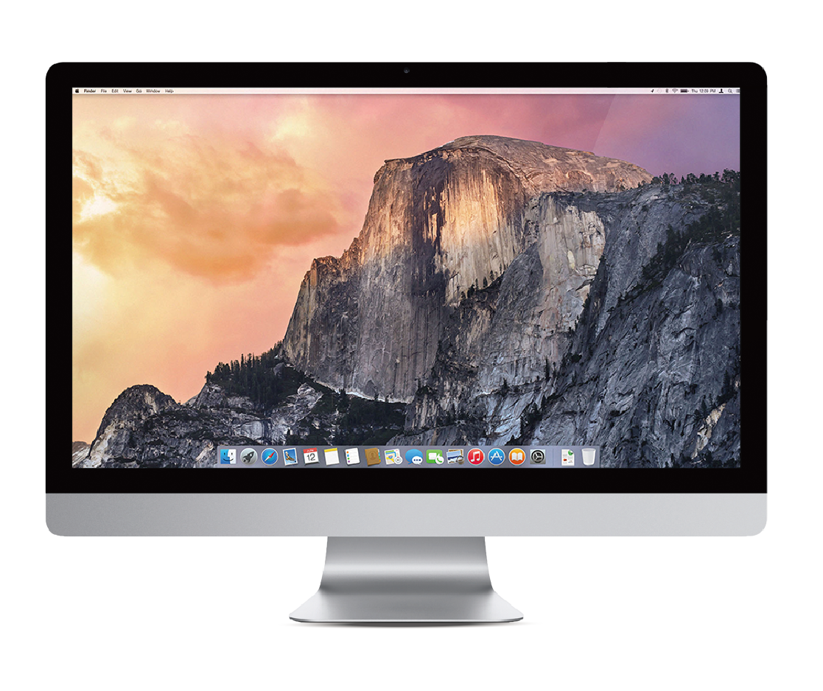
Thunderbolt 2/ 3 compatible
Thunderbolt 3 cable
Thunderbolt 2 cable
Apple Thunderbolt 3 to
Thunderbolt 2 adapter

Slide 8
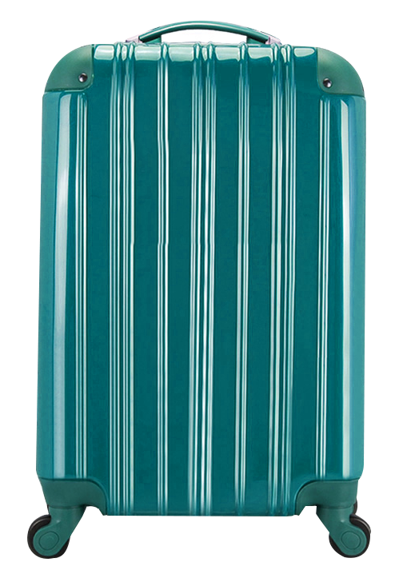
Portable and Powerful
Test environment:
NAS: TVS-882ST3-i7-8G with QTS 4.3.3
Volume type: RAID 5; 8 x Intel S3500 240GB SSDs (SSDSC2BB240G4)
Client PC:
Intel® Core™ i7-4770 3.40GHz CPU; 16GB DDR3L-1600; WD 1TB WD10EZEX; Windows® 10 64-bit
Throughput (MB/s)
19”hand carry case fits 4 of them
1200
900
1180
1168
600
300
0
0
Read
Write

Slide 9

Let us show you
1
Qfinder connection
Live Demo
2
Mount Share folder
3
Performance
Notes:
----------------------------------------------------------------------------------
English:
LIVE Demo - Bilateral Mount in two steps
Photo Station 5.4/ Qphoto 3 - Photo/Video Instant Upload
Open Qphoto and click “take photos” or “record videos”
Select a destination folder. Start taking(recording)!
QTS 4.3.4 File Station - Mobile phone mounting.
Connect mobile phone and NAS with USB connector.
Open File Station and start transfering the files!
----------------------------------------------------------------------------------
逐字稿:
現在來現場示範
示範錄影就好，跟jeffrey錄一小段影片
示範完Qphoto，講file station
除了Qphoto可以直接拍照錄影上傳NAS，現在file station也可以很方便地把手機裡面的照片傳到NAS，只要手機接USB插上NAS，就可以在file station裡面看到手機，然後就可以直接拖曳檔案到NAS囉
Demo操作步驟：
＊需搭配QTS 4.3 & Photo Station 5.4或之後版本
開啟Qphoto後登入NAS
預設進入shared photos頁面，即可看到右下角有拍照跟錄影按鈕
點選拍照或錄影按鈕，第一次使用的話，會要求選擇上傳路徑（注意：須上傳到共享的媒體資料夾，照片才可以在shared photos頁面看到）
開始拍照或錄影，完成後按左上角的回上一頁，回到shared photos頁面
如果上傳未完成，頁面最上方會出現即拍即傳上傳狀態，上傳完成的檔案會打勾，請在打勾後重新整理頁面，即可看到剛剛拍攝的檔案（注意：一定要用時間軸模式瀏覽，這樣最新拍攝的檔案才會在最上面，很明顯可以看到）
點開剛剛拍的影片或照片，給使用者看

Slide 10
TVS-882ST3
Case Sharing

Slide 11

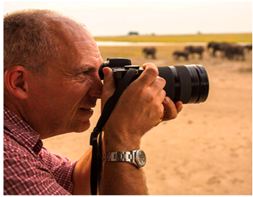
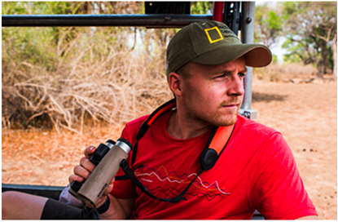
Photographers on the Passion That Drives Them
"Using the QNAP TVS-1282T3 and its Thunderbolt™ 3 interface, I'm much more efficient in my workflow. Compared to my previous NAS, that was connected to my network with 10 Gigabit, I now benefit from an 800% to 1000% faster data transfer rate.”
………………………………….
Falco Peters
"We have been able to condense a rather eclectic collection of different hard drives and storage systems into one single unit. This makes data-wrangling a whole lot easier.“
………………………………….
Nick Rains
“If you want to focus on getting the creative job done, QNAP devices are great partners. QNAP gives us a complete solution for all network storage and sync needs, in one easily-manageable ecosystem”
………………………………….
Martin Edström
Notes:
12 cameras
4 or 5 editors

Slide 12
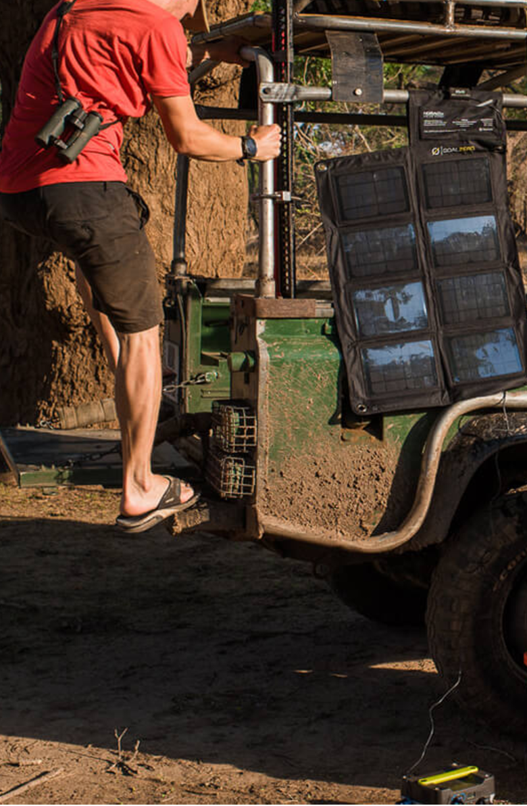
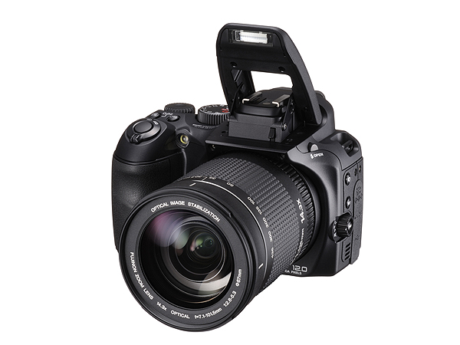
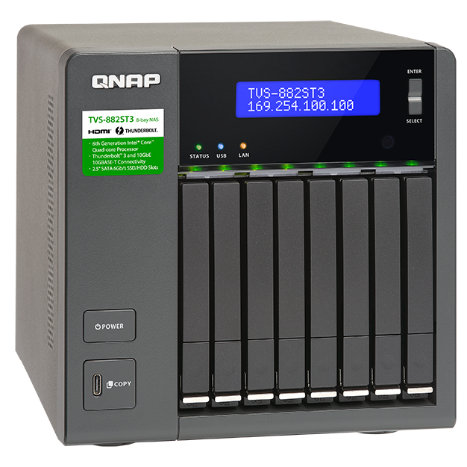
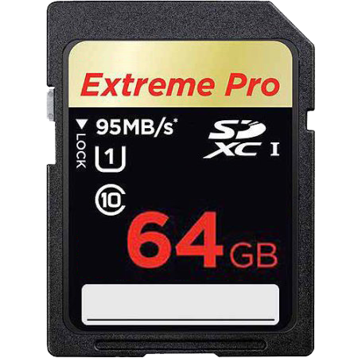
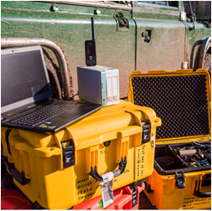
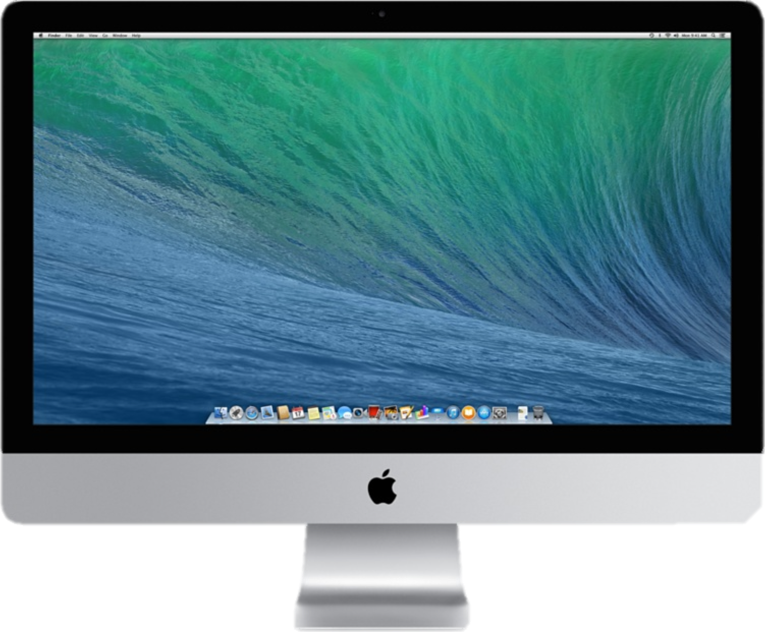
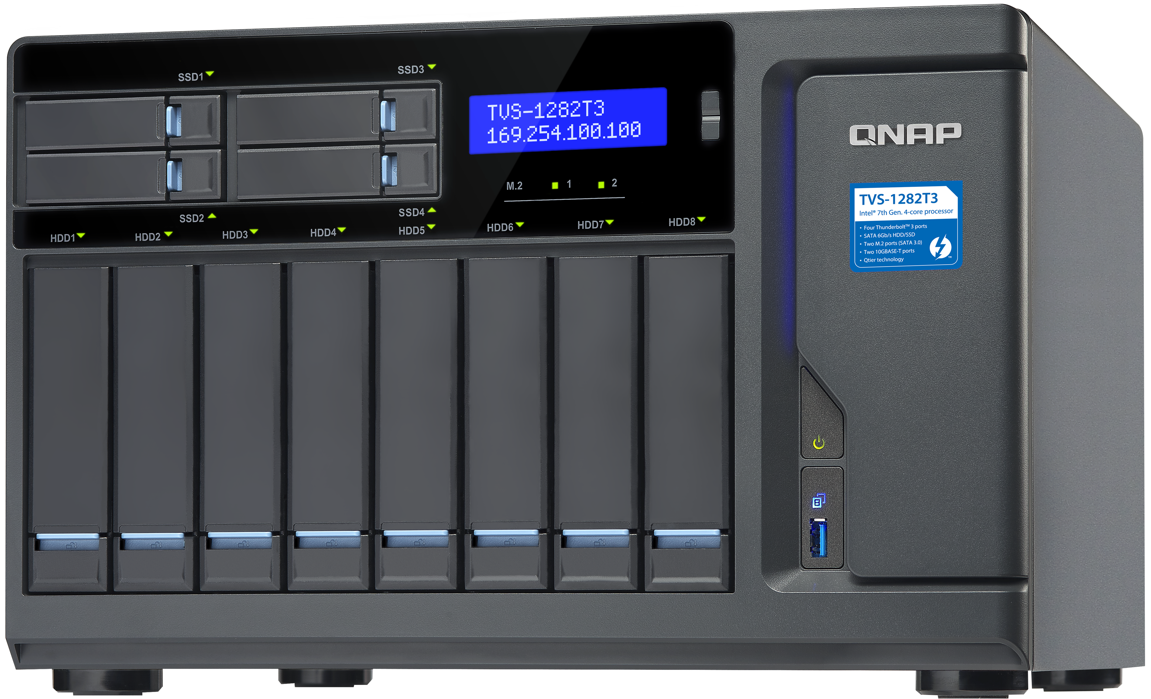
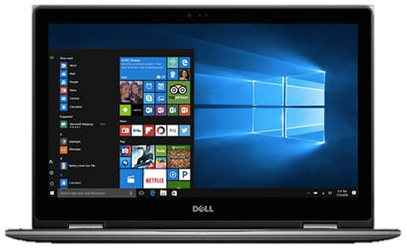
QNAP NAS helps them
Outdoor
High speed import
And backup
In studio
Works with SD card reader
Backup
Collaboration

Slide 13

Video Editing Workstation Onsite
More than 12 high definition
cameras
5 people work on the same file
at the same time
5 TB data remote backup
Collaboration in different
countries

Slide 14
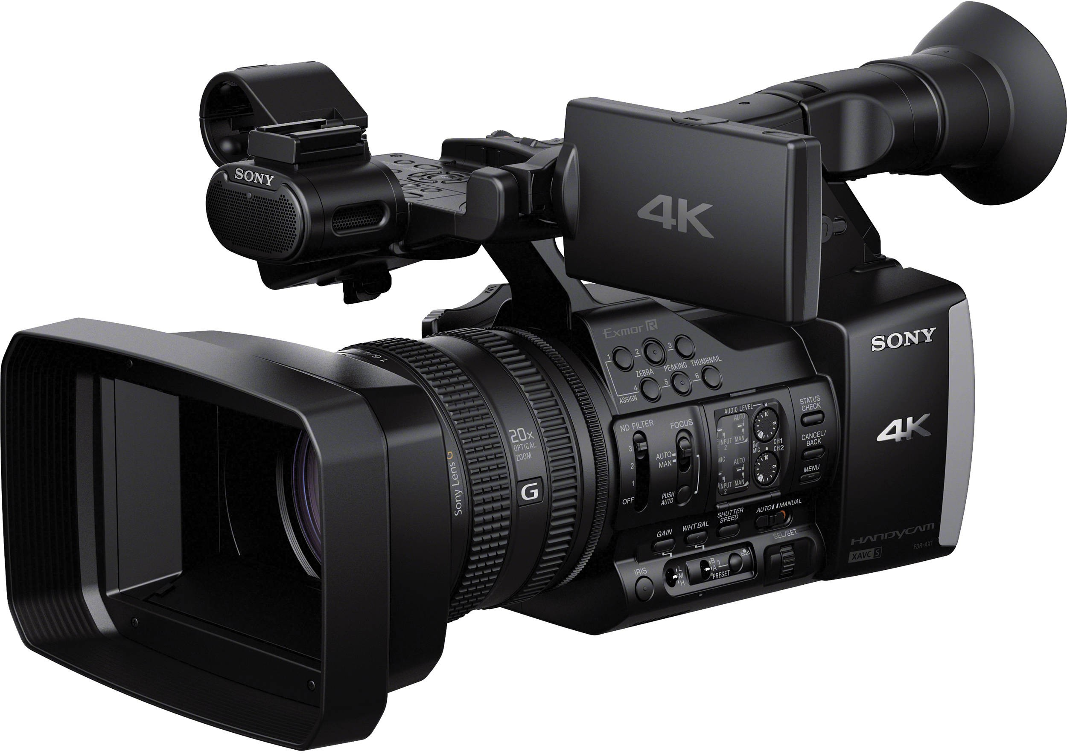
The perfect workflow
Detroit Onsite
New England HQ
High speed import
and backup
1
4
Collaboration
3
Remote Replication
(QNAP RTRR)
Collaboration in
real-time
2

Slide 15
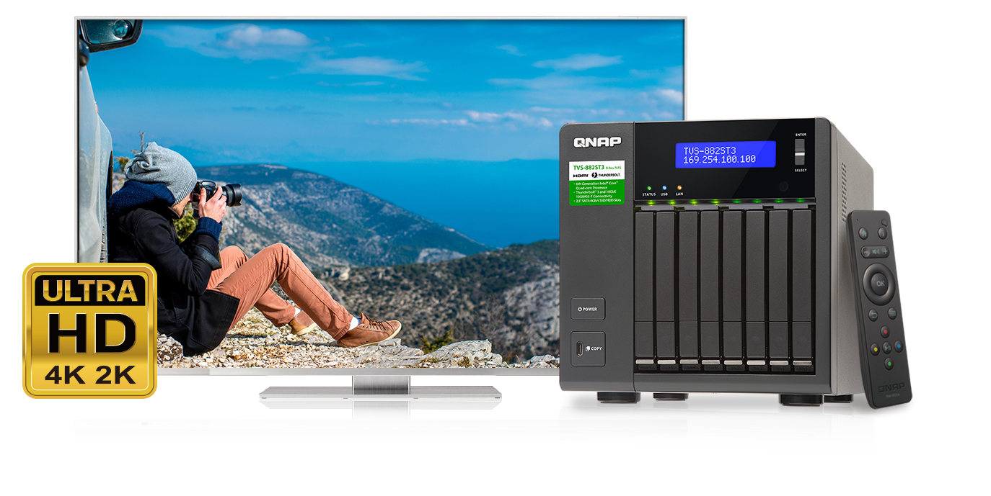

Instant view your edited 4K videos
750MHz
9th Gen Intel
HD Graphics 500
4K UHD
2 x HDMI v1.4b
3840 x 2160, 30Hz
H.265/H.264
8-bit HEVC
4K Display & 2 CH Transcode
The supported video and audio formats may vary depending on the software you use

Slide 16
We’ve got more for you!

Slide 17

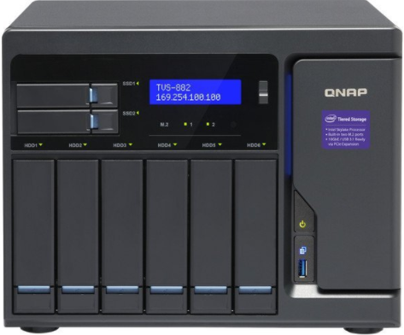


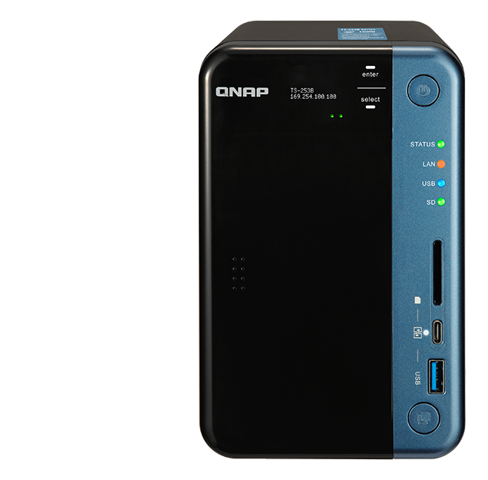
Virtual JBOD - flexible expansion storage
Container Station
Use the VJBOD function to create remote LUN directly and mount as local disk
iSCSI LUN
2 x 10G SFP+
TS-882ST3
VJBOD 1
RAID
Ethernet, flexible connection
VJBOD 2

Slide 18
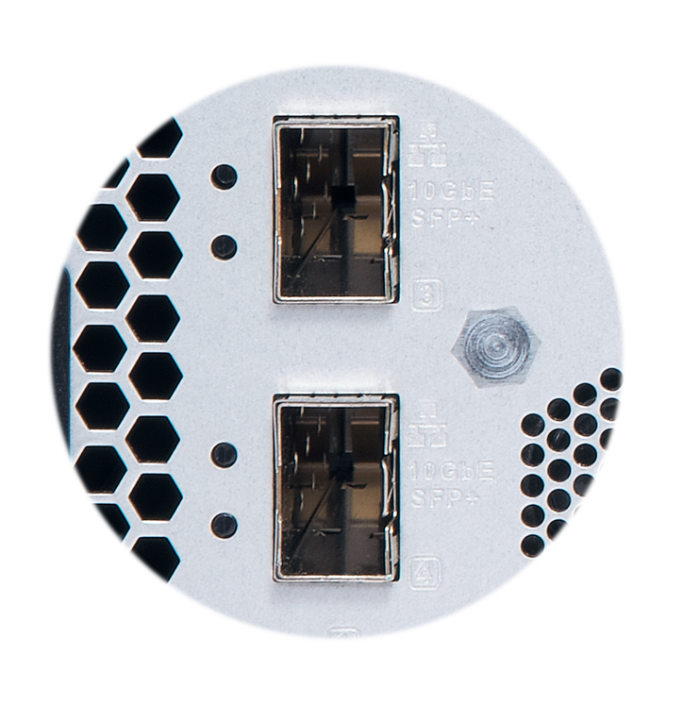
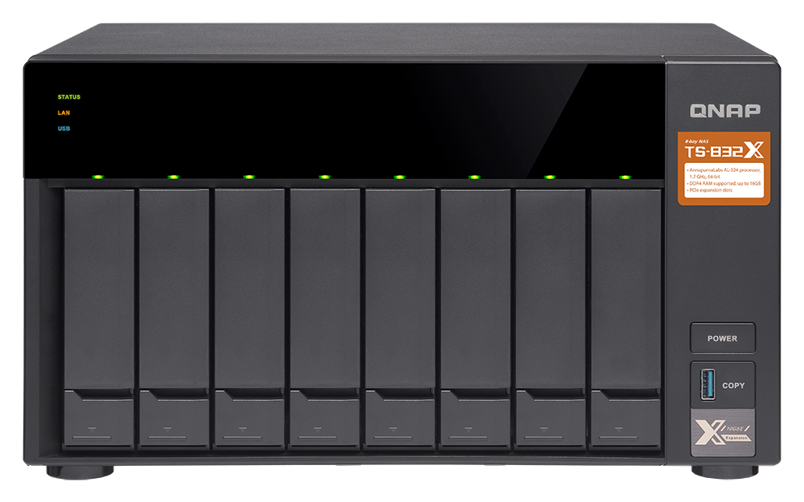
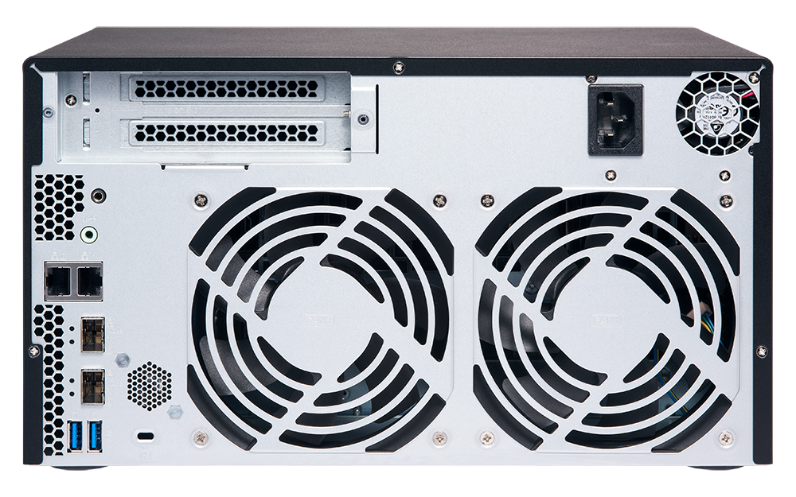
VJBOD Expansion using the TS-832X
Dual SFP+ 10GbE
Ethernet interface

Slide 19
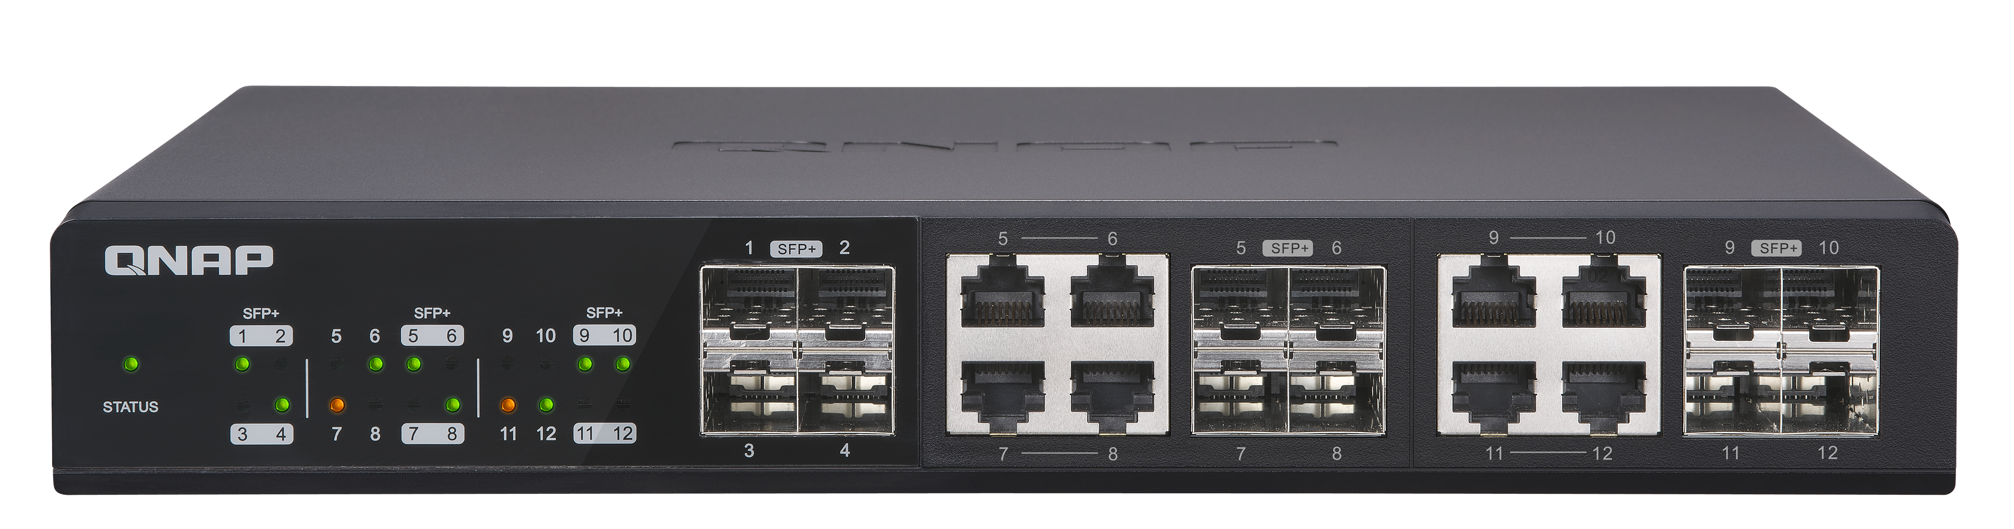
The QSW-1208-8C 10GbE/NBASE-T switch
4 x SFP+ (fiber) ports
8 x SFP + RJ45 (copper) combo ports
QSW-1208-8C

Slide 20
Connect SFP+ and 10GBASE-T devices with ease
SFP+ cables
Cat 6a cables

Slide 21
1
Working environment
Live Demo
2
VJBOD expansion

Slide 22
TVS-882ST3
We've Got Your Back!
Copyright © 2018 QNAP Systems, Inc. All rights reserved.
QNAP® and other names of QNAP Pr oducts are proprietary marks or registered trademarks of QNAP Systems, Inc. Other products and company names mentioned herein are trademarks of their respective holders.

