Slide 1
Data backup and Disaster Recovery Expert
Acronis X QNAP
New-generation backup solution for enterprises to minimize downtime

Slide 2
Insight into Acronis X QNAP NAS
Acronis 使用者如何選擇備份架構
Acronis with QNAP NAS supports your backup plan with high performance
Acronis advanced features
Live Demo - Highly efficient data backup and recovery
Acronis and QNAP keep your data safe

Slide 3
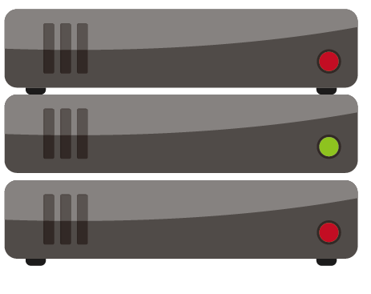
How to deploy Acronis backup solution
Acronis Backup Management Server
PC/Workstation
DAS
Server
NAS
Virtualization
Acronis Cloud

Slide 4
A Solid Backup Solution Needs ...
Efficient Backup Software
Reliable Storage

Slide 5
Compare storage options of Acronis
 | Local Disk | DAS | Acronis Cloud | NAS
Storage Capacity | Small | Large | Charge by demand | Large
Storage Protection | Limited protection | Limited protection | Complete protection | Complete protection
Share Storage | No support | No support | Support | Support
Remote Replication | No support | No support | No support | Support (Remote NAS, Cloud service)
Backup Speed | Fast | Normal | Slow | Fast (10GbE)

Slide 6
QNAP NAS is the best storage options for Acronis
High-speed interface embedded
Full Product Lines
Global Service Network
Complete data protection
Notes:
Why QNAP NAS
規格齊全的產品線
Enterprise
SMB
SOHO
全面的全球支援網路
完善的資料保護方案
RAID
Snapshot
Disaster Recovery solution
傳輸超快速
SSD
10GbE
Thuderbolt

Slide 7
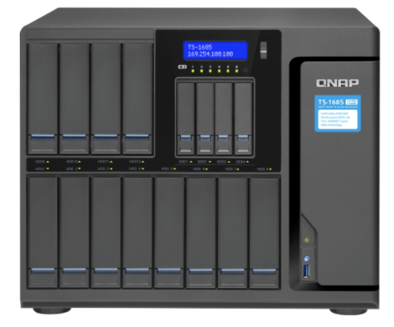
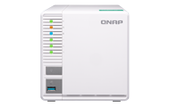
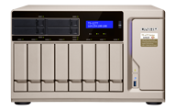
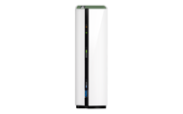
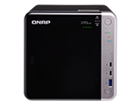
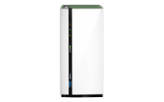
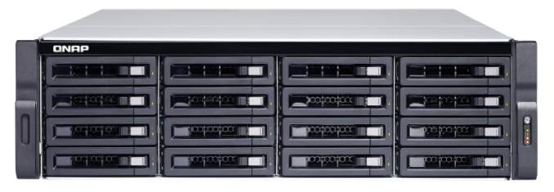
QNAP delivers comprehensive NAS solution
HOME / SOHO
SMB
Enterprise

Slide 8
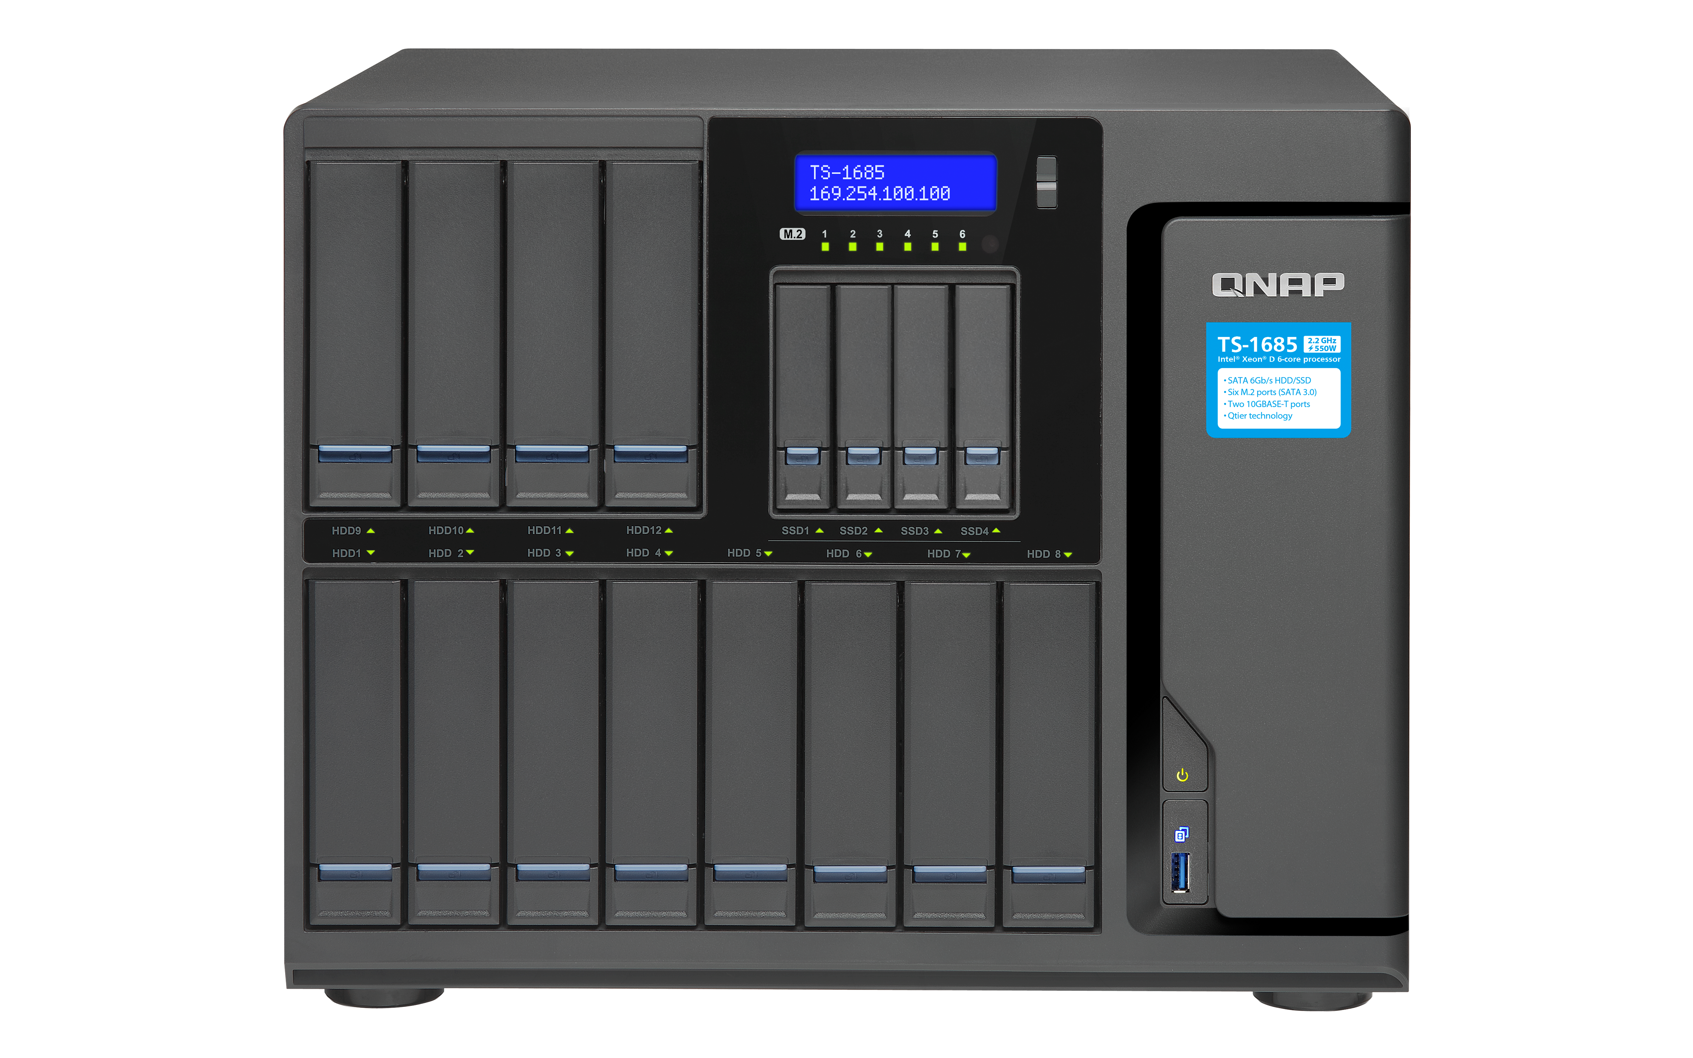
Full-range data protection capabilities
Hybrid Backup Sync
Snapshot
RAID

Slide 9
Qtier 2.0 enhances file I/O performance
SSD 快取技術
應用層
快取純加速，不能當做儲存使用
僅以區塊大小篩選快取 >比較適合短期隨機加速
SSD
HDD
Qtier 2.0 自動分層技術
SSD空間直接用來存放關鍵資料
結合智慧判別與資料夾分層 >從長短期全面提升儲存性價比
SSD 快取加速
Qtier 2.0 自動分層
SSD Cache
Applications
Cannot be used to store data
SSD
> For short term performance boost
HDD
Sequential
Qtier 2.0
Random
The SSD tier can store data
IO Aware and Tiering On-demand
> For both short and long term performance improvement
SSD Cache
Qtier 2.0

Slide 10
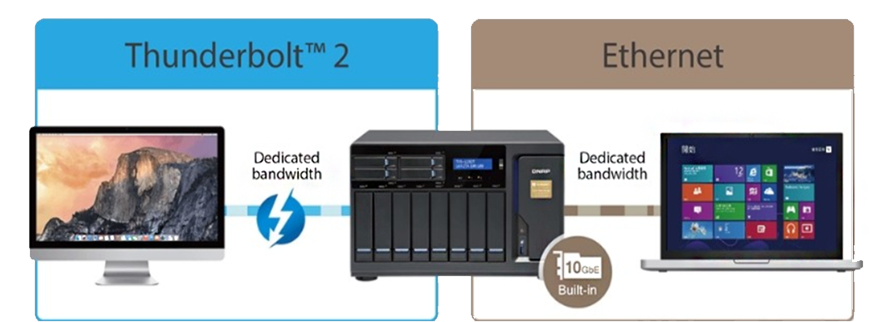
Accelerate transferring via high-speed interfaces
Thunderbolt 3 built-in
10GbE Ready

Slide 11
QNAP provides global service network
QTS Helpdesk App
helpdesk.qnap.com
eMail-based Conversation
Online Chat
Hotline
Taiwan, China, Hong
Kong, Germany, US, UK ,
Netherlands, India

Slide 12
Acronis Advanced Features

Slide 13
Acronis strengthens every aspect of data backup
Fastest Recovery
Complete Protection
Efficient Backup
Flexible Storage Options
Innovations
Acronis Backup Advanced 12.5
Intuitive Manage-ment
Notes:
完整保護
高效備份
快速復原
靈活儲存
彈性管理
創新保護

Slide 14
Complete protection with up-to-date backup technology

Slide 15
Off-Host optimizes the backup efficiency
Execution Time of single backup task
驗證
(Verify)
Backup
Compress
Encrypt
Backup replication
Conversion to VM
Cleanup
Validation
With off-host framework, the loading of a single backup task could be shared by other Acronis agents to reduce the backup time and system usage of backup host.

Slide 16
Construct a 10GbE off-host environment
Acronis Storage Node / Off-host agent
Backup Management Server
10GbE LAN
Backup Replication
Acronis Storage Node
Off-host agent
Conversion to VM
Validation
Cleanup

Slide 17
Deduplication maximizes storage availability
Dedup at Target
Check hash values in Dedup database
Store hash values in backup archive, and unique data blocks to a temp file
Store unique data blocks to Dedup data store
Store hash values to Dedup database
Remove temp file
Dedup at Source
Calculate the hash value of data block
Send the hash values to Acronis Storage Node
Send the unique data block

Slide 18
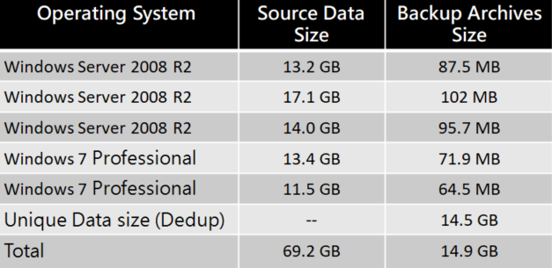
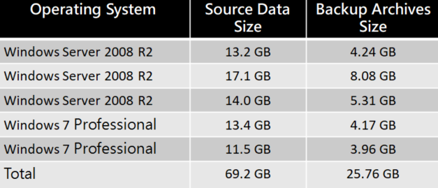
Acronis deduplication performance analysis
With Deduplication
Without Deduplication
Data size: 25.7 GB
Data size: 14.9 GB

Slide 19
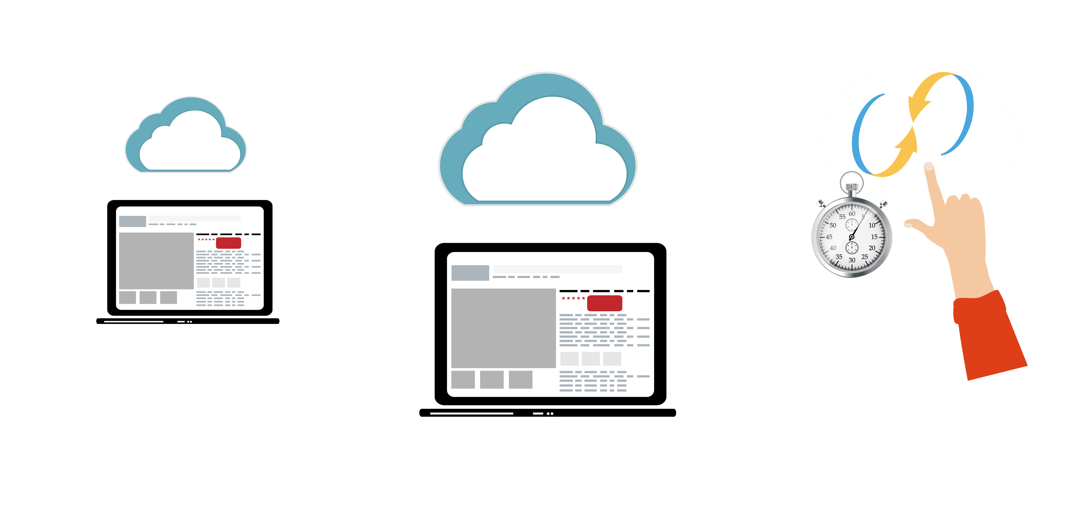
Experience world fastest recovery
Acronis Universal Restore
Acronis Instant Restore

Slide 20
Role-based Administrative Access
User A
User B
User C

Slide 21
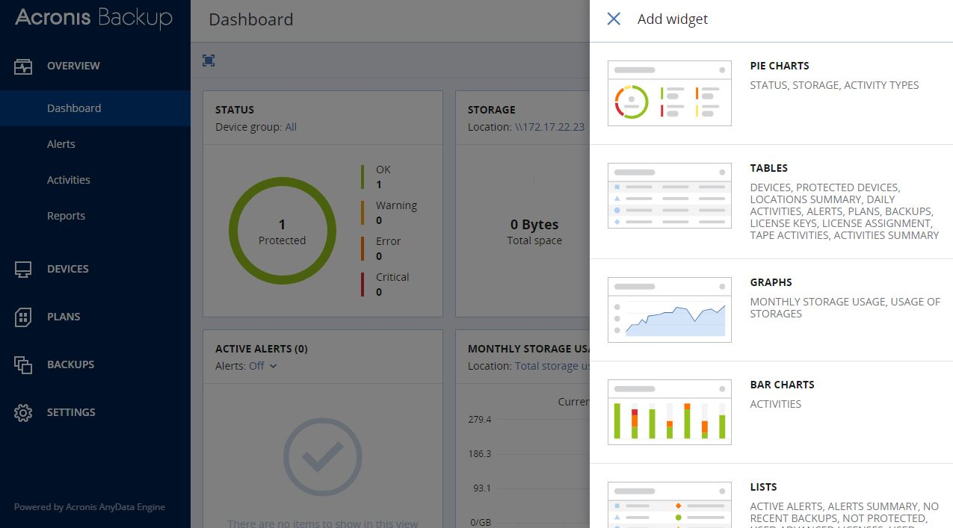
Customizable dashboards to overview your data protection plan

Slide 22
Acronis X QNAP
keep your data safe and secure

Slide 23
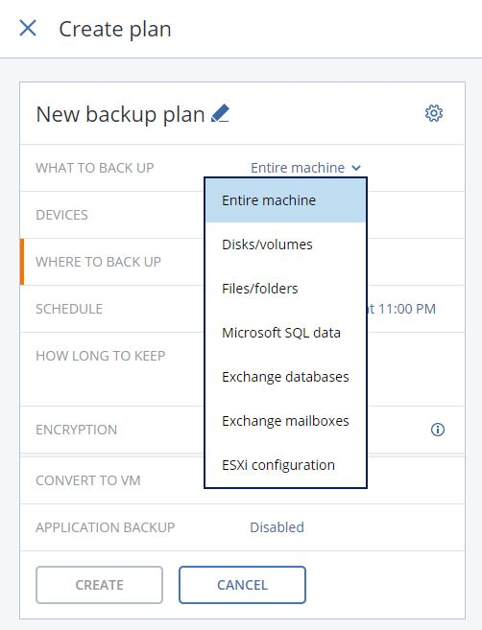
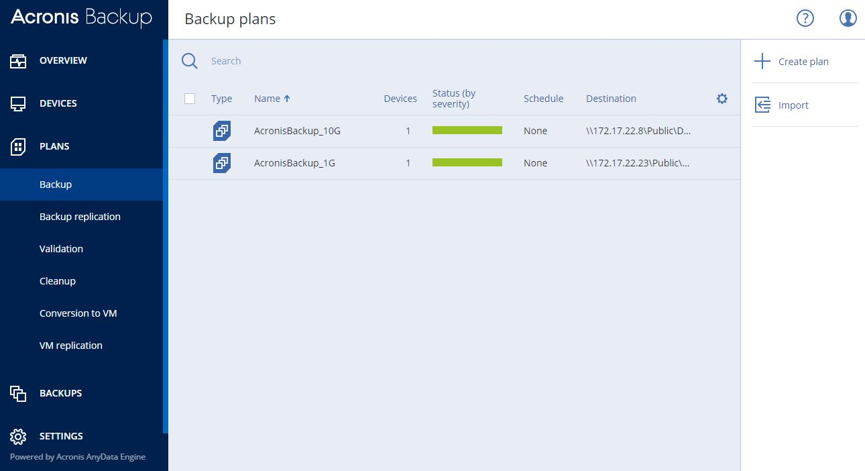
Acronis backup your entire computer to NAS
Backup your files, folders, disks and even the entire machine to QNAP NAS

Slide 24
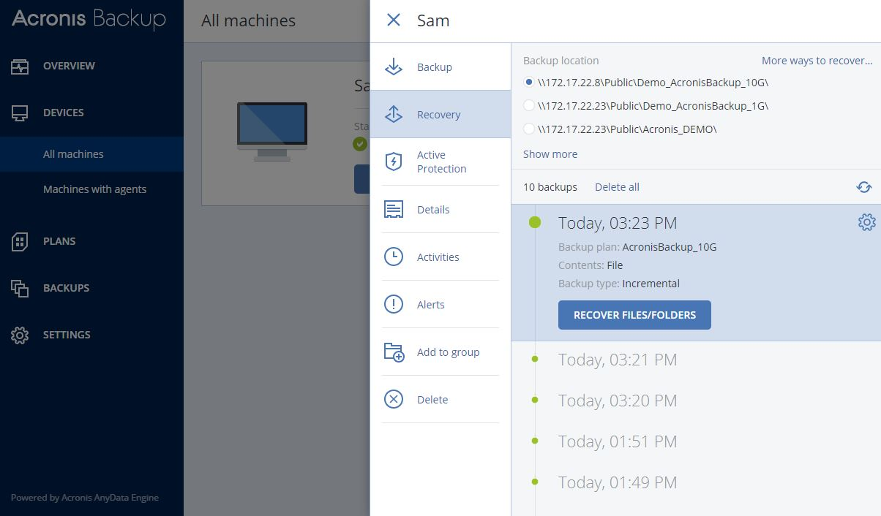
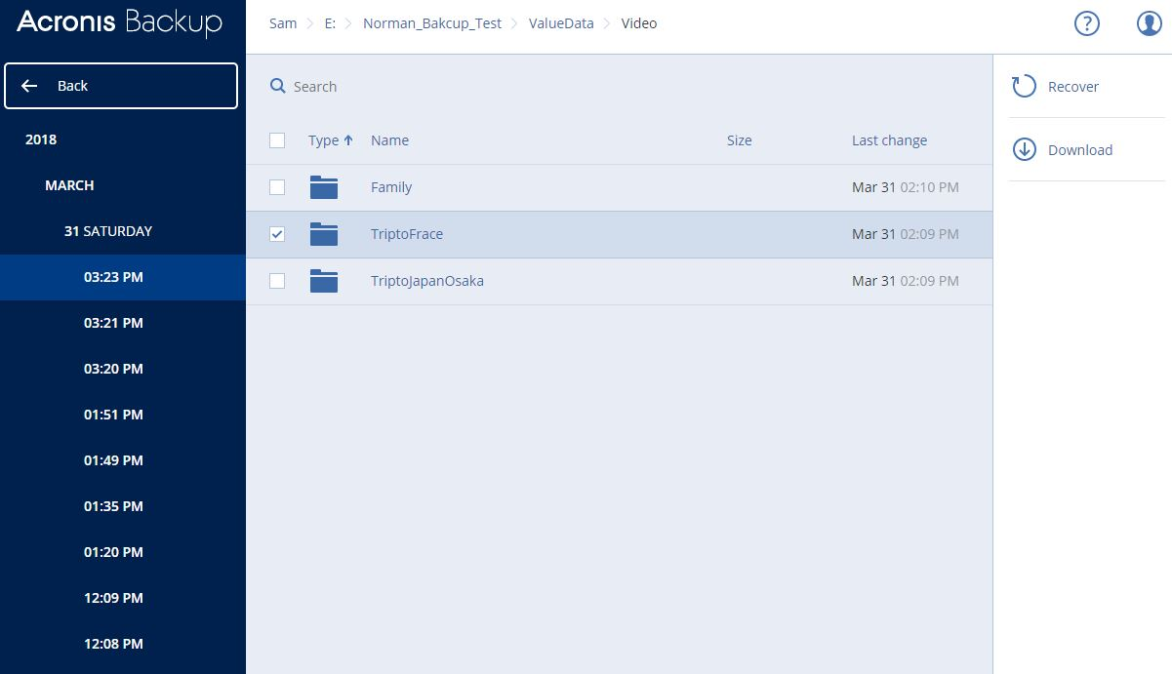
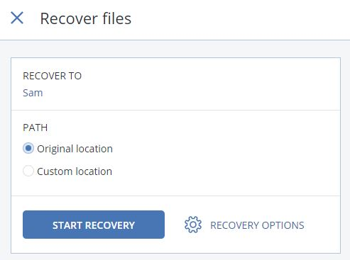
Acronis granular recovery
You can select individual file for data restore, the data will restore to its original location by default, or the other destination you select

Slide 25
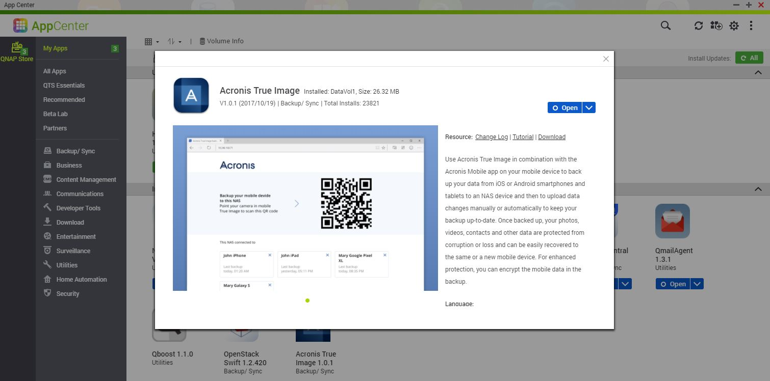
Acronis True Image backups your mobile phone
Install Acronis True Image via QNAP App Center to backup your phone directly to QNAP NAS

Slide 26
Live Demo
Highly efficient data backup and recovery
Notes:
整機備份
10GbE / 10G switch
單檔快速還原
10GbE / 10G switch

Slide 27
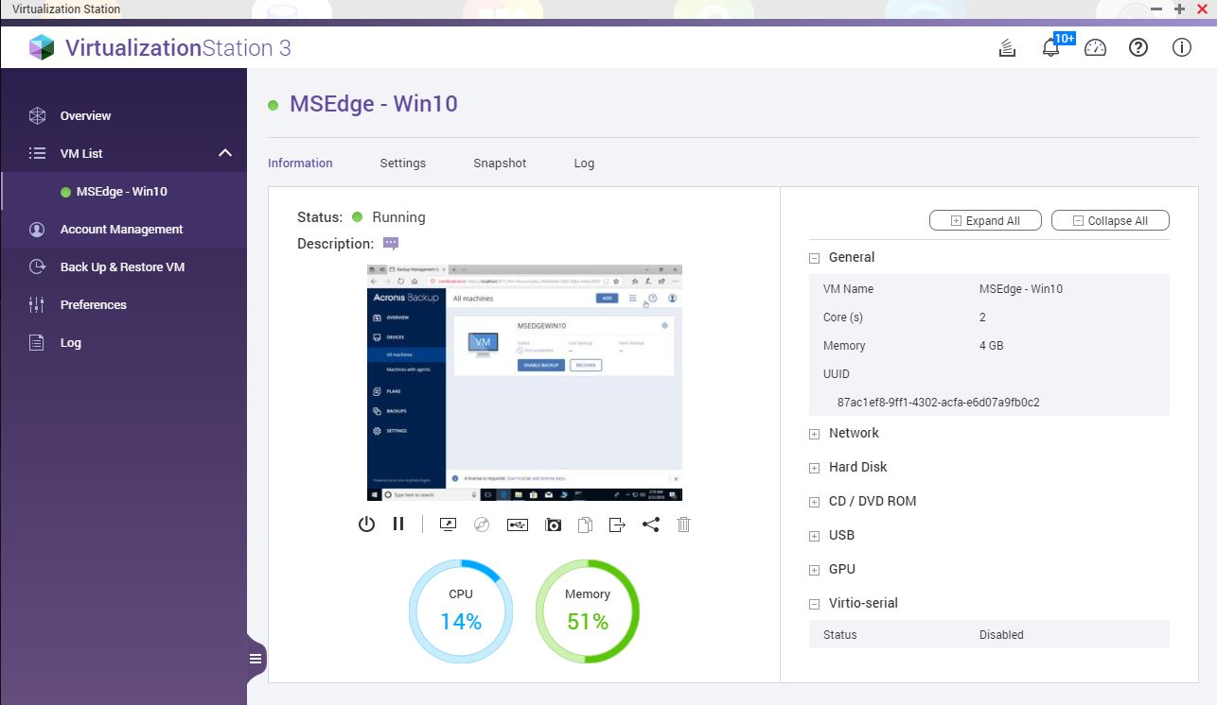
3 steps to build the backup appliance
Activate QNAP Virtualization Station
Install Windows OS
Install Acronis Backup

Slide 28
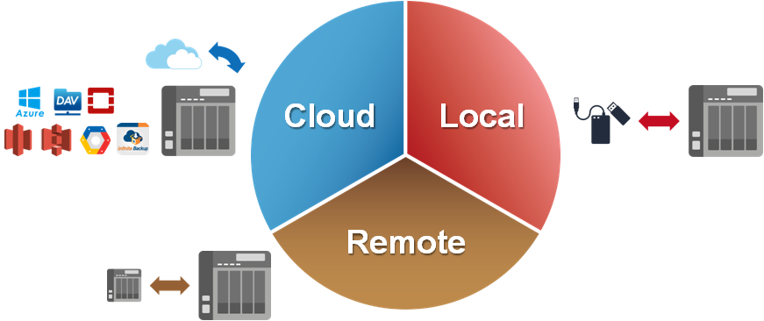
QNAP multi-layer protection for backups
Hybrid Backup Sync

Slide 29
Special Thanks to

Slide 30
Acronis X QNAP
is your best choice!
Copyright © 2018 QNAP Systems, Inc. All rights reserved.
QNAP® and other names of QNAP Pr oducts are proprietary marks or registered trademarks of QNAP Systems, Inc.
Other products and company names mentioned herein are trademarks of their respective holders.

