Slide 1
Transform NAS into your personal Ubuntu computer

Slide 2
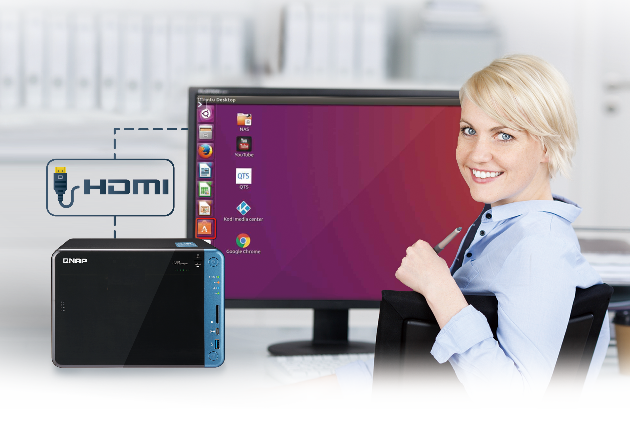
Transform NAS into a personal Ubuntu computer?
NAS becomes a
host computer
Use Ubuntu OS on NAS

Slide 3
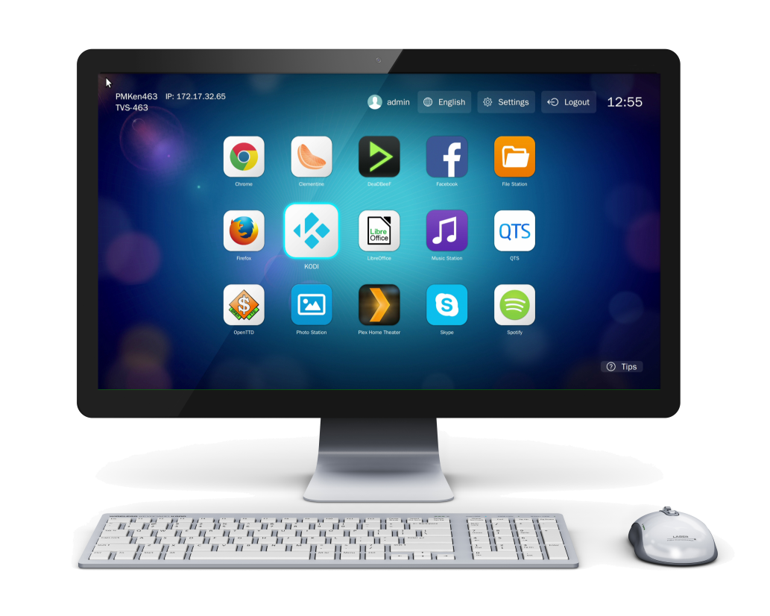
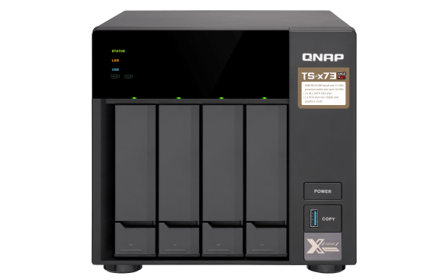
You may be thinking…
Which one should I use ?
HD Station can also transform NAS into a personal computer via HDMI output ?
What’s the difference between Linux Station and HD Station?

Slide 4
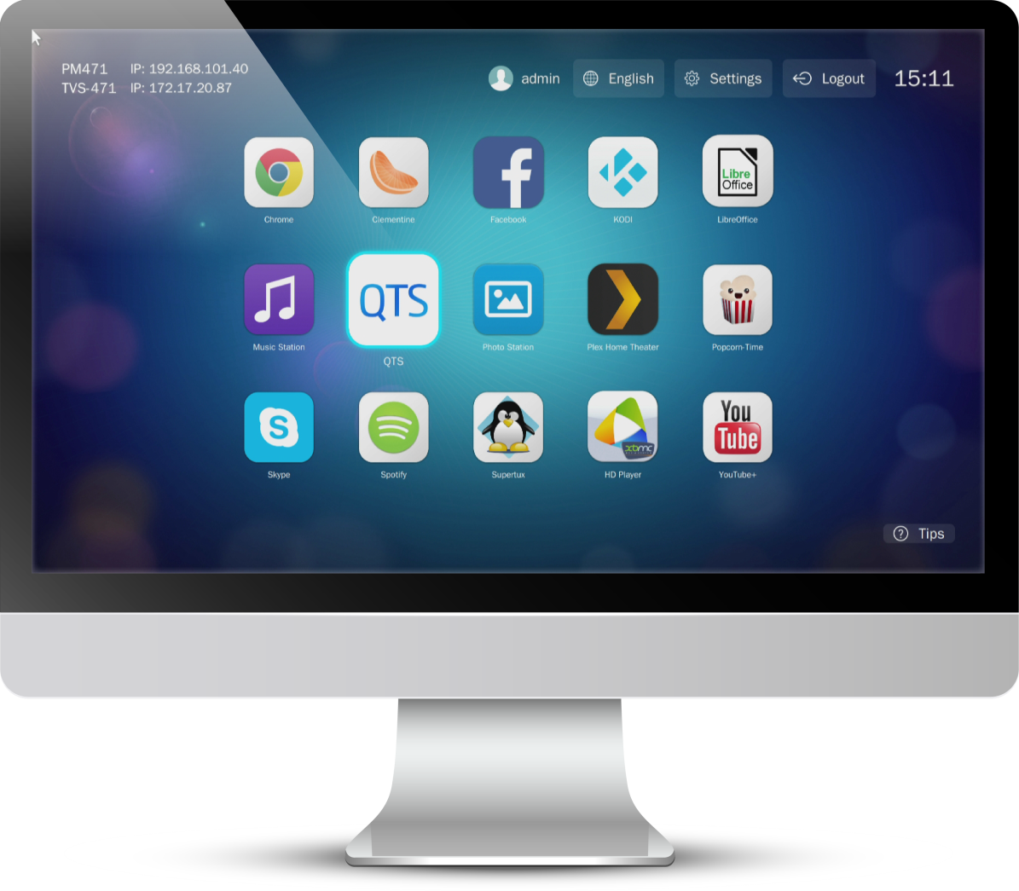
Features of HD Station
Provide abundant and diverse applications
Manage QTS
File Station HD, Photo Station HD, etc
Access to browser, communication add-ons and productivity tools
Chrome, Skype, LibreOffice
Multimedia applications
HD Player, Ocean KTV, Spotify, etc

Slide 5
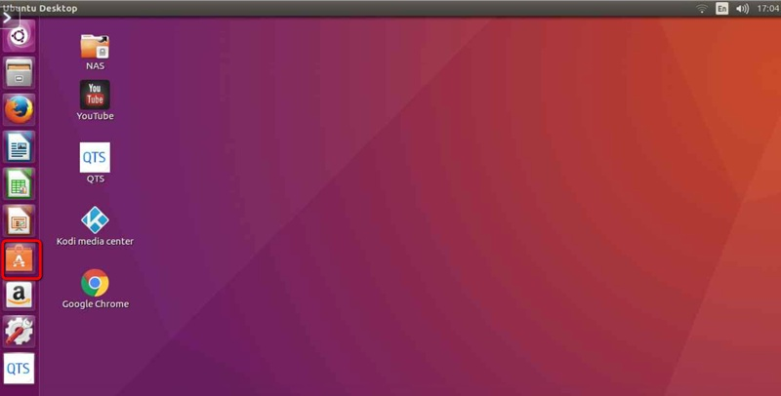
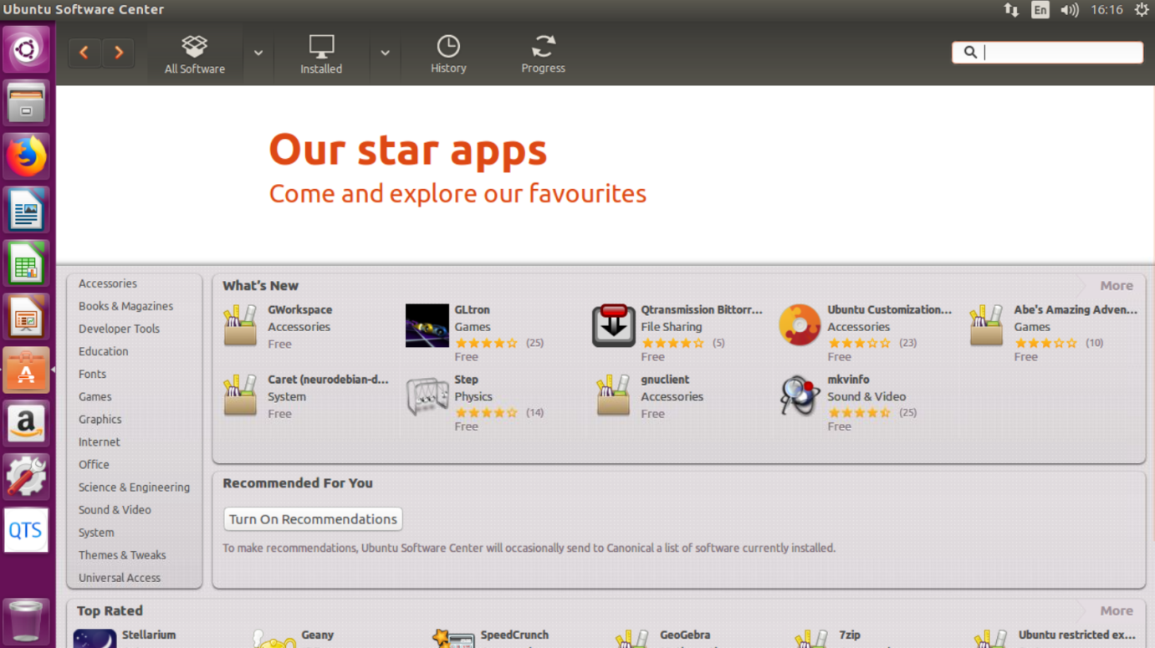
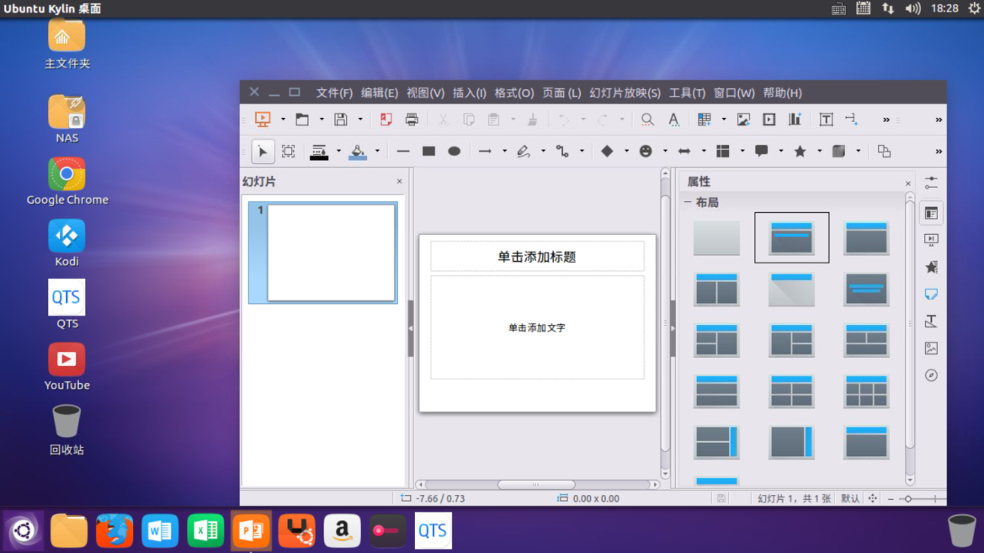
Features of Linux Station
Ubuntu Operating System
Provide abundant and diverse applications
Ubuntu Software Center, apt-get, etc
Quick deployment of developing environment
Python built in
Manage QTS
Duel system service of QTS and Ubuntu

Slide 6
Differences between Linux Station and HD Station
HD Station
Linux Station
Easy GUI
Provide miscellaneous
applications to fulfill
basic needs
Standard Ubuntu OS
Abundent applications
in Ubuntu Software
Center
Beginner
Advanced User
Technical knowledge
Flexibility

Slide 7
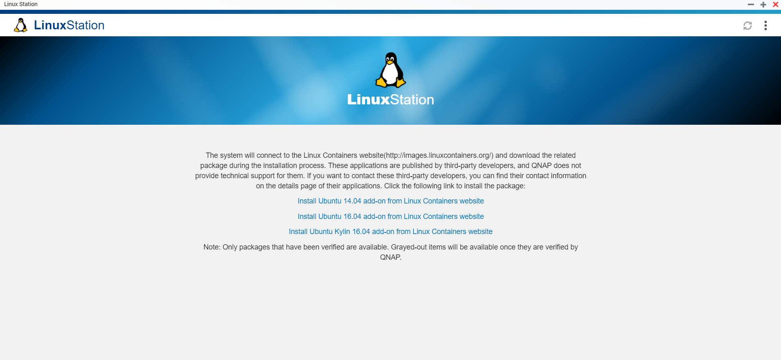
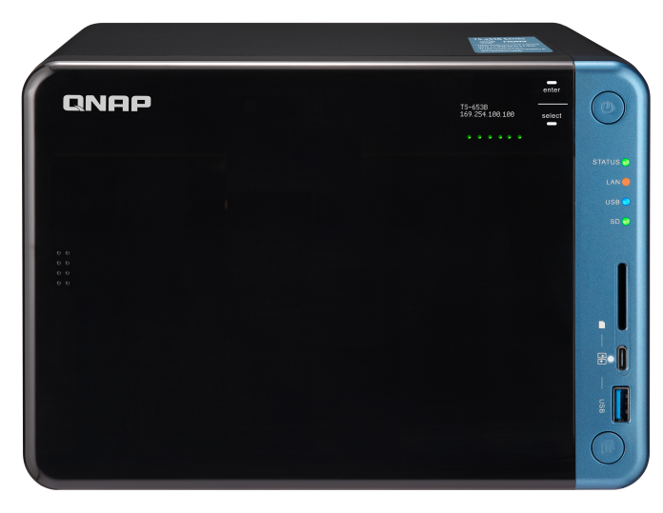
QNAP is the only NAS provider to integrate Ubuntu
QNAP cooperates with Ubuntu to provide Linux Station that allows for installing the Ubuntu OS on NAS in just one click.

Slide 8
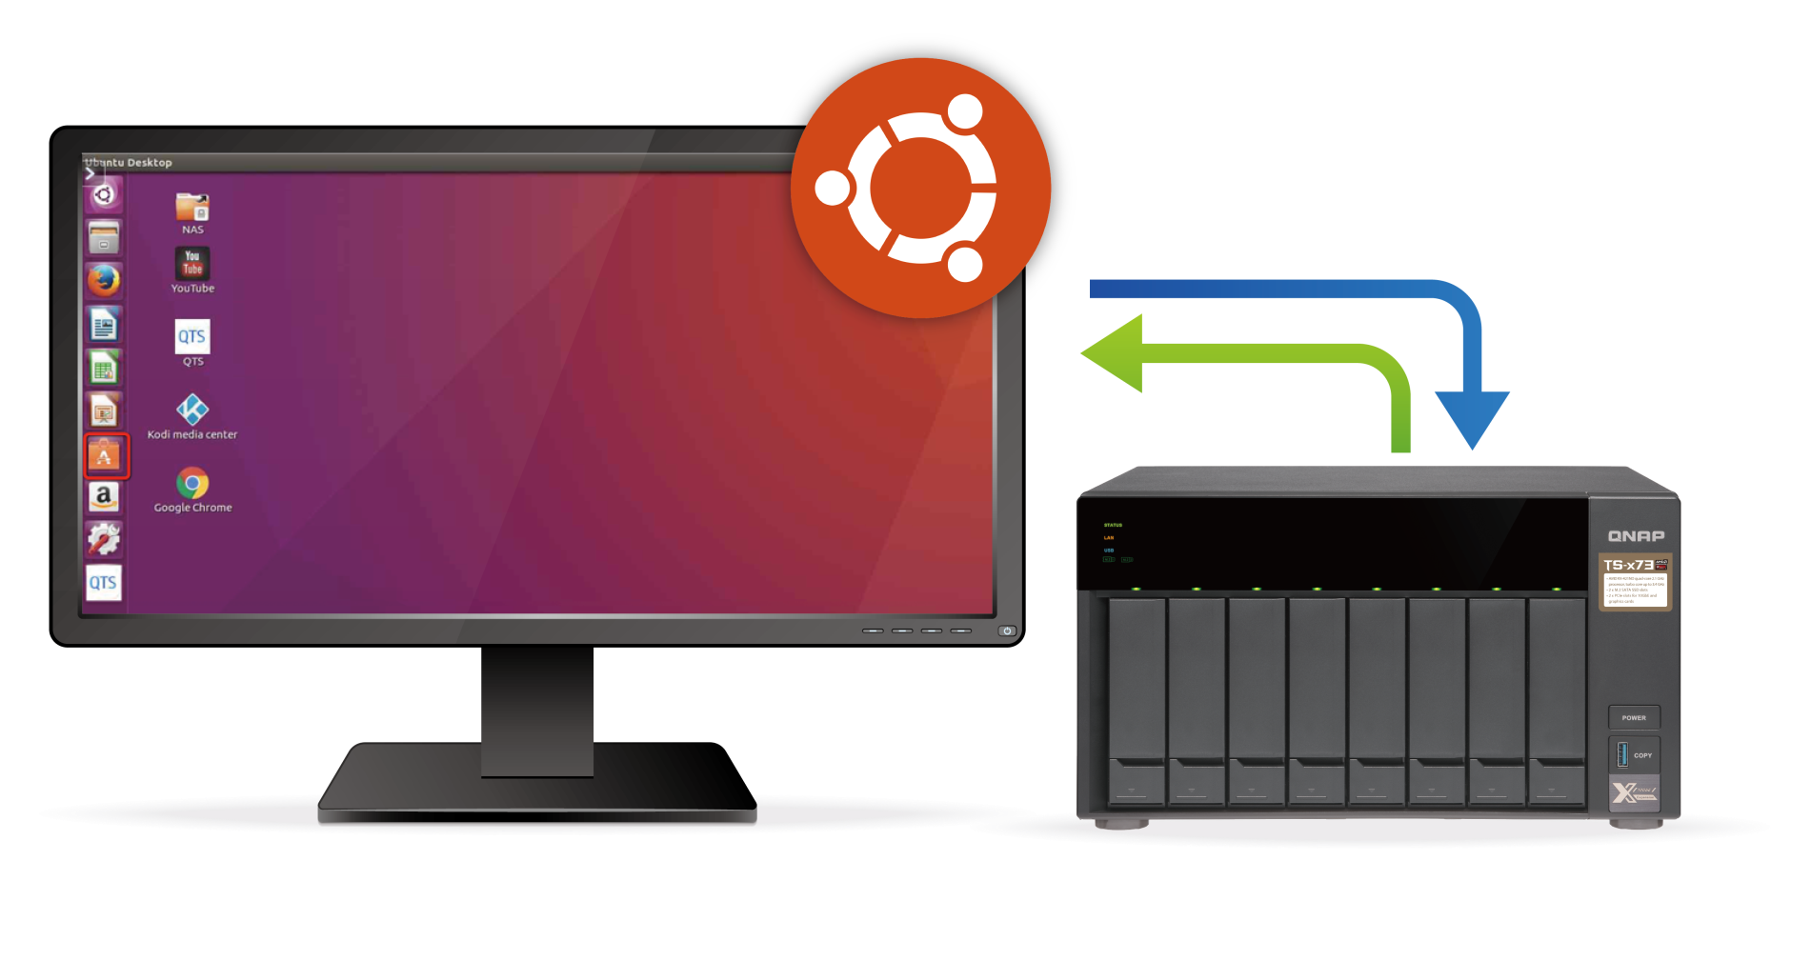
Advantages of Linux Station
QTS & Ubuntu dual system
Use Linux system for programming and
store your codes on NAS.
Data is transferred through internal
network.
Quick data access and storing.
No data size limitation when transferring data.
Best environment for development
and data storage.
Data security.

Slide 9
Advantages of Linux Station
Multiple Ubuntu versions
Ubuntu 14.04
Ubuntu 16.04
Specially support Ubuntu Kylin
(Chinese version)
* Only one version of Ubuntu can be
enabled at a time.

Slide 10
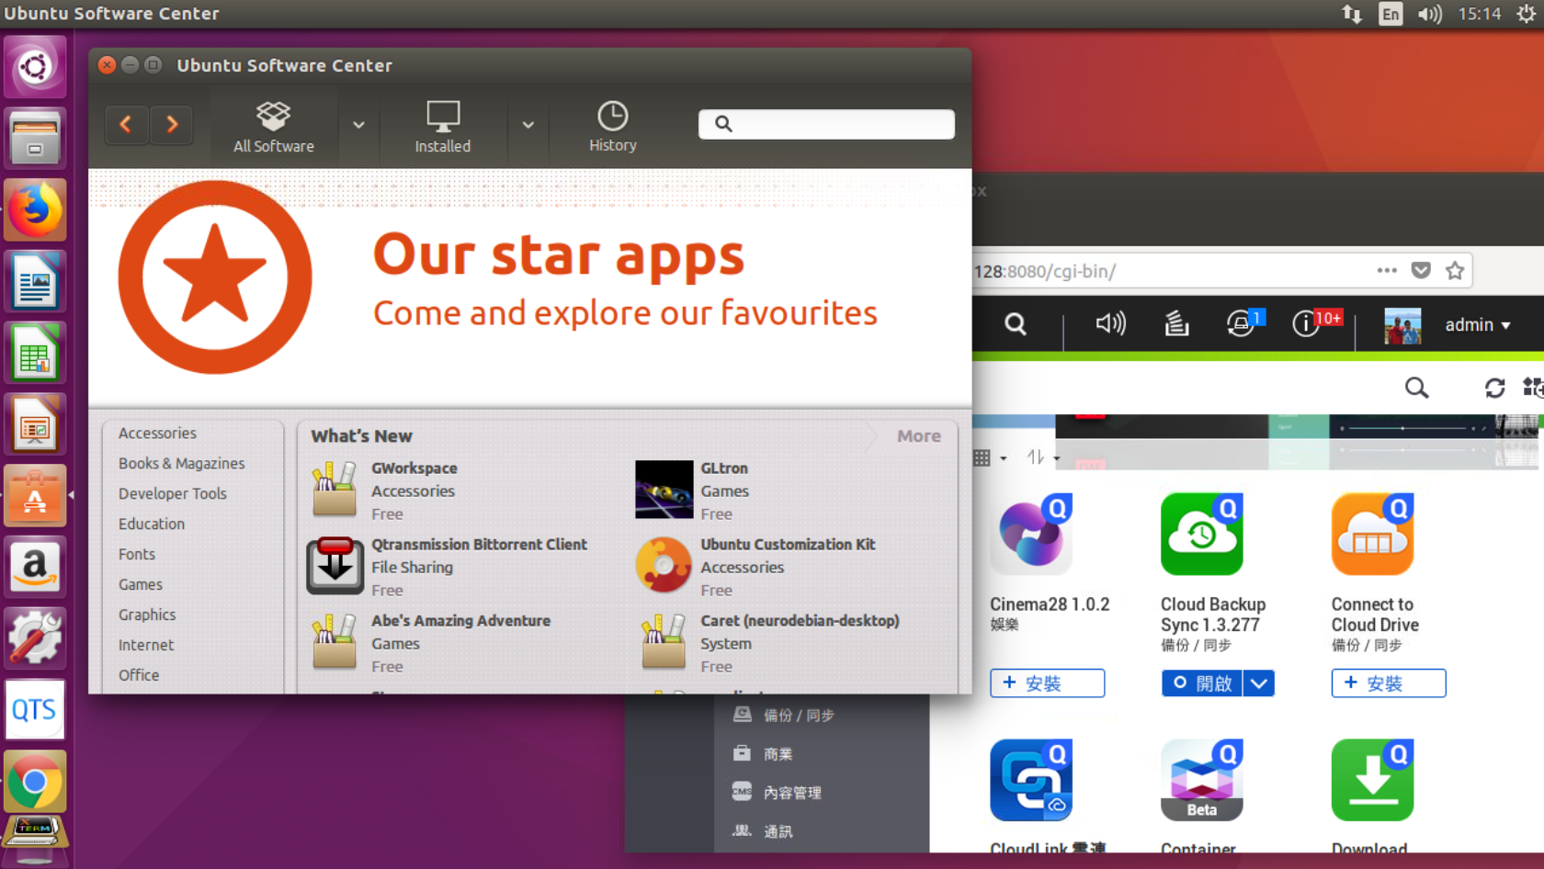
Advantages of Linux Station
QTS App Center and Ubuntu Software Center
Abundant applications
Miscellaneous ways of
applying them

Slide 11
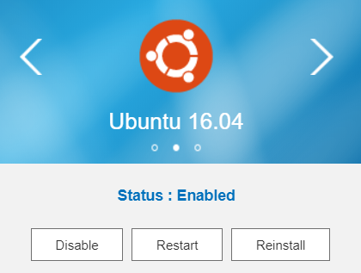
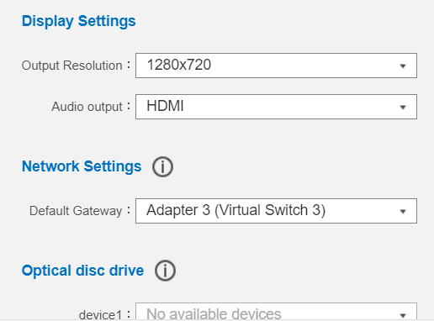
Advantages of Linux Station
Manage Ubuntu settings through Linux Station
Enable and disable Ubuntu
Set display resolution
- Just like managing your PC.
Network settings -Adjust default gateway

Slide 12
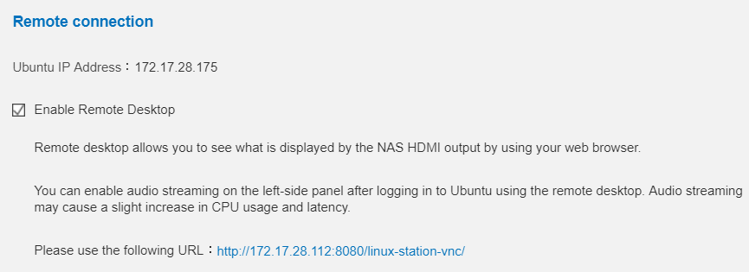
Advantages of Linux Station
Ubuntu remote desktop function
Access to QTS & Ubuntu dual system anywhere in the world
Operate Ubuntu through browser
Just like using Linux Laptop

Slide 13
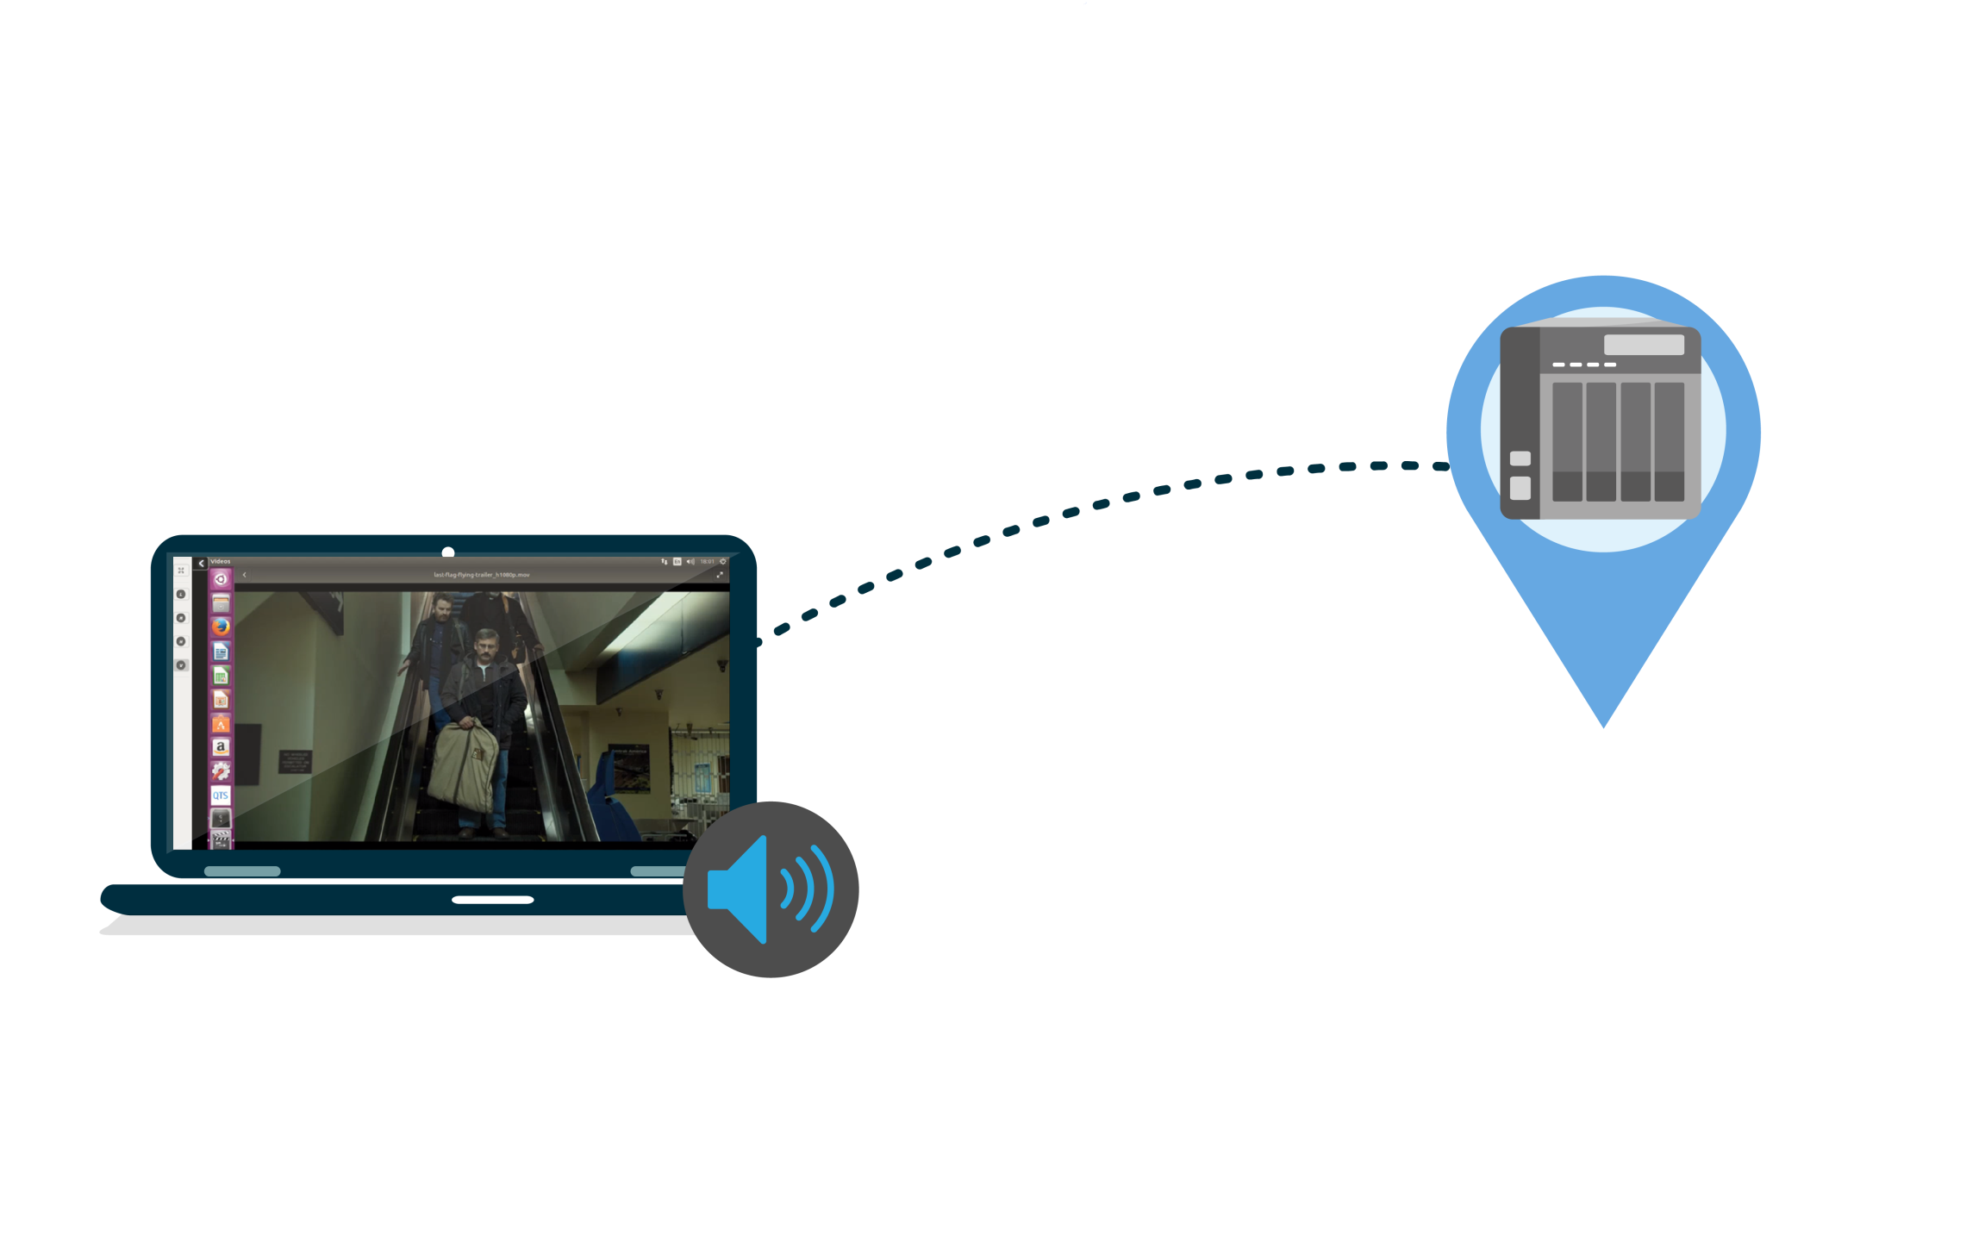
Advantages of Linux Station
Remote desktop streaming
Audio output
through remote
computer desktop
Easy to manage
media file

Slide 14
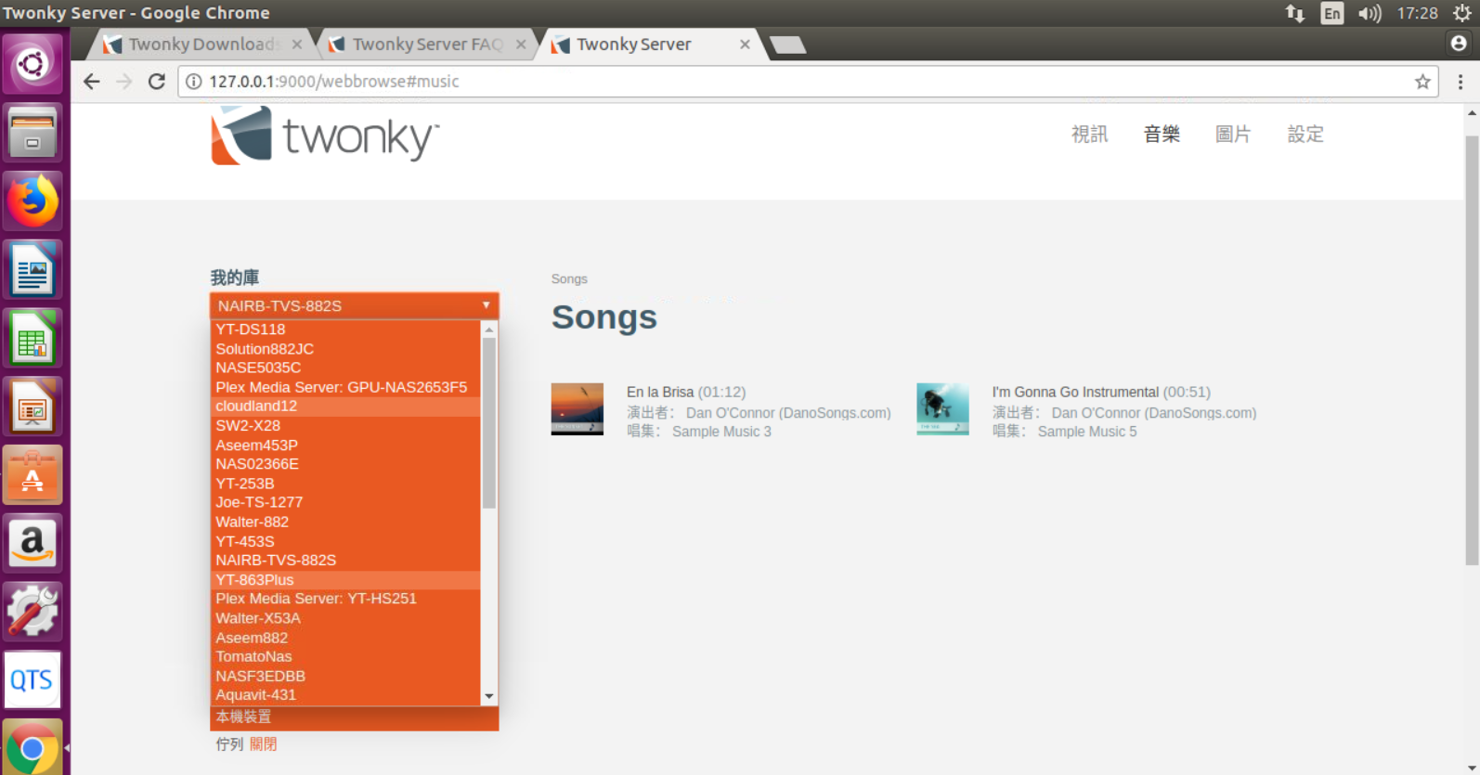
Advantages of Linux Station
Play the media files on NAS through DLNA enabled device
By installing Twonky Server in Ubuntu

Slide 15
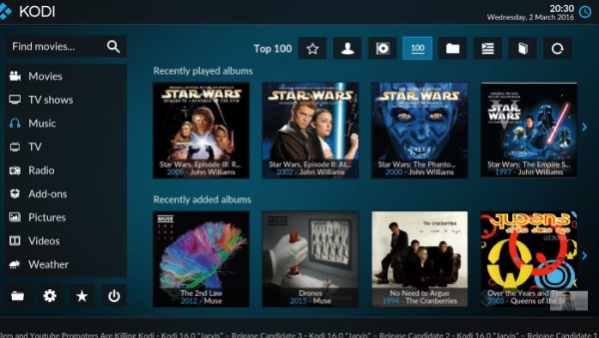
Advantages of Linux Station
Use KODI to play the media files on NAS
KODI is ready after
Ubuntu installation.
Use QNAP remote to
control KODI
(RM-IR002, RM-IR004)

Slide 16
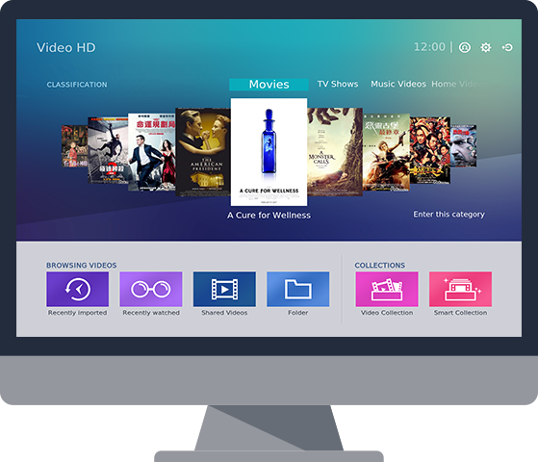
Advantages of Linux Station
Video HD is a free KODI add-on. With KODI's streaming and video decoding capabilities, you can directly access and stream NAS files to computers or set-top boxes. Video HD also fully supports Video Station's features, including current play time, video type, online subtitle lookup and more, allowing you to enjoy high-quality multimedia entertainment.

Slide 17
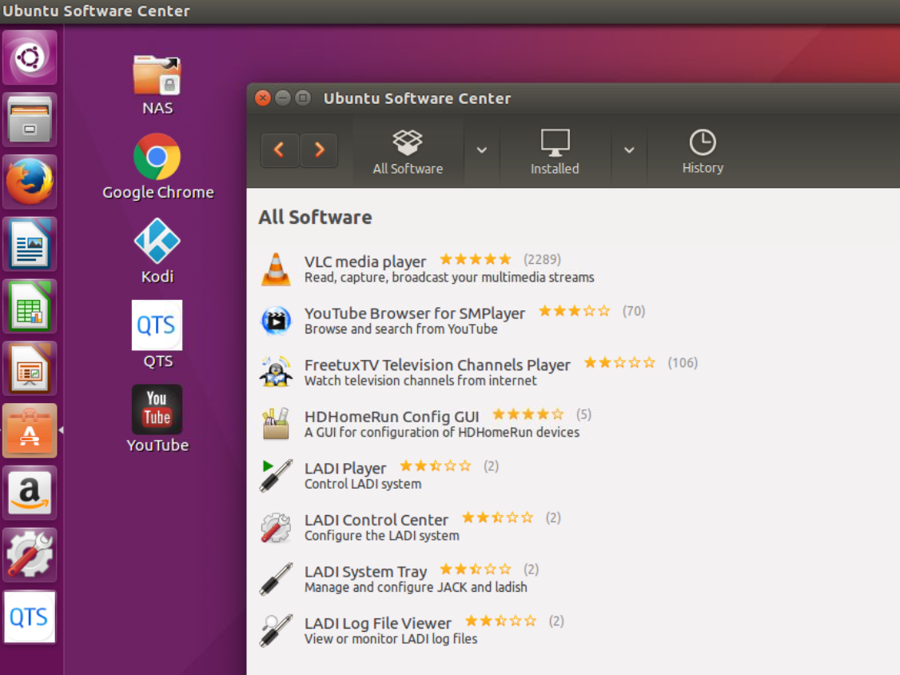
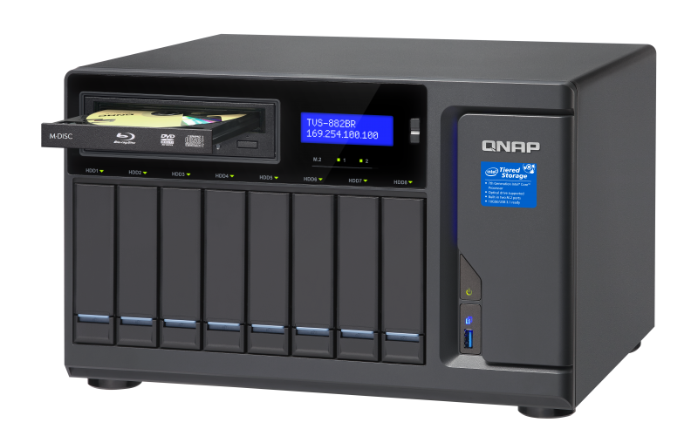
Advantages of Linux Station
Read data from and write data to blu-ray device via Ubuntu
Multimedia applications (ex: VLC) and data writing applications (ex: Brasero, k3b)
Applications can be found easily in Ubuntu software center.

Slide 18
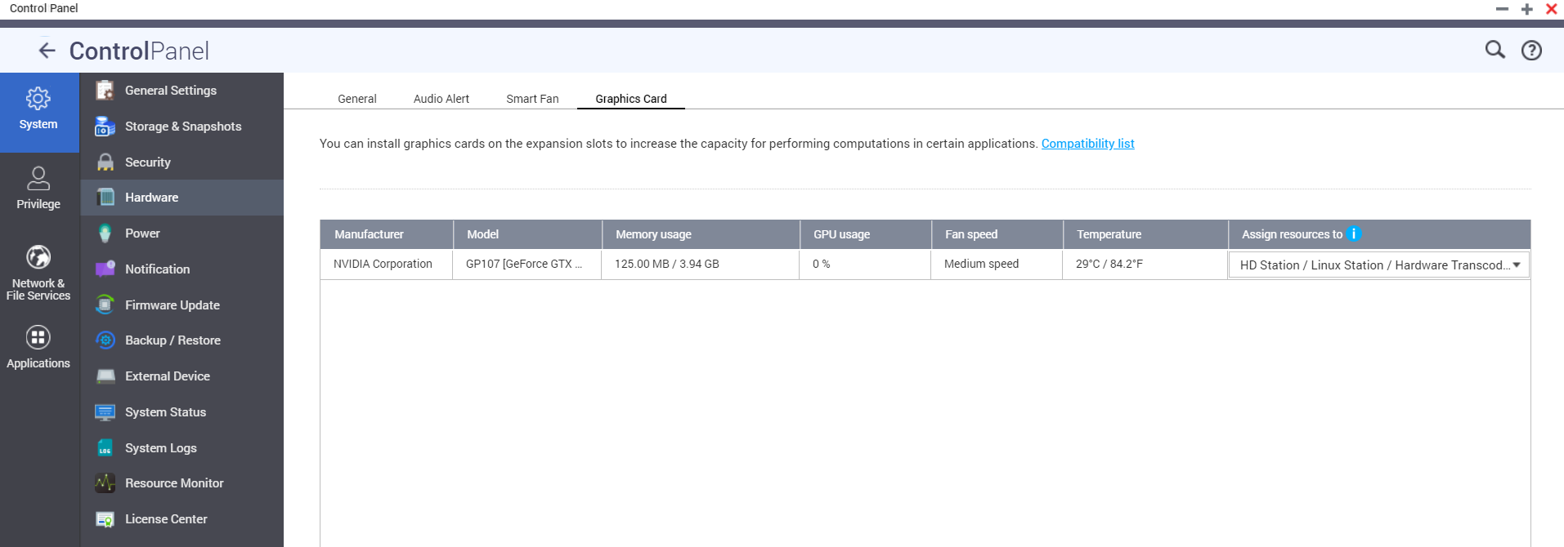
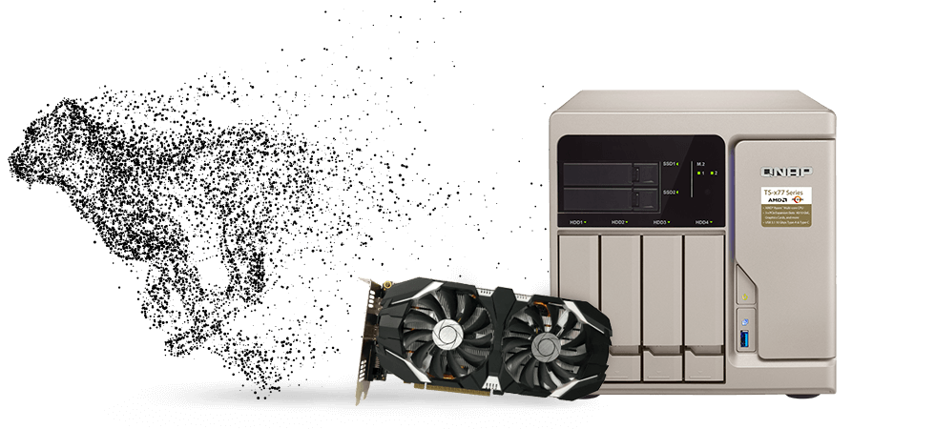
Advantages of Linux Station
Install graphics card on TS-x77 and TS-1685 for using Linux Station.
Ubuntu Linux Station can use graphics card for large media file processing.
* Without graphics card, only the remote desktop function can be used.

Slide 19
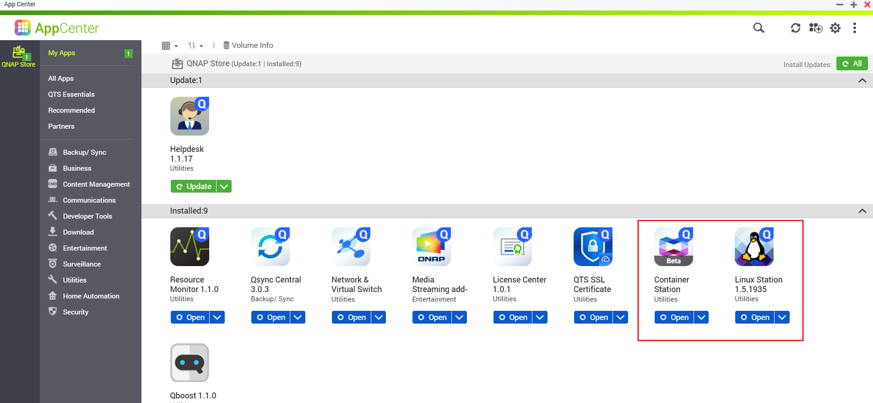
How to use Linux Station
Install Container Station and Linux Station from the App Center

Slide 20
How to use Linux Station
Enable Linux Station and install the required Ubuntu version (Ubuntu 14.04, 16.04, 16.04 Kylin)
*HD Station and Linux Station cannot be enabled at the same time.
* Only one Ubuntu version can be enabled at a time.

Slide 21
How to use Linux Station
Installing the Ubuntu
(version displayed).
Showing the progress of installation.

Slide 22
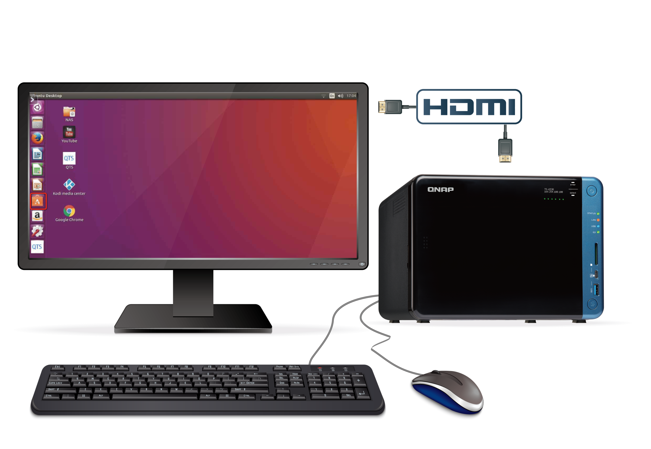
How to use Linux Station
Connect NAS and monitor through HDMI output
Connect mouse and keyboard to NAS and start using Ubuntu like your PC.

Slide 23
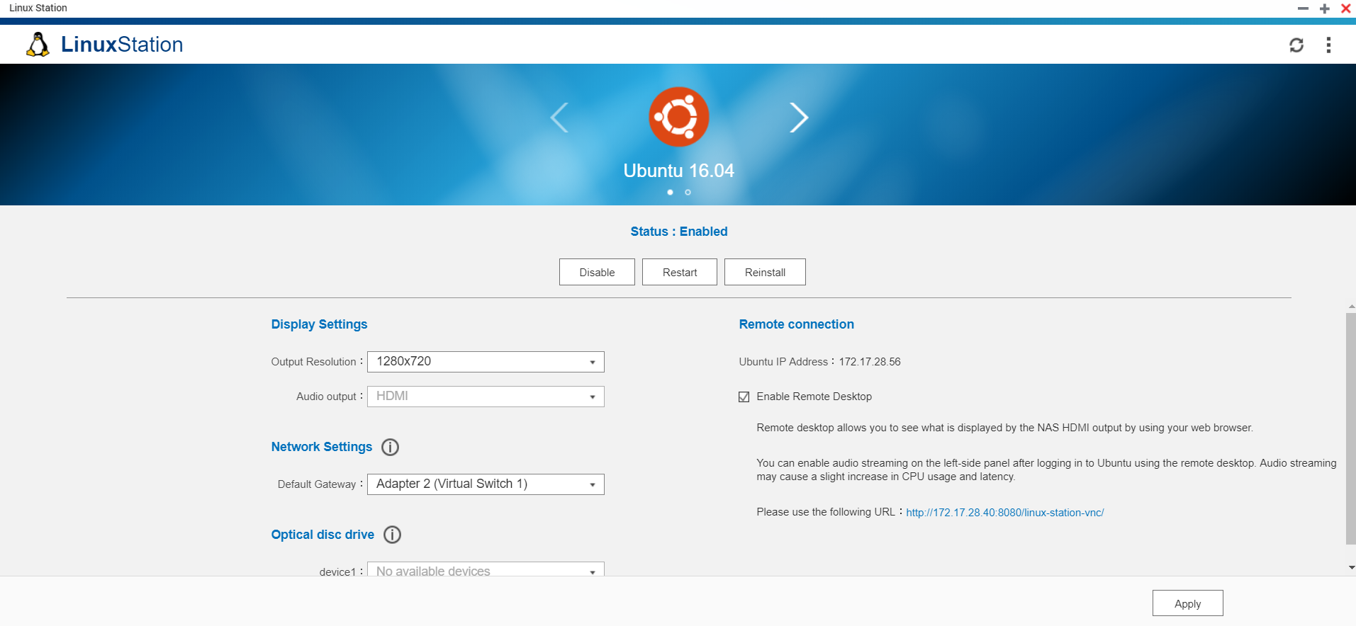
How to use Linux Station
Ubuntu installation completed.
Adjust display resolution and network setting if needed.
* Enable one Ubuntu version at a time.

Slide 24
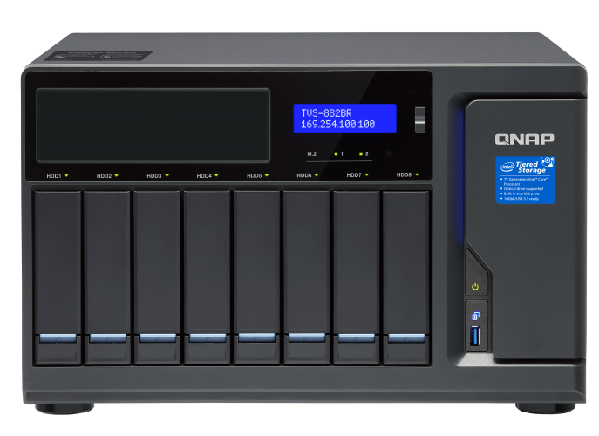
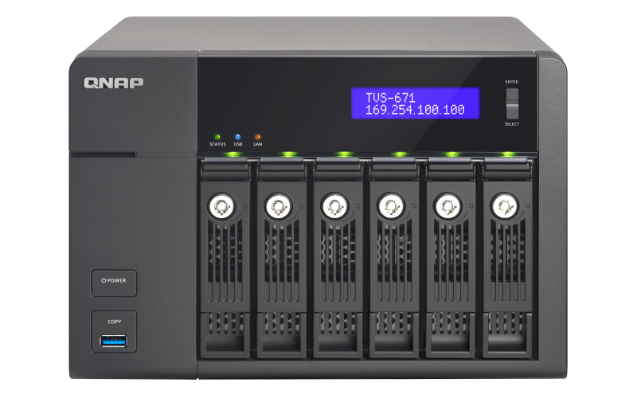
Linux Station requirements and supported NAS models
TS-x51, TS-x51A, TS-x53, TS-x53A, TS-x53B, IS-x53S, TS-x63,
TS-x70, TS-x79, TVS-x71, TS-x73, TVS-x73, TS-x80, TVS-x82,
TVS-x82ST, TS-x77, TS-x85
Minimum RAM requirement is 4GB
Linux Station version 1.5 (or older) is supported on QTS 4.2.1-4.3.4.
(Container Station 1.5-1.8 needs to be installed first)
Linux Station version 1.6 (or later) will be supported on QTS 4.3.5 or later.
(Container Station 1.9 or later version needs to be installed first)

Slide 25
QNAP and Ubuntu
The only NAS providers to
integrate Ubuntu OS on NAS
Continuous upgrade of Ubuntu version
-Linux Station will integrate and release the coming
LTS Ubuntu version 18.04 in Q2 , 2018
QNAP NAS is the best platform for Ubuntu user.

Slide 26
is your best choice

