Slide 1

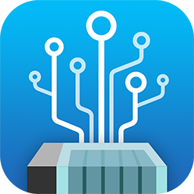
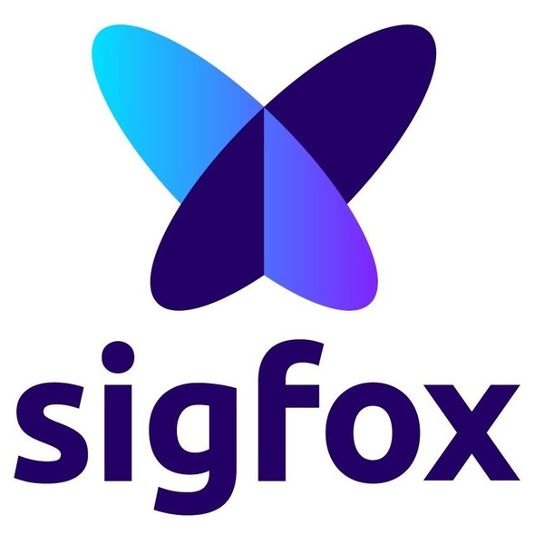
QIoT＋Sigfox
IoT for marine environment protection and fisheries

Slide 2
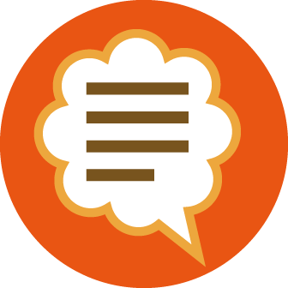

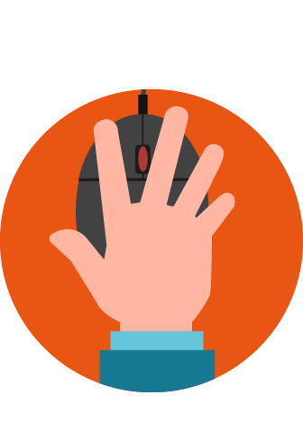

Outlines
Introduction
Sigfox
QIoT Suite Lite
Fishackathon
Videos
Fishackathon video
Message from Sigfox Taiwan
Guest speaker
Formosan salmon submarine sampling system
Live Demo
Connect QIoT Suite Lite with Sigfox

Slide 3
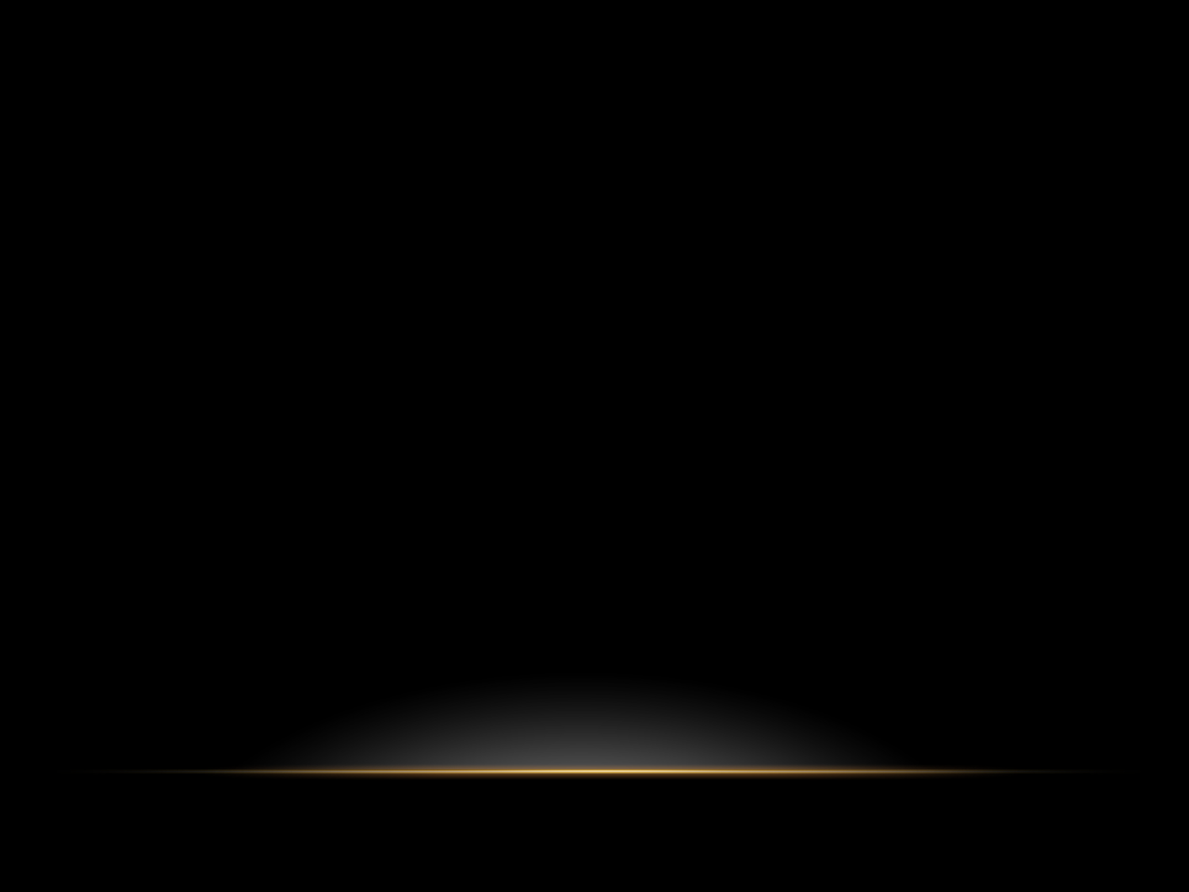

Sigfox & QIoT
Introduction

Slide 4
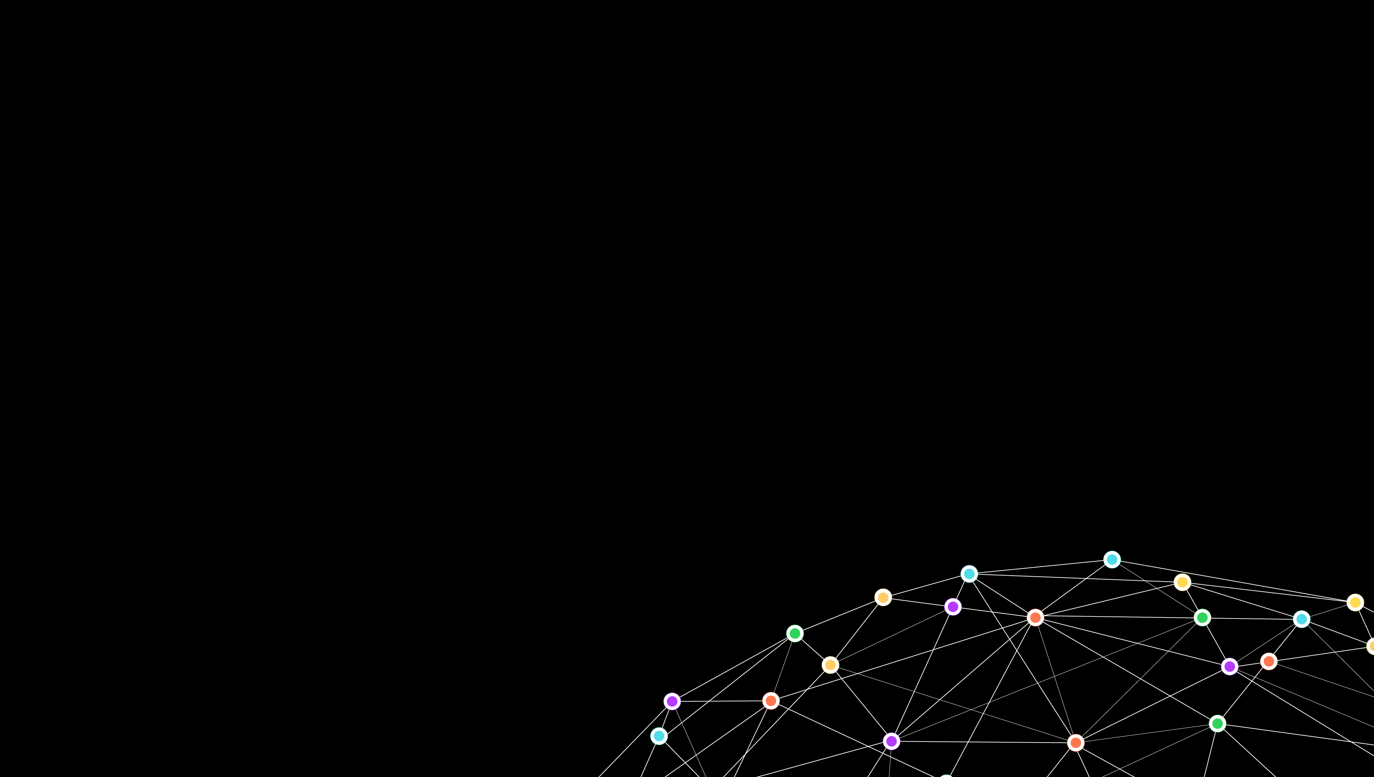

Using the Ultra Narrow Band modulation, Sigfox operate in the 200 kHz of the publicly available band to exchange radio messages over the air. Each message is 100 Hz wide and transferred at 100 or 600 bits per second a data rate, depending on the region.
A French company founded in 2009
Global IoT network operator with Low Power Wide Area Network (LPWAN) technology
The network requires mobile operators to carry the generated traffic Signal can also be used to easily cover large area and to reach underground objects

Slide 5
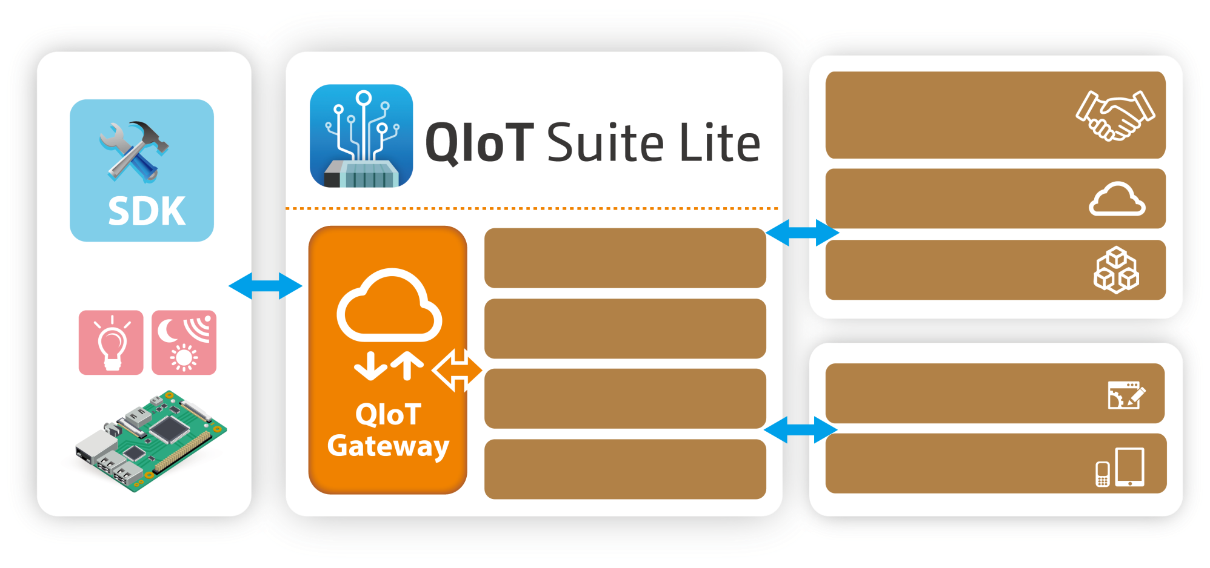
QIoT Suite Lite Private Cloud to
Hybrid Cloud
Hybrid Cloud
QIoT Suite Lite
3rd Party Data and Service
Private Cloud
PaaS
User Management
SaaS
Device Management
Rules Engine
Enterprise Systems
Dashboard
Mobile Devices
QIoT Suite Lite

Slide 6
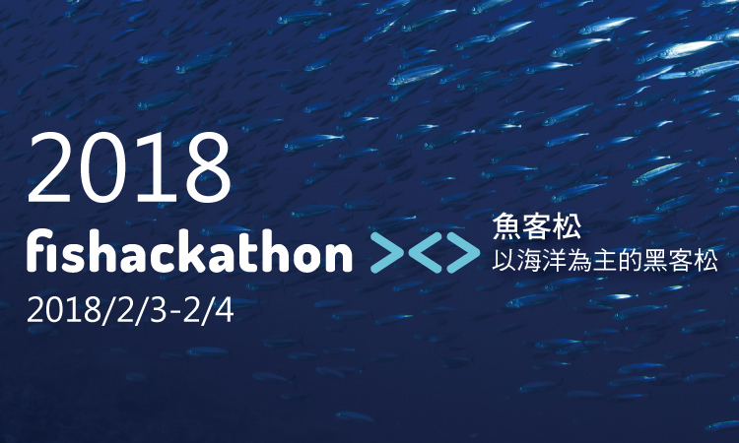
Fishackathon
First organized by the US Secretary’s Office of Global Partnerships in 2014, Fishackathon inspires the creation of digital solutions to address sustainable fisheries challenges.
Overfishing and other serious problems harm marine environments and can devastate already-struggling, small-scale fishing marketplaces and communities, many of them in developing countries. Protections exist, but actual enforcement faces major obstacles.
To combat this, Fishackathon brings together thousands of concerned designers, developers, and subject matter experts for a weekend to build practical tech solutions to endemic problems defined by the world’s most respected fisheries experts.
Save our waters, save our world!

Slide 7
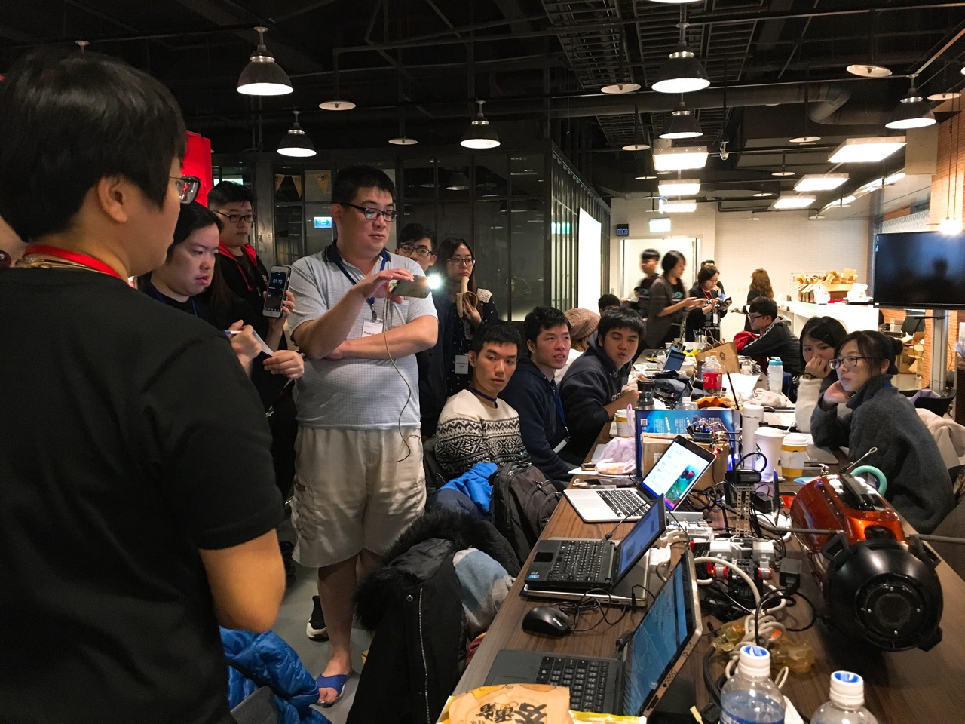
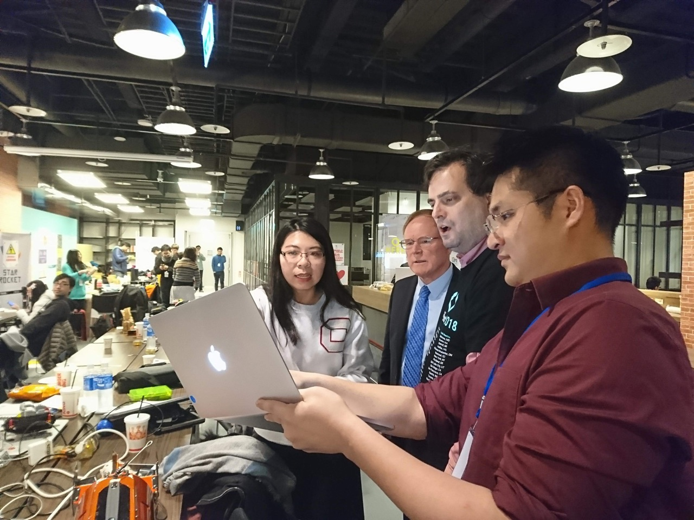
National championship - Ocean Fox

Slide 8
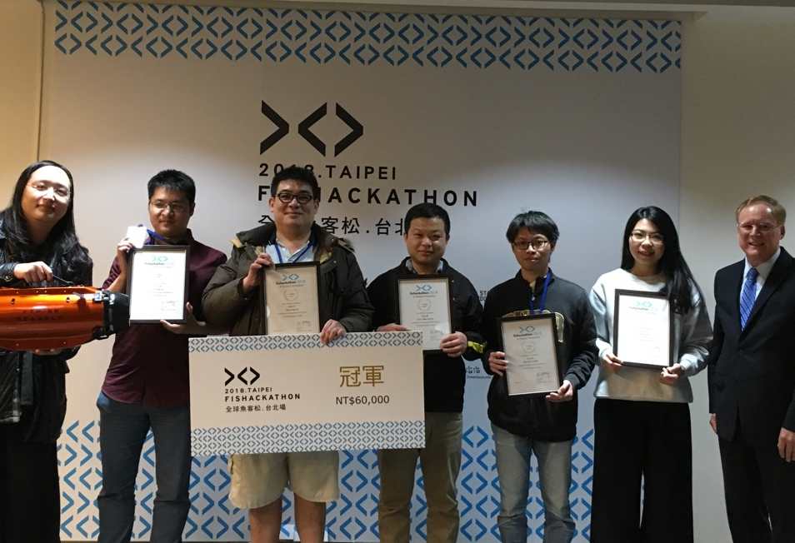
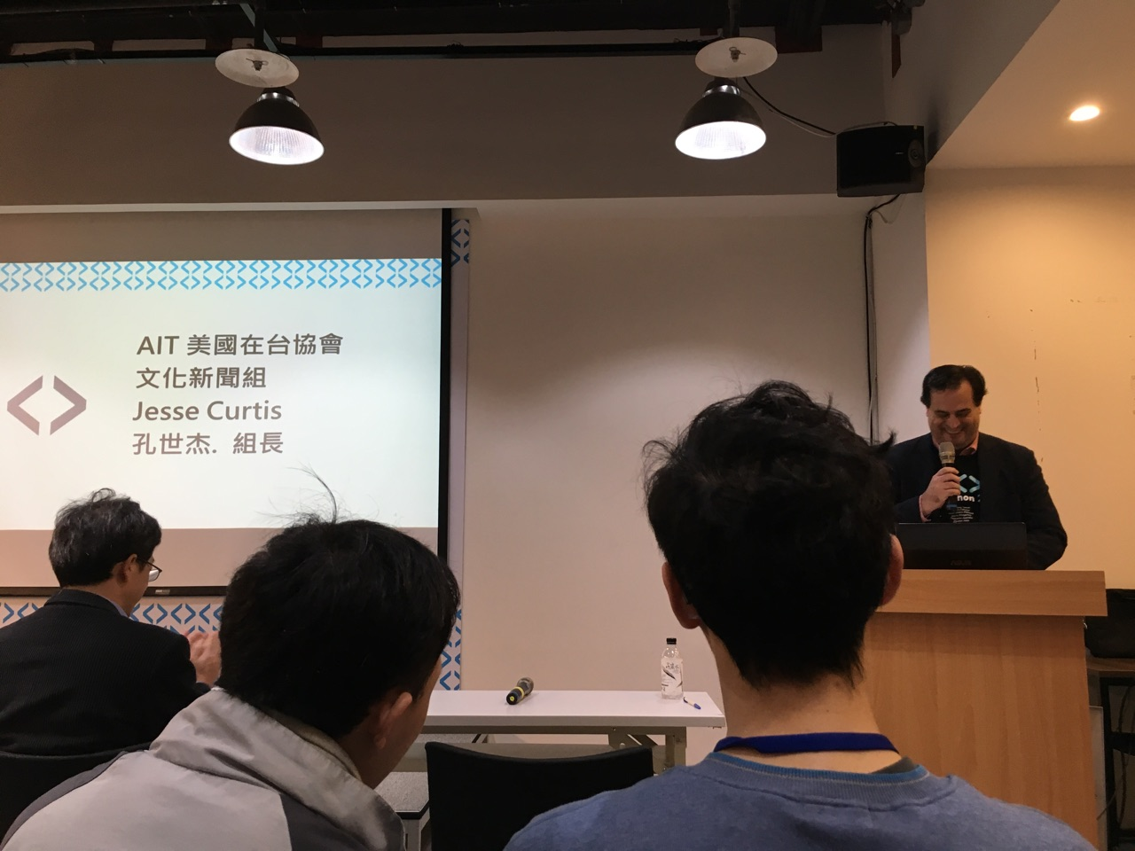
National championship - Ocean Fox

Slide 9
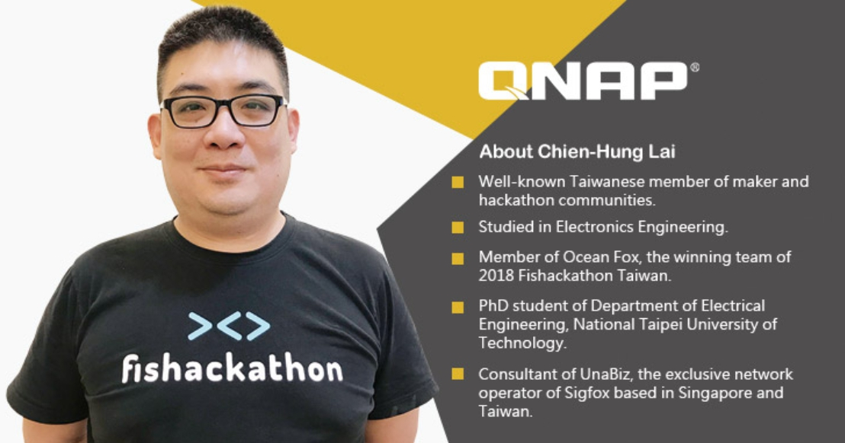
Ocean Fox Team Leader

Slide 10
Guest speaker -
The national championship team

Slide 11
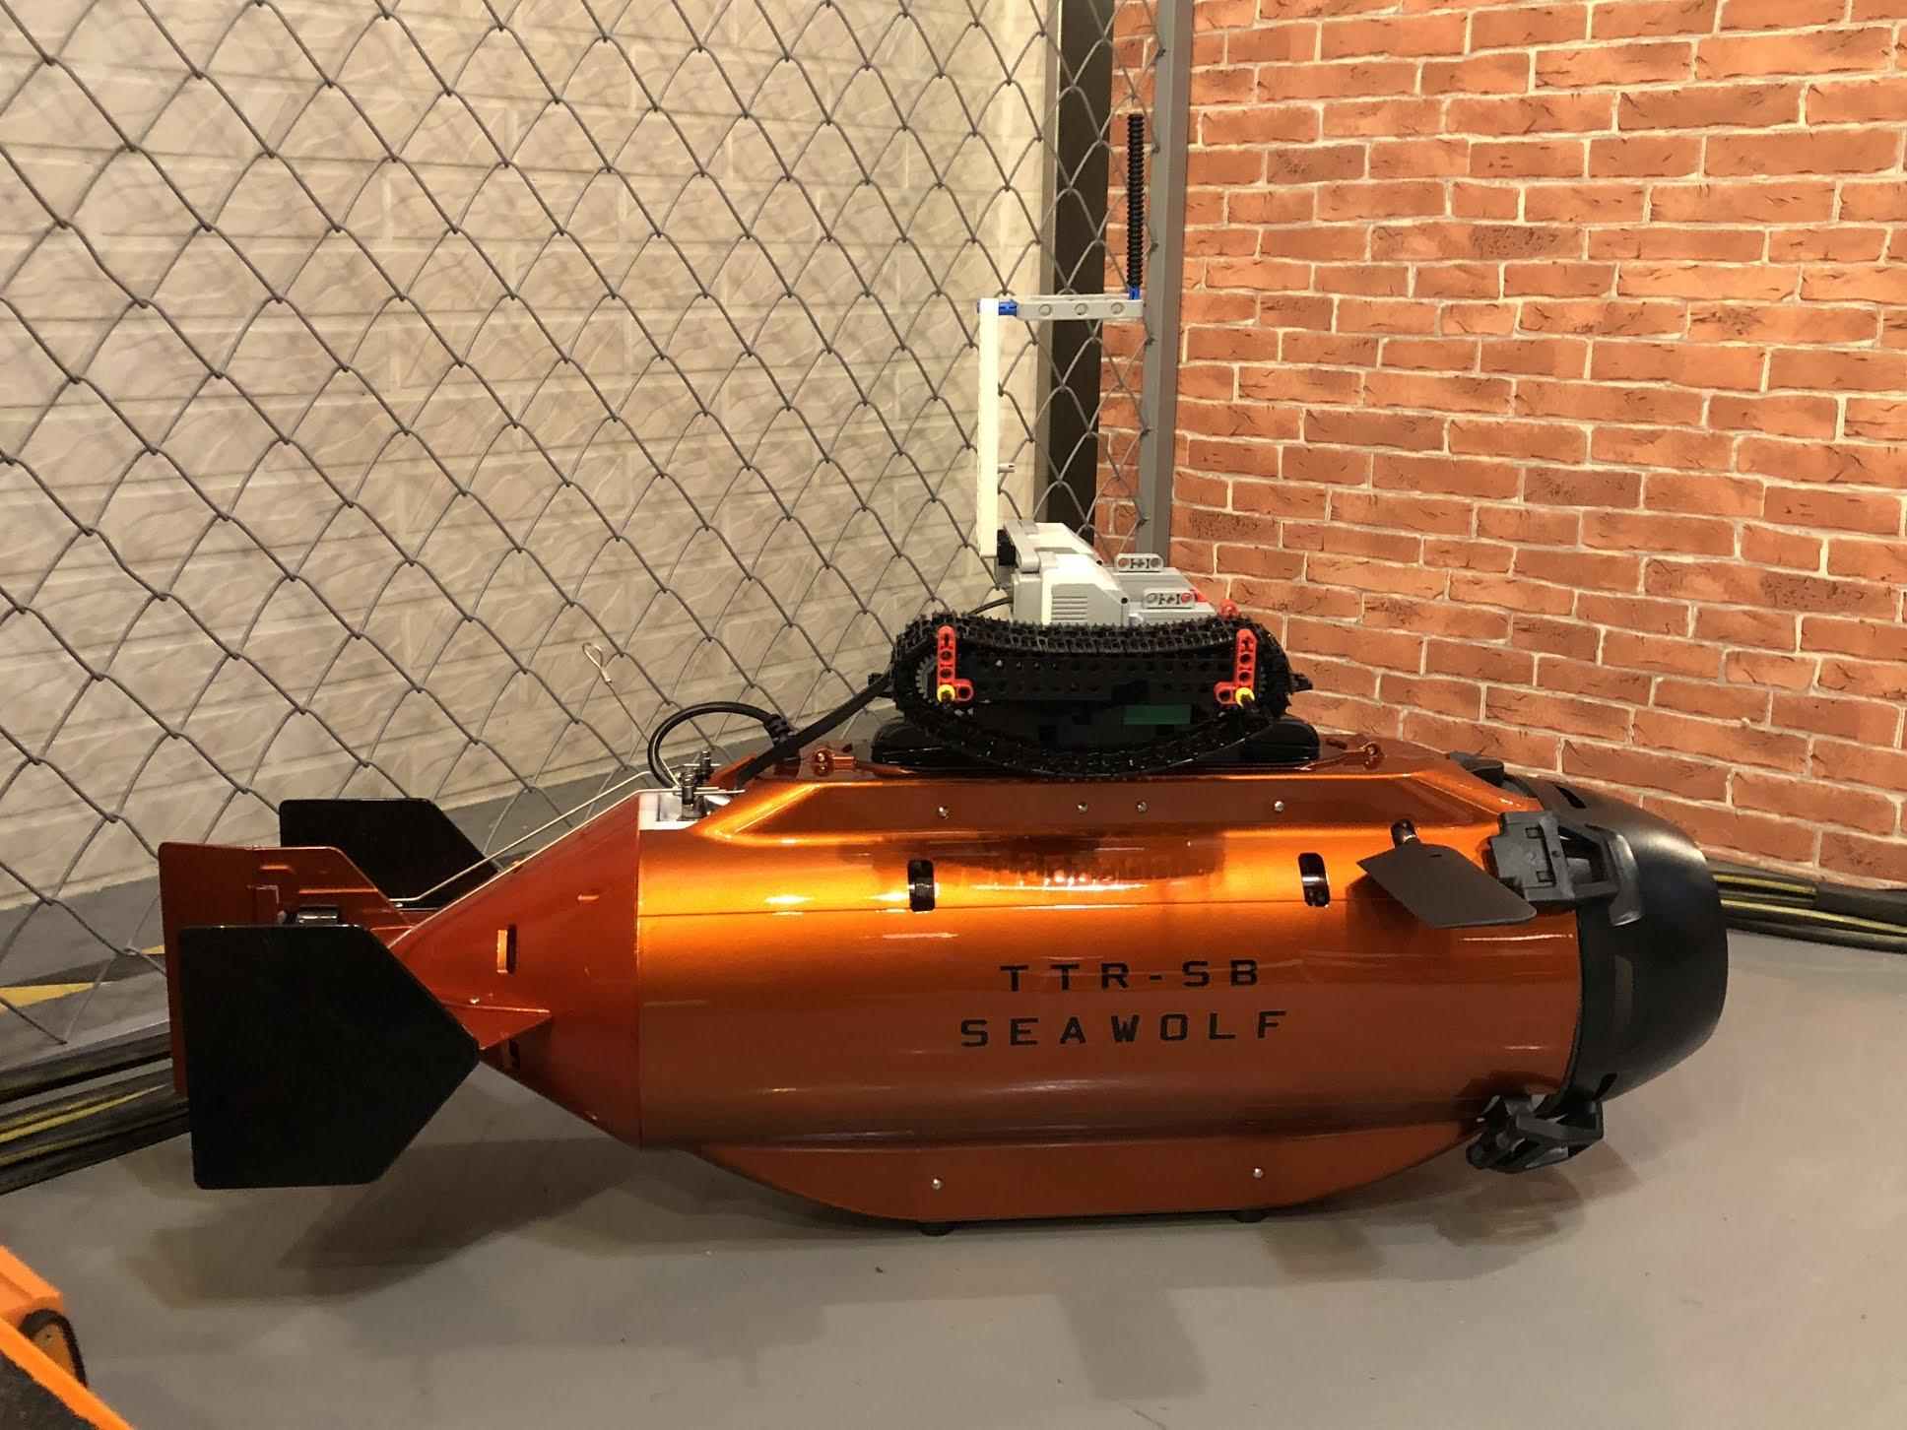
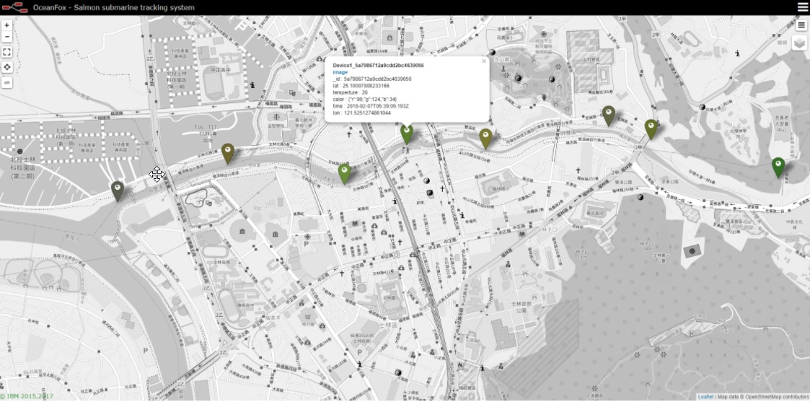
Formosan salmon submarine sampling system
Ocean Fox
Notes:
賴桑: 說明作品名稱

Slide 12
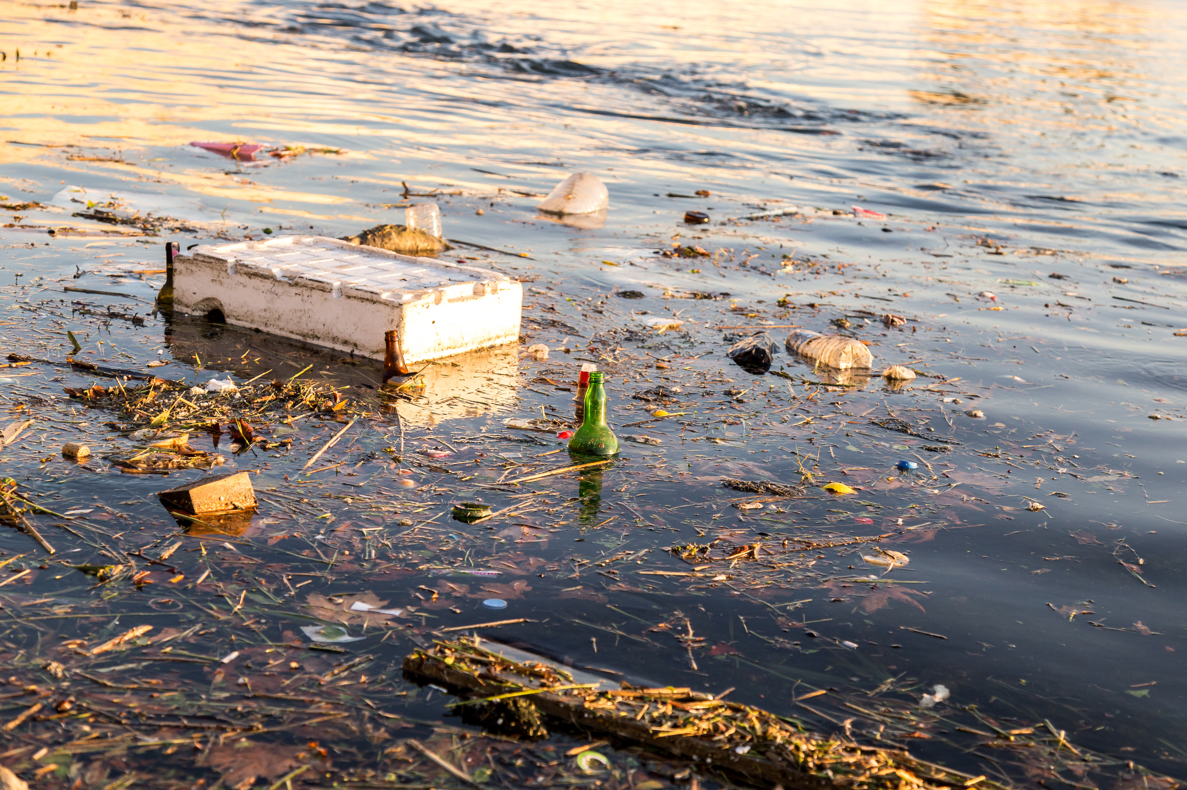
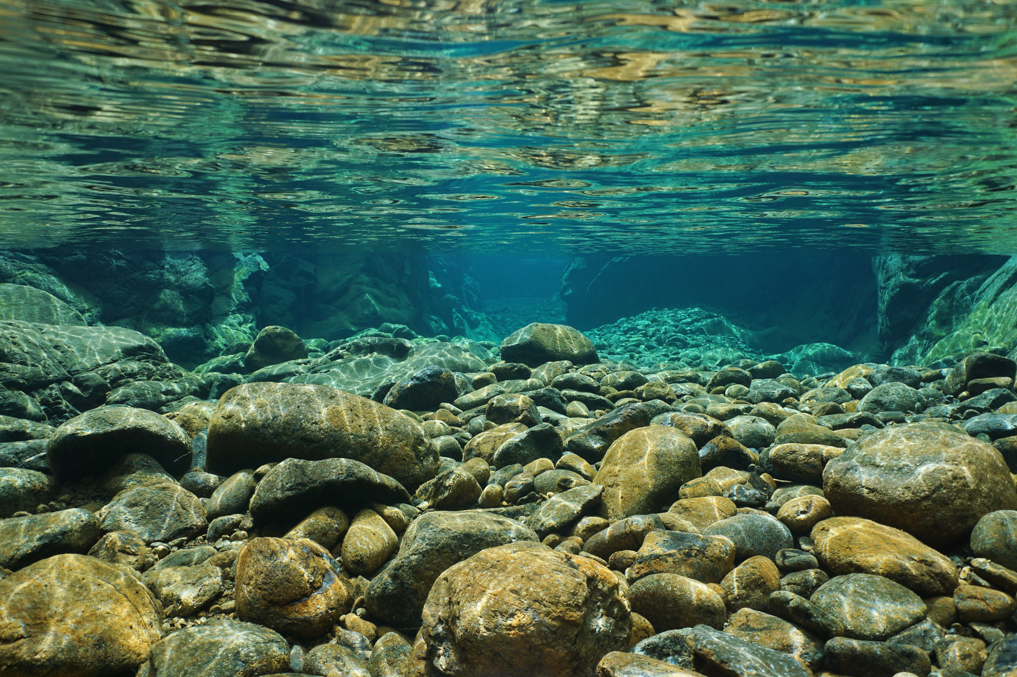
Problems & Purpose
Freshwater Monitoring and Communication
River eutrophication
Draining hazardous sewage from electroplating factory
Sighting of massive fish kills in river after typhoon
Improper sewage sludge treatment
Sustainability
Protecting ecosystems

Slide 13
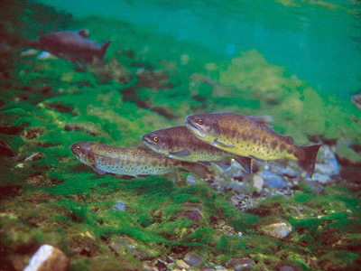
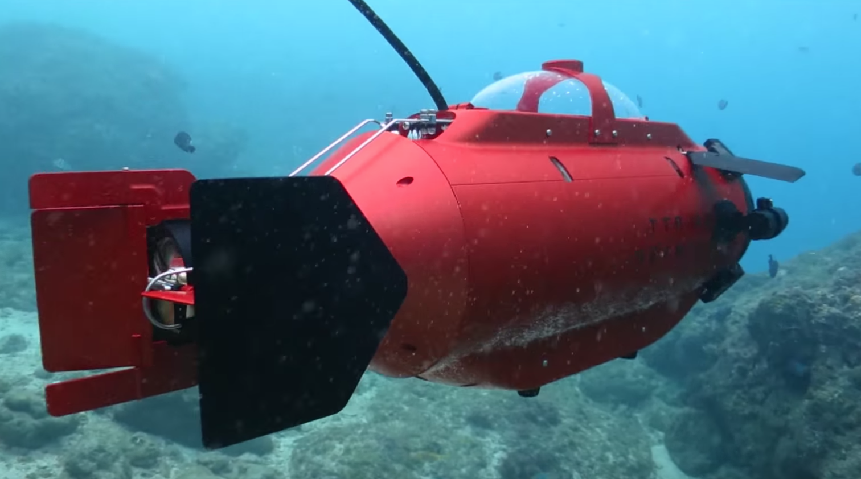
Formosan salmon submarine
Solution
Feature
  A submarine is released at the source of a river upstream and automatically returns to its base after reaching the sea
Environmental sensor
    Sensors for monitoring temperature, colors, oxygen level, and water pressure; GPS, etc
Internet of Things (IoT)
    Data collection via Sigfox to cloud
Sampling
    Turn on Solenoid valve and collect & retrieve abnormal sample

Slide 14
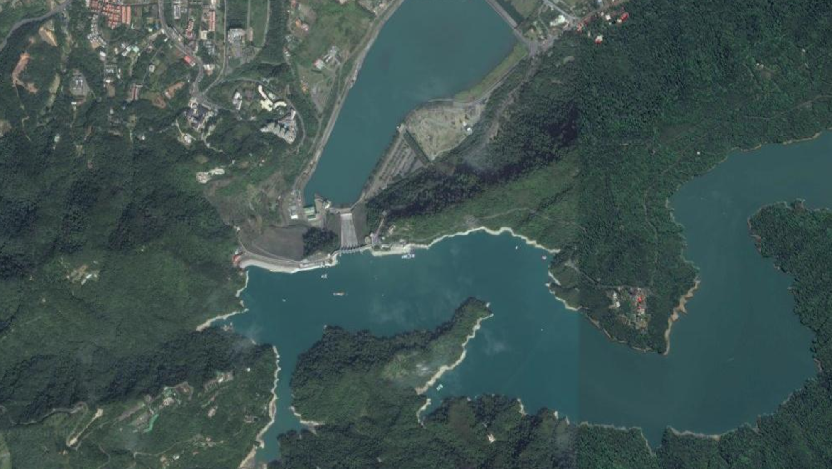
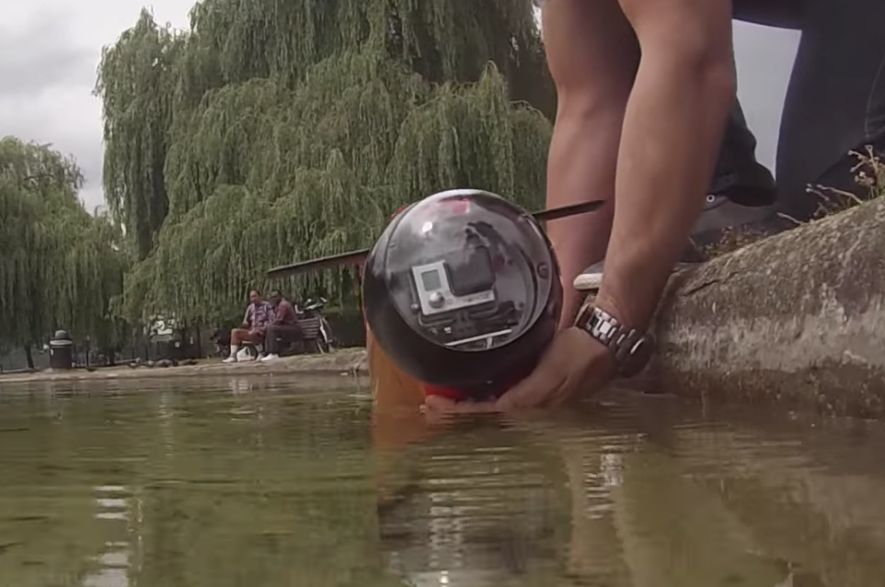
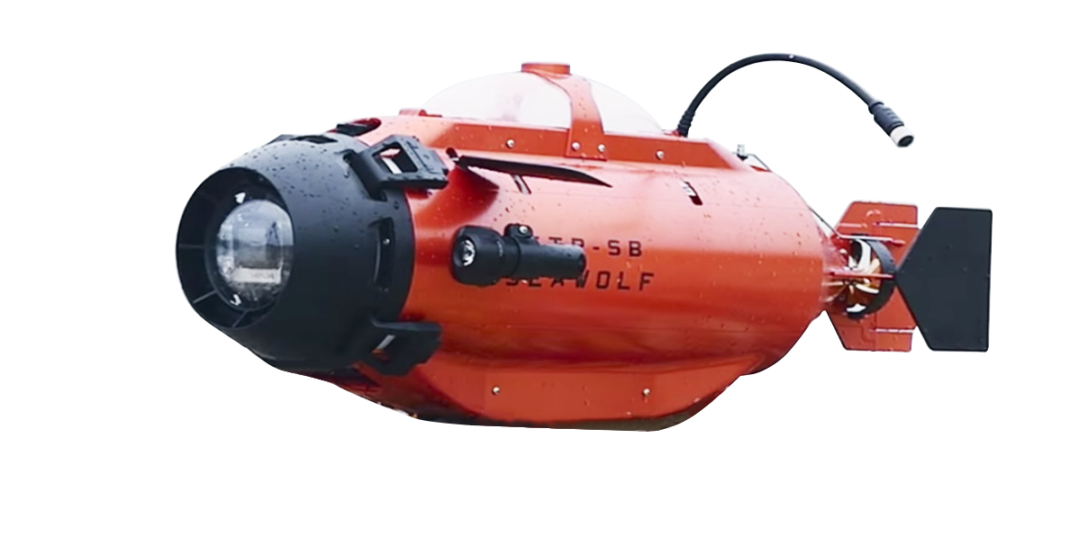
Releasing the submarine at the source of a river
* Information provided by Ocean fox

Slide 15
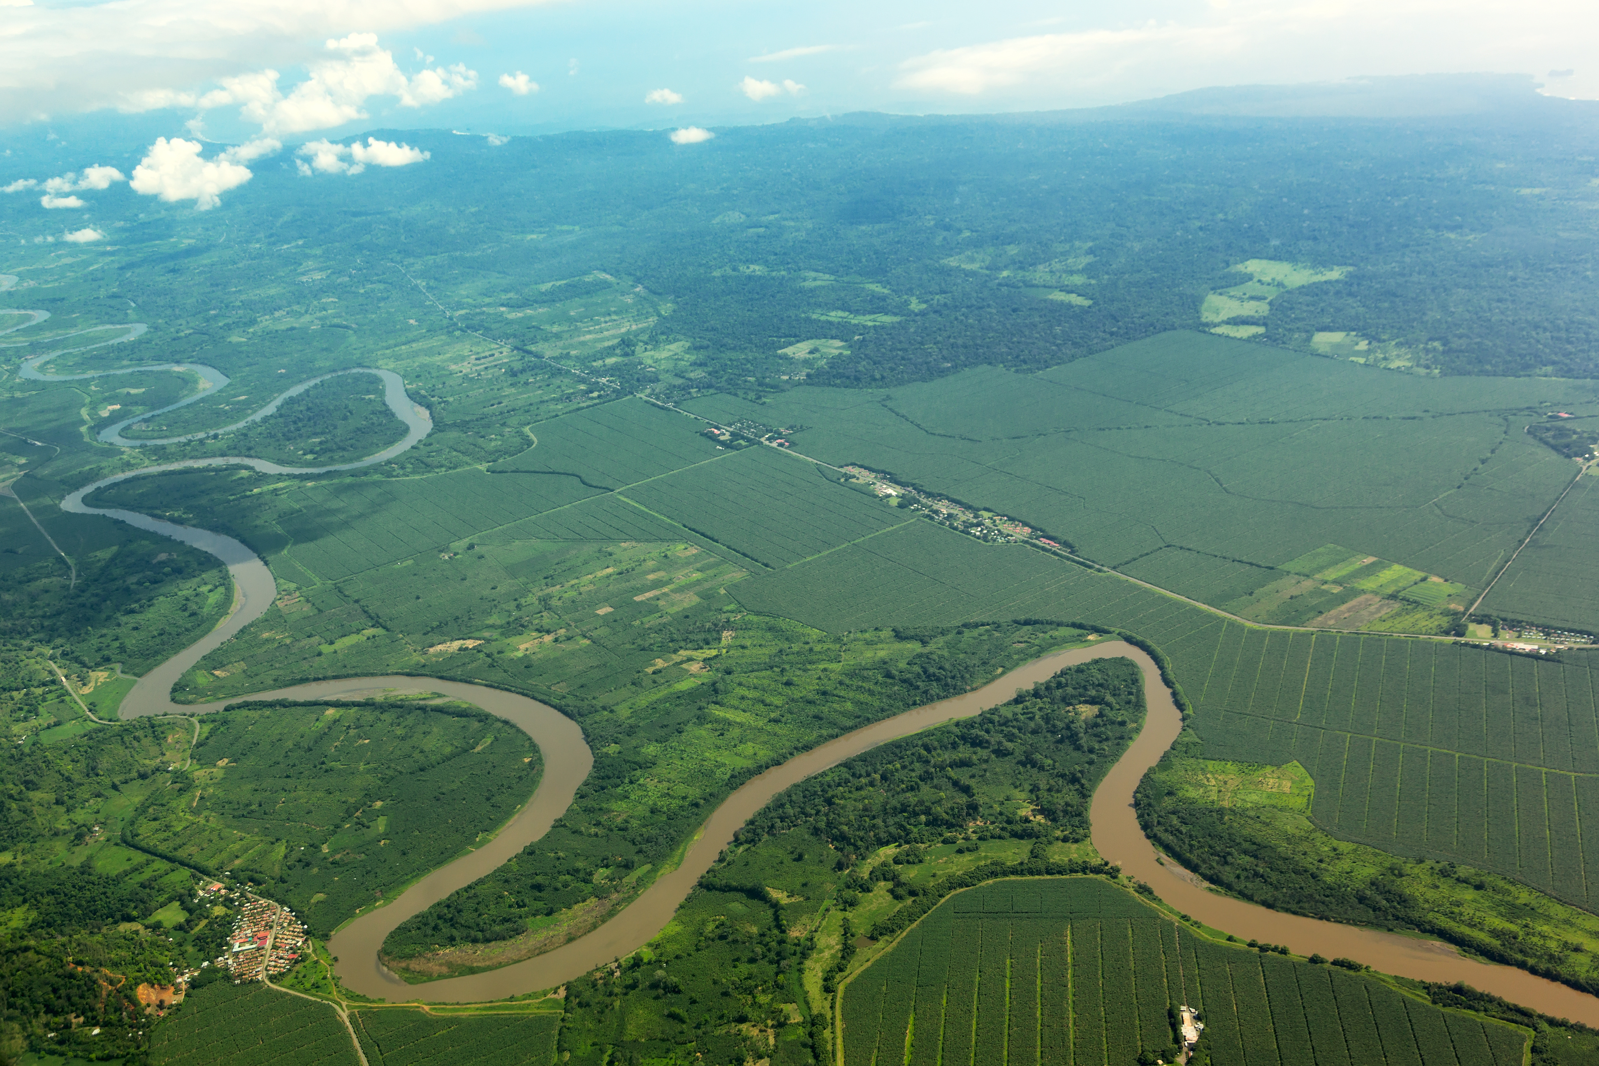
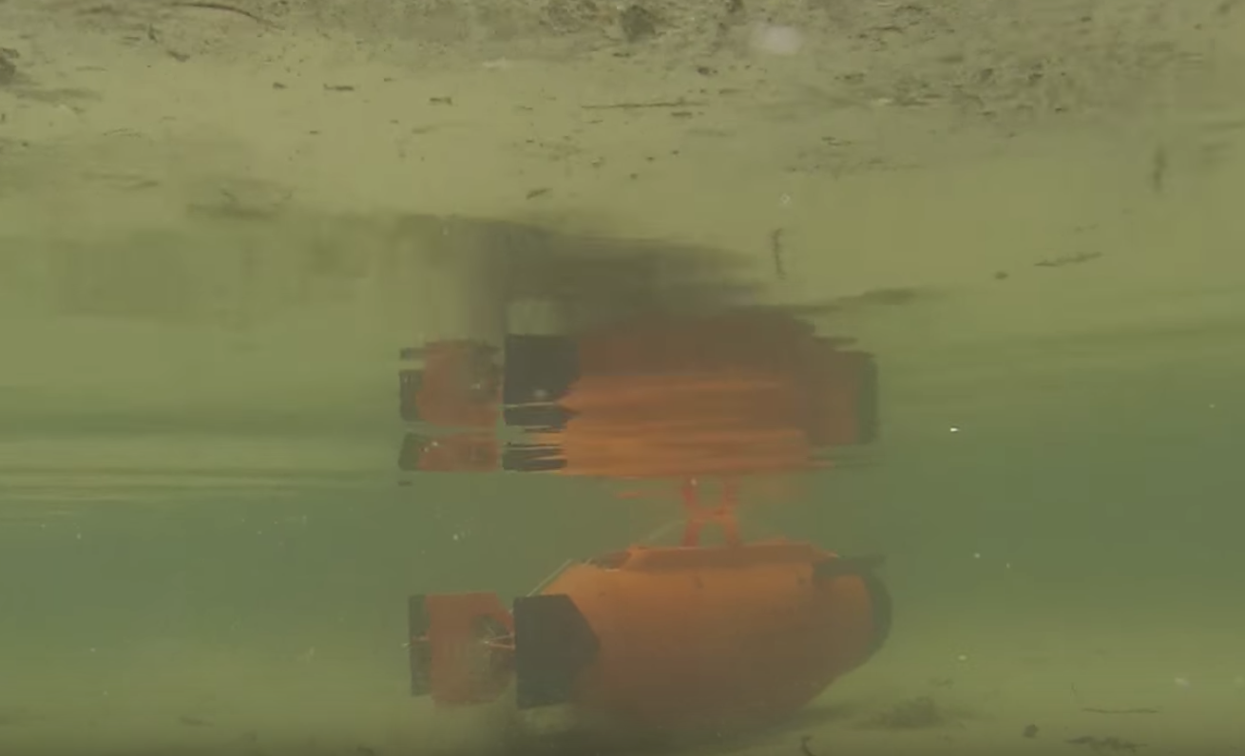
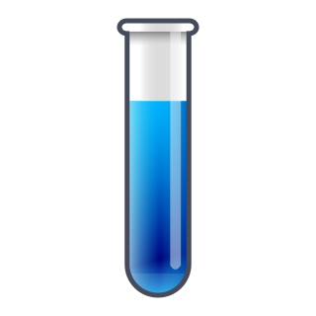
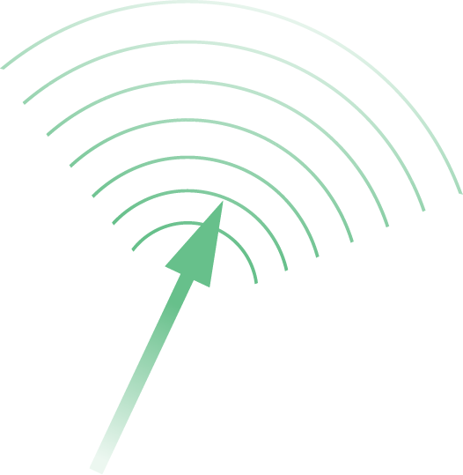
Collecting data and uploading GPS location, real-time environmental information to Sigfox
* Information provided by Ocean fox

Slide 16
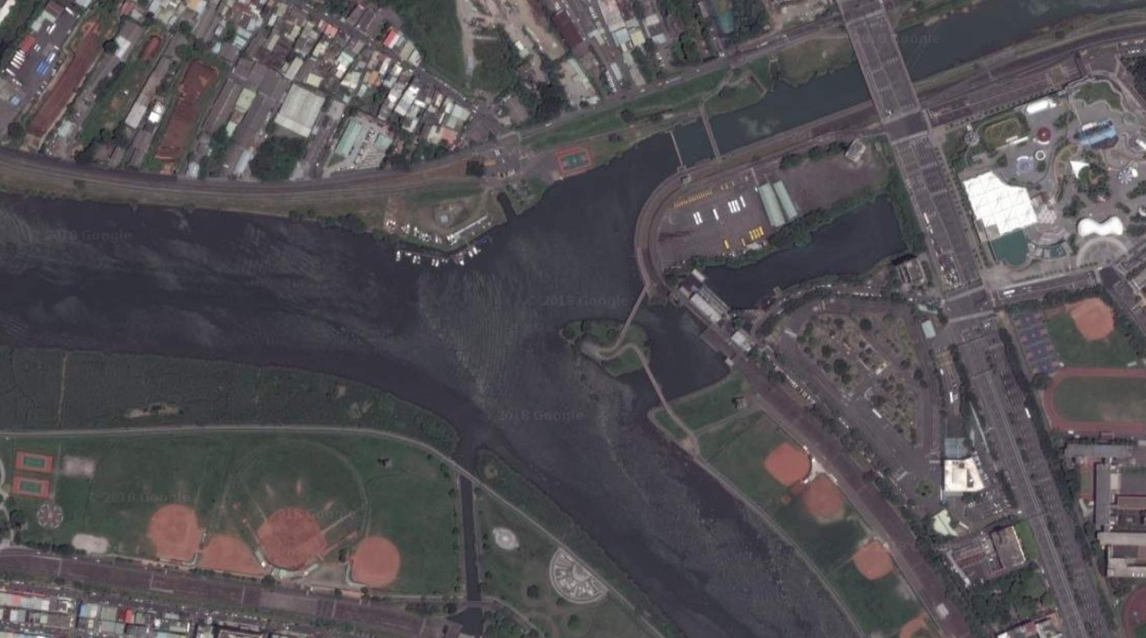
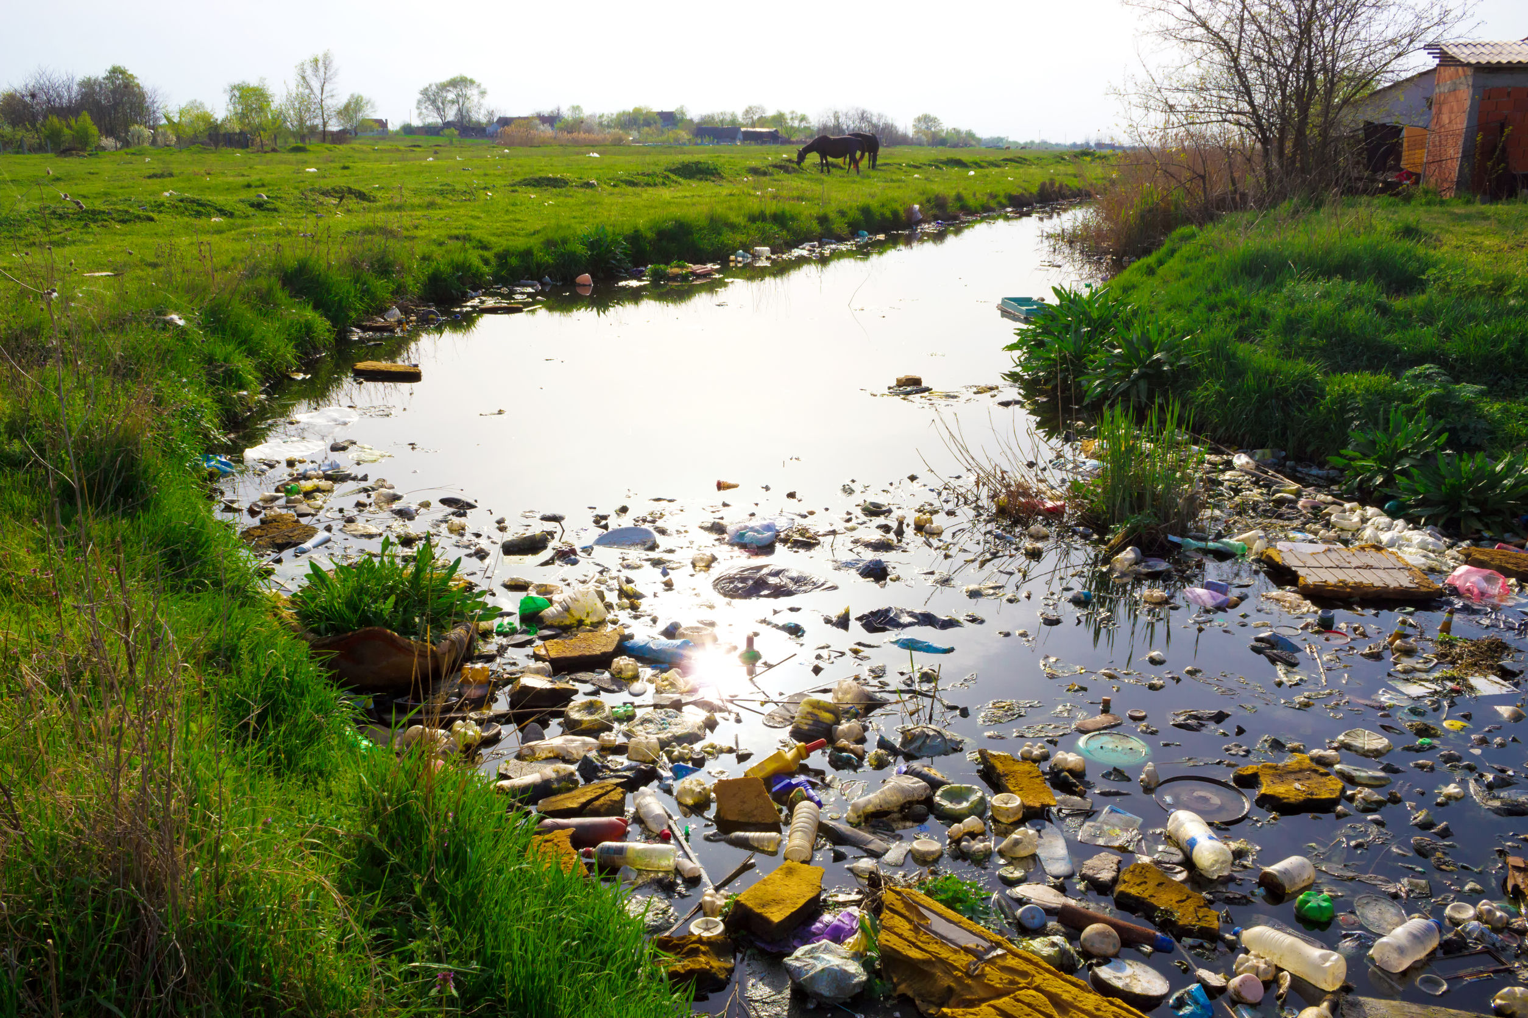
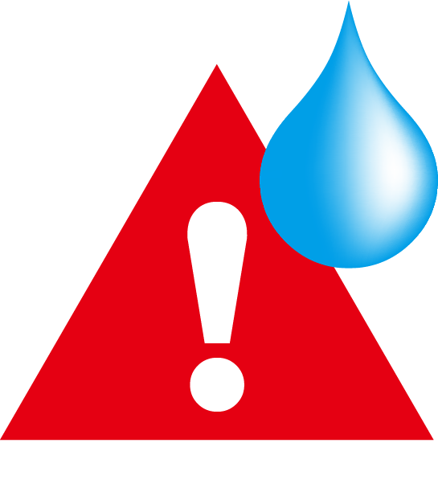
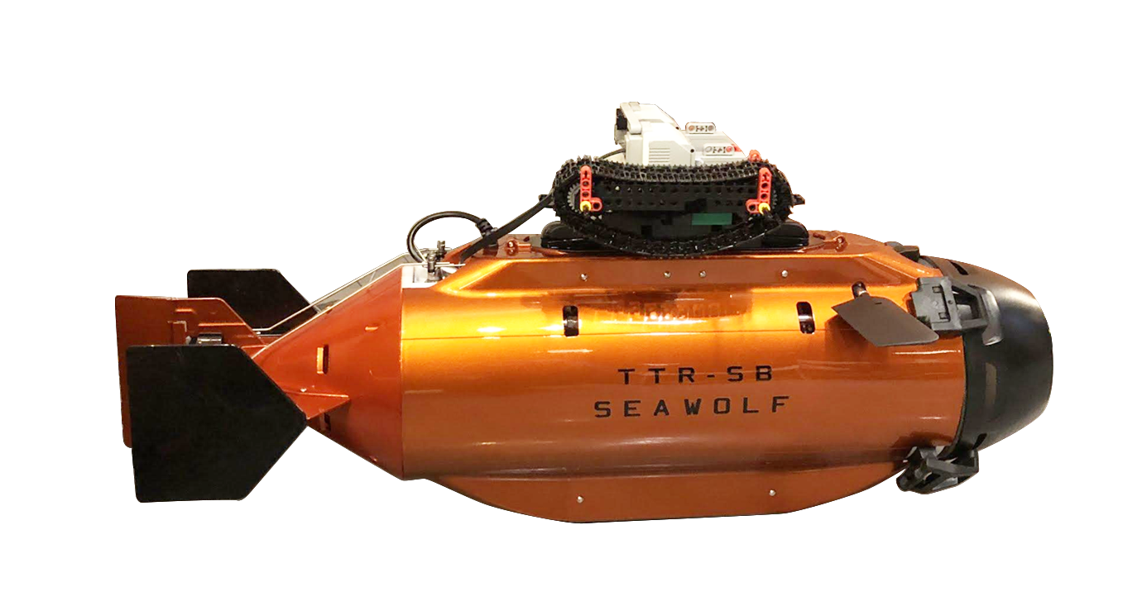

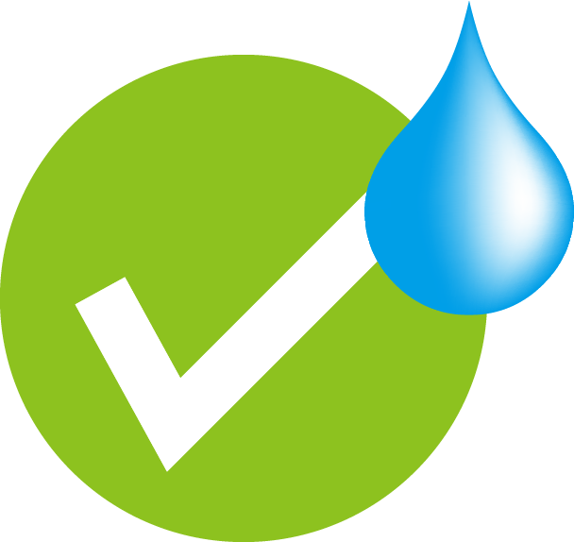
Centralizing monitoring and preventing illegal draining of sewage
* Information provided by Ocean fox

Slide 17
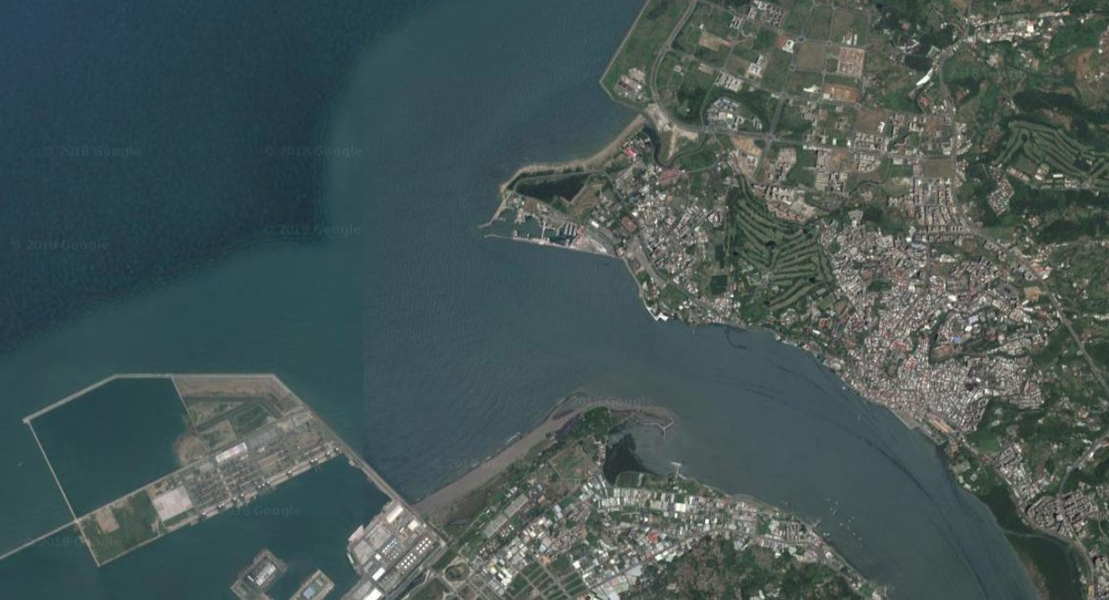

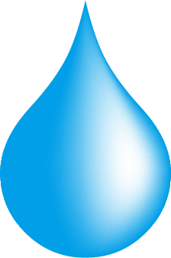



Automatically returns to its base after reaching the sea
*Information provided by Ocean fox

Slide 18
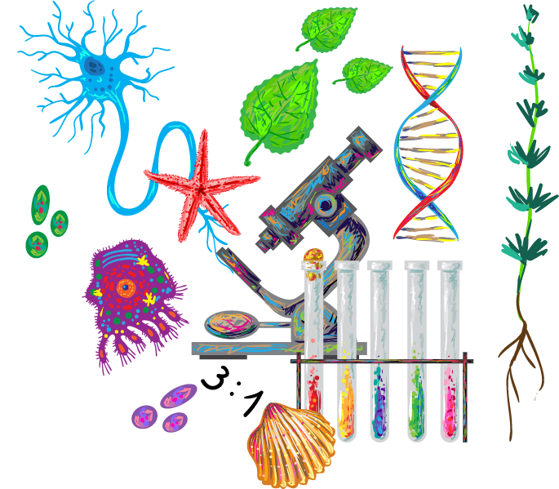
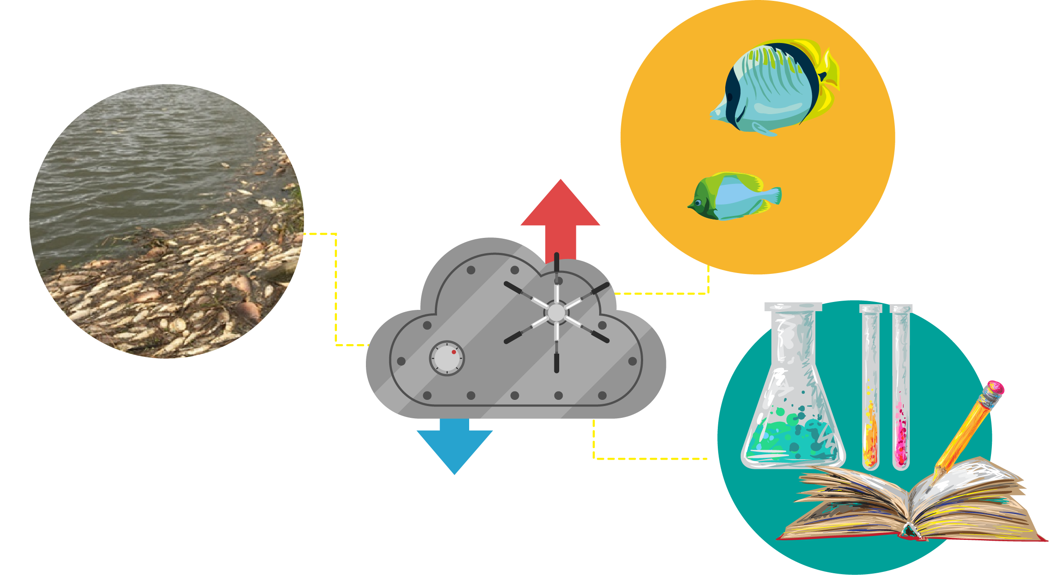
After data collection
Advanced water quality testing
Biochemical oxygen demand
Algae analysis
Historical record
  Storage data to cloud
  Environment analysis
  Video record and analysis

Slide 19
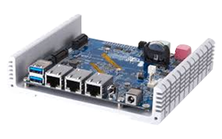
System Framework (1/2 )
QNAP QBoat Sunny
  Dump data
Camera
Action
Data Transmission
Sensor
GPS
UnaShield V2S for Sigfox

Slide 20
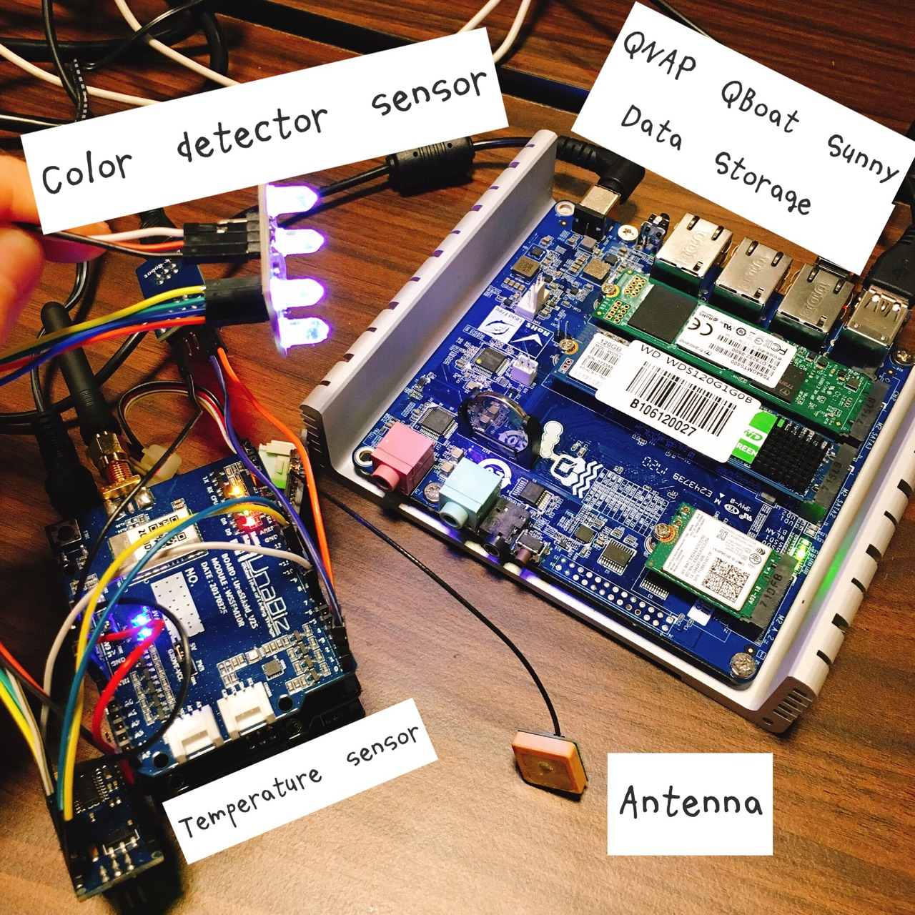
System Framework (2/2 )
雷虎潛水艇
Thunder Tiger Submarine
  Pixhawk autopilot system
Environmental detection addon
  Arduino, color detector sensor and temperature sensor
Connectivity and cloud service
  Sigfox & GPS
  QNAP QBoat Sunny (Private Cloud)
  Public Cloud

Slide 21
Data Collector
Component
  QNAP QBoat Sunny as a control center, data storage with connectivity
  Arduino as sensor hub
  Wireless communication by UnaShield V2S for sigfox
Feature
  User friendly
  Expandable Sensors

Slide 22
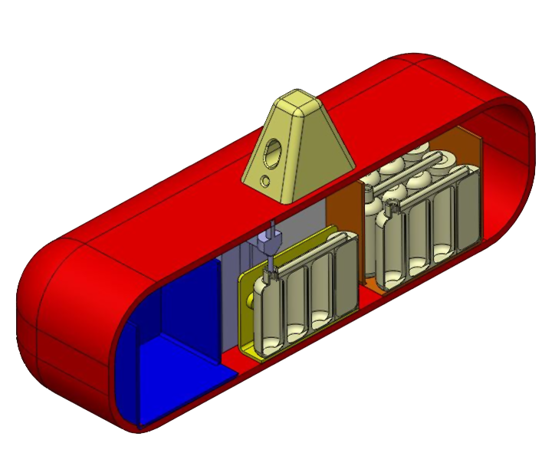

Sample Analysis
10 cc of water sample is placed along with chemical reagent into each test tube to collect real-time data
Uploading GPS location, real-time environmental information to Sigfox and storing data to QNAP QBoat Sunny
Analyzing data with Public Cloud
Carrying samples back to labs for further analytics
Public Cloud
QNAP QBoat Sunny
Notes:
每一管10cc並滴入化學試劑，用於即時檢驗的現況，並搭配GPS、環境資訊上載到Sigfox網路；同樣的資訊會也會被保留在QBoat Sunny中，待回實驗室後可透過區域網路複製出來，同時也副本給Microsoft Azure

Slide 23
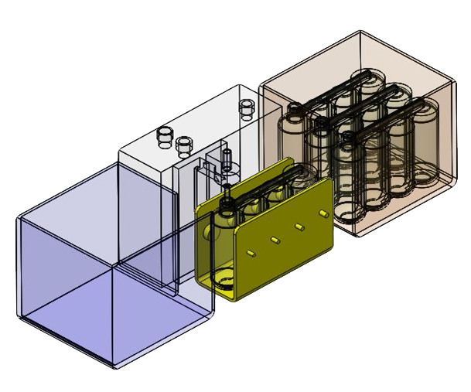
Data collection 3D illustration (1/2)
Sectional drawing

Slide 24
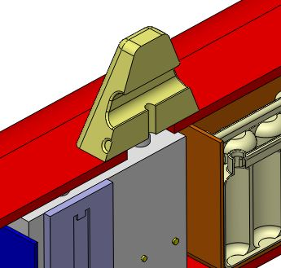
Data collection 3D illustration (2/2)
Put turbidity measurement equipment here
Thermograph
Sampling port

Slide 25
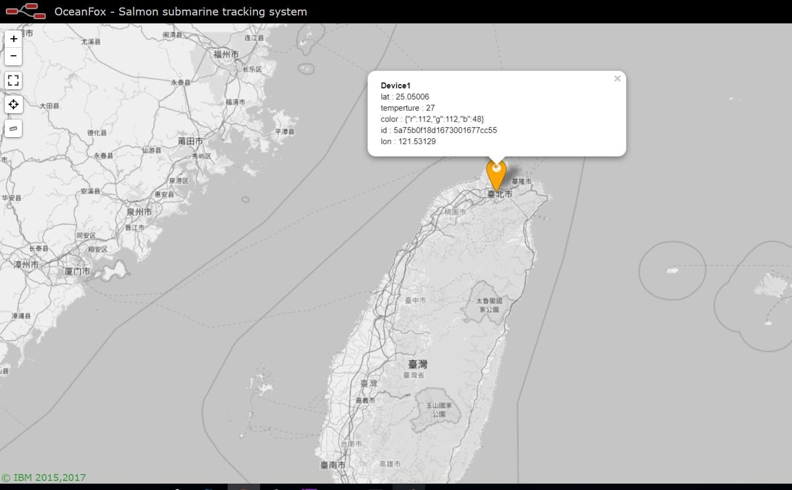
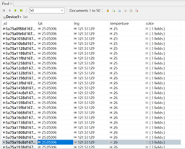
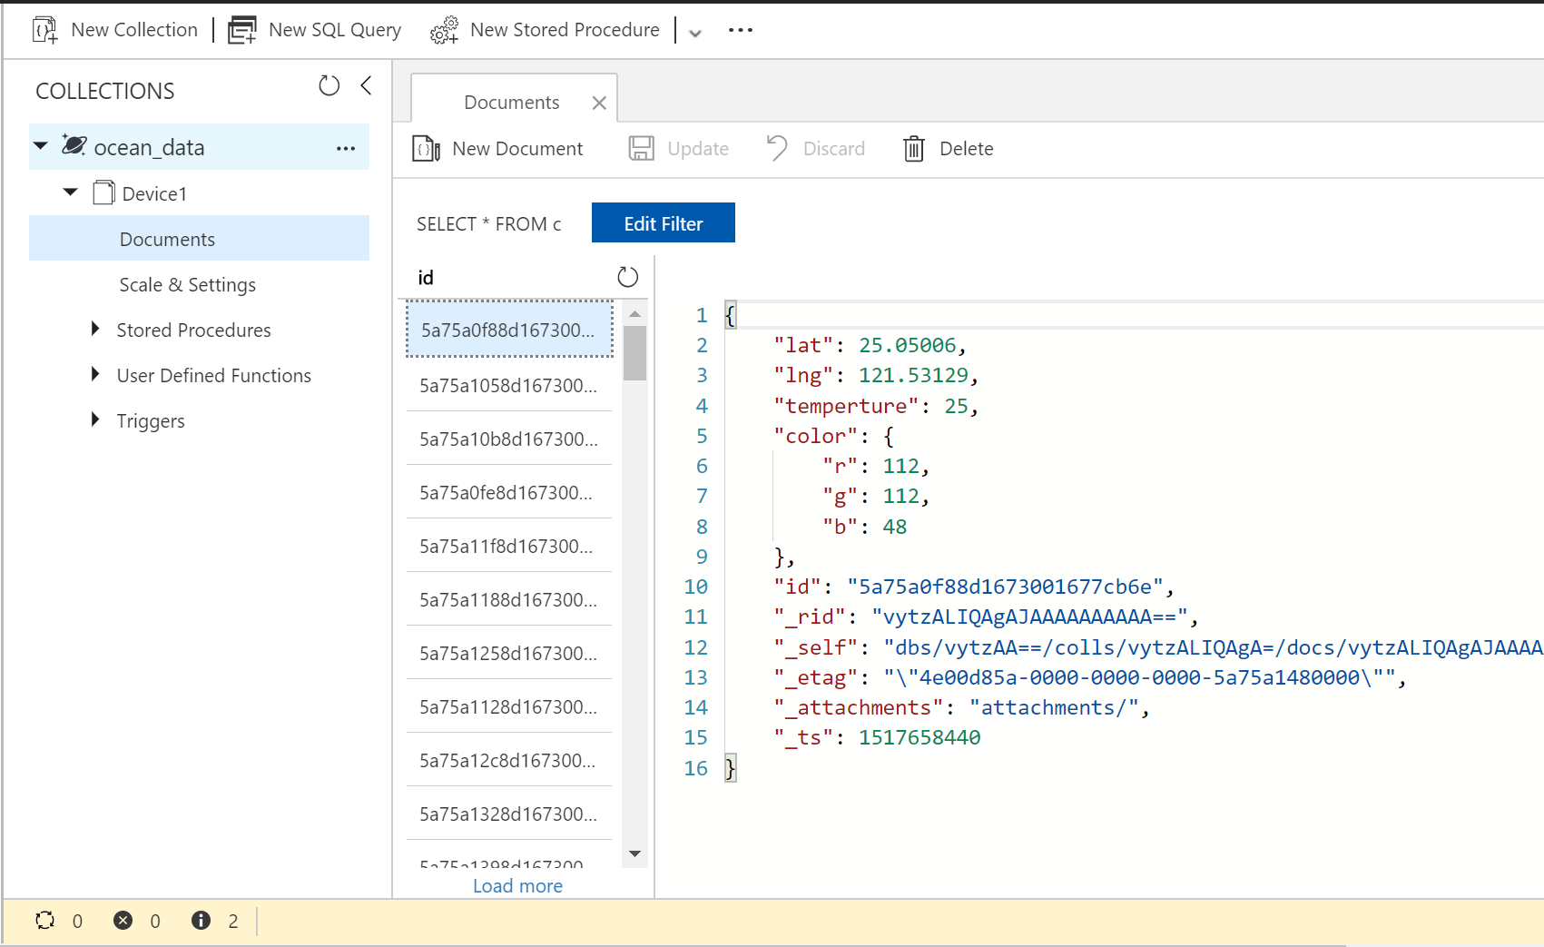
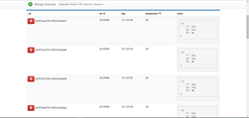
Sample management in lab
Sigfox
Transmits real-time data
QNAP QBoat Sunny
Record sample & data storage
Public Cloud
Big data storage
Advanced data analysis
Notes:
藉由Sigfox回傳並記錄於QBoat Sunny中的詳細取樣記錄，回到實驗室後結合Microsoft Azure的雲端服務，可以只用瀏覽器就在畫面上呈現各個取樣點的資訊狀況

Slide 26
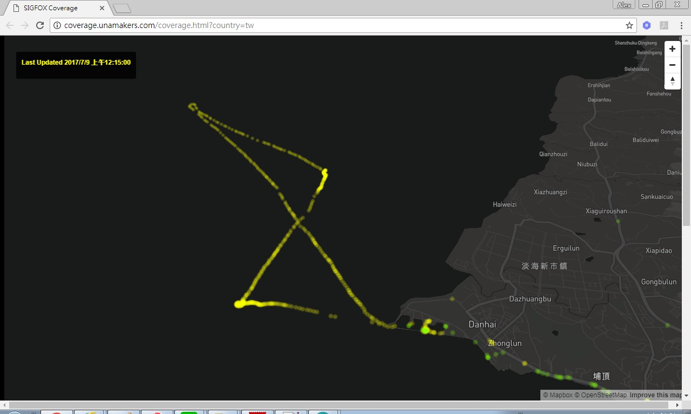
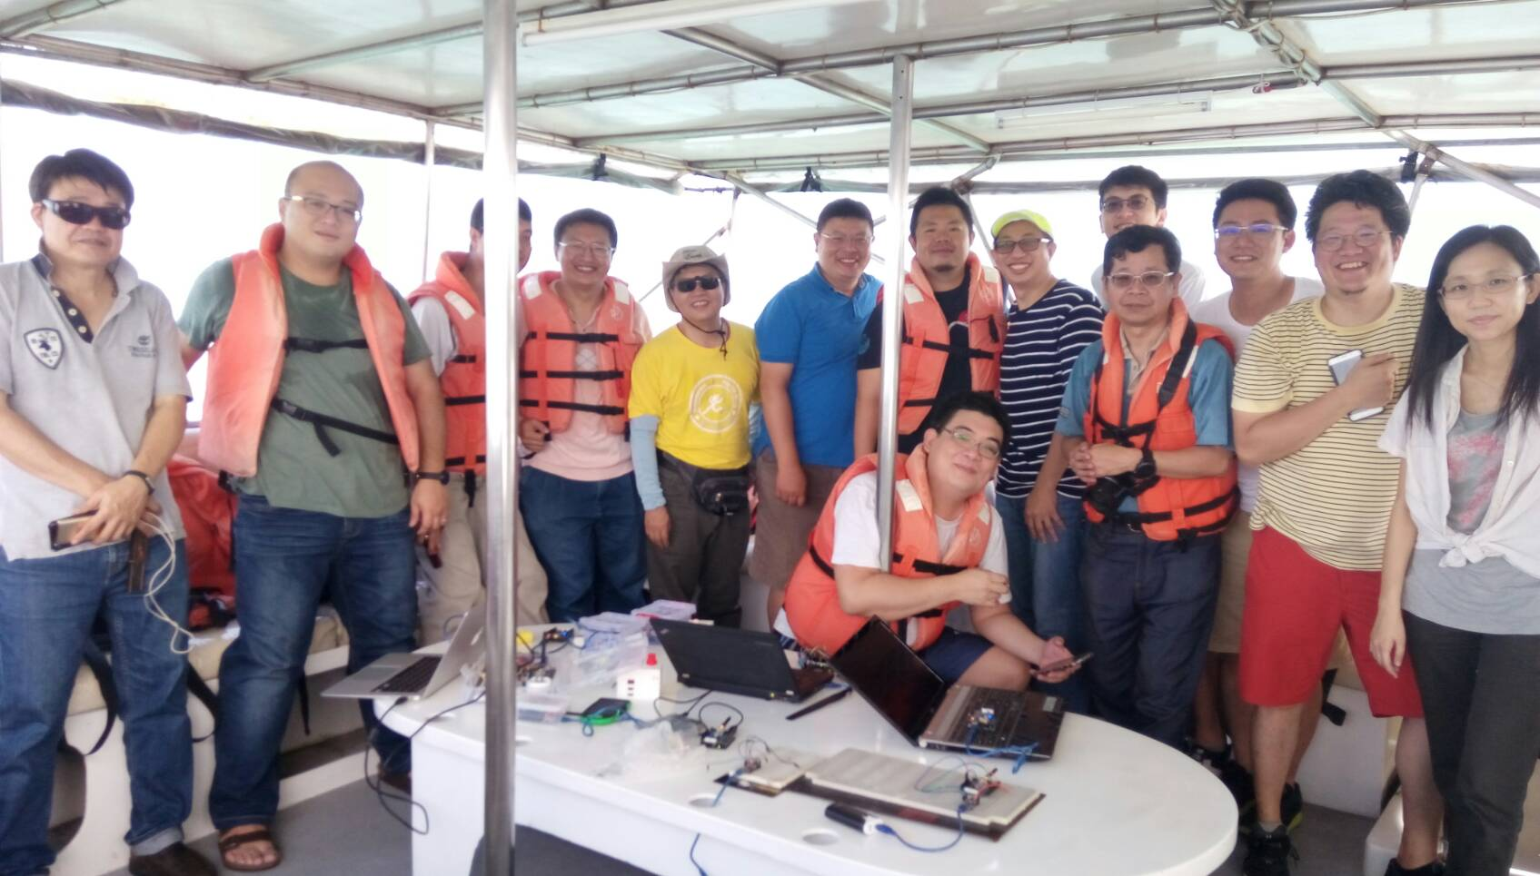
Sigfox wireless communication
Compatible with IEEE 802.11ah standard
Low power consumption
Transmission distance up to 10 km
  No signal booster (such as repeater) used
Notes:
20170807在台灣淡水出海實測，只利用手機行動電源，在沒有Repeater以及任何輔助強波裝置下，能達到10km的傳輸距離

Slide 27
Videos

Slide 28

Fishakathon video

Slide 29
Message from Sigfox
Nicolas Lesconnec
Head of Technology Adoption | University Programs & Developer Relations

Slide 30
Connect
QIoT Suite Lite & Sigfox

Slide 31
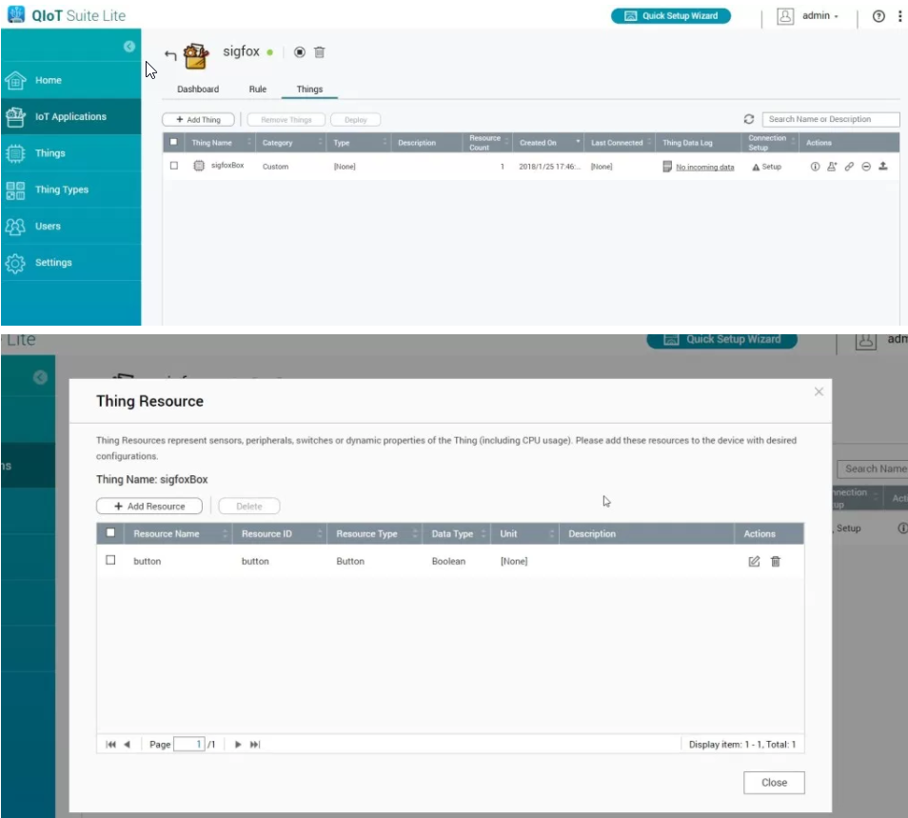
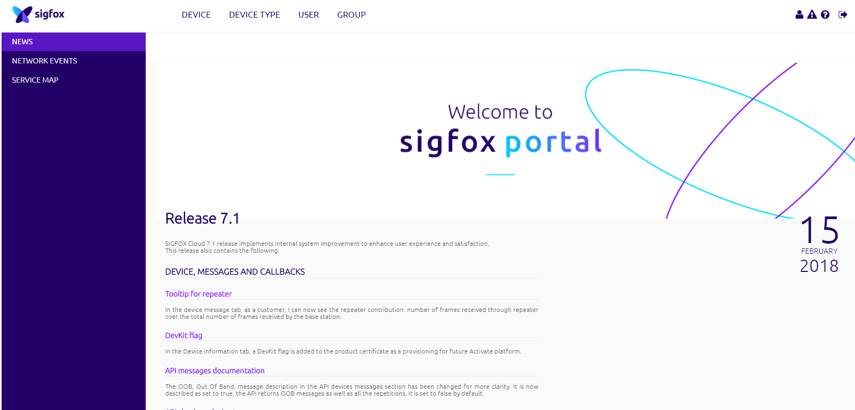
Live Demo - How to connect
QIoT with Sigfox
Create IoT Application, Things, Resource with QIoT Suite Lite. You will acquire resource URLs (HTTP and HTTPS)
Sign up a Sigfox account and activate your device

Slide 32
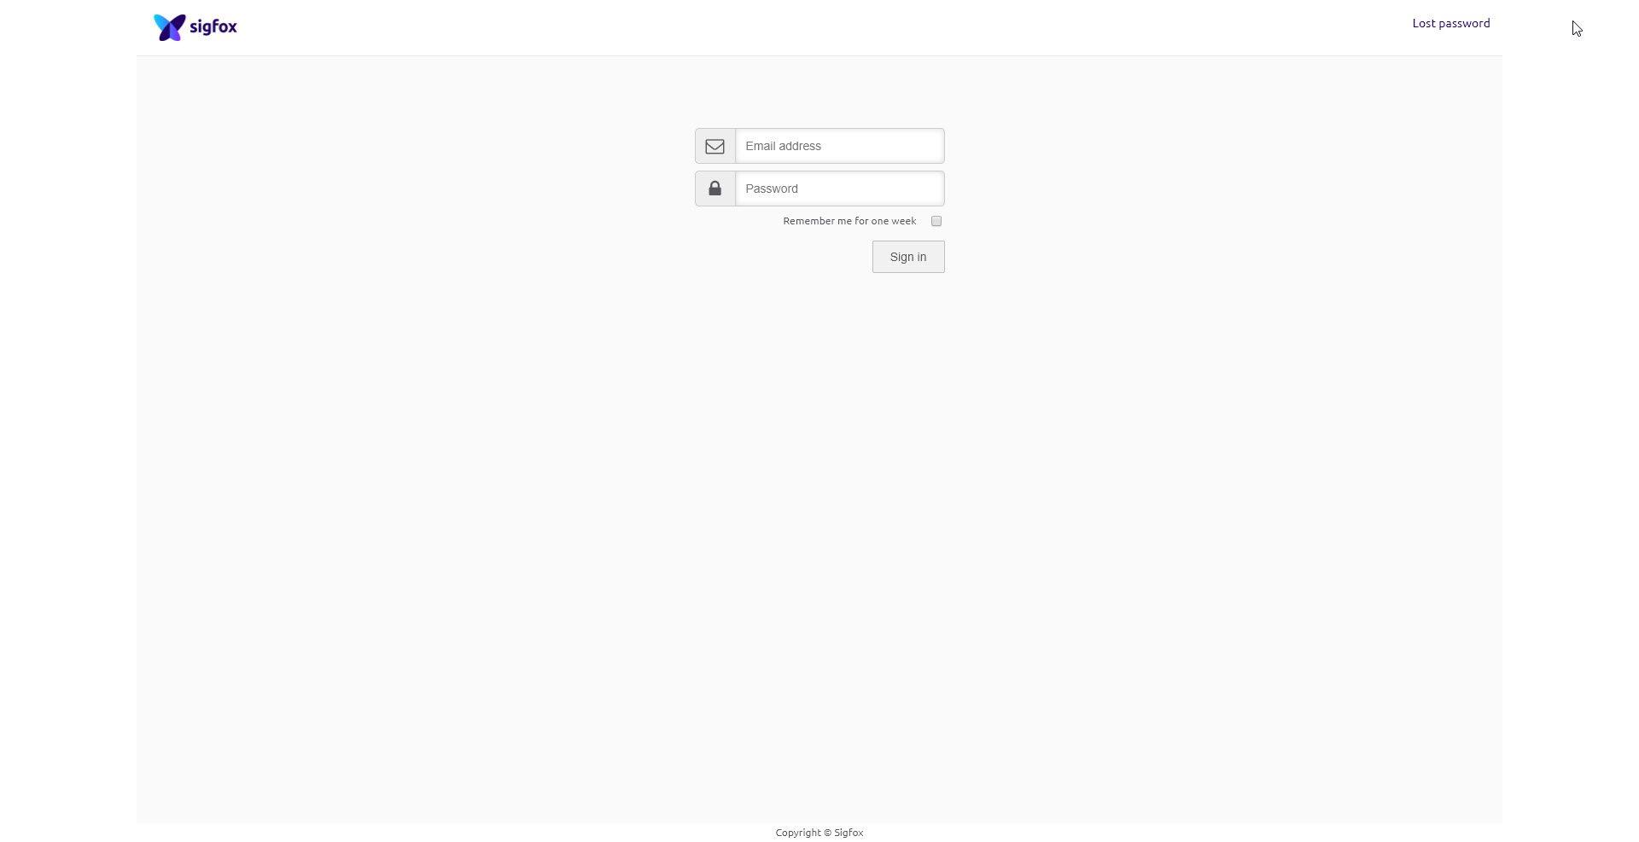
Sigfox login

Slide 33
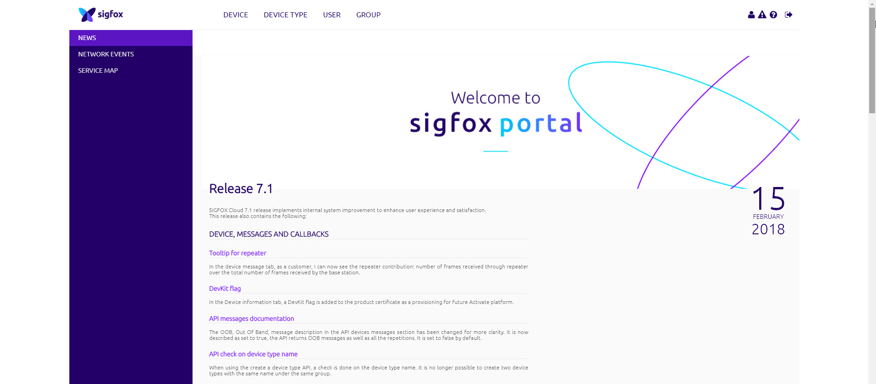
Sigfox Homepage

Slide 34

Device Type → Click "New"
New

Slide 35

Enter associated information → Click "OK"
Ok

Slide 36

CALLBACKS → Click "New"
New

Slide 37

Click "Custom callback"

Slide 38

Enter associated information →Click "Ok"
Ok

Slide 39

You are now good to go!

Slide 40
QIoT＋Sigfox
Your Best Choice

