Slide 1


Smaller Size
Full Performance
5 x 3.5” + 4 x 2.5” bays in compact chassis
10GBASE-T and Qtier automated storage tiering

Slide 2

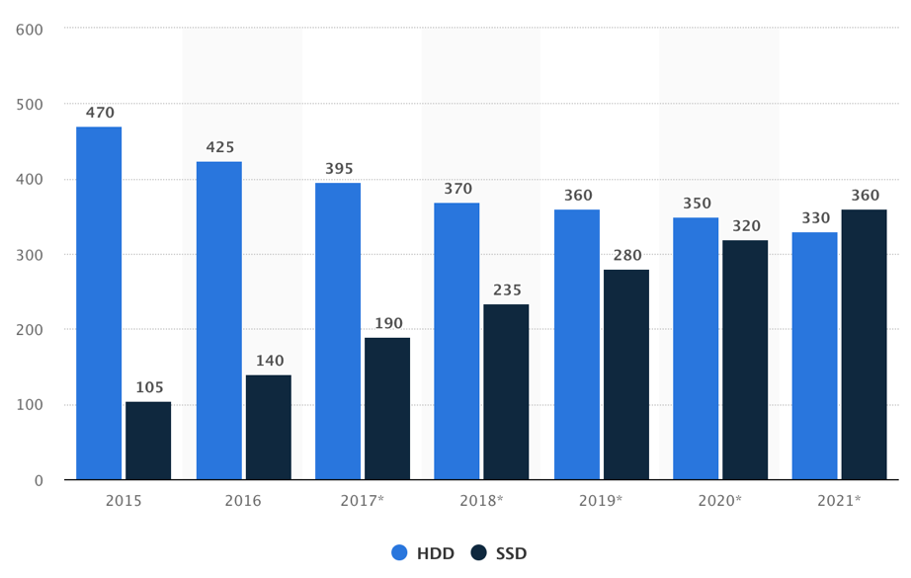
SSD gaining popularity
SSD and HDD global sales & forecast
Unit in millions
SSD advantages compared to HDD
High performance and fast response
No mechanical moving parts means less prone to shock and vibration
Thin and light weight
Lower power consumption
Source: https://www.statista.com/statistics/285474/hdds-and-ssds-in-pcs-global-shipments-2012-2017/

Slide 3
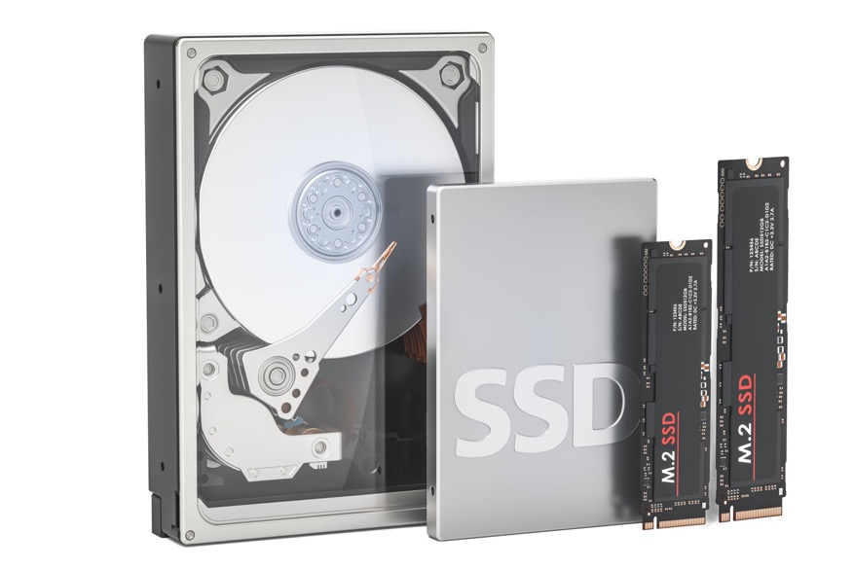
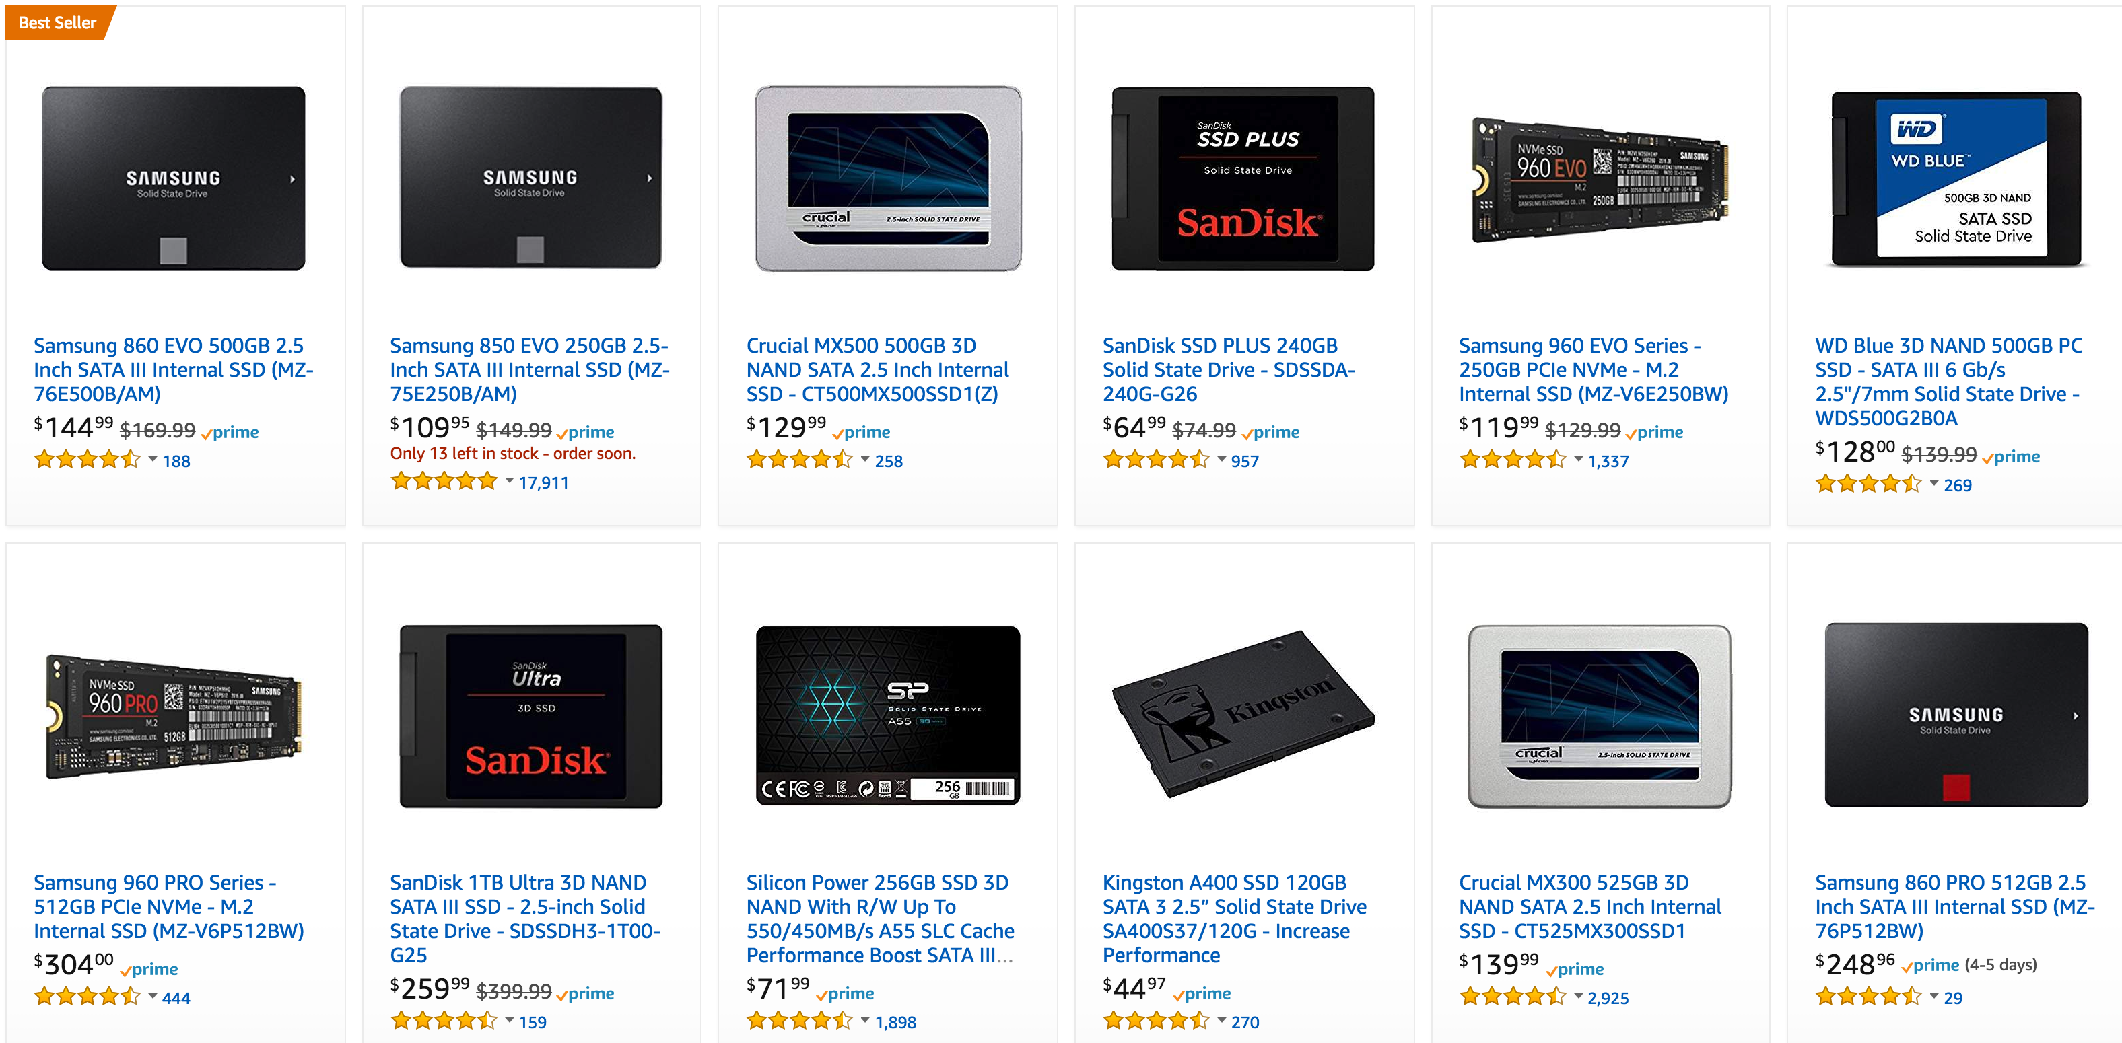
2.5” SSD becomes more popular
W 101.6 mm
2.5” SSD is commonly seen
Long history since thin & light laptops
Leftover parts after PC storage upgrade
Highest exposure and discount on e-shops
3.5”HDD
W 22 mm
W 69.85 mm
H 110 mm
2.5”SSD
H 147mm
H 80 mm
Source: 2018 Mar 26. https://www.amazon.com/s/ref=sr_st_featured-rank?lo=computers&rh=n%3A172282%2Cn%3A!493964%2Cn%3A541966%2Cn%3A1292110011%2Cn%3A1292116011&qid=1522034837&sort=featured-rank
H 100.1 mm

Slide 4


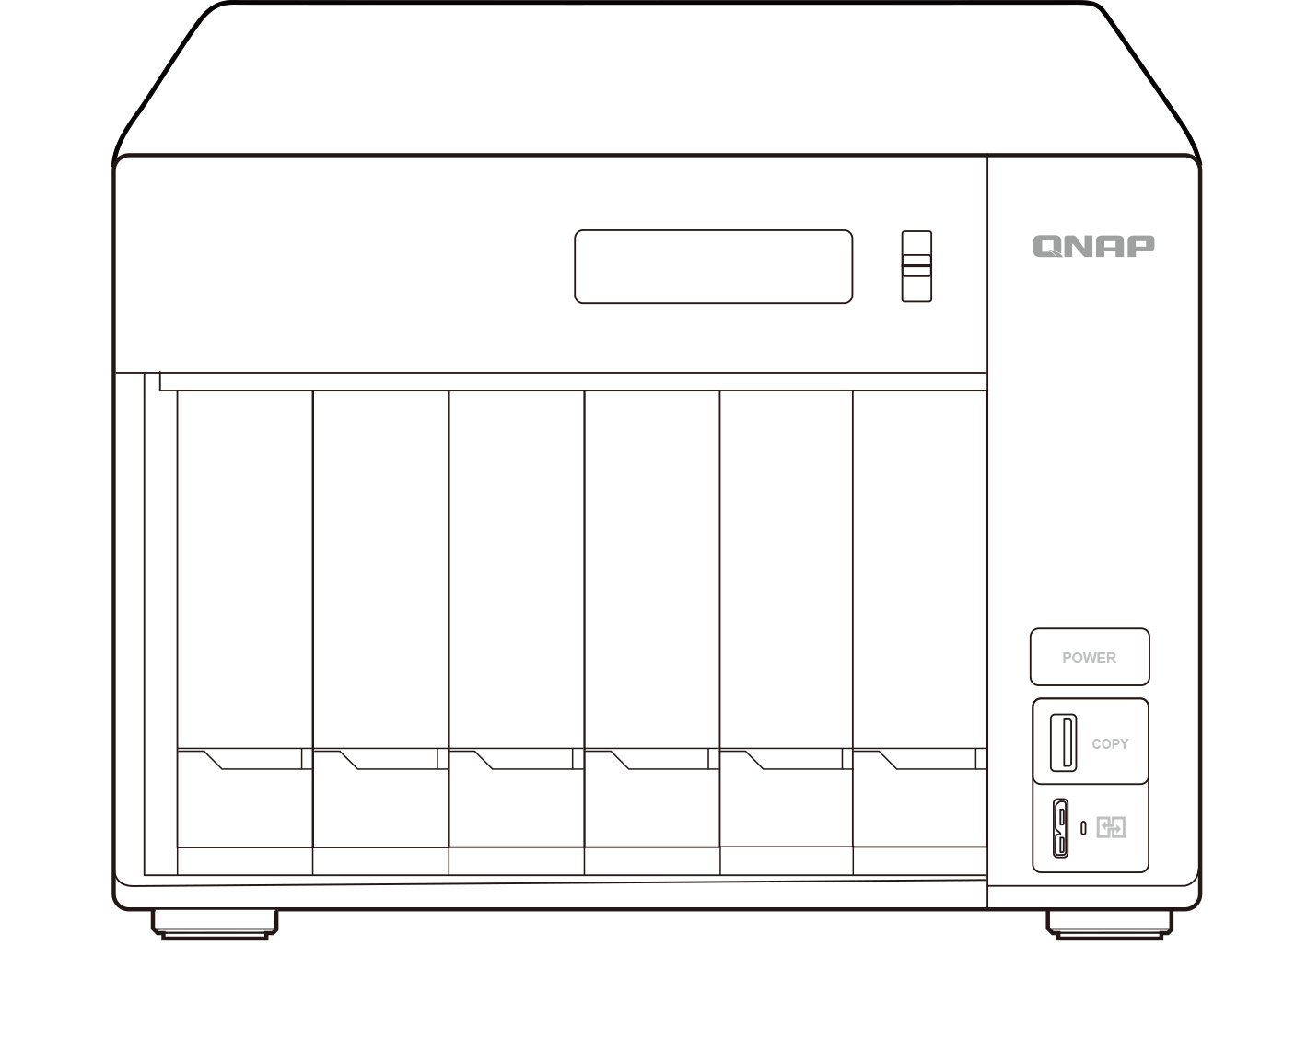
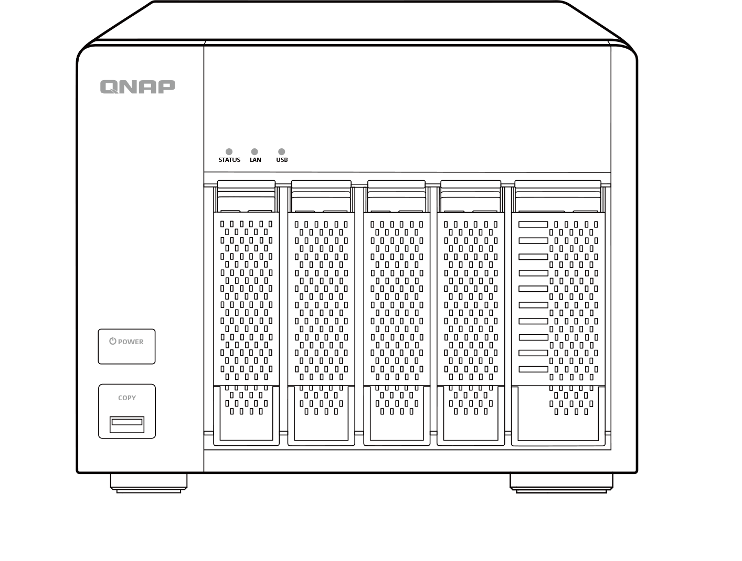
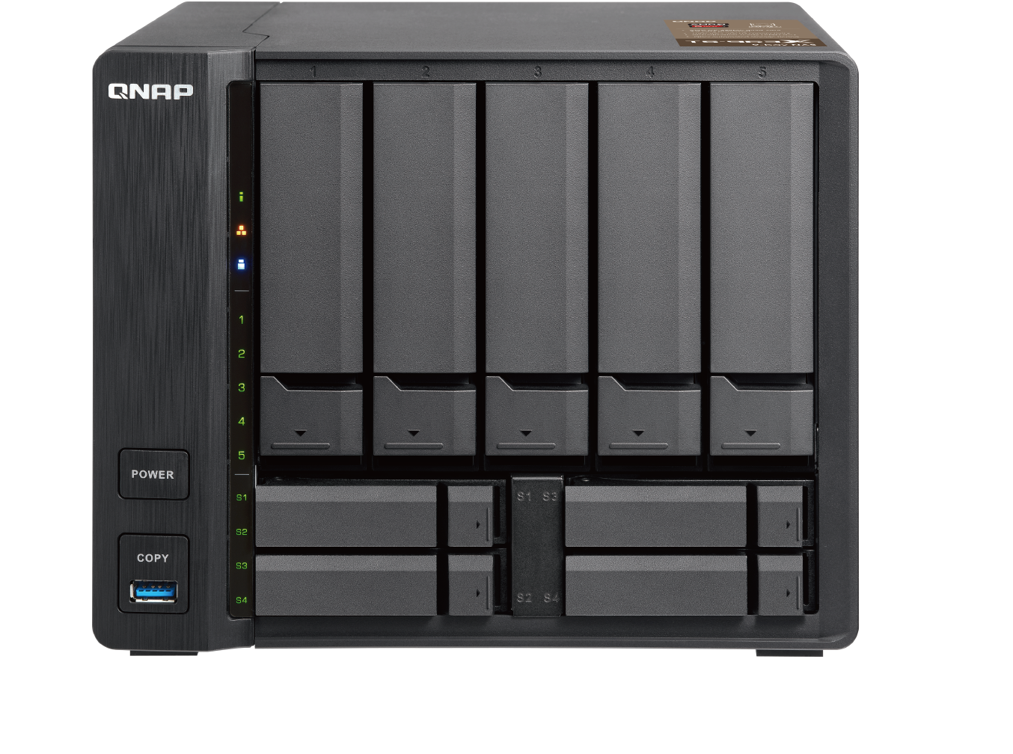
Finely crafted with the most capacity
5-bay TS-563
9-bay TS-963X
6-bay TVS-673e
185 x 211 x 236 mm
182 x 217 x 236 mm
185 x 264 x 279 mm
Notes:
桌面寸土寸金

Slide 5

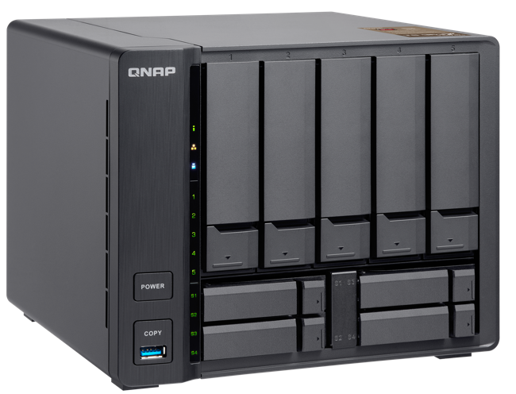
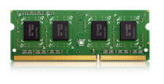
AMD 4-core 2.0 GHz embedded SoC
64-bit quad-core 2.0 GHz
Long-term supply from AMD
AES-NI encryption acceleration
2 x SODIMM DDR3L slots, up to
GX-420MC
16GB
(2 x 8GB)
TS-963X-2G: 1 x 2GB DDR3L-1600
TS-963X-8G: 1 x 8GB DDR3L-1600

Slide 6
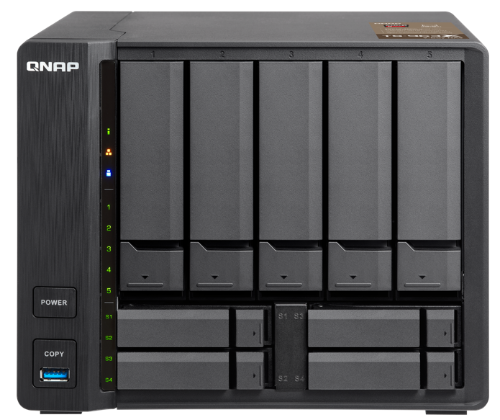
TS-963X front view
LEDs：Status, LAN,
USB, 3.5” HDDs
5 x 3.5” SATA 6Gb/s HDD bay
(also support 2.5” SSD/HDD)
Patented design
Power button
4 x 2.5”SATA 6Gb/s
SSD bay
USB 3.0 port with copy button
2.5” SSD LEDs

Slide 7
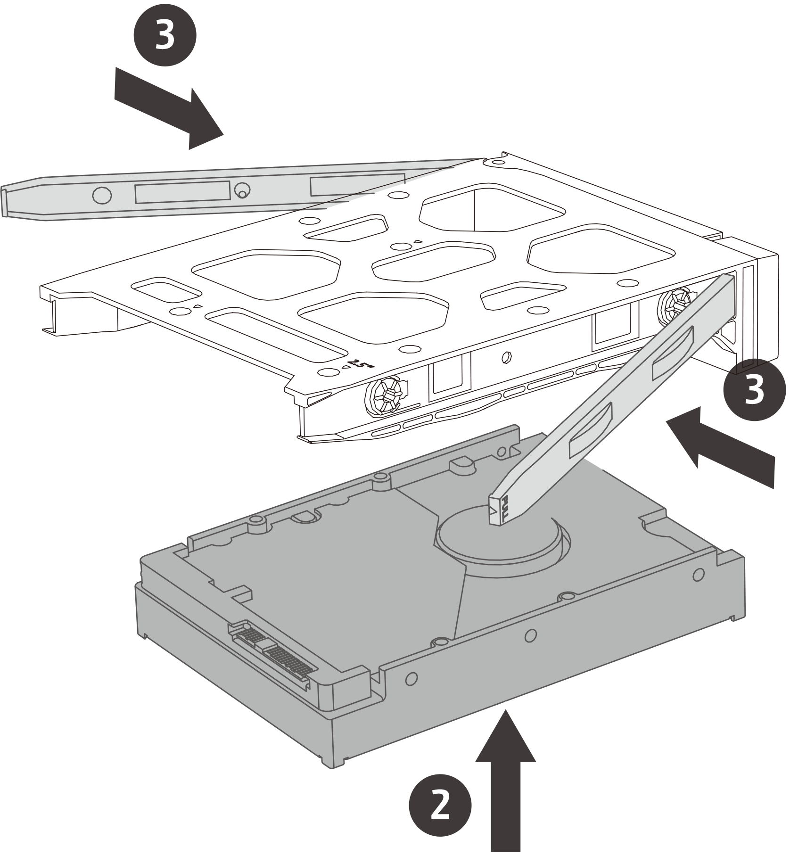
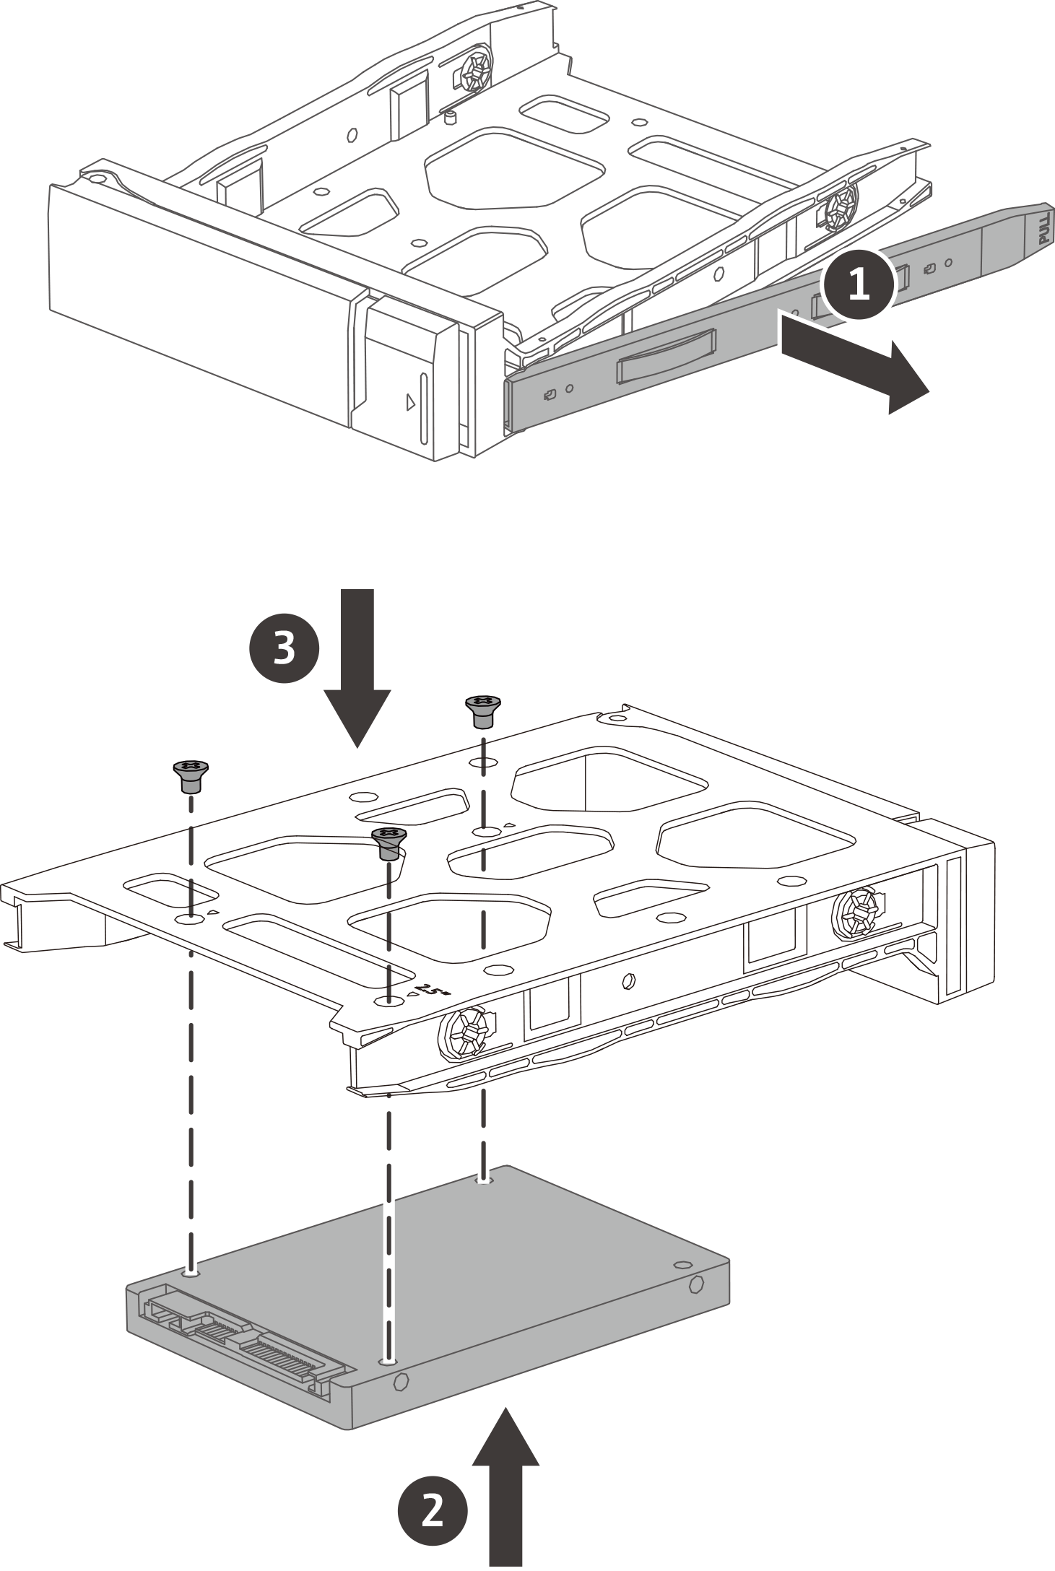
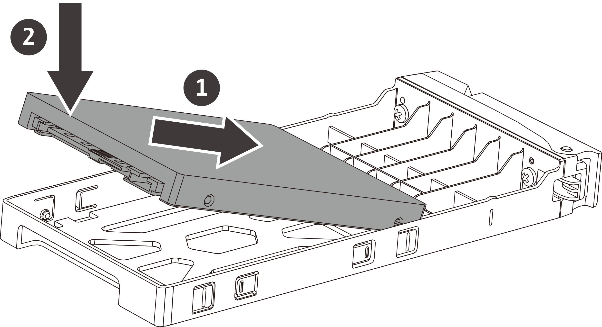
Install HDD and SSD in a snap
3.5” HDD tray
2.5” SSD tray
Also supports
2.5“ SSD with screws
Toolless installation of 3.5” HDD
Toolless installation of 2.5”SSD

Slide 8
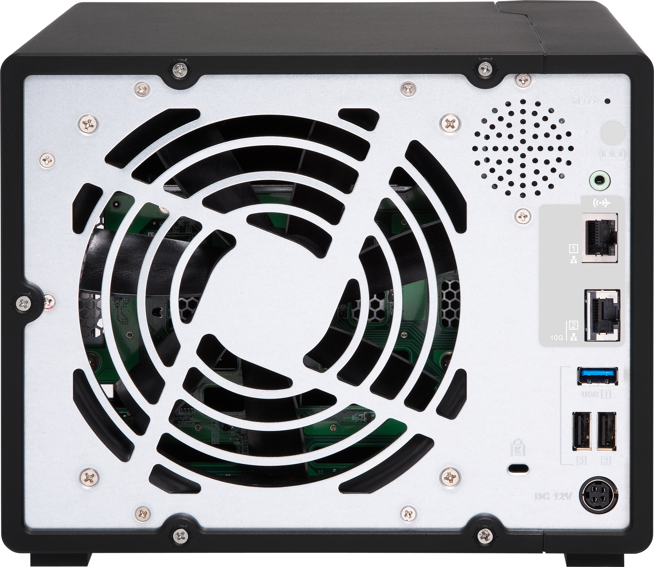
TS-963X rear view
Reset button
Speaker
3.5mm audio line out
GbE RJ-45 LAN port
10GbE 10GBASE-T
LAN port
Kensington security slot
1 x USB 3.0
2 x USB 2.0
DC 12V
power input

Slide 9



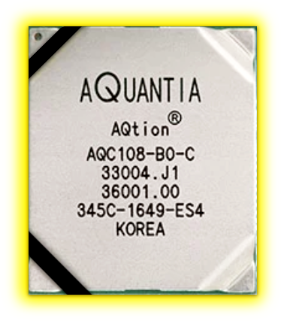
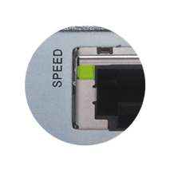
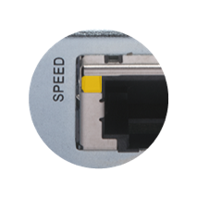
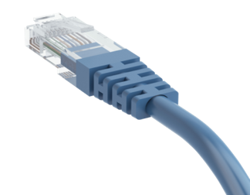
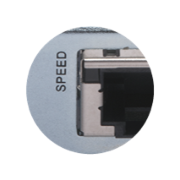
Integrated Multi-Gigabit 10GBASE-T
Five speeds
 | CAT 5e | CAT 6 | CAT 6A & CAT 7
100M | ✔ | ✔ | ✔
1G | ✔ | ✔ | ✔
2.5G | ✔ | ✔ | ✔
5G | ✔ | ✔ | ✔
10G | X | ✔(55m) | ✔
10G
5G/2.5G/1G/100M
Don’t throw away your old cables yet！
Multi-Gigabit NBASE-T technology supported
Disconnected

Slide 10
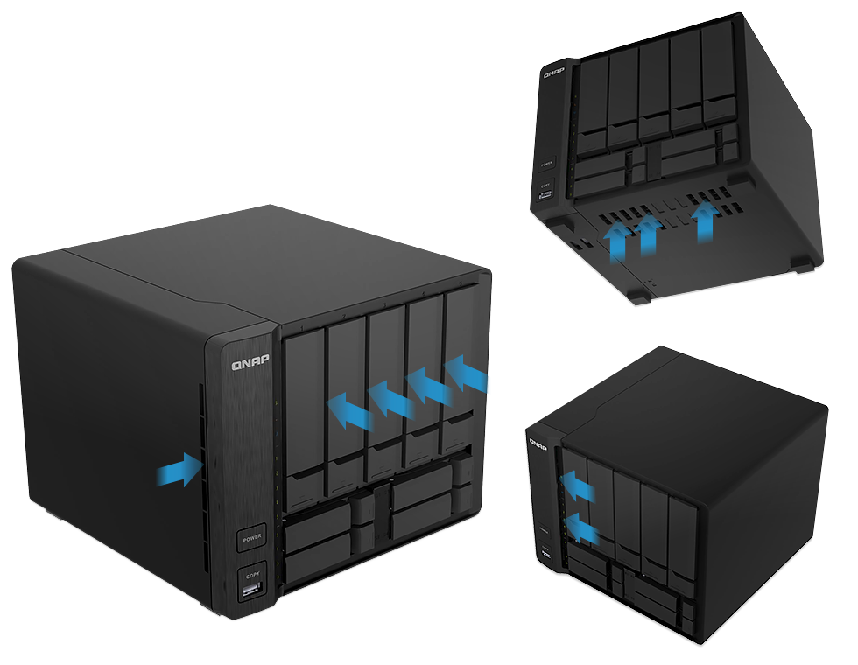
Keep NAS and drives cool and quiet
Large 14cm smart system fan
Multi air flows

Slide 11

Memory upgrade
Demo

Slide 12
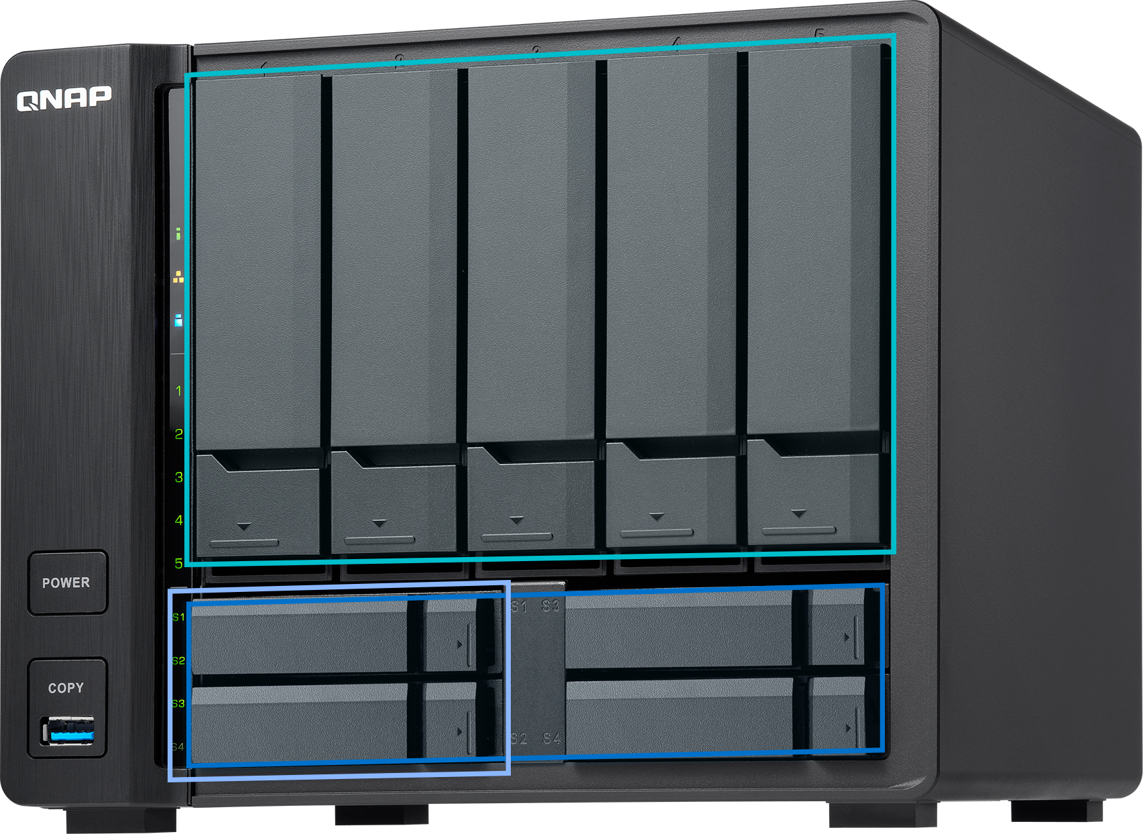

SSDs for auto-tiered hybrid architecture
5 x 3.5” HDDs for high capacity
Boost performance
Boost performance and capacity
All in one for SMB
2 x SSD for caching, RAID1
High capacity file and media server 4 x SSD for Qtier, RAID5
Boost applications’ random IO access
Boost both sequential and random access!

Slide 13

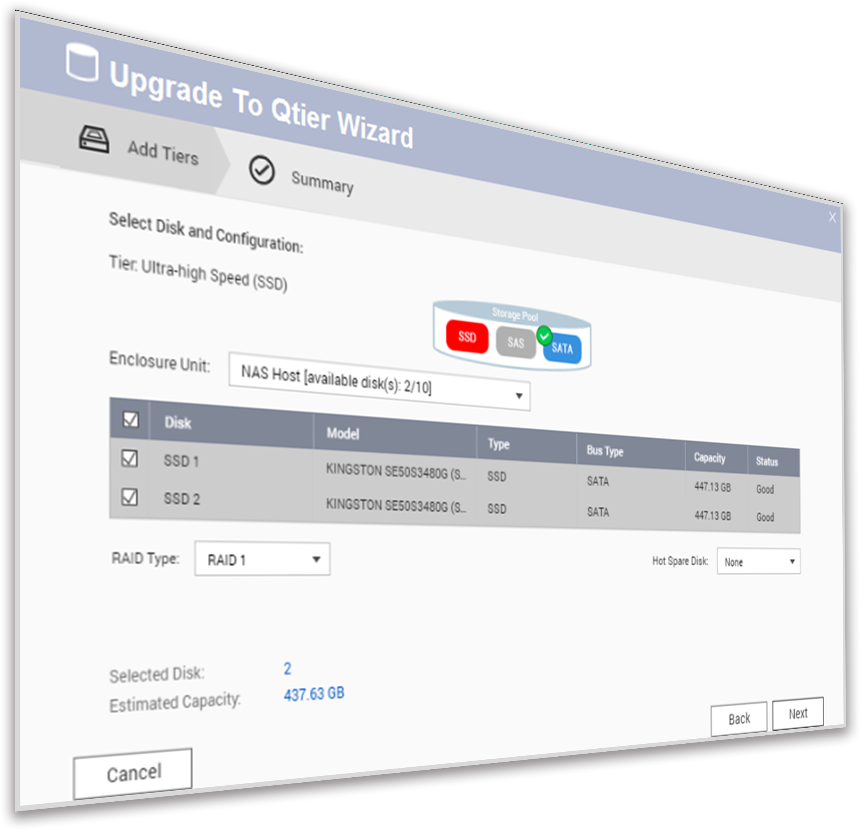
Switch from SSD cache to Qtier
Step
1
Step
2
Disable SSD cache online
Confirm SSDs that will be added to the storage pool
Step
3
Upgrade to Qtier pool!

Slide 14

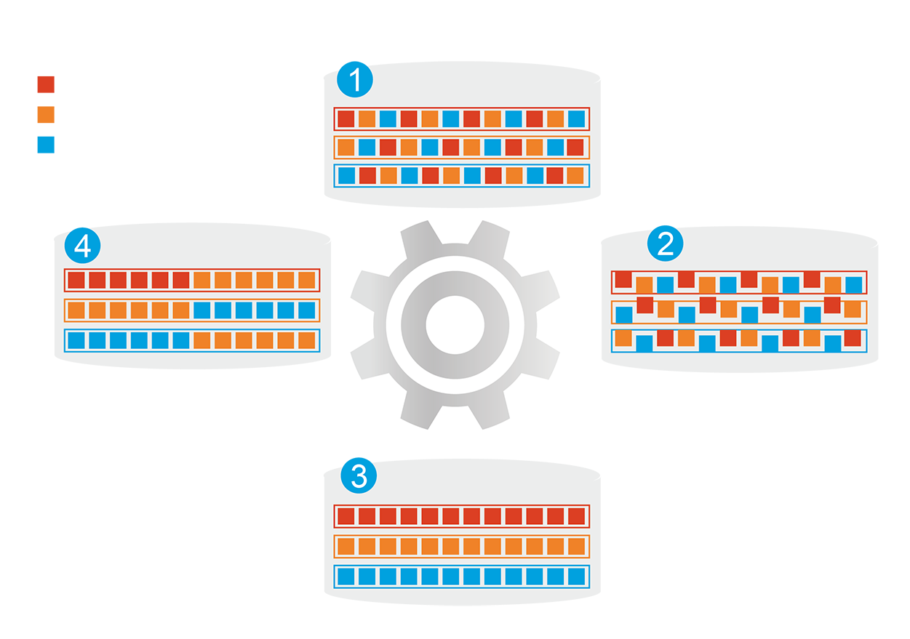
Qtier auto-tiering: speed and capacity
1
Before tiering:
Frequently-accessed data
performance is not optimized
Frequently-accessed data
Infrequently-accessed data
Automatically moves data between different tiers
Rarely-accessed data
4
Changes in data
access patterns
2
Start data tiering
SSD tier capacity will not be limited by
RAM size
How Qtier works
3
After tiering:
Frequently-accessed data
performance is optimized

Slide 15
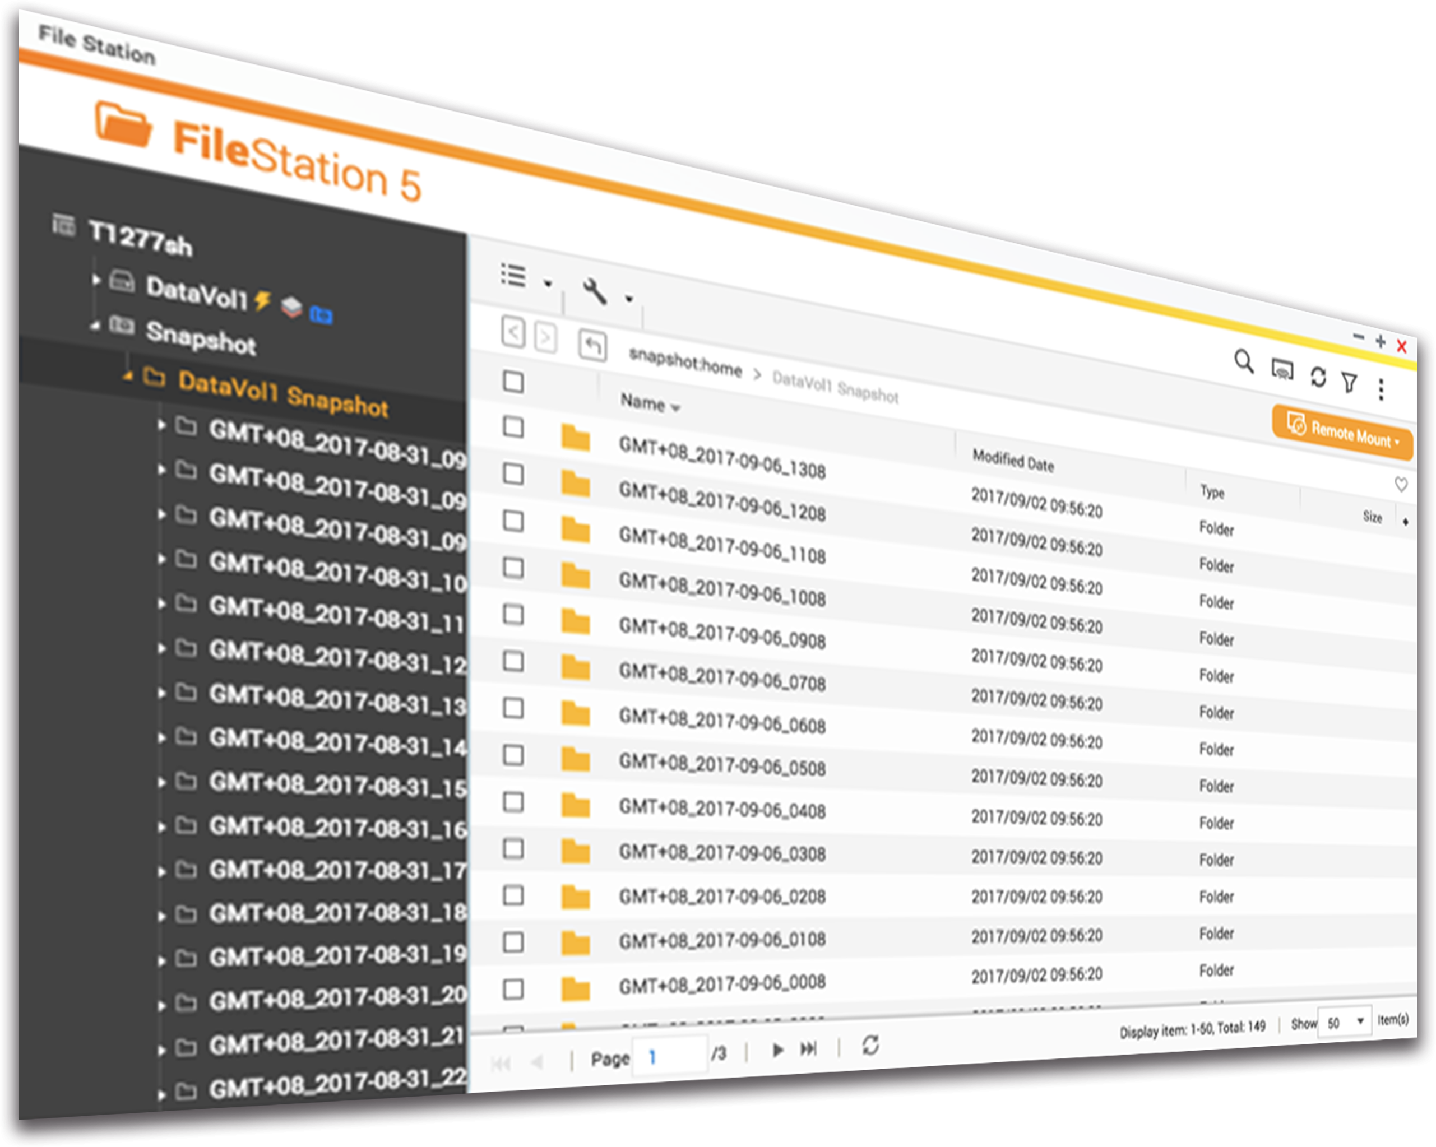
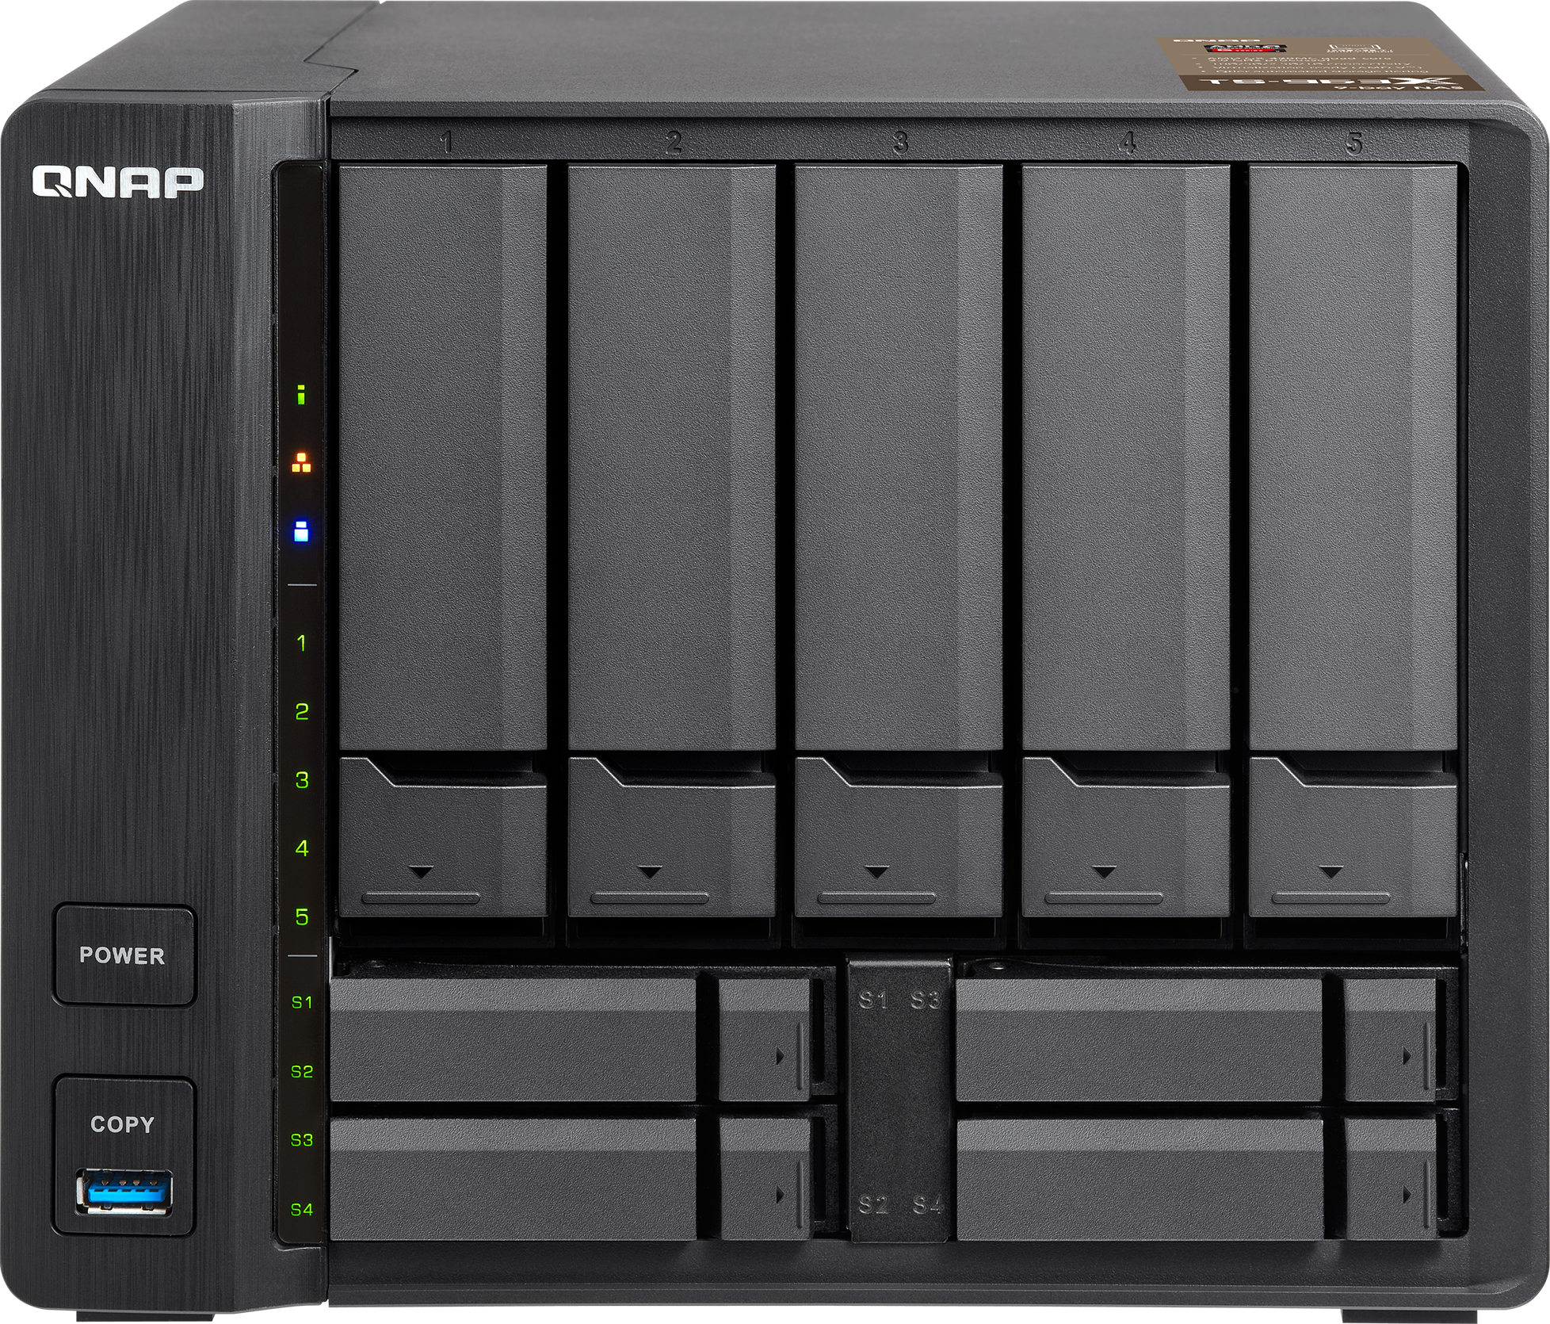

Snapshots protect your data
2GB
RAM
8GB
RAM
For whole NAS
1024
64
----------------------------------------------------
For a single volume/LUN
32
256
Memory upgrade is easy!
TS-963X

Slide 16
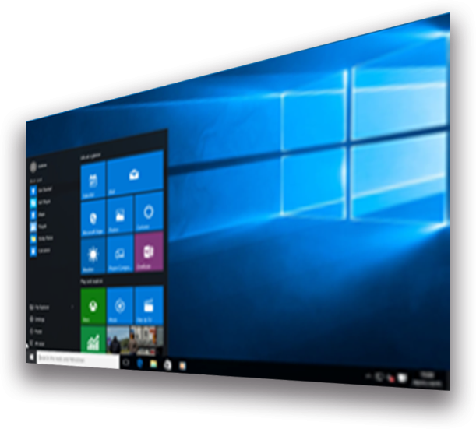

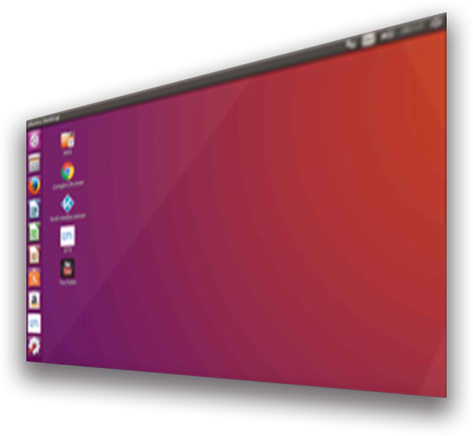

QTS & virtualization improve productivity
Supports Windows/Linux VMs and containers
Virtualization
Station
Container
Station

Slide 17

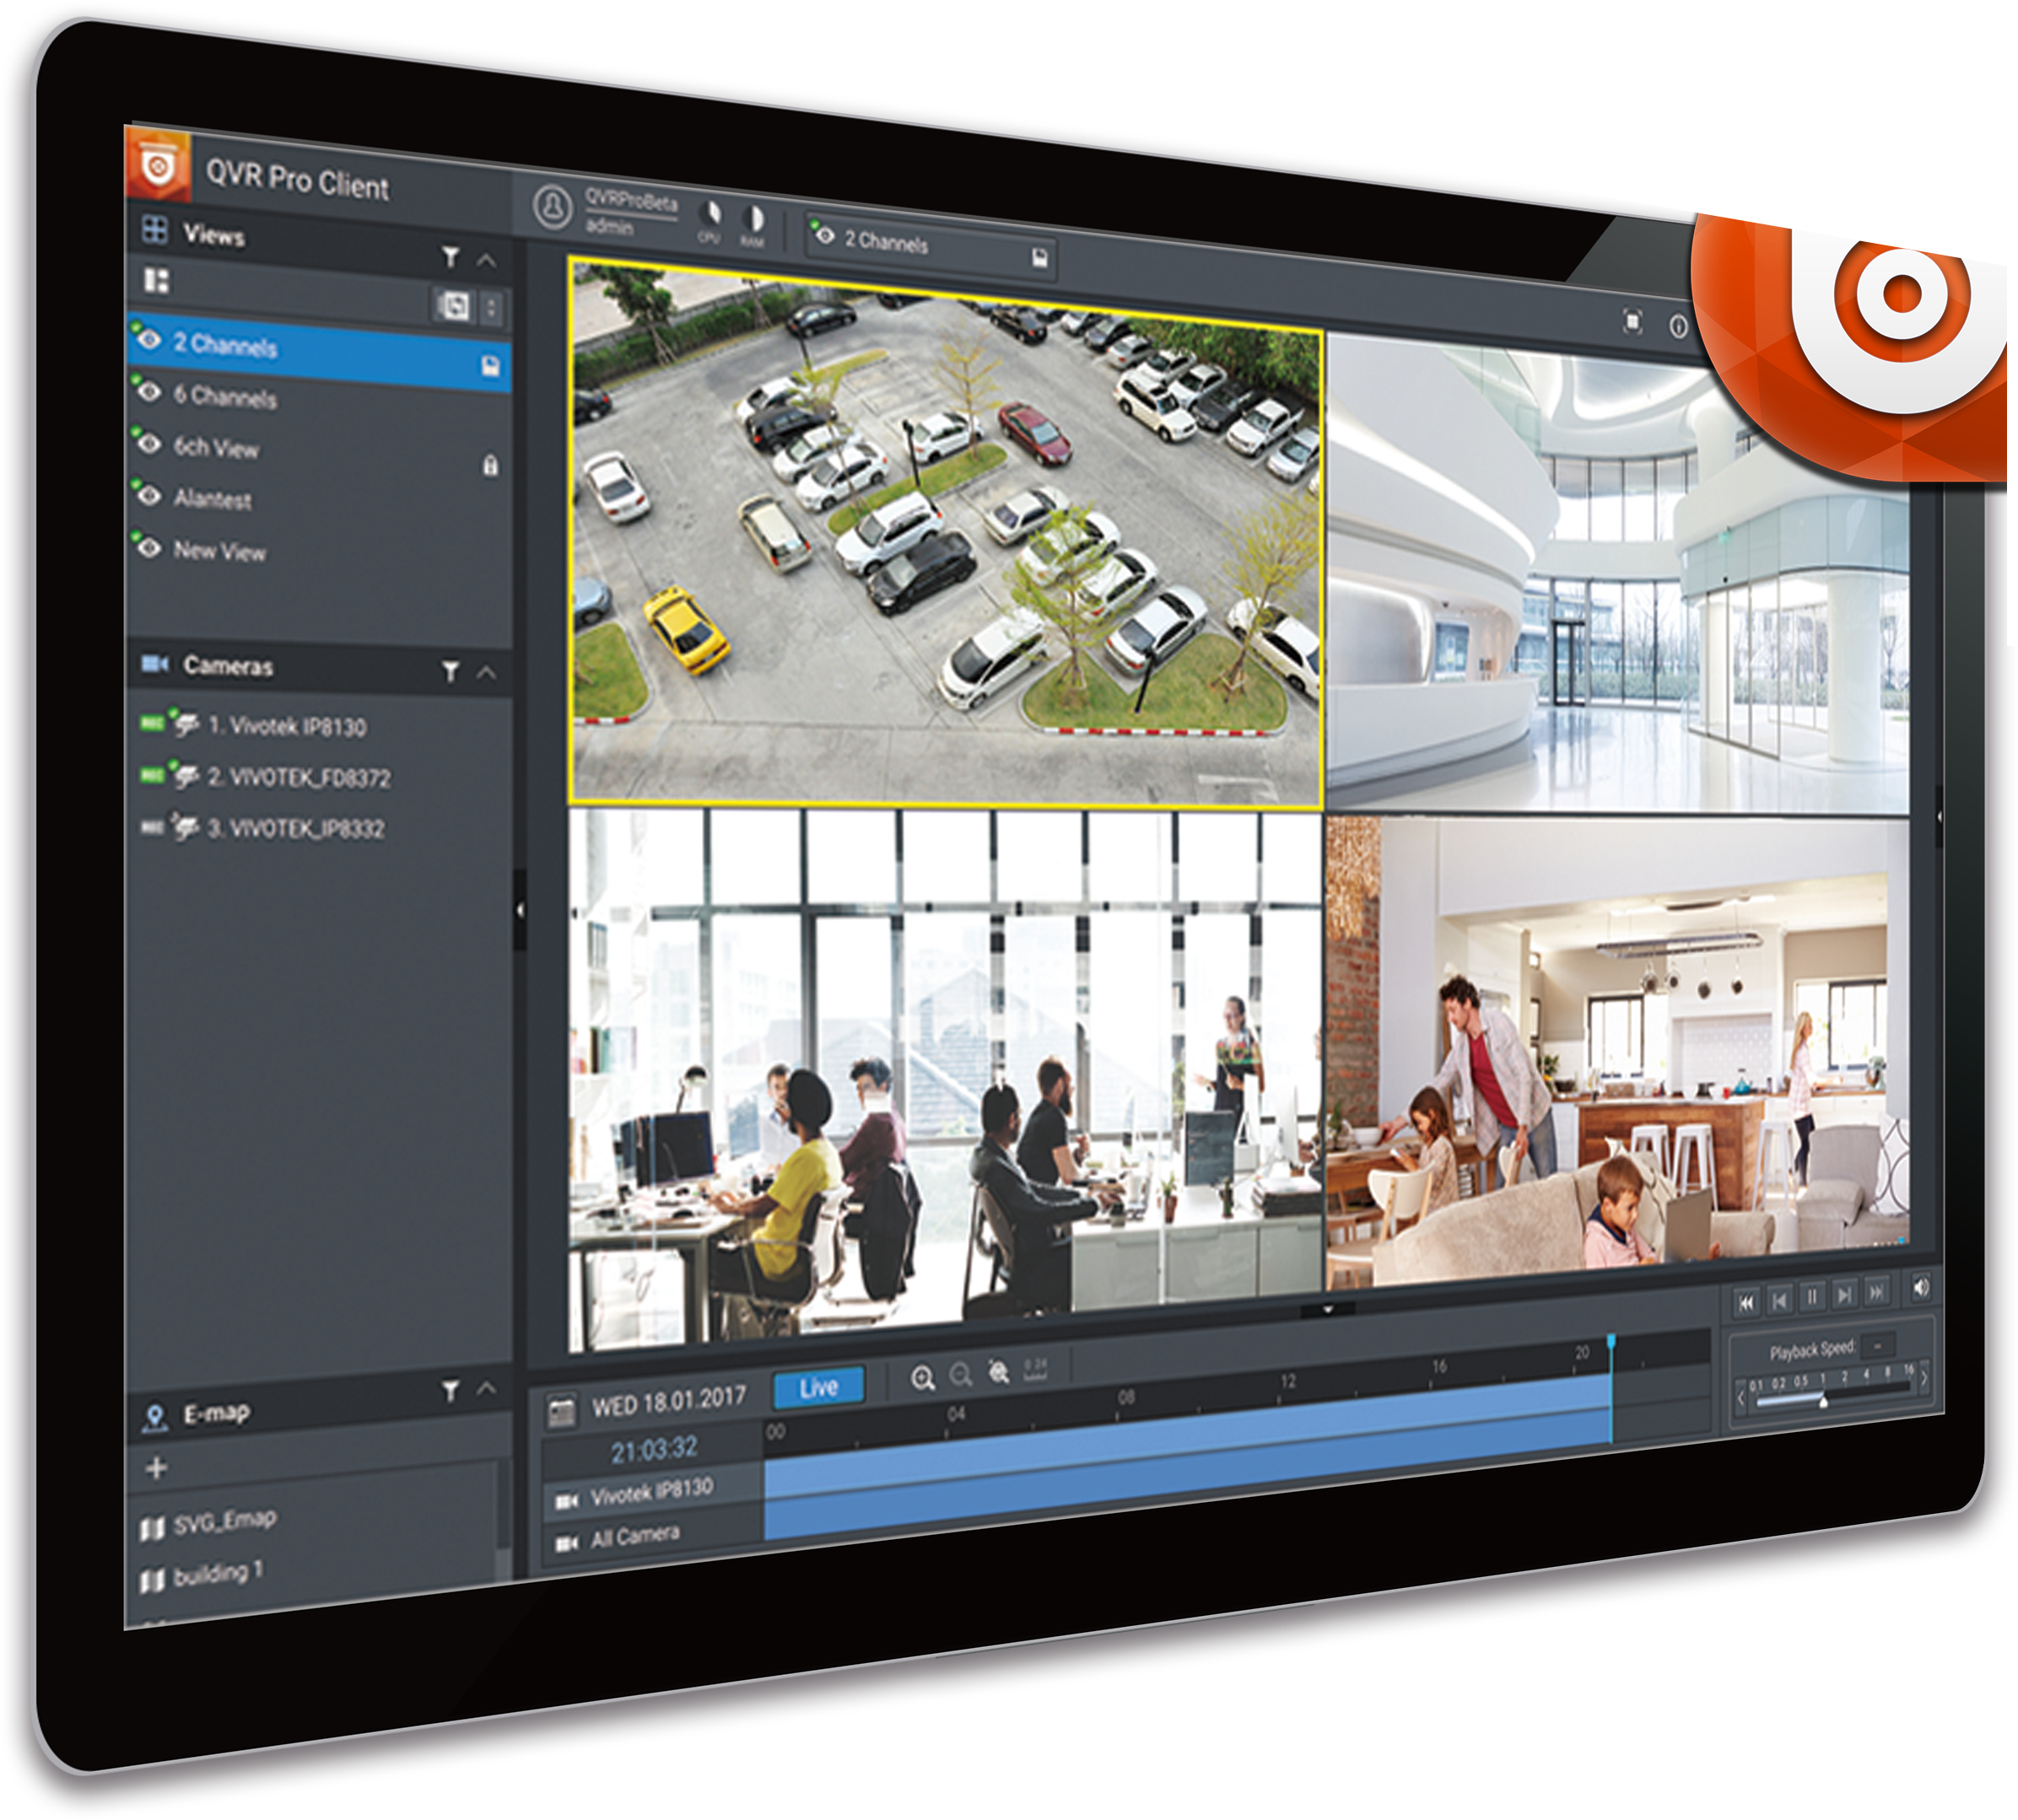


QVR Pro surveillance solution
5,000+ compatible IP cameras
8 free IP camera channels
128 max. IP camera channels
QUSBCam2 for up to 1080P USB webcam live view & recording
Surveillance Station 5.1
4 free channels
40 max channels with licenses

Slide 18





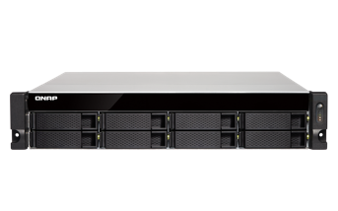
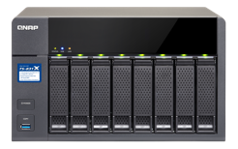
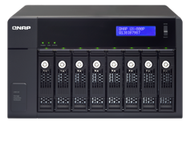
Capacity expansion
TS-963X
USB 3.0 connection
Max 8 VJBOD units
Max 1
UX-800P/UX-500P unit
1GbE / 10GbE
iSCSI connection
TS-831XU
TS-831X
UX-800P

Slide 19
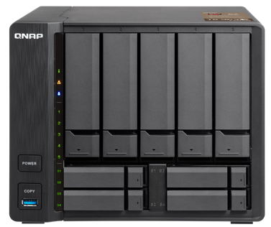

Support 10GbE 10GBASE-T
TS-563 + QM2-2S10G1T card
TS-963X integrates 10GBASE-T
2 x M.2 SSD
= RAID 0/1
4 x 2.5”SSD
= RAID 0/1/5/6/10
Fully support 10GbE high-speed networks, delivering a major speed increase for virtualization tasks, fast backup & restoration, and large-data applications.

Slide 20
10GbE data transfer
Demo

Slide 21
Quad-core performance with 10GbE 10GBASE-T and Qtier auto-tiering storage

