Slide 1


Multimedia Solution
Solution for Photographers

Slide 2

Photographer’s troubles
How to find the same files in hard disk?
Want to access
photos anytime from the smartphone.
How to backup thousands of photos?
It takes too much time to upload photos to the cloud.
Hard disk is broken.
Hard to find photos in different disks.

Slide 3


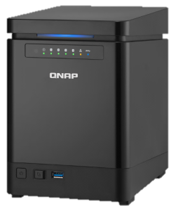

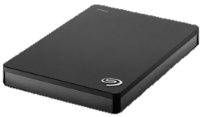
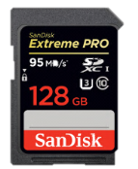
Common ways to store photos
Cloud
Portable
Private
Cloud
  Public
  Cloud
  External hard drive
  SD card

Slide 4
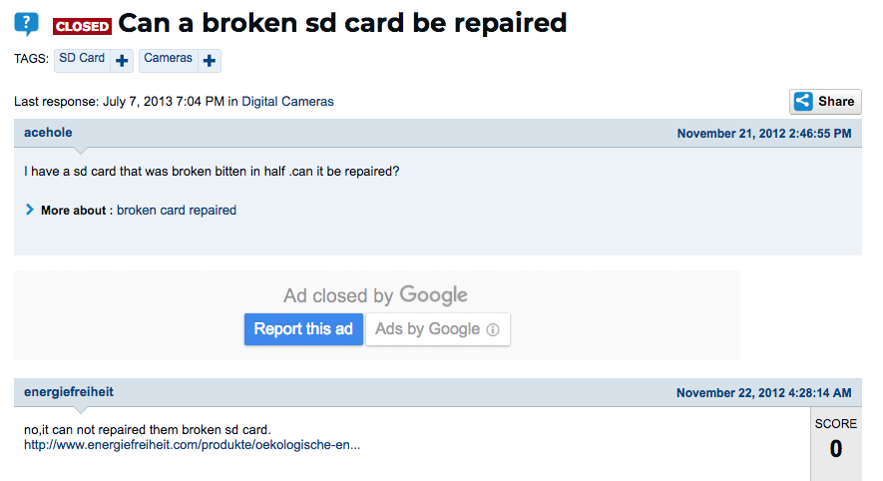
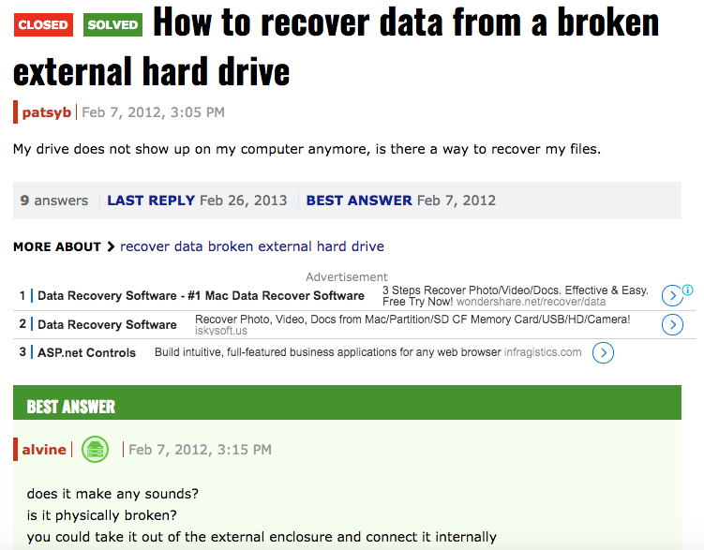
SD card & external hard drive
Advantages: low-cost, easy to use
Disadvantages: Break and lose data easily, hard to find
photos in different devices

Slide 5
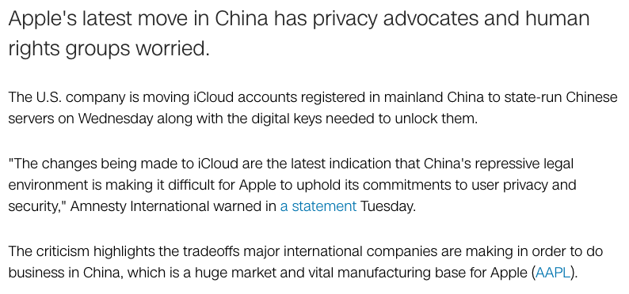

Public cloud
Advantage: Share data easily
Disadvantages: Upload files to the cloud takes time; the service may be closed anytime; data on public cloud belongs to the company, not yours

Slide 6

A Better Choice
QNAP NAS
Private cloud for photographers

Slide 7


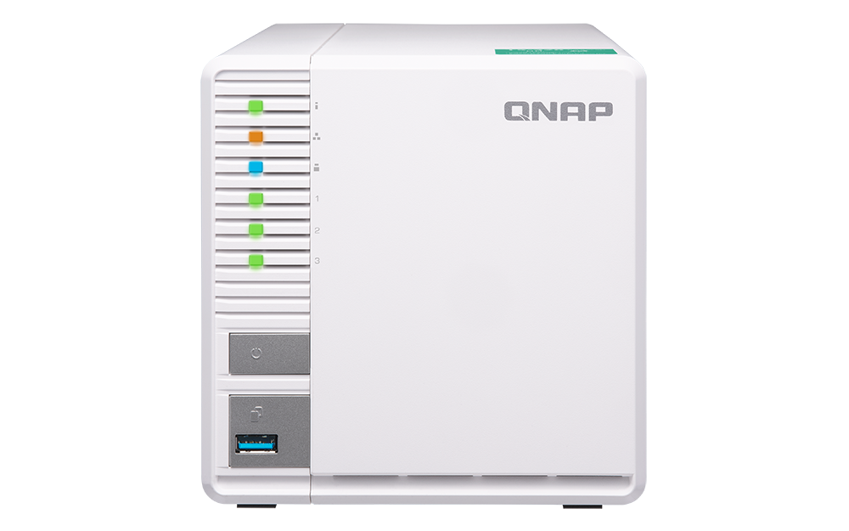

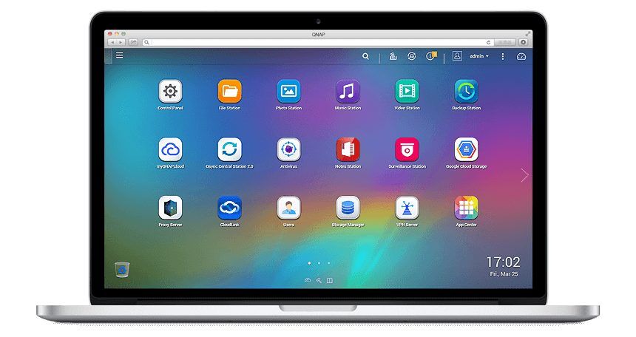
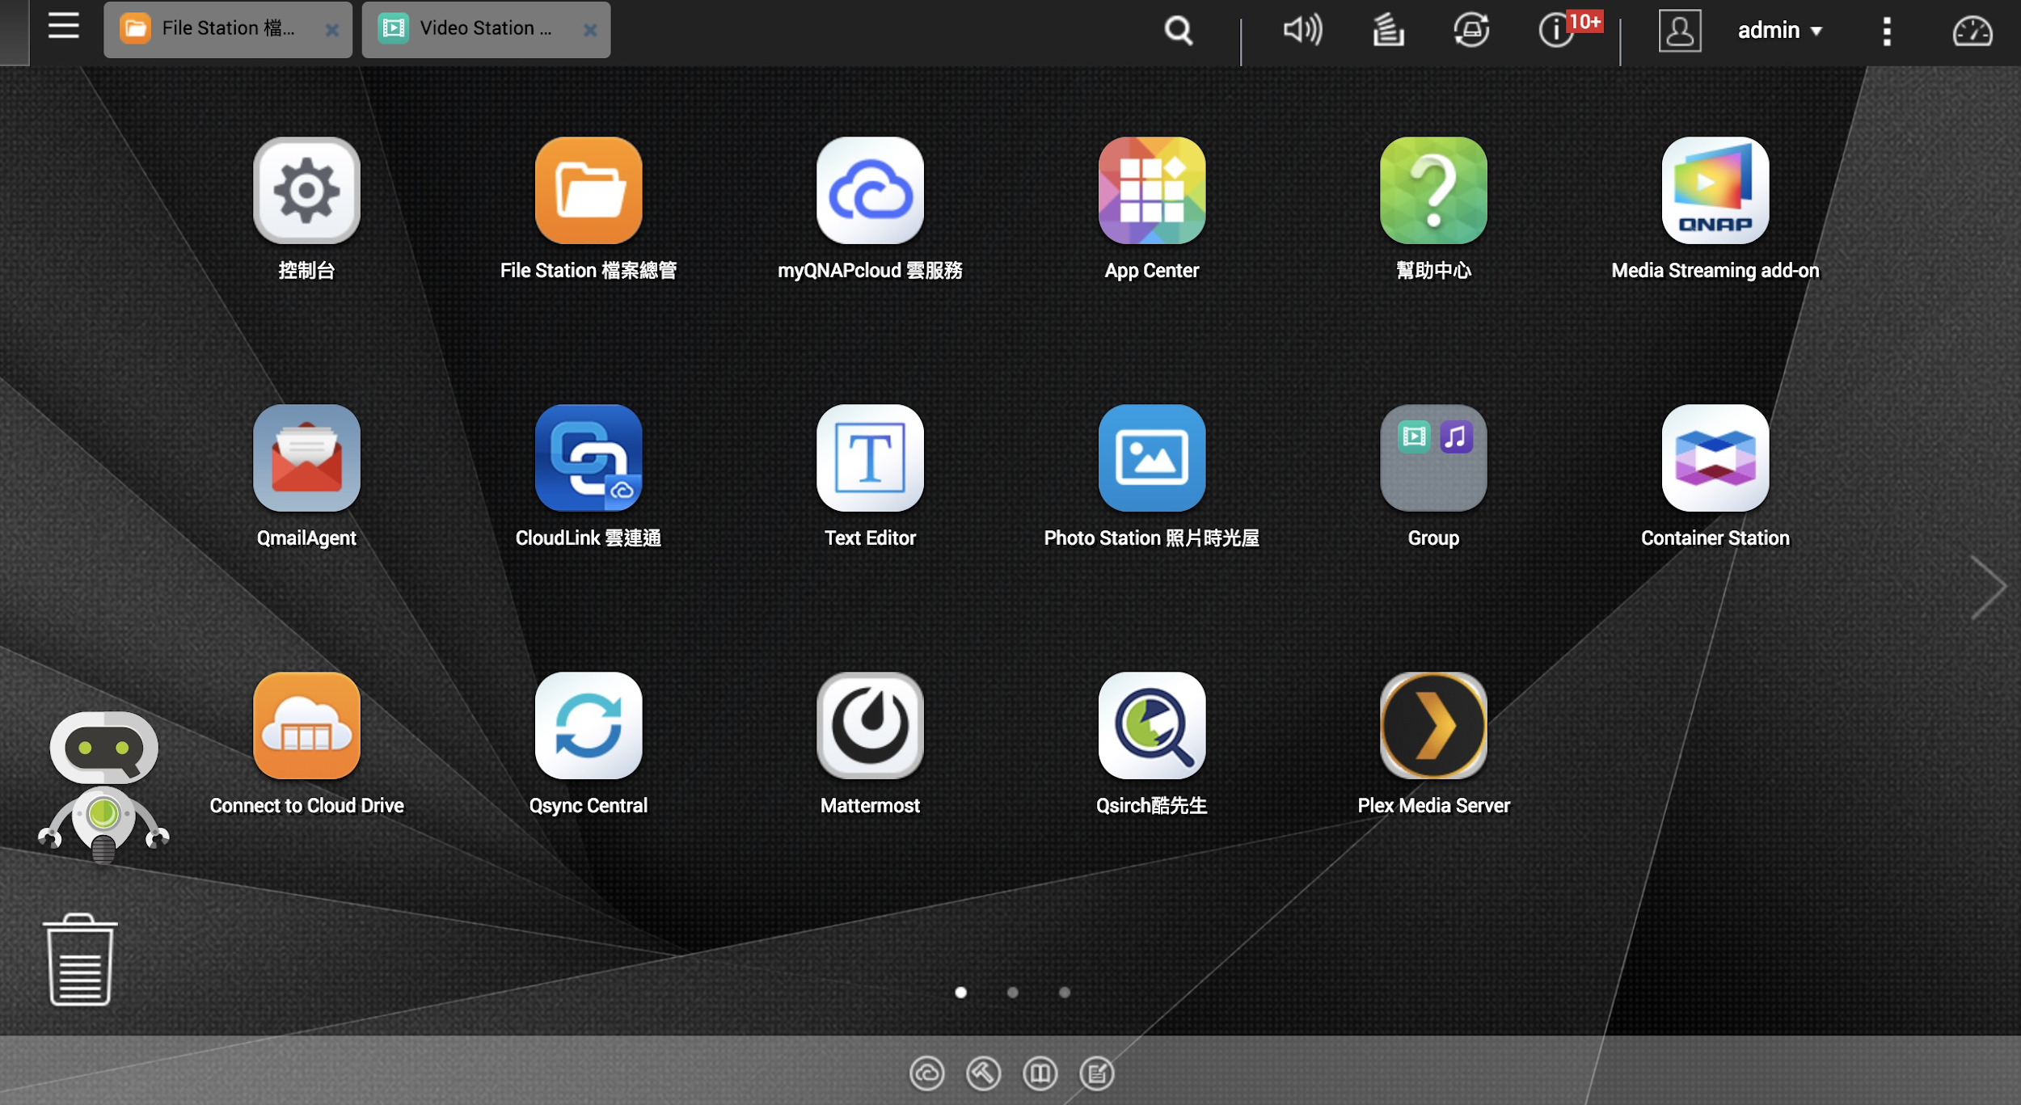
Private Cloud - QNAP NAS
A Server
Contains CPU, RAM and Apps
Easy to Access
From PC, Mac or mobile and from local or foreign networks
Secure
Multiple data security protection mechanisms
Multiple users
Different permission for users

Slide 8
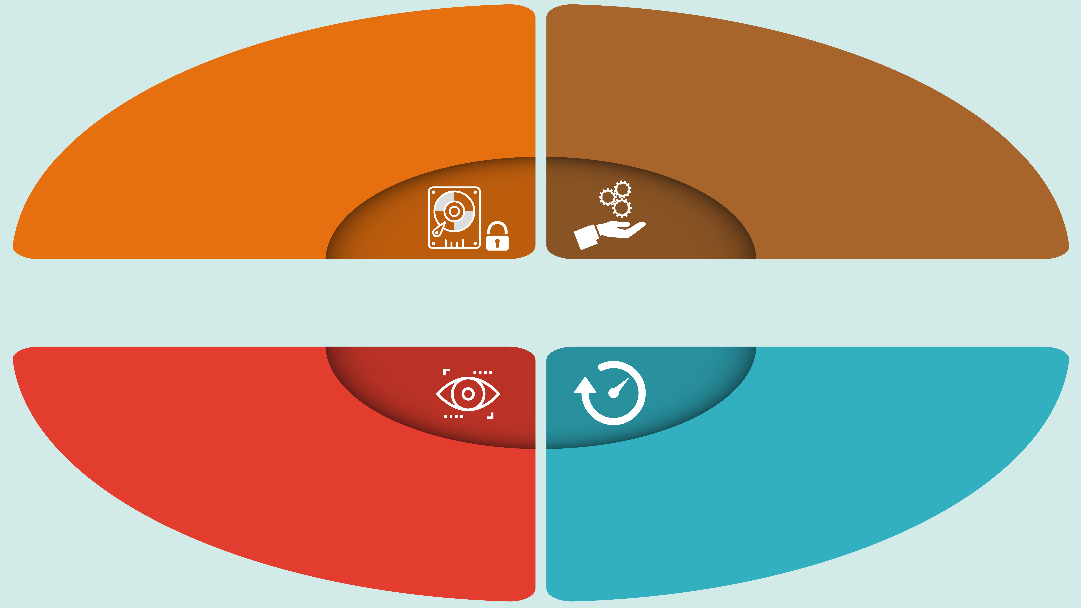
1. Secure
2. Quickly
Import
RAID1/RAID5 arrays: when one of the disks is broken, your data is still there
Just plug and use
QNAP NAS 4 Advantages
Easy to browse and share
Transmit photos rapidly
3. Flexibly
Manage
4. High-speed
Editing

Slide 9
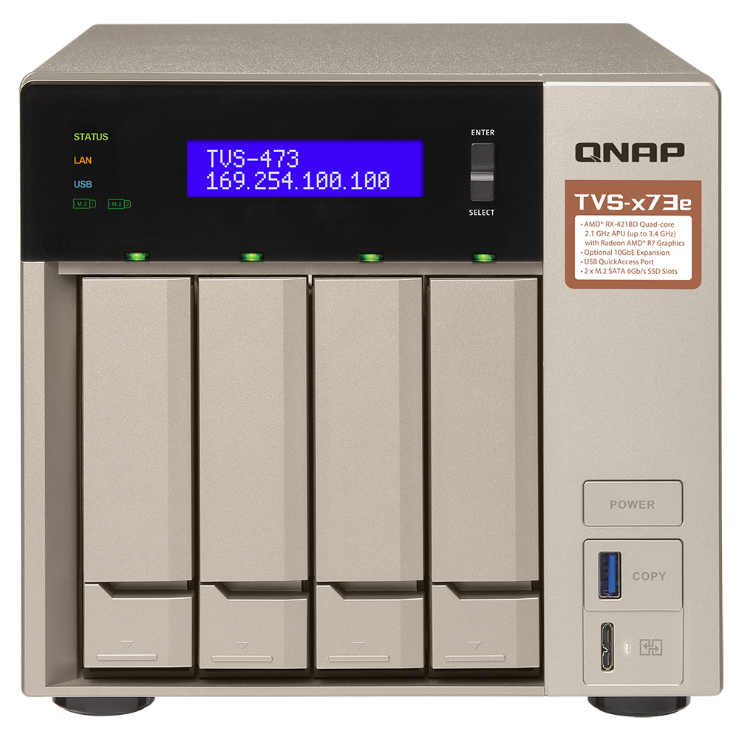



No.1
Secure
RAID1/5
Settings
When one of the disks is broken,
your data is still there.
Snapshot protection
Prepare multiple copies at different locations

Slide 10
What is RAID?
RAID | Disk number | Capacity | Data protection | Performance | Usage
RAID 0 | 2 | 100% | No | Excellent | High speed server
RAID 1 | 2 | 50% | Good (Allow 1 hard drive to be broken) | Normal | 2-bay Disk group
RAID 5 | 3 | (Disk number-1)* Capacity | Good (Allow 1 hard drive to be broken) | Good | 3~5-bay Disk group
RAID 6 | 4 | (Disk number-2)* Capacity | Excellent (Allow 2 hard drive to be broken) | Very good | 6-bay above Disk group
RAID 10 | 4 | 50% | Good (Allow 1 hard drive in RAID1 group to be broken) | Excellent | High speed server
Note: It’s better to use the disks with the same capacity when setting the RAID configuration

Slide 11
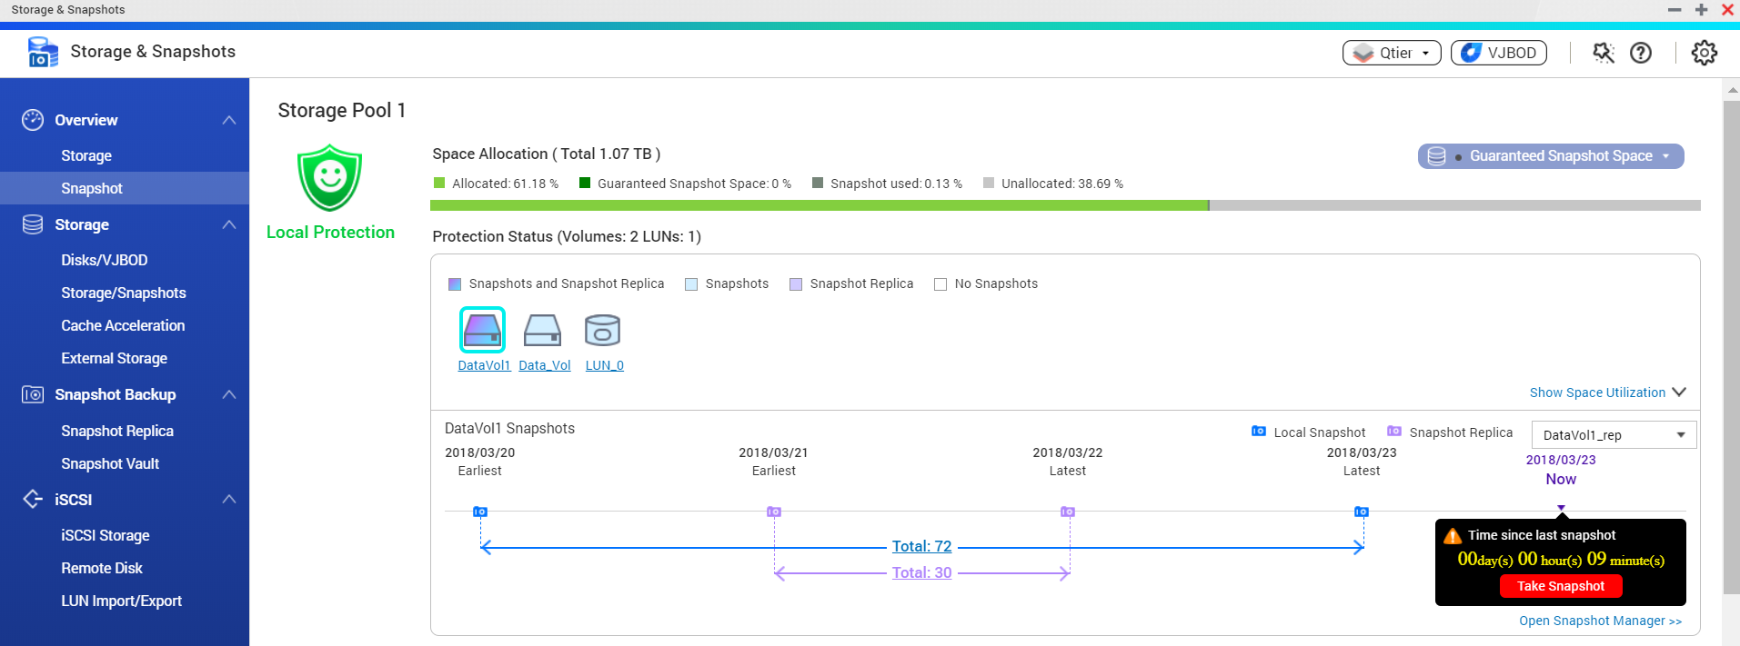

Snapshot Protection
Supports up to 256 versions backup per volume/LUN, 1024 versions per NAS.*
Quickly restore whole disk / LUN
Block-level snapshots protect from ransomware
*The number of snapshot versions supported vary by model. Please check QNAP website for more detail.

Slide 12





Backup at different locations
Don’t put your data in the same place. Any disaster can ruin all your data within a short time.
Don’t put all your eggs in one basket
Don’t put all your photos in one NAS
RTRR: Remote synchronization between NAS
(Real-time Remote Replication)

Slide 13
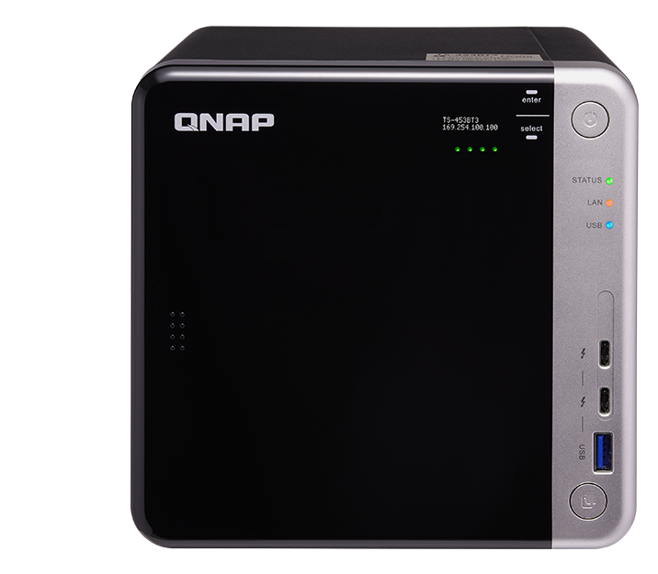
No.2
Quickly Import
Plug and use
Directly connect via Thunderbolt or USB port
Automatically archive photos from multiple sources

Slide 14

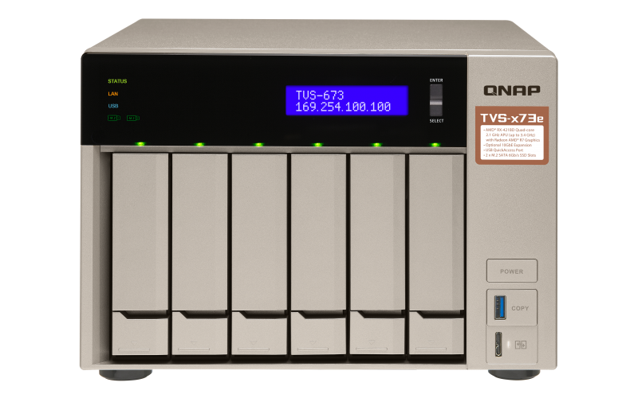
How to move thousands of photos to NAS?

Slide 15
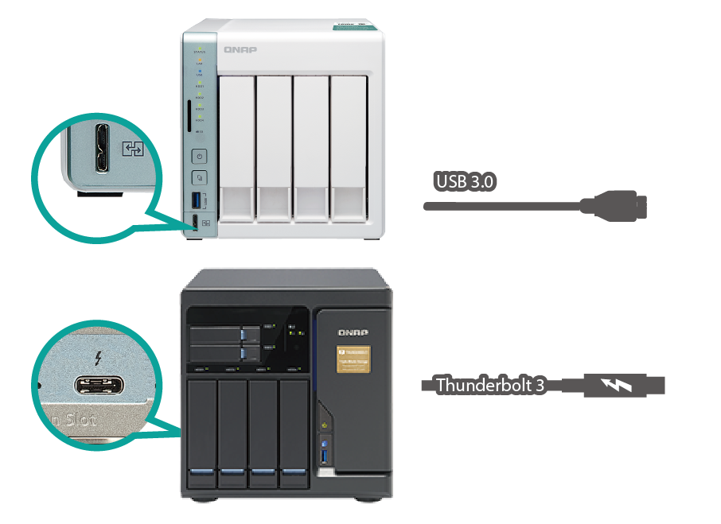
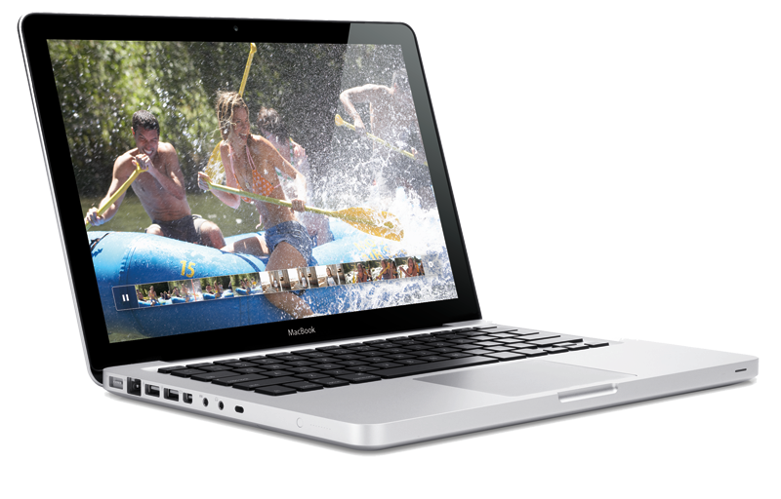
1
USB/ Thunderbolt connection
Just like backup photos to an external hard drive
Transfer speed
USB 3.0
4 minutes / 1000 RAW files
Thunderbolt 3
40 seconds / 1000 RAW files

Slide 16
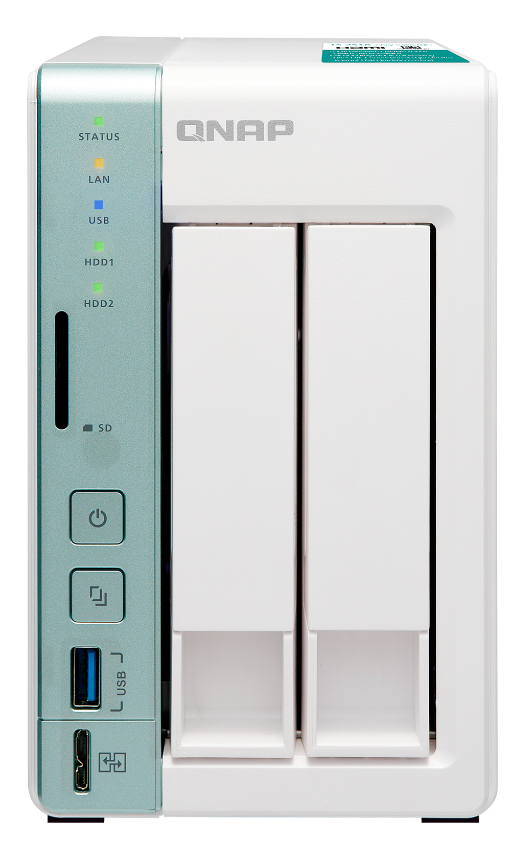




2
Qfiling: File organization
Archive photos by multiple criteria to destination
Three steps to use
Select source
Set filing criteria
Select
destination
Auto archive by schedule

Slide 17
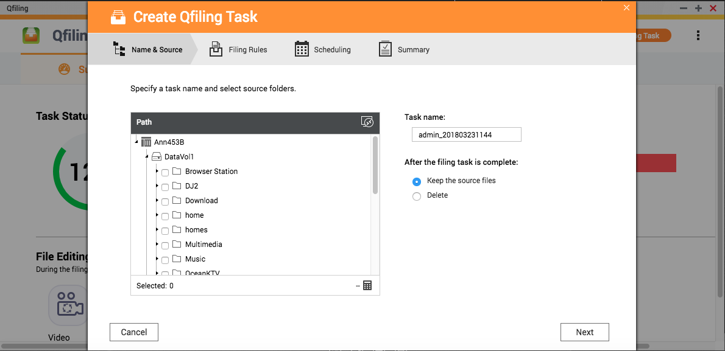
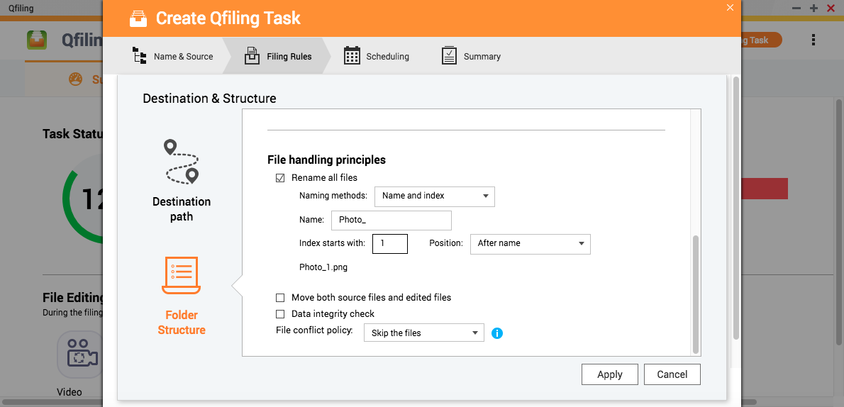
Why Qfiling?
Automatically rename photos
Only save one copy for identical photos
Rename different photos with the same name

Slide 18
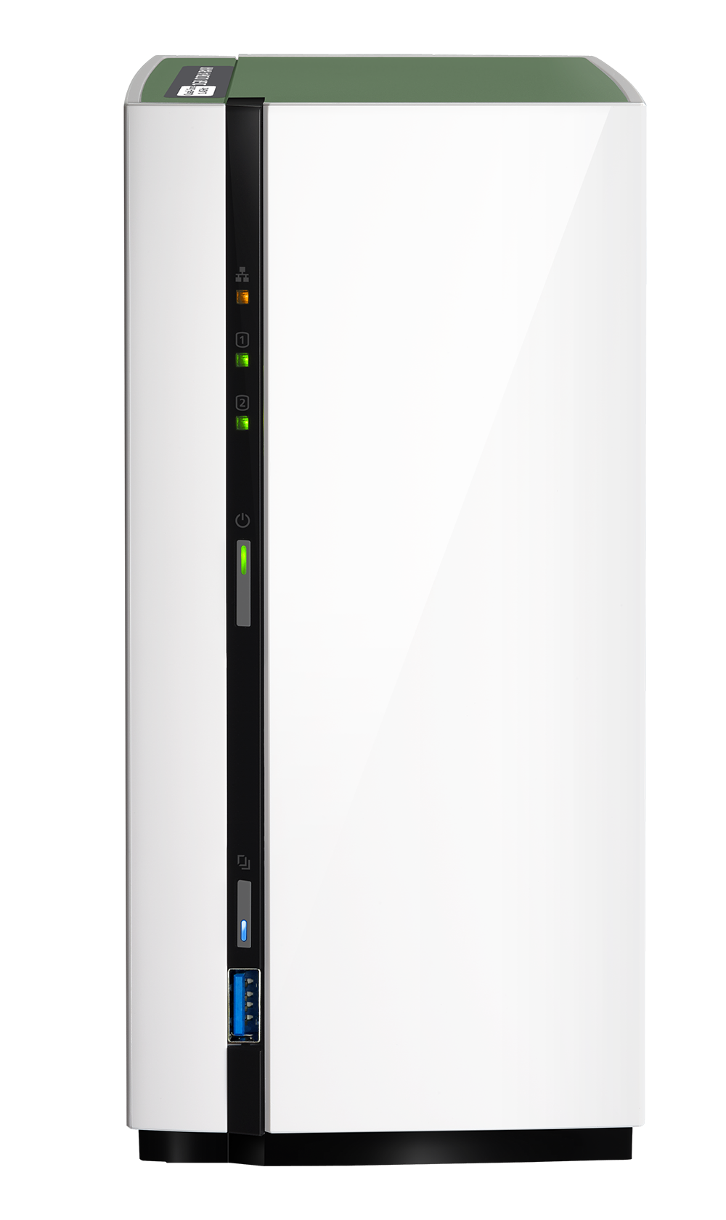
No.3
Flexibly Manage
Useful Applications
Use Qsirch to find photos quickly
Use Photo Station to create a portfolio
Share the portfolio instantly

Slide 19


How to find photos after backup them to the NAS

Slide 20


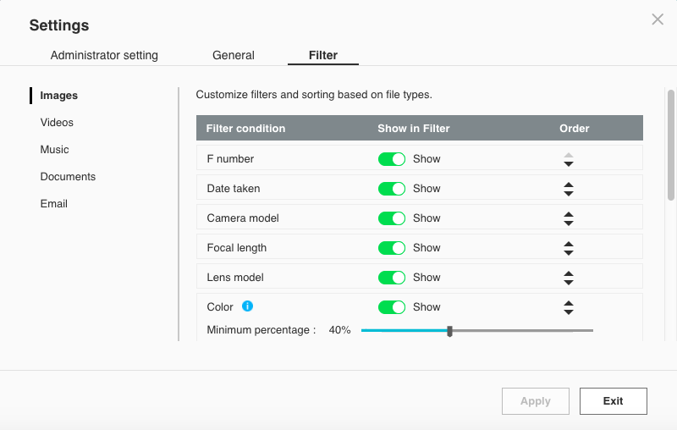
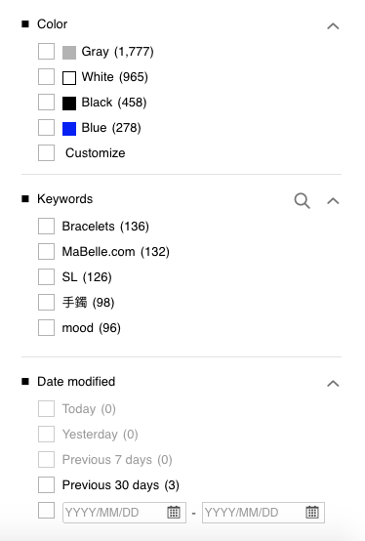


Qsirch:
Use filters to find photos

Slide 21
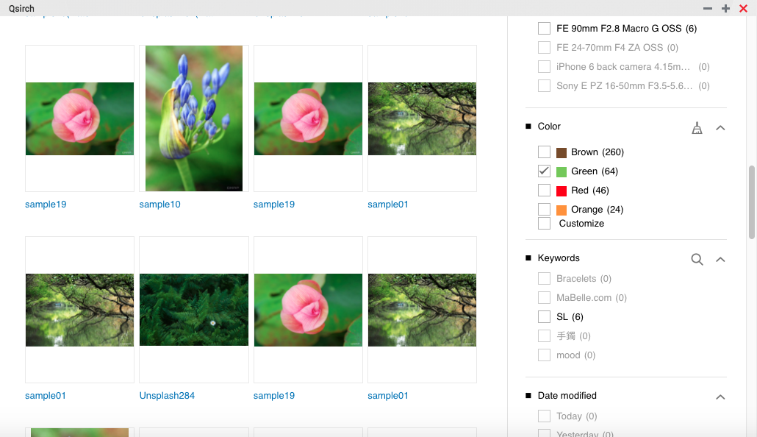
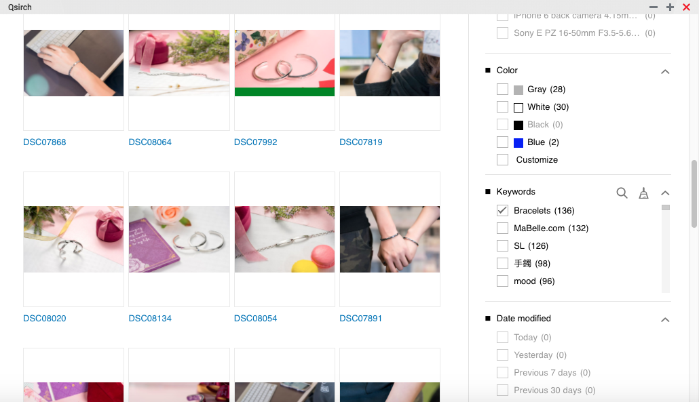
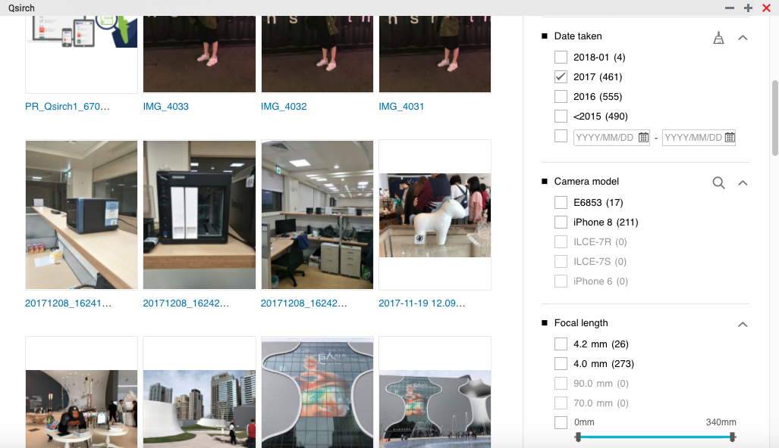
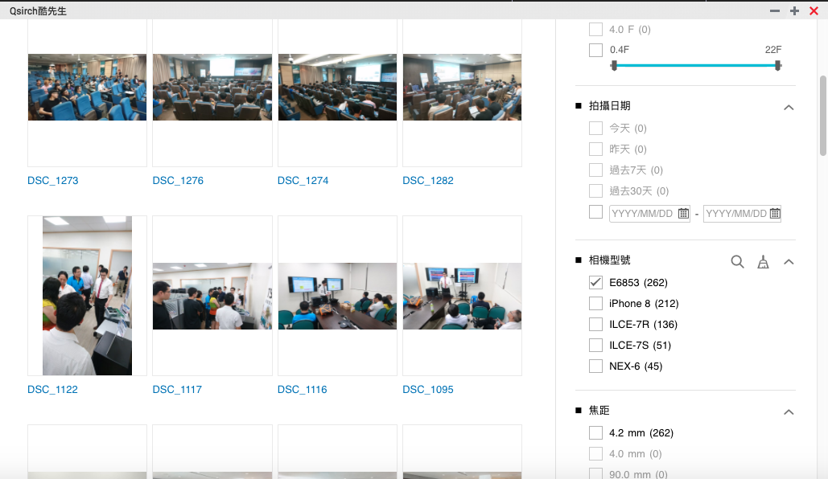
Color filter
Keywords filter
篩選相機型號
Date taken filter

Slide 22
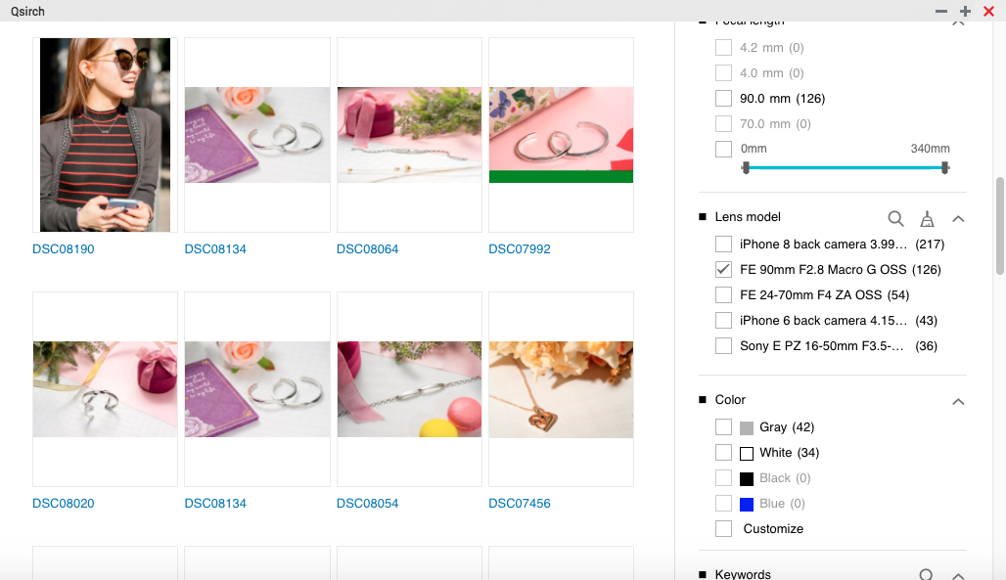
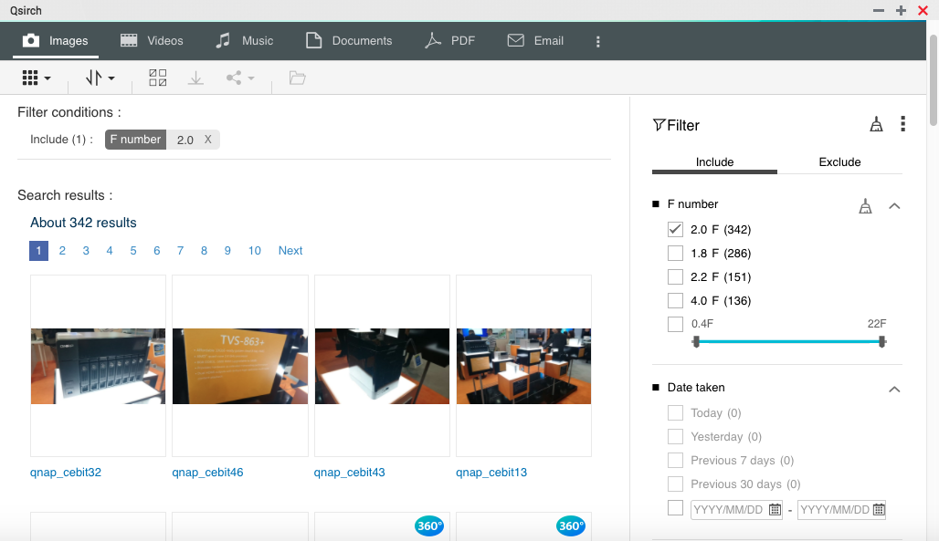
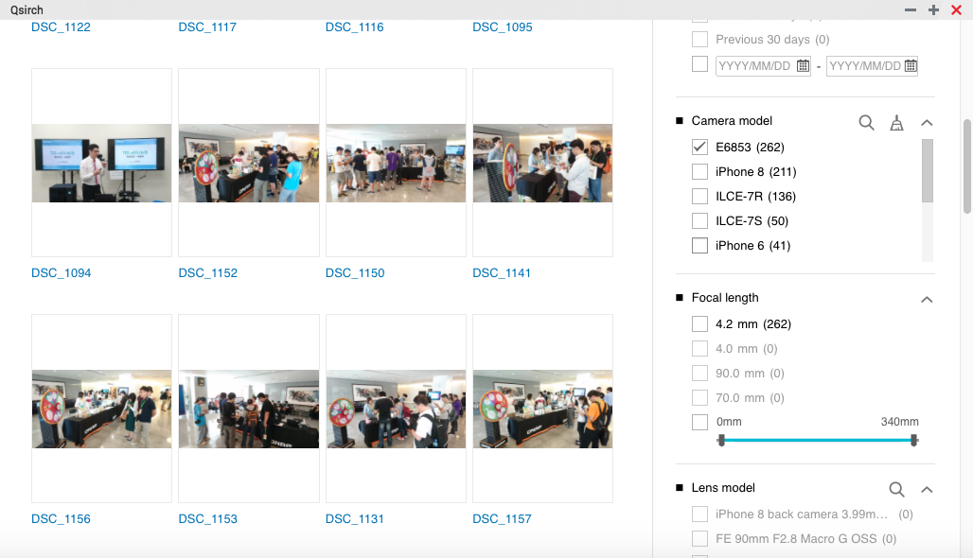
Lens model filter
F number filter
篩選光圈值
Camera model filter
篩選相機型號

Slide 23


Use Photo Station to
Create a Portfolio

Slide 24
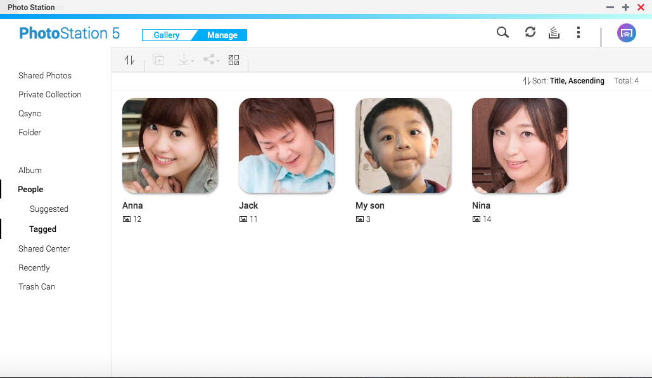
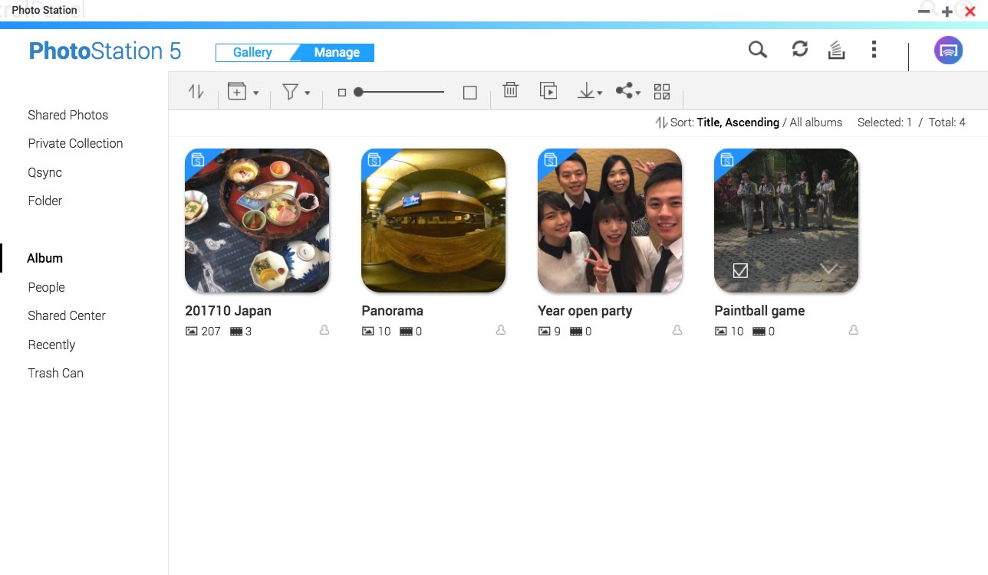
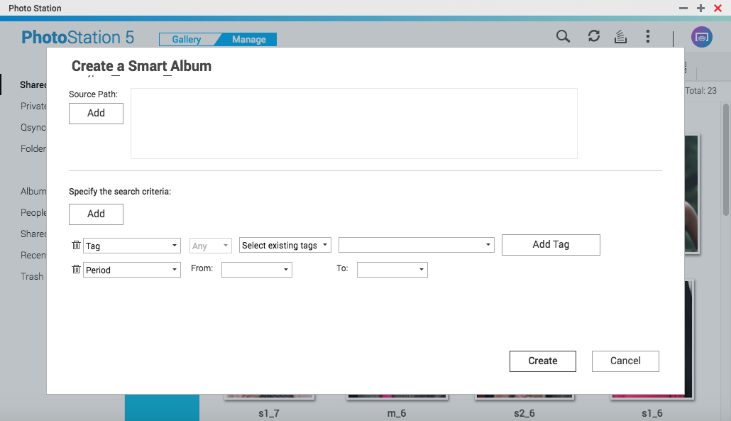
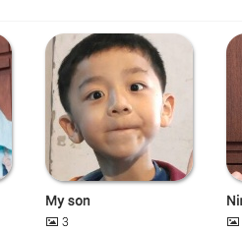
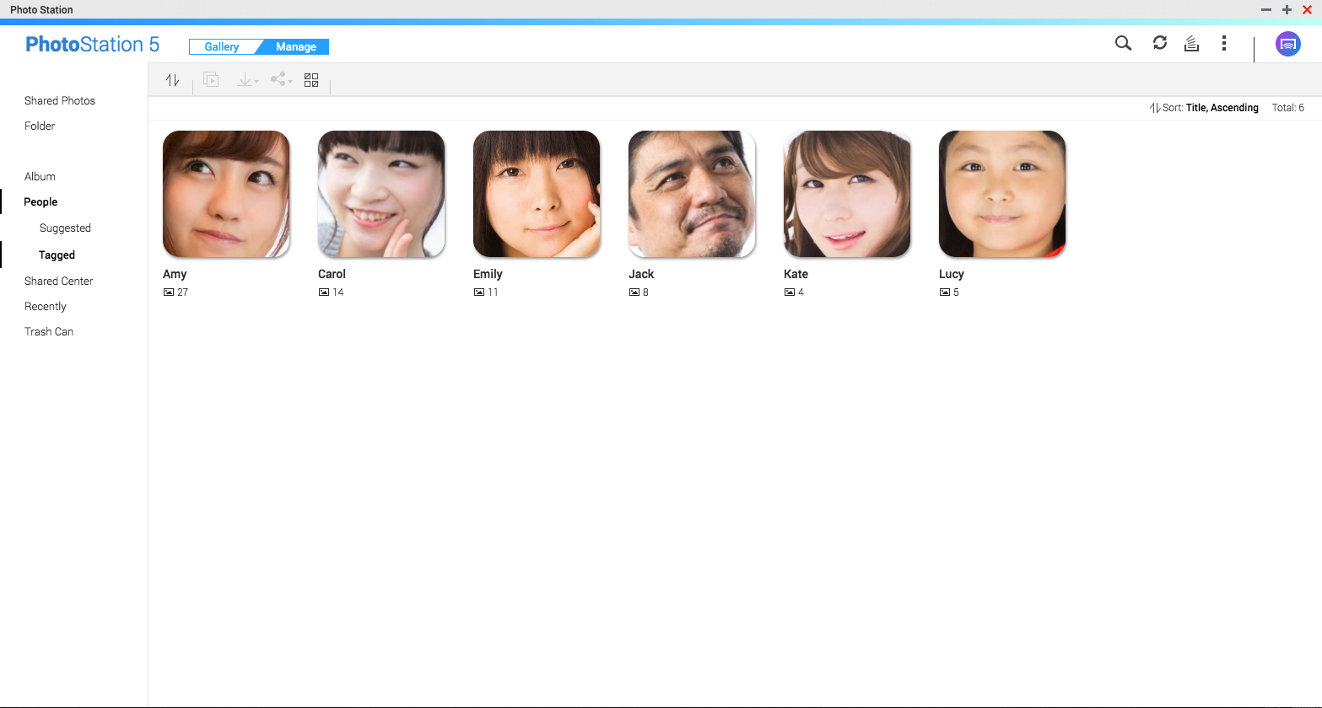
Photo Station portfolio
Facial Recognition
Albums and Smart Albums
Enter a keyword “wedding”
Group my son’s photos
Find photos of Tokyo in Feb. by date taken
Create smart albums by date taken, keywords and etc.
Add photos to an album manually
    * Only support x86 models
    * Requires Photo Station
    Extension to be installed

Slide 25

How to share photos in NAS ?
Share wedding photos to the couple
Share my son’s photos to friends
Photos of Tokyo are for the exhibition

Slide 26
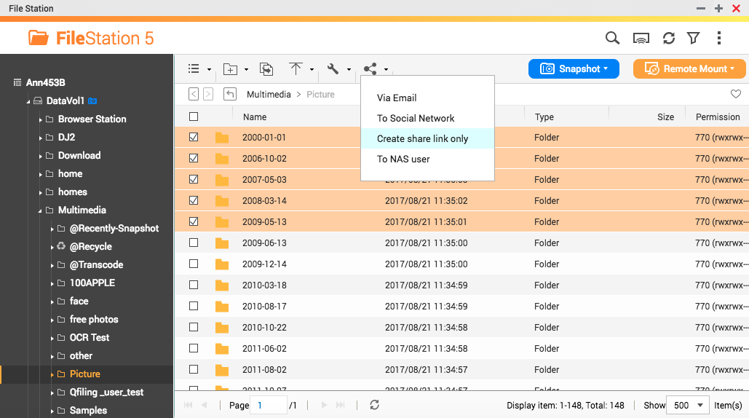
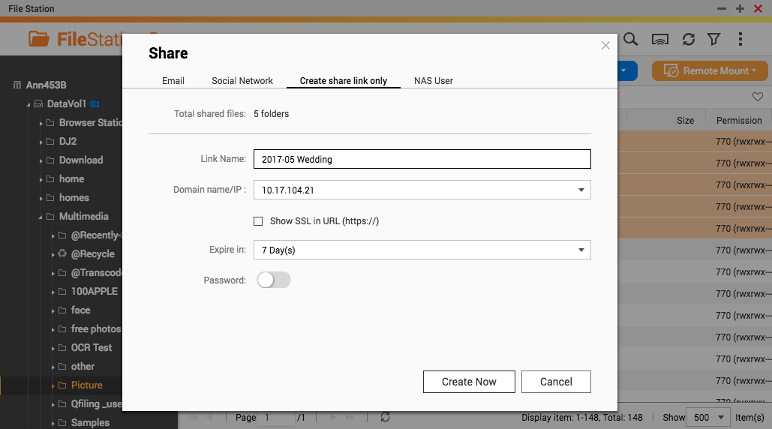
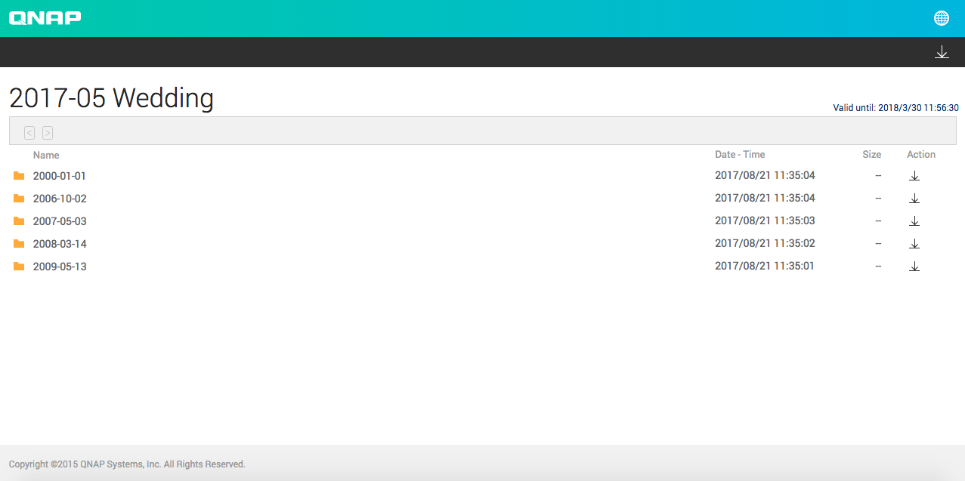
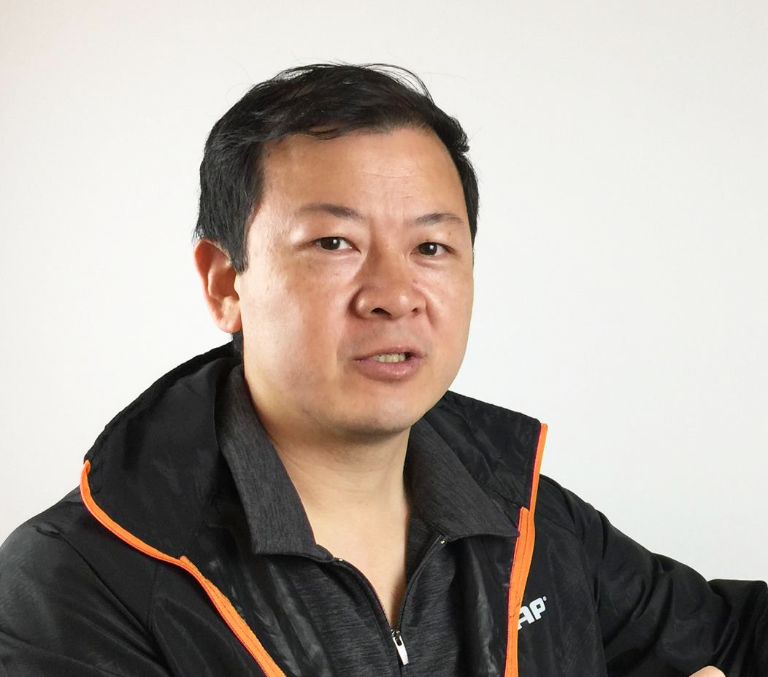

Use File Station to share folders
Find folders
Set sharing method
Send the link
Select folders to be shared
Create a sharing link
Specify link name, expiration or password
Send the link to customers
Allow uploading files

Slide 27

How to Display Your Photos
on Big Screen?

Slide 28
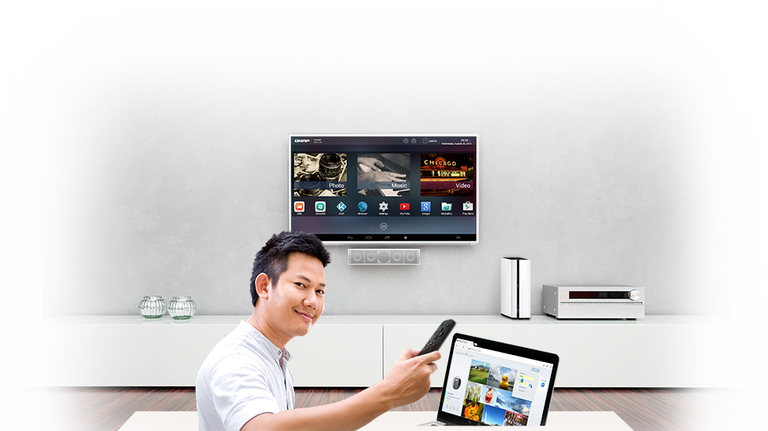


Share photos with others on big screen using HDMI
Support remote control
HD Player

Slide 29

Want to Share Photos on NAS Using Smartphone?

Slide 30
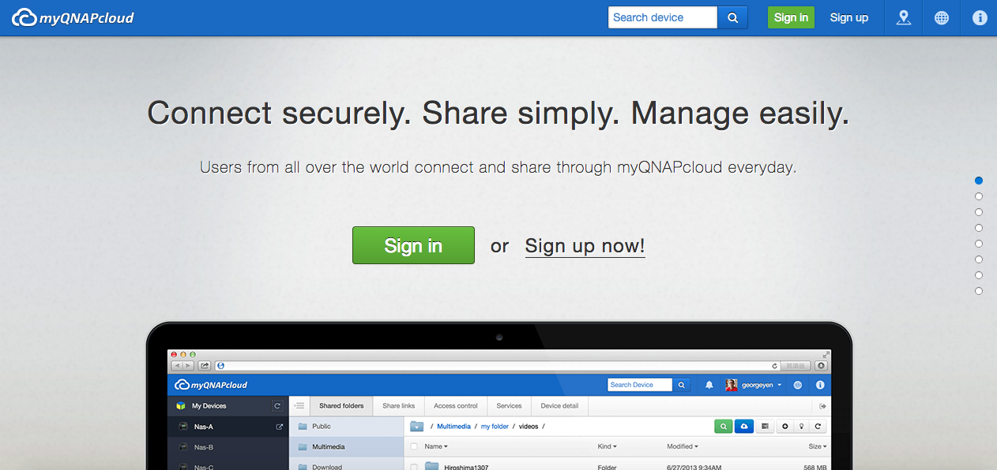
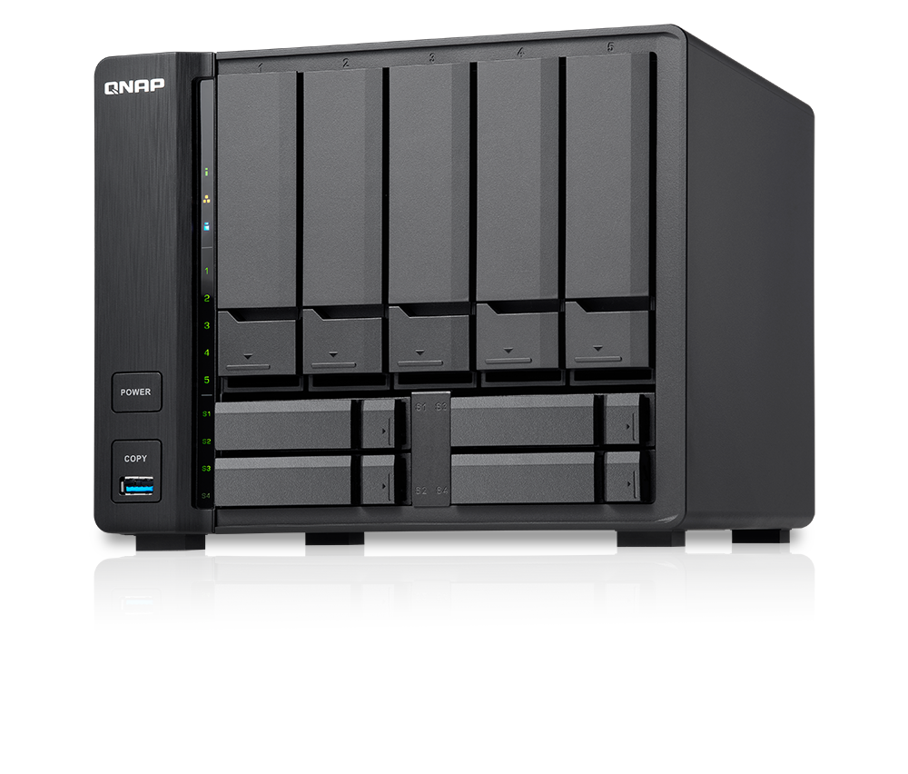
Your private cloud
Register QID to login NAS

Slide 31
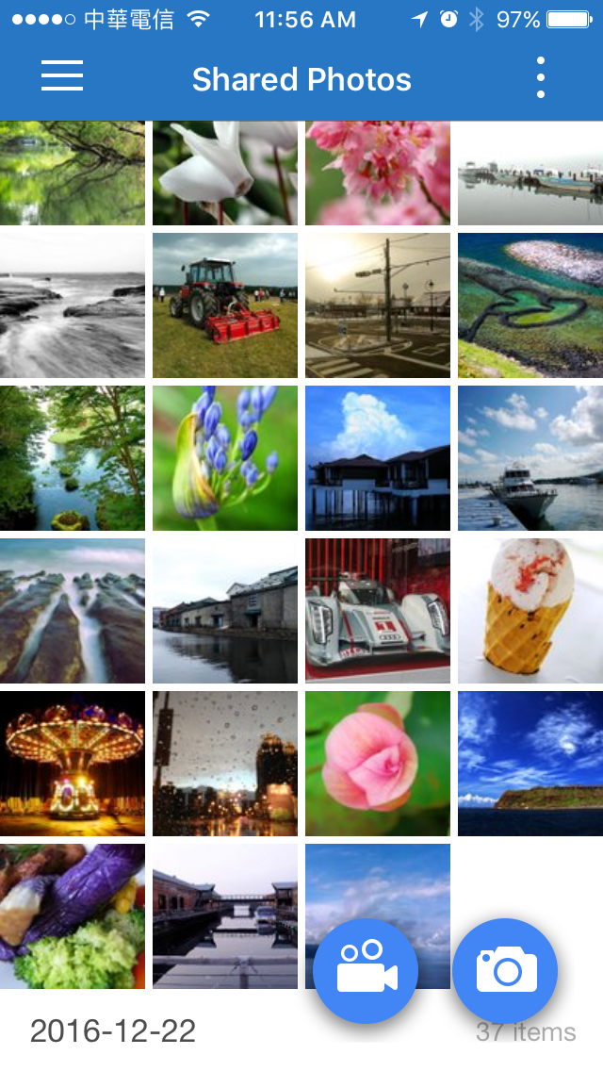
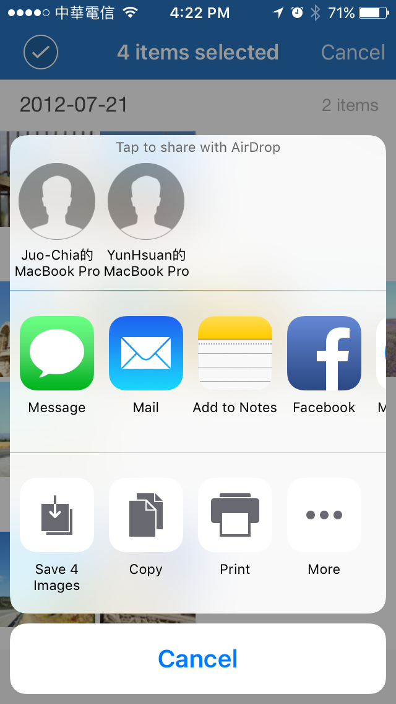
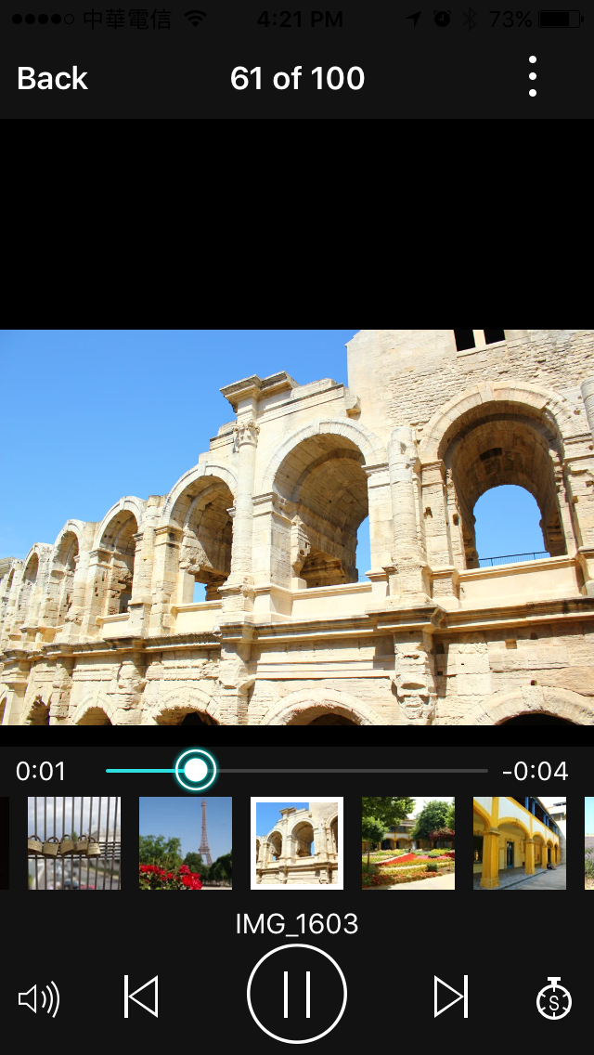


Mobile Apps
Qfile
Qphoto
Share to others
Auto upload photos
No need to worry about your phone capacity
Notes:
截圖更新

Slide 32

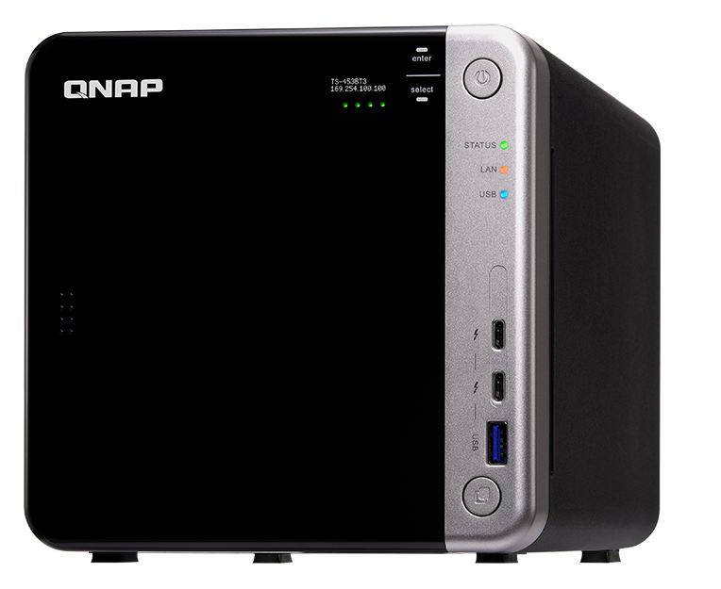
No.4
High-speed editing
Thunderbolt 3
High speed transmission: 40Gbps
Easily plug and use
Edit RAW files on NAS with Lightroom directly

Slide 33
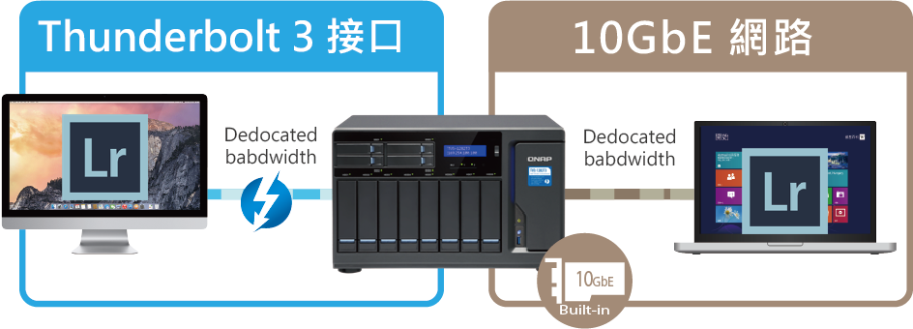
Plug and use Thunderbolt 3:
Fast transmission
Connect NAS via Thunderbolt and directly edit RAW files with Lightroom on NAS
Thunderbolt 3
10GbE
40 seconds / 1000 RAW files
Notes:
https://www.qnap.com/solution/thunderbolt3-nas/zh-tw/index.php

Slide 34
QNAP NAS
Recommended Models
Notes:
TVS-453BT 比 Giga (USB quick access) 快3倍

Slide 35
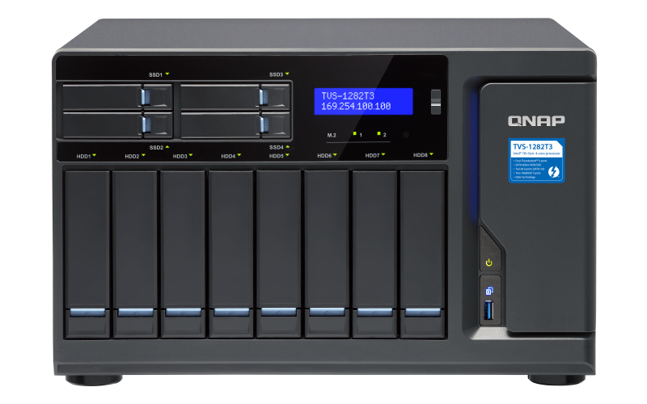
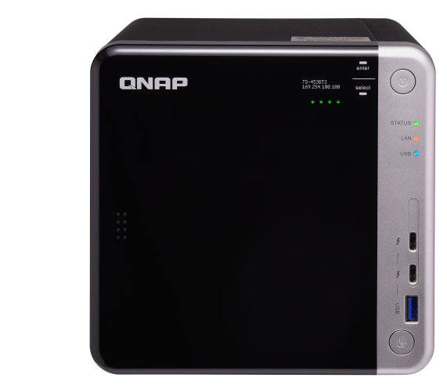
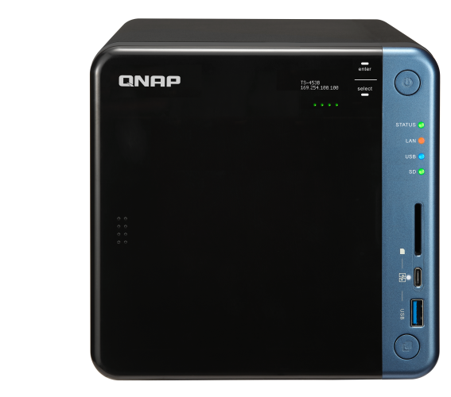
Pro
photographer
High-speed
Thunderbolt
Large capacity
Senior
photographer
High-speed
Thunderbolt
Quickly share
Photographer
Amateur photographer
USB connect
Good value
Beginner
Good performance for multimedia
USB connect
Budget-friendly and good
TVS-1282T3
TS-453BT3
TVS-673e
TS-453B
TS-251A
12~72TB
12 bays
Intel i5/i7 quad-core
16GB RAM
Thunderbolt 3
HDMI 4K output
4~24TB
4 bays
Intel Celeron quad-core
8GB RAM
Thunderbolt 3
HDMI 4K output
4~36TB
6 bays
AMD quad-core
8GB/4GB RAM
USB connect
HDMI 4K output
Expandable for 10GbE
4~24TB
4 bays
Intel Celeron quad-core
8GB/4GB RAM
USB connect
Support SD card
Expandable for 10GbE
2~12TB
2 bays
Intel Celeron dual-core
2GB RAM
USB connect
Support SD card
For photo storage, searching and sharing
Notes:
TVS-453BT 比 Giga (USB quick access) 快3倍

Slide 36
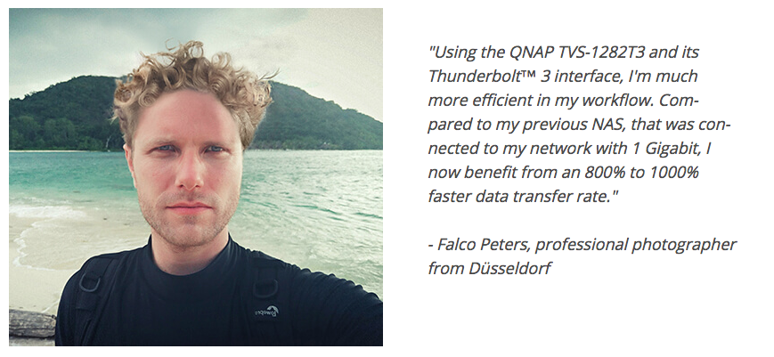


Photographers said…
Notes:
https://www.qnap.com/zh-tw/case-studies/

Slide 37
QNAP Solution
The best choice for photographers

