Slide 1
Photo Station Facial Recognition
Let photos evoke precious memories of people

Slide 2
Old friends are all over the world. I miss the old days with them…

Slide 3
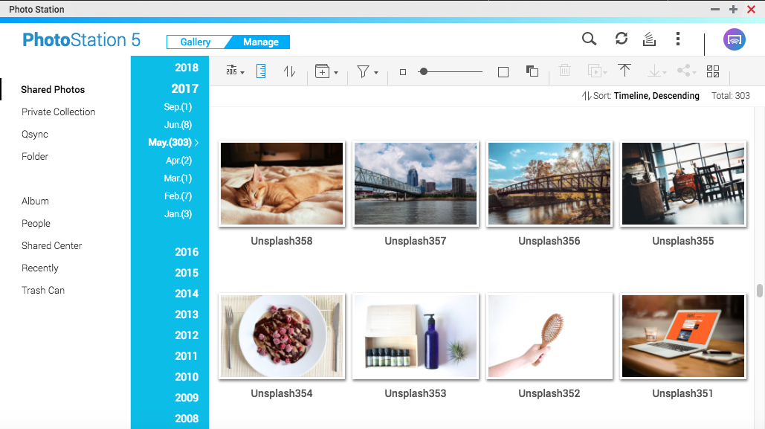
How to find my friends in thousands of photos?

Slide 4
You need Photo Station
Facial Recognition
Note: This feature is for x86 models

Slide 5
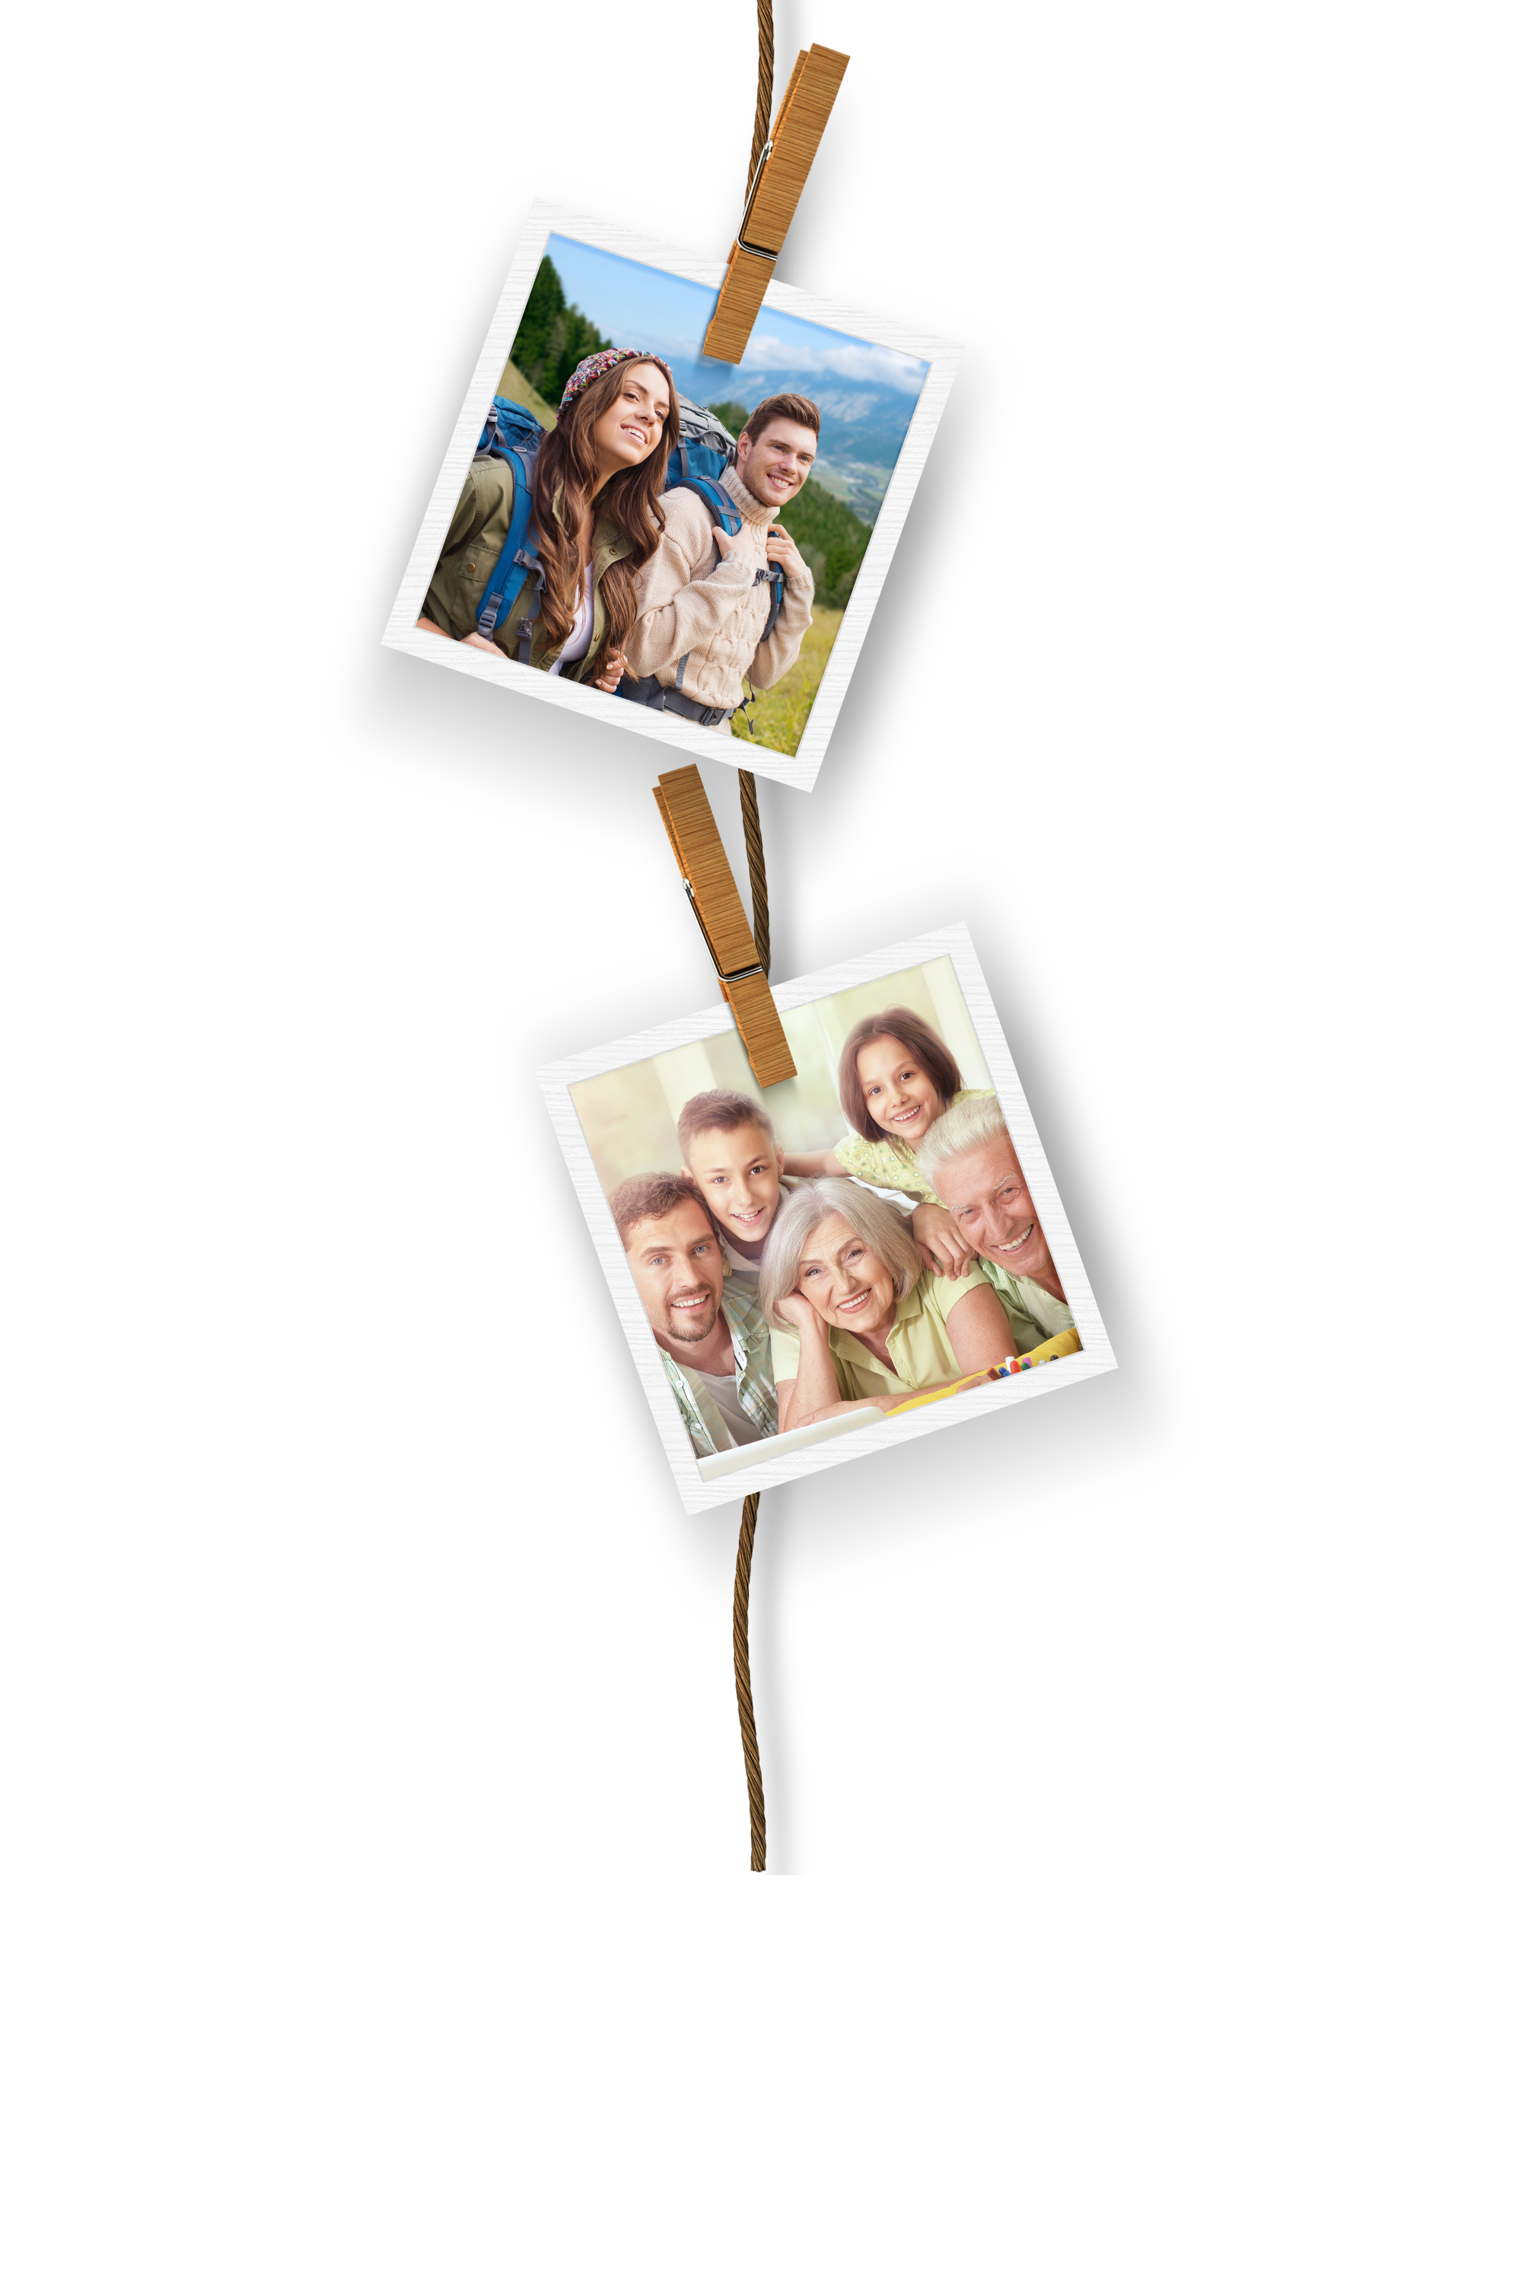
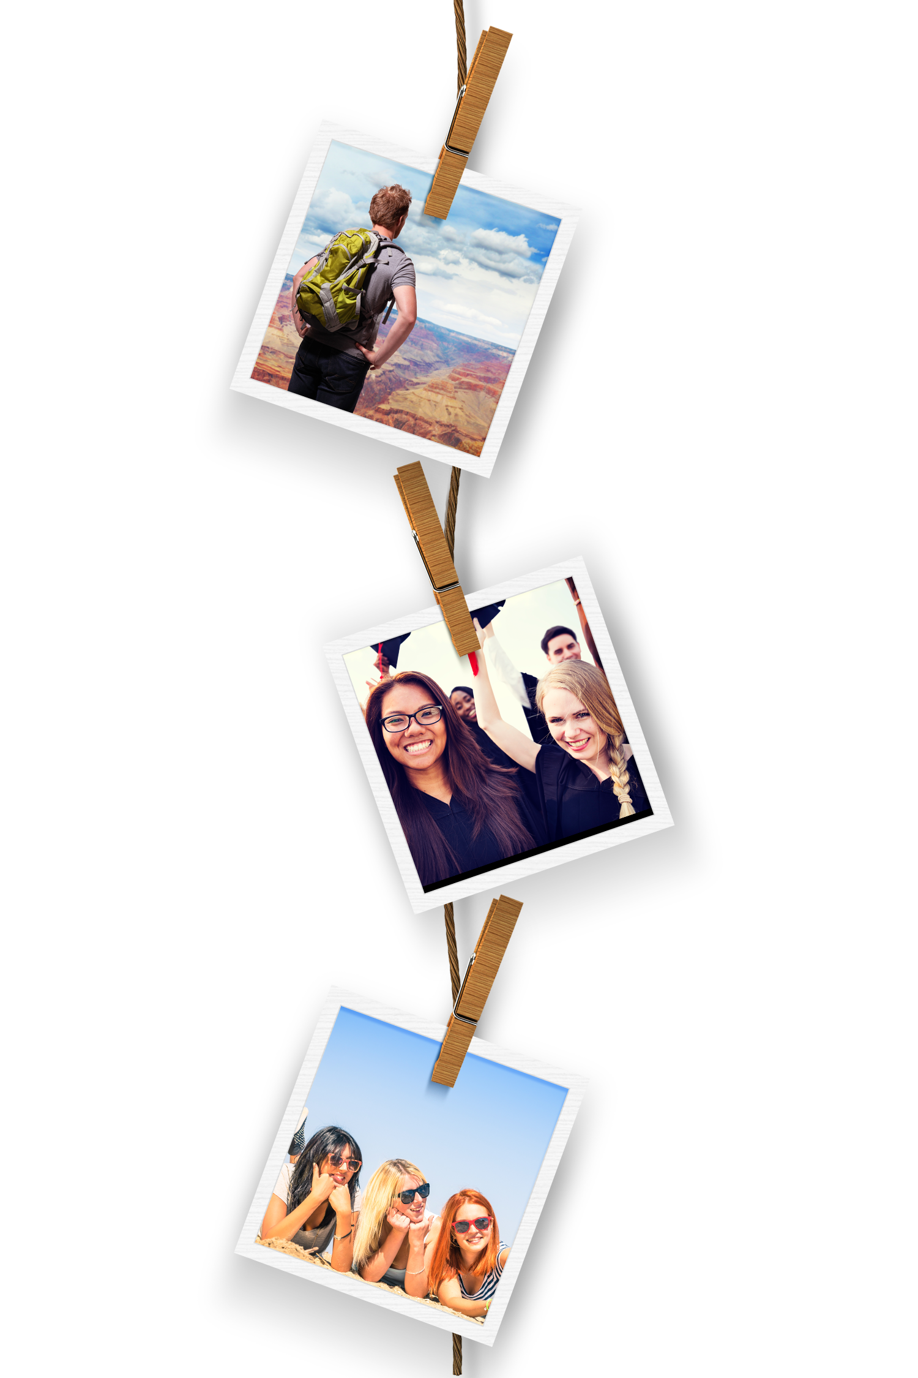
Great! Can Photo Station find all my memories with friends?
Yes, keeping precious memories alive is the first priority for Photo Station.
Notes:
圖片編號 : 35560988

Slide 6
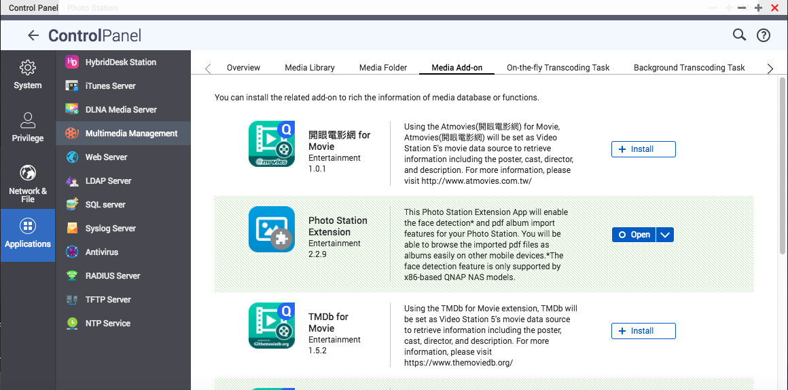
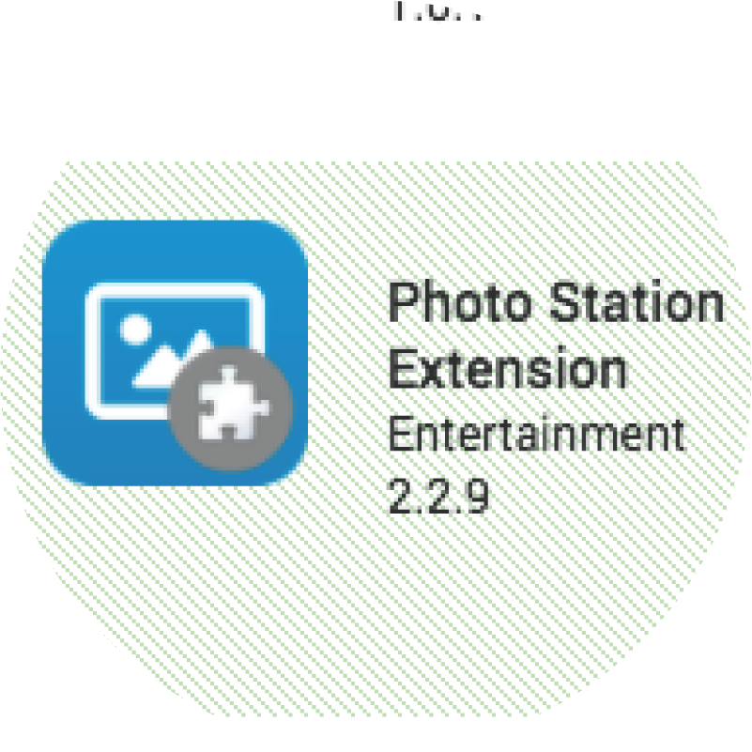
Three Steps to Start
Install Photo Station Extension 2.2.9

Slide 7
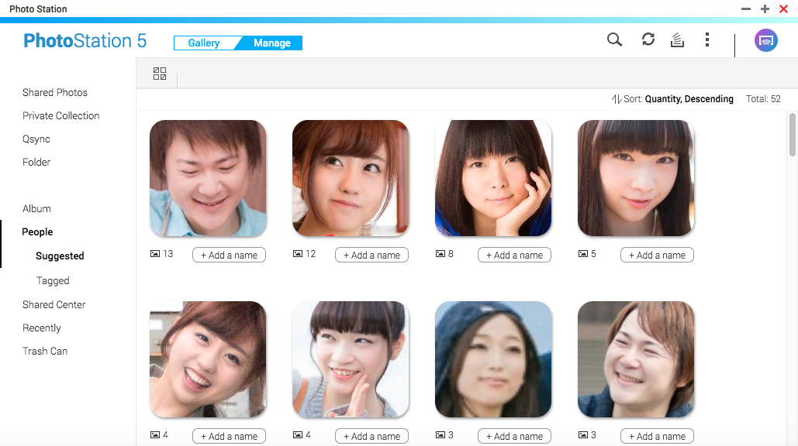
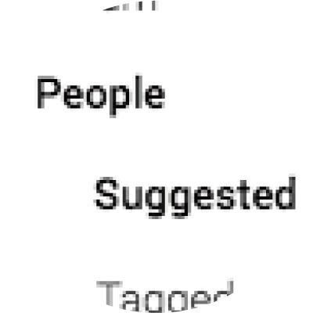
Three Steps to Start
Wait for faces to be recognized
Refresh to update results
Recognized results

Slide 8
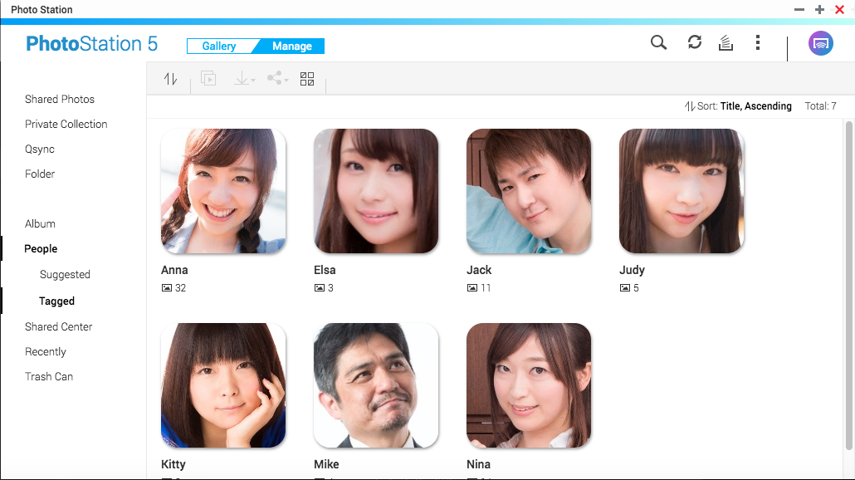
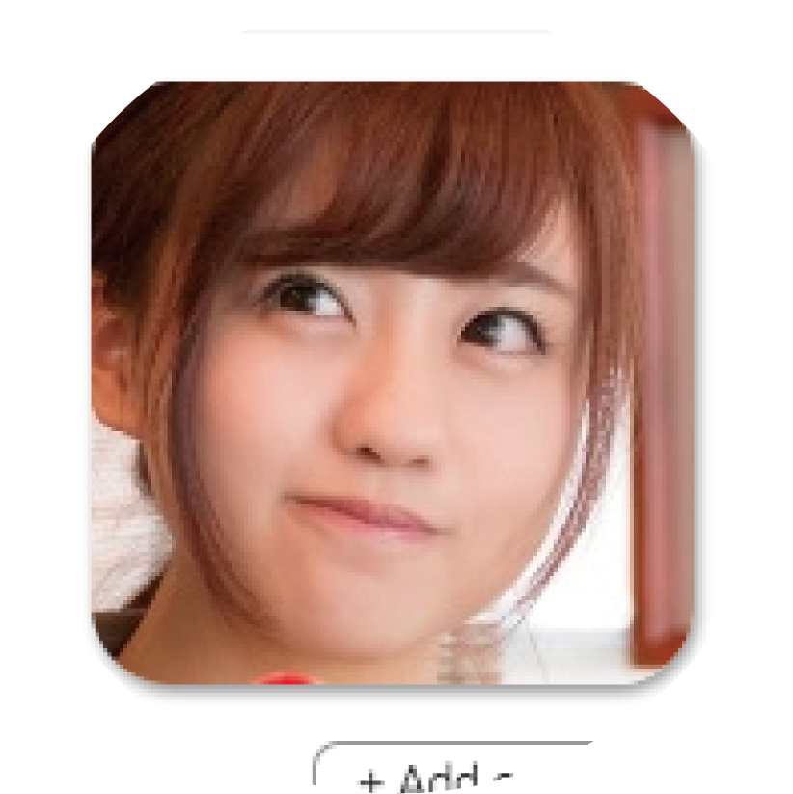
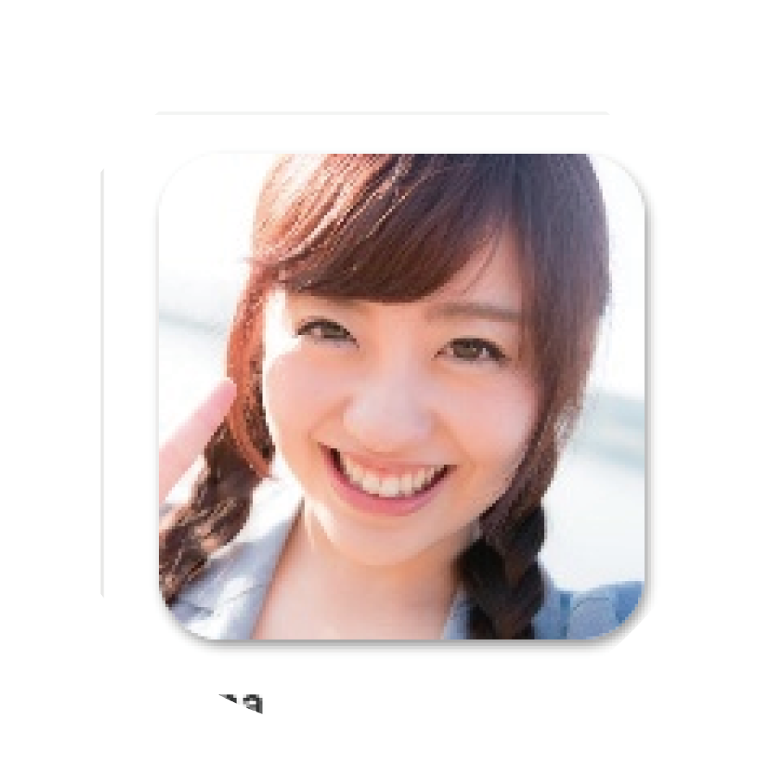
Three Steps to Start
Add a name to the face and enjoy your memories
Faces of the same person can be merged
Enter “Anna”

Slide 9
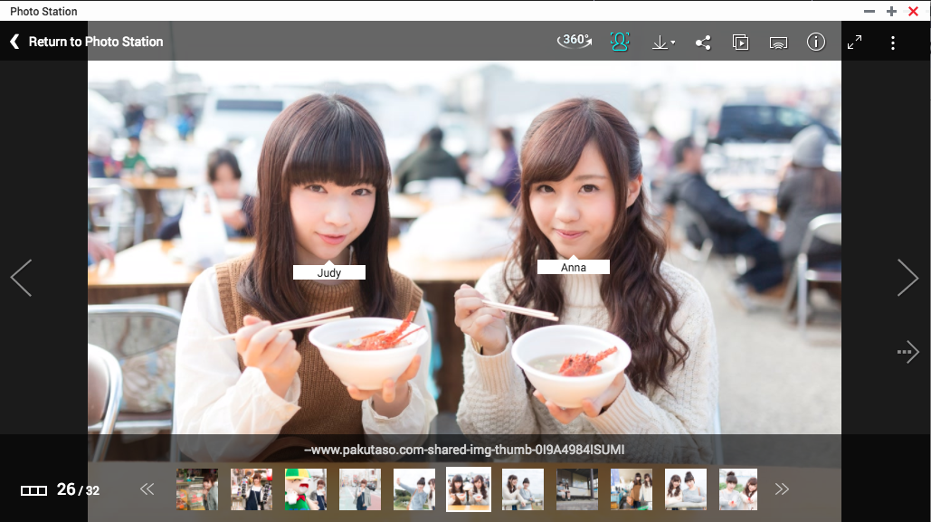
View People Albums
The memory of Anna rose in front on my eyes

Slide 10
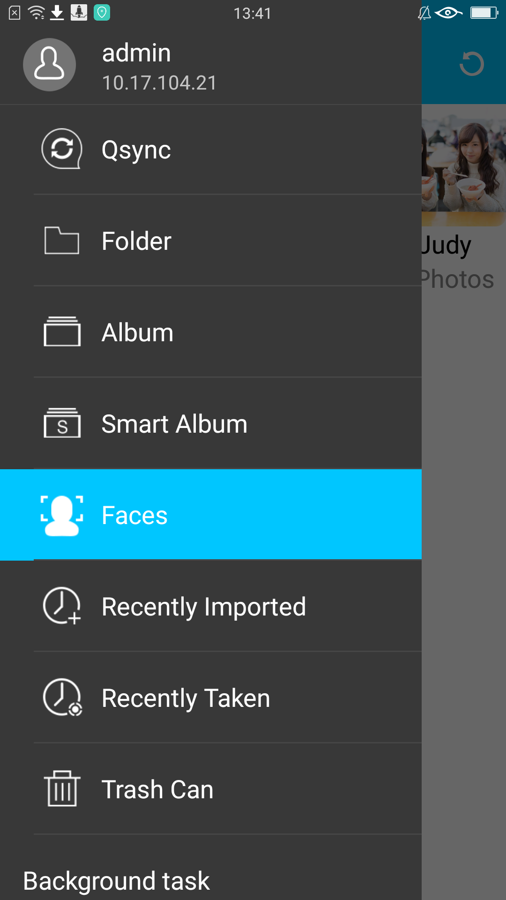
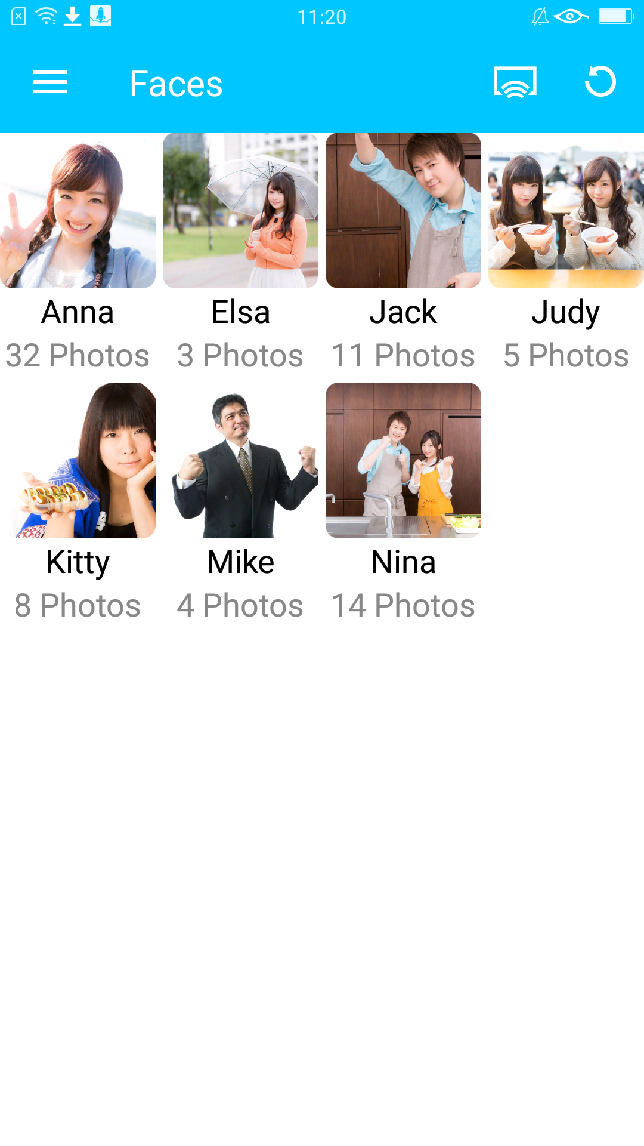
Qphoto: View Photos Right Away

Slide 11
QNAP Facial Recognition Explained by Senior R&D Engineer

Slide 12
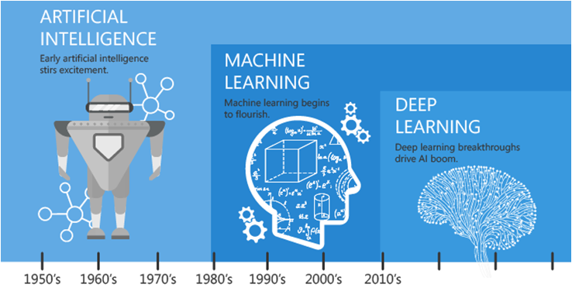
Why Deep Learning
AI’s evolution history

Slide 13
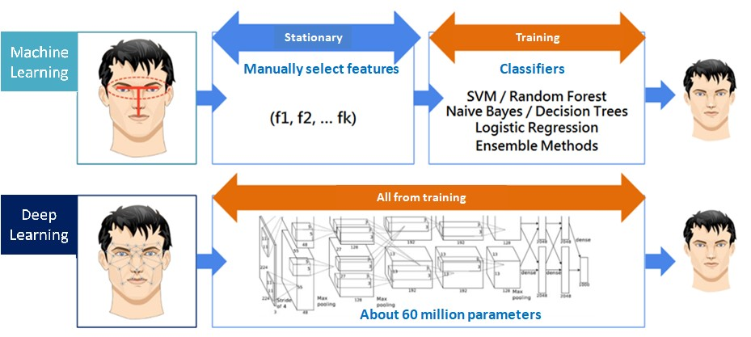
Why Deep Learning

Slide 14
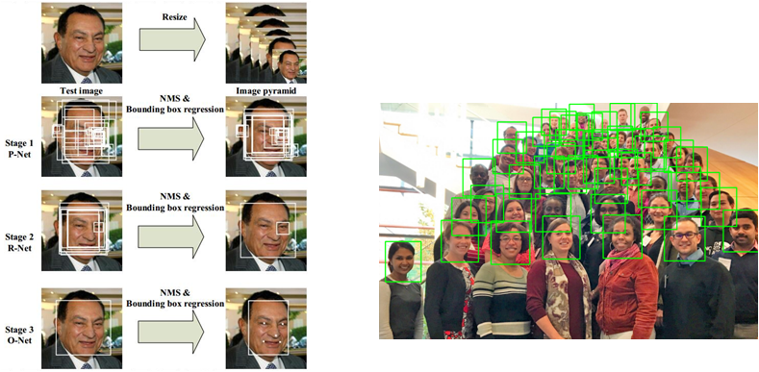
First Step: Face Detection
Cascade structure
Proposal net --> Refine net --> Output net

Slide 15
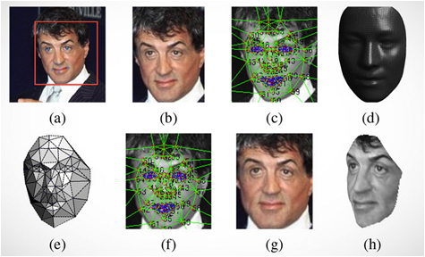
Face Alignment
•Difficulties
–Pose difference
–Non-rigid expression
•3D Alignment
–Generic 3D face model
–Affine projection
–Model adjustment
–Warping to frontal face

Slide 16
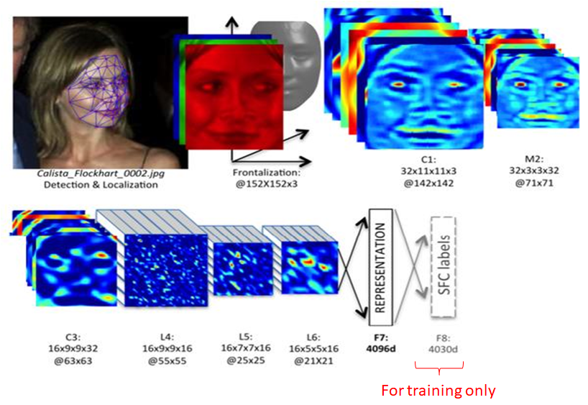
Representation

Slide 17
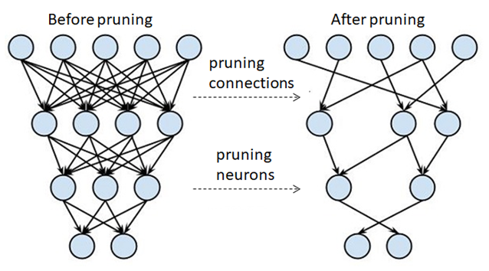
Optimize Recognition Speed
Prune connections
Prune neurons

Slide 18
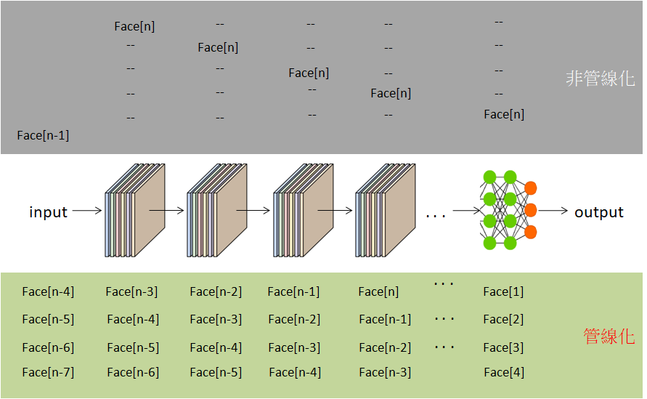
Pipeline Inference
Non-pipeline
Pipeline

Slide 19
Last Step: Face Grouping
Calculate face distances
Put similar faces in a group

Slide 20
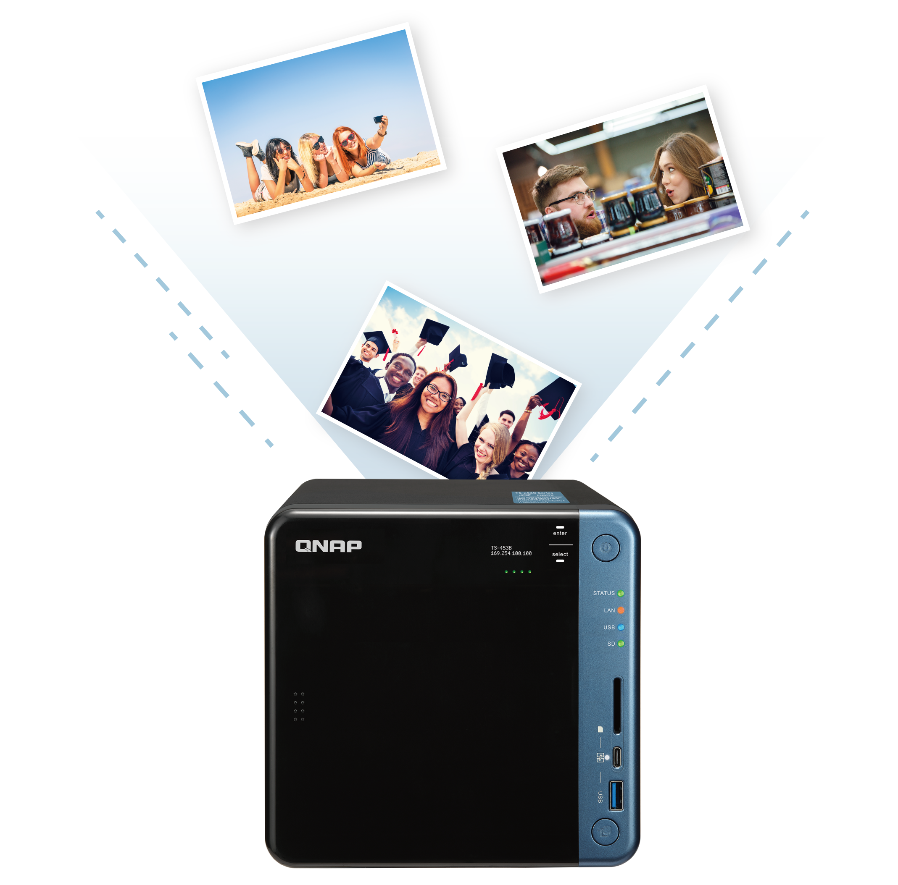
Recognizing Speed
Recognize 1000 photos
Only 8 minutes
Test environment: QNAP TS-253B, QTS 4.3.4.0486, Photo Station 5.6.2
Steps: Designated a folder with 1000 photos as facial recognition folder, then wait for the system to recognize

Slide 21
QNAP Photo Station Has More Features

Slide 22
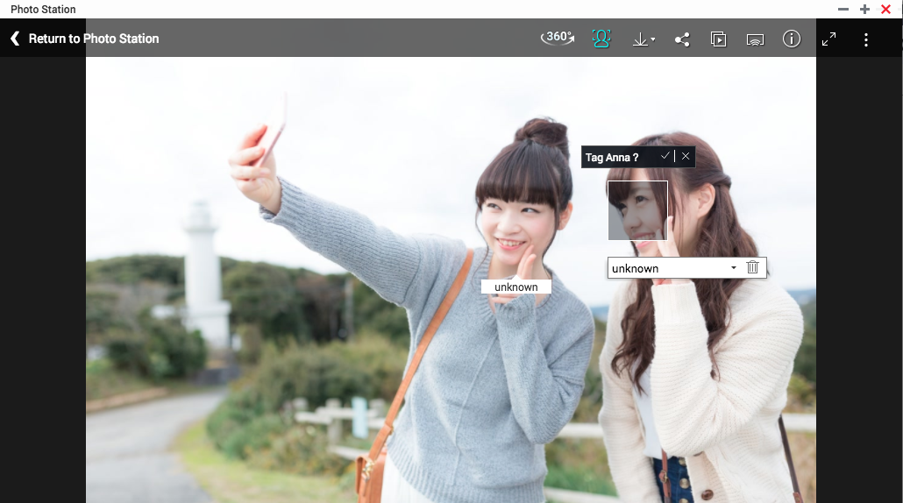
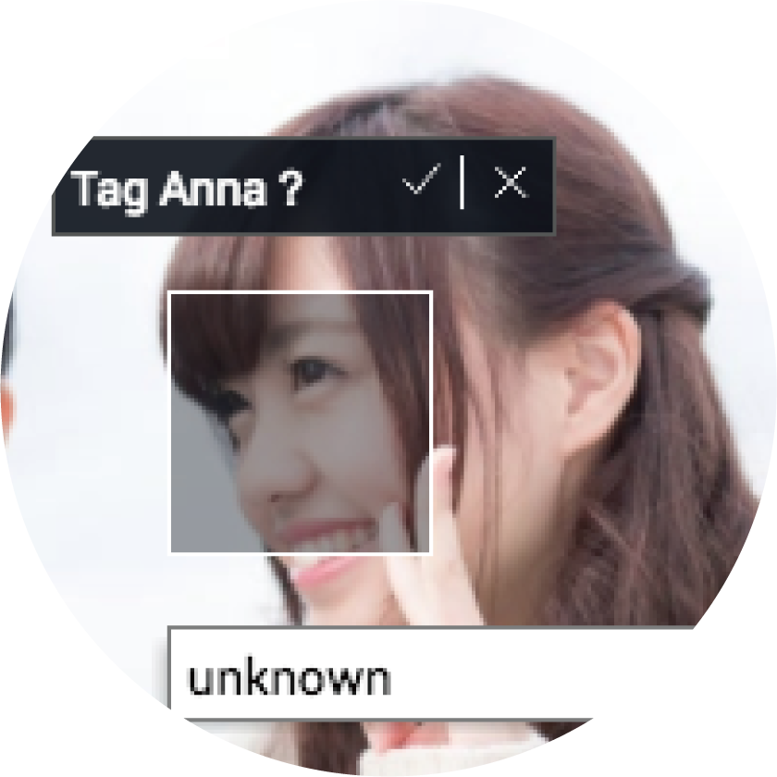
Recommend for Tag Name
QNAP
Photo Station
Synology
Moments
Ask tag name for unknown person
Drag a box to define faces
No this feature

Slide 23
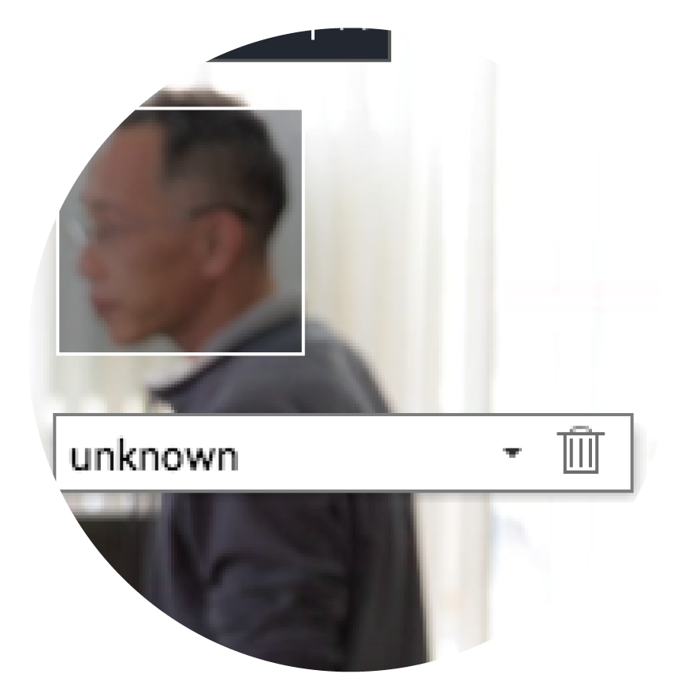
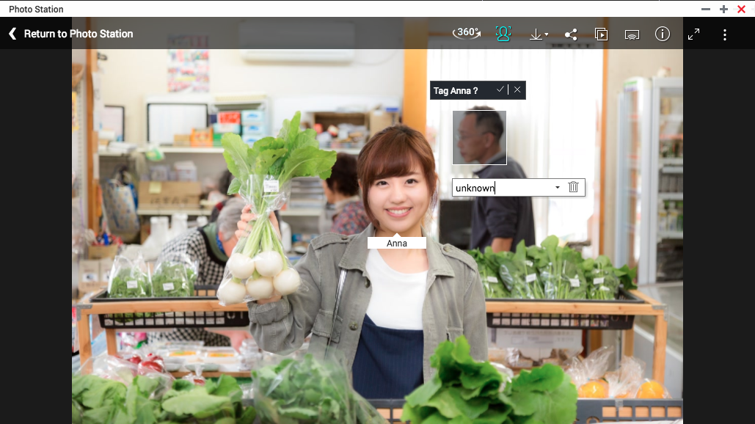
Remove Strangers
QNAP
Photo Station
Synology
Moments
Remove tags on photos
No this feature

Slide 24
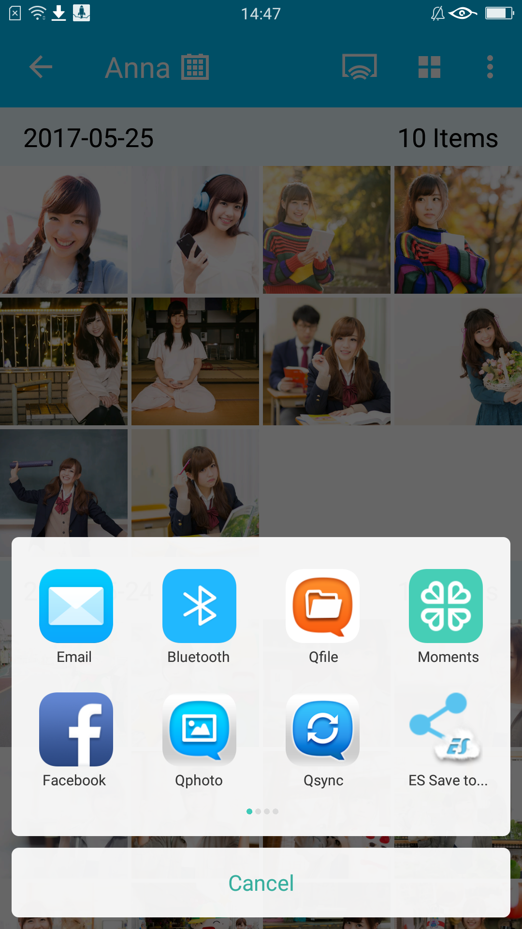
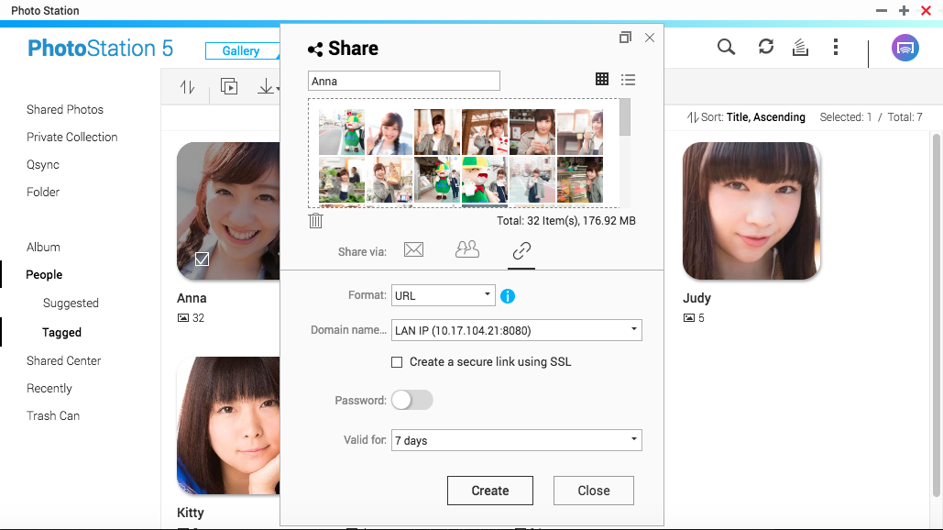
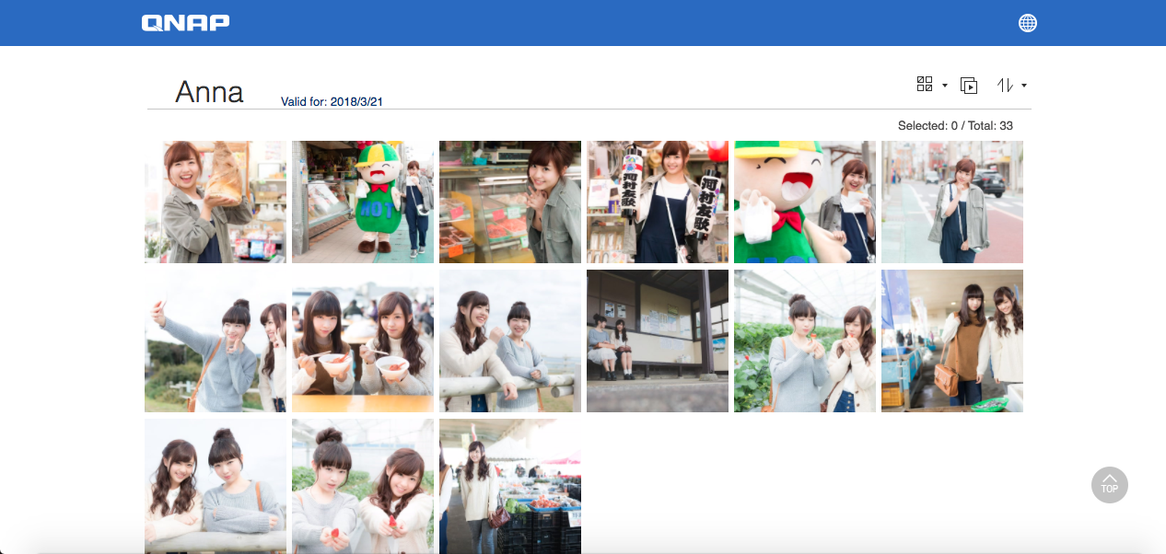
If you miss her, take actions now
Anna, I saw our old photos and I miss you.
Share via
Qphoto
What photos? Let me see.
Share via
Photo Station
Receive sharing link and download photos

Slide 25
Demo

Slide 26
QNAP facial recognition is your best choice

