Slide 2
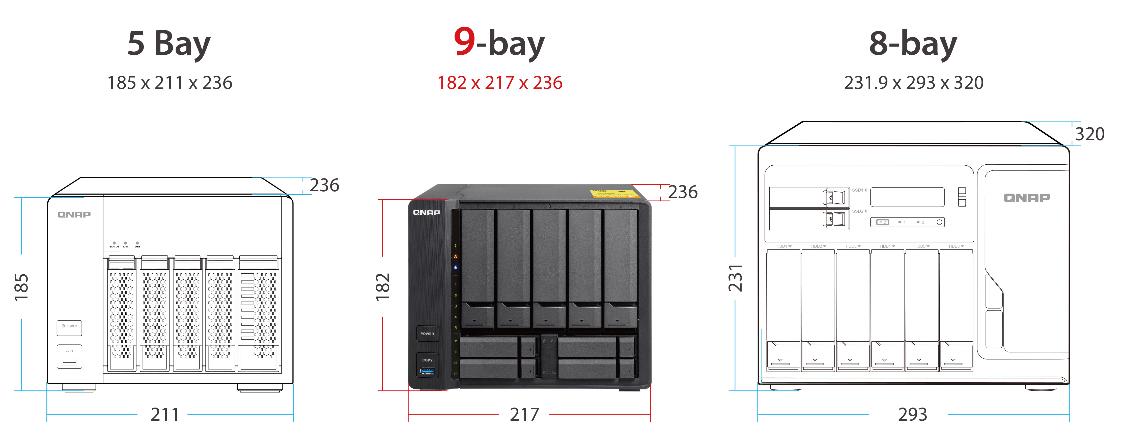
Compact & high storage potential

Slide 3
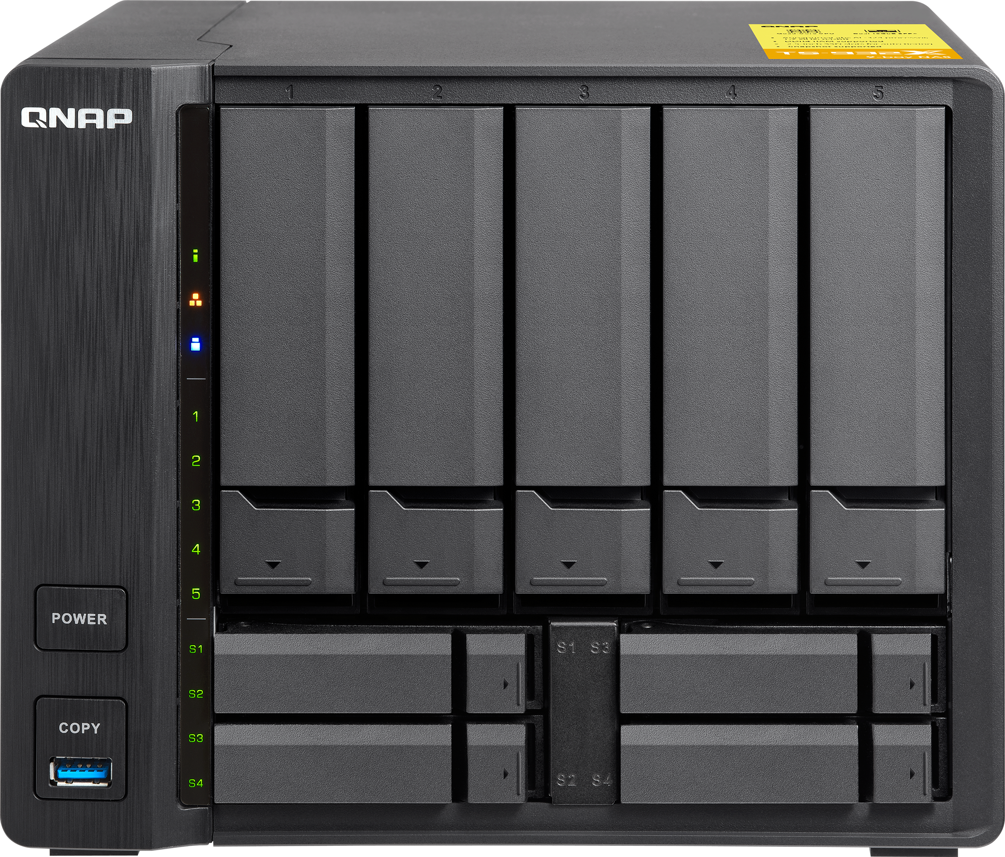
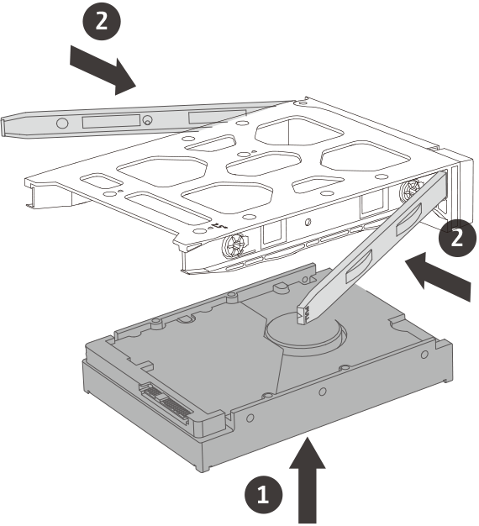
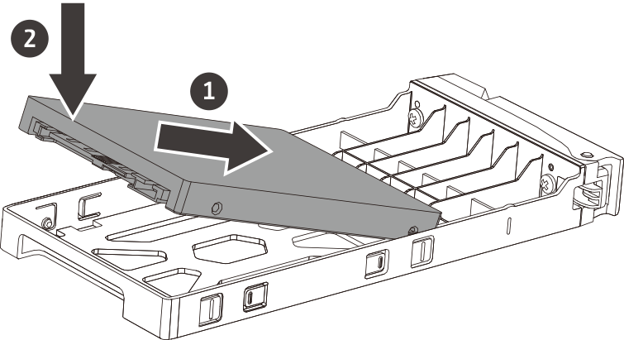
Hybrid HDD/SSD design
Tool-less installation
5 x 3.5" drive bays
4 x 2.5" drive bays

Slide 4
The best way to utilize SSDs
5 x 3.5" for HDDs (high capacity)
Boost performance
Boost both performance and capacity
All in one for SMB
2 x SSD for caching, RAID1
High Capacity File & Media Server
4 x SSDs for Qtier, RAID5
Boost applications' random IO access
Boost both sequential and random access

Slide 5
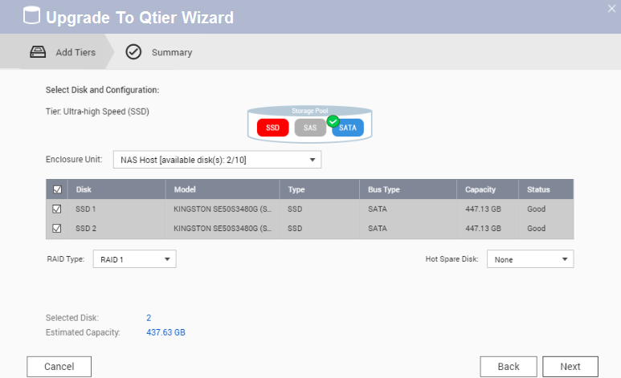
Switch from SSD Cache to Qtier
1
２
Step
Step
Disable SSD Cache Online
Confirm SSDs that will be added to the storage pool
３
Step
Upgrade to Qtier pool !

Slide 6
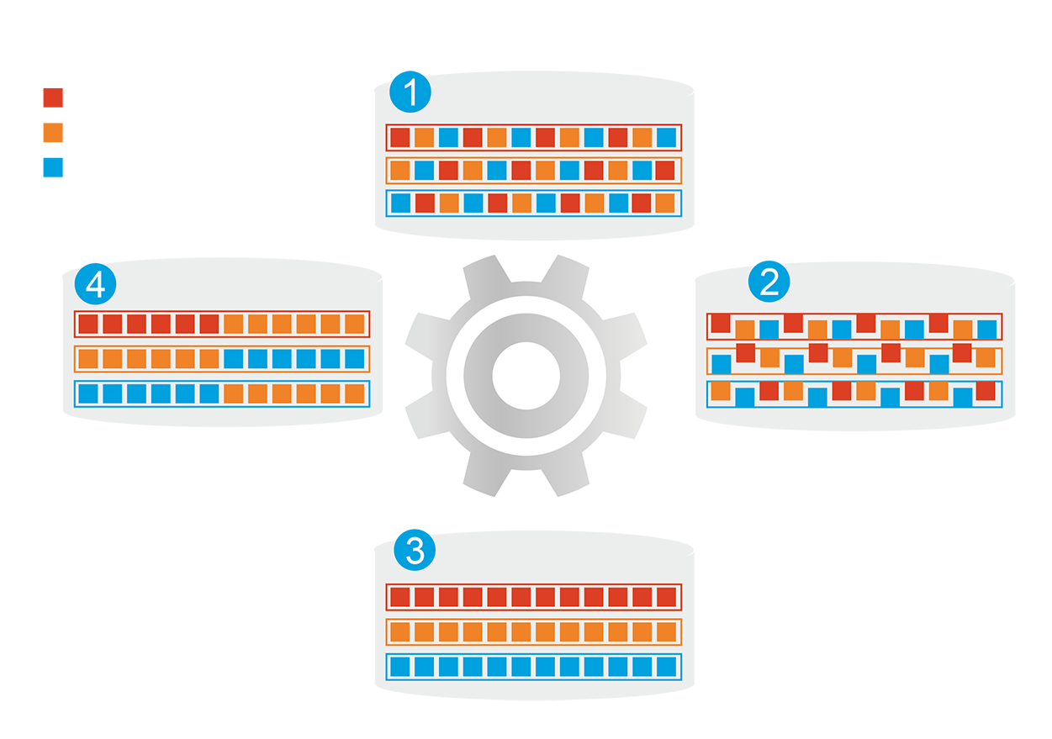
Qtier auto-tiering: speed and capacity
Automatically moves data between different tiers
Before tiering: Frequently-accessed data performance is not optimized
Frequently-accessed data
Infrequently-accessed data
Rarely-accessed data
SSD cache capacity will not be limited by
RAM size
Changes in data access patterns
Start data tiering
How Qtier Works
After tiering: Frequently-accessed data performance is optimized

Slide 7
Quad-core 64-bit Cortex-A57 CPU
Hardware Encryption Engine
DDR4 Memory, up to
16GB
TS-932X-8G
TS-932X-2G

Slide 8
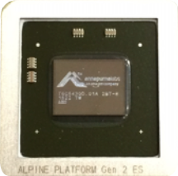
New AL processor family
 | Alpine V1 |  | Alpine V2
Product name | AL214 | AL314 | AL324
# of cores | 4 x A15 |  | 4 x A57
Frequency | 1.4 GHz | 1.4-1.7 GHz | 1.7 GHz
DDR | DDR3 1600 (32-bit) | DDR3 1600 (32/64-bit) | DDR4 1866 (32/64-bit)
ECC | - | ✔ | ✔
Max 1G/2.5G ports* | 4 x 1/2.5 SGMII (2 ports can be RGMII) | 4 x 1/2.5 SGMII (2 ports can be RGMII) | 4 x 1/2.5 SGMII (2 ports can be RGMII)
Max 10G ports* | 1 port XFI/KR | Up to 2 ports XFI/KR | Up to 2 ports XFI/KR
40% more computing power!
Computing Power
24K dmips
32K dmips

Slide 9
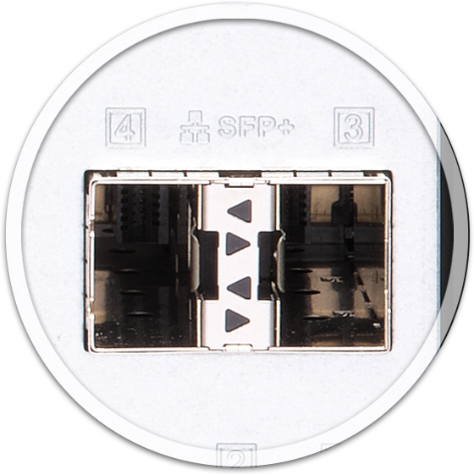
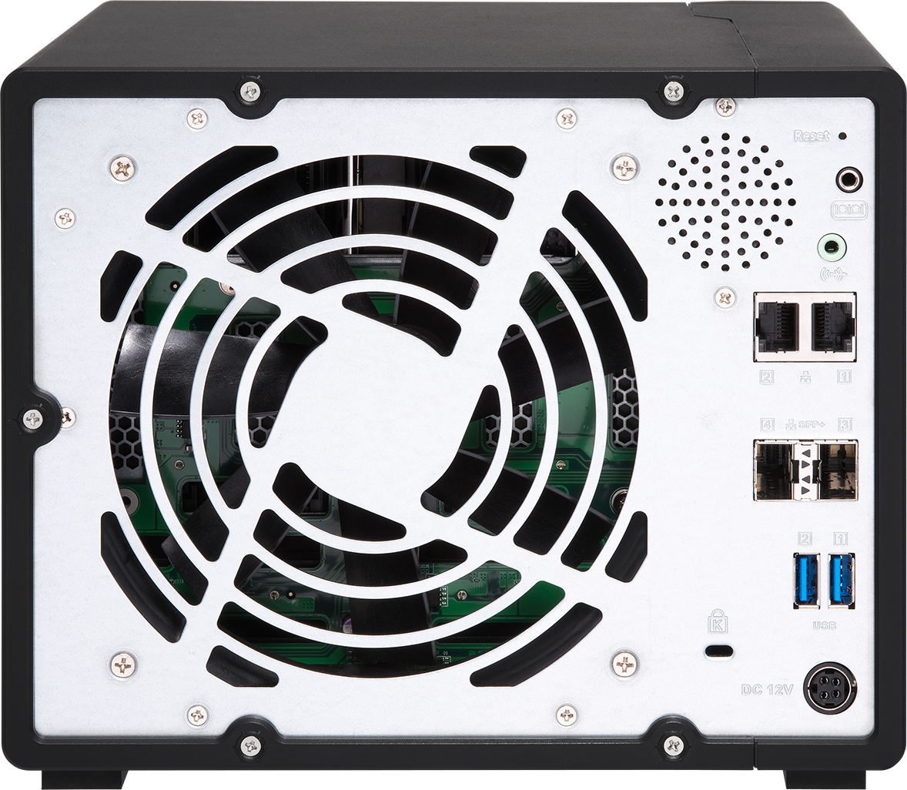
Built-in two 10GbE SFP+ ports
Fully support 10GbE high-speed networks, delivering a major speed increase for virtualization tasks, fast backup & restoration, and large-data applications.

Slide 10
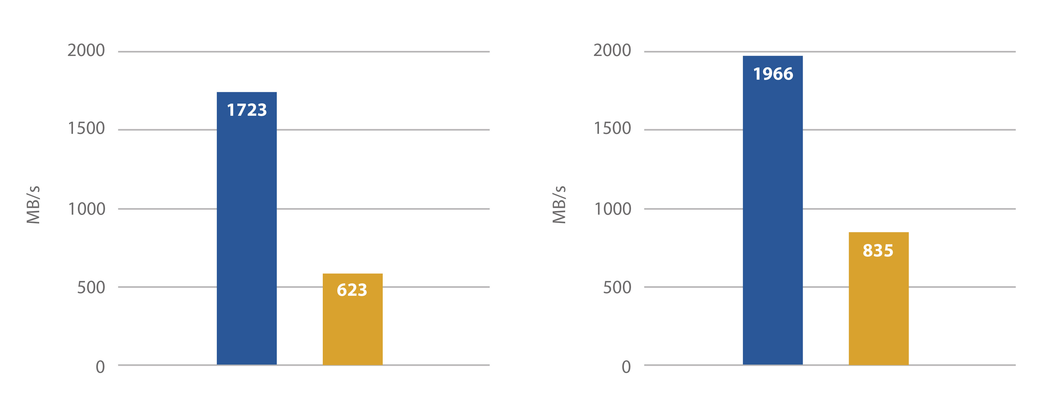
Major performance improvements
Windows File Transfer (2 x 10GbE)
Windows Download
Windows Upload
Windows Download
Windows Upload
TS-531X
TS-932X
Notes:
TS-531X: 5 x SSD, RAID5, 2 x 10GbE SFP+, transfer 10GB file via normal volume
TS-932X: 9 s SSD, RAID5, 2 x 10GbE SFP+, transfer 10GB file via normal volume

Slide 11
Lightning fast transfers
Demo

Slide 12
Hardware design
Built-in Speaker
LED indicators:Status, LAN, HDD, USB
Reset
1 x 14 cm
Smart Fan
Power button
3.5 mm audio jack
2 x Gigabit
ports
Kensington security slot
2 x 10GbE
SFP+ ports
2 x USB3.1
Gen 1
USB3.1 Gen 1 & One-Touch Copy button
DC 12V power input

Slide 13
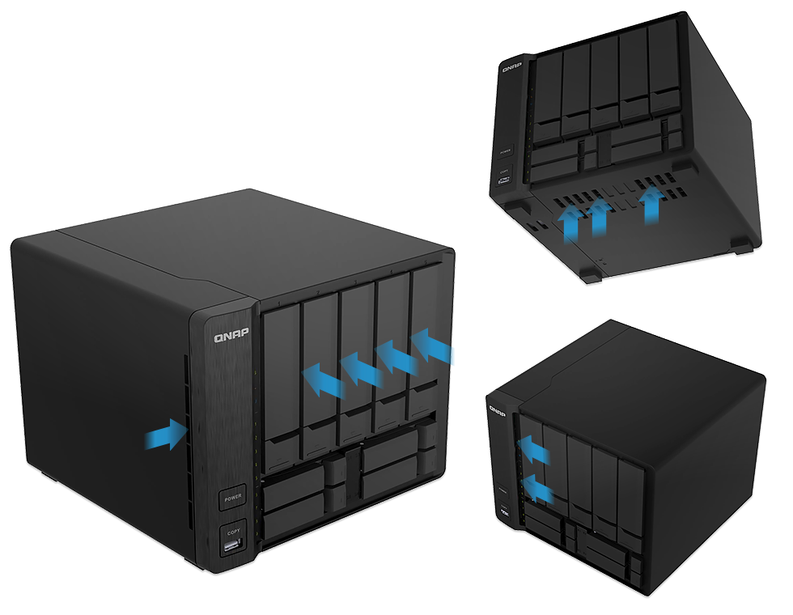
Effective cooling design
TS-932X performs smoothly even under heavy loads.
Brushed metal texture

Slide 14
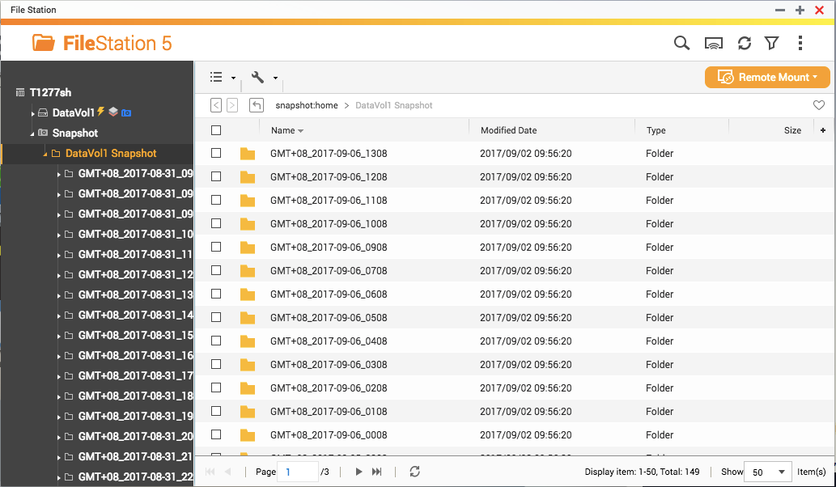
Cost effective snapshots
2GB RAM
8GB RAM
For whole NAS
64
256
----------------------------------------------------
For a single
Volume/LUN
32
64

Slide 15
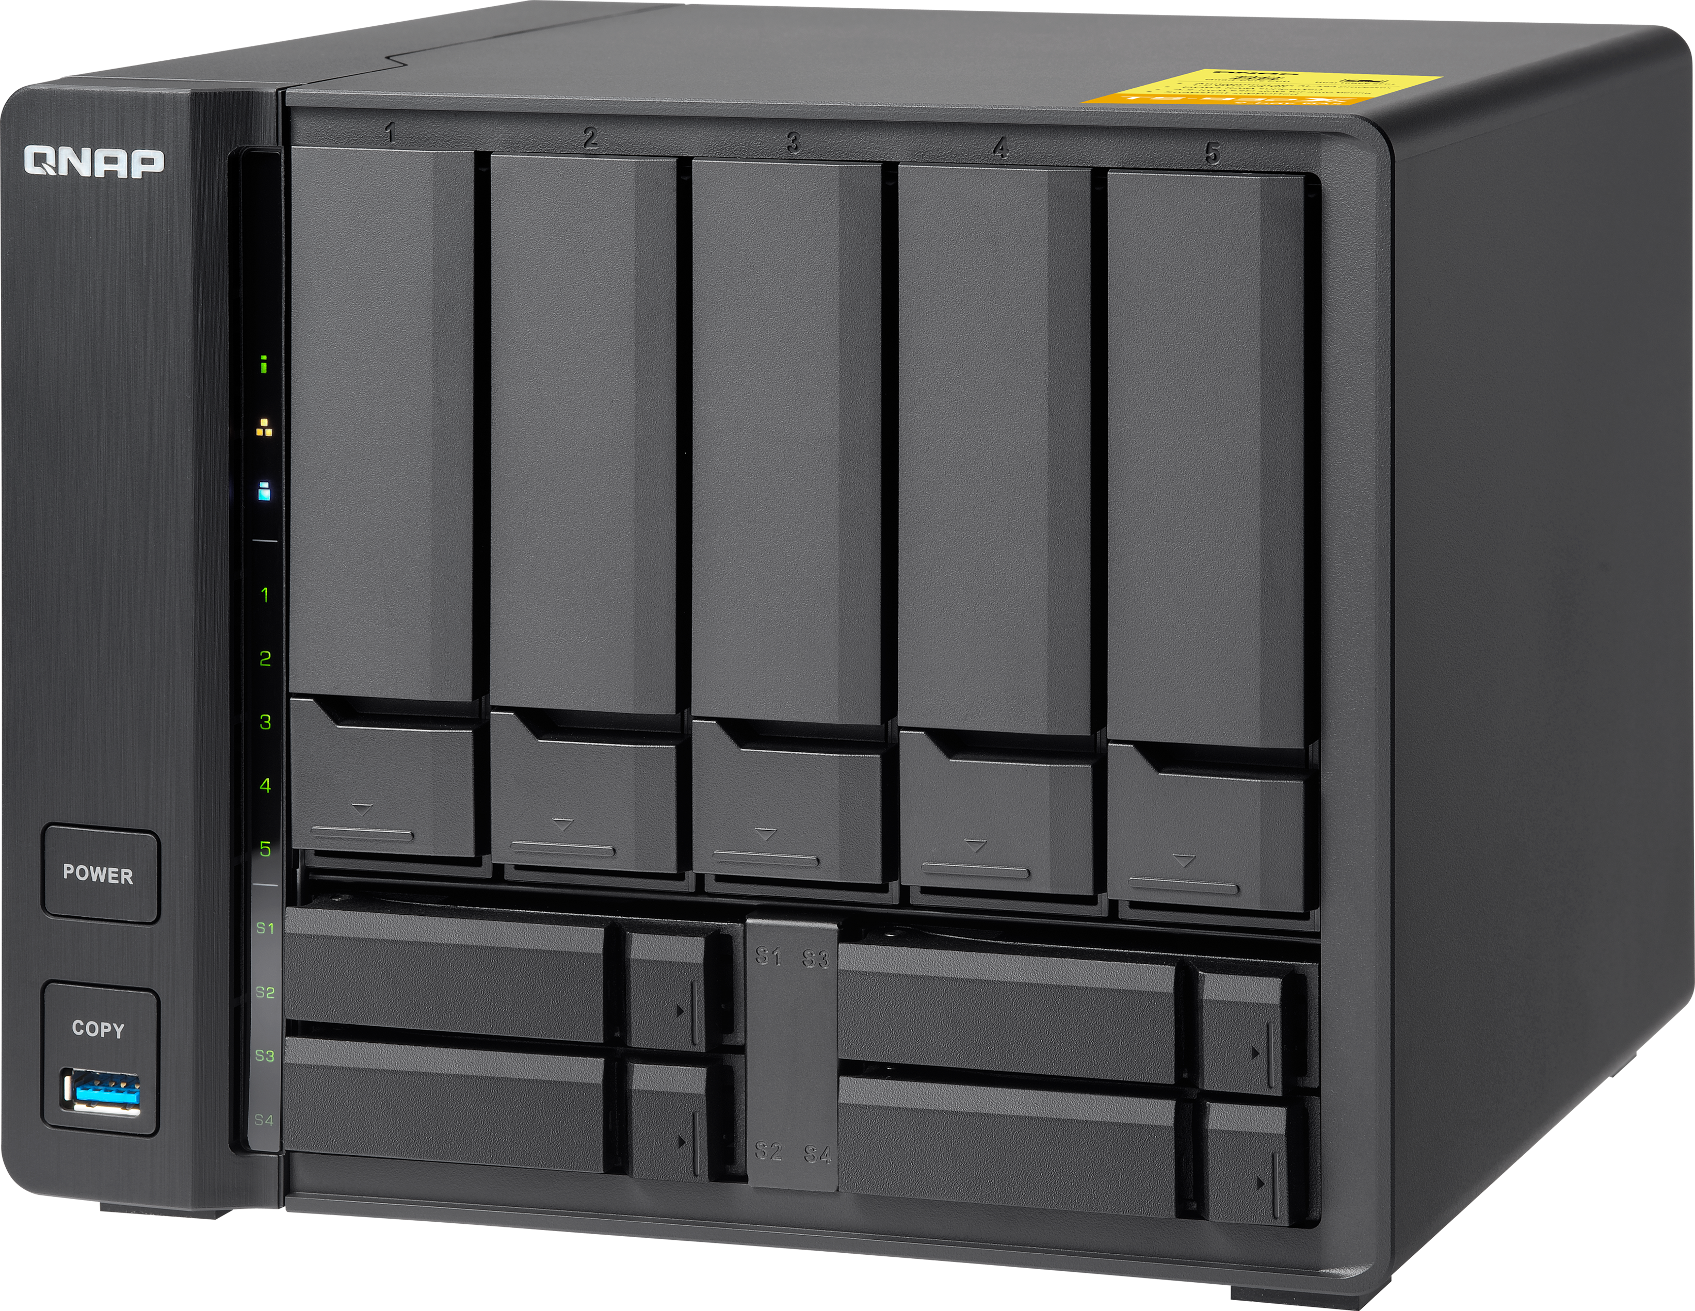
Virtual JBOD for expand NAS capacity
Give unused space to other NAS
iSCSi

Slide 16
Attach expansion enclosures
Expand storage by connecting up to 2
UX-800P or UX-500P
UX-800P
TS-932X
UX-500P

Slide 17
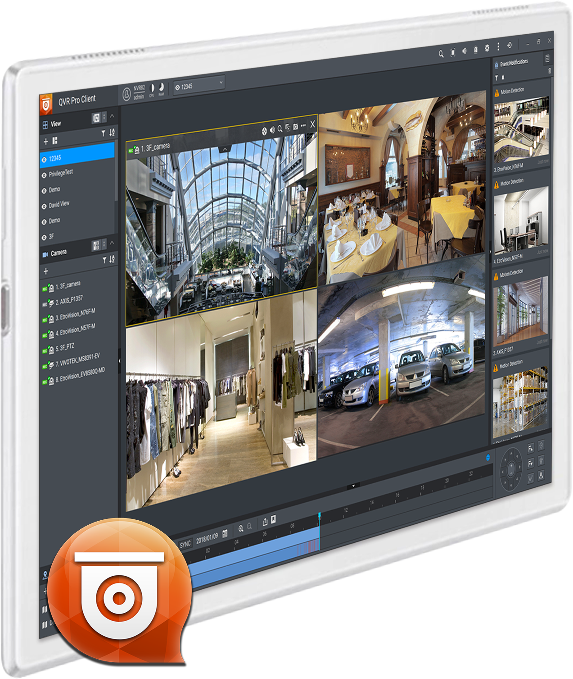
QVR Pro surveillance solution
5,000+ compatible IP cameras
8 free IP camera channels
16 max. IP camera channels
QUSBCam2 record from USB webcams

Slide 18
Upgrade your RAM
Demo

Slide 19
What can TS-932X do？
Hybrid 3.5"/2.5" drive bays
- High storage capacity potential
- Flexible using SSD cache or Qtier
Data protection
- Max. 256 snapshots for whole NAS
- Time Machine and Netback Replicator
- Cloud service
High speed throughput
- Built-in dual 10GbE SFP+ ports
- 32K dmips computing power
Surveillance solution
- QVR Pro
- Secure environment

Slide 20
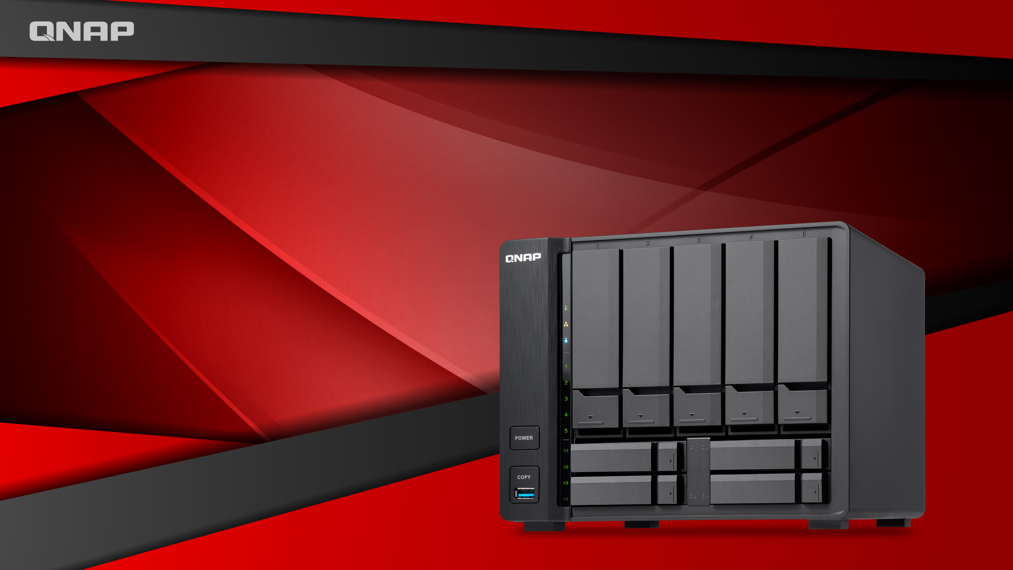
QNAP NAS: your best choice

