Slide 1
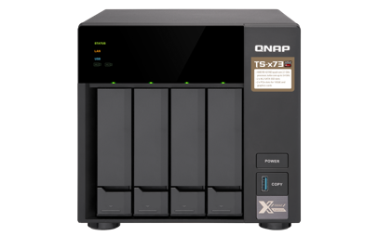
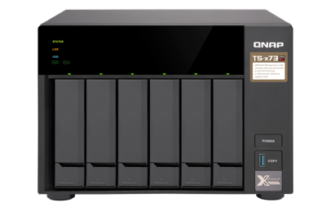
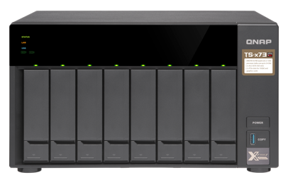

TS-x73 Series
The most cost-effect dual PCIe 3.0 slot NAS
Dual M.2 SATA SSD slots & quad-core 2.1 GHz (Turbo Core 3.4 GHz)
TS-473
TS-673
TS-873

Slide 2



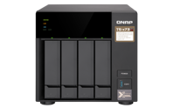
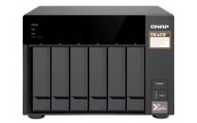
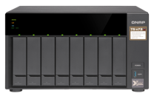
Long-term (5+ years) support processors
AMD RX-421BD 4-core
TVS-x73e Series
Base: 2.1 GHz Turbo Core: 3.4 GHz
Radeon R7 graphics
TVS-x73e: 2 x PCIe slots, USB QuickAccess
, and 4K multimedia
TS-x73 Series
NEW
AMD RX-421ND 4-core
Base: 2.1 GHz Turbo Core: 3.4 GHz
TS-x73U Series
TS-x73: 2 x PCIe slots
TS-x73U: 2 x 10GbE SFP+ ports
* TS-473, TS-673, TS-873, TS-873U, TS-1273U, and TS-1673U do not have GPU and HDMI output．

Slide 3
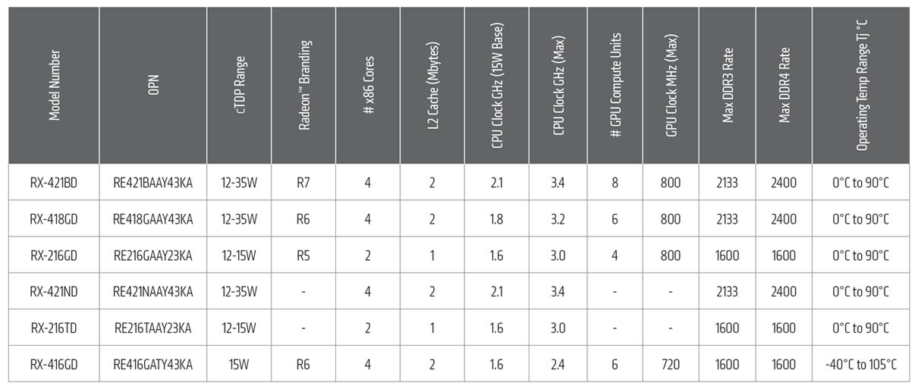
AMD R Series flagship embedded SoC
TVS-x73e
00
TS-x73 & TS-x73U
Source: http://www.amd.com/zh-hant/products/embedded-r-series-soc

Slide 4

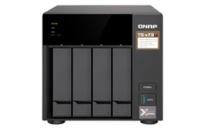
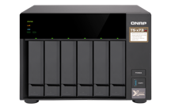
TS-x73 front view
LEDs: status, LAN, USB, M.2 slot 1 & 2, and 3.5" slots
IR receiver
(RM-IR004 supported with expansion graphics card installed)
Power button
Tool-less installation of 3.5” HDDs or screw- secured 2.5” HDDs/SSDs
USB 3.1 Gen 1 port & One-Touch Copy button

Slide 5
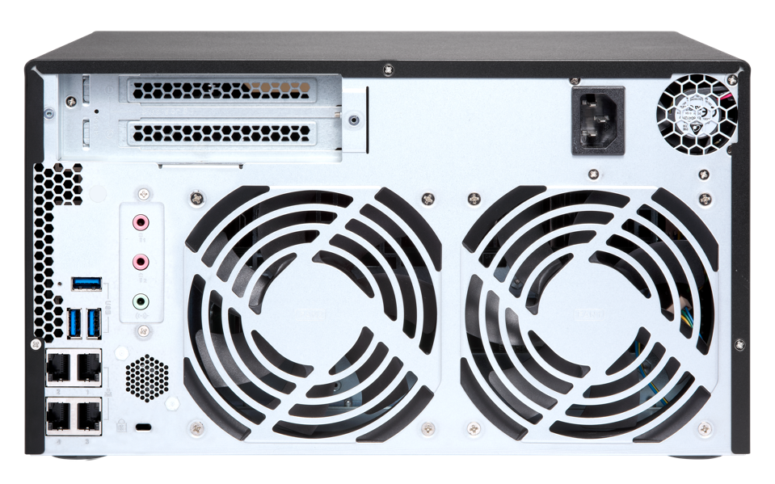
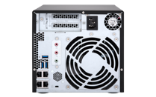
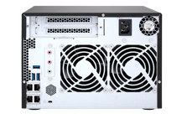
TS-x73 rear view
2 x PCIe 3.0 x4 slots
TS-473 supports low-profile cards
TS-673 & TS-873 support full-height cards
2 x 3.5mm
dynamic microphone input
& 1 x 3.5mm Line Out
speaker
Kensington
security slot
3 x USB 3.1 Gen1
4 x Gigabit LAN

Slide 6
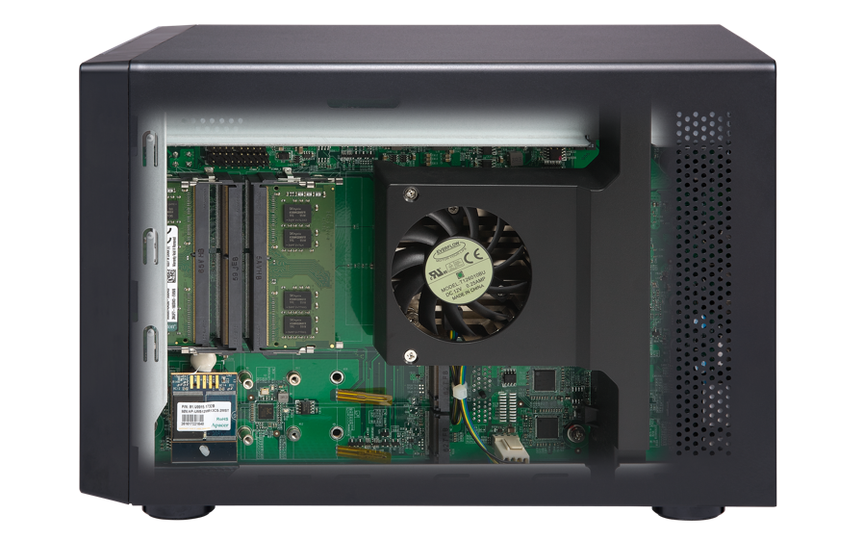
High potential RAM size for big projects
4 x DDR4 SODIMM
Memory slots, max
4 x 16GB
4GB RAM (2 x 2GB)
8GB RAM (2 x 4GB)
TS-473-4G
TS-673-4G
TS-873-4G
TS-473-8G
TS-673-8G
TS-873-8G
*ECC 與非 ECC 記憶體不可混用．

Slide 7
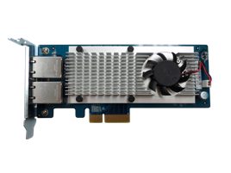
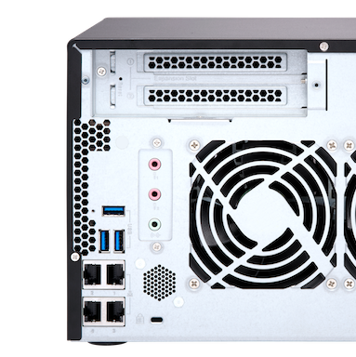
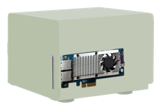
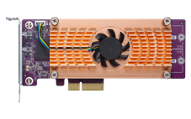

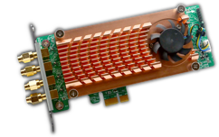
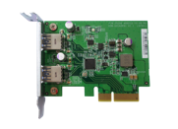
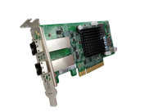
Versatile for most business environments
TS-x73 supports dual PCIe 3.0 x4 slots for two expansion cards
Other brand with just one 2.0 x4 slot
10G/1G NICs
QM2 M.2/10GbE card
QWA-AC2600 wireless NIC
USB 3.1 Gen 2 10G card
SAS 12G card

Slide 8
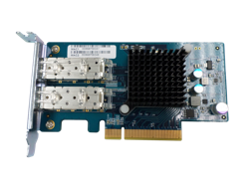

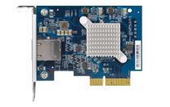
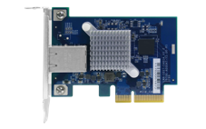
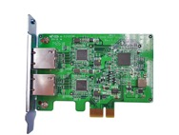
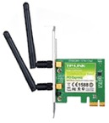
Unleash potentials with fast NICs
10GbE/1GbE network card
LAN-10G2SF-MLX
LAN-10G2T-X550
QXG-10G1T
LAN-10G1TA
LAN-1G2T-I210
Wireless network card
NEW
TL-WDN4800 N900
TL-WDN3800 N600
TL-WN881ND N300
TL-WN781ND N150
QWA-AC2600
TP-Link

Slide 9
QM2 card adds SSD cache, Qtier, & 10GbE
2 x M.2 2280 /2260
SATA 6Gb/s SSD slots
SSD cache or storage space
Qtier auto tiering
Independent thermal sensors
QM2 card provides 2 x M.2 SSD, combined with the two M.2 SATA SSD slots on x73e to form a RAID 5 pool/volume for better protection and performance.

Slide 10
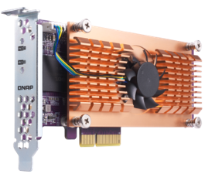
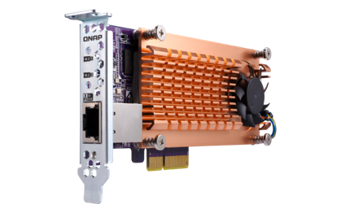
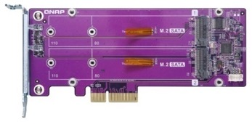
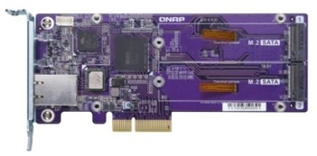
QM2 cards with M.2 SSD slots & 10GbE
Support all NAS models
with a PCIe slot
10GbE
Combo
QM2-2S10G1T
QM2-2S
2 x M.2 2280 SATA SSD slot
2 x M.2 22110 / 2280 SATA SSD slot
1 x 10GBASE-T 10GbE port (10G/5G/2.5G/1G)
QM2-2P
QM2-2P10G1T
2 x M.2 22110 / 2280 PCIe NVMe SSD slot
2 x M.2 2280 PCIe NVMe SSD slot
1 x 10GBASE-T 10GbE port (10G/5G/2.5G/1G)

Slide 11

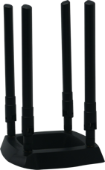
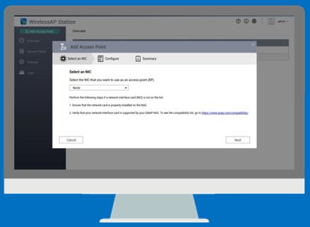



Turn TS-x73 into a wireless access point
Install WirelessAP Station and devices can connect to NAS wirelessly
Setup isolated wireless connections for max bandwidth ( IoT/VM/Container)
Powerful x86 performance; add more wireless cards to increase bandwidth
QWA-AC2600 wireless card
4 x 4 MU-MIMO AC2600
Dual Band Dual Concurrent

Slide 12


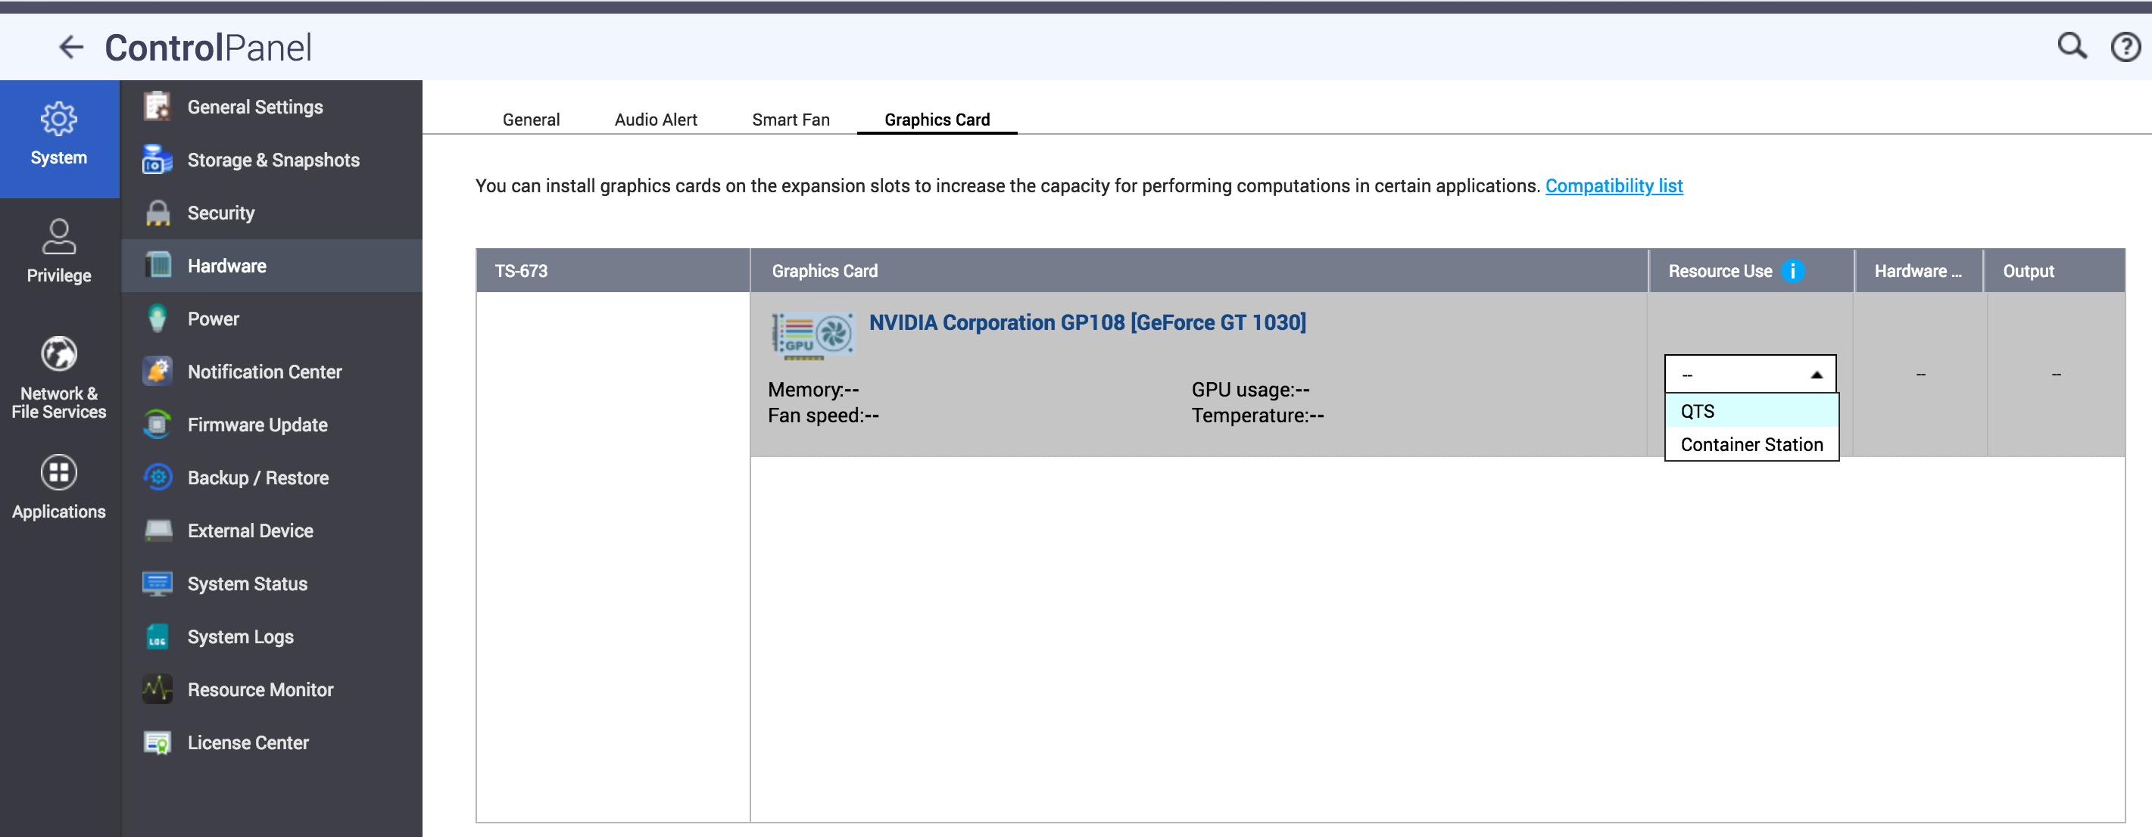
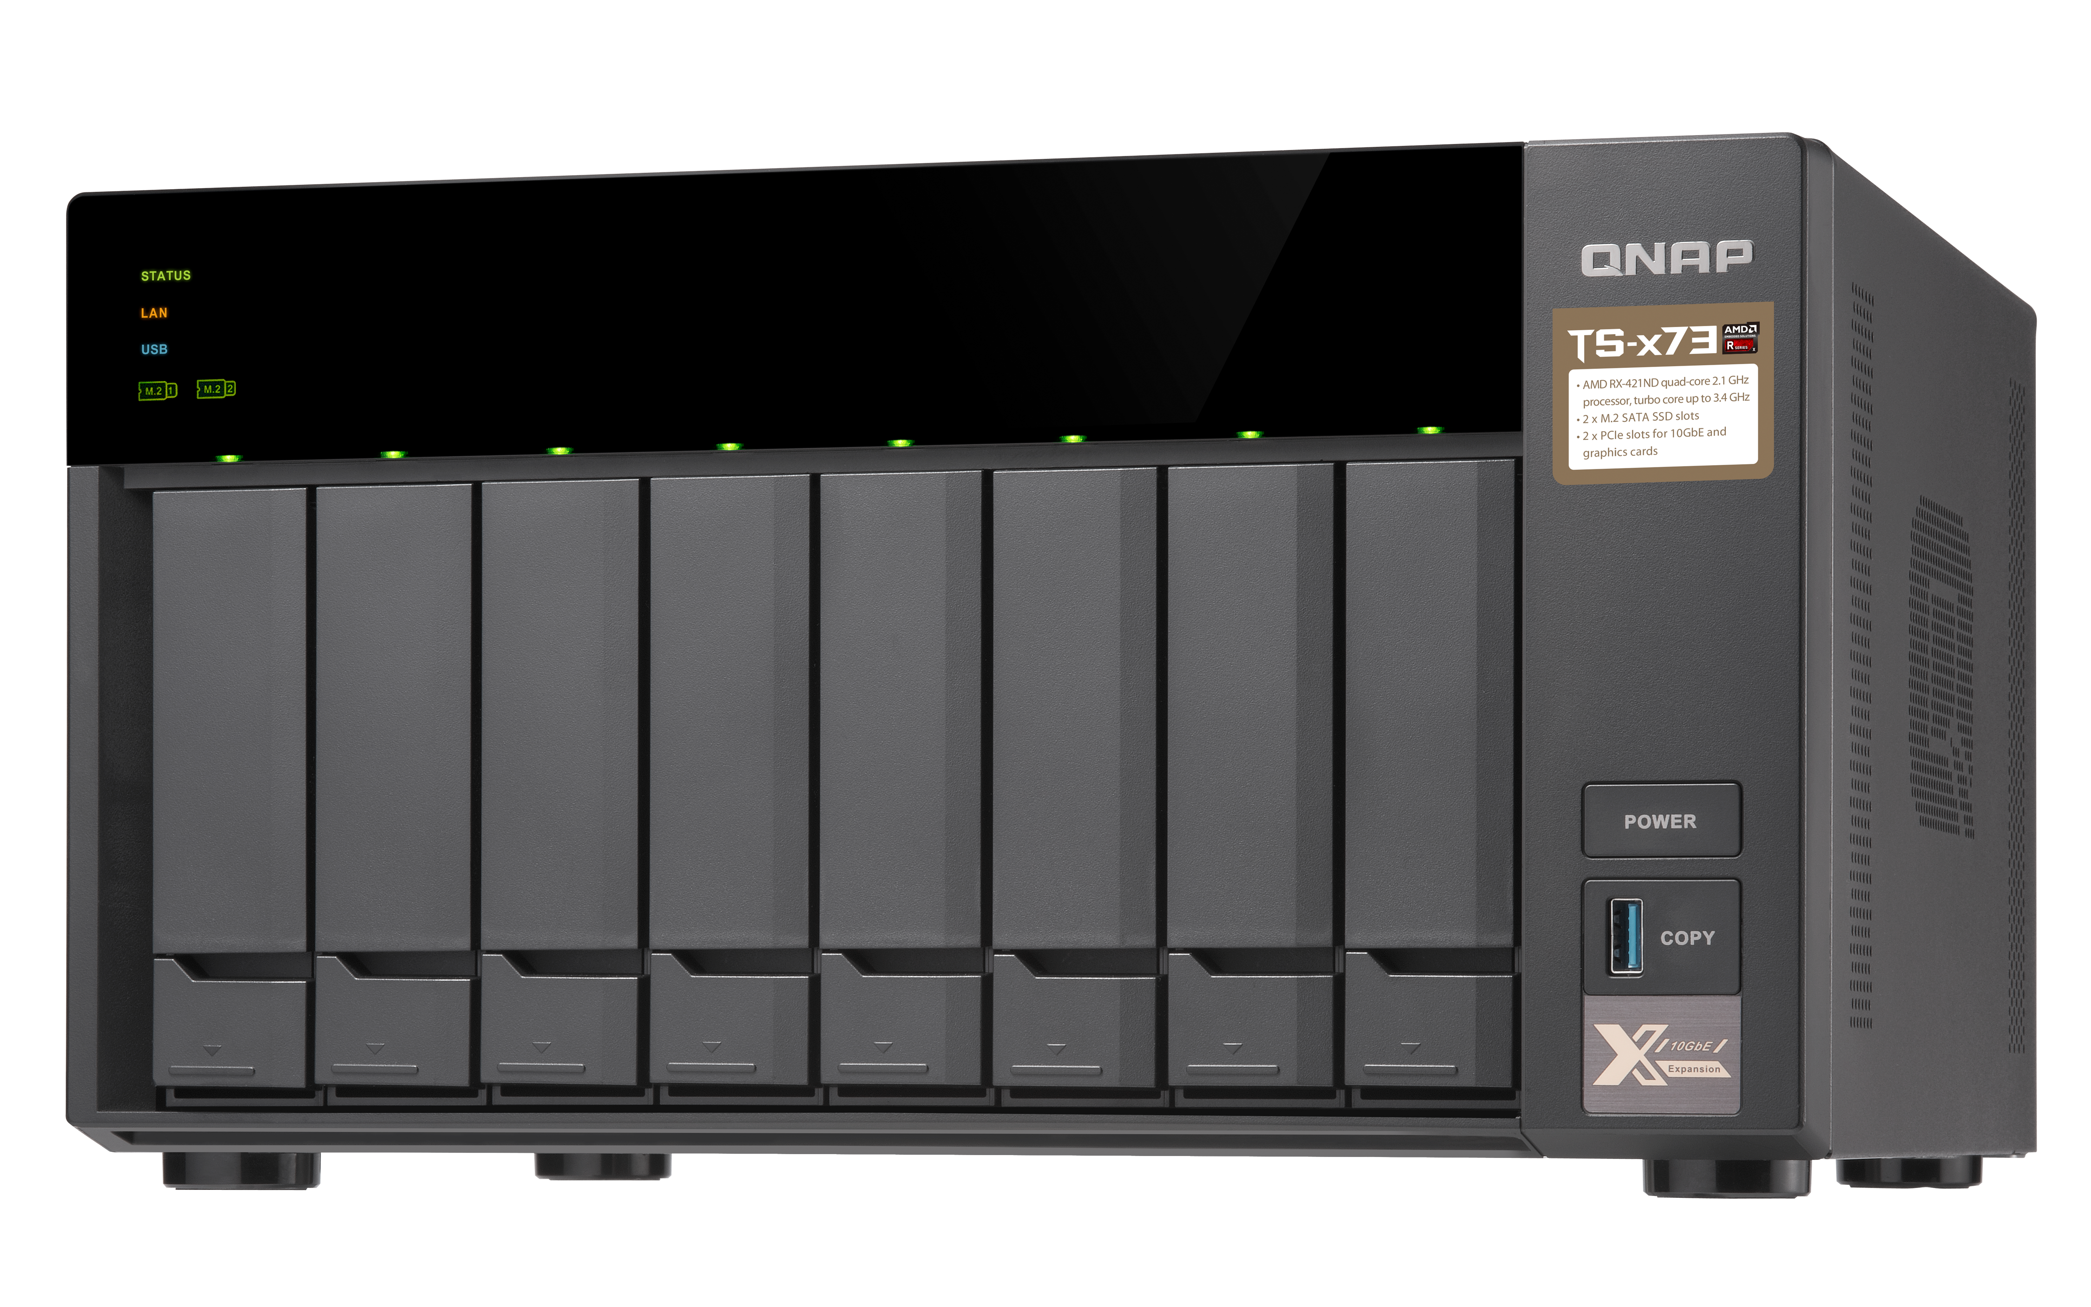



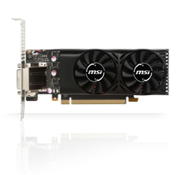

HDMI output with a graphics card
HybridDesk Station, Linux Station, accelerated transcoding
Supports
RM-IR004 remote control with Qbutton feature
QTS 4.3.5 supports NVIDIA graphics card!
Without it: 146s
Install a graphics card to accelerate transcoding
With it: 26 s !!

Slide 13
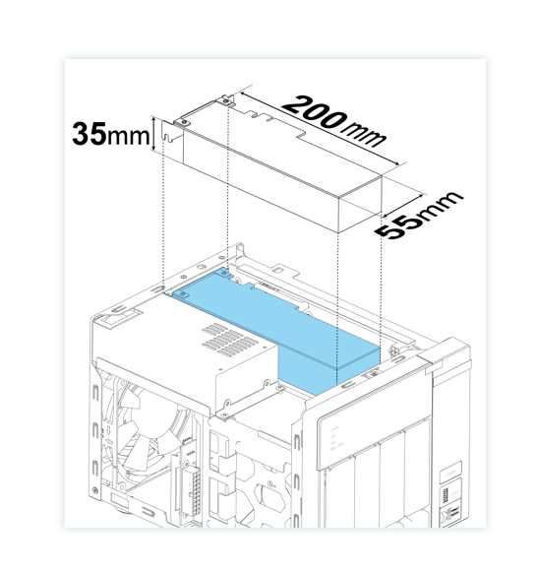
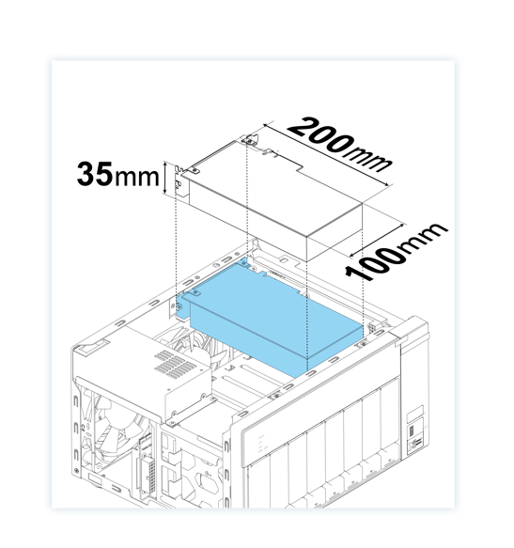
Supported graphics card dimension
250W power supply
TS-473
TS-673 / TS-873
Supports bus-powered NVIDIA graphics cards such as GeForce® GT1030 & 1050
Low-profile PCIe card
Full-height PCIe card

Slide 14


QTS & virtualization increases productivity
一機多系統
Supports Windows/Linux VMs & containers
All-new QTS 4.3.4 Storage & Snapshot Manager, and multimedia management
Virtualization Station
Container
Station

Slide 15

24x7 surveillance center
Surveillance Station 5.1
Free: 4 channels
Max: 72 channels (optional license purchase)
QVR Pro
Free: 8 channels
Max: 128channels (optional license purchase)
QUSBCam2
Up to 1080p USB Webcam recording

Slide 16
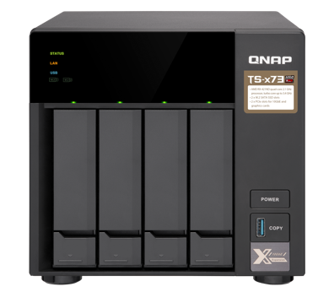
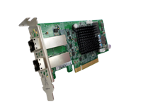




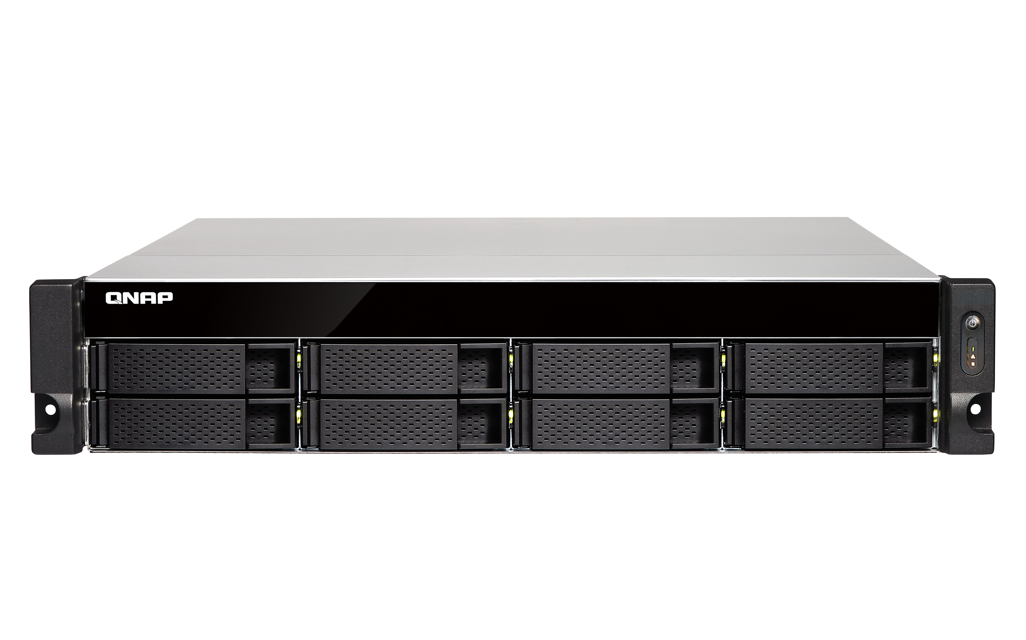
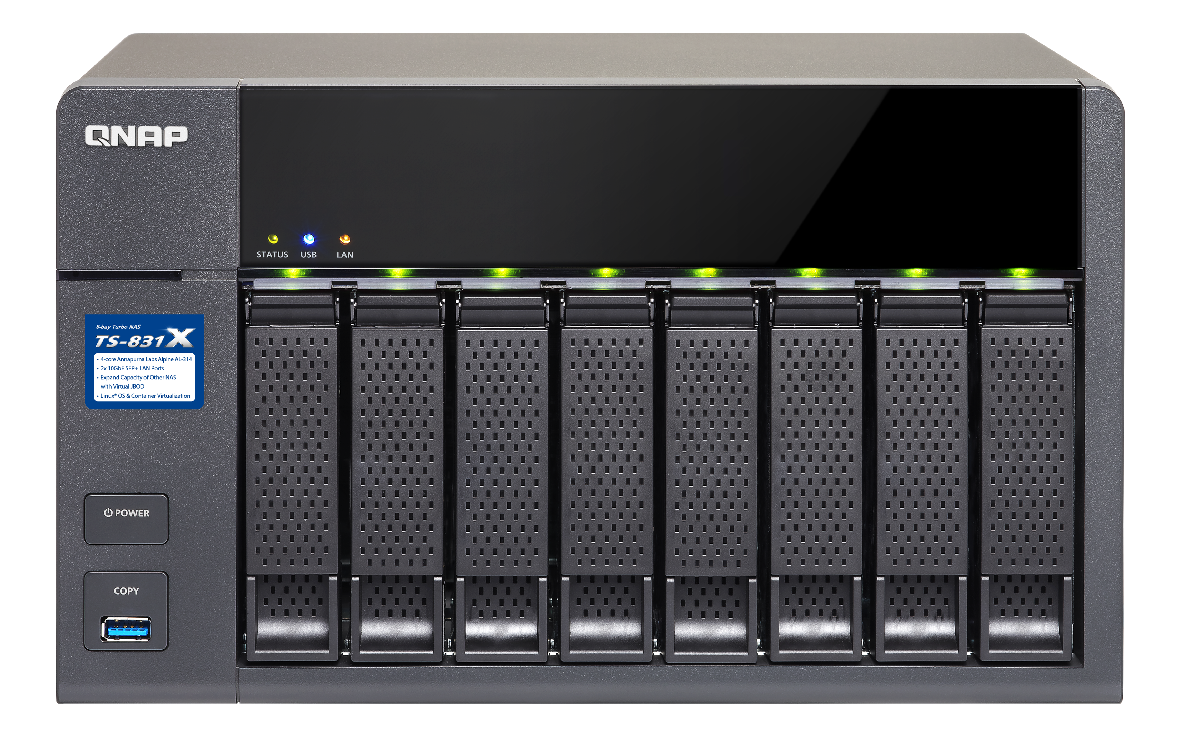
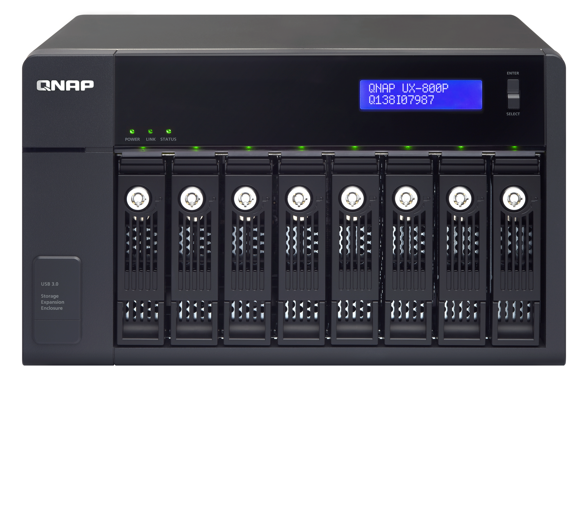
Expand capacity with VJBOD & more
Mini SAS 12G -> 6G
Max 4
REXP-1000P devices
Optional SAS-12G2E card and
SFF-8644 to SFF-8088 cable
USB 3.1 Gen 1 connection
1GbE / 10GbE
iSCSI connection
Max 2
UX-800P/UX-500P devices
Max 8 VJBOD devices
Notes:
add USB & network connection

Slide 17
Let’s get started with TS-x73 live demo
Upgrade memory &
install M.2 SATA 6Gb/s SSD
Install a PCIe graphics card
1
Remove top cover
1
Remove top cover
2
Remove the PSU
2
Install RAM and SSD
3
Install the PCIe card

Slide 18
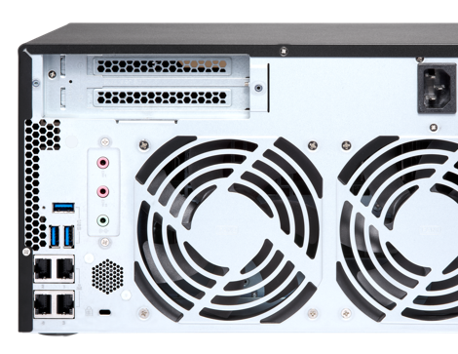
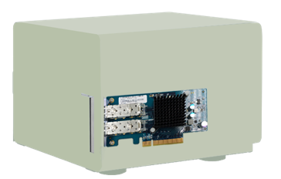
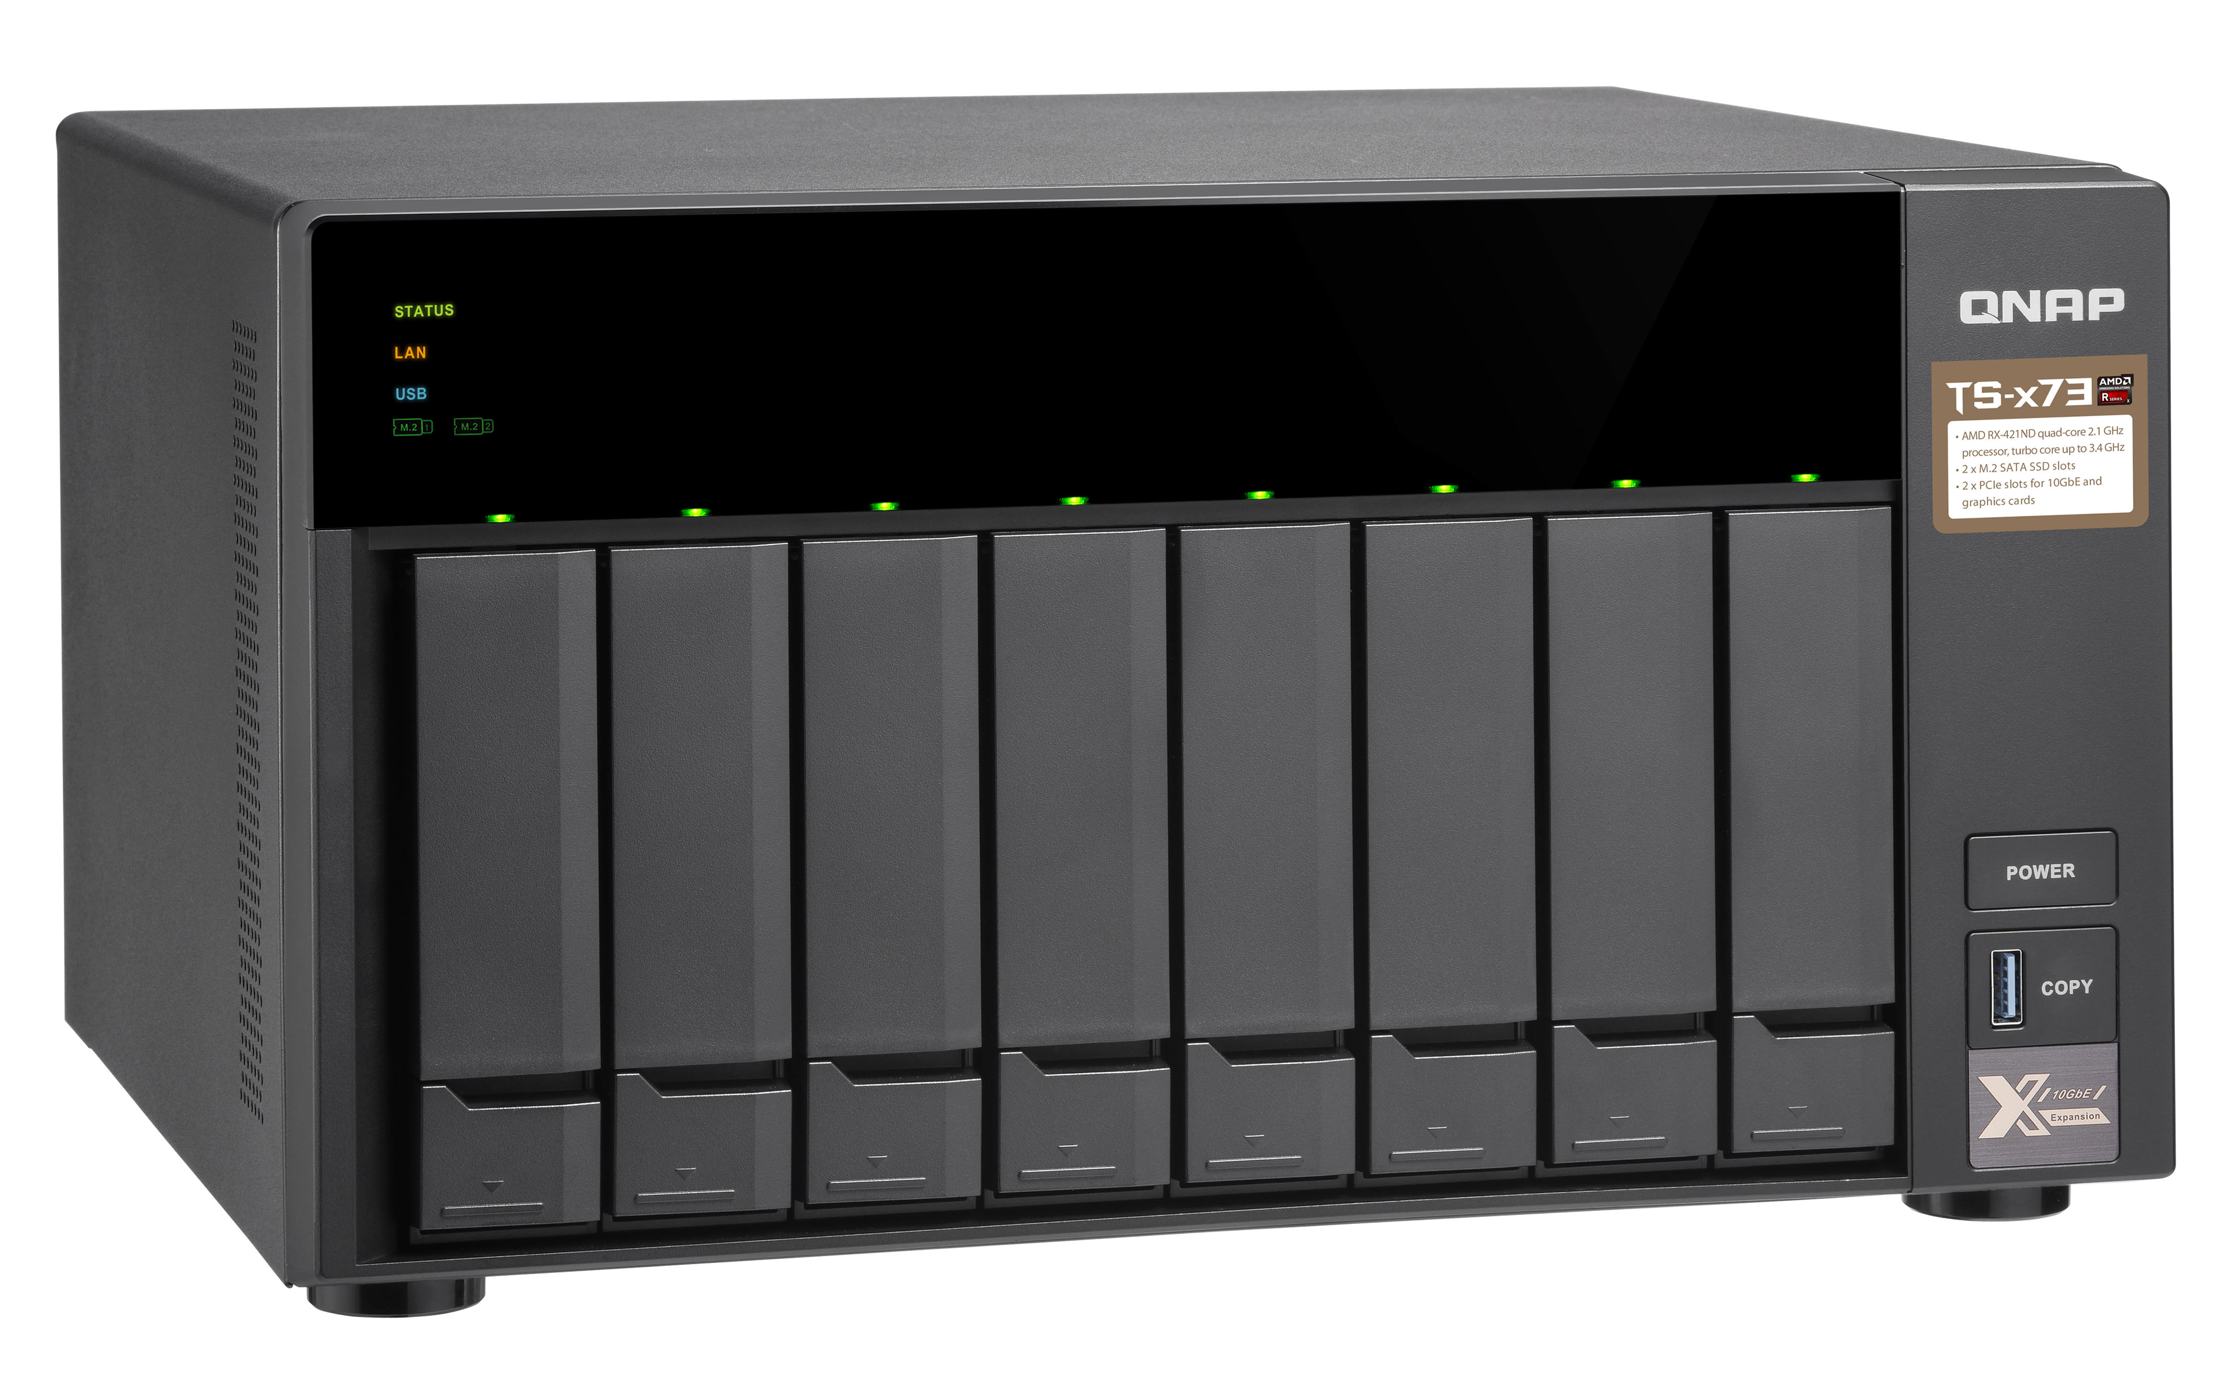
Test #1: 10GbE performance setup
QNAP TS-873
HDD : 8 x 2.5”SSD, RAID 5, QTS 4.3.4
PCIe #1 : 2-port 10GbE SFP+ card
(LAN-10G2SF-MLX)
Synology DS1817+
HDD : 8 x 2.5”SSD, RAID 5, DSM 6.2
PCIe : 2-port 10GbE SFP+ card
(LAN-10G2SF-MLX)

Slide 19
Test #1: 10GbE performance run
IOmeter Sequential Throughput, 2 x 10GbE, 64KB
Up to 3.4 GHz CPU
for 40%+ boost!
Up to 3.4 GHz CPU
For 15%+ boost
2000
1200
1500
1661
900
1000
1122
600
683
570
500
300
0
0
(MB/s)
(MB/s)
QNAP TS-873
Synology DS1817+
QNAP TS-873
Synology DS1817+
Sequential Read (SR-64K)
Sequential Write (SW-64K)
Test in the QNAP lab.
Environment: NAS with 8 x Intel SSDSC2BB240G4 RAID 5, 8GB RAM
Client: Intel Core i7-4700 3.4GHz, RAM cache, Windows 10
IOmeter: Max Disk Size: 67108864, 20-workers, 1-outstanding, 30-sec ramp up time, 3-minute run time.

Slide 20
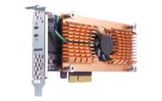

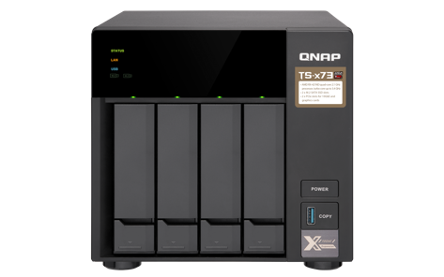
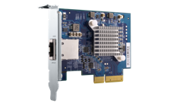
Test # 2: Qtier accelerated 10GbE speed
QNAP TS-473
HDD: 3 x 1TB SATA HDD, RAID 5
Internal M.2 SATA SSD slots: 2 x 256GB M.2 SATA SSD
PCIe #1: 2-port M.2 SATA SSD card (QM2-2S)
with 2 x 256GB M.2 SATA SSD
PCIe #2: 1 port 10GbE 10GBASE-T card (QXG-10G1T)
4 x M.2 SSD for Qtier RAID 5 tier
With SATA HDDs, M.2 SSDs and Qtier for the best performance
1200
1150
900
600
657
300
0
(MB/s)
Write
Read
Performance

Slide 21

x73 family outruns the competition
NAS Model | TVS-x73e | TS-x73 | Synology DSxx17+
Processor | AMD R series quad-core 2.1 GHz, Turbo Core 3.4 GHz |  | Intel Atom quad-core 2.4 GHz
Memory | Up to 64GB DDR4 (4 x SODIMM) |  | Up to 16GB DDR3 (2 x SODIMM)
USB QuickAccess | ✔️ | --- | ---
PCIe Slot | 2 x 3.0 x4 slot |  | 1 x 2.0 x4 slot
Accelerated Transcoding | ✔️ | Requires a PCIe graphics card | ---
HDMI | 2 x 4K HDMI v1.4b 30Hz | Requires a PCIe graphics card | ---
Internal M.2 SSD slot | 2 x M.2 2280/2260 SATA 6Gb/s slot |  | ---
LCD | ✔️ | --- | ---
Audio | 2 x 3.5mm MIC in + 3.5mm line out + speaker |  | ---

Slide 22

The most cost-effective NAS with
dual PCIe 3.0 expansion slots, dual M.2 SATA SSD slots and quad-core CPU up to 3.4 GHz
TS-473
TS-673
TS-873

