Slide 1
Intelligent IoT Edge Computing Platform
AWS Greengrass QIoT QuAI

Slide 2
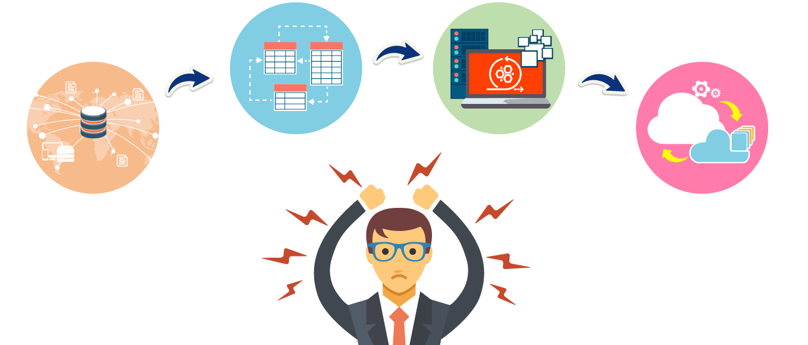
Solve your intelligent IoT problems！
Data collection and analysis
AI model training / validation / deployment / Inference
Public cloud service / Intelligent cloud integration
Device deployment and management

Slide 3
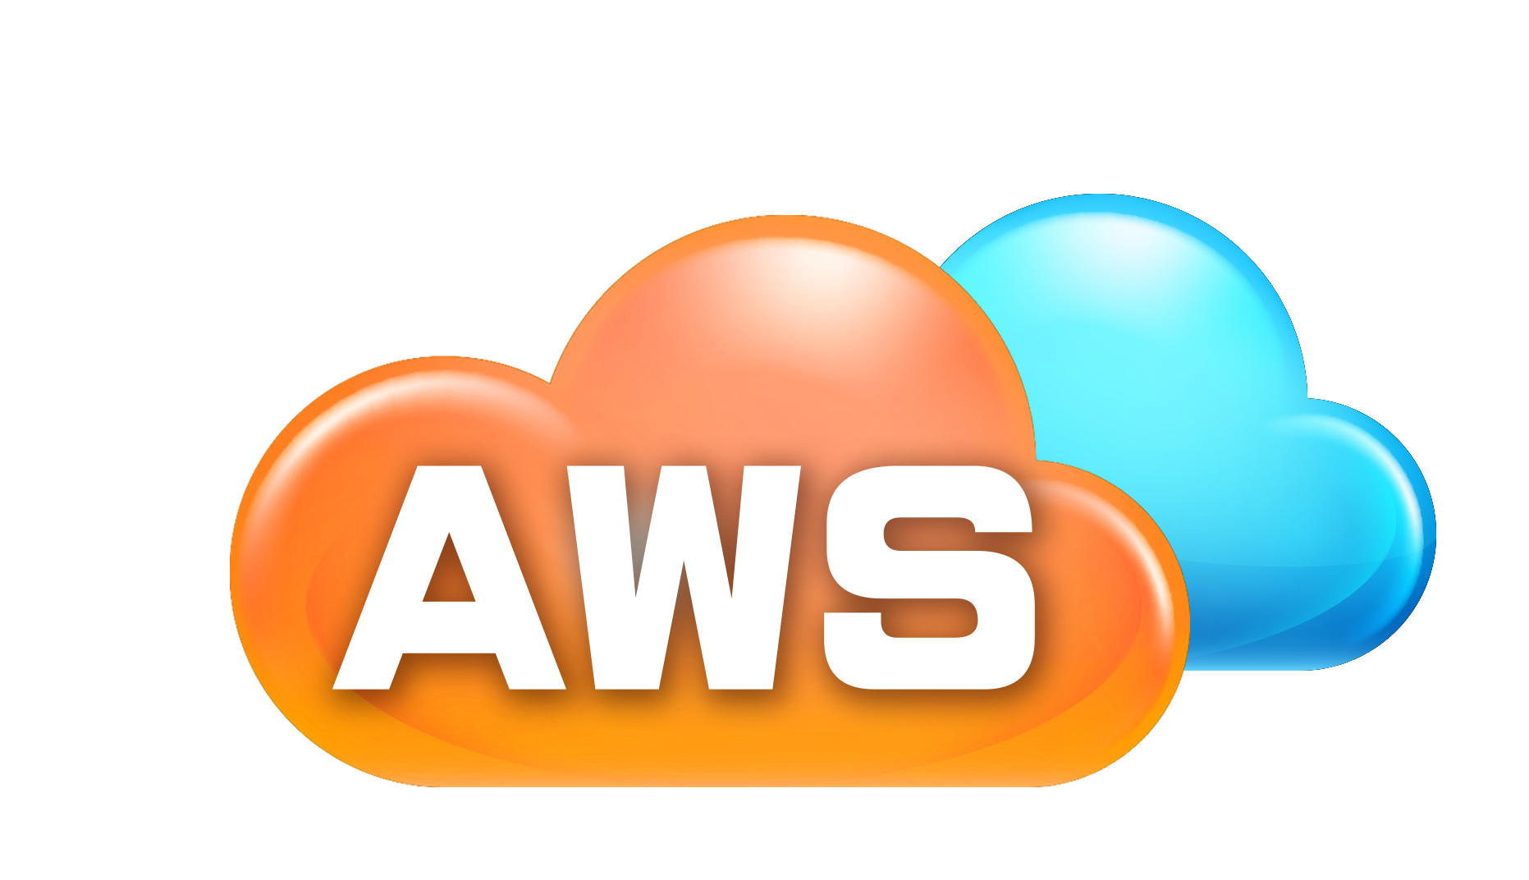
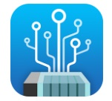
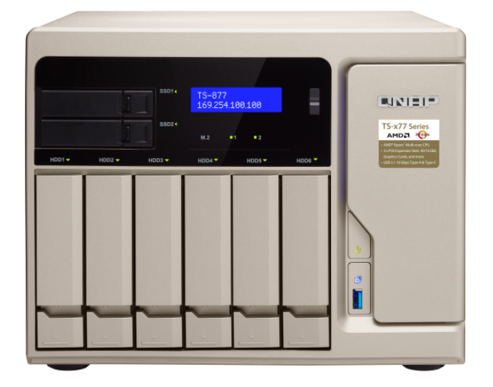
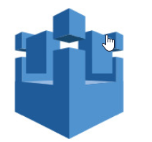
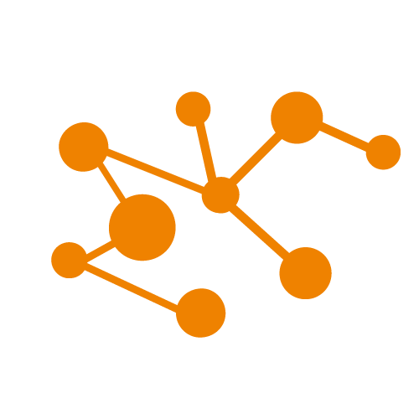
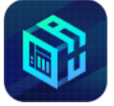
Intelligent edge computing-Embrace AIoT application
Public cloud services
System Integration (SI)
QNAP QIoT supported devices
AWS IoT supported devices
Maker
Edge Computing
Edge Storage
Edge Intelligence
Rule Engine
App Center
QuAI

Slide 4
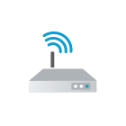
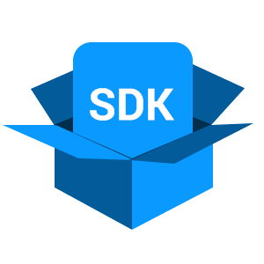
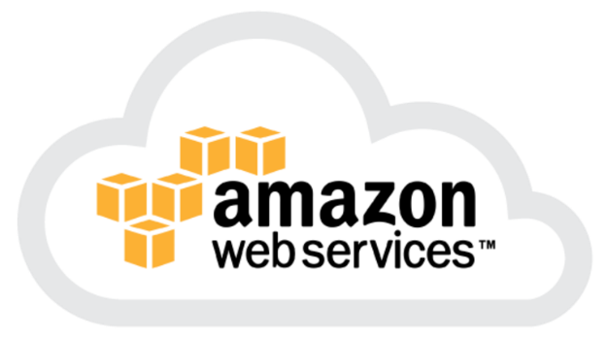
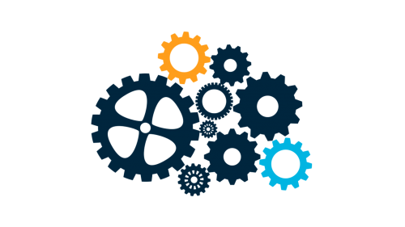
What is AWS IoT ?
Uplink to the cloud
AWS IoT
Connect your device to AWS services
Secure device connections and data
Support multiple protocols
output
Input
Device gateway
MQTT
HTTP 1.1
WebSocket
AWS service
AWS IoT device SDK
Authentication
Rule Engine
Application

Slide 5
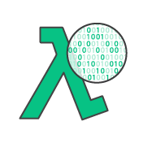
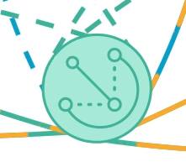
What is AWS Greengrass ?
Downlink to the Edge
AWS Cloud Services
AWS Greengrass Core
Devices
Ensures your IoT devices can respond quickly to local events
Device can run with AWS Lambda functions, and keep device data in sync
Support offline Machine Learning inference
Lambda function
Benefits
Respond to Local Events in Near Real-time Operate Offline
Secure Communication Simplified Device Programming with AWS Lambda
Reduce the Cost of Running IoT Applications

Slide 6
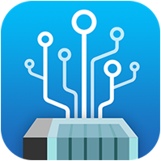
QIoT Suite Lite
整合智慧IoT平台
生態系統合作模式創造雙贏的價值
成功因素
Integrated Intelligent IoT Platform
Ecosystem partnership model : Create win-win
Key success Drivers
Strategic Alliance Partners
SI with Domain Knowledge
Applications - driven
QIoT Suite Lite

Slide 7
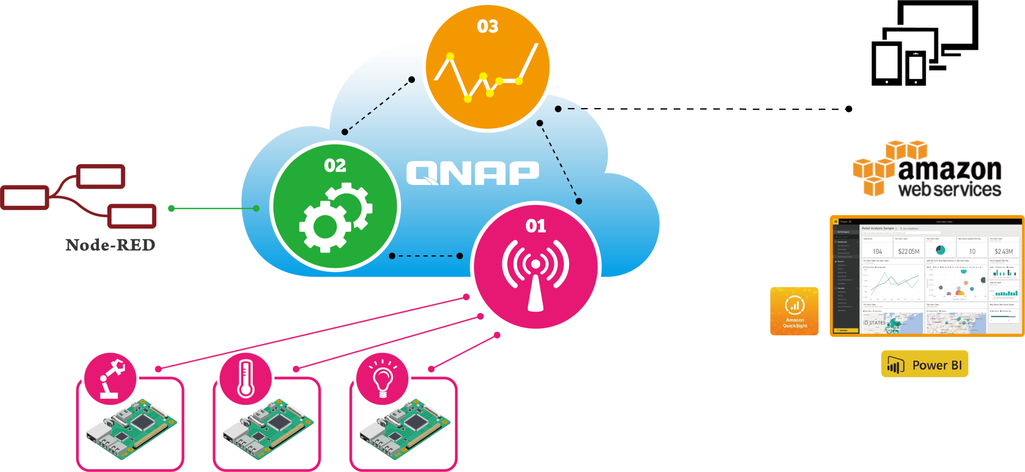
QIoT Suite Lite：Private cloud to Hybrid cloud
Stage 2：Data Processing
Stage 3. Data Visualization
Show Data on Dashboards
Rules Setting
Threshold
Local Storage
Applications
Stage 1. Data Collecting
Sensors
Devices
Development Board

Slide 8
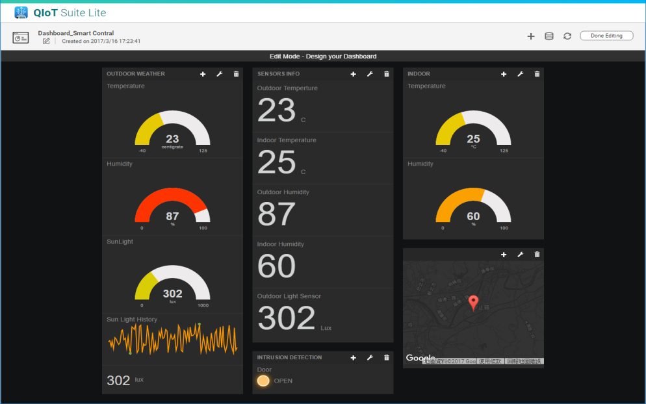
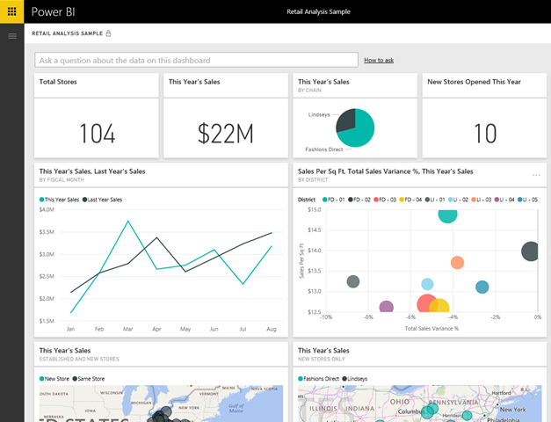
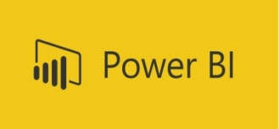
Transfer data to third-party services
Third Party business analytics tool
Push the collected data to Power BI for further data analytics

Slide 9
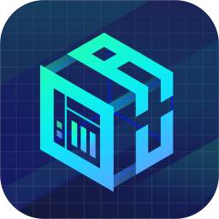
QuAI
輕鬆快速地建立高效益的機器學習模型
打造專屬的 AI/ML/DL 解決方案
支援多種AI 程式開發架構及函式庫
體驗人工智慧帶來的潛力與價值
Build a cost effective machine-learning model quickly
and easily
Start your own AI/ML/DL solutions
Support multiple AI programming frameworks
and libraries
Fully realize benefits of cognitive technologies
QuAI

Slide 10
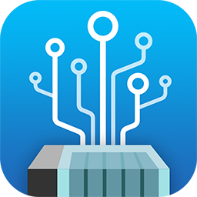
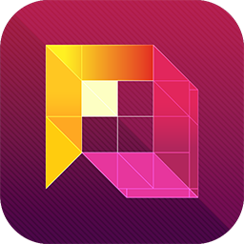
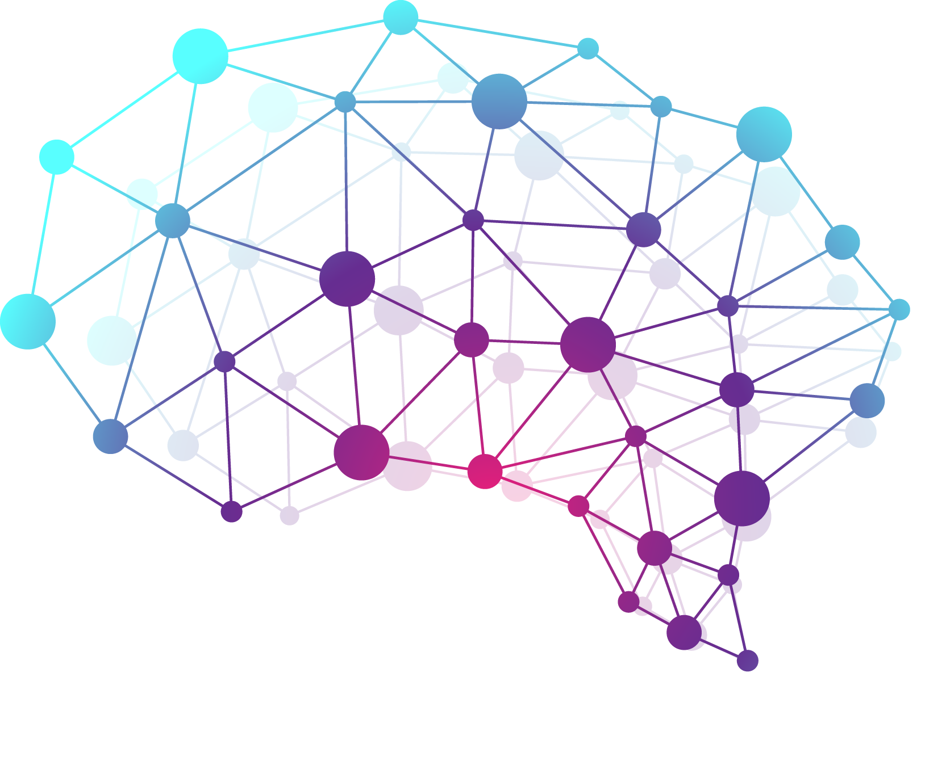
QuAI: Quickly build AI application
Benefits
Saving data transmission time, establishing database with existing data on QNAP NAS for training, inference and analysis
Storage and manage massive of data
Complete data protection
QuAI utility for rapid deployment of developer environment
Higher cost efficiency and easier control of your spending
QuAI Deep Learning Model

Slide 11
Hand in hand - Demo
Demo
Rapid IoT image recognition system
Device：Collect images
Edge：Establish ML model, video inference, data mark, data storage, upload identified images to cloud automatically
Cloud：For advanced data analysis and application integration

Slide 12
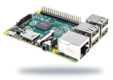
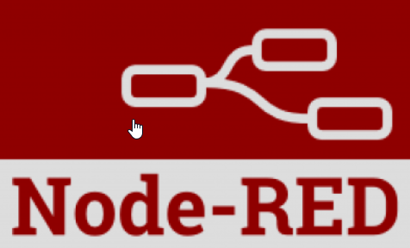
Extend your Intelligent application
Demo
AWS Greengrass
Module
Deploy
IoT devices
QuAI Model Training
1
3
Start QuAI (Caffee, CNTK, MXnet, TensorFlow)
AWS Greengrass Core
2
Collect training data
QuAI
4
Subscribe QIoT topic
9
Train and validate model
QIoT
10
Create Lambda
function
Get published data from QIoT
6
5
8
Inference
Deploy ML model
(via container)
Push data to AWS / Trigger AWS rule actions
7
Inferred results
11
Trigger QIoT action
AWS machine learning

Slide 13
Deploy your own model API
1
2
3
Install QuAI, and confirm the machine learning environment is ready
Establish a tensorflow: gpu container environment and set up external Port
Start sample program from Container image recognition
(Using Keras / Resnet50)
4
5
Using Resnet50 file and using swagger page to test the results
Go to QIoT and use NodeRed to Integrate the API


Slide 14
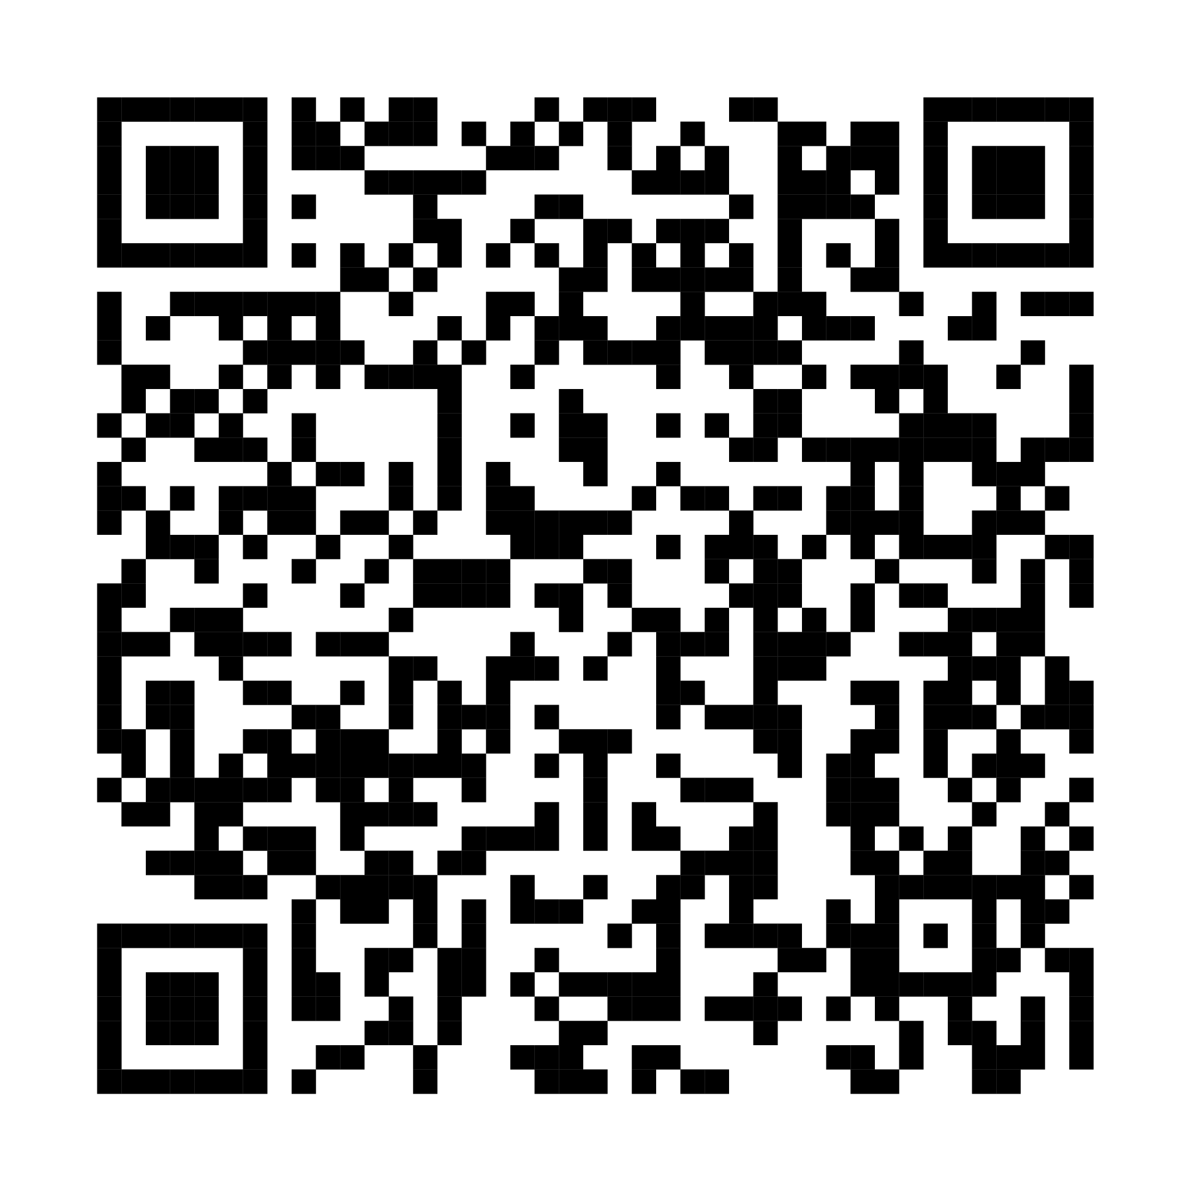
More information……
https://github.com/qnap-dev/qnap-qiot-sdks/tree/master/projects/AWSGreengrass-Integration-Scenarios

Slide 15
AWS Greengrass QIoT QuAI
Your best choice for
NAS / IOT integration

