Slide 1
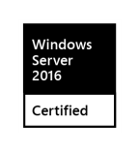
Dual 10GBASE-T and up to 8-core performance Get jobs done quickly and efficiently
16-bay Enterprise Ryzen Supreme NAS
TS-1677X
3 slots

Slide 2
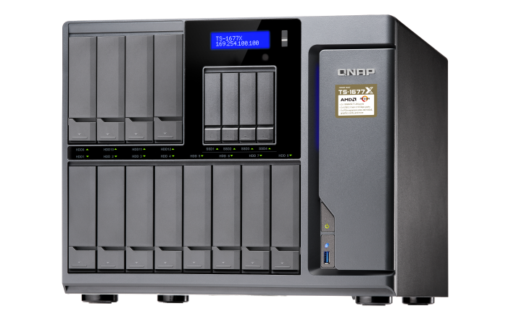
There’s always something for you
Entry
4 cores / 4 threads
3.1 GHz / 3.4 GHz
High-end
8 cores / 16 threads
3.0 GHz / 3.7 GHz
TS-1677X-1200-4G
Ryzen 3 1200, 4GB RAM (1x 4GB)
TS-1677X-1700-16G
Ryzen 7 1700, 16GB RAM (2x 8GB)
TS-1677X-1700-64G
Ryzen 7 1700, 64GB RAM (4x 16GB)
Balanced
6 cores / 12 threads
3.2 GHz / 3.6 GHz
TS-1677X-1600-8G
Ryzen 5 1600, 8GB RAM (2x 4GB)
60%
Notes:
白手起家款

Slide 3
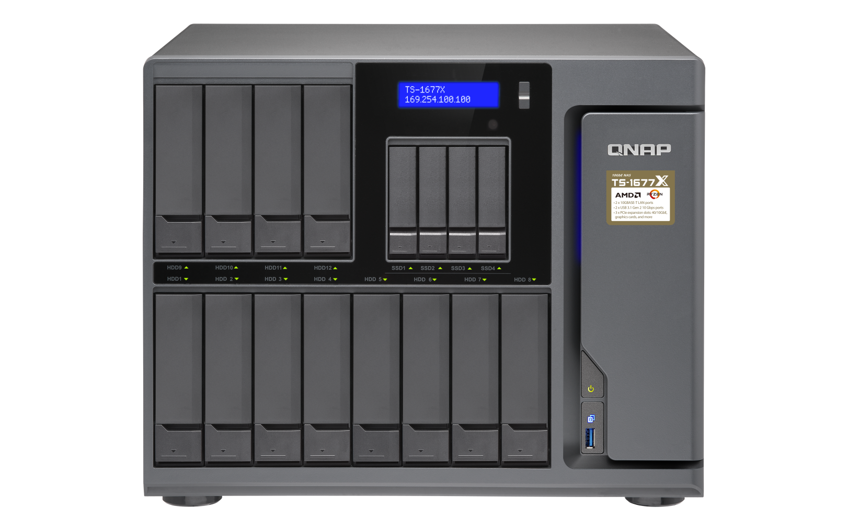
TS-1677X front view
LCD monitor with Enter & Select buttons
IR receiver
(w/ PCIe graphics card)
4 x 2.5”SSD drive bays, supporting Qtier auto tiering and SSD cache
Power button
LEDs with adjustable brightness
USB 3.1 Gen 1 & Copy button
12 x 3.5”/2.5” drive bays

Slide 4
TS-1677X internal view
Compartmentalized smart cooling
Separately detects the CPU & hard drive temperatures to dynamically control fan speeds for quieter operations
Max 64 GB RAM
4 x DDR4 Long-DIMM dual-channel memory slots

Slide 5
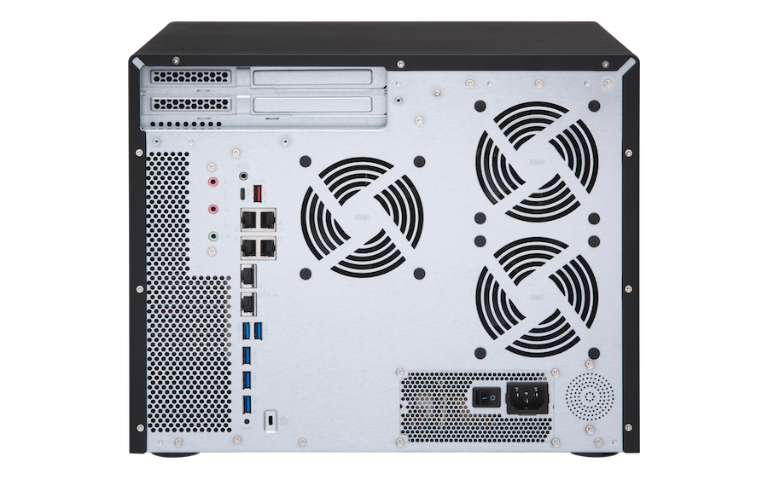
TS-1677X rear view
1 x USB 3.1 Gen 1 Type-A
1 x PCIe 3.0 x8
1 x PCIe 3.0 x4
1 x PCIe 2.0 x4
1 x USB 3.1 Gen 1 Type-C
speaker
2 x dynamic MIC in
1 x Line out
550W PSU
(w/ 8pin+6pin
graphics card power connector)
4 x GbE LAN
2 x 10GBASE-T
5 x USB 3.1 Gen 1 Type-A

Slide 6
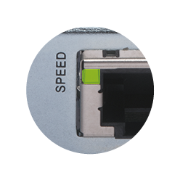
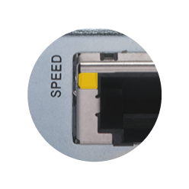
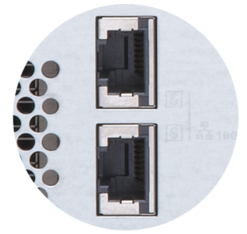
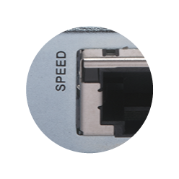
Dual Multi-Gigabit 10GBASE-T port
 | CAT 5e | CAT 6 | CAT 6a & CAT 7
100M | ✔ | ✔ | ✔
1G | ✔ | ✔ | ✔
2.5G | ✔ | ✔ | ✔
5G | ✔ | ✔ | ✔
10G | X | ✔(55m) | ✔
Five speeds
10G
5G/2.5G/1G/100M
Don't throw away your old cables yet!
Multi-Gigabit NBASE-T technology supported
Disconnected

Slide 7
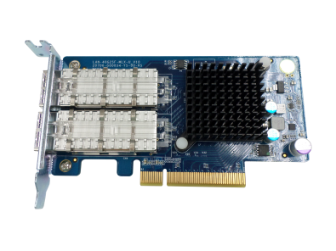
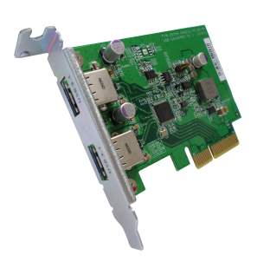
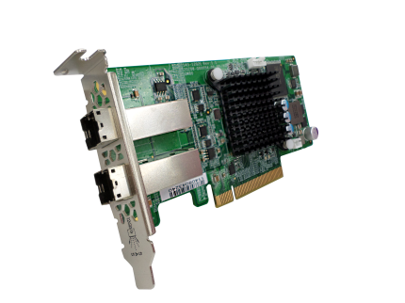
Industry-leading 3 PCIe slots
QM2
40GbE/10GbE/wireless
QM2 provides 2 x M.2 SSD slot and 10GBASE-T port for SSD cache or Qtier auto tiering for optimized storage performance.
40GbE/10GbE and wireless network expansion cards
provide high bandwidth, low latency, or wireless AP.
USB 3.1 Gen 2
SAS (12G)
USB 3.1 Gen 2 expansion cards provide 10Gb/s with external USB devices．Type-A port is also backward compatible with USB 3.1 Gen 1/2.0 devices
SAS expansion card is for adding support of REXP expansion units for up to 40 additional SAS/SATA drives.

Slide 8
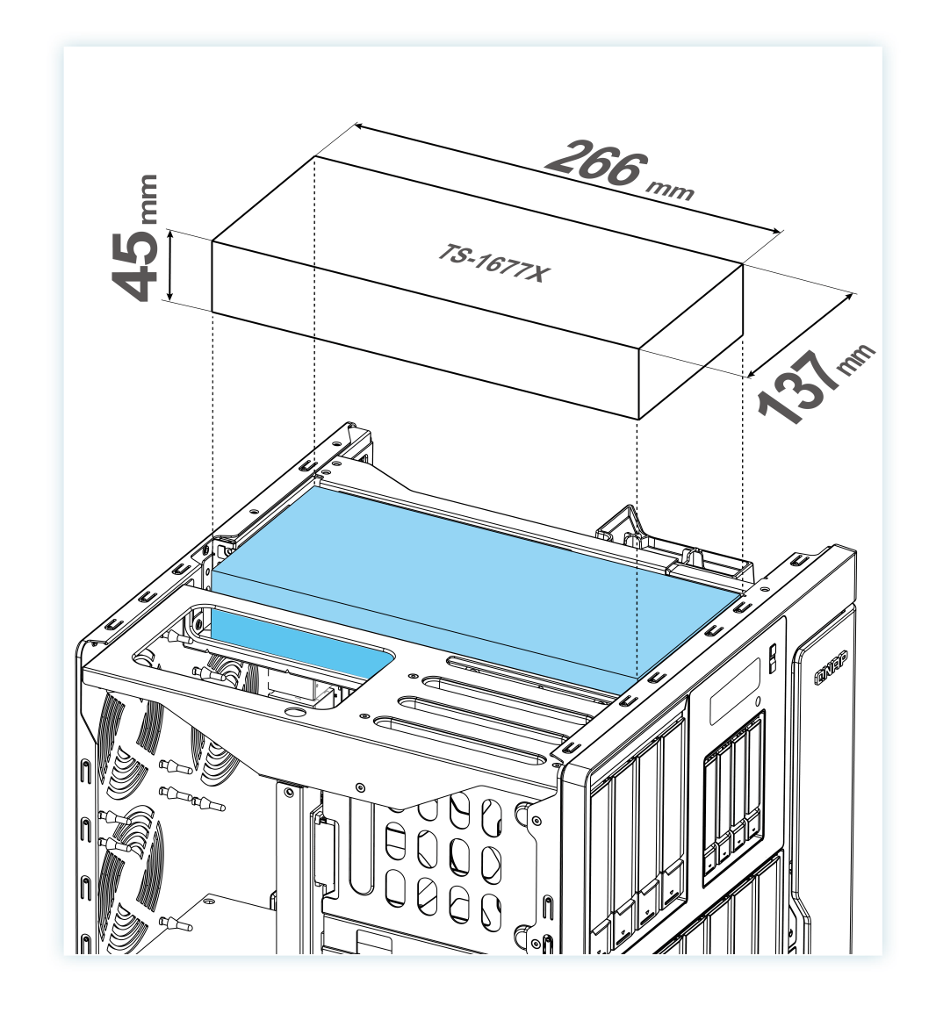
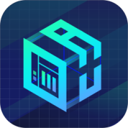
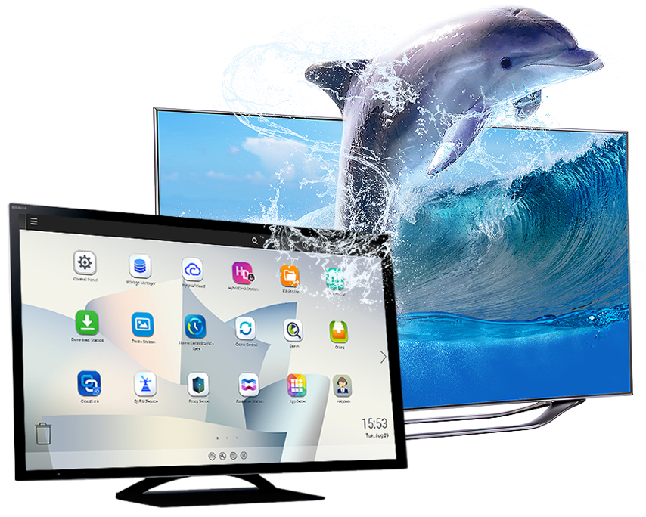
Do more with a graphics card
QuAI
550W PSU

Slide 9
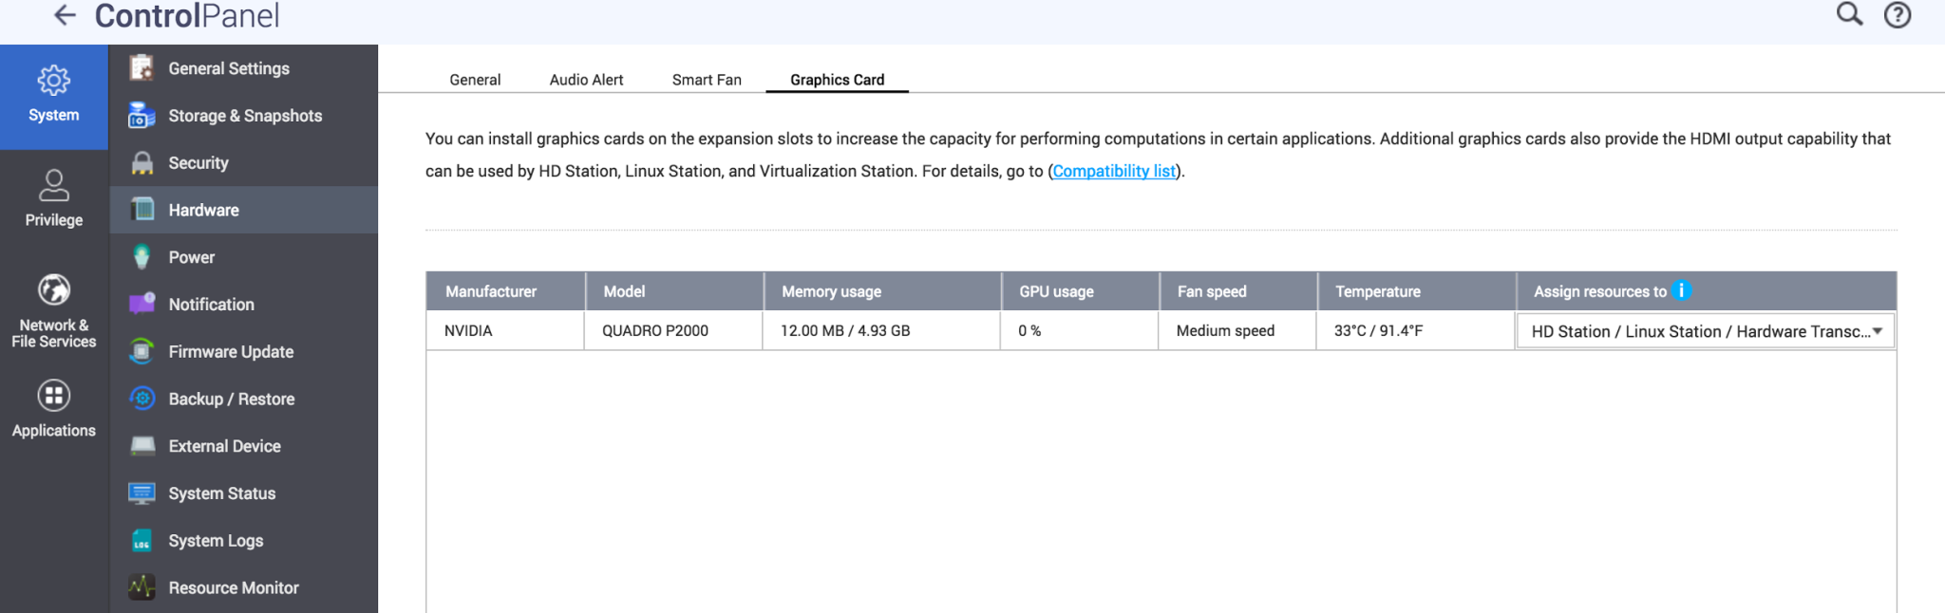
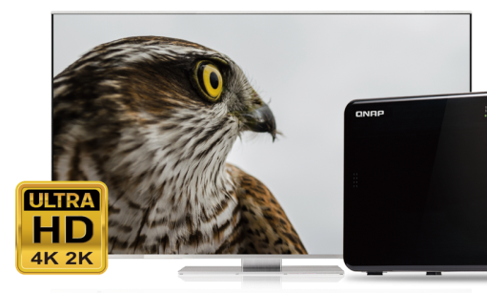
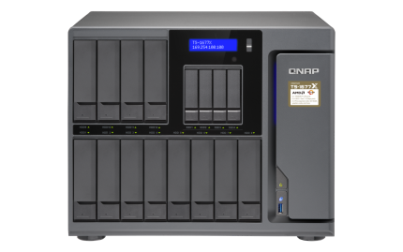
GPU Passthrough & QTS support
Virtualization Station: AMD & NVIDIA graphics cards
HybridDesk Station, Linux Station, accelerated transcoding:
NVIDIA GTX 1050/1060/1070, P2000 graphics card only
Optional Qbutton-supported RM-IR004 remote!

Slide 10
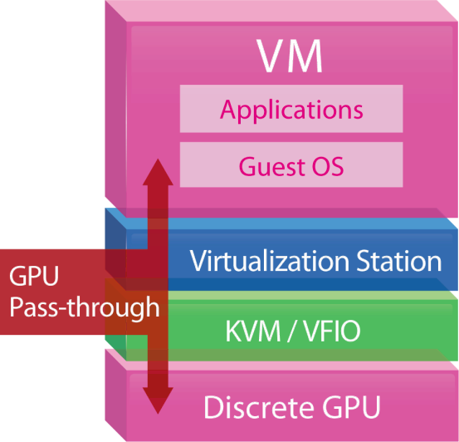
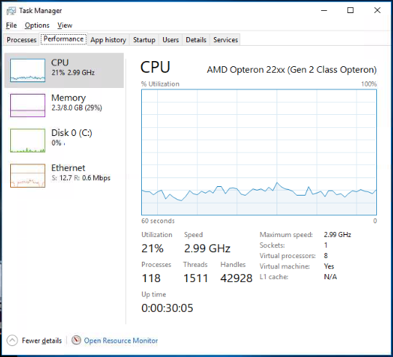
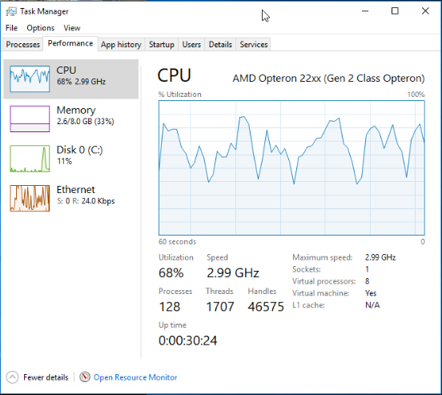
GPU upgrades image/video processing
For OpenGL & DirectX applications
H/W accelerated with GPU to lower CPU usage.
21%
68%
W/ GPU
W/O GPU
Tested at QNAP Lab. Results vary by actual environments. NAS：TS-1677X Ryzen 1700
QTS 4.3.4, Seagate ST4000VN0001
nVIDIA GeForce GTX 1060 6GB

Slide 11
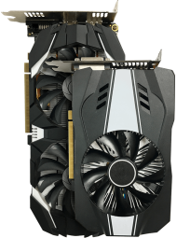
Ride the AI wave with “QuAI”
QNAP QuAI
>> AI Developer Package
Is intended for data scientists and developers to quickly build, train, and optimize their AI Models on QNAP NAS.
+
+
=
TS-1677X
GPU accelerated computing
QuAI
AI

Slide 12
QTS & virtualization increase productivity
QTS 4.3.4
Storage & Snapshot Manager, and multimedia management
Supports Windows/Linux VMs and containers
Virtualization Station
Container Station

Slide 13
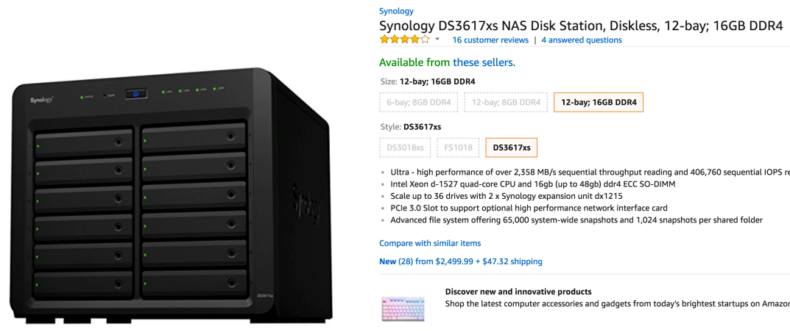
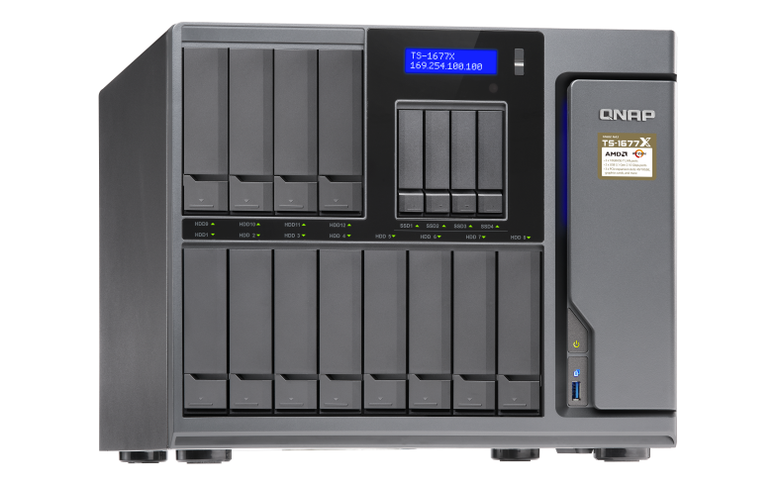
Multi-core with high frequency
Brand | Processor | Cores | Threads | Base Freq. | Boost Freq. | L3 Cache
QNAP | Ryzen 7 1700 | 8C | 16T | 3.0GHz | 3.7GHz | 16MB
QNAP | Ryzen 5 1600 | 6C | 12T | 3.2GHz | 3.6GHz | 16MB
QNAP | Ryzen 3 1200 | 4C | 4T | 3.1GHz | 3.4GHz | 8MB
Synology | Xeon-D 1527 | 4C | 8T | 2.2GHz | 2.7GHz | 6MB
TS-1677X
Sources 2018/03/13: 1. AMD & Intel websites 2. https://www.amazon.com/Synology-DS3617xs-Station-Diskless-12-bay/dp/B01MSTCXPN/ref=sr_1_1?ie=UTF8&qid=1520932215&sr=8-1&keywords=synology+ds3617xs

Slide 14
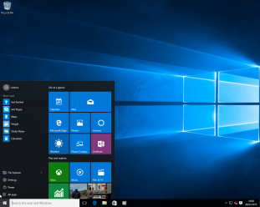
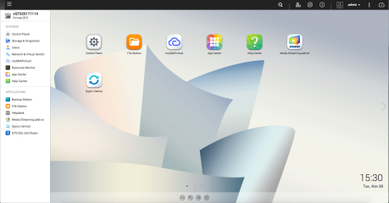
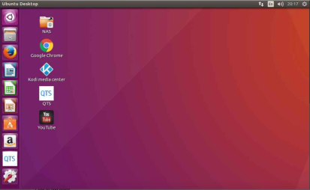
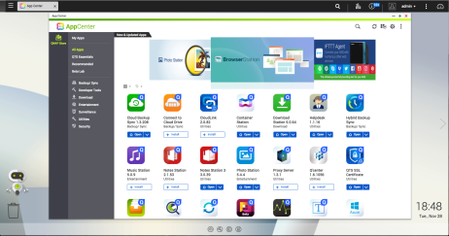
Running vQTS via Virtualzation Station
Conventional VM: Windows,
Linux, UNIX
Virtual QTS - vQTS
Virtualization Station

Slide 15
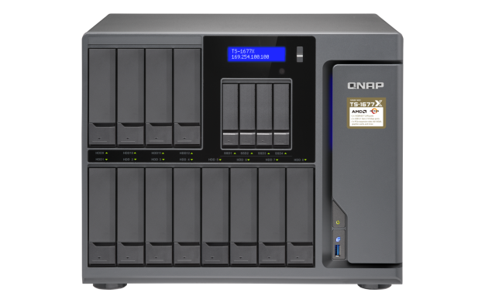
One-for-many
It allows IT admins to flexibly allocate system resources to different
departments or groups for different privileges and applications.
Managing Director
Accountants
Customer Service Reps
Engineers

Slide 16
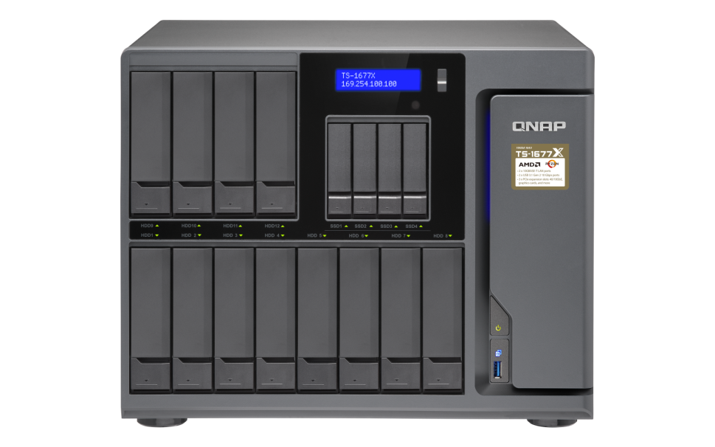
Dedicated resource allocation
Allocation of dedicated HW resources (CPU, RAM, storage space,
and Internet) ensures performance quality.
Quad-core
4 GB
250 GB
1
Octa-core
8 GB
500 GB
2

Slide 17
The best platform for vQTS
Number of allowed vQTS instances is based on the number of cores of the physical CPU.
AMD Ryzen™ 5 1600 6 cores =
2
AMD Ryzen™ 7 1700 8 cores =
4
TS-1677X-1600-8G
Ryzen 5 1600, 8GB RAM (2x 4GB)
TS-1677X-1700-16G
Ryzen 7 1700, 16GB RAM (2x 8GB)
TS-1677X-1700-64G
Ryzen 7 1700, 64GB RAM (4x 16GB)

Slide 18
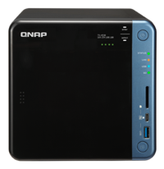
Super high capacity surveillance
Surveillance Station 5.1
Default: 8 free channels
Max: 80 ch (optional license)
QVR Pro
Default: 8 free channels
Max: 128 ch (optional license)
QUSBCam2
Up to 1080p USB Webcam recoding
* 在 QVR Pro 正式發行時，正式頻道授權數請參閱 QNAP 官網．

Slide 19
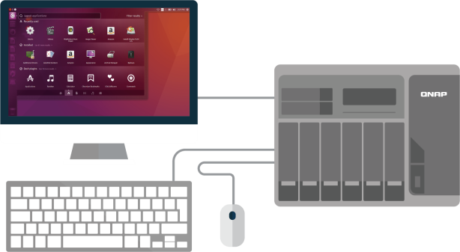
Upgrading parts is easy
Upgrade memory
Install a graphics card
QTS
Control Panel - Hardware - Graphics Card
Compare the transcoding speed before and after

Slide 20
Born with fast 2 x 10GBASE-T
TS-1677X integrates 2 x 10GBASE-T without additional costs
Compatible with 40GbE and 10GbE 10GBSE-T or SFP+ cards
Live test of 2 x 10GbE transfer performance
2001 MB/s
2009 MB/s
Tested in QNAP Labs. Figures may vary by environment. 2 x 10GbE Transfer Test environment: NAS: TS-1677X-1700-16G OS: QTS 4.3.4 Volume type: RAID 5; 16 x Intel SSDSC2BB240G4 SSD
Client PC：Windows 10, Intel Core i7-6700 3.4 GHz, 32GB RAM, QNAP QXG-10G1T NIC, IOMeter sequential read and write

Slide 21
High-capacity 16-bay Enterprise Ryzen Supreme NAS
3 slots
TS-1677X

