Slide 1

Notes:
The powerful search engine in your NAS

Slide 2



Have you ever had those concerns?
Always need to spend a long time to check search results…
Too many files to find the right one…
Finding the files will always interrupt the workflow…
Suddenly need files when going out ...

Slide 3

Qsirch 334
Solves All Your Concerns

Slide 4



Qsirch 334 core competencies
Search tools
◆ Advanced search for complex keyword search
◆ Category bar for quickly finding every kinds of files
◆ 35+ powerful filter conditions
Search aids
◆ Tags for every search criteria
◆ Highlight keywords for viewing the search result clearly
◆ Easy steps from preview to sharing
Search channel
◆ Web ◆ Mobile app
◆ Browser extension ◆ Mac Finder

Slide 5

Do you always spend a lot of time on searching files because you don't remember the keyword or you don’t have full text search tools?
Notes:
CC free photo
https://www.pexels.com/photo/design-desk-display-eyewear-313690/

Slide 6
With Qsirch
Any search criteria won't bother you!
1

Slide 7
3 Search tools of Qsirch
01
Advanced search for complex keyword search
02
Category bar for quickly finding every kinds of files
03
35+ powerful filter conditions
Notes:
◆ Advanced search for complex keyword search
◆ Category bar for quickly finding every kinds of files
◆ 35 up powerful filter conditions

Slide 8
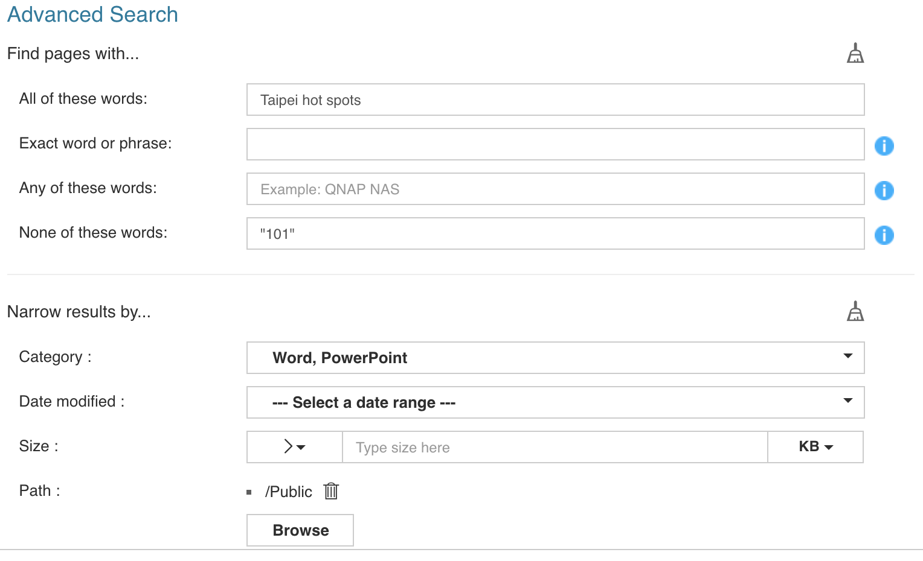
01
Advanced Search
With advanced search panel, you can search with complex keywords easily without understanding any syntax!
Four basic criteria to improve search accuracy!

Slide 9
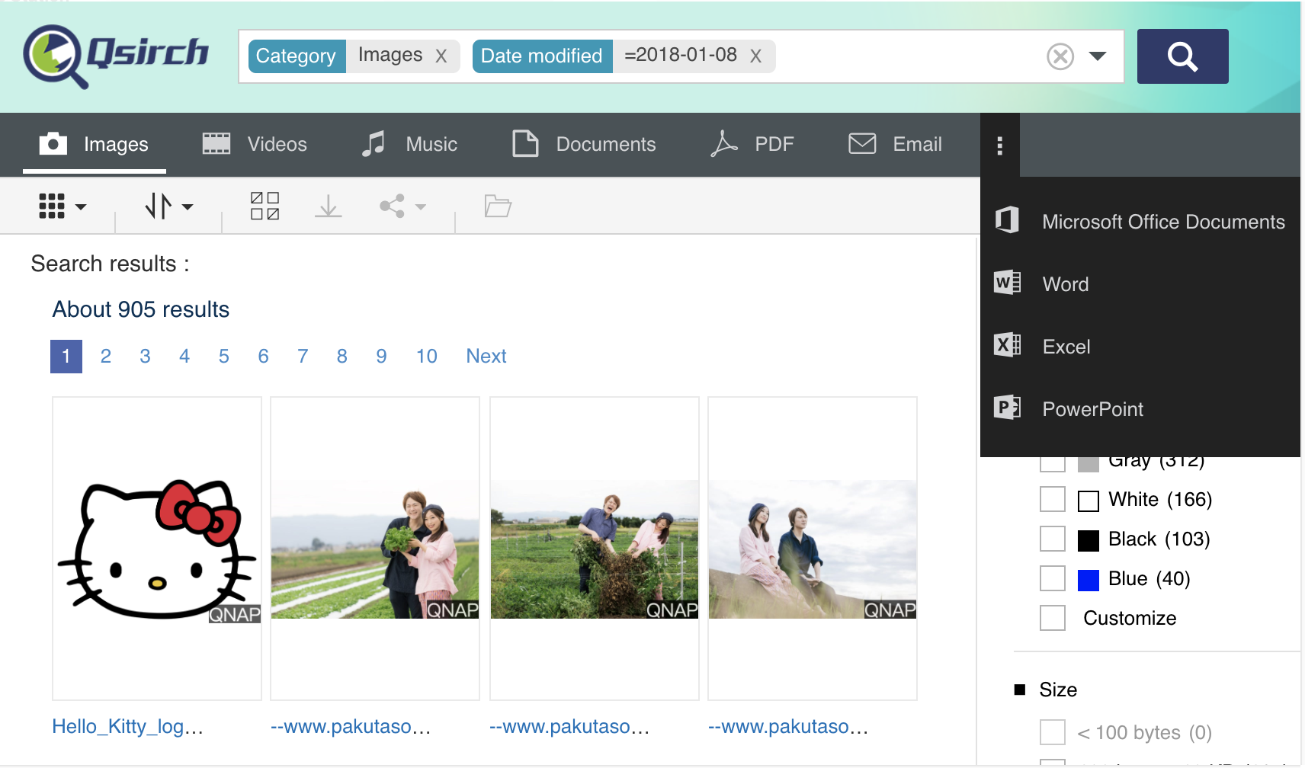
02
Category Bar
Ten categories, search with one click!
Email can also be searched after installing QmailAgent!

Slide 10

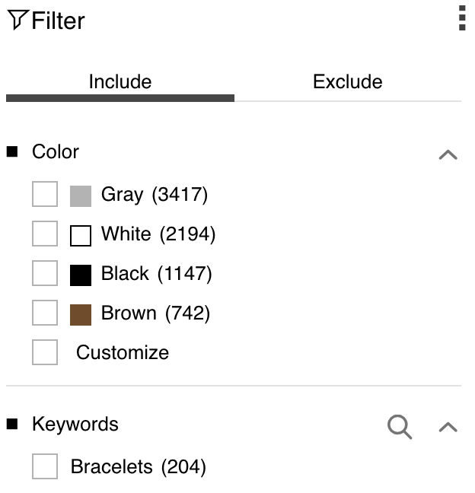
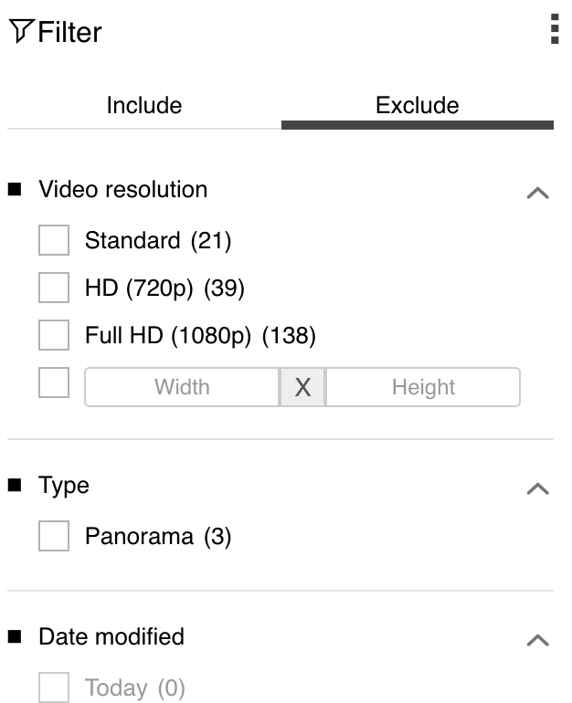
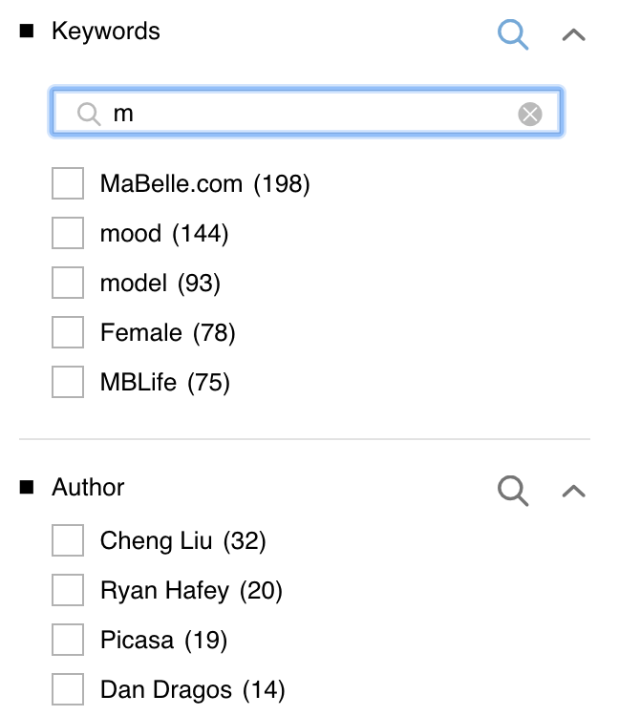
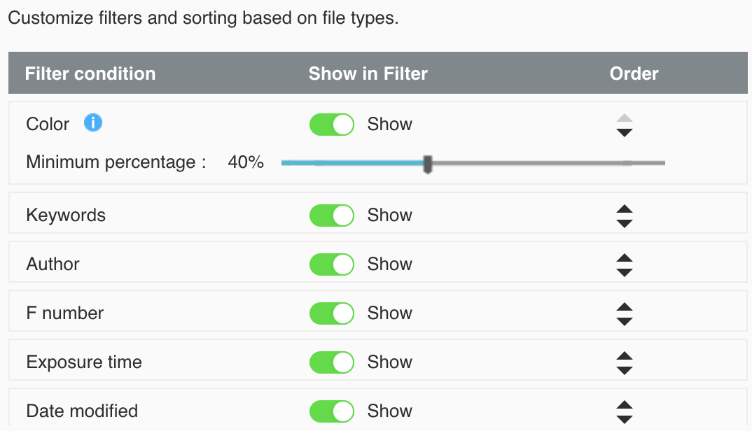
03
Filter Conditions
35+
filter conditions
Flexible
Quickly Specify
Customized
New filter for image
Color filter
Include or Exclude
Depends on your needs
Search function for filter conditions
Adjust the sort of filters by your preferences

Slide 11
Are you always wasting time to check search results because of the inconvenient search tool?
Notes:
CC free photo
https://www.pexels.com/photo/book-pages-books-close-up-grass-415078/

Slide 12
With Qsirch
Search, preview to share
Quickly completed
2

Slide 13
3 Search aids of Qsirch
01
Tags for every search criteria
02
Highlight keywords for viewing the search result clearly
03
Easy steps from previewing to sharing
Notes:
◆ Tags for every search conditions
◆ Highlight keywords for viewing the search result clearly
◆ Easy steps from preview to sharing

Slide 14
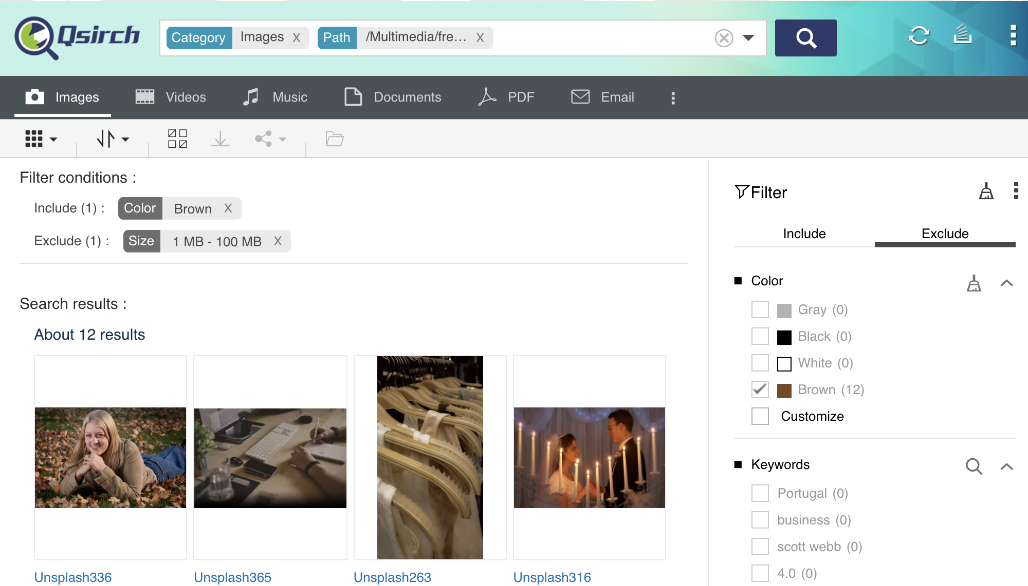
01
Tags
Easily separate the search criteria and filter conditions.
You can also delete any criteria/ conditions at anytime.

Slide 15
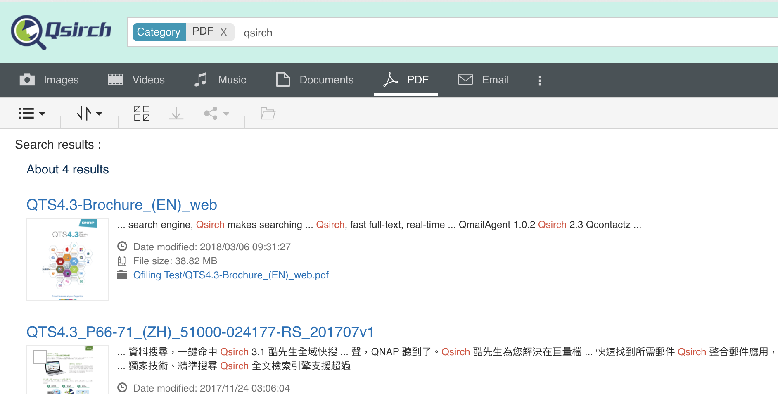
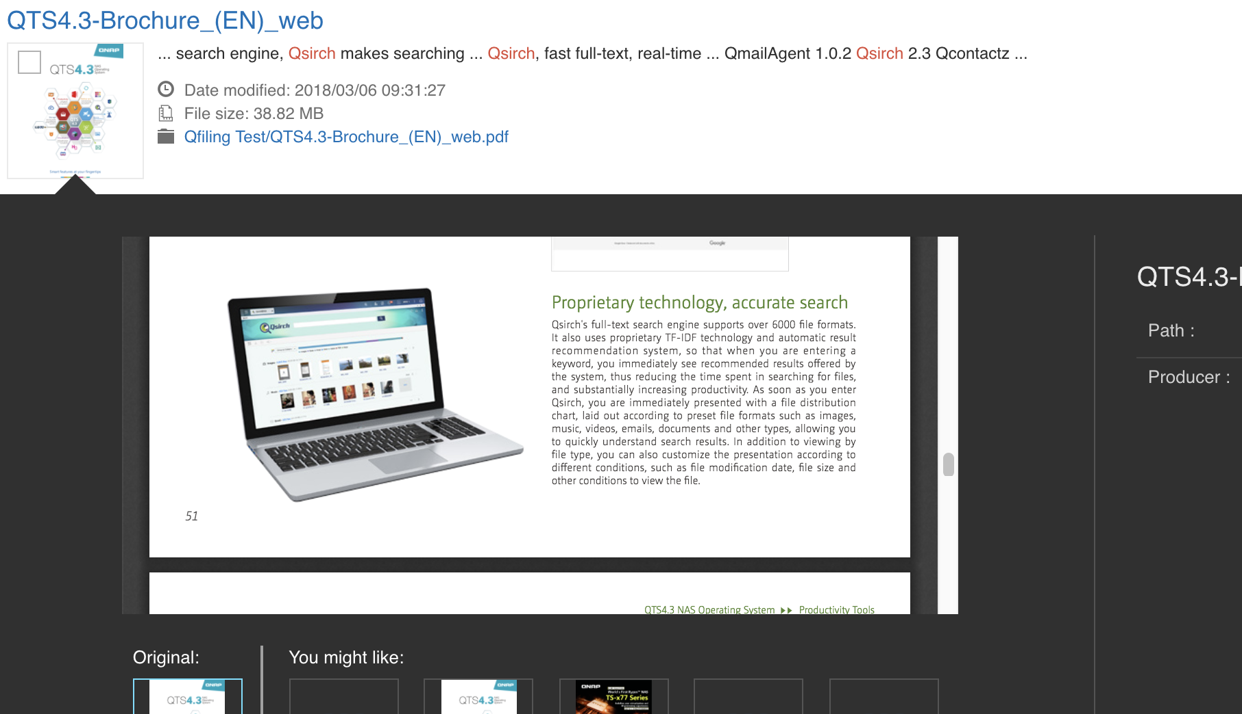
02
Highlight keywords
Quickly browse your search results with keyword highlighted!
Further browse the full text after confirming !

Slide 16


03
Easy steps from previewing to sharing
Preview
Share
PDF, Microsoft Office preview
Various Methods
NAS User
Email
More SM
Music, Photo, Video instant preview and thumbnail.
Custom Domain
360 panoramic
videos/photos preview
Custom domain
High flexibility
Smartshare
Secured Sharing
Streaming to VLC Client
Valid date
Password
SSL Secured

Slide 17
DEMO

Slide 18
Are the following situations slowing you down?
1. Finding the files will always interrupt the workflow…
2. Urgently need certain files when going out …
Notes:
CC free photo
https://www.pexels.com/photo/iphone-technology-iphone-6-plus-apple-17663/

Slide 19
With Qsirch you can search files anytime, anywhere
3

Slide 20







Search files in 4 ways
Browser Extension
Mobile app
Mac Finder
Web

Slide 21

Instantly find files with Qsirch mobile app
1. Advanced Security
                QNAP ID login
                Passcode & TouchID
2. Comprehensive Search
                Search multiple NAS
                Search by category
                35+ filter conditions
3. Preview, Download and Share
4. Offline Search
Notes:
https://www.pexels.com/photo/blur-cellphone-close-up-communication-574284/

Slide 22
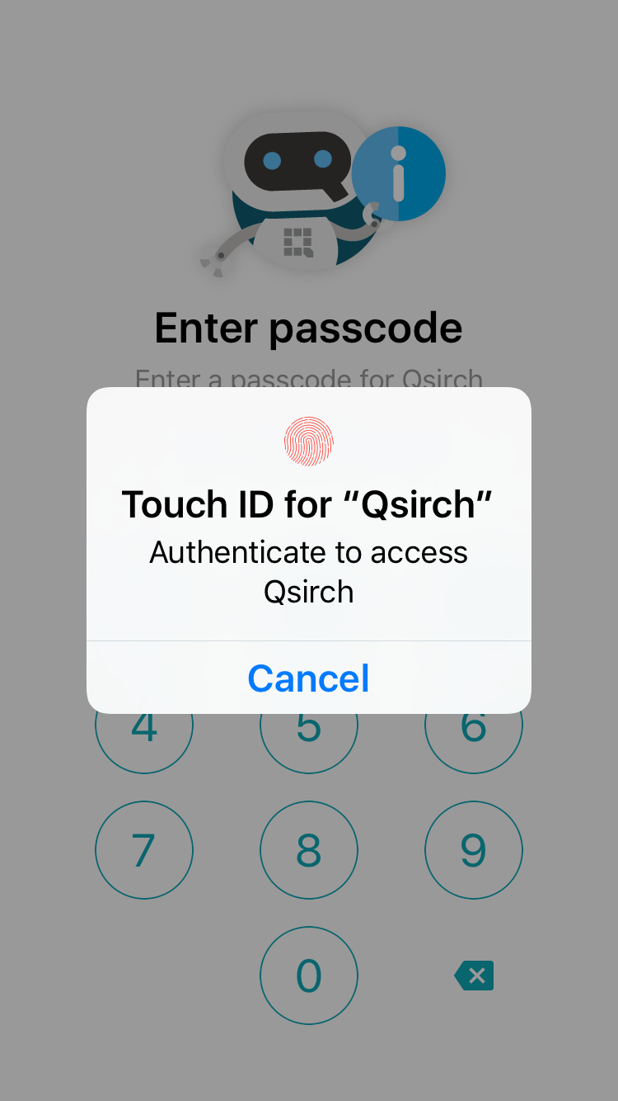

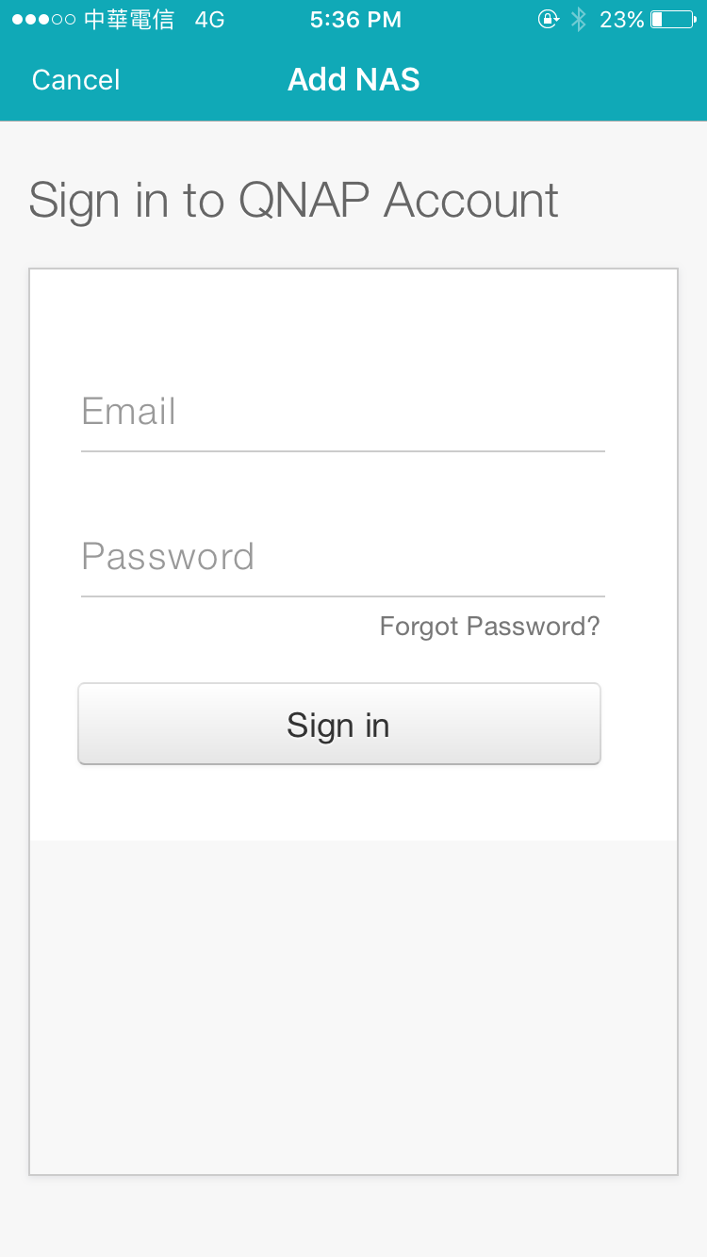
Triple protections secure your data
Passcode & Touch ID
QNAP ID
Notes:
密碼與指紋辨識

Slide 23
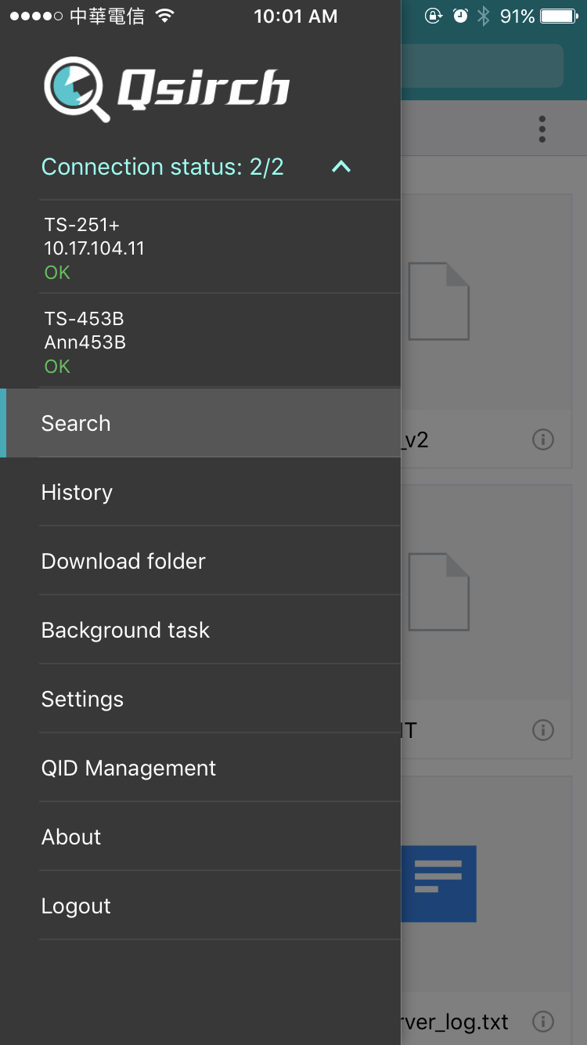
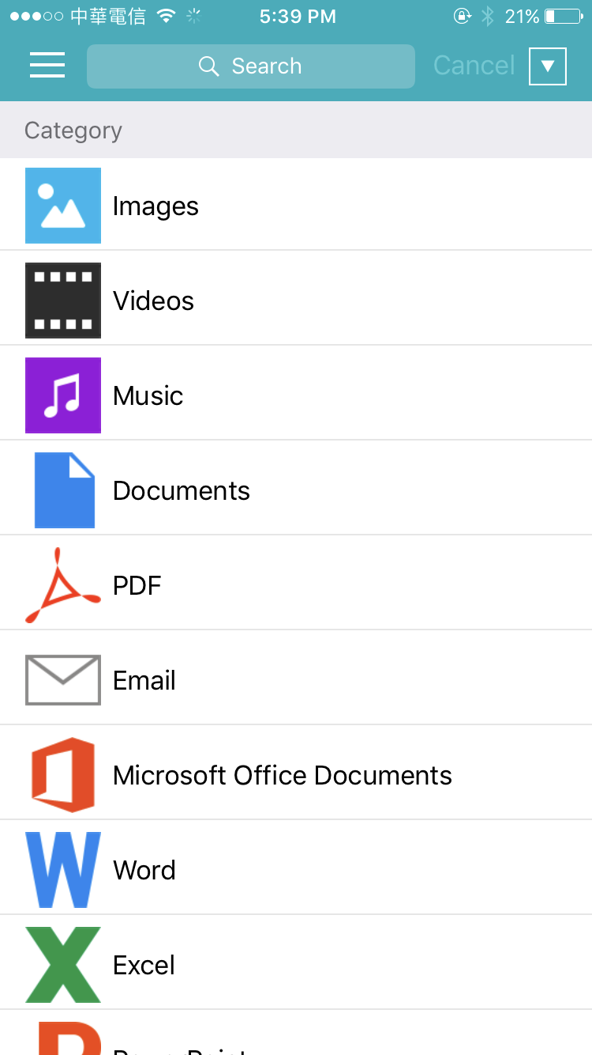
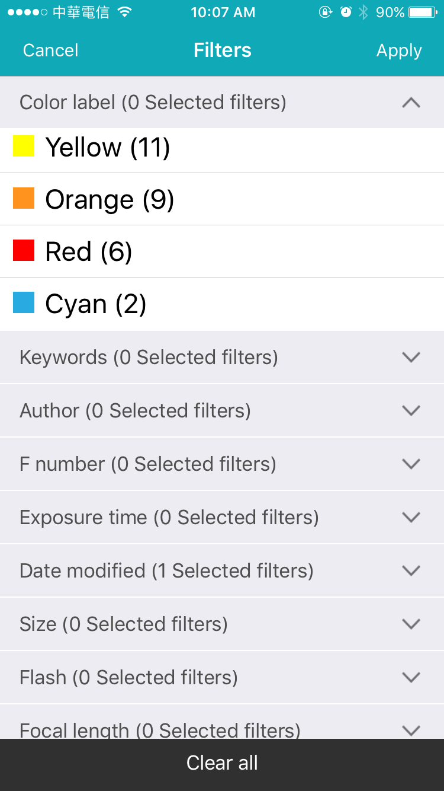
Comprehensive Search
Search Multiple NAS
Search by Category
35+ Filter Conditions
Notes:
Search Multiple NAS
Search by Category
35+ filter conditions

Slide 24

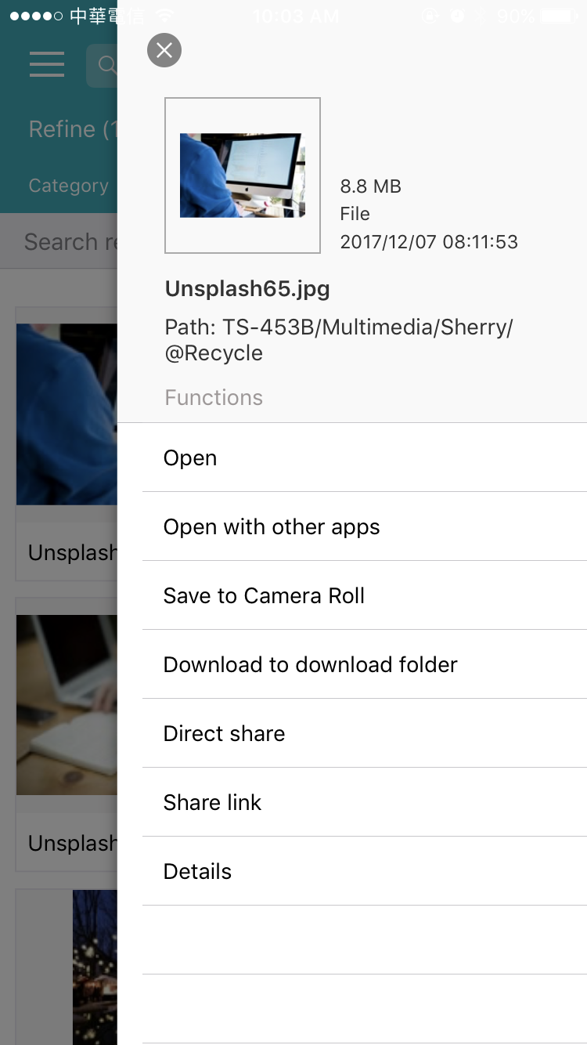
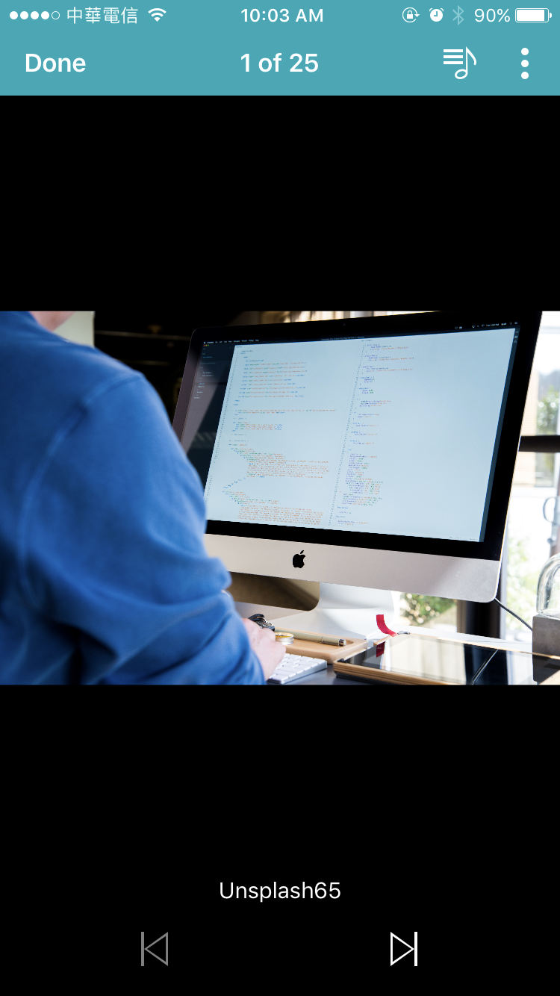
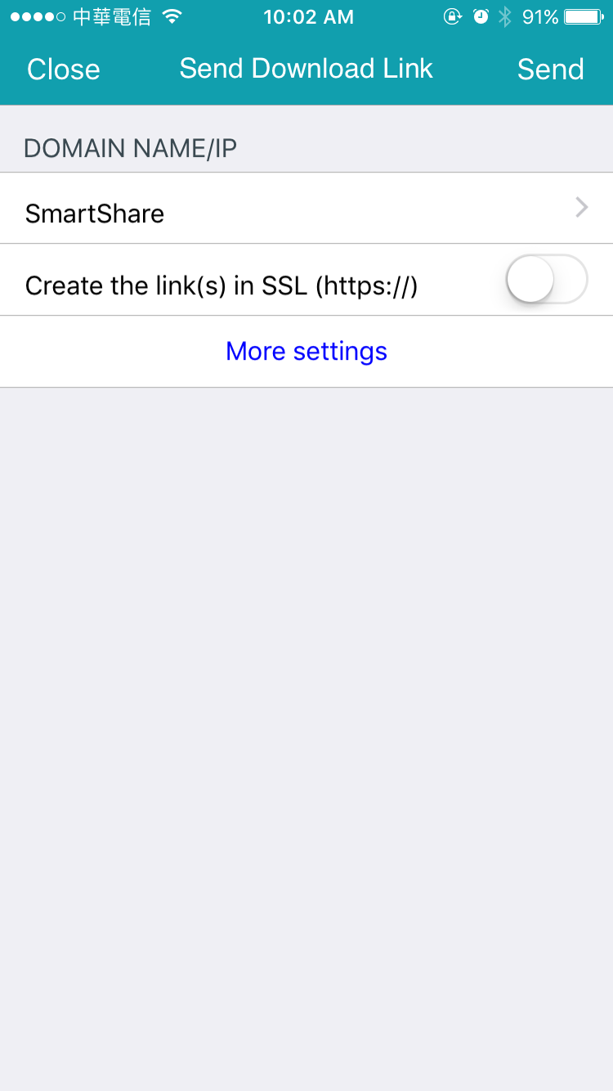
Preview, Download and Share
Preview
Share

Slide 25


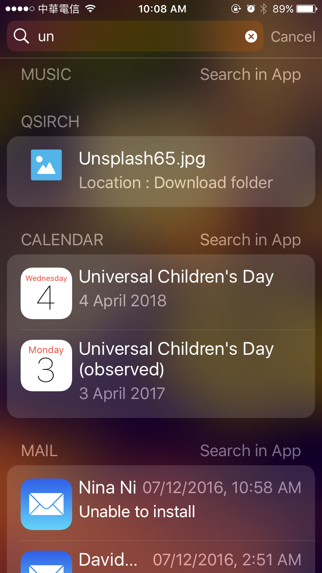
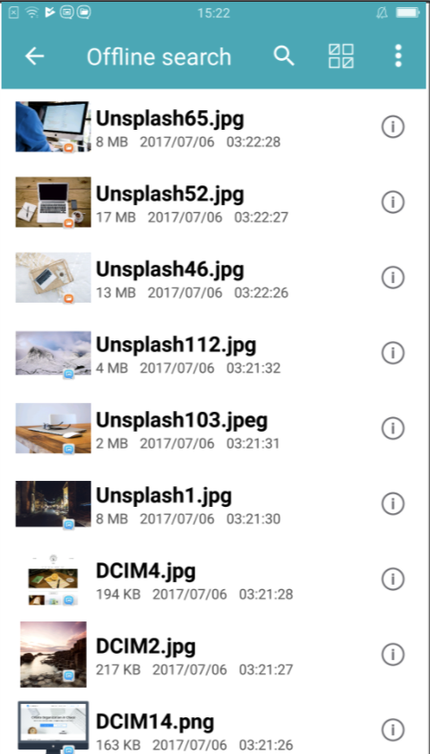
Offline Search
spotlight search
in app search

Slide 26
DEMO

Slide 27

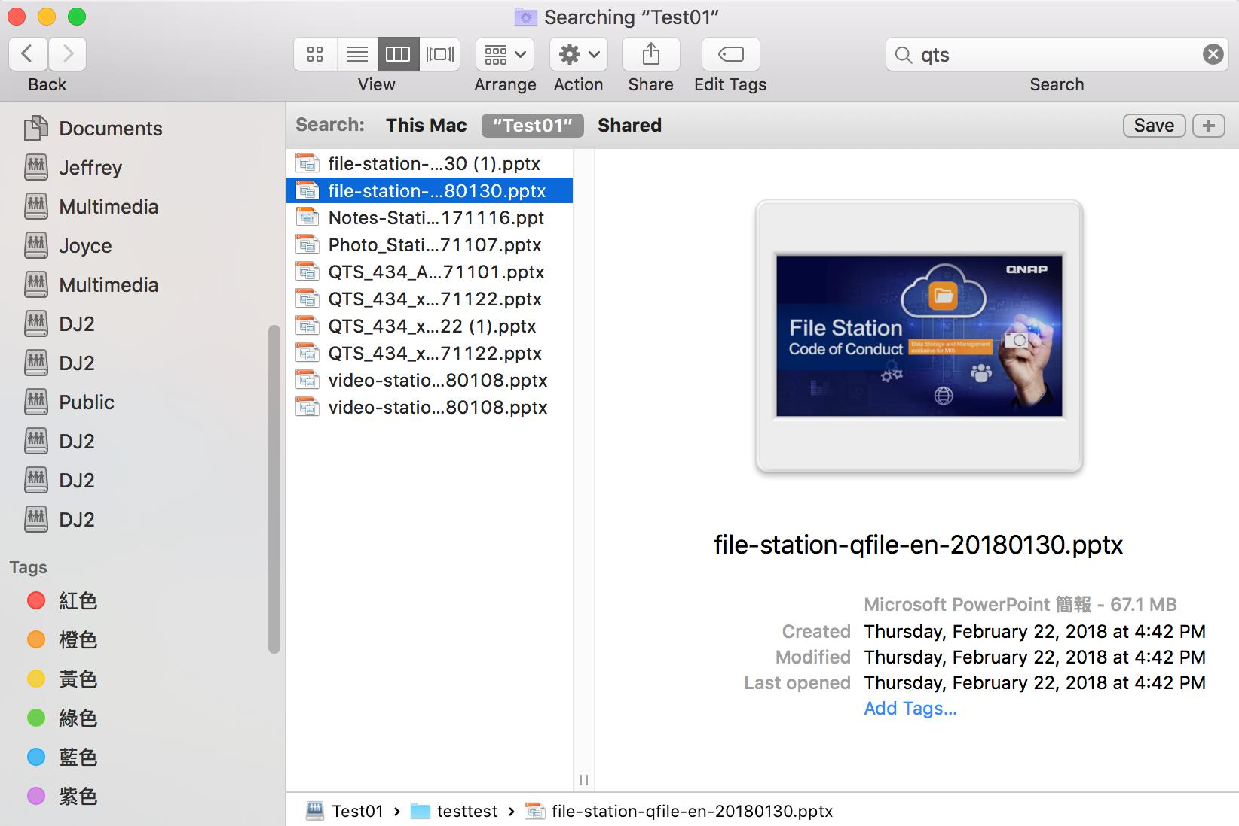
Integration with Mac Finder
1. SMB folder
2. Full-text search NAS and Macbook at the same time
3. Metadata of Email and Image can also be searched.
Notice：This feature will be supported in the upcoming QTS 4.3.5 .
Notes:
https://www.pexels.com/photo/computer-desk-electronics-indoors-374074/

Slide 28
DEMO

Slide 29

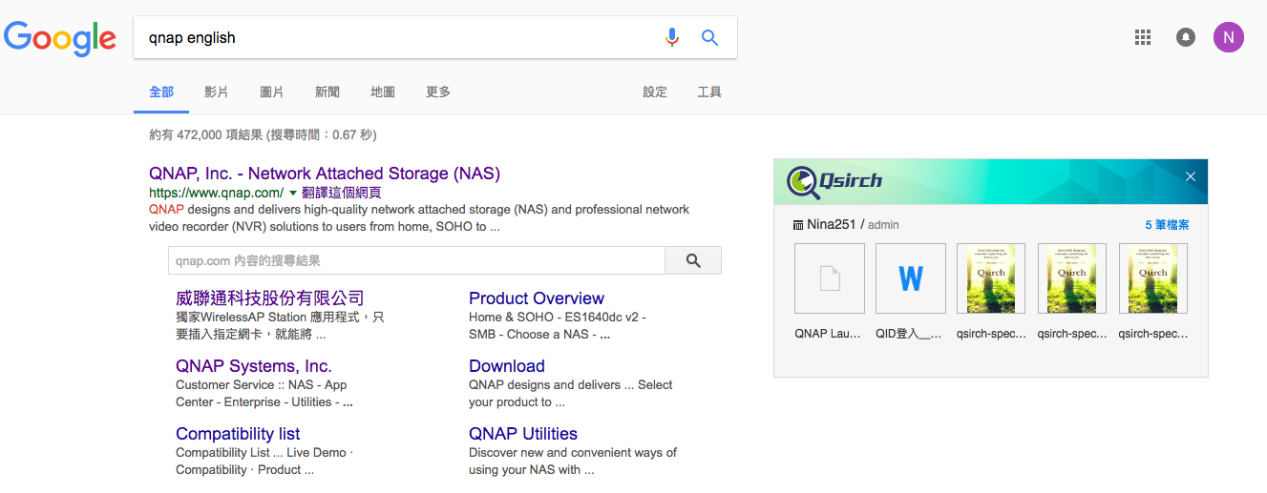
Qsirch Helper- Web Extension
1. QNAP ID Login
2. Search on both the NAS and the internet at the same time
3. Search on a single interface
4. Chrome and Firefox plugin

Slide 30
DEMO

Slide 31

Core competency analysis
Qsirch | Synology – Universal search
Supports indexing pause function (with upcoming Qsirch 3.3.0) | Supported
Supports Mobile app | N/A
Supports browser extensions – Chrome and Firefox | N/A
Supports Mac finder search (with upcoming QTS 4.3.5) | Supported with less search criteria

Slide 32
Core competency analysis
Qsirch | Synology – Universal search
Supports advanced search panel | Only supports syntax
Supports 35+ filter conditions | Only 20+ filter conditions
Microsoft documents preview | Supported
360 panoramic videos/photos preview | N/A
File sharing | N/A

Slide 33

Notes:
Your best choice!

