Slide 1
TS-253Be/TS-453Be & QWA-AC2600 wireless NIC
PCIe slot for versatile expansion
QWA-AC2600
TS-453Be
TS-253Be
擴充槽

Slide 2
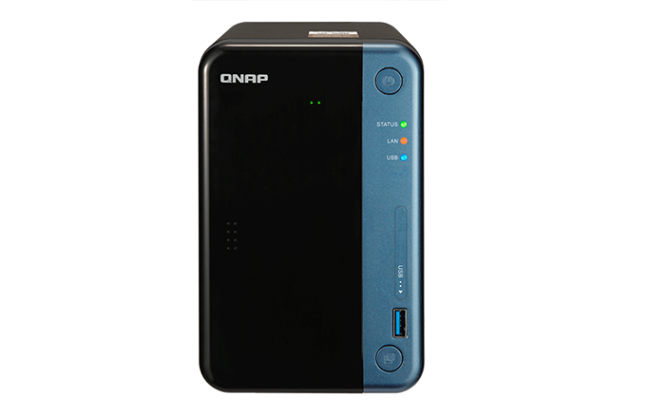
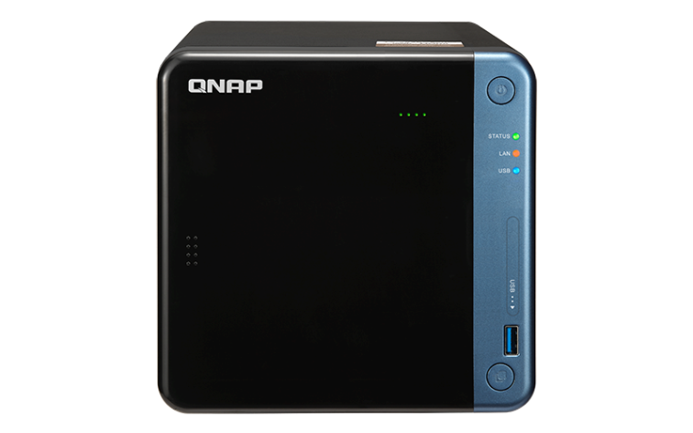
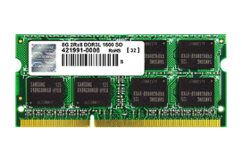
Affordable high performance quad-core multimedia NAS
Quad-core J3455
Apollo Lake SoC
1.5GHz
Base
2.3GHz
Max
TS-253Be-2G:
2GB RAM (1 x 2GB)
TS-253Be-4G:
4GB RAM (1 x 4GB)
TS-453Be-2G:
2GB RAM (1 x 2GB)
TS-453Be-4G:
4GB RAM (1 x 4GB)
Dual-channel RAM
DDR3L
2 x SODIMM Slots
Up to 8GB total
Expansion

Slide 3
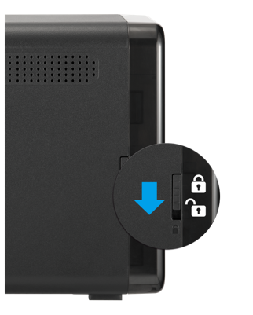
When sleek design meets high usability
Power button
HDD LEDs with adjustable brightness
Status, LAN, USB LEDs with adjustable brightness
IR sensor
Lockable front cover
USB 3.1 Gen 1 Type A port
USB One Touch Copy button

Slide 4
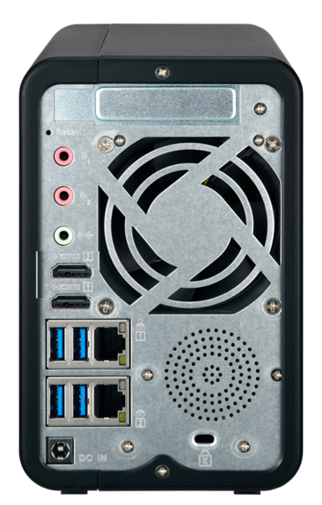
Enhanced productivity with abundant connectivity
1 PCIe 2.0 x2 slot
Reliable ball-bearing smart system fan
TS-253Be: 1 x 7 cm
TS-453Be: 1 x 12 cm
2 x 3.5mm dynamic microphone input
1 x 3.5mm line out
2 watt speaker +
Texas Instruments amplifier
System events
Audio playback
2 x 4K HDMI v1.4b output
4 x USB 3.1 Gen 1 Type-A port
2 x Gigabit LAN port
Kensington security slot
DC 12V power input

Slide 5
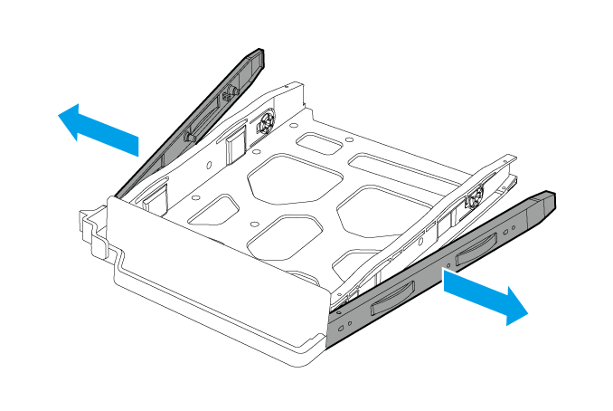
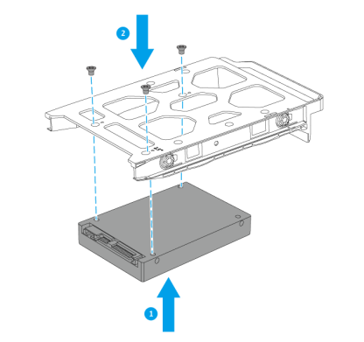
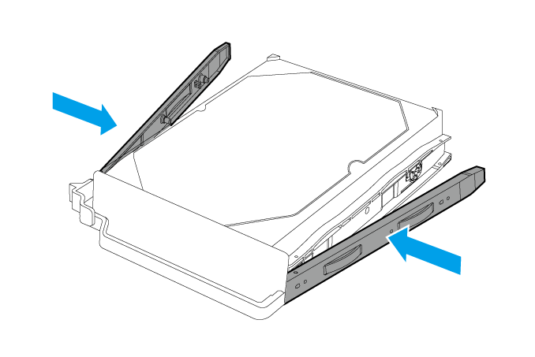
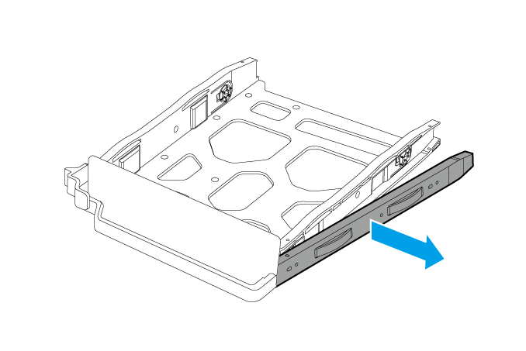
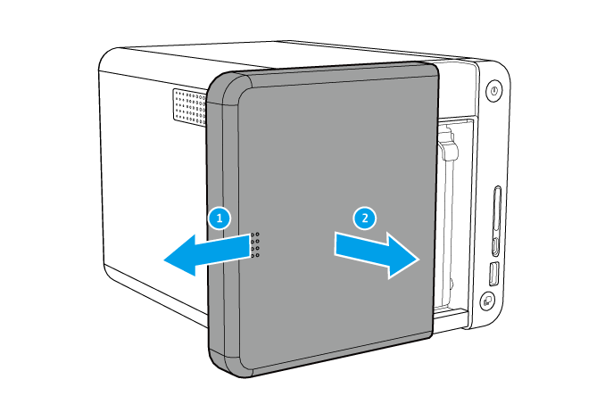
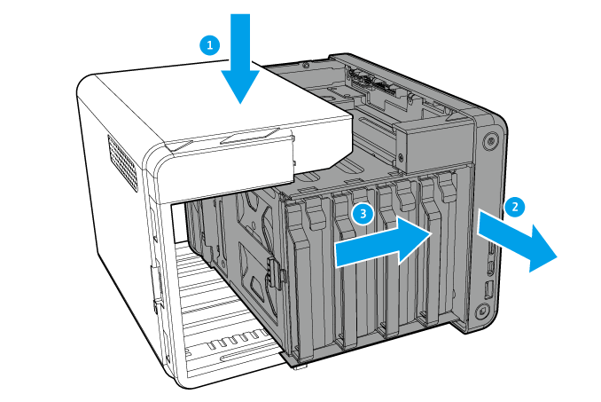
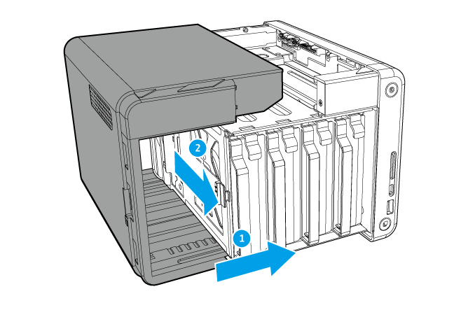
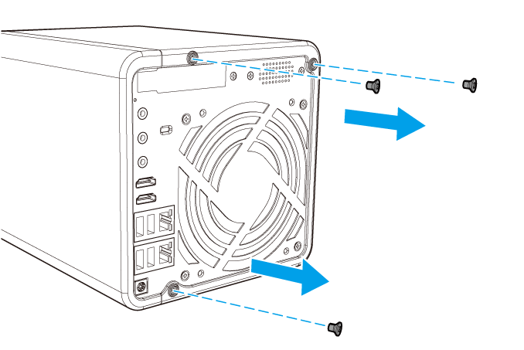
Easy to get started
3.5-inch HDD：tool-less installation
2.5-inch HDD/SSD：screw installation
2
1
2
1
2
Install a PCIe card by removing a few screws and the cover
1
2
3
4

Slide 6
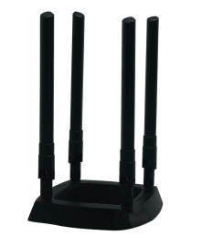
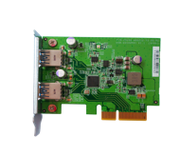
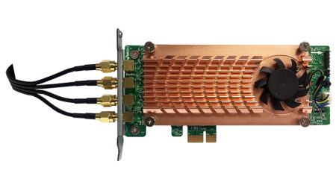
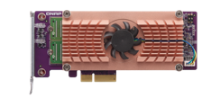
A versatile NAS that grows with you
Cache
2Xperformance
SSD
Volume/LUN
10Gb/s
Tiered Space
Storage pool
5Gb/s
USB 3.1 Gen 1
USB 3.1 Gen 2
QM2 M.2 SSD / 10GbE
network expansion card
2-port USB 3.1 Gen 2 Type-A expansion card
DBDC 2.4 GHz/5 GHz
wireless expansion card (AP function)
1 PCIe 2.0 x2 slot

Slide 7
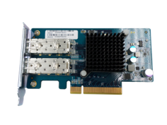
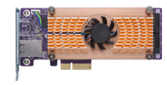
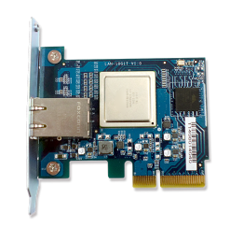
10GbE via PCIe expansion
2 x SFP+
1 x 10GBASE-T
2 x 10GbE, TS-453Be
QM2-2S10G1T
QM2-2P10G1T
LAN-10G2SF-MLX
720
659
648
540
(MB/s)
360
1 x SFP+
1 x 10GBASE-T
LAN-10G1SR
LAN-10G1T
180
0
Read
Write
Tested in QNAP lab. Results vary depending on the environment. Test Configurations: NAS: TS-453Be, QTS 4.3.3 RAID Configuration: RAID 5; Intel S3500 240GB SSDs (SSDSC2BB240G4); QNAP LAN-10G2SF-MLX 2 port 10GbE SFP+
Client PC: Intel® Core TM i7-4770 3.40GHz CPU; DDR3L 1600Hz 16GB; WD 1TB WD10EZEX; Intel Gigabit CT( MTU 1500 ) ; Windows® 7 Professional 64bit SP1 & Windows 8.1 Pro 64-bit

Slide 8
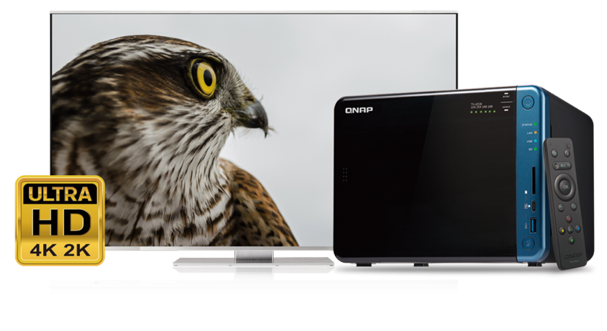
Full multimedia experience over competitors
2 x 4K HDMI v1.4b output
Optional RM-IR004 remote
Integrated speaker for
system events and music
Up to 2-ch H.264/H.265 transcoding
Use Cinema28 for multi-room streaming

Slide 9
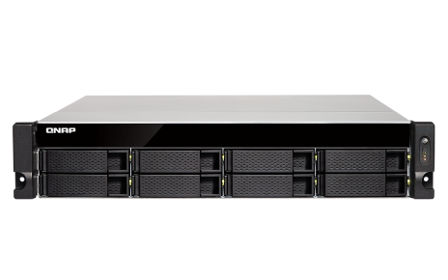
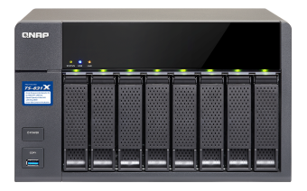
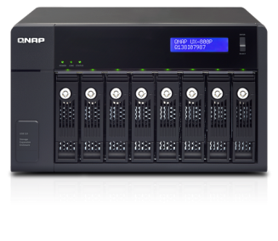
Capacity expansion via Vitual JBOD or expansion units
1GbE / 10GbE
iSCSI VJBOD connection
Max 8 VJBOD connections
USB 3.1 Gen 1 connection
Max 1 UX-800P/UX-500P expansion unit

Slide 10
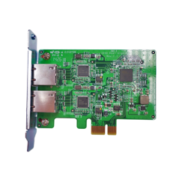
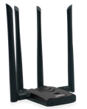
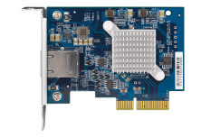
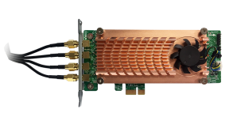
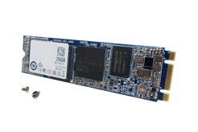
Accessories for TS-x53Be
Expansion units
Memory modules
USB 3.1 Gen 2 expansion card
RAM-4GDR3LA0-SO-1866
RAM-2GDR3LA0-SO-1866
UX-800P
UX-500P
USB-U31A2P01
Wired NICs
Wireless NICs
LAN-10G2SF-MLX
QXG-10G1T
LAN-1G2T-I210
QWA-AC2600
QWA-AC1900U
QM2 M.2 SSD/10GbE network expansion cards
256GB M.2 SATA 6Gb/s SSD*
QM2-2S
QM2-2P
QM2-2S10G1T
QM2-2P10G1T
SSD-M2080-256GB-A01
*To install M.2 to TS-x53Be, QM2 expansion card is required.

Slide 11
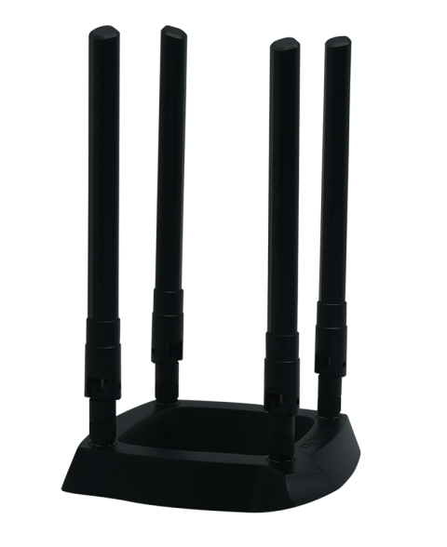
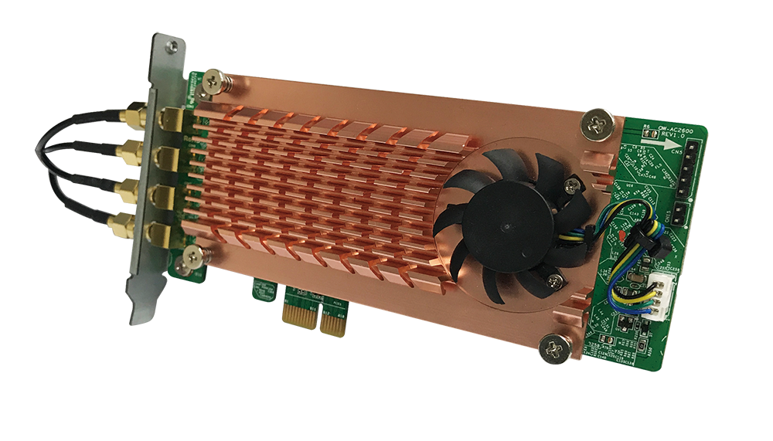
Turns your NAS into a Dual Band Dual Concurrent Wireless Access Point with the QWA-AC2600 PCIe expansion NIC
QWA-AC2600

Slide 12
QWA-AC2600
Active cooling module to ensure the transmission quality
4 X Detachable RP-SMA connector
Adjust the 3-level fan speed by real time chip temperature
For extending to Quad-antenna magnetic base
Low profile PCIe
Compact design for most QNAP NAS
Up to 500 MB/s PCIe bandwidth
With a PCIe 2.0 x1 interface

Slide 13
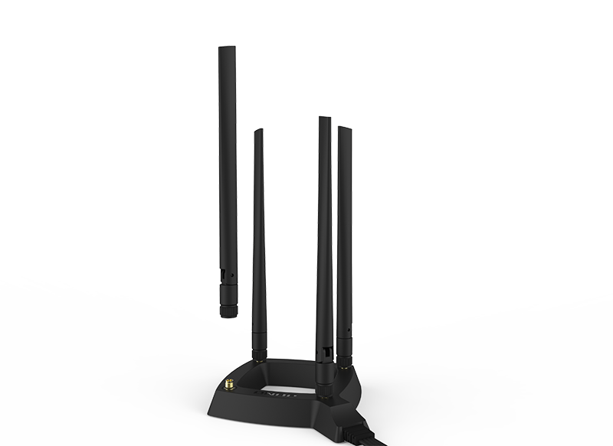
High mobility Quad-antenna base
0.8 m RF high frequency coaxial cable
For optimized antenna placement
4 x 5dBi detachable omni-directional high gain antennas
Upgrade or replace the antenna by demand

Slide 14
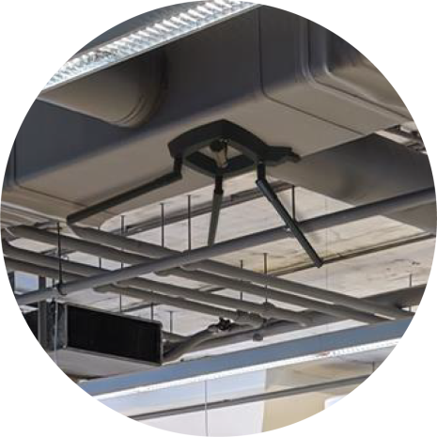
Flexible deployments with the antenna base
Wall-mount
Magnetic
Attached on the wall or ceiling
Attached to metal surfaces

Slide 15
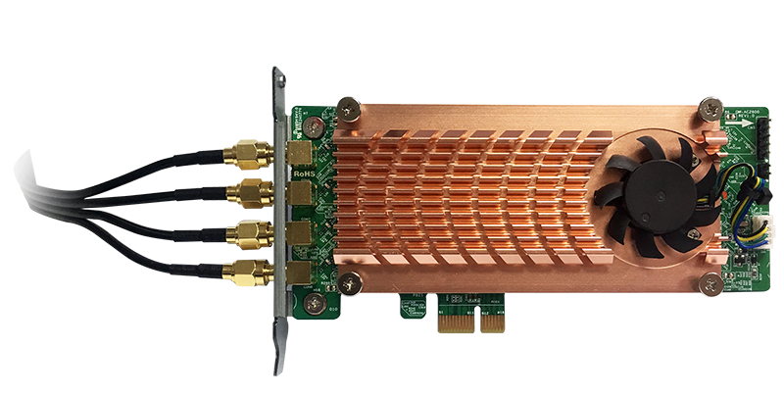
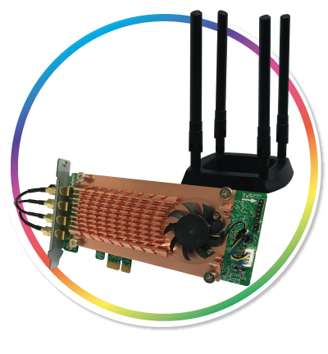
Qualcomm QCA9984 wireless NIC
多人無線裝置當底圖
4 x 4 MU-MIMO
Simultaneously communicate with multiple devices
Compliant with IEEE 802.11ac wave 2
Compatible with IEEE 802.11ac, IEEE 802.11n and IEEE 802.11a/b/g
Notes:
5G: 1733 Mbps (4*433Mbps)
2.4G: 600 Mbps (4*150Mbps)
支援 160MHz 連續模式（Contiguous）與 80MHz 加 80MHz 非連續（Non-contiguous）的 802.11ac 頻寬組成方式，所提供資料傳輸容量為現有 80MHz 通道的兩倍。(spec: 20/40/80/160 MHz)

Slide 16
5 GHz and 2.4 GHz dual band
Up to 2600 Mbps total bandwidth
802.11ac (5GHz): up to 1733 Mbps
Dual Qualcomm QCA9984 support Dual Band Dual Concurrent
802.11n (2.4GHz): up to 800 Mbps
Notes:
5G: 1733 Mbps (4*433Mbps)
2.4G: 600 Mbps (4*150Mbps)
支援 160MHz 連續模式（Contiguous）與 80MHz 加 80MHz 非連續（Non-contiguous）的 802.11ac 頻寬組成方式，所提供資料傳輸容量為現有 80MHz 通道的兩倍。(spec: 20/40/80/160 MHz)

Slide 17
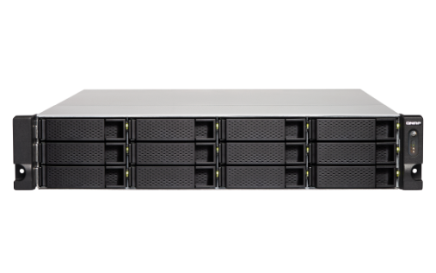
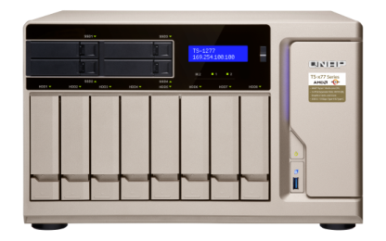
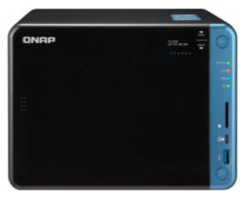
Your NAS needs one empty PCIe slot
ARM-based processor *
x86-based processor
TS-531P, TS-531X, TS-831X
TS-x31XU
TS-1635
TS-x53B/x53Be, TS-x53BU
TVS-x63, TS-x63U
TVS-x73/x73e, TS-x73U
TS-x77
TVS-x82/x82T, TVS-1582TU
*QTS 4.3.5 or newer required
Note: The WirelessAP Station is required to be installed from the QTS App Center

Slide 18
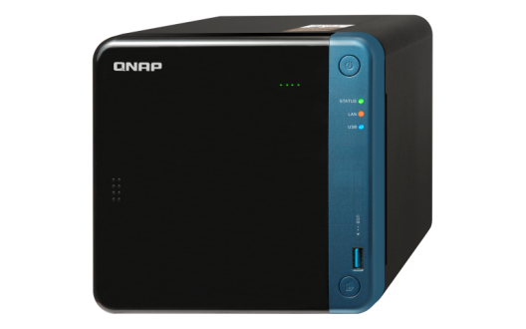
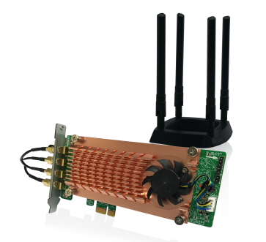
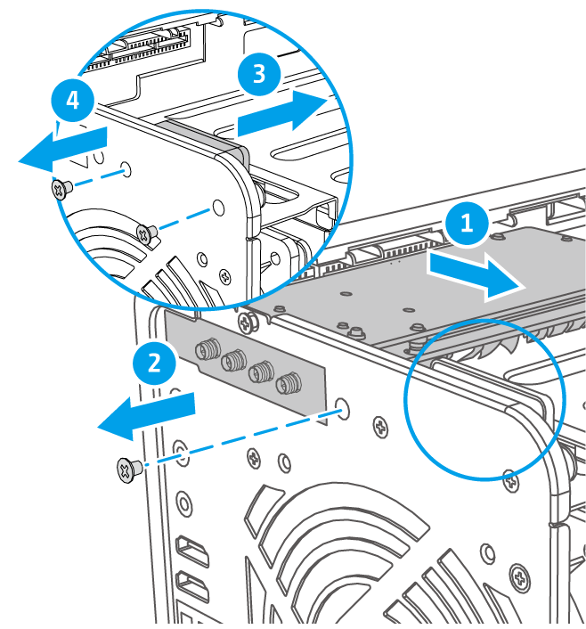
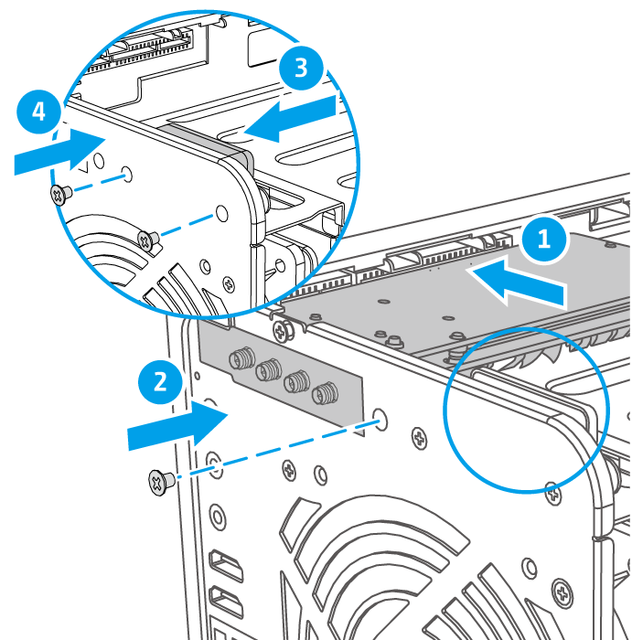
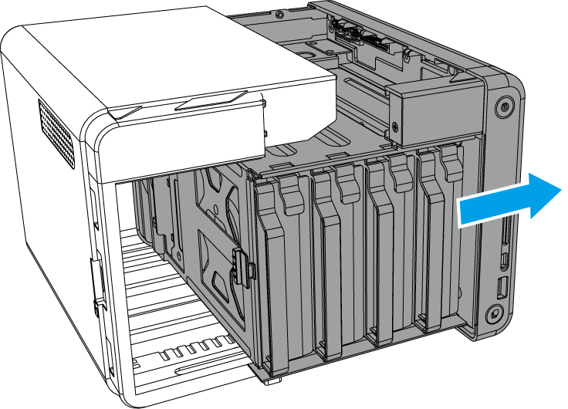
Installation of QWA-AC2600
1
Remove the cover of TS-453Be
2
Remove the PCIe cover
3
Install QWA-AC2600
Note 1: TS-453Be may require its speaker to be temporary removed to install QWA-AC2600
Note 2: Bracket exchange of QWA-AC2600 is required to install it in the TS-x53Be

Slide 19
Extend the Internet coverage by wireless
Install WirelessAP Station from QTS App Center, and break barriers of physical cabling

Slide 20
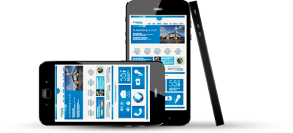
Build a private wireless network between NAS and mobile devices
Install WirelessAP Station from QTS App Center and enable the DHCP server function to create a private network environment
QWA-AC2600

Slide 21
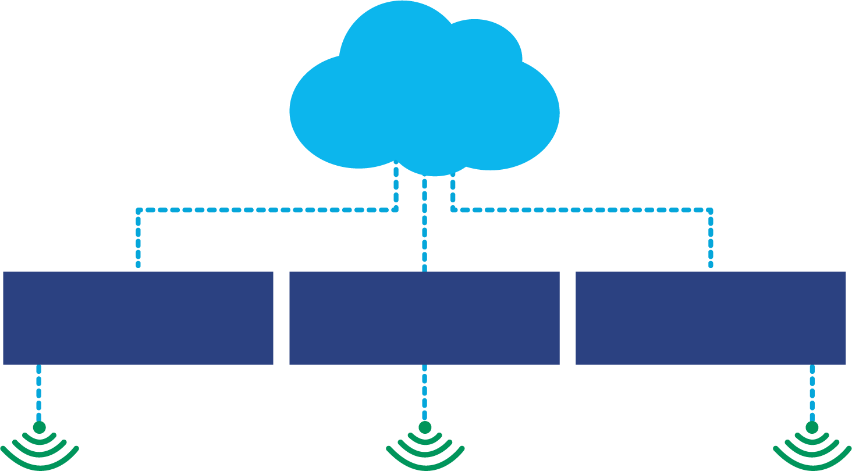
Scenario I: Optimized bandwidth configuration
QIoT Suite Lite
IoT device
Maximize the number of connections
Maximized the available bandwidth
QTS
Application
Services
AfoBot
Companion
Robot by QNAP
Container
(Database)
WirelessAP Station
QIoT Suite

Slide 22
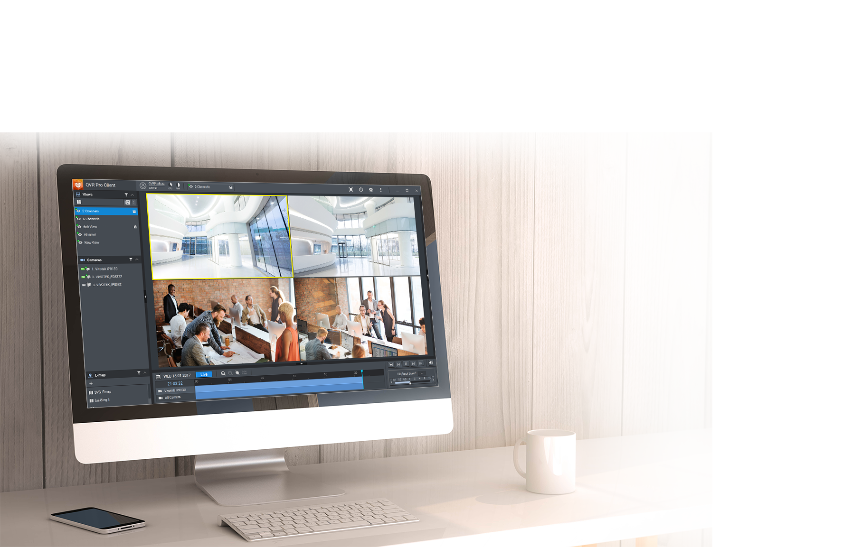
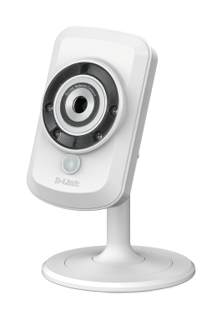
Scenario II: Private Surveillance
Connect wireless cameras to the network provided by WirelessAP Station and build a secure and professional surveillance system with QVR Pro

Slide 23
WirelessAP Station installation and configuration
Go to QTS App Center, download and install WirelessAP Station
1
2
3
Click "Add Access Point"
Select QWA-AC2600
Configure the Access Point

Slide 24
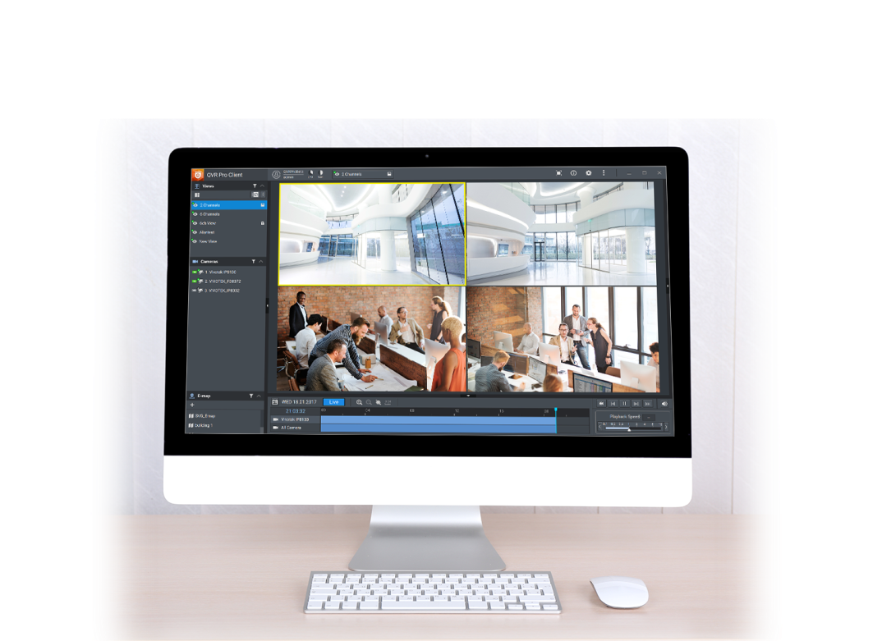
Enable DHCP and NAT services to a secure your surveillance environment
Create a Virtual Switch to a private network by QTS "Network and Virtual Switch" function. No more physical router is required.
QVR Pro Client
Adapter 1
1 Gbe
10.0.0.3
Virtual Switch 1
Wireless camera
WirelessAP 1
10.0.0.1
10.0.0.2
Set SSID as QVR Pro
Wireless encryption as WPA2

Slide 25
Build low-cost professional storage server with dedicated wireless network applications
TS-453Be
TS-253Be
QWA-AC2600

