Slide 1
Budget-Friendly RAID 5 NAS for Cost Effectively Utilizing Your Storage
Notes:
用輕鬆一點的畫面類似小咖啡廳之類的 可以先用型錄封面

Slide 2
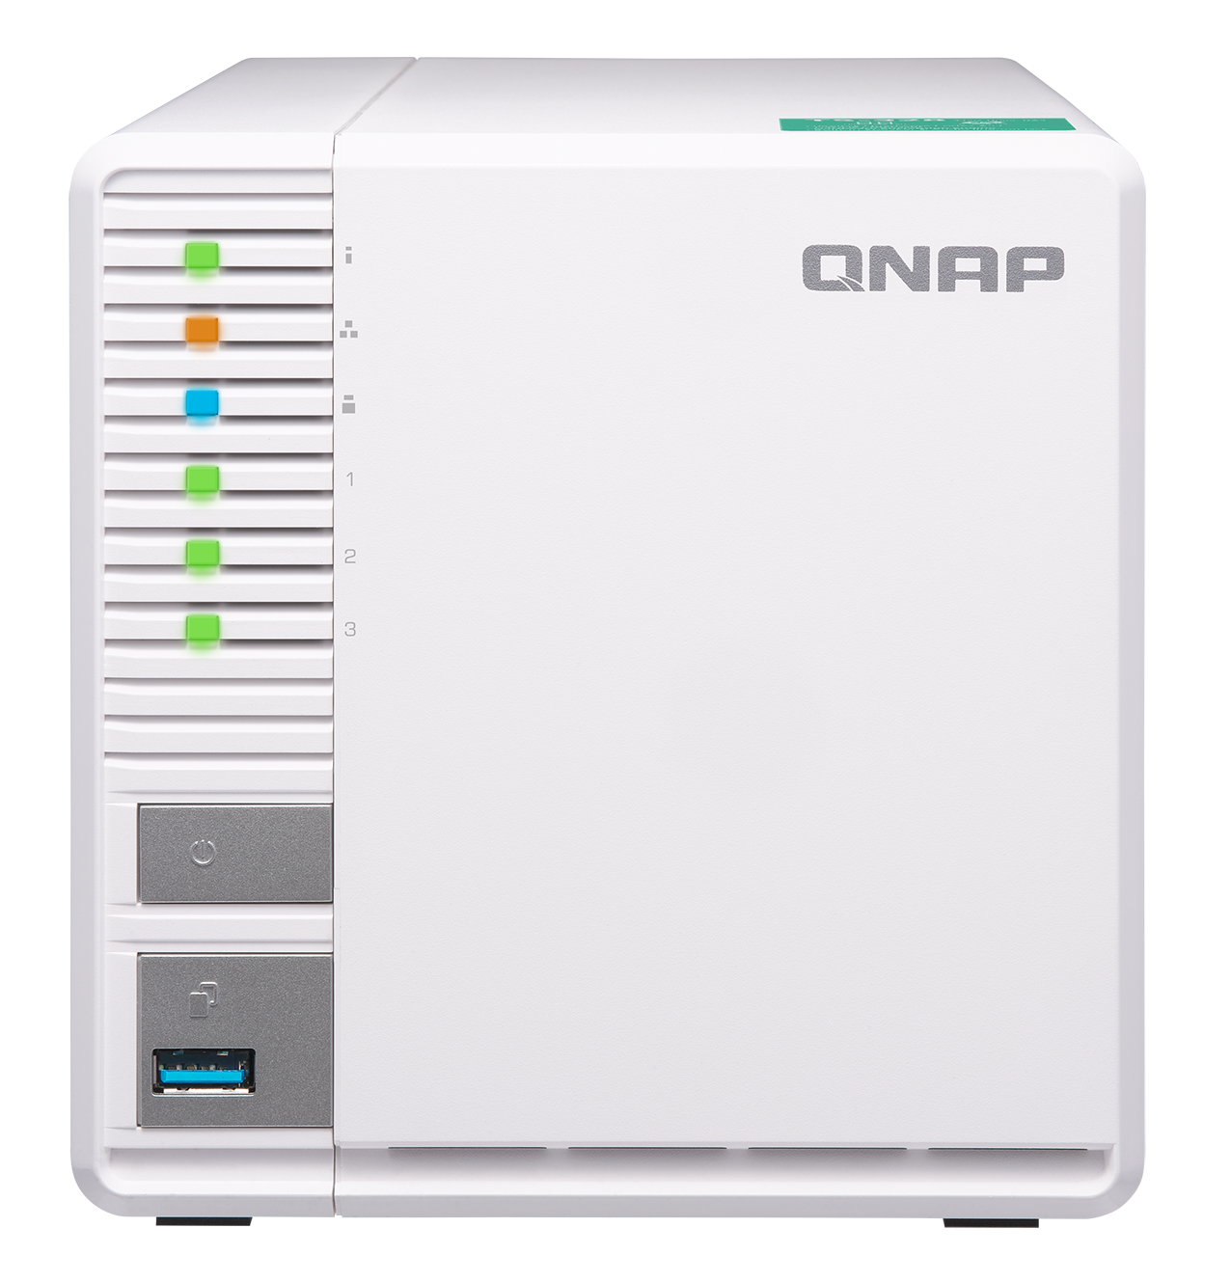
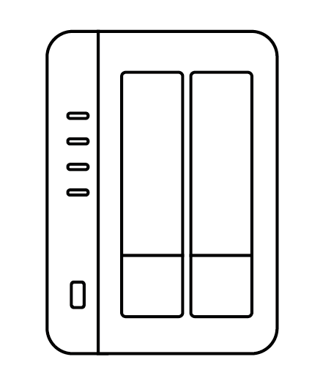

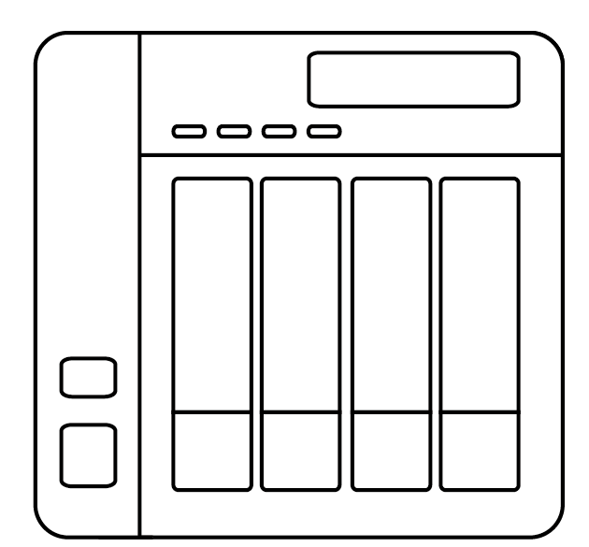
Cost effectively secure data with RAID5
2-Bay NAS
4-Bay NAS
RAID 1 :
Actually use: 1 x HDD
RADI 5 :
Actually use: 2 x HDD
RAID 5 :
Actually use: 3 x HDD
HDD utilization: 50%
HDD utilization: 67%
Budget concern
Notes:
2-bay and 4-bay用線圖或卡通圖

Slide 3

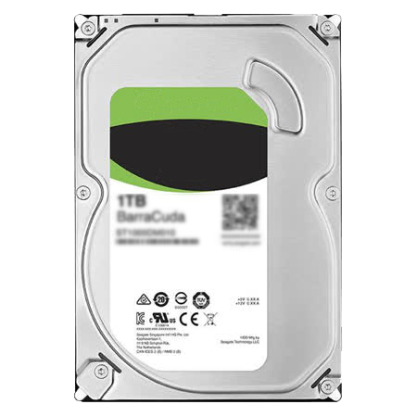

The most economical choice
I need
6TB capacity
2 Bay NAS RAID1
3 Bay NAS RAID5
2 x
3 x
6TB
3TB
2 x 189 = $378
3 x 99.9 = $299.7
27 / Feb,2018, Amazon, search Ironwolf HDD

Slide 4
SSD support for cache acceleration
Program 1
Program 2
1 x SSD for cache
2 x HDD, RAID1
3 x HDD, RAID5
Better performance
Data protection
Big storage
Data protection

Slide 5


4-core processor with DDR4 memory
2 GB DDR4 RAM
Realtek RTD1296 Quad-Core 64-bit 1.4G Processor
Hardware Encryption Engine

Slide 6
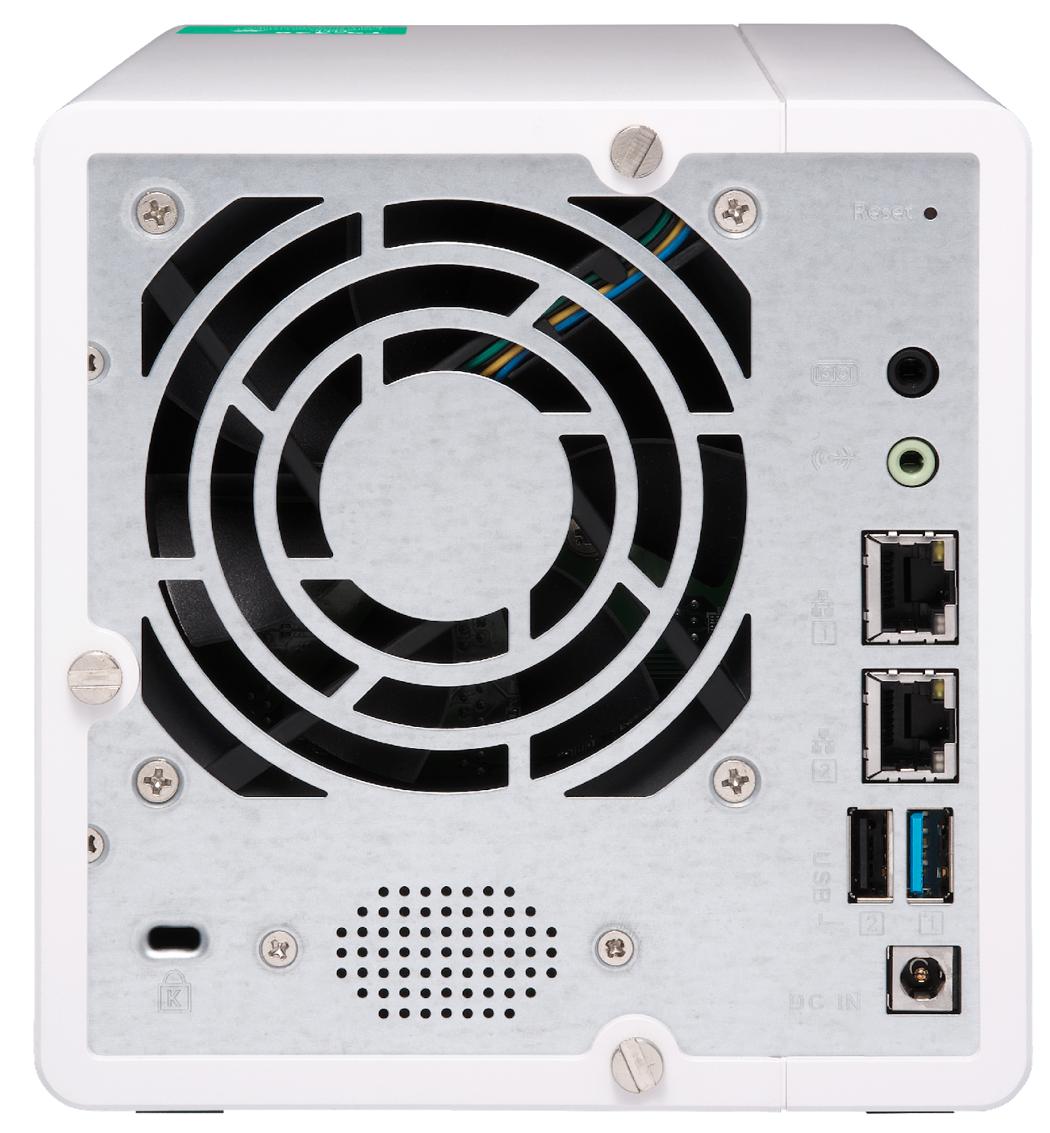
Physical interfaces
Reset
Debug port
LED indicator:
Status, LAN, USB, HDD1-3
one 9 x 9
cm system fan
3.5mm line out jack
2 x GbE RJ-45
LAN ports
Power
Security slot
USB3.1 Gen 1
One Touch Copy
1 x USB 3.1 Gen 1 & 1 x USB2.0 Port
Built-in speaker
DC 12V Power in

Slide 7
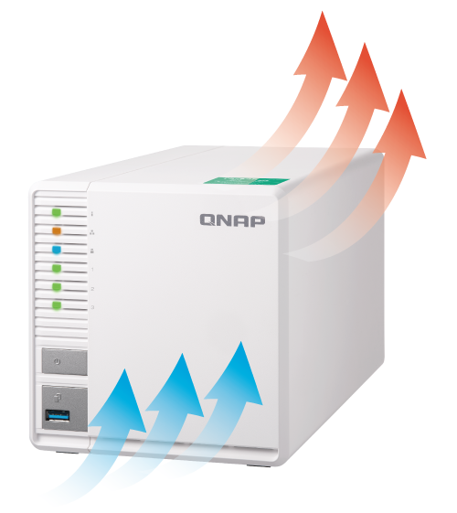
Elegant, quiet and energy saving
ARM CotexA53 Energy saving
architecture
Standby : 7.24 W
Operating : 18.35 W
Quiet cooling fan
Noise level：16.5 dB (A)

Slide 8

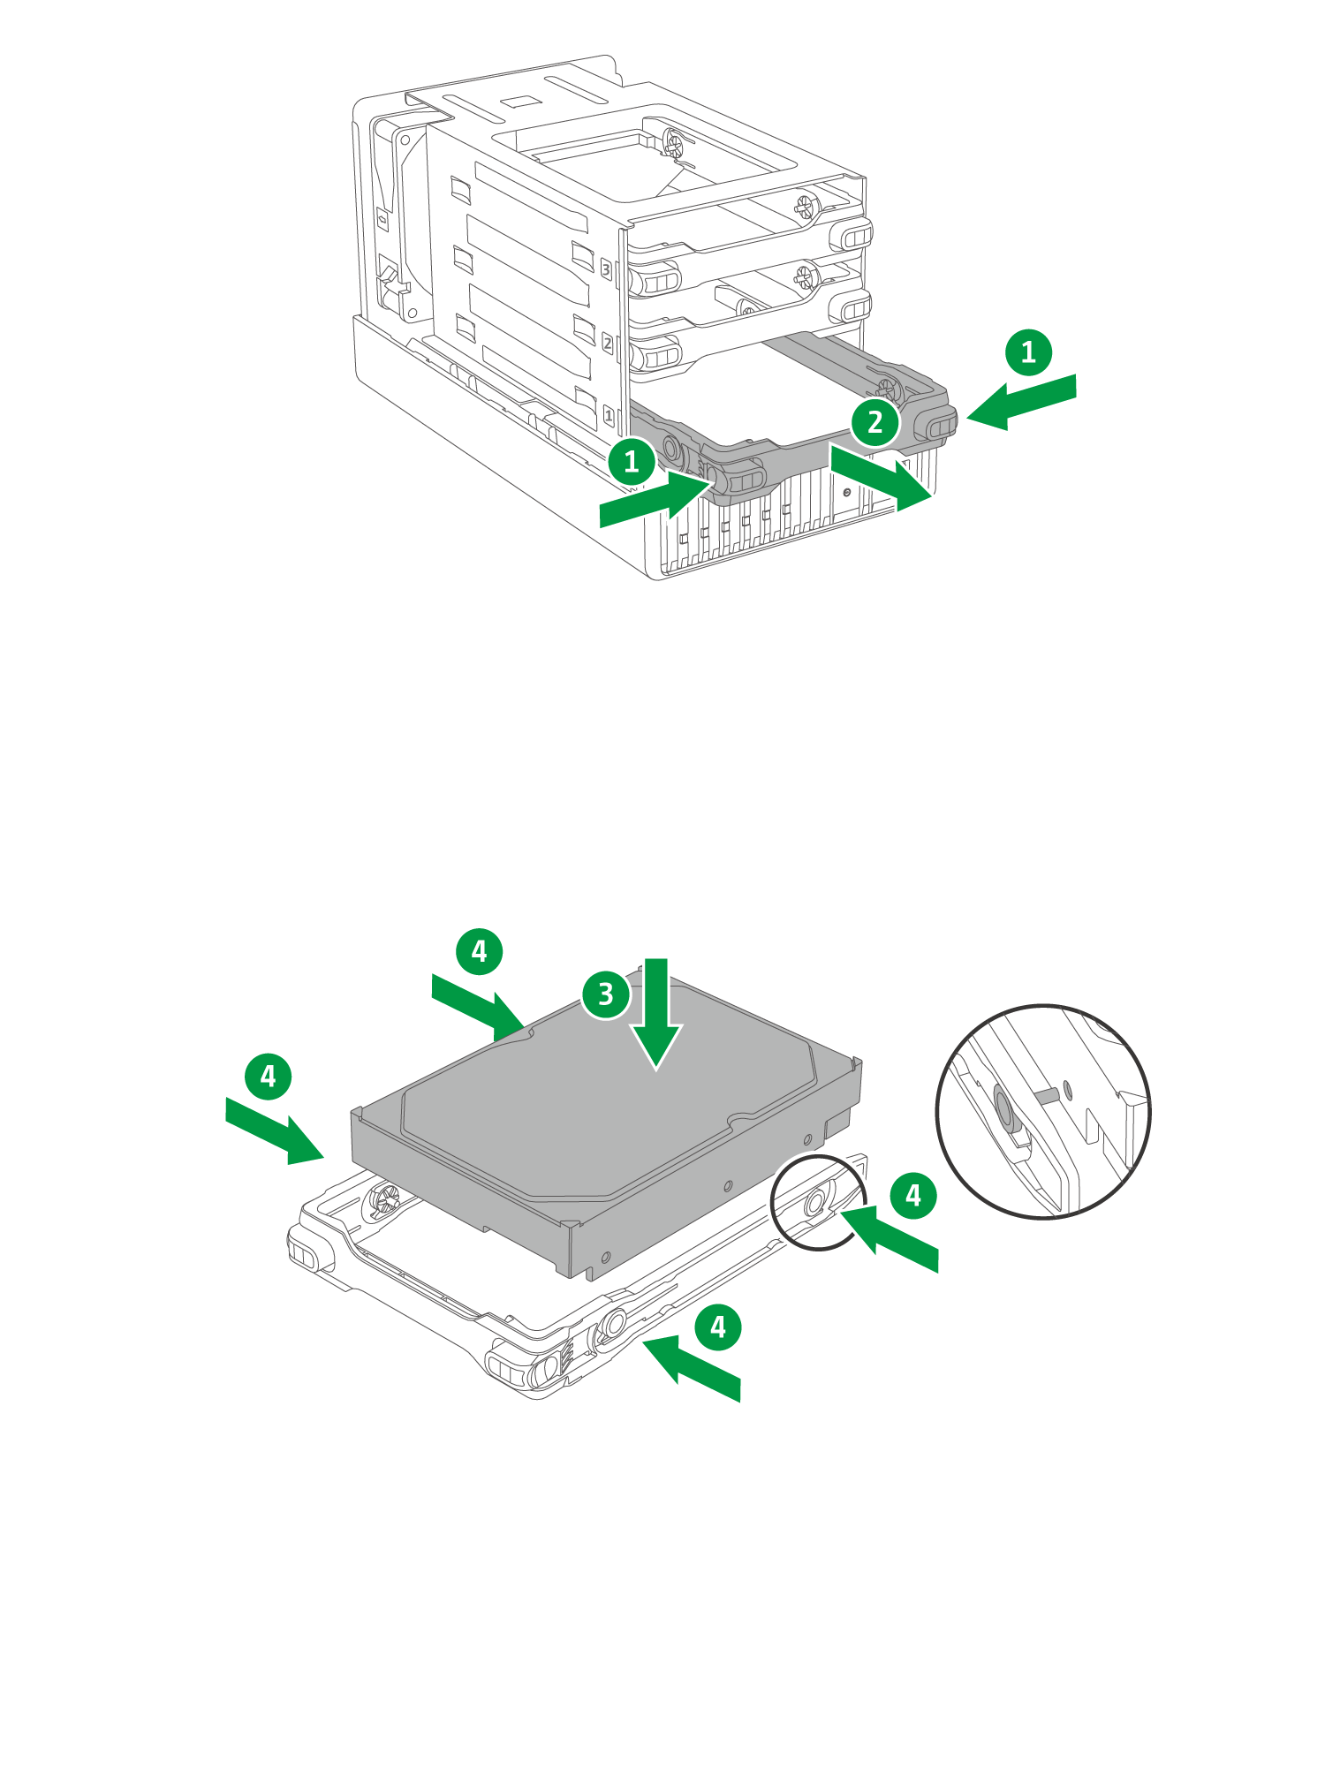
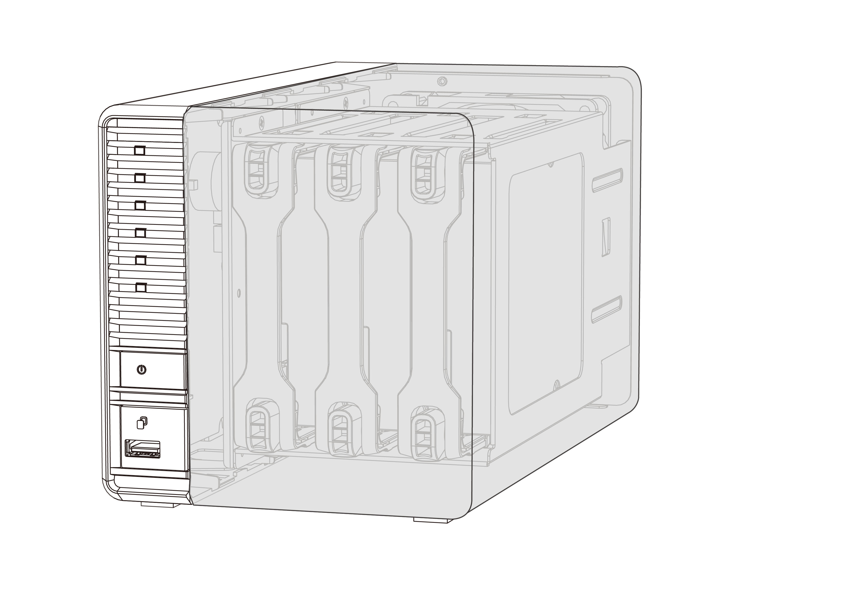
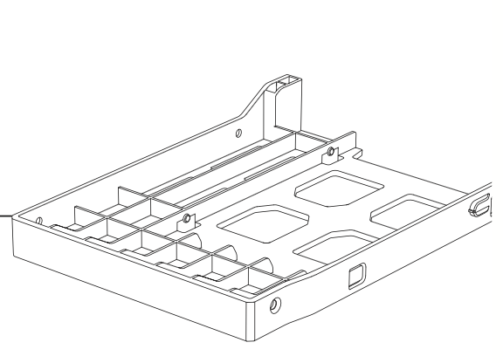
Hot swappable and invisible slots
Toolless installation
Prevent HDD mishandling
Anti-theft
1 x 2.5” HDD/SSD tray base is bundled for SSD caching

Slide 9


Data Backup
Snapshot with Time Machine
provides a complete data backup solution
Notes:
分頁要改

Slide 10
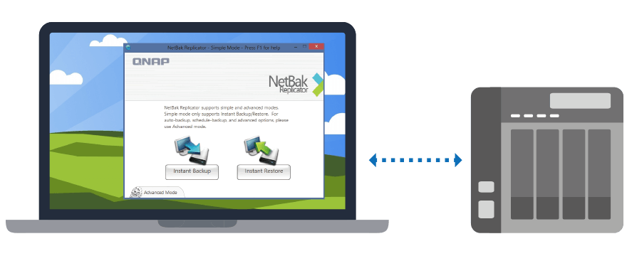
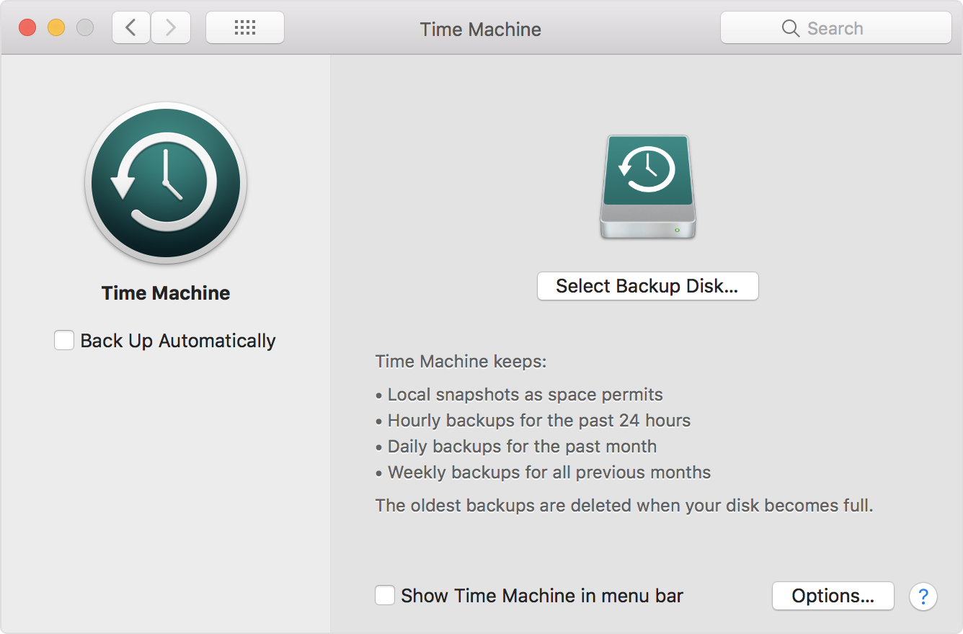
A complete backup solution
Data backup is the most effective way againsting ransomware
Mac O.S.
Time Machine
Real-time or scheduled back up to the TS-328 easily.
Windows
NetBak Replicator

Slide 11


Protect your backup with QNAP Snapshot
For the
whole NAS
64
-----------------------------------
-----------------------
For a single volume/LUN
32

Slide 12

Time Machine Support
Faster and Safer Mac backup choice
Notes:
# 操作管理好容易
# 備份還原超快速
# 資料保護更強化
#操作管理好容易 #備份還原超快速 #資料保護更強化 @ QNAP NAS

Slide 13
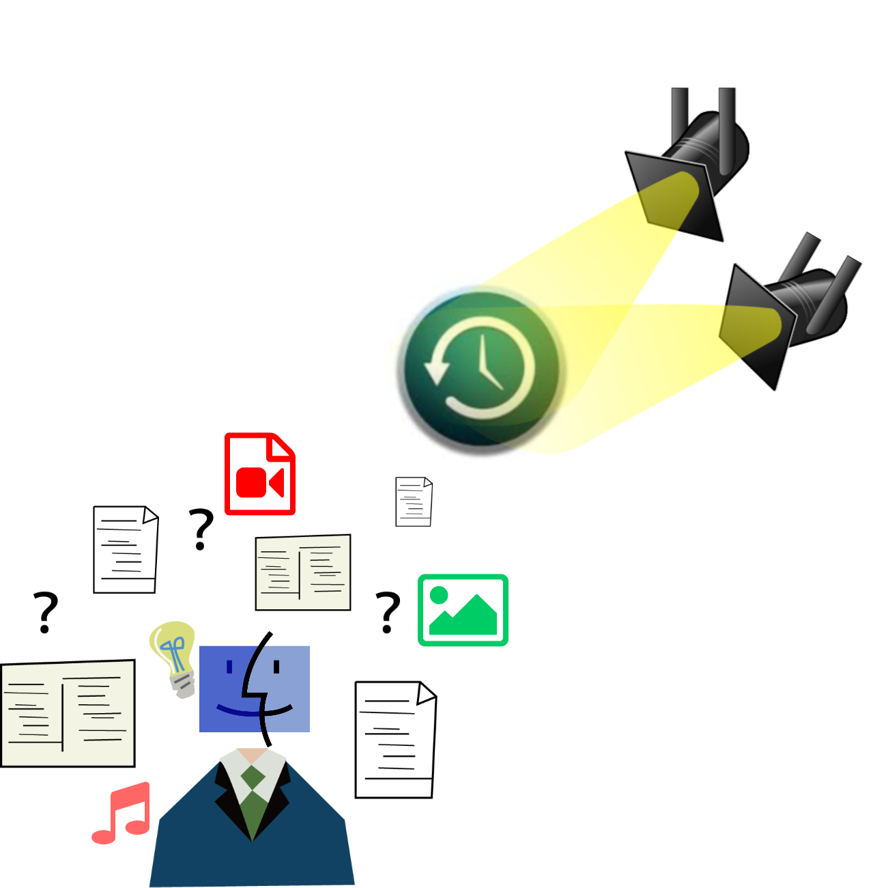

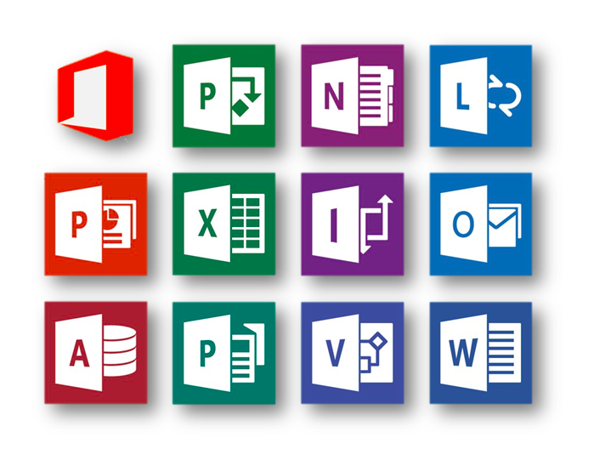
How to backup data on Mac
In addition to file copy...
- Copy to external drive
- Copy to remote file server
- Copy to cloud
You have a better choice - Time Machine
Notes:
一般備份方式:
手動處理
無多版本
還原
容量控管
資料加密
備份速度

Slide 14
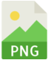
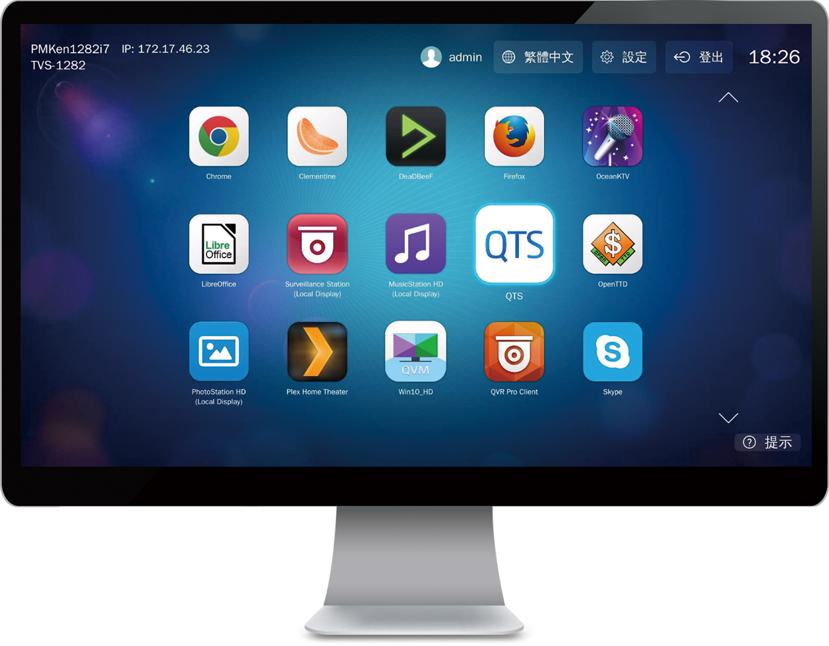
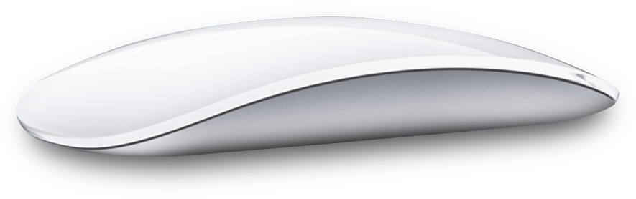
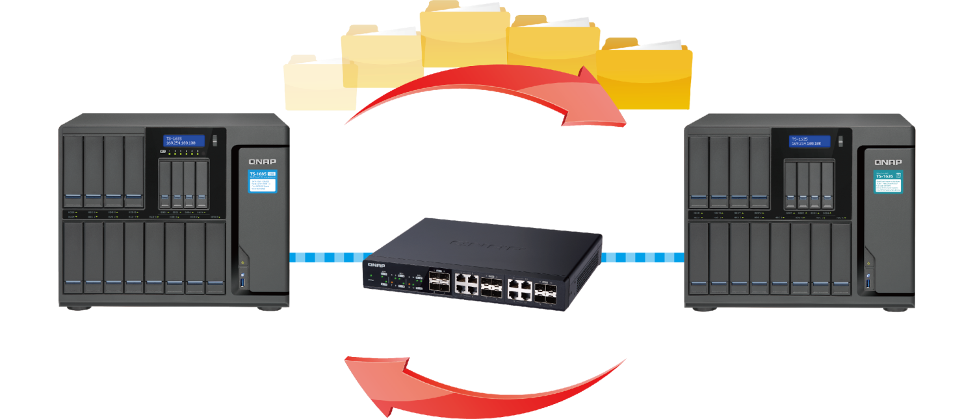
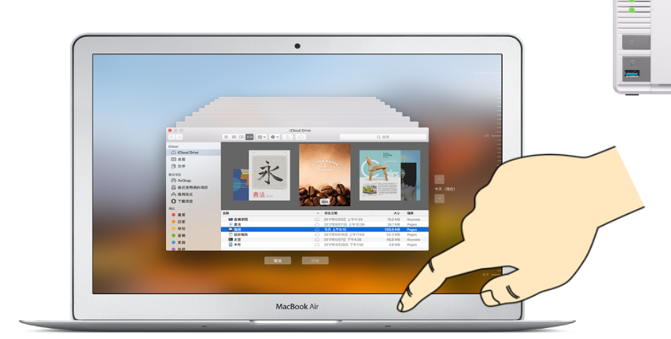
Backup software born for Mac
Time Machine gives you...
Comprehensive backup
Multi-version backup
File level restore, System restore
Backup encryption
Backup management
Notes:
全面備份
系統檔案
應用程式
音樂、影片、文件檔案
Mac 整機備份
多版本備份
單檔還原、系統還原
備份加密
備份管理
插上電源即備份

Slide 15
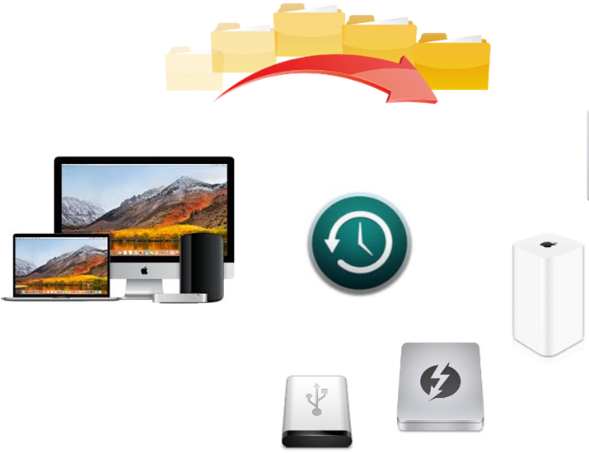
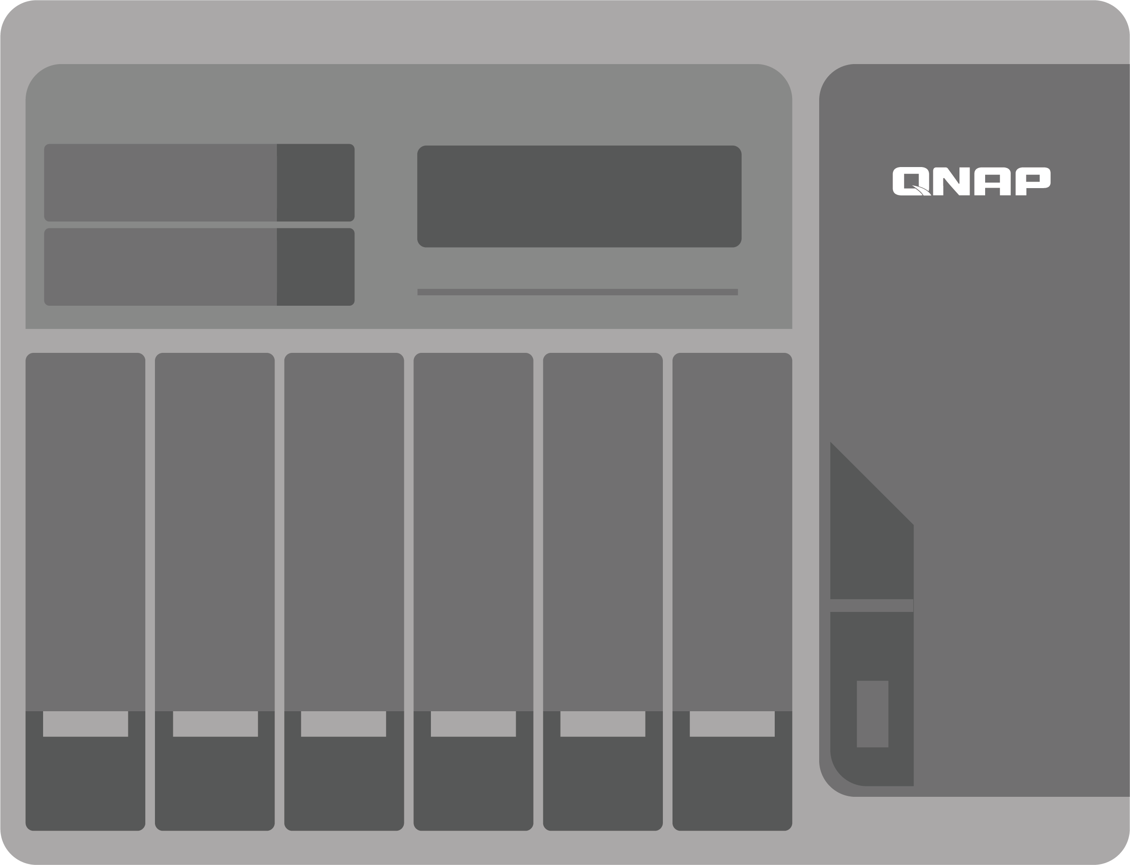
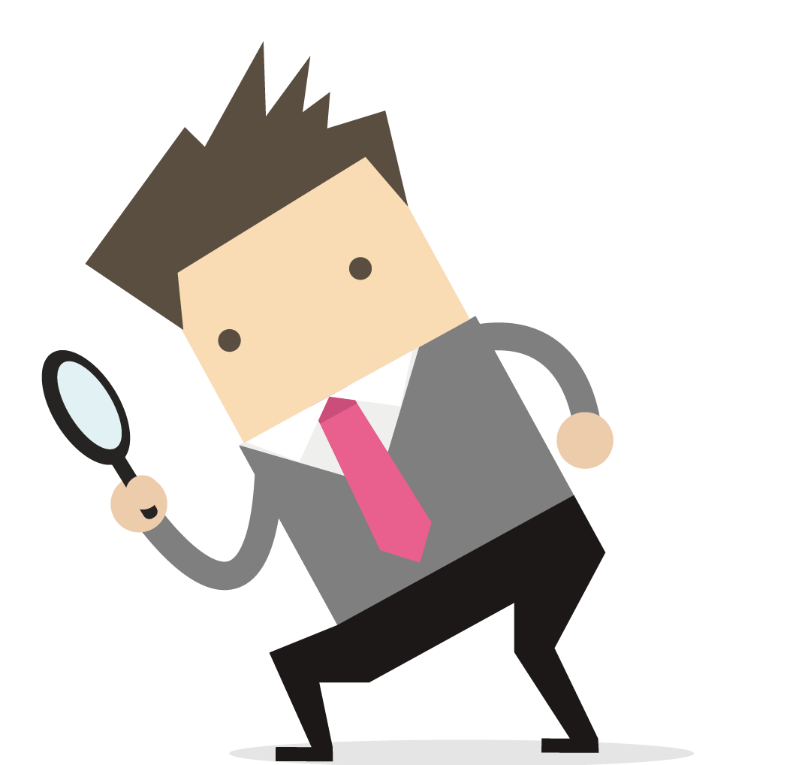
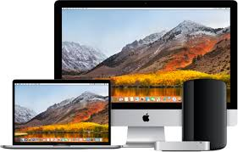

Time Machine external storage solution
1 GbE / 10 GbE / Thunderbolt
0
1 GbE
Thunderbolt
USB

Slide 16
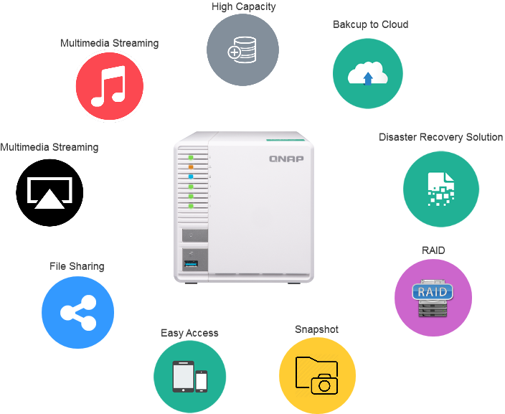
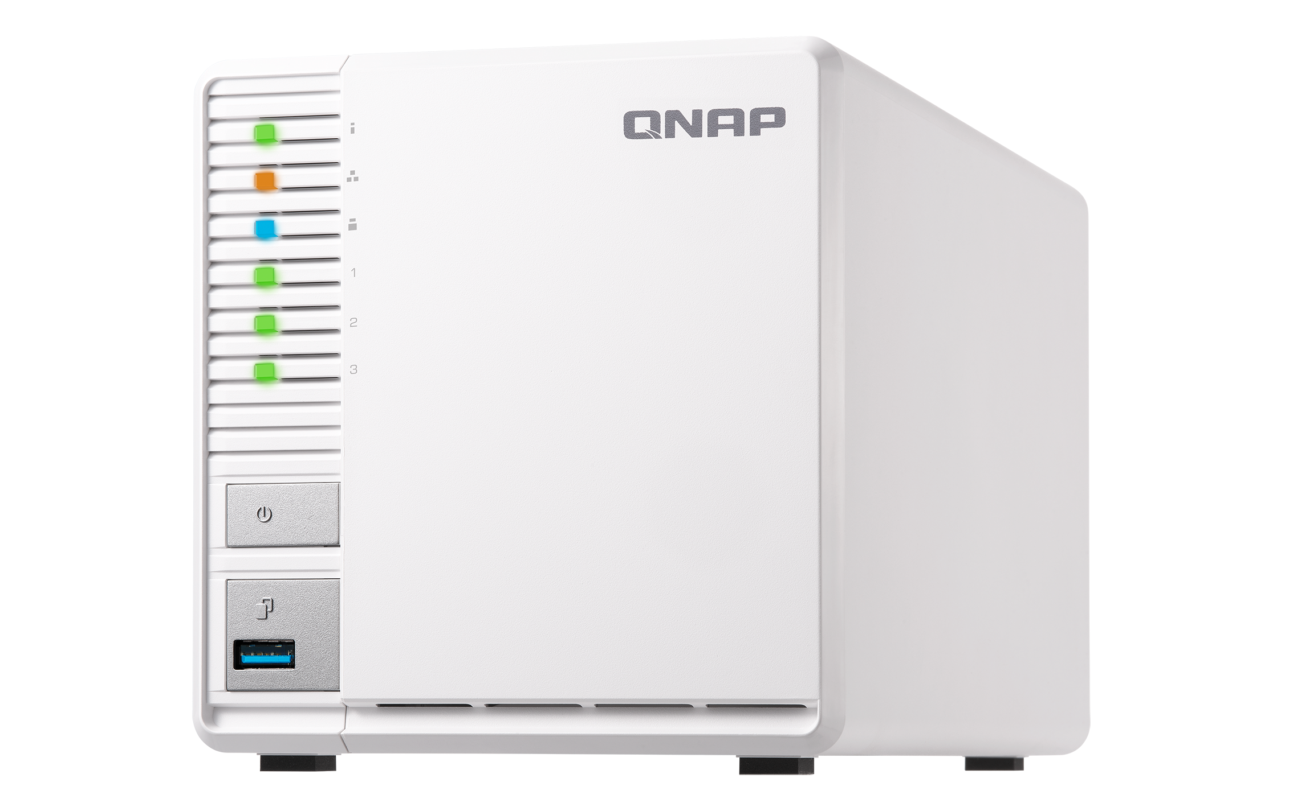
Best backup solution for Mac user
High storage capacity
Support multiple network protocols and easy access
File sharing and synchronization
Complete data protection plan
  - RAID
  - Snapshot
  - Hybrid Backup Sync

Slide 17
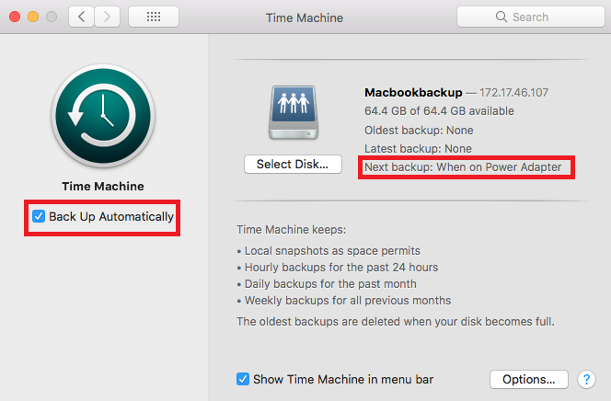
QNAP NAS makes automatic backup easy
Automatic backup lets you set-it-and-forget-it
Easy setup
          Plug and backup
          Keep backup versions automatically
Notes:
全面備份
系統檔案
應用程式
音樂、影片、文件檔案
Mac 整機備份
多版本備份
單檔還原、系統還原
備份加密
備份管理
插上電源即備份

Slide 18



Best partner of Time Machine
Easy setup via QTS
- Backup Mac using different NAS account or Time Machine backup account
- User quota management
Multi-layer protection for the backup
  - RAID, snapshot and remote replication ready
High performance 10 GbE / Thunderbolt 3
  - Greatly improves the backup and restore performance
註: 限部分支援機型

Slide 19
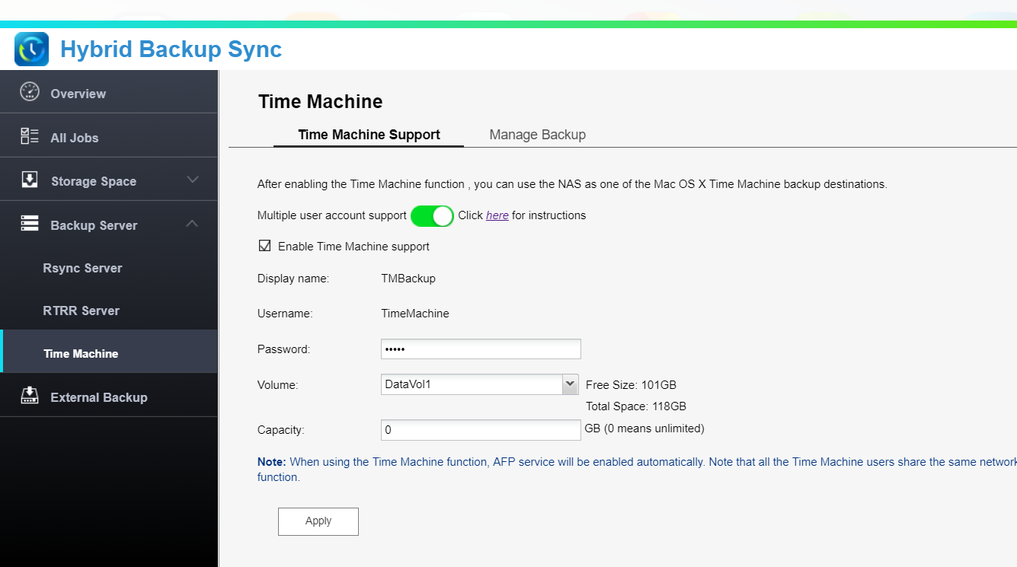
How to prepare the NAS
1
Enable Time Machine support
Enable multiple user account support
2
Setup account
3
Setup a maximum storage quota
Default Time Machine backup account

Slide 20
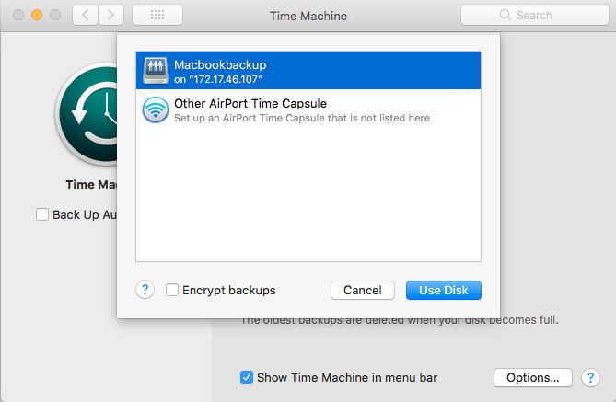
How to setup on Mac
Step 1:
Select Disk for Time Machine backup
Step 2:
Setup file exclusion rules

Slide 21
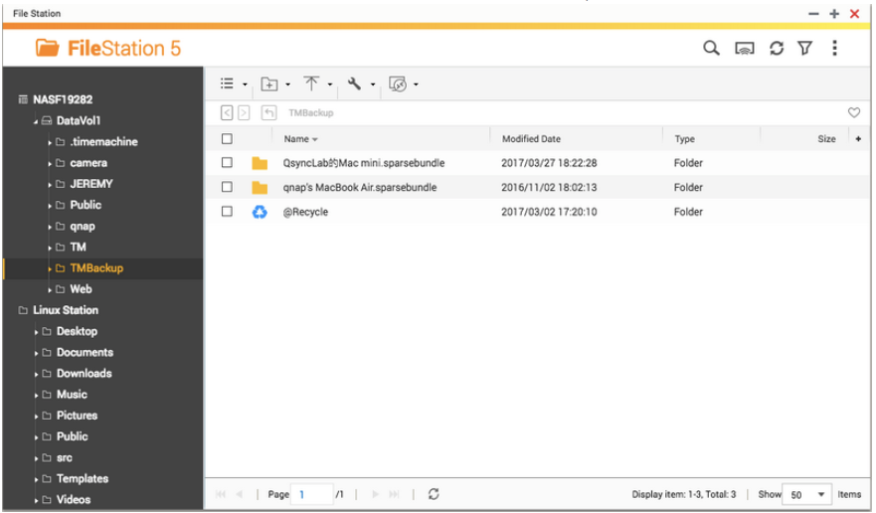
View the Time Machine backup
Notes:
1 GbE vs 10 GbE Time Machine 備份還原
檢視 Time Machine 備份檔案
MAC (Time Machine)
NAS (File Station)

Slide 22
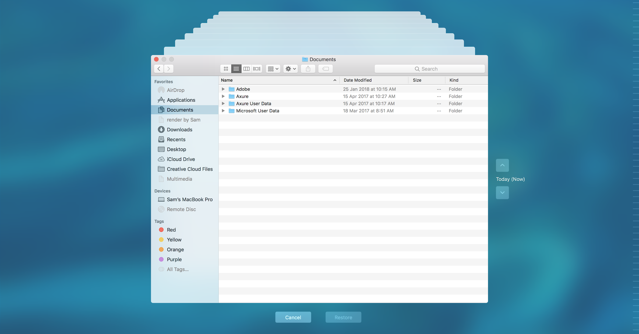
Timeline brings your file back to life

Slide 23

Live Demo
Live

Slide 24


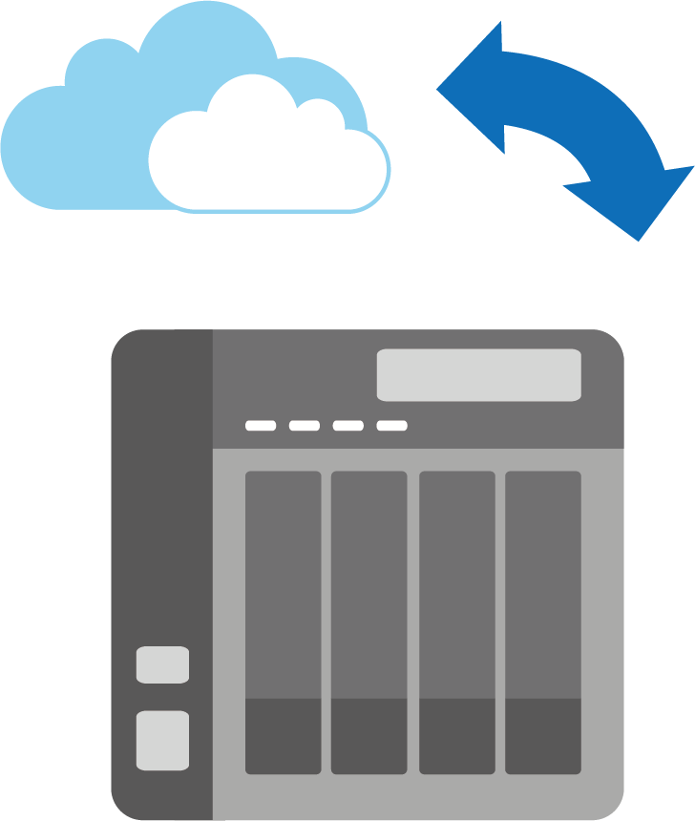



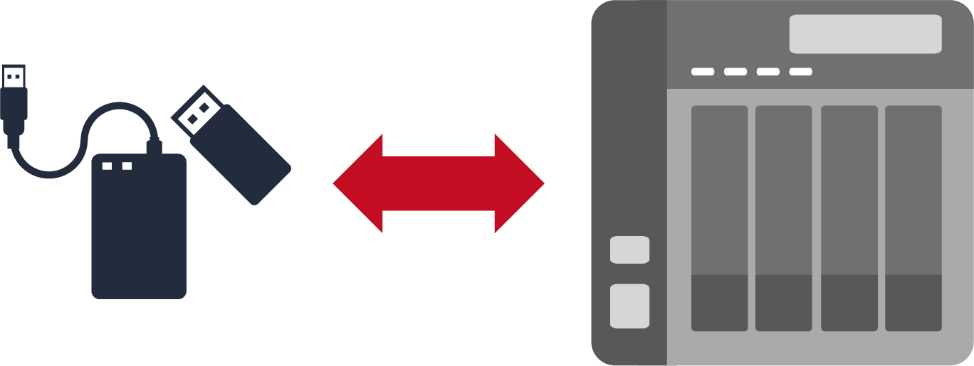



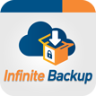
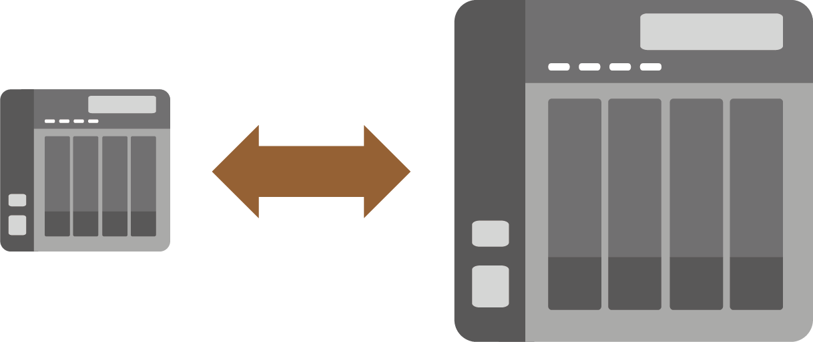
Multi-layer protection for the backup
Remote
Backup
Hybrid Backup Sync
Cloud
Local
Remote

Slide 25

Video Transcoding
4K HEVC/H.264 hardware transcoding
Notes:
分頁要改

Slide 26

First ARM NAS supporting 4K video transcoding
supported 4K video source format
MP4 / AVI / MOV / MKV / MPEG / FLV……..
FHD H264 30fps
Support 10-bit H.265 (HEVC)/H.264 transcoding

Slide 27
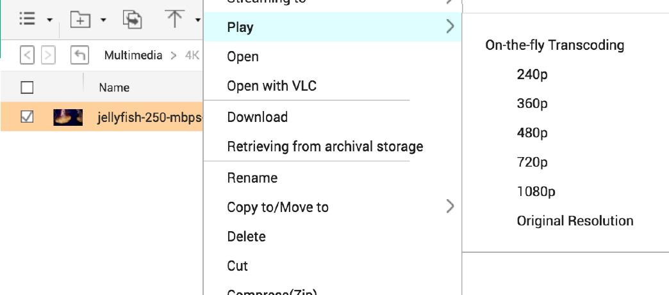
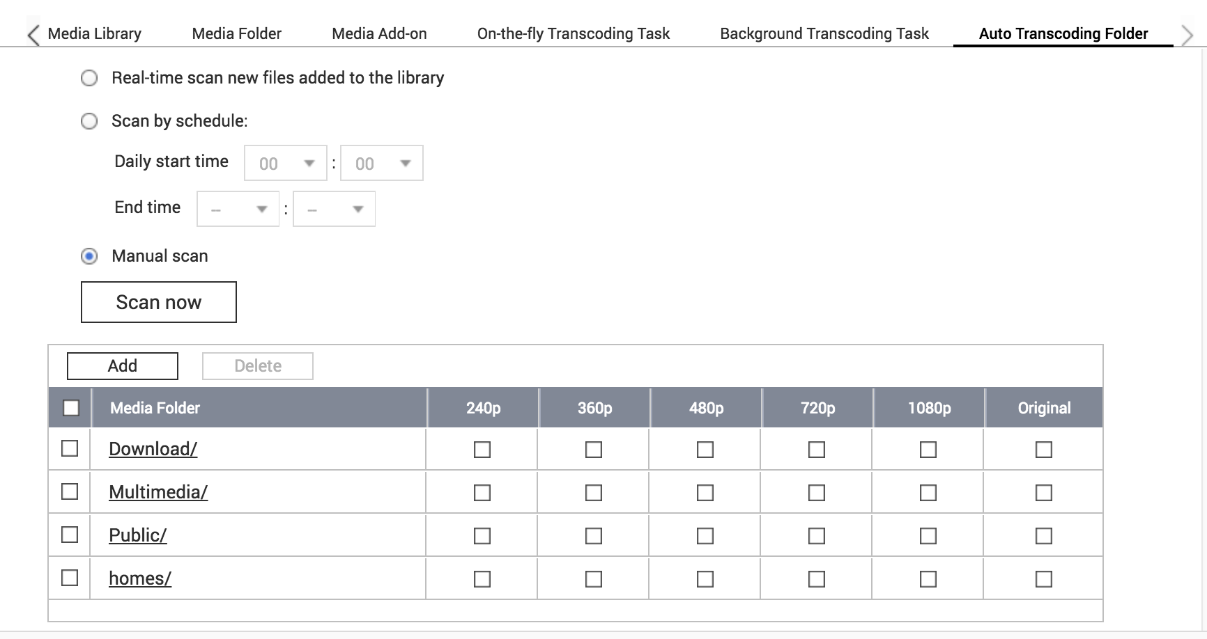
Real-time or background transcoding
On the fly transcoding
Play on different devices with high quality
Background transcoding
Set the auto transcoding folder

Slide 28
Real-time and background transcoding
Live

Slide 29



Data management
Qsirch
Full text search
Qfiling
Smart filing
Notes:
分頁要改

Slide 30

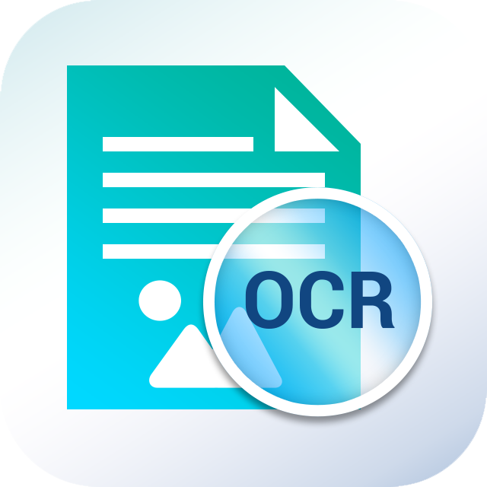



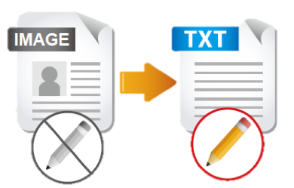
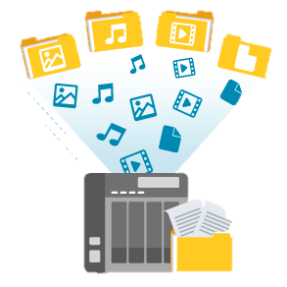




QNAP meets all needs for an office
File Station
OCR Converter
Qsirch
Qfiling
Store and backup
File Digitization
Search
Archive
With OCR Converter, Qsirch can search for image context.
Notes:
QTS4.3.4 P.58

Slide 31
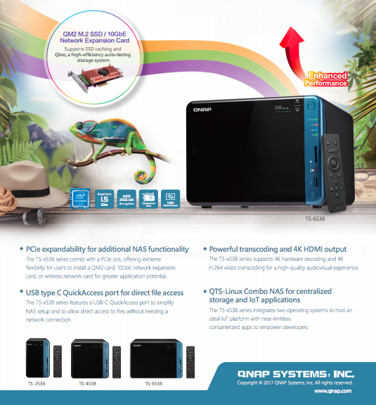






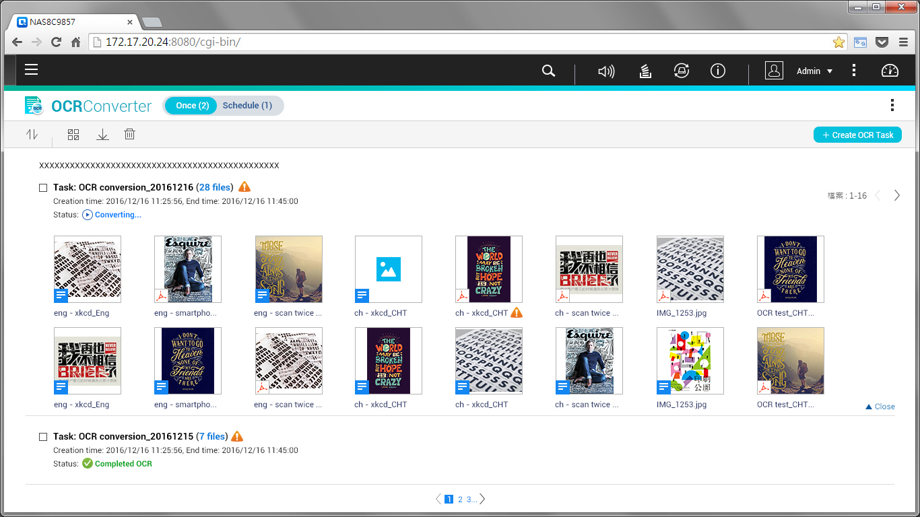
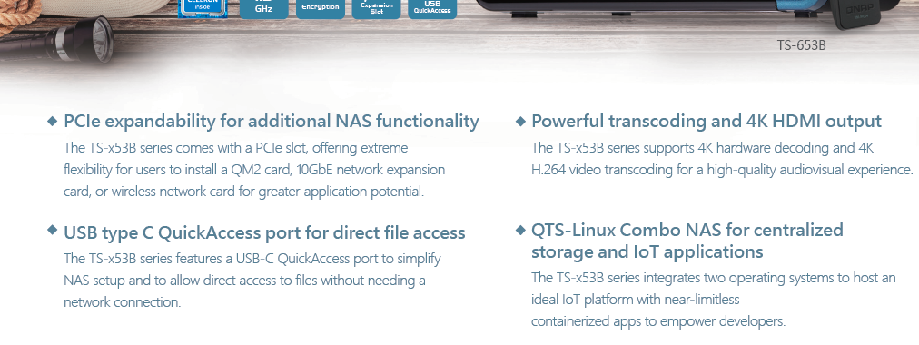
OCR: Best solution for document digitization
Picture with text
Searchable documents
Search
Edit
Archive
Notes:
QTS4.3.4 P.64

Slide 32
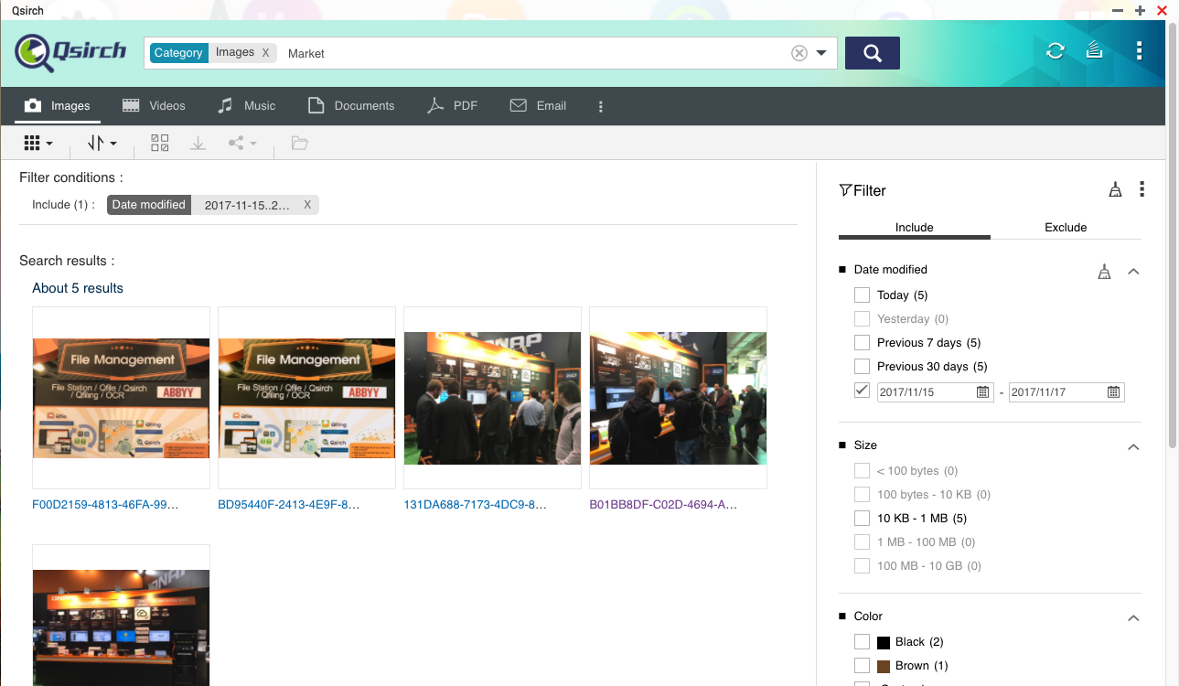
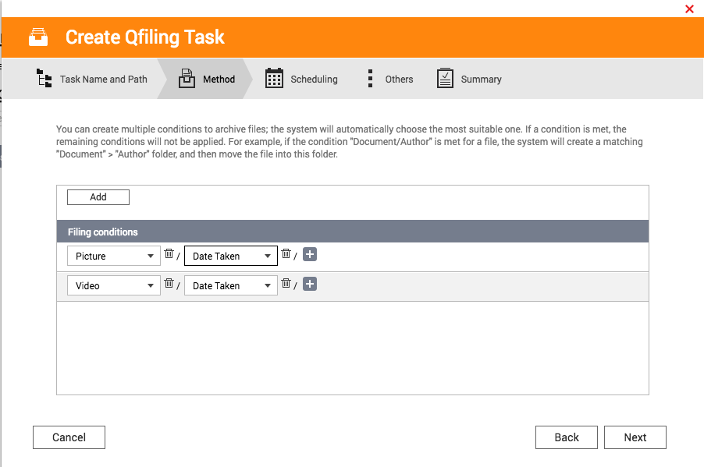

Smart file searching and filing
Qsirch
Qfiling
Notes:
QTS4.3.4 P.69

Slide 33

TS-328 provides you..
The most cost-effective RAID5 NAS
  - Improve the utilization of HDD
  -Using SSD as cache to boost system performance
Data safety
  - Snapshot protection
  - Time Machine and Netback Replicator backup solution
  - Cloud service
Video transcoding
  - support 10bit HEVC transcoding
  - On the fly or background transcoding
Data management
  - full text search and smart filing
  - document digitization

Slide 34
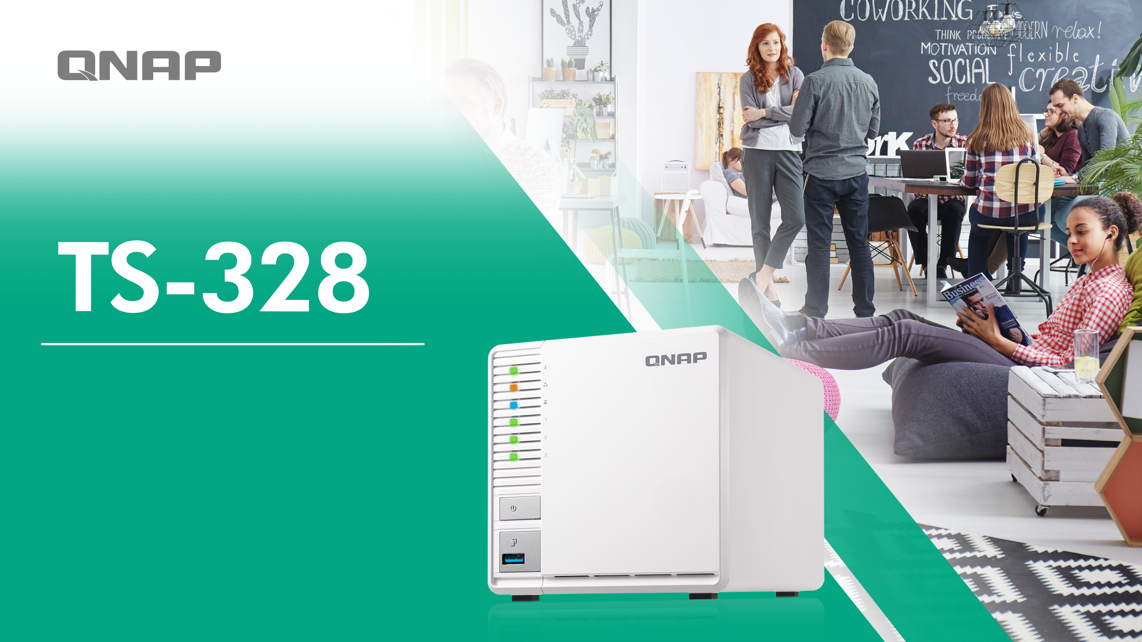
Your best choce!

