Slide 1
QNAP & Roon Team up to Provide an Optimal Music Streaming Solution for Music Enthusiasts
Roon
x
QNAP

Slide 2
In-depth intro of Roon & QNAP NAS
Roon & QNAP NAS Make an Optimal Music Streaming Solution
Roon Intro
Choose a Roon Core
Plays with your gear
Roon x QNAP NAS: Guide for Environment Setting
Build a Multi-zone Streaming Environment
Successful Story

Slide 3
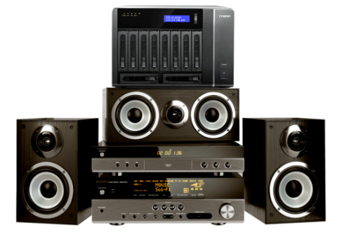
I’m a Music Lover...
我是專業音樂玩家，我有以下需求...
1
I own a rich collection of digital music. Lots of them are in high quality - lossless formats. I need a massive storage.
2
I want an easy way to manage the collection. Quickly
locating desired music is a must.
3
I want to share and stream my music to multiple devices and outputs.
Notes:
Bridge: 呼應三個問題的痛點

Slide 4
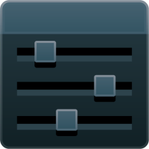
A perfect music management requires...
Intuitive Management Panel
Advanced storage solution

Slide 5
The best combination for Hi-Fi streaming
Roon x QNAP NAS
Professional
Music Library Management
Secure & powerful storage

Slide 6
Roon Intro

Slide 7
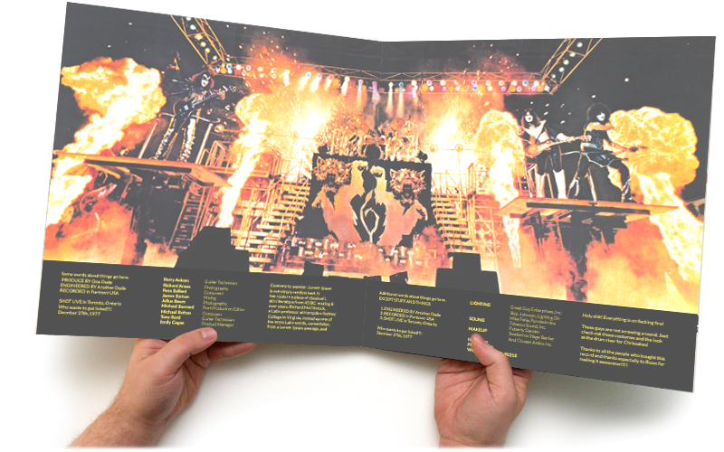
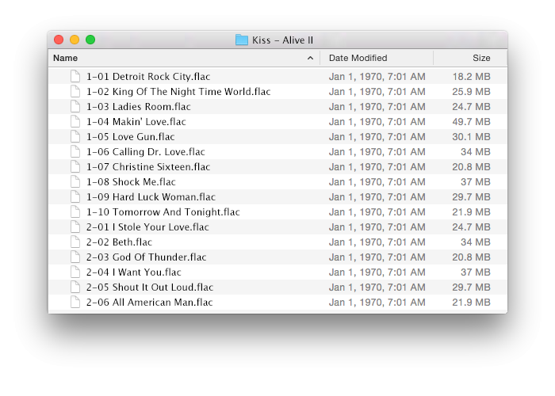
Challenges to Digital Music
Exquisite Album
Hmm...
Great music experience that you can not experience by windows and folders.

Slide 8
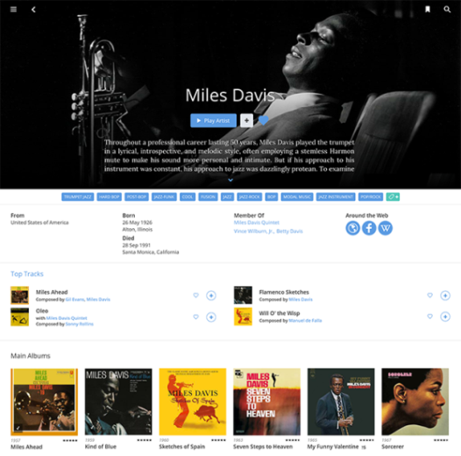
What Roon helps you...
Turn ordinary database...
into delicate music magazine
>
Roon is your music guide to broaden your musical horizons

Slide 9
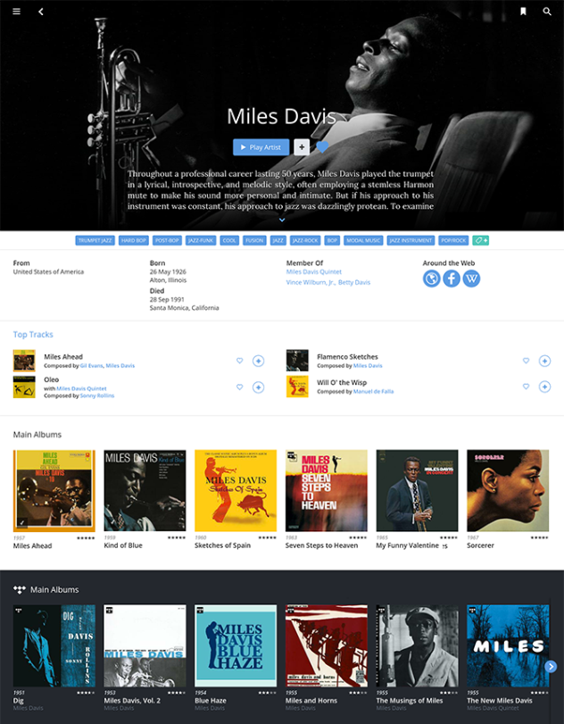
Roon - The Music Player for Music Lover
1
1 Hybrid Music Library
Integrate local library with online Roon metadata. Artist bio and albums are available.
2
2 Quick Play
Categorized by genre, artist, top ranking. You can quickly find what you want.
3
3 Multizone Streaming
Support high quality, various formats, and customized zone streaming.
Notes:
快速找到音樂
多房串流
整合線上資料庫 - 作曲家演奏家專輯演唱會
Roon 每個歌手以至每張專輯，都會有詳細介紹，而專輯內又有相關歌手甚至相關專輯之連結，可以讓用家即時繼續「延伸聆聽」，從而擴闊音樂視野。另外，Roon 也會將 Roon Core 共享音樂伺服器的音樂專輯歌手作分類，用家也可從中掌握歌手的音樂風格。

Slide 10
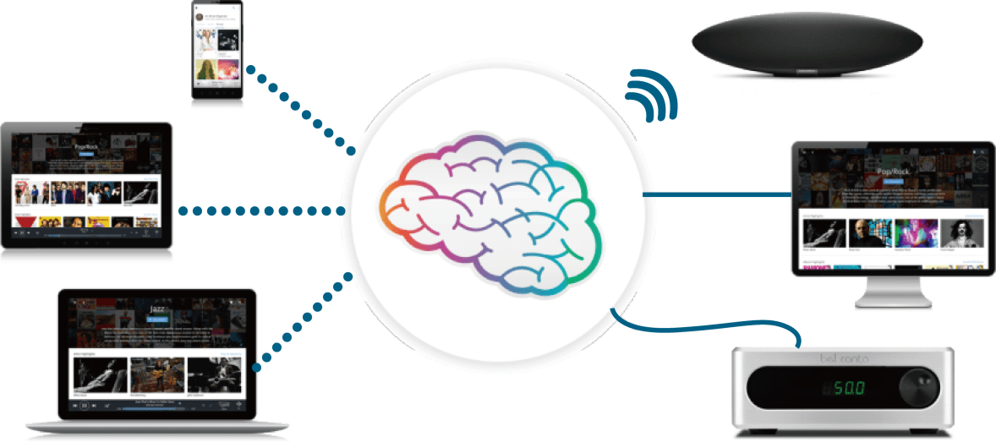
Roon Infrastructure
Roon Control
Computers, Phones, Tablets
Browse and Control Applications
Roon Core
Computers, NAS
The core to integrate personal music library and online database
Roon Output
Network players, Roon ready devices
Stream music to multimedia devices.

Slide 11
Choose a Roon Core

Slide 12
Requirement of Roon Core
The Core manages your music collection from many sources, and builds an interconnected digital library using enhanced information from Roon.
Secure and reliable
data protection
A
High Efficiency
B
Massive Storage
C
Properties of an ideal hardware platform

Slide 13
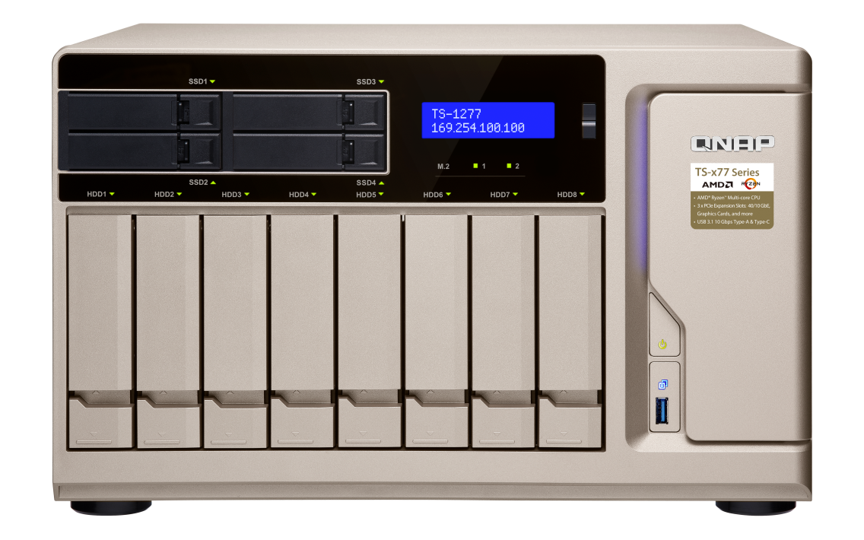
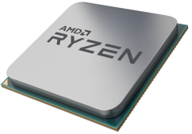
The Highly-Efficient TS-1277 - your best choice
SSD Cache
optimizes output quality
SSD
Install Roon Core on SSD to speed up the application.
HDD*8, RAID 5,
Massive storage for Music Library and its backup
HDD
CPU: AMD Ryzen 5 1600 6-core/12-thread 3.2GHz processor, Turbo Core 3.6 GHz

Slide 14
Secure your data with QNAP storage solutions
RAID Data Protection
Backup
Snapshot
No worries for disk damage
on RAID1/RAID5. A copy is
always there.
Automatically recovers data
on the hard disk.
Backup to cloud storage,
remote NAS.
Safeguards the data
transmission with advanced
protection
Scheduled auto snapshot
Flexible version restoration
Notes:
安全性: RAID 災難備援: HBS + Snapshot

Slide 15
The best choice for Roon Core - QNAP NAS
 | Common Storage Option: Computer as core | QNAP NAS as core
High Performance Computing
Large Storage Space | Need to Plug in External Hard Disk
Appropriate Backup System | Need to build Independent Backup System.

Slide 16
Plays with your gear

Slide 17
Support multiple devices as a Roon Control
Download the application and connect to the core. Enjoy the high quality music experience!
Android
iOS
Mac / Windows

Slide 18
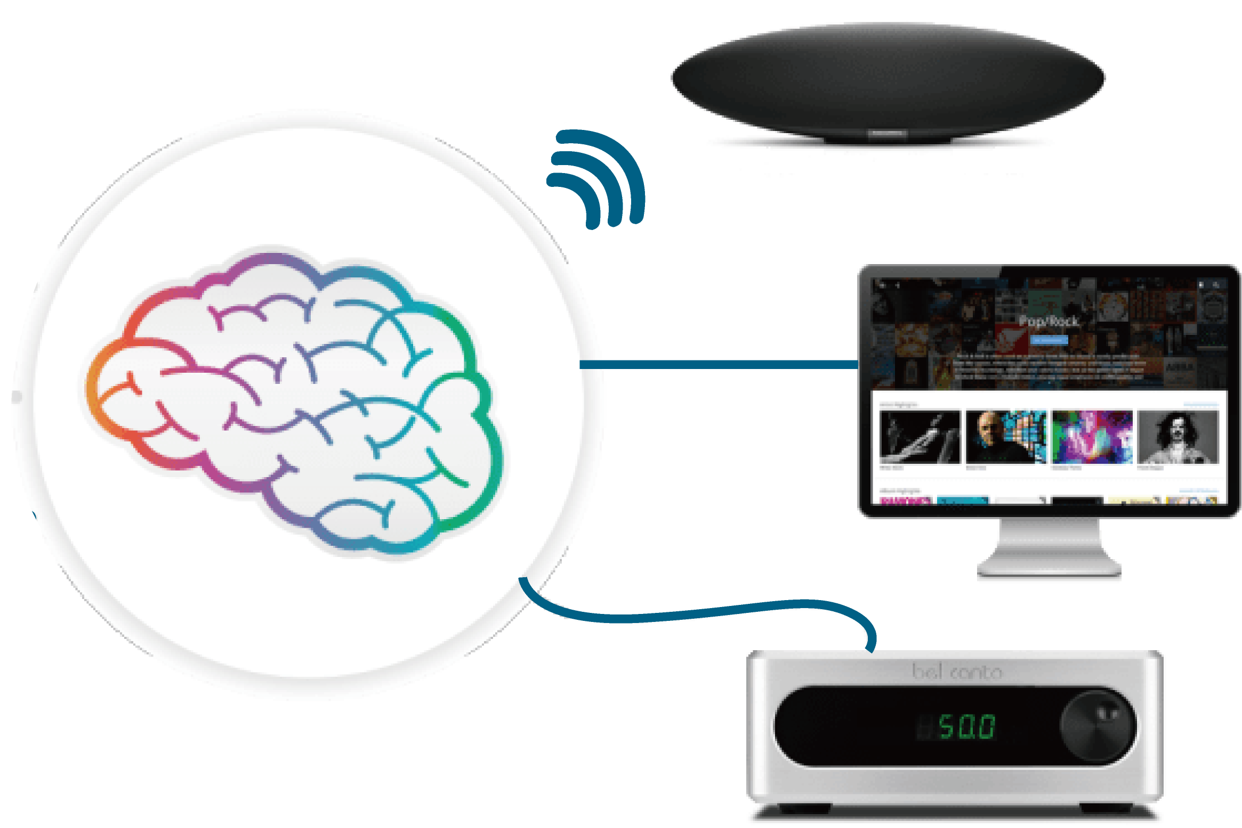
Stream music to players
Roon streams to all the audio gears you have, and makes them all play nice together.
Mac / Windows
Network Players Airplay, Squeezebox, Meridian
Roon Ready Partners
Quad-core Silent NAS HS - 251+

Slide 19
Roon x QNAP NAS Guide for Environment Setting

Slide 20
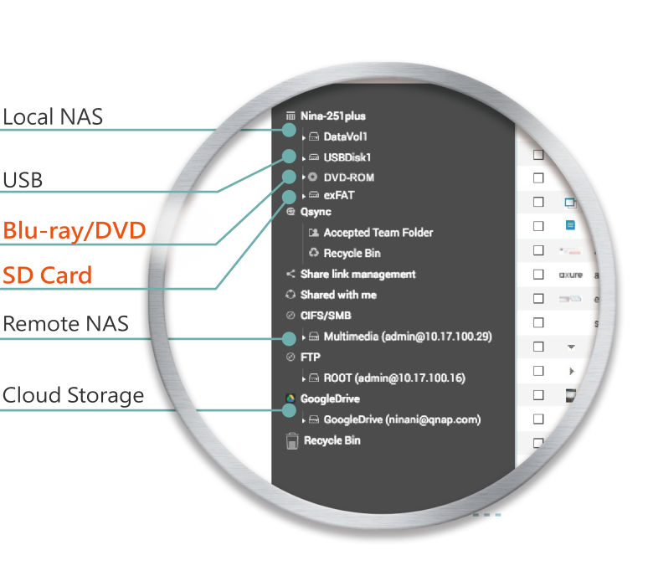
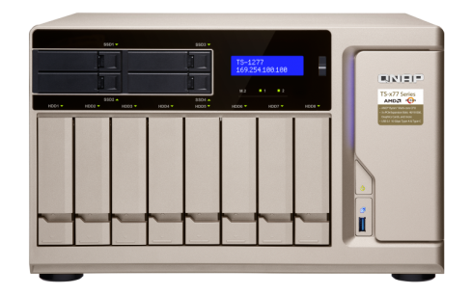
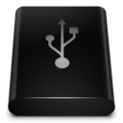
Import music contents to QNAP NAS
To import from exFAT storage devices, please purchase a license in License Store first.

Slide 21
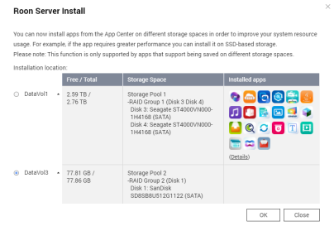
Install Roon Core on QNAP NAS
Create Storage Pool and
Volume on SSD
Build Core Folder
ImstallRoon Server
Create a storage pool in "Storage & Snapshots."
Create a Shared Folder for the SSD
Search "Roon Server" in "App Center" and install it
Create a volume on SSD
Name the folder "RoonServer"
Specify the SSD volume

Slide 22
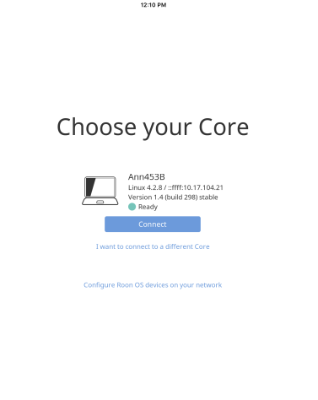
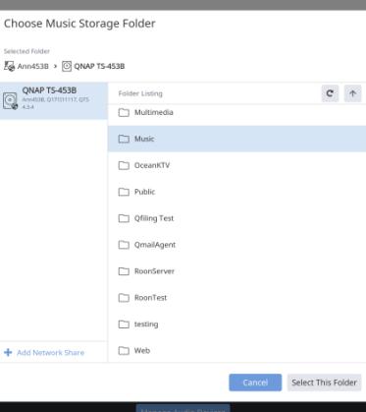
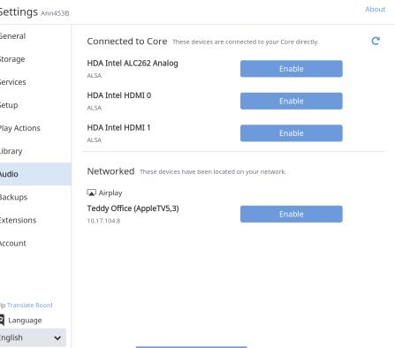
Use Roon App to import your music library
Open Roon (PC/Mac/Android/iOS)
Import Music
Setup Outputs
Choose your core
Import music from NAS
Enable the output devices

Slide 23
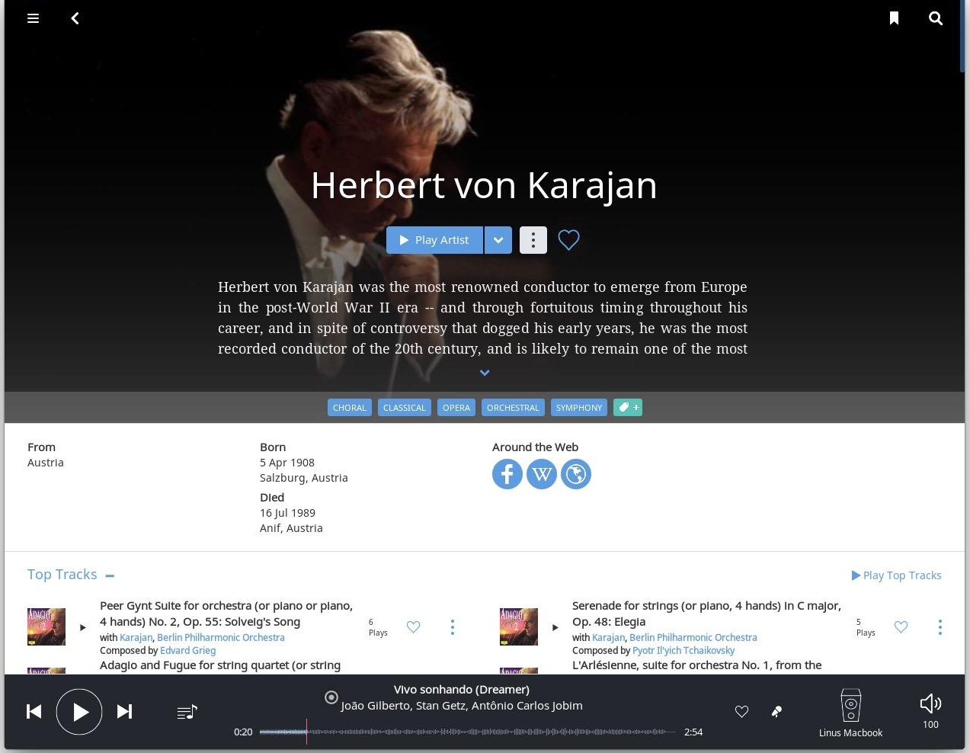
The Hybrid Music Library
Artist bio
Community, Wikipedia
Top ranking

Slide 24
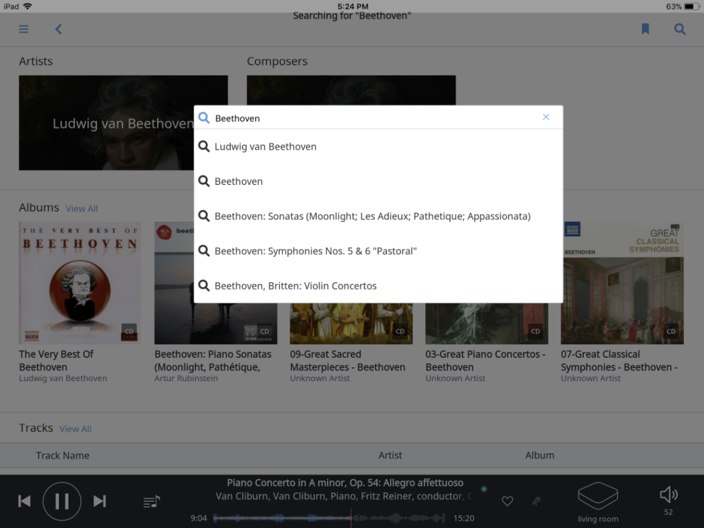
The Quick Search
Simple and Quick search
Surf to the content you want
Recommended
And more surprises...we just name a few...

Slide 25
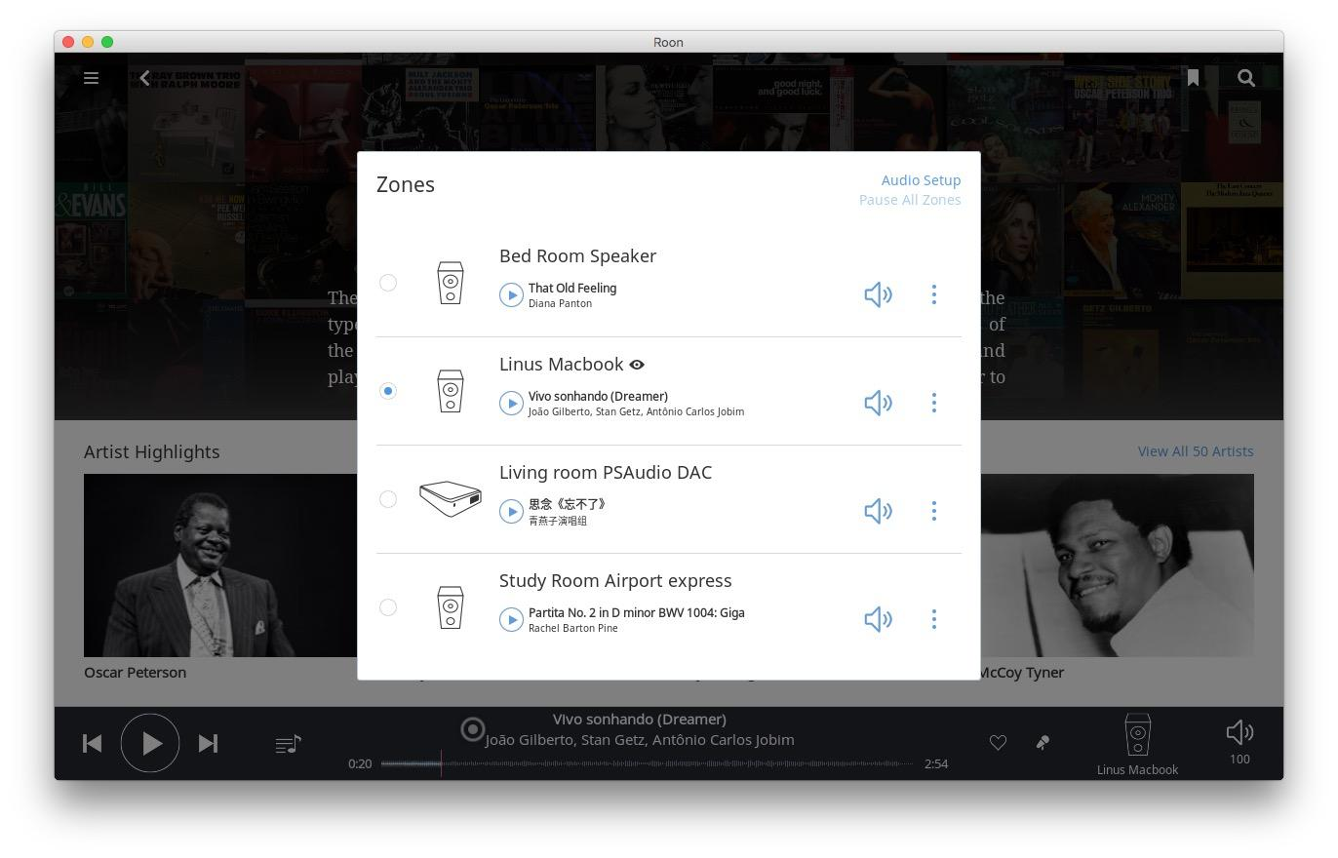
Multi-zone streaming
Control multiple devices simultaneously
Volume control
Stream to individual devices

Slide 26
DEMO Music on Demand with Roon

Slide 27
Build a Multi-zone Streaming Environment

Slide 28
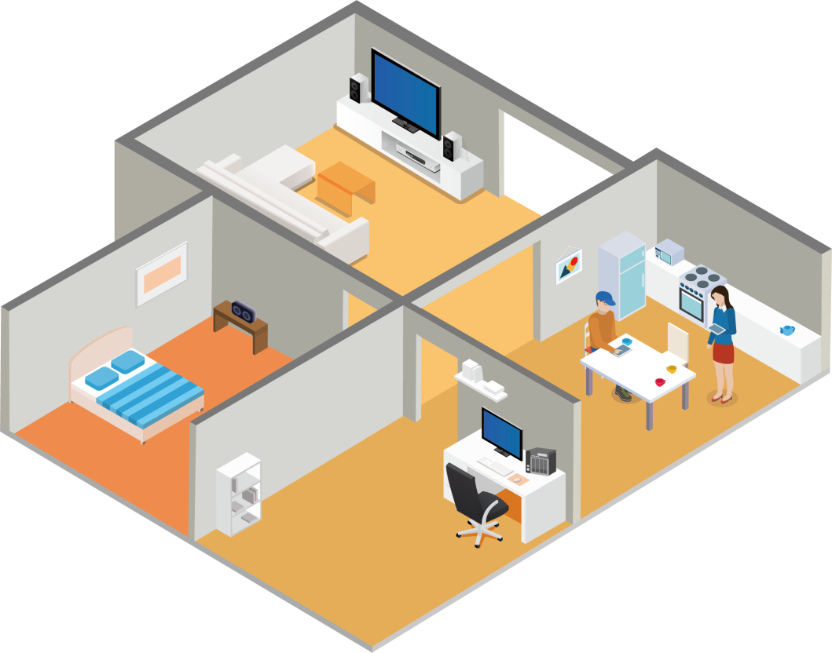
Music in every corner, a delightful experience
Living room stereo (Output)
Apple TV (Output)
USB DAC (Output)
iOS/Android (Control)
Bedroom Speaker (Output)
QNAP NAS (Roon Core)
PC (Control)
Roon ft. QNAP NAS - Multi-zone streaming
Notes:
Multizone,
一張release computer
雙NAS的情境

Slide 29
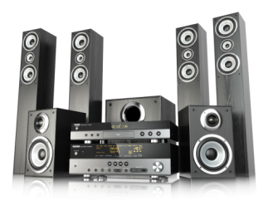
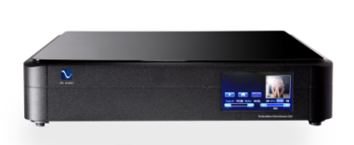
Roon ft. QNAP NAS - Advanced Devices
Contained Room
Media Room
QNAP NAS (Core)
Fanless QNAP NAS (output)
USB DAC (output)
Amplifier
(output)
Enjoy better sound quality by using NAS as another independent output.
Notes:
第二台要用Fanless NAS, 免除噪音干擾
第一第二台之間要作空間區隔

Slide 30
Successful Story MJ Audio in Hsinchu, Taiwan

Slide 31
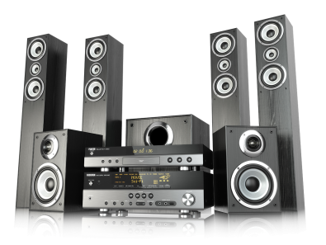
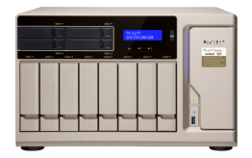
Player
The Golden
Combination for Music Streaming
Quality output devices
QNAP NAS (Storage)

Slide 32
Special Thanks to
Hsinchu Minjan Audio Flag Store

Slide 33
Roon x QNAP NAS Your Best Choice

