Slide 1
Container Station
Go beyond your creativity with containers

Slide 2
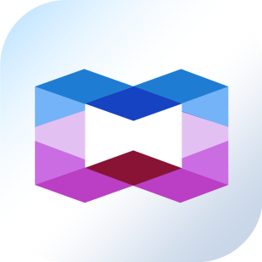
Agenda
What is a container?
QNAP NAS - The best platform
Live Demo - Container Station
FAQ

Slide 3
What is a container?

Slide 4
Container 101
Containerization is an application-level virtualization technology where Linux kernel is shared to reduce resource consumptions and enable rapid migrations of containers to different platforms.
APP 1
APP 2
bins/libs
bins/libs
APP 1
APP 2
APP 3
Guest OS
Guest OS
bins/libs
bins/libs
bins/libs
Hypervisor
Container Engine
Host Operating System
Operating System
infrastructure
infrastructure
Virtual Machines
Containers
Notes:
容器的運作不會模擬硬體資源，故相對於 VM，容器並沒有額外運行作業系統 (Guest OS)。簡而言之，容器就是虛擬化「應用程序及其相對應的環境」。
1.VM 的映像檔通常落在數 GB 至數十 GB 都有，而容器映像檔一般最大也才數百 MB。如此輕量級的特性，讓映像檔管理以及 App 的啟動、關閉流程皆方便迅速許多。
2.容器的移轉性強；只要在實體伺服器上安裝了 Docker，無論 Host OS 為任何作業環境，皆能正常運行容器化後的應用程序。
3.容器擁有不可變的特性，意指只要 App 能正常運作一次，未來不必擔心系統環境變動造成 App 出錯。
4.透過 Docker 容器引擎，容器的開發、管理與運行非常簡易，因此實踐 DevOps 的運作 (Development + Operation)，解決以往常見開發與維運立場不一的問題。
看需求選擇 VM 或是 Container
在選擇使用容器或虛擬機時，有些很關鍵的因素必須深入考量，其中， App 所運作的環境便尤其重要。前面提及容器不可變之特性，雖然非常有利於 App 的運行，但同時也意味著將無法隨意修改系統環境。如此一來，若維運人員需要升級或更動系統設置 (System Configuration) 時，則會遇到不少麻煩，通常也必須由開發人員協助深入改寫程序。反之，在使用 VM 的情況下，維運人員將能夠相對輕易地管理系統環境。

Slide 5
Containers Become Prominent
Most software developers and system administrators use containers
Fast launch and deploy:
The use of container allows each bare metal to be defined as one computing unit to accelerate the deployment, upgrade and maintenance of software applications. It takes only a few dozens of minutes to deploy the settings of 10,000+ servers.
Efficient operations:
Rebooting one server takes at least a few minutes, yet rebooting container takes only a few seconds. Besides, upgrading becomes painless as well. All we need to do is preparing the container image, which reduces the difficulty of cross-platform maintenance.
Notes:
維運：開發與維運之間的效率，透過容器技術大幅降低開發時間與快速應變市場反應

Slide 6
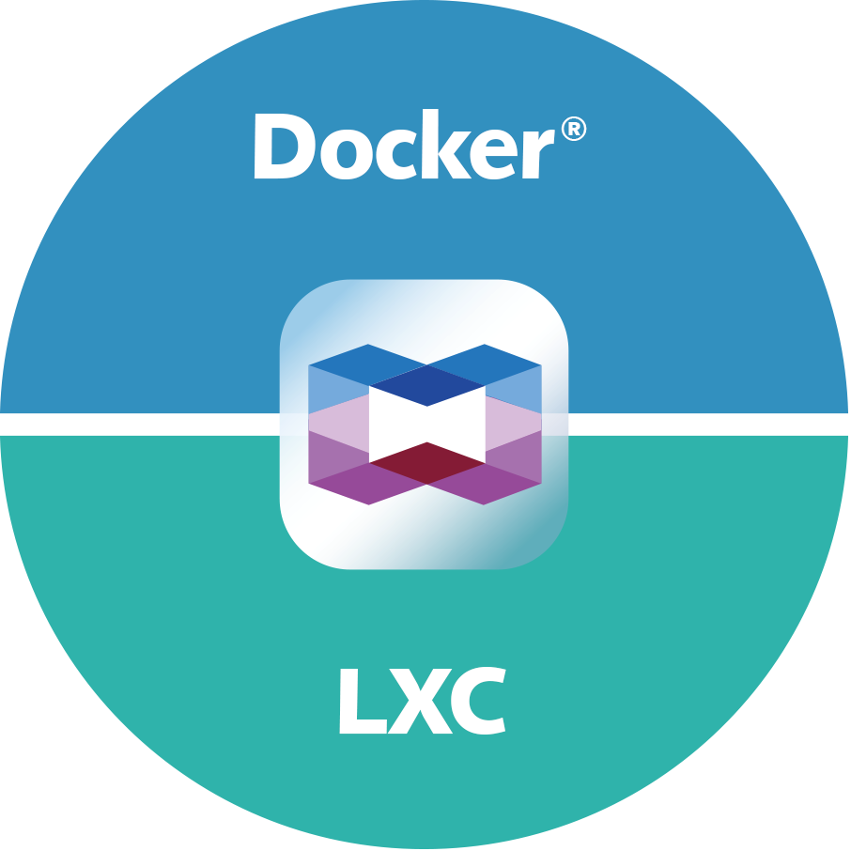
QNAP NAS: The Best Platform
Your personal cloud QNAP NAS is well-prepared for the advent of containers! QNAP's exclusive advantage: we support both LXC and Docker® container!
Efficient, Privacy-protective
Flexible Network Settings
Supports GPU computing

Slide 7
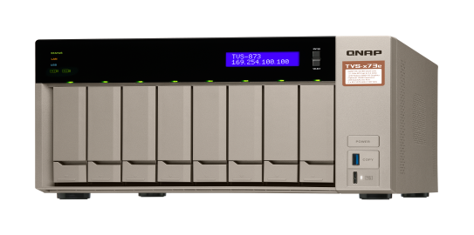
Private & Efficient
Developing and executing software applications/ containers on private clouds
Comprehensive control of container and personal cloud's operation
Optimizing storage and managing great amount of data
Notes:
公有雲收費模式複雜
隱私權和資安規範等都是潛在議題

Slide 8
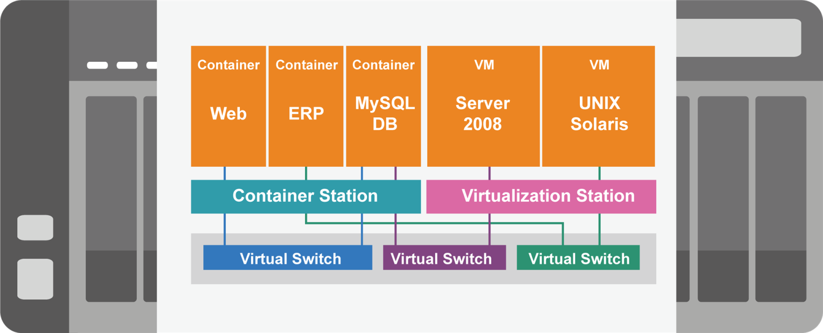
Flexible Network Settings
Supports Host, Bridged, and NAT modes.
Using Virtual Switches to customize a network environments for containers and VMs.

Slide 9
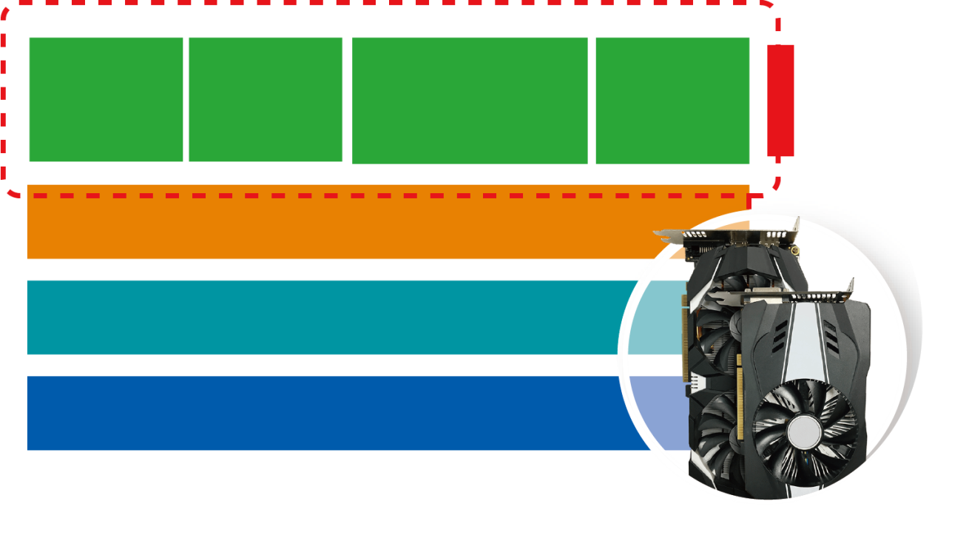
GPU-accelerating
QNAP NAS supports expansion graphics cards to notably enhance the performance of QuAI-relevant container applications.
CNTK
MXNet
TensorFlow
Caffe
QuAI Containers
Container Station 1.8
GPU Card
QTS 4.3.4
QNAP NAS + GPU
* Supported models： TS-x77 and TS-1685

Slide 10
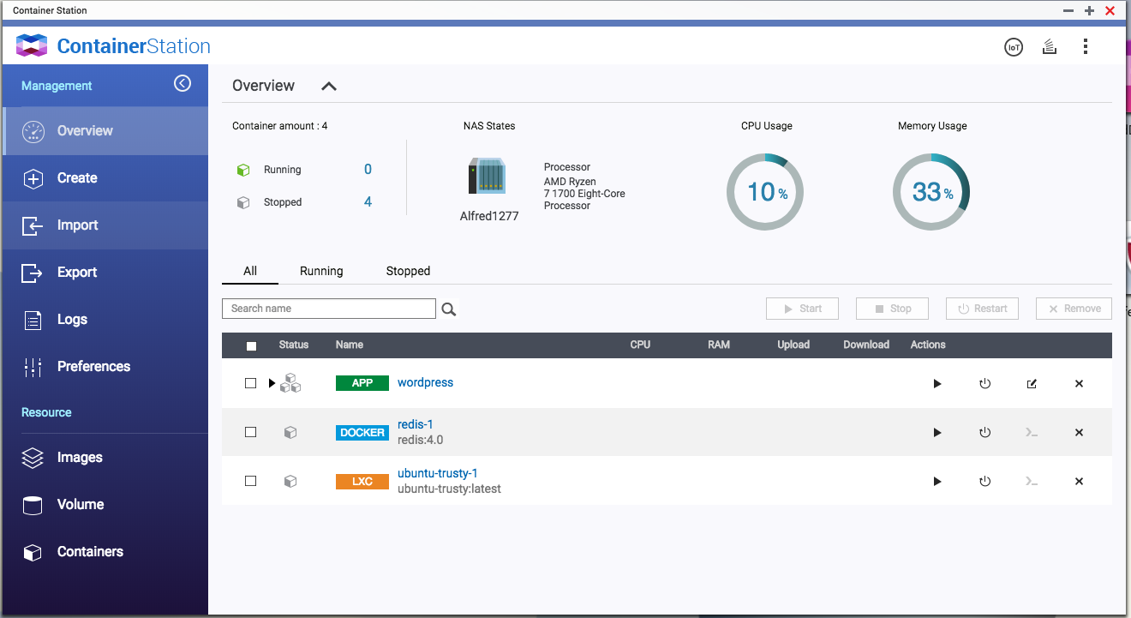
Experience Container Station Right Away!

Slide 11
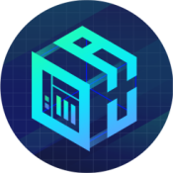
Container Station
Intuitive Visualized Management
Overview of all software container
Built-in Docker Hub Marketplace
Easily downloadable tools
AI, IoT, Commonly-used Container Recommendation
One-click installation wizard helps you quickly setup
Supports Docker Compose YAML format to create applications
Easily import/export containers
Imports images or containers from PC or NAS
Exports images or containers to NAS as backup

Slide 12
Intuitive Visualized Management

Slide 13
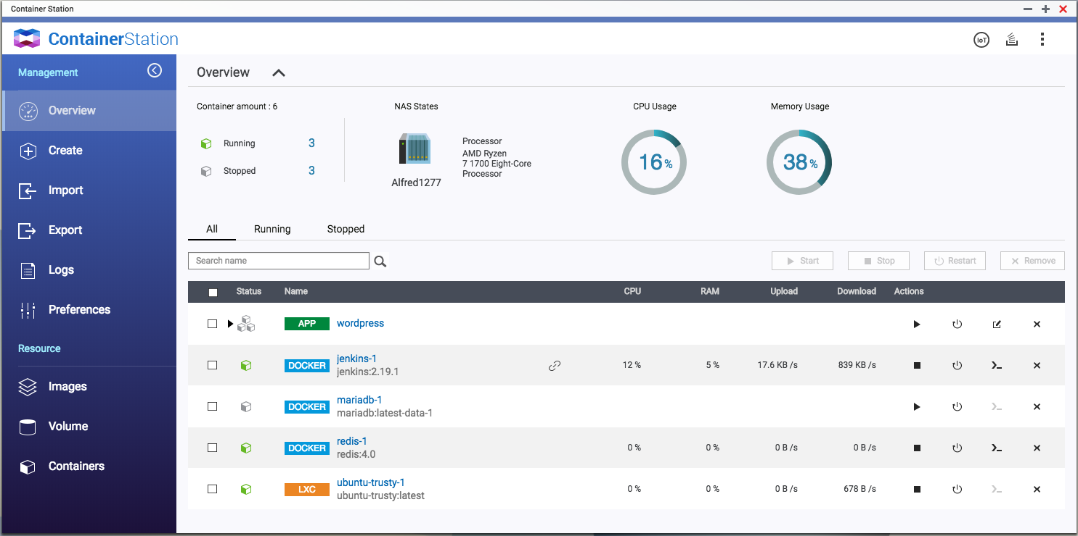
Overview of All containers and Management Tools
Total amount of container including running/ stopped
CPU model
CPU & RAM usage
Start/stop, restart, edit and remove containers
Web service of containers
Network usage

Slide 14
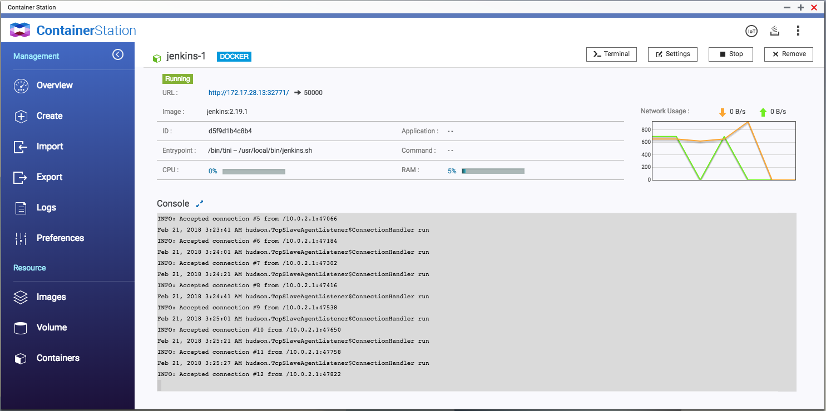
Easily Checks Detailed Information
Web service of container
Container name, ID, Entry point, command and CPU/RAM usage
Terminal and Settings of Containers
Network Traffic
Console

Slide 15
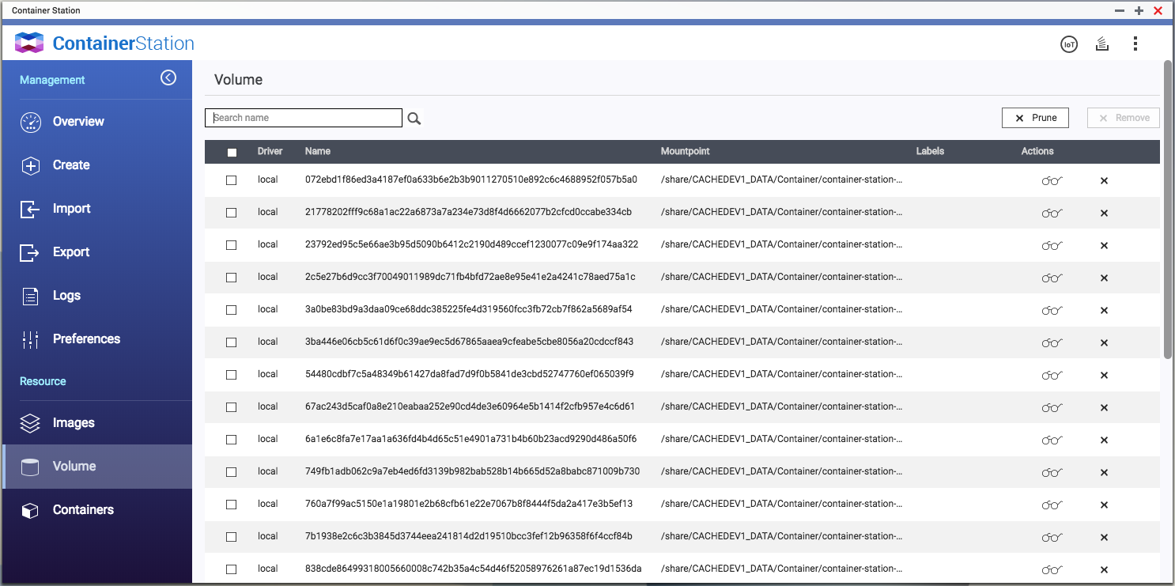
Container Volumes at a Glance
Volume name
Mountpoint
Labels
Container in Use

Slide 16
Built-in Docker® Hub MarketPlace

Slide 17
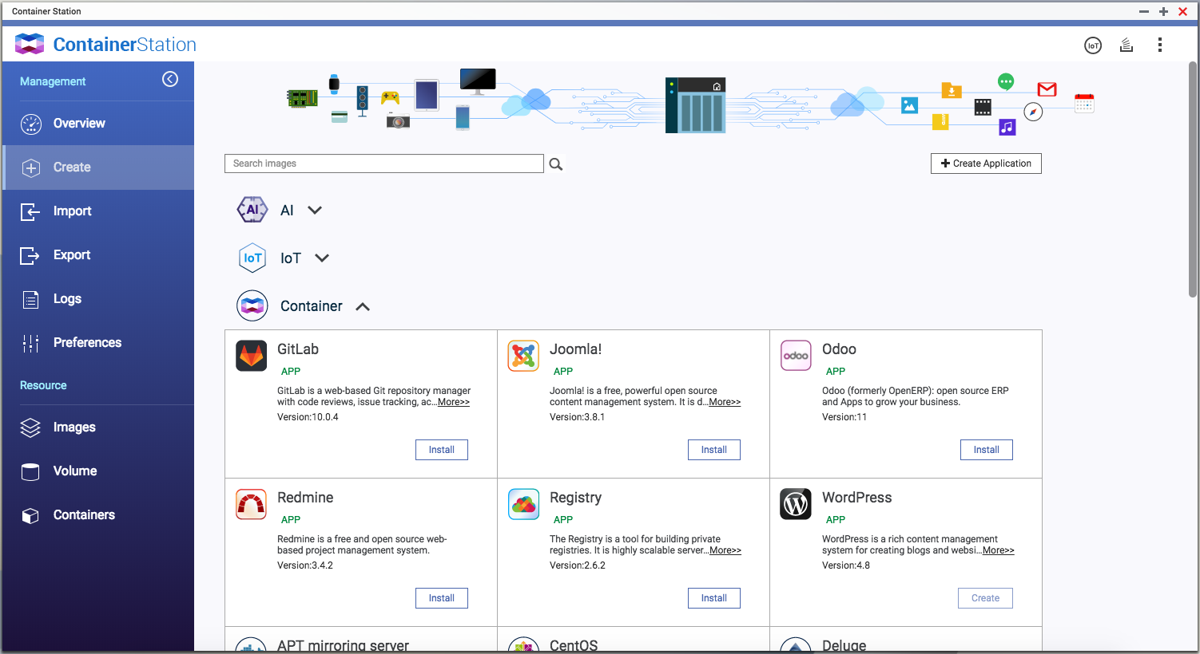
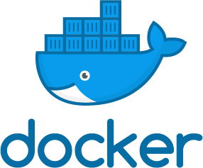
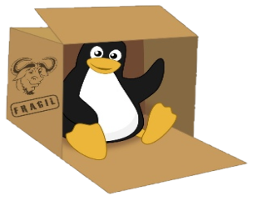
Easily Downloadable Tools
AI, IoT and commonly-used LXC/Docker containers.

Slide 18
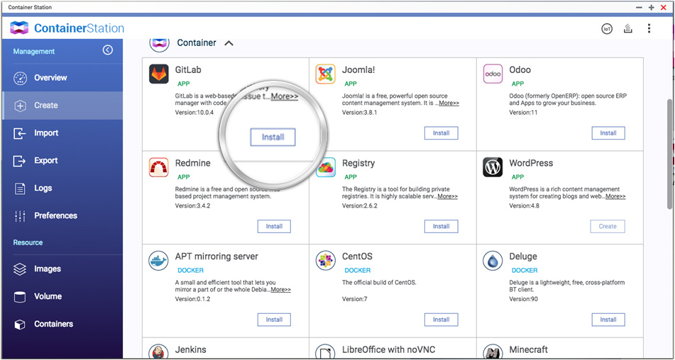
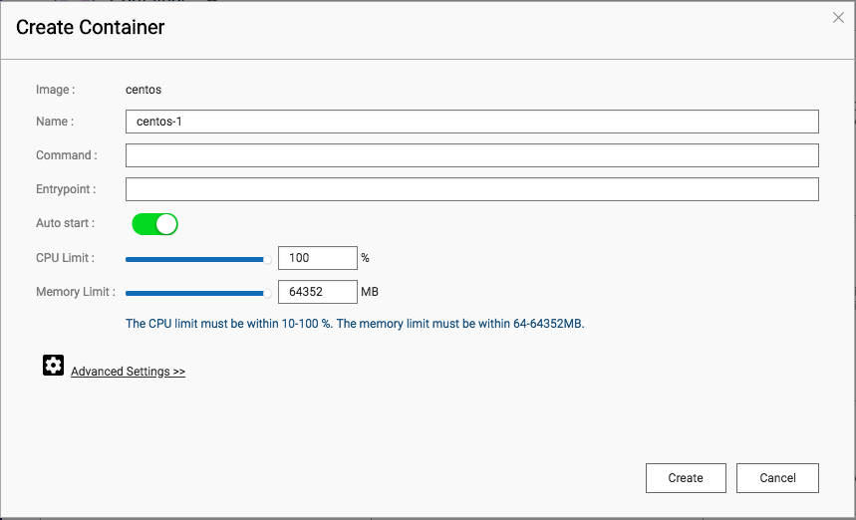
One-click Installation

Slide 19
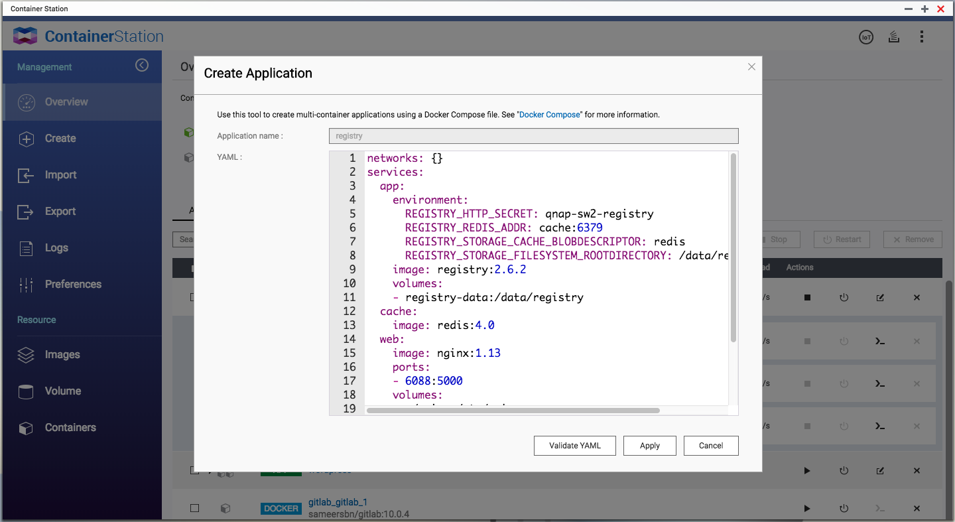
Docker Compose YAML config.
Quickly adjusts the containers of the specified application.

Slide 20
Easily import/export containers

Slide 21
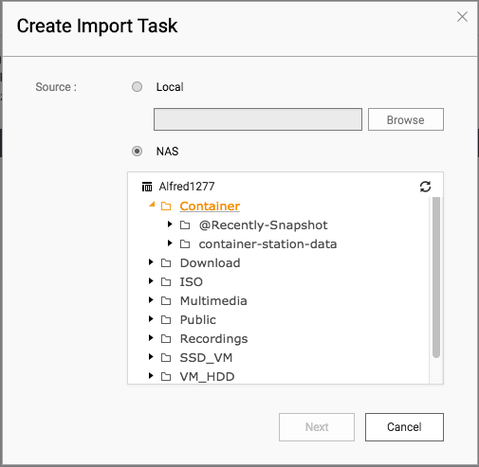
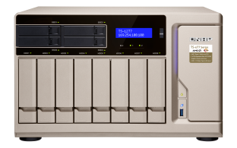
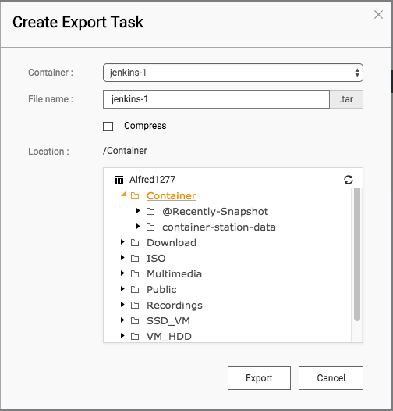
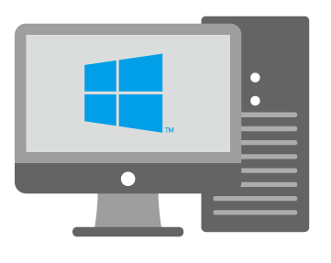
Imports from PC or NAS &
Exports to NAS as Backup
Import/ Export
Import

Slide 22
Live Demo
Notes:
總覽
建立容器 (安裝精靈、GPU 擴充)
匯入匯出
紀錄
屬性 (網段、倉庫伺服器、應用程式倉庫、憑證)
映像檔
儲存空間
虛擬交換器結合 VM 應用

Slide 23
FAQ (1/3)
Q1
What is the version of Docker® Engine? A: The version of Docker Engine used in Container Station 1.8 is v17.07.
Q2
How to modify a container's networking mode?
A: The networking mode of created containers can be modified by
[Containers] > [Settings] > [Advanced Settings] > [Network] >
[Network Mode]. (Docker: Host, NAT and Bridged; LXC: NAT
and Bridged)

Slide 24
FAQ (2/3)
Q3
How to use expansion graphics cards to run QuAI containers?
A: Go to QTS desktop > [Control Panel] > [System] > [Hardware] > [Graphics Card], assign resources to "HD Station/Linux Station/Transcoding." QuAI containers can thus directly use GPU resources.
Q4
How to calculate the allocated CPU usage?
A: Allocated percentage means the maximum capability of each CPU physical core which can be used for a container. For instance, assigning 50% for a NAS with 8 physical cores means the container can use up to 50% capability per physical core.

Slide 25
FAQ (3/3)
Q5
How to access containers via Internet?
A: Select "Bridged" or "Host" modes for containers and ensure the service ports of containers are forwarded in your network. Generally, you can setup port forwarding in the management interface of your router.
Q6
Is there Ubuntu V16.04 containers for ARM-based NAS models?
A: Available by the end of March.

Slide 26
Joining Development of QNAP's Applications

Slide 27
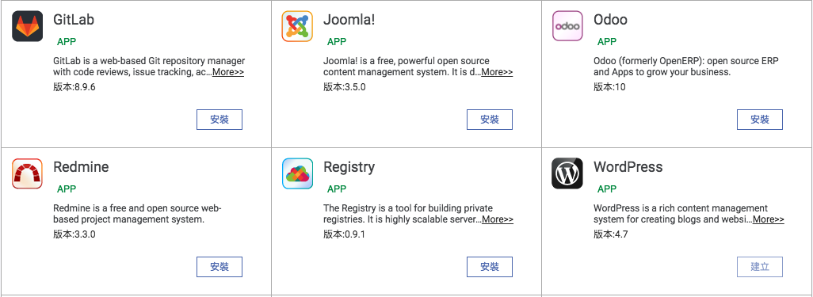
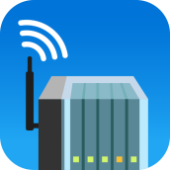
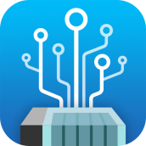
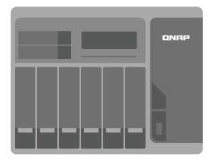
Joining Development
Welcome to build your own self-developed QNAP applications.

Slide 28
Comprehensive Development Support
QTS QDK：
File Management
Account and User Rights Management
Storage Management
System setup
Doc/Support resources:
SDK/ API
Guidelines
Toolchains for X86/ARM
FAQ
Support

Slide 29
Ready-to-use docs

Slide 30
Supported Model list
Container Station 1.8
Available for QTS 4.3.0~4.3.4
At least 1 GB RAM or more:
- X86-based :
TS-x51, TS-x51+, TS-x51A, TS-x53, TS-x53A, TS-x53B, TBS-453A, TS-x55, TS/TVS-x63, TVS-x70, TVS-x71, TS-x73, TS/SS-x79, TS/TVS-x80, TVS-x82, TVS-x77, TS-1685 and TDS-16489U
- ARM-based :
TS-x28, TS-x31P, TS-x31X, TS-1635 and TS-x31+

Slide 31
Your Best Choice
Container Station

