Slide 1
QTS System
A sneak peek into the high performance NAS operating system

Slide 2
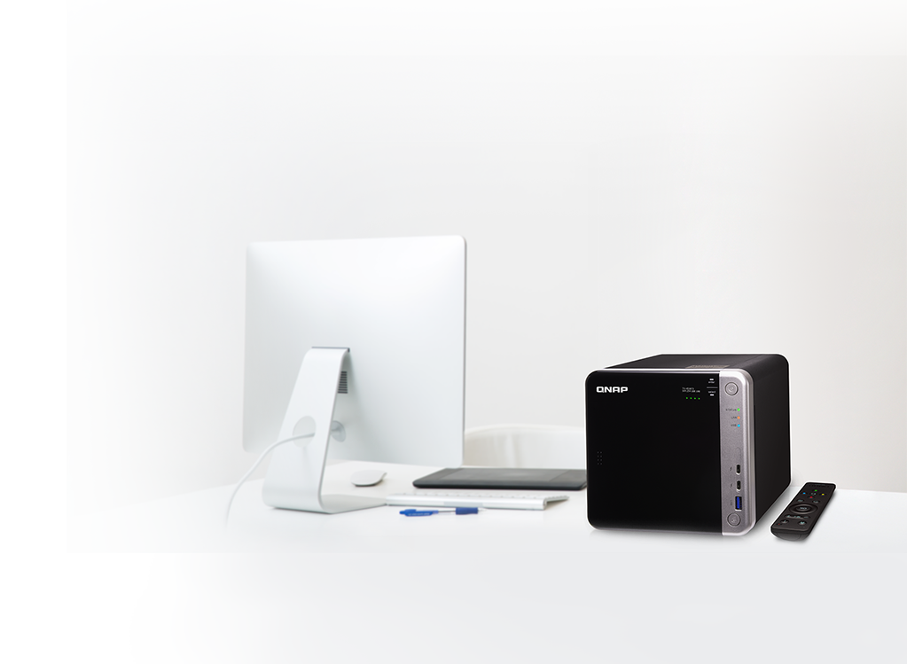
QTS Kernel Introduction
The QTS
Linux Kernel
Kernel History of QTS
Major Features of Kernel

Slide 3
What you need to know when selecting NAS?
Performance
Functionality
& Applications
Kernel version & Update
Cost
Support

Slide 4
What’s the value of system upgrades?
For consumer
For system
For manufacturer
Assurance
Peace of mind
Reduces difficulties on software development
Enhance performance
Enhance security
Bug fixing
New hardware support
Enhance stability
Positive brand image

Slide 5
Why should you update the system kernel?
New kernel functionality
Stability improvements of hardware
Increased performance
Updated drivers
Stability improvements of system
Security fixes

Slide 6
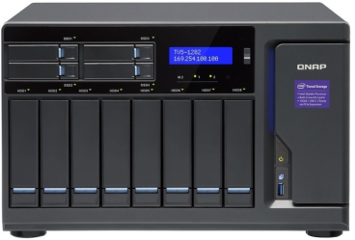
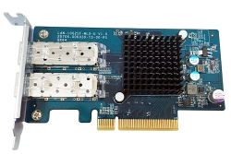
QNAP NAS Basic Components
Hardware
QTS
Application
Accessories
Mobile Apps & Utilities
Cloud Service

Slide 7
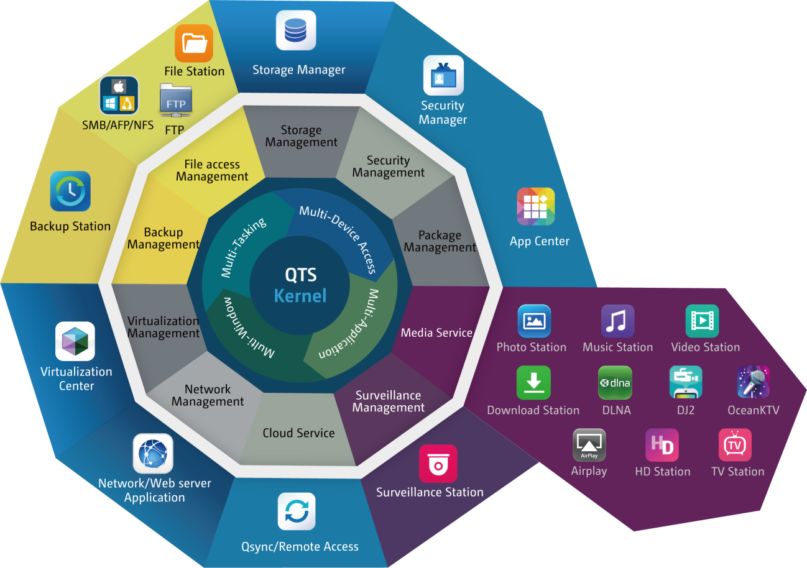
The QTS Core
QTS core:
Linux Kernel

Slide 8
What is a kernel?
Application, Tools
System Kernel
QTS
Linux Kernel
CPU
Memory
DISK
Network
Devices
Hardware
Notes:
核心是作業系統中最早被載入到記憶體的咚咚， 他包含了所有可以讓硬體與軟體工作的資訊，所以，如果沒有搞定核心的話， 那麼你的系統肯定會有點小問題
Linux 核心是一個檔案(/boot/vmlinuz for most case)
核心支援各項電腦硬體配備，讓所有程式可以透過核心與電腦硬體溝通。
有效率的核心必須與電腦狀況(硬體周邊)配合
核心提供周邊硬體驅動程式：網路卡、音效卡、SCSI卡等
通訊協定：TCP/IP、PPP、Router等
核心提供檔案系統支援：ext2、umsdos、iso9660...
核心提供記憶體管理、多CPU平行處理....

Slide 9
Kernel structure overview
User-space program
System Call Interface
Kernel
VFS
Process Scheduler
IPC
Memory Manager
Network
Device
Manager
Hardware
CPU
Memory
DISK
Other Devices
Network Interface

Slide 10
Sub-systems
Process Scheduler
Memory Manager
Network
Responsible for controlling process access to the CPU
Permits multiple process to securely share the machine's main memory system
Provides access to several networking standards and a variety of network hardware
VFS
Virtual File System
IPC
Inter-Process Communication
Abstracts the details of the variety of hardware devices by presenting a common file interface to all devices
Supports several mechanisms for process-to-process communication on a single Linux system

Slide 11
Process Scheduler
O/S Services
Programmatic Scheduler Interface
Kernel
Process Scheduler
Memory Manager
System Call Interface
IPC
Architecture Independent scheduler
File System
Network
Architecture Specific Schedules
Scheduling Policy
Hardware
CPU
Notes:
1. Scheduling Policy，实现进程调度的策略，它决定哪个（或哪几个）进程将拥有CPU。
2. Architecture-specific Schedulers，体系结构相关的部分，用于将对不同CPU的控制，抽象为统一的接口。这些控制主要在suspend和resume进程时使用，牵涉到CPU的寄存器访问、汇编指令操作等。
3. Architecture-independent Scheduler，体系结构无关的部分。它会和“Scheduling Policy模块”沟通，决定接下来要执行哪个进程，然后通过“Architecture-specific Schedulers模块”resume指定的进程。
4. System Call Interface，系统调用接口。进程调度子系统通过系统调用接口，将需要提供给用户空间的接口开放出去，同时屏蔽掉不需要用户空间程序关心的细节。
http://www.wowotech.net/linux_kenrel/11.html

Slide 12
VFS - Virtual File System
O/S Service
Programmatic File System Interface
Kernel
VFS
Memory Manager
System Call Interface
Process Scheduler
System Independent Interface
Network Interface
Logical Systems
Device Independent Interface
Device Drivers
Hardware
Device Hardware
Notes:
在傳統的UNIX系統中，檔案系統是固定的實體檔案系統。但在Linux當中，為了統合各個檔案系統，因而加上了一層虛擬檔案系統 (Virtual File System: VFS) ，VFS 是一組檔案操作的抽象介面，我們可以將任何的真實檔案系統，透過 VFS 掛載到 Linux 中。
由於 VFS只是個虛擬的檔案系統，並不負責組織磁碟結構，因此，所有的組織動作都交由真實的檔案系統處理。VFS 所負責的操作都是在記憶體當中的部分，包含目錄結構的快取等功能，這樣就能增快存取的速度。
VFS 是一個軟體層的介面，負責處理檔案的處理請求，像是讀取、寫入、複製、刪除等。由於各種檔案系統的格式並不相同，所以 VFS 並不直接處理檔案格式，而是規定這些處理請求的介面及操作語意，然後交由真實的檔案系統 (像是 EXT2) 去處理。圖 5 顯示了 Linux 核心、VFS 與真實檔案系統之間的架構關係。
http://sp1.wikidot.com/linuxvfs
1. Device Drivers，设备驱动，用于控制所有的外部设备及控制器。由于存在大量不能相互兼容的硬件设备（特别是嵌入式产品），所以也有非常多的设备驱动。因此，Linux内核中将近一半的Source Code都是设备驱动，大多数的Linux底层工程师（特别是国内的企业）都是在编写或者维护设备驱动，而无暇估计其它内容（它们恰恰是Linux内核的精髓所在）。
2. Device Independent Interface， 该模块定义了描述硬件设备的统一方式（统一设备模型），所有的设备驱动都遵守这个定义，可以降低开发的难度。同时可以用一致的形势向上提供接口。
3. Logical Systems，每一种文件系统，都会对应一个Logical System（逻辑文件系统），它会实现具体的文件系统逻辑。
4. System Independent Interface，该模块负责以统一的接口（快设备和字符设备）表示硬件设备和逻辑文件系统，这样上层软件就不再关心具体的硬件形态了。
5. System Call Interface，系统调用接口，向用户空间提供访问文件系统和硬件设备的统一的接口。

Slide 13
How upgrade works
Full upgrade
Selective upgrade
Current version: 3.12.6
Patch
Current version: 3.12.6
Upgrade
Back porting
Choose the require function and back porting to current version
Upgrade to 4.2.8

Slide 14
Development processes of kernel upgrades
Develop
Select a Linux kernel version
Adjust
Test
Release

Slide 15
QTS Kernel Upgrade History
Model \ QTS version | QTS 4.0.x | QTS 4.1.x | QTS 4.2.x | QTS 4.3.x
x70/x79(2014) | 3.4.6 | 3.4.6 | 3.12.6 | 4.2.8
x51/53 (2015) | 3.4.6 | 3.12.6 | 3.12.6 | 4.2.8
x63/x73(2015/16) | -- | 3.12.6 | 3.12.6 | 4.2.8
x31P/x31+(2015/16) | -- | 3.10.20 | 3.10.20 | 4.2.8
x71(2016) | -- | 3.12.6 | 3.12.6 | 4.2.8
x28 (2016) | -- | -- | 3.10.20 | 3.10.20
Evaluate for next kernel
*The evaluation for new kernel will depend on hardware capability and functionality.

Slide 16
QTS Kernel Upgrade History
Model \ QTS version | QTS 4.0.x | QTS 4.1.x | QTS 4.2.x | QTS 4.3.x
x80(2016) | -- | 3.4.6 | 3.12.6 | 4.2.8
X82(2016) | -- | -- | 3.19.0 | 4.2.8
X31X/TS-1635(2017) | -- | -- | -- | 4.2.8
x85(2017) | -- | -- | -- | 4.2.8
x77(2017) | -- | -- | -- | 4.2.8
x28A(2018) | -- | -- | -- | 4.2.8
Evaluate for next kernel
*The evaluation for new kernel will depend on hardware capability and functionality.

Slide 17
Function highlights of QTS Kernel upgrade
Braswell
Skylake/ Apollo Lake
Nvidia
New hardware platform / Graphic driver
Managed by folder/LUN properties
Qtier
Cache / Pool architecture enhancement
Block device stability enhancement
Storage stack performance optimization
Storage Management
Notes:
https://www.kernel.org/pub/linux/kernel/v4.x/ChangeLog-4.2.8
ext4 crypto: fix memory leak in ext4_bio_write_page()

Slide 18
Function highlights of QTS Kernel upgrade
VFS
Major fix in Ext4
Wi-Fi drivers (Ath9K, Ath10K)
Enhanced the network transfer performance
Network
Virtualization Station
KVM Acceleration
GPU Pass-through
Notes:
https://www.kernel.org/pub/linux/kernel/v4.x/ChangeLog-4.2.8
ext4 crypto: fix memory leak in ext4_bio_write_page()

Slide 19
Kernel upgrade plans
Under
construction.
See you in 2018Q3!

Slide 20
QTS System Your best choice!

