Slide 1
Notes:
打破距離的藩籬

Slide 2
Have Trouble When Using QTS?

Slide 3
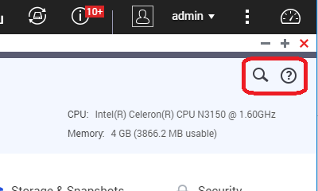
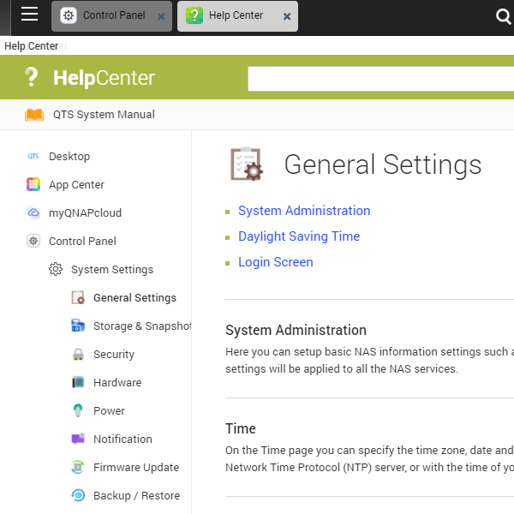
QTS Management Interface Support Online Help

Slide 4
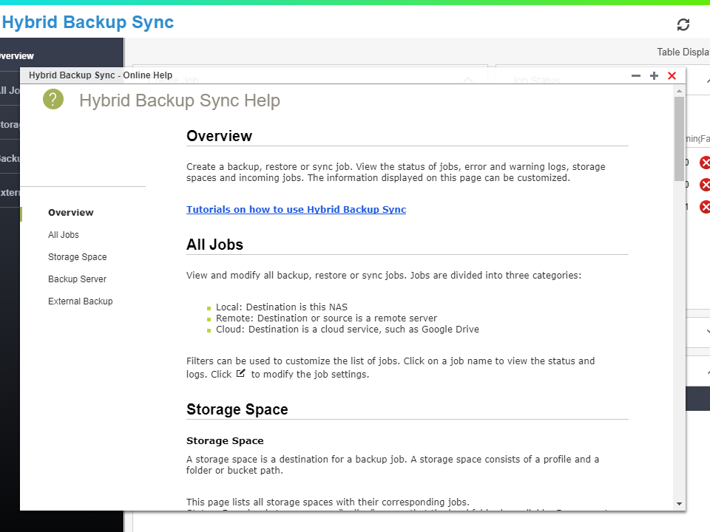
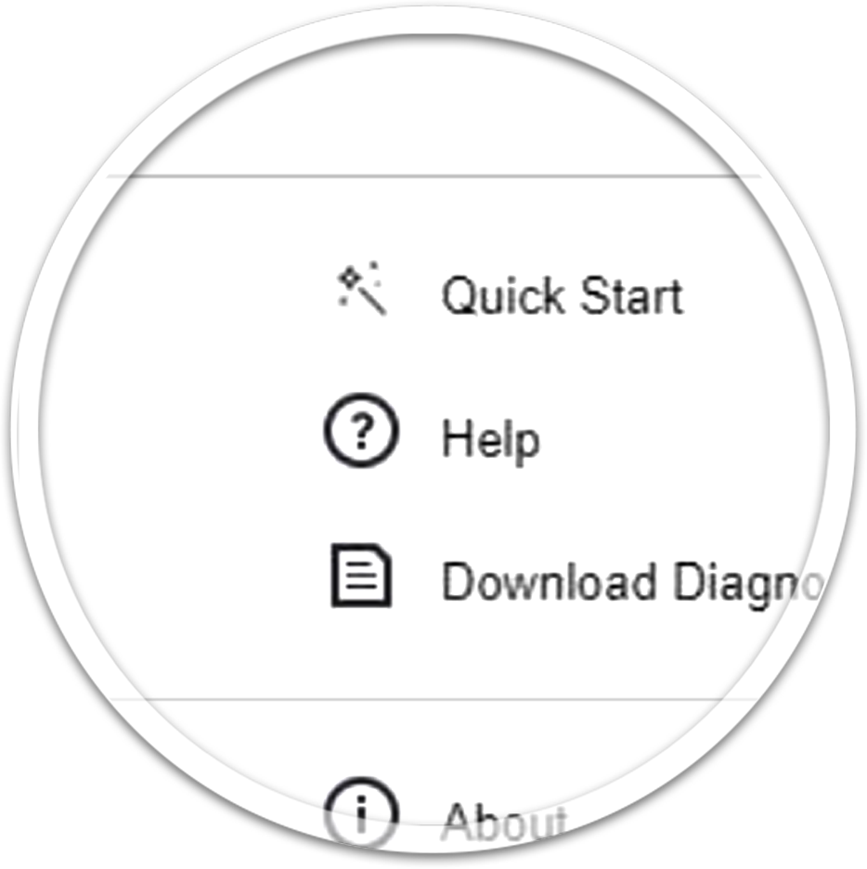
Specified App Online Help

Slide 5
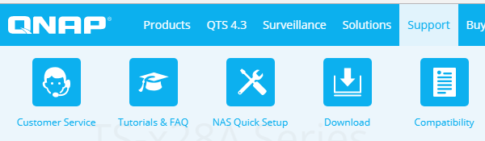
QNAP Website Support Information

Slide 6
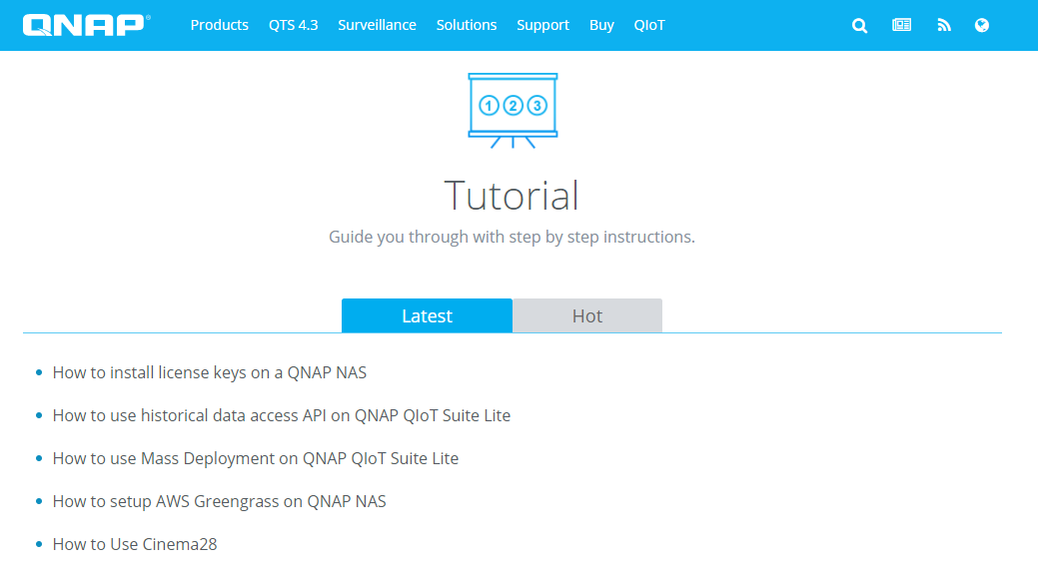
QNAP Website Tutorial & Frequently Asked Questions

Slide 7
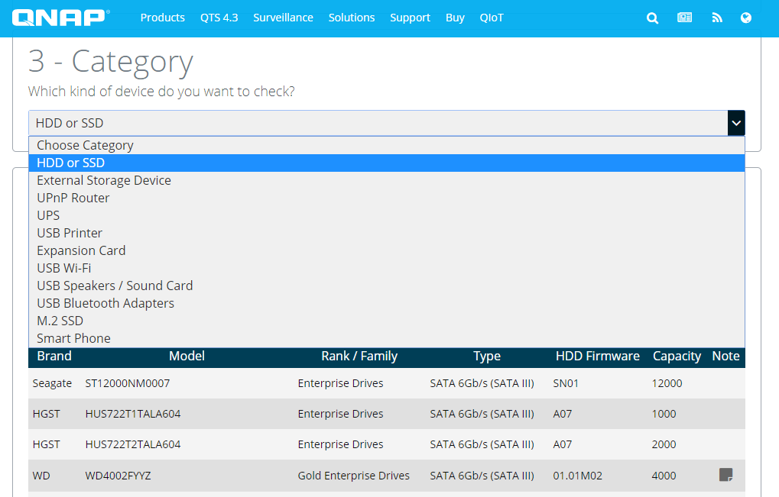
QNAP Website Compatibility List

Slide 8
QNAP Website Hand-On Live Streaming

Slide 9
Contact QNAP Technological Support Team

Slide 10
QNAP Technological Support
QTS Helpdesk App
helpdesk.qnap.com
eMail-based Conversion
Online Chat
Hotline
Taiwan, China, Hong Kong,
Germany, Netherlands, India
US, UK

Slide 11
QNAP Support Ticket Lifecycle
BUG
QC
Tech. Support
Quality Assurance
Development
User

Slide 12
QNAP Support Ticket Lifecycle
Issue Category
By NAS functions
Issue Investigation
Hand by hand
Function Abnormal
Remote Check
Reproduce
Report to PM
Confirm Issue Solved
Close Case
Survey
Issues Type
NAS Configurations
Function Abnormal
Features Request
Notes:
操作支援-熟悉產品 使用者希望完成某個需求，但不確定如何操作
功能異常-排除障礙 使用者依照說明操作，但得不到預想的結果
功能需求-更快更好 使用者找不到能滿足需求的功能，希望能夠加強
作helpdesk demo示範如何開案件

Slide 13
What is Helpdesk?

Slide 14
什麼是支援平台Helpdesk？
What is Helpdesk？
Helpdesk allows support engineer using remote session to help your issues.
My NAS
is abnormal.
I can help!
Helpdesk

Slide 15
How to Use Helpdesk? (1/2)
Using Helpdesk to submit your issue to the support team.
My NAS is abnormal
Input your question.
Submit your ticket.
Helpdesk
System will send Ticket ID through email to you.
Notes:
流程可以用動畫

Slide 16
How to use Helpdesk？(2/2)
Support team will answer within 24 hours for your question!
Input your ticket ID at Helpdesk to approve remote access.
If required, support team will request remote access permission.
Helpdesk
Unique encrypted
key with AES-256 bit
Helpdesk Server
After support session, support team will confirm the issue is solved and satisfaction survey email.
Support team connect to your NAS through Helpdesk.
Notes:
流程可以用動畫

Slide 17
What resource is available at Helpdesk ？
Every channel that can help you is prepared in Helpdesk.
Compatibility List
NAS User Manual
Help Center
Tutorial & FAQ
Knowledge Base
Help Request
Find the drive or other devices that are compatible with QNAP NAS.
All the basic knowledge relate to configure QNAP NAS.
The QTS build in online help document.
Online Application Note and Frequencies Asked Question.
Find the most popular questions and answers.
Submit your help request to QNAP support team.
General question
Specified question
From general to specified questions

Slide 18
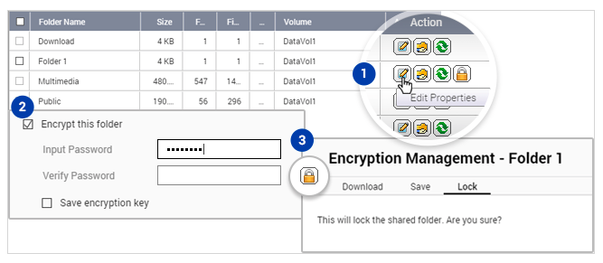
Helpdesk Kind Reminder
The system logs will never include your personal data such as stored files or passwords.
You can encrypt one or more shared folders before submitting the ticket.
You can turn off the remote support session at any time.
Every remote support session will have record for tracking.

Slide 19
Case Study
There are 8 folders in Media Folder but user only found 2 videos in Video Station. User submit a helpdesk ticket via helpdesk app ...

Slide 20
What is Diagnostic Tool?

Slide 21
QNAP Diagnostic Tool
An Official App for support team and power user to diagnostic NAS issue
Download system log same as Helpdesk does
Acquire Linux Kernel log and other information without the need of using SSH (Command Line)
Report abnormal NAS resets
Support team identify issue note related to QTS
Install Diagnostic Tool to retrieve Kernel Log
Improve diagnostic efficiency
Kernel Logs can identify errors including : UNC path error, abnormal hard reset, Segfault error…

Slide 22
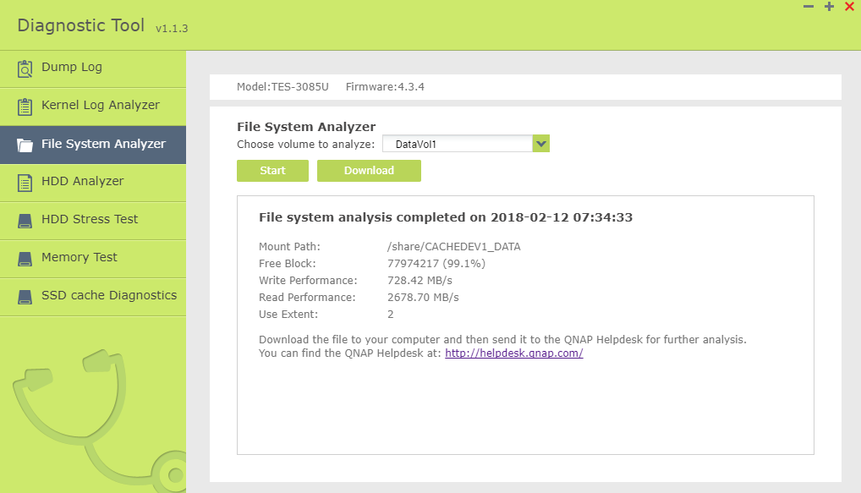
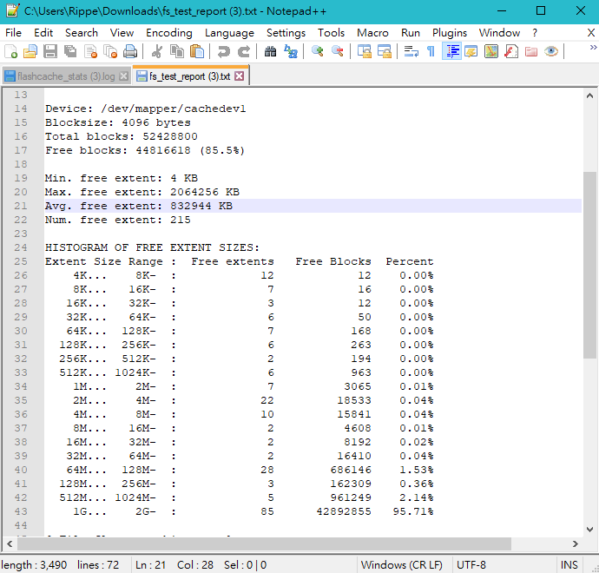
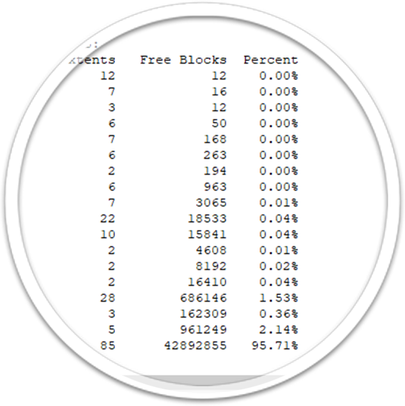
檔案系統分析器
File System Analyzer
Retrieve mount path, free block and performance records
Check Extent distribution percentage
QNAP already optimized this item for the user!

Slide 23
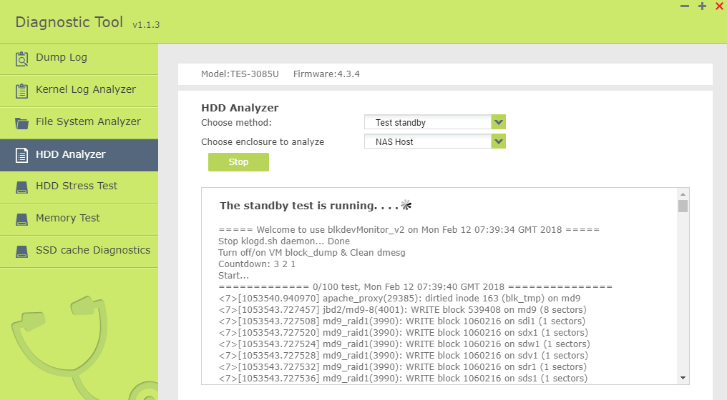
Disk Test
Disk S.M.A.R.T. Download
Disk Performance Test
RAID information
Disk Stand By Test (Identify process that wake disk up)
Allow support team to quickly grasp disk condition

Slide 24
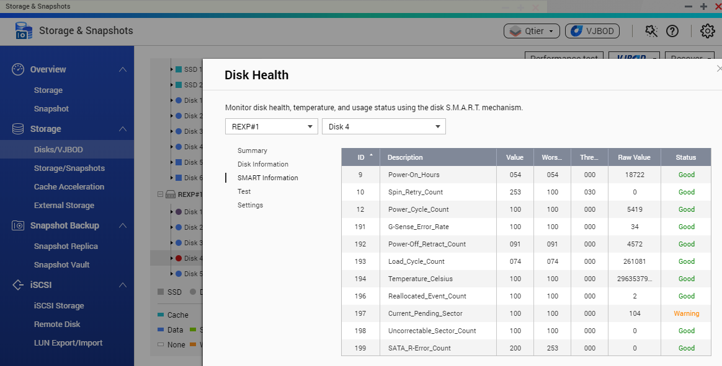
What is Disk S.M.A.R.T.
Disk Self-Monitoring Analysis and Reporting Technology
An industry standard defined by system and disk vendor
Record more than 50 disks operation attributes
EX: Power On Hours, Reset Count, Error Sectors Count.
When contact disk vendor, download SMART report to increase support efficiency.

Slide 25
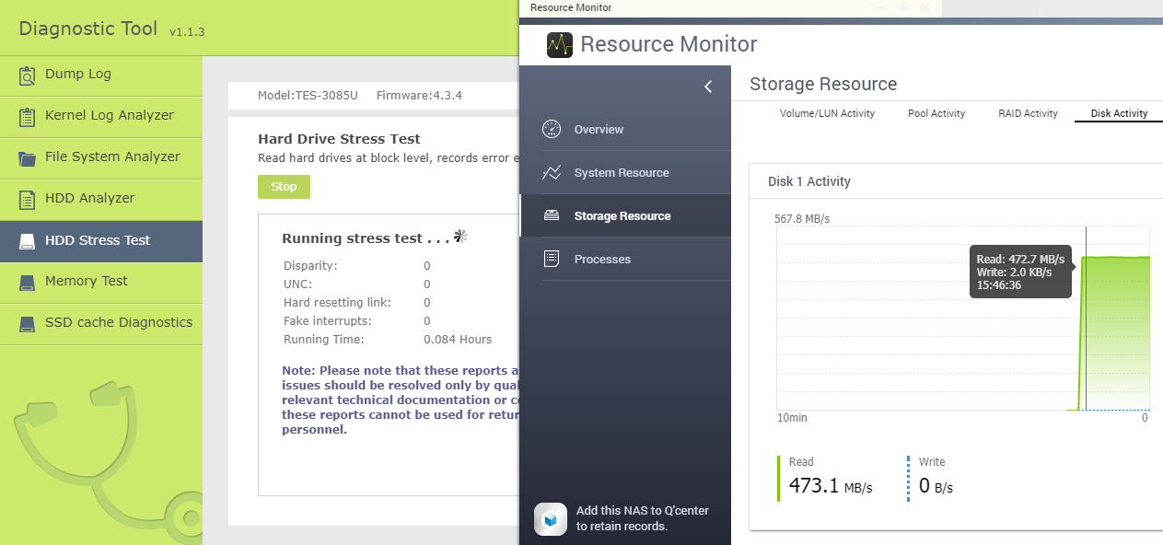
Disk Stress Test
Using maximum load to test disk performance in log time
Conduct performance stability test and record error event
This function is recommended only to be used by power user to avoid performance side effect!

Slide 26
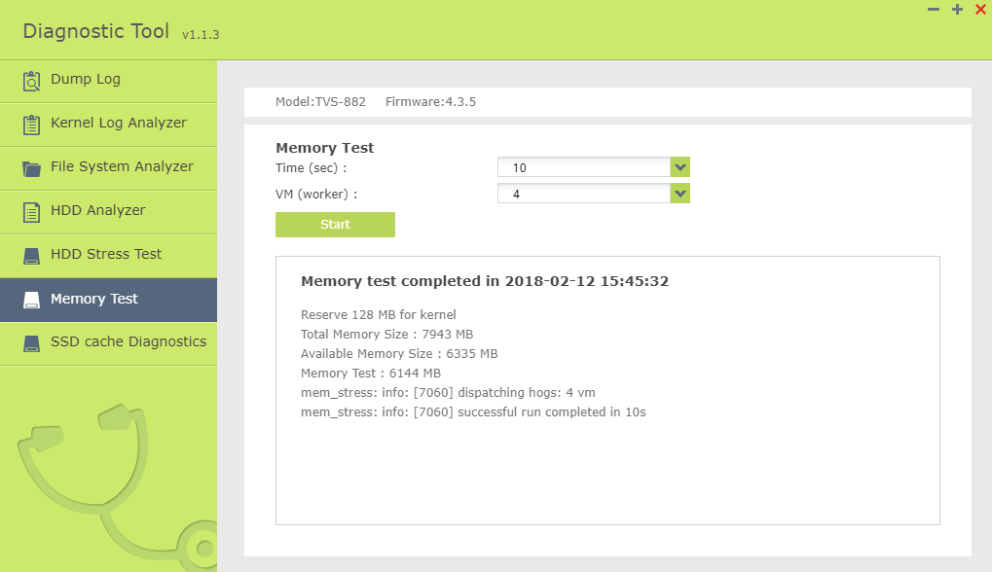
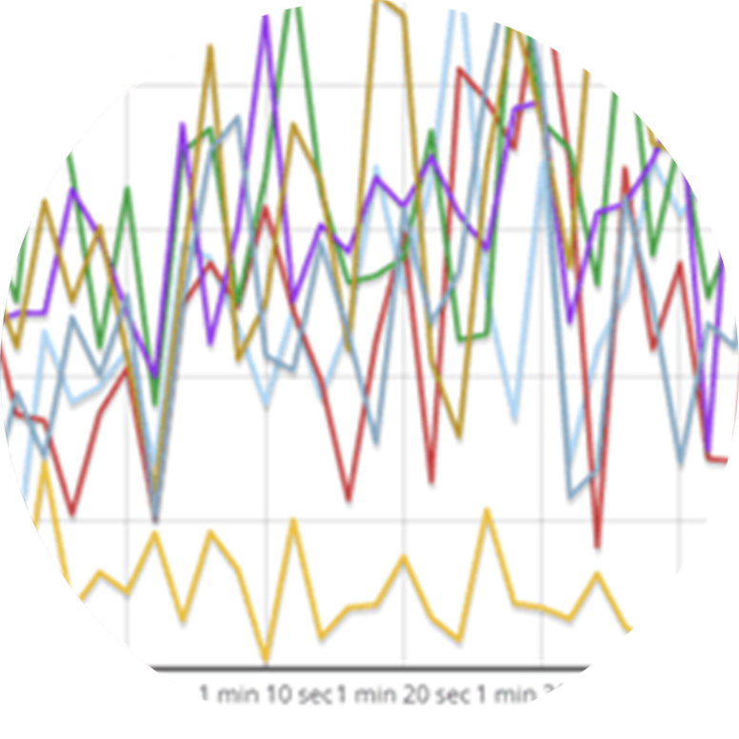
Memory Test
Create Virtual Worker inside the NAS
Continually write Memory Pages to identify actual RAM size
This function is recommended only to be used by power user to avoid performance side effect!

Slide 27
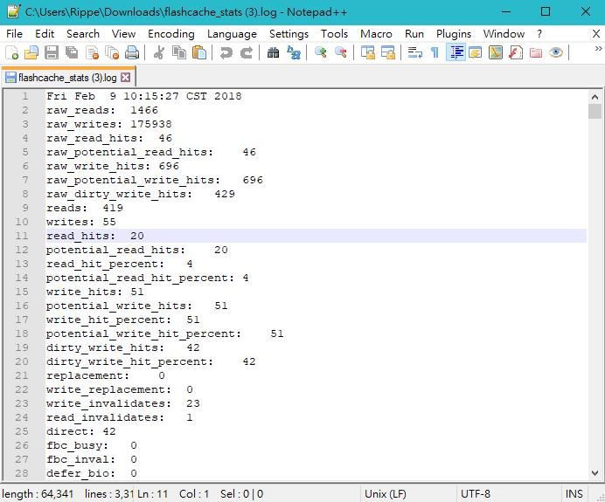
SSD Cache Test
When NAS has SSD cache and is writing data, conduct this test to record cache operations.
EX: Potential Read/Write Hits
When this value is larger than
Read/Write Hits, it may mean SSD
Cache need to be expended
Allow support team to understand if the SSD configuration suit specified scenario

Slide 28
Summary
Diagnostic Tool allows Support Team to quickly grasp NAS condition without the need of using command line.
Power User can also use this tool to identify interest fact on QNAP NAS.
For General User, it is recommended to run this tool only under support team’s instructure.

Slide 29
QNAP NAS,
Your best choice!

