Slide 1
QNAP VPN (Virtual Private Network)
Secure network experience

Slide 2
What is VPN (Virtual Private Network)

Slide 3
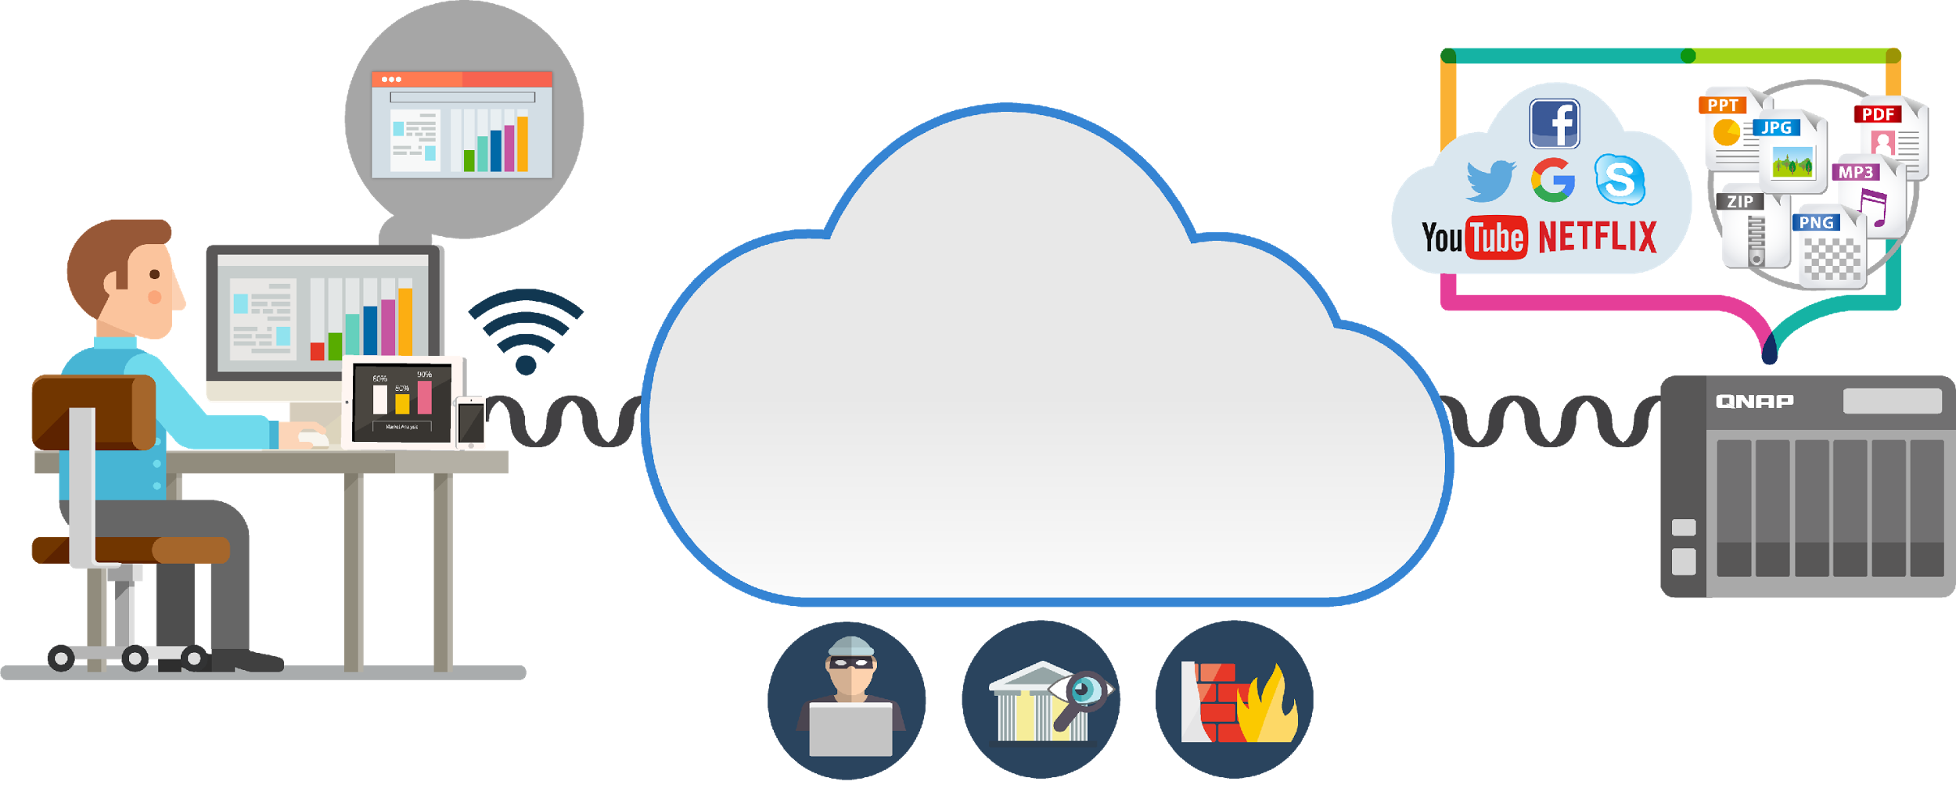
The general Internet style
Internet

Slide 4
What is VPN?
UNENCRYPTED
ENCRYPTED
ANONYMOUS

Slide 5
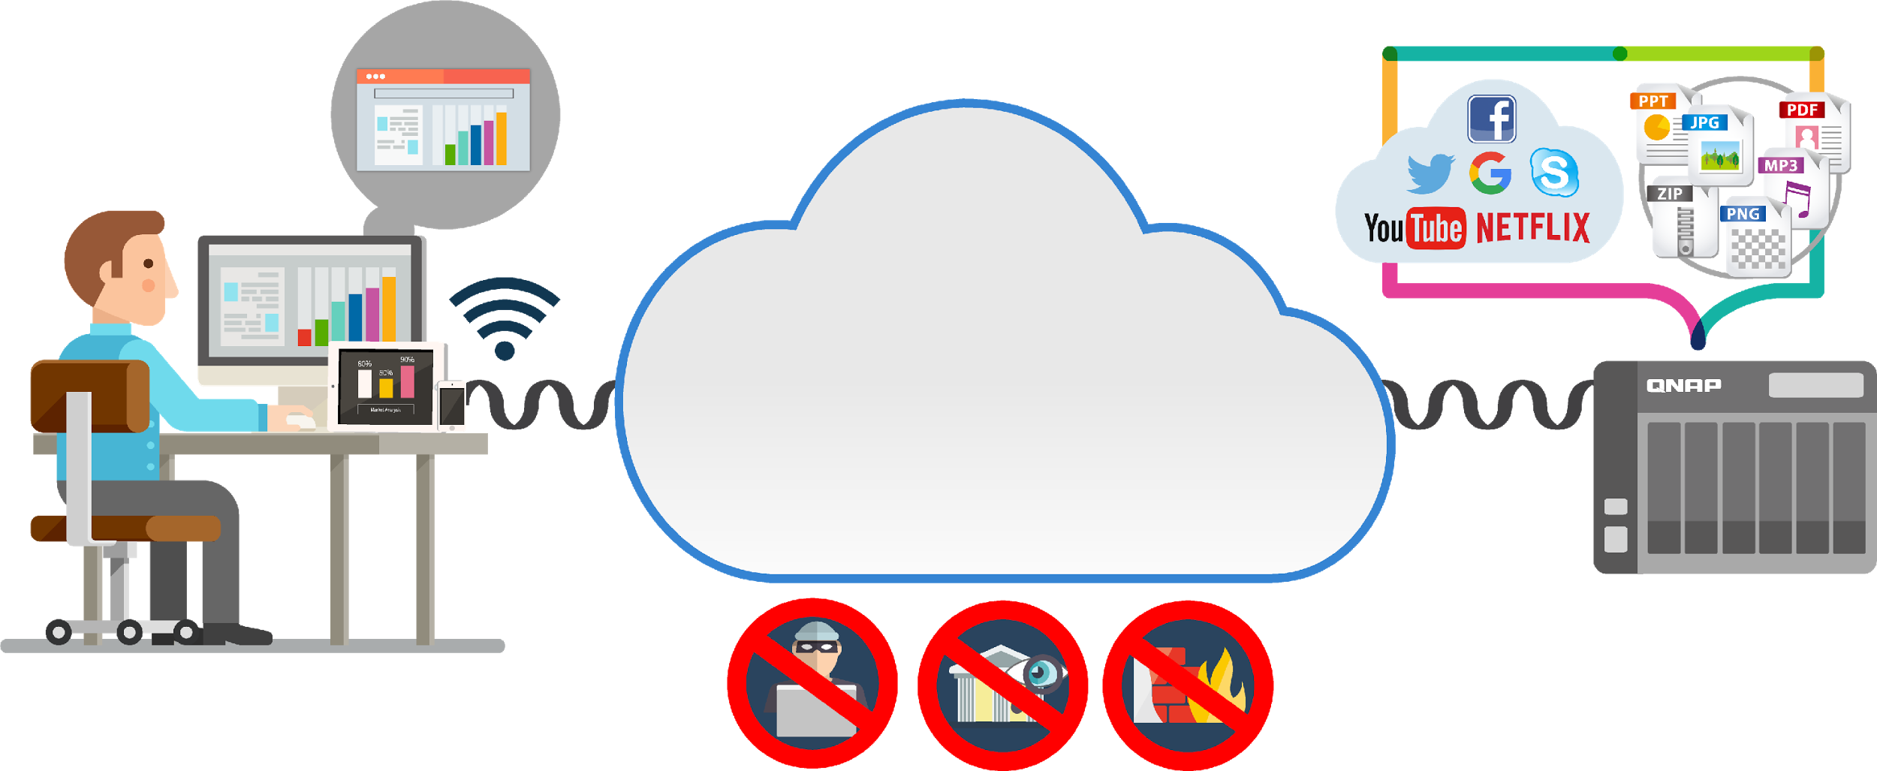
When you connect through the VPN
Internet in Tunnel

Slide 6
Who needs the VPN service
Multi-National corporations (File exchange, Backup)
Business-persons
Sensitive data
(Financial transaction)
Gamers
(Regional restrictions)

Slide 7
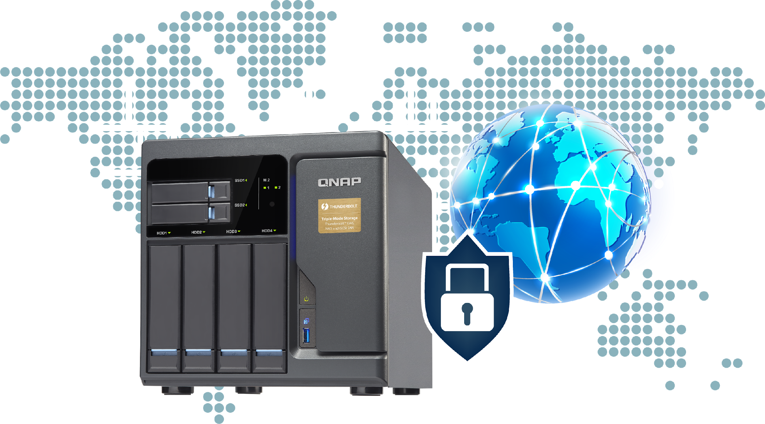
VPN does make you feel secure
Offers the flexibility to employees to take advantage of the company`s Intranet over an existing Internet connection. (also between student and school)
Secure communication is easier
Privacy protection
Reduces business travel costs
Access to regionally restricted contents

Slide 8
QVPN Service
Build your VPN server

Slide 9
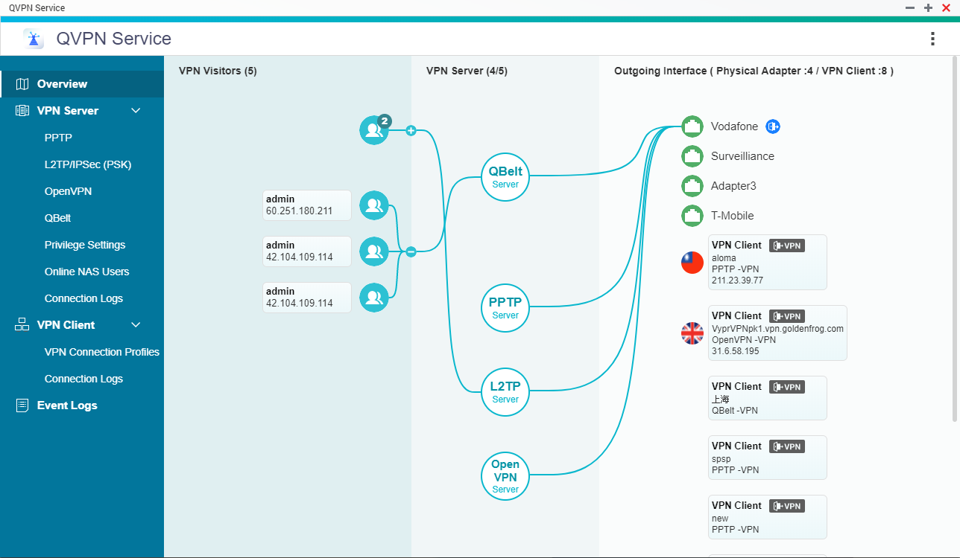
New topology of QVPN Overview

Slide 10
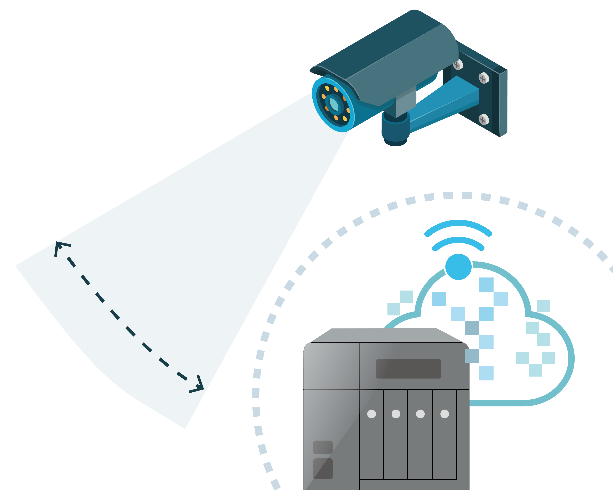
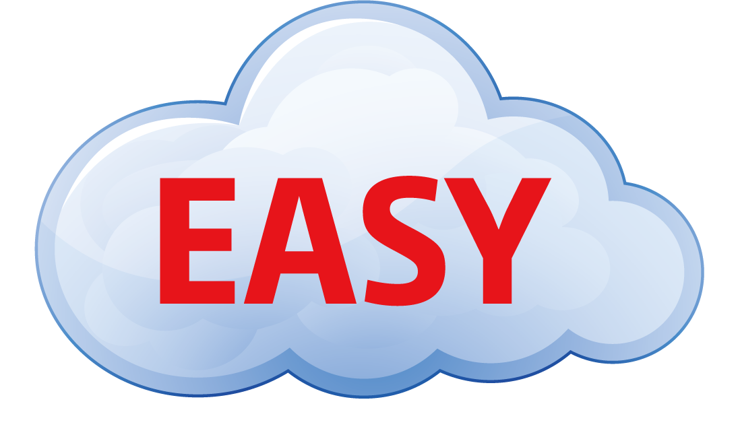
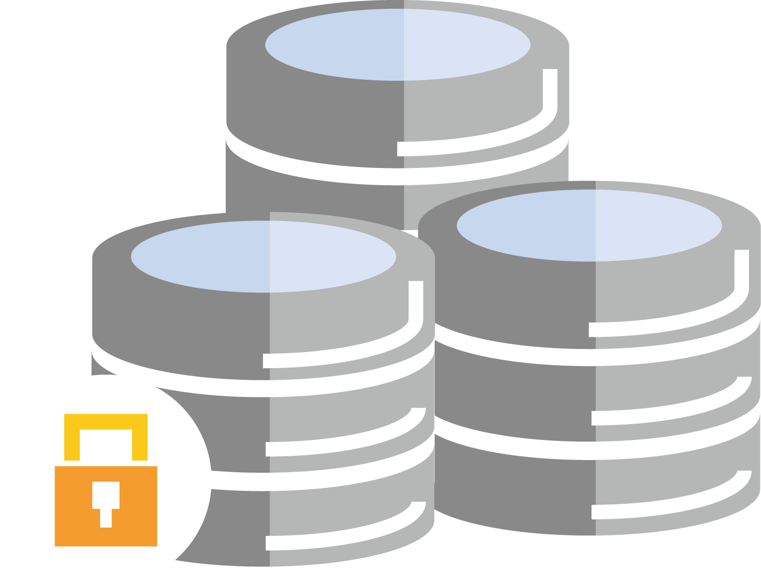
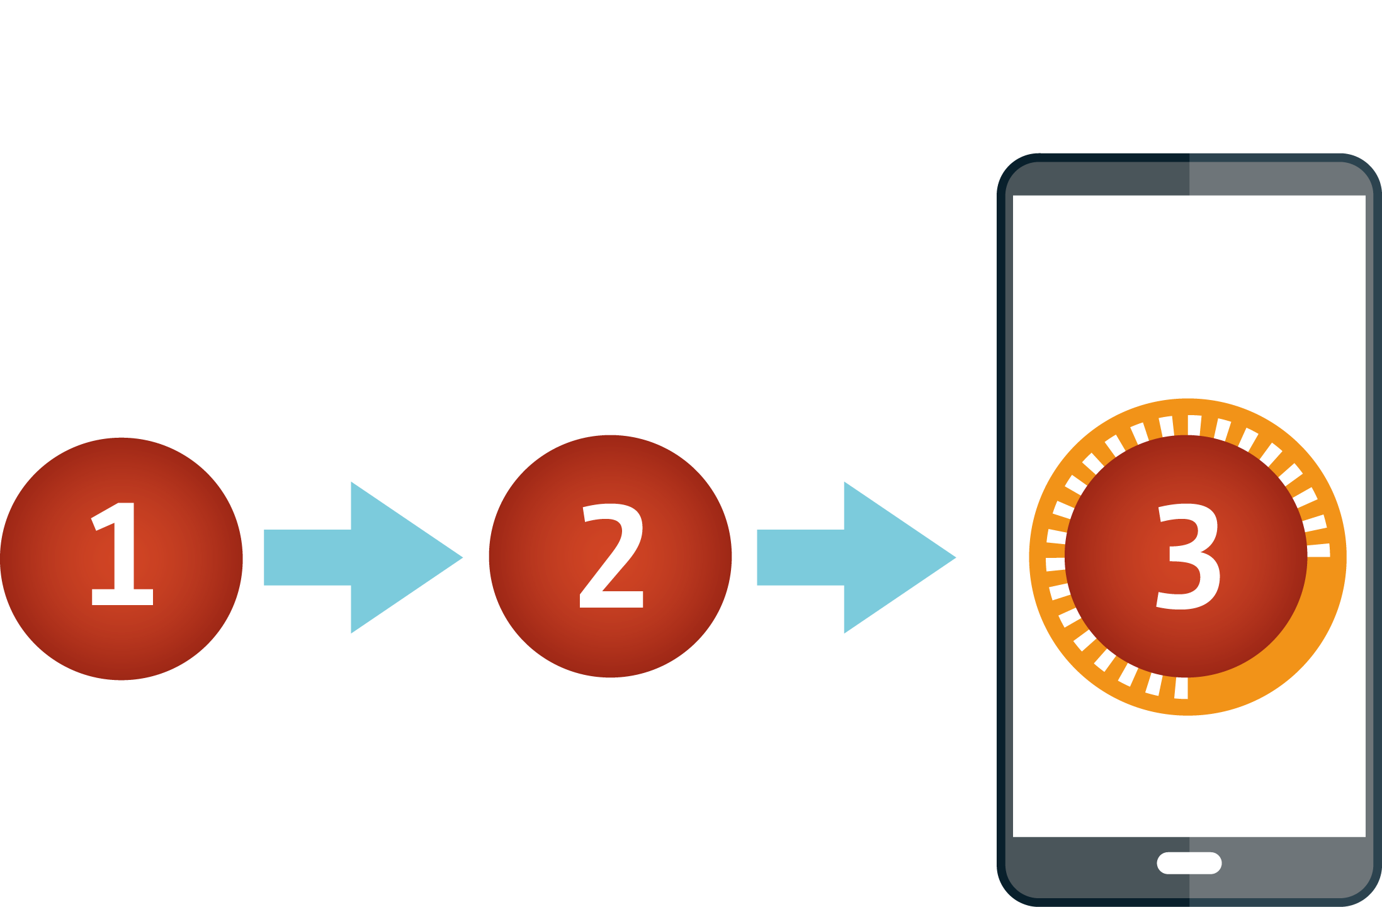
Q1, 2018 QNAP will release
proprietary VPN protocol - QBelt
Secure Encrypted Connection :
DTLS + SSL + AES-256 encryption
New protocol:
decrease the chance of being detected
Works on all your devices
Easy to Use
Notes:
It use the DTLS to establish the SSL connection, with AES-256 encryption.
Protect your Internet connection across mobile devices or desktop with QNAP apps. Our app & utility offer a variety of easy-to-configure, automatic features, ensuring your connection remains encrypted at all times.

Slide 11
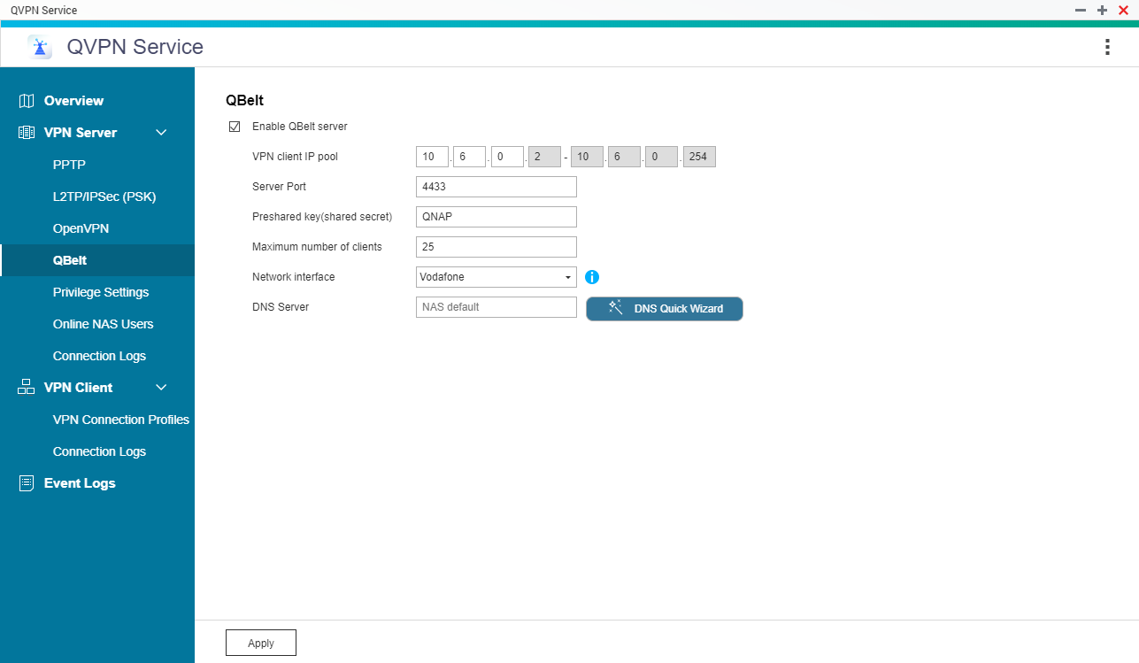
QBelt VPN Server

Slide 12
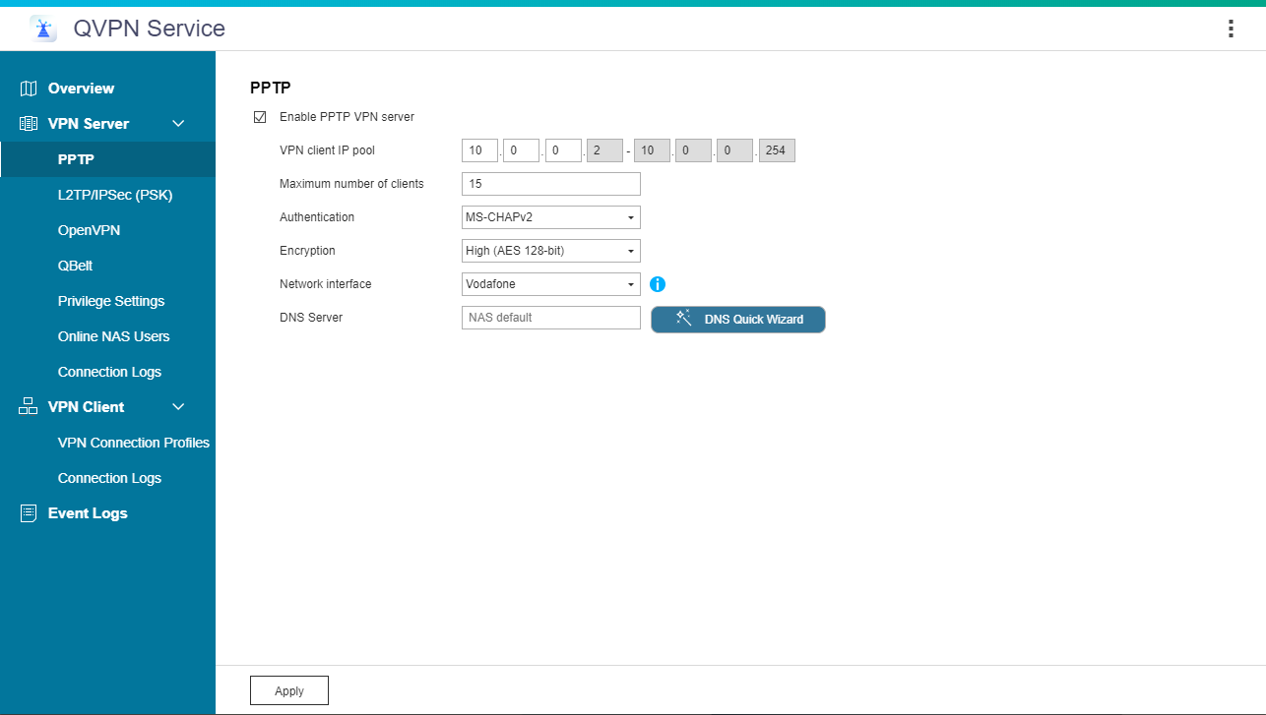
PPTP VPN Server

Slide 13
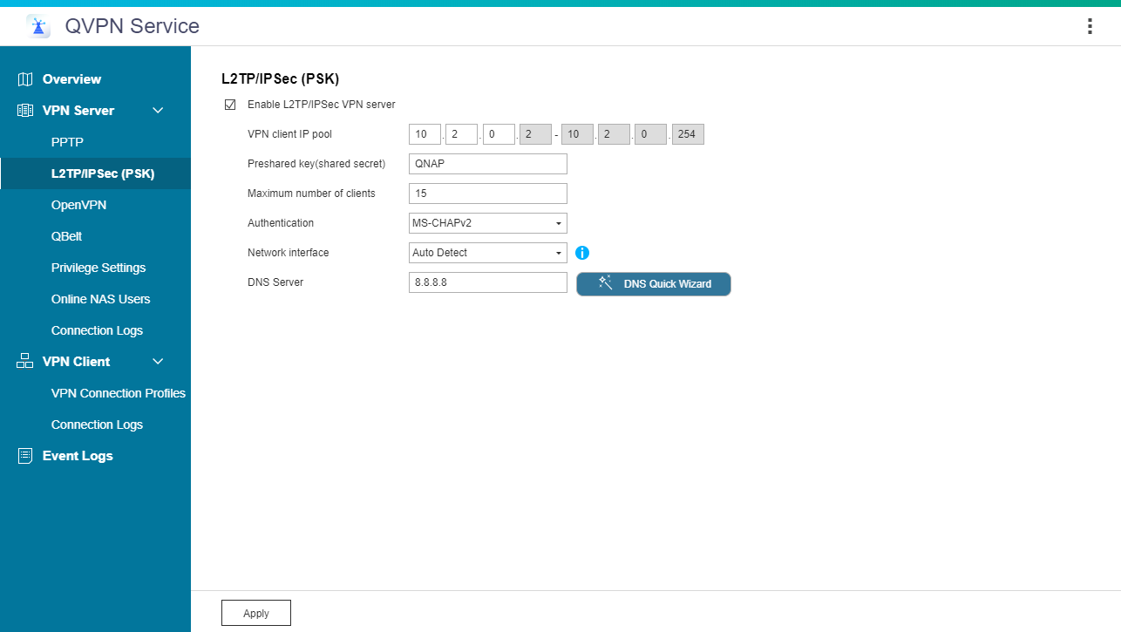
L2TP VPN Server

Slide 14
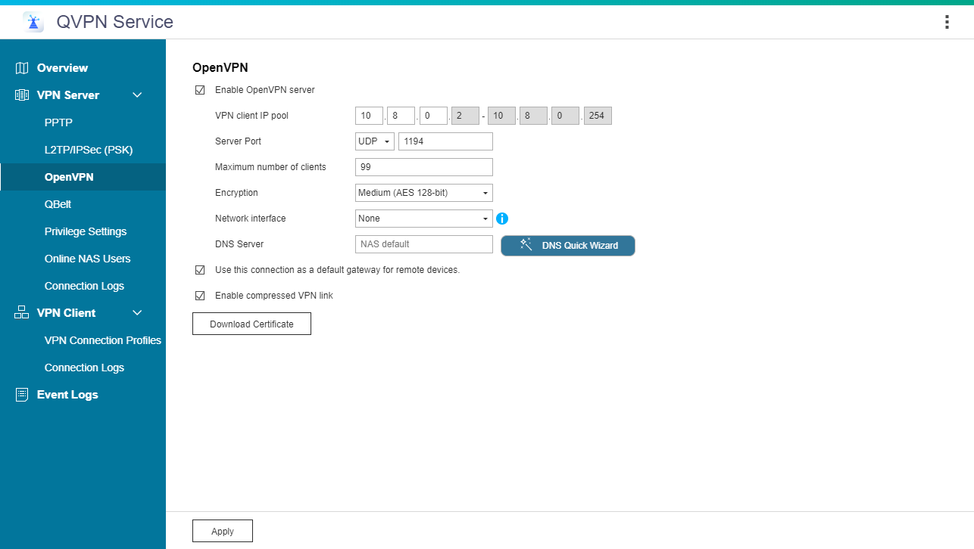
OpenVPN Server

Slide 15
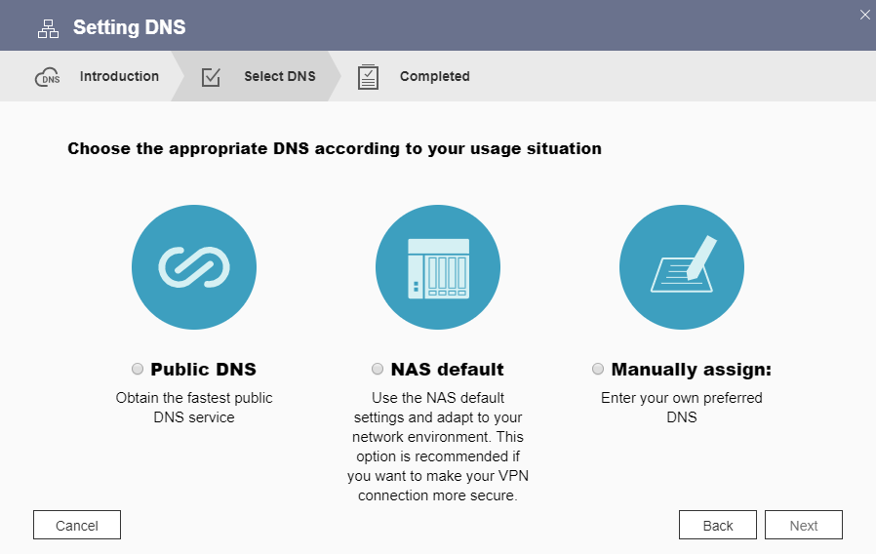
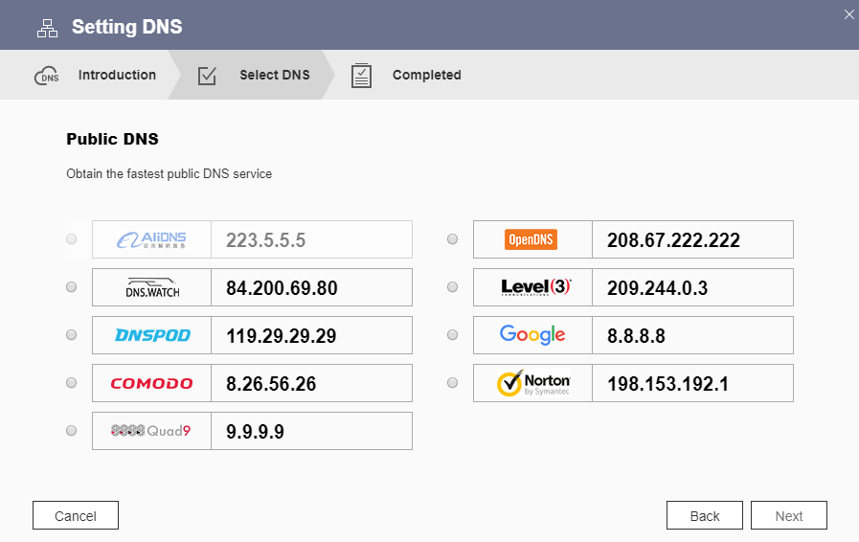
Select the suitable DNS service
Set manually or apply NAS default setting
Choose the fastest public DNS server

Slide 16
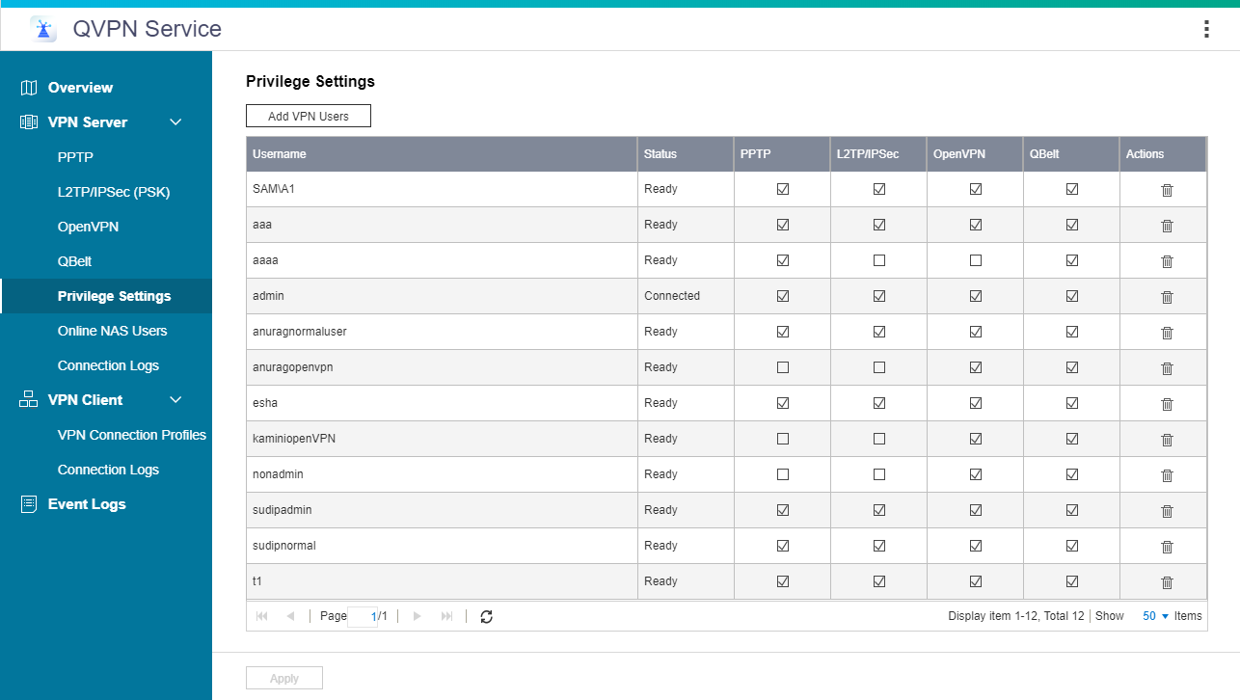
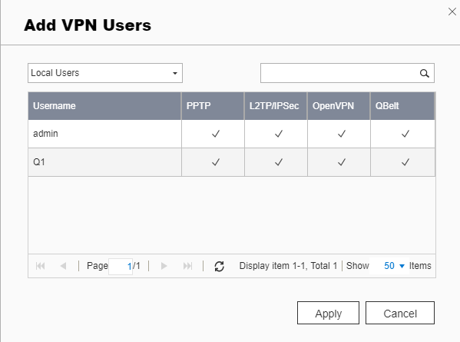
Specify the user’s login privileges
Use QTS accounts and privileges

Slide 17
QNAP supported protocol
 | PPTP | L2TP/IPsec | OpenVPN | QBelt
Encryption | 128-bit | 256-bit | 128-bit / 256-bit | 256-bit
Supported | Windows / Android | Windows / macOS iOS / Android | OpenVPN app/utility: Windows / macOS iOS / Android | QNAP app/utility: Windows / macOS iOS / Android
Security | Basic encryption | Highest encryption | Highest encryption | Highest encryption
Conclusion | simple and convenient, but low security and less supported platforms | simple, only one more setting needed. (PSK) | Most secure, However, the setting is complicated and difficult | Provide high security and highly intergrated tool for you. (including QNAP advanced function)

Slide 18
The most common problems when you build a VPN server.

Slide 19
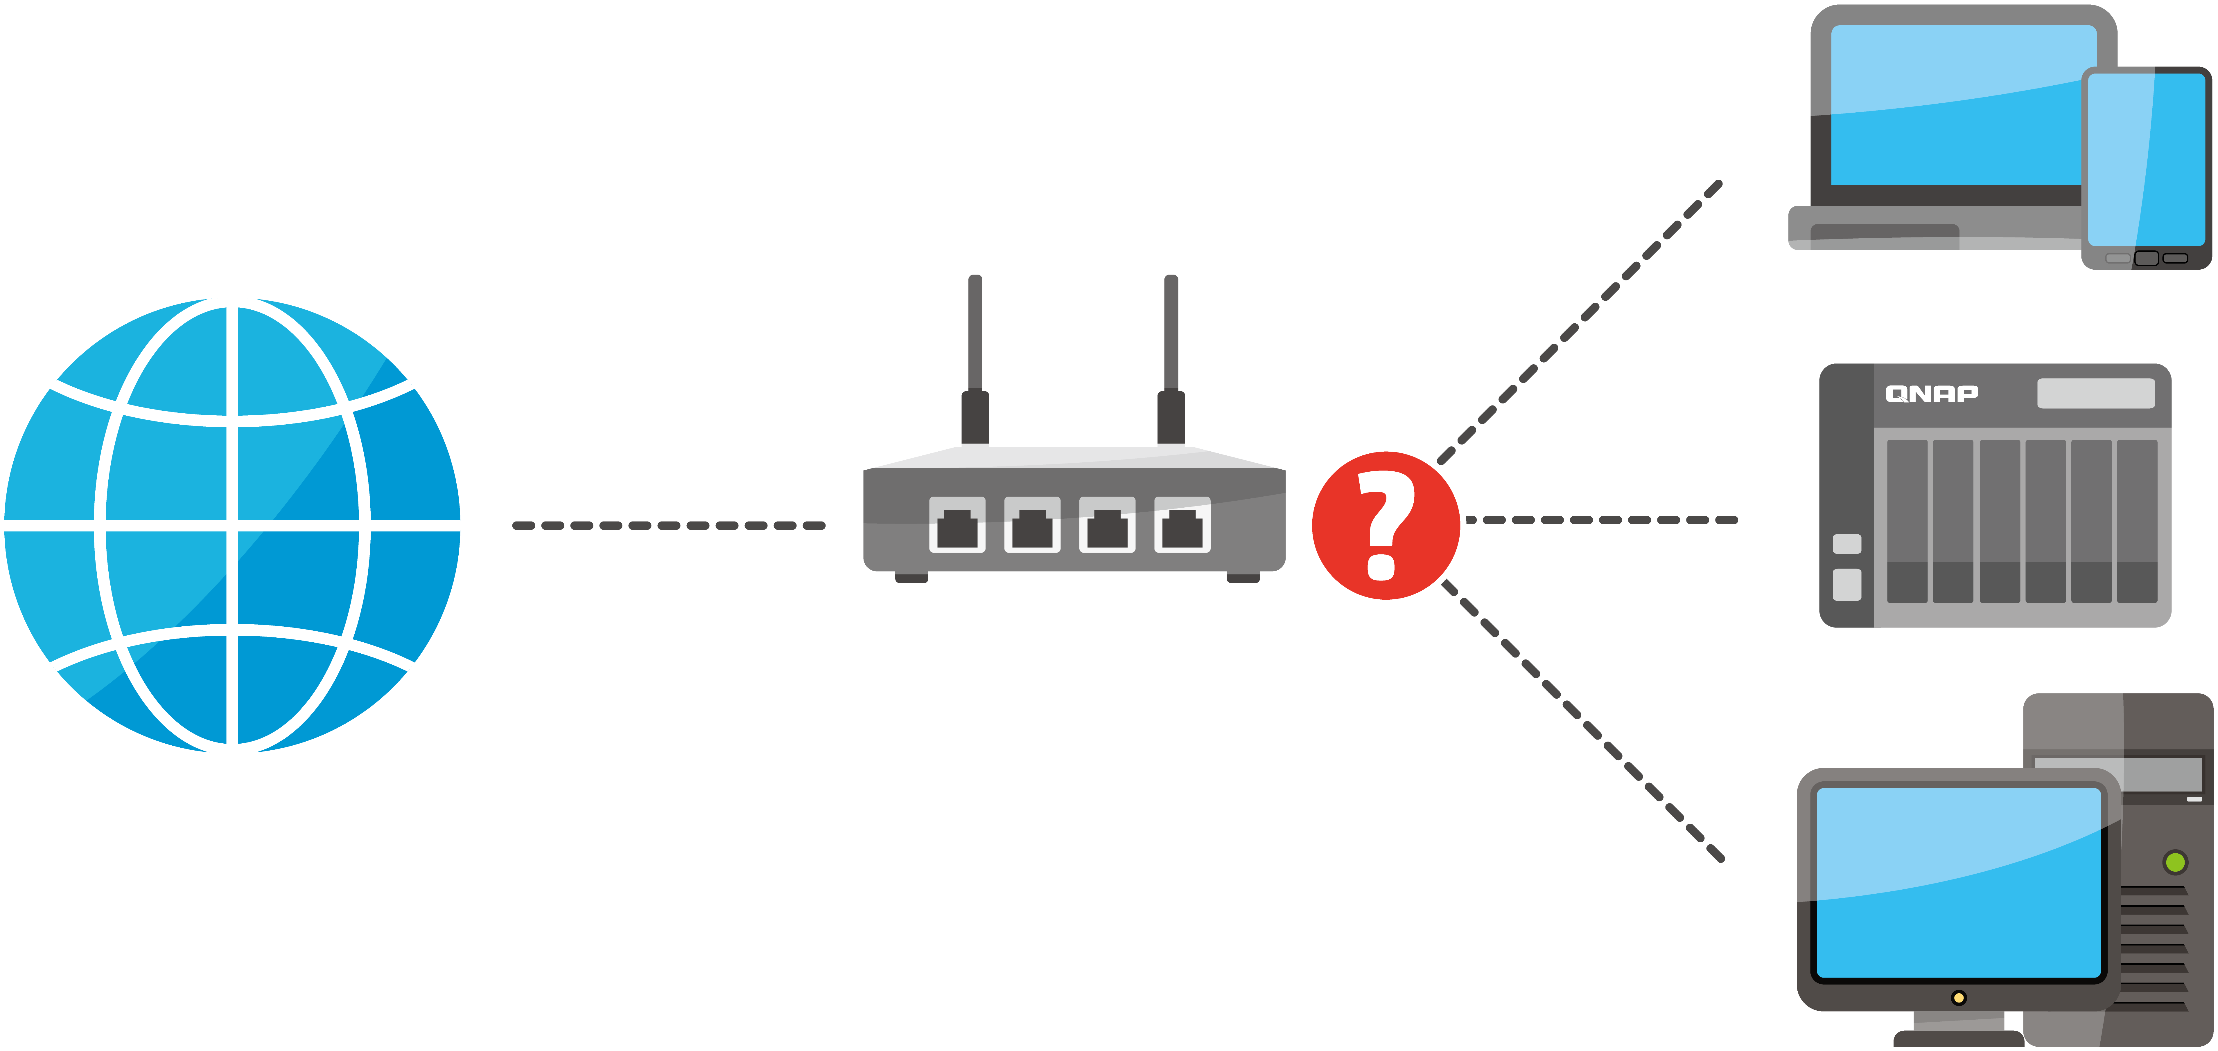
The most common problems
?
The router does not know which device to relay the traffic to
!
Blocked by firewall

Slide 20
QNAP NAS helps you
setup the VPN easily

Slide 21
Manually setup the router
Port Forwarding
DMZ
Control everything
Super easy
All router support
Set the forwarding IP
1
Set the required port to forward
All ports/packets forwarded
More secure (only open the required port)
enable VPN passthrough
Security concern => all ports exposed
too many steps and complicated
Notes:
the only thing lacking is too many steps and complicated for general users

Slide 22
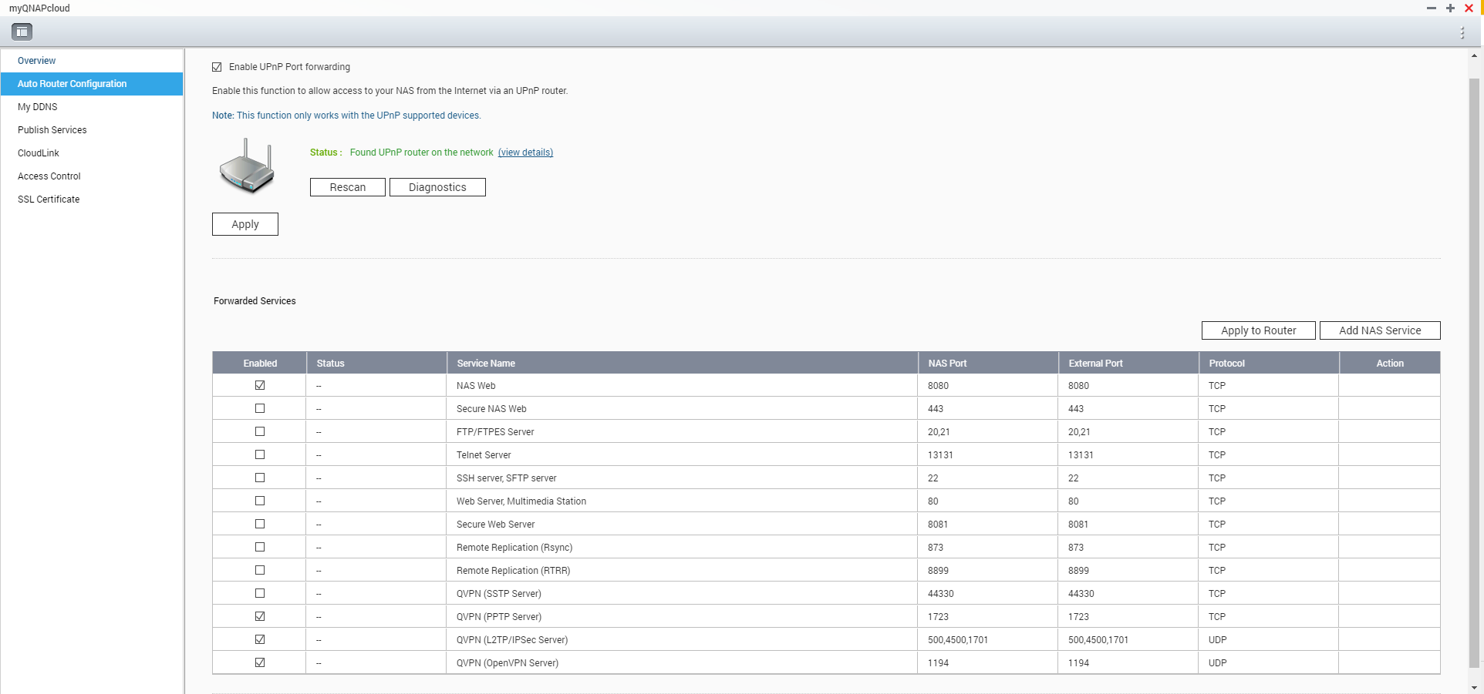
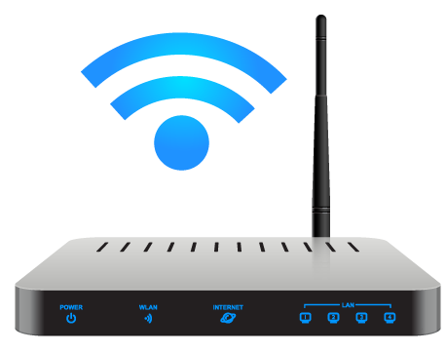
UPnP auto enables VPN port forwarding
myQNAPcloud will take care of it!
Sets automatically
UPnP router required

Slide 23
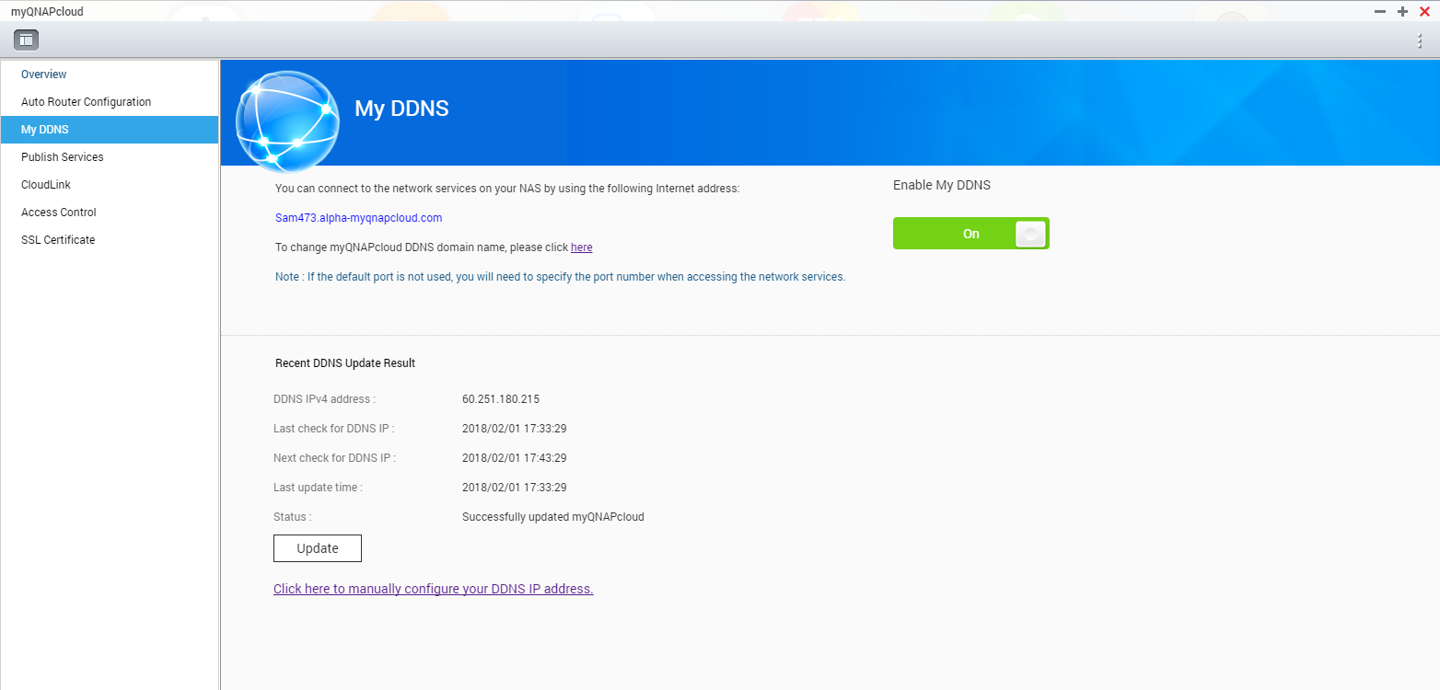
The best tool when IP is dynamic
myQNAPcloud DDNS
UPnP (Auto Router Configuration)
port
NAS Web
port
FTP Server
port
VPN Server
WAN IP
LAN IP1
port
…………….
xxx.myqnapcloud.com:port
LAN IP2

Slide 24
How to set your client device
to connect to NAS via VPN

Slide 25
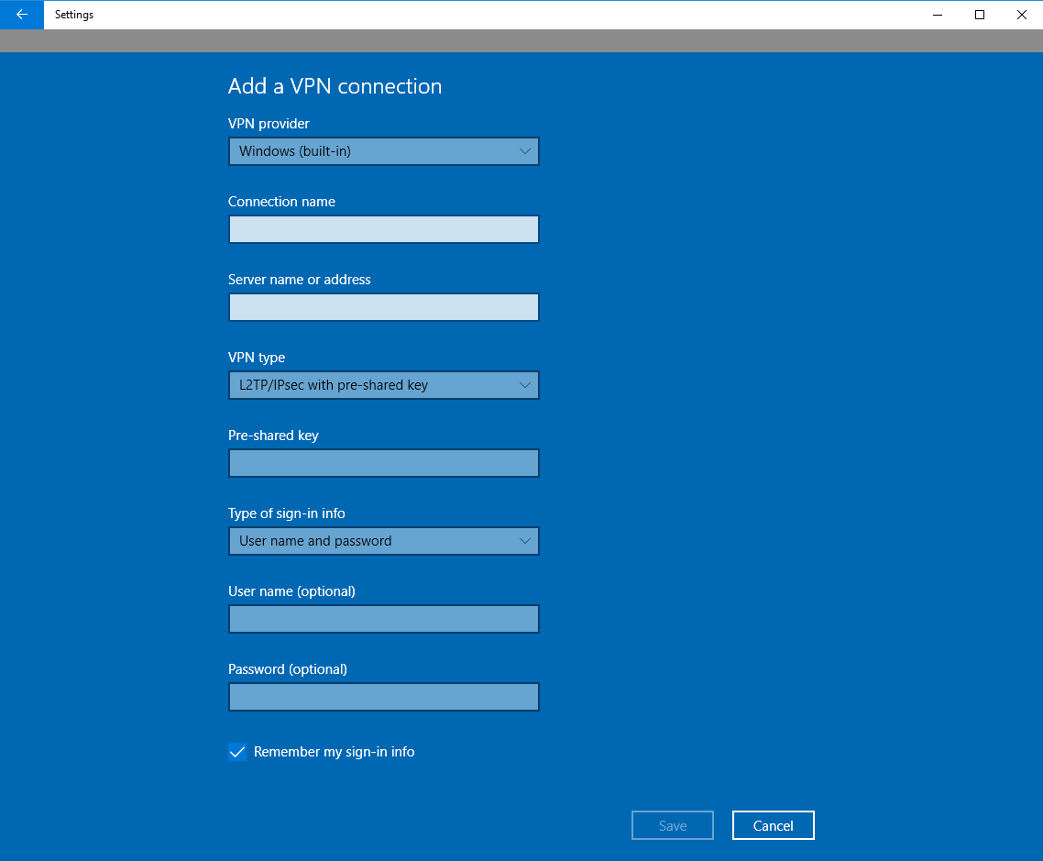
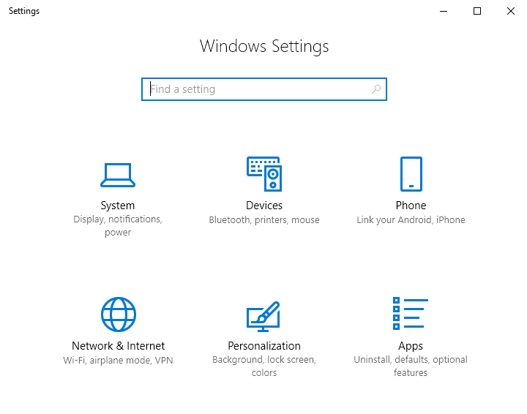
Use Windows to connect to VPN
Click the Start menu >> [ Setting ]
Select the VPN type: for PPTP, only entering the credential is required; for L2TP, one more setting of Pre-shared key is required
Choose [ Network & Internet ]
Choose [ VPN ] >> [ Add a VPN connection ]

Slide 26
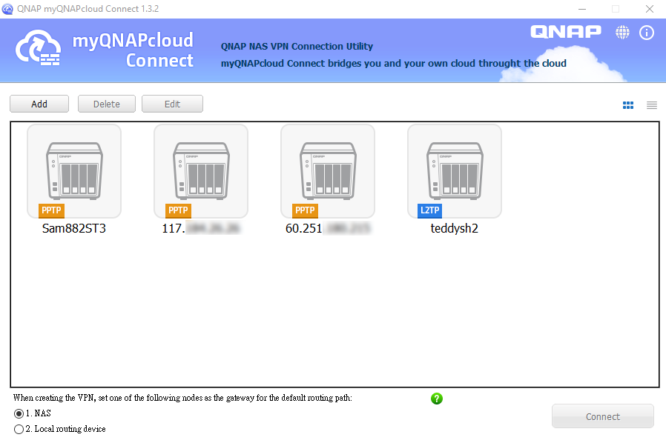
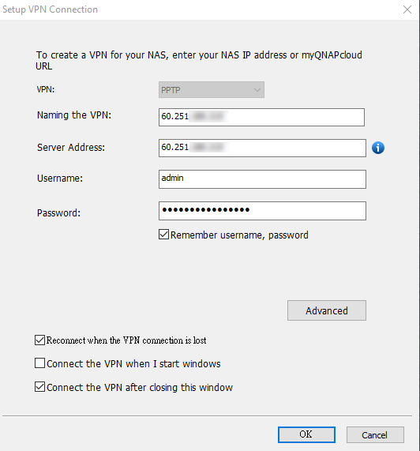
Windows utility (myQNAPcloud connect)

Slide 27
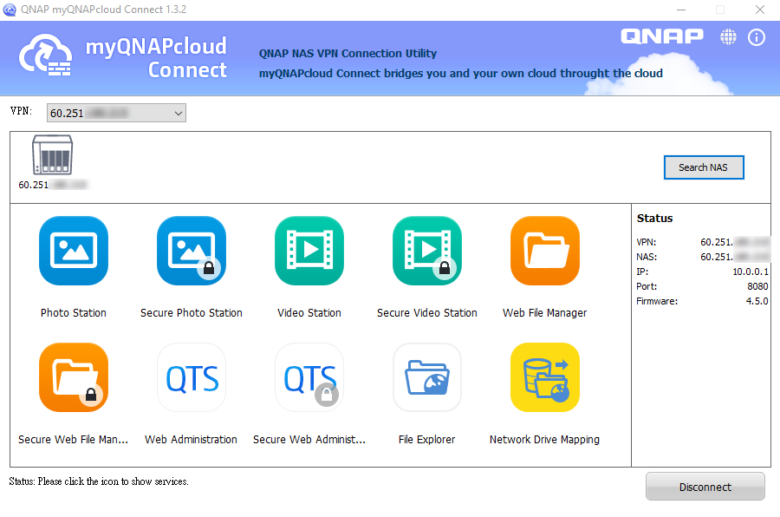
Windows utility (myQNAPcloud connect)
Connect to your NAS easier
Provide the shortcut or supported service.

Slide 28
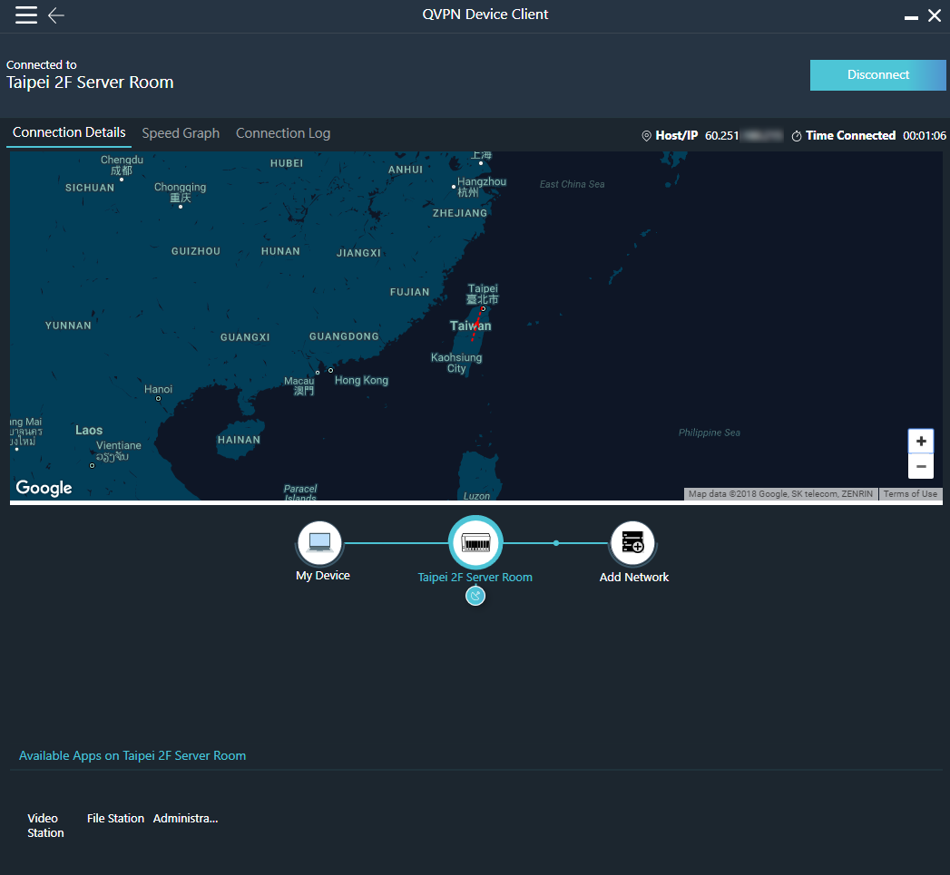
New Windows utility will soon be available
Create the secure connection to the NAS via QNAP proprietary VPN protocol - QBelt.
Search the surrounding QNAP NAS.
Use this VPN connection to access other NAS (credential required)
Create the next VPN tunnel via original VPN connection.

Slide 29
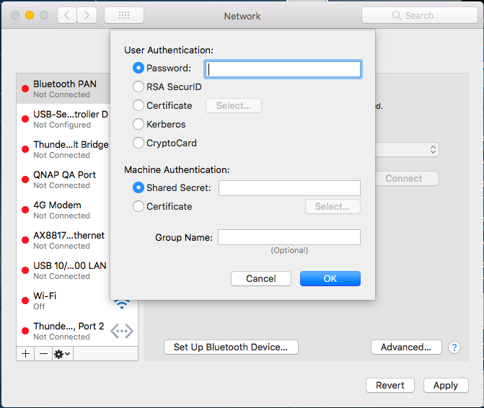
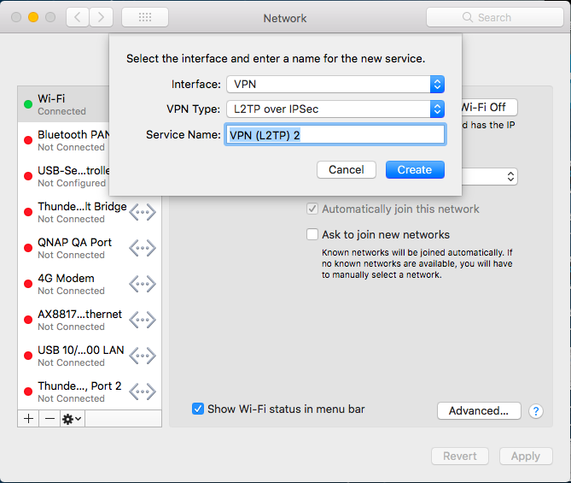
Use macOS to connect to VPN
Next, click "Authentication Settings...", then set the Password & Shared Secret
System Preferences => Network
click the plus sign to add a VPN interface, Type is L2TP over IPsec

Slide 30
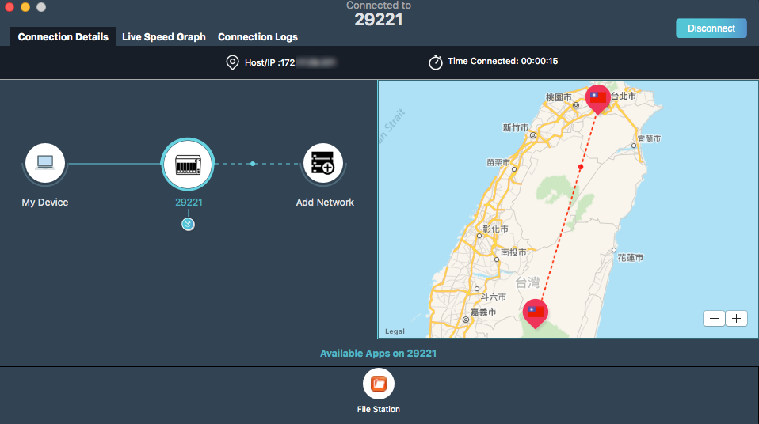
New macOS utility will soon be available

Slide 31
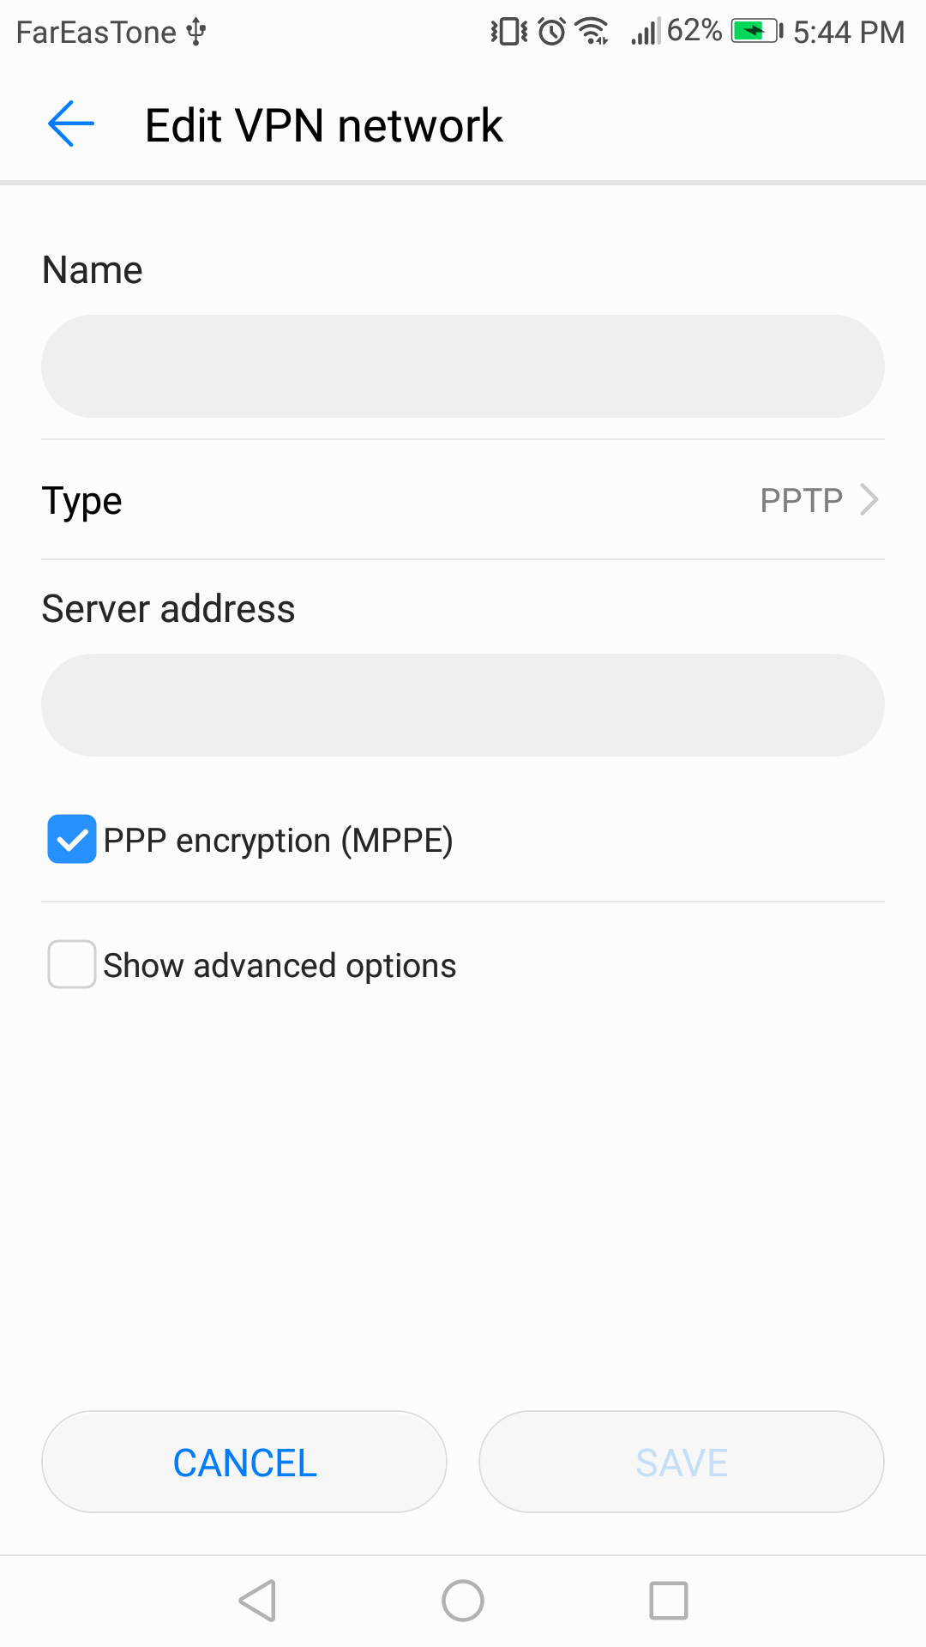
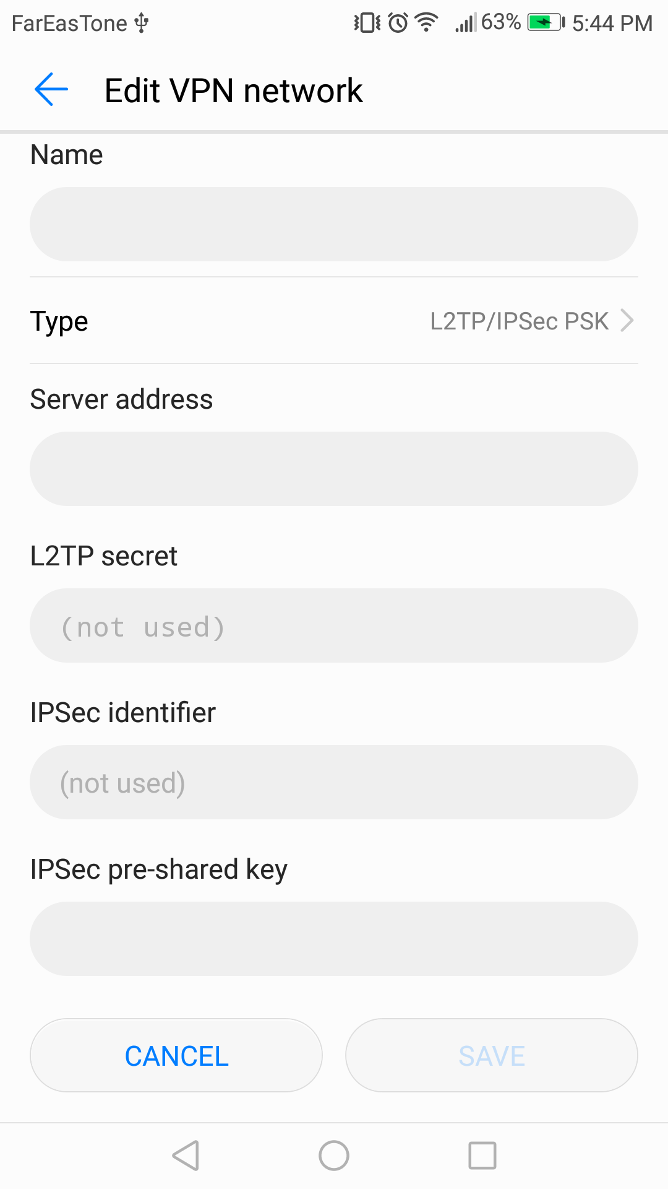
Use Android to connect to VPN
Settings
Wireless & Networks
VPN
Add network
select VPN type for L2TP, you must insert the IPsec pre-shared key
insert the credential when you connect

Slide 32
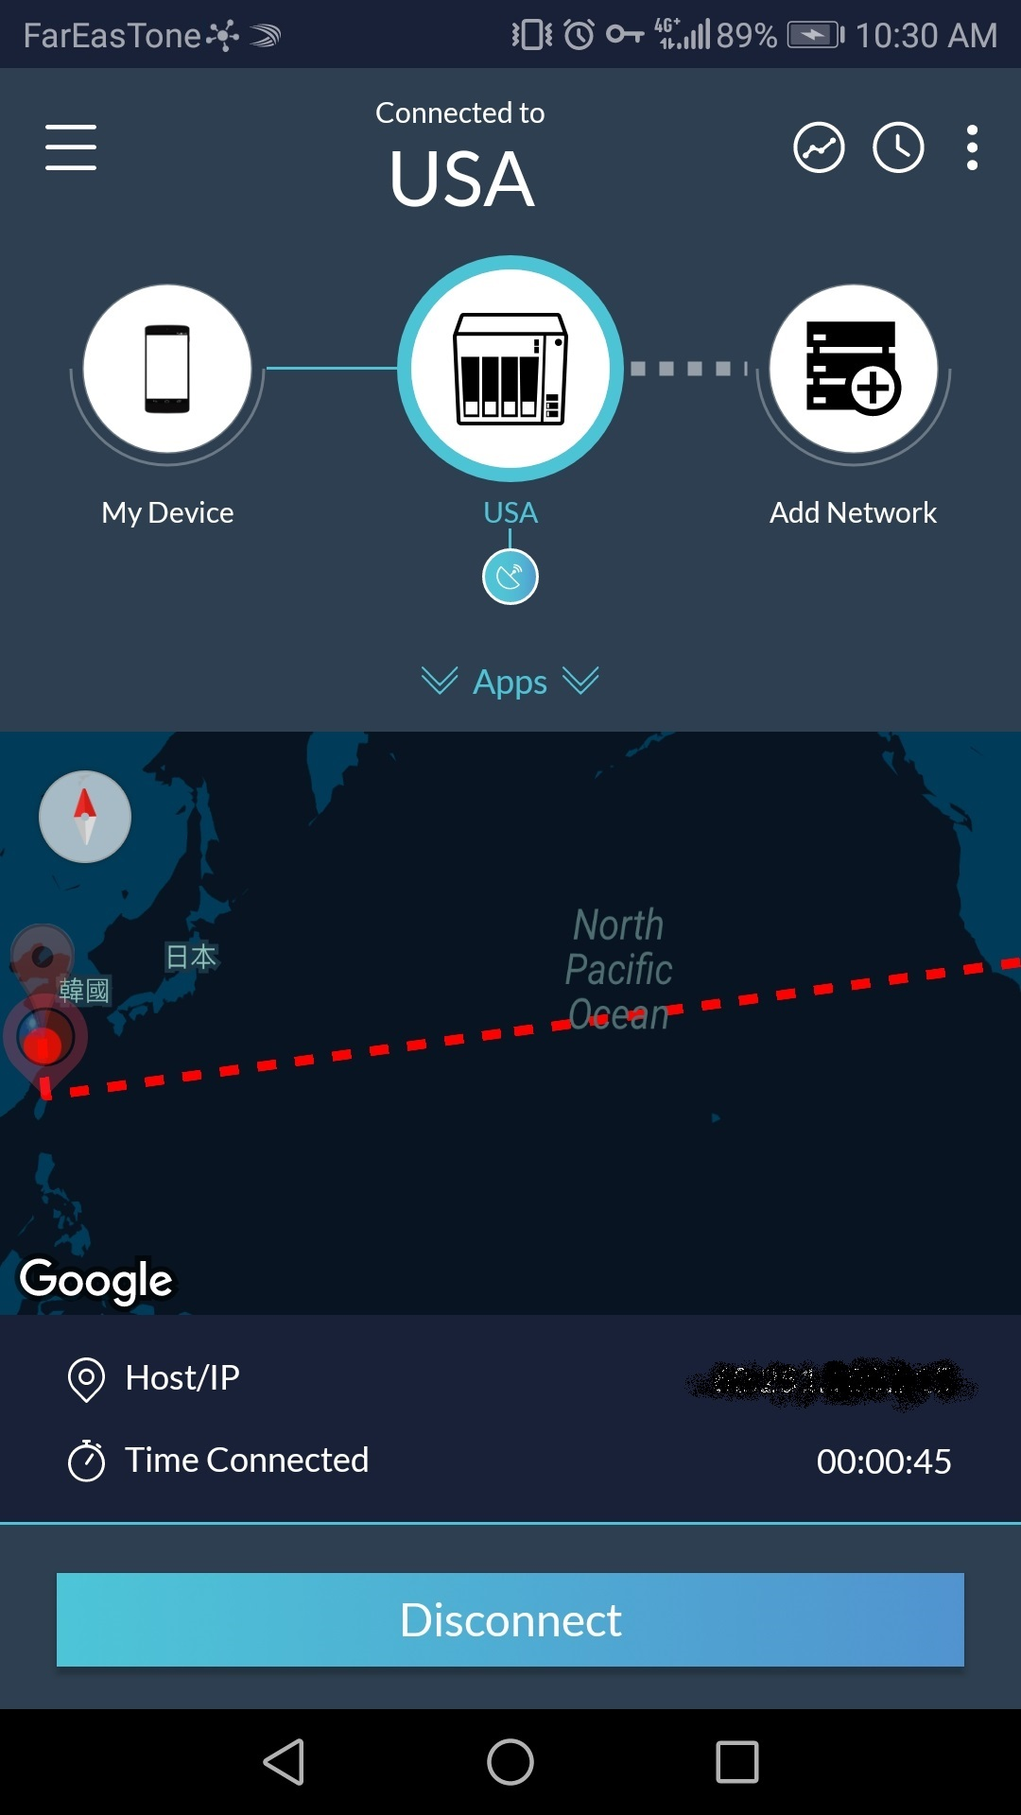
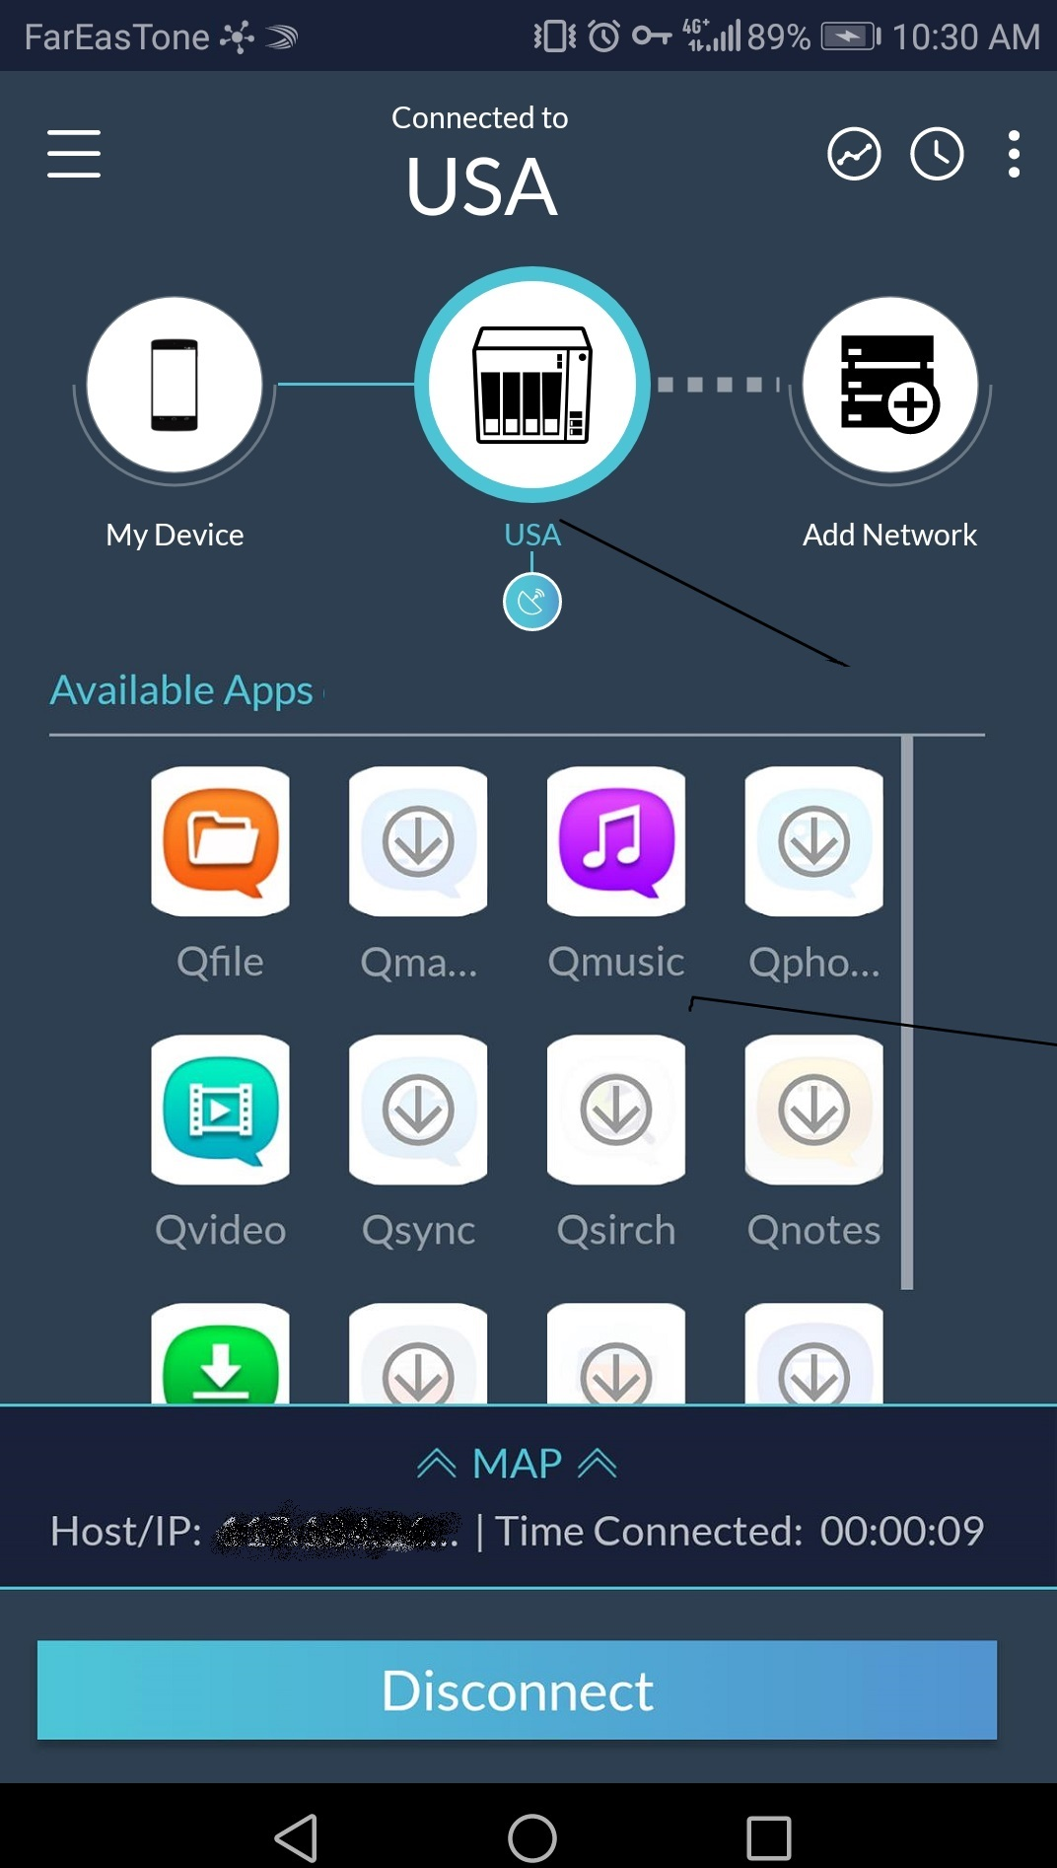
New Android app will soon be available
Create the secure connection to the NAS via QNAP proprietary VPN protocol - QBelt.
Search the surrounding QNAP NAS.
Use this VPN connection to access other NAS (credential required)
Create the next VPN tunnel via original VPN connection.
Launch other app through the secure VPN connection

Slide 33
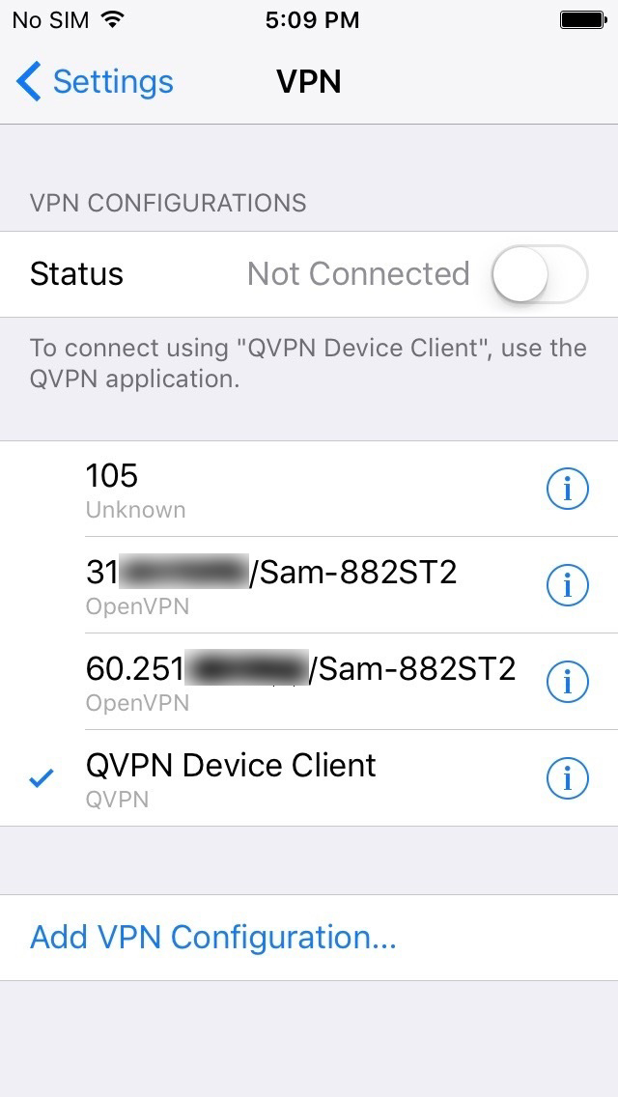
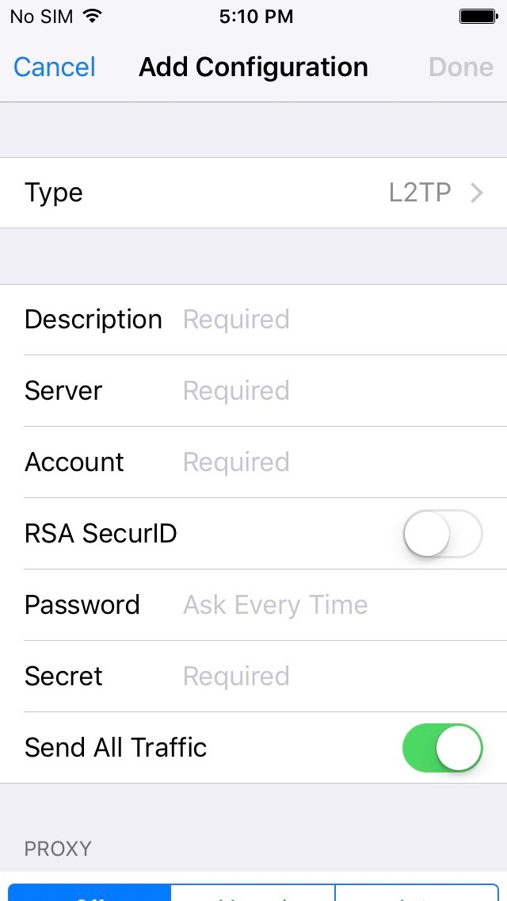
Use iOS to connect to VPN
Settings
click VPN
Add VPN configuration
The type should be L2TP
Insert credential & Secret (pre-shared key)

Slide 34
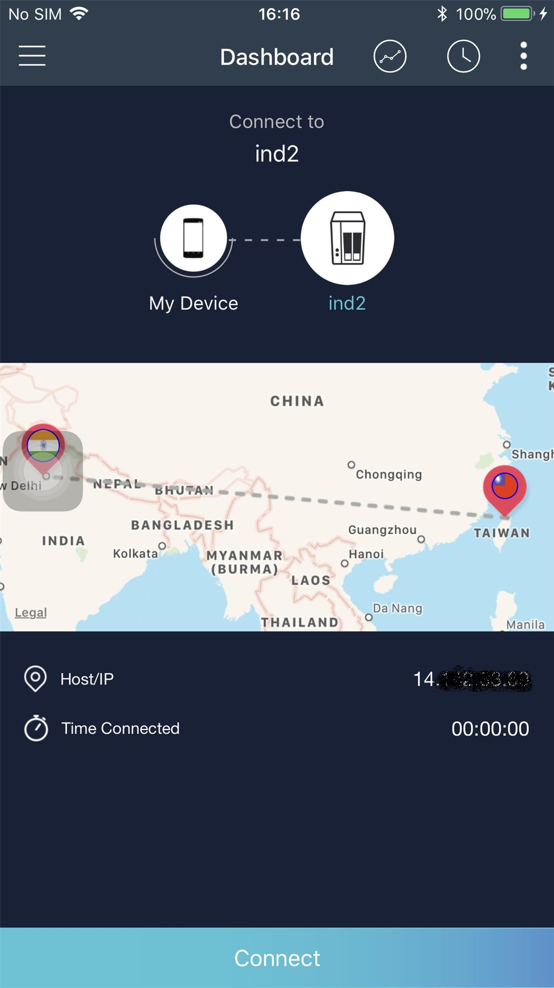
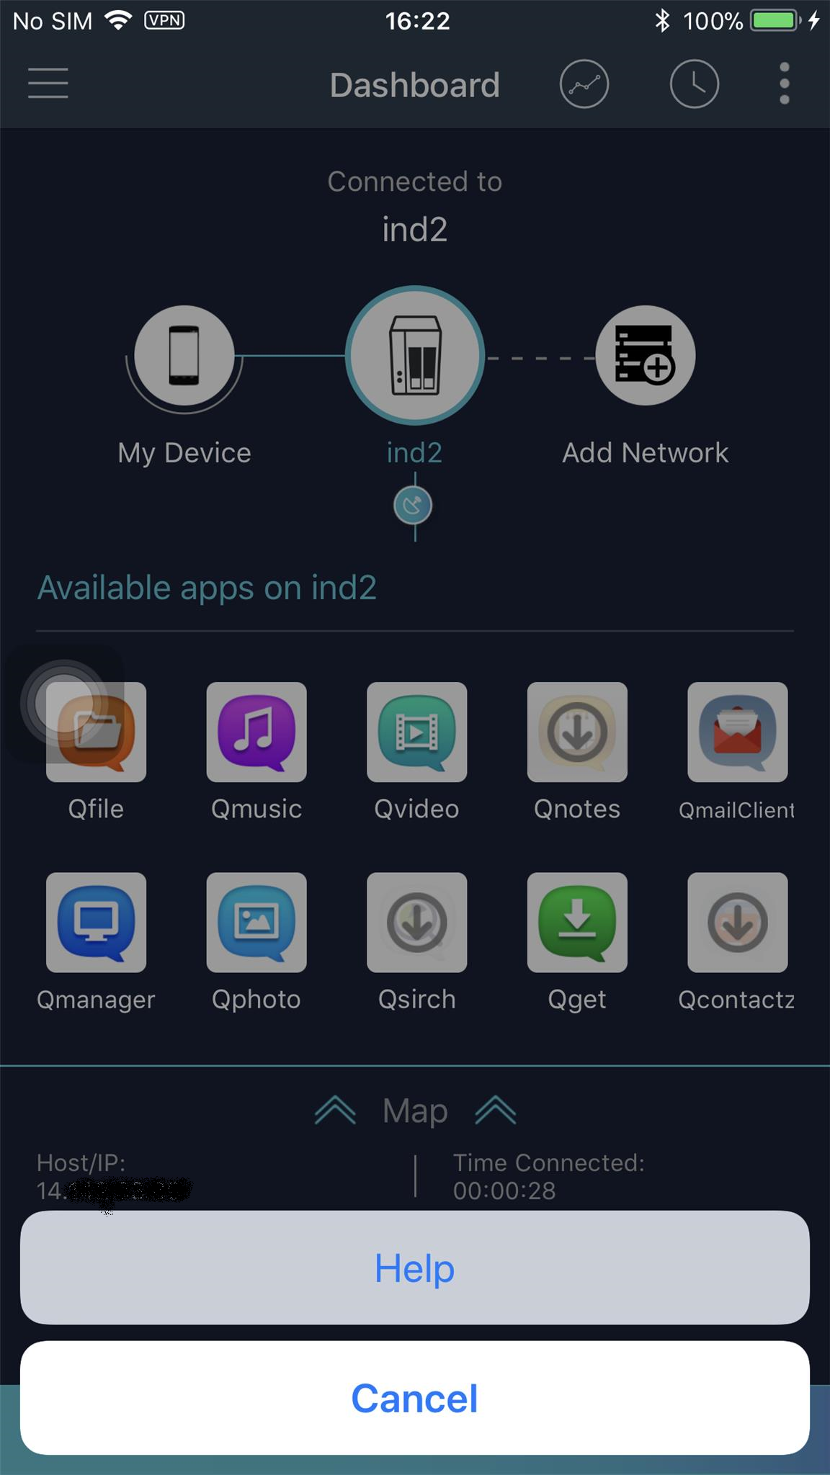
New iOS app will soon be available
Create the secure connection to the NAS via QNAP proprietary VPN protocol - QBelt.
Search the surrounding QNAP NAS.
Use this VPN connection to access other NAS (credential required)
Create the next VPN tunnel via original VPN connection.
Launch other app through the secure VPN connection

Slide 35
Let your NAS connect to remote NAS/ VPN server via the VPN Client function

Slide 36
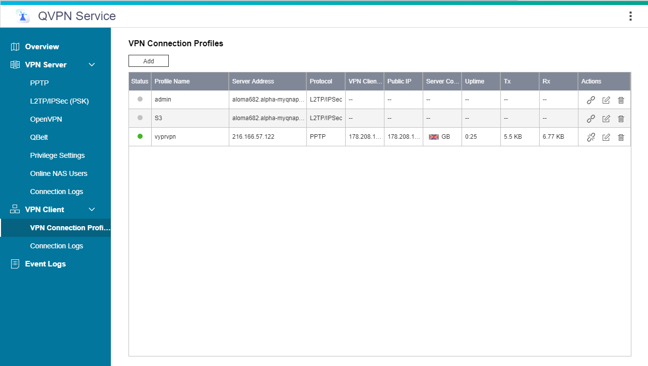
Your NAS can reach almost everywhere
Your NAS can connect to another VPN easier. (Yours / shared NAS from your friend / public VPN server)
PPTP
L2TP / IPsec
OpenVPN
QBelt (QNAP only)

Slide 37
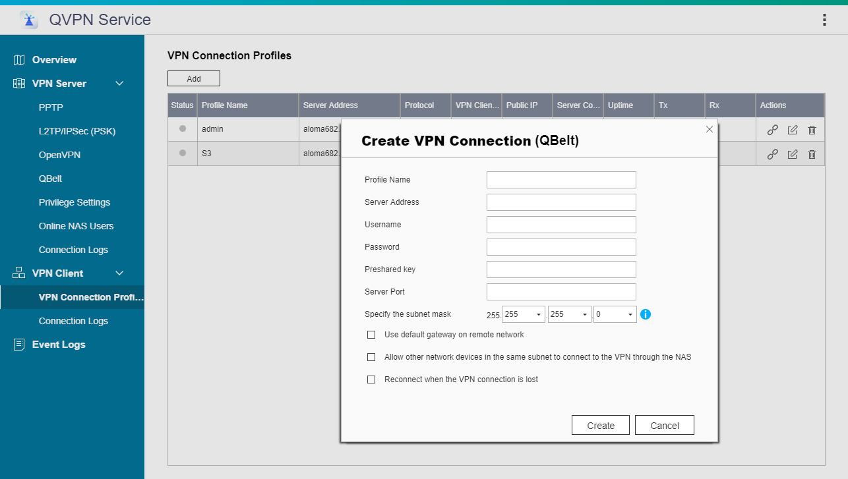
Support all VPN-Client format
Set the necessary VPN parameter
Allows your NAS to use this VPN as the system default gateway.
Allows other local networked devices connect to the same VPN connection.

Slide 38
Request for secure backup between 2 NAS
QBelt VPN
Secures your Data

Slide 39
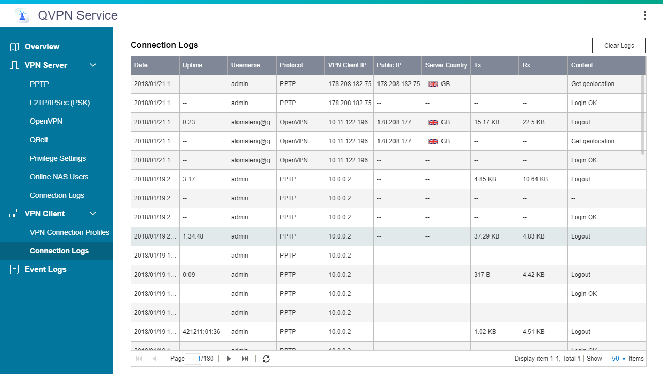
Detail connect log of VPN Client

Slide 40
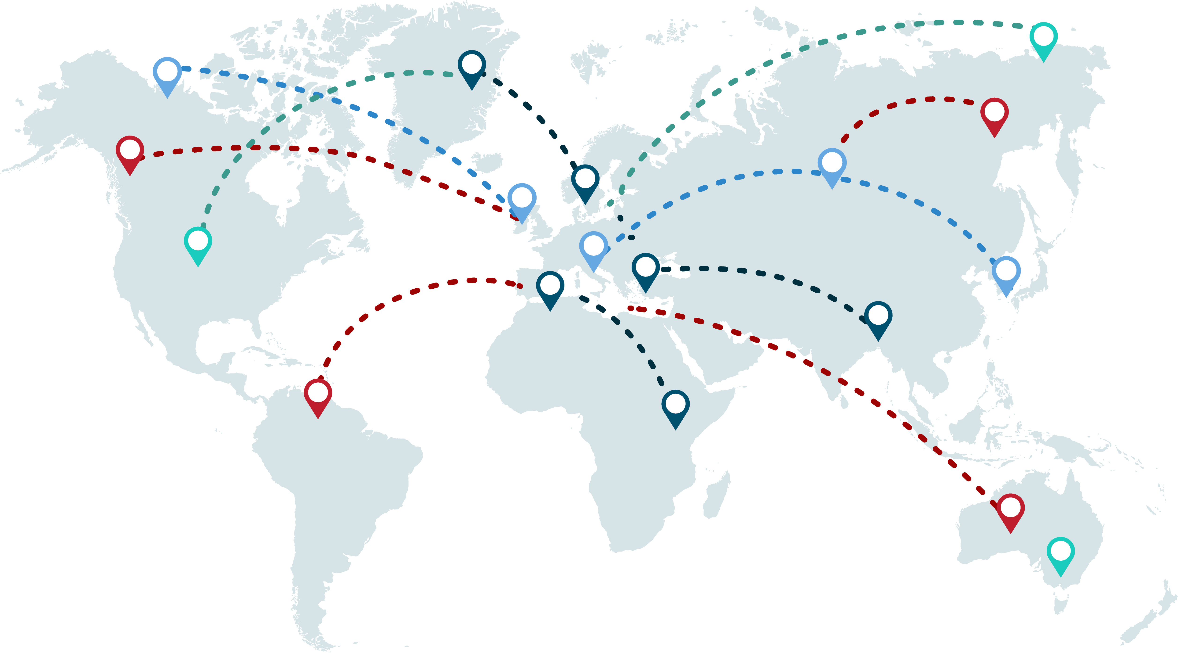
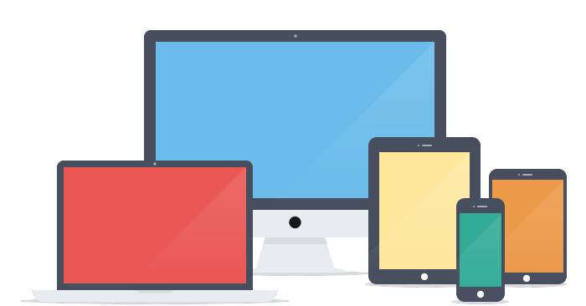
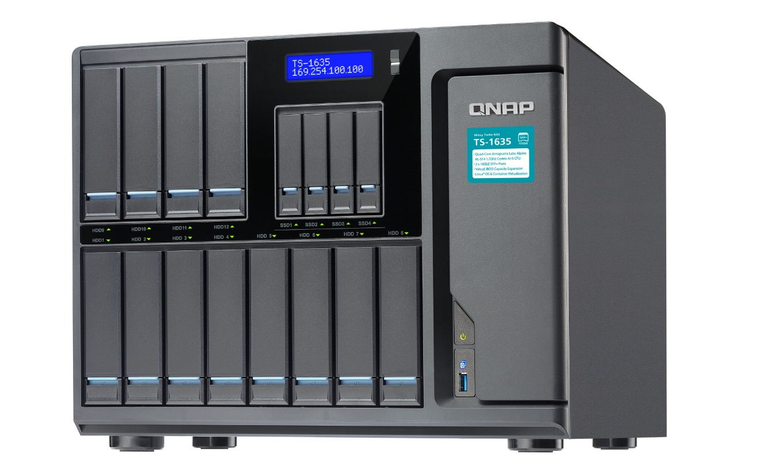
Cross the world with your NAS !
integrated with the service provider - VyprVPN
VPN Tunnel
VPN Tunnel
Notes:
If you want to connect to one country but without any friend can help you there or without the resource of public server,
you can apply the 3rd-party VPN service - VyprVPN which already integrated with QNAP to help you cross to anywhere around the world.

Slide 41
QVPN is Your Best Choice

Slide 42
QNAP QVPN 優勢分析
 | QNAP QTS 4.3.5 | Synology DSM 6.2
專屬的VPN協定 | Qbelt專屬協定 | 無
專屬的連線工具及手機App | 支援 Windows, MacOS, Andriod, iOS 等多客戶端 | 無
配置恰當的DNS | 多種市面上的公有DNS替您偵測可連性 NAS的配置 手動指定 | NAS的配置 手動指定
無須架點到全世界, (整合第三方VPN服務) | 有專屬整合App可直接啟動, 也可手動設定連線其他服務商 | 無專屬整合的便利性, 只能透過手動設置

Slide 43
目前開發計畫
QVPN service v2.0 (RD預計2/14釋出給DQV驗證)
15532 [QVPN Service] QNAP proprietary VPN protocol - Qbelt
12628 [API Request] API for QVPN_Device_Client related.
11931 [QVPN Service] Outgoing network interface supports virtual switch
11925 [QVPN Service] The wizard of DNS setting. (Include Public DNS detect automatically, Pass the DNS from the destination server, Manually assign)
12051 [API request] Provide the VPN related info via myQNAPcloud
11926 [QVPN service] 列表清單重新調整 + 訊息優化
11930 [QVPN Service] Connection list & connection log欄位新增 (device info / Tx / Tx rate / Rx / Rx Rate)
Nagarro outsourcing
1/12~1/12: drop1 (DQV剛測完, 目前仍有很多P1問題在解: 31隻, P1+ P2 mojor 80隻, 目前Nagarro把RD leader派來台灣直接與RD/DQV接口解問題與看bug)
2/09: drop 3 (all functions without multi-language infrastructure)
1 more week for multi-language infrastructure and English String
Sam 拿到後即送多國翻譯, 預計3/B~3/M可以送翻回來給我們自己RD上多國

Slide 44
目前開發計畫
VPN app
15478 QVPN-iOS first edition (the beta version after we take over the project from the outsourcing company)
support iOS11(iPhoneX), new QID implement, support multi-language...etc.
15579 [QVPN-iOS] Add one more option QBelt when the user creates the tier-2 connection
15529 [QVPN-Android] Upgrade the target-sdk-version of QVPN Android app to the version 8.0
15484 QVPN-Android first edition (the beta version after we take over the project from the outsourcing company)
15582 [QVPN-Android] Add one more option QBelt when the user creates the tier-2 connection
VPN utility
15486 QVPN-Windows first edition (the beta version after we take over the project from the outsourcing company)
QNAP signature, new QID implement, support multi-language...etc.
15584 [QVPN-Windows] Add one more option QBelt when the user creates the tier-2 connection
15485 QVPN-MacOS first edition (the beta version after we take over the project from the outsourcing company)
15583 [QVPN-MacOS] Add one more option QBelt when the user creates the tier-2 connection

Slide 45
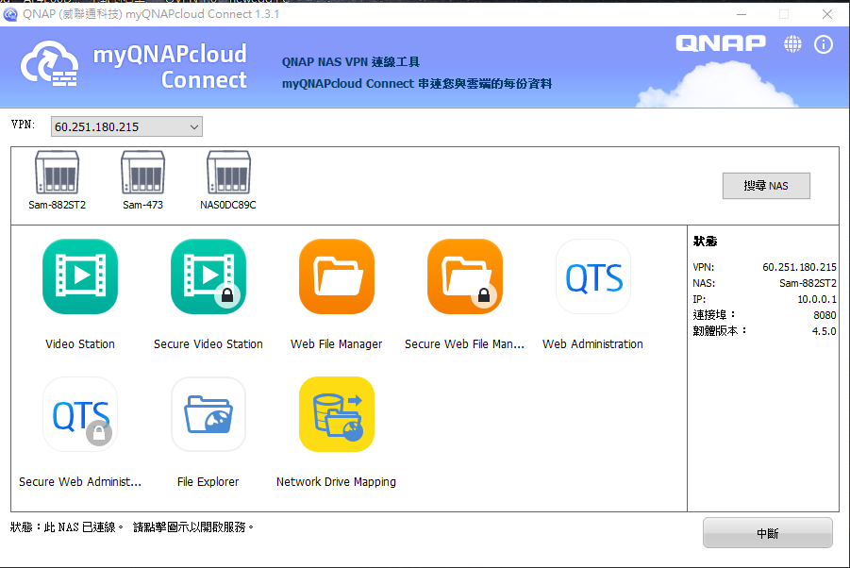
使用VPN存取周遭NAS-(myQNAPcloud connect)
透過您VPN所連上的NAS
可搜尋出周遭的其他QNAP NAS, 並以此安全連線去連線其他NAS (需各自的密碼)

