Slide 1
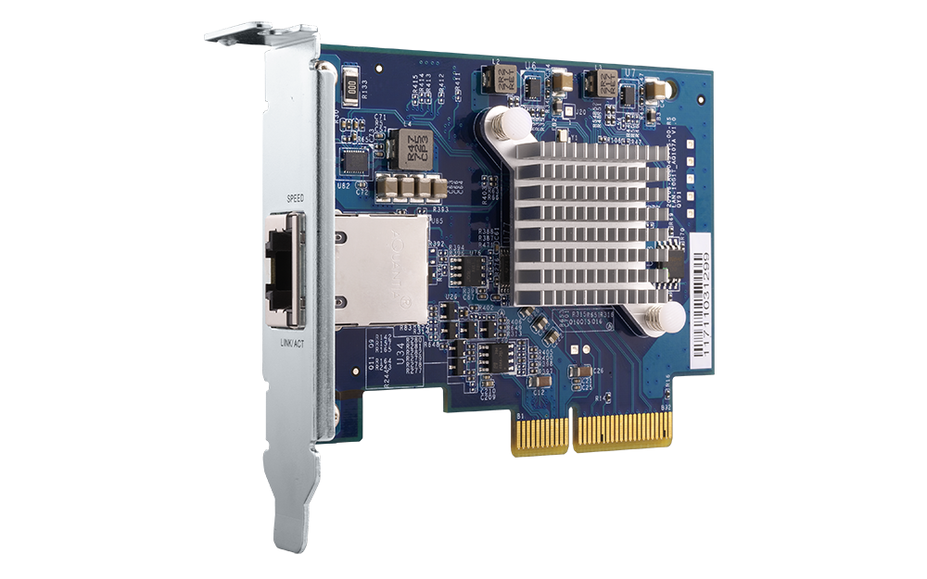
Upgrade your NAS or PC with the QXG-10G1T
High speed 10 GbE solution
A single-port, 5-speed 10GBASE-T network expansion card

Slide 2
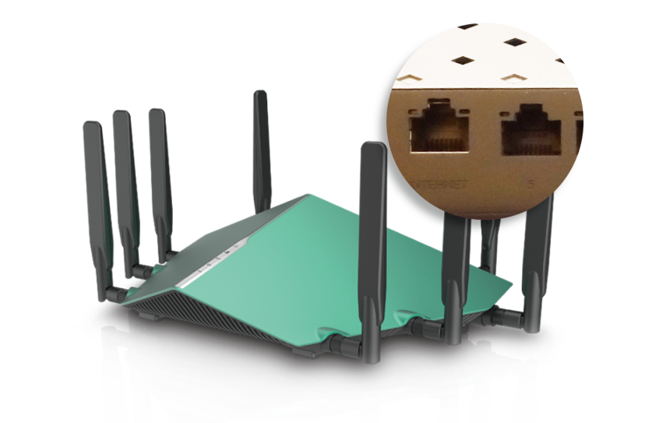
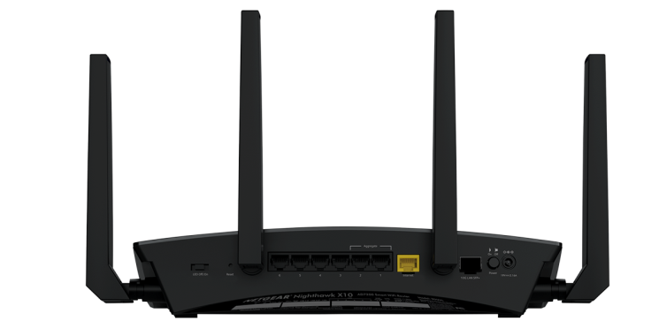
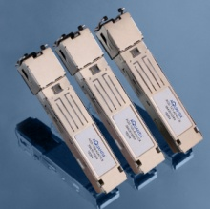
Break barriers of gigabit ports
Wi-Fi Router with 10G
Wireless Router w/ 2.5G WAN
Netgear NIGHTHAWK® X10
802.11ac Router R9000
D-Link 802.11ax 4 x 4 Wireless Router
DIR-X6060
2.5GBASE-T
SFP+ Module supports 10GBASE-T
10G SFP+
Source: Netgear.com; Aquantia.com & dlink.com

Slide 3
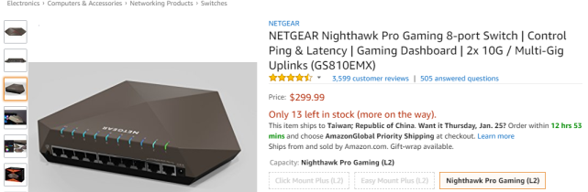
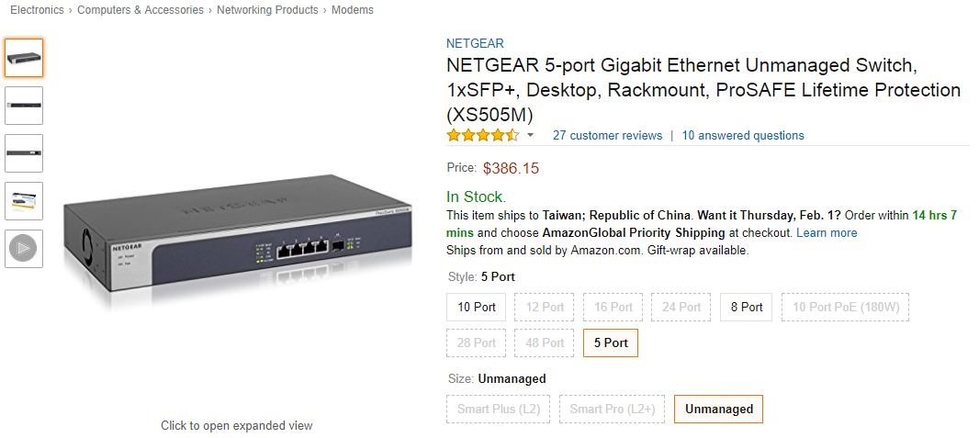
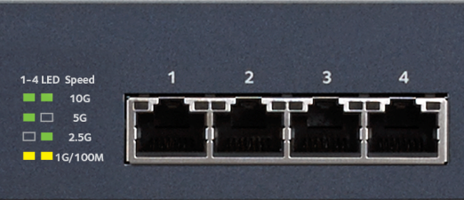
10GbE is now more accessible
2 x 10GBASE-T & 8 x GbE ports
Nighthawk Pro Gaming SX10（GS810EMX）
4 x 10GBASE-T & 1 x 10G SFP+ ports
5-speed Unmanaged Switch ( XS505M )
Source: Amazon.com & Netgear.com

Slide 4
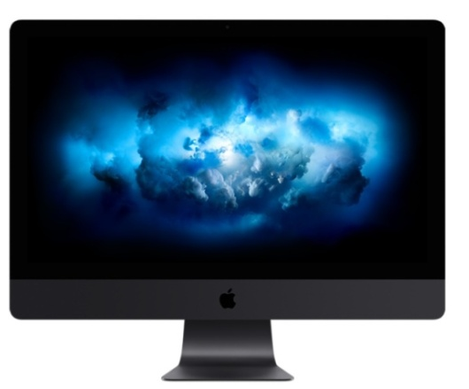
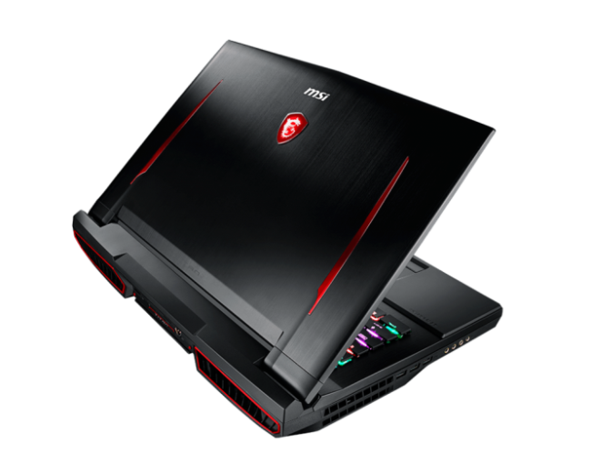
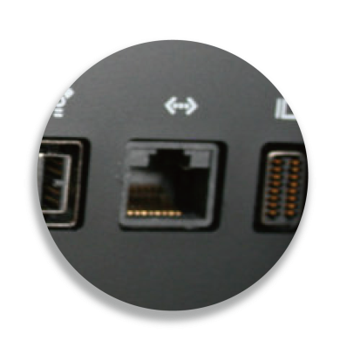
10GbE is now more accessible
Video editing workstation
with a 10GBASE-T port
Gaming PC/motherboard
with a 10GBASE-T port
10GBASE-T
Apple iMac Pro
MSI GT75VR

Slide 5
The QXG-10G1T network expansion card
Passive heat sink (fanless)
5-speed 10GBASE-T RJ45 connector
Silence & efficiency
10G/5G/2.5G/1G/100M
PCIe 3.0 x 4 interface
Speed & Status LED
Maximize transfer speed
For easily checking network status

Slide 6
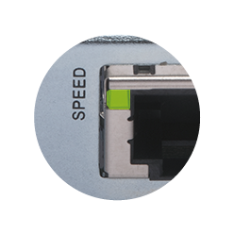
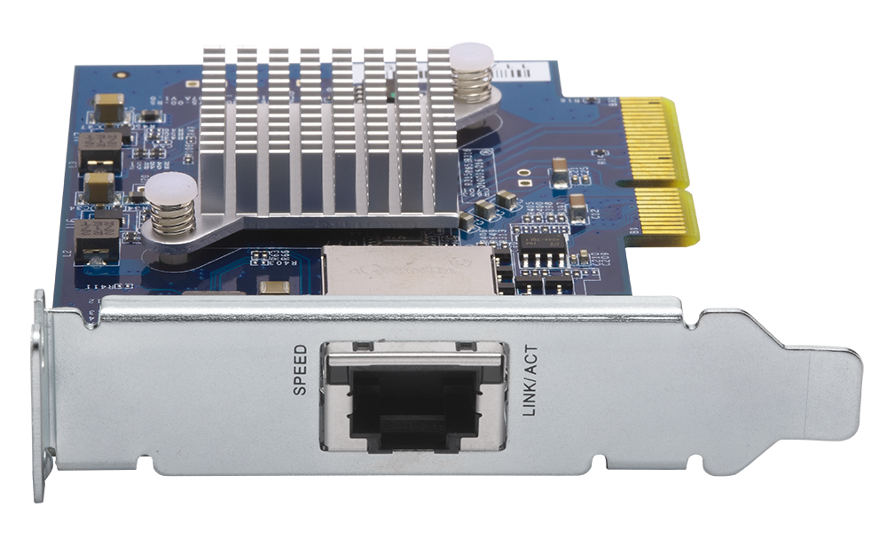
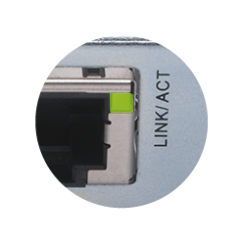
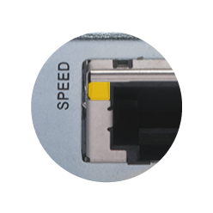
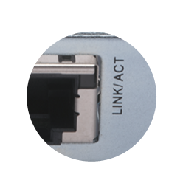
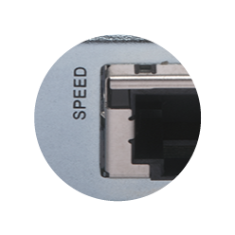
Easily check status with LED indicators
Speed
Status
10G
Connected
5G/2.5G/1G/100M
Disconnected
Disconnected

Slide 7
Take advantages of existing infrastructure
Don't throw away your old cables yet!
Multi-Gigabit NBASE-T technology supported
Current LAN cables may be already capable for > 1Gbps speeds!
 | CAT 5e | CAT 6 | CAT 6A & CAT 7
100M | ✔ | ✔ | ✔
1G | ✔ | ✔ | ✔
2.5G | ✔ | ✔ | ✔
5G | ✔ | ✔ | ✔
10G | X | ✔(55m) | ✔

Slide 8
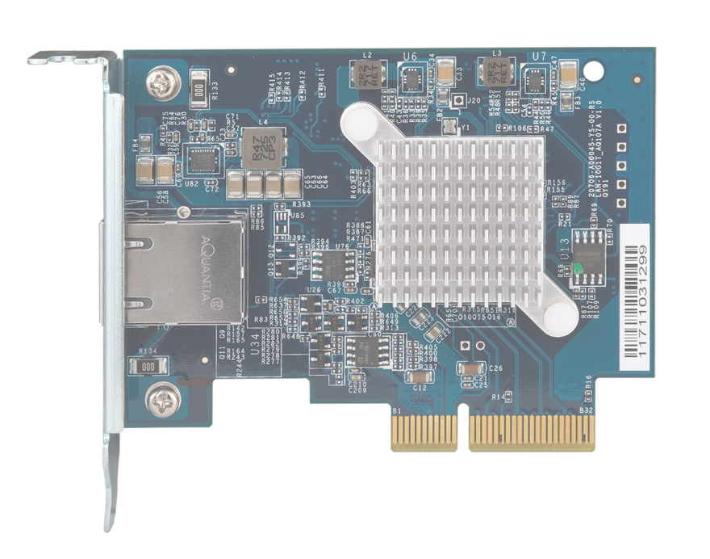
Aquantia AQC107 NIC for enterprises
Strong investors & NBASE-T Alliance
Used in various solutions
Source: Aquantia.com & NBASET.org
Notes:
AQC是省電高效的網路晶片，所以很多人採用～
Intel X550 單 port 耗電量平均值為7.4W, AQC107 是 6W

Slide 9
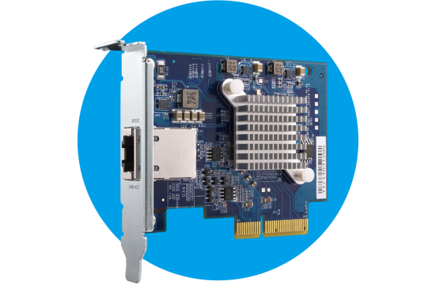
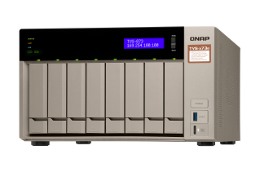
Perfect match for NAS with PCIe 3.0 slot
IOMeter (1 x 10GbE、64KB)
954 MB/s
PCIe 3.0 x 4 high-speed network expansion
Windows Download
1032 MB/s
Windows Upload
64KB, sequential transfer
TVS-873e
Tested in the QNAP lab. Figures may vary by environment. NAS：TVS-873e-8G w/ QTS 4.3.4, RAID 5 w/ 8 x Intel SSDSC2BB240G4 SSD, Cat. 6a cable. Test with IOMeter

Slide 10
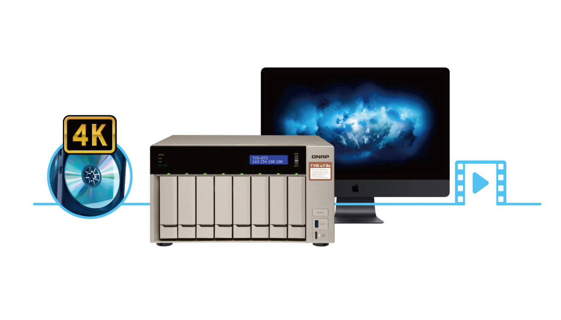
Getting things done instantly
Download a 50GB Blue-ray file
8 mins
20 secs
Time-saving
1GbE
100MB/s
10GbE
50 secs
1000MB/s

Slide 11
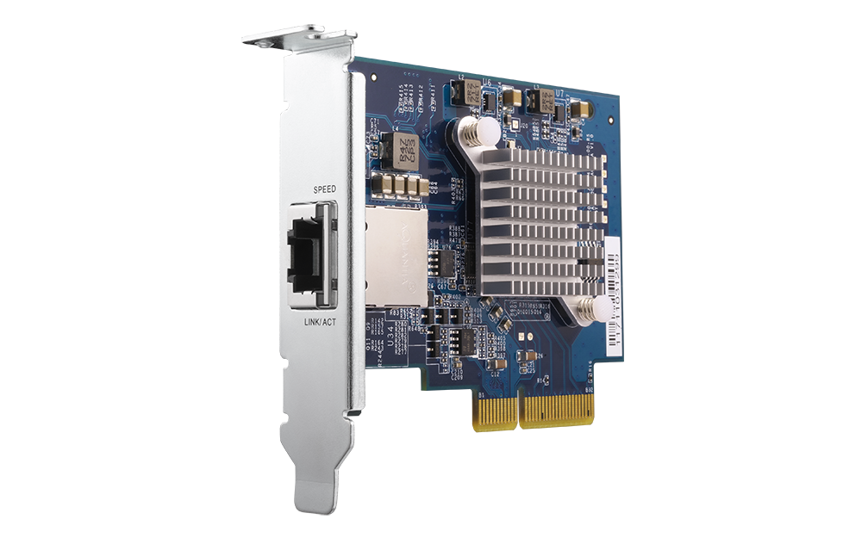
Bundled with brackets for NAS & PCs
Low profile PCIe expansion card
Standard low profile bracket (pre-installed)
Standard full height bracket
Specialized low profile flat

Slide 12
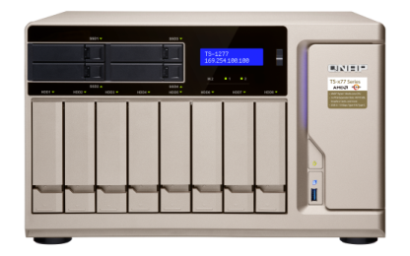
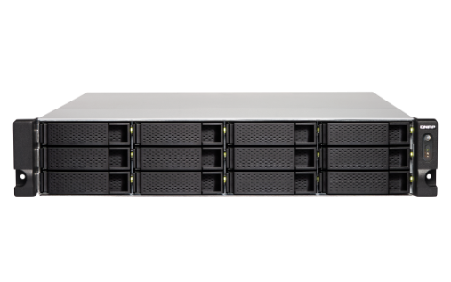
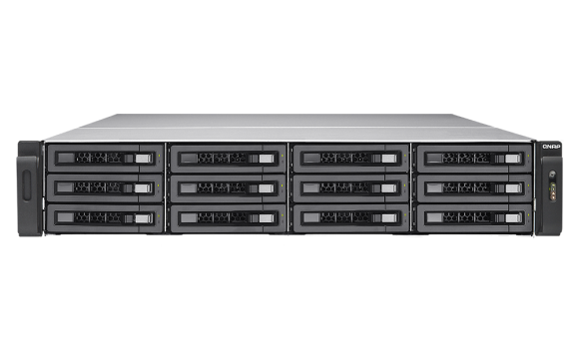
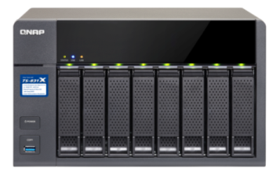
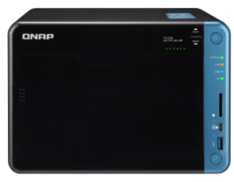
Supports all NAS with a PCIe slot
Multiple PCIe slot
TVS-x71, TVS-x71U, TVS-x73, TS-x73U, TS-x77,
TVS-x82(T)(U), TS-x79(U)(-SAS), TS-x80(U)(SAS), TS-1685, TES-x85(U), TS-x89U
Single PCIe slot
TS-531P, TS-531X, TS-831X, TS-1635, TS-x31XU, TS-563, TVS-x63, TS-x63U, TS-x53B(T)(U), TS-x70, TS-x70U
*Requires 4.3.4 or later version

Slide 13
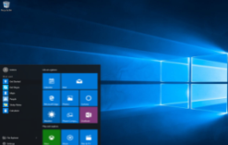
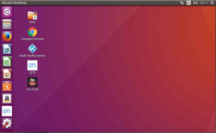
Not just for NAS; it’s for everyone
Driver downloads are available from Aquantia
Windows® 10, 8.1, 8, 7 (32/64 bit)
Linux 3.2, 3.10, 3.12, 4.2, 4.4
Source: Aquantia.com
Notes:
最低需求Windows® 10, 8.1, 8, 7 (32/64 bit)
Linux 3.2, 3.10, 3.12, 4.2, and 4.4

Slide 14
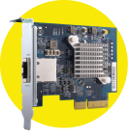
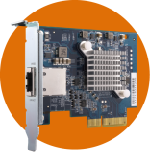
Upgrade to 5Gb/s with minimum cost
TVS-473e
1GbE
Cat 5e
10G/5G/2.5G/1G/100M switch
1GbE
Cat 5e
1GbE
Cat 5e
Install QXG-10G1T
on NAS & PC
TVS-473e
5GbE
Cat 5e
5Gb
5GbE
10G/5G/2.5G/1G/100M switch
Cat 5e
5GbE
Cat 5e
Existing LAN cable wiring
Existing LAN cable wiring

Slide 15
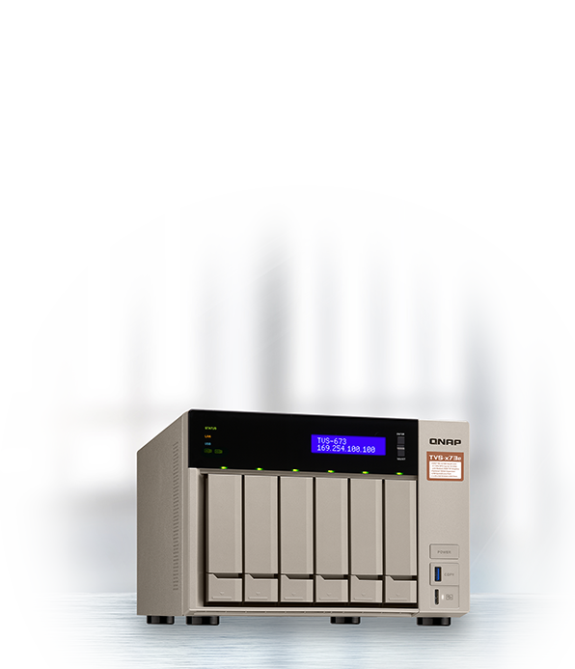
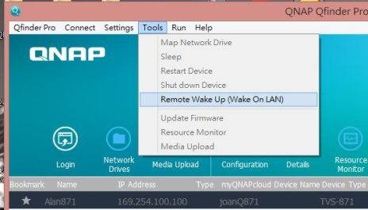
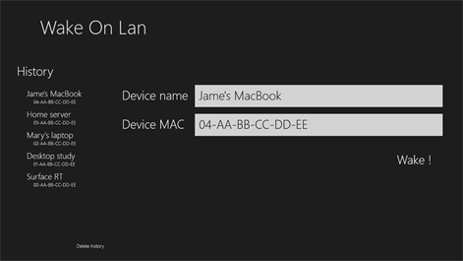
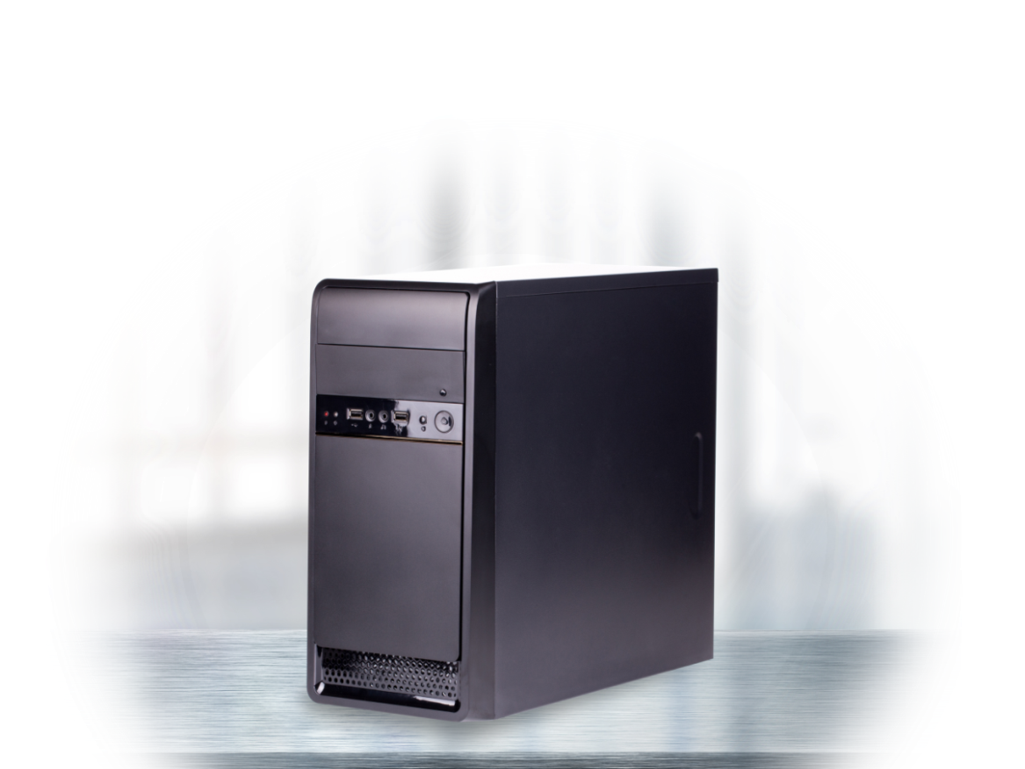
WOL & network booting
Wake your NAS or PC by WOL
Boot the PC by PXE
Qfinder Pro
Wake on Lan
PXE boot
Source: Microsoft.com & dell.com

Slide 16
Get ready for a 10G LAN party
Lower latency
High bandwidth
Source: Geforce.com
Notes:
win

Slide 17
High-speed transmission applications for NAS
File transfer between NAS
iSCSI JBOD (VJBOD)

Slide 18
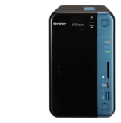
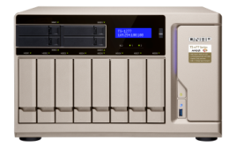
Speed up file sharing between workgroups
Collabration
File sharing
10GbE Switch
Server room
Notes:
QNAP NAS的各種端口能用來做什麼呢?
GbE: 進行一般網路傳輸， 雲端備份(S3， google cloud， one drive， dropbox)， 下載東西(download station， happyget)， 進一步還可以 shared link讓別人網路下載， 用web伺服器架站
Thunderbolt: 能讓您的Mac進行快速資料拷貝， 以及一下子就能完成TimeMachine備份. 新一代高階的Windows筆電也不需要透過隨身碟或WiFi慢慢傳檔， 他們也開始內建Thunderbolt接口帶來最方便的體驗.
10 GbE: 原本主要用在高階快速的機房， 但現在您在家就可以透過NAS架起來虛擬化的世界. 另外還有跨入家用市場的影像編輯， 機器間的快速備份(HybridBackup sync)， 甚至佈建5~8百萬畫素， 高達4K解析度的監控系統.

Slide 19
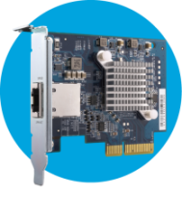
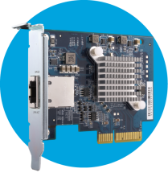
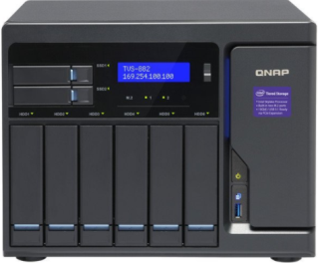
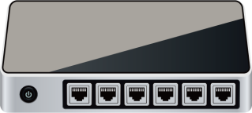
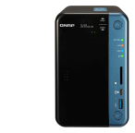
Mount huge storage space with VJBOD
Use VJBOD to mount other NAS's LUN as local disk
2 x QXG-10G1T
High speed
10GbE
Virtual Pool 1
RAID
TVS-682
10GbE
Virtual Pool 2

Slide 20
Enterprise-grade disaster recovery solution
High-speed
Hybrid
Backup Sync
Backup
Restore
Notes:
check if the backup transfer rate degraded
高效的資料備份
及時的災難復原ch
妥善保存機密及敏感性資料

Slide 21
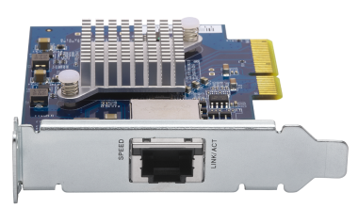
QXG-10G1T NAS installation
1
2
3
Identify the required bracket
Change bracket
Install the QXG-10G1T in the NAS
TS-x77 series (PCIe slot 1) requires a full-height bracket
Notes:
裝兩張 QXG-10G1T 到 x73e，然後前往NVS

Slide 22
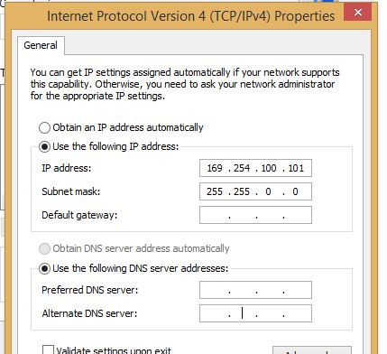
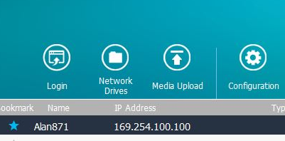
Connect PC & NAS with QXG-10G1T
1
Modify Interface setting
2
Use Qfinder Pro
Notes:
對接設定教學或是NAS發ip給PC (DHCP server)
PC+NIC, <> NAS+ NIC
PC 裝 Qfinder Pro

Slide 23
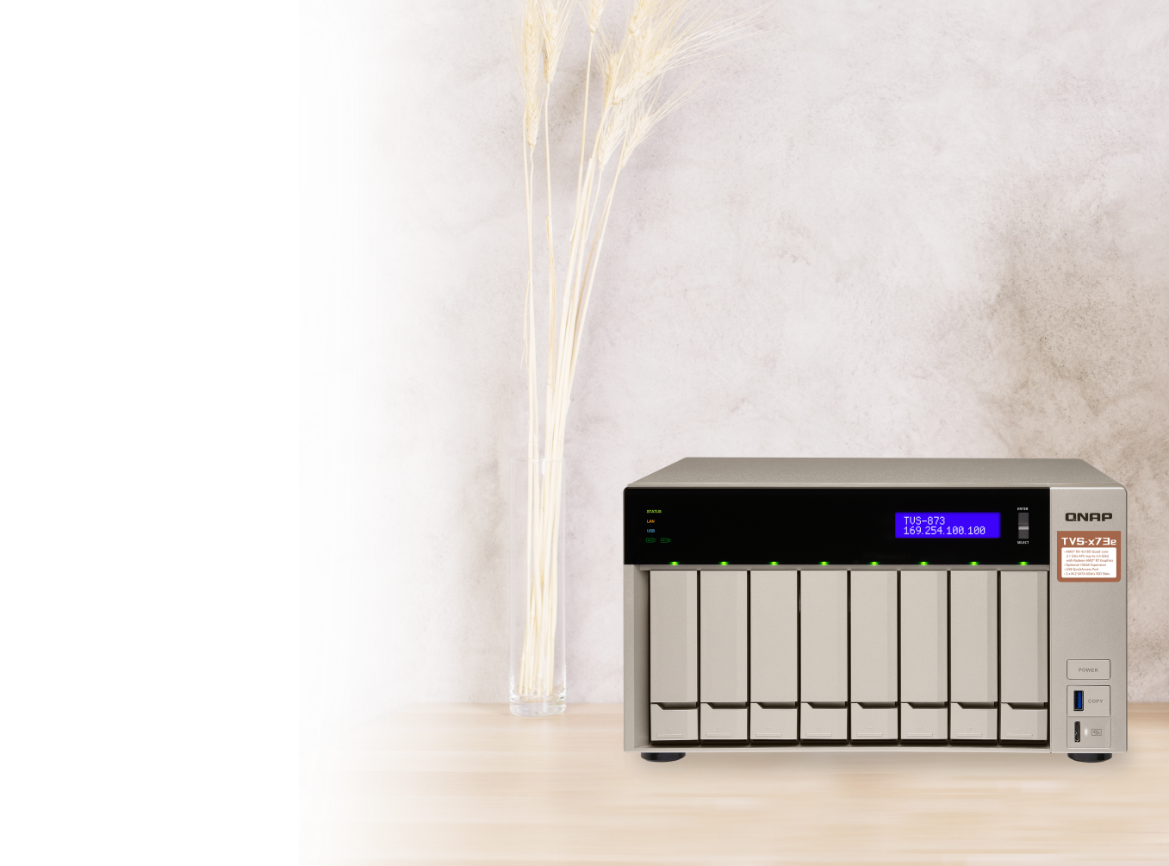
10GbE performance test results
QXG-10G1T
(1 x GbE)
(1 x 10GbE)
1056
1175
Windows PC & NAS
with QXG-10G1T
113
112
MB/s
Download
Upload
Download
Upload
Tested in the QNAP LAB. Figures may vary by environment. NAS operating system: QTS 4.3.4, RAID 5 w/ 8 x Intel SSDSC2BB240G4 SSD
Client PC: Intel® Core™ i7-4770 3.40GHz CPU; 16GB RAM; QXG-10G1T NIC ; Windows® 10 64-bit; 10GB file transfer by Robocopy
TS-1277

Slide 24
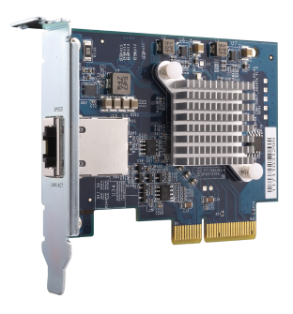
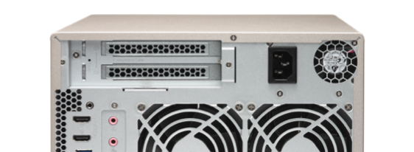
Manage multiple NICs in Network & Virtual Switch
1
Check the topology in Network & Virtual Switch
X2
2
Edit each NIC directly
Notes:
裝兩張 QXG-10G1T 到 x73e，然後前往NVS

Slide 25
Add redundancy with port trunking
x 2
Provides a failover mechanism to maintain network availability
Increases bandwidth and adds load balancing for more clients
Applicable for both 1 GbE & 10 GbE
10GbE bandwidth
PC
802.3ad
8 x GbE & 2 x 10GBASE-T Switch
laptop
GbE bandwidth
Android
TV
Port Trunking
Notes:
目前可以 1GbE + 10GbE 混用

Slide 26
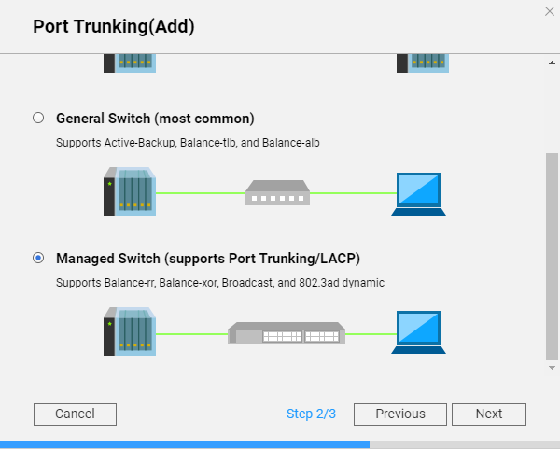
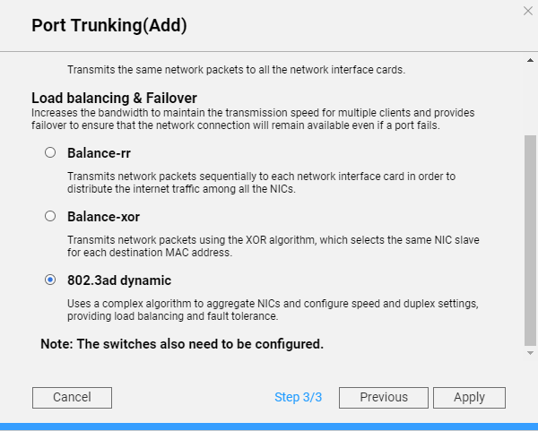
Demo: set up port trunking
1
Interfaces
2
Switch mode
3
Type

Slide 27
QXG-10G1T Single-port, 5-speed 10GBASE-T network expansion card

