Slide 1
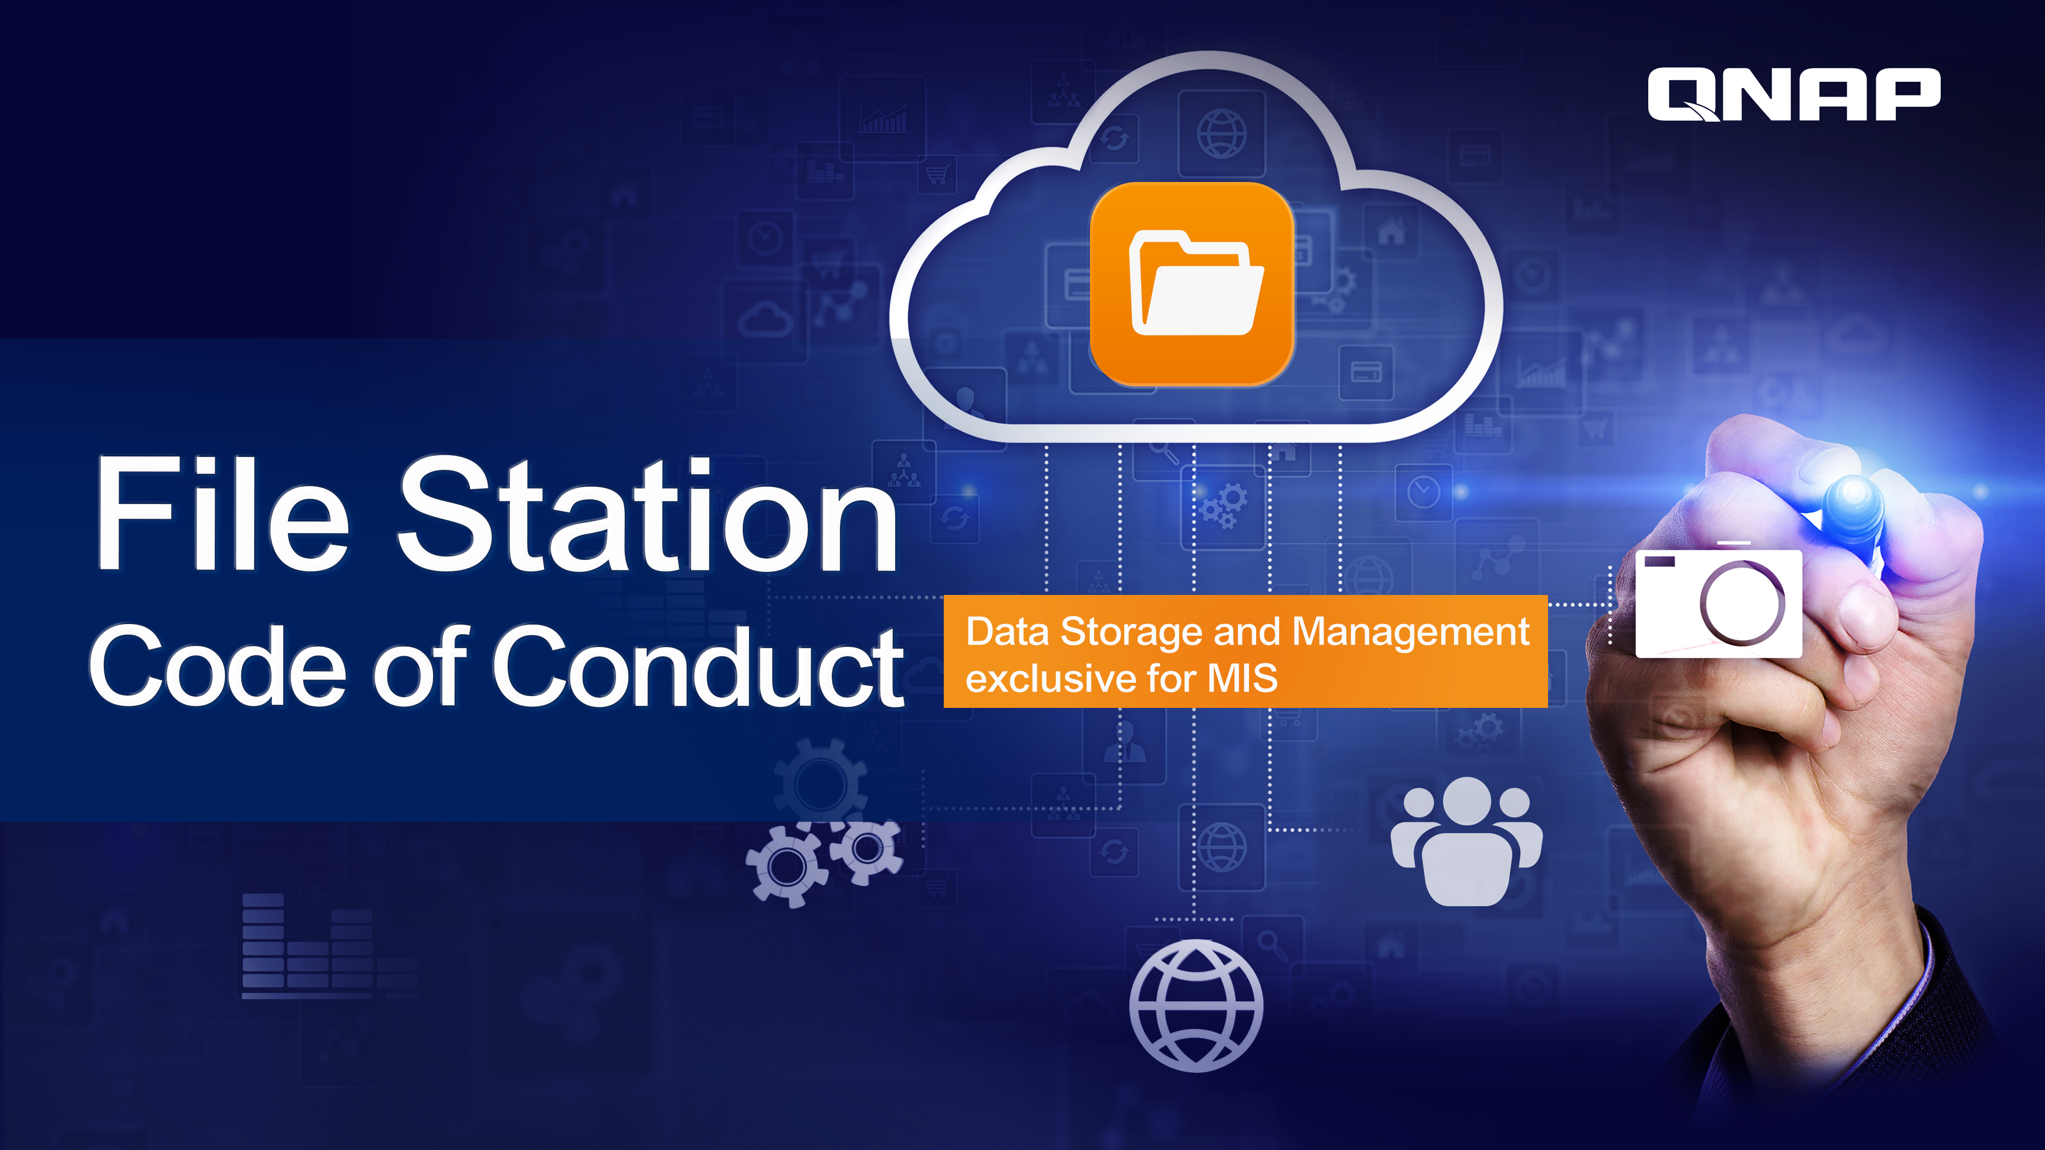
Notes:
File Station
Code of Conduct
Data Storage and Management exclusive for MIS

Slide 2

Most discussed features explained!
Notes:
Facebook trending topics session

Slide 3

A top storage solution should be…
A.
B.
Highly efficient to save time and efforts for users
Easy to manage without any side-effects

Slide 4
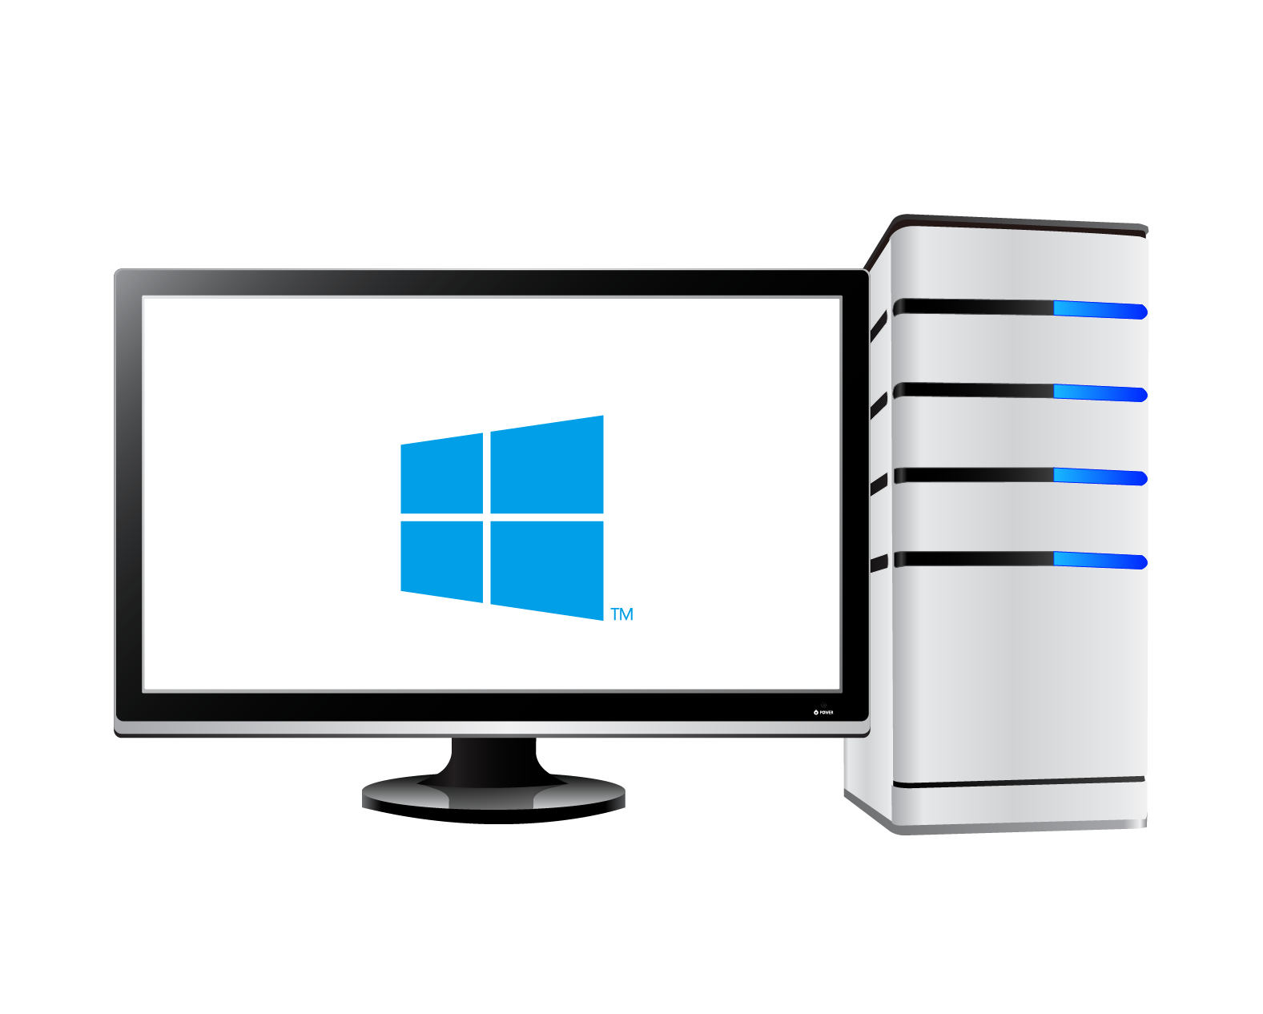

What is server-side copy?
Client-side copy
Server-side copy
Server (NAS)
Server (NAS)
Folder A
Folder B
Folder A
Folder B
File Copy
Download
Upload
Send Instruction
With server-side copy, copying is instantly done inside the
server (NAS). No additional network traffic is generated.

Slide 5

A highly efficient storage…
Action (23GB file x 1) | Clip | Item | QNAP TS-253B EXT4 | Synology DS 718+ EXT4
Server-side copy in Windows (SMB 3.0) |  | Time spent (m:ss) | 0:11 | 2:33
 |  | Throughput (MB/s) | 2189(MB/s) | 157(MB/s)
Copy via File Station |  | Time spent (m:ss) | 0:03 | 2:46
 |  | Throughput (MB/s) | 8028(MB/s) | 145(MB/s)
Above testing used QNAP QTS 4.3.4.0464, RAM 4GB vs. Synology DSM 6.2 - 23511, RAM 4GB
TS-253B has 13 times higher efficiency than DS 718+.

Slide 6
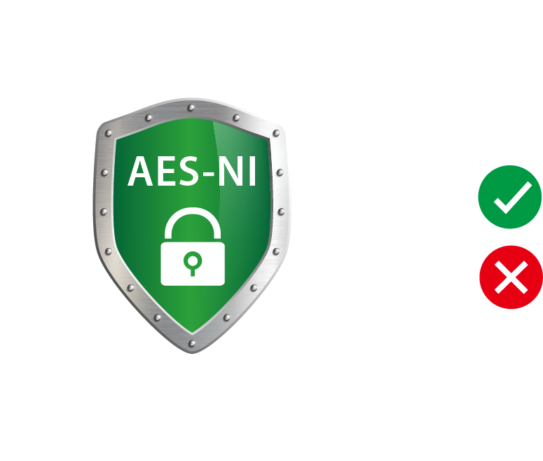
…and a worry-free storage
 | File System | Properties | Original File Damaged | Upload copied file to overwrite original file
QNAP Fast Block Cloning | EXT4 | Occupied space = file size. | Copied file stays normal | Performs as normal
Synology Fast Clone | BTRFS | Occupied space ≠ file size | Copied file damaged as well | Required space increases
Unpredictable usage
Worse with multiple users
QNAP EXT4 is advanced in data protection and storage management.

Slide 7

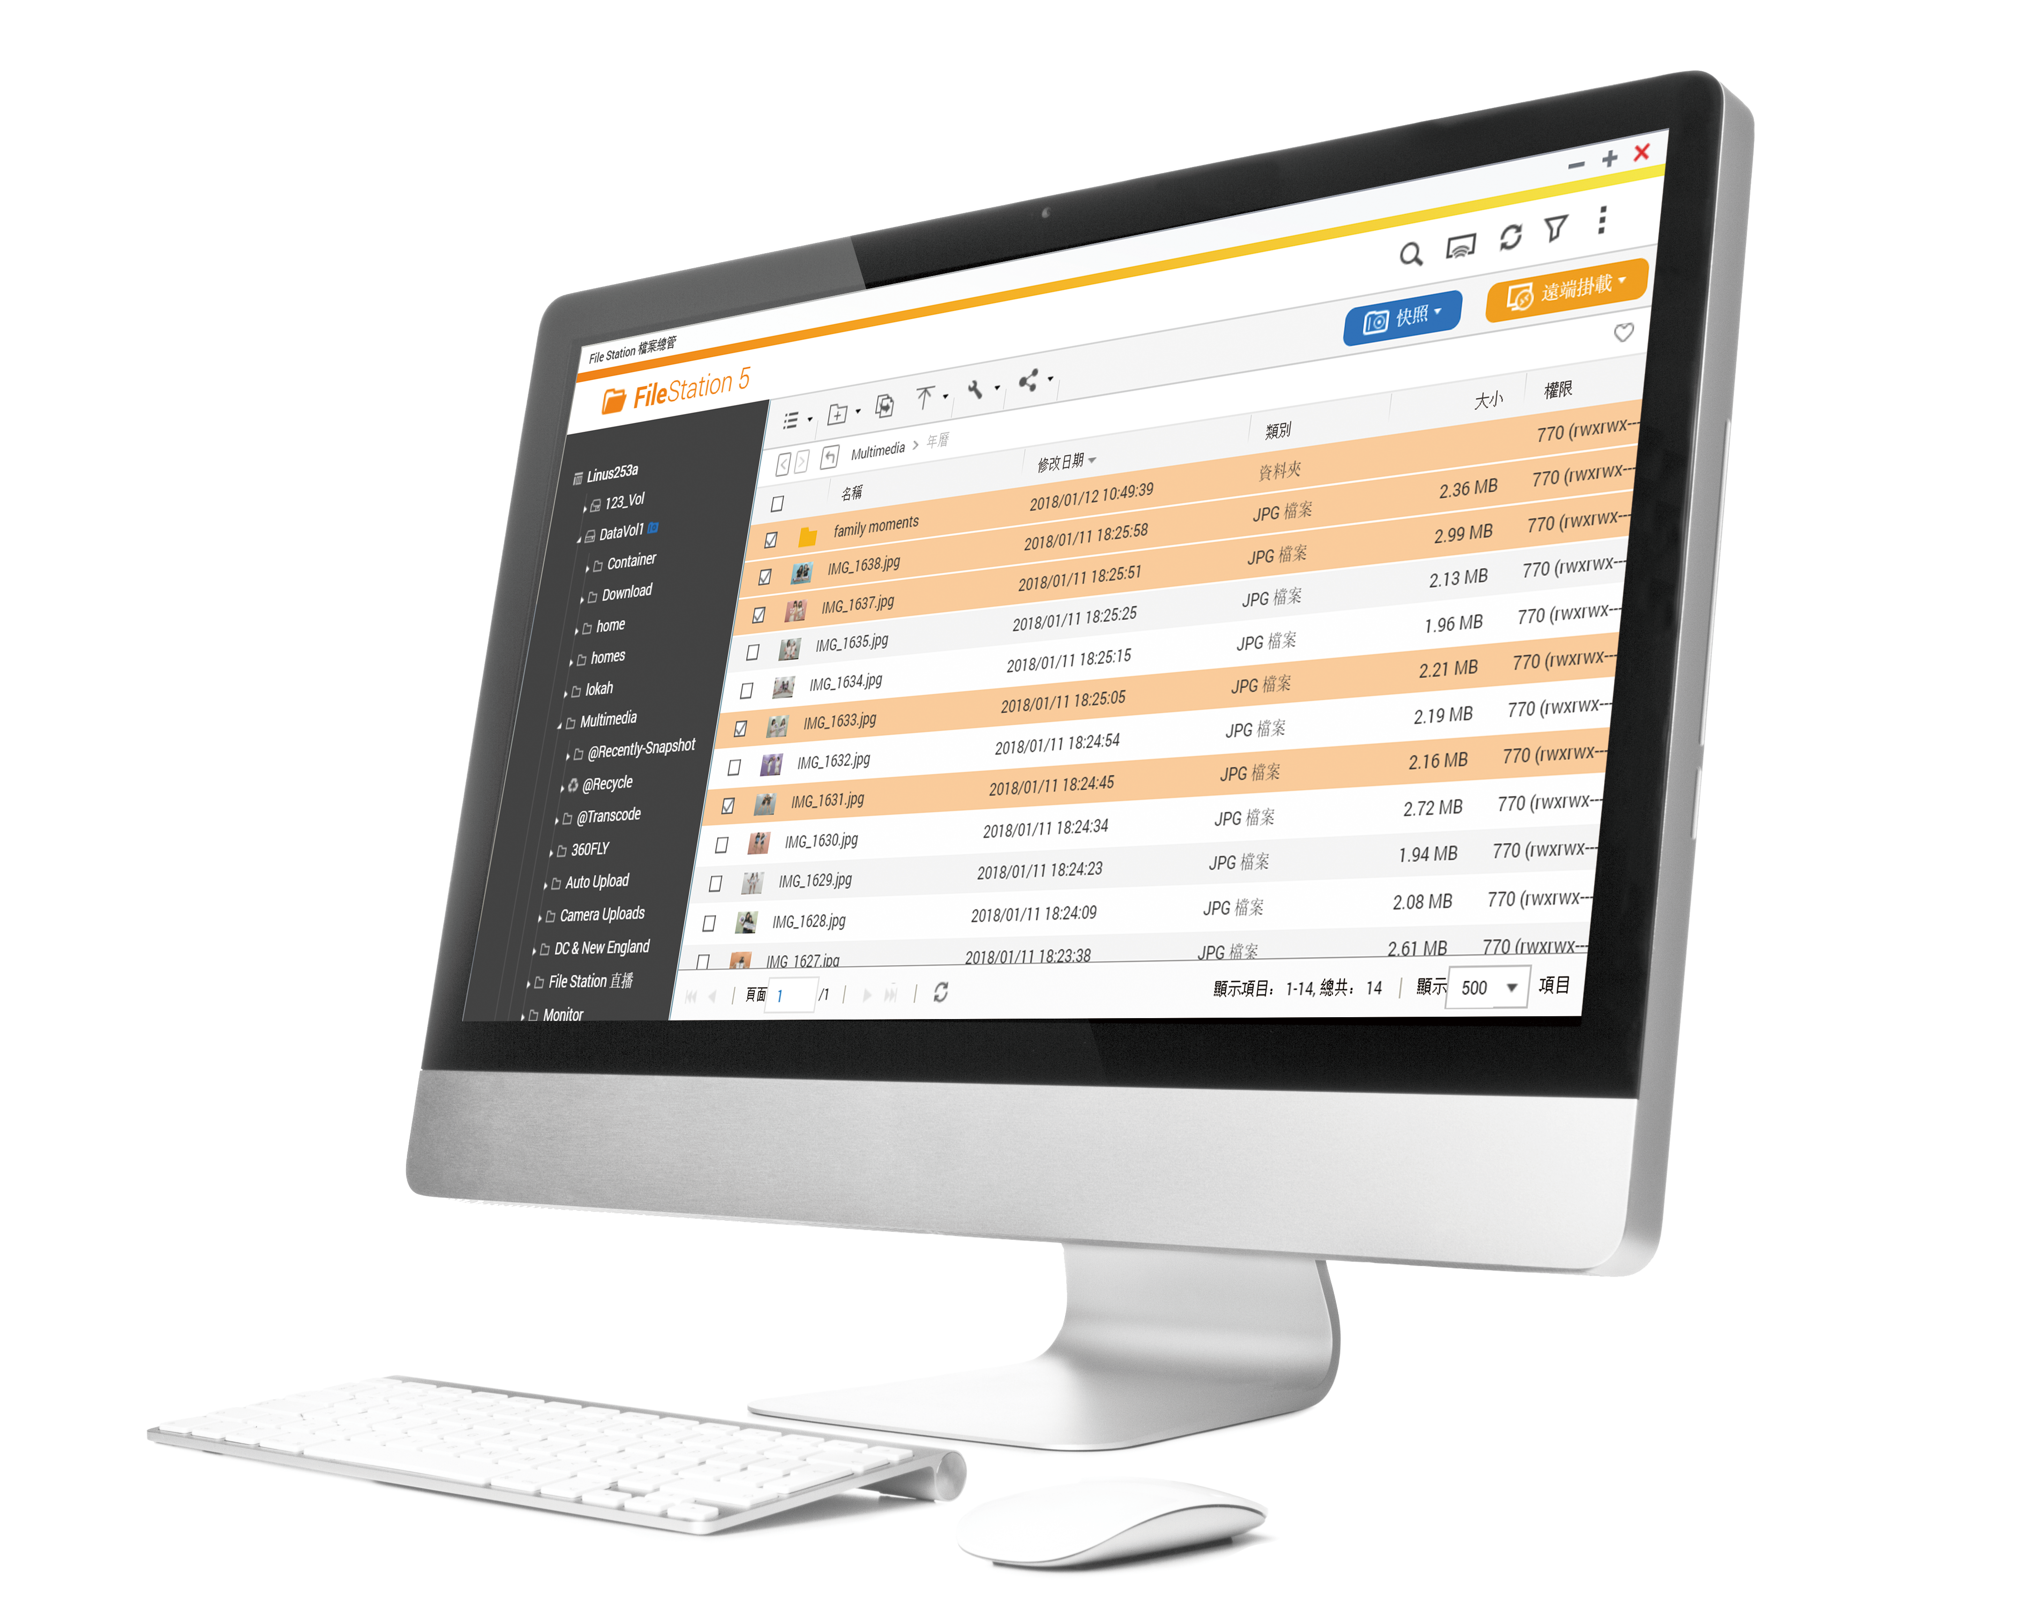

File Station
Intuitively manage all files

Slide 8
File Station core competences
The Center of Everything
    Local NAS
    Cloud Service
    Mounted
    Remote NAS
    External Devices
File Preview
Online Office, Google Doc
Multimedia file
360 panoramic videos & photos
Stream to client VLC
Instant file sharing
Social Media
Security – Password, Valid Date
Smartshare
Snapshot
Snapshot, snapshot vault
Restore snapshot
Volumes, folders, File flexibly select

Slide 9
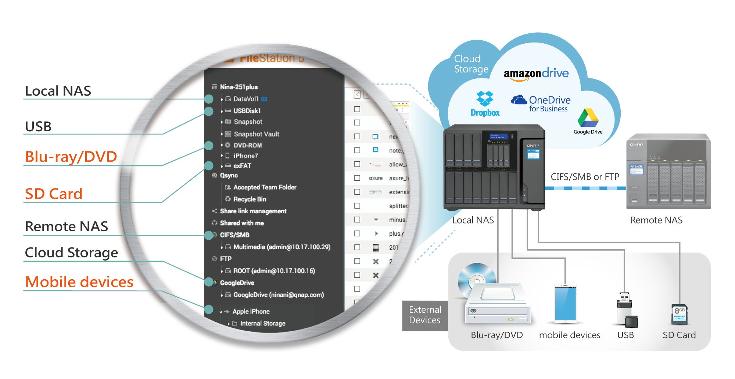
The center of everything
8 Cloud Services
Remote NAS
New
All-in-one interface.
4 External Devices

Slide 10






The center of everything
QNAP File Station
DSM File Station
win
Cloud Service
DVD/Blu-ray, mobile device
SD Card, USB external device
win
SD Card, USB external device
External Device

Slide 11
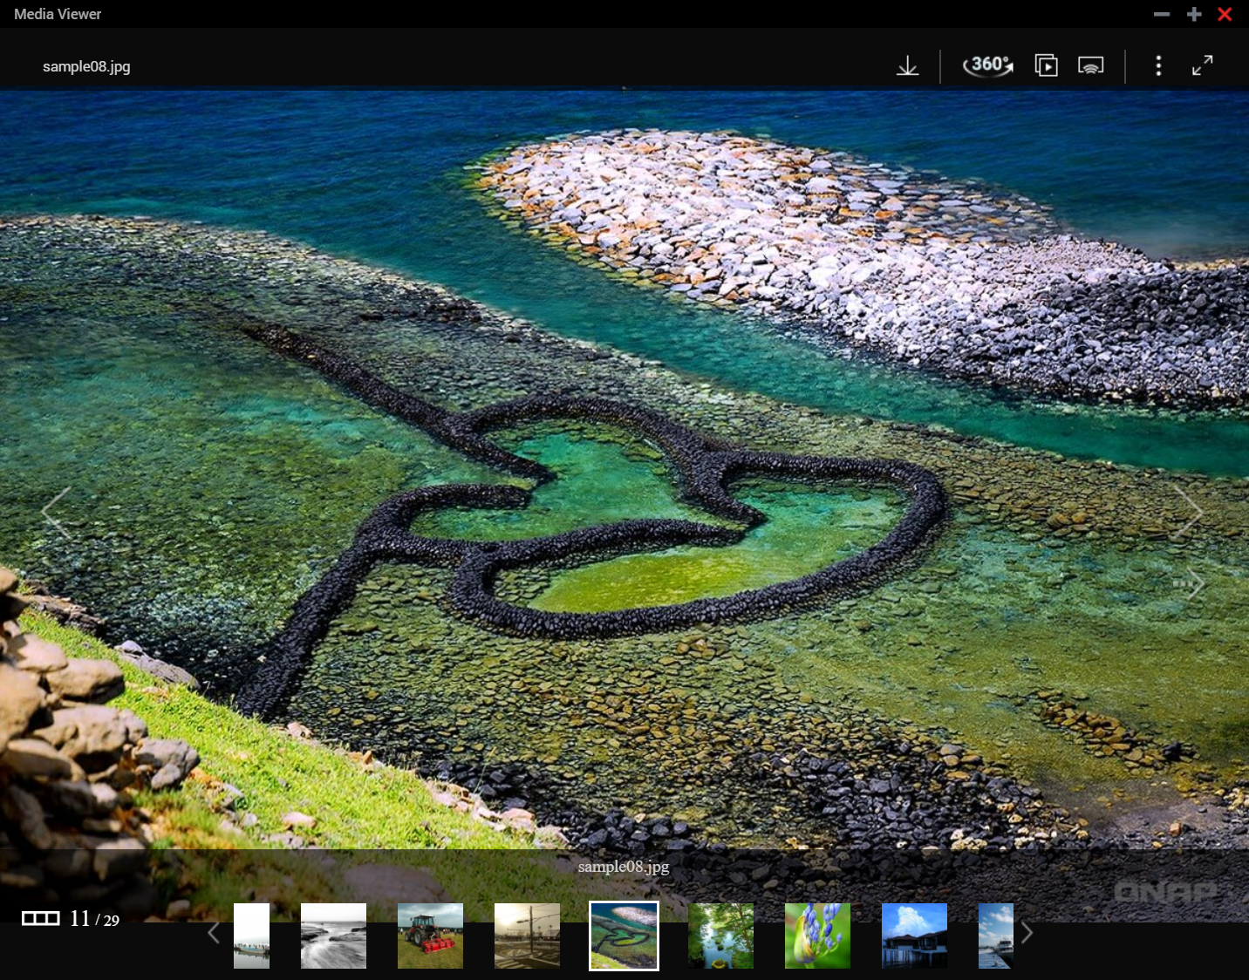
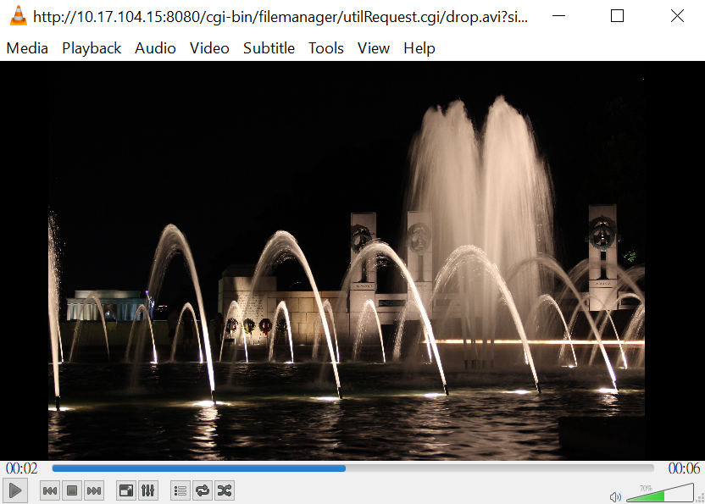

File preview at a glance
Music, Photo, Video instant preview and thumbnail.
360 panoramic
videos/photos preview
Streaming to various devices
Streaming to VLC Client

Slide 12

Problems about file sharing
How to share files with group members easily?
How to gather files from all members quickly?
How to ensure file sharing security?
How to manage files that are being shared?

Slide 13
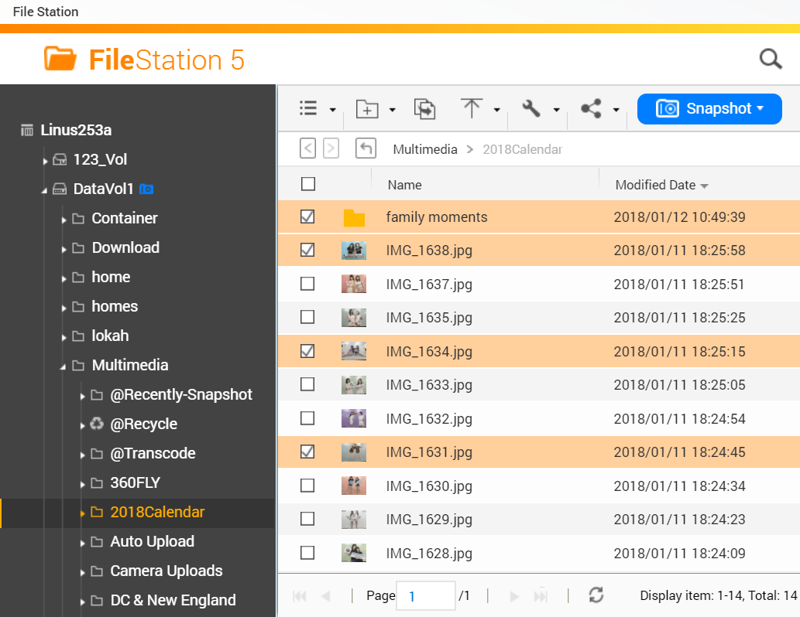
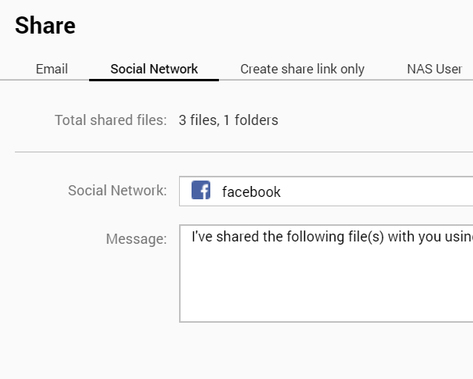

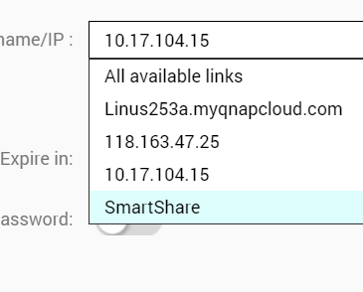
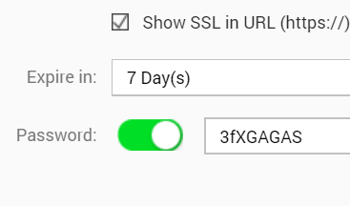
Share files easily and securely
File
NAS User
Folder
Email
Flexible Selection
Various
Methods
On Demand
More SM
Custom
Domain
Secured
Sharing
Smartshare
Valid date
Custom domain
Password
High flexibility
SSL Secured

Slide 14

Sharing in 3 steps
Select
Pick folders and files
Set
Choose domain and security settings
Send
Send to forum or
NAS user

Slide 15
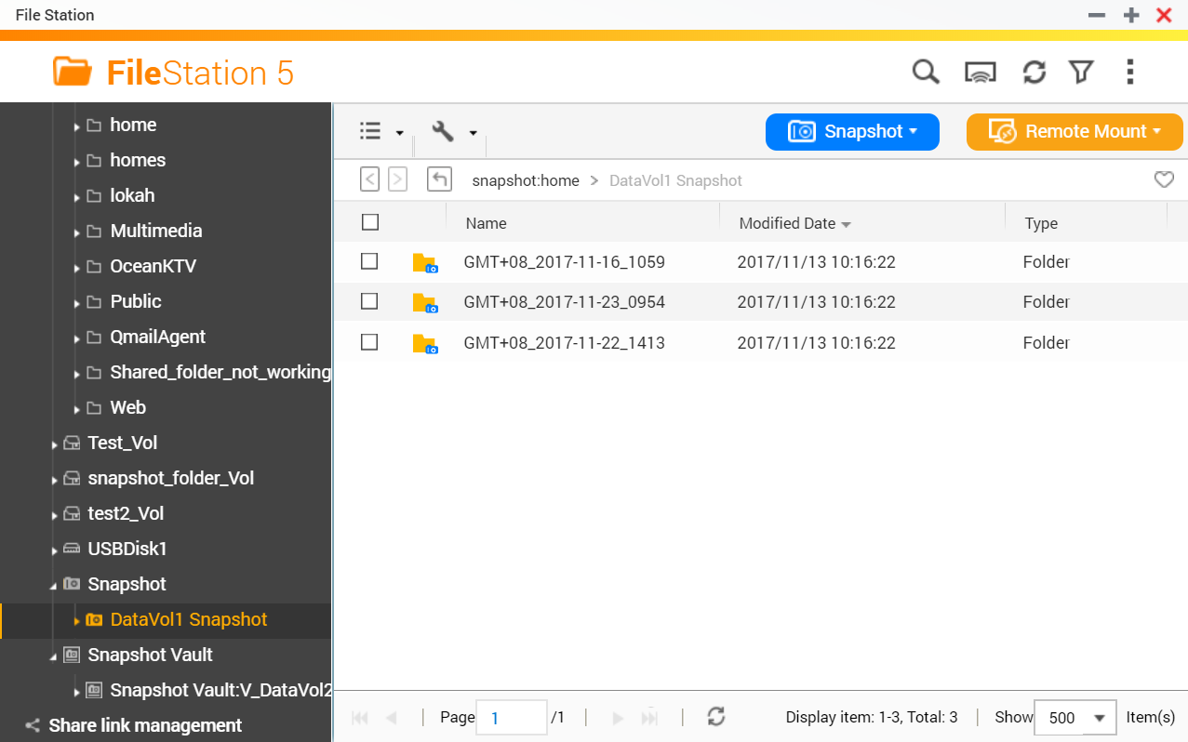
Snapshots at your disposal
QTS 4.3.4
File Station
Snapshot Manager
Manager Files
Version Control
Instant Preview
File restore
All-in-one interface
Snapshot vault
1+1 > 2 Single interface, double the features

Slide 16


Qfile
Put massive files into
your pocket

Slide 17

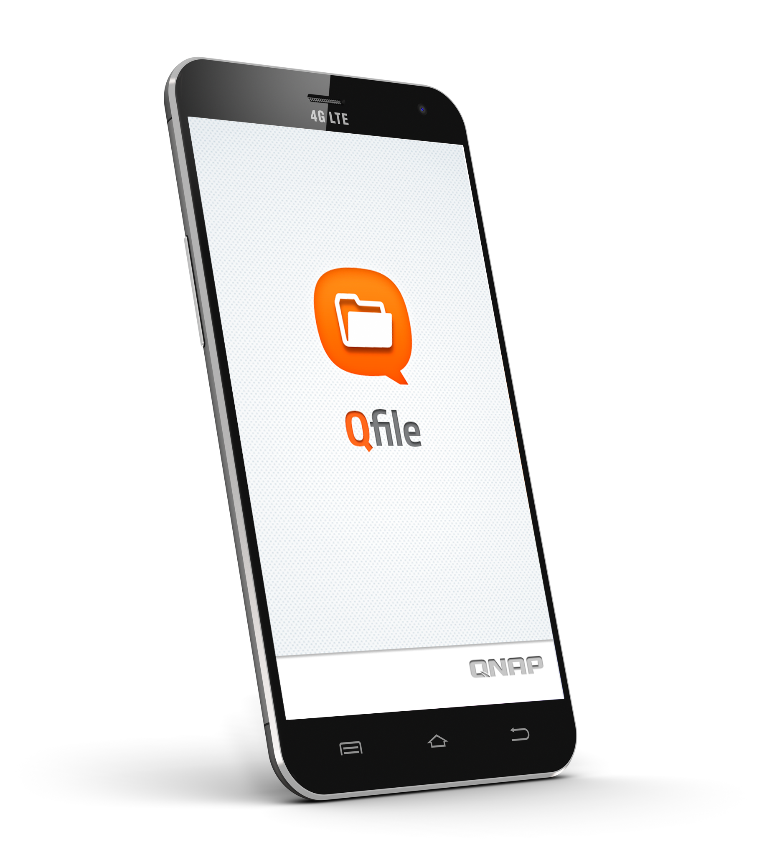
Qfile
Open ShareLink
All-in-one App
Support File Station sharing settings
Qfile open share link
Local NAS files
Cloud Service mounted
Remote NAS files
External devices
Advanced Security
Auto Upload
Import NAS info with QNAP ID
2-step authentication.
Passcode & Touch ID
Photo, Video, File auto upload
Get instant status with status bar

Slide 18
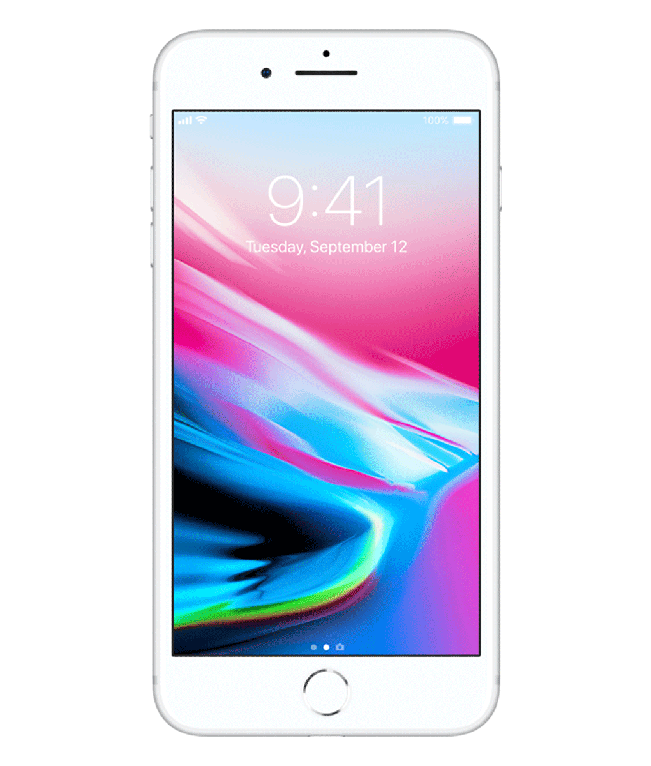
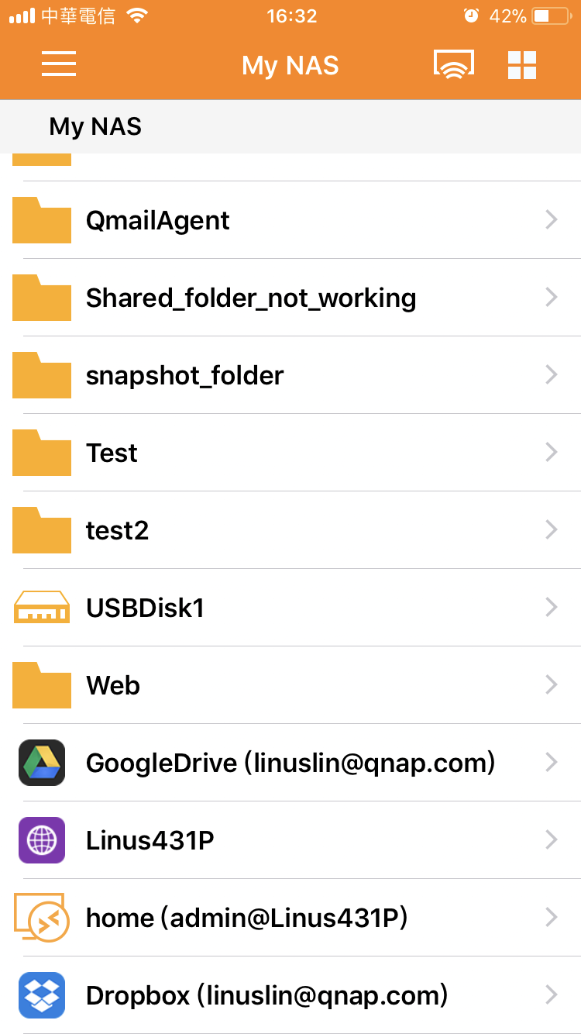
Qfile – an all-in-one app
External Device
Local NAS files
Remote NAS files
Cloud Service mount

Slide 19
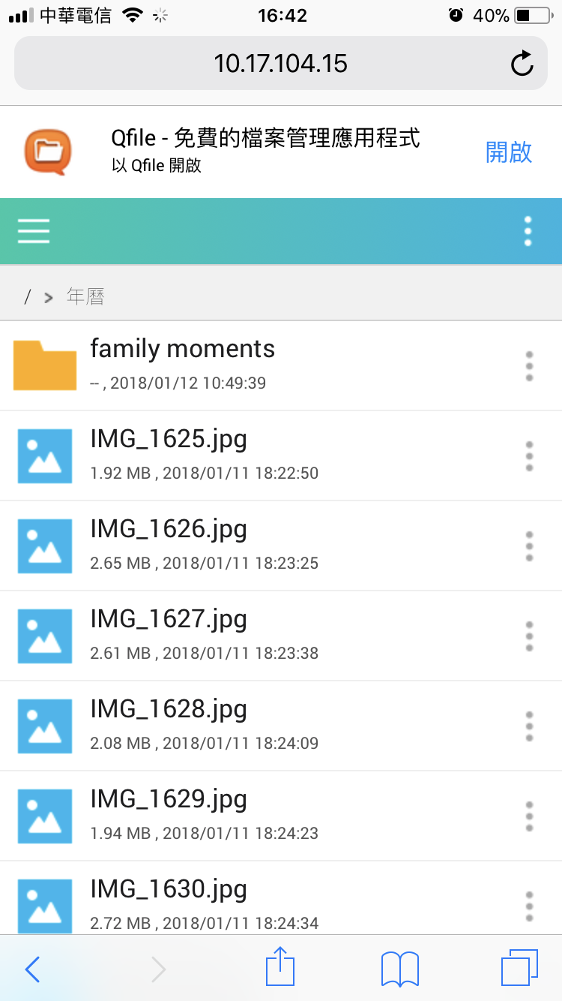
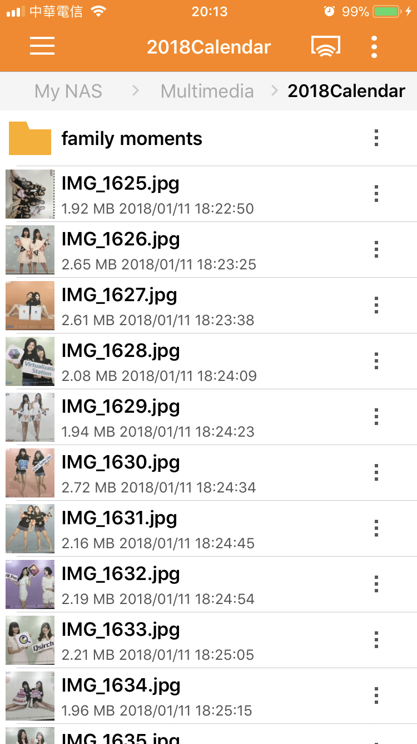
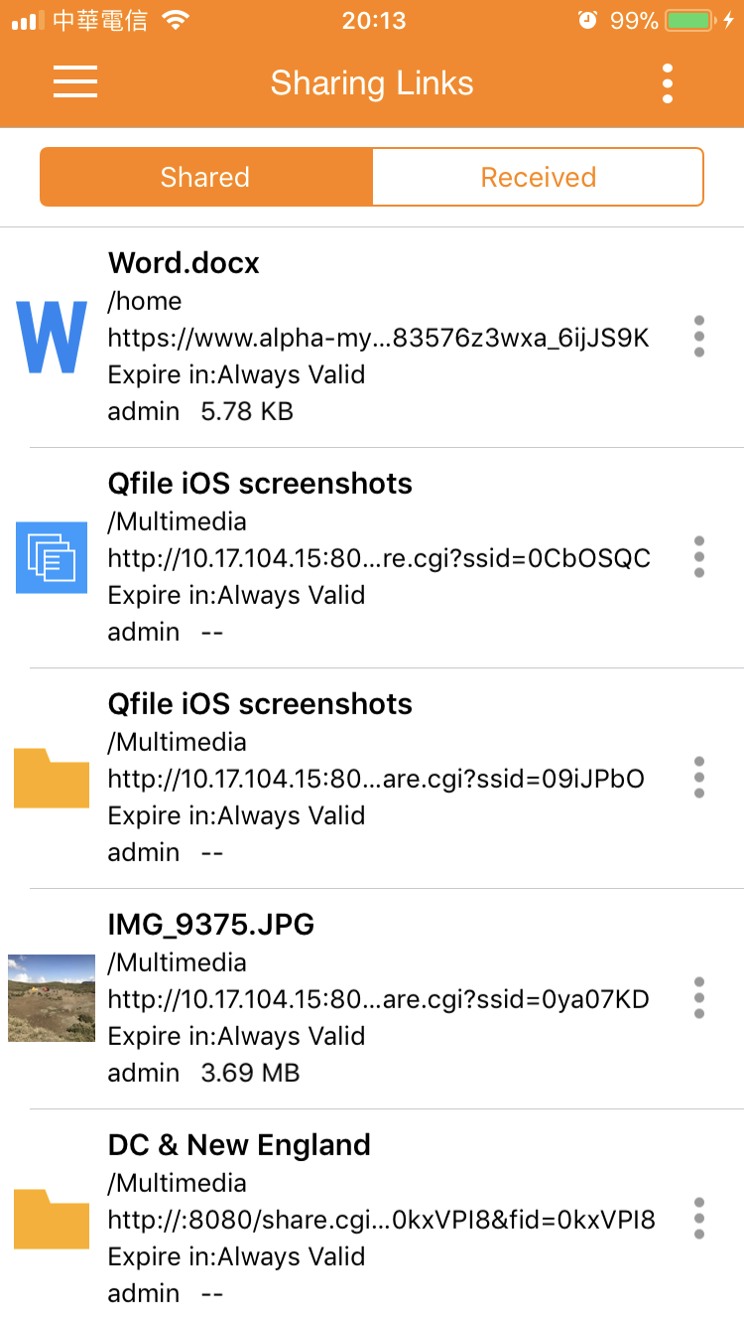
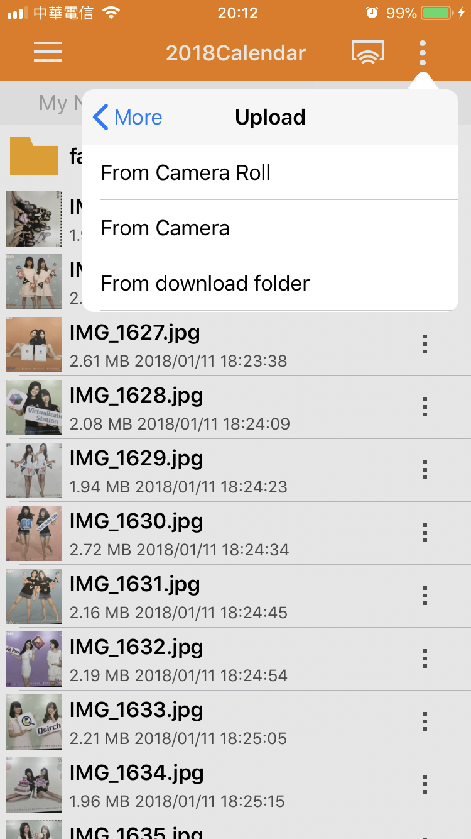
Qfile – sharing links
Open with
mobile browser
Open with Qfile
Advanced Sharelink
Share, receive, upload, and download, all actions covered.
Open with Qfile

Slide 20
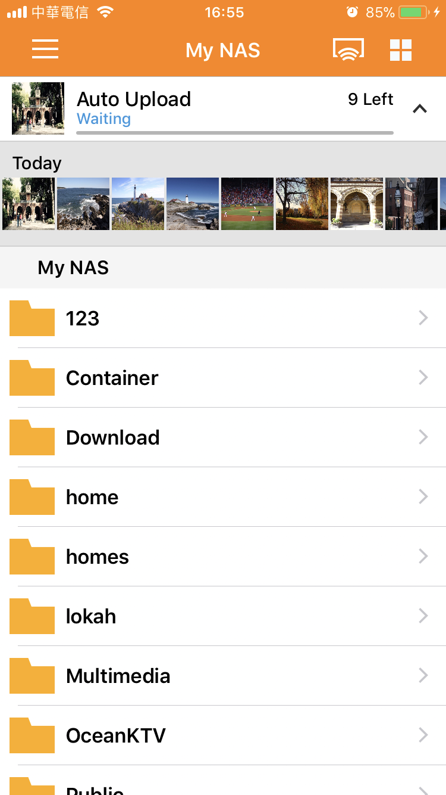
Auto upload - massive space for you
Custom Settings
Auto Upload Status Bar
Current status
Files waiting in list
Enable with
one switch
Wifi Only
saves your data plan
Background Upload
Non-stop upload
Recent files preview

Slide 21
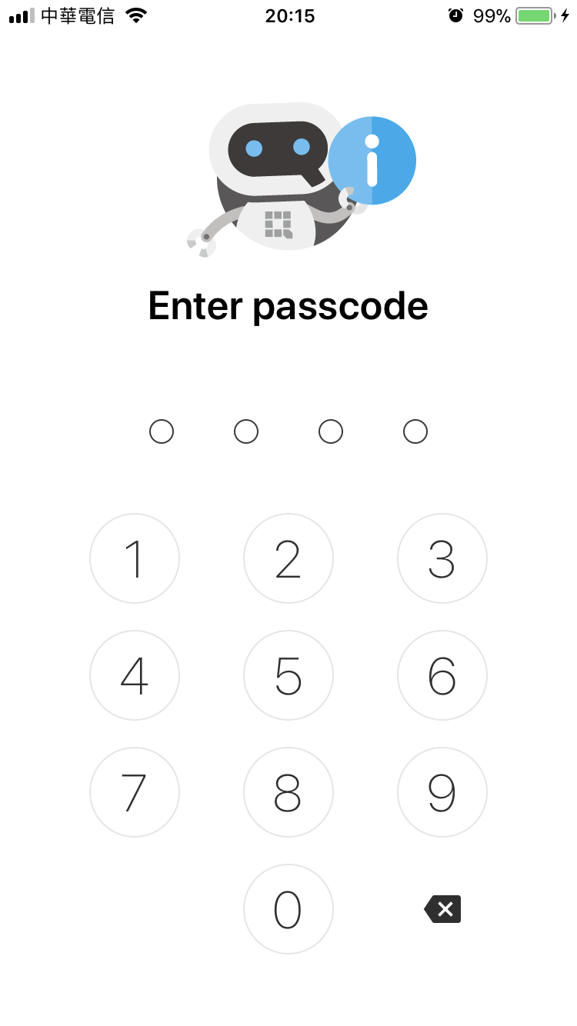
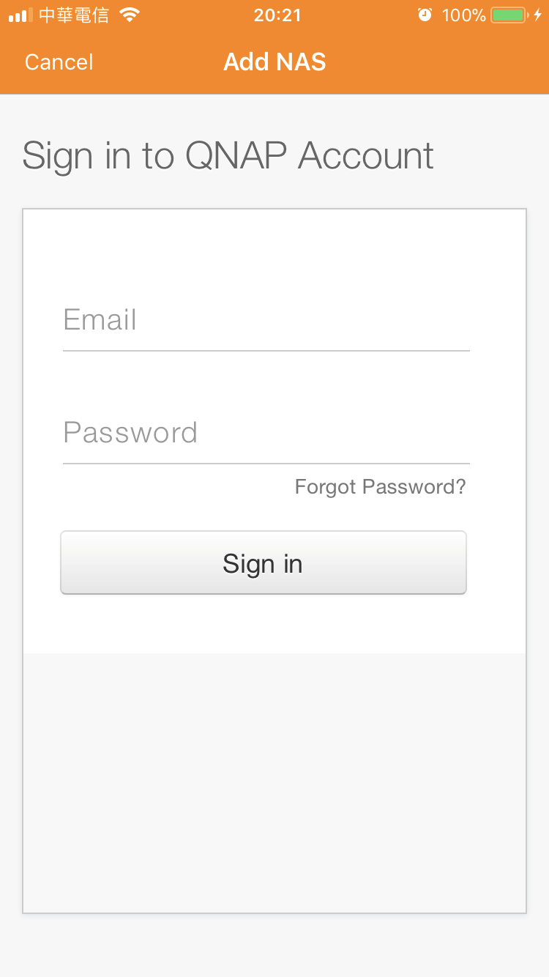
Triple protections secure your data
Passcode & Touch ID
QNAP ID
2-step authentication
Install authenticator
Setup in QTS
Get authentication codes when login

Slide 22


Demo

Slide 23
Core competence analysis
Item | QNAP QTS | Synology DSM
File Station | Manage 8 cloud services, blu-ray/DVD, mobile device, USB external devices with one interface | 4 cloud services, USB external devices
 | 360 panoramic video/photo preview | N/A
 | Snapshot at your disposal | N/A
 | Outstanding performance | Average performance
Mobile App (Qfile) | Open share link in Qfile | N/A
 | Monitor auto upload with status bar | Need to go to settings page.
 | Manage remote mount space | N/A

Slide 24
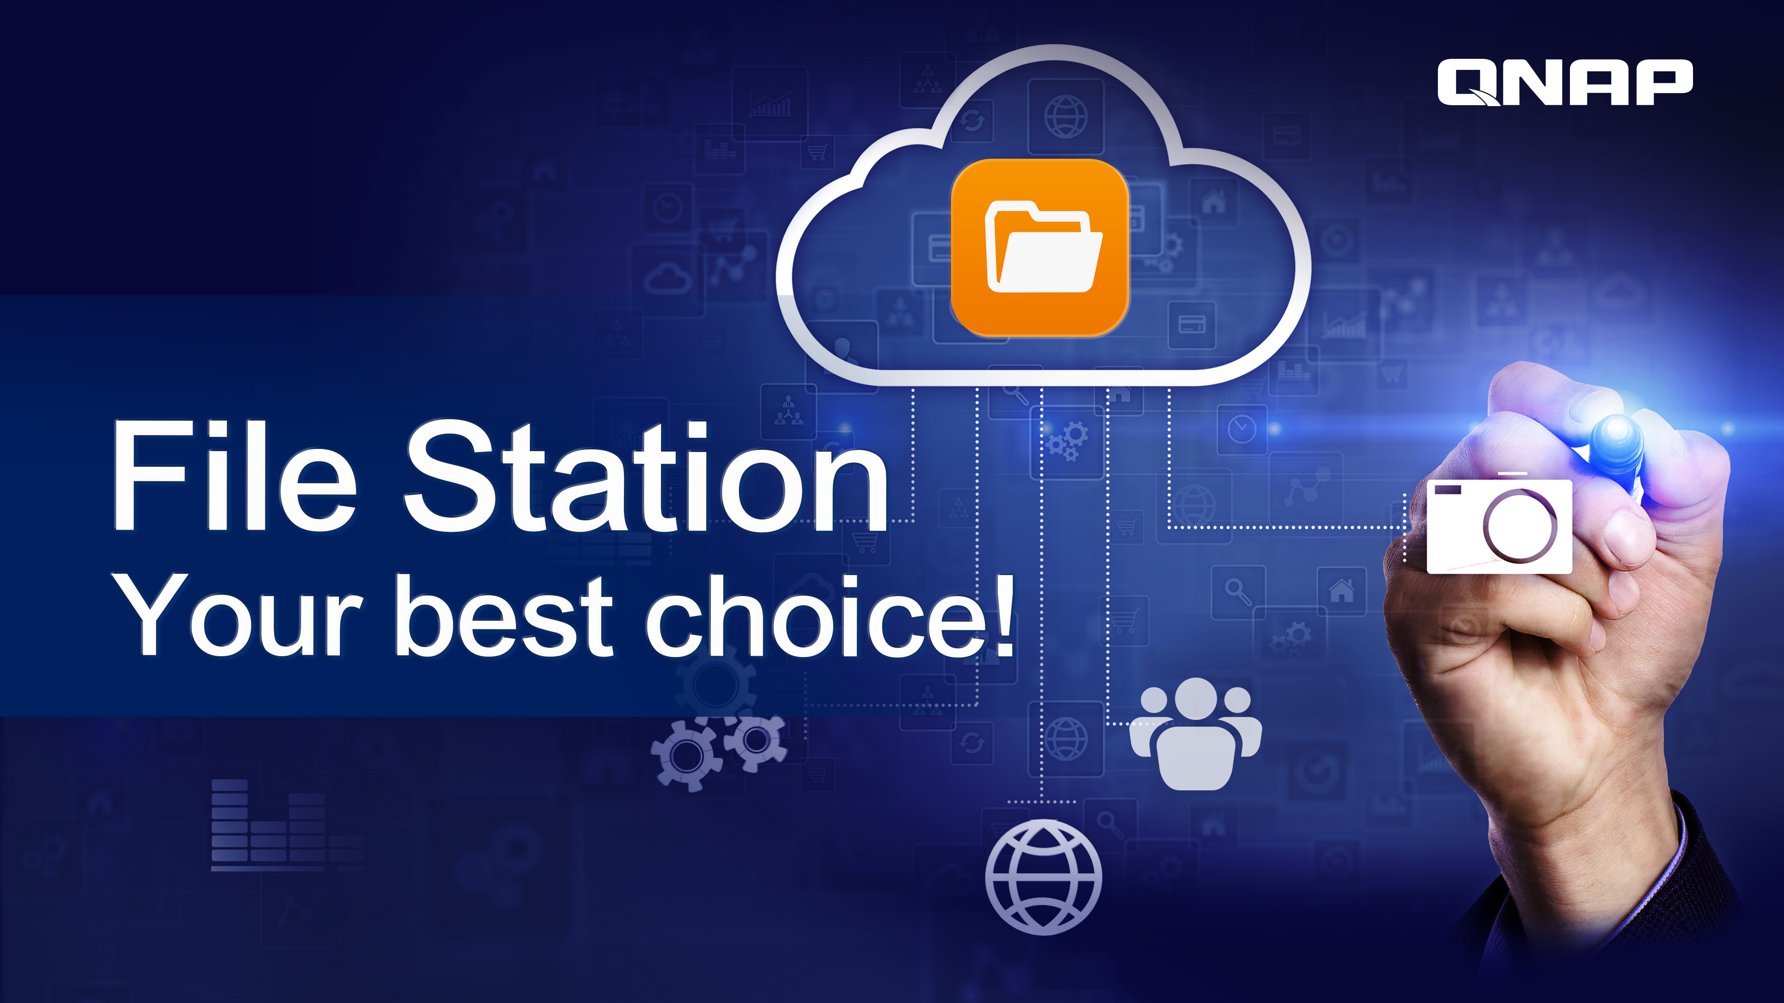
Notes:
File Station
Your best choice.

