Slide 1
QVR
Guard
The failover solution
for QVR Pro

Slide 2
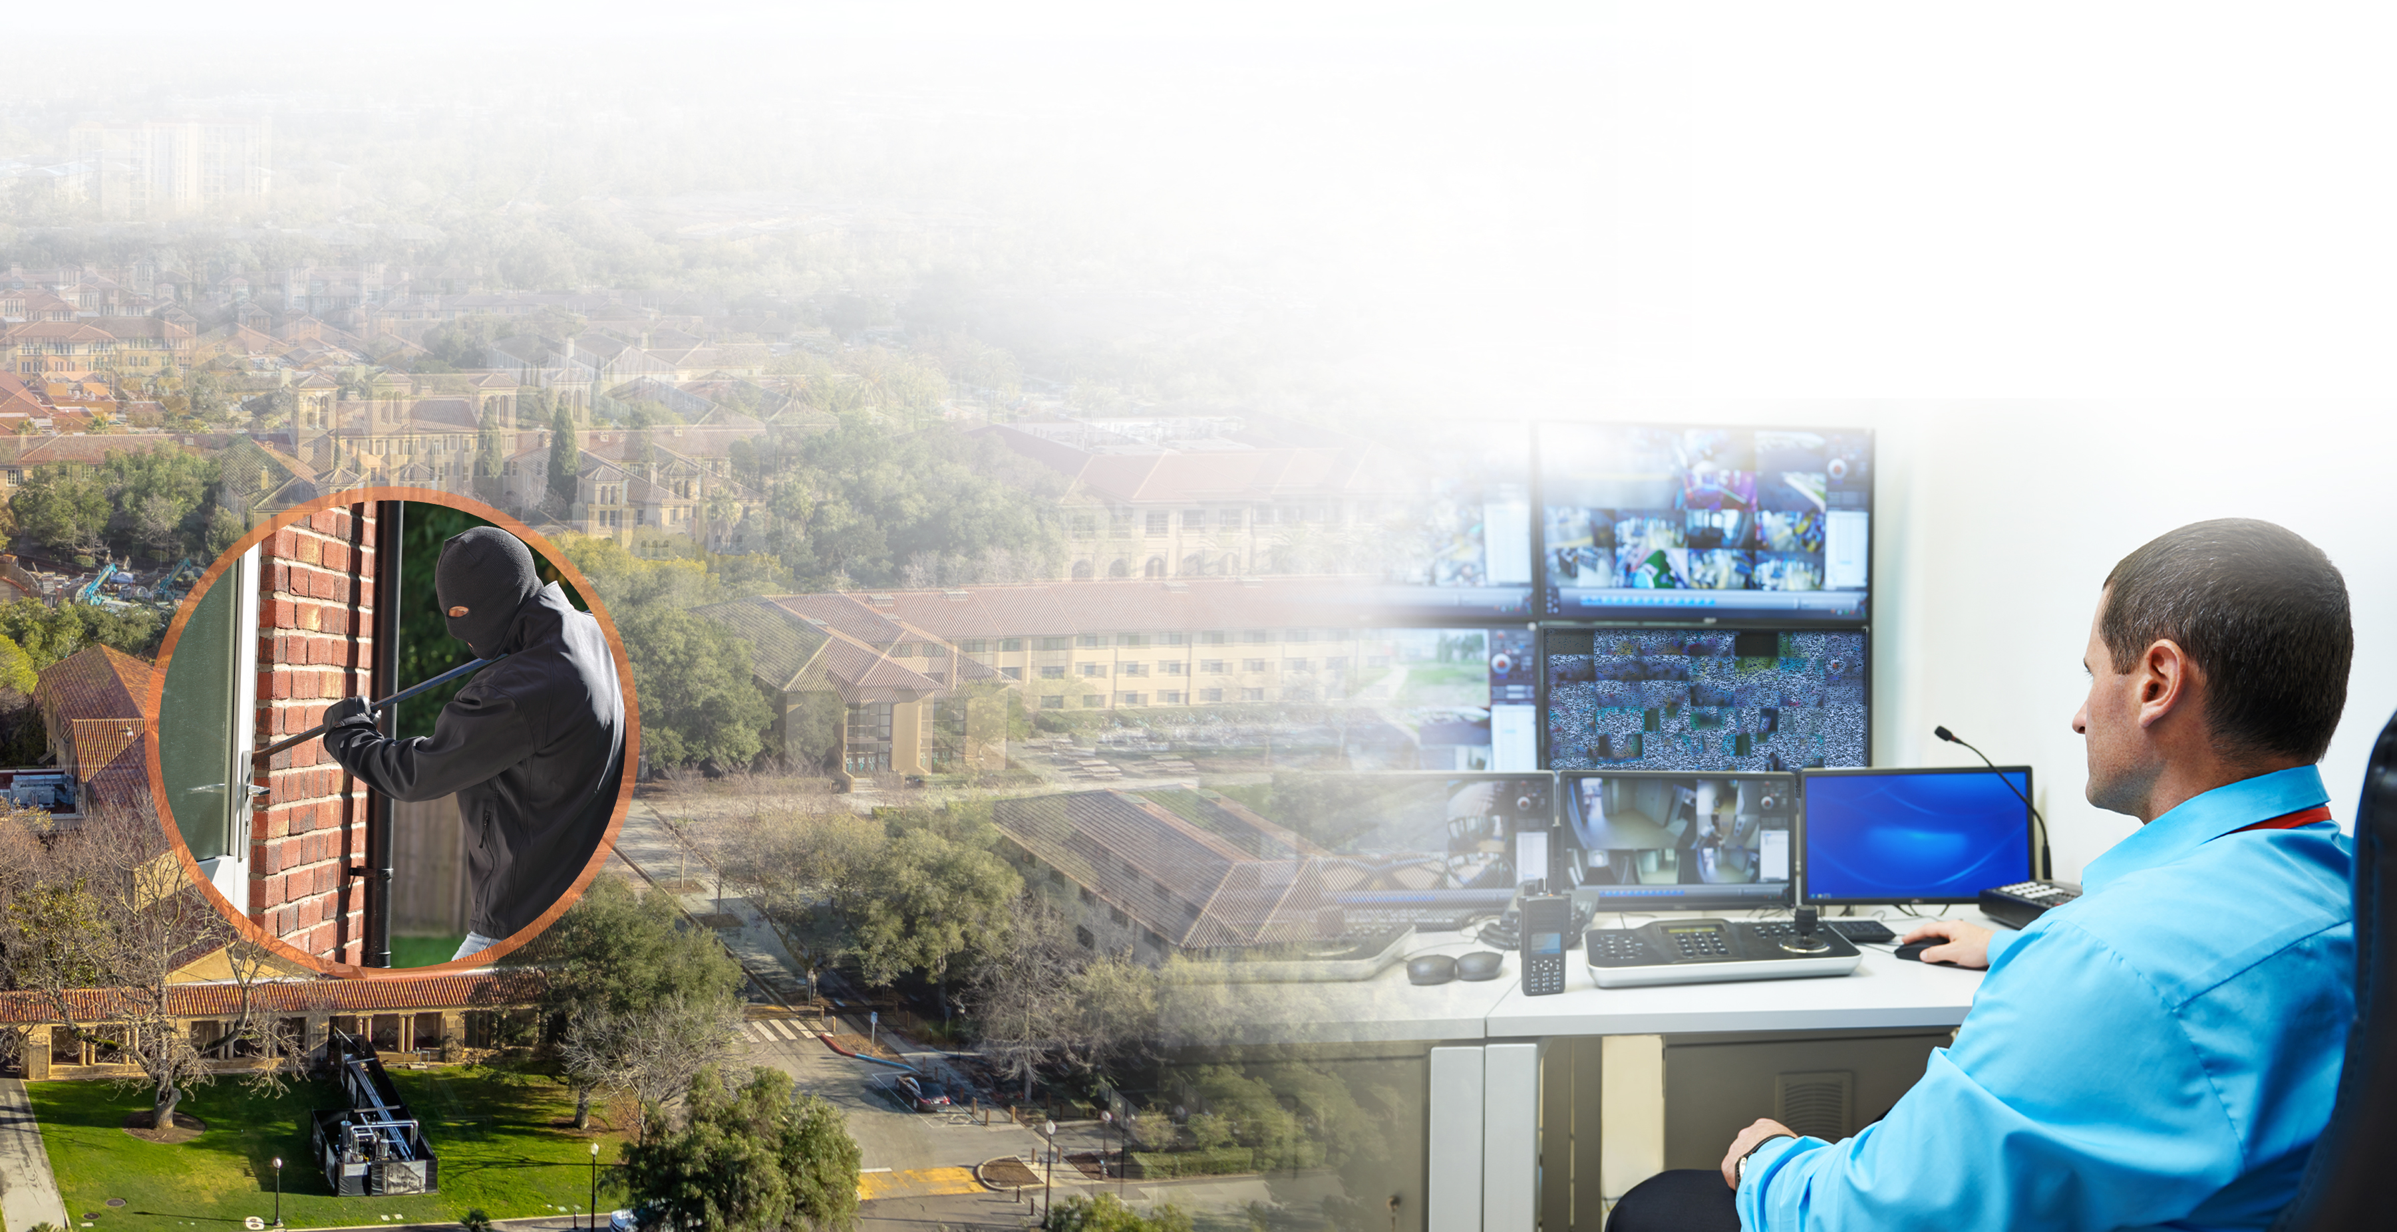
How to stay in control at all times?
How to ensure the important video feed is still being recorded when the recording system is malfunctioning?
How to select the failover device economically?
?
Unable to view and play video feed.
?
?
?

Slide 3
Why do you need QVR Guard?
UPS for power failure, RAID for disk failure, what's the solution for a malfunctioning NAS?
Install QVR Guard on a NAS of the same model as QVR Pro, then you have the failover capability to ensure uninterrupted recording.
QVR Guard has an independent failover recording space, ensuring uninterrupted recording.
During the takeover period, the recording is still 24/7.
During the takeover period, in QVR Pro Client, you can log into QVR Guard with the "admin" account to keep monitoring.

Slide 4
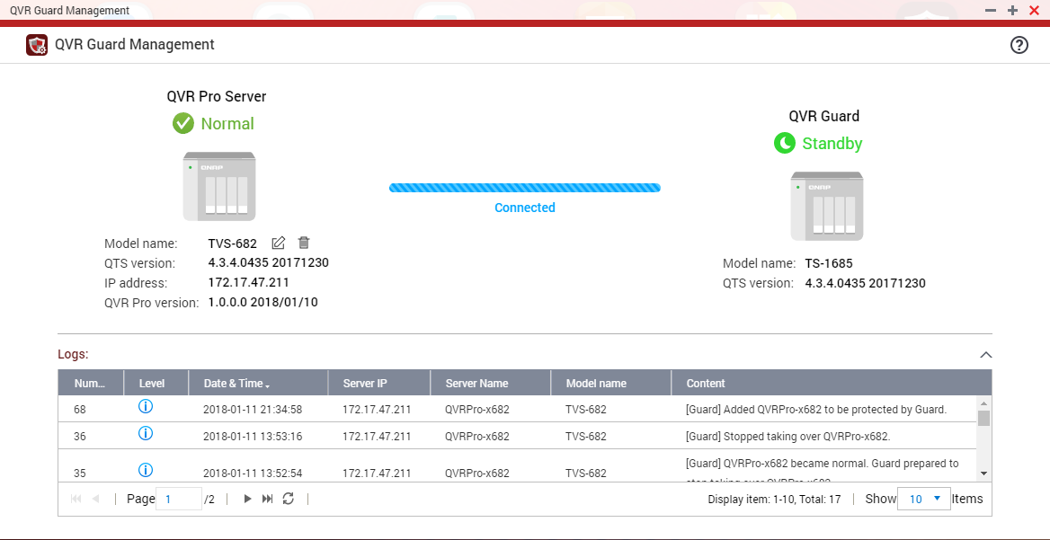
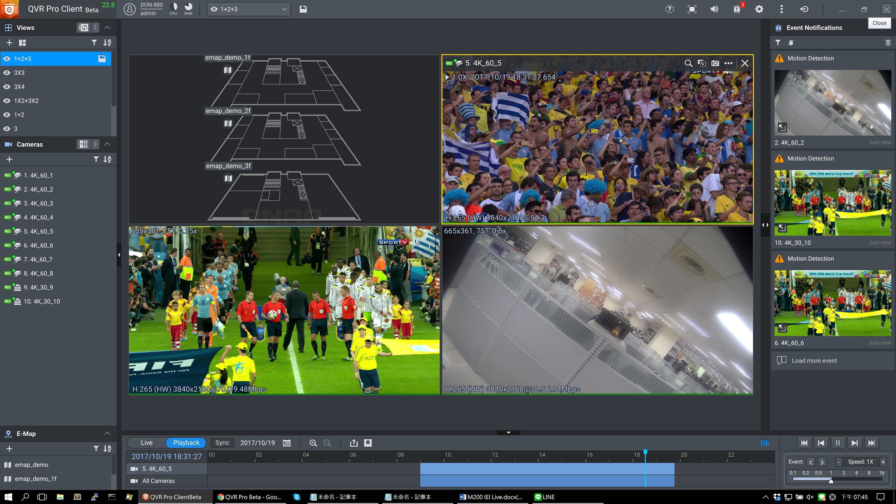
Why do you need QVR Guard?
Apart from ensuring uninterrupted recording, what else do you need from failover?
QVR Guard Management UI helps you take a overview of QVR Pro's operating status.
QVR Guard shows its operating mode, indicating the QVR Pro's operating status.
QVR Guard has its own logs, recording of the takeover time and the executed actions. Easy for the management to check for troubleshooting.
Uninterrupted remote monitoring
Upon QVR Pro's malfunctioning, QVR Pro Client can connect to QVR Guard to continue the monitoring.

Slide 5
Failover Mechanism
QVR Guard

Slide 6
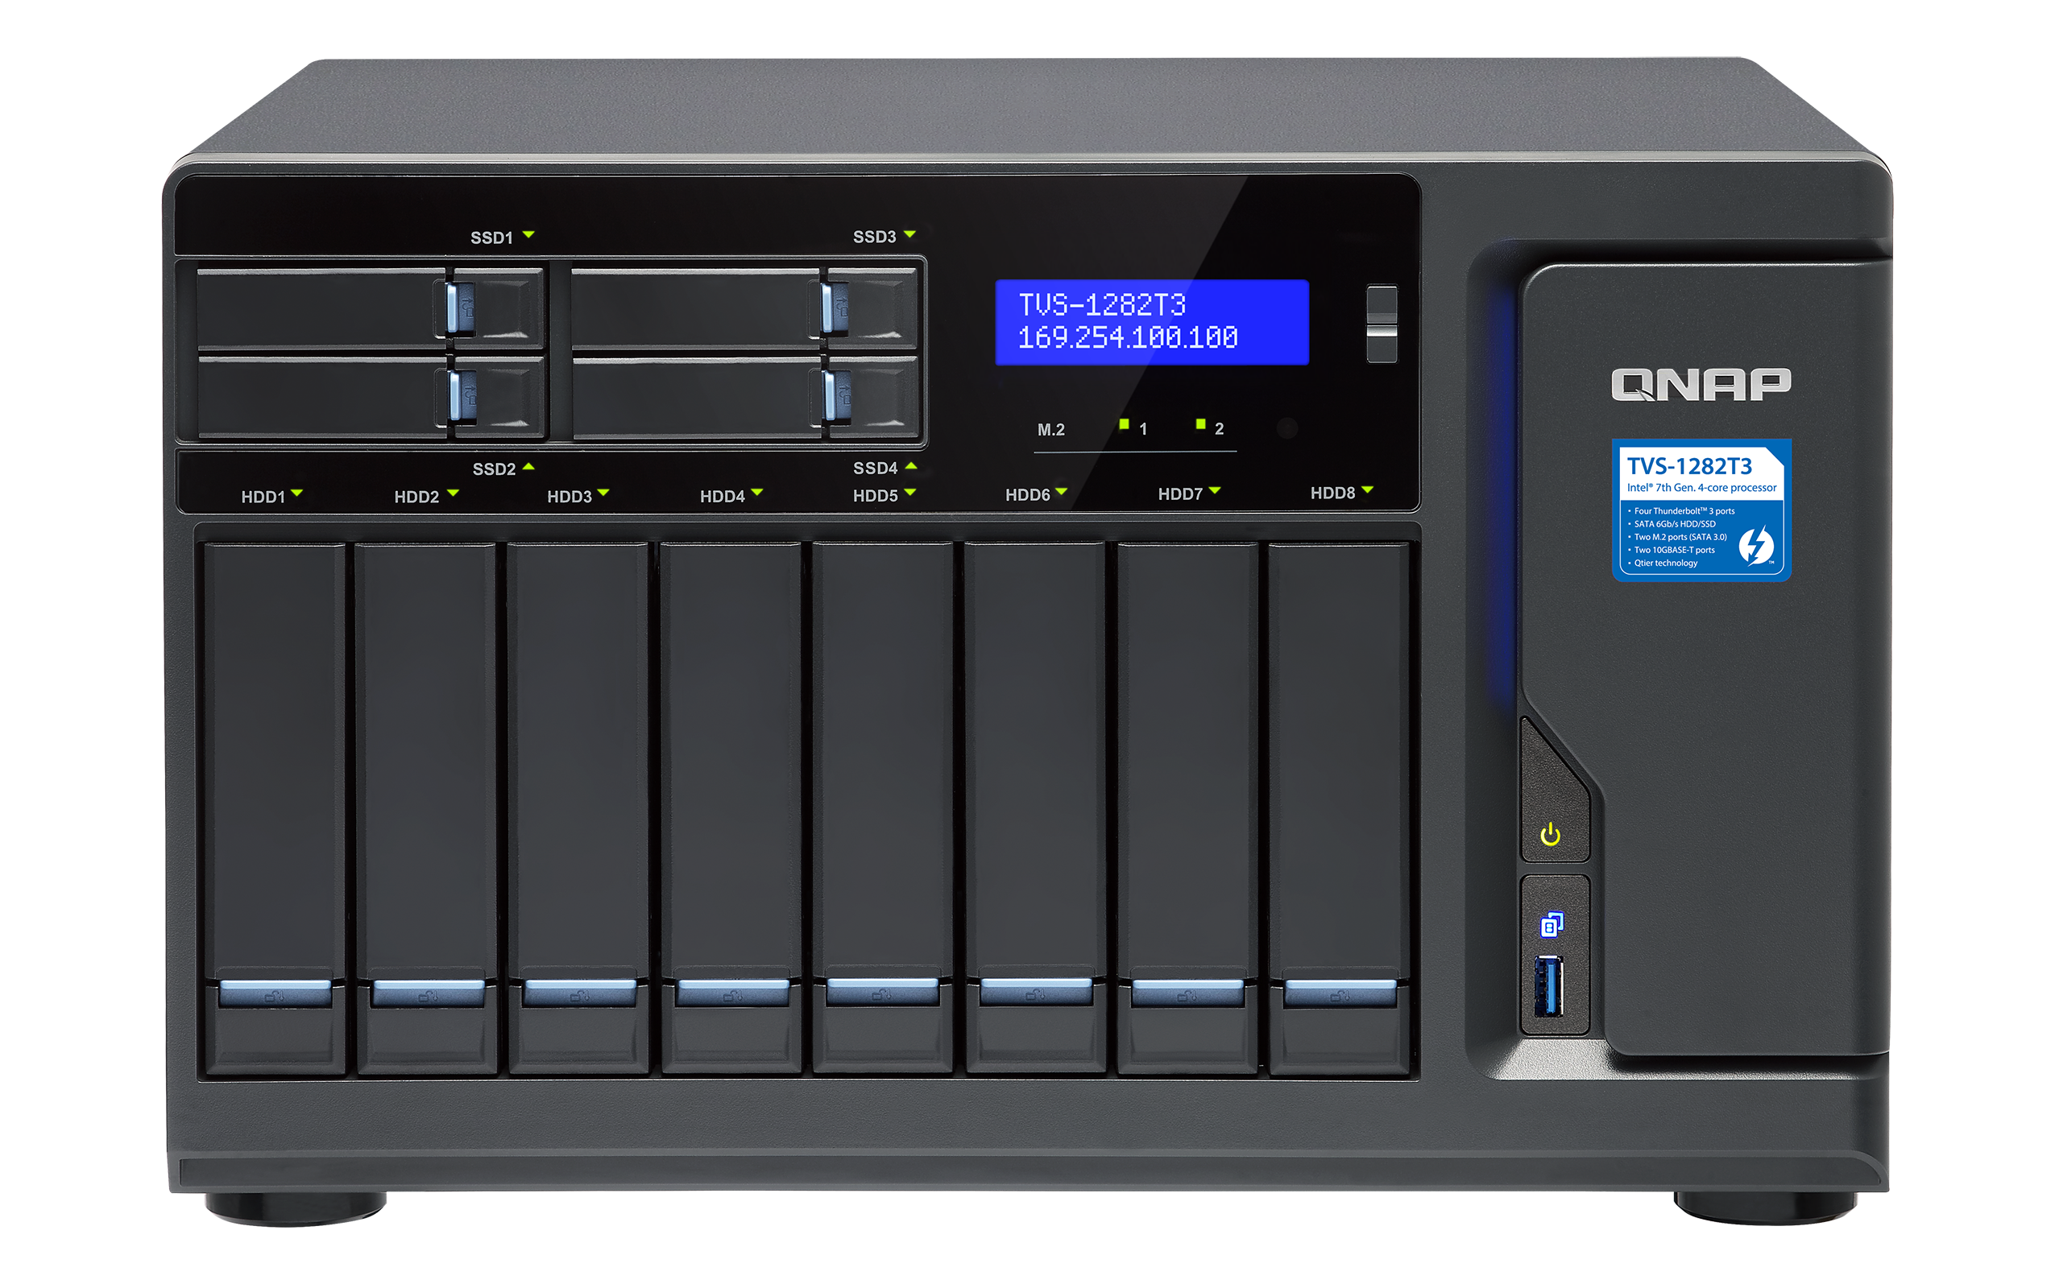
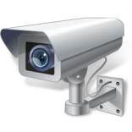
Standby Mode
QVR Guard stays in the standby mode, and other applications on this NAS can be used, when QVR Pro is running normally.
QVR Pro Client
QVR Pro Normal
Health check: Normal
IP Camera
QVR Guard
Standby Mode

Slide 7
Takeover Mode
QVR Guard takes over the recording
once QVR Pro is malfunctioning.
During the takeover period, in QVR Pro Client, you can log into QVR Guard with the "admin" account to monitor and look for video feeds, and view the Camera Settings (editing is not available with QVR Guard).
QVR Pro Client
switches the connected server manually
QVR Pro Abnormal
Health Check: Abnormal
Take over the recording automatically
IP Camera
QVR Guard Takeover
Notes:
Q:為何 QVR Guard 接管 QVR Pro 後，QVR Pro Client 無法使用 admin 以外的帳號登入。
A:QVR Guard 為防止此錄影伺服器上的使用者對其進行變更，禁止使用者登入QVR Pro ，限制存取該伺服器的各項設定。請使用 admin 帳號登入進行管理。(包含 Web Server 及QVR Pro Client )
Q: QVR Pro 有設定事件錄影，請問 QVR Guard 接管時期會執行設定的事件條件錄影嗎?
A:會，但 QVR Guard 接管錄影服務將以 24 小時全天候錄影。例如 QVR Pro 在事件管理設定攝影機位移事件觸發錄影，QVR Guard 接管後啟動24 小時全天候錄影)

Slide 8
QVR Pro Recovered -> QVR Guard Standby Mode
Upon detection of the restored QVR Pro, QVR Guard stops taking over the recordings.
Recordings during the takeover period can be accessed via logging in to QVR Guard.
All functions
QVR Pro Client
QVR Pro Normal
Health check: Normal
IP Camera
QVR Guard Standby
Watch recordings for the takeover period
Notes:
Q: QVR Pro 有設定事件錄影，請問 QVR Guard 接管時期會執行設定的事件條件錄影嗎?
A:會，但 QVR Guard 接管錄影服務將以 24 小時全天候錄影。例如 QVR Pro 在事件管理設定攝影機位移事件觸發錄影，QVR Guard 接管後啟動24 小時全天候錄影)

Slide 9
QVR Guard
Getting started

Slide 10
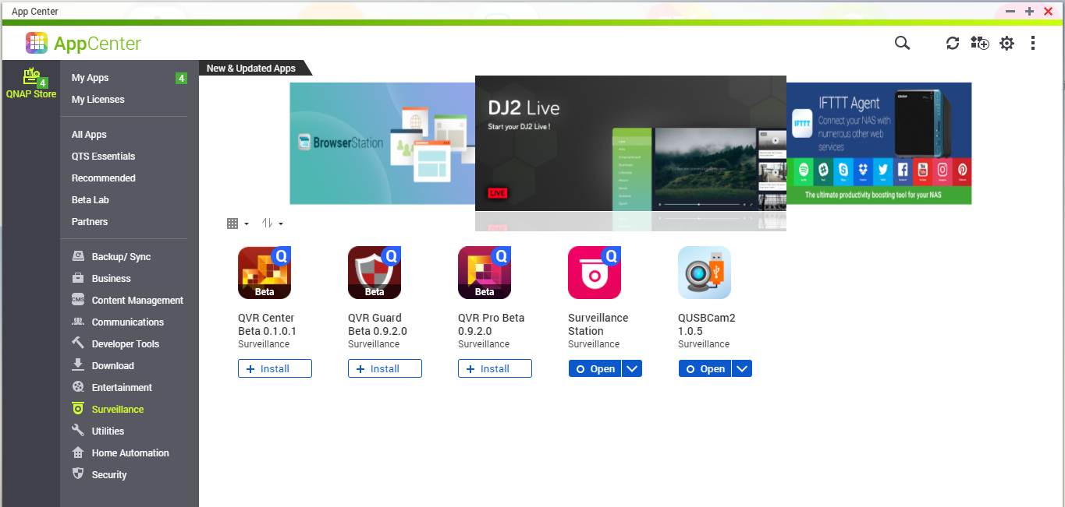
How to install QVR Guard
QTS App Center → Surveillance → QVR Guard
QVR Guard & QVR Pro can not be installed on the same NAS.
2
1

Slide 11
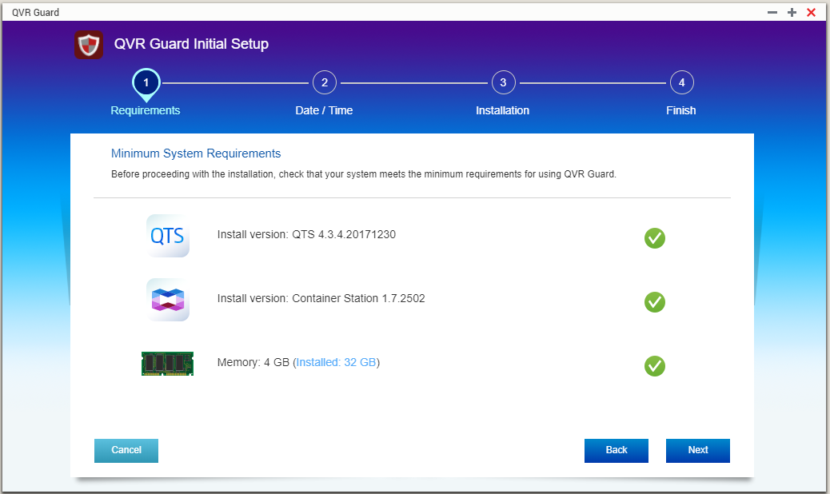
Initial Setup
Follow the Initial Setup to finish the below steps:
Minimum requirement: check the QTS, Container Station, and Memory requirement.
Date / Time: make sure QVR Guard & QVR Pro have the same time zone settings.
Start the Installation.

Slide 12
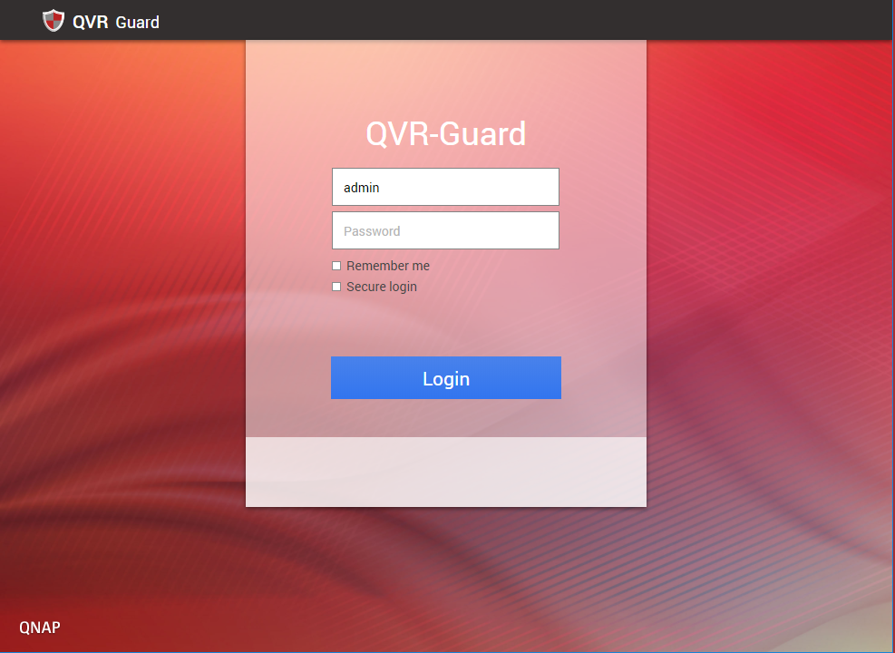
Login to QVR Guard
QVR Guard has its own login page.
→ how to login:
QTS Desktop > QVR Guard
Direct input of URL in web browser
(https:// NAS IP /qvrpro/)
QVR Guard shares the same admin account/password with QTS.

Slide 13
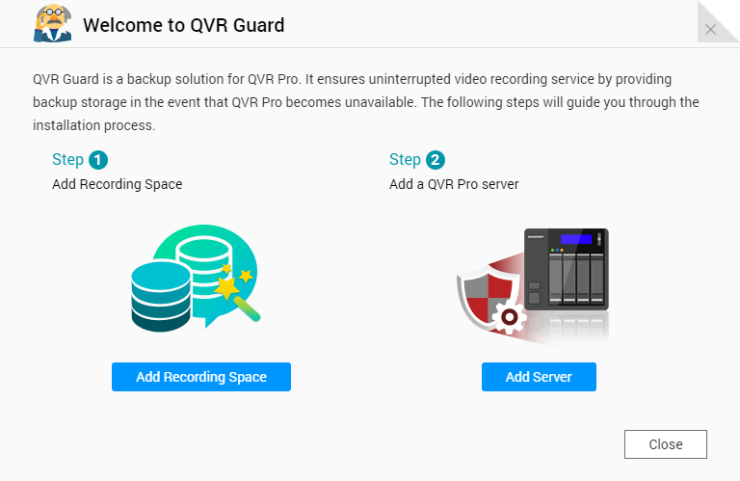
Add Recording Space & QVR Pro
Initial Setup will guide you through to add the recording space, and select the QVR Pro to be protected.

Slide 14
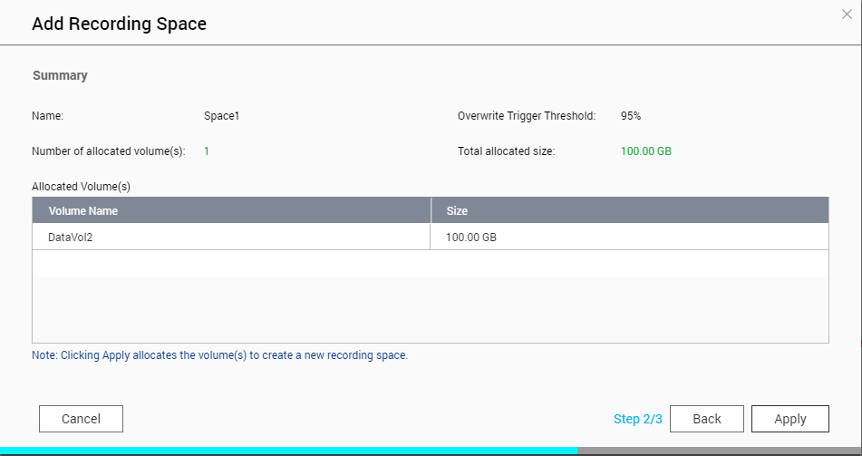
Add recording space
Add recording space to store the QVR Guard recordings when taking over the recording task of QVR Pro.

Slide 15
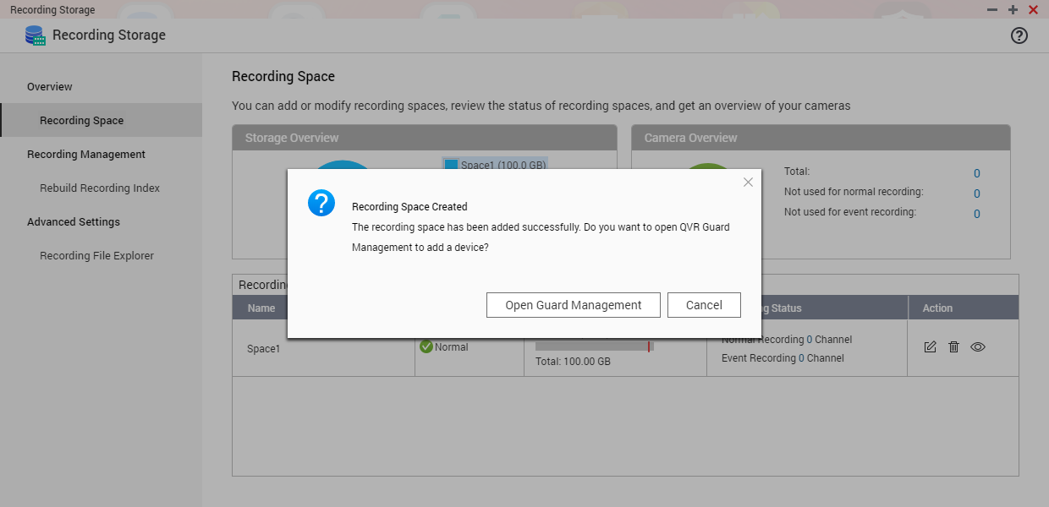
Finish creating the recording space
After the recording space is created, add QVR Pro.

Slide 16
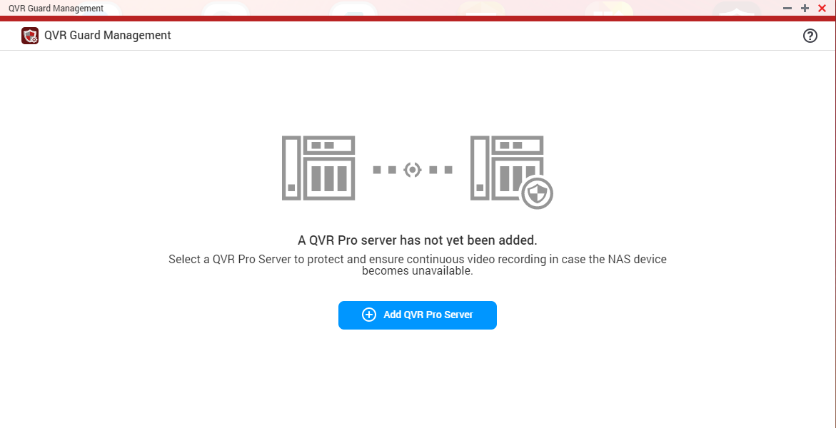
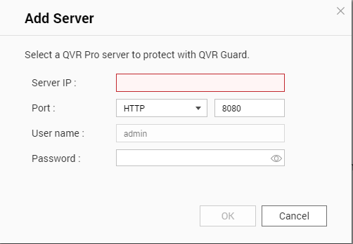
Add QVR Pro
Add the QVR Pro to be protected by the failover mechanism.

Slide 17
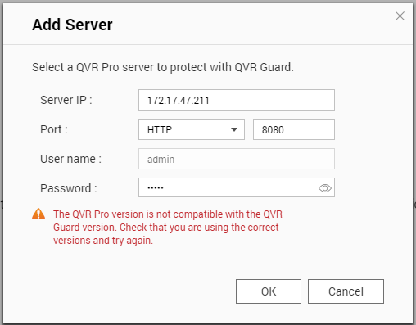
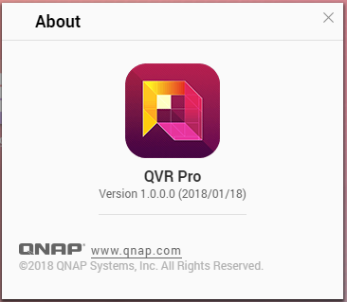
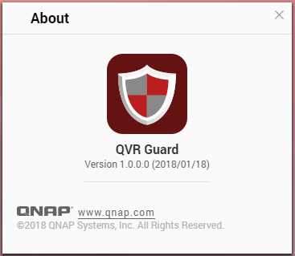
Tips
To ensure QVR Guard can takeover QVR Pro successfully, make sure that the QVR Guard & QVR Pro are of the same version. If a version mismatch message is shown, go to “About” to check versions.

Slide 18
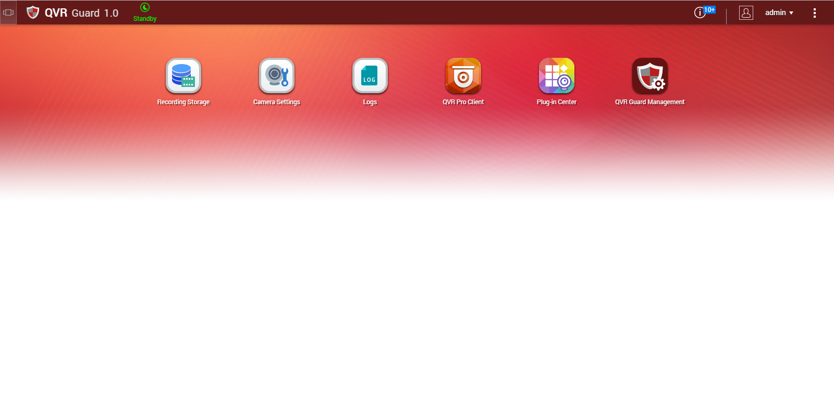
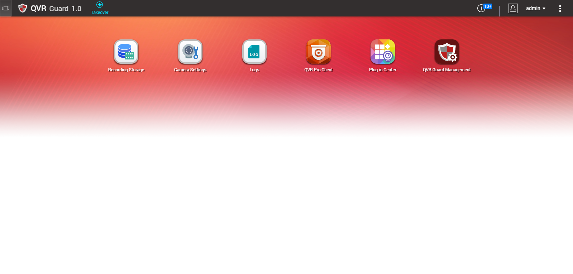
QVR Guard Mode Info
Show the QVR Guard Mode info,
so you can instantly know the QVR Pro operating status.
Standby mode: indicating QVR Pro running normally.
Takeover mode: indicating QVR Pro is malfunctioning.
Standby
Takeover

Slide 19
QVR Guard Management
You can open the QVR Guard Management UI from Main Menu or Desktop.
QVR Pro/QVR Guard operating status, connection status, versions and IP Address.
QVR Guard system logs give you a glance of the
QVR Pro operating status.

Slide 20
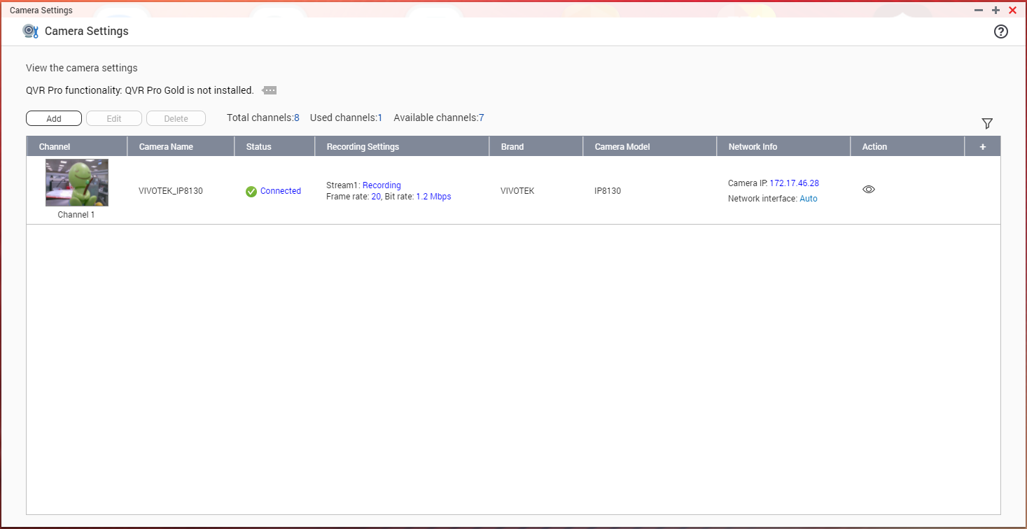
View Camera Settings
During the takeover time, Camera Settings info can be viewed (editing unavailable) inside QVR Guard.

Slide 21
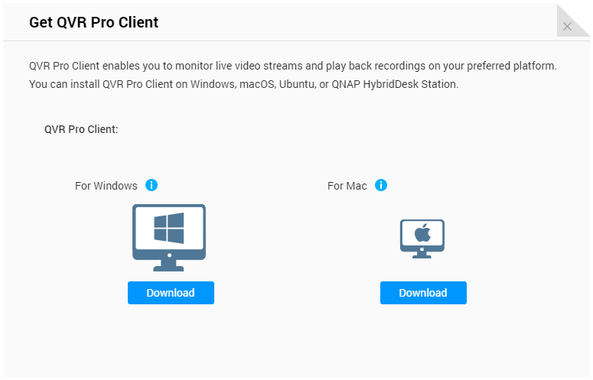
How to get QVR Pro Client
If your PC doesn’t have QVR Pro Client installed yet, you can install it via the Desktop or Main Menu.

Slide 22
QVR Pro Client
During the takeover time, QVR Pro Client can login to QVR Guard to keep the live feed view and playback.
All editing functions in QVR Pro Client will be disabled, to avoid setting mismatch before and after QVR Pro’s malfunction.

Slide 23
Live Demo

Slide 24
QVR Guard
Your best choice!

