Slide 2
Your Challenges, Our Solutions: Storage budget is limited, but data growth is not! How to expand storage capacity?

Slide 3
Why NAS Expansion Important
When purchasing NAS with 8+ bays, about 50% of SMBs choose not to fill all bays initially
Primary considerations are budget and flexibility
As your company grows, IT managers will need a solid plan to ensure continued operation

Slide 4
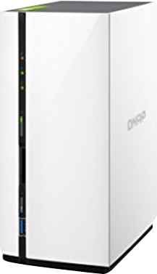
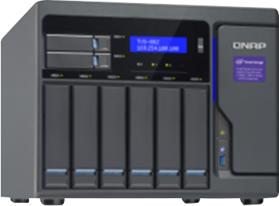
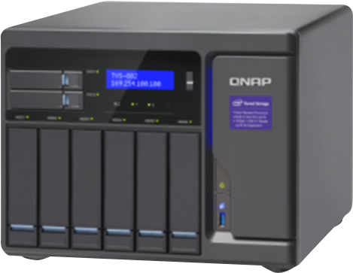
QNAP NAS Road to Expansion
Add new disks to migrate RAID type
Connect expansion unit or external storage
Replace disks and system migration
Add new disks to expand RAID or upgrade to Qtier
Use iSCSI VJBOD to share NAS space
RAID 1
RAID 5/6
RAID Expansion
NAS+JBOD
NAS+VJBOD

Slide 5
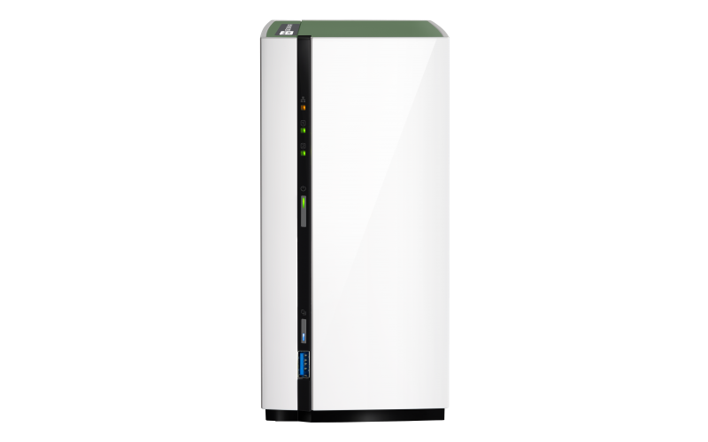
NAS grows as your applications expand
Scenario : Mike is a YouTuber and he always stores his materials in the TS-228A. With his followers increasing, he now needs a NAS with more storage to keep more video…
Challenge:
How to expand a 2-bay NAS?
Solution:
Replace Disks One by One, System Migration

Slide 6
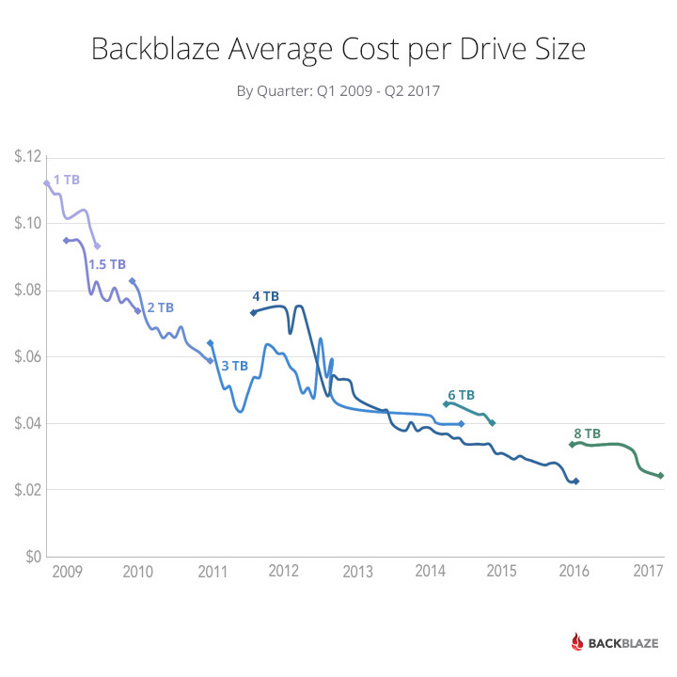
Replace Disk One By One
Disk capacity/price ratio drops year over year
Mainstream size from 2 TB in 2010 to 8 TB now
QNAP NAS RAID 1/5/6/10 support replacing
disk on line
When planning for expansion, technology advancements need to be evaluated.
Source: https://www.backblaze.com/blog/hard-drive-cost-per-gigabyte/

Slide 7
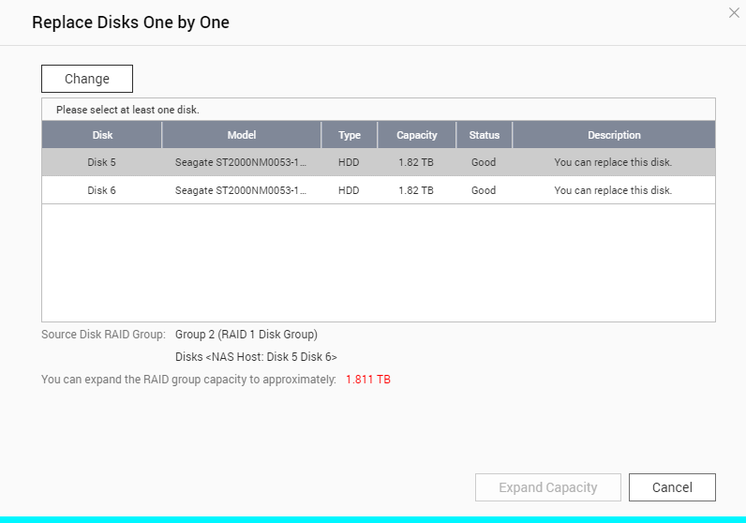
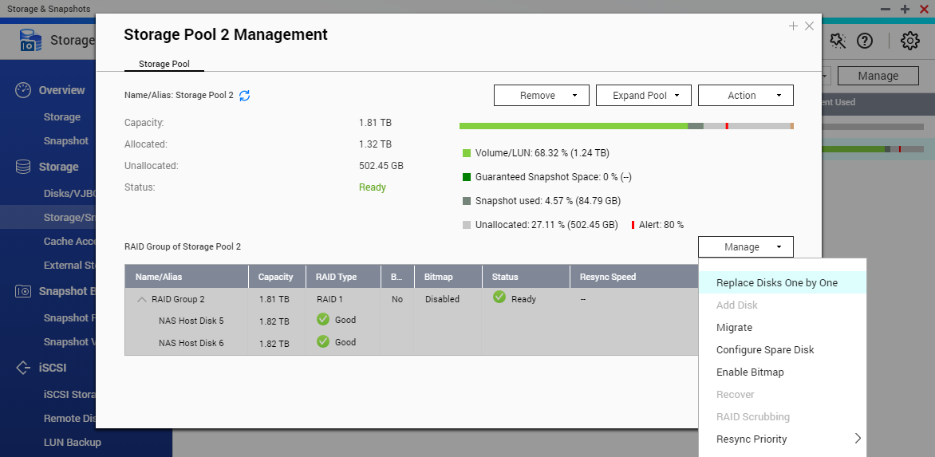
3 Steps to Replace Disks
Prepare new disks with the same number as the NAS’s RAID group
Storage & Snapshot > Storage/Snapshot > Manage Storage Pool > Select a RAID Group > Manage > Select “Replace disk one by one”
Following wizard guide to unplug, plug in and sync disk one by one
Use “Priority “ to increase
disk re-sync speed
“Replace disk one by one” only supports replacing smaller disk with larger disk

Slide 8
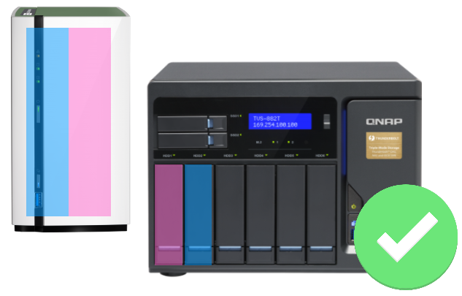
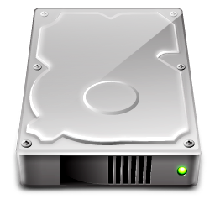
System Migration With RAID Auto Re-Ordering
On QNAP NAS, system configurations will be backed up to disks
When purchasing new NAS, the system settings can be migrated with disk directly
Settings
RAID order can be auto detected : No need to worry if plug in the disk with a wrong order
Data

Slide 9
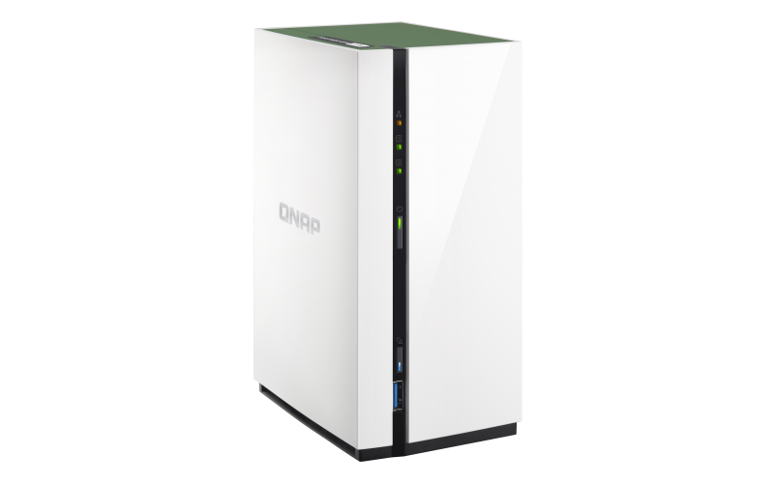
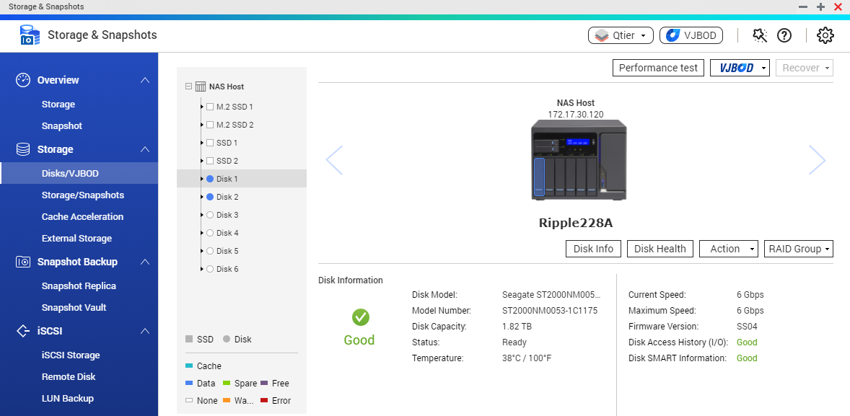
3 Steps to Migrate System
Initialize new NAS and upgrade to the latest QTS version
Shutdown both NAS and plug original disks into new NAS
Power on new NAS and start QTS
System migration may not support migrating NAS from an enterprise model back to an entry one. For details please visit: http://docs.qnap.com/nas/4.3/cat2/en/index.html?system_migration.htm

Slide 10
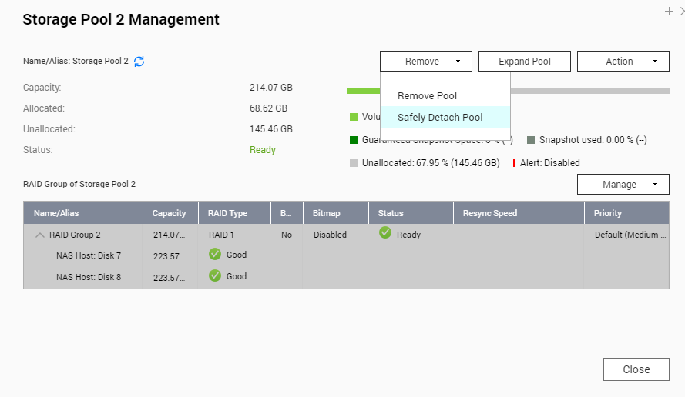
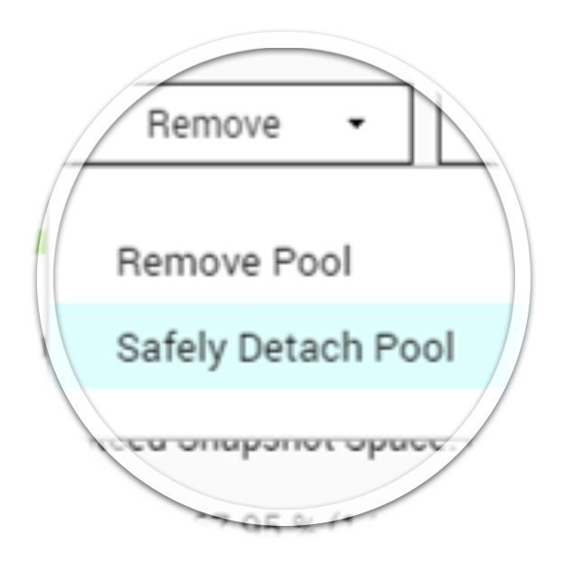
Advanced Tip: Safety Detach Storage Pool
For non-system volume and storage pool, the space & disk can be safely detached and roaming between NAS
Storage/Snapshot> Storage Pool manage
> Remove > Safely Detach
Remove and plug in disks to new NAS
Storage & Snapshot > Disk/VJBOD
> Recover > Scan all free drives

Slide 11
Start expanding from only 1 disk
Challenge: How to expand a single disk to benefit from RAID protection?
Solution:
RAID Migration
With method based on “Reshape”
Single >
RAID 1 > RAID 5 > RAID 6

Slide 12
RAID Migration
Supports migrating Single > RAID 1 > RAID 5 > RAID 6
Using Linux RAID Reshape: Requiring longer time to re-sync every disk to ensure post-migration performance
DSM 6.2: Using RAID Recover for faster migration but the newly added disk will not be used when reading data
QTS 4.3.4: Using RAID Reshape to ensure 4 disks can all be used when read data
D
D
P1
P2
D
D
P1
P2
P1
D
D
P2
P2
D
D
P1
D
P1
D
P2
P1
P2
D
D
Disk
Disk
Disk
Disk
Disk
Disk
Disk
Disk
The actual performance may differ based on NAS models. RAID 50 /60 do not support direct RAID migration

Slide 13
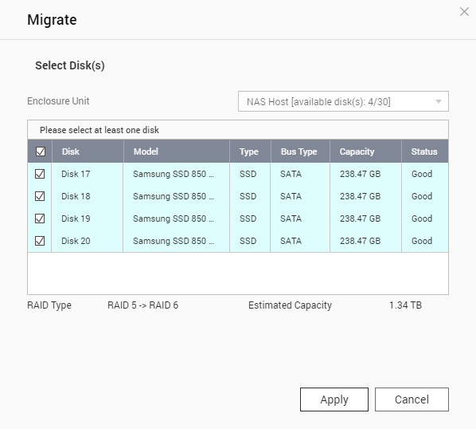
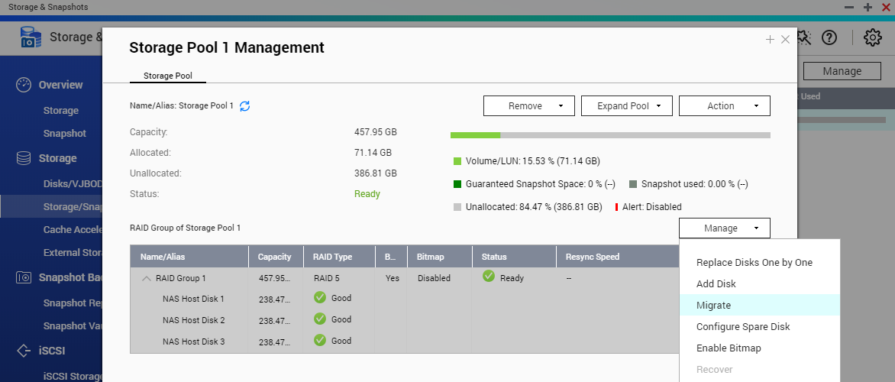
3 Steps to Migrate a RAID
Plug in new disks into the NAS
Storage/Snapshot> Pool Management> RAID Manage> Migrate
Follow the wizard to select new disk for migration

Slide 14
Demo: Use QNAP NAS to perform RAID migration

Slide 15
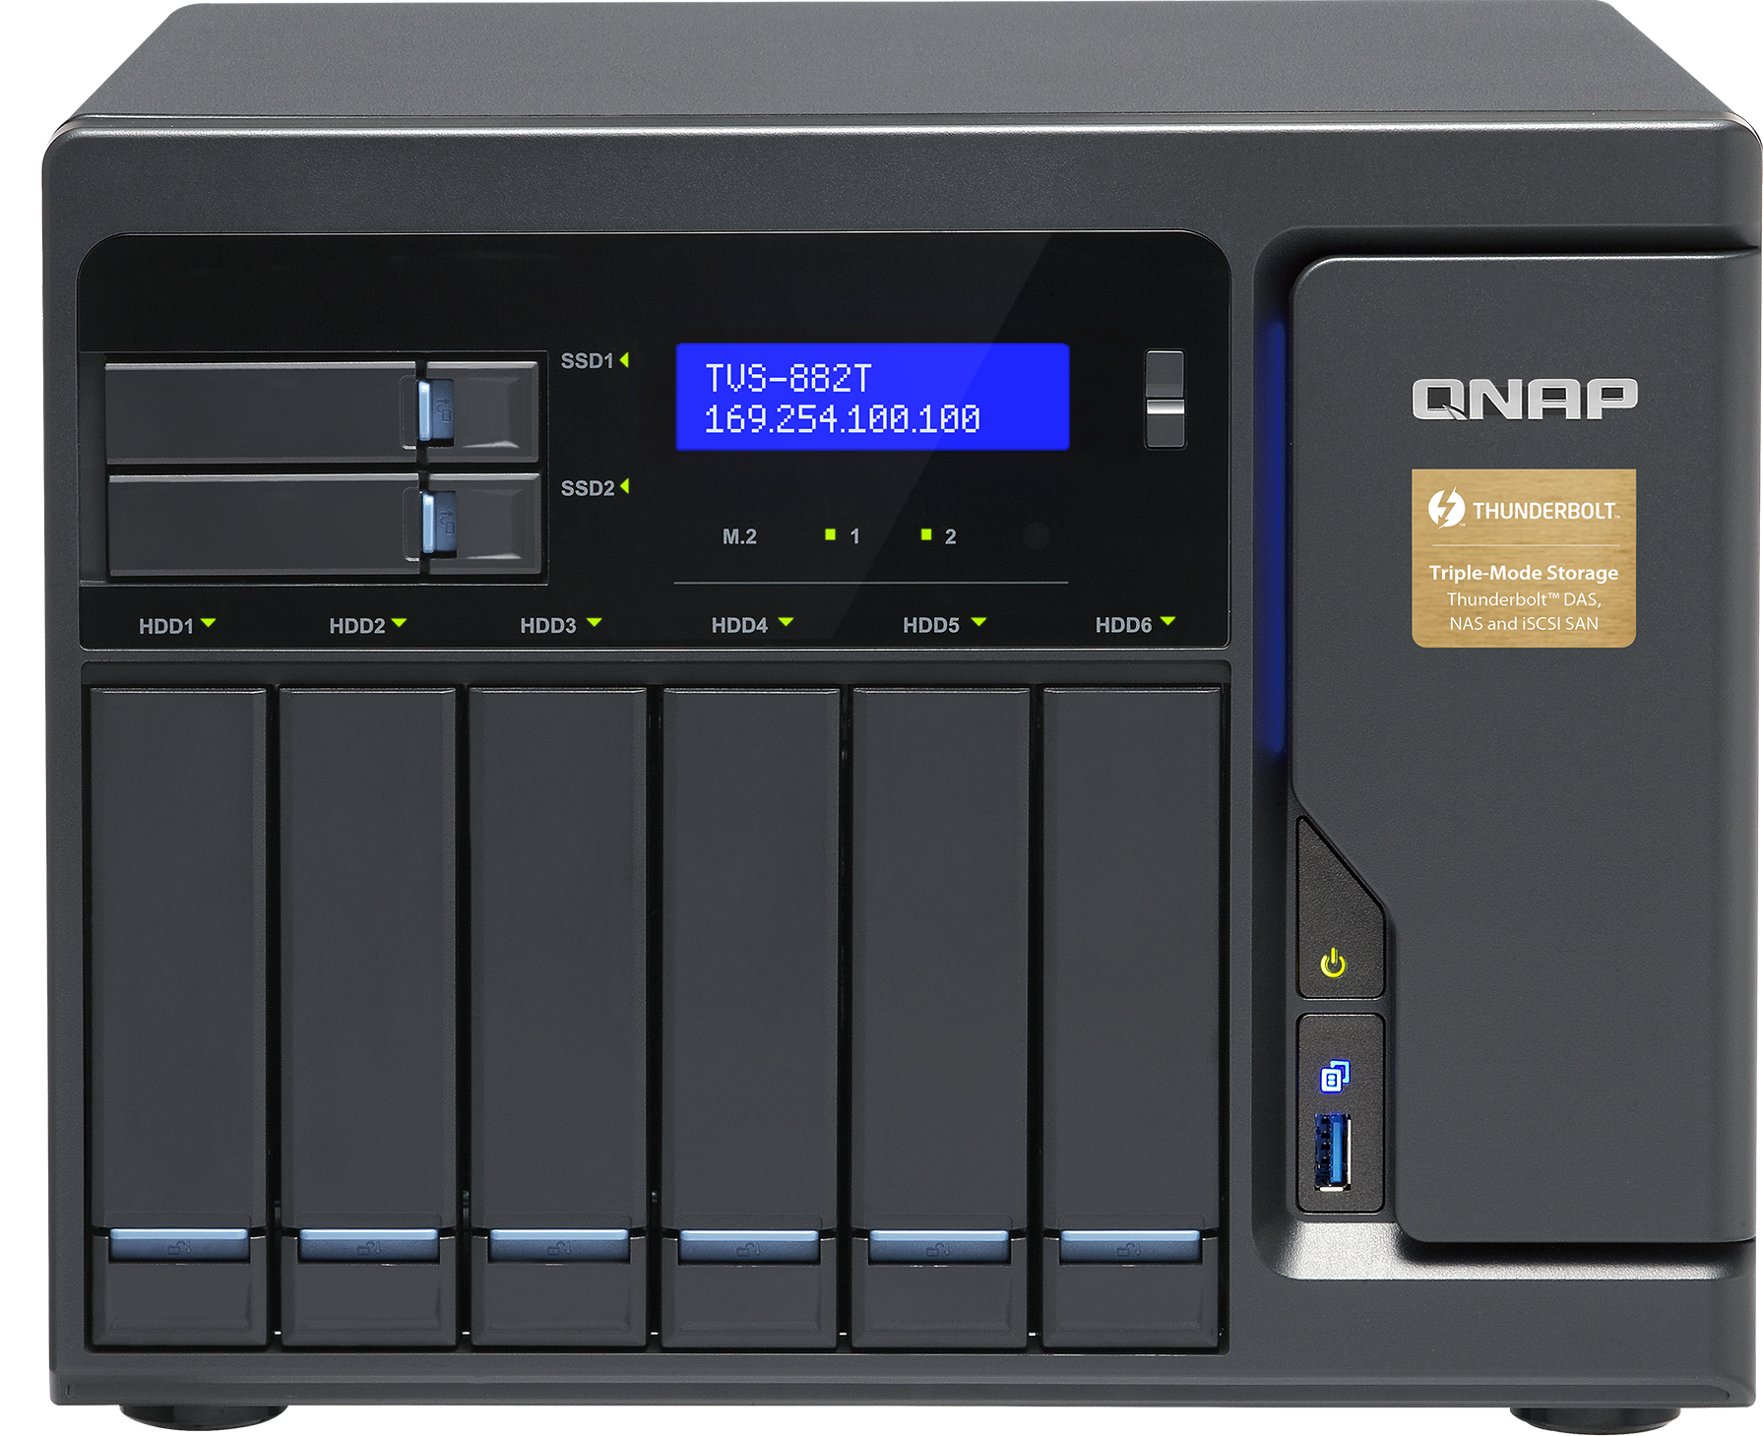
Advanced Tip: RAID 1 Parallel Read
QNAP RAID 1 support read data from both disks at the same time
Apart from normal RAID 1, performance can be
boosted even when migrate from Single to RAID 1
SSD RAID 1 Sequential Read Increase 50%
Normal RAID 1
QNAP RAID1 with Parallel Read
D
M
D
M
HDD RAID 1 Sequential Read Increase 10%
D
M
D
M
D
M
D
M
D
M
D
M
The actual performance may differ based on NAS models

Slide 16
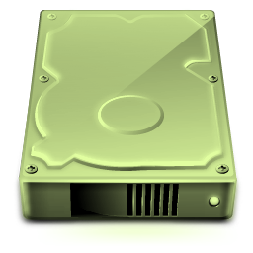
Advanced Tip: move to RAID 50/60 from 5/6
QNAP RAID 50/60 sub-array can only be set up when creating storage pool
To move to RAID 50/60 from 5/6, purchase NAS with doubled bays
Create RAID 50/60 with minimum disks (6/8) and copy data to it
Finally, add old disks to new sub-arrays
RAID 50 Storage Pool
A1
A2
B1
B2
C1
C2
RAID 5 #1
RAID 5 #2
Disk
Disk
Disk
Disk
Disk
Disk

Slide 17
Bigger Capacity Comes Greater Responsibility
Scenario: Mike has finished system and RAID migration, but the requirement of
capacity, performance and protection also increase as his channel grows
Challenges:
How to increase capacity, performance and protection with the same RAID configuration?
Solutions:
Add new disks to the RAID group
Upgrade to Qtier Pool (With optional QM2 expansion card)
Setup hot spare disk

Slide 18
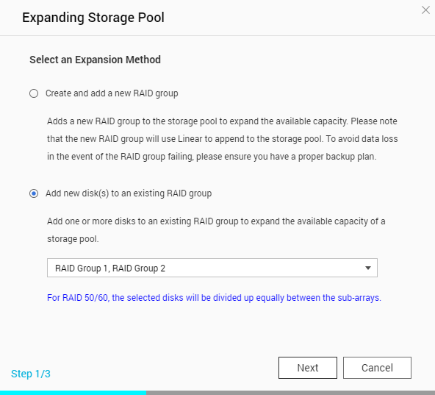
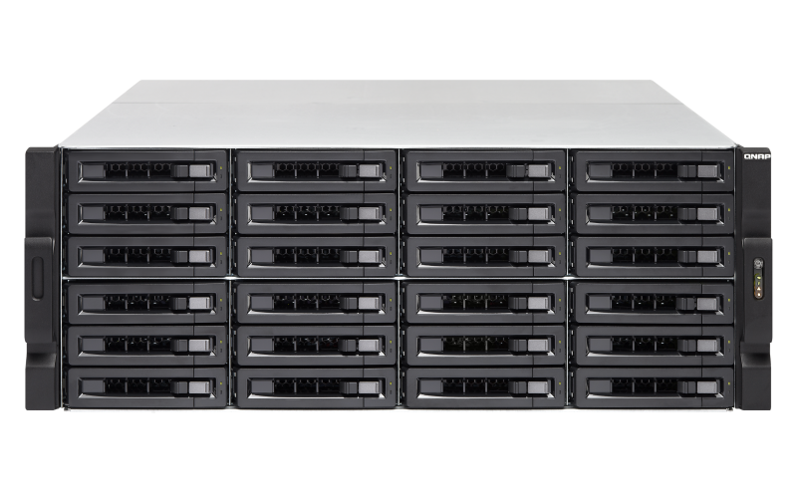
RAID 5/6/50/60 Add Disk
RAID 5/6/50/60 support online RAID expansion
RAID 50/60 has dedicated UI to add disks to all sub-arrays at once
Best-practice under limited budget: load half # of bays first for future 50/60 expansion
RAID 6
Half # of empty bays for RAID 60 expansion

Slide 19
Replace SSD Cache with Qtier 2.0
SSD Cache
Application
The cache space cannot be used as data storage
SSD
HDD
Cold Data
Qtier 2.0 Auto Tiering
Hot Data
The SSD can be used to store hot data directly, resulting to higher ROI from purchased SSD
SSD Cache
Qtier 2.0

Slide 20
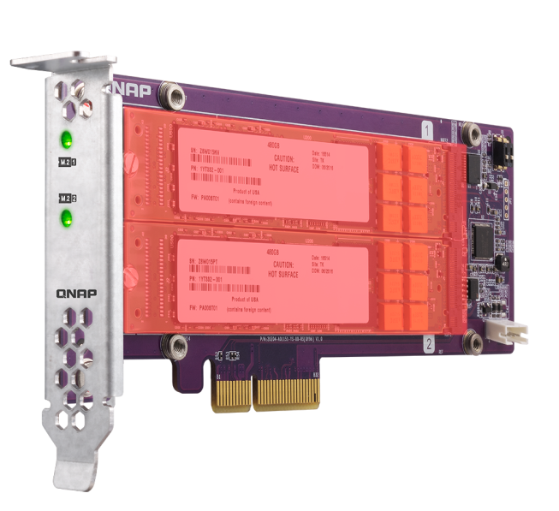
Use QM2 to upgrade to Qtier
QM2 Support TS-x31X, 53B and above (with PCIe expansion slots)
QM2 also has T sensor and heat sink to ensure disk health
NAS can be expanded with 2 additional M.2 SSD slots
QM2 SSD RAID

Slide 21
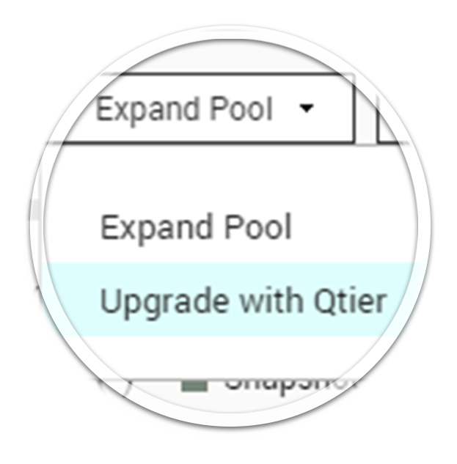
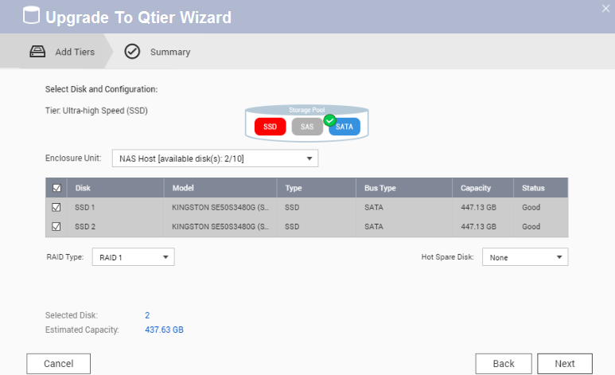
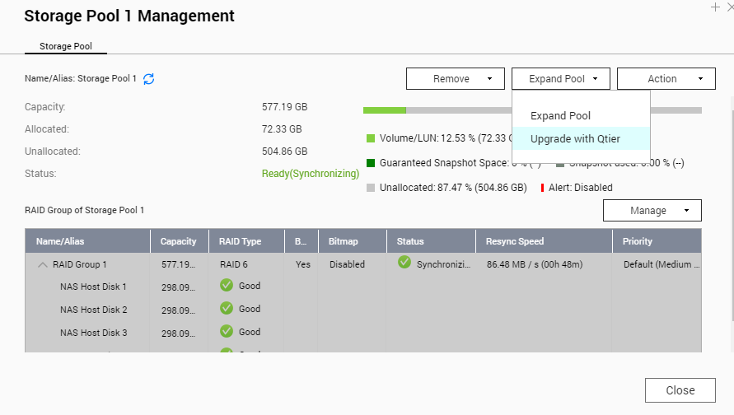
3 Steps to expand RAID group
Insert new disks into NAS
Storage/Snapshot > Storage Pool Management >
Expand Storage Pool > Expand or Upgrade to Qtier
Follow the wizard to select new disks
RAID expansion can be conducted online, while upgrading to Qtier temporarily suspends services to move metadata to SSD

Slide 22
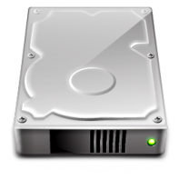
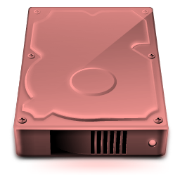
Add hot spare disks for additional protection
Hot Spare: When a disk in the RAID becomes unavailable, system
will auto use hot spare disk to replace the faulty disk
RAID 1/5/6/10 support local hot spare
With multiple RAID or RAID 50/60, global hot spare is also supported
RAID 50/60 Pool
Global
Hot Spare

Slide 23
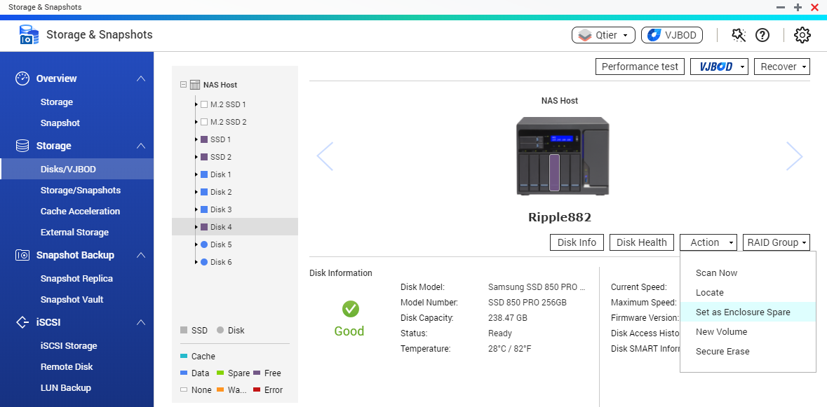
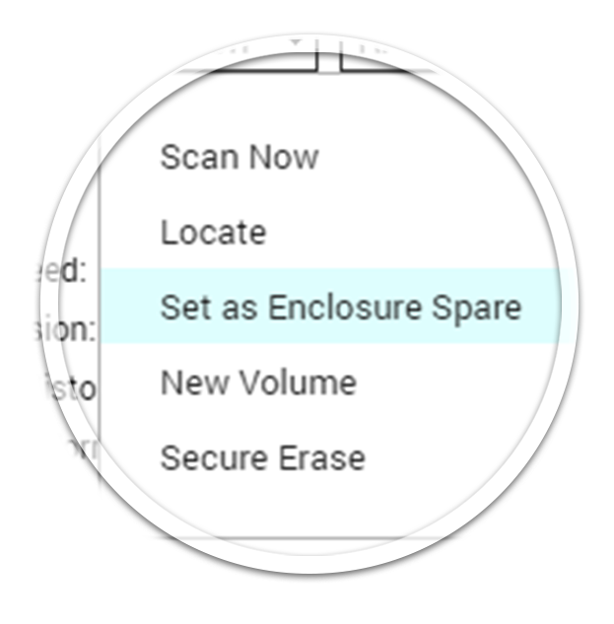
3 steps to configure hot spare
Insert new disks into NAS
Storage/Snapshot > Storage Pool Management > RAID Group
> Manage >Set Hot Spare
Disk/VJBOD
> Select a free disk
> Action
> Set as Spare

Slide 24
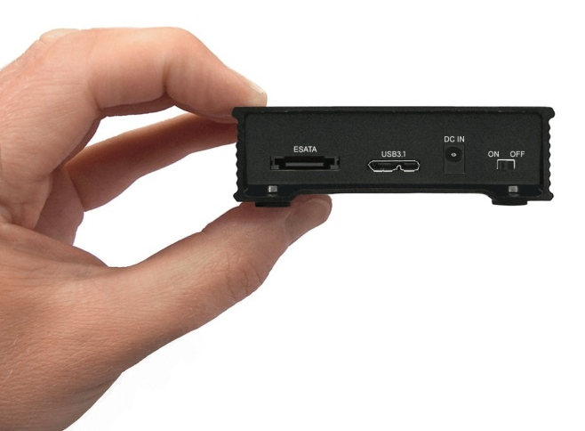
Add JBOD if one NAS is not enough
Scenario: As Mike's YouTuber career soars, he now needs a storage to
back up and archive data.
Challenge:
When RAID cannot be expanded further, how to expand?
Solutions:
Use USB/SAS/Thunderbolt JBOD
Use USB 3.1/Thunderbolt External Storage

Slide 25
QNAP Expansion Units
Interface | USB 3.0 (UX) | SAS (REXP) | Thunderbolt 2 (TX)
Major Use for | Tower NAS | Rackmount NAS | Thunderbolt NAS
Maximum Slots | 12 (UX-1200U-RP) | 16 (REXP-1620U-RP) | 8 (TX-800P)
Theory Speed | 5Gb/s | 12Gb/s or 6Gb/s | 20Gb/s
Connection Method | Direct Connect | Direct Connect/Daisy Chain | Direct Connect/Daisy Chain
Scenario | File server expansion or archiving storage | Deploy high capacity storage from the start | Deploy high capacity video editing server
Daisy Chain: Connect a JBOD to another JBOD that is already connected to host, so the maximum connection count will not limited to # of physical interfaces of host
To connect REXP-1620U-RP to 6Gb/s SAS NAS or other 6Gb/s SAS expansion unit, additional 12Gb/s to 6Gb/s converter is required.

Slide 26
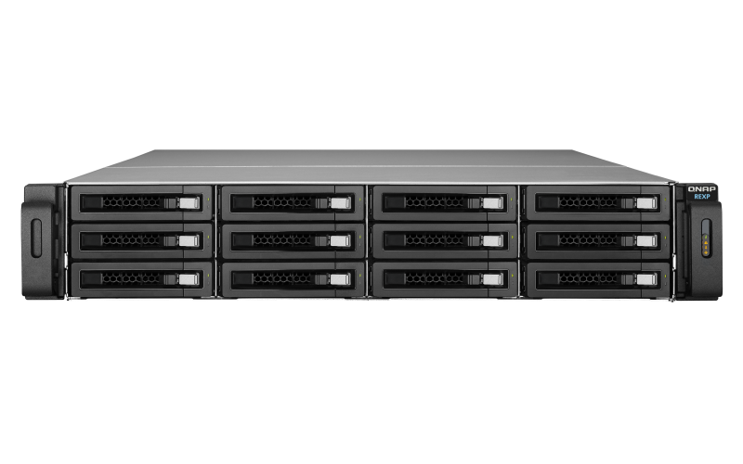
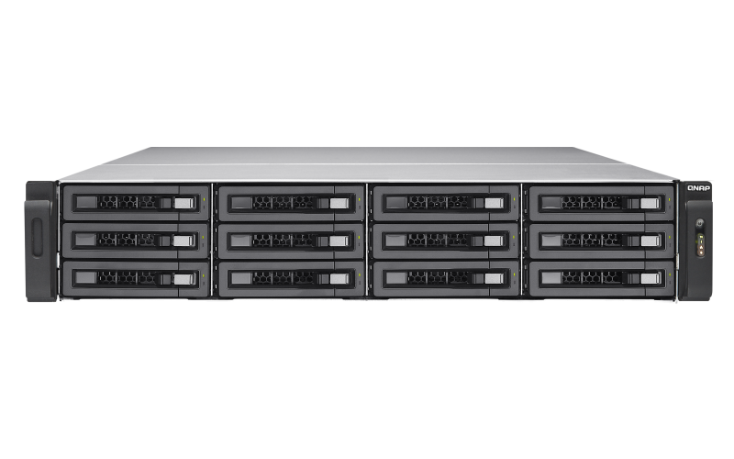
Linear expansion or new storage pool
Liner: Combine New RAID with existing RAID
Drawback >Any failed RAID will affect entire storage
New Storage Pool: Independent expansion units can roam between NAS
When using expansion unit as backup or archiving server, new storage pool is recommended

Slide 27
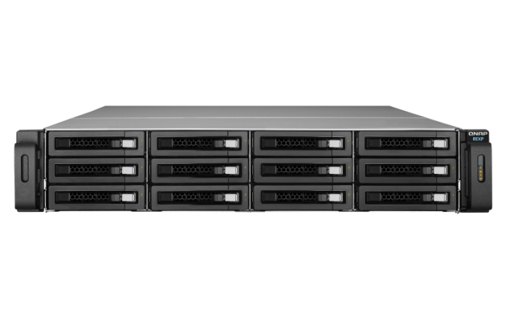
3 Tips to manage expansion units
When expanding, use SAS expansion cards for higher performance
Use multiple daisy chains and add
new expansion units in turns
Expand as a new storage pool
Chain 1
Multiple daisy chains
decrease the chance of storage
being affected by abnormal
connection.
Chain 2
SAS-12G2E expansion card and mini SAS cable info:
http://shop.qnap.com/index.php?route=product/category&path=35_430

Slide 28
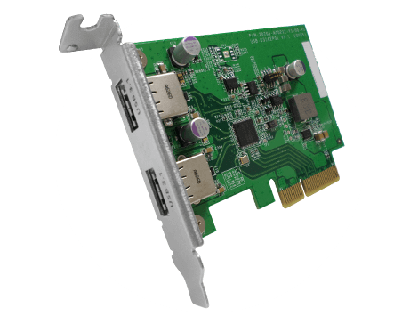
Advanced Tip: USB 3.1 external storage
QNAP NAS support USB 3.1 Gen 2 Type A dual port USB-U31A2P01 expansion card
QTS4.3.4 TVS-882ST3 with USB 3.1 Gen 2 Sequential Write is faster than RS-3614RPxs USB 3.0 for 25%
External device: SanDisk Extreme 900, USB 3.1 Gen 2 Type C; CP command used for testing

Slide 29
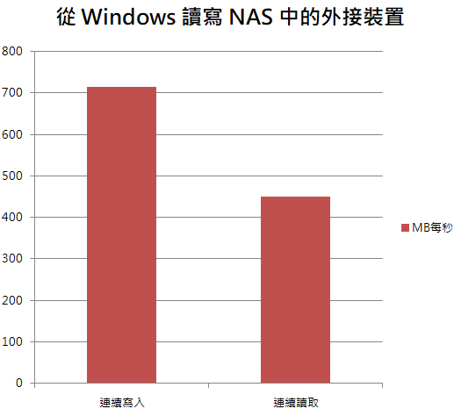
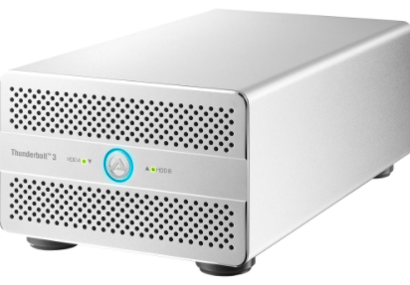
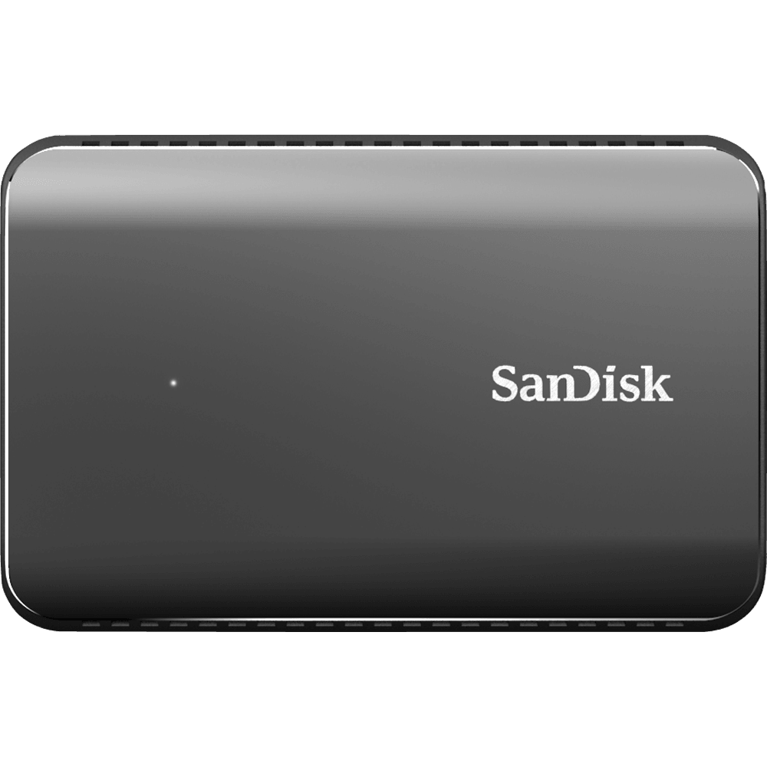
Advanced Tip: Thunderbolt 3 is compatible with USB 3.1 Gen 2
Thunderbolt 3 port on supported models support both Thunderbolt & USB 3.1 Type C external storage device, with speed of USB 3.1 Gen2
Mount TVS-882ST3’s SanDisk Extreme 900 from Windows can reach 700MB/s (with NAS cache)
From windows write data to external disk on NAS
Thunderbolt3 and USB 3.1 Type C port are the
same, with lighting mark as Thunderbolt supported
MB/s
Sequential Write
Sequential Read
To use QNAP Thunderbolt™ 3 NAS with Thunderbolt™ 2 expansion device, Thunderbolt 3 (USB-C) to Thunderbolt 2 converter is required

Slide 30
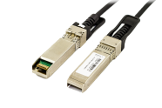
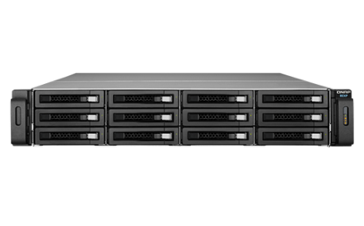
Multiple NAS can work together
Scenario: Mike is now a famous YouTuber and works with others in a studio. He finds not all space on every NAS is fully utilized
Challenge
Solution
How to share space on
multiple NAS?
iSCSI Initiator
QNAP Virtual JBOD
TVS-882
TS-1263U-RP
REXP-1220U-RP#1

Slide 31
Use iSCSI initiator to mount different storage devices
iSCSI initiator and target are industry standards
QNAP iSCSI initiator can be used with EMC, NetApp, Synology, QSAN and iSCSI target with special configuration
Utilize different storages space while enjoying QNAP software features
The trademarks belong to respective companies.

Slide 32
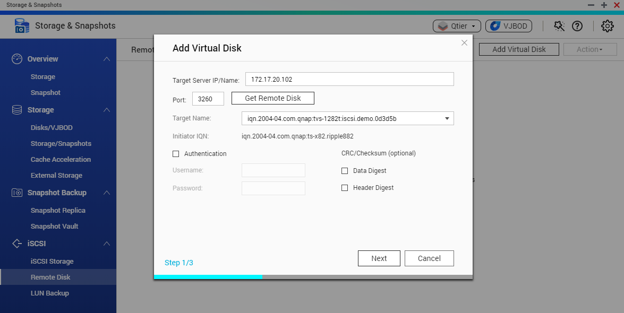
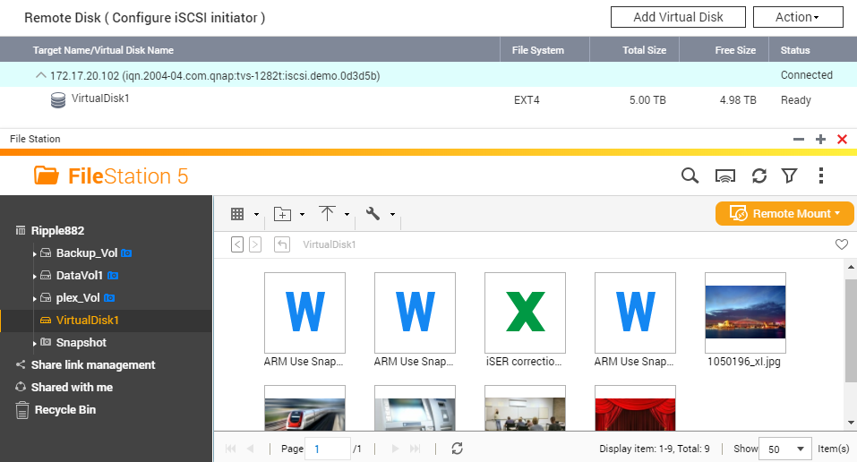
3 Steps to use remote disk space
Configure iSCSI LUN and iSCSI target at the storage device with free space
Storage & Snapshot > Remote Disk > Create Virtual Disk
Follow the wizard’s instructions to connect to disk

Slide 33
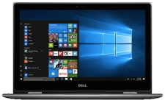
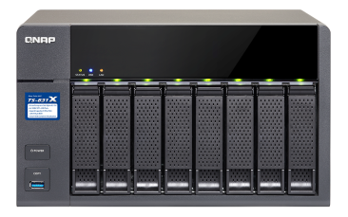
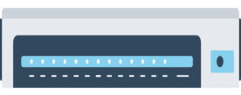
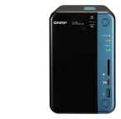
Use iSCSI VJBOD to replace JBOD
Use VJBOD to mount other NAS's LUN as local disk
Container Station
iSCSI LUN
2 x 10G SFP+
Create Storage Pool; use snapshot, media indexing, Qsirch and other features
TS-831X
Virtual Pool
RAID
Flexible Ethernet
Virtual Pool

Slide 34
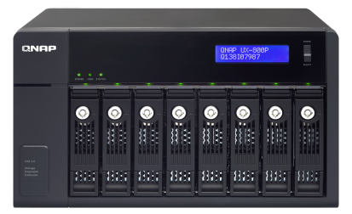
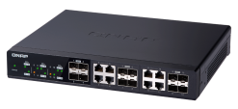
Build a super storage With JBOD and VJBOD
Connect with 8 NAS as
VJBOD disks
Over 1 PB
Connect 4 UX-800P expansion enclosures
USB 3.0
JBOD 8TB x 8 x 6 = 384TB
iSCSI
Total Raw Storage Space
can exceed 1 PB
8TB x 8=64TB
8TB x 12 x 8 = 768TB

Slide 35
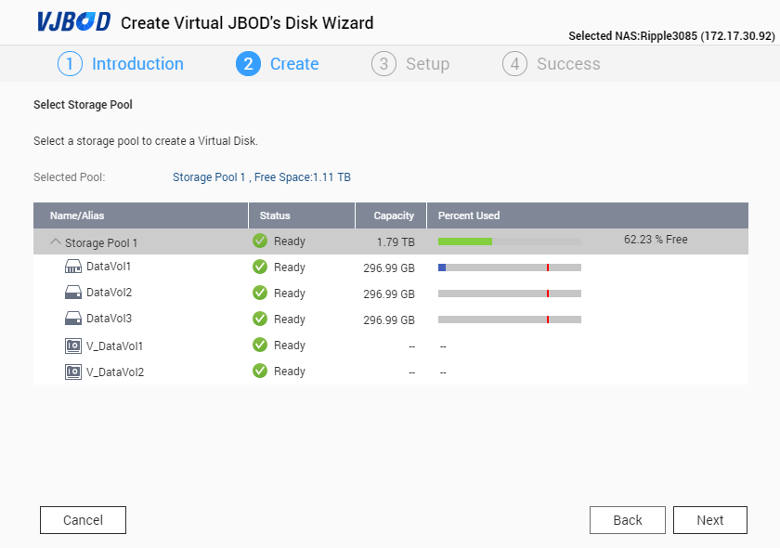
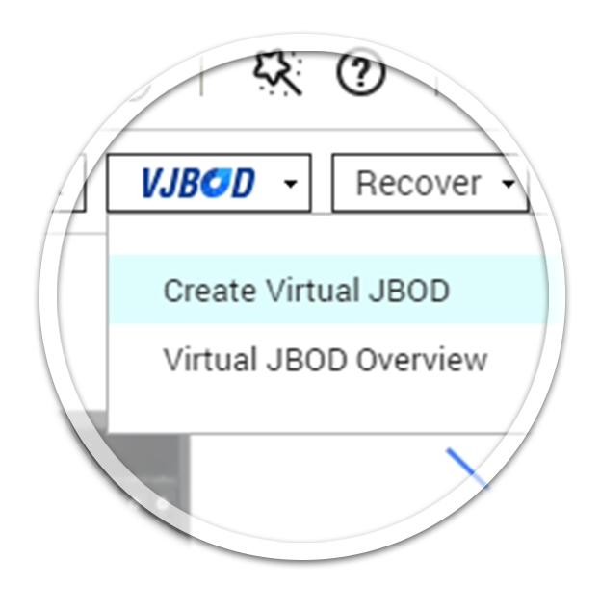
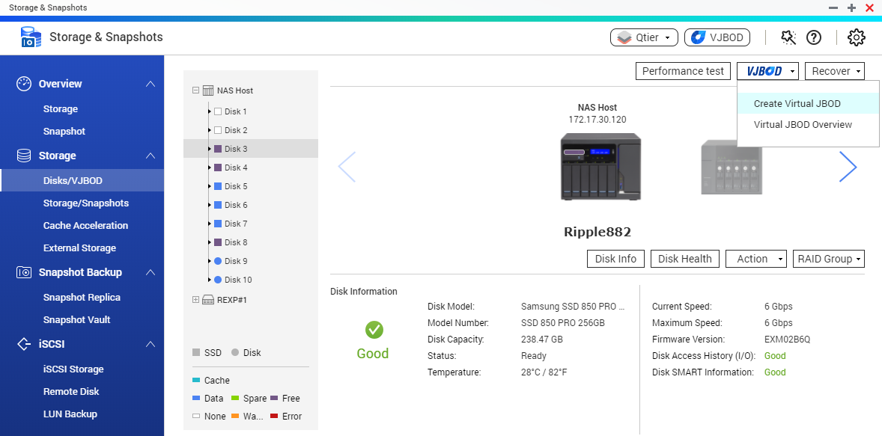
3 steps to use QNAP iSCSI VJBOD
Storage & Snapshot > Disk/VJBOD >VJBOD >Create VJBOD
Input remote QNAP NAS address and allocate space
After creation, create new Storage
Pool with the VJBOD disk

Slide 36
Demo: Use QNAP NAS with
iSCSI VJBOD

Slide 37
Summary
Scenario | Expand on original NAS |  |  |  | Additional Devices
Method | RAID Migration | RAID Expansion | Upgrade to Qtier | Replace Disk | System Migration | JBOD | VJBOD | Remote Disk | External Disk
Empty Bays | Needed | Needed | Needed | - | - | - | - | - | -
Other Benefits | Improve Protection | Improve Performance | Greatly Improve Performance | - | Increase # of Available Bays | Support Storage Pool | Support Storage Pool | Connect and Go | Plug and Go
Notes | Support Single→ RAID 1→5→ 6 | Support RAID 5, 6, 50, 60 | Storage Service Will be paused when upgrading | Replace every disk need re-sync | Advance models may not migrate to entry-level models | Maximum number depends on models | Maximum 8 NAS | Storage Pool Not Supported | Storage Pool Not Supported

Slide 38
QNAP NAS Road to Expansion
QNAP Storage & Snapshot allow the NAS to grow with the user!
Add new disks to migrate RAID type
Connect expansion unit or external storage
Replace disks and system migration
Add new disks to expand RAID or upgrade to Qtier
Use iSCSI VJBOD to share NAS space
RAID 1
RAID 5/6
RAID Expansion
NAS+JBOD
NAS+VJBOD

Slide 39
QNAP NAS ,Your best choice!

