Slide 1
Notes:
Connect, Anywhere, Anytime
myQNAPcloud
Securely build your NAS to a cloud.

Slide 2
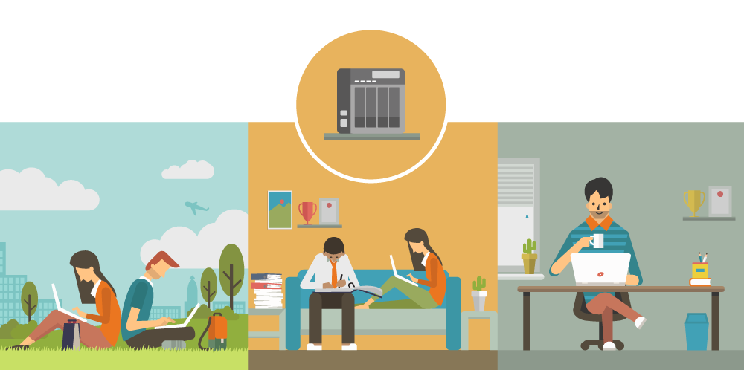
Access your data from anywhere
Notes:
[OK]
戶外、家中、辦公室，您總是希望在任何地方都能夠自在地運用所有的資料

Slide 3
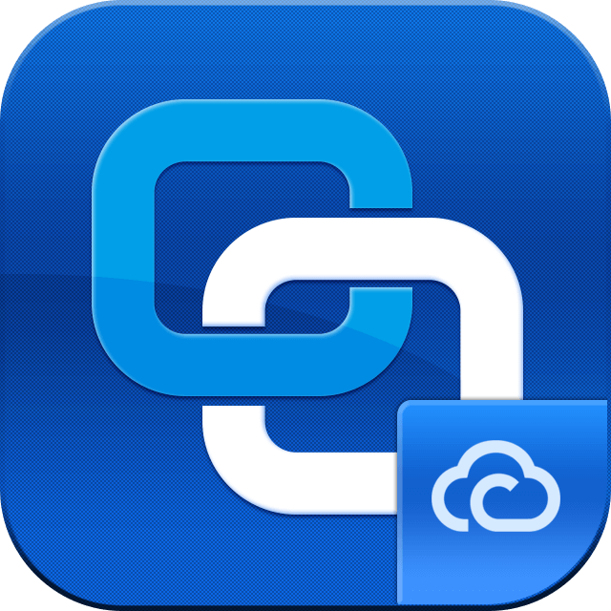
Connect Securely, Manage Easily
myQNAPcloud service infrastructure
Connect via various devices
Cloud Server
Flexible connecting methods (NAS Client)
1
2
3
Browser
QNAP ID
Account Center
QNAP NAS
QTS
Mobile devices
Cloud Installation
DDNS
Auto Router
Configuration
Manage multiple NAS
CloudLink
…more
Account Security
SmartURL
PC/Mac
Qsync
Service Status Dashboard
Notes:
[OK][動]

Slide 4
01
myQNAPcloud
Connecting via Various Devices

Slide 5
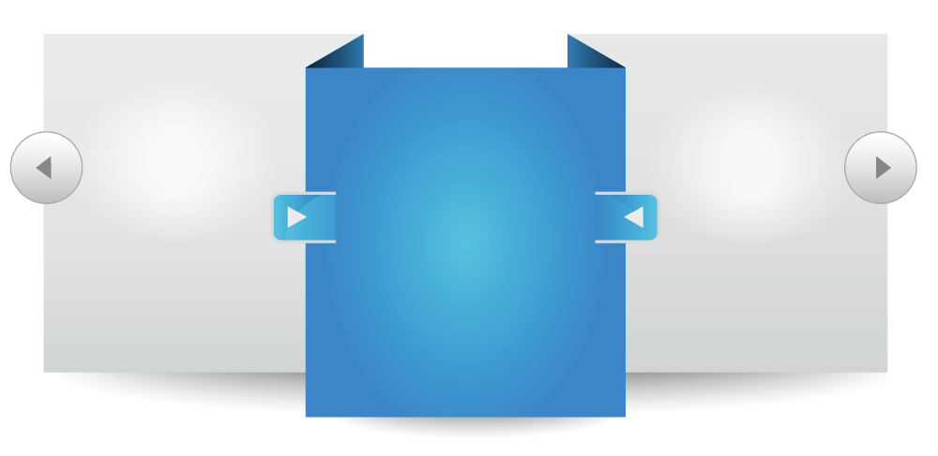
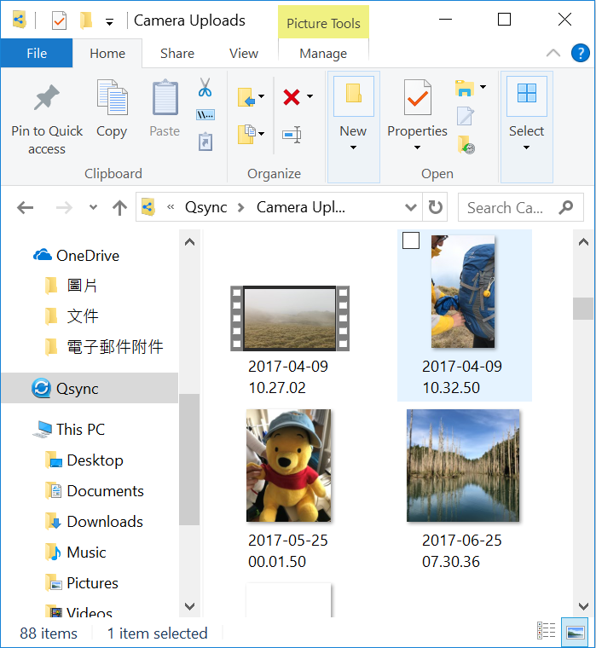
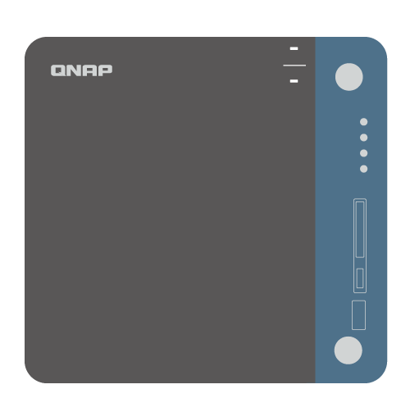
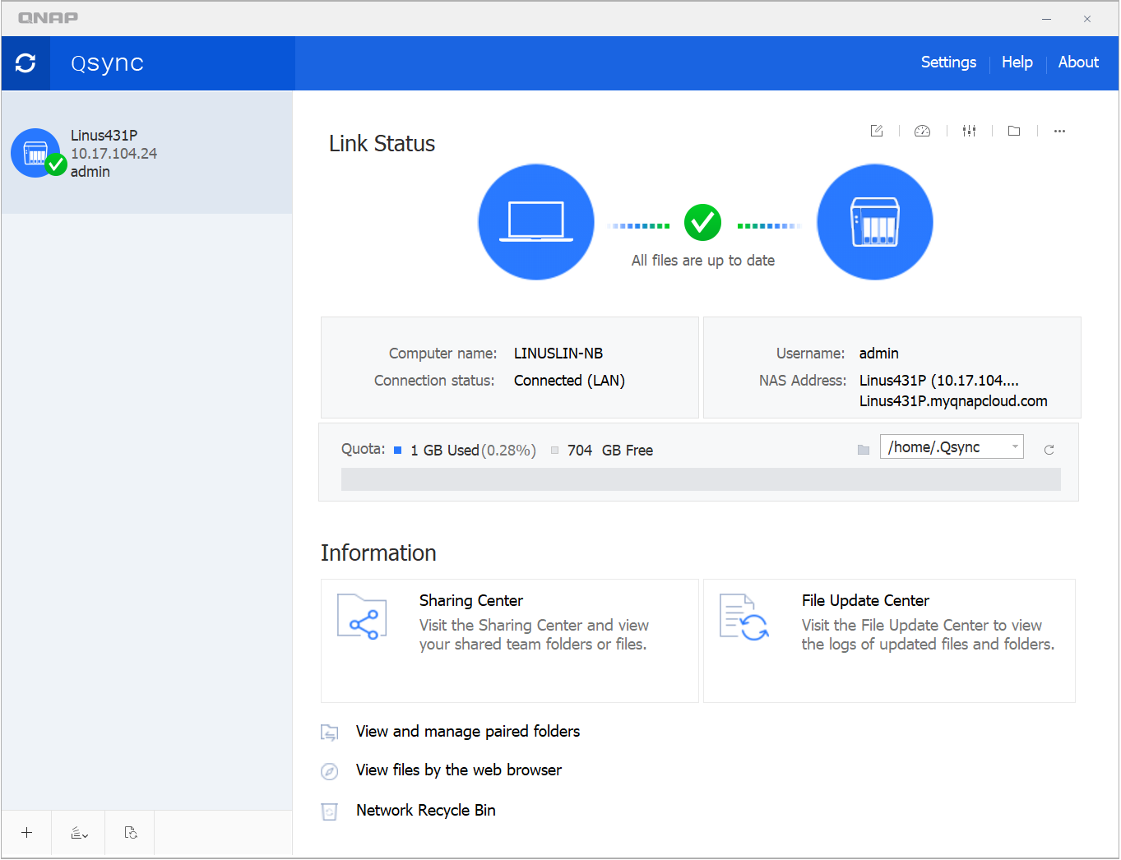
Data in hand, Anytime, Anywhere
Browser
PC Utility
Mobile App
...more
Notes:
瀏覽器、手機App、PC Utility，以上三者幾乎是所有NAS擁有者的標準配備。而myQNAPcloud毫無疑問地支援您每天使用的所有裝置，

Slide 6
02
myQNAPcloud.com
The cloud server that makes you
stay connected

Slide 7
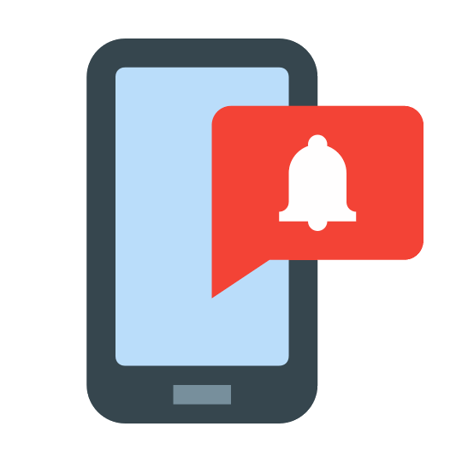
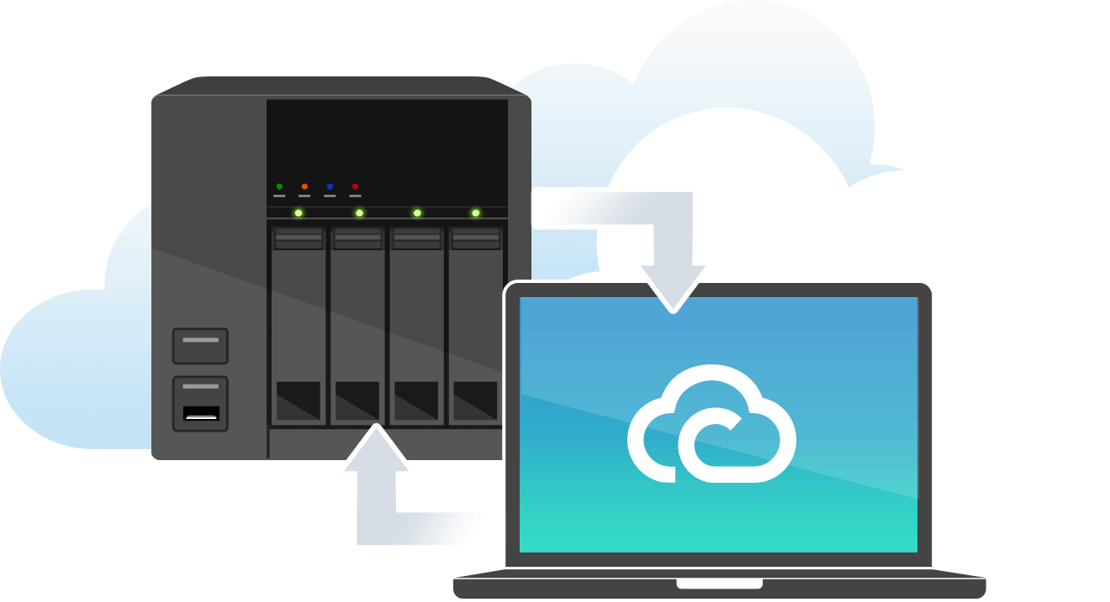
QNAP ID, the Identity to Cloud Service
Remote Connection
Purchase
License
Receive Notifications
Supports login with both Email and phone number!
Notes:
[OK][動]

Slide 8
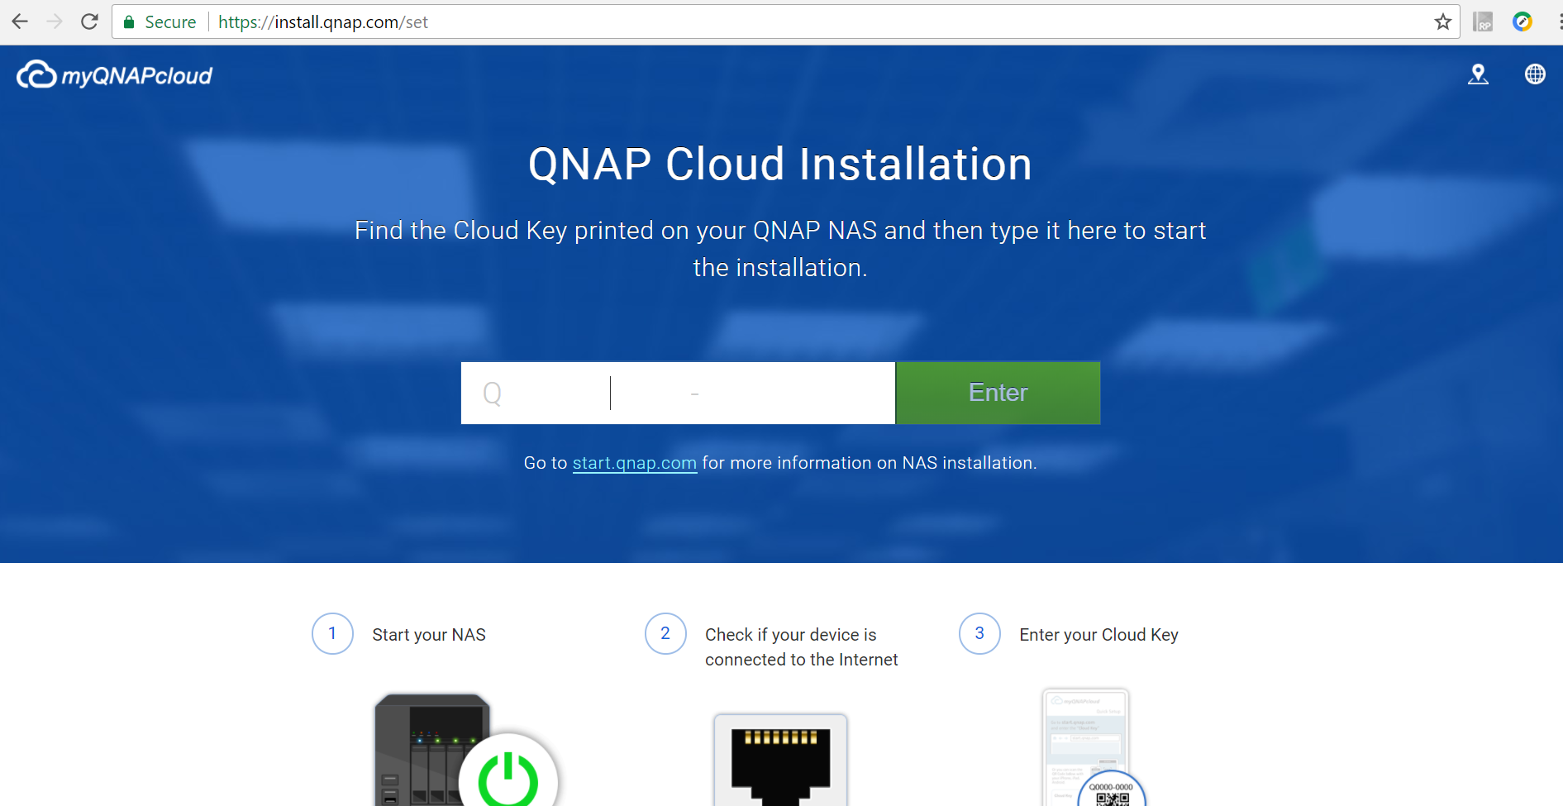
NAS Installation via myQNAPcloud
install.qnap.com
Make sure there is Internet access
Enter Cloud Key or Scan QRcode
Start Installation!

Slide 9
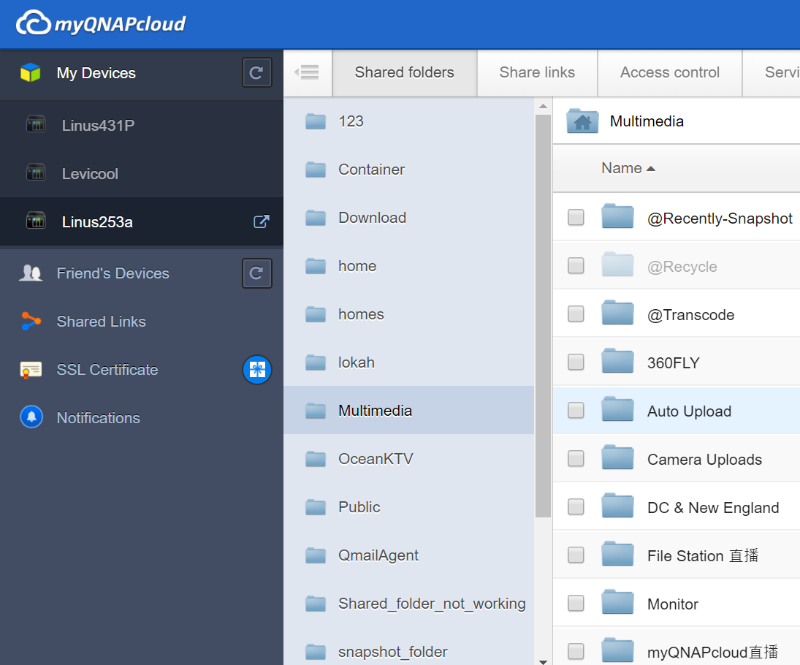
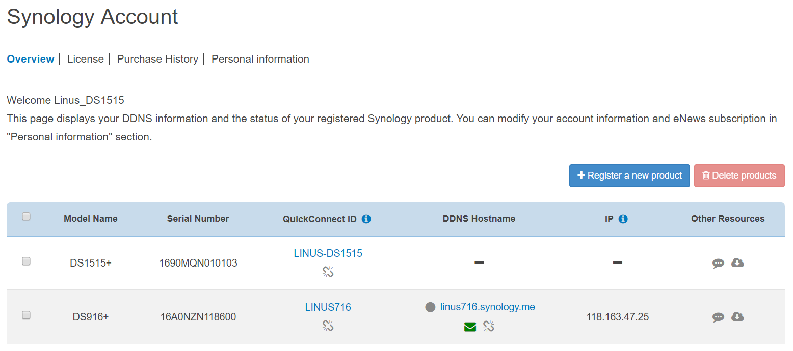
Manage All NAS in One Interface
www.myqnapcloud.com
Synology Account
Log in QNAP ID
Manage multiple NAS
Can check NAS IPs
Can't manage files
Instant file sharing
and management

Slide 10
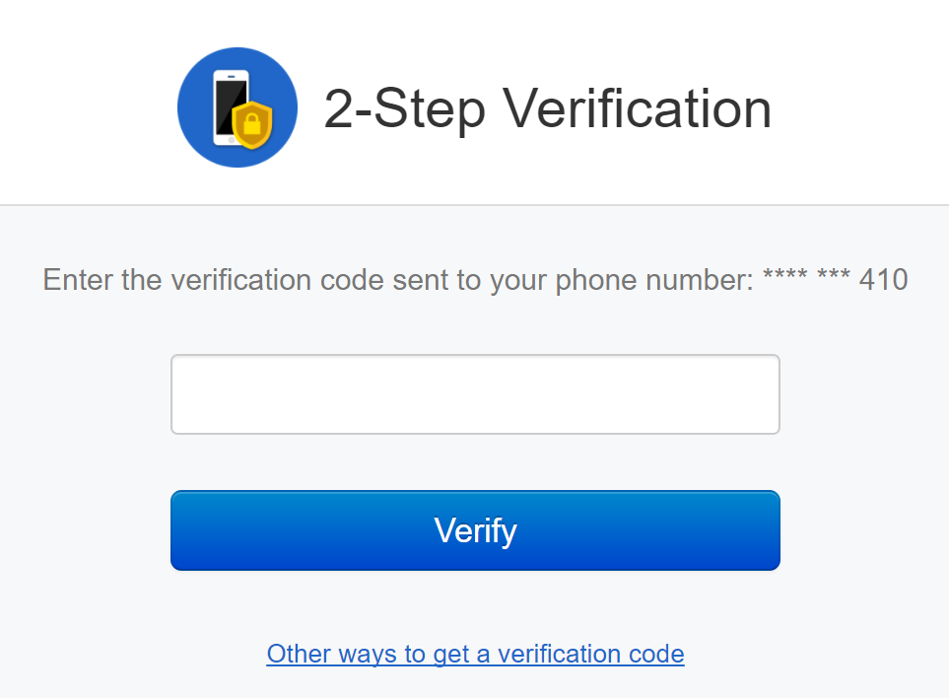
QNAP ID Security Protection
authentication
Protected Data Transfer
Account Activity
2- step
Mobile
Email
AES Encryption
Activity log and
notifications
Secured Access Control
Public
Access Control
Private
Customized
Notes:
[OK][動(大標題文字)]

Slide 11
Synology's QuickConnect service seems to be abnormal today.
Problems with connections?
Asking on forum
Official Information
Accuracy?
Perfectly Answered!
Not Instant?
Notes:
Translation:
Synology's QuickConnect service seems to be abnormal today.

Slide 12
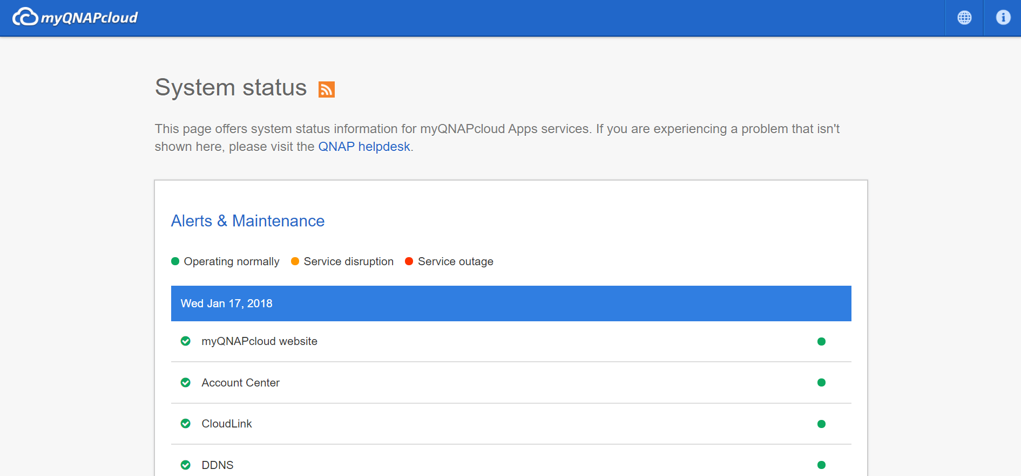
Service Status (Heartbeat) Dashboard
status.myqnapcloud.com
Instant Service Status
Issue report
First-hand Official Information!

Slide 13
03
Flexible Connecting Methods
Connect to the Cloud easily

Slide 14
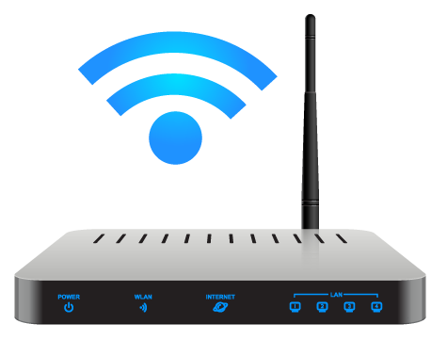
Access files remotely ?
myQNAPcloud brings you remote connection
1
2
Auto Router Configuration
CloudLink
UPnP-Enabled required
Full compatibility
Notes:
[OK]

Slide 15
1- DDNS w / Simplified Setting Process
myQNAPcloud DDNS
Auto Router Configuration
port
NAS Web
WAN IP
port
FTP Server
port
VPN Server
xxx.myqnapcloud.com:port
LAN IP1
port
…………….
DDNS keeps WAN IP info updated.
Auto Router Configuration maps External/Internal ports.
LAN IP2
Notes:
[OK][動(大標題)]
小註解：
DDNS處理變動的WAN IP
Auto Router Configuration 處理外部與內部的Port的連接

Slide 16
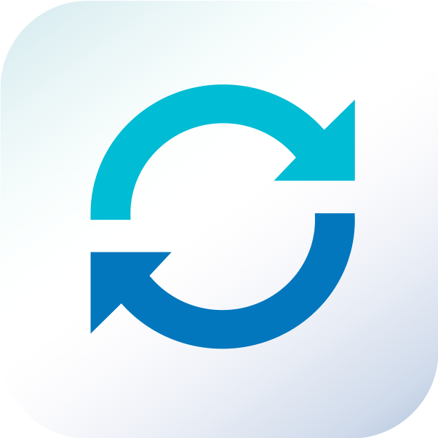
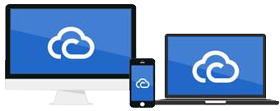
2- Relay Connection Solution
CloudLink
Top Compatibility
Easy to Setup
Connect Various Devices
No UPnP needed
1
Signup QNAP ID
No port forwarding needed
2
Follow Wizard
Internet is all you need
3
Done
Notes:
[OK][動(大標題)]

Slide 17
Which connecting method should I use ?
DDNS
LAN
Others
WAN
Notes:
[OK]

Slide 18
No worries. We've got you !
SmartURL selects the most suitable method.
LAN
WAN
DDNS
CloudLink
SmartURL
Secure | https://qlink.to/device_name
Notes:
[OK]

Slide 19
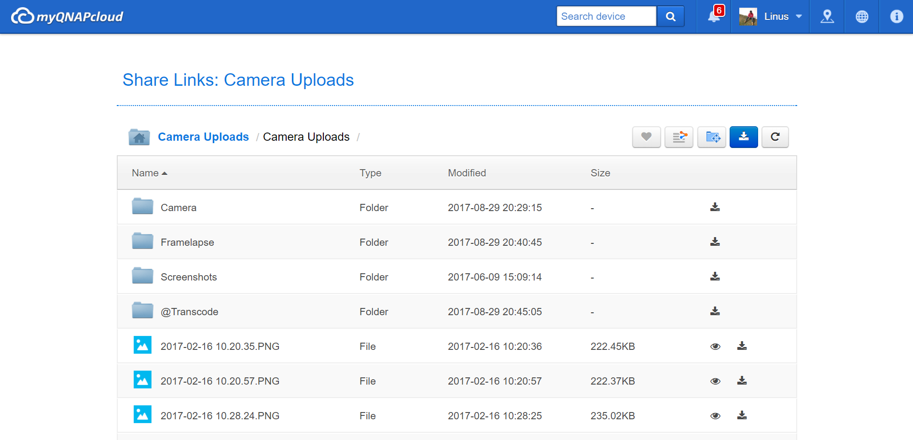
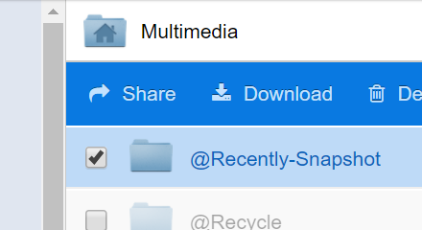
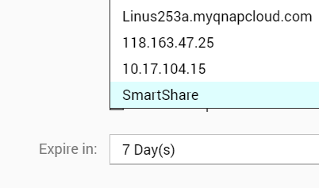
Smartshare works too !
myQNAPcloud
File Station
Notes:
[OK]

Slide 20
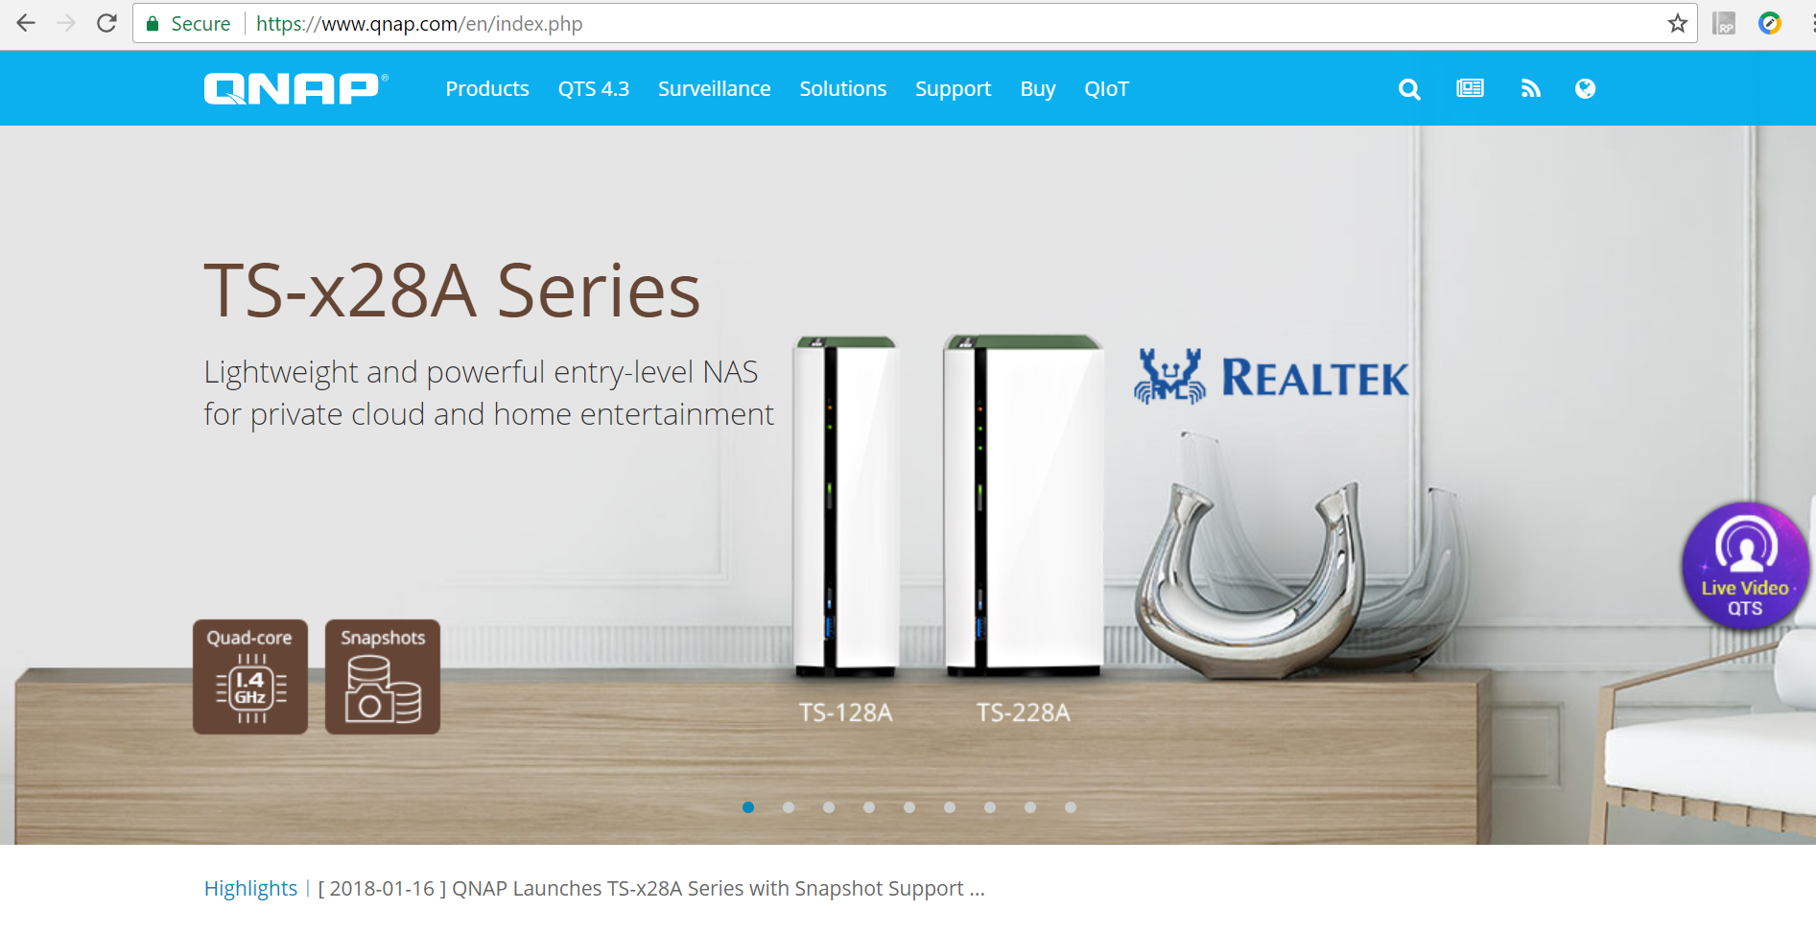
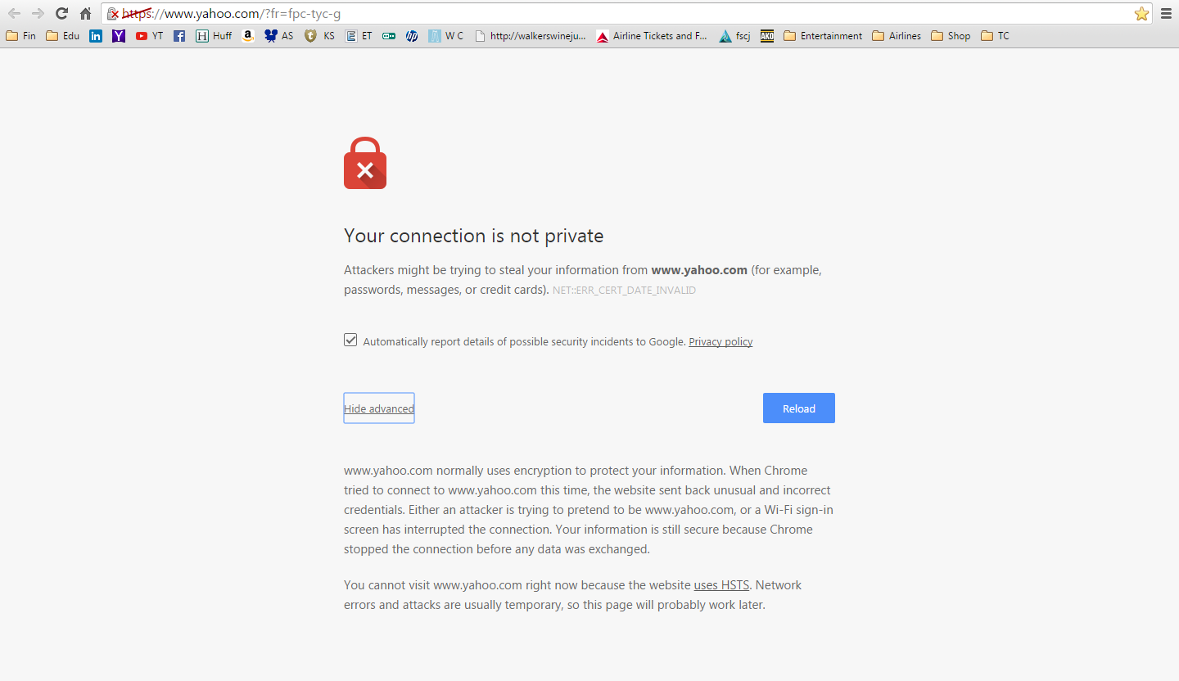
A More Secured Connection
QTS SSL Certificate
Secured tunnel between QNAP NAS and browser
Secured Connection
Security alarm
Notes:
[OK]

Slide 21
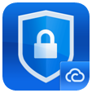
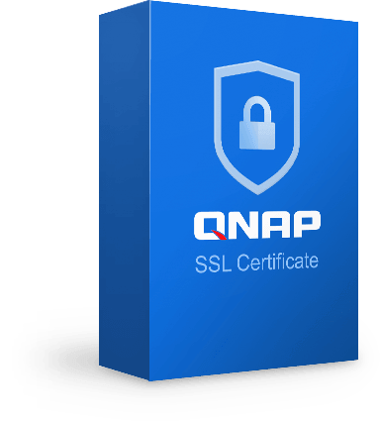
Choices to Secure the Connection
QTS SSL Certificate
Synology DSM
myQNAPcloud
SSL Certificate
Paid License
Free
No enterprise class certificate
Full Technical Support
Partly Support
Valid Date Notification
Auto Renew License
Notes:
[OK][動(新增大標題)]

Slide 22
Time to get your hands dirty!
Setup step-by-step
Notes:
[OK][動(標題文字)]
DEMO前導

Slide 23
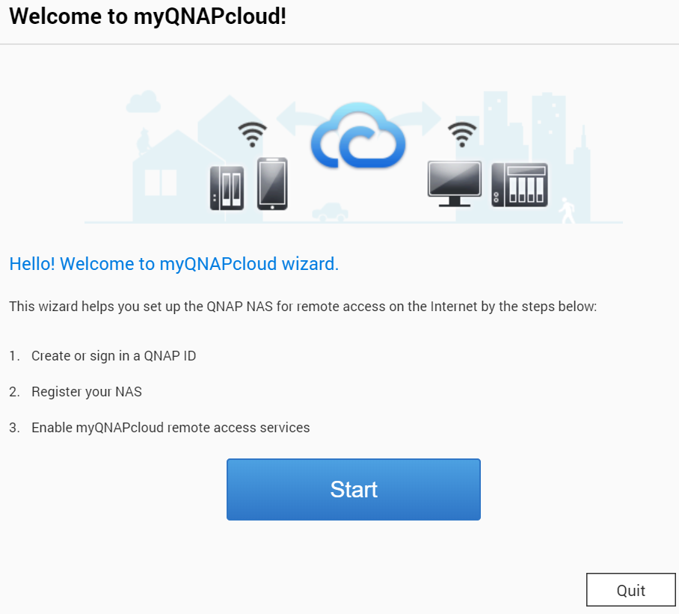
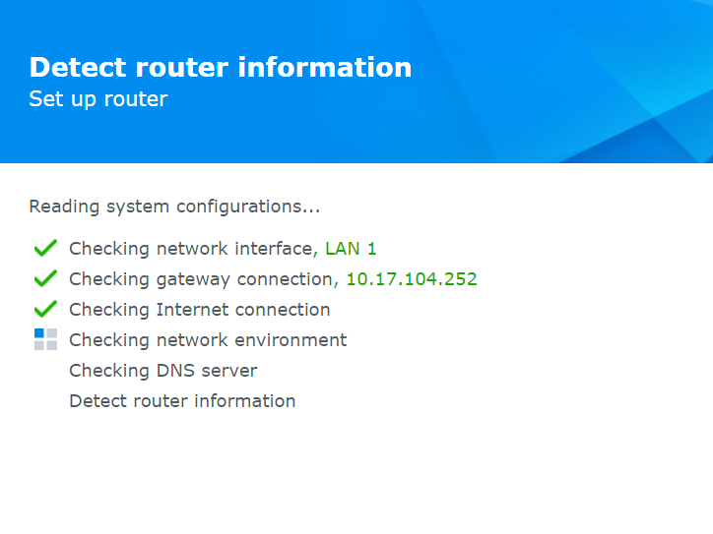
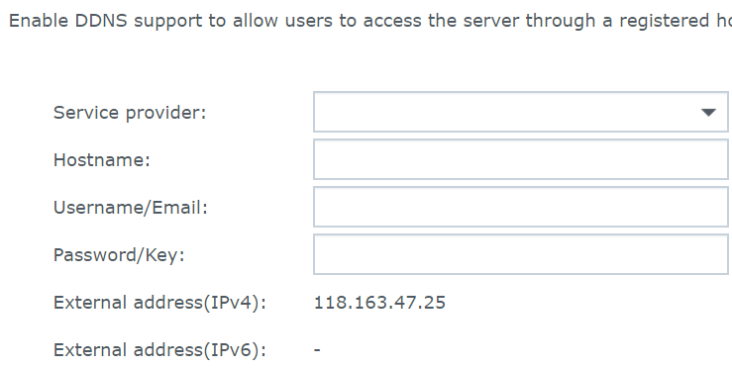
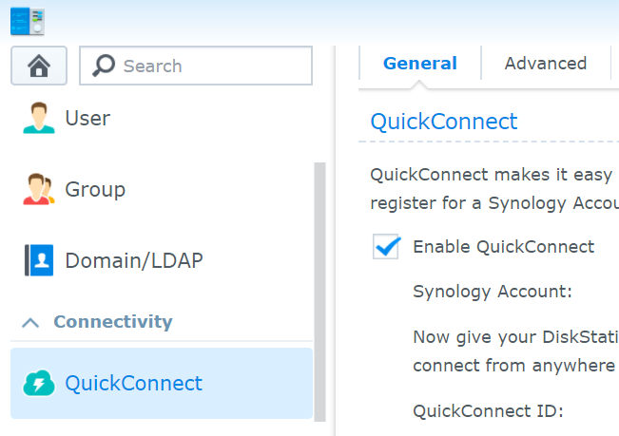
Remote Connection Wizard
QNAP Remote Connection Wizard
Synology Settings
Auto Router Configuration
DDNS Service
Relay Connection
All-in-one Wizard
Setup individually
Notes:
[OK][動]

Slide 24
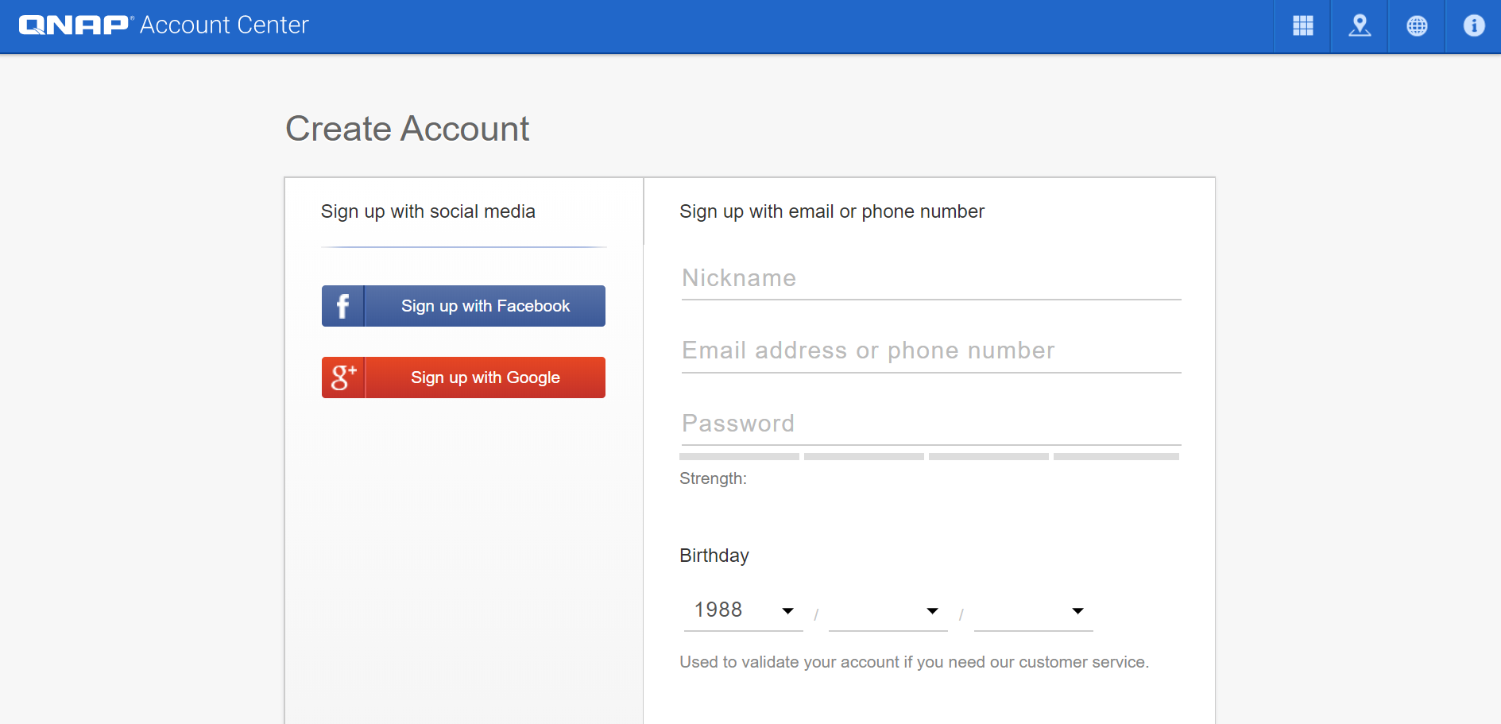
Remote Connection Episode I
Signup QNAP ID
Go to Wizard
Sign in QNAP ID
Go to account.qnap.com
Fill up signup form
Verification
Notes:
[OK][動]

Slide 25
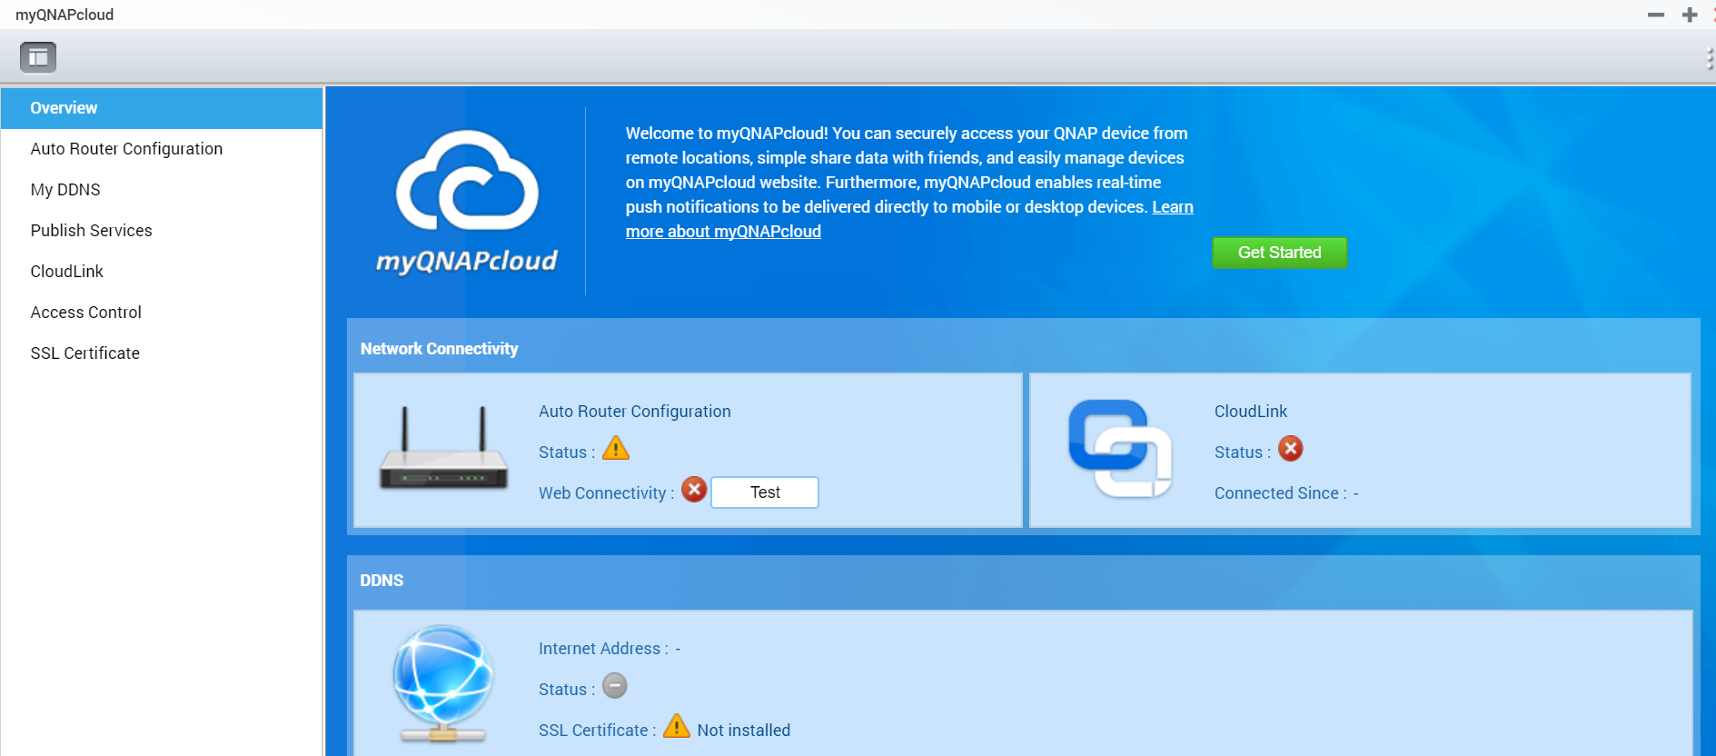
Remote Connection Episode II
Sign up QNAP ID
Go to Wizard
Sign in QNAP ID
Go to QTS
Click "myQNAPcloud"
Click "Start"
Notes:
[OK][動]

Slide 26
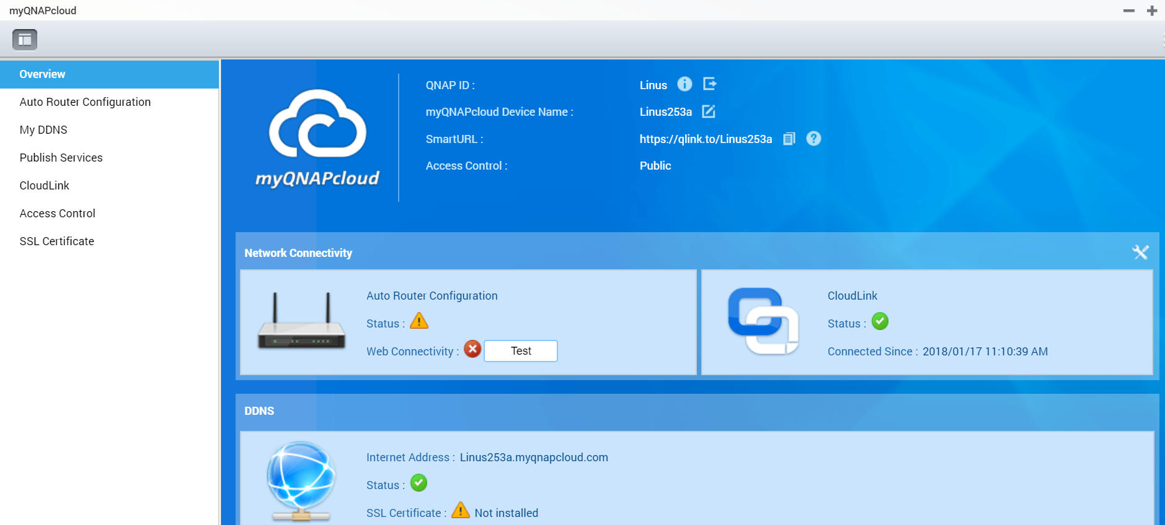
Remote Connection Episode III
SignQNAP ID
Go to Wizard
Sign in QNAP ID
Sign in QNAP ID
Set myQNAPcloud Device Name
Done!
Notes:
[OK][動]

Slide 27
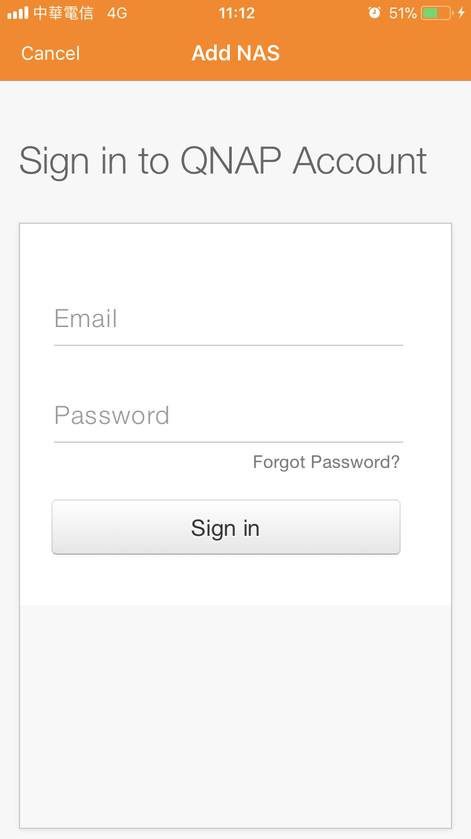
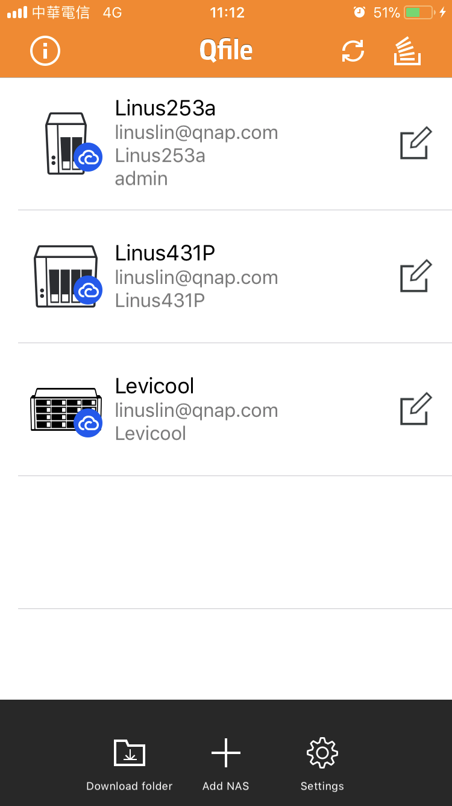
Try it now with Qfile !
Import all NAS info at once
Connect!!!
Click "Add NAS"
1
Sign in QNAP ID
2
Import successfully!
3
Notes:
[OK]

Slide 28
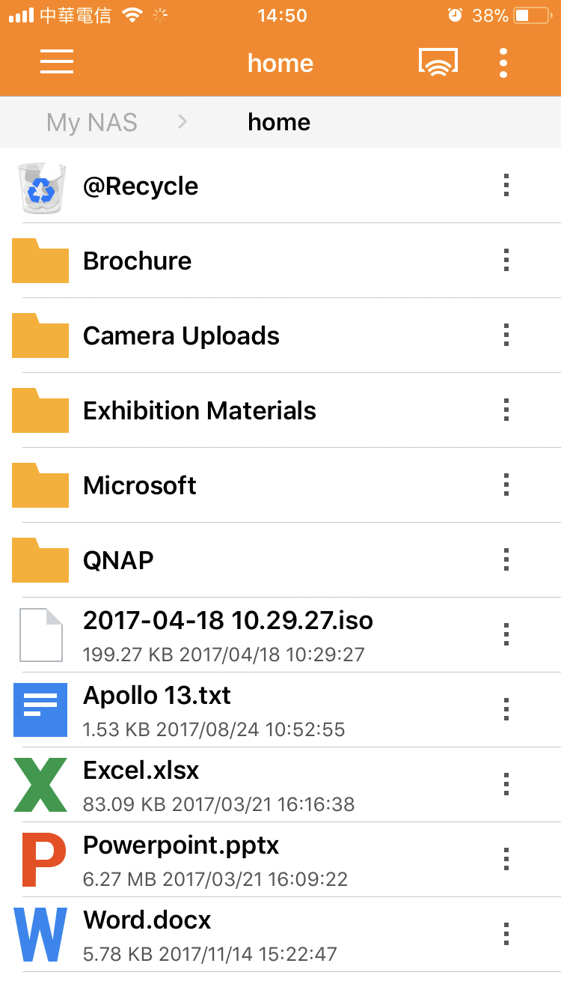
Try it now with Qfile !
Import all NAS info at once
Connect!!!
Automatically uses the best connection method
Notes:
[OK]

Slide 29
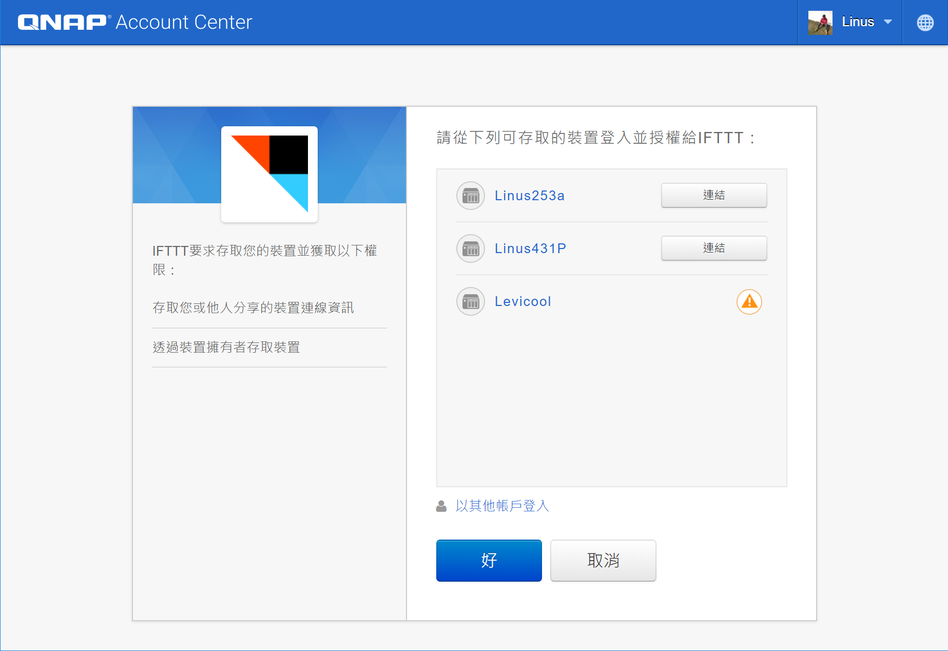
Connects IFTTT with QNAP ID！
Open IFTTT Agent
Sign in IFTTT Account and select device
Select IFTTT Applet
Done!

Slide 30
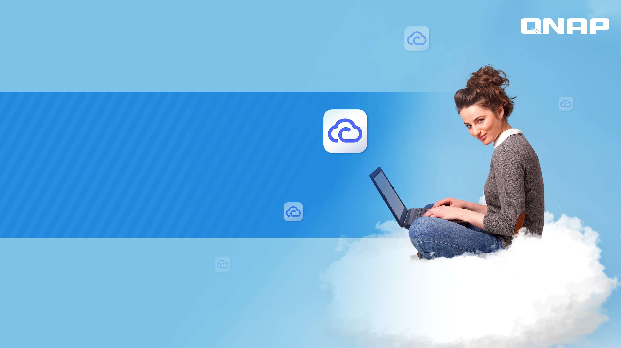
DEMO
Notes:
[OK]

Slide 31
Cloud Service Pros / Cons
Category | QNAP myQNAPcloud | Synology QuickConnect
NAS and File Management | Full Account Access Control (Public, Private, Customized) | Unable to setup account control
 | Manage and share files. | N/A
 | Check multiple NAS info: IP, Firmware version, connection status. | Check out IPs.
 | myQNAPcloud SSL Certificate . Enterprise class certificate with support | N/A
Cloud Account Management | 2-step authentication | N/A
 | Account activity log and notification. | N/A

Slide 32
Cloud Service Pros / Cons
 | QNAP myQNAPcloud | Synology QuickConnect
Setup Process | All-in-one-Wizard： 1. Auto Router Configuration 2. myQNAPcloud DDNS 3. CloudLink | Setup services individually in each panel.
Service Status | myQNAPcloud Service Status Dashboard | Needs to contact tech support.

Slide 33
myQNAPcloud,
Your best choice!
Notes:
[OK]

