Slide 1
Insider Tips for using Music Station & Qmusic
Notes:
音樂管理及音樂收藏的好夥伴

Slide 2
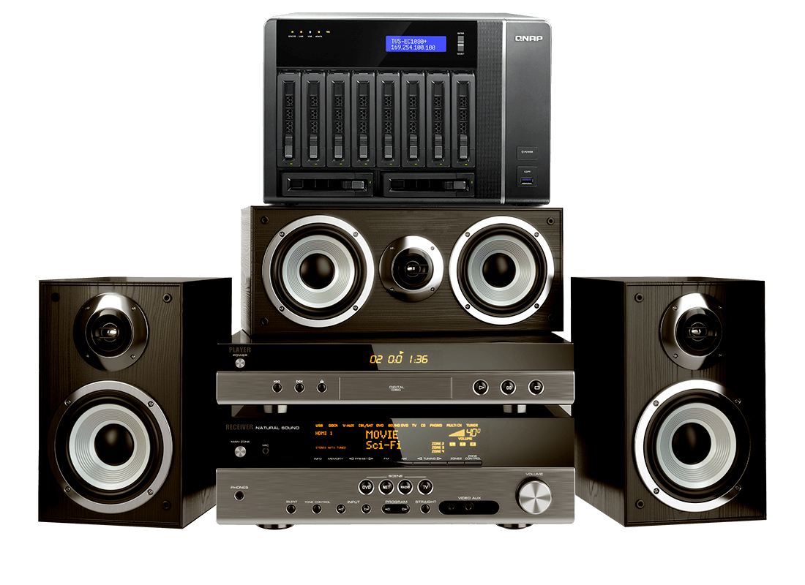
I am a music enthusiast, and I...
…have a huge amount of digital music, including high resolution FLAC files. I hope there could be a huge storage to keep files
…want an easy way to manage my collections
…wants to share music across
many devices
Notes:
我有大量的數位音樂收藏，其中不乏高音質 FLAC 格式的音樂檔案，不過檔案管理分類、儲存空間不足等問題始終困擾著我，跨裝置分享及播放更是一大挑戰。

Slide 3
I am just a music lover, and I...
…have lots of music files, and I want to easily manage them.
…wants to share my favorites with friends
…wants to listen to music anytime, anywhere
Notes:
輕鬆管理音樂檔案
快速建立歌單 並且能夠分享給朋友
在房間聆聽時也能串流到家中電視
音樂隨時帶著走 走到哪能聽到哪

Slide 4
No matter who you are, we've got it
Manage music files
High storage potential
Share music
Cross-device playback
Music on the go
Music Station
meets your needs!

Slide 5
Fantastic music feast in Music Station
Manage files easily
Convenient music sharing
1. Supports various music formats
2. Categorizes songs automatically according
to metadata
3. Advanced search
4. Smart playlist
1. Set and manage shared link
2. Easily share music to social media websites
Supports streaming to various devices or local output
1. Qmusic on the go
2. Network streaming to multi-zone or local output

Slide 6
Manage huge amount of music files with ease
Support various music formats
Lots of functions for you to easily manage

Slide 7
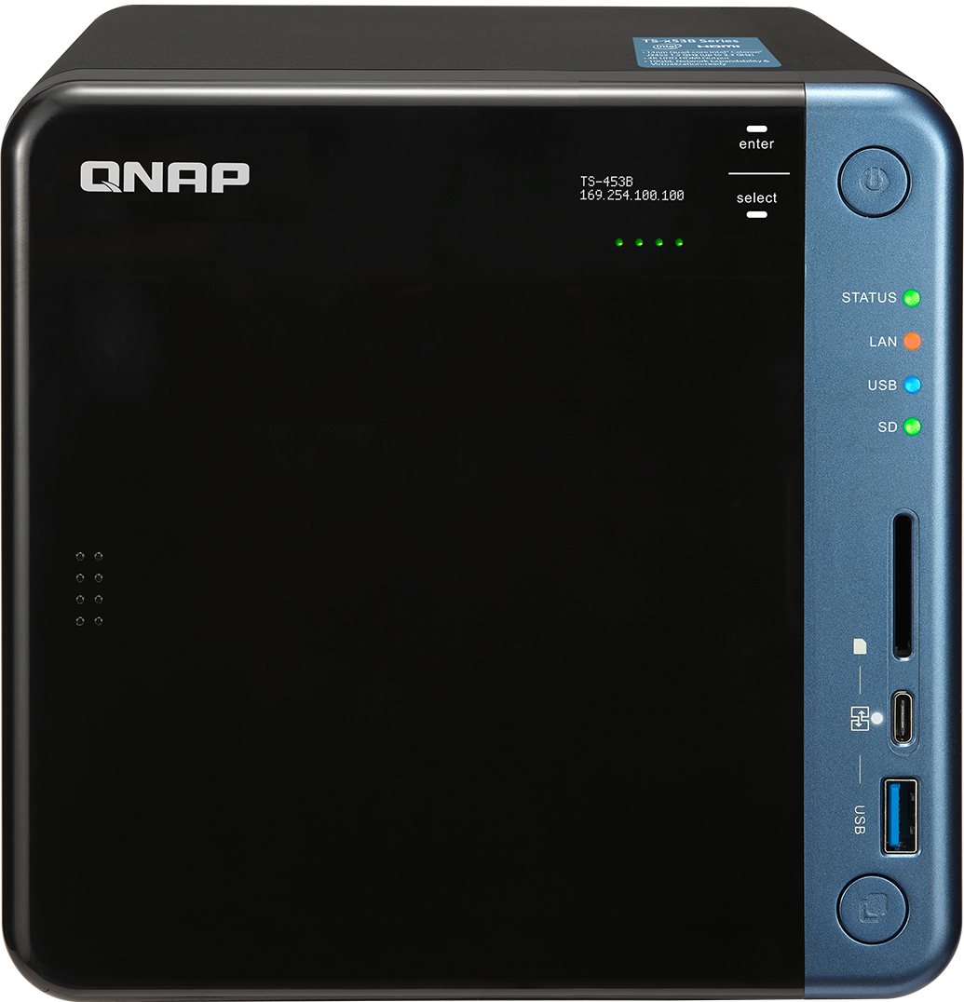
Lots of collections, but kept in different devices?
No space to centrally store and manage all the collections?
Store on QNAP NAS! Music Station solves your problems!

Slide 8
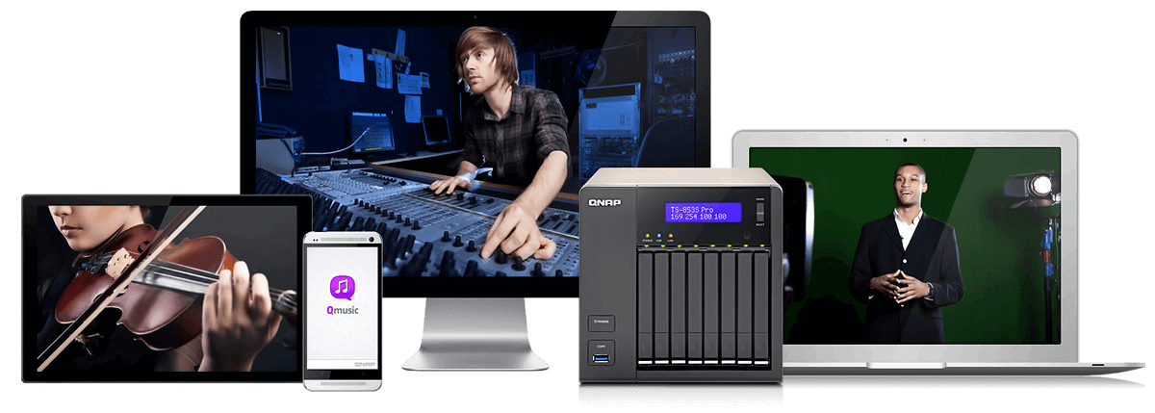
Physically small, but large in capacity
By using high-capacity hard drives, terabytes of storage is available for music!
Music Station supports some common music formats :
MP3, FLAC, APE, M4A, DSD …etc
It won’t be a problem to store and listen to thousands of lossless files!

Slide 9
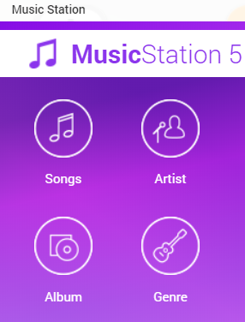
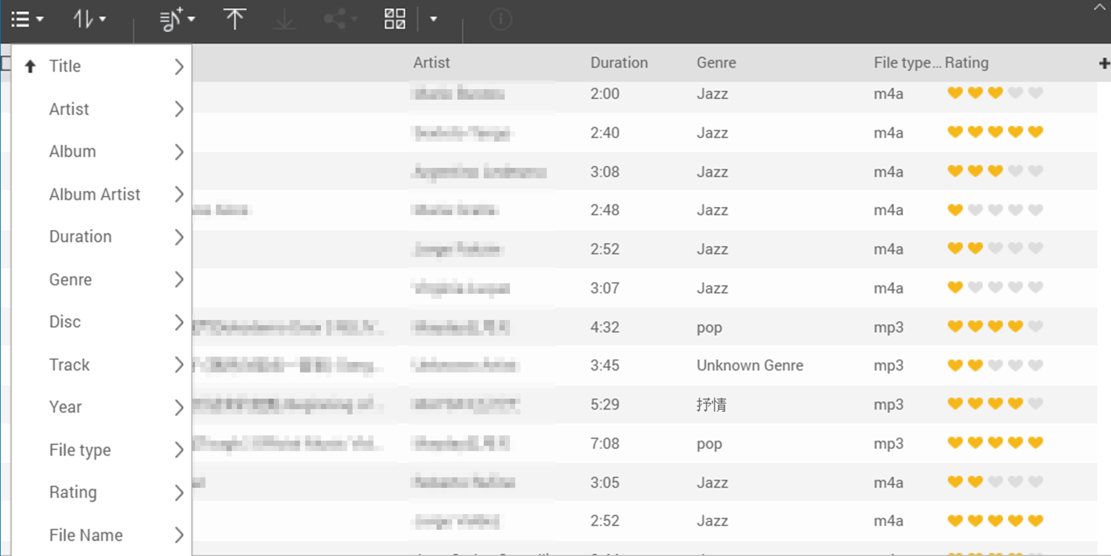
Categorizes songs automatically
Upload music through File Station or Music Station.
Music Station will categorize songs by their ID3 Tag.
Browse songs' information in columns, or choose different sorting criteria.

Slide 10
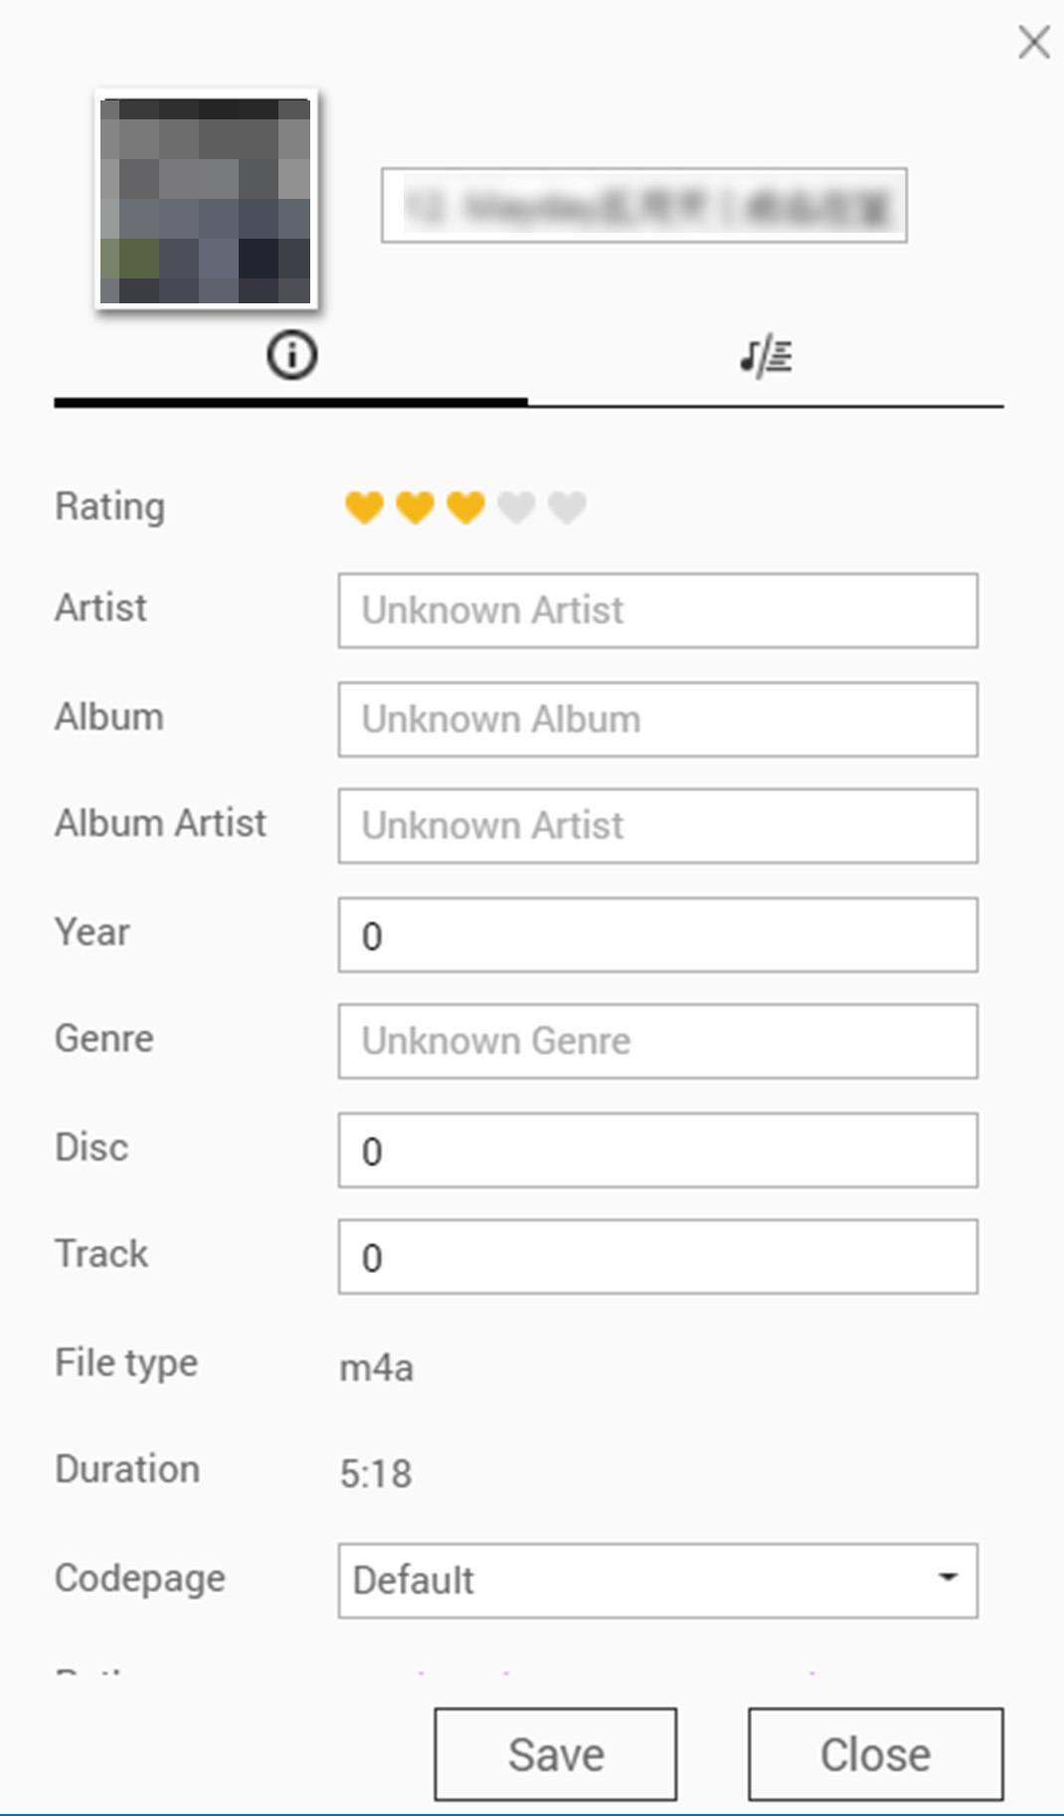
Edit metadata
It is not the problem if the metadata of song is incomplete!
You can edit information by yourself
Edit song information ：Right click → ”Information”→ Edit

Slide 11
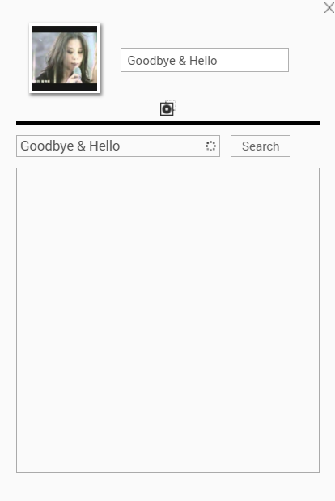
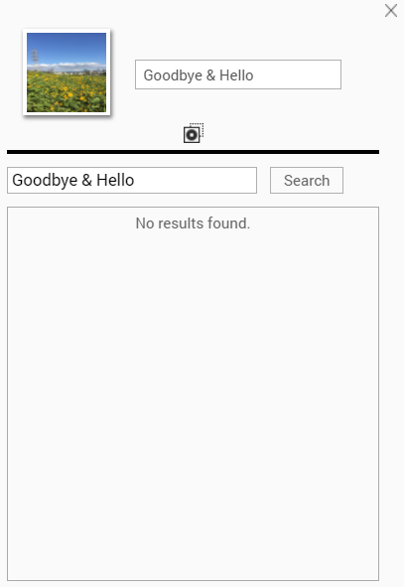
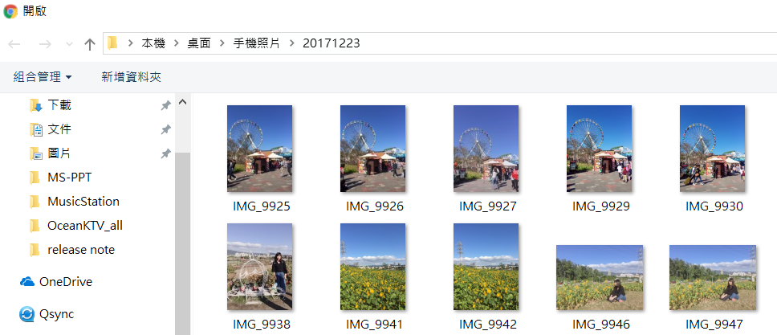
Change the cover as you want it
Change the photo of album cover or artist
Click to upload a new cover
Notes:
Yoc
變更封面
您可以用喜愛的照片替換專輯封面與演唱者照片。在工具列選擇［以圖示方式顯示項目］，右鍵點擊專輯縮圖，選擇［資訊］，再點擊專輯封面或演唱者照片即可上傳您的照片。

Slide 12
Have you ever had those concerns?
Forgetting the song title
I remember the artist and the release year, but forget the song title! How to find the song?
Only listen to songs qualified to specific criteria
I want to listen to songs of 80’s. How to quickly find them?
How to look for songs precisely?
Notes:
I remember the artist and the song year, but forget the song title! How to find the song?

Slide 13
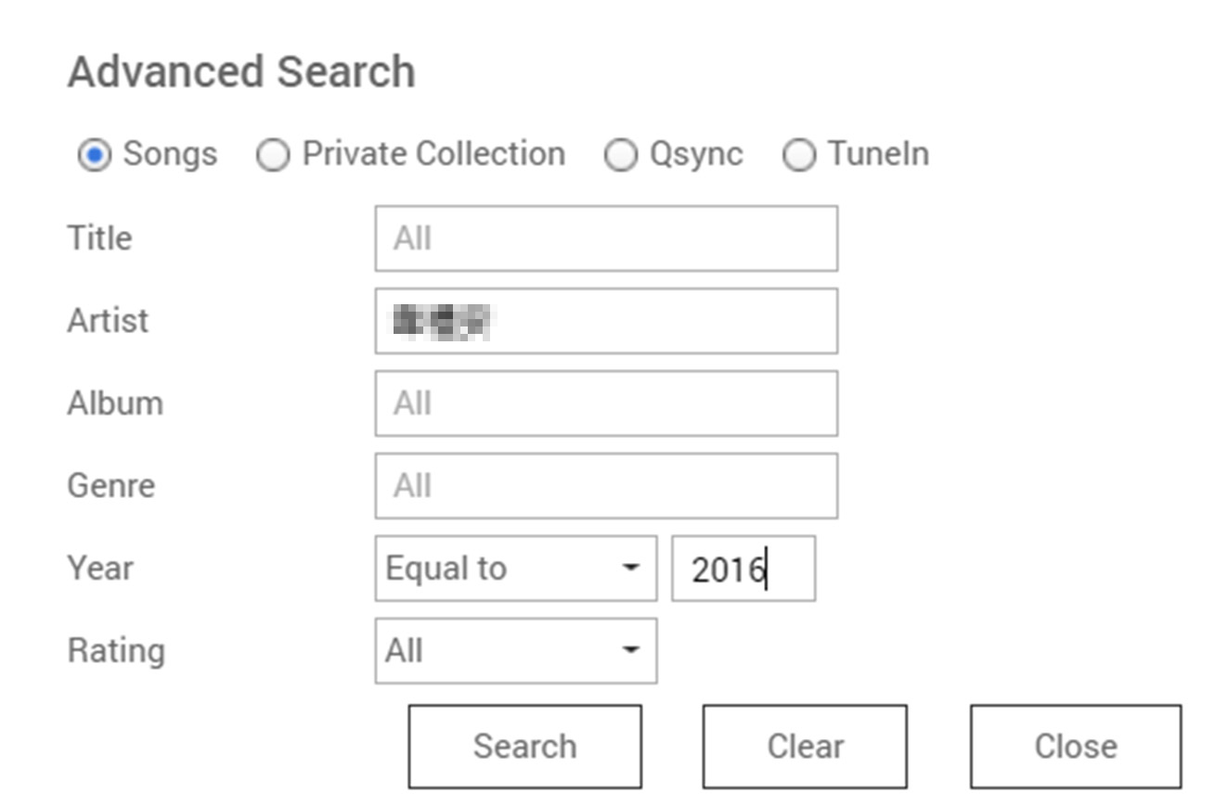
Advanced search
Besides searching with specific criteria, you can
set multiple criteria to precisely find the song!
I really found the song by setting multiple criteria!
Notes:
Set multiple criteria to find out the song you want!
Besides search for certain criteria, yo

Slide 14
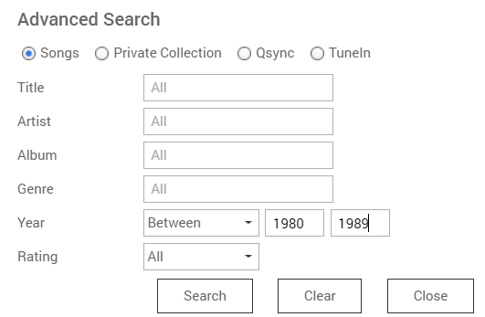
Advanced search
Enter criteria in Year, and I easily find the songs I want!

Slide 15
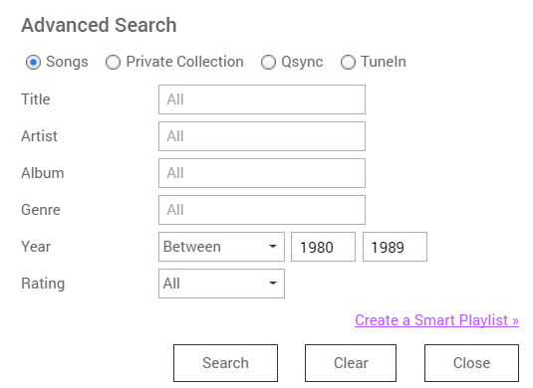
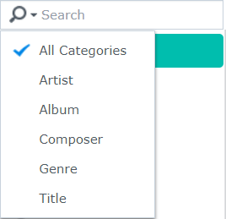
Advanced search
DSM 6.2
Audio Station
Search -> Smart Playlist
Can not search with multiple criteria

Slide 16
Have you ever had those concerns?
I want to quickly create playlists,
but adding songs one by one is bothering
After going to the concert, I want to create a playlist of that band! How can I quickly pick up songs from them?
Smart Playlist meets your needs

Slide 17
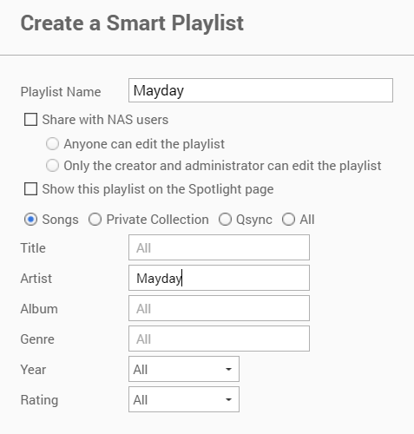
Smart Playlist
Edit permission
Anyone or Creator/Administrator
Multiple search criteria
While making setting, system would
gather songs meeting criteria for the Smart playlist!

Slide 18
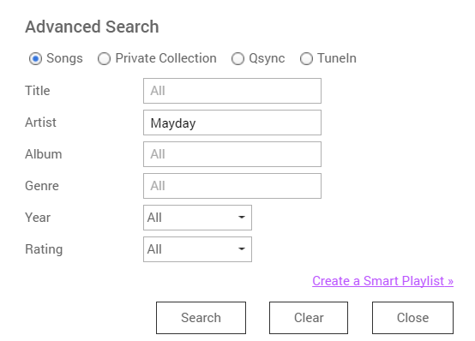
Smart Playlist
Search -> Smart Playlist

Slide 19
Convenient Music Sharing
Supports password and expire date
Easily share music to social media websites

Slide 20
Multiple ways to share links to music
After going to the concert, I created a smart playlist. I want to share it with friends!
Share song or playlists to your friends
Email
Publish
Link Code
Share music with email invitations
Publish shared music to social media websites
Share music through shared links
DSM 6.2
Audio Station
Only process link, need to share by yourself
Notes:
分享中心
您能在此管理所有透過 Music Station 分享的檔案連結。
分享音樂
選擇歌曲或專輯後，在工具列上點擊［建立新的分享］，即透過下列三種方式分享您的音樂：
電子郵件：以電子郵件分享連結。寄發電子郵件前，請先確認SMTP伺服器已正確設定。如需設定SMTP，請至［控制台］>［系統］>［通知設定］>［電子郵件］。
發佈：將連結發佈至各大社群網站。
連結代碼：將建立的連結透過網路論壇或通訊軟體分享。
在［分享中心］，您可以瀏覽分享檔案的歷史記錄。您也可以再次分享或播放音樂檔案。
注意：
［分享中心］僅能直接播放MP3檔案。如需播放其他格式的檔案，請下載並使用其他播放器。

Slide 21
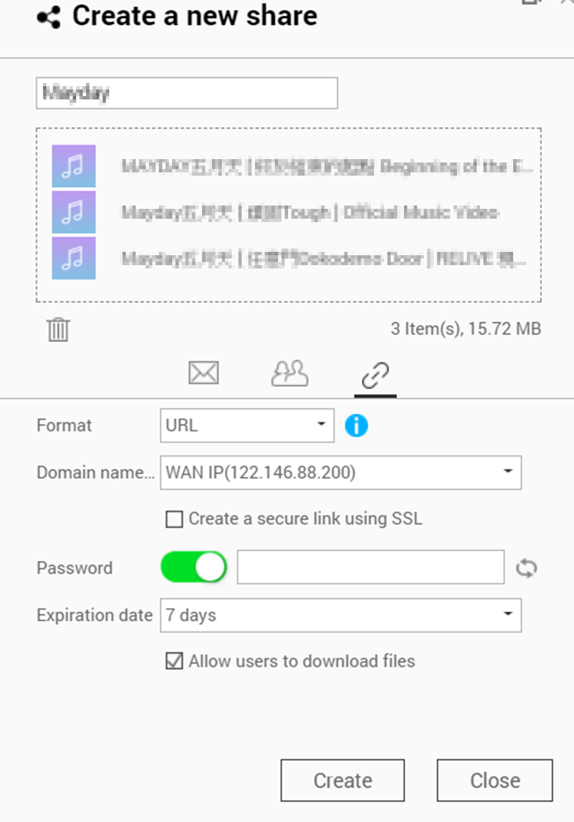
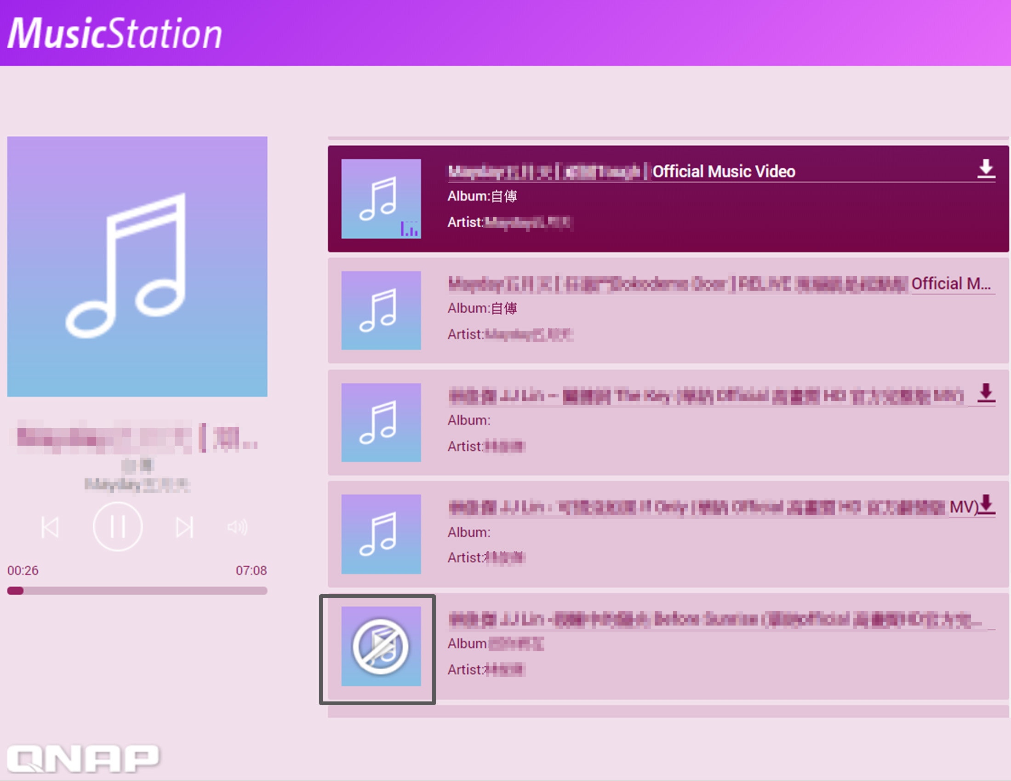
Share music
The recipients will be directed to the following page
Online play or Download
the shared music
*Only .mp3 files can
be played online
Notes:
無論您用任何一種方式分享您的音樂播放清單，收到連結的使用者都會連結到以下頁面。在這個頁面內，可以選擇線上播放音樂或下載到本地儲存。請注意：線上播放僅支援.mp3格式，其餘格式將只能下載至本地再進行播放。
分享中心
您能在此管理所有透過 Music Station 分享的檔案連結。

Slide 22
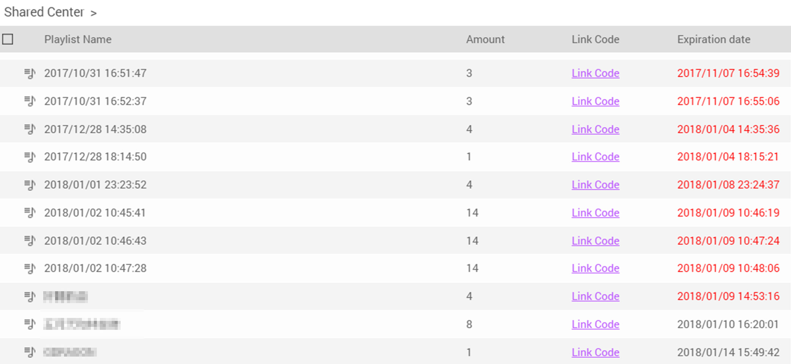
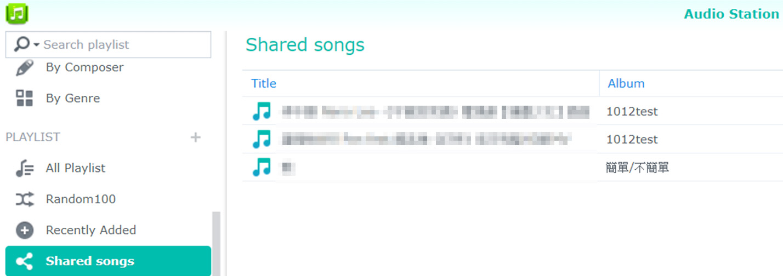
Manage your shared music
﹝Shared Center﹞records each and every shared information. You can efficiently manage each shared records
DSM 6.2
Audio Station
No central place to manage
each shared link
Only the shared songs will be recorded in [Shared songs]

Slide 23
Music Station Demo
Live
Live

Slide 24
Supports versatile
kinds of devices
From mobile devices to media players, music playback is easy
Notes:
Support each ty

Slide 25
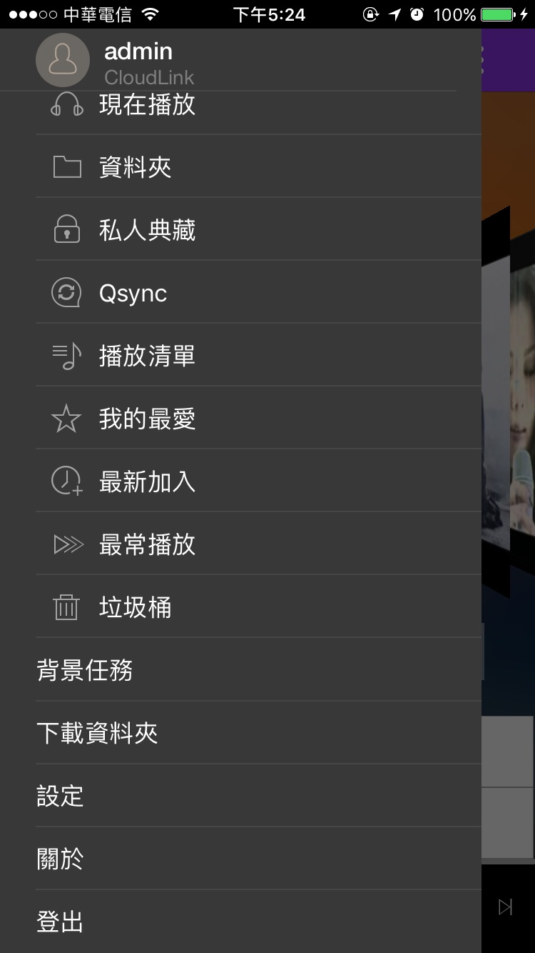
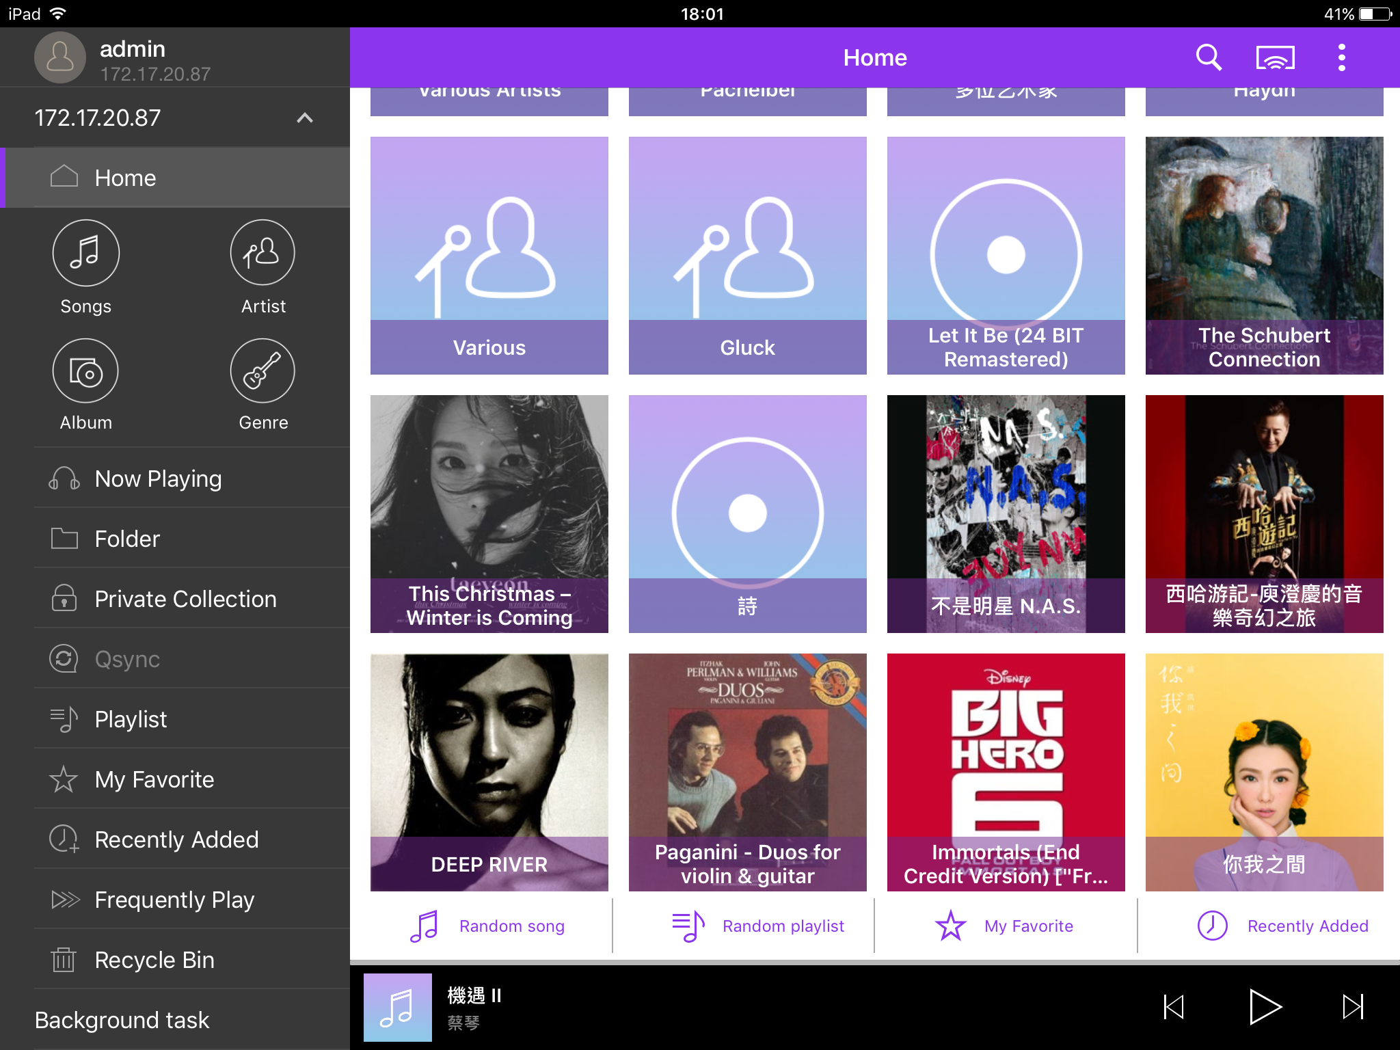
Music Station supports various devices
Stream on
website
Stream to
Network Media
Players
DLNA
Apple TV
Chromecast
Output locally
Audio
Line Out
HDMI
HD Player
Bluetooth
USB
DAC
Stream to mobile apps
Qmusic

Slide 26
Stream on website - Music Station
Open browser and go to Music station to play your collections
能清楚瞭解每筆分享記錄的資訊

Slide 27
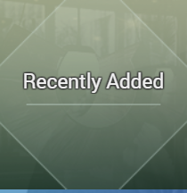
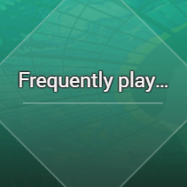
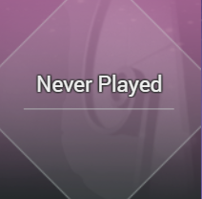
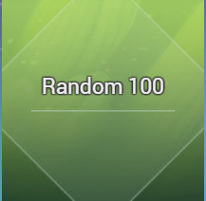
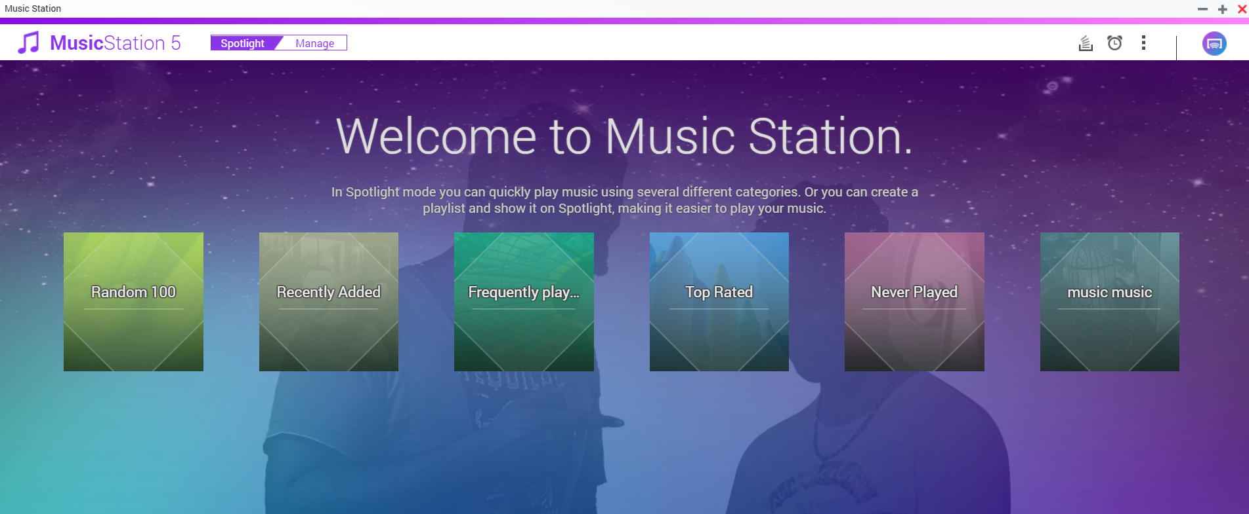
Music Station – Spotlight mode
Spotlight gives you easier ways to play music!

Slide 28
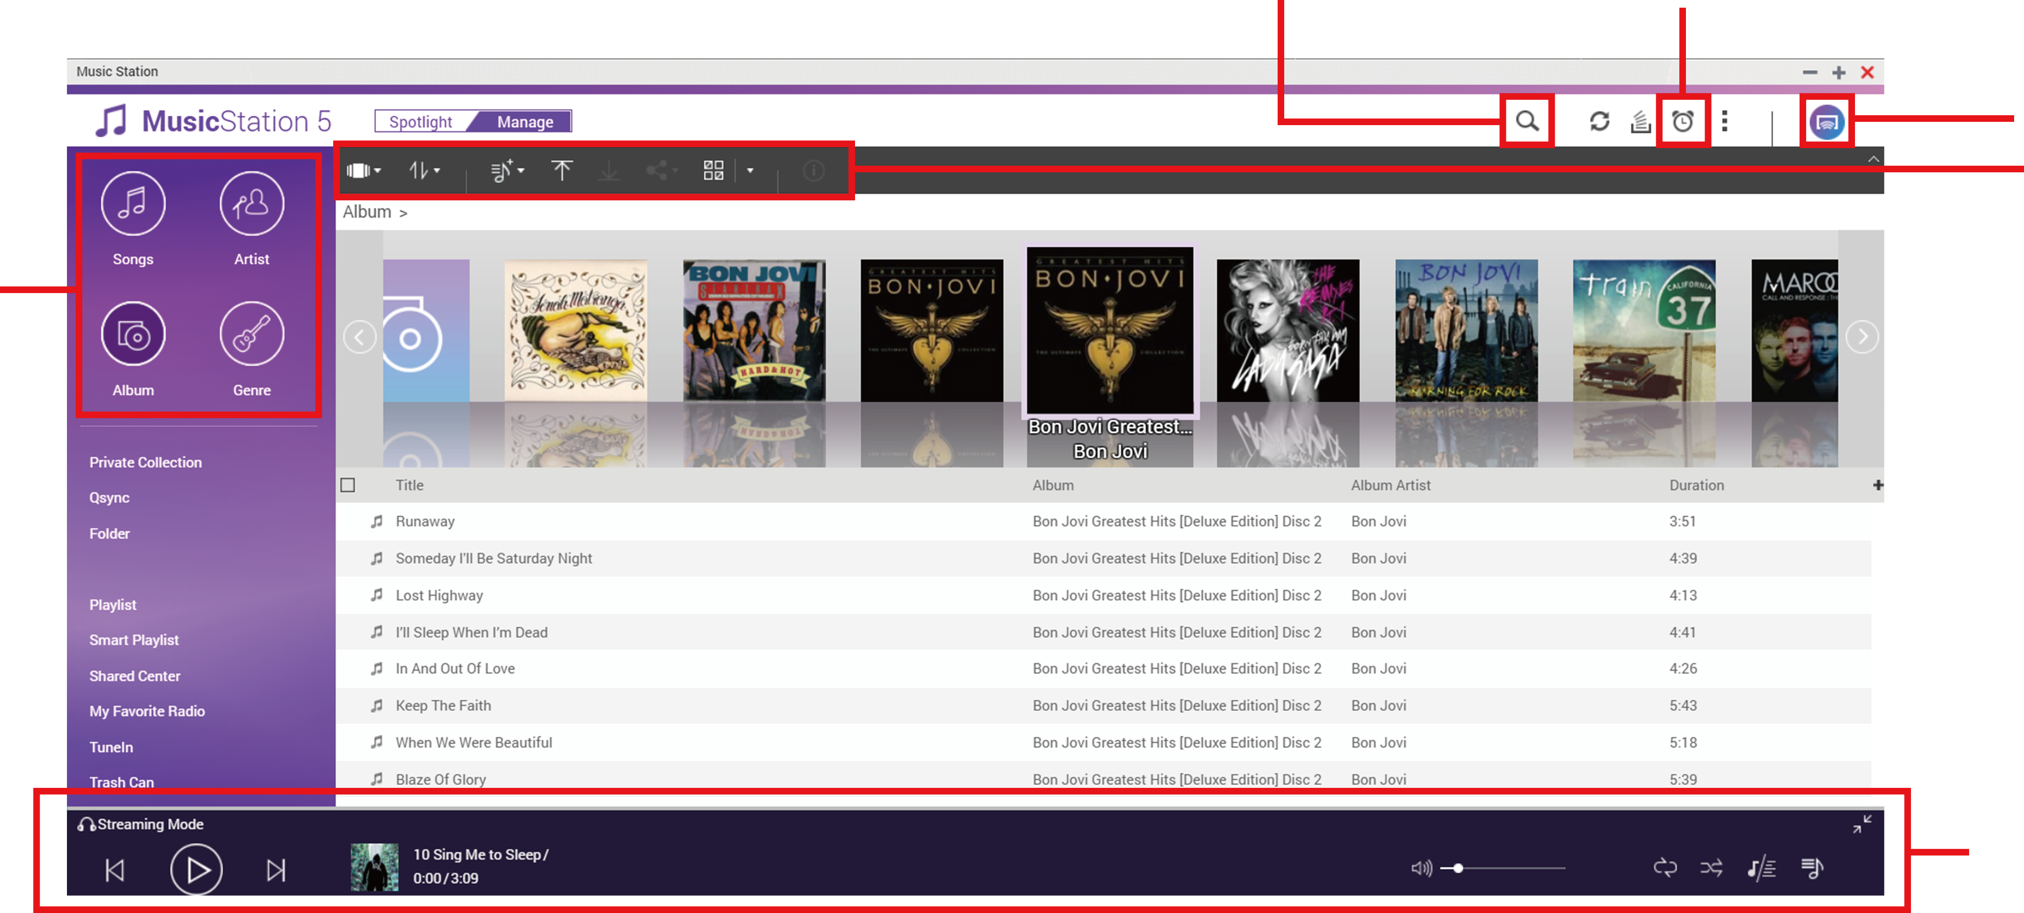
Music Station – Manage mode
Advanced search
Music Alarm
Multi-zone Control and Streaming
Tool bar
Browse type
Music playback control
Different ways to browse music for you to easily select and play music!

Slide 29
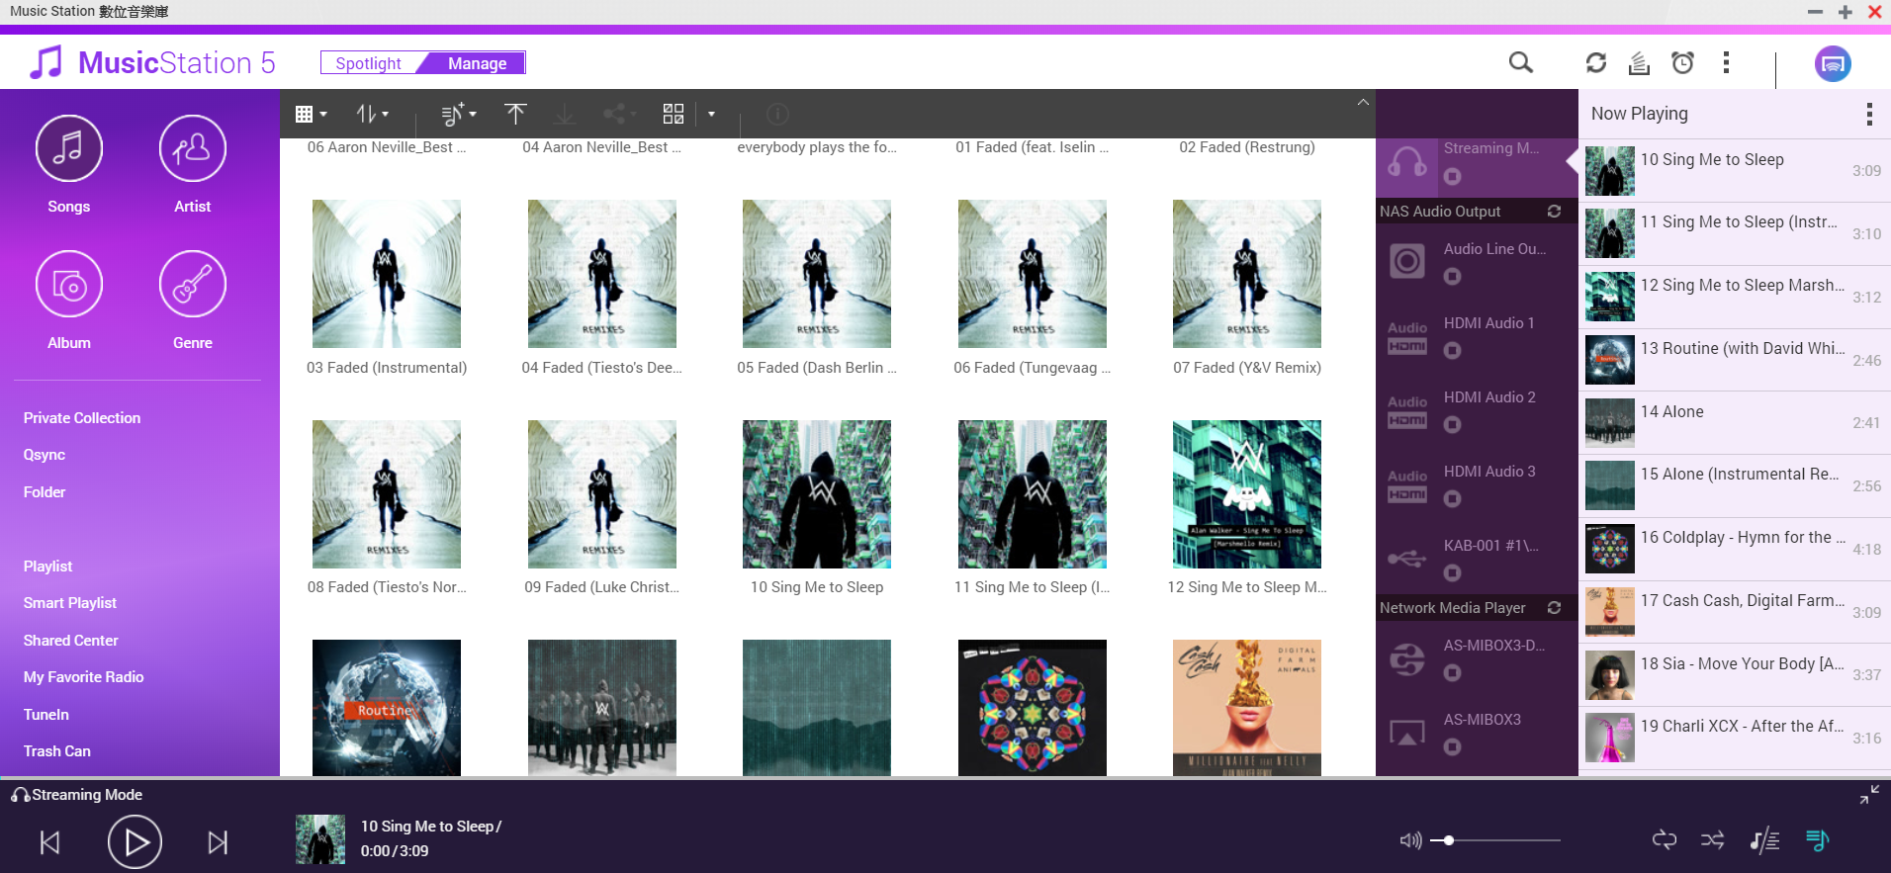
Music Station – Manage mode
Manage Currently Playing of multiple devices in a single interface

Slide 30
Music Station Demo
Live
Live

Slide 31
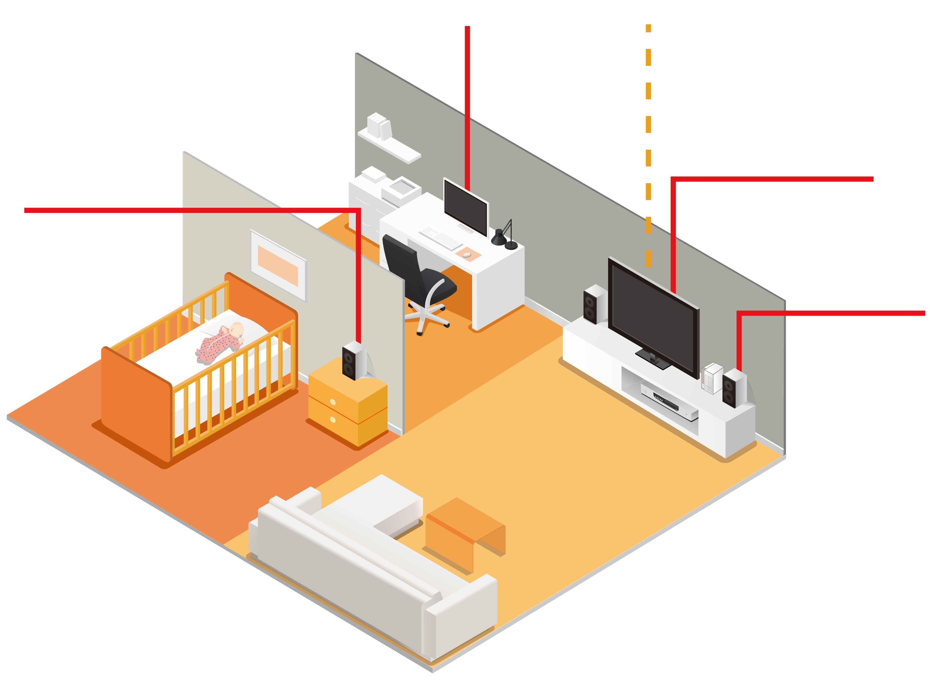
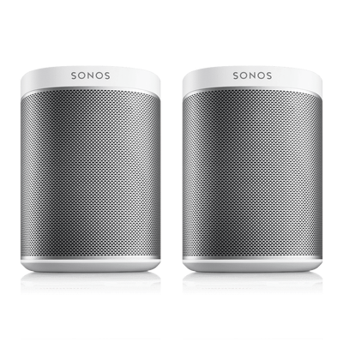
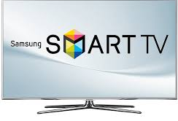
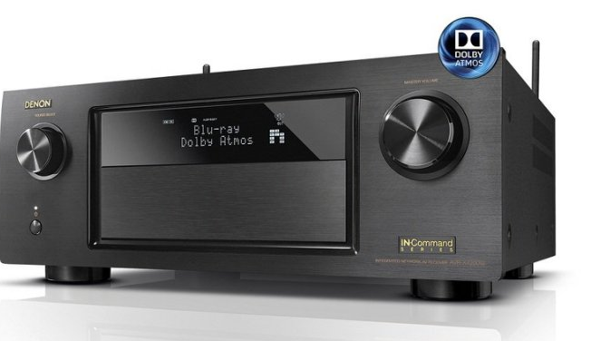
Stream to Network Media Players
Apple TV
Chromecast,
Chromecast Audio
Smart TV
SONOS
DLNA Amplifier

Slide 32
Directly output to devices connected to NAS
Audio out
HDMI
Audio Line Out
HDMI
HD Player
Bluetooth*
USB
*Bluetooth
USB DAC
*Optional USB bluetooth dongle required.

Slide 33
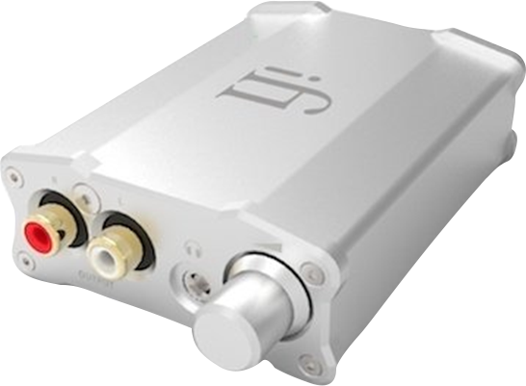
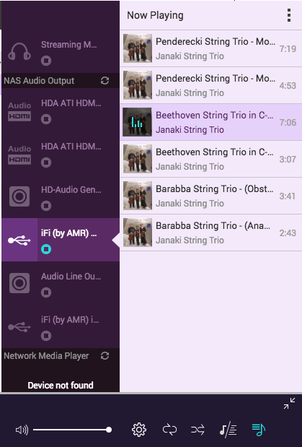
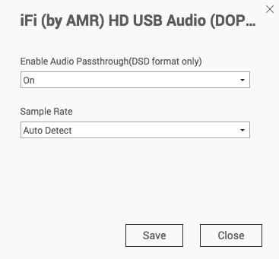
DSD Audio Passthrough
Silent & fanless NAS
USB DAC - iFi nano iDSD
DSD Audio Passthrough

Slide 34
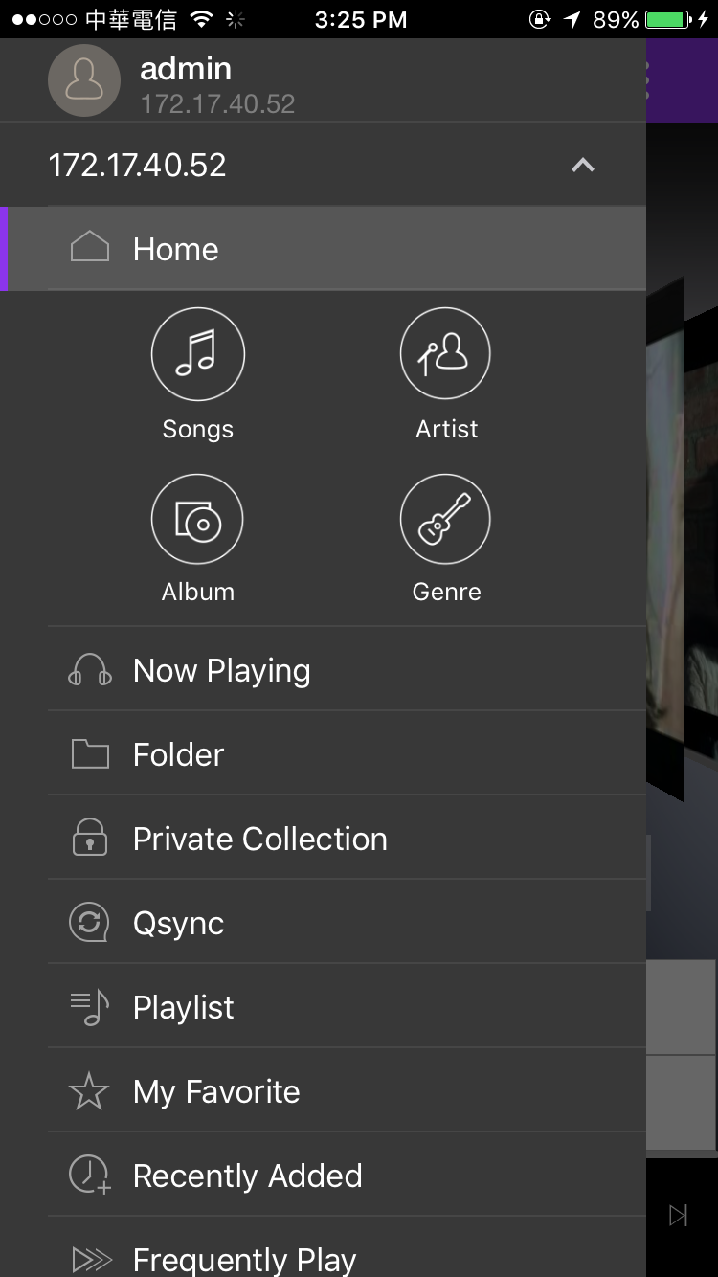
Mobile App - Qmusic
Play your collections stored on NAS through mobile device. You do not need to store music on mobile devices where storage space is relatively limited.
Android / iOS supported
Music Station media database
Download music, offline playback
Multi-zone Streaming

Slide 35
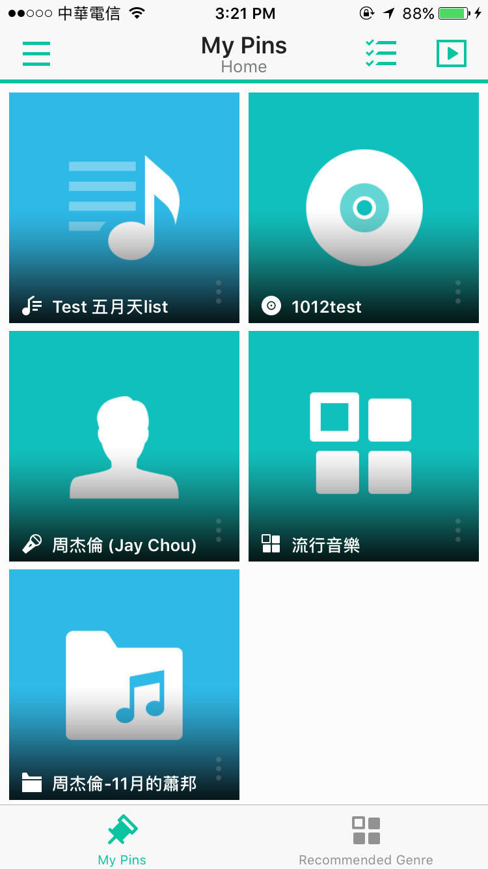
Random recommendations on homepage
DS Audio
Display randomly-selected albums and artists to let you quickly play music
Need to pin by yourself
Four items for you to quickly play songs

Slide 36
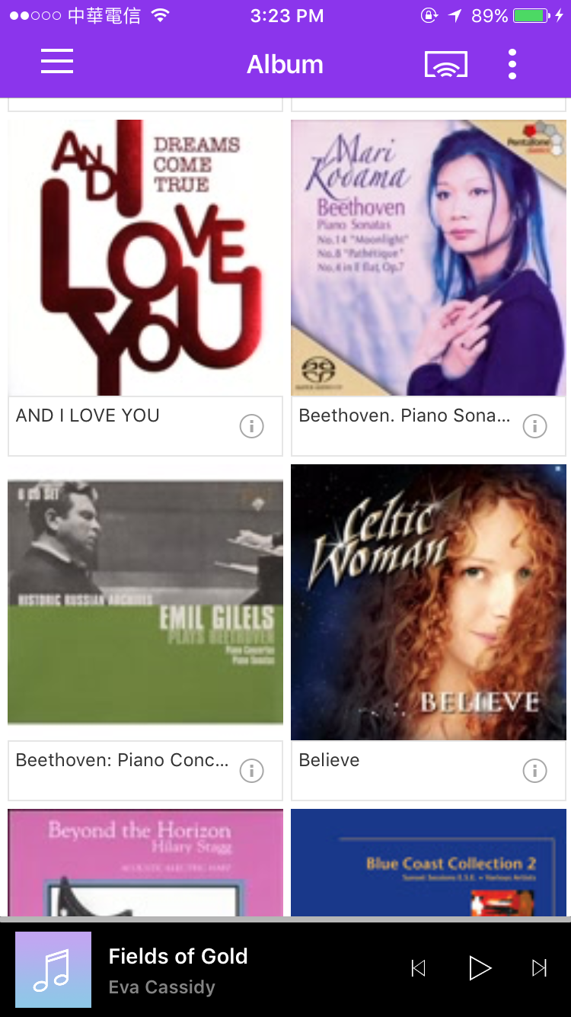
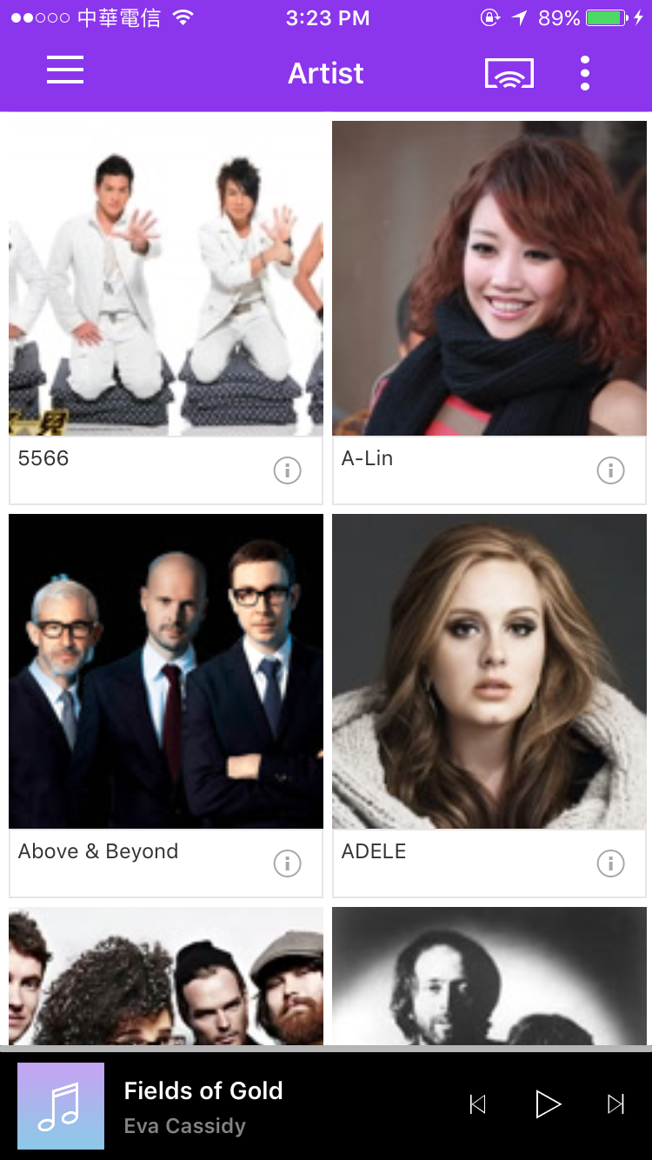
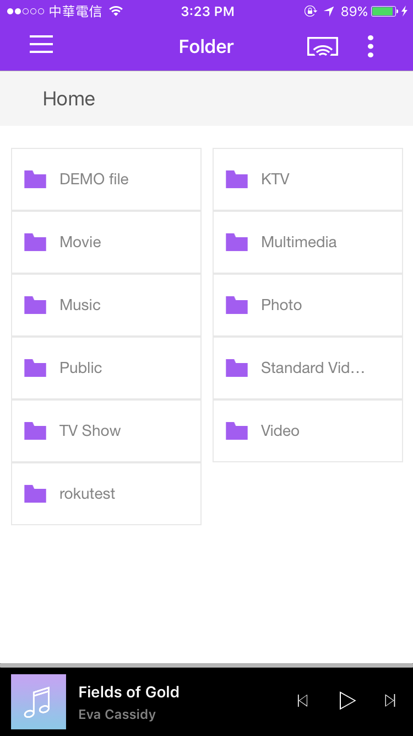
Browse music as you want it
Different types to browse from:
Song, Artist, Album, Genre, Folder

Slide 37
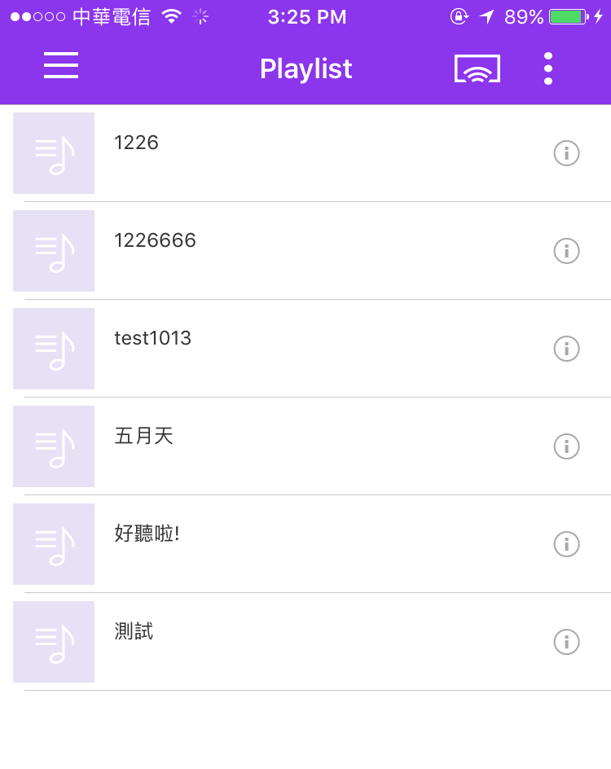
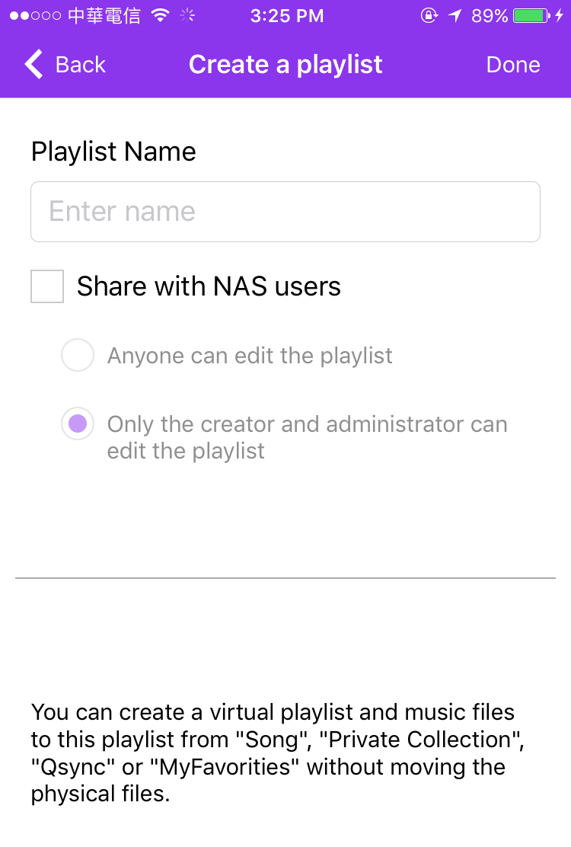
Manage Playlist
Besides managing playlists created in Music Station, you also can create playlists in Qmusic

Slide 38
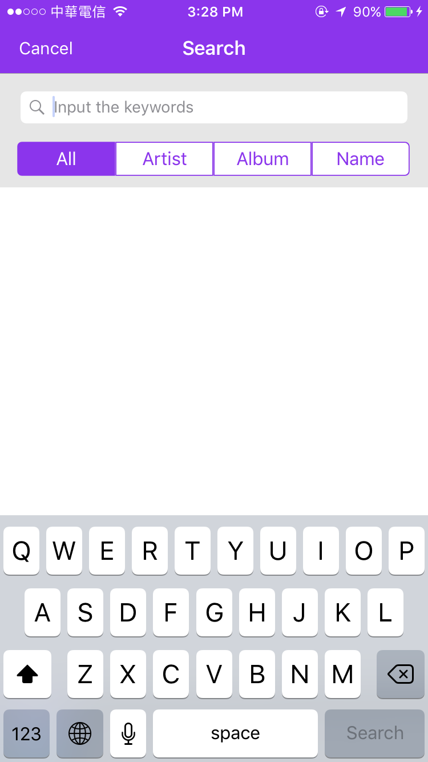
Search
Type keyword to search
All, Artist, Album, Name

Slide 39
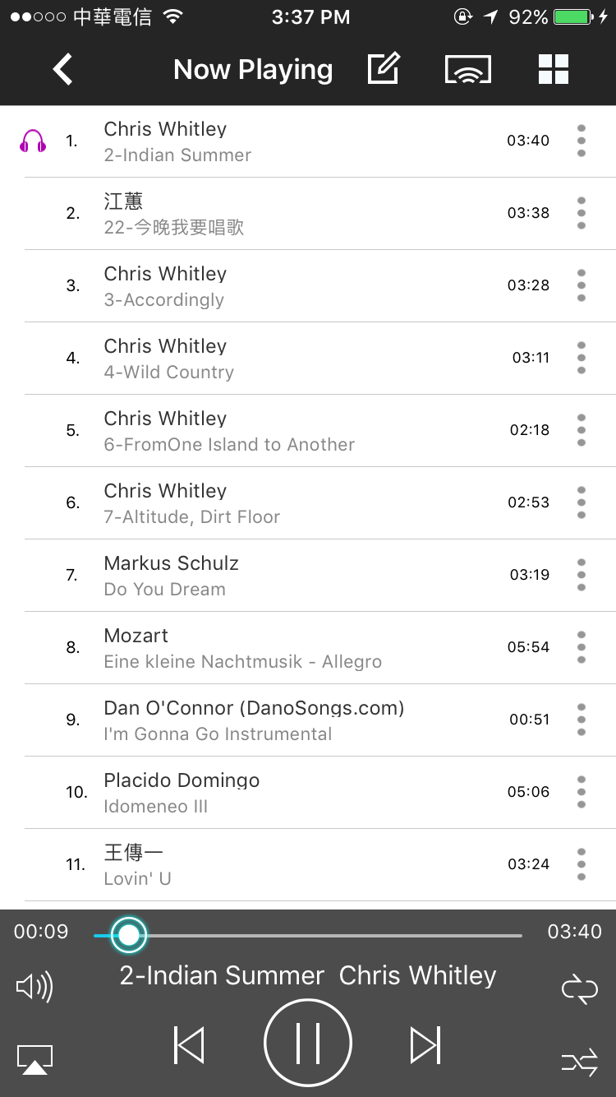
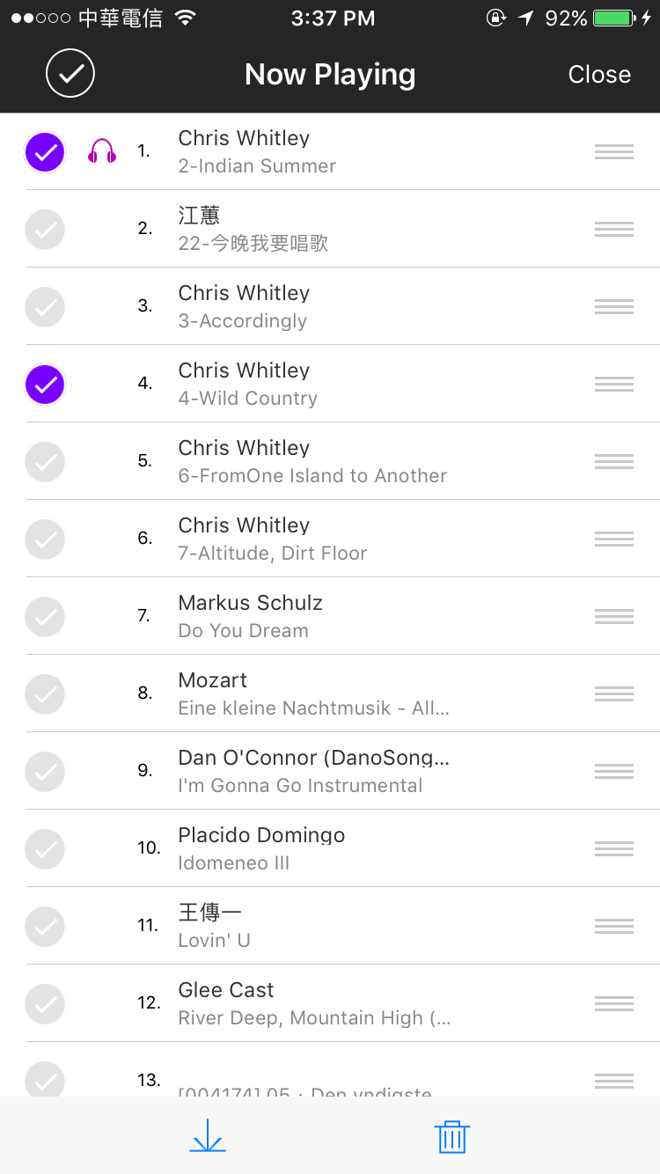
Now Playing list
Edit
Multi-zone
Change the order
Provides many settings：
Edit
Multi-zone
Playback control
Download or remove the song
Notes:
P

Slide 40
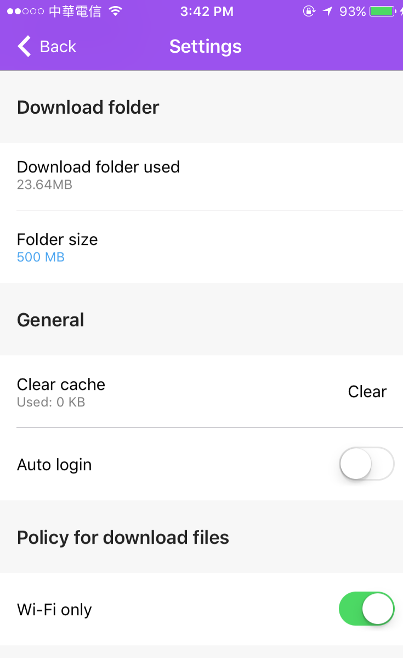
Download music for offline playback
Use Qmusic to download music from NAS and play the music!
Settings and policy for download files
Notes:
分享中心
您能在此管理所有透過 Music Station 分享的檔案連結。
分享音樂
選擇歌曲或專輯後，在工具列上點擊［建立新的分享］，即透過下列三種方式分享您的音樂：
電子郵件：以電子郵件分享連結。寄發電子郵件前，請先確認SMTP伺服器已正確設定。如需設定SMTP，請至［控制台］>［系統］>［通知設定］>［電子郵件］。
發佈：將連結發佈至各大社群網站。
連結代碼：將建立的連結透過網路論壇或通訊軟體分享。
在［分享中心］，您可以瀏覽分享檔案的歷史記錄。您也可以再次分享或播放音樂檔案。
注意：
［分享中心］僅能直接播放MP3檔案。如需播放其他格式的檔案，請下載並使用其他播放器。

Slide 41
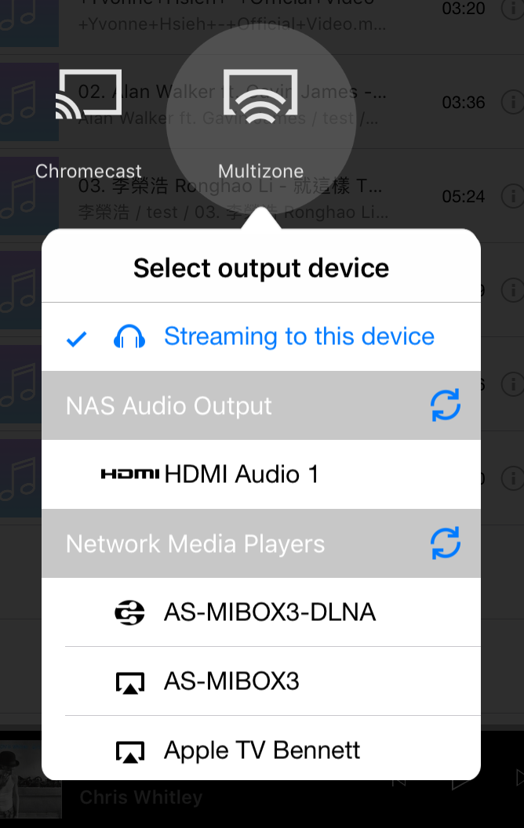
Stream to other devices
Control contents playing on different devices in a single interface
Music Station can stream music to other devices! So does Qmusic!

Slide 42
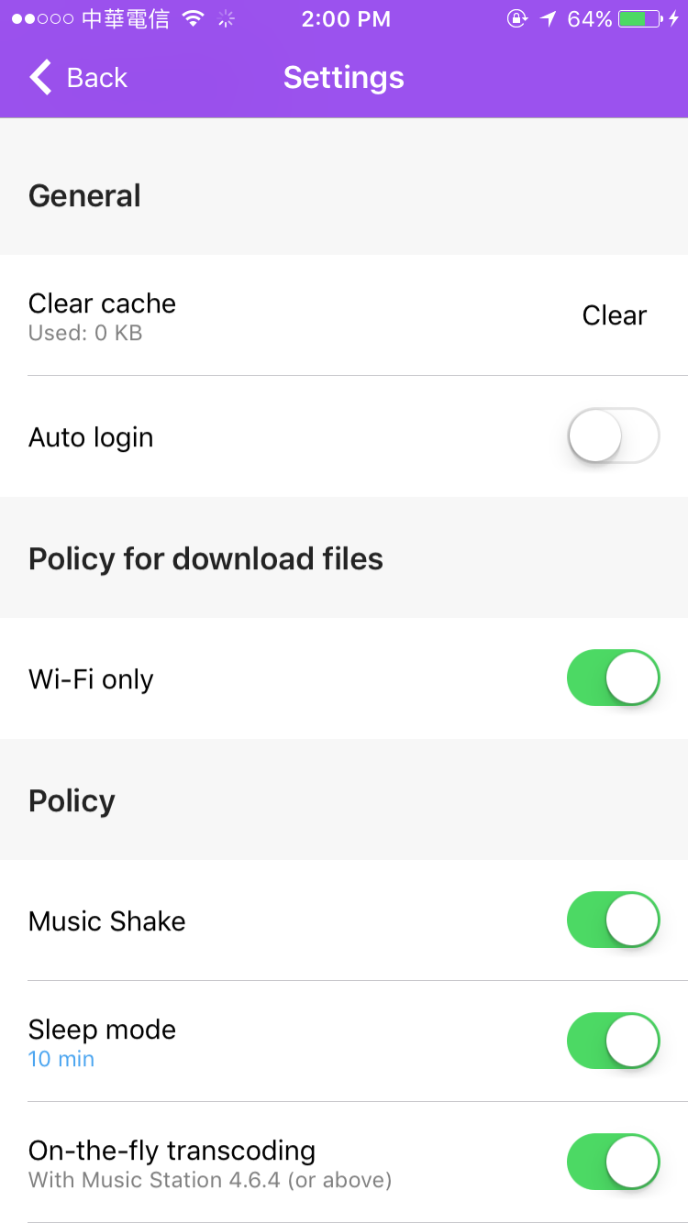
Sleep mode
Automatically stop music playback according to the time at your choice

Slide 43
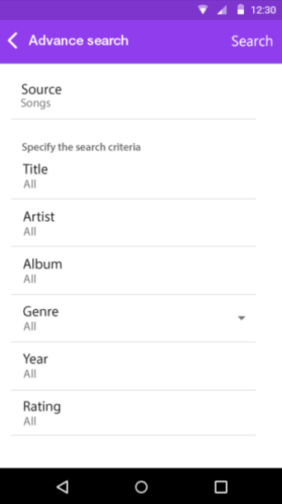
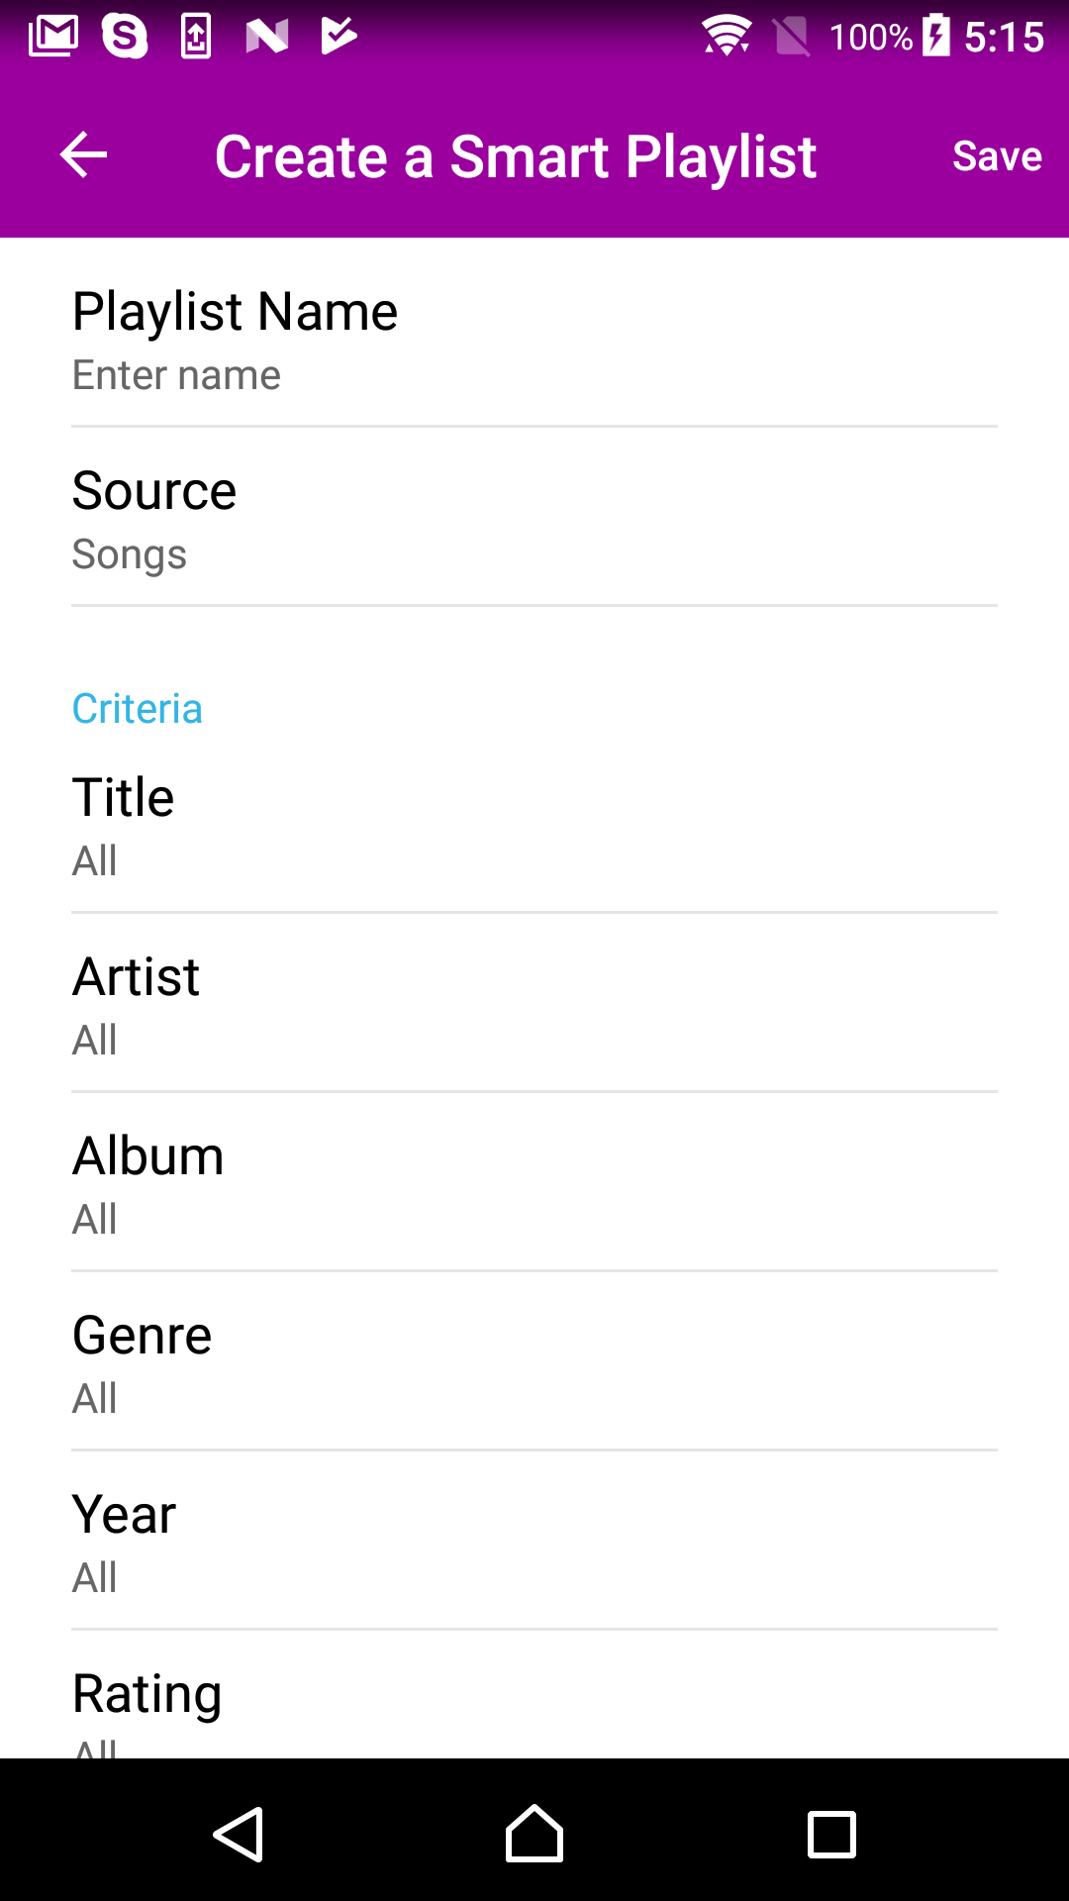
Upcoming functions in Qmusic
Supports Smart Playlist
Support Advanced search
Can create, edit, and manage Smart playlist in Qmusic
Set multiple criteria to find the song quickly

Slide 44
Qmusic Demo
Live
Live

Slide 45
Music Station
Exclusive Features

Slide 46
Listen to thousands of Internet radio stations
Built-in online radio stations allow you to listen to thousands of radio stations around the world
Add Internet radio manually

Slide 47
Music Alarm
Select playlist and device

Slide 48
QNAP Music Station Advantages
Win
 | QNAP | DSM 6.2 Audio Station
Music search | Can set multiple criteria, and use those criteria to create smart playlists directly | Can not search with multiple criteria
Music sharing | Customize settings for expiration date, password & file download Multiple ways to share links Shared Center can efficiently manage each shared files | Only settings for expiration date Only produce shared link No central place to manage each shared link
Multi-zone streaming | Supported output locally （Audio out／HDMI） | Hardware does not support HDMI or Audio out
Music Alarm | Supported | Not Supported

Slide 49
Music Station/ Qmusic
Your Best Choice

