Slide 1
DJ2 Live
Enable CDN and Build up Your Private Live Studio

Slide 2
Live streaming is become more and more popular
Education
Internal Training
eSports
Whatever you want to share

Slide 3
Which platform is your best choice for live streaming?
Gamer
Trainer
Auctioneer
Spread to different audiences as much
as possible
4K resolution streaming
Stable network to allow thousands of
viewers at the same time
Internal staff only
Storage for archiving videos
Support watching videos on
mobile devices
Membership
Reliable network is required due to
the varied geographic locations of
audiences

Slide 4
DJ2 Live One solution that meets all your needs!

Slide 5
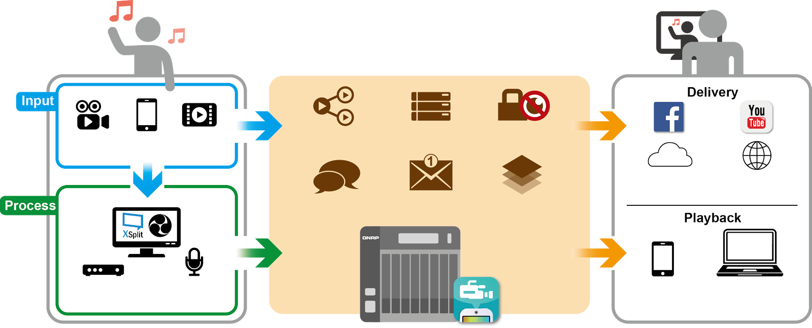
What is DJ2 Live?
DJ2 Live is a Live video streaming platform which is built on QNAP NAS
Camera
Mobile
Video
Transcoding
Storage
Privacy
Cloud
Streaming
CDN
Chat room
Notification
Platform
Video/Audio
Encoder
Mobile App
Browser

Slide 6
6 advantages of DJ2 Live
1
Intuitive user interface
2
Hybrid cloud platform for higher flexibility
3
4K resolution and multi-channel transcoding support
4
High potential storage to keep your precious data
5
CDN integration for streaming your videos to the world
6
Mobile app available to easily start live streaming
in 3 steps

Slide 7
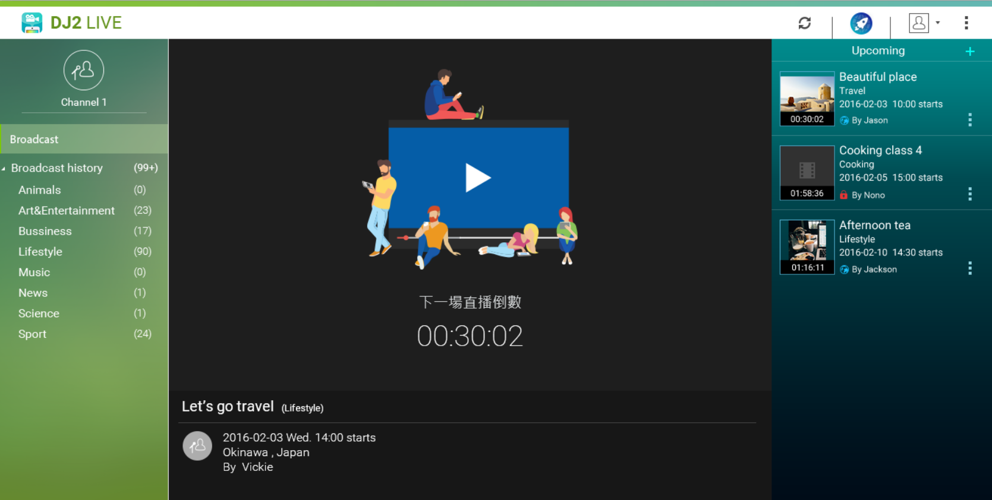
Easy to Manage Your Channel
Save your live videos into different categories
Countdown to the next show
Create program listings of your channel

Slide 8
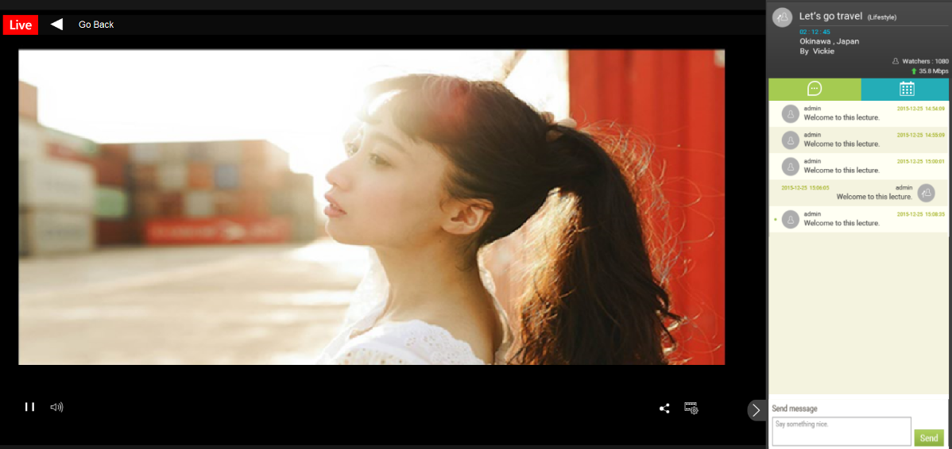
Best User Experience to the Audience
Automatically choose the appropriate resolution based on available internet bandwidth
One touch to share the live video to other audience
Online text chatting with other users or the host

Slide 9
Streaming to multiple public clouds
Supports RTMP(Real-Time Messaging Protocol), and stream your videos to different platforms at the same time. Let you broadcast your videos toward more and more audiences.
Input
Delivery
DJ2 Live

Slide 10
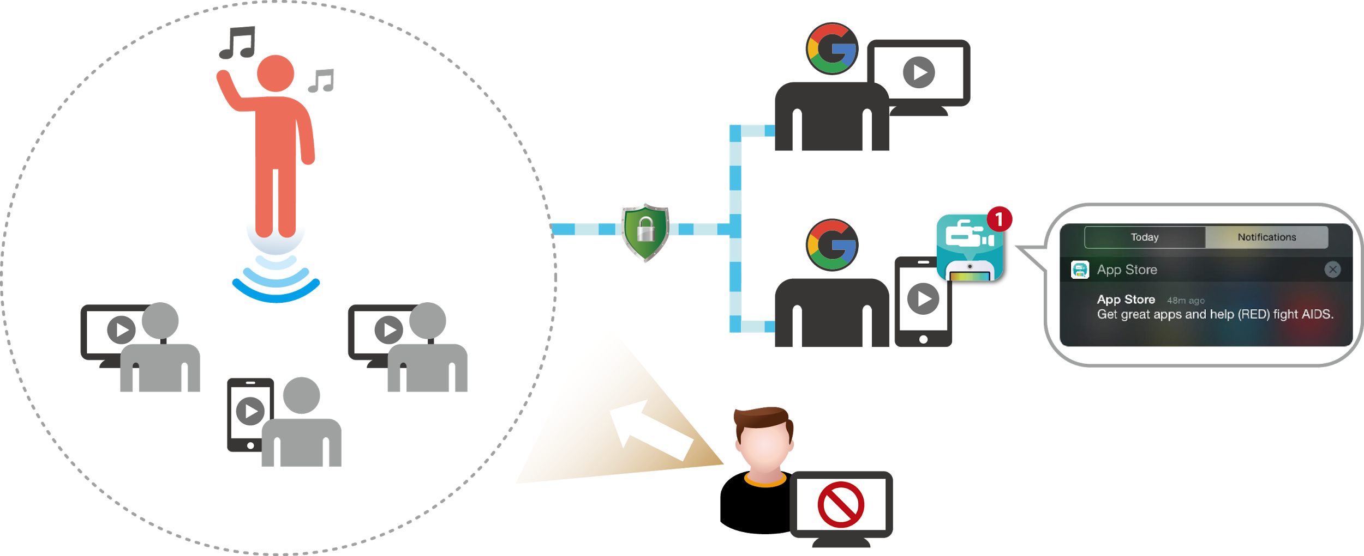
Highly secure live streaming on private cloud
Customized privilege settings for audiences to increase security of live feeds/videos
- You can limit viewers to intranet users
- Integrated with Google OAuth 2.0: share your video to specific Google users
Intranet
Secured Connection
Browser
Browser
Browser
Mobile
Block unauthorized users
Mobile

Slide 11
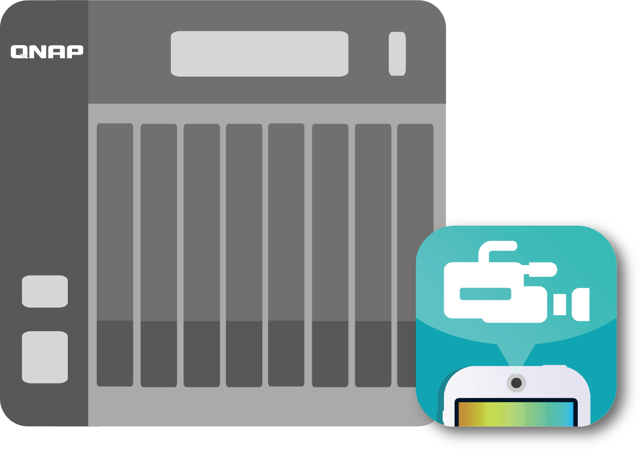
HD video streaming and multi-channel transcoding
Supports up to 4K resolution videos
Transcode you videos to different resolutions to save bandwidth for devices of different screen sizes
Original (4K)
4K video
High quality (1080P)
Normal quality (720P)
DJ2 Live

Slide 12
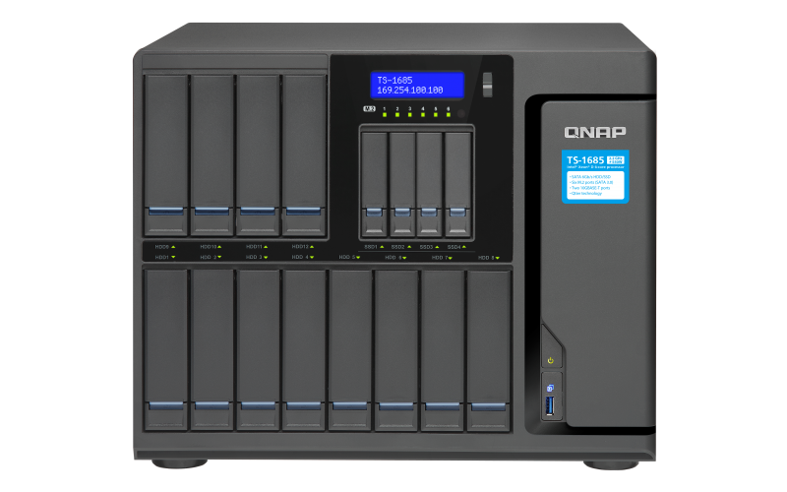
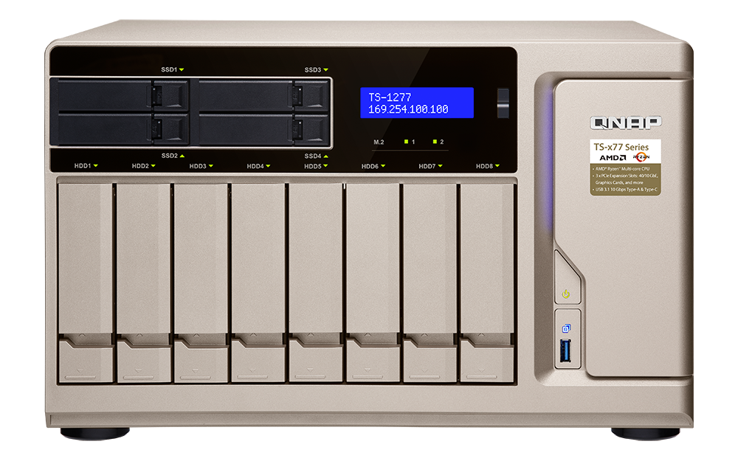
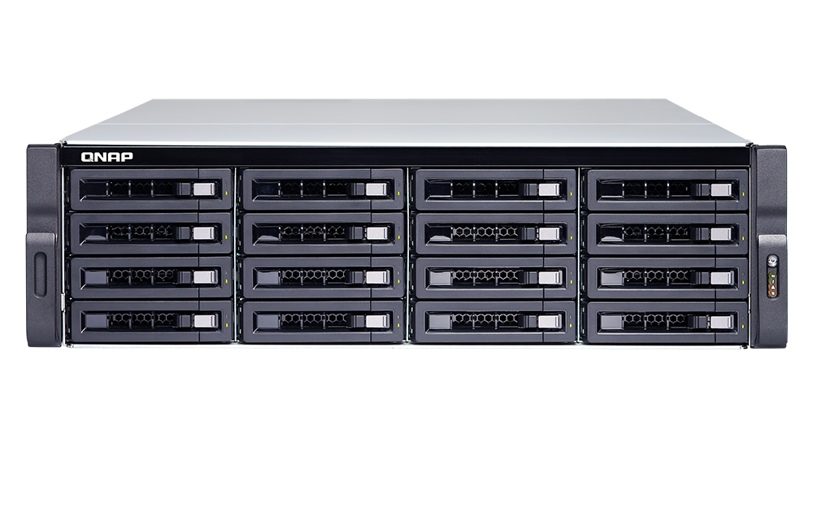
Use expansion GPU to extend functionality
You can install NVIDIA graphics cards to the following models to make DJ2 Live alive
TS-1685
TS-x77 Series
TDS-16489U
Models: TS-1685, TS-x77 series, TDS-16489U
dGPU cards: GeForce GTX 1050, GeForce GTX 1060, GeForce GTX 1070, Quadro p2000

Slide 13
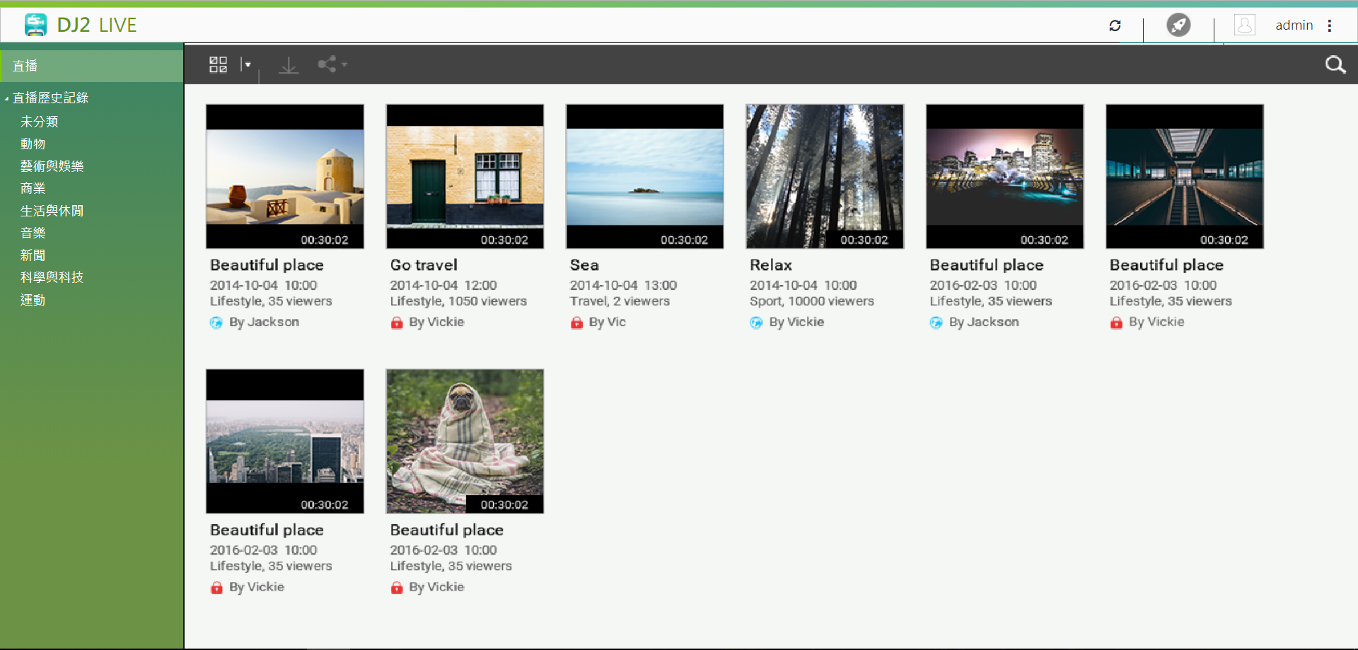
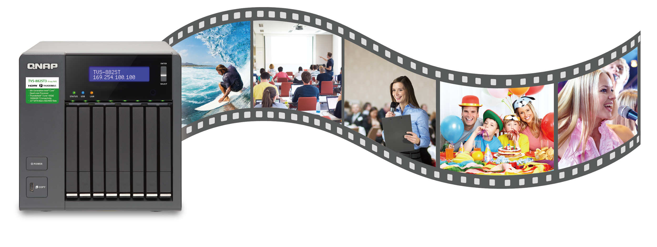
High potential storage to keep your precious data
Higher storage potentials for archiving and backup
Live streaming history
- Share you videos again with other audiences
- Categorize your videos for fast search and instant play

Slide 14
It seems perfect...

Slide 15
Wait! What if my broadband bandwidth is not fast enough to support so many online viewers concurrently?
DJ2 Live integrates CDN service to maintain quality of your live stream videos

Slide 16
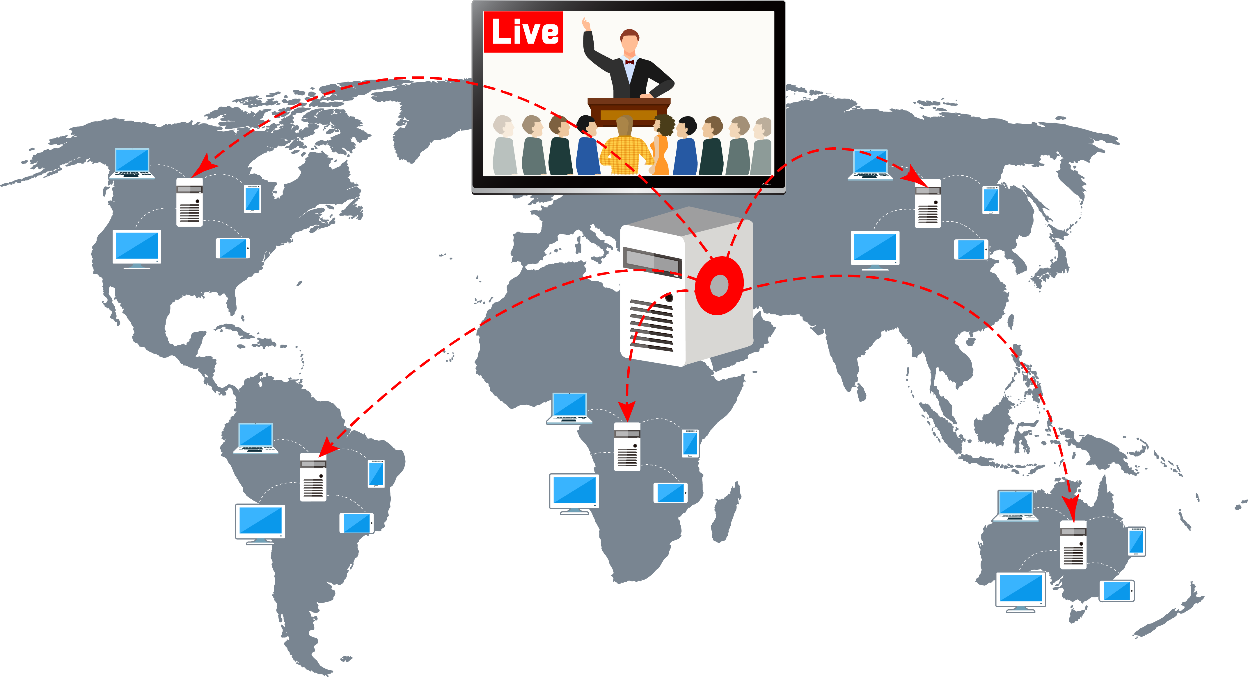
CDN
What is CDN (Content delivery network)?
- A mechanism to distribute service spatially relative to end-users to provide
high availability and high performance
What advantages can I get by using CDN?
- Save your broadband bandwidth
- Speed up connection for your audience
- Hide your NAS under CDN to prevent
from being attacked.

Slide 17
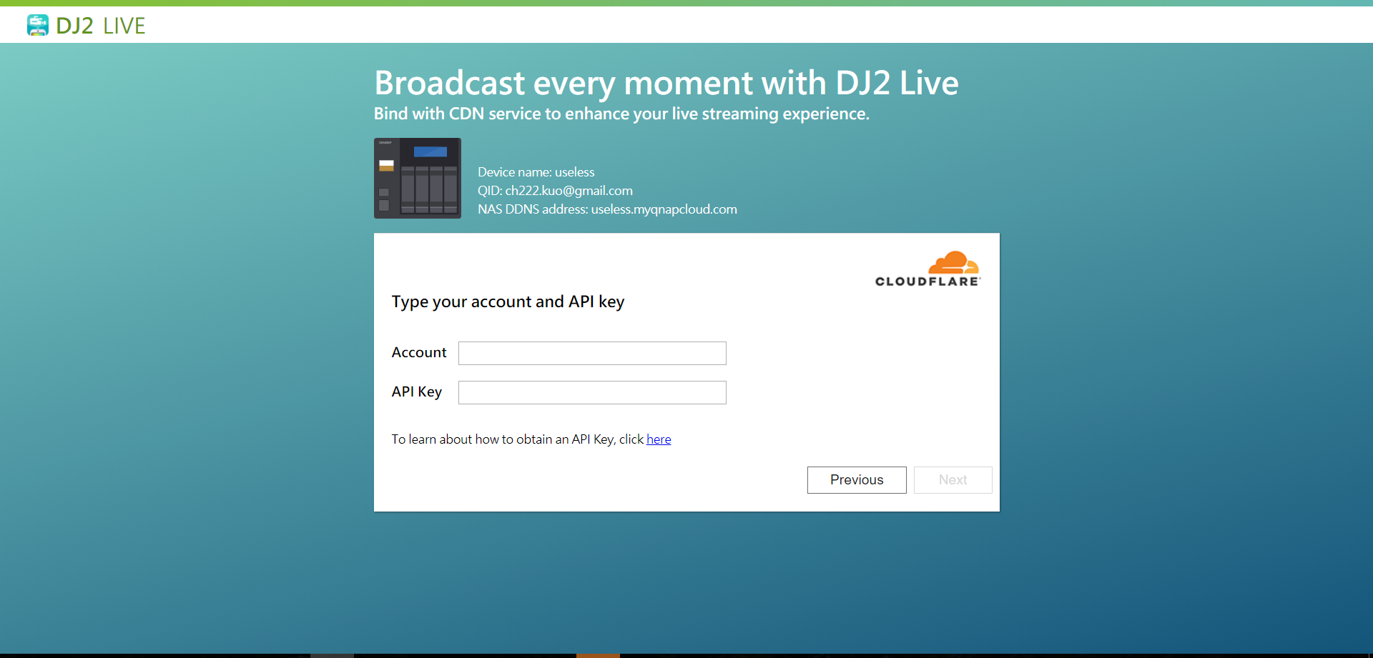
How to start using CDN services?
Click the CDN icon on the main screen and follow instructions to link CDN services to DJ2 Live
Subscribe to the following
CDN services
- Cloudflare: monthly fee
- CDN77: pay as you go
Domain name services
Link CDN and domain
name service together
Setting completed!

Slide 18
How to use DJ2 Live to host a private webinar?
Create an event for your meeting and notify all participants
Set authentication methods for attendants
- NAS account – Google account
Set up connection restrictions
- Internet or Intranet
- Enable secure connections
Set up CDN to speed up the connection
Start the meeting, attendants can use chatting room to interact with each other
Meeting finished, save the videos for reference

Slide 19
The advantages of using DJ2 Live
Functionality
High Security
Storage
Others
Upcoming info
Chatting room
Great connection
quality
User authentication
Secure connection
Save videos to build
up your knowledge
base
Cost-effective

Slide 20
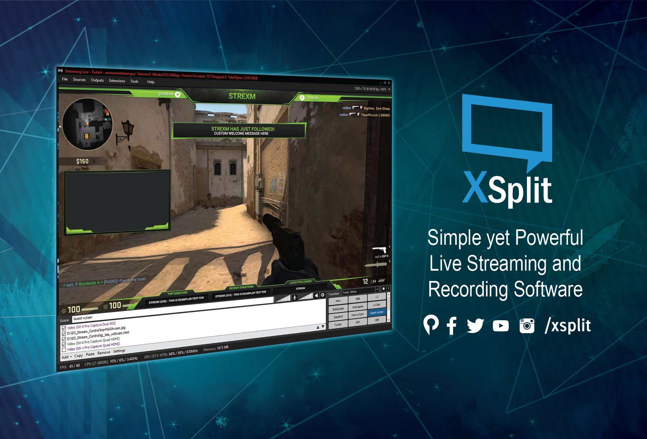
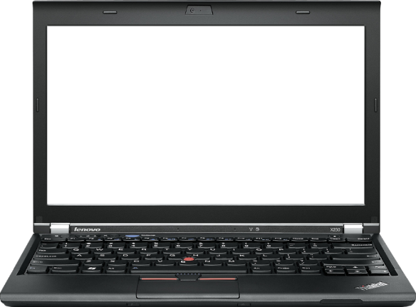
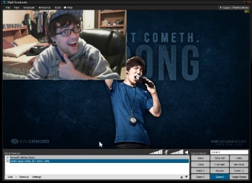
Partner-XSplit (PC utility)
XSplit is the most popular PC utility to assist your live streaming: the main feature is to encode the source (videos and/or audio) and stream to live streaming platforms
Capture different sources and encode them to a single source
Manage the layout of your streaming
Stream to different platforms
Plug-in Store to extend the ability of your XSplit

Slide 21
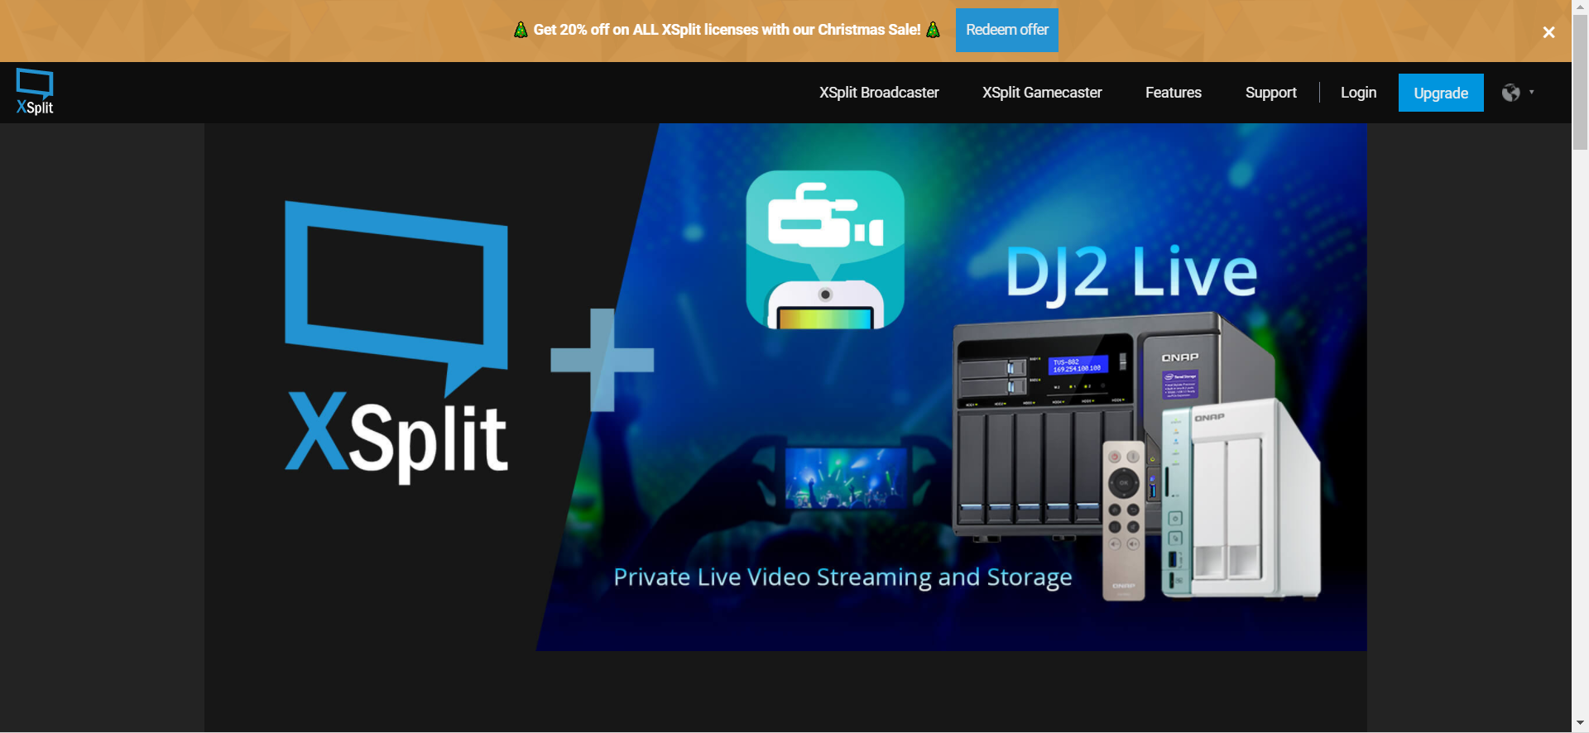
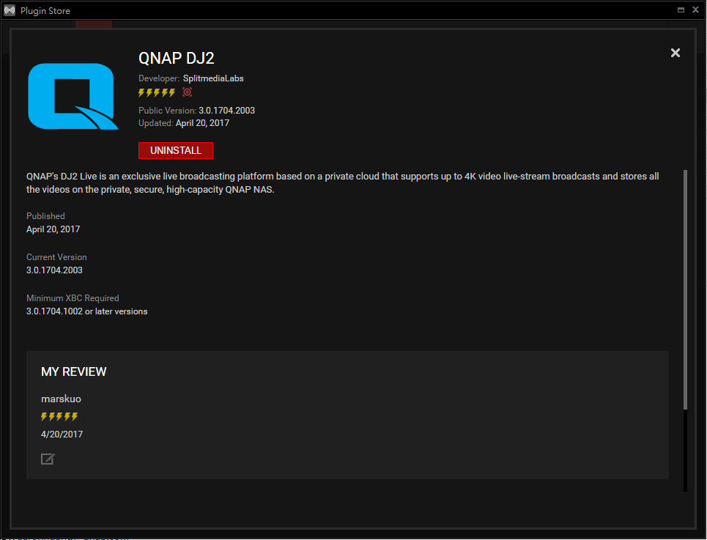
DJ2 Live Plug-in for XSplit
Help to Search target QNAP NAS on the same LAN
Automatically fill in the streaming settings
One press to start the live streaming

Slide 22
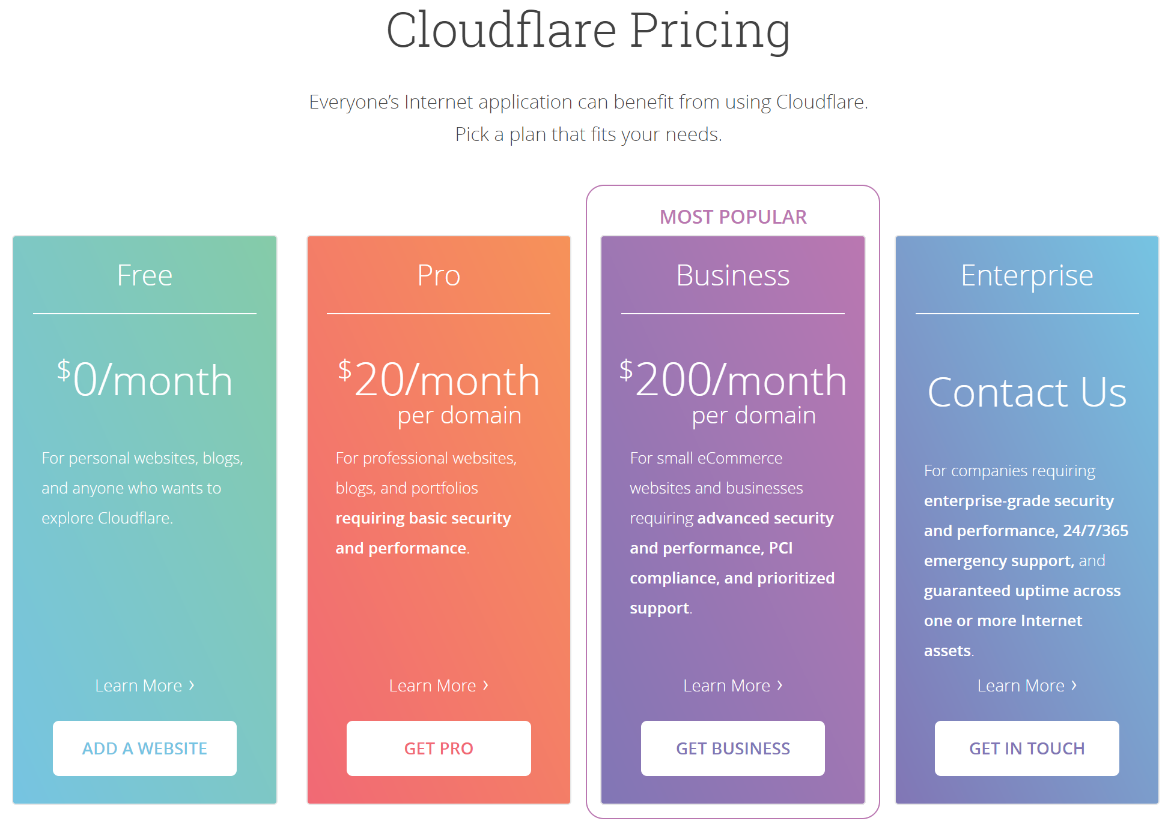
Partner-Cloudflare (CDN Provider)
Support multiple protocols/technologies
115 data centers globally
Over millions of website's choice
Monthly fee, for unlimited plan

Slide 23
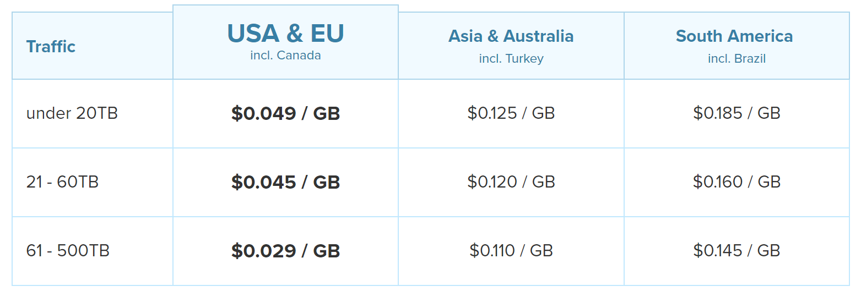
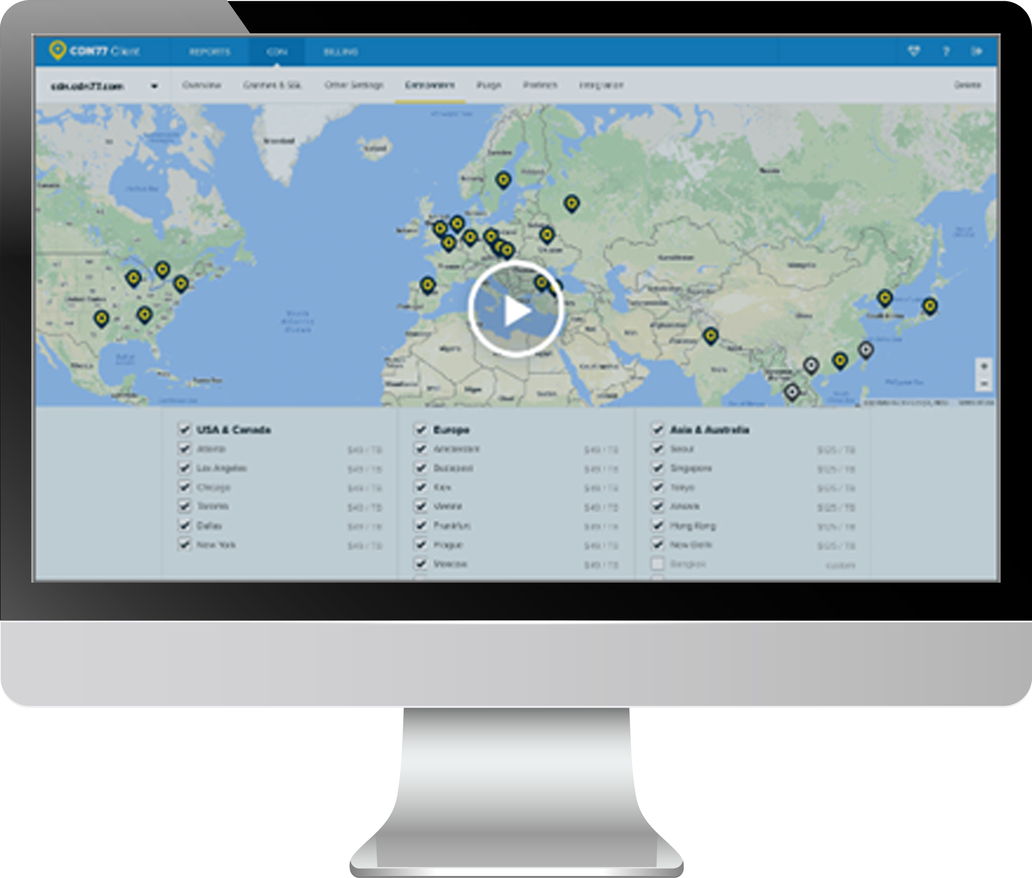
Partner-CDN77.com (CDNProvider)
Support multiple protocols/technologies
32 data centers globally
Pay as you go plan

Slide 24
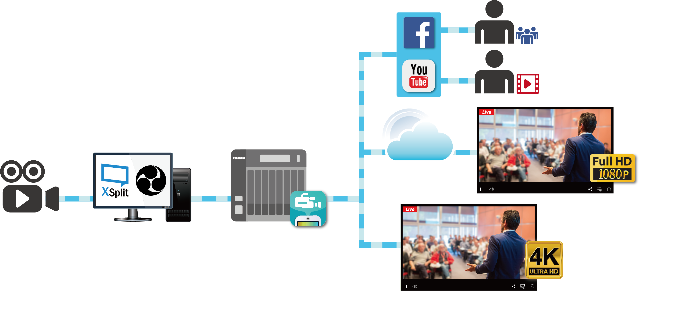
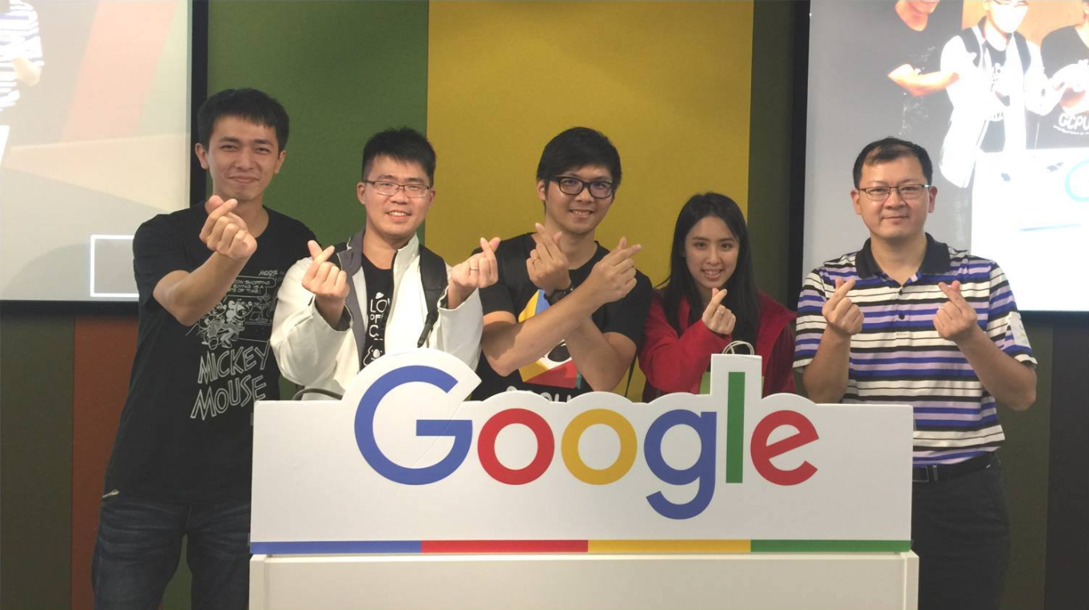
Case Study-GCPUG Seminar
Provide live streaming services for Google Cloud Platform User Group seminar
Public Cloud
Taipei 101
Google
QNAP HQ
CDN
Intranet
內網

Slide 25
DJ2 Console DEMO Create a Live Video

Slide 26
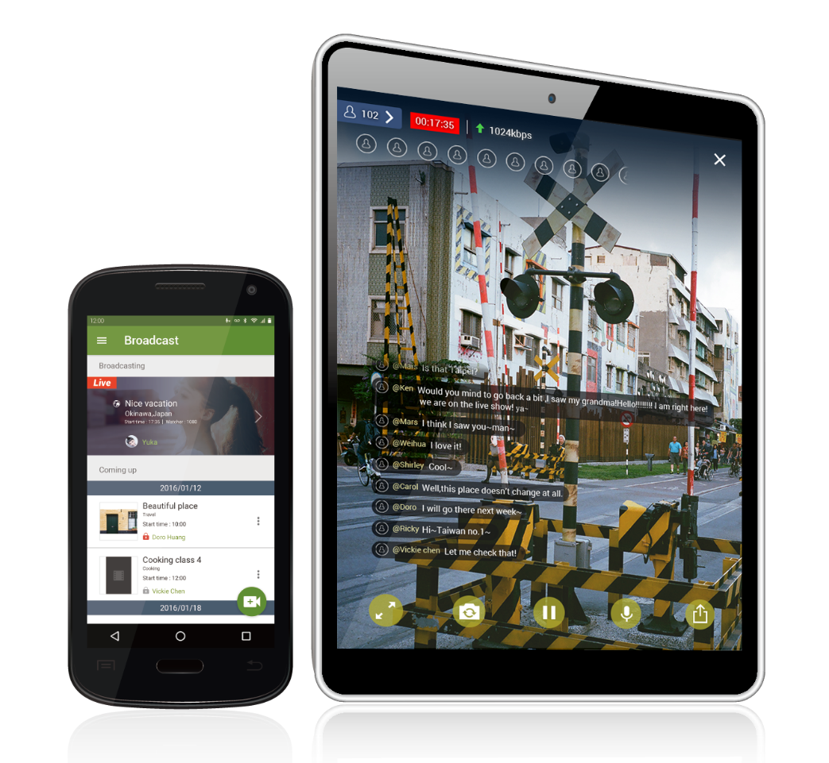
Mobile App-DJ2 Client
Break geographic limitations. Live broadcast and watch videos on the go
Start your live streaming on the go with myQNAPcloud service
Support Secure Connection
Support Android and iOS(iPad) devices
iPhone version coming soon

Slide 27
DJ2 Client-Host mode
Stream your phone camera feed to DJ2 Live for broadcasting
- Use the same network with the NAS (Wi-Fi)
- Use mobile network for streaming
3 steps to start live broadcasting
support both front/rear cameras

Slide 28
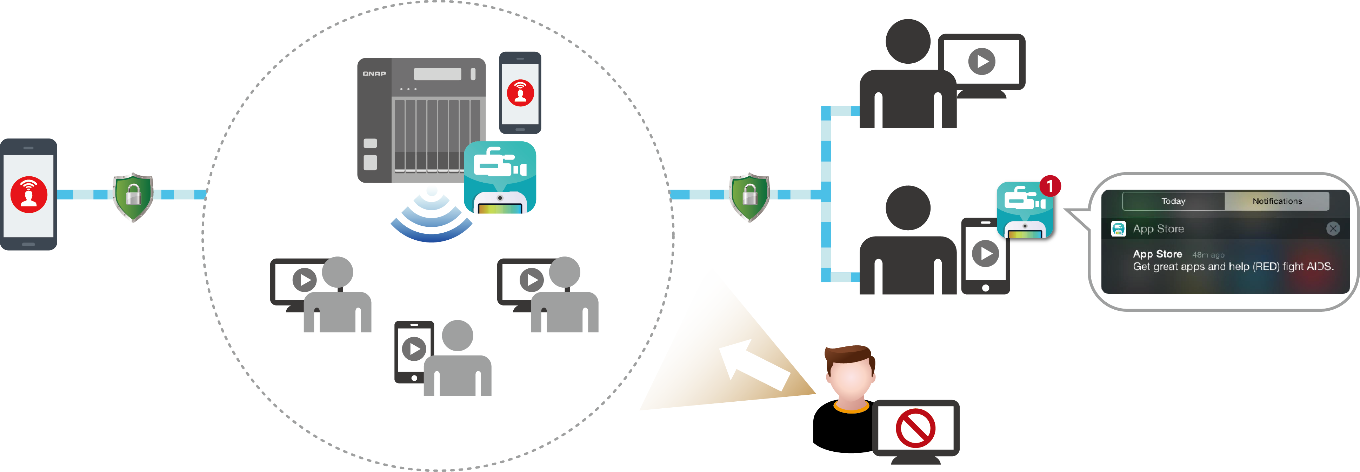
DJ2 Client-Host mode
Go Outdoor!
Case 2
Use the same network with the NAS(Wi-Fi)
Suitable for indoor
Recommend to use Wi-Fi, 5G or 4G mobile network to get the best user experience
Case 1
Use mobile network
suitable for outdoor
Browser
SSL
SSL
Intranet
Host's scenario
Mobile
Browser
Browser
Mobile
Block unauthorized users

Slide 29
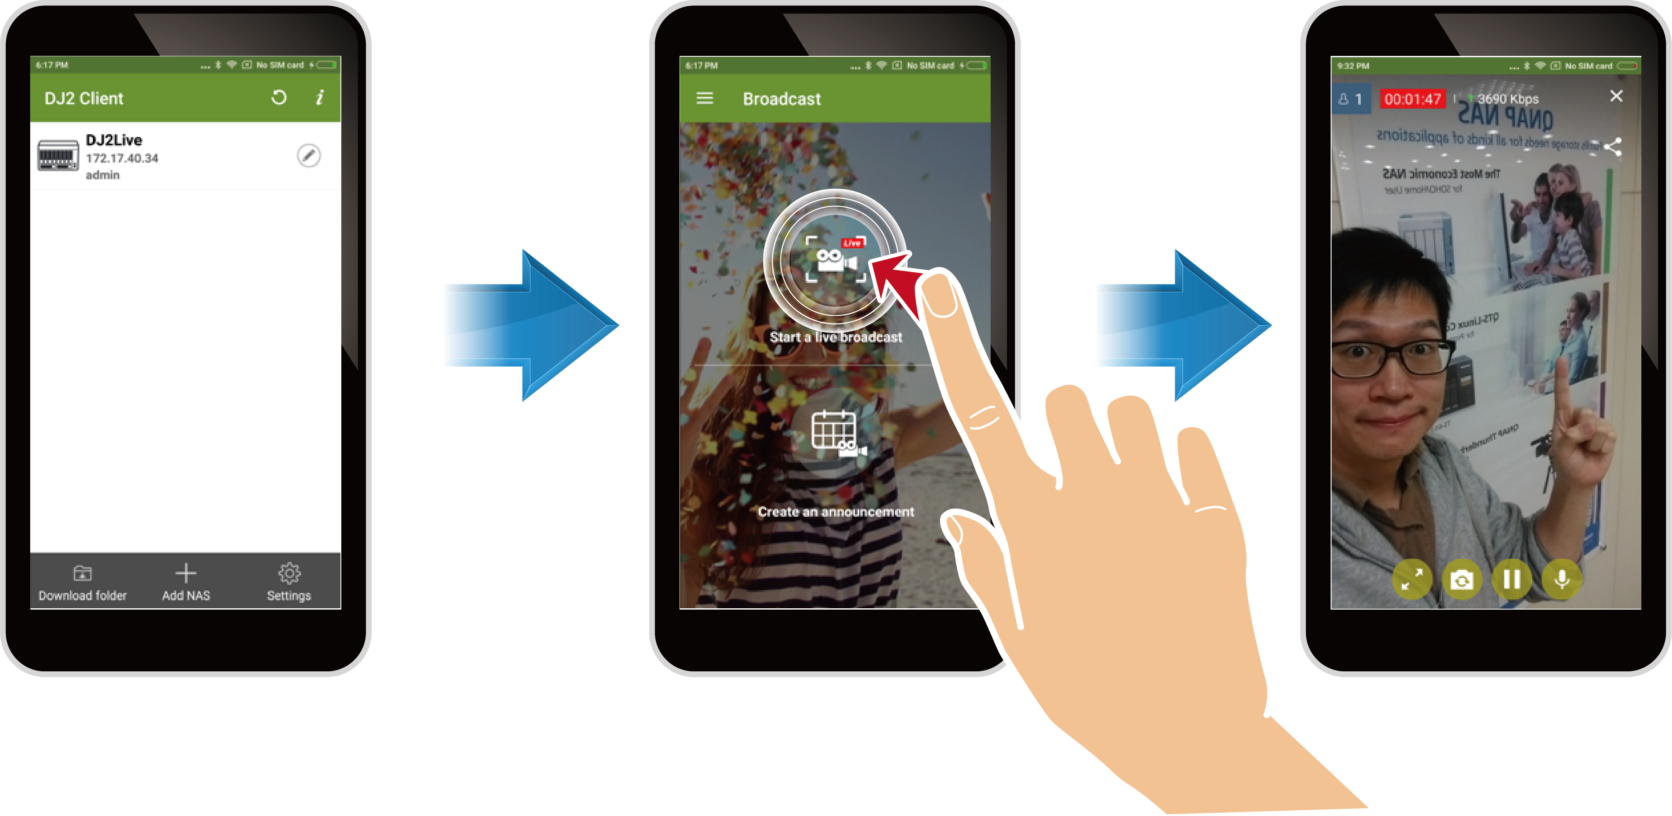
3 steps to start a live stream
Start Live Streaming
Log in NAS
Press "Start"

Slide 30
DJ2 Client-Viewer mode
Browse and download past videos
Automatically detect the network bandwidth and set to the most appropriate resolution for watching
View upcoming shows
Break geographical and network limitations: watch videos wherever you want

Slide 31
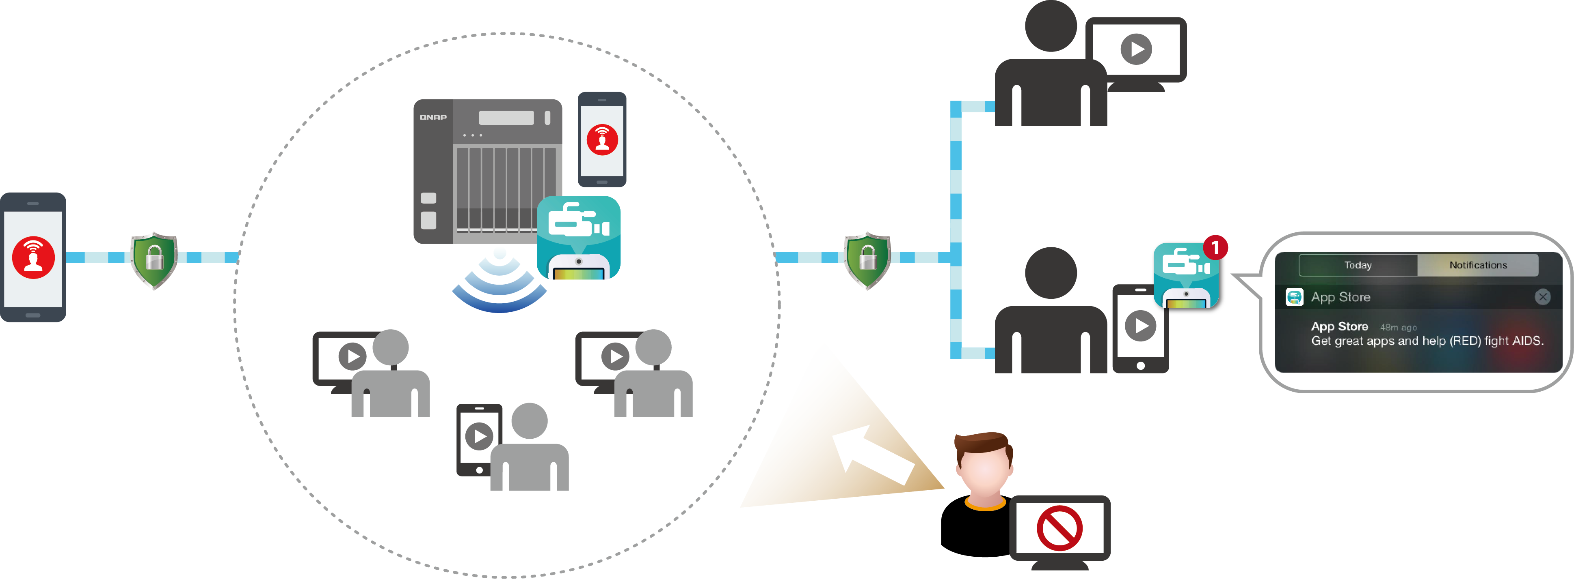
DJ2 Client-Viewer mode
Browser
Recommend to use Wi-Fi, 5G or 4G mobile network to get the best user experience
Case 2
Use mobile network suitable for outdoor
SSL
SSL
Intranet
Case 1
Use the same network with the NAS (Wi-Fi)
Suitable for indoor
Mobile
Browser
Browser
Mobile
Block unauthorized users

Slide 32
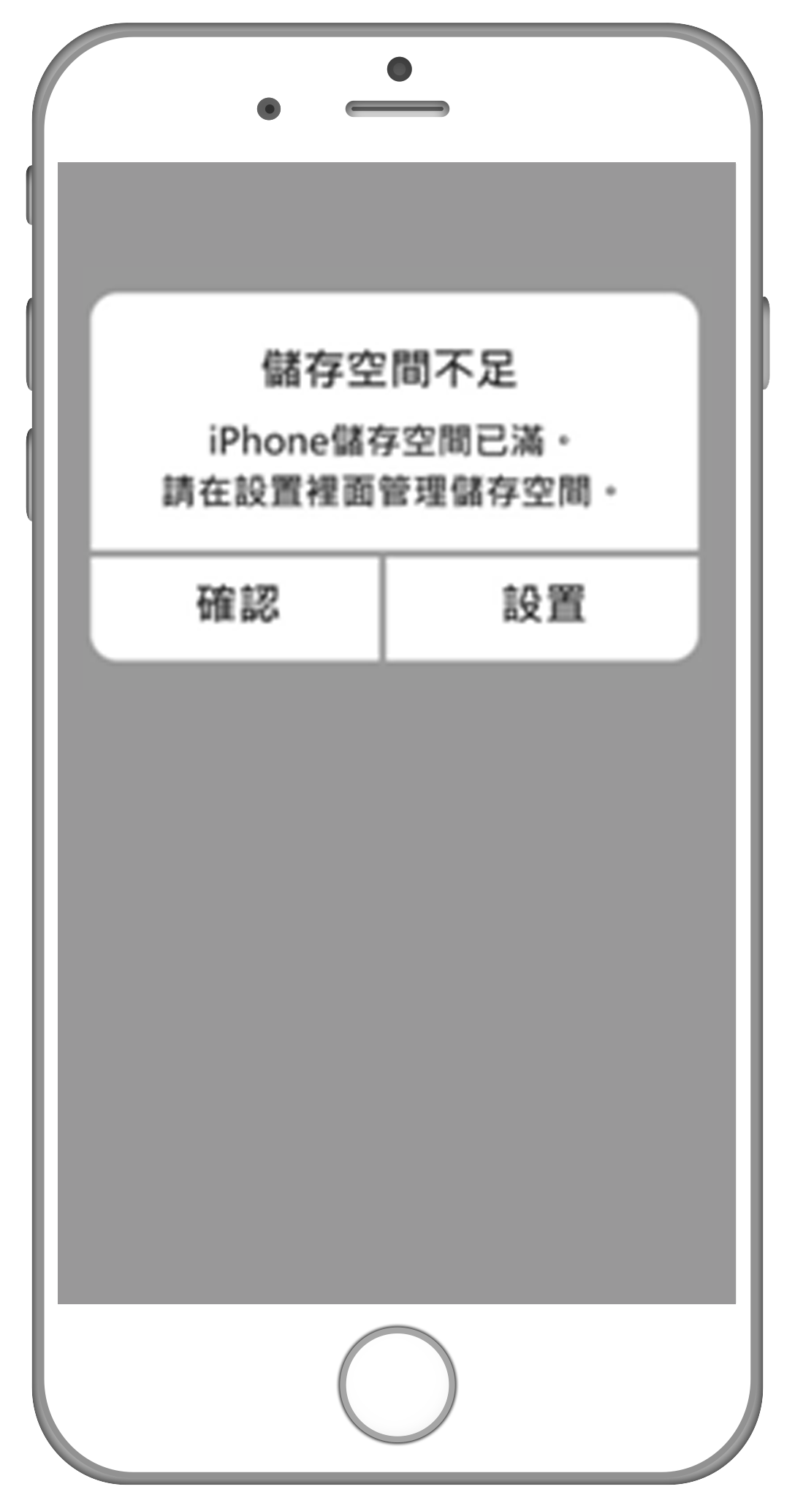
Advanced User Scenario of DJ2 Client - Use NAS to Save Your Video Recordings
So beautiful~ I want to record video to save the moment. But...
You can use DJ2 Client this way: use DJ2 Client to instantly stream your recorded video to the NAS
Set up a private live streaming, instant upload your videos to the NAS
You can record a long video without worrying about the insufficient
storage size of your mobile device
!!!
Not enough storage space
OK
Settings

Slide 33
DJ2 Client DEMO Use Mobile Phone to start a Live Streaming

Slide 34
Thank you

