Slide 1
QNAP NAS & PLEX
Build Your Home Media Center

Slide 2
In-depth use of PLEX & QNAP
1
QNAP NAS & Plex
2
Plex Introduction
3
Installation & Setup
4
How to use Plex
5
Transcoding

Slide 3
QNAP NAS & PLEX

Slide 4
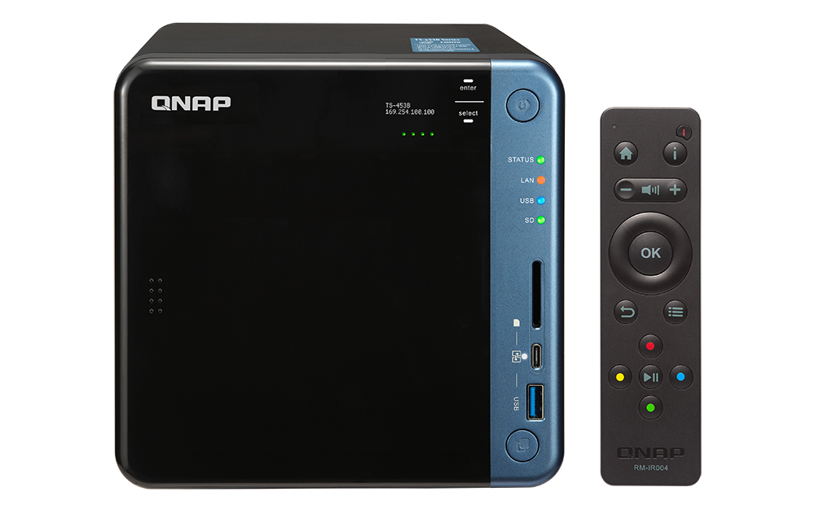
Build Your Home Media Center
Powerful Hardware
Comprehensive Storage Functionality
Multimedia Application
Your Best Choice - QNAP NAS

Slide 5
Powerful hardware support
High-speed network / expansion Capabilities
Local display
10GbE
Thunderbolt 3
USB-C QuickAccess
SD Card slot
HDMI
Easy storage expansion
Powerful GPU
Qtier
VJBOD
Attach Expansion Enclosure

Slide 6
High-speed network / expansion capabilities
Variety options meet your need
Thunderbolt™ 3
10GbE Network
High-speed Thunderbolt 3 with SMB protocol, allowing Mac and Windows users to collaborate on media editing.
10GbE connectivity accelerates file sharing across devices.
USB-C QuickAccess
SD Card Slot
The files and data stored on the NAS can be directly accessed by using a USB cable
Allows you to quickly transfer data from other devices to the NAS

Slide 7
One Plex for different NAS series
Intel series
AMD series
ARM series
High performance
for Video Transcoding
High-speed
multi-tasking
Light multimedia application
GPU transcoding
CPU transcoding
Audio transcoding only

Slide 8
Multimedia Transcoding
Supported models - Intel-based
Intel-based models support video transcoding via GPU
Suitable for photo, music and video.
Support hardware transcoding for high bitrate videos;
some series also can support up to HEVC 4K.

Slide 9
Multimedia Transcoding
Supported models - Intel-based
NAS Model | 1080P | H.264 4K | HEVC 4K 8-bit | HEVC 4K 10-bit
x51+
x51A, x53A
x82 (Core i Gen6)
x53B (Apollo Lake), x82T3, x82BR (Core i Gen7)
HEVC 10-bit sample file: 4K 30F Level 5.1 main10 -> 1080P(10Mbps)
Notes:
https://docs.google.com/spreadsheets/d/1MfYoJkiwSqCXg8cm5-Ac4oOLPRtCkgUxU0jdj3tmMPc/edit#gid=314388488
NAS 機種
1080P
H.264 4K
HEVC 4K 8-bit
HEVC 4K 10-bit
x51+
Y
--
--
--
x51A, x53A
Y
Y
--
--
x82 (Core i Gen6)
Y
Y
Y
--
x53B (Apollo Lake), x82T3, x82BR (Core i Gen7)
Y
Y
Y
Y
ApolloLake/ Gemini Lake: MP L5.1 8b/10b, up to 4kx2kp60 MP L5 8b/10b, up to 4Kx2Kp30" KabyLake: 4kp60 8b/10b

Slide 10
Multimedia Transcoding
Supported models - AMD-based
AMD-based models support video transcoding via CPU
Suitable for photo, music and video. The NAS will use more resource for
processing high bitrate video formats.
With QNAP multimedia packages, such as Qmedia for Android TV or
Apple TV, you can play videos on TV directly. With QVHelper, you can
stream media files or music playlists from QNAP NAS to VLC media
player, providing more choices for your multimedia enjoyments.

Slide 11
Multimedia Transcoding
Supported models - x31 (ARM-based)
ARM-based models only support audio transcoding
Suitable for photo and music.
With QNAP multimedia packages, such as Qmedia for Android TV or
Apple TV, you can play videos on TV directly. With QVHelper, you can
stream media files or music playlists from QNAP NAS to VLC media
player, providing more choices for your multimedia enjoyments.

Slide 12
Multimedia Solution
Collect
Manage
Play

Slide 13
Multimediaa Solution Package
Collect
Manage, Backup
& Search
Playback
File Station remote mount
Qsync
Mobile apps
Download Station
Happyget
File Station
Mobile apps
Hybrid Backup Sync
Qsirch
Snapshot
PLEX
Video Station
Photo Station
Music Station
Cinema28
Mobile apps

Slide 14
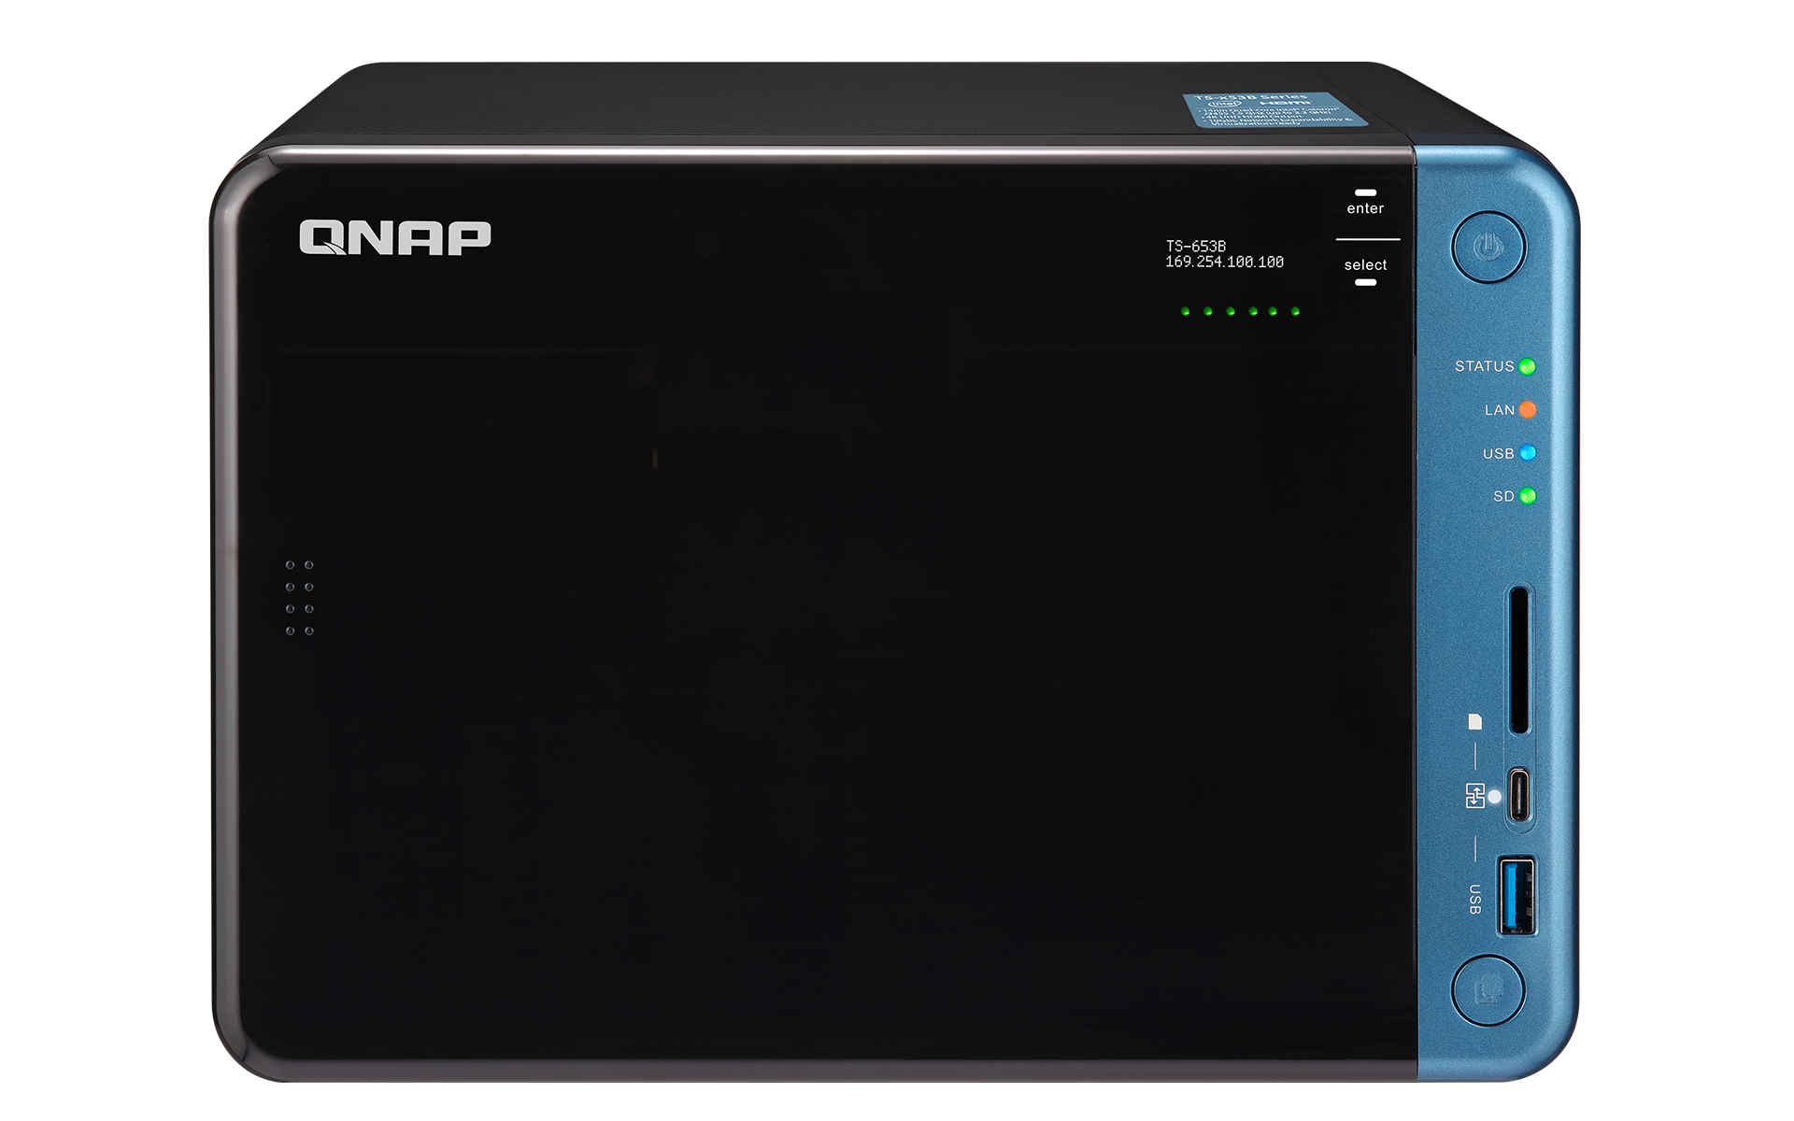
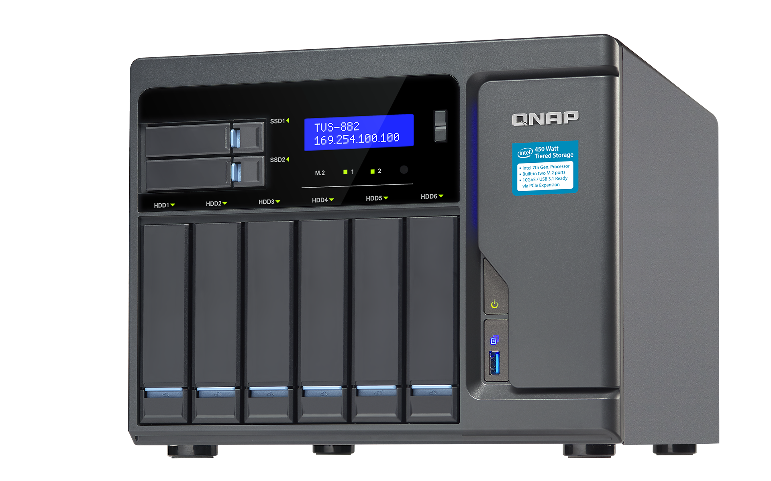
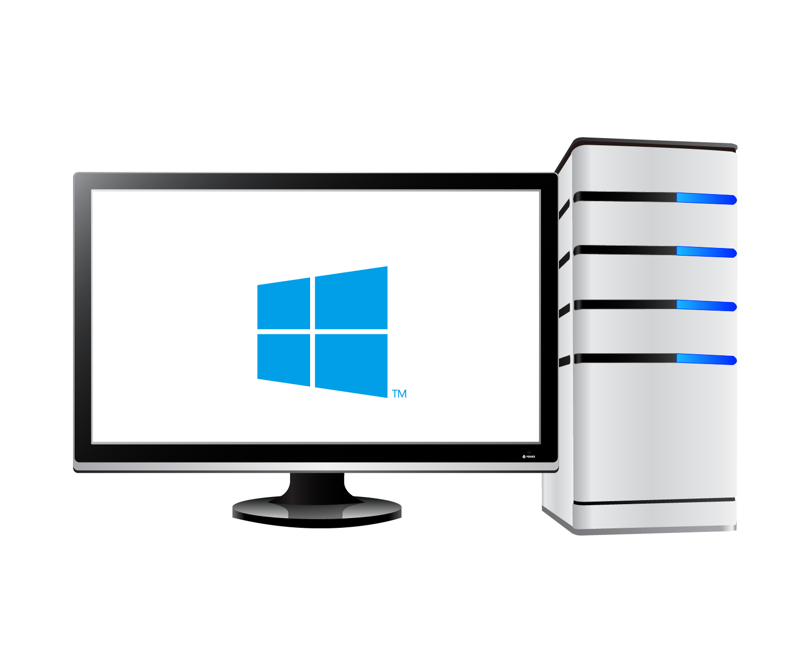
Collect data to NAS
NAS
PC

Slide 15
Plex Introduction

Slide 16
Plex is like mission control for your personal media collections
Easy to use
Available anywhere
Rich media information
Support any format
Support various devices
Sharing

Slide 17
Plex Media Server and Apps
PLEX
Media Server
PLEX App

Slide 18
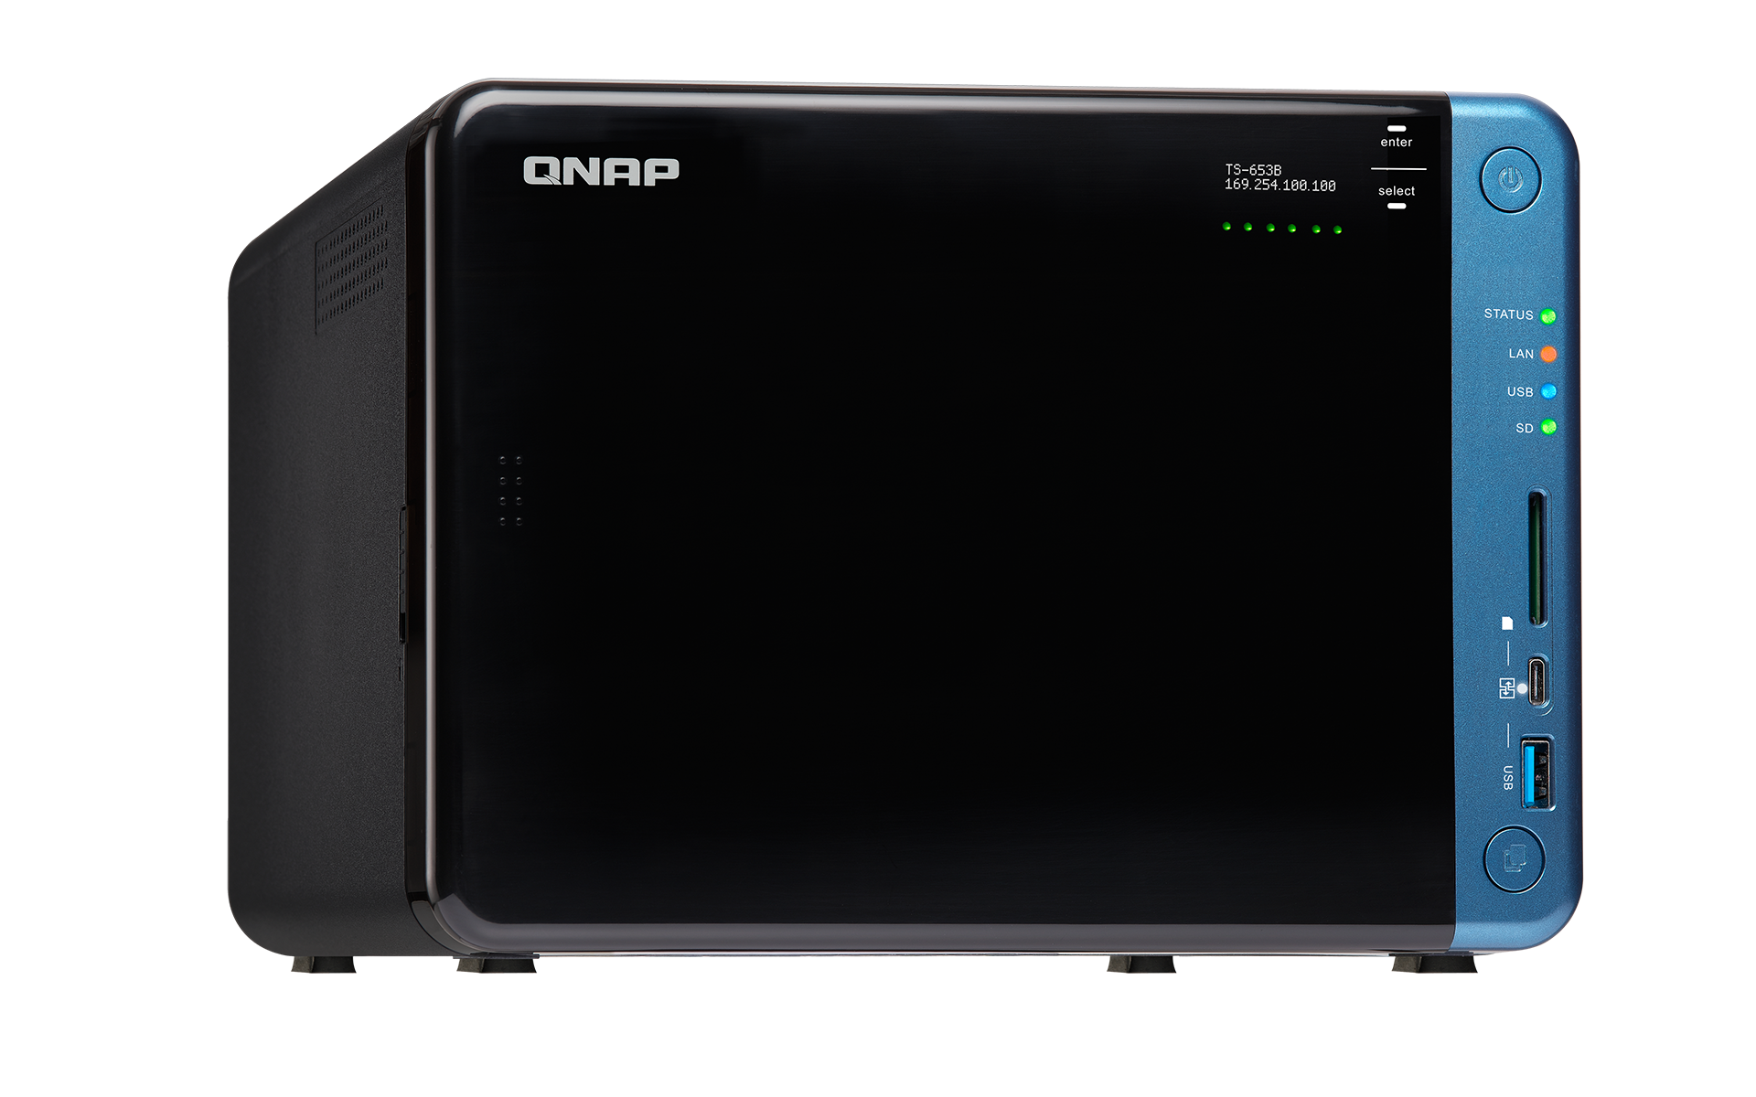
PLEX Media Server
Internet
Centralized control
Media information
Supports any media format
Sharing management

Slide 19
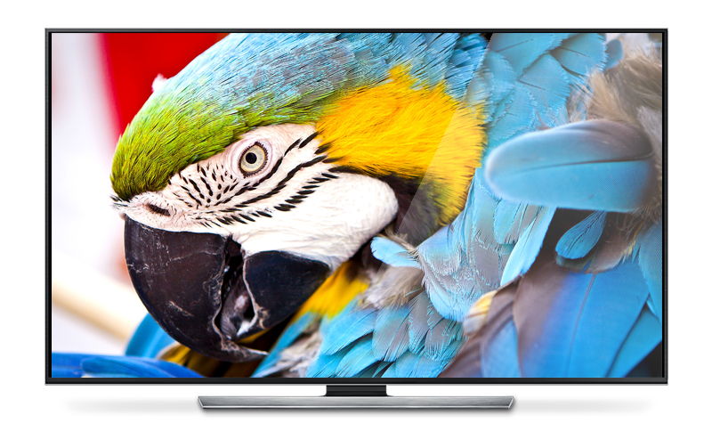
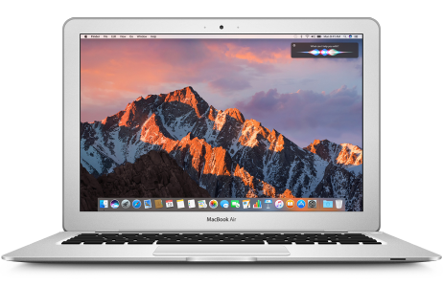
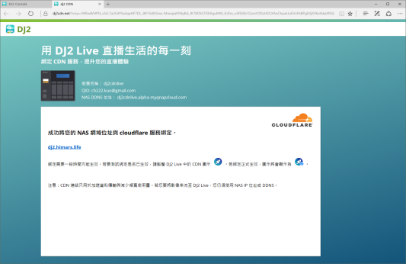
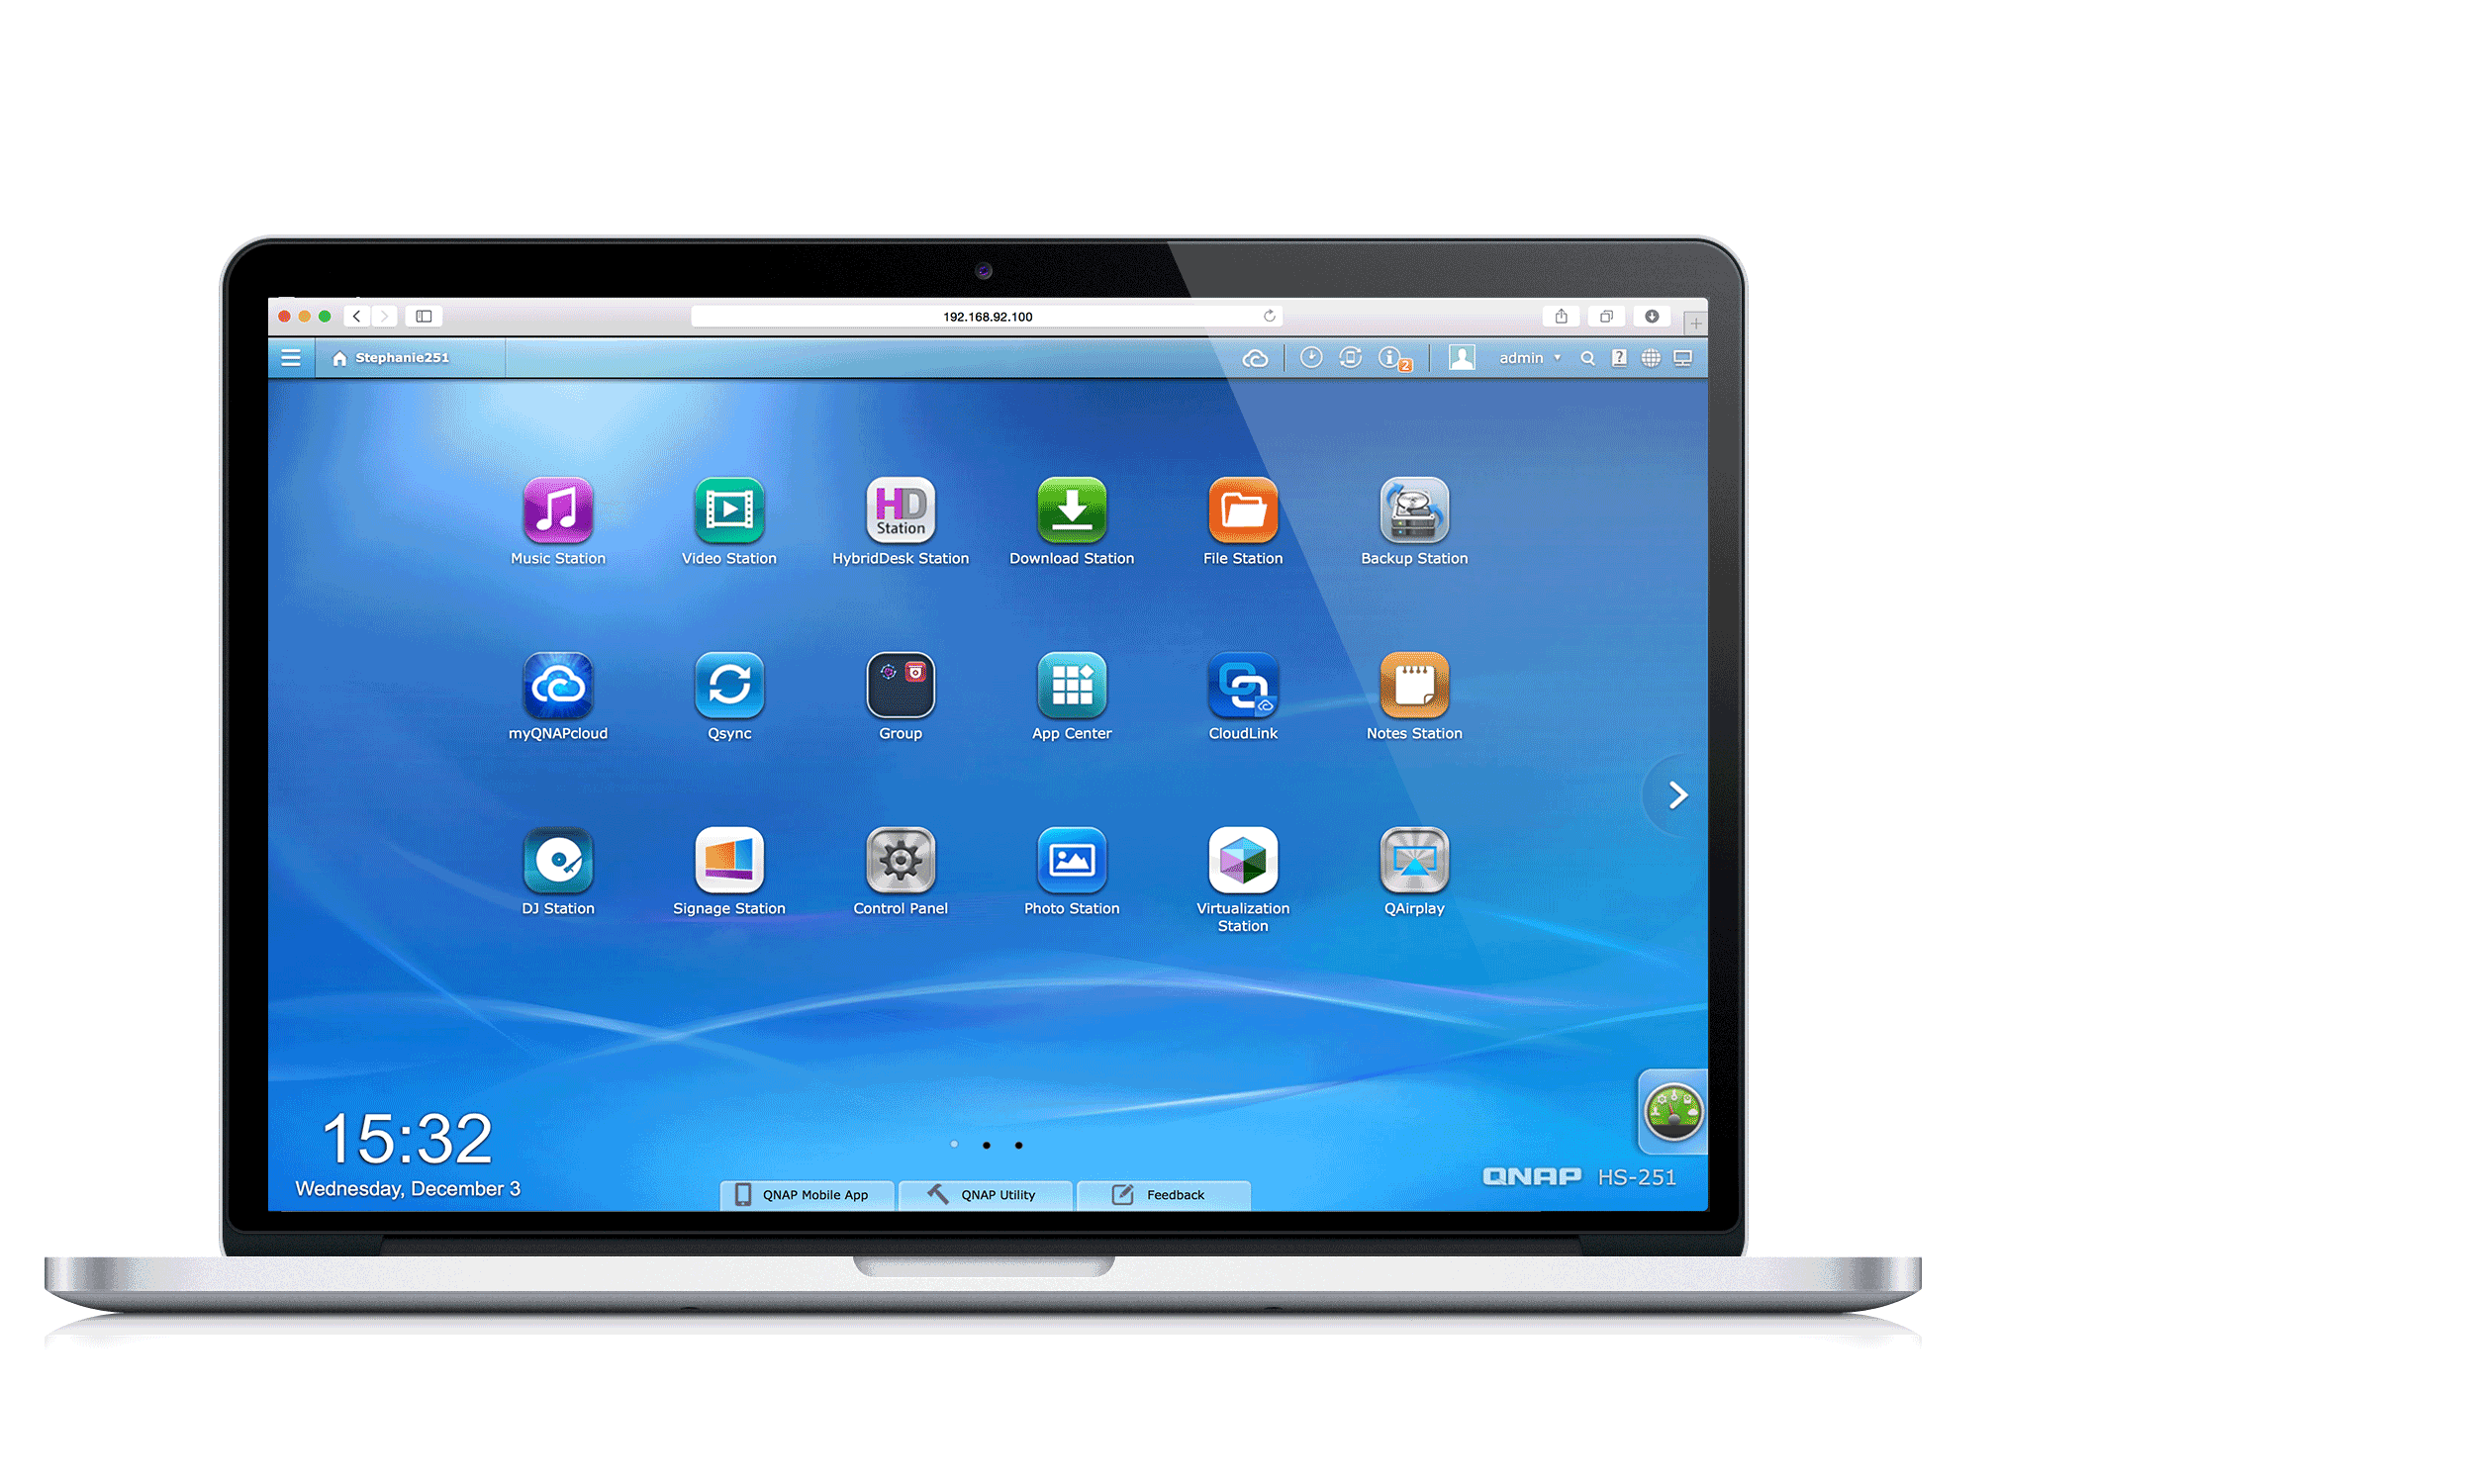
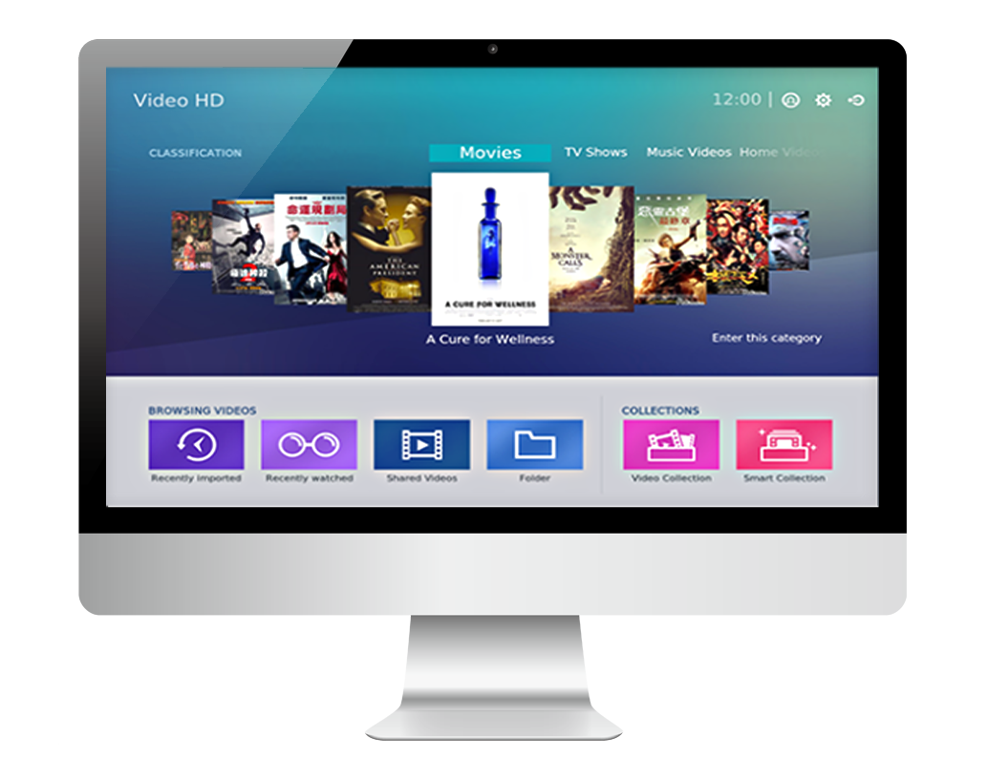
PLEX APP
Streaming
Streaming
Smart TV
PC
Streaming
Phone
Tablet
Local playback
HDMI
TV / Monitor

Slide 20
PLEX features
Feature | Free | Premium
Any Format
Support various devices, such as Apple TV
Library Organization
Sharing
Trailers and Extras
Hardware-Accelerated
For more information, please visit PLEX official website: https://www.plex.tv/

Slide 21
Installation and Setup

Slide 22
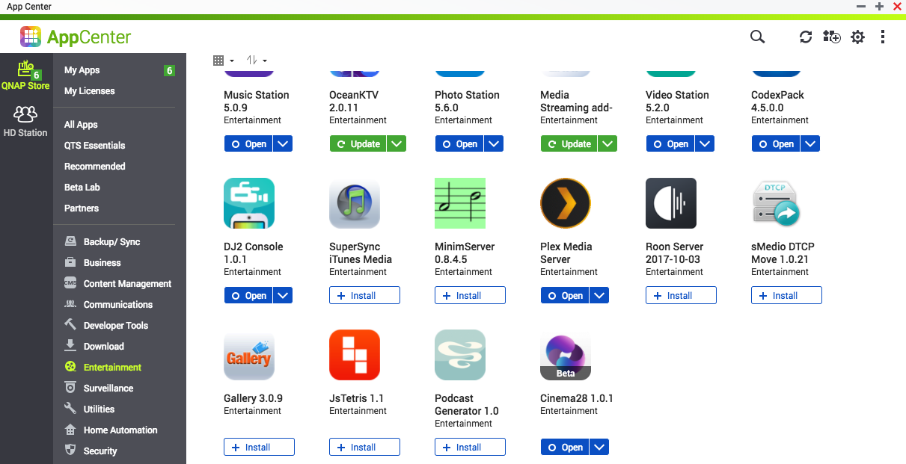
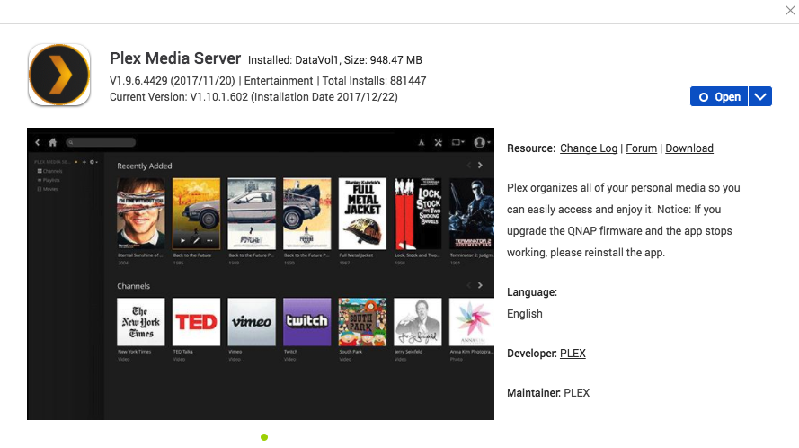
Install / Update
Install / Update Plex Media Server via App Center inside QTS
Notes:
Demo

Slide 23
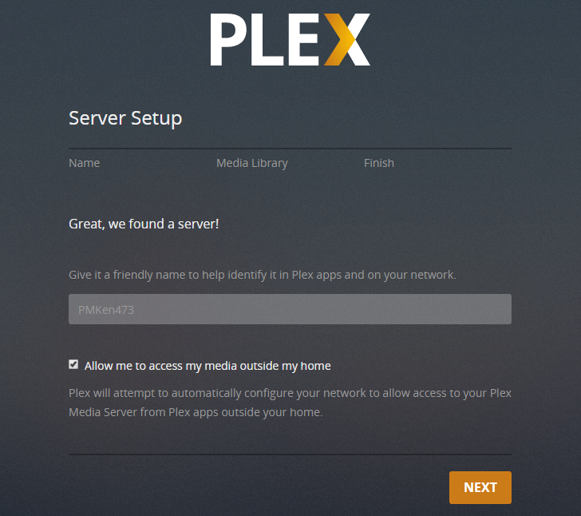
Setup - 1
Set up the server name
Enter a server name
Notes:
Demo -VNC

Slide 24
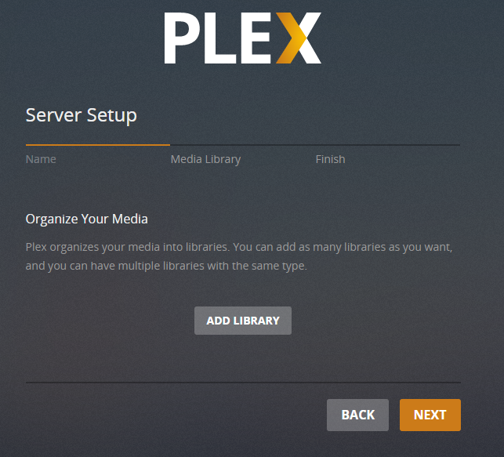
Setup – 2 (a)
Set up the multimedia library
Add Library
Notes:
Demo -VNC

Slide 25
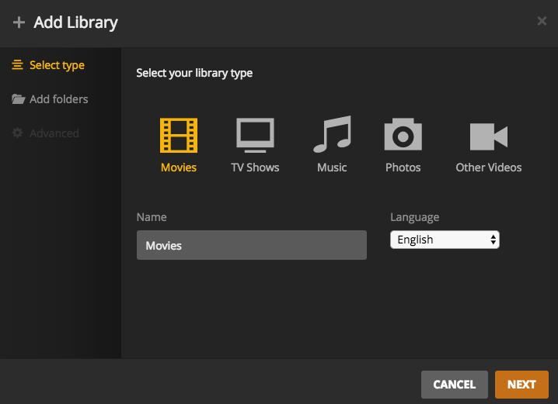
Setup – 2 (b)
Define the library type
Define the library type
1
-
Define the language for this type
Set up a name
2
3
Notes:
Demo -VNC

Slide 26
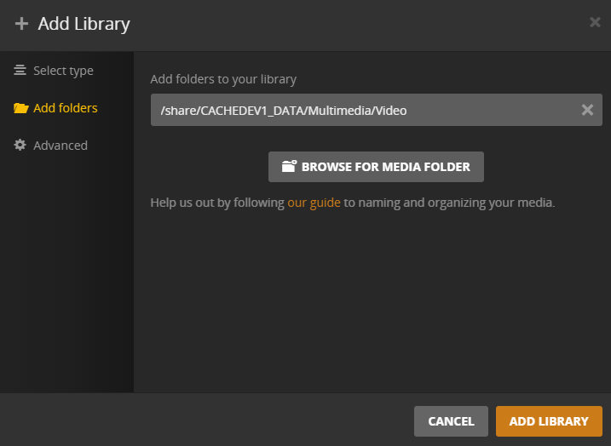
Setup – 2 (c)
Add folder to this library
Select the source of the library
Notes:
Demo -VNC

Slide 27
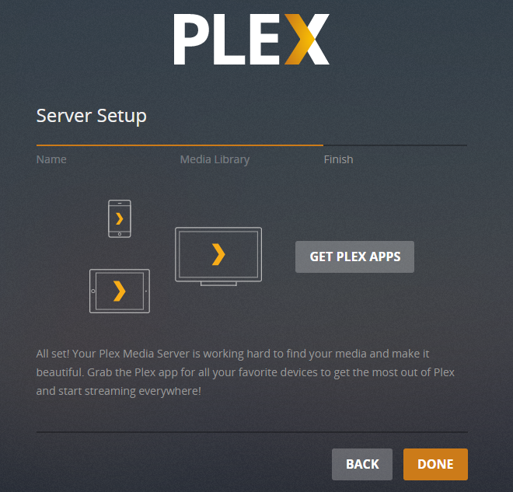
Setup - 3
Confirm
Click "Done" to finish setting up

Slide 28
How to use Plex

Slide 29
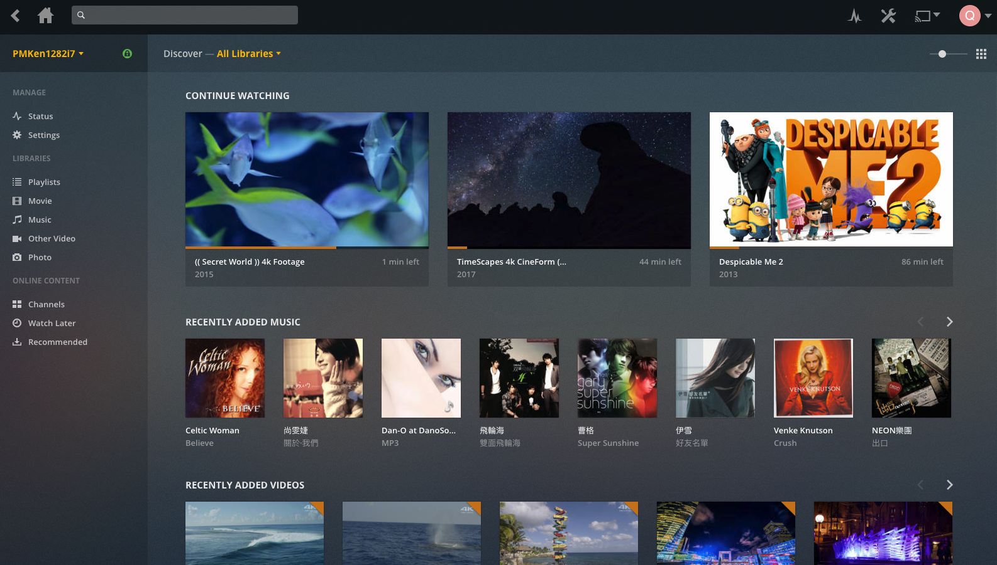
Plex Web UI
Main page

Slide 30
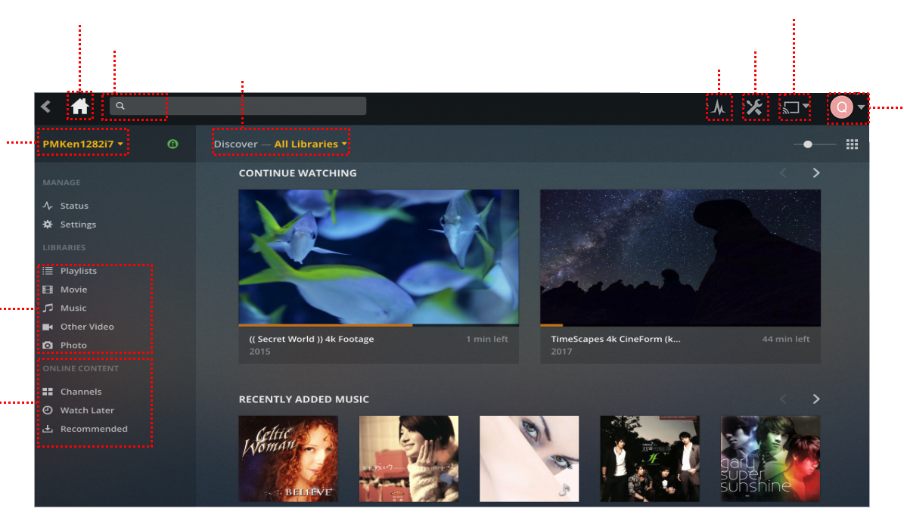
PLEX Web UI
Introduction of Plex web UI
Back to main page
Switch between output devices
Search
Settings
Switch between categories
Status
Plex account setting
Switch between servers
Local contents
Online services

Slide 31
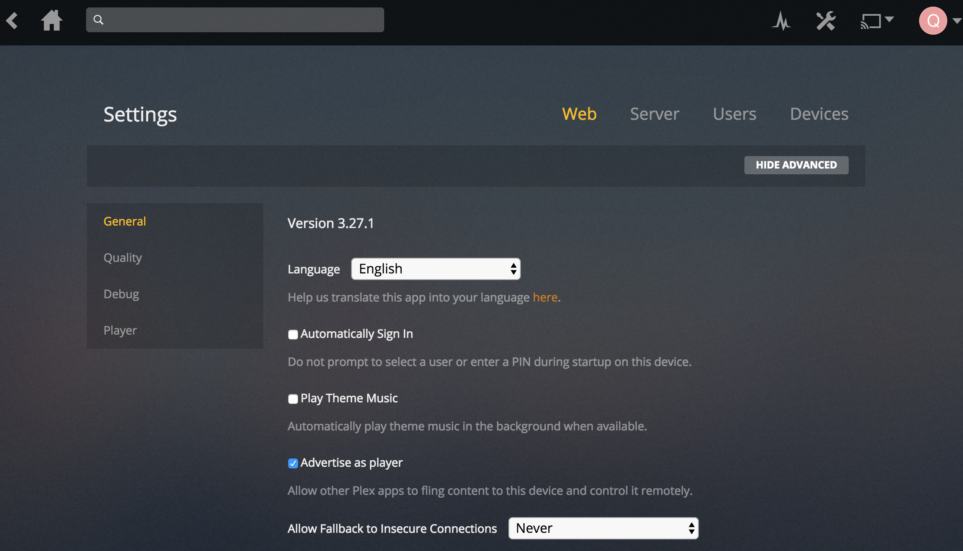
Plex Settings
Web browser setting

Slide 32
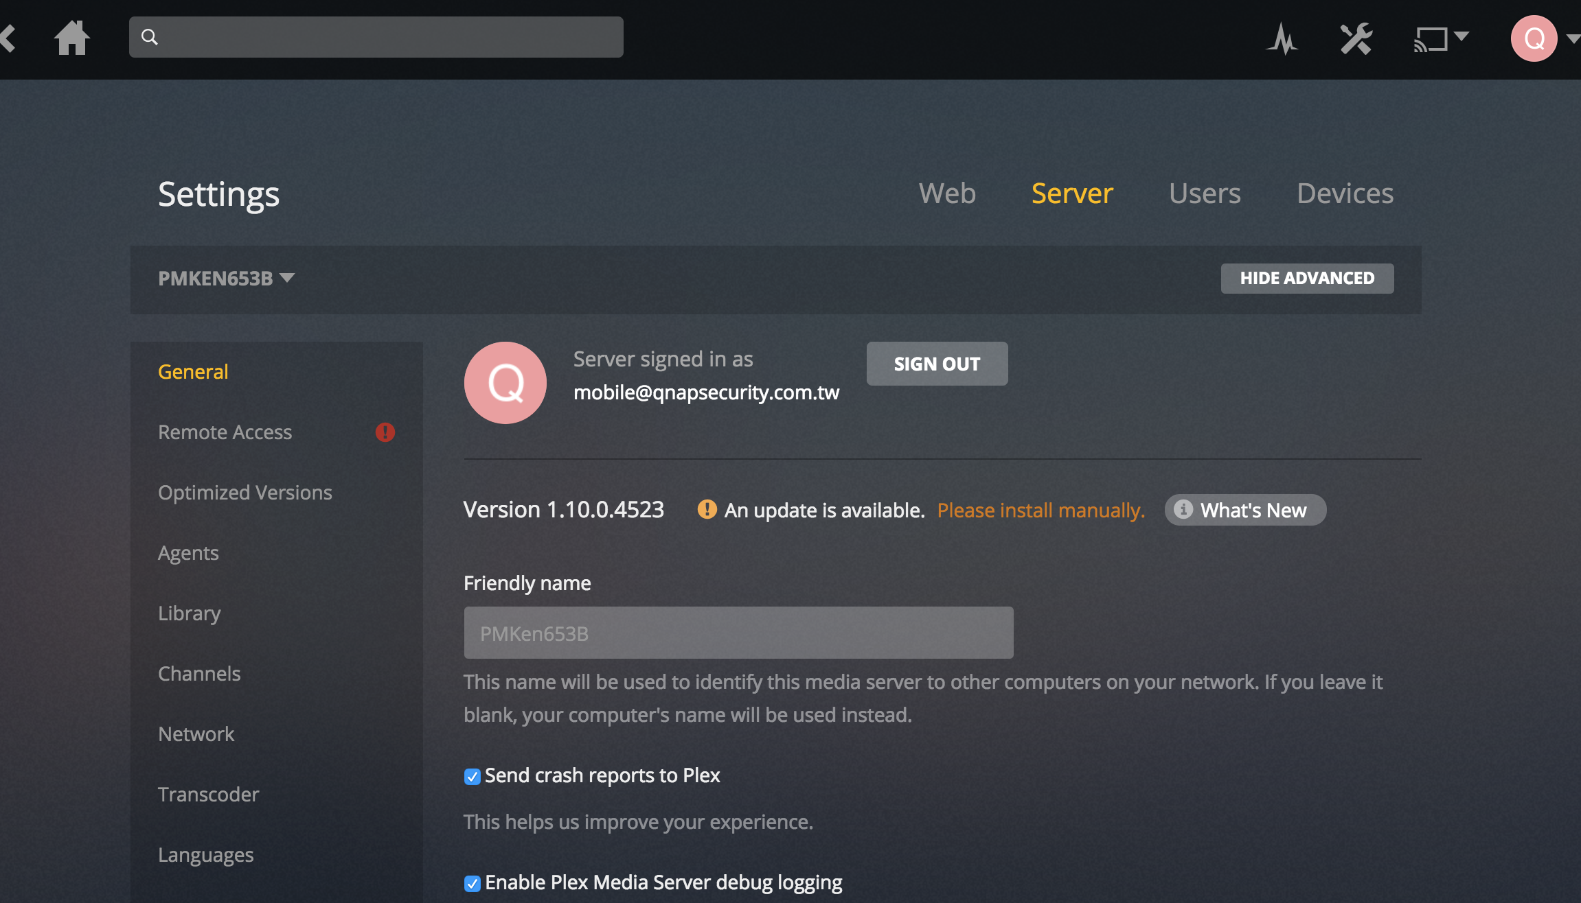
Plex Settings
Server

Slide 33
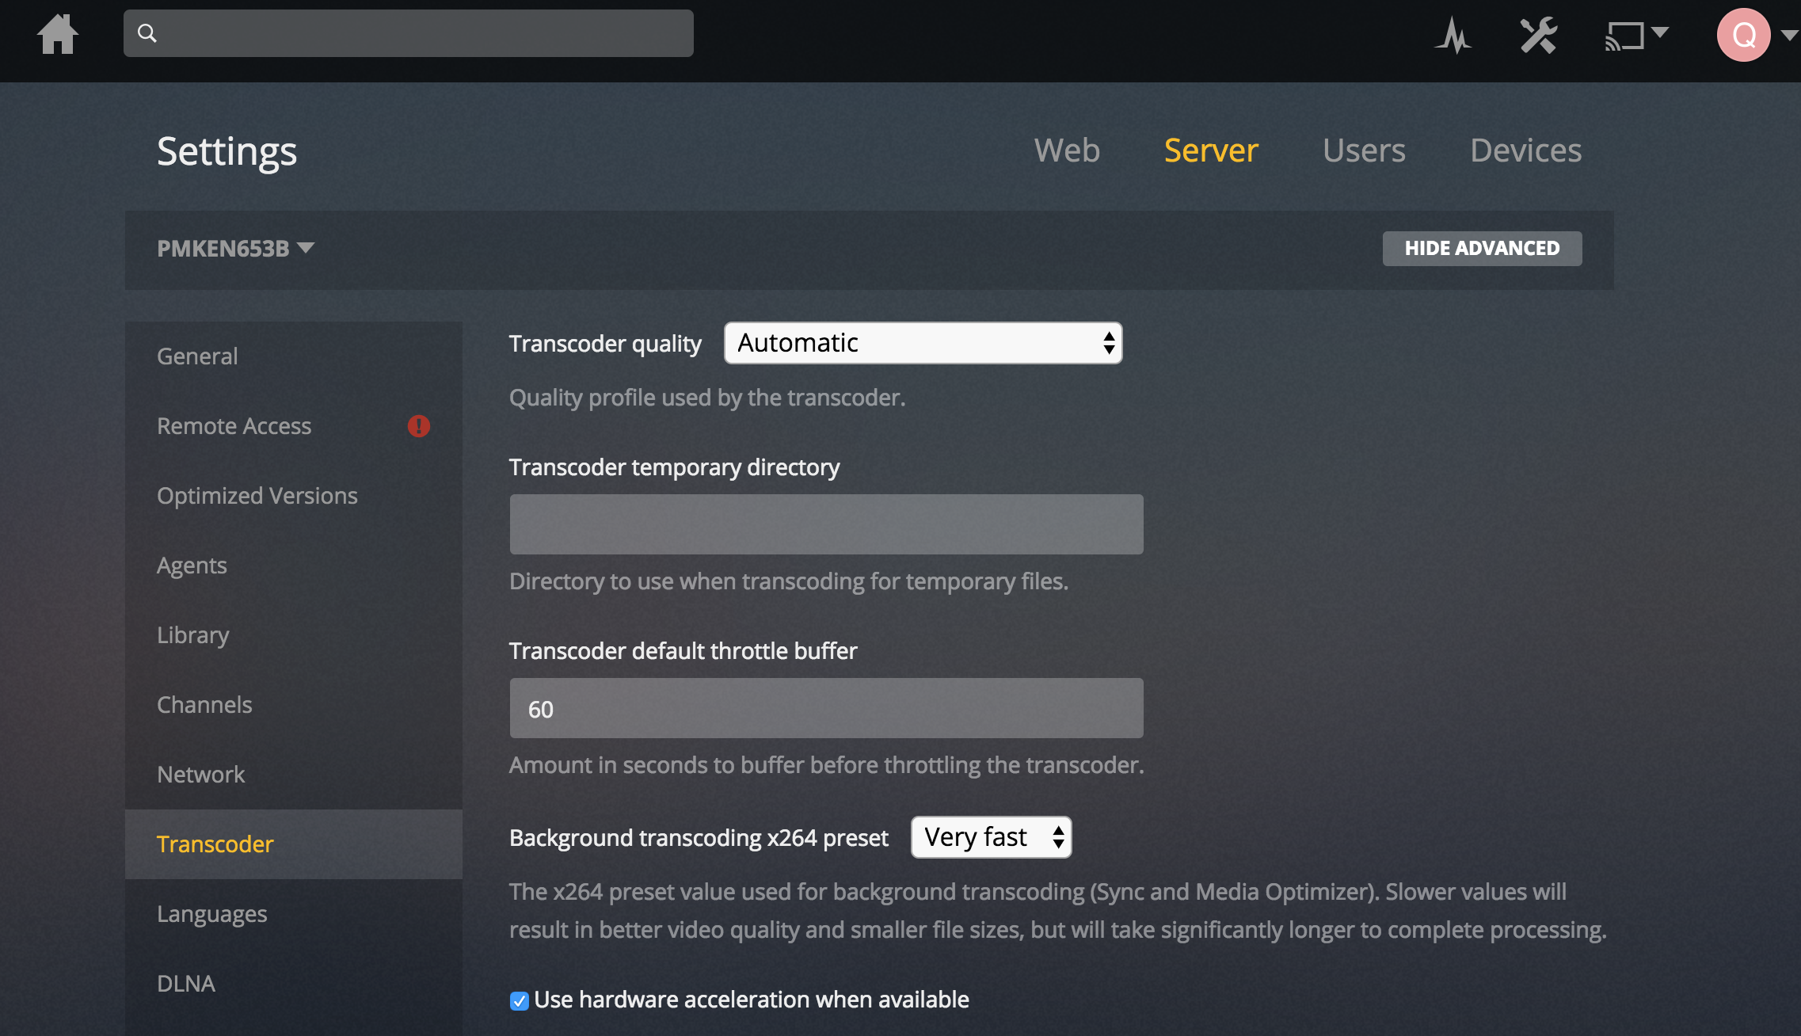
Plex Settings
Server - Hardware-accelerated transcoding
Enable Hardware-accelerated transcoding
Only for Plex Pass

Slide 34
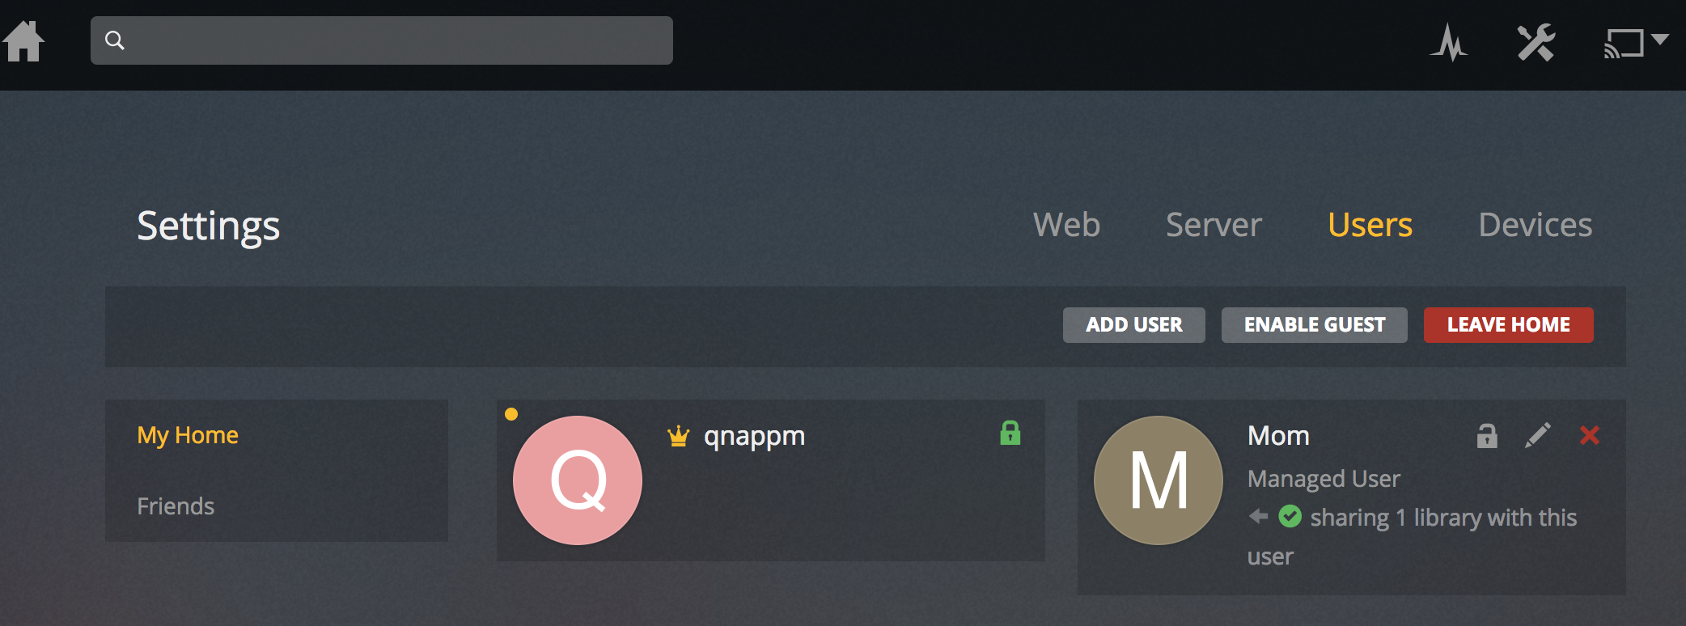
Plex Settings
Users

Slide 35
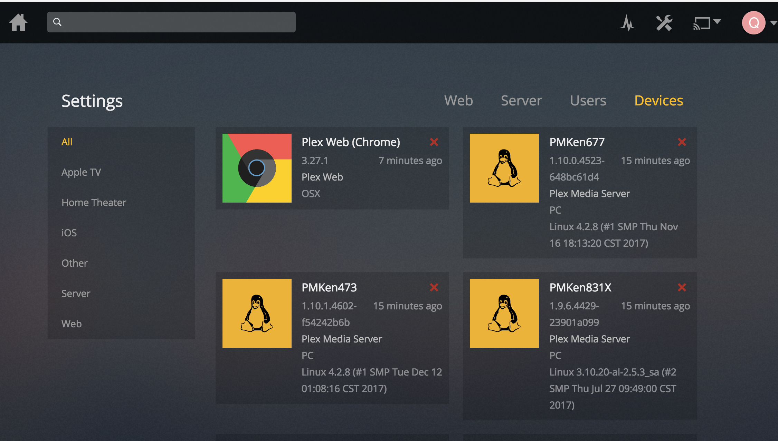
Plex Settings
Devices

Slide 36
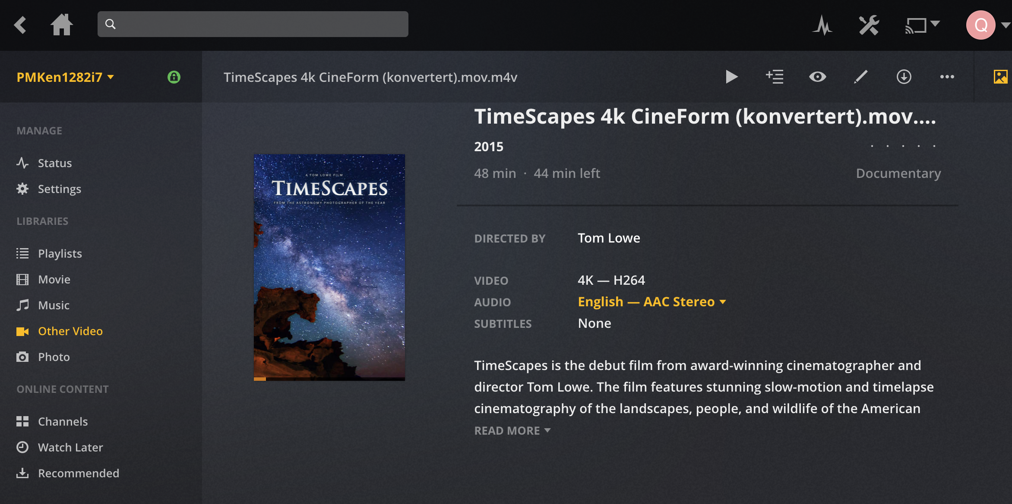
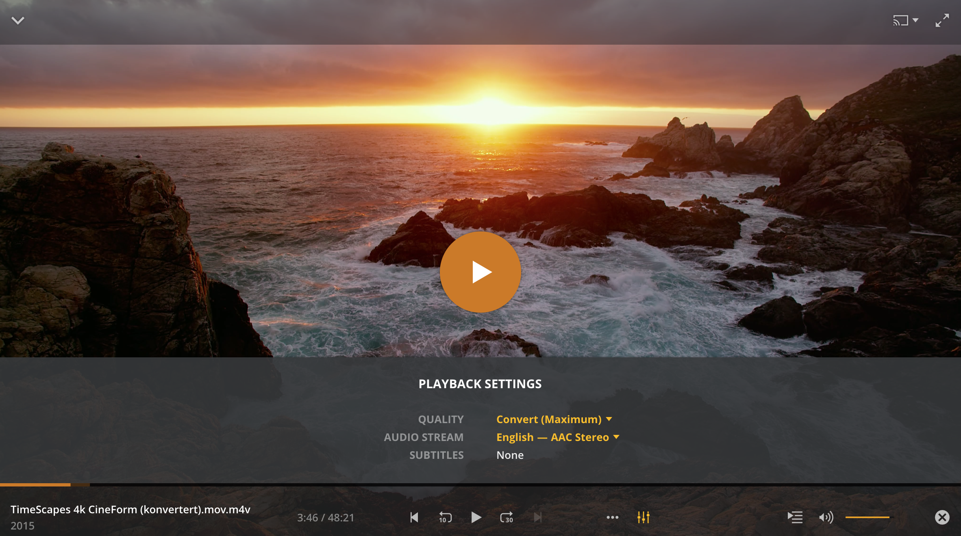
Plex - Web
Play videos via web browser

Slide 37
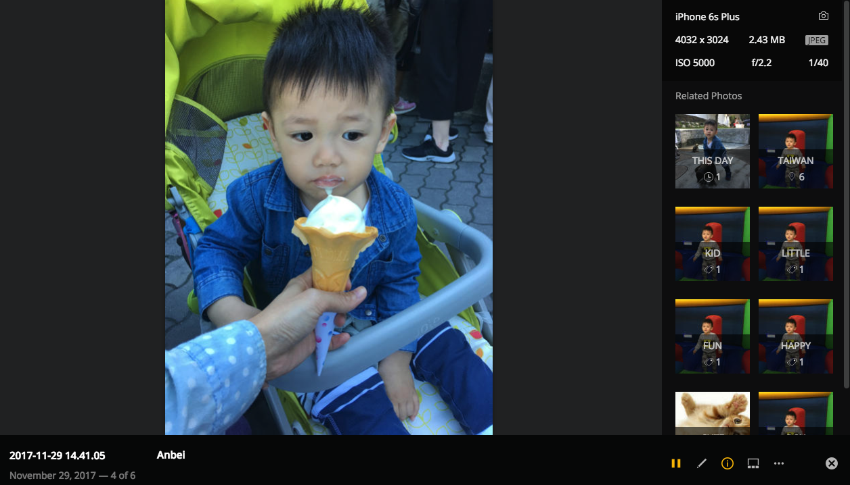
Plex - Web
Play photos via web browser
Automatic photo-tagging

Slide 38
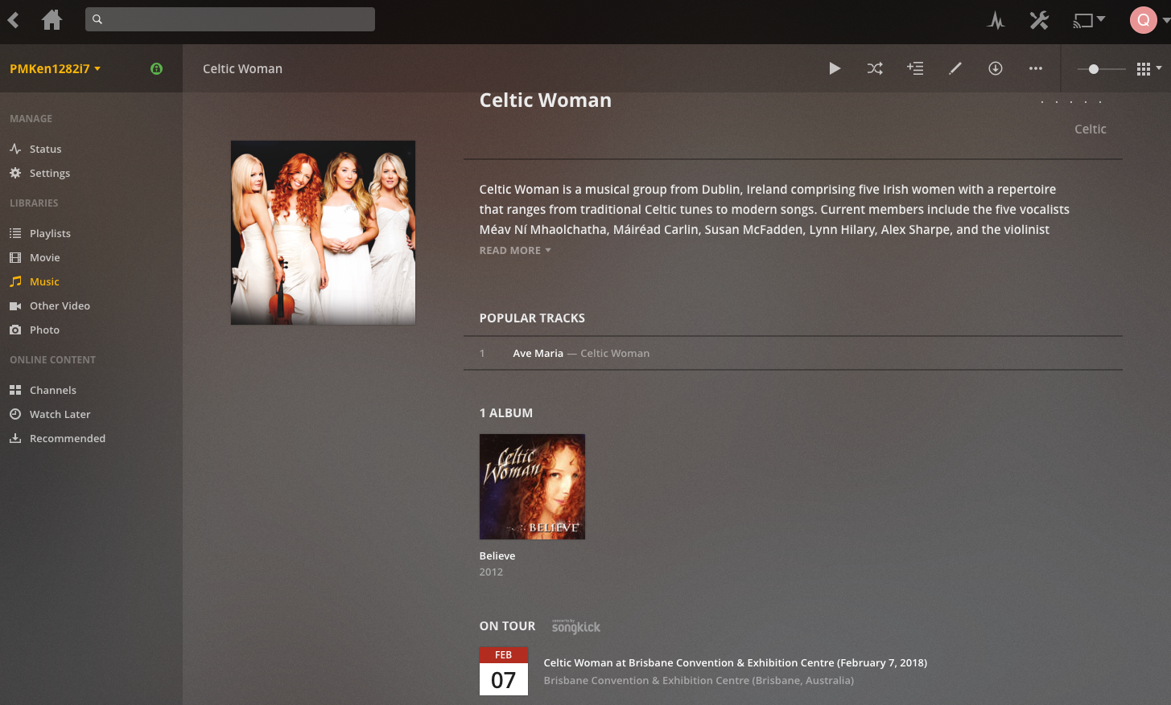
Plex - Web
Play music via web browser
Audio fingerprinting helps Plex recognize your music files so it can find premium metadata.

Slide 39
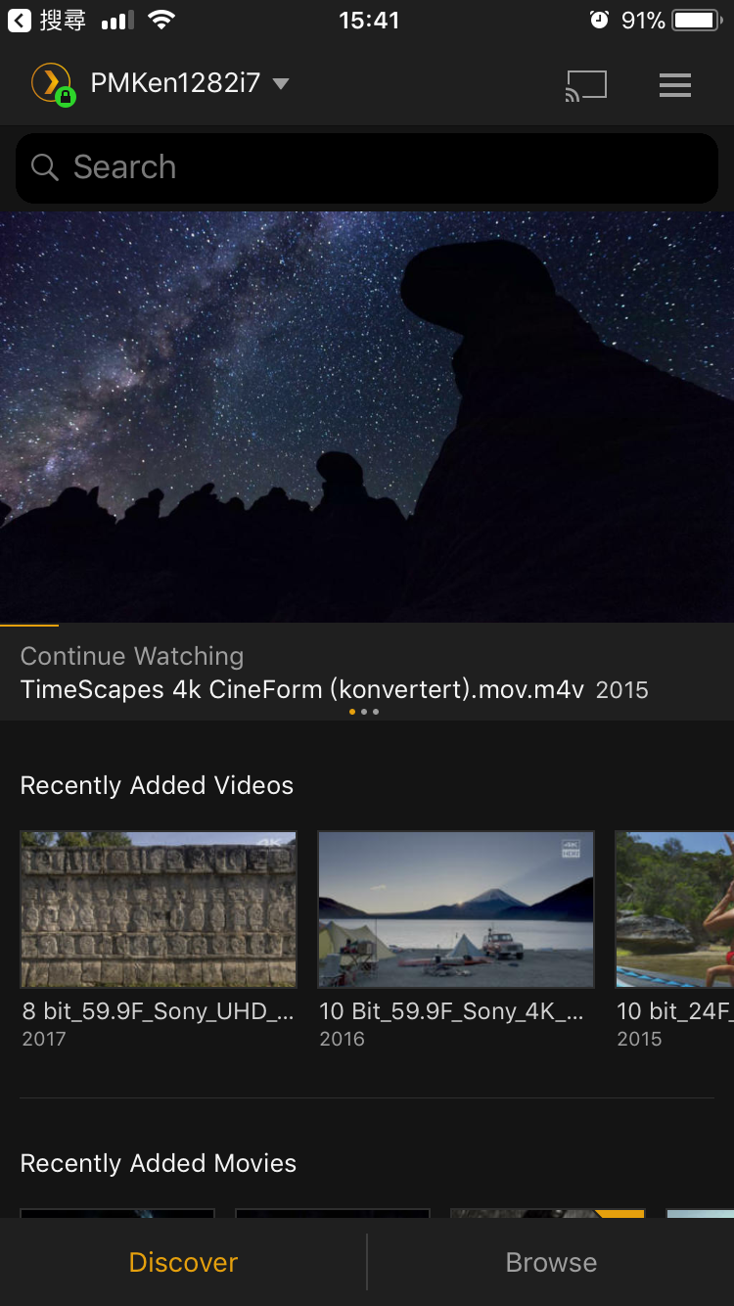
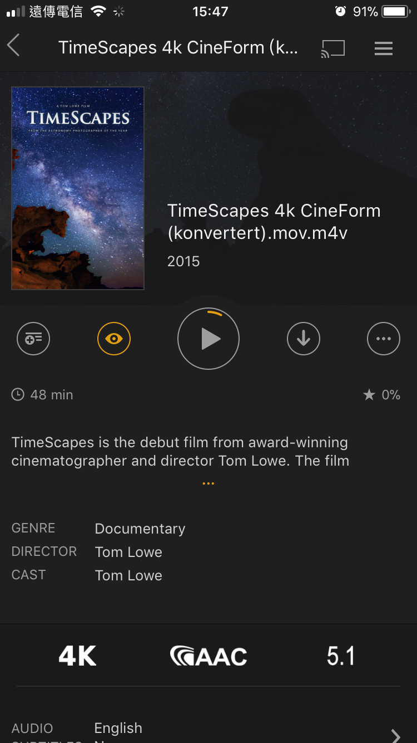
Plex - Apps
Play multimedia contents via Plex apps

Slide 40
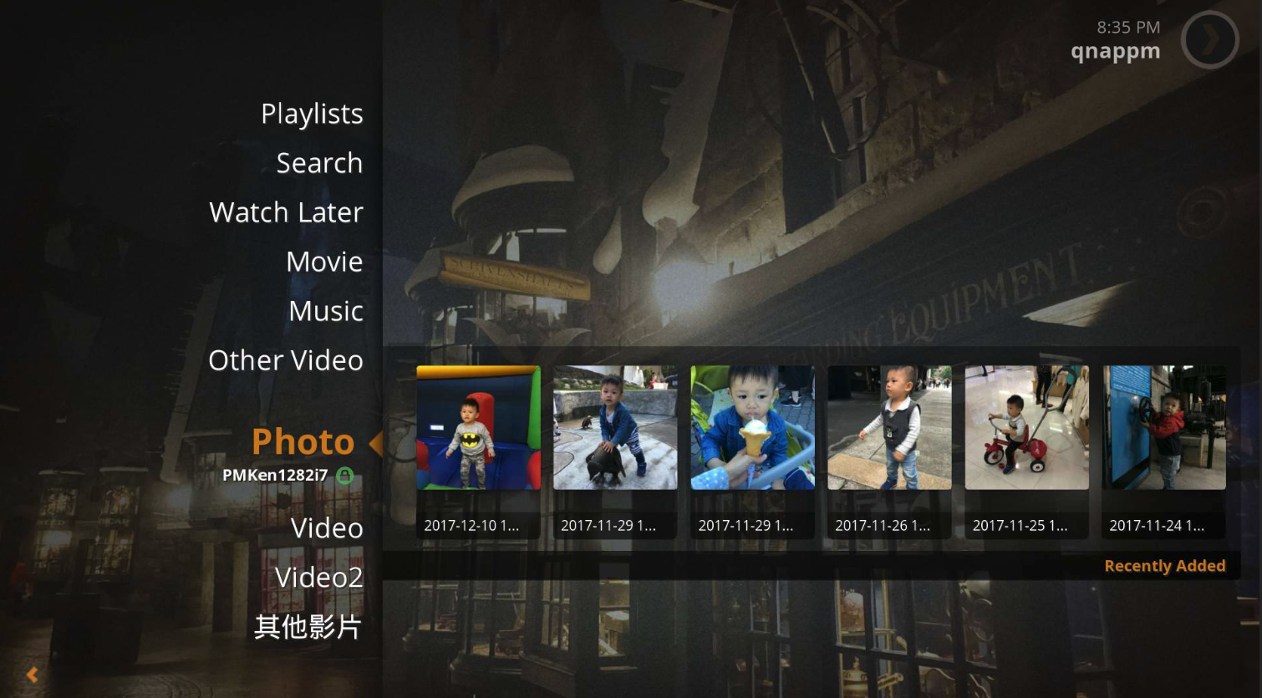
Local playback
PLEX Home Theater
Play multimedia contents directly on TV by using Plex Home Theater on HD Station

Slide 41
Transcoding

Slide 42
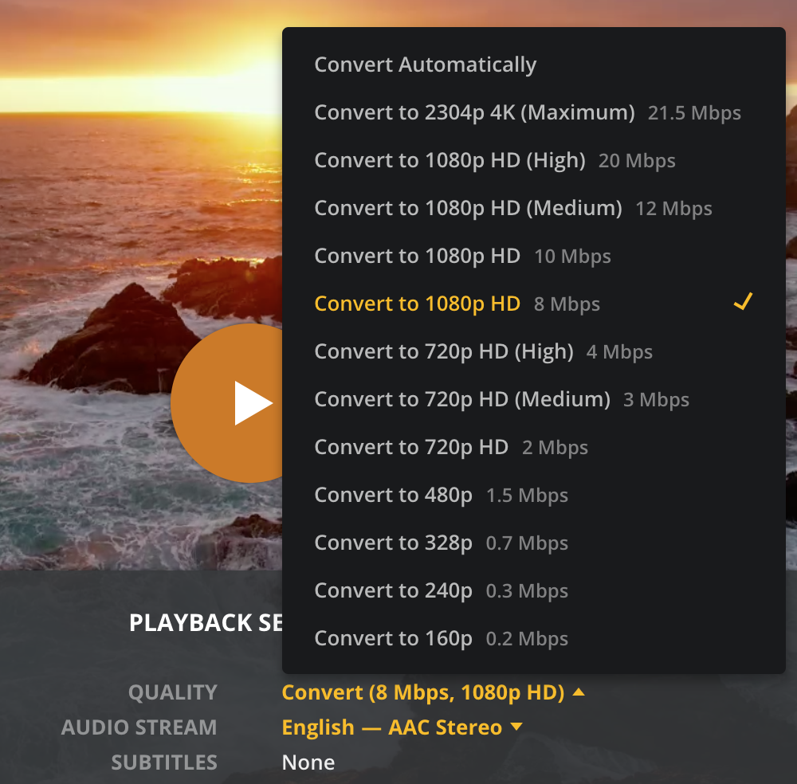
Realtime transcode
Realtime transcode option
Video quality:
The higher the resolution selection, the greater the network bandwidth required.

Slide 43
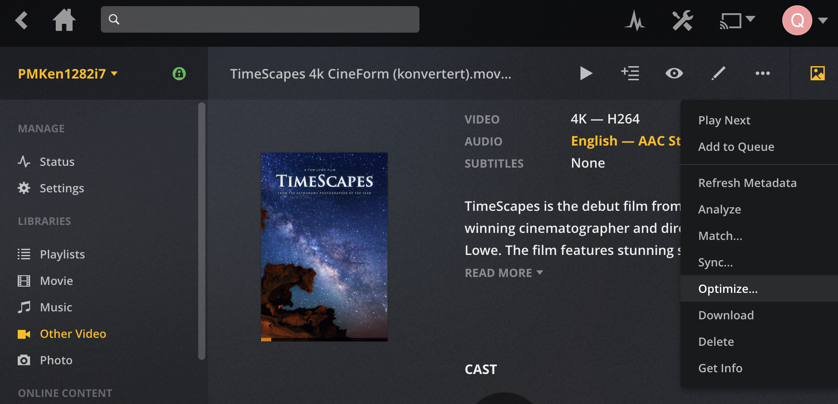
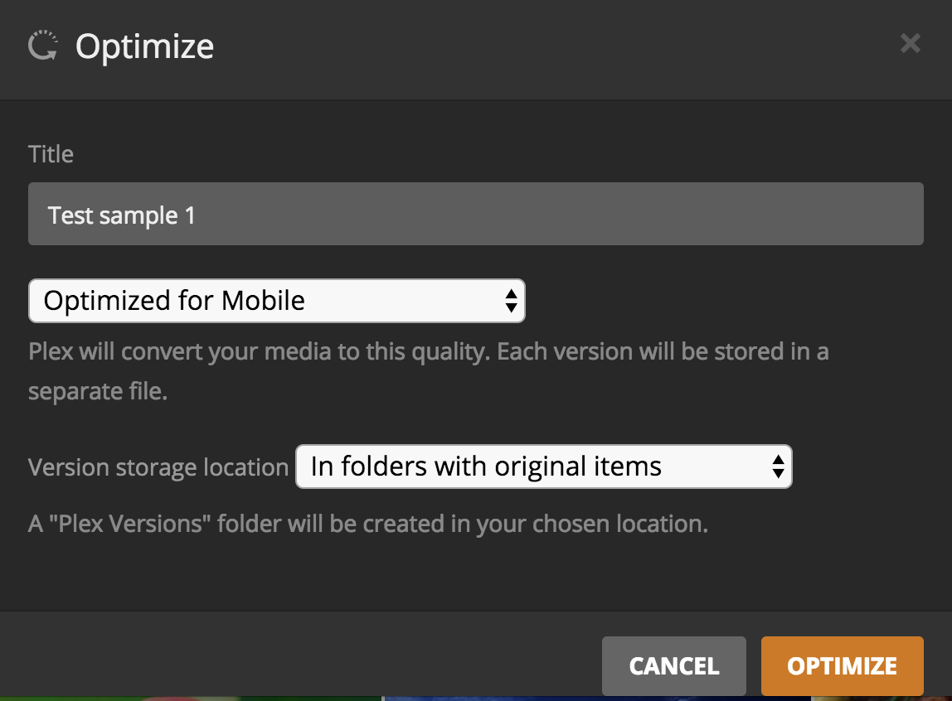
Offline transcode
Set up a offline transcoding process

Slide 44
Tips
Naming rule - Movie
Movie’s file naming format：MovieName (release year).ext
Example：
/Movies /Avatar (2009) Avatar (2009).mkv /Batman Begins (2005) Batman Begins (2005).mp4 Batman Begins (2005).eng.srt poster.jpg
For more information, please visit PLEX official website:
https://support.plex.tv/hc/en-us/categories/200028098-Media-Preparation

Slide 45
Tips
Naming rule - TV shows
TV show’s file naming format：
Single-Episode Files -> ShowName - sSeasonNumbereEpisodeNumber.ext
Multi-Episode Files -> ShowName - sSeasonNumbereEpisodeNumber-eEpisodeNumber.ext
Example：
/TV Shows /Grey's Anatomy /Season 01 Grey's Anatomy - s01e01.avi Grey's Anatomy - s01e02 - The First Cut is the Deepest.avi /Season 02 Grey's Anatomy - s02e01.avi Grey's Anatomy - s02e02-e07.mkv

Slide 46
Tips
Naming rule - Music
PLEX will use the embedded ID3 tag metadata priority.
For those do not have the embedded metadata:
Music’s file naming format：
ArtistName - AlbumName/TrackNumber - TrackName.ext
Example：
/Music /Pink Floyd - Wish You Were Here 01 - Shine On You Crazy Diamond (Parts I-V).m4a 02 - Welcome to the Machine.mp3 03 - Have a Cigar.mp3

Slide 47
See you

