Slide 2
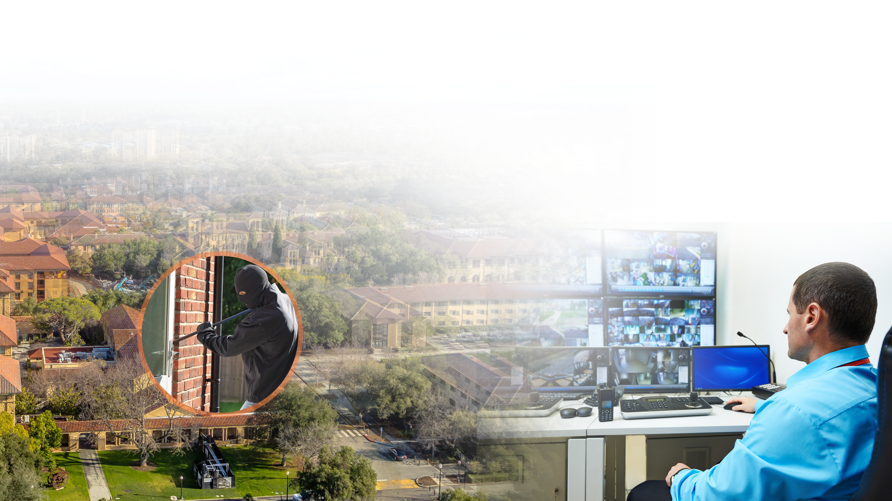
How to manage a big project site?
When your project site is installed with multiple QVR Pro, having hundreds of thousands of cameras, how can the security guard…
quickly know the servers' status?
notice and deal with situations in time?
pay attention to the most important video feeds efficiently?

Slide 3
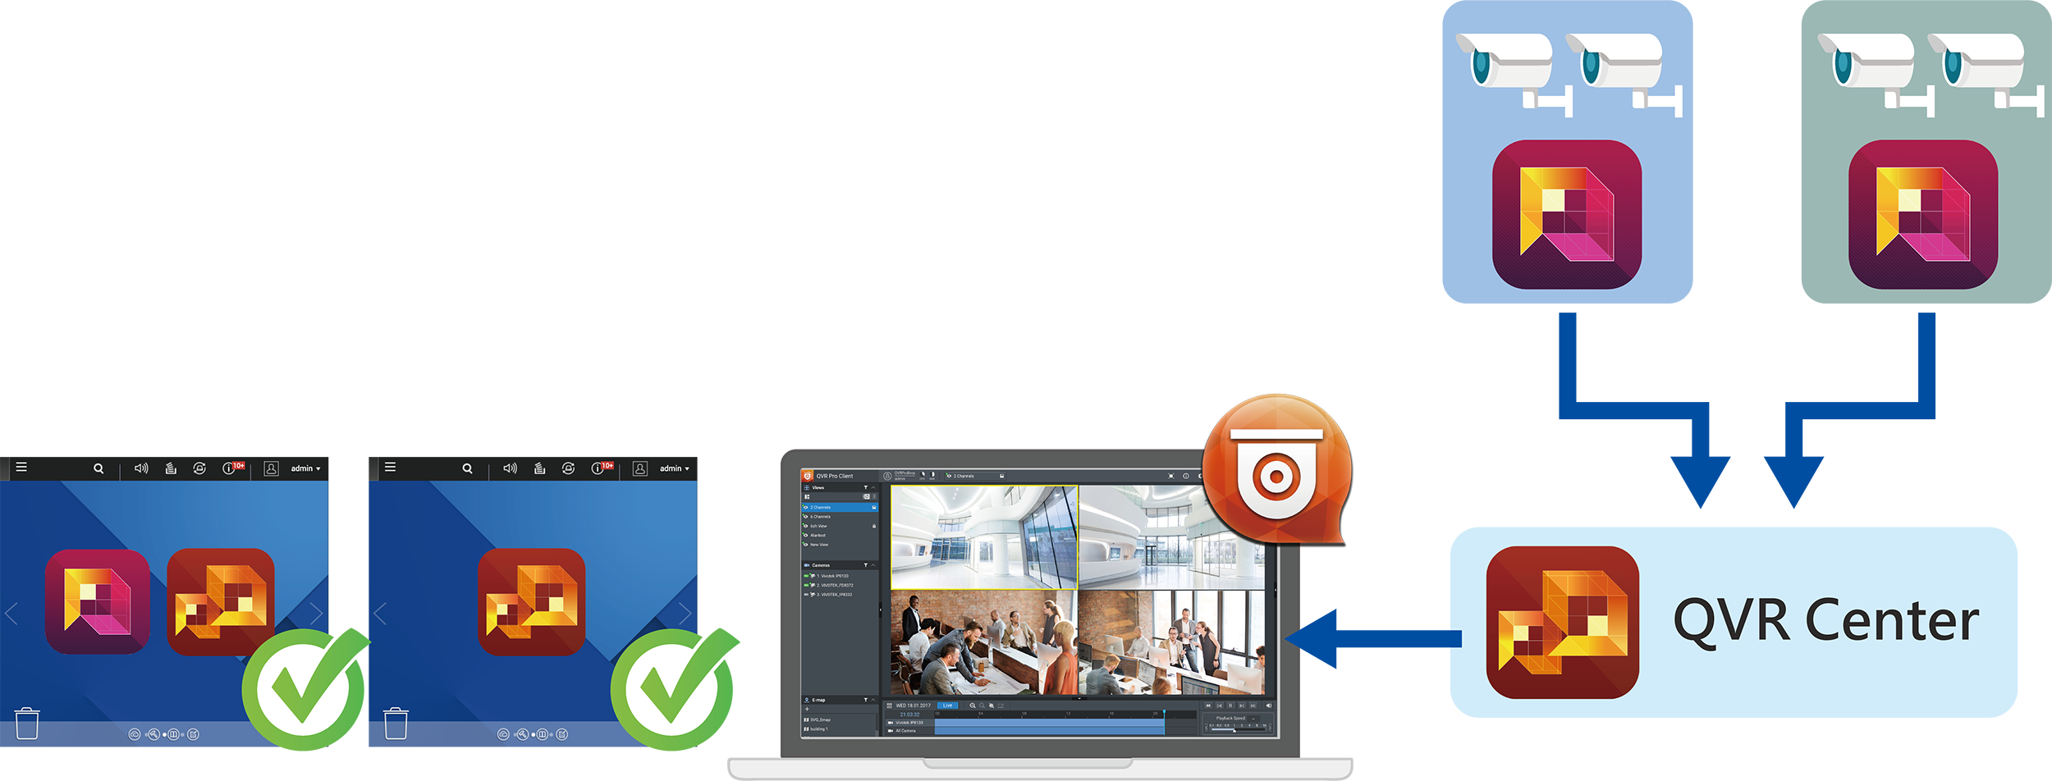
QVR Center
Centrally manage up to 128 servers
  QVR Center 1.1.0 provides downward compatibility for
  QVR 5.1.x & Surveillance Station *.
  Max. 2 QVR Pro Free.
  Combined max. (QVR Pro Free + QVR Pro Gold + QVR 5.1.x +
  Surveillance Station) = 128
Centrally monitor multiple QVR Pro's live feeds & playback.
Centrally receive multiple QVR Pro's event notifications.
* Not all functions are supported.

Slide 4
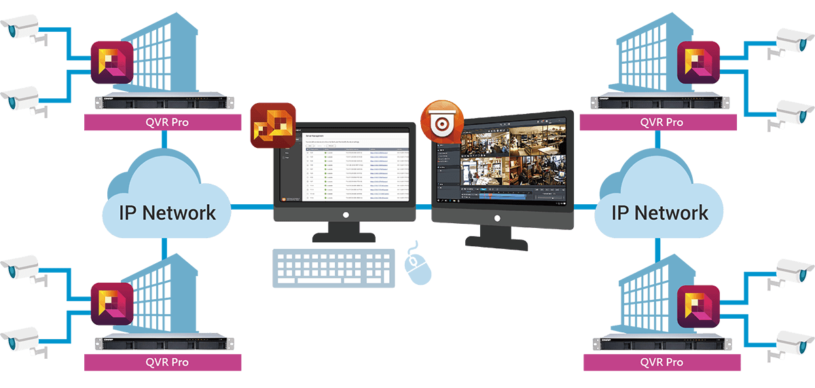
Distributed infrastructure that canbe centrally managed
Build independent video surveillance systems and manage all
of them collectively
Add QVR Pro via LAN IPs, WAN IPs or domain names.

Slide 5
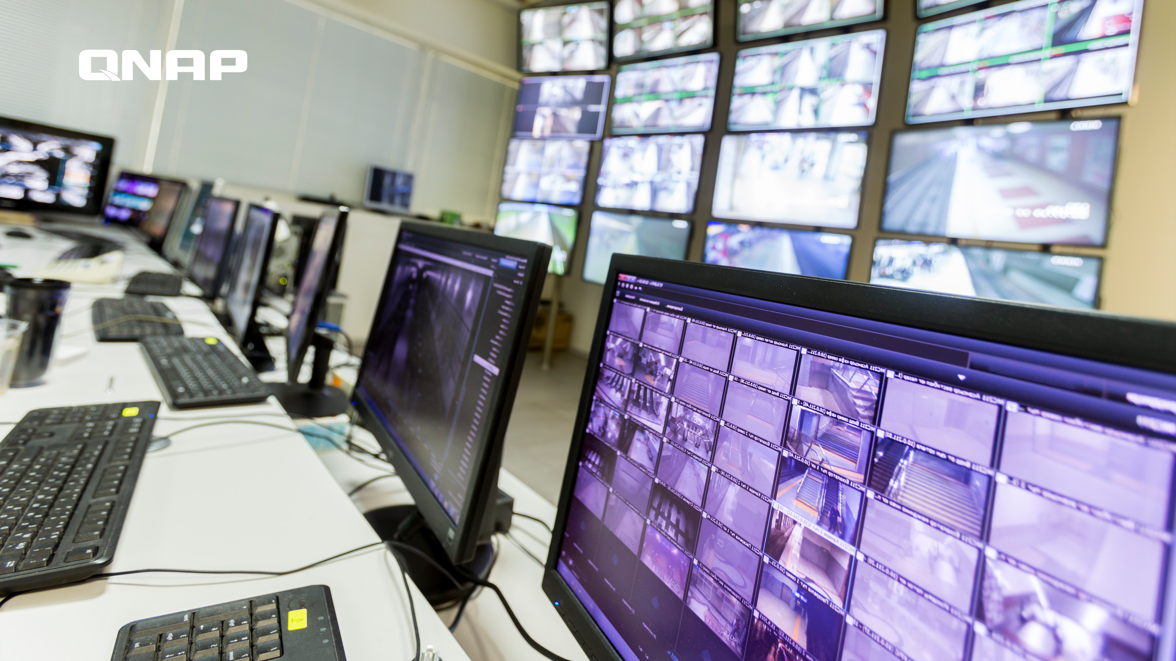
QVR Center
How to start using QVR Center

Slide 6
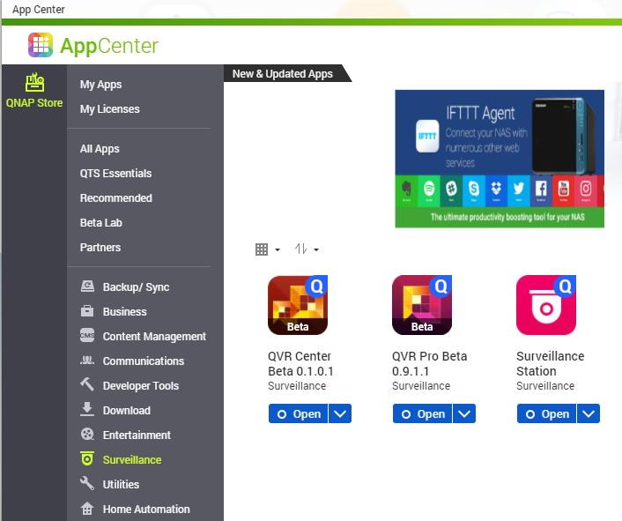
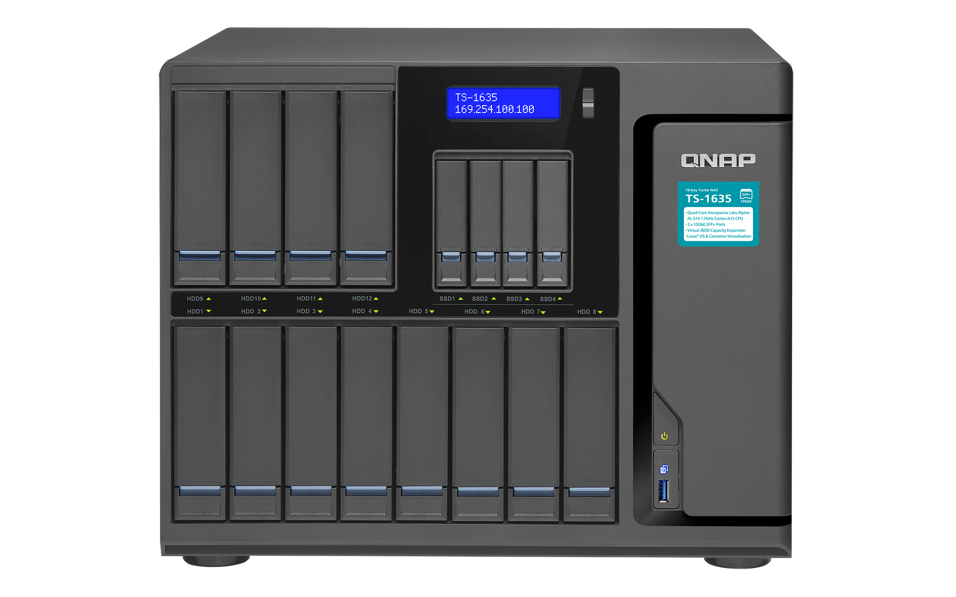


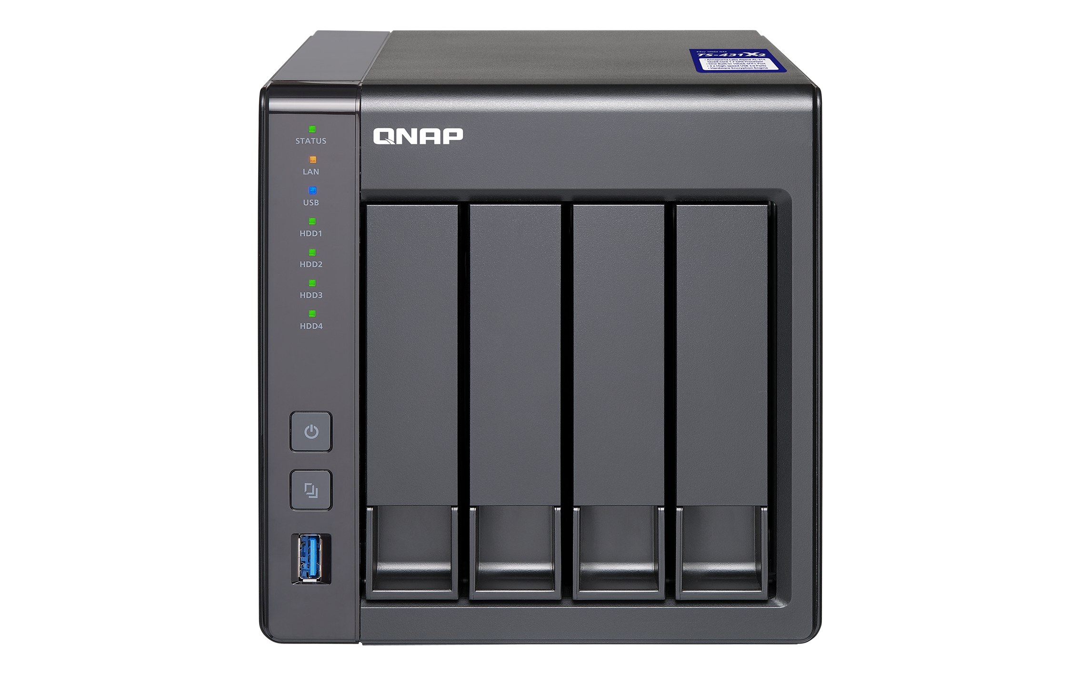
Install QVR Center
QVR Center can be installed on the same NAS as QVR Pro
installation, or a different one.
Go to QTS > App Center > Surveillance, and install QVR Center.
or

Slide 7
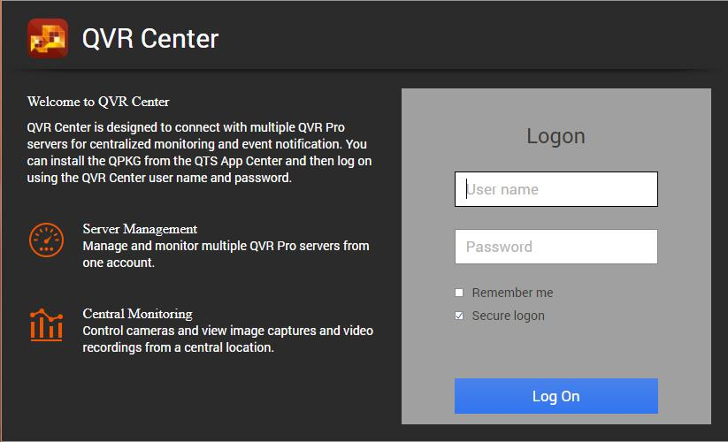
Log into QVR Center
QVR Center has its own login page.
How to log in:
QTS Desktop > QVR Center
Direct input of URL in web browsers
( https://(IP address of NAS)/qvrcenter/ )
QVR Center owns its user accounts (independent from QTS). (default: admin/admin)
Other username/password need to be created by the admin.
QVR Center can only be accessed via secure connections (https).

Slide 8

User role and privilege settings
When adding QVR Center users, you can assign a user with a role to quickly and easily set up privileges.
Administrator
New Role
Supervisor
Viewer

Slide 9
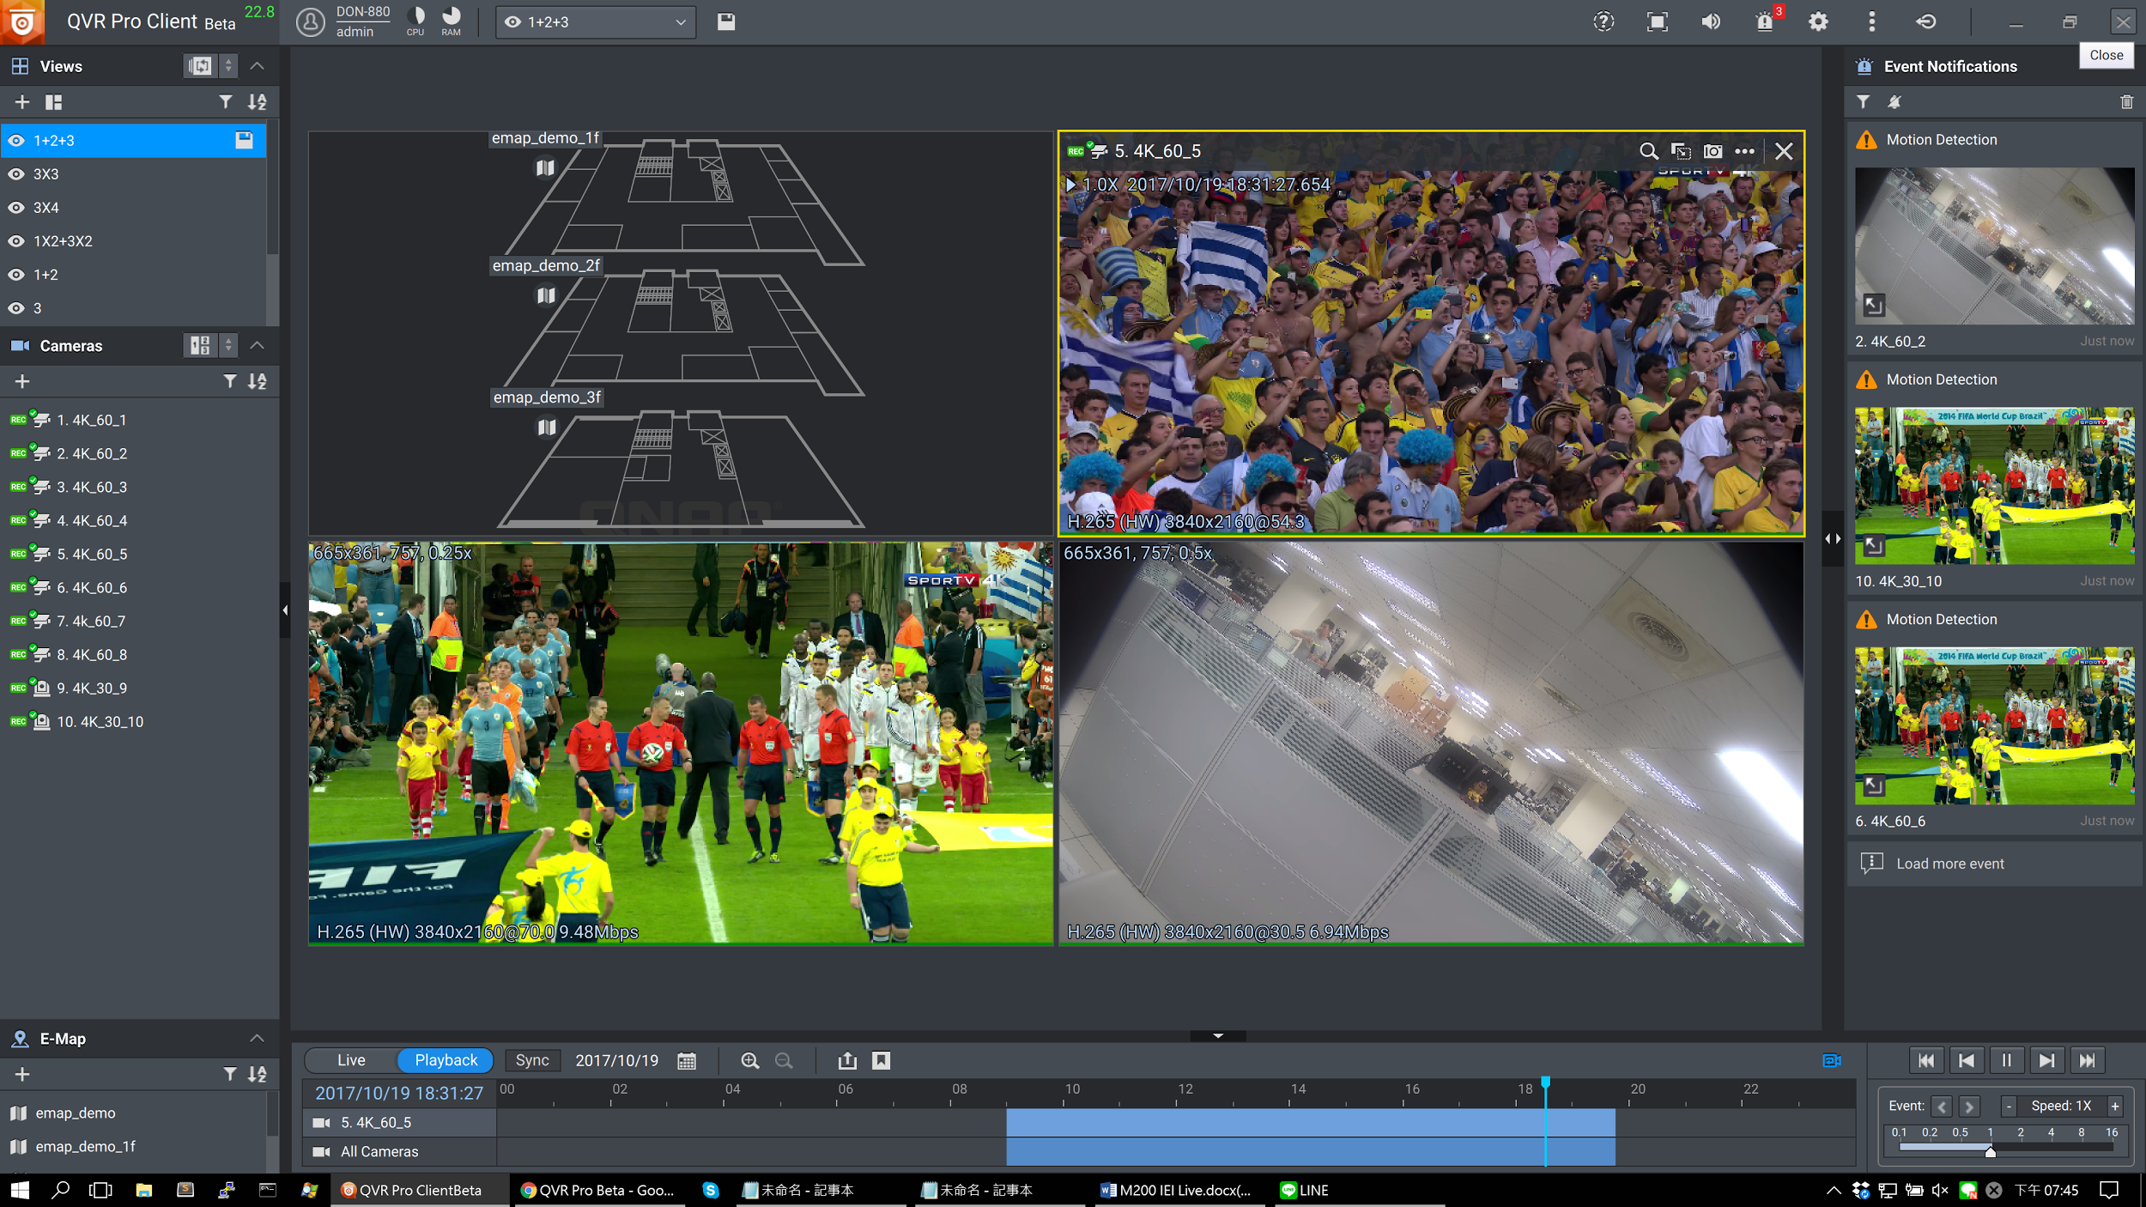
Role and privilege settings
Controls whether the following privileges are granted
  System management privilege
  View layout privilege
  View camera privilege
  View E-map privilege
  System default role:
  Administrator
  Supervisor
  Viewer

Slide 10
Detailed Role Privilege Settings
 | System Management Privilege | Camera Privilege | E-map Privilege | View Privilege
Administrator | ○ | ○ | ○ | ○
Supervisor | X | ○ | ○ | ○
Viewer | X | ○ | X | ○
New Role | Customizable | Customizable | Customizable | Customizable

Slide 11
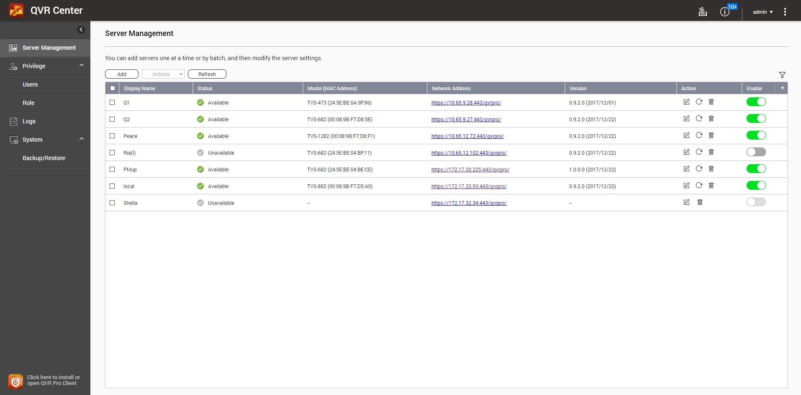
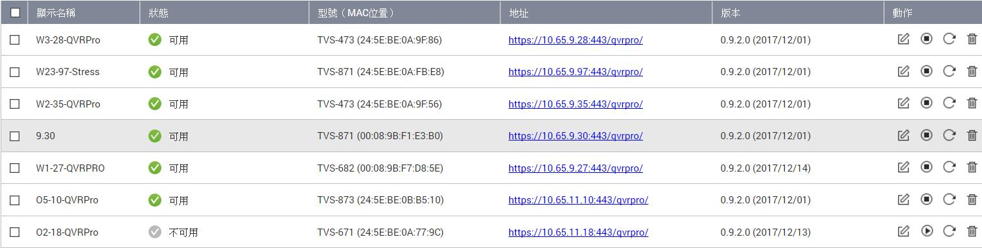

Web interface after logging in
Server Management
Privilege
Logs
Backup/Restore
Open QVR Pro Client

Slide 12
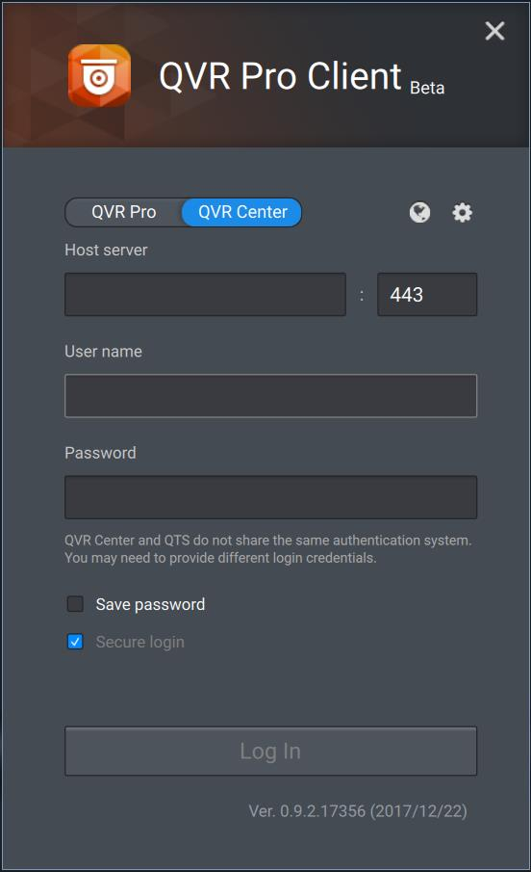
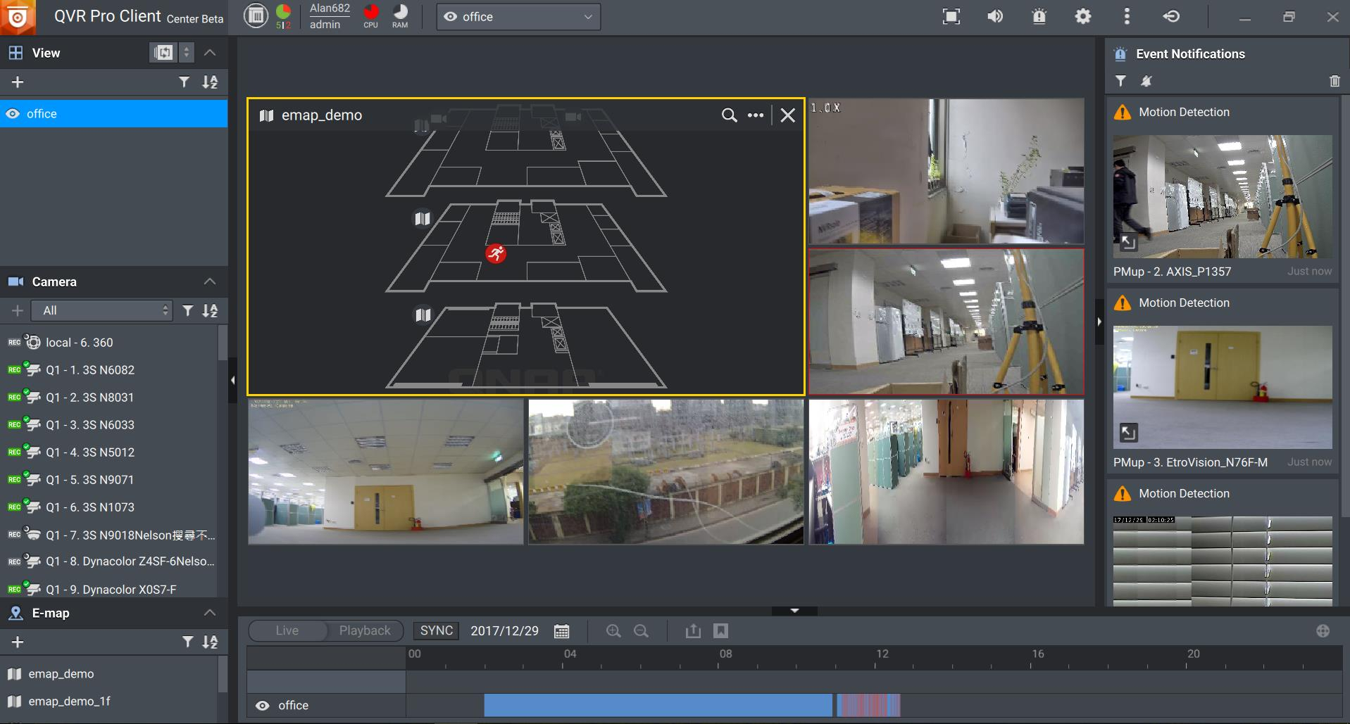
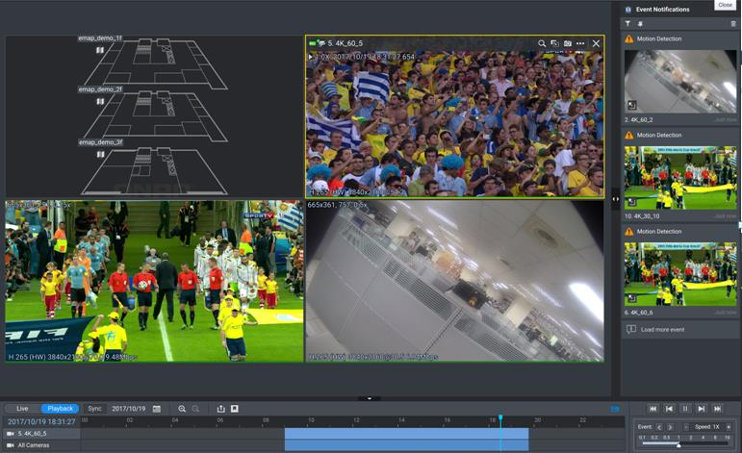
QVR Pro Client UI after logged in
QVR Center & QVR Pro shares the same QVR Pro Client.
Quickly pick it up in no time

Slide 13

QVR Center
Functions at a Glance

Slide 14
QVR Center Server functions
Manage servers in batches
Privilege Management
Log Server
Customizable surveillance event dashboard
Downward compatible with QVR 5.1.x & Surveillance Station

Slide 15
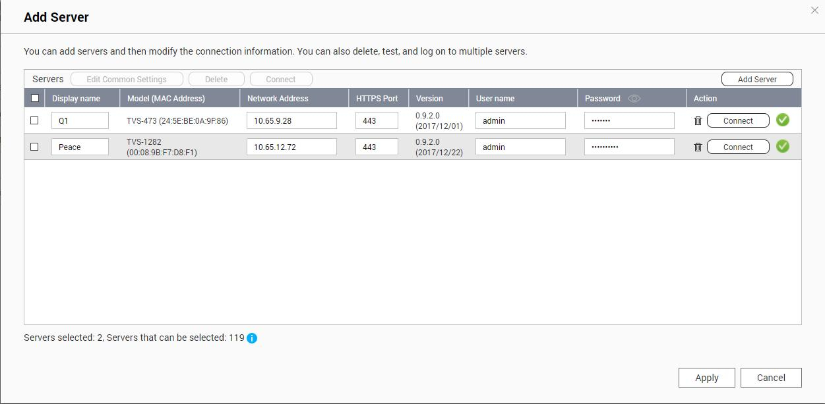
Batch Add Servers
Batch add and connect to multiple servers.
Speed up the process of adding servers.
Assign an display name that suits this server from the centrally
monitoring view, for easier management.

Slide 16
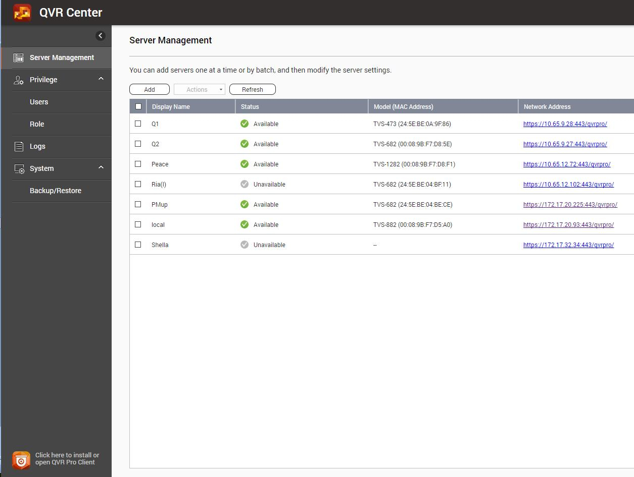

Server Overview
Status:
  Available Updating…
  Unavailable Checking…
Shows reasons for unavailability for
troubleshooting.
  Unable to connect to QTS
  QVR Pro not detected
  QVR Pro not activated
  Incorrect username/password
  No license
  Incorrect QVR Pro version

Slide 17
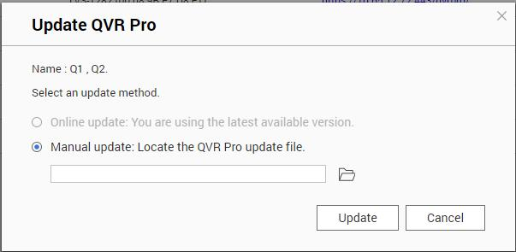

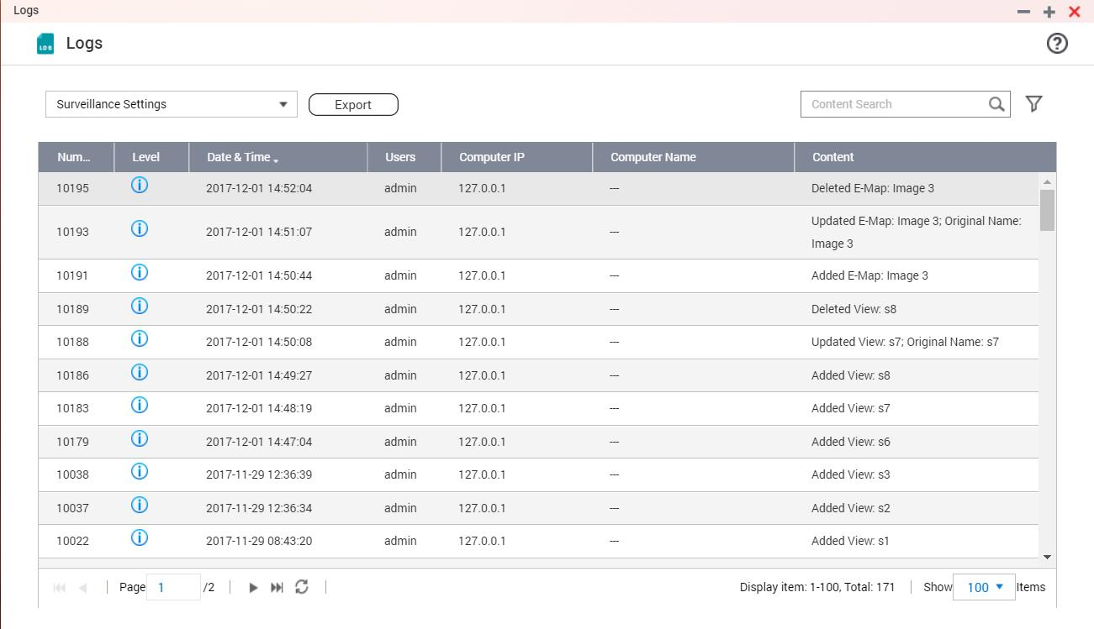
Managing servers in batches
Batch edit, stop, activate, update and delete QVR Pro.
Save time for updating multiple QVR Pro.
Update
Update
Update

Slide 18

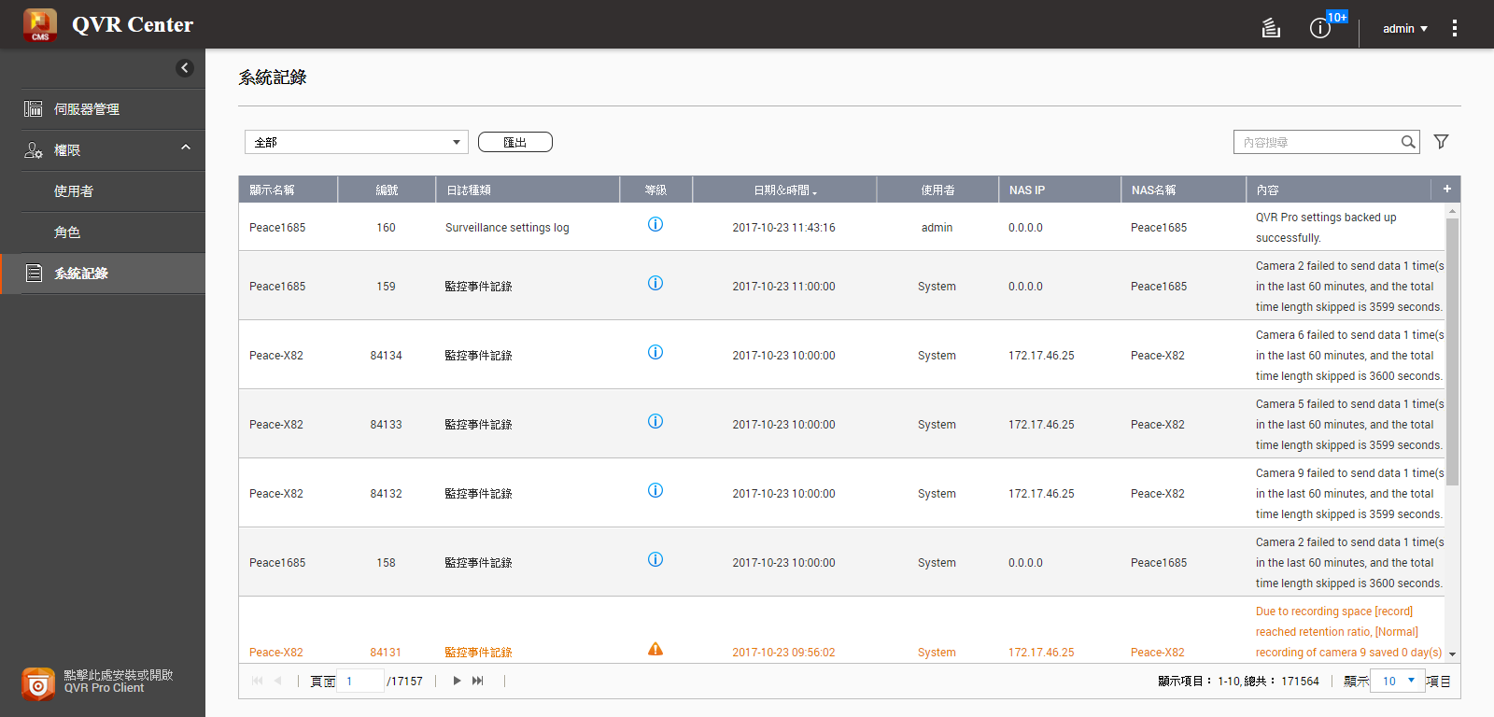
Log server – Centralized log keeping
Log server: Centrally store and show logs from all QVR Pro, and QVR Center's own logs.

Slide 19
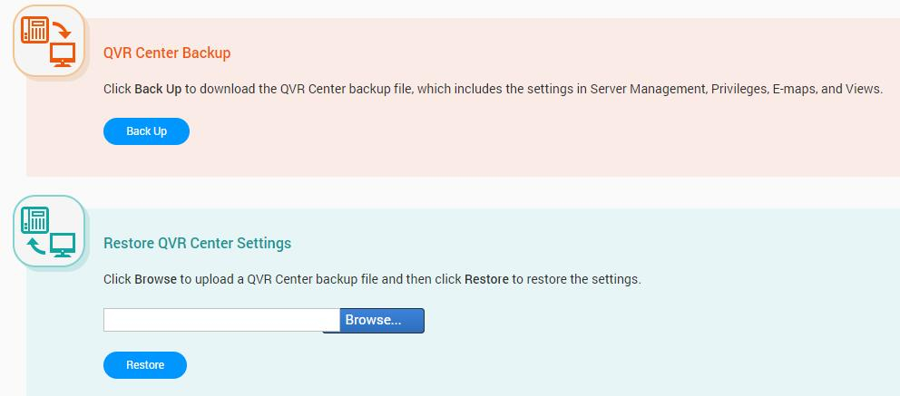
Backup / restore QVR Center Settings
Backup / restore QVR Center settings to protect settings you made and managed centrally.
  Server management
  Privilege management
  View (QVR Center)
  E-map (QVR Center)

Slide 20
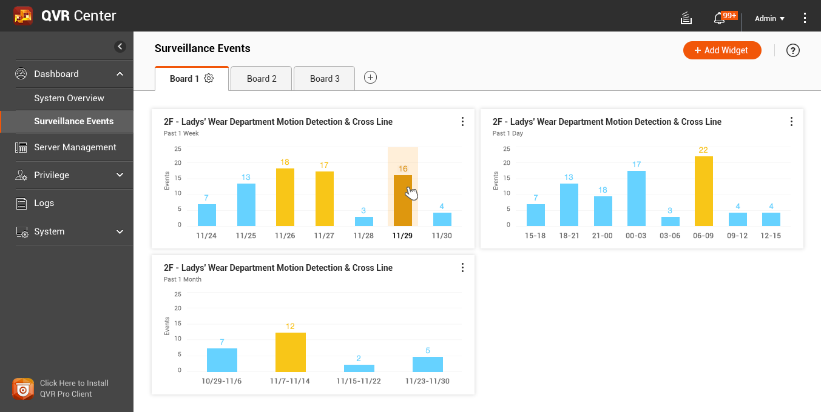
Customizable surveillance event dashboard
On QVR Center 1.0.0
Help managers analyze peak hours of their businesses, and adjust manpower allocations, based on the event triggering frequencies.
Notes:
On QVR Center 1.0.0

Slide 21

Customizable surveillance event dashboard
On QVR Center 1.0.0
Group relevant widgets into a board, for easier investigation.
Widget's data source:
  View
  E-map
Widget's event type:
  Motion detection
  Digital input
  Camera IVA
  Connection
  and more…
Motion detection @ 1F
Motion detection
@ 1F counter
Board
Widget
Motion detection
@ 1F restaurant
Motion detection
@ 1F Hallway

Slide 22
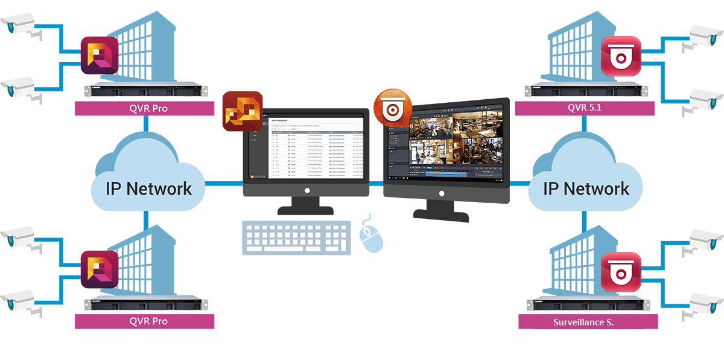
Downward compatible with QVR 5.1 & Surveillance S.
On QVR Center 1.1.0
On QVR Center 1.1.0
In your existing projects, you can use QVR Center to simultaneously manage and monitor video feeds from QVR Pro, QVR 5.1.x, and Surveillance Station*.
* Not all functions are supported.

Slide 23

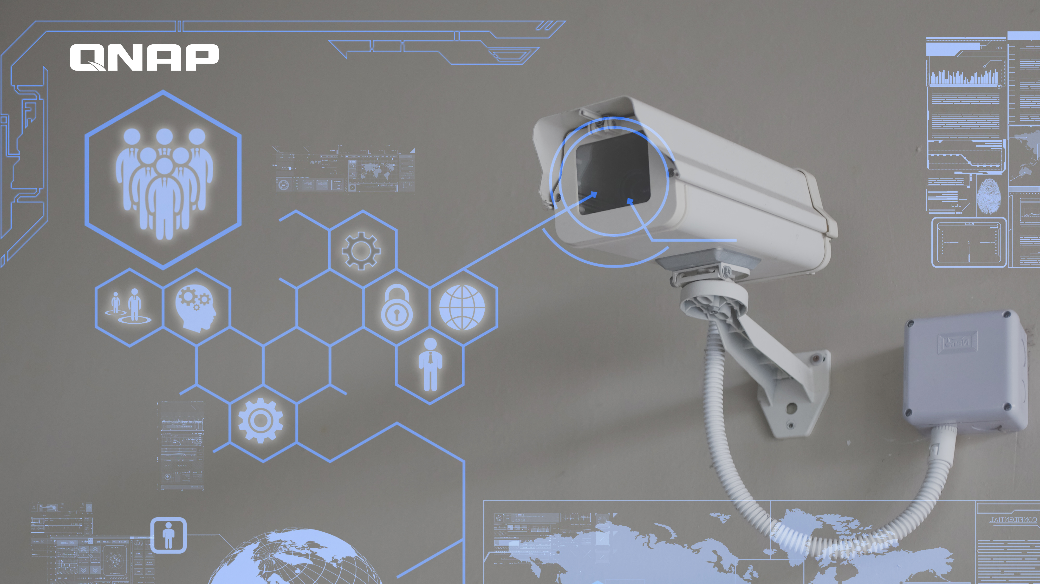
QVR Pro Client
for QVR Center

Slide 24
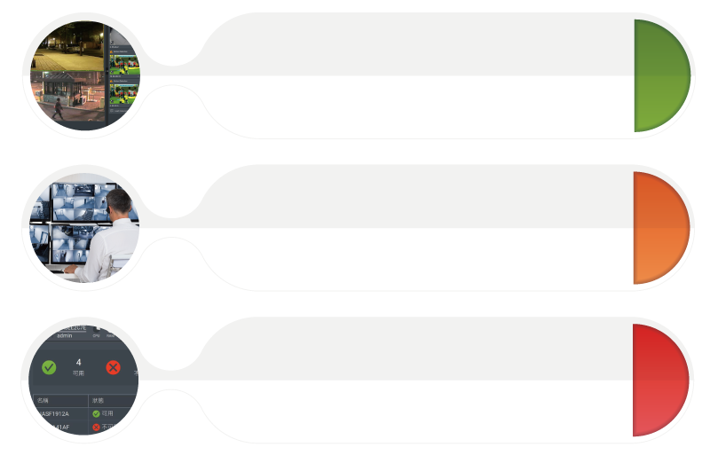
QVR Center Client functions
Centrally monitor feeds
- Cross-server View & E-map
- Links to connect multiple E-maps
中央監看影像
  跨伺服器的View、E-map
  超連結串接眾多電子地圖
Centrally receive events
Receive event notifications from all servers
- Playback the event video
Server status overview
Connection status between QVR Center
& QVR Pro

Slide 25
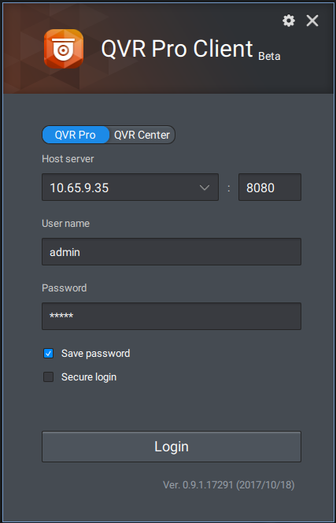
QVR Pro Client
When logging in from QVR Pro Client,
choose to log in to QVR Pro or QVR
Center.
QVR Center & QVR Pro shares the same
QVR Pro Client.
Easily pick it up in no time

Slide 26
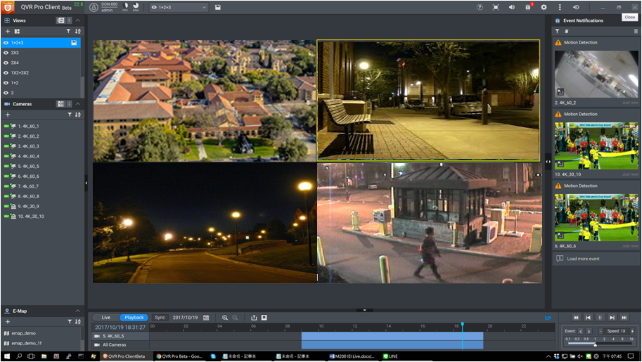
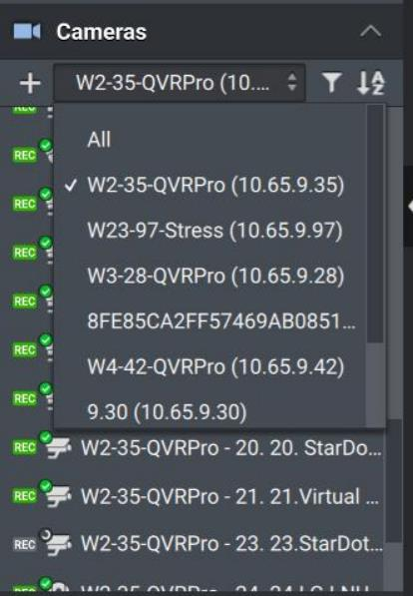
Cross-server feed monitoring
Create cross-server View & E-map in QVR Center

Slide 27
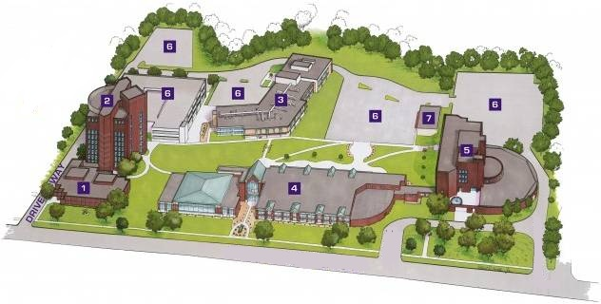

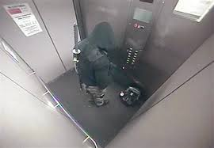

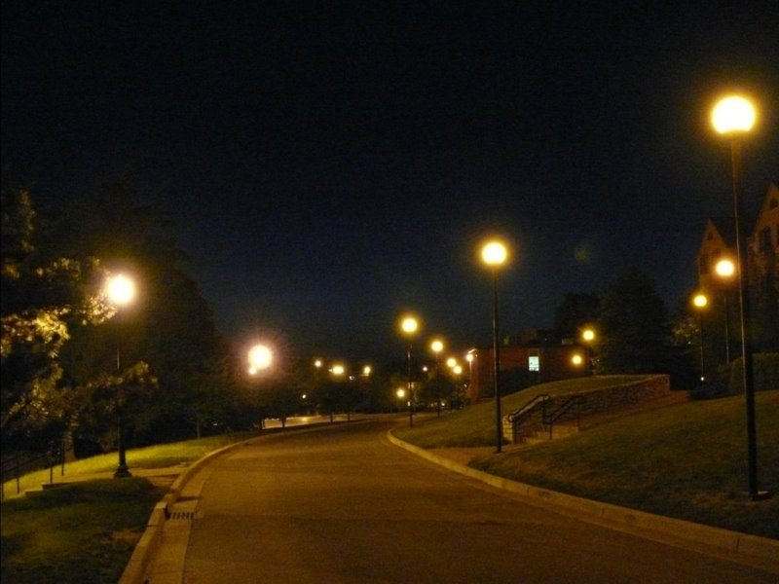
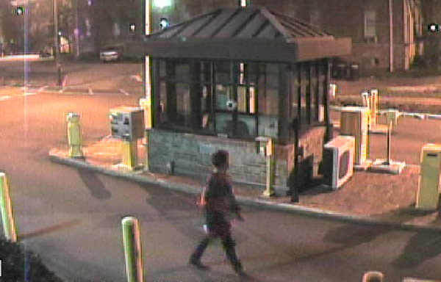
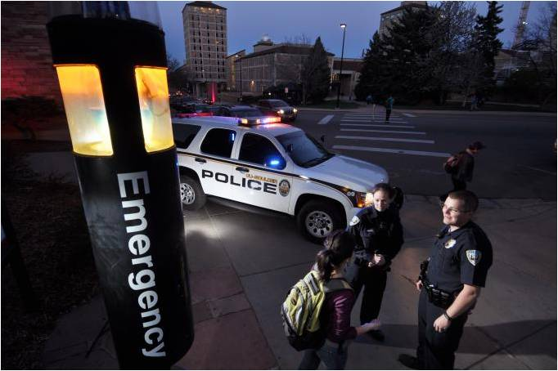
Cross-server receive events
Even without showing the camera feed, its events will still be shown in the event column upon event detection.
Event Notification

Slide 28
Centrally receive & monitor events
Click on the event notification to playback the event video
Event
playback

Slide 29
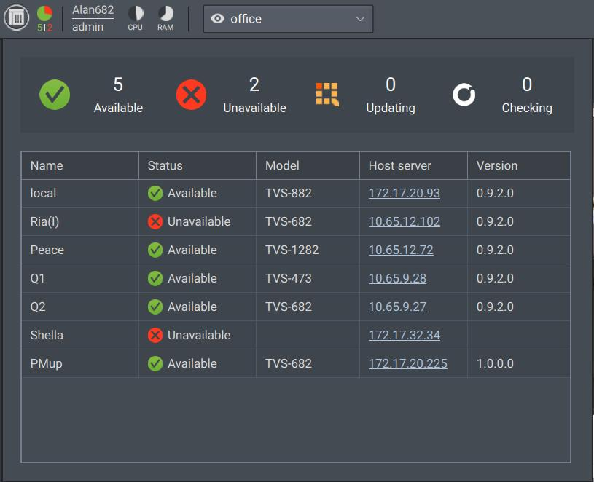
Server status overview
On QVR Center 1.0.0
In QVR Pro Client, shows the connection status between QVR Center & each server.
When video feeds are unavailable, it is easier this way to determine root causes.

Slide 30

Live Demo
Live Demo

