Slide 1
Orthanc: Value-Added Healthcare Solution for QNAP NAS
Turn NAS into a DICOM server

Slide 2
Orthanc: Value-Added Healthcare Solution for QNAP NAS
Turn NAS into a DICOM server
Orthanc introduction and use cases
3 advantages of Orthanc + QNAP NAS
Demonstration

Slide 3
What is Orthanc?
A lightweight yet powerful application for hosting a Digital Imaging and Communications in Medicine (DICOM) server.

Slide 4
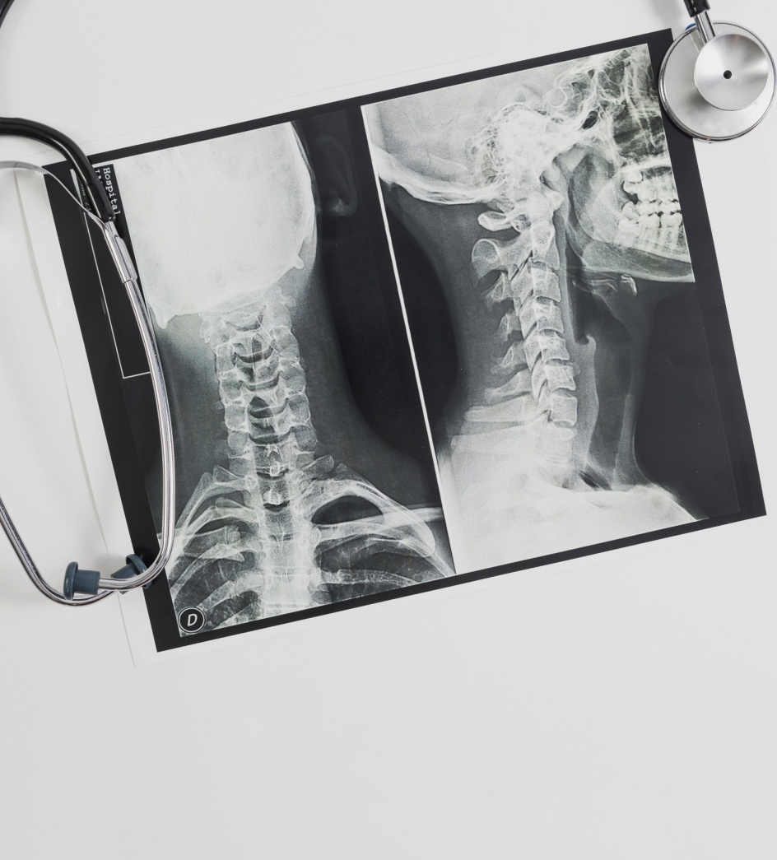
What is DICOM?
Digital Imaging and COmmunications in Medicine:
an international standard associated with the exchange, storage and communication of digital medical images.

Slide 5
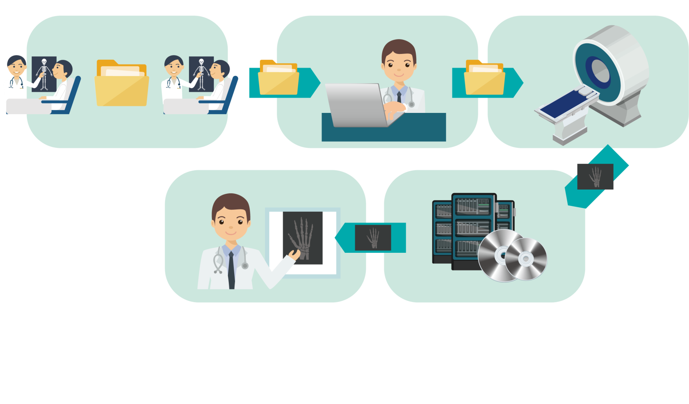
Workflow of medical imaging service
Card reader get patient info
Example: Request Procedure : Chest X-ray
RIS gets the order and schedules of the exam
Console of modality displays the schedules from MWL
Communication
between HIS and RIS
RIS passes the scheduled order to PACS MWL
image acquisition complete, generate DICOM file
E.g.: X-ray /Mammography/ Ultrasound/CT scan/MRI
Doctors or radiologists, image review
analyze the DICOM tag, write it to the database and store
Notes:
放射科資訊系統 radiological information system (RIS) 醫療資訊系統 Health Information System (HIS)
醫療影像擷取與傳輸系統 Picture Archiving and Communication System (PACS)

Slide 6
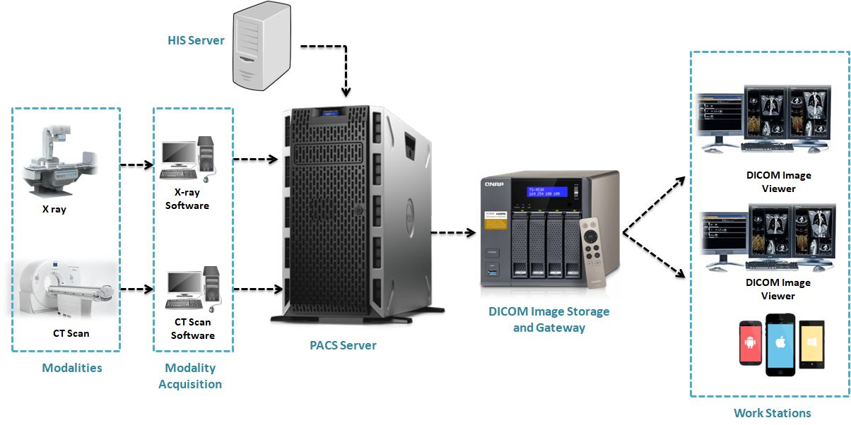
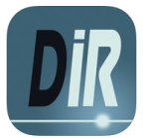
Orthanc + NAS use cases
Remote viewing
e.g.: on-call Doctors
Mobile
viewer
DICOM images are transferred from PACS server to NAS for smart management
*Picture Archiving and Communication System (PACS)

Slide 7
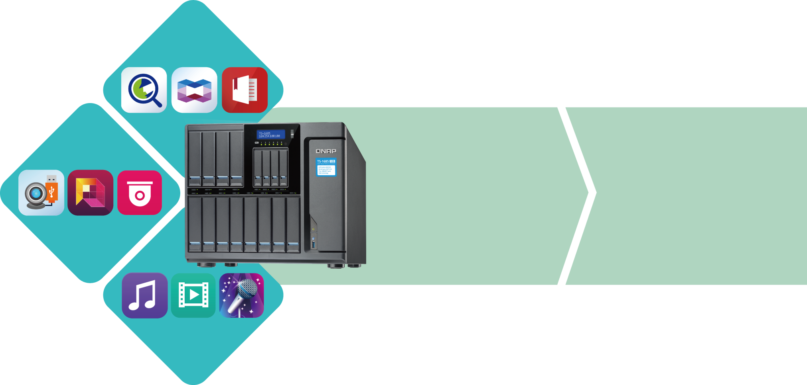
Orthanc+NAS
Tools
Surveillance
Integrated with Orthanc, QNAP NAS now offers storage solutions for medical images, accompanying three features -Data security, efficient management and easy access
New-added healthcare App
Entertainment

Slide 8
3 advantages of Orthanc + NAS
Data security
Hybrid Backup Sync: a flexible backup, restore and sync solution
The snapshot function helps protect important medical images
Secure storage
Smart management
Efficient management
Visualized Storage & Snapshots Manager
Easy access
easy to operate
supports mobile DICOM viewers
Easy and convenient

Slide 9
3 advantages of Orthanc + NAS
Data security
Hybrid Backup Sync a flexible backup, restore and sync solution
Ease the workload of DICOM image manager
According to medical laws, medical images shall be archived for 7+ years

Slide 10
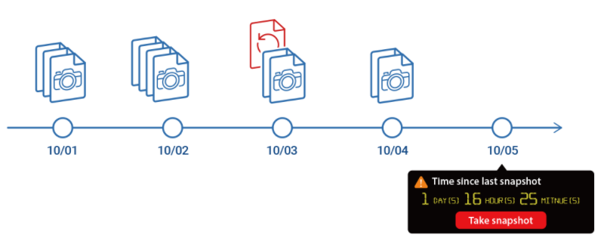
3 advantages of Orthanc + NAS
The snapshot function helps protect
important medical images
Restore accidentally deleted files+ Recovery plan against viruses
Data security
Ease the workload of DICOM image manager
According to medical laws, medical images shall be archived for 7+ years

Slide 11
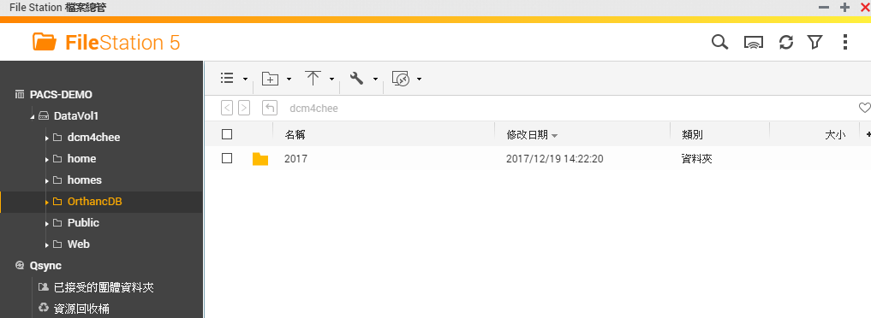
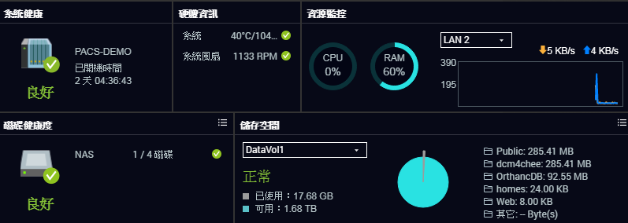
3 advantages of Orthanc + NAS
Visualized Storage & Snapshots Manager
Monitor storage space Intuitive backup solution OrthancDB(DICOM database)
Efficient
management
Ease the workload of DICOM image manager

Slide 12
3 advantages of Orthanc + NAS
There are countless medical images in our lifetime and it is difficult to manage well…
Pregnancy ultrasound scans, flat feet Treatments, tooth development X-ray,
frozen shoulder images, CT scan, MRI, etc.
Easy access
THRF encourages people to collect personal medical records, including medical images
Notes:
Taiwan Healthcare Reform Foundation (THRF)

Slide 13
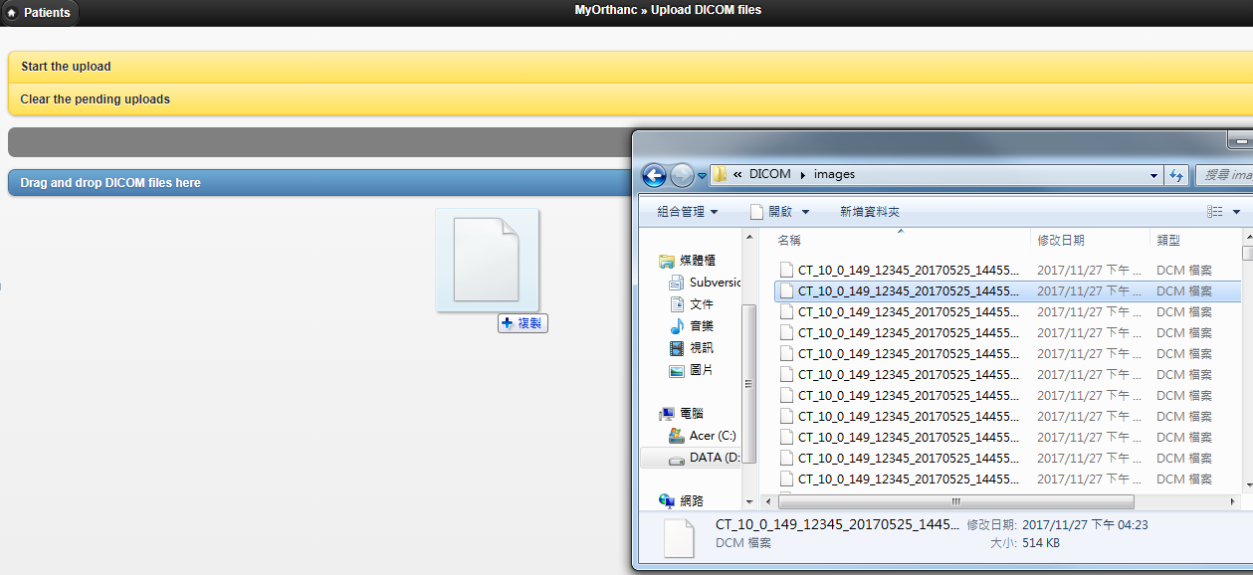
3 advantages of Orthanc + NAS
Just drag & drop images
Run the Orthanc app, drag & drop files and click upload to NAS for easy managing all medical images in your families
Easy access
Family health keeper (seeing is believing) create healthcare journals with DICOM images

Slide 14
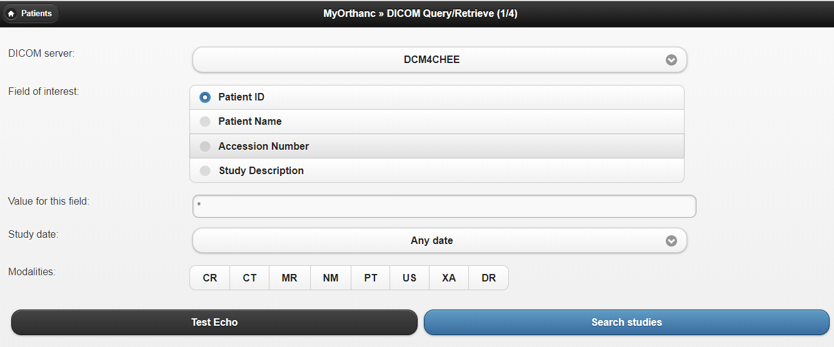
3 advantages of Orthanc + NAS
How to retrieve medical images from another server/NAS?
Orthanc supports image query/retrieve functions
(from other server/NAS)
Easy access
DICOM server setting for images query/retrieve

Slide 15
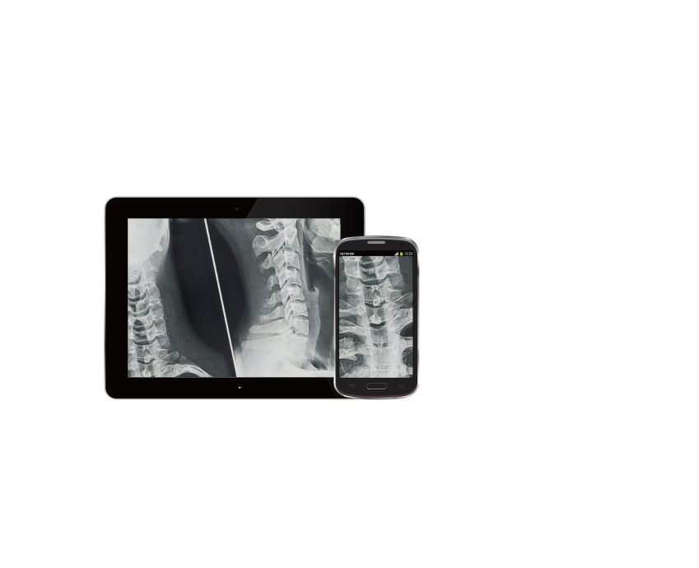
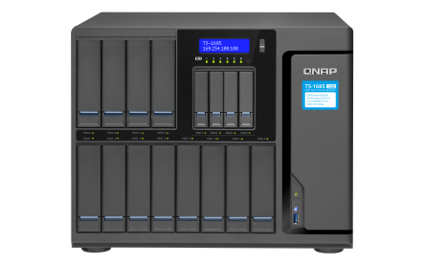
3 advantages of Orthanc + NAS
support mobile DICOM viewers
Set mobile DICOM viewers to connect with Othanc for remote viewing uploaded images in NAS
Easy access
Mobile devices
mobile App (local)
NAS (remote)
on-call Doctors, remote viewing

Slide 16
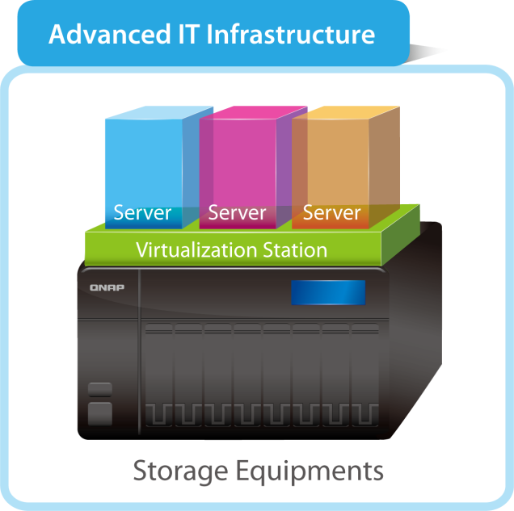
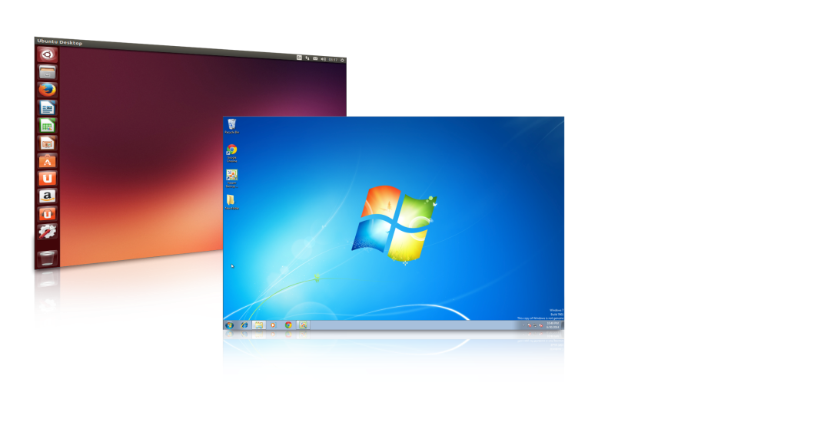
Advanced application: virtual machines
QNAP NAS provides a platform for virtualization to move the current server to run on NAS. It supports various OS, such as Windows and Linux
Virtual machines: backup, snapshot and complete system protection
Bandwidth-saving and secure to access NAS data
Supports connecting USB devices and PCIR to VMs to enable multiple application

Slide 17
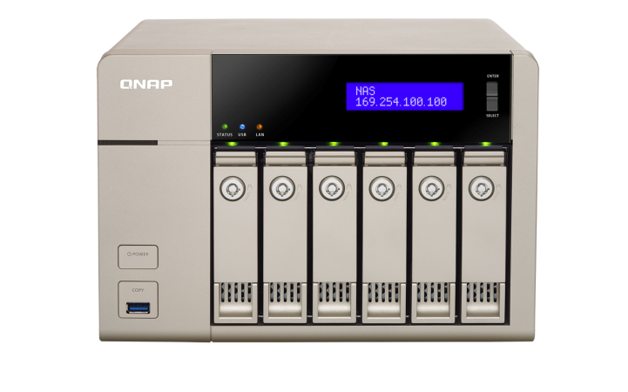
Demo

Slide 18
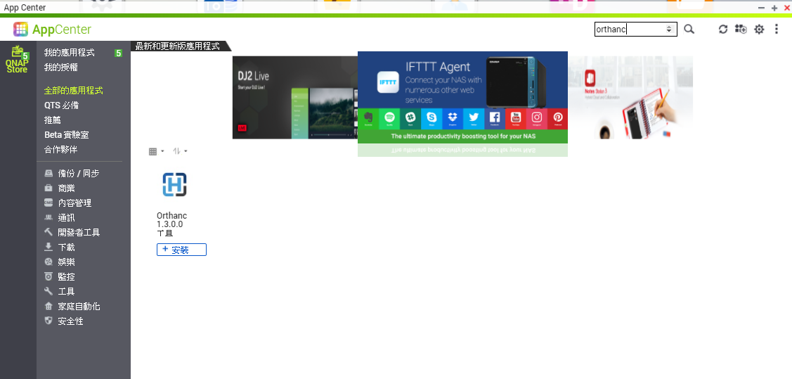
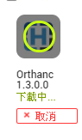
How to download Orthanc (in QTS)
1
2
3
4
5

Slide 19
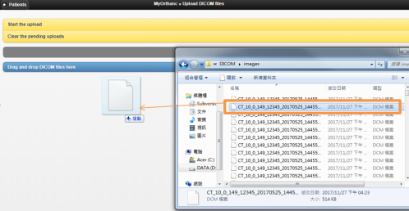
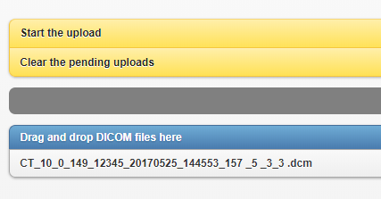
How to use Orthanc
1
2
3
4
Install
Orthanc
App
run
App
Drag & drop
Start to upload
5
finished
installing

Slide 20
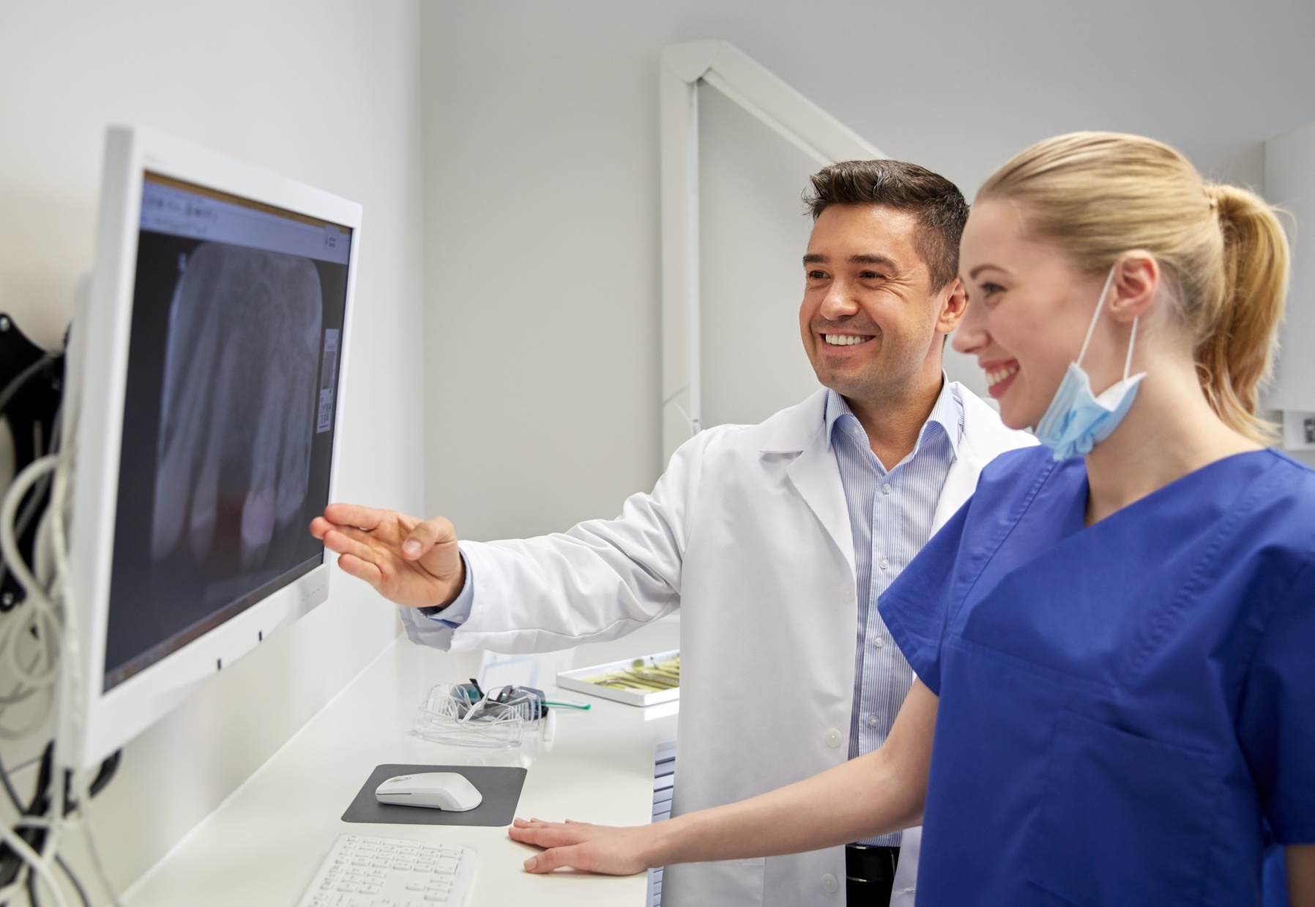
Thank You

