Slide 1

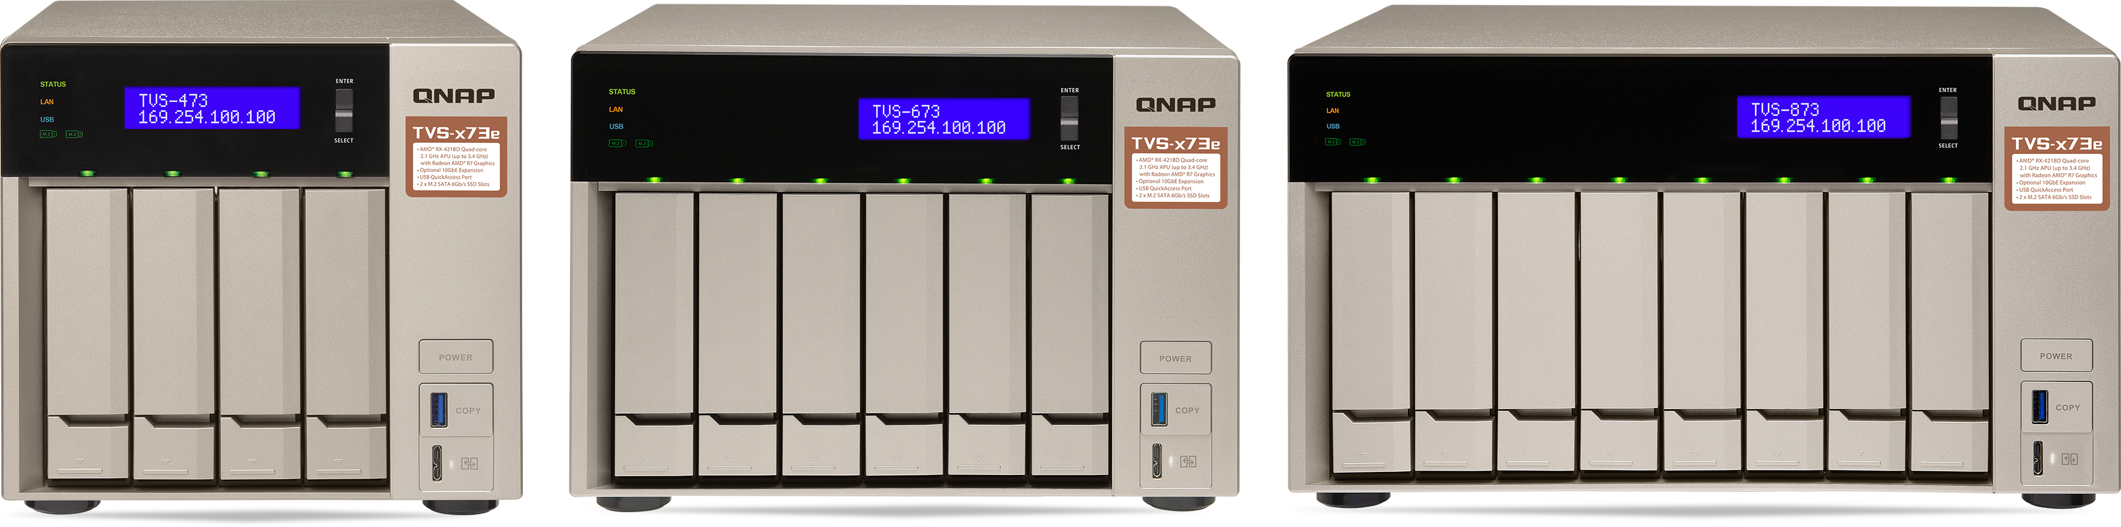



Series
Dual PCIe Gen3 expansion slots & dual M.2 SATA SSD slots
For high expandability and versatile applications
TVS-473e
TVS-673e
TVS-873e

Slide 2
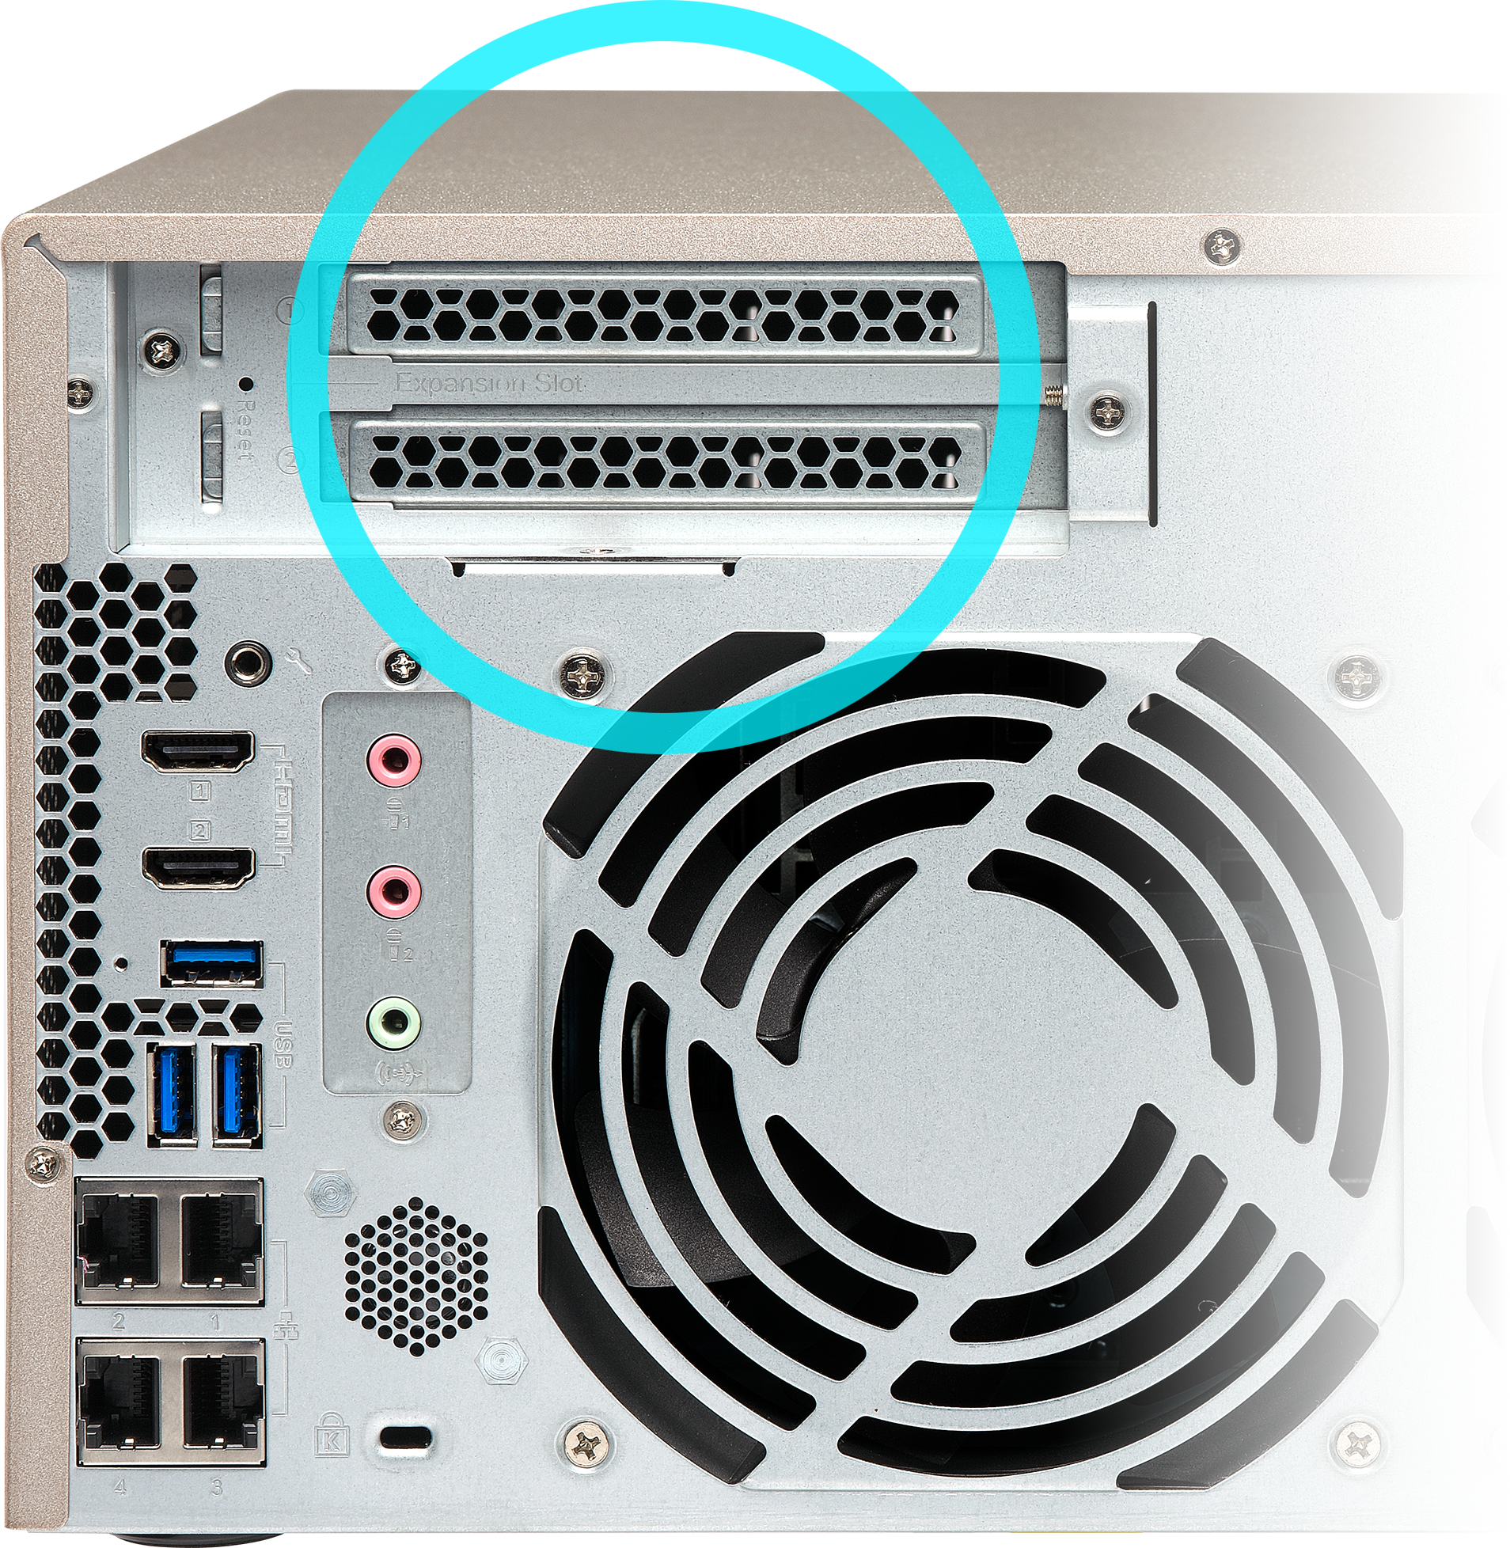
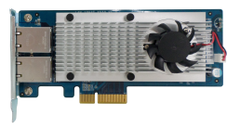
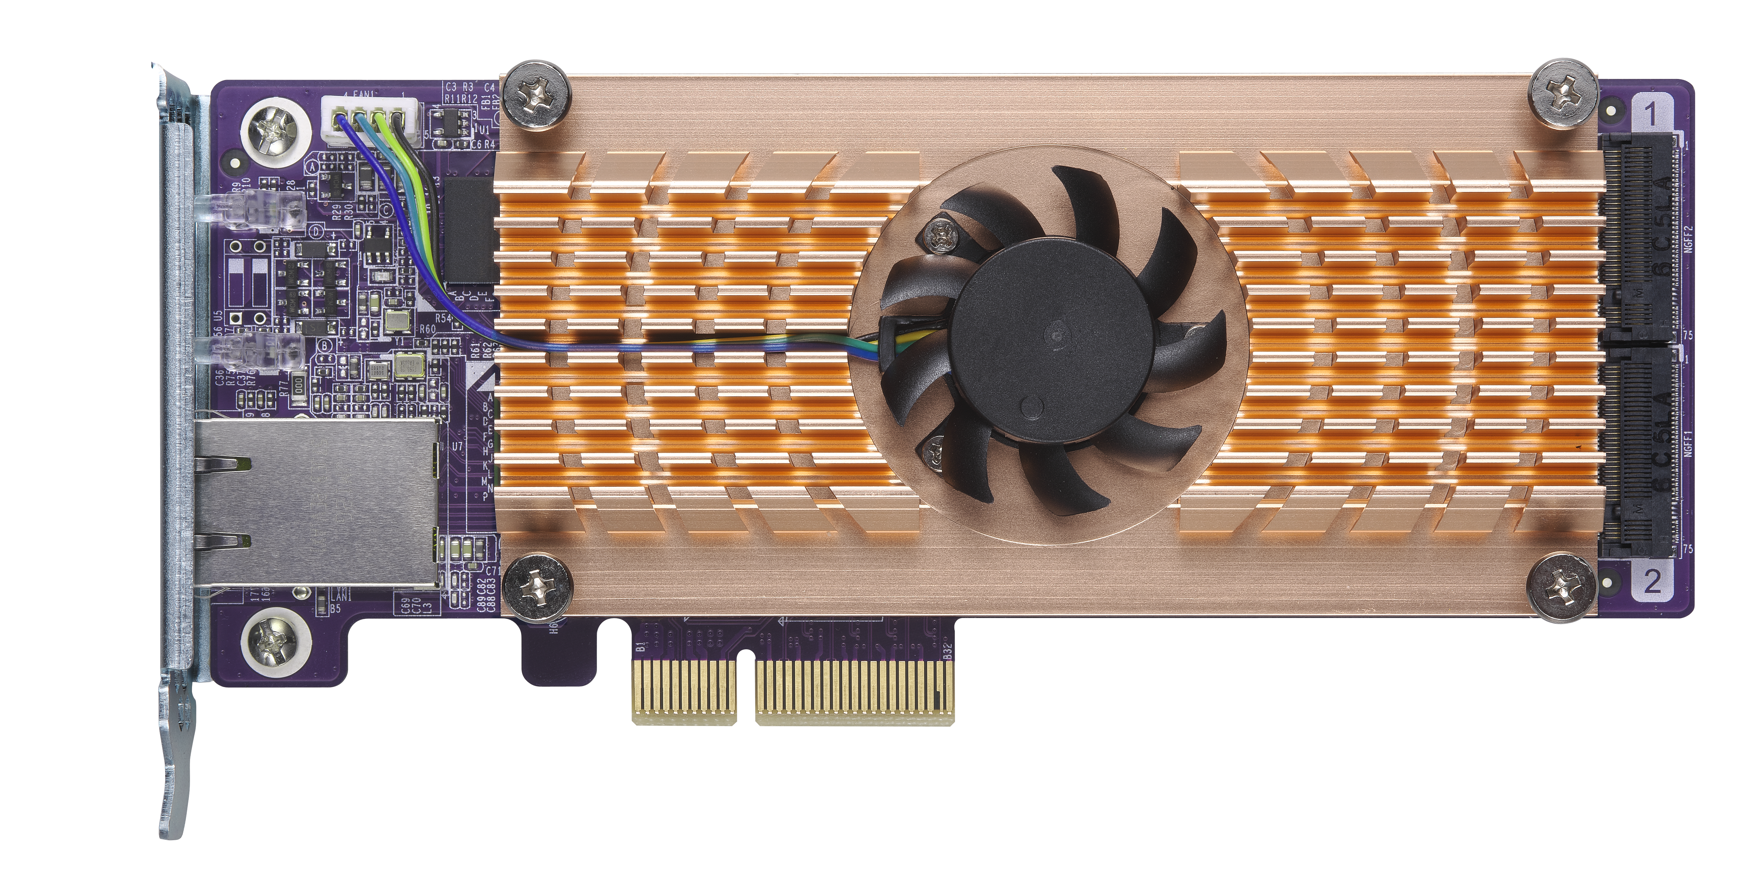
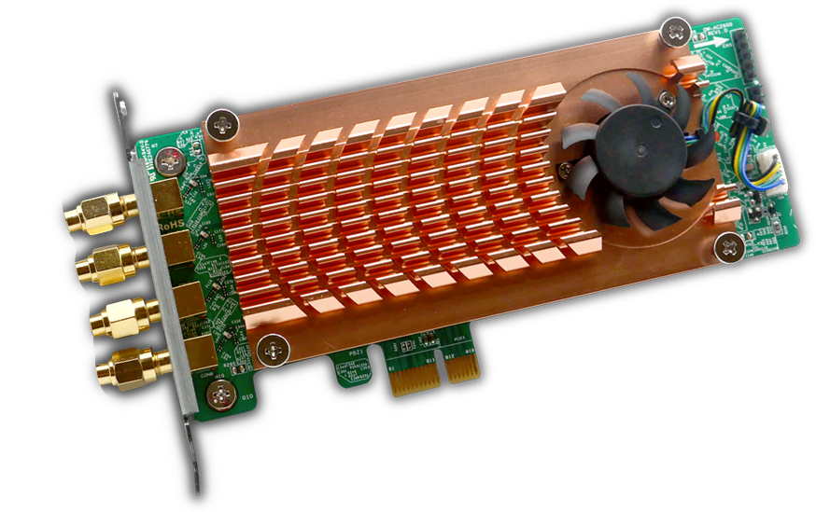
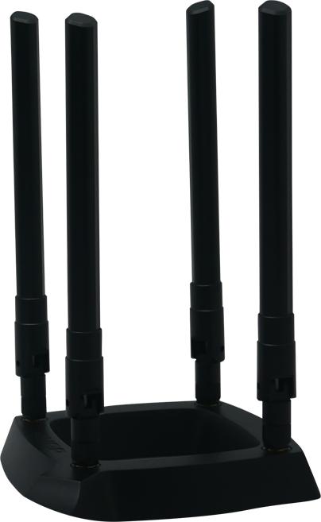
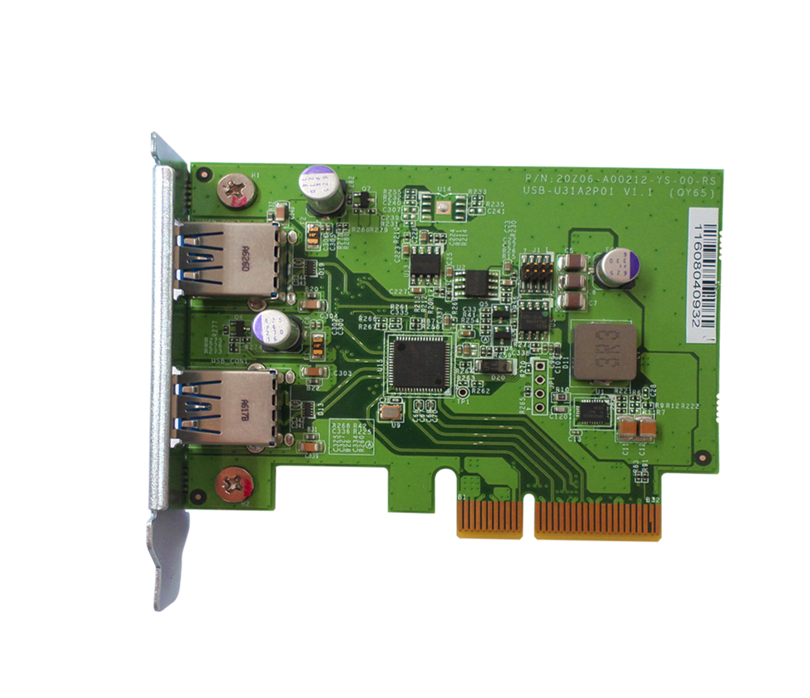
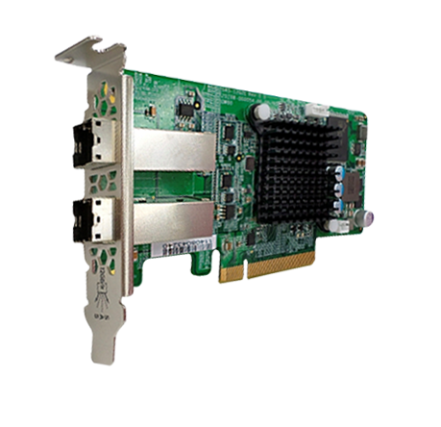
Versatile for most business environments
TVS-x73e supports dual PCIe Gen3 x4 slots for two expansion cards
10Gb/1Gb NIC card
QM2 M.2/10Gb card
QW-AC2600 wireless card
USB 3.1 card (10Gb)
SAS card (12Gb)
Notes:
Add wifi 卡 (圖片請找 coco 拿)
speech: 炒出一手好菜. 客戶自己配套

Slide 3
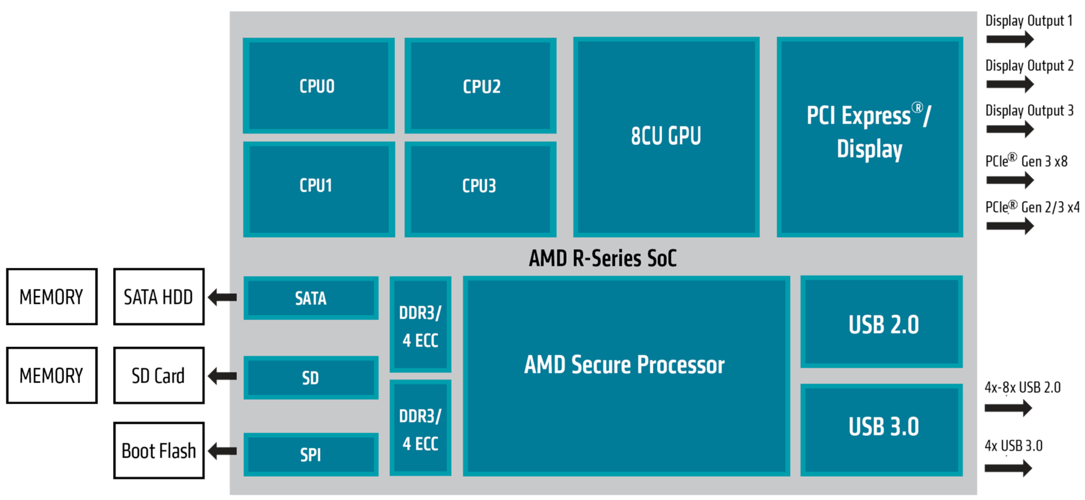
Gen 3 x4 ensuring 10G network bandwidth
AMD R Series diagram
TVS-x73e
Breaks into two Gen3 x4
PCIe slots
Each slot max
32 Gb/s
Source: http://www.amd.com/zh-hant/products/embedded-r-series-soc

Slide 4
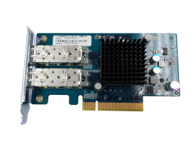
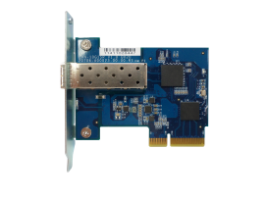
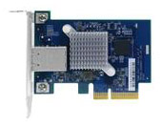

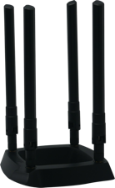
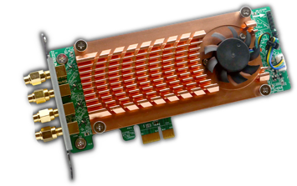
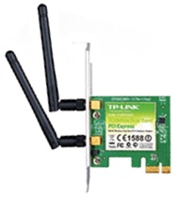
Unleash performance with NIC cards
10GbE/1GbE network card
LAN-10G2SF-MLX
LAN-10G2T-X550
LAN-10G1SR
LAN-10G1TA
LAN-1G2T-I210
Wireless network card
NEW
TL-WDN4800 N900
TL-WDN3800 N600
TL-WN881ND N300
TL-WN781ND N150
QW-AC2600
TP-Link

Slide 5
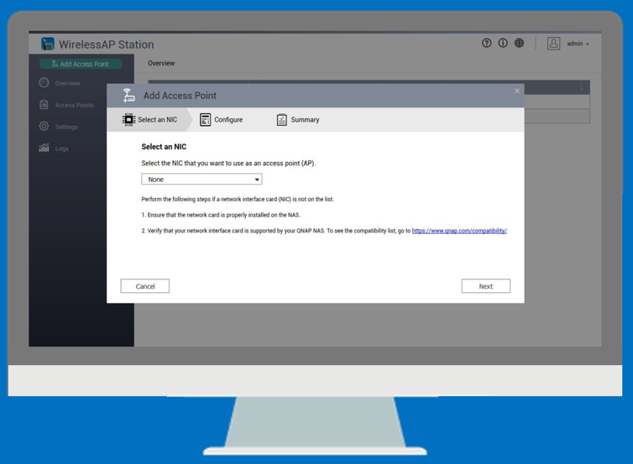
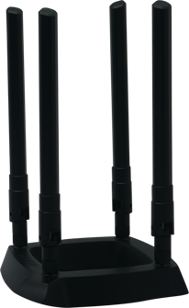
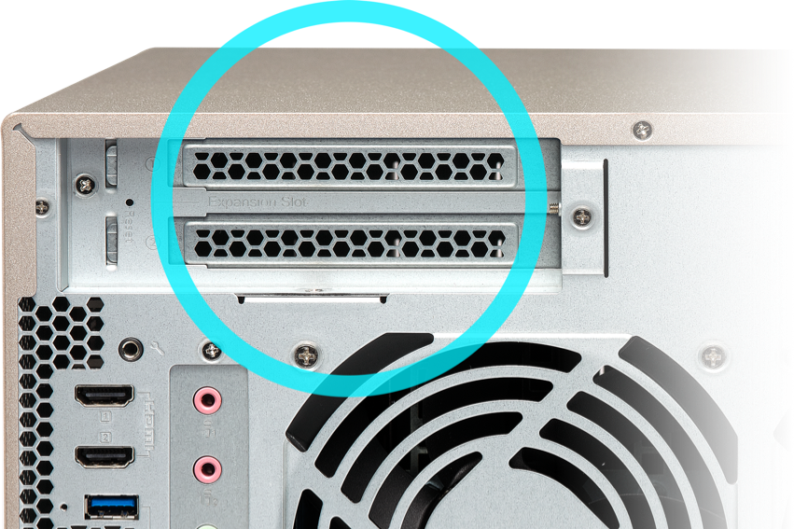



Turn TVS-x73e into a wireless access point
Install WirelessAP Station and devices can connect to NAS wirelessly
Setup isolated wireless connections for max bandwidth ( IoT/VM/Container)
Powerful x86 performance; add more wireless cards to increase bandwidth
QW-AC2600 wireless card
4 x 4 MIMO AC2600
Dual Band Dual Concurrent

Slide 6
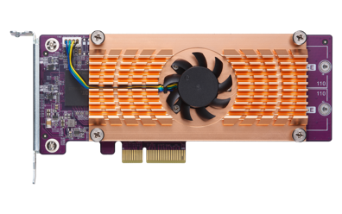
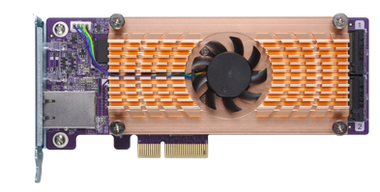
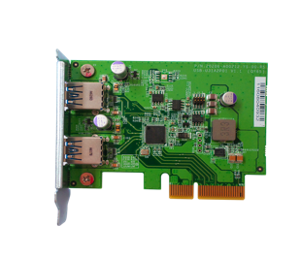
ＱＭ2 card and productivity tools
QM2 M.2 SSD / 10GbE card
QM2-2S
QM2-2P
QM2-2S10G1T
QM2-2P10G1T
USB 3.1 card
SAS 12Gb card
USB-U31A2P01
SAS-12G2E

Slide 7


5 year+ long term support processors
AMD Embedded R Series
TVS-x73e series
TVS-x73e
2 x PCIe slots, best for 4K
multimedia, advanced computing
and high workload
TS-x73U series
TS-x73U
2 x 10GbE SFP+ ports, business-ready
AMD Embedded G Series
TS-x63U series
TS-x63U 系列
TS-x63U
Versatile and energy efficient
1 x 10GbE SFP+ port
* TS-x73U & TS-x63U do not support GPU & HDMI output.

Slide 8
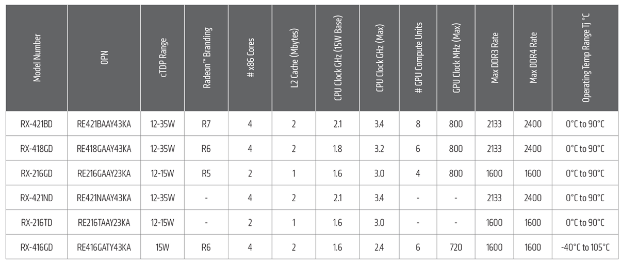

AMD R Series flagship embedded SoC
Source: http://www.amd.com/zh-hant/products/embedded-r-series-soc

Slide 9
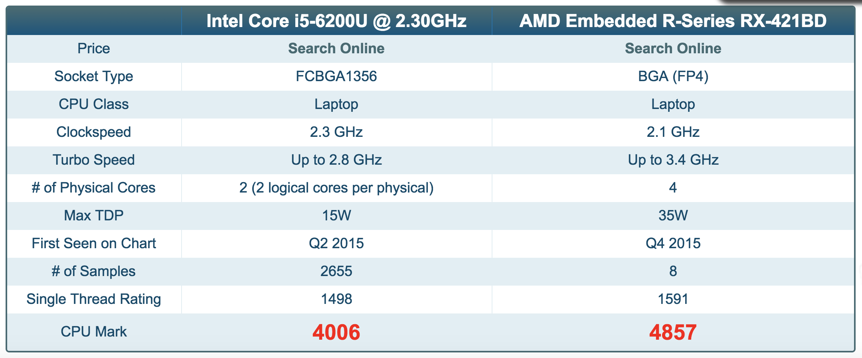

PassMark PerformanceTest™
Win
Intel 6th gen
Skylake U
Source: https://www.cpubenchmark.net/compare.php?cmp[]=2556&cmp[]=2655
Notes:
Skylake U is commonly seen on laptops

Slide 10
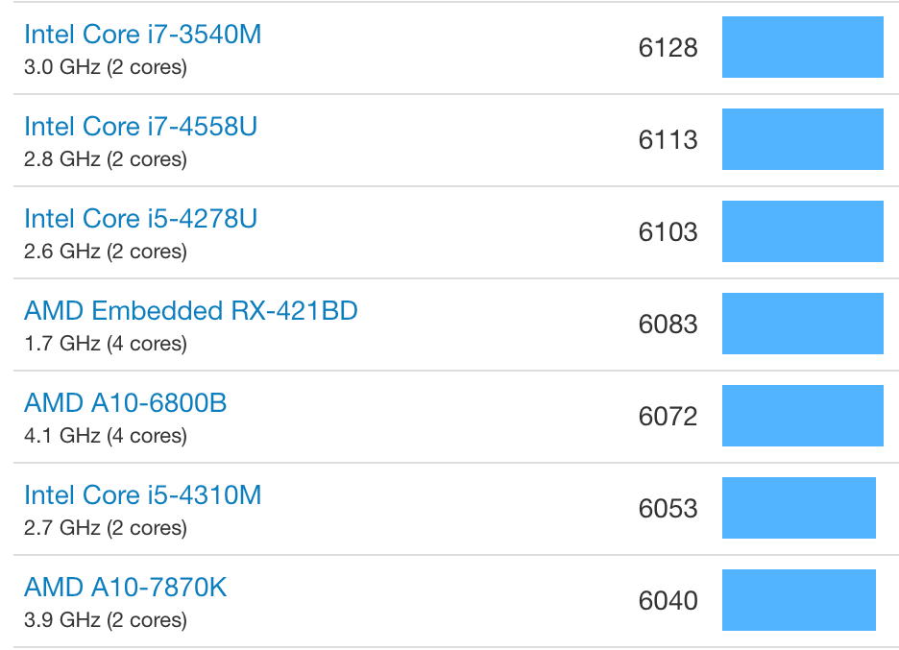
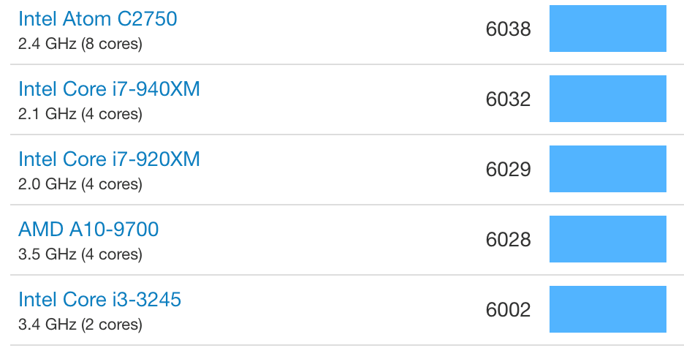
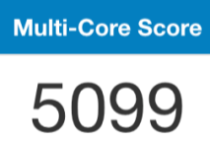

Geekbench 4 CPU multi-core test
Other NAS with
Intel® Pentium®
D1508 dual-core
processor
Source: https://browser.geekbench.com/processor-benchmarks

Slide 11
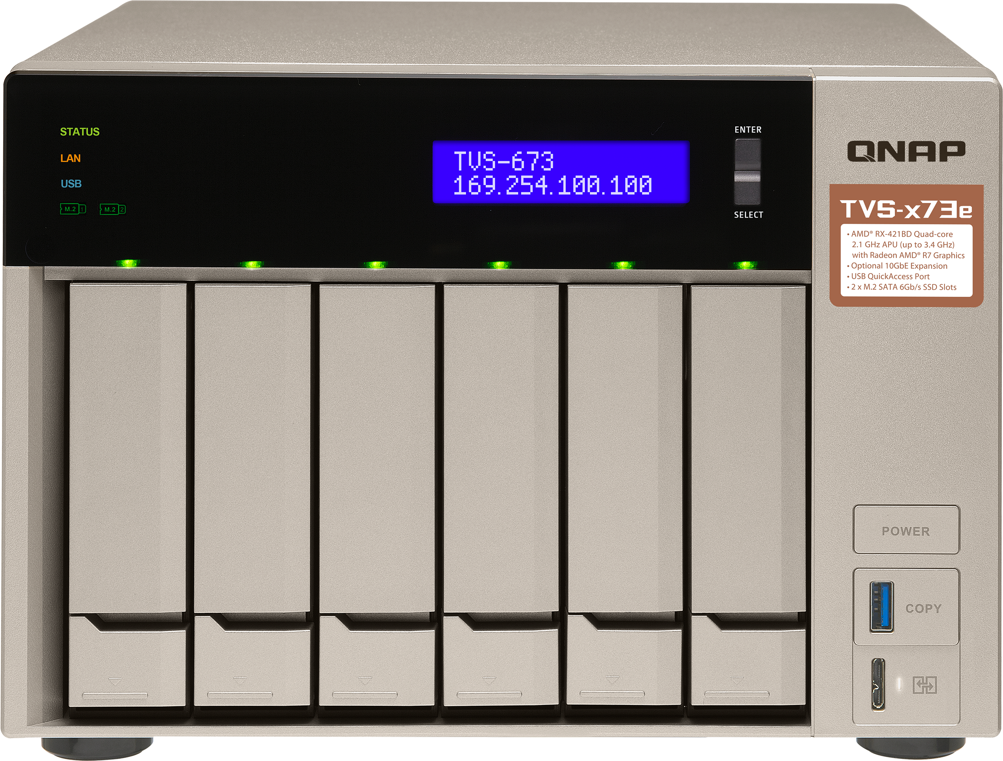
TVS-x73e front view
LEDs: status, LAN, USB, M.2 SSD1,
M.2 SSD2, HDDs
LCD with Enter & Select buttons for status display and operations
IR receiver
(supports RM-IR004 remote control)
Tool-less installation of 3.5” HDDs or screw- secured 2.5” HDDs/SSDs
Power button
USB 3.1 gen 1 port & one-touch copy button
USB QuickAccess

Slide 12
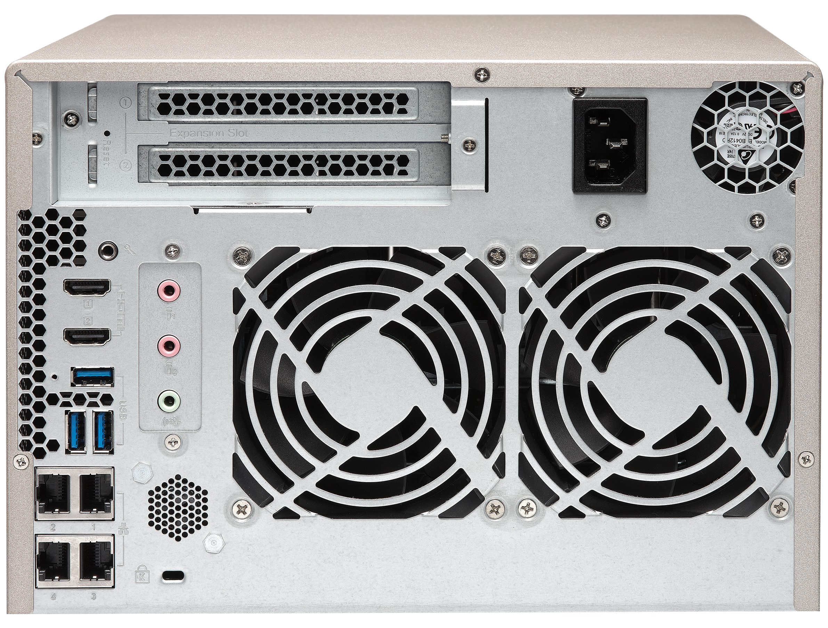
TVS-x73e rear view
2 x PCIe Gen 3 x4 slots
473e supports half-height cards
673e & 873e supports full-height cards
2 x 3.5mm
Dynamic microphone input
& 1 x 3.5mm Line Out
Speaker
2 x 4K HDMI v1.4b
Kensington
security slot
3 x USB 3.1 (Gen1)
4 x Gigabit LAN

Slide 13
QM2 card enhances SSD cache & 10GbE
2 x M.2 2280 /2260
SATA 6Gb/s SSD slots
SSD cache or storage space
Qtier auto tiering
Independent thermal sensors
QM2 card provides 2 x M.2 SSD, combined with the two M.2 SATA SSD slots on x73e to form a RAID 5 pool/volume for better protection and performance.

Slide 14
Large 64GB DDR4 RAM for huge projects
4 x DDR4 SODIMM
Memory slots, max
4 x 16GB
4GB RAM (2 x 2GB)
8GB RAM (2 x 4GB)
TVS-473e-4G
TVS-673e-4G
TVS-873e-4G
TVS-473e-8G
TVS-673e-8G
TVS-873e-8G
*ECC 與非 ECC 記憶體不可混用．
Notes:
右下角會被人頭擋住

Slide 15
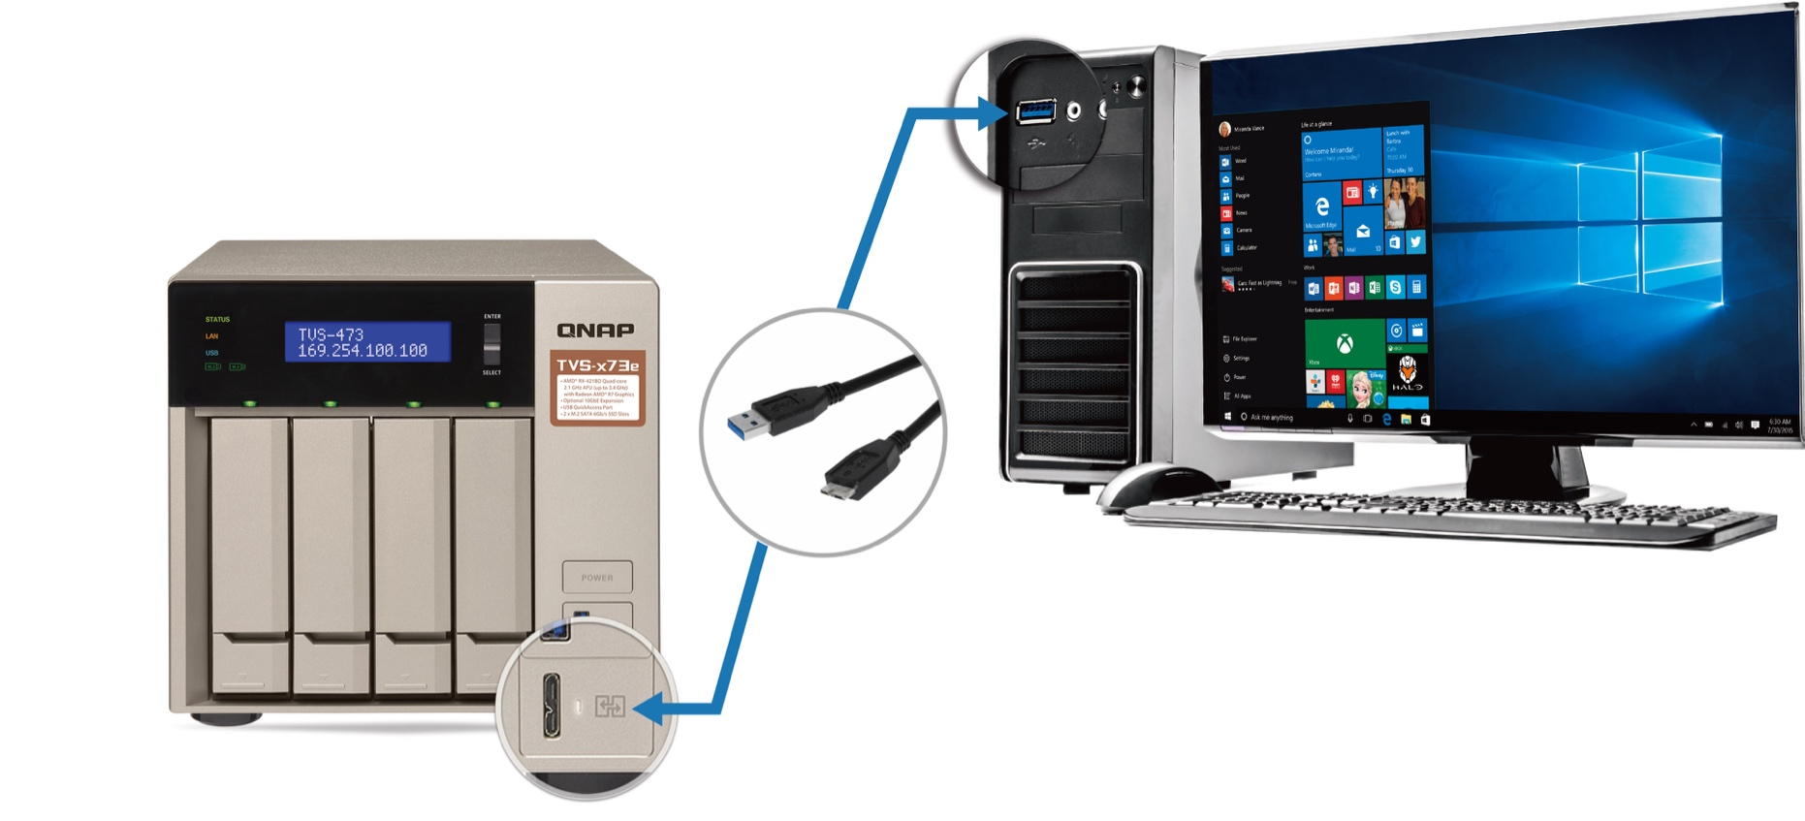
USB QuickAccess for direct USB connection
Direct connection between PC/MAC & NAS
1st time setup
Up to
100 MB/s!
Data transfer
To
computer
To NAS

Slide 16
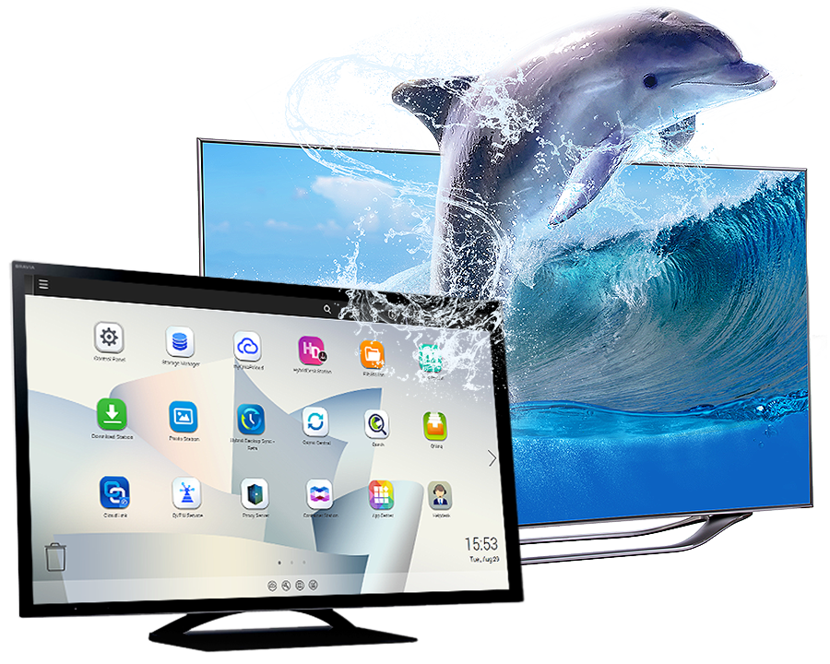


Radeon™ R7 brings solid graphics power
4K Video
4K H.264 video playback & transcoding
800 MHz
Radeon R7
3rd gen GCN GPU
Supports optional QNAP
RM-IR004 QButton remote control!
RM-IR004
Playback quality may vary due to factors including playback software, file formats, system usage, and available bandwidth.

Slide 17


QTS & virtualization increases productivity
All-new QTS 4.3.4 Storage & Snapshot Manager, and multimedia management
Supports Windows/Linux VMs & containers
Virtualization Station
Container Station

Slide 18


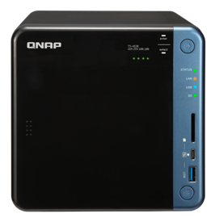
24/7 surveillance center
Surveillance Station 5.1
Free: 4
Max: 72 (optional license purchase)
QVR Pro Beta
Up to 124 free channels during the beta period
QUSBCam2
Up to 1080p USB webcam recording
* Refer to QNAP website for QVR Pro channel information when it becomes official.

Slide 19
TVS-x73e Live Demo
Upgrade memory &
Install M.2 SATA 6Gb/s SSD
Install QM2 & 10 GbE PCIe expansion cards
1
1
Remove the top cover
Remove the top cover
2
2
Move aside the power supply unit
Upgrade the components
3
Install the PCIe cards

Slide 20
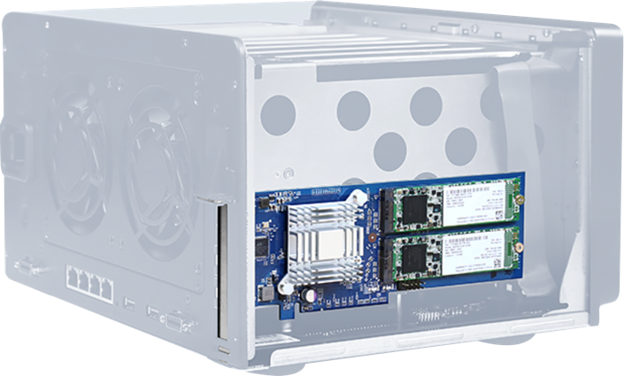
Why 2 PCIe slots are better than 1
QNAP 6-bay TVS-673e
Dual PCIe slots, can support QM2 M.2 SSD & 10GbE cards. Not to mention the onboard 2 x M.2 SATA SSD slots
Synology 6-bay DS3018xs
One PCIe slot have to give up M.2 SSD or 10GbE

Slide 21
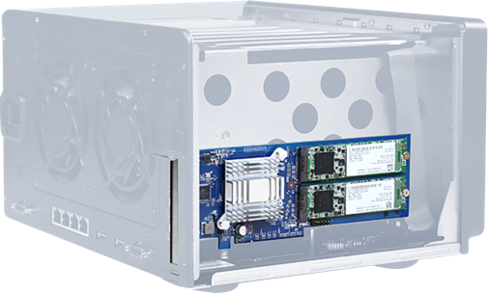
Test #1: iSCSI 10GbE Performance
QNAP TVS-673e
HDD: 6 x 2.5” SSDs, QTS: 4.3.4.0427
PCIe #1: 2-port 10GbE SFP+ card
(LAN-10G2SF-MLX)
Synology DS3018xs
HDD: 6 x 2.5” SSDs, DSM 6.1.4-15127
PCIe: 2-port 10GbE SFP+ card
(E10G17-F2)

Slide 22
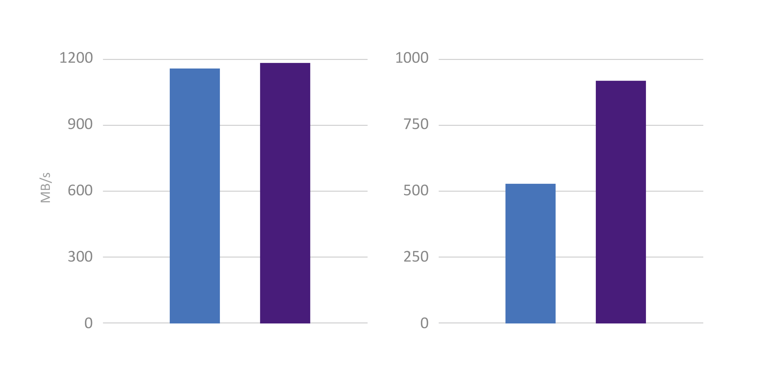
Test #1: iSCSI 10GbE Performance
IOmeter iSCSI Performance
1177
Up to 3.4GHz CPU
for 55%+ boost!
1166
918
587
Synology DS3018xs
QNAP TVS-673e
Synology DS3018xs
QNAP TVS-673e
Sequential Read (SR-2M)
Sequential Write (SW-2M)
Test in the QNAP lab.
Environment: NAS with 6 x Intel SSDSC2BB240G4 RAID 5, 8GB RAM
Client: Intel Core i7-4700 3.4GHz, RAM cache, Windows 10
IOmeter: Max Disk Size: 67108864, 20-workers, 1-outstanding, 30-sec ramp up time, 3-minute run time.

Slide 23
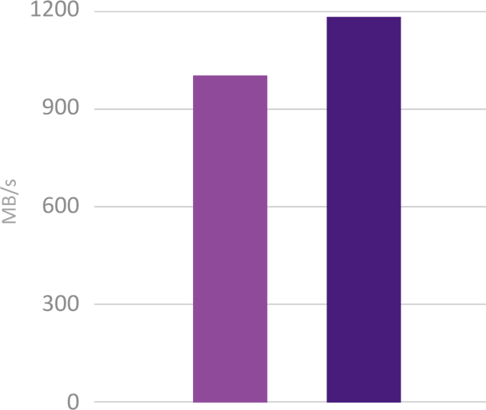
Test #2: Qtier Accelerating 10GbE
QNAP TVS-673e
HDD: 3 x 1TB SATA HDDs, RAID 5
M.2 SATA SSD port: Install 2 x 256GB M.2 SATA SSDs
PCIe #1: 2-port M.2 SATA SSD card (QM2-2S)
Install 2 x 256GB M.2 SATA SSDs
PCIe #2: 2-port 10GbE SFP+ card (LAN-10G2SF-MLX)
4 x M.2 SSDs for Qtier RAID 5 tier
With SATA HDDs, M.2 SSDs and Qtier for the best performance
1178
992
Write
Read
Performance

Slide 24

360° Panorama
Photos & Videos

Slide 25


Trend of 360 ° panoramic photo and video
Record surrounding scenes
Easily take
360-degree photos
實機演練
Wide-angel group picture
More surreal views

Slide 26



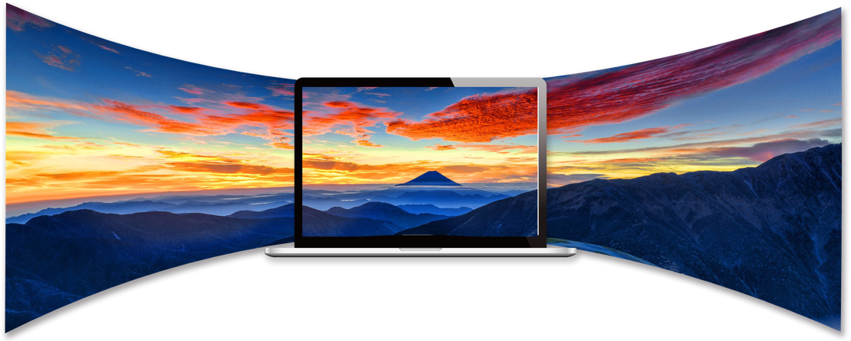

Panorama mode, experience a whole new world
360-degree view in panoramic mode, Keep all the good memories
Support panoramic mode in File Station, Photo Station or Video Station
Google Cardboard
Google Daydream View
Samsung Gear VR
Xiaomi VR Play 2

Slide 27

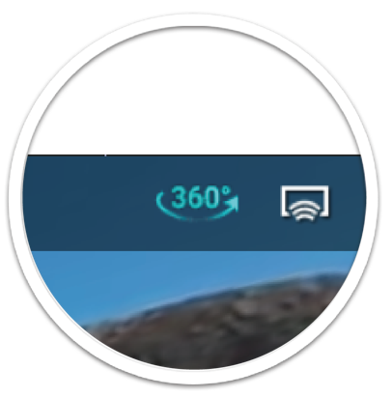
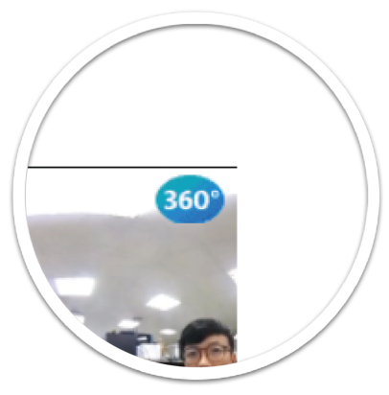
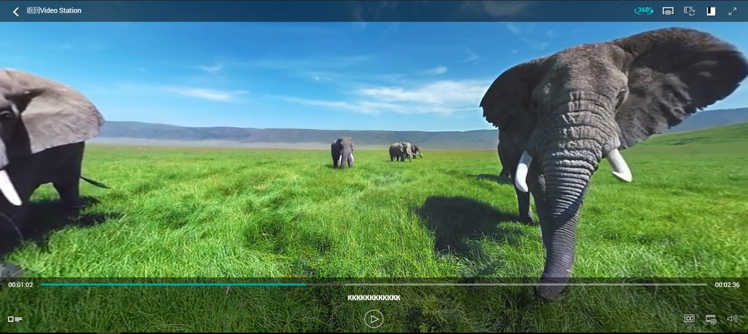
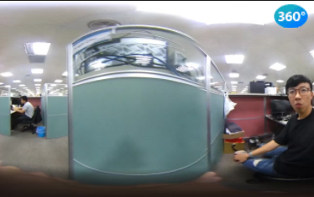
360° Panorama Mode
Supports manually switching to
360-degree panorama mode
Video Station will automatically recognizes videos taken with a 360-degree camera and automatically enables panorama mode when browsing

Slide 28
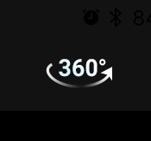
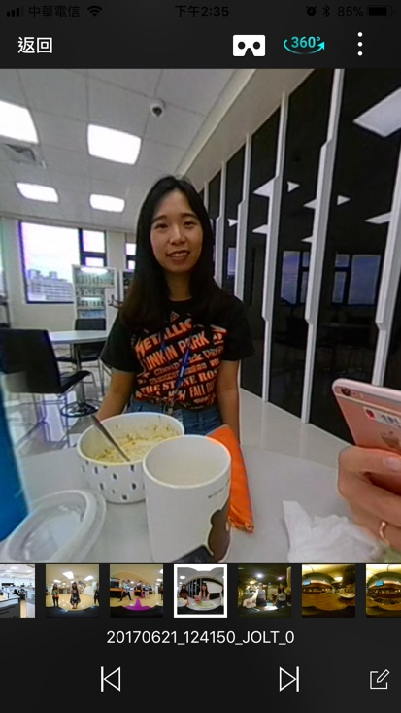
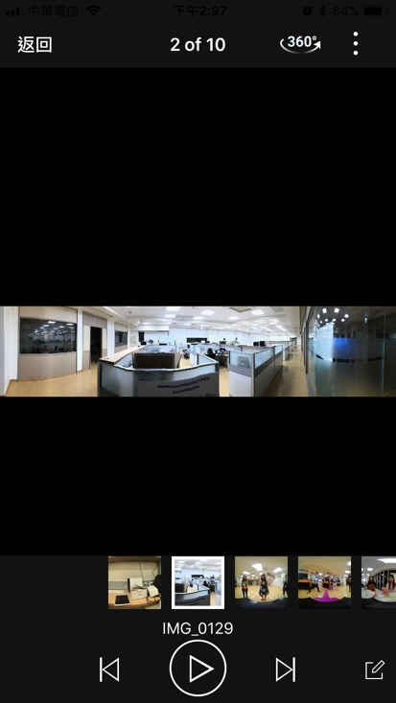

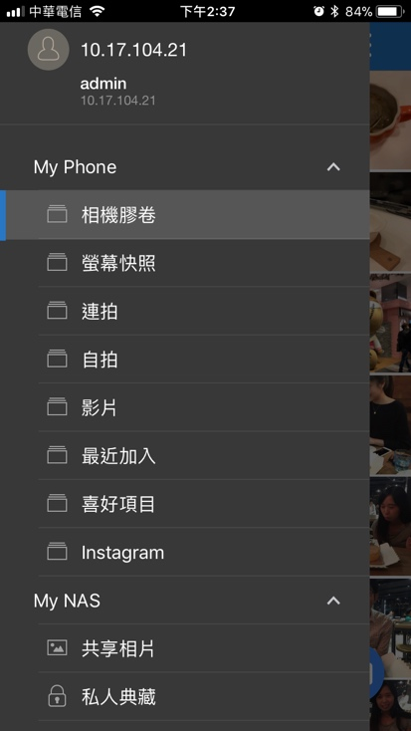
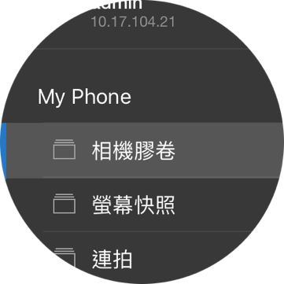
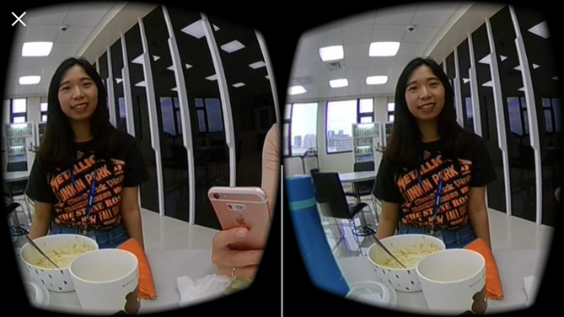



360° Panorama mode in mobile apps
Automatically detects 360° files, and supports VR mode
Also supports the panorama mode for local files
Qphoto
Qvideo
Qfile

Slide 29




360° photo/video Demo
Live
Live

Slide 30
Expandable & more economical
TVS-x73e
TVS-x73
處理器
AMD RX-421BD quad-core 2.1 GHz, Turbo Core to 3.4 GHz
Processor
Memory
4GB, 8GB
(Easily upgradeable to 64GB)
8GB, 16GB, 64GB
M.2 SSD 埠
2 x M.2 2280/2260 SATA 6Gb/s port
M.2 SSD Port
2 x PCIe 3.0 x4
(Upgrade NAS functionality at anytime)
2 x PCIe 3.0 x4
(Bundle a USB 3.1 card)
PCIe Slots
IR Remote Control
Optional
Budled
HDMI Port
2 x HDMI v1.4b 4K UHD, 30Hz

Slide 31
Thank you!

