Slide 2
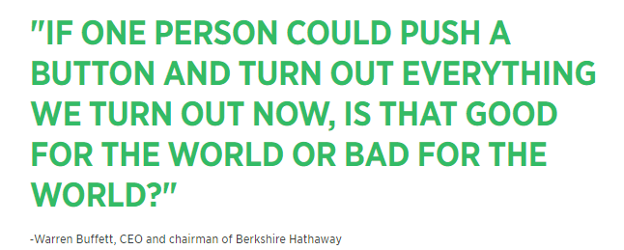
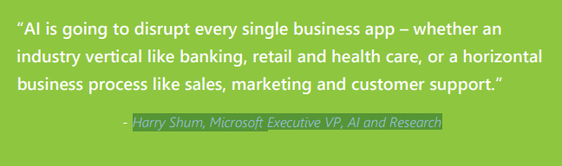
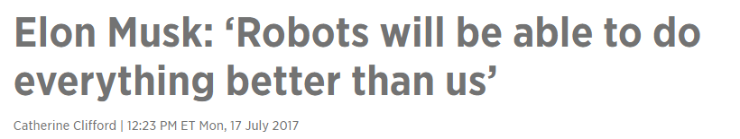
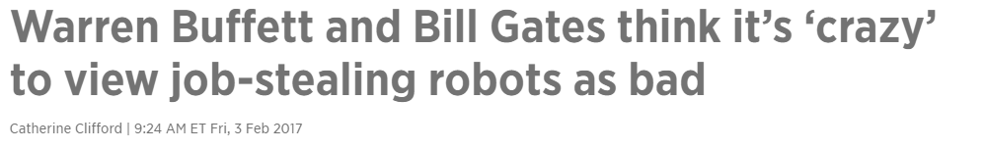
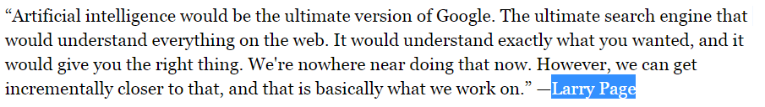
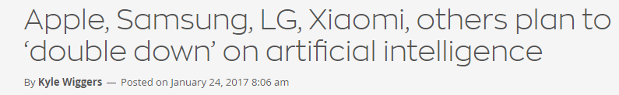
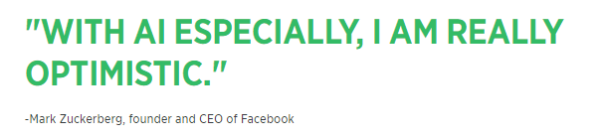
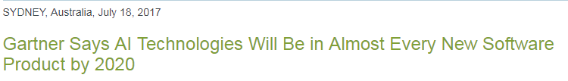
Everyone is talking about AI

Slide 3
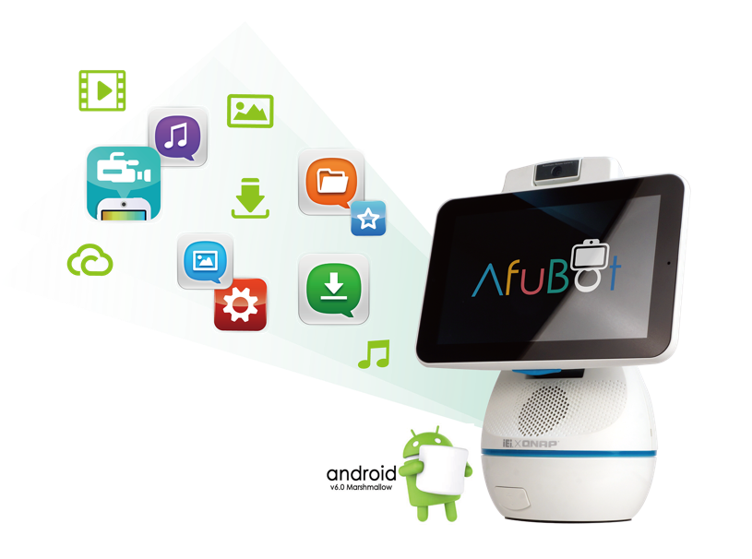
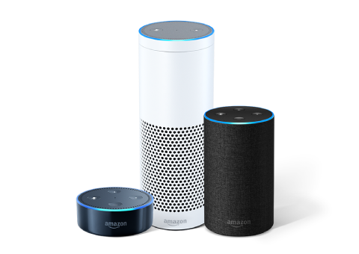
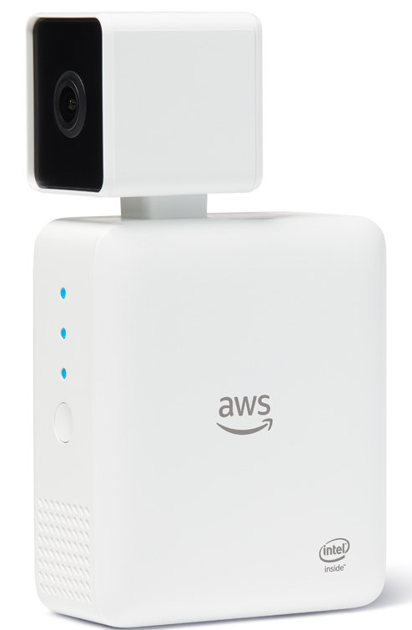
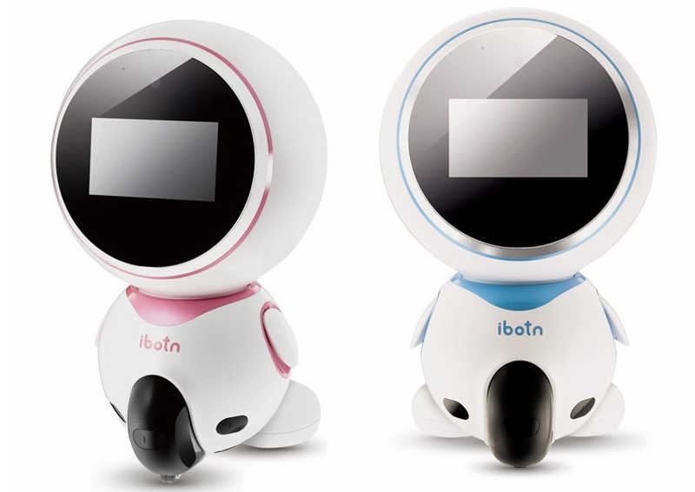
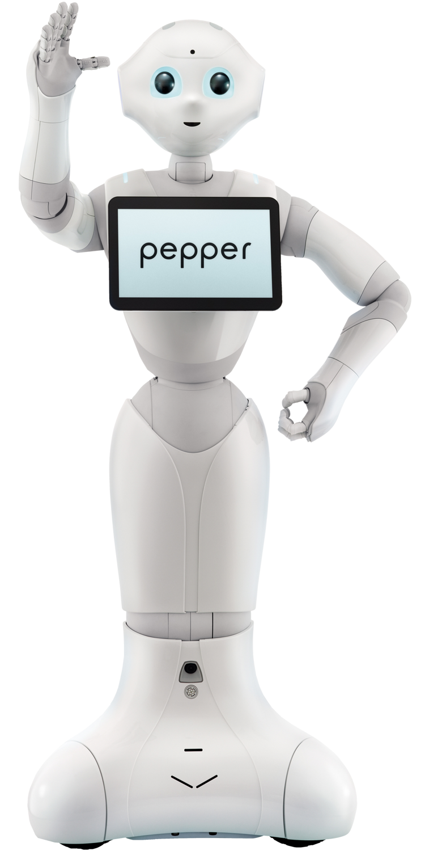


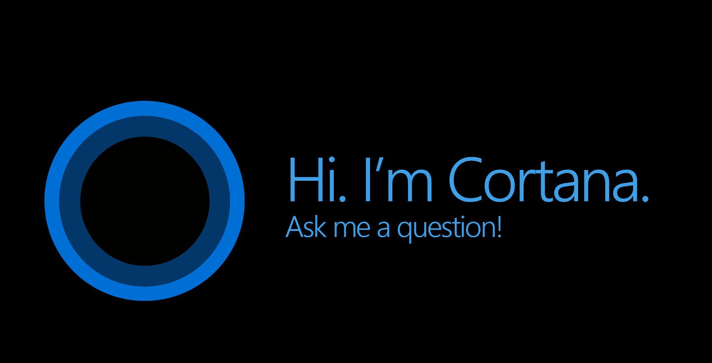
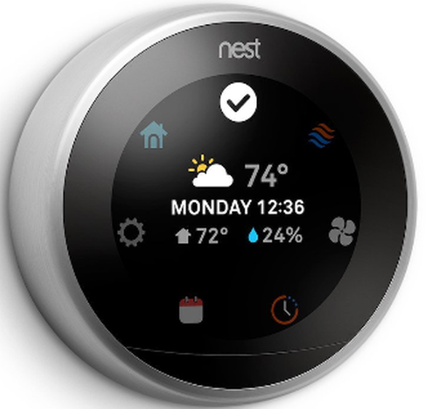
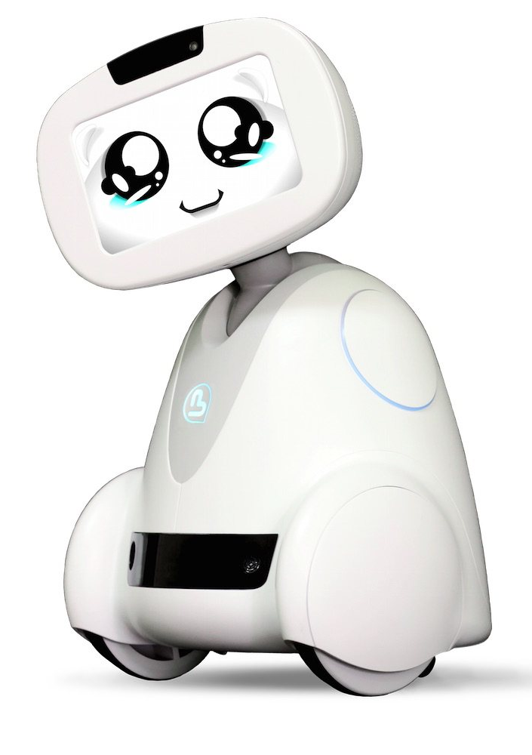
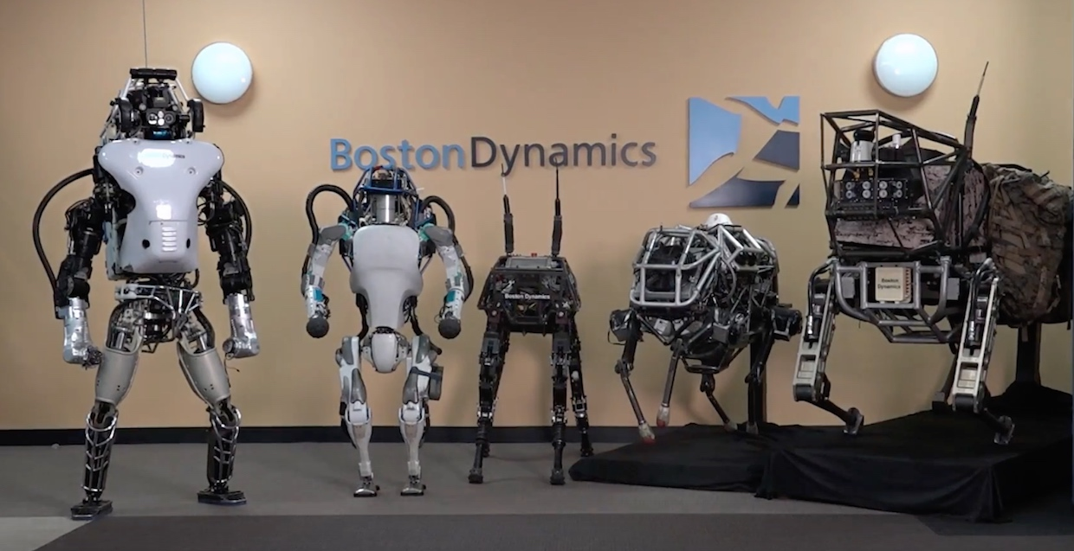


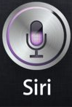
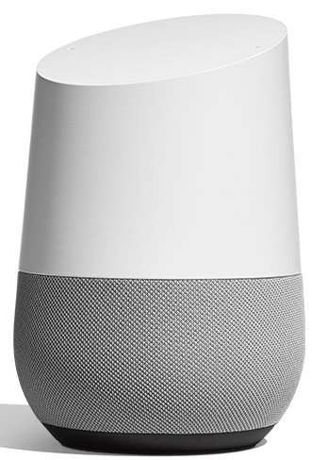
The AI Era is here…

Slide 4


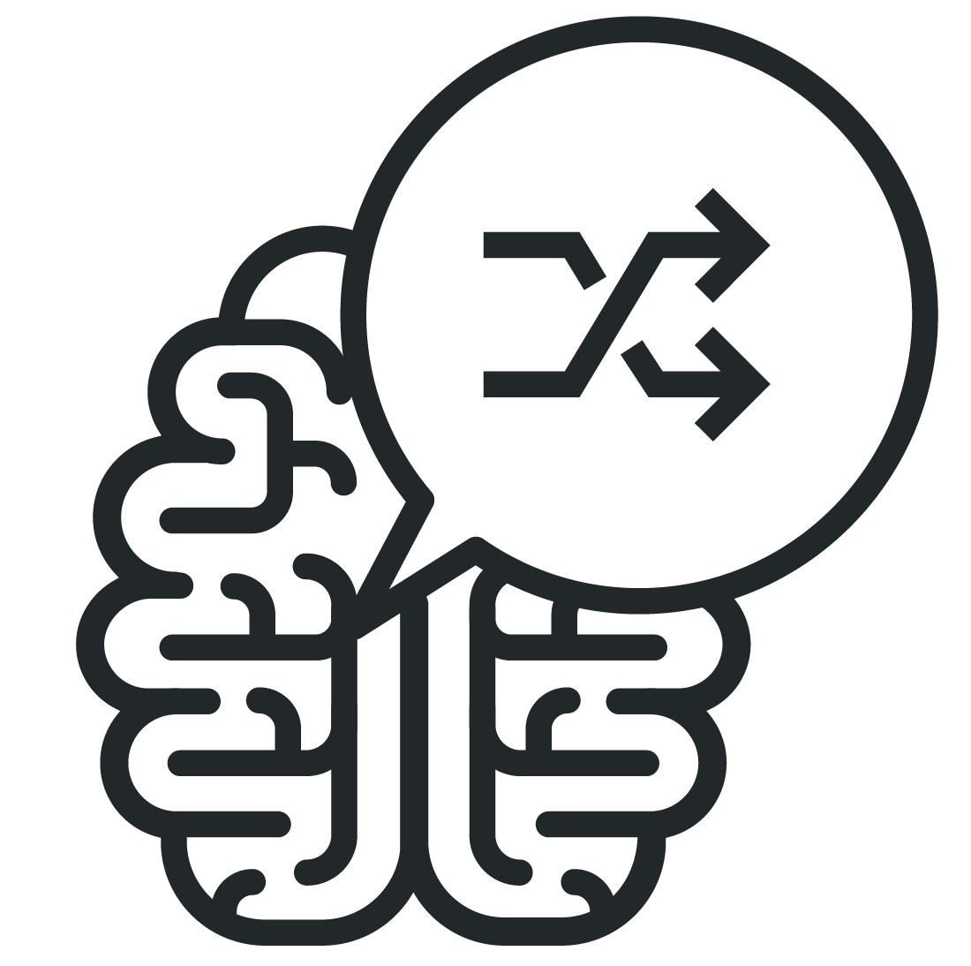
AI/ML/DL: the buzzwords…
AI
Artificial Intelligence
ML
Machine Learning
DL
Deep Learning
Artificial intelligence is a branch of science which is into making machines think like humans.
Machine Learning is a collection of algorithms that can learn from and make predictions based on recorded data, optimize a given utility function under uncertainty, extract hidden structures from data, and classify data into concise descriptions.
Deep Learning is a branch of machine learning that involves layering algorithms in an effort to gain greater understanding of the data.

Slide 5
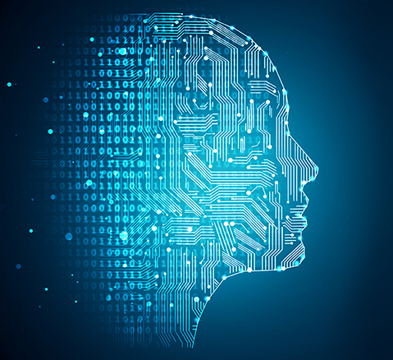

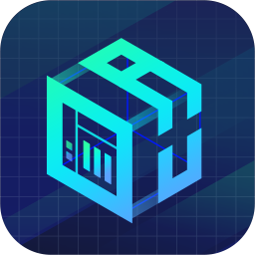
Ride the AI wave with "QuAI" from QNAP
QuAI
AI Developer Package
Is intended for data scientists and developers to quickly build, train, and optimize their AI Models on QNAP NAS.
+
=
QNAP NAS
QuAI
AI

Slide 6
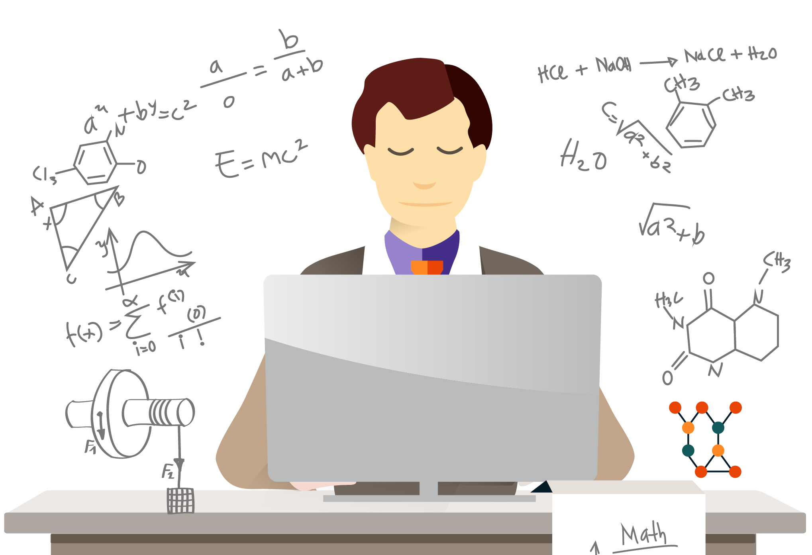


Who is it for ?
Data Scientists
Engineers
Students

Slide 7

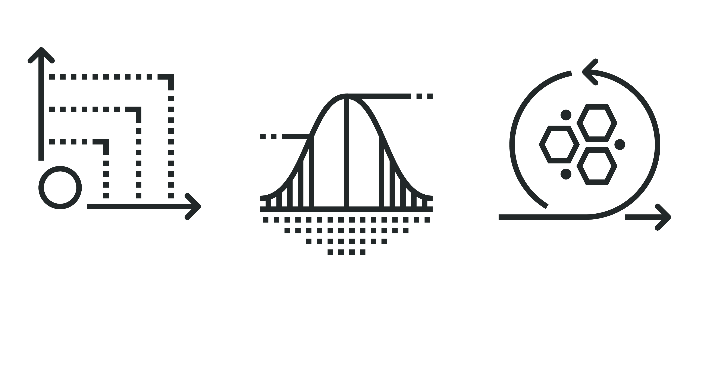
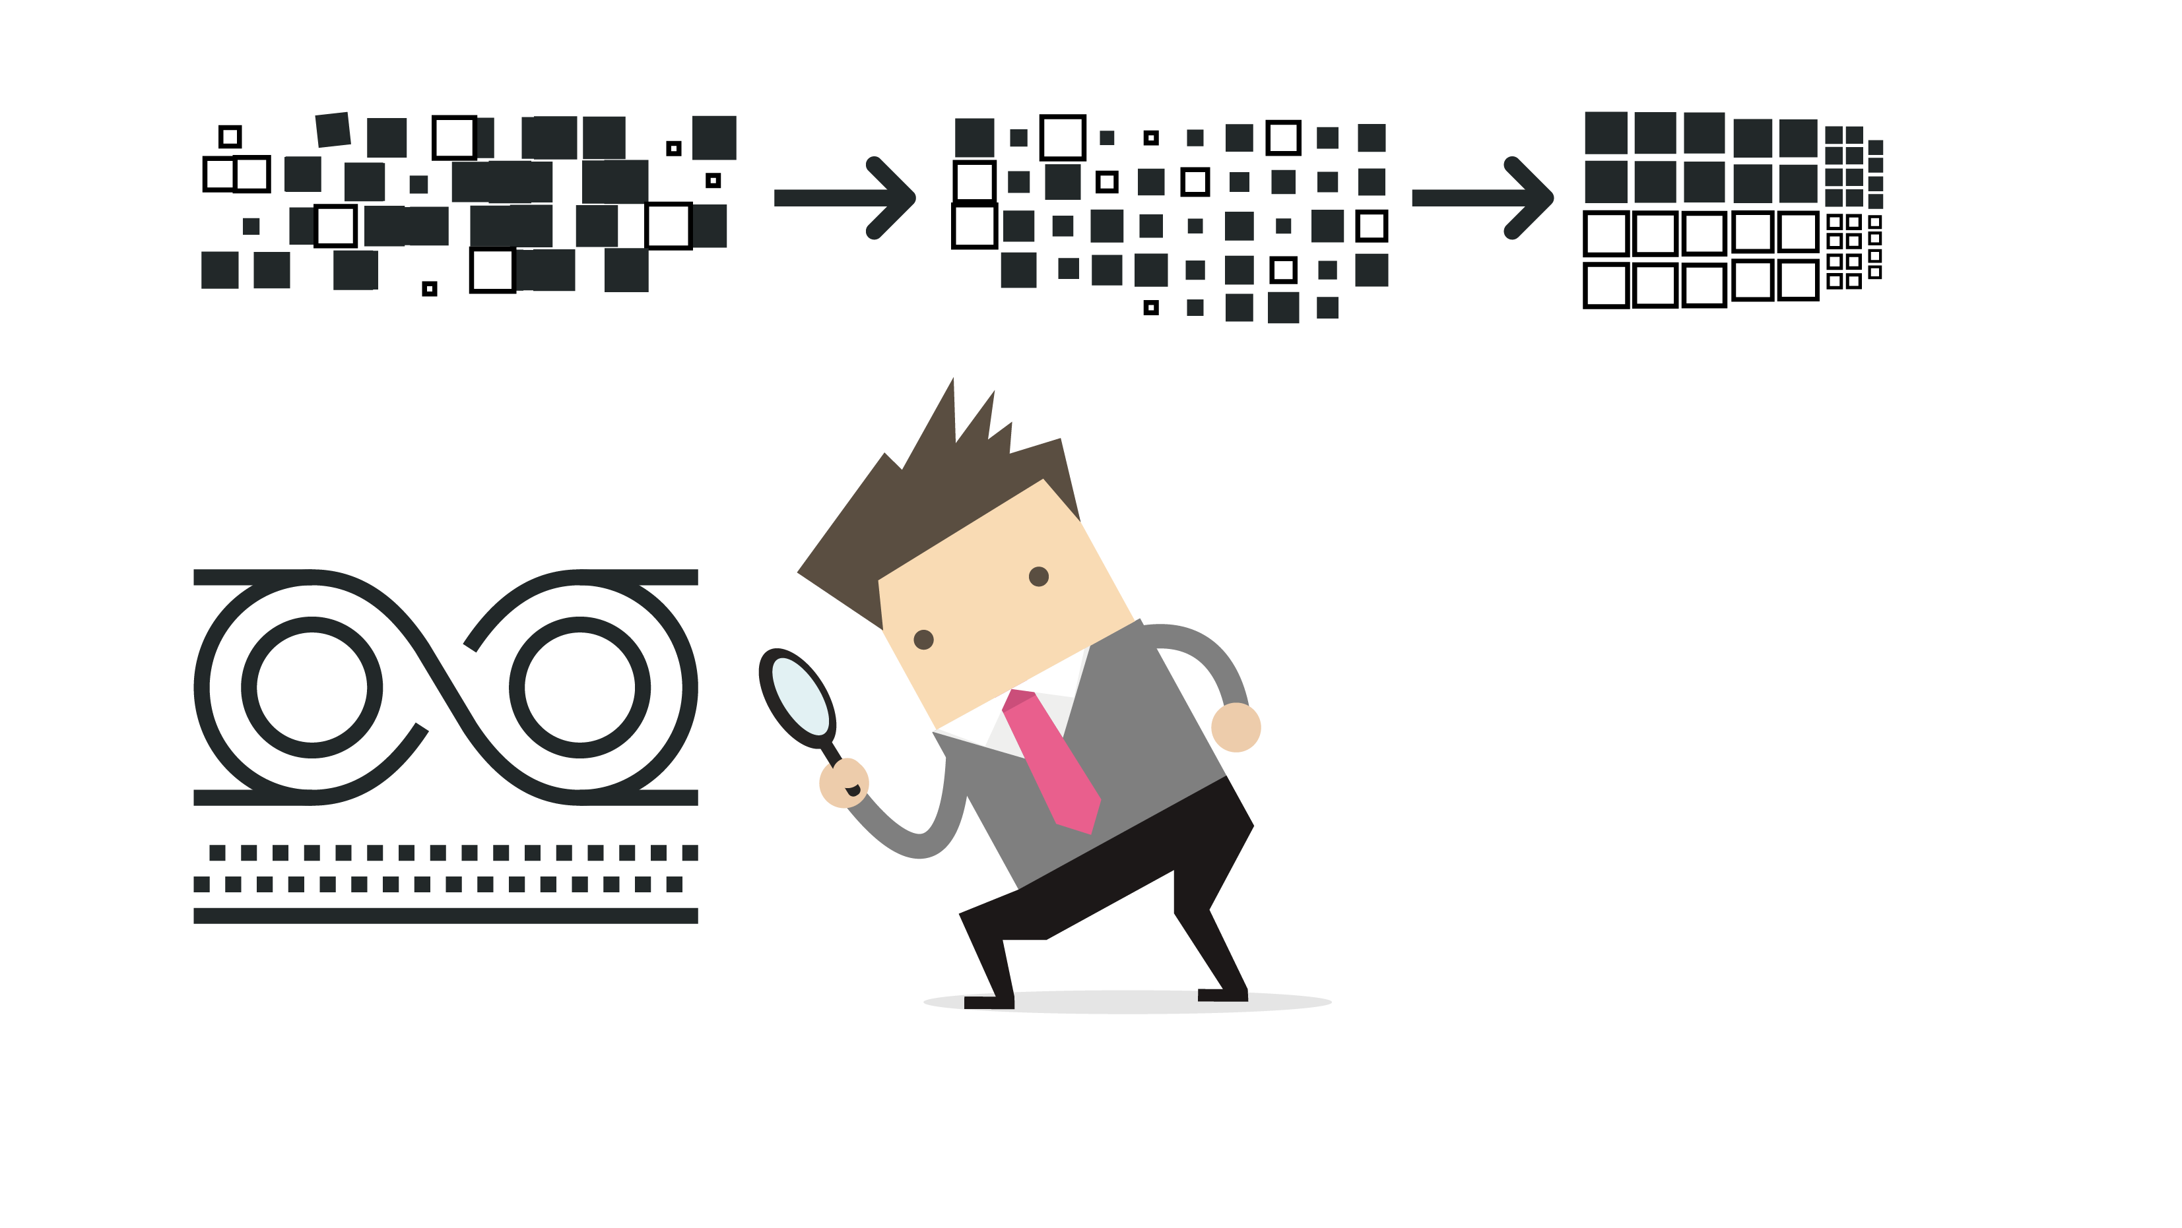

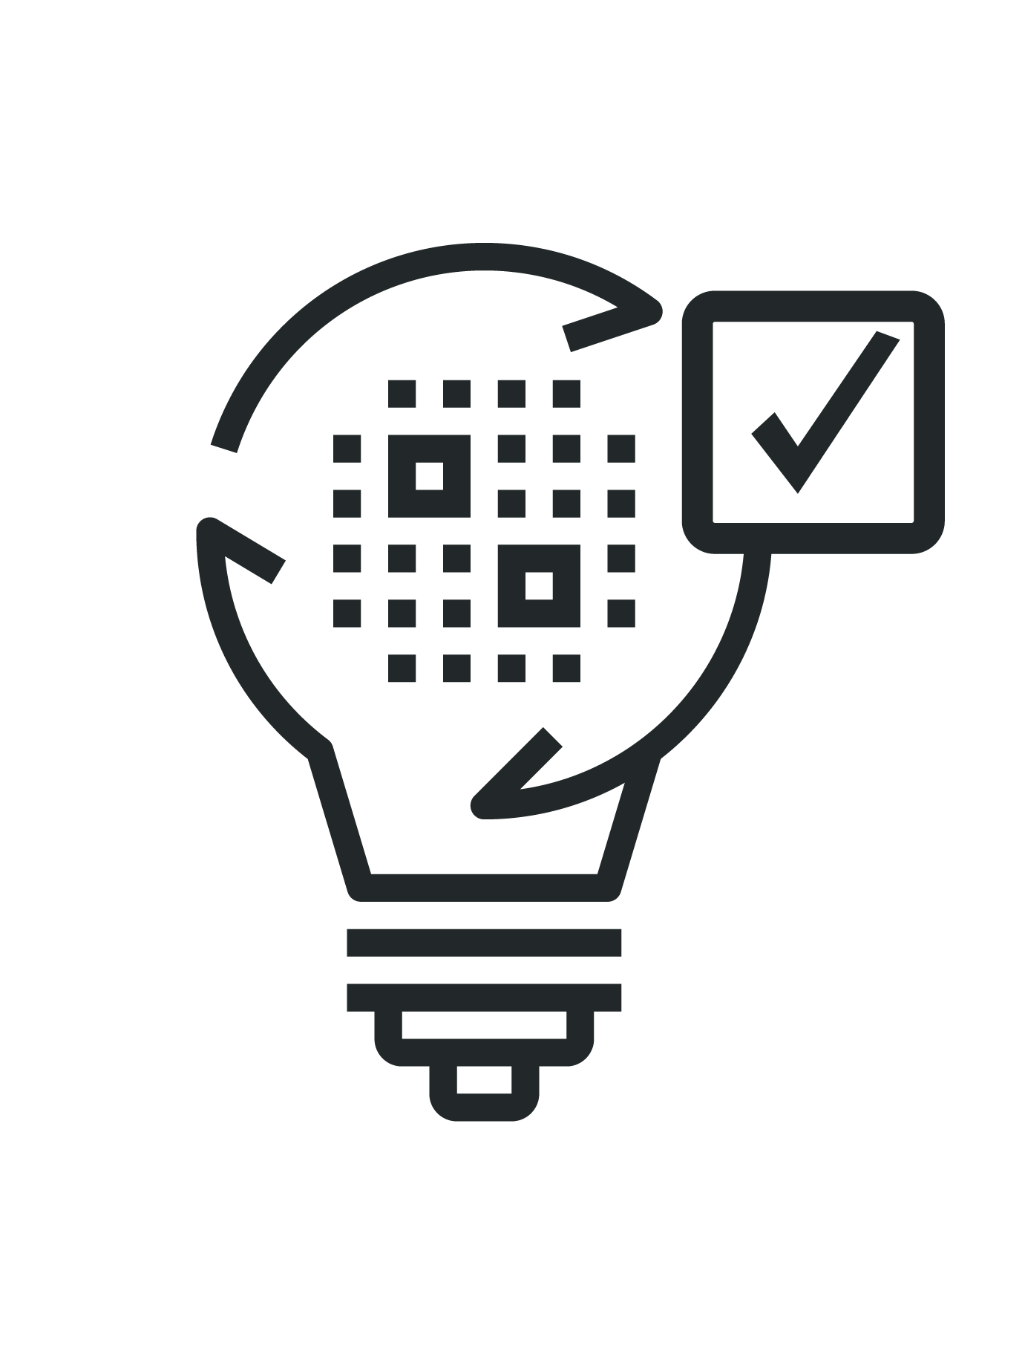
Deep Learning Application Development Process
Data Scientist is presented with business goal
He puts together dataset and target to accomplish that business goal
He goes through iterative process to build and optimize models/algorithms
ＯＫ

Slide 8
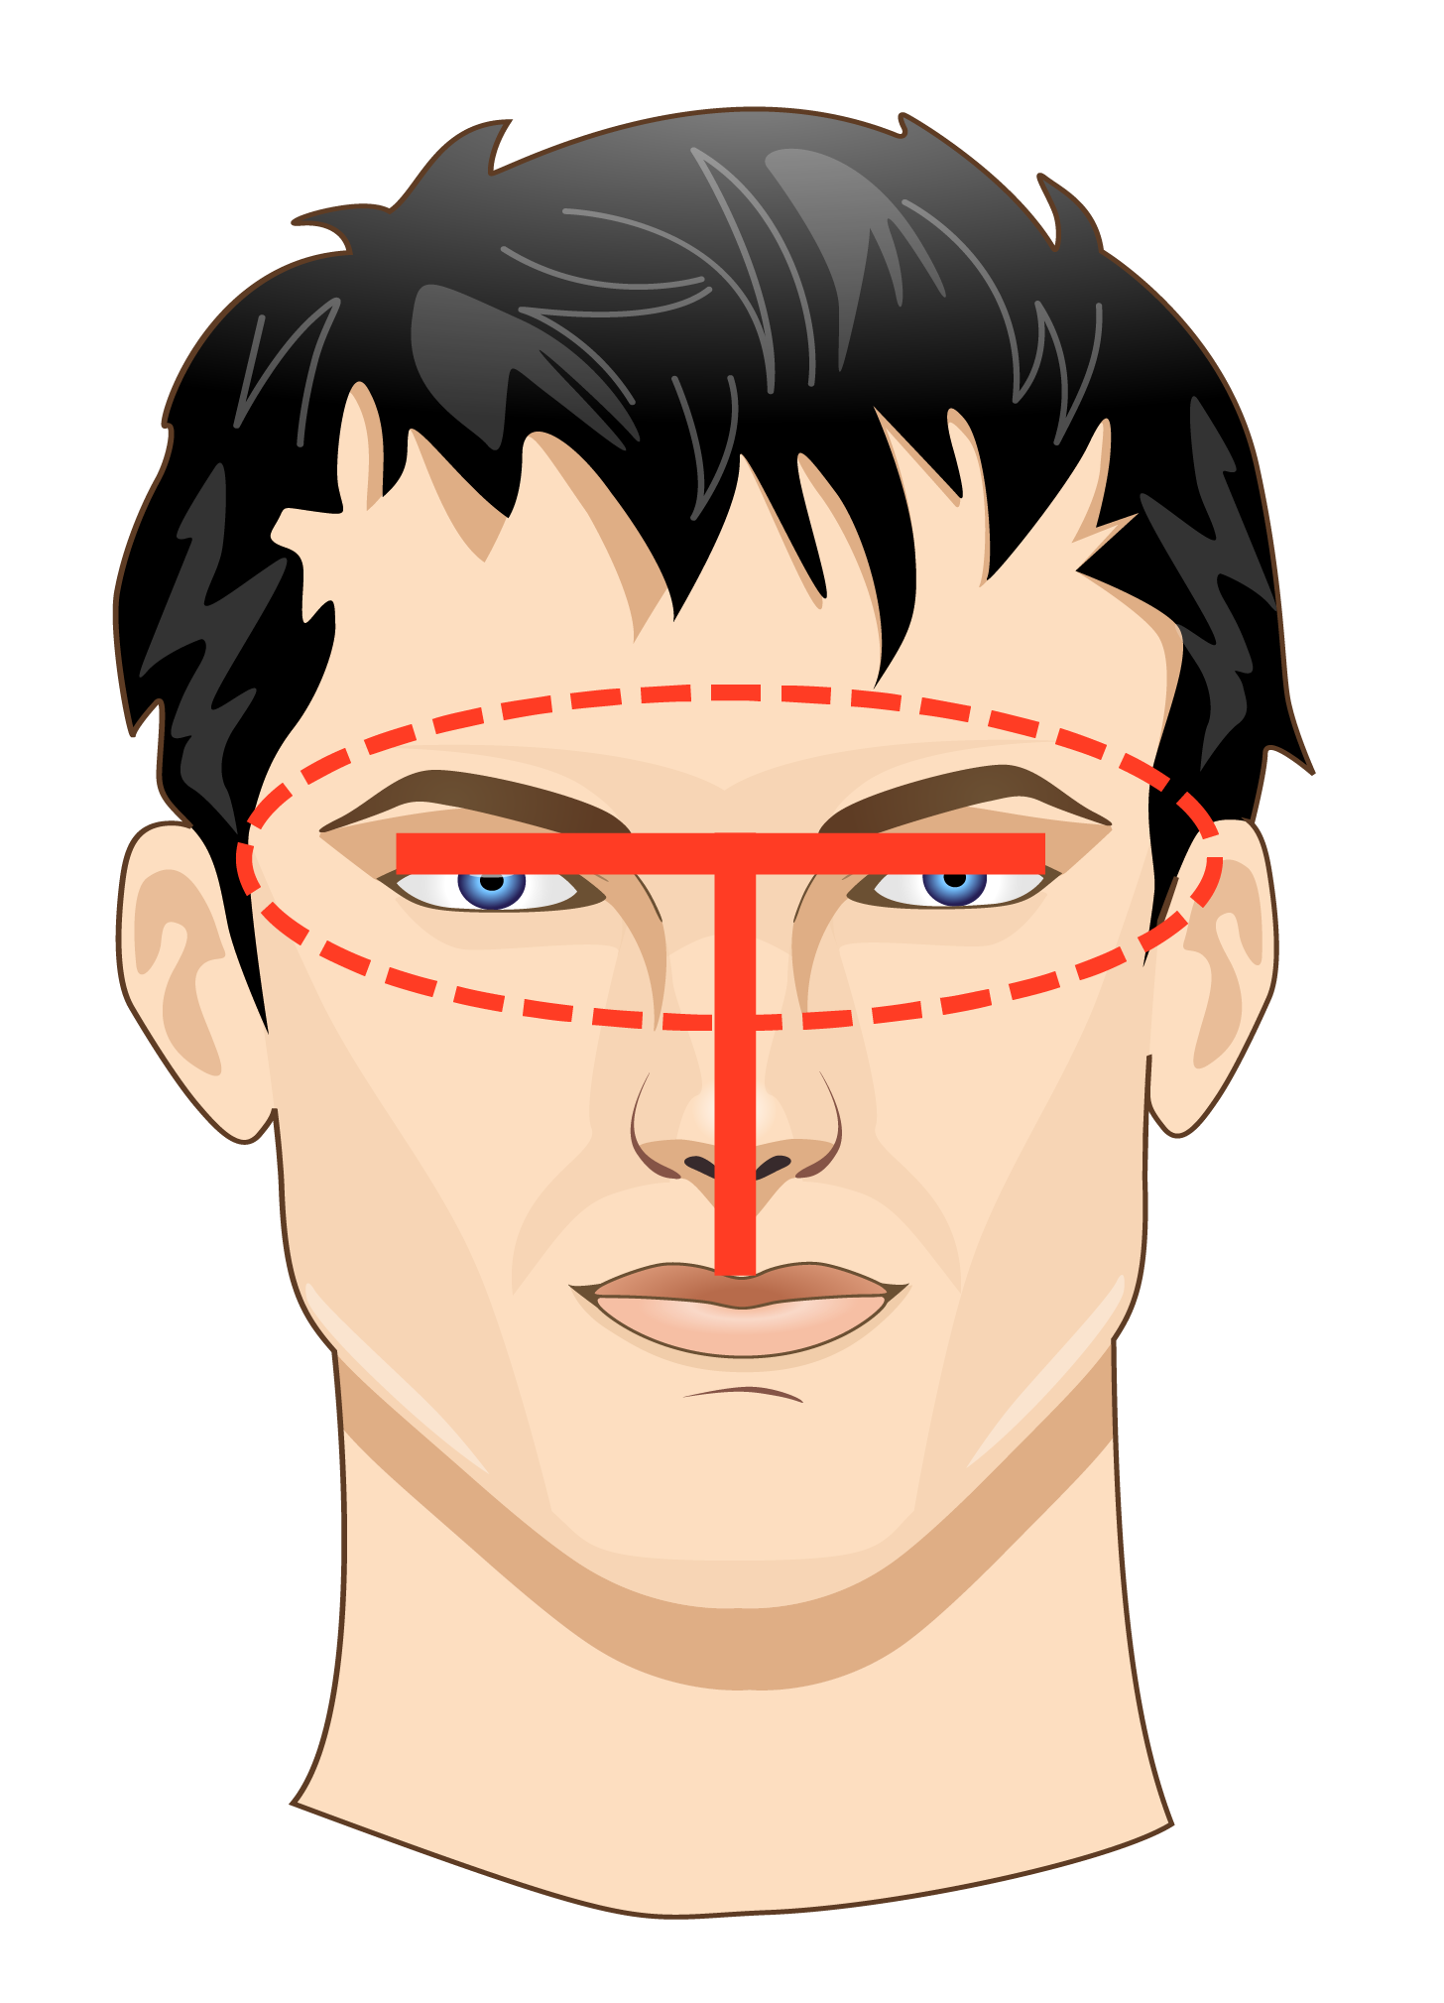
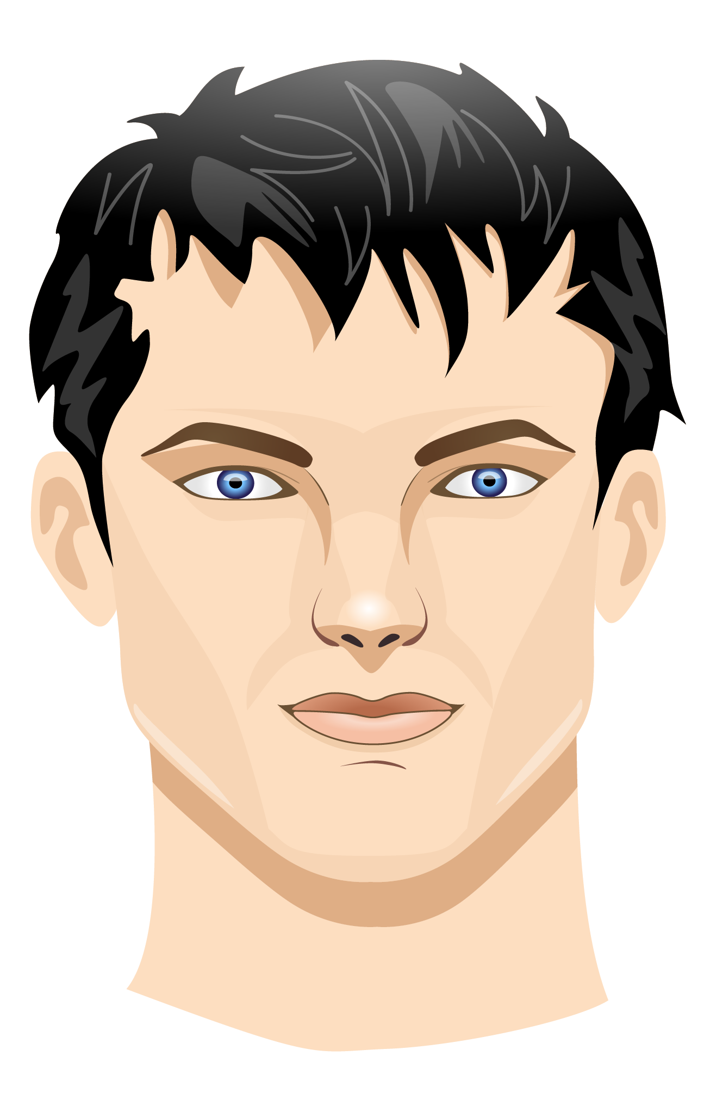
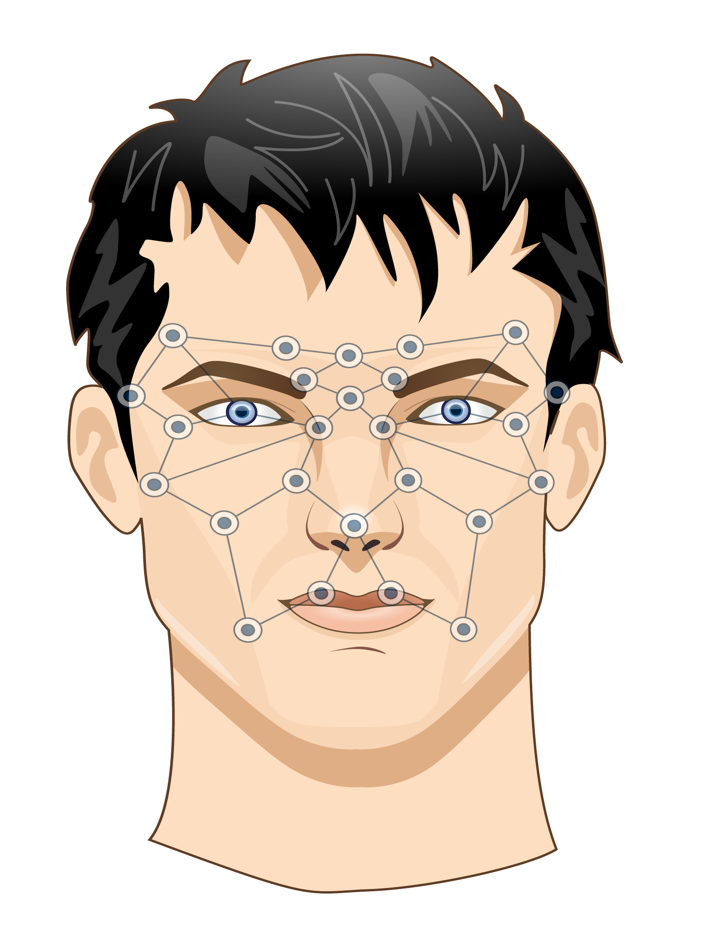
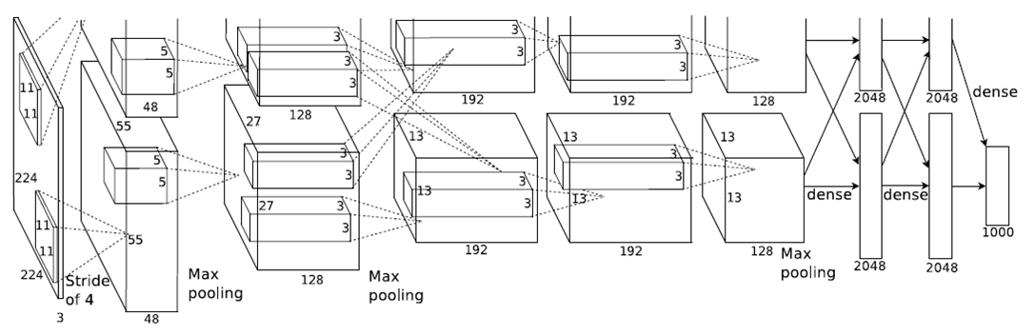
What's the differences between ML and DL?
Fixed
Training
ML
Manual determination
(f1, f2, … fk)
Classifier
SVM / Random Forest
Naive Bayes / Decision Trees
Logistic Regression
Ensemble Methods
Training
DL
~ 60 million parameters

Slide 9
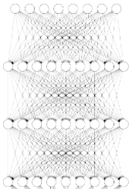
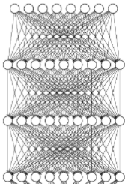
What is difference between classic
ML and DL?
Machine Learning
Deep Learning
Using optimized functions or algorithms to extract insights from data.
Using massive labeled data sets to train deep (neural) graphs that can make inference about new data.
Algorithms
- Random Forest
- SVM
- Regression
- Naive Bayes
- Hidden Markov
- K-Means Clustering
- Ensemble Methods
- More ...
Training
Data
Inference, Clustering, or Classification
CNN, RNN, ...
Untrained
model
Trained
model
+ Computing
+ Labeled data
Hours to Days
Milliseconds to seconds
Step 1
Step 2
Training
Inference
New Data

Slide 10
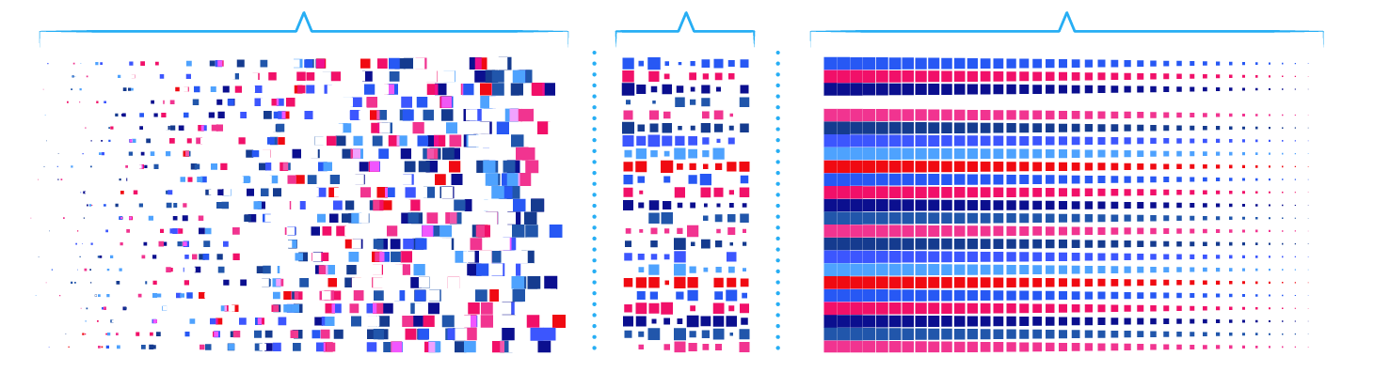
Sample DL application– Image Classification
Typical training run
Pick a DNN design.
Input 100 million training images spanning 1,000 categories.
Test accuracy
If bad: modify DNN, fix training set or update training parameters.

Slide 11
Successful deep learning (training) depends on 3 key factors
Data
Computing
Algorithm
Notes:
Data:
Labels Data was hard to collect.
Several entities (for ex, ImageNet, Kaggle) provide training data sets and request for best models.
130 GB for 1k categories image classification training data
1.7 TB for video theme classification training data.
Google search, flickr, Youtube are also good ways to collect (crawl) training data sets.
Data scientist, labs & startups already using NAS or similar solutions to store their (training, test, validation) data sets.
We may preload public training data sets if no license issue.
Computing:
The GPUs increase the speed of deep learning systems by about 10 ~ 100 times.
Example: MNIST CNN
1282 (i7) need 148 sec to training 60k examples for 1 round.
1050 Ti need only 11 sec.
NAS now support GPU card(s).
Existing customers purchase separate servers as GPU servers, and spend more money for high-speed switch / network.
Lan: 10Gb
PCIE: 16GB
We may proposed the Machine Learning training appliance concept to market.
Algorithm:
Almost all Deep Learning models are open sourced
AlexNet
GoogLeNet
ResNet
Data scientists can fine-tune the models, and easily repeat the research result in their own environment
Application is the key when developing the models
A platform / tools for data scientist to quickly and easily discovery the data, fine-tune the models, try-errors, sharing & education are required
Jupyter is the most famous one

Slide 12
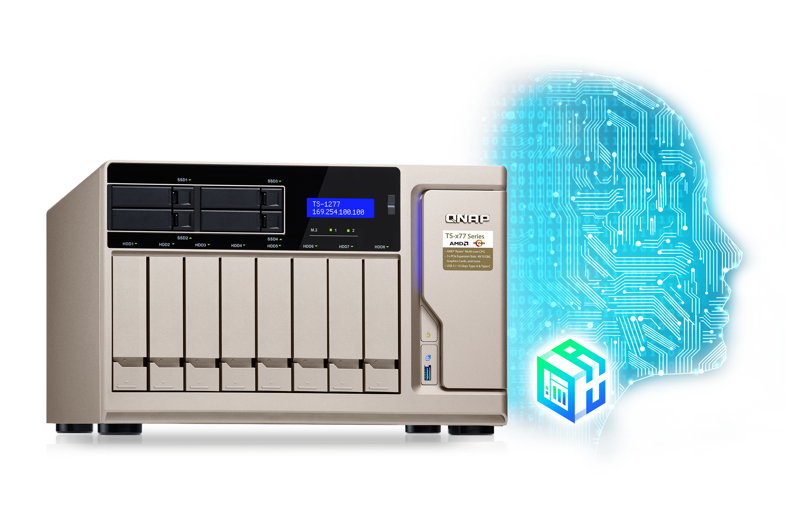
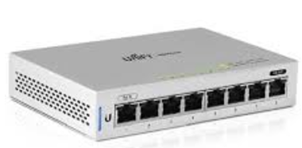
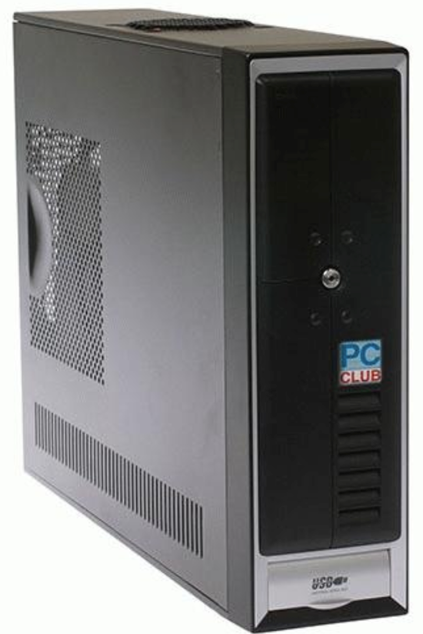

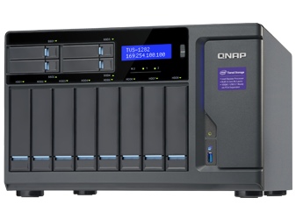
Pain points for data scientists
Using laptops/desktops to develop their model, but storage and computing resources are limited. A workstation with GPU and storage is needed to train / validate their model.
Lack of knowledge to setup NVIDIA GPU drivers, containers, GPU passthrough, etc.
Lack of knowledge to setup data backup/sharing, network configurations, etc.
PAST
FUTURE

Slide 13
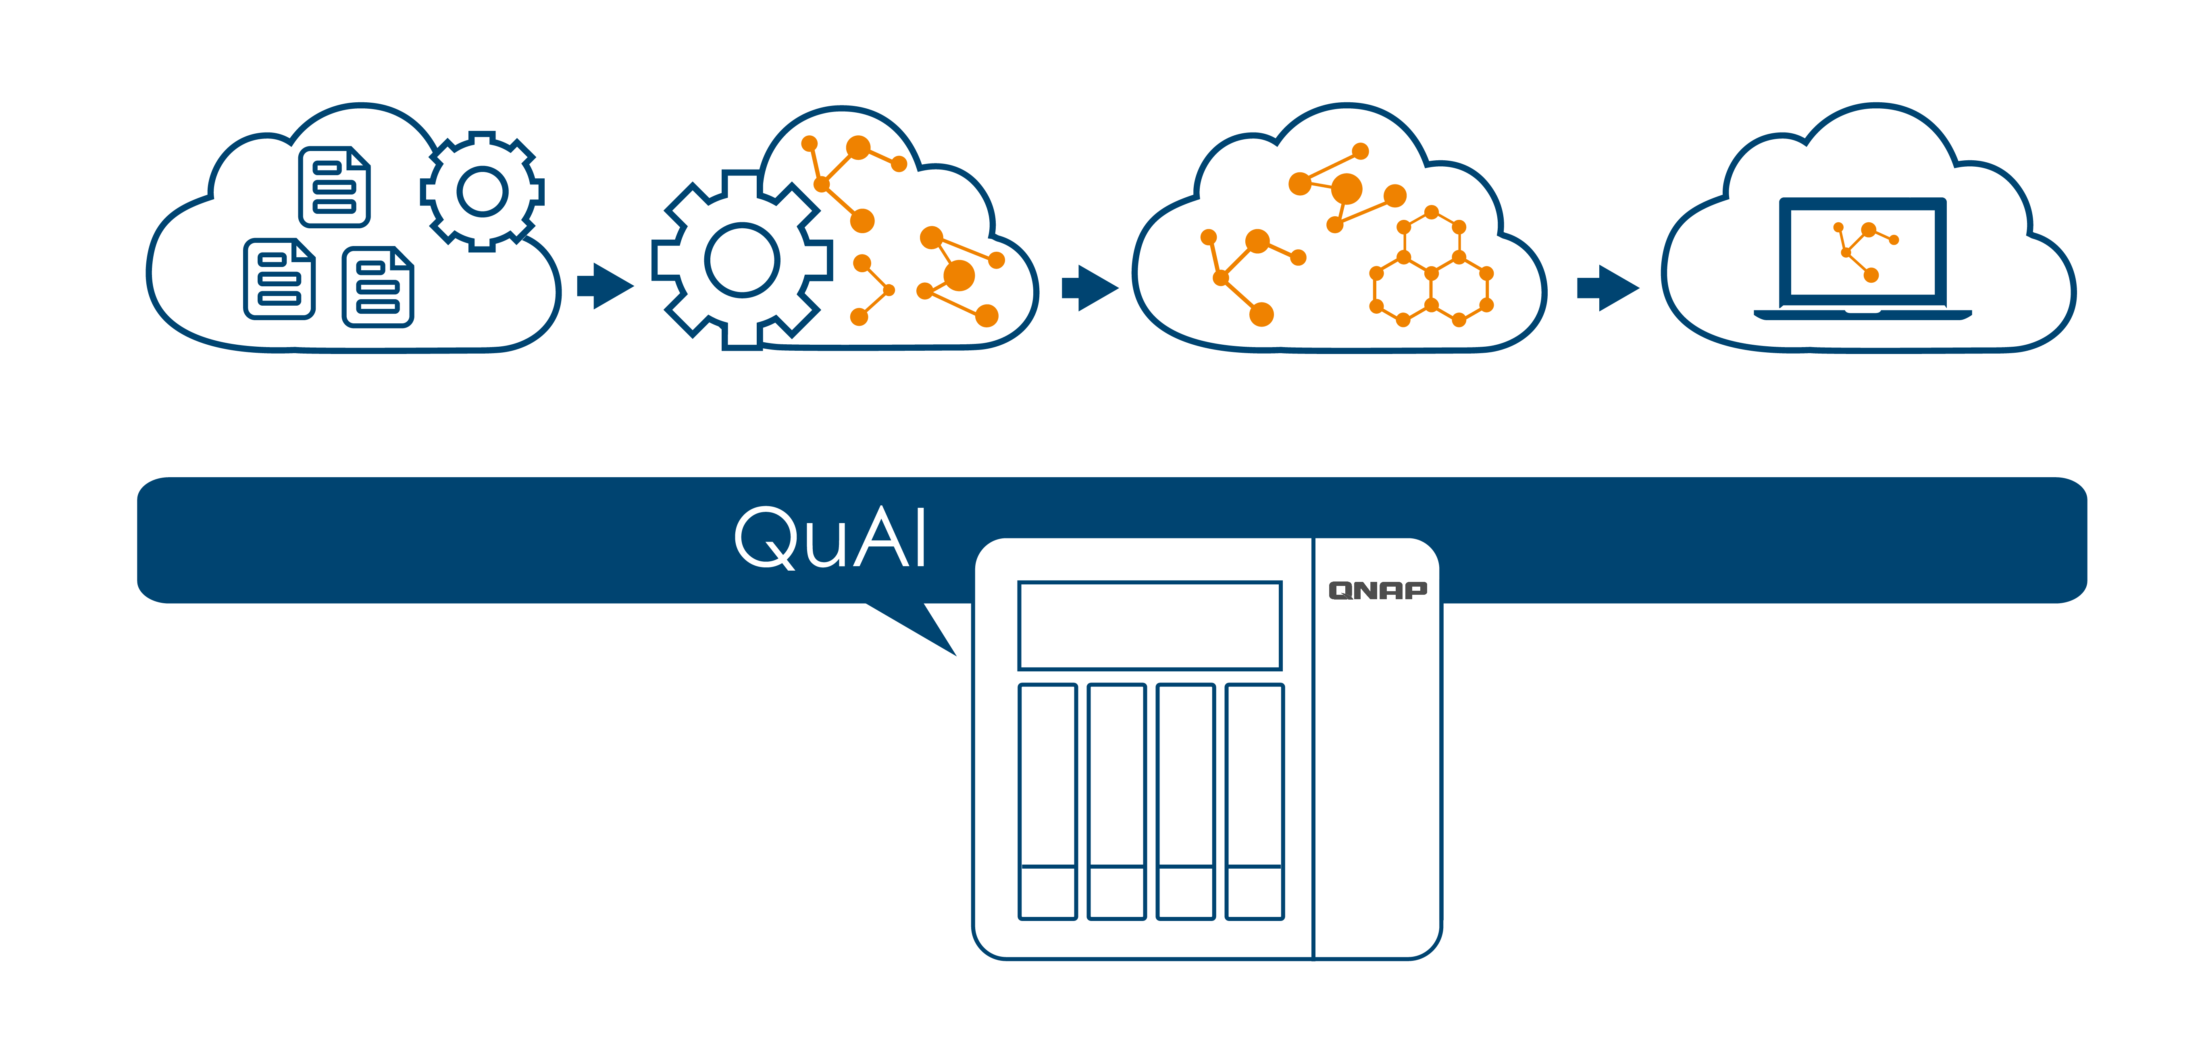
AI Development with QuAI
Build
Train
Tune
Deploy

Slide 14
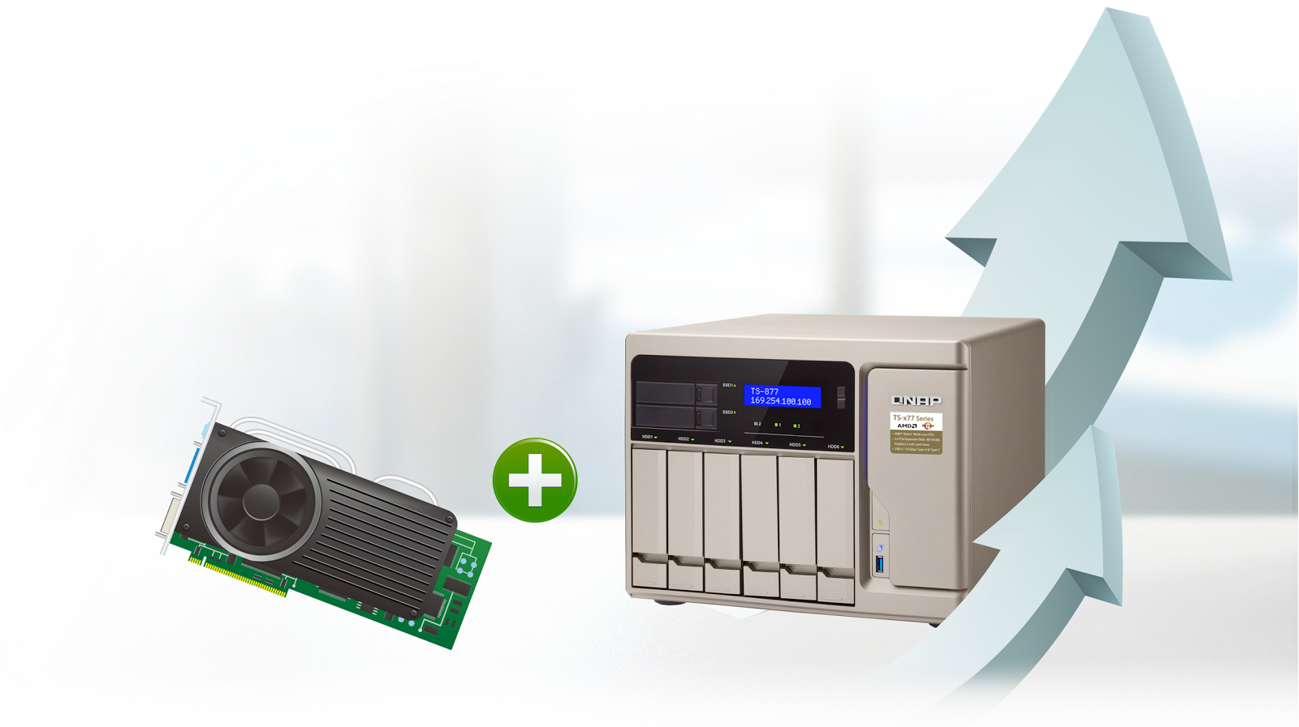

QTS 4.3.4 Adds Graphics Card Support

Slide 15
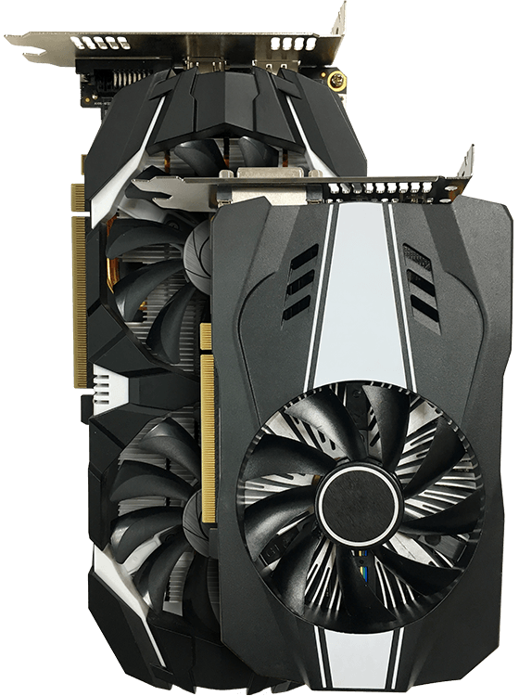
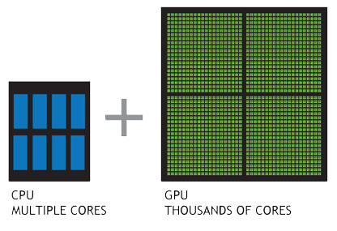
QuAI with GPU Accelerated Computing
Fuel QuAI development with GPU-accelerated computing.
QNAP NAS integrates the capabilities of a PCIe graphics card into QTS and in-turn to Container Station.
With the power of modern graphics cards in QNAP NAS, performance of AI modeling can be greatly boosted.

Slide 16
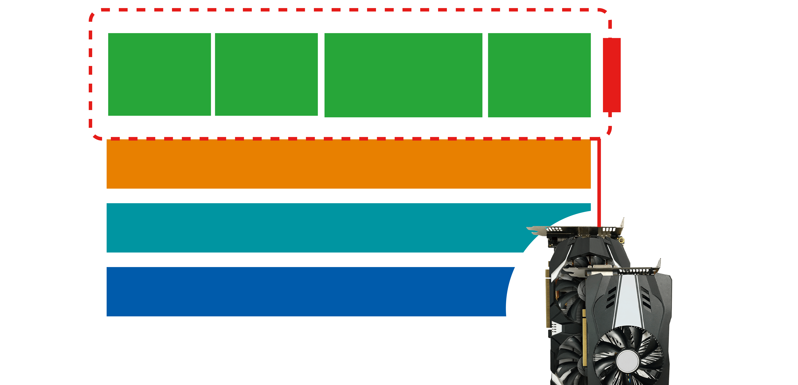

QuAI Architecture
TensorFlow
QuAI Containers
CNTK
MXNet
Caffe
Container Station
QTS 4.3.4
QNAP NAS + GPU
GPU Card

Slide 17





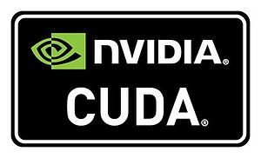
Supports multiple frameworks/libraries

Slide 18
Get Started with QuAI
1
2
3
Install and run QuAI from App Center inside QTS.
Insert a compatible graphics card into the NAS.
Install drivers for the graphics card from App Center inside QTS.
5
4
Create the required framework containers in Container Station and start your first AI application.
Set the GPU allocation to QTS.

Slide 19
Get Started with QuAI
1
2
3
Install and run QuAI from App Center inside QTS.
Insert a compatible graphics card into the NAS.
Install drivers for the graphics card from App Center inside QTS.
5
4
Create the required framework containers in Container Station and start your first AI application.
Set the GPU allocation to QTS.

Slide 20
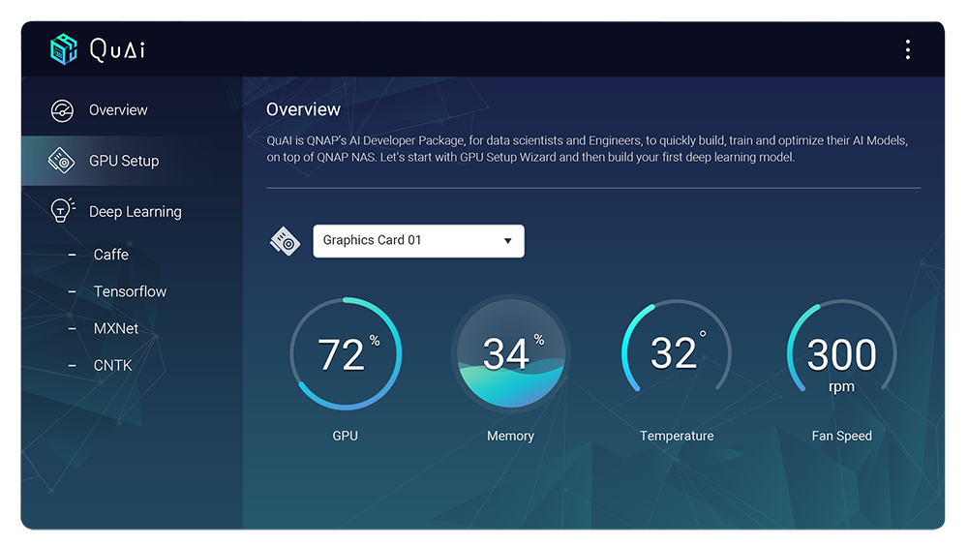
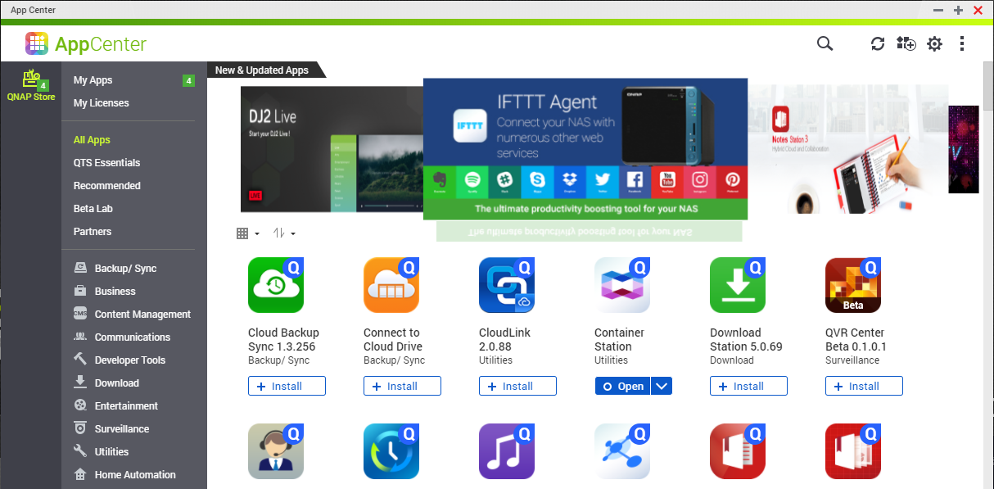
Install and run QuAI from App Center inside QTS

Slide 21
Get Started with QuAI
1
2
3
Install and run QuAI from App Center inside QTS.
Insert a compatible graphics card into the NAS.
Install drivers for the graphics card from App Center inside QTS.
5
4
Create the required framework containers in Container Station and start your first AI application.
Set the GPU allocation to QTS.

Slide 22
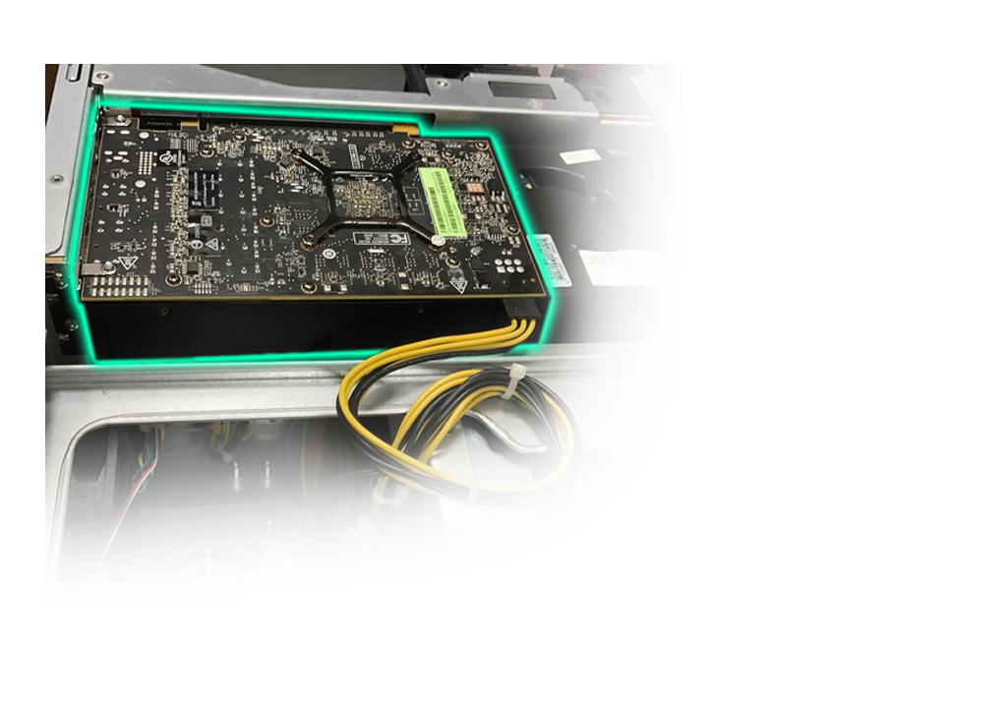
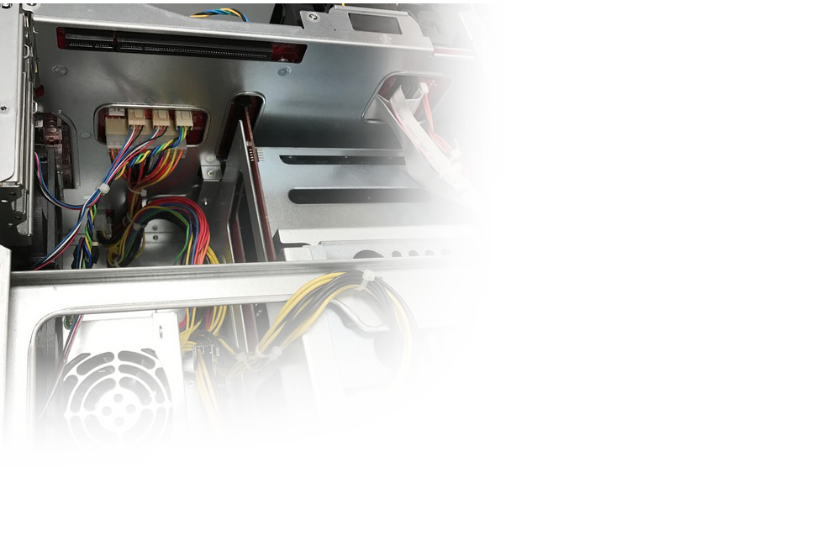
Insert a compatible* graphics card into NAS

Slide 23
Get Started with QuAI
1
2
3
Install and run QuAI from App Center inside QTS.
Insert a compatible graphics card into the NAS.
Install drivers for the graphics card from App Center inside QTS.
5
4
Create the required framework containers in Container Station and start your first AI application.
Set the GPU allocation to QTS.

Slide 24

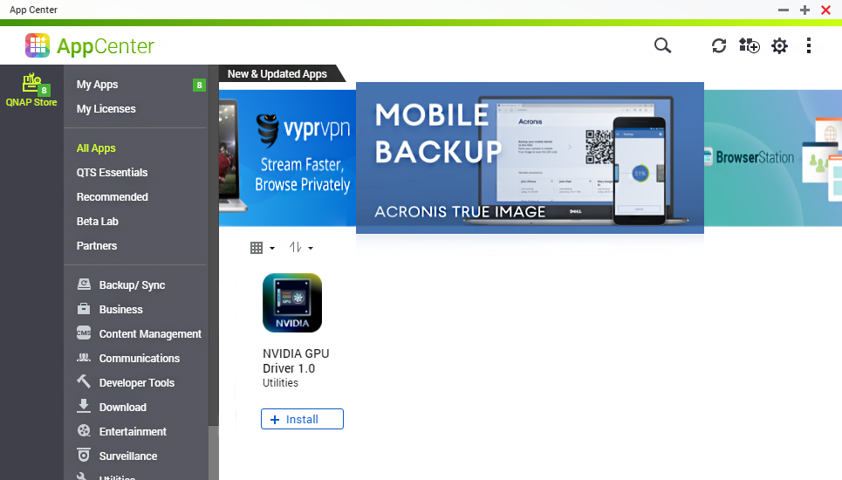
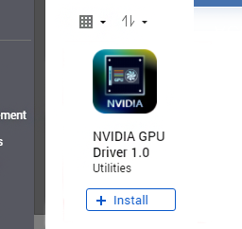
Install Graphics Card Drivers

Slide 25
Get Started with QuAI
1
2
3
Install and run QuAI from App Center inside QTS.
Insert a compatible graphics card into the NAS.
Install drivers for the graphics card from App Center inside QTS.
5
4
Create the required framework containers in Container Station and start your first AI application.
Set the GPU allocation to QTS.

Slide 26
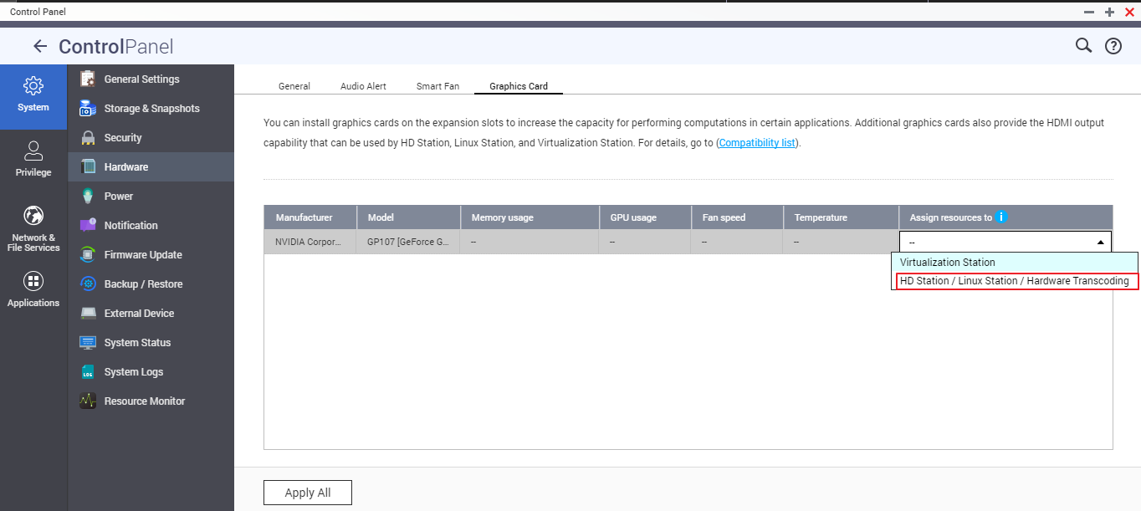


Set GPU Allocation to QTS
Single selection only!
Resource allocation
For the GPU to be used with QTS, NVIDIA GPU Driver needs to be installed from App Center.

Slide 27
Get Started with QuAI
1
2
3
Install and run QuAI from App Center inside QTS.
Insert a compatible graphics card into the NAS.
Install drivers for the graphics card from App Center inside QTS.
5
4
Create the required framework containers in Container Station and start your first AI application.
Set the GPU allocation to QTS.

Slide 28

Create required framework containers in Container Station
2
1
3

Slide 29




Why QNAP NAS for AI?
Keys are building, training and optimizing your AI models.
Typically high performance workstations or public clouds are used for this process.
Generally these elements are complemented by GPUs.
High Performance Workstations
Public Cloud Platforms
But are these the best solutions
for AI development?

Slide 30


Why QNAP NAS for AI?
High Performance Workstations
Public Cloud
High TCO (total cost of ownership).
Difficult to setup.
Long time to configure AI frameworks.
Not optimized to store and manage huge data.
Very complex pricing model.
Difficult to transfer terabytes of data to public cloud to train AI models.
Privacy might be an issue.

Slide 31


Why QNAP NAS for AI?
Low investments and
high gains
It's FAST, it's EASY and
It's QuAI
Relatively lower total cost of ownership, compared to workstations.
One time cost against complex billing model of public cloud platforms.
Higher cost efficiency with QNAP NAS.
QuAI helps setup AI environment in few quick and easy steps.
Provides an advanced wizard for quick GPU configurations.
It takes just few minutes, against few hours on workstations.

Slide 32


Why QNAP NAS for AI ?
Designed to manage huge data
Unique and most sophisticated storage management capabilities with new Storage and Snapshots Manager.
Provides almost unlimited storage.
Qtier identifies hot and cold data through self-learning based on data access frequencies.

Slide 33

Why QNAP NAS for AI ?
SSDs
HDDs
Hot Data
Cold Data
High IOPS
Accelerate IOPS performance for your IOPS-intensive AI applications with QNAP’s SSD cache technology.

Slide 34

Why QNAP NAS for AI?
Multiple layers of data protection
Built on the security first principal to minimize the risk of data breaches with multiple data protection mechanisms, and user privilege controls.

Slide 35

Why QNAP NAS for AI?
QTS 4.3.4
QNAP NAS with QTS, the most stable, robust, comprehensive and Intelligent operating system, is a strong foundation for your AI applications and training frameworks.

Slide 36







Why QNAP NAS for AI?
Availability of Huge Training Data:
Leverage huge and diverse data which is readily available from huge range of
QNAP NAS applications to train your AI Models.
QuAI Deep Learning Model

Slide 37
Applications of QuAI
QuAI
Machine Learning
Speech
Robotics
Vision
NLP
Deep learning
Predictive Analysis
Translation
Classification and clustering
Information extraction
Speech to text
Text to Speech
Image recognition
Machine vision

Slide 38
Supported Models and System Requirements
NAS Models
System Requirements:
QTS 4.3.4 and above; Container Station v1.8 and above
TS-x77
Supported Graphics Cards: (TBD)
Brand | Model
ASUS | DUAL-GTX1050-O2G-GAMING
ASUS | GPH-GTX1050-2G
ASUS | PH-GTX1050TI-4G
ASUS | PH-GTX1060-3G
EVGA | GTX1050 2G SC
EVGA | GTX1050TI 4G SC GAMING
EVGA | GTX1060 6G SC GAMING
GIGABYTE | GV-N1050TD5-4GD
GIGABYTE | GV-N1070IXOC-8GD
Brand | Model
MSI | GTX1050 TI 4GT LP
MSI | GTX1060 6GT OCV1
MSI | GTX1060 AERO ITX 3G OC
NVIDIA | Quadro M2000
NVIDIA | Quadro P2000 5G
NVIDIA | Quadro P4000
Notes:
Add some more Nvidia GC
Asus can use Nvidia driver

Slide 39

Demo
Getting Started with QuAI
Image Classification using Caffe
Training a handwritten digits predication model using Tensorflow
Image Classification using Caffe

Slide 40
Thank You
Notes:
Questions

